Slide 1
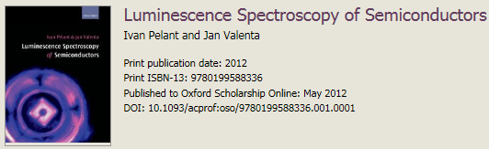
Time-Resolved Luminescence
Seminar for course SK3889
―Equipment and Kinentic description of the process
Lige Liu
06-11-2017
(pp. 67-122)

Slide 2
Contents
1. Technique of Time-Resolved luminescence
1.1 Lifetime and decay curve
1.2 Time-correlated single photon counting technique
2. Kinetic description of luminescence process
2.1 Radiative and non—radiative recombination
2.1 Monomolecular process
2.3 Bimolecular process
2.4 Multiple process
3. Phonons and their participation in optical phenomena
3.1 Lattice vibration―phonon
3.2 How charge carriers influence the lattice vibration?
3.3 How point defects influence the lattice vibration?

Slide 3
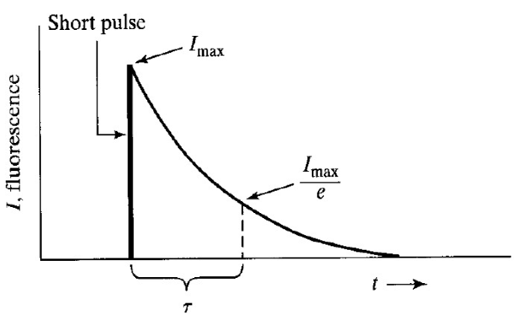
Life-time and Decay curve
Life-time
Decay curve
excited state
ground state
Upon excitaion, the luminescence emission builds up
The time electrons stay in the excitation state—life-time
After removing the excitaion, the emission decays with time prolonging

Slide 4
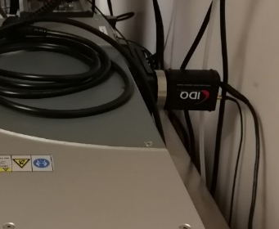
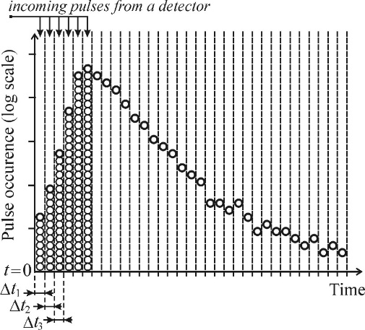
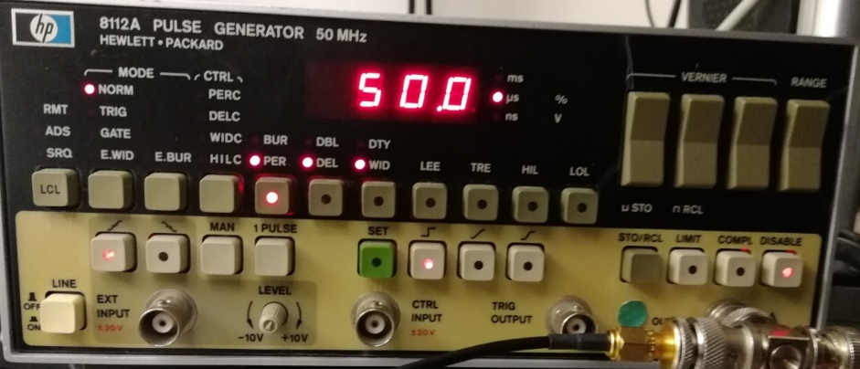
Equipment
Need ultrashort laser pulse to excitate the electrons
Avalanche photon-diode (APD)
Detect the emission photons, and record the arrival time of single photons when a pulse appears at the APD output
Turn ON
Rectangular pulse
photons
photoelectric effect
voltage
Turn OFF
t
put out
WID
PER
Spectroscopy
Digital signal
Pulse generator
The pulse excitation of the sample is repeated many times and the APD record the arrival photons.
Time-correlated single photon counting

Slide 5
Why time-resolved luminescence?
It is a route to get knowledge of the temporal behavior of the luminescence
Kinetic process of electrons/excitons
Monomolecular process
Bimolecular process
Multiple process

Slide 6
Contents
1. Technique of Time-Resolved luminescence
1.1 Lifetime and decay curve
1.2 Time-correlated single photon counting technique
2. Kinetic description of luminescence process
2.1 Radiative and non-radiative recombination
2.1 Monomolecular process
2.3 Bimolecular process
2.4 Multiple process
3. Phonons and their participation in optical phenomena
3.1 Lattice vibration-Phonon
3.2 How charge carriers influence the lattice vibration?
3.3 How point defects influence the lattice vibration?

Slide 7
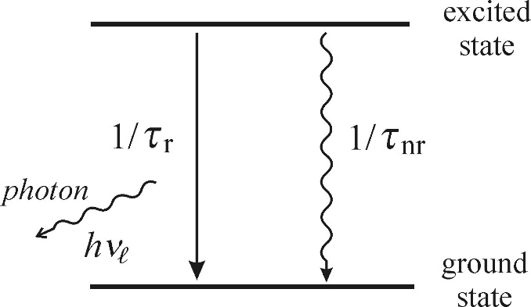



Probability of (non-)radiative transition and quantum efficiency
Under the rule of non-equilibrium thermodynamic, the excited electrons must transition back to the ground state.
The total probability of transition to the ground state is given by
$$\frac{1}{τ}=\frac{1}{τ_{r}}+\frac{1}{τ_{nr}}$$
phonon (heat)
τ_{r} — radiative recombination time (radiative lifetime)
τ_{nr} — non-radiative recombination time (non-radiative lifetime)
Define the luminescence quantum yield or quantum efficiency by the ratio of radiative recombination rate to the total recombination rate as
$$η=\frac{1/{τ_{r}}}{1/{τ_{r}}+1/{τ_{nr}}}≤1$$
or
$$η=\frac{τ}{τ_{r}}≤1$$

Slide 8
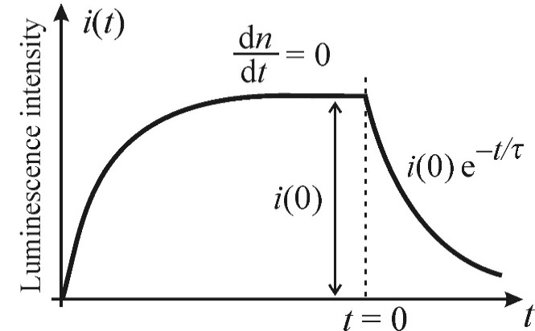
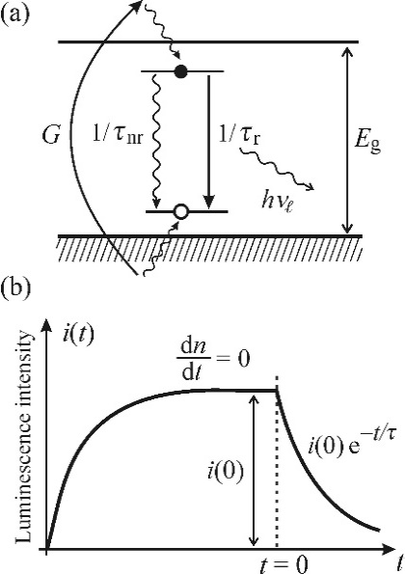

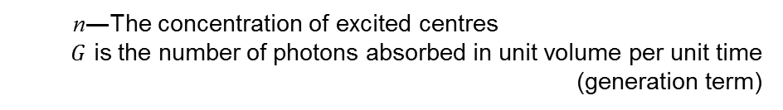


Monomolecular process
A localized luminescence center
Excitons are localized at a certain impurity or defect
The steady state
off
1/τ_{nr}
1/τ_{r}
E_{g}
Kinetic equitation
$\frac{ⅆn}{ⅆt}=G−\frac{n}{\text{t}\text{r} }−\frac{n}{τ_{nr}}=G−$ $\frac{n}{τ}$
n―The concentration of excited centres
$G$ is the number of photons absorbed in unit volume per unit time (generation term)
Decay state
Turn off the excitation at t=0 ($G$=0)
$$\frac{ⅆn}{ⅆt}=−\frac{n}{t}$$
n(t)=n(0)exp(-t/τ)
i(t)=i(0)exp(-t/τ)
Boundary condition n(t=0)=n(0)
i(t)=n(t)/τ_{r}
Single-exponential decay
i(t) is the number of photons emitted from unit volume per unit time

Slide 9





Monomolecular process
i(t)=a₁exp(-t/τ₁)+ a₂exp(-t/τ₂)
Double-exponential decay
Two kinds of localized luminescence centres
Steady state
$$\frac{ⅆn}{ⅆt}=0$$
$G=\frac{n(0)}{τ_{r}}+\frac{n(0)}{τ_{nr}}=i\left(0\right)$+ $\frac{n(0)}{τ_{nr}}$
$$G=αI_{ex}$$
$$i\left(0\right)=ηαI_{ex}$$
$$η=\frac{1/{τ_{r}}}{1/{τ_{r}}+1/{τ_{nr}}}$$
η is quantum efficiency, α is absorption coefficient, I_{ex} is excitation intensity
The steady-state-luminescence intensity exhibits a linear dependence of the excited intensity

Slide 10







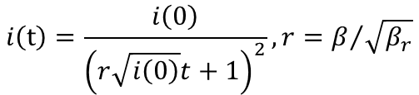
Bimolecular process
Excitons are not localized at a certain impurity or defect
Kinetic equation
$$\frac{ⅆn}{ⅆt}=G−βnp$$
β_{nr}
β_{r}
E_{g}
β=β_{nr}+ β_{r}
β ― the bimolecular recombination coefficiency
n ― the concentration of electrons
p ― the concentration of holes
For the sake of simplicity, n=p
$$\frac{ⅆn(t)}{ⅆt}=G−βn^{2}$$
Decay state
Turn off the excitation at $t$=0 ($G$=0)
$$\frac{ⅆn(t)}{ⅆt}=−βn^{2}$$
$$n(t)=\frac{n(0)}{βn\left(0\right)t+1}$$
$$i\left(t\right)=\frac{i\left(0\right)}{{\left(r\sqrt{i\left(0\right)}t+1\right)}^{2}}, r=β/{\sqrt{β_{r}}}$$
$$i(t)=β_{r}n^{2}(t)$$
Approximate it as i(t) ≈ t ⁻²
Notes:
the amplitude of the luminescence response pulse is proportional to the square of the excitation intensity I _{ex}

Slide 11


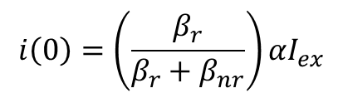

Bimolecular process
Steady state
$$\frac{ⅆn}{ⅆt}=0$$
$$G=βn^{2}=β_{r}n^{2}+β_{nr}n^{2}$$
$$i\left(0\right)=\left(\frac{β_{r}}{β_{r}+β_{nr}}\right)αI_{ex}$$
$$i(0)=β_{r}n^{2}(0)$$
The steady-state-luminescence intensity remains a linear function of the excited intensity.

Slide 12
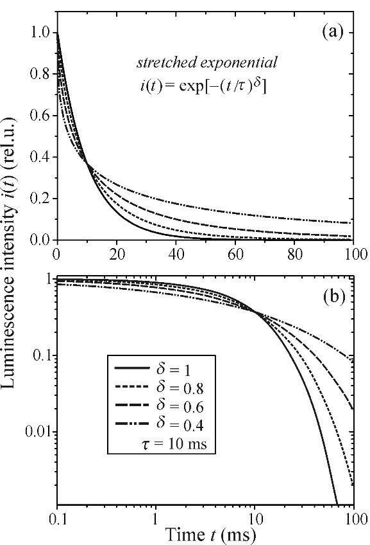



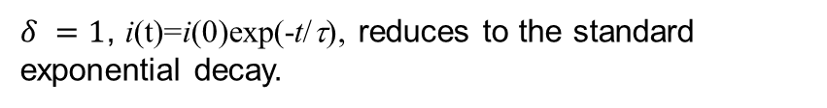
Stretched exponential
disorderd system
dispersion diffusion of photoexcited carriers
$$i\left(t\right)=i\left(0\right)e^{−{\left(\frac{t}{τ}\right)}^{δ}}$$
$δ$ is the dispersion factor with $0<δ<1$
lin-lin scale
Limiting value
$δ =0$, i(t) =constant
$δ =1$, i(t)=i(0)exp(-t/τ), reduces to the standard exponential decay.
$$0<δ<1$$
, as if we ‘stretched’ an exponentially decreasing function towards later times.
log-log scale

Slide 13
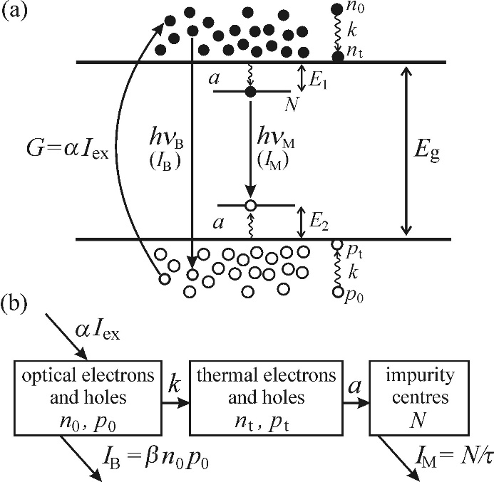







Multiple process
k ― rate constant
a ― rate constant of photocarriers
N ― the concentration of excited centres
The photothermal carriers have the highest chance to be captured by am impurity centre, promoting this into an excited state
For the sake of simplicity,
we assume 100% quantum yield
$${β=β}_{r}$$
$${τ=τ}_{r}$$
Kinetic equation:
$$\frac{ⅆn_{0}}{ⅆt}=αI_{ex}−βn_{0}n_{p}−kn_{0}$$
Bimolecular process + thermal relaxation
$$\frac{ⅆn_{t}}{ⅆt}=kn_{0}−a(N_{0}−N)n_{t}$$
${N≠N}_{0}$, $N≠$0
$n_{0}=n_{p}$, $n_{t}=p_{t}$
$$\frac{ⅆN}{ⅆt}=a\left(N_{0}−N\right)n_{t}−\frac{N}{τ}$$
Monomolecular process
Notes:
N0-N the concentration of impurity centres in the ground state with the concentration of thermal electrons nt or pt

Slide 14
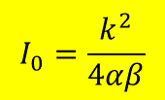

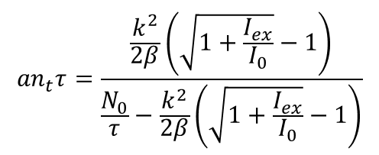

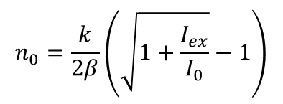


Multiple process
$\frac{ⅆ}{ⅆt}=0$,
we obtain
In the steady state,
$$βn_{0}^{2}+kn_{0}−αI_{ex}=0$$
$$kn_{0}−a\left(N_{0}−N\right)n_{t}=0$$
$a\left(N_{0}−N\right)n_{t}−\frac{N}{τ}$=0
Solving the equations, we obtained,
$$n_{0}=\frac{k}{2β}\left(\sqrt{1+\frac{I_{ex}}{I_{0}}}−1\right)$$
$${an}_{t}τ=\frac{\frac{k^{2}}{2β}\left(\sqrt{1+\frac{I_{ex}}{I_{0}}}−1\right)}{\frac{N_{0}}{τ}−\frac{k^{2}}{2β}\left(\sqrt{1+\frac{I_{ex}}{I_{0}}}−1\right)}$$
$$I_{0}=\frac{k^{2}}{4αβ}$$
governed by the material parameters

Slide 15






Multiple process
Two excitation modes,
Weak excitation,
$$I_{ex}≪I_{0}$$
The process is dominated by monomolecular radiation.
The monomolecular intensity
$$I_{M}=αI_{ex}$$
linearly
The bimolecular intensity
$$I_{B}=\frac{α^{2}β}{k^{2}}I_{ex}^{2}$$
quadratically
Compare
$$I_{M}=αI_{ex}$$
with
$$\frac{ⅆn_{0}}{ⅆt}=αI_{ex}−βn_{0}n_{p}−kn_{0}$$
All the absorbed energy $αI_{ex}$ is radiated in the form of monomolecular impurity luminescence. Thus,
$I_{M}$ $≫$ $I_{B}$
Physical significance: almost all the photo generated carriers are trapped in the impurity centers under the low density of excitation
Notes:
IB varies quadratically with the excitation intensity
IM increases linearly with the excitation

Slide 16




Multiple process
Strong excitation,
$$I_{ex}≫I_{0}$$
$$I_{M}=\frac{N_{0}}{τ}$$
$N_{0}$―The total concentration of impurity atoms
The monomolecular intensity
This is the maximum achievable intensity of the monomolecular process, which means that all the impurity centres are excited.
The bimolecular intensity
$$I_{B}=αI_{ex}$$
linearly
It swaps roles with monomolecular luminescence
The life-time of the luminescence is dominated by bimolecular radiation process.

Slide 17
Contents
1. Technique of Time-Resolved luminescence
1.1 Lifetime and decay curve
1.2 Time-correlated single photon counting technique
2. Kinetic description of luminescence process
2.1 Radiative and non—radiative recombination
2.1 Monomolecular process
2.3 Bimolecular process
2.4 Multiple process
3. Phonons and their participation in optical phenomena
3.1 Lattice vibration―phonon
3.2 How charge carriers influence the lattice vibration?
3.3 How point defects influence the lattice vibration?

Slide 18
Phonon
Affects the shape of the absorption edge, the wide both of the absorption and emission spectra lines
Fine structure of the spectrum
Thermal luminescence quenching

Slide 19
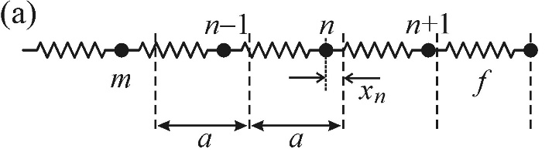



The notion of phonon―lattice vibration
Atoms in a crystal keep oscillating around their equilibrium positions
The amplitudes of these oscillations rise with temperature increasing
Model: An infinite chain of identical atoms of mass m in a one-dimensional crystal
Consider interactions of the nearest neighbors and assume a harmonic approximation (harmonic oscillator), the equation of motion reads
$m{\ddot{x}}_{n}=−f\left(x_{n}−x_{n−1}\right)$ $−f\left(x_{n}−x_{n+1}\right)$
Force constant or “spring constant”
The instantaneous deflection of the nth atom from its equilibrium position
A solution is
$$x_{n}=Ae^{(iωt−kna)}$$
$A$―the amplitude of the vibration
$k=\left|\vec{k}\right|$= $\frac{ω}{c}$, where $\vec{k}$ is the wavevector and c is the velocity of wave motion

Slide 20
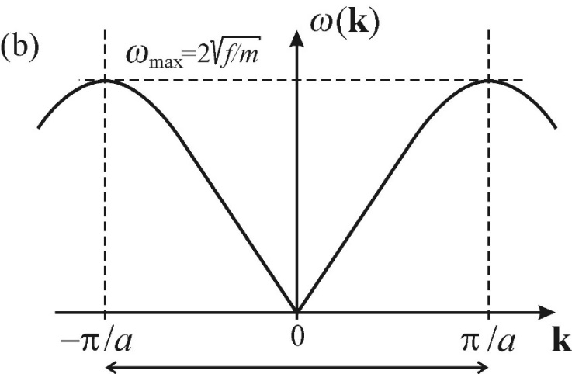

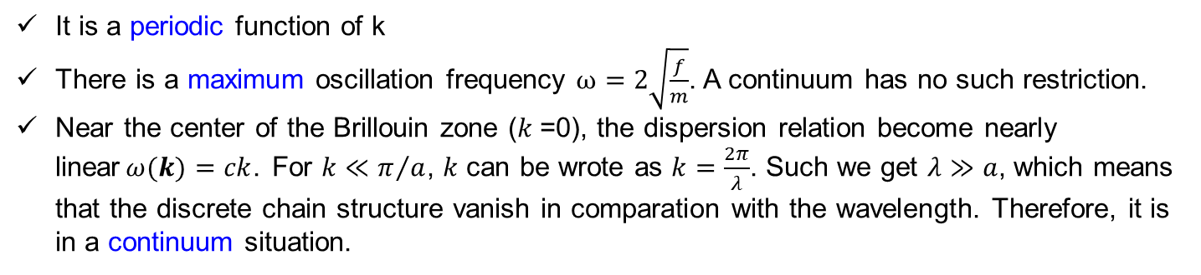
The notion of phonon―lattice vibration
We are interested in the dispersion relation
$ω=ω(k$)
It is a periodic function of k
There is a maximum oscillation frequency $ω=2\sqrt{\frac{f}{m}}$. A continuum has no such restriction.
Near the center of the Brillouin zone ($k$=0), the dispersion relation become nearly linear$ω(k)=ck$. For $k≪π/a$, $k$ can be wrote as $k=\frac{2π}{λ}$. Such we get $λ≫a$, which means that the discrete chain structure vanish in comparation with the wavelength. Therefore, it is in a continuum situation.
Notes:
It is enough to consider the range of the first Brillouin zone

Slide 21
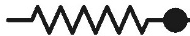





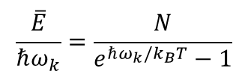






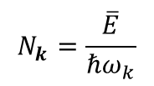
Quantization of the vibration energy
View the chain as an ensemble of $N$ harmonic oscillators.
....
$$N$$
$$\overline{ε}$$
$$\overline{ε}$$
$$\overline{ε}$$
$$\overline{ε}$$
$$\overline{ε}$$
The mean energy of a quantized harmonic oscillator at a given temperature T is $\overline{ε}$
$$\overline{ε}=\frac{ℏω_{k}}{e^{ℏω_{k}/k_{B}T}−1}$$
(it constitutes part of Plank's blackbody radiation law)
$$\overline{E}=N\overline{ε}=\frac{Nℏω_{k}}{e^{ℏω_{k}/k_{B}T}−1}$$
$$\frac{\overline{E}}{ℏω_{k}}=\frac{N}{e^{ℏω_{k}/k_{B}T}−1}$$
The entire energy is
$$N_{k}=\frac{\overline{E}}{ℏω_{k}}$$
There are $N_{k}$ quasi-particles
Assign energy $ℏω_{k}$to every quasi-particle. We call these quasi-particle―quanta of the vibration energy ―phonon
So the phonon distribution function will be
$$n_{k}=\frac{N_{K}}{N}=\frac{1}{e^{ℏω_{k}/k_{B}T}−1}$$
As the temperature drops, the phonon population decay quickly.

Slide 22
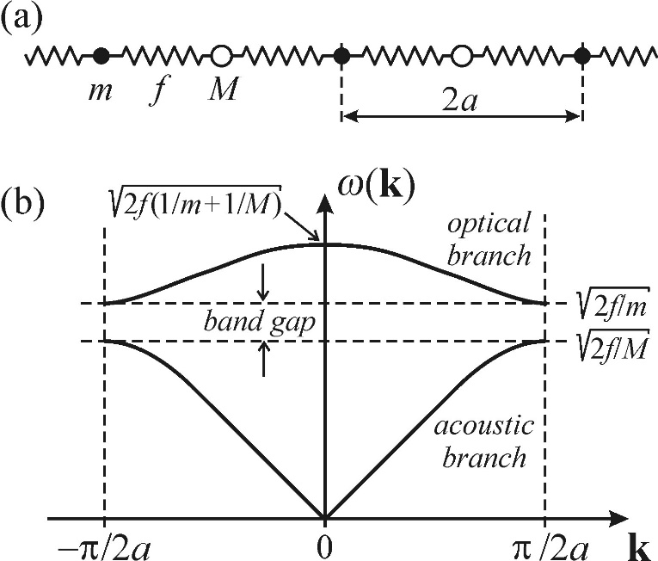


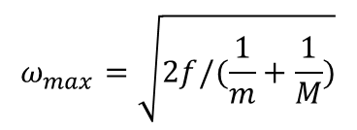
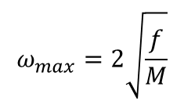
The modification
Two kinds of oscillating atoms with different mass of m and $M$ (m$<M$)
Optical branch:
higher energy
Unit cell
$$ω_{max}=\sqrt{2f/(\frac{1}{m}+\frac{1}{M})}$$
at $k$=0
Atoms move in counter phase―leave the center of the mass at rest
Acoustic branch:
lower energy, but wider range of change with k
$$ω_{max}=2\sqrt{\frac{f}{M}}$$
at $k=±2π/a$
Atoms vibrate in phase. The center of the mass move like travelling in the crystal, as for sound propagation
Notes:
Although the one-dimensional chain of identical atoms provide us with the basic concept of the phonon, it cannot compass the full reality of a three-dimensional crystal.

Slide 23
Phonon
Actually,
Atoms oscillate along the chain axis―longitudinal vibrations
Atoms move perpendicularly to the chain―transverse vibrations
So,
Longitudinal optical phonons (LO)
Transverse optical phonons (TO)
Longitudinal acoustic phonons (LA)
Transverse acoustic phonons (TA)
In three-dimensional case,
If a crystal has n atoms per unit cell
3 types of acoustic vibration
3n-3 types of optical vibrations

Slide 24
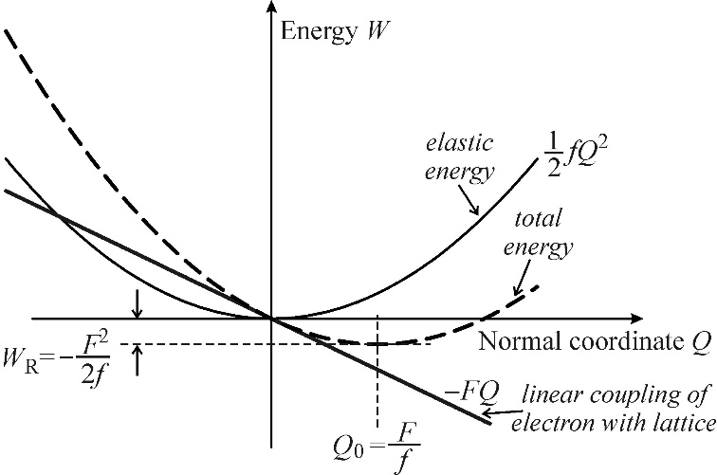
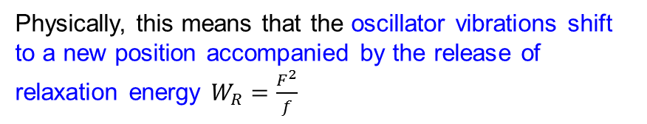


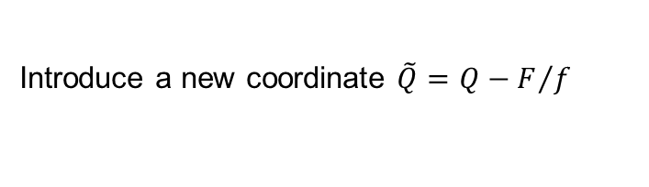

How charge carriers influence the lattice vibration?
Focus on the one dimensional chain with a harmonically oscillation
In the absent of charge, the total energy is
$$W_{0}=\frac{1}{2}m{\dot{Q}}^{2}+\frac{1}{2}fQ^{2}$$
kinetic energy
elastic energy
Insert a charge into the lattice,
$${W=W}_{0}−FQ$$
Introduce a new coordinate $\tilde{Q}=Q−F/f$
$$W=\frac{1}{2}m{\dot{\tilde{Q}}}^{2}+\frac{1}{2}f{\tilde{Q}}^{2}−\frac{1}{2}\frac{F^{2}}{f}$$
Physically, this means that the oscillator vibrations shift to a new position accompanied by the release of relaxation energy $W_{R}=\frac{F^{2}}{f}$

Slide 25
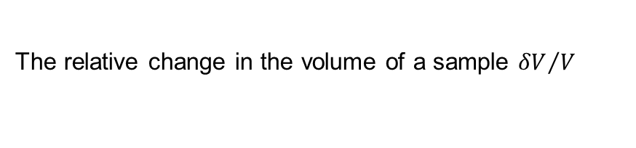

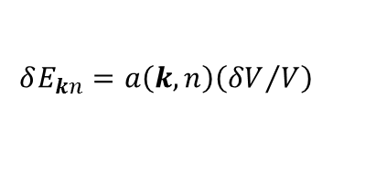
How charge carriers influence the lattice vibration?
There are three microscopic mechanisms mediating the carrier-phonon interactions
Long wavelength ($λ≫a$)
Atomic oscillation
Lattice vibration
Longitudinal acoustic vibrations
The deformation emchanism
Periodic expansion and compressions of the medium on a microscopic distance
The piezoelectric mechanism
The Fröhlich mechanism
The relative change in the volume of a sample ${δV}/V$
A shift in the extreme of the electron energy band$δE_{kn}$
To a first approximation,
$$δE_{kn}=a\left(k, n\right)\left({δV}/V\right)$$
The band
The electron wavevector
Volume deformation potential of the energy level $E_{kn}$

Slide 26
How charge carriers influence the lattice vibration?
Calculation of the deformation potential
Absolute deformation potential― difficult either in theory or experiment
Relative deformation potential ― much easier
External hydrostatic pressure
Optical measurement
Energy difference near the onset of the absorption edge
Sample
Note:
The optical phonon may partially denoted to the deformation potential, particularly the long-wavelength one.
The exciton-phonon interaction due to the deformation potential also occurs in the crystalline solids.

Slide 27
How charge carriers influence the lattice vibration?
The piezoelectric mechanism
Piezoelectric effect
For lower lattice symmetric crystal
Mechanical deformation
Electric field
Electric voltage
Deformation varies in time
(Relative shift between adjacent atomic layer)
Electric field
Electric voltage
Most importantly, in the case of longitudinal acoustic modes of lattice vibrations
Note:
Since the piezoelectric electron-phono interaction is under long-range Coulomb forces, the interaction is strongest for long-wavelength LA-phonons.
The exciton-phonon interaction only occurs in crystals whose crystallographic point group does not contain the centre of inversion.

Slide 28
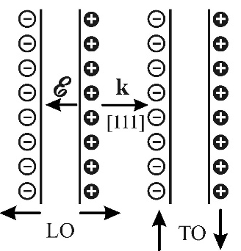
How charge carriers influence the lattice vibration?
The Fröhlich mechanism
The most important exciton-phonon interaction
Ionic crystals
Only occurs in
Semiconductors with ionic contribution to the lattice energy―polar semiconductors
Principle:
The opposite charge ions
The opposite orientation of oscillations
Long-wavelength LO-phonons
Long-range macroscopic electric field (or macroscopic crystal polarization)
Thus, the energy of long-wavelength LO-phonons is always greater than TO-phonons

Slide 29





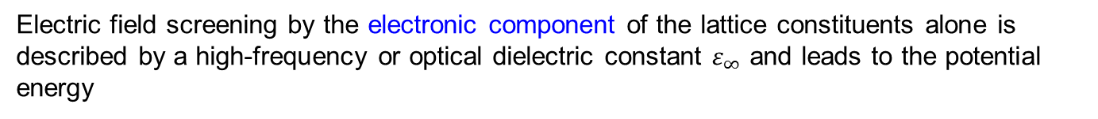
How charge carriers influence the lattice vibration?
Quantify the Fröhlich mechanism
The polarization involves two components, and they are both jointly accociate with a static dielectric constant
The electronic polarization component: the shift of the electron cloud with respect to the nuclei
The ionic polarization component: the shift of ions from their equilibrium position
At low field frequency, the potential energy at a distance r from a point charge reads
$$\frac{1}{4πε_{0}ε_{s}}\frac{e^{2}}{r}$$
$ε_{0}$―dielectric constant of free space
$ε_{S}$―a static dielectric constant
Electric field screening by the electronic component of the lattice constituents alone is described by a high-frequency or optical dielectric constant $ε_{∞}$ and leads to the potential energy
$$\frac{1}{4πε_{0}ε_{∞}}\frac{e^{2}}{r}$$
$$ε_{∞}=ε\left(ω→∞\right)$$
Ionic polarization itself, which is due to the relative motion of anions and cations (representing the mass of the vibrating lattice), is then characterized by the difference
$$\frac{e^{2}}{4πε_{0}r}\left(\frac{1}{ε_{∞}}−\frac{1}{ε_{s}}\right)$$
A crucial factor to describe the Fröhlich mechanism

Slide 30

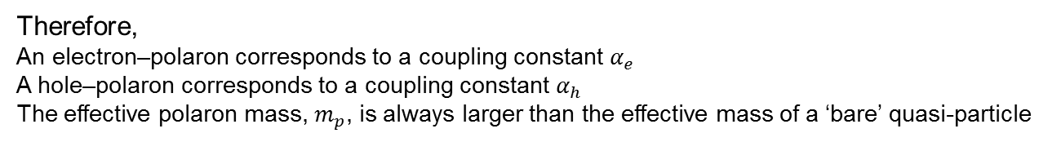

How charge carriers influence the lattice vibration?
Quantify the fröhlich mechanism
In practice, one introduces the coupling constant α in the form
$$α=\frac{e^{2}}{4πε_{0}r_{p}}\left(\frac{1}{ε_{∞}}−\frac{1}{ε_{s}}\right)\frac{1}{ℏω_{LO}}$$
where
$$r_{p}=ℏ\sqrt{2m_{p}ℏω_{LO}}$$
Polaron radius― the very size of the polarization-deformed lattice region around the charge carrier
A polarized electron or hole ― Polaron (a quasi-particle)
Therefore,
An electron–polaron corresponds to a coupling constant $α_{e}$
A hole–polaron corresponds to a coupling constant $α_{h}$
The effective polaron mass, $m_{p}$, is always larger than the effective mass of a ‘bare’ quasi-particle
Note:
As for exciton-phonon coupling, it is not only related to the coupling constant, but also the exciton Bohr radius

Slide 31
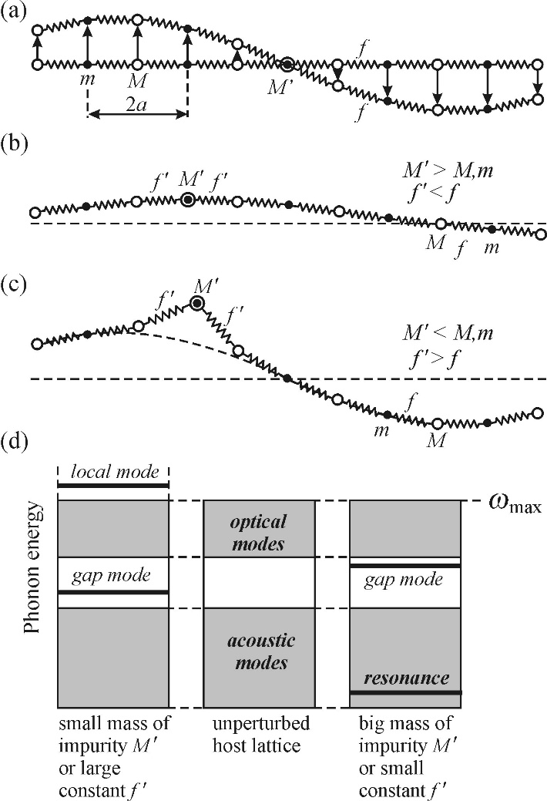
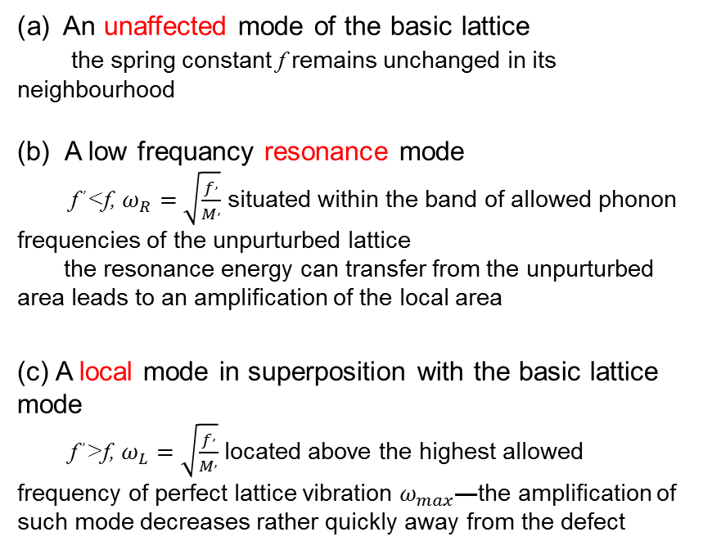
How point defects influence the lattice vibration?
Assume that the lattice contains a single point defect (an impurity atom of mass M,≠m ≠M)
For one-dimensional chain,
An unaffected mode of the basic lattice
the spring constant f remains unchanged in its neighbourhood
(b) A low frequancy resonance mode
f ,<f, $ω_{R}=\sqrt{\frac{f^{,}}{M^{,}}}$ situated within the band of allowed phonon frequencies of the unpurturbed lattice
the resonance energy can transfer from the unpurturbed area leads to an amplification of the local area
(c) A local mode in superposition with the basic lattice mode
f ,>f, $ω_{L}=\sqrt{\frac{f^{,}}{M^{,}}}$ located above the highest allowed frequency of perfect lattice vibration $ω_{max}$―the amplification of such mode decreases rather quickly away from the defect
Unaffected mode
Resonance mode

Slide 32


How point defects influence the lattice vibration?
Quantify of the localization of the mode
Assume: there are N atoms oscillating in this mode, with the same amplitudes $u$. The potential energy $\left\langle V\right\rangle$ of $N$ oscillating atoms in the harmonic approximation is
$$\left\langle V\right\rangle =Nfu^{2}/2$$
the total energy of a quantum harmonic oscillator, independence of N, is
$$2\left\langle V\right\rangle =\frac{1}{2}ℏω\coth{\frac{ℏω}{2k_{B}T}}$$
which is fully determined by the frequency $ω$ and temperature $T$
Note:
in infrared spectra and Raman scattering
Translation symmetry of the unperturbed crystal
Only optical phonons around k=0 are active
Defects breaks the symmetry and modified the selections rules for infrared and Raman spectroscopy
modes from almost the entire Brillouin zone can participate in infrared and Raman experiments

Slide 33
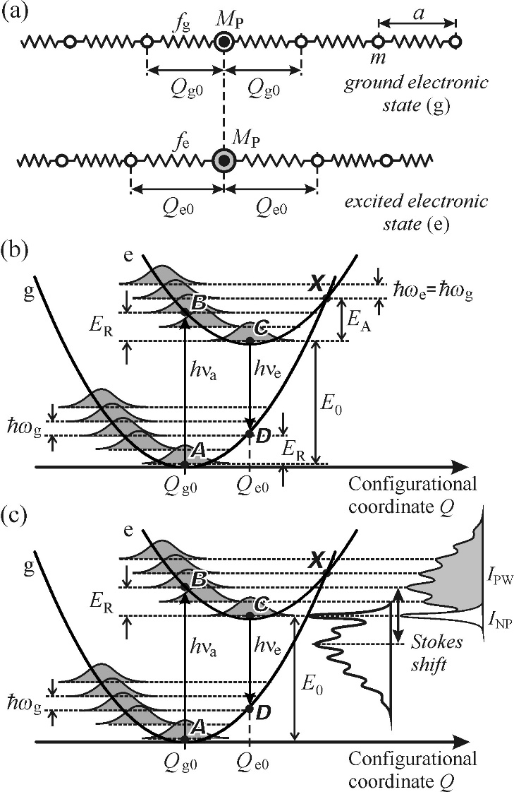

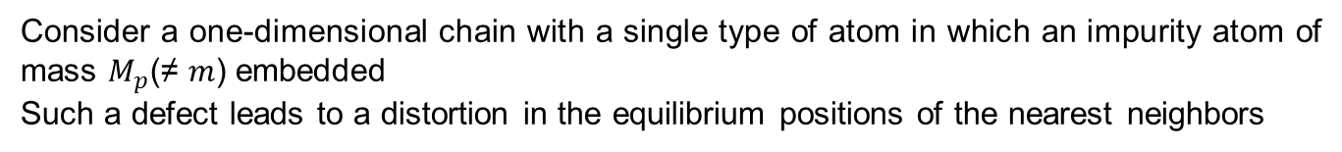

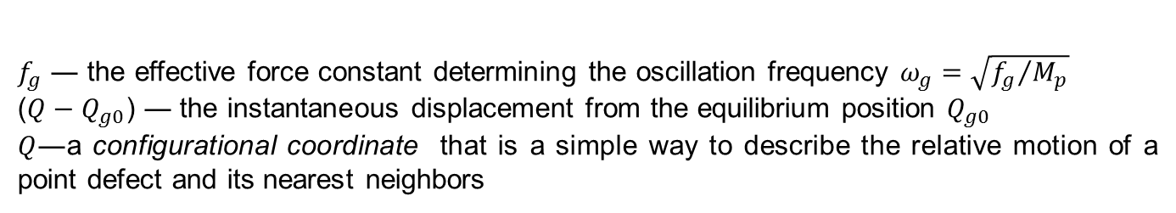
How point defects influence the lattice vibration?
An impurity centre related optical excitation and subsequent radiative transition
Consider a one-dimensional chain with a single type of atom in which an impurity atom of mass $M_{p}$(≠ $m$) embedded
Such a defect leads to a distortion in the equilibrium positions of the nearest neighbors
The impurity atoms, just like the host atoms, oscillate around their equilibrium positions at any temperature and (assuming harmonic oscillations) we can write for the total energy of the oscillating impurity
The impurity will oscillate around a new equilibrium position, and we can write its total energy
$$E_{g}=E_{g0}+\frac{1}{2}f_{g}{\left(Q−Q_{g0}\right)}^{2}$$
$f_{g}$ ― the effective force constant determining the oscillation frequency $ω_{g}=\sqrt{{f_{g}}/{M_{p}}}$
($Q−Q_{g0}$) ― the instantaneous displacement from the equilibrium position $Q_{g0}$
$Q$―a configurational coordinate that is a simple way to describe the relative motion of a point defect and its nearest neighbors
$$E_{e}=E_{e0}+\frac{1}{2}f_{e}{\left(Q−Q_{e0}\right)}^{2}$$
Here we assume that the force constant $f_{e}$remains unchanged as the atom goes to the excited electronic state, thus $f_{e}$= $f_{g}$

Slide 34
How point defects influence the lattice vibration?
The energy picture of ground and excited state
The excited electron in the position of [$Q_{e0}$, $E_{g0}$+ $E_{0}$]
The ground electron in the position of [$Q_{g0}$, $E_{g0}$]
One of the valence electrons jumps to a higher energy level.
The equilibrium distance grows from the value $Q_{g0}$to a value $Q_{e0}$(> $Q_{g0}$)
Notes:
Q _{g0} the equilibrium distance between the impurity and its nearest neighbours of mass m, this distance generally differs from the unperturbed ‘lattice constant’ a,

Slide 35
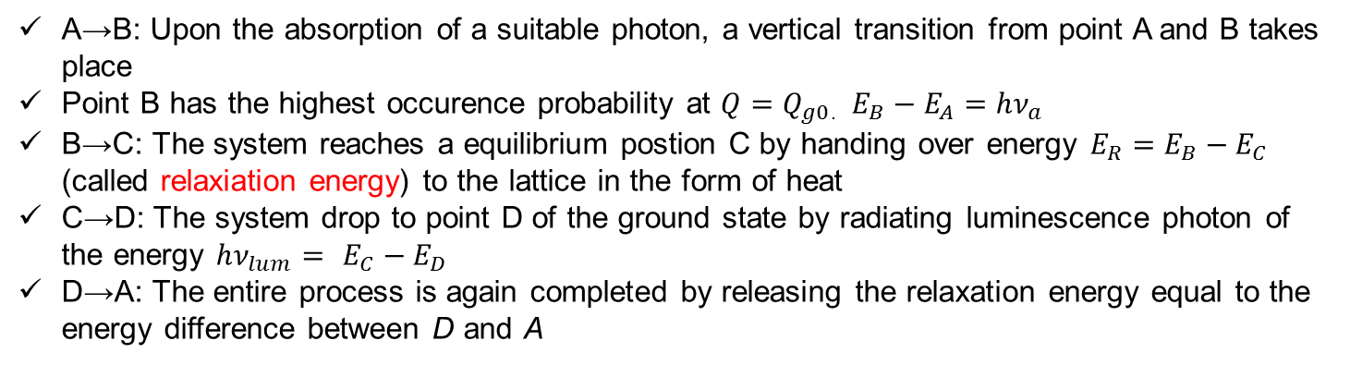
How point defects influence the lattice vibration?
Excitation and Radiation
The absorption of a suitable photon proceeds extremely faster (~ 10⁻¹⁵ s) than the typical frequencies of lattice vibrations (ω ~ 10¹² –10¹³ s⁻¹), which leads to verticality of the resulting optical transitions in the configurational coordinate diagram―Franck–Condon principle
A→B: Upon the absorption of a suitable photon, a vertical transition from point A and B takes place
Point B has the highest occurence probability at $Q=Q_{g0}$. $E_{B}−E_{A}=hν_{a}$
B→C: The system reaches a equilibrium postion C by handing over energy ${E_{R}=E}_{B}−E_{C}$ (called relaxiation energy) to the lattice in the form of heat
C→D: The system drop to point D of the ground state by radiating luminescence photon of the energy ${hν_{lum}= E}_{C}−E_{D}$
D→A: The entire process is again completed by releasing the relaxation energy equal to the energy difference between D and A
We can immediately see that the principle inherently explains the Stokes’ luminescence law: $h_{νa}≥h_{νlum}$
Notes:
In its ground electronic state, the system is located on the lower parabola around the minimum A
Point B, as the final transition state, is determined by that vibronic level of the excited electronic state that has the highest occurrence probability at Q = Q _{g0}
However, point B represents an excited vibrational state of the upper energy curve, which is a non-equilibrium position. Hence, by rearranging the configuration of its adjacent nuclei, the system gradually reaches an equilibrium given by the minimum C of the upper phonons hω e (= hω g )
At point C, the system is still in an excited electronic state of finite lifetime (10⁻⁹ –10⁻⁸ s for the allowed dipole transitions); after this time, it drops to point D of the ground electronic state, radiating a luminescence photon of energy hν _{lum}= E _{C}– E _{D}.

Slide 36
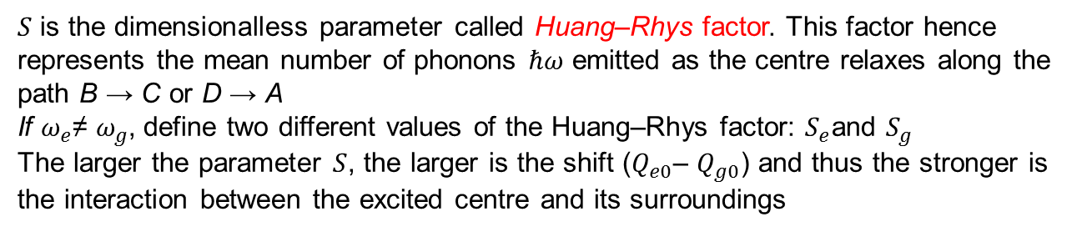



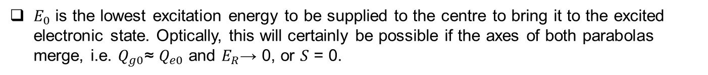
How point defects influence the lattice vibration?
The relaxation energy
$$E_{R}=Sℏω,$$
supposing
$ℏω=ℏω_{g}$ $=ℏω_{e}$
$S$ is the dimensionalless parameter called Huang–Rhys factor. This factor hence represents the mean number of phonons $ℏω$ emitted as the centre relaxes along the path B → C or D → A
If $ω_{e}$≠ $ω_{g}$, define two different values of the Huang–Rhys factor: $S_{e}$and $S_{g}$
The larger the parameter $S$, the larger is the shift ($Q_{e0}$– $Q_{g0}$) and thus the stronger is the interaction between the excited centre and its surroundings
Phonon wing
No-phonon line
The lowest excitation energy
$$E_{0}=E_{e0}−E_{g0}$$
$E_{0}$ is the lowest excitation energy to be supplied to the centre to bring it to the excited electronic state. Optically, this will certainly be possible if the axes of both parabolas merge, i.e. $Q_{g0}$≈ $Q_{e0}$ and $E_{R}$→ 0, or $S$ = 0.

Slide 37
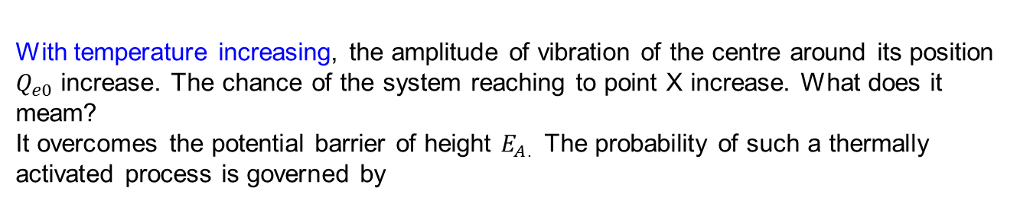

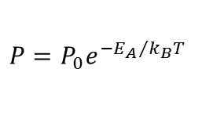
How point defects influence the lattice vibration?
The two parabolic curves intersect at point X
Putting aside zero-point oscillations, the energy separation $E_{A}$ of point X from the minimum C of the upper parabola is equal to
$$E_{A}=\frac{{\left(E_{0}−E_{R}\right)}^{2}}{4E_{R}}$$
This is the activation energy
At a temperature close to absolute zero, the excited centre is located near point C.
With temperature increasing, the amplitude of vibration of the centre around its position $Q_{e0}$ increase. The chance of the system reaching to point X increase. What does it meam?
It overcomes the potential barrier of height $E_{A}$. The probability of such a thermally activated process is governed by
$$P=P_{0}e^{{−E_{A}}/{k_{B}T}}$$
where $P_{0}$(s⁻¹) is the so-called frequency factor
heat

Slide 38
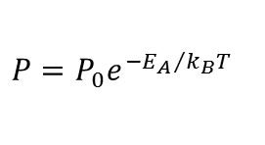



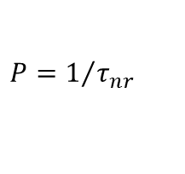
How point defects influence the lattice vibration?
Thermal quenching of the luminescence
$$η=\frac{1/{τ_{r}}}{1/{τ_{r}}+1/{τ_{nr}}}=\frac{1}{1+{τ_{r}}/{τ_{nr}}}$$
$$η=\frac{1}{1+ξe^{{−E_{A}}/{k_{B}T}}}$$
$$ξ=τ_{r}P_{0}$$
$$P=P_{0}e^{{−E_{A}}/{k_{B}T}}$$
$$P=1/{τ_{nr}}$$
$η$ drops with increasing temperature and this effect is called thermal quenching of the luminescence
Note:
The above analysis of thermal quenching was based on the assumption that the intersection point X is at a higher energy than point B. If both points are located on the same level or if X is even lower than B then there will be a steep drop in luminescence intensity since a non-radiative transfer of the electronic excitation energy to the matrix will prevail already at very low temperatures.

Slide 39
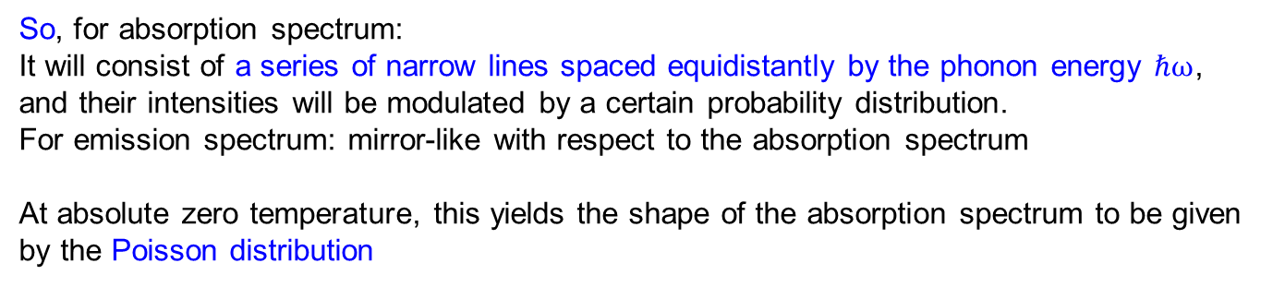

How point defects influence the lattice vibration?
The shape of absorption and emission spectra of a localize centre
At first glance, it may seem that both the absorption and emission are formed by narrow lines corresponding to the transitions A → B and C → D.
However, the truth is somewhat more complicated. The ‘harmonic oscillators’ of the ground as well as the excited electronic states oscillate incessantly, and so both the initial and the final point of an optical transition must respect the spatial distribution of the oscillator probability density.
So, for absorption spectrum:
It will consist of a series of narrow lines spaced equidistantly by the phonon energy $ℏω$, and their intensities will be modulated by a certain probability distribution.
For emission spectrum: mirror-like with respect to the absorption spectrum
At absolute zero temperature, this yields the shape of the absorption spectrum to be given by the Poisson distribution
$$I\left(n\right)≈\frac{e^{−n}S^{n}}{n!}, n=0, 1, 2, …$$
where $n$ numbers the vibrational level of the excited electronic state.

Slide 40
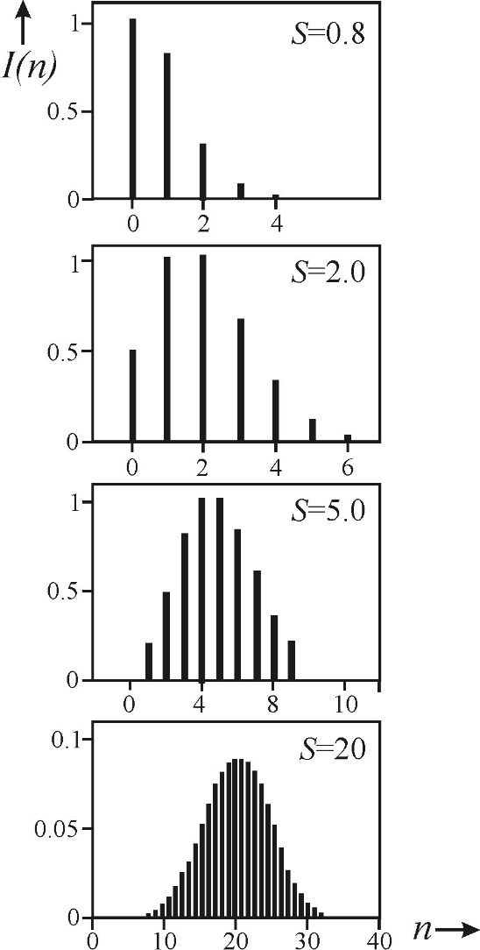

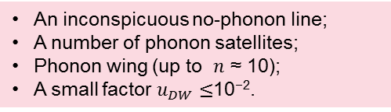
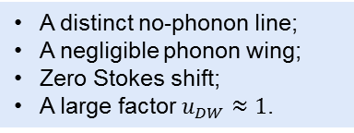



How point defects influence the lattice vibration?
Various strength of the exciton-phonon coupling:
Weak
Medium
Strong
A distinct no-phonon line;
A negligible phonon wing;
Zero Stokes shift;
A large factor $u_{DW}≈1$.
An inconspicuous no-phonon line;
A number of phonon satellites;
Phonon wing (up to $n$ ≈ 10);
A small factor $u_{DW}≤$10⁻².
The no-phonon line missing completely;
A broad phonon wing;
A large Stokes shift;
Poisson distribution → Gaussian form ($n$ ≥ 10);
A small factor $u_{DW}≈$0.
At $S$=0， single line cooresponds to the zero-phonon transition―no-phonon line
With $S$ increasing,
The intensity of the no-phonon line $I\left(0\right)=I_{NP}$ decreases;
Appear phonon replicas or satellites at higher $n$;
The maximum of the spectral ‘envelope’ occurs roughly at $n=S$ ;
The phonon satellites gradually merge into a continuum―phonon wing.
The ratio of the no-phonon line intensity $I_{NP}$ to the total intensity of the absorption (or emission) band ($I_{NP}$+ $I_{PW}$) is called the Debye–Waller factor
$$u_{DW}=\frac{I_{NP}}{I_{NP}+I_{PW}}≤1$$

Slide 41
Thanks for your attentions!

Slide 42

定义被激发电子停留在激发态的平均时间称为荧光寿命，荧光寿命代表分子轨道更加详细的组成及复合机理。荧光寿命通常在ps到us级。如此短的时间过程，我们无法直接采 用现有的电子及检测手段准确获取ps级间隔的数据，所以以统计学为基础的时间相关单光子计数方法（TCSPC）成为最成熟、最准确、灵敏度最高的荧光寿命测试方法。
荧光寿命的物理模型是δ脉冲光源激发，样品发射荧光，荧光强度对应这个δ脉冲的响应。实际的光源中，脉宽都是存在的，于是我们把脉宽分解为多个δ脉冲的集合，实际获取的荧光寿命成为这个集合的响应的加和。高等数学上面称之为卷积，
随后通过数学解卷积过程，我们就获得准确的样品的荧光寿命及组成。
对于TCSPC测试过程，整个荧光衰减过程采用时间通道的方案来进行，通常时间通道有256-8096个供选择，统计假设采集到光子的概率和当时的荧光强度成正比。脉冲光源开始工作时，我们获取计时Start信号，设定检测器在一次脉冲获取一个光子的概率是2%，通过TAC时幅转换器把获得光子的时间（start to stop）以电压形式记录下来，记录在对应的时间通道中；多次脉冲后，多通道时间记录器中就获得了实际的荧光衰减曲线；然后我们以同样的方法采集光源的脉宽曲线。荧光衰减曲线和光源脉宽曲线带入专门的拟合软件，我们可以获得荧光寿命的数值、组成及相关系数。
电压输出一个数字信号并在多道分析仪(Multichannel Analyzer)的相应时间通道计入一个信号,表明检测到寿命为该时间的一个光子。几十万次重复以后,不同的时间通道累积下来的光子数目不同。以光子数对时间作图可得到荧光衰减曲线。

Slide 43

时间相关单光子计数(Time-correlated single photon counting, TCSPC)、相调制(Phase modulation method)和频闪(strobe techniques)等三种现代荧光寿命测定方法
相调制与TCSPC不同之处在于样品被正弦调制的激发光激发
频闪技术: 与脉冲光源同步,电压脉冲启动或按一定程式延迟启动光电倍增管,光电倍增管按预设时间门(Δt)检测样品的荧光强度
Turn ON
Quantum dot
electron
Turn OFF
t
hole
Localized center
WID
PER
(t _{p} → ∞)

