Slide 1
Radiative/non-radiative recombination and Free excitons
SK3889 Luminescence Spectroscopy of Semiconductors
Yanyan Liu, PhD candidate
Energy Technology Department, ITM
2017.11.13
Notes:
the most important spectral features connected with luminescence processes occurring at low-fluence excitation levels will be treated

Slide 2
Outline
Radiative recombination
- Overview of luminescence processes in crystalline semiconductors
- Recombination of free electron-hole pairs
- Recomination of a free electron with a neutral acceptor and of a free hole with a neutral donor
- Recombination of donor-acceptor pairs
- Luminescence excited by two-photon absorption
- Luminescence from transition mental and rare earth ion impurities
Non-radiative recombination
- Transformation of the excitation energy into heat
- Creation of lattice defects
- Photochemical changes
Luminescence of excitons: Wannier exciton

Slide 3
Outline
Radiative recombination
- Overview of luminescence processes in crystalline semiconductors
- Recombination of free electron-hole pairs
- Recomination of a free electron with a neutral acceptor and of a free hole with a neutral donor
- Recombination of donor-acceptor pairs
- Luminescence excited by two-photon absorption
- Luminescence from transition mental and rare earth ion impurities
Non-radiative recombination
- Transformation of the excitation energy into heat
- Creation of lattice defects
- Photochemical changes
Luminescence of excitons: Wannier exciton

Slide 4
Recombination
Recombination is the opposite of generation.
Recombination is most common when impurities or defects are present in the crystal structure, and also at the surface of the semiconductor. In the later case, energy levels may be introduced inside the energy gap, which encourages electrons to fall back into the valence band and recombine with holes.
In recombination process, energy is released in one of the following ways:
Radiative recombination – phonons, light or EM-waves
Non-radiative recombination – photons, lattice vibrations
Auger recombination – which is releasing kinetic energy to another free carrier

Slide 5
Luminescence processes in crystalline semiconductors
Low-fluence exciation - a pulsed laser with excitation intensity of the order of 0.01kW-10MW/cm²:
radiative recombination of free excitons
radiative recombination of free excitons with simultaneous emission of photon
radiative recombination of a bound exciton, which can be further subdivided into
  an exciton bound to a neutral donor
  an exciton bound to a neutral acceptor
  an exciton bound to an ionized donor
  an exciton bound to an ionized acceptor
  an exciton bound to an isoelectronic impurity;
radiative recombination of donor-acceptor pairs
radiative recombination of a free hole with a neutral donor or a free electron with a neutral acceptor
radiative, which can also be referred to as band-to-band recombination.
High-fluence exciation - a pulsed laser with excitation intensity of the order of 1kW-10MW/cm²:
radiative recombination of free excitons with simultaneous emission of photon
luminescence coming from inelastic collisions of excitons
luminescence of electron-hole liquid
luminescence of electron-hole plasma
Bose-Einstein condensation of excitons or excitonic molecules and luminescence coming from the condensate
Two or more types of these processes can occur simultaneously in a material.
Notes:
The classification of luimiscence processes according to the intensity of exciation:
most of these processes can also be observed in low-dimensional semiconductor structures

Slide 6
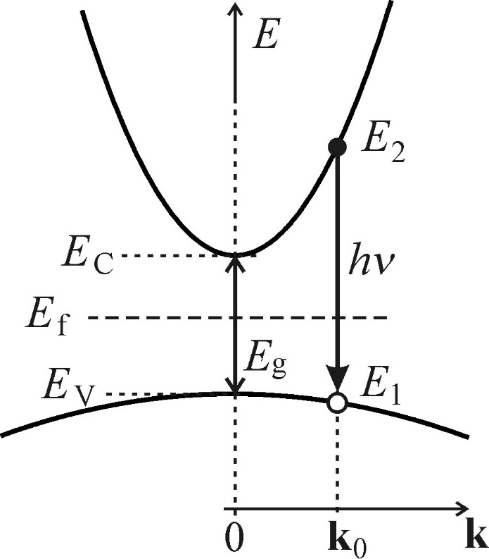
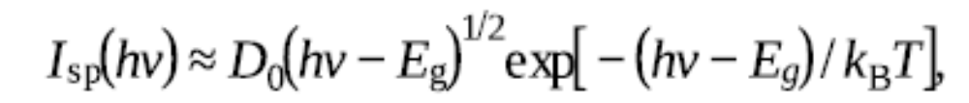
Recombination of free electron-hole pairs
Direct bandgap: An electron with energy E₂ situated close to the minimum of the conduction band spontaneously recombines with a hole situated at the top of the valence band with energy E₁ and wavector k₀ via a direct vertical transition.
Influencing factors of the probability density I_{sp}(hν) of the spontaneous emission of a photon with energy hν = E₂ - E₁:
1. the probability of a suitable configuration of occupancy of conduction and valence band states f_{e}(ν);
2. the quantum-mechanical probability of this transition in the form of the square of the absolute value of the matrix element of the transition (in the dipole approximation) |M|²;
3. the joint density of electron and hole states ρ(ν) in the corresponding bands.
Free electron-hole recombination in a direct bandgap
The spectral shape of luminescence coming from the radiative in a semiconductor with direct bandgap:
(5.9a)

Slide 7
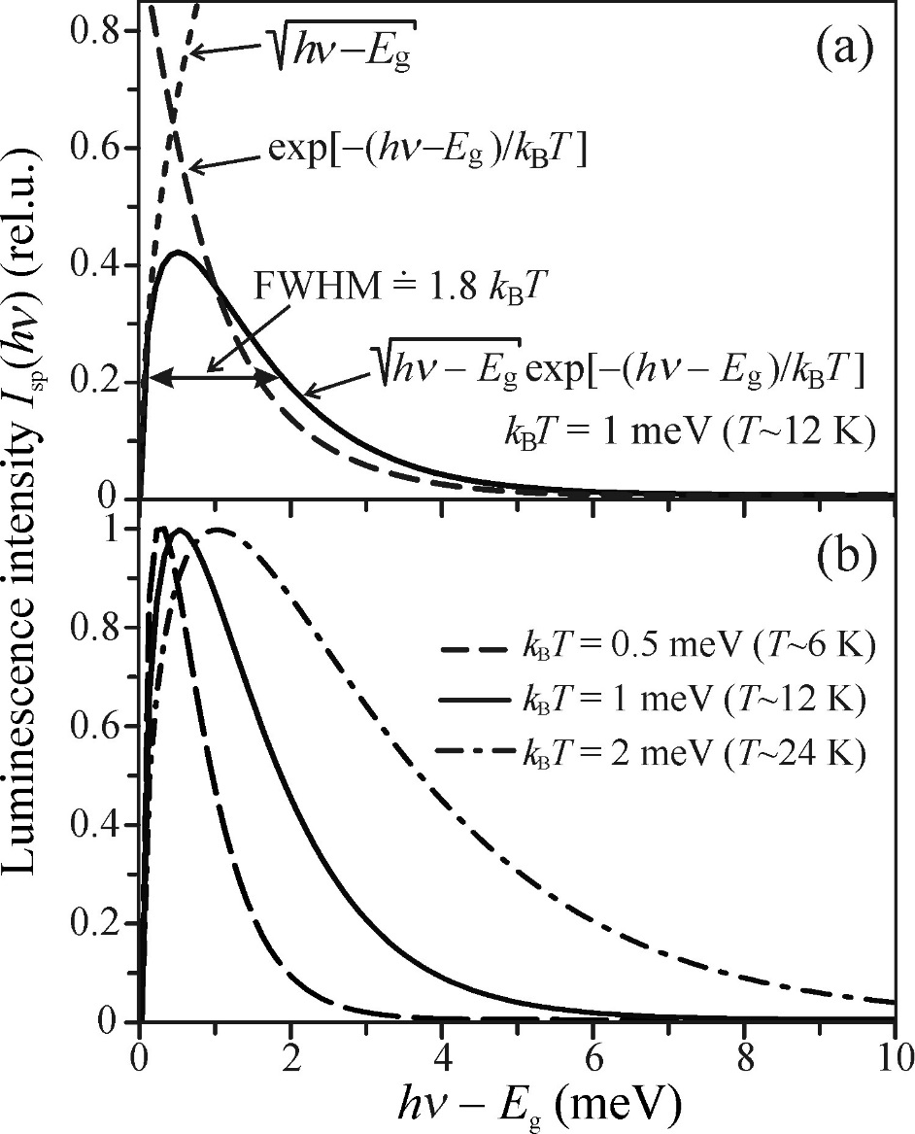
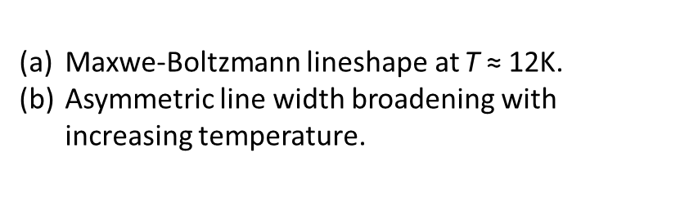
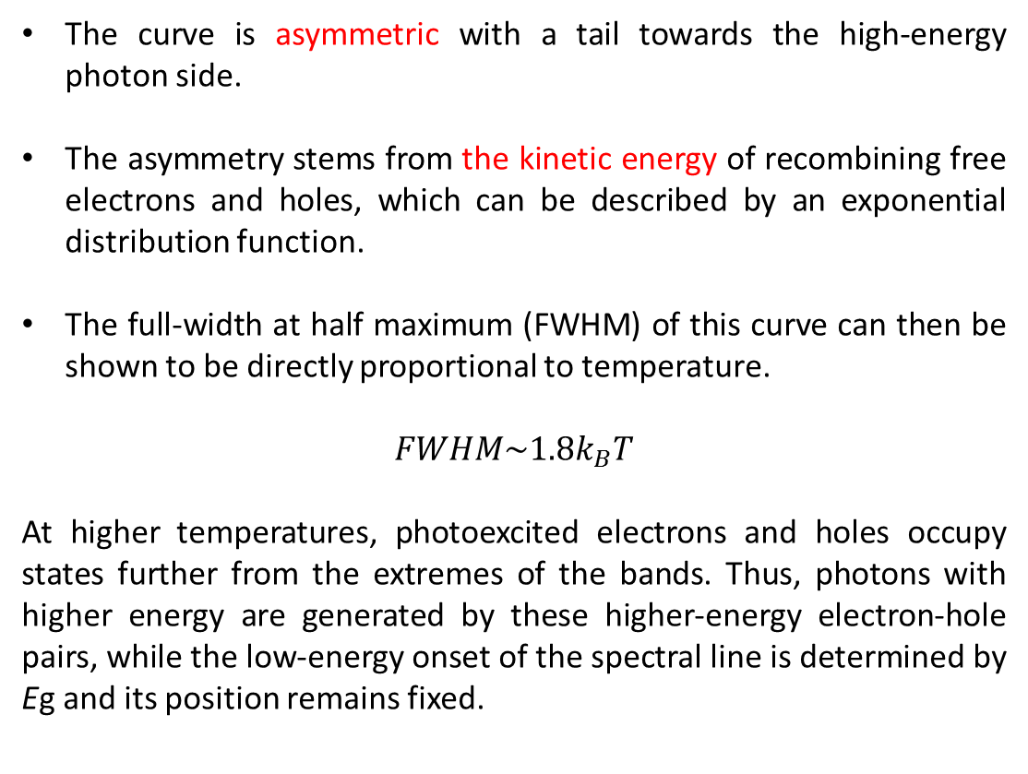
The shape of the luminescence spectrum (5.9a) is also called the Maxwell-Boltzmann distribution.
The curve is asymmetric with a tail towards the high-energy photon side.
The asymmetry stems from the kinetic energy of recombining free electrons and holes, which can be described by an exponential distribution function.
The full-width at half maximum (FWHM) of this curve can then be shown to be directly proportional to temperature.
$$FWHM\sim 1.8k_{B}T$$
At higher temperatures, photoexcited electrons and holes occupy states further from the extremes of the bands. Thus, photons with higher energy are generated by these higher-energy electron-hole pairs, while the low-energy onset of the spectral line is determined by Eg and its position remains fixed.
Maxwe-Boltzmann lineshape at T ≈ 12K.
Asymmetric line width broadening with increasing temperature.
Notes:
at higher temperatures photoexcited electrons and holes occupy states further from the extremes of the bands. Thus, photons with higher energy are generated by these higher-energy electron-hole pairs, while the low-energy onset of the spectral line is determined by Eg and its position remains fixed.

Slide 8
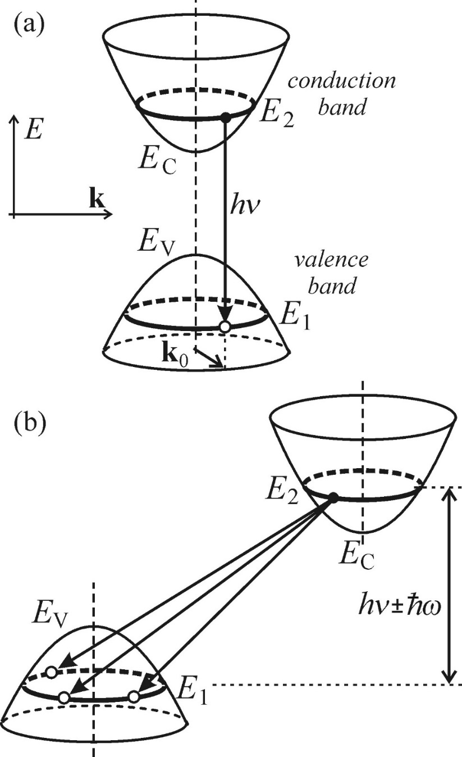
Recombination of free electron-hole pairs-Indirect bandgap
In a direct-bandgap semiconductor, the recombination takes place between electrons and holes with the same wavevector.
In an indirect-bandgap semiconductor, an excited electron with energy E₂ can recombine with any hole with energy E₁ and varying values of k, as long as the energy-conservation rule E₂-E₁ = hν ± ћω is fulfilled.
direct bandgap
Here, the energy ћω denotes the energy of a phonon, which takes part in the process in order to ensure the conservation of quasimomentum. An appropriate phonon can always be found, unless the transitions are forbidden due to the symmetry of electron and/or phonon states.
indirect bandgap
Schematic drawing of radiative recombination of electron-hole pairs in the energy band structure diagram.

Slide 9
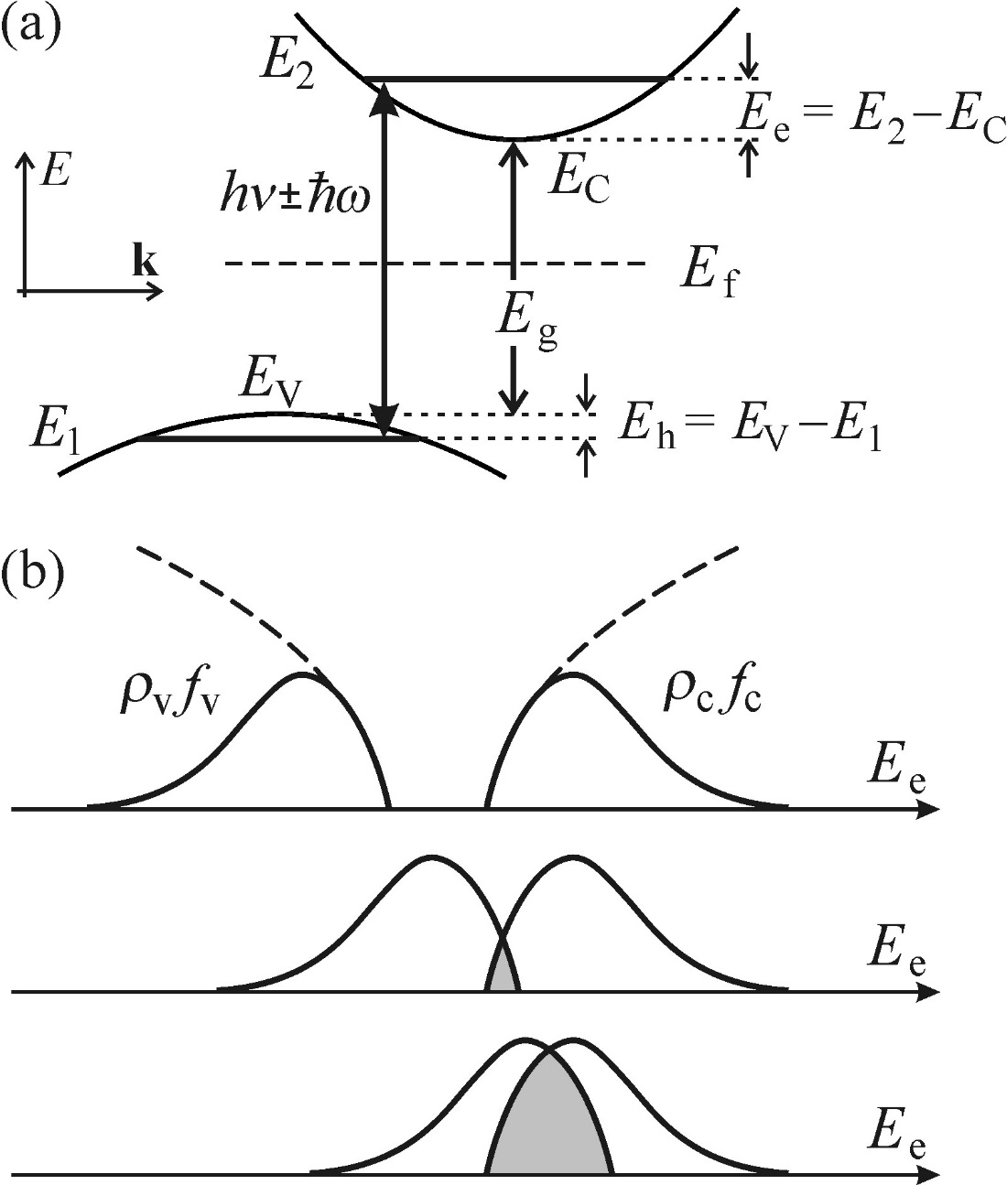
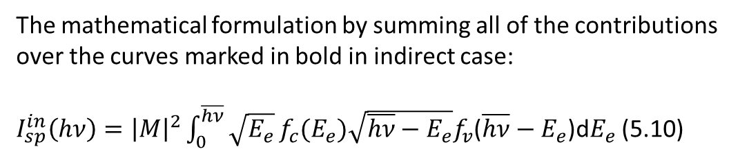
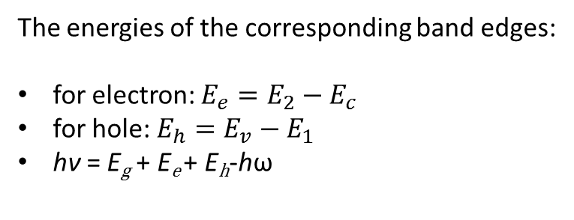
Recombination of free electron-hole pairs-Indirect bandgap
The energies of the corresponding band edges:
for electron: $E_{e}=E_{2}−E_{c}$
for hole: $E_{h}=E_{v}−E_{1}$
hν = E_{g} + E_{e} + E_{h}-hω
band structure
The mathematical formulation by summing all of the contributions over the curves marked in bold in indirect case:
$I_{sp}^{in}\left(hν\right)={\left|M\right|}^{2}\int_{0}^{\overline{hν}}{\sqrt{E_{e}}}f_{c}(E_{e})\sqrt{\overline{hν}−E_{e}}f_{v}$($\overline{hν}−E_{e}$)d$E_{e}$ (5.10)
The convolution of states occupied by electrons in the conduction band with the states occupied by holes in the valence band.
The matrix element contains both vertical transitions and also electron-phonon scattering ensuring the indispensable alteration of quasi-momentum in the recombination event.
This matrix element can be in a very good approximation treated as independent of both E_{e} and E_{h} and its influence on the emission lineshape can be neglected, If both the photon and phonon parts of the matrix element are symmetry-allowed.
Convolution of occupied electron and hole
Illustrating the calculation of the spectral lineshape of luminescence coming from the in an indirect-bandgap semiconductor.

Slide 10
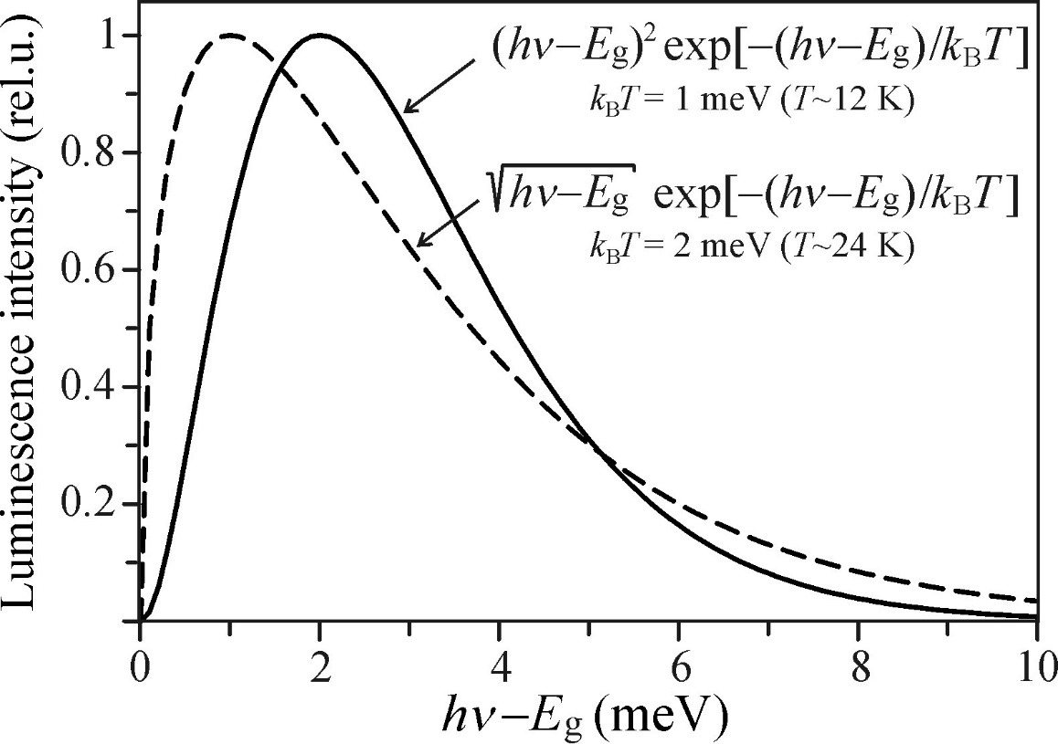
Comparison of emission lineshapes of the recombination of free electron-hole pairs
The spectral shape of luminescence coming from the radiative in a semiconductor with indirect bandgap:
Comparing with direct bandgap:
the red-shift of the low-energy side of the spectrum by hω,
the replacement of the square-root dependence of the pre-exponential factor in direct bandgap case by a quadratic dependence in indirect bandgap case.
Note: This change in the pre-exponential factor just slightly modifies the low-energy onset of the spectrum while the shape of the high-energy tail is most significantly influenced by the exponential factor.

Slide 11
Recombination of a free electron with a neutral acceptor and of a free hole with a neutral donor
In an impurity atom in a semiconductor:
Shallow acceptor: the valence is smaller by one electron than that of the main constituent of the crystal lattice.
Shallow donor: the valence is larger by one electron than that of the main constituent of the crystal lattice.
Ionization energy: the additional hole or electron arising from the replacement of the main constituent’s atom in its position in the crystal lattice by the impurity atom is weakly bound and can be thermally excited into the valence (conduction) band, thus boosting the electrical conductivity of the material. The corresponding amount of energy needed for the release of the hole or electron is referred to as the ionization (binding) energy of the acceptor E_{A} or donor E_{D}.

Slide 12
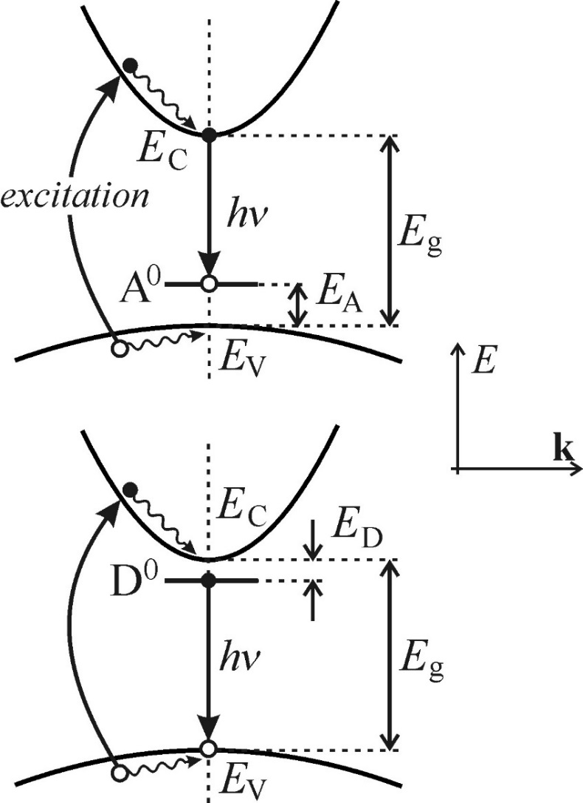
Recombination of a free electron with a neutral acceptor and of a free hole with a neutral donor
In acceptors (top panel):
A free electron at the bottom of the conduction band recombines with a hole localized on the acceptor level;
It leads to the emission of a luminescence photon with approximate energy hν ≈ E_{g}-E_{A}.
The luminescence process would not proceed further, however, if it were not for excitation, resulting in the liberation of other free electron-hole pairs. (as shown)
Excited electrons and holes quickly thermalize and ‘diffuse’ close to the extremes of the bands.
The electron remaining after the radiative recombination at the acceptor level recombines with a hole at the top of the valence band, which restores the neutral state of the acceptor.
The whole process of the emission of a luminescence photon can happen again.
(e-A⁰) recombination (top panel) and (h-D⁰) recombination (bottom panel) in a direct-bandgap semiconductor.

Slide 13
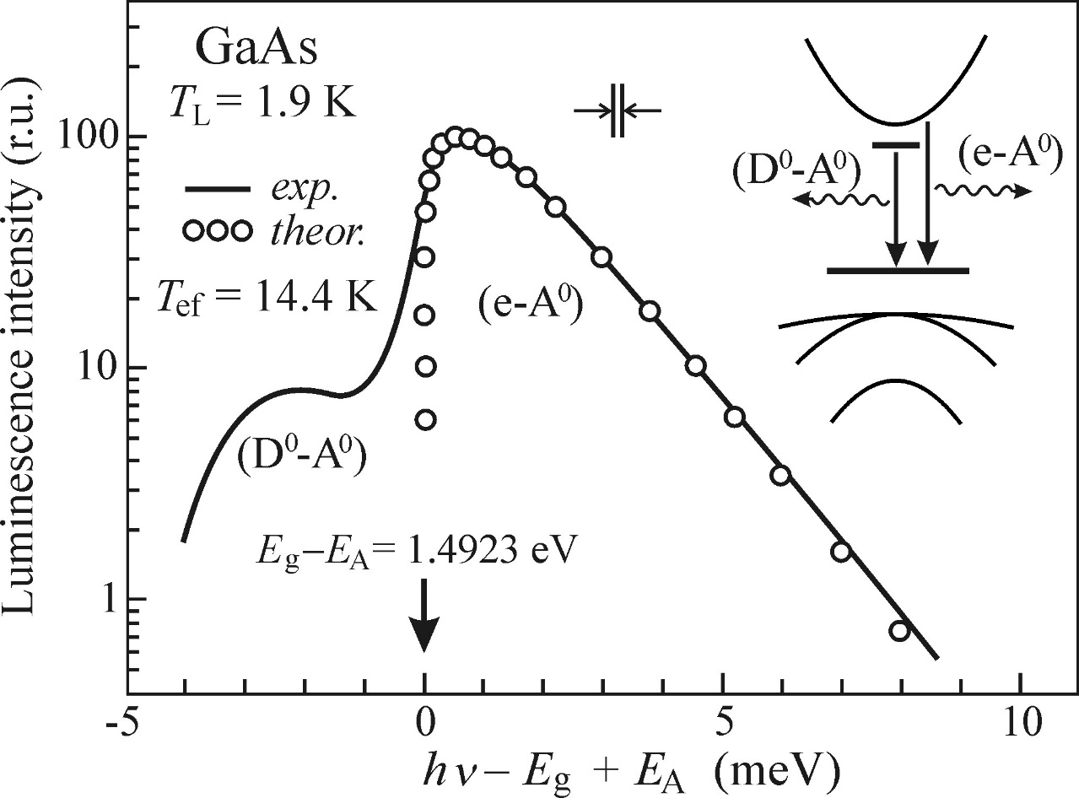
Recombination of a free electron with a neutral acceptor and od a free hole with a neutral donor
the temperature T_{ef} in the relevant formula is higher than the lattice temperature T_{L} at which the sample is kept (liquid helium, nitrogen, etc.).
even if the free quasi-particles are in thermal equilibrium with one another, they are not in thermal equilibrium with the subsystem of atoms (ions) vibrating in the lattice.
the difference between the temperatures T_{ef} and T_{L} increases if a high power excitation source is used or when the energy difference between the exciting photons and the bandgap Eg rises.
Note: Radiative recombination (e-A⁰), (h-D⁰) is difficult to observe in an indirect-bandgap semiconductor due to the negligible concentration of free electrons and holes with respect to the concentration of excitons.
Photoluminescence spectrum (e-A⁰) of high-purity GaAs containing a single residual shallow acceptor with ionization energy E_{A} ≈ 27meV.

Slide 14
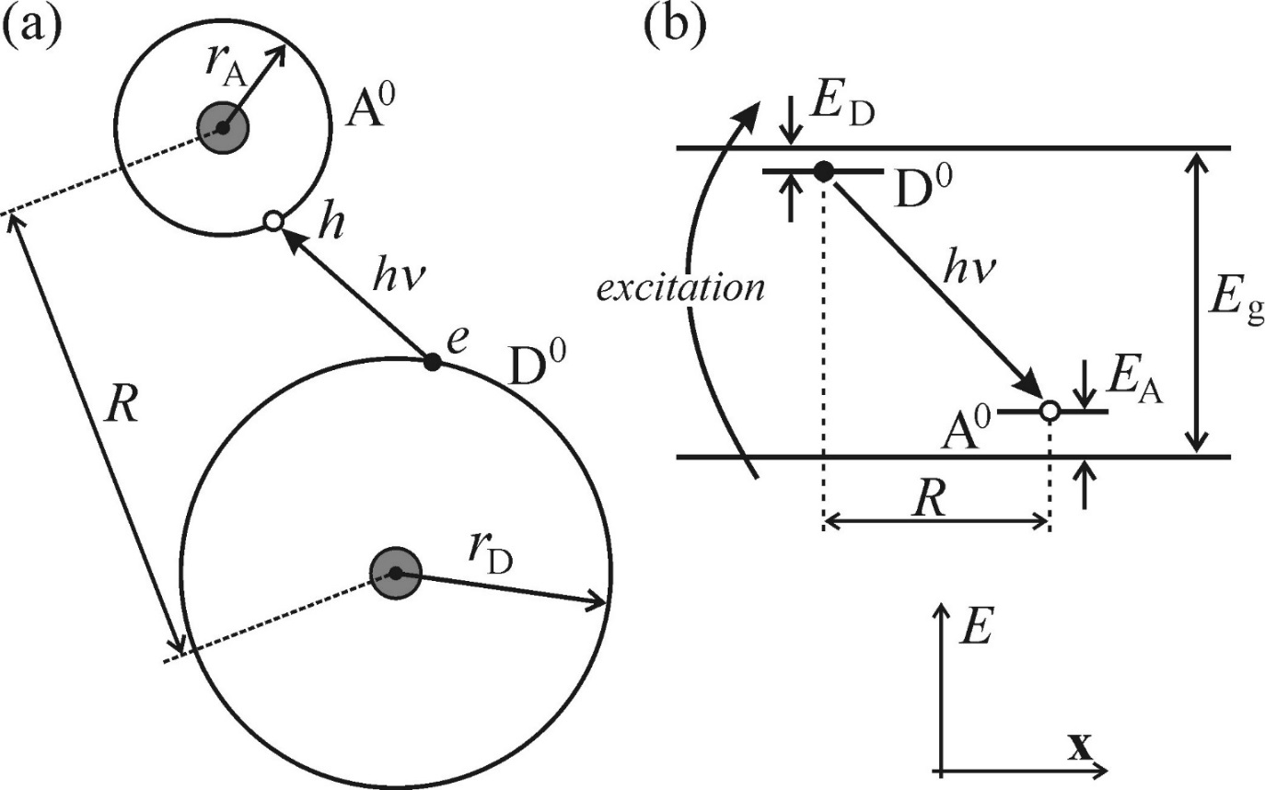
Recombination of donor-acceptor pairs
in the electron energy band structure
in real space
The neutral donor D₀ can be considered as an ‘extra’ electron orbiting all the remaining parts of the atom, i.e. the atomic nucleus, the inner atomic shells and electrons taking part in the covalent bonding with the nearest constituents of the crystal lattice.
A neutral acceptor A₀ can then be treated analogously, if the extra electron is substituted with a hole.
This electron-hole pair can recombine radiatively while emitting a photon hν.
After the recombination, both the donor and the acceptor become ionized (D⁺, A⁻), but free electron-hole pairs generated by the band-to-band excitation quickly neutralize these ionized donors and acceptors.
The concept of luminescence arising from the recombination of donor-acceptor pairs (D⁰-A⁰).

Slide 15
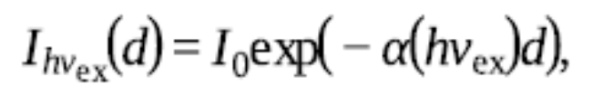
Luminescence excited by two-photon absorption
The excitation of the photoluminescence processes takes place via the conventional absorption of a single photon leading to the generation of electron-hole pairs or excitons. This kind of absorption is governed by Lambert-Beer law:
Here, α (hν_{ex}) - the absorption coefficient
d - the depth under the surface of the sample to which the light penetrates.
Note: The typical values of absorption coefficient for these cases are in the order of α (hν_{ex}) ≈ 10⁴-10⁵ cm⁻¹, which allows the penetration of light only into depths of the order of d = 100nm - 1μm.

Slide 16
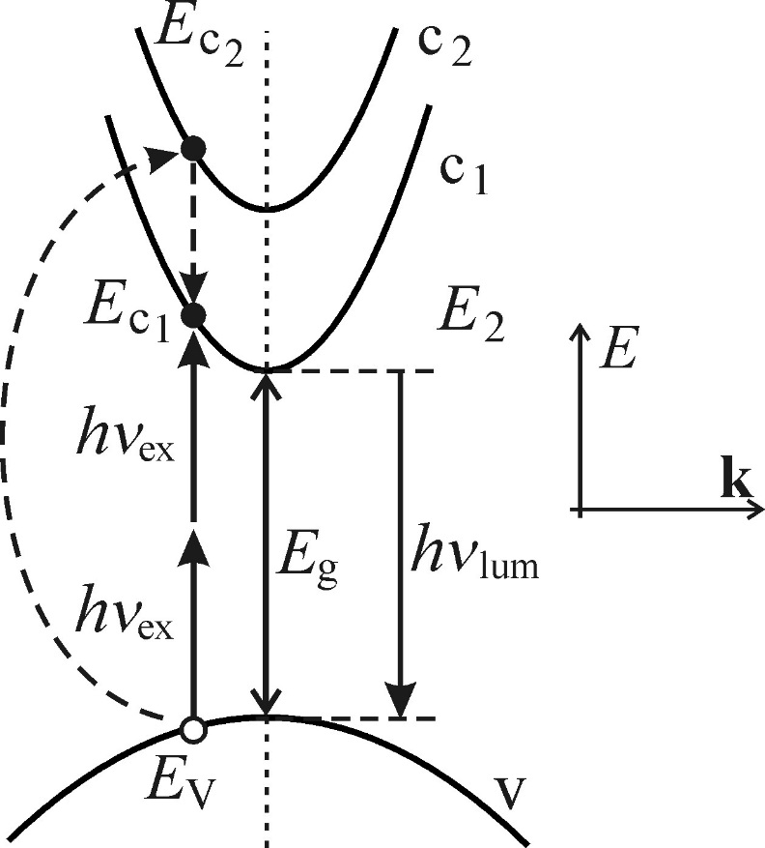
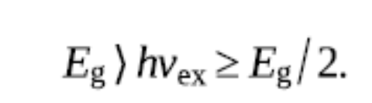
Luminescence excited by two-photon absorption
two-photon absorption process:
a nonlinear optical phenomenon
two photons are absorbed at the same time in a single elemental act
A condition to be fulfilled:
energy-conservation law: E_{c1} − E_{v} = 2hν _{ex}.
Schematic illustration of two photon
absorption in semiconductors.

Slide 17
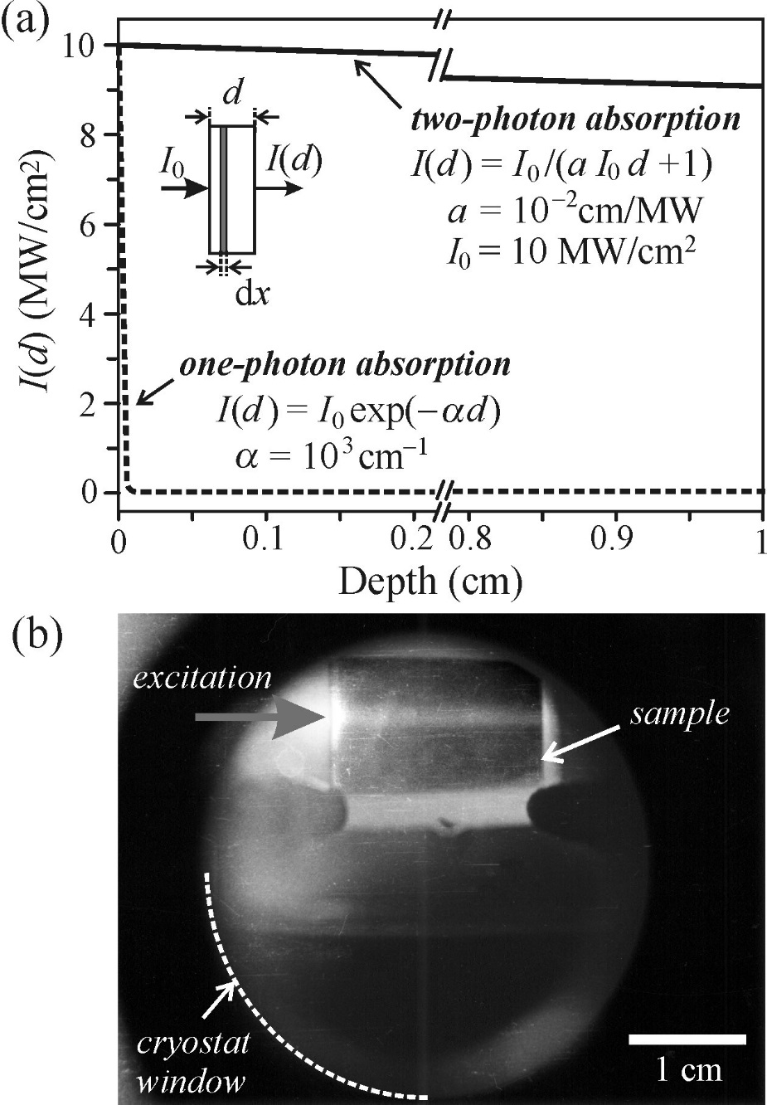
Luminescence excited by two-photon absorption
Numerical comparison of the decrease in intensity of a light beam as a function of the penetration depth:
one-photon: exponential decrease; two-photon: hyperbolic decrease
the hyperbolic decrease is incomparably slower.
a high-power source of light is necessary.
a sample length of 1cm(!) is needed so that the intensity could decrease by a single percent.
Notes:
The influence of surface states on luminescence is not so pronounced as was commonly supposed in the past.
These new features are more closely related to the properties of the material itself than to its surface.
Cryostat

Slide 18
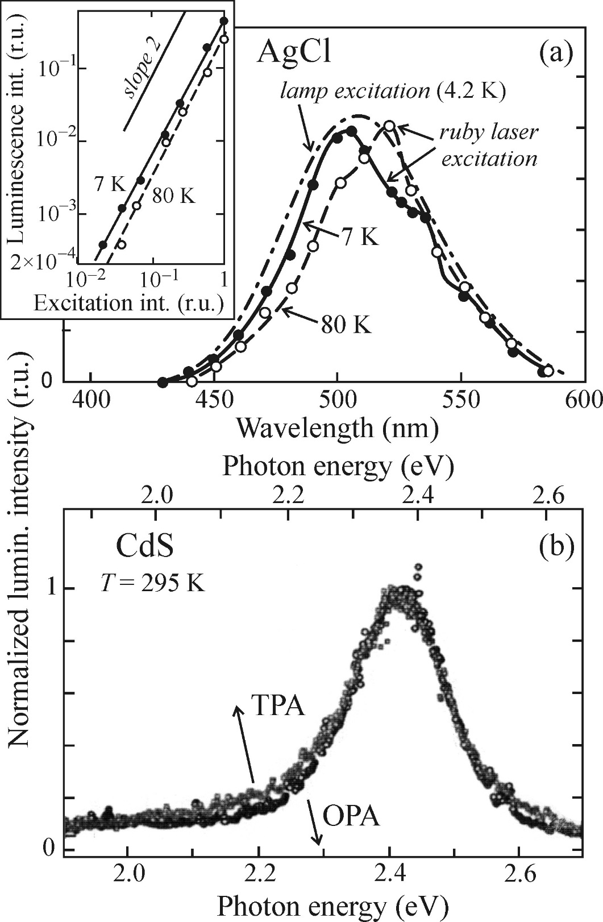
How to recognize undoubtedly that the observed luminescence is two and not one-photon excited?
one-photon
two-photon
Two characteristic features of two-photon excited luminescence:
the quadratic intensity dependence
an ‘anti-stokes’ shift of the two-photon excited luminescence.
The term ‘anti-stokes shift’ indicates that the spectral position of the emission spectrum violates Stokes’ law. It states that the luminescence wavelength λ_{lum} is always longer than the excitation wavelength λ_{ex}.
two-photon
one-photon

Slide 19
Luminescence from transition metal and rare earth ion impurities
The impurities are introduced into solids in order to boost the luminescence efficiency and achieve a particular emission wavelength.
Transition metal ions
Rare earth ions
Transition metal ions exhibit luminescence as a result of transitions of electrons between the levels of the partially filled 3d shell.
It is important to realize that 3d^{n∗} → 3d^{n} transitions are, from the atomic point of view, dipole-forbidden.
When the ions are embedded into the crystal lattice, the interaction with the electric field of the crystal makes the transitions partially allowed.
This interaction can be described in the frame-work of the ligand-field theory.
The most commonly applied rare earth ions are trivalent ions of lanthanides Ce³⁺-Yb³⁺, in which luminescence comes from 4f^{n∗} → 4f^{n} transitions.
Apart from the trivalent form, rare earths can be built into the lattice also in the form of divalent ions.

Slide 20
Outline
Radiative recombination
- Overview of luminescence processes in crystalline semiconductors
- Recombination of free electron-hole pairs
- Recomination of a free electron with a neutral acceptor and of a free hole with a neutral donor
- Recombination of donor-acceptor pairs
- Luminescence excited by two-photon absorption
- Luminescence from transition mental and rare earth ion impurities
Non-radiative recombination
- Transformation of the excitation energy into heat
- Creation of lattice defects
- Photochemical changes
Luminescence of excitons: Wannier exciton

Slide 21
Non-radiative recombination
A portion of the supplied excitation energy is not transformed into luminescence radiation but, during relaxation to the system ground state, changes into other types of energy instead. The relevant transitions are called non-radiative transitions and the relevant electron-hole Recombination is called non-radiative recombination.
The non-radiative recombination is due to the imperfect materials (impurities or crystal lattice defects).
1. the excitation energy transforms into heat (phonons);
2. the creation of new point defects in the lattice;
3. transforming the excitation energy into photochemical changes.

Slide 22
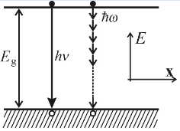
Transformation of the exciation energy into heat
Mulitphoton recombination
An excited electron near the bottom of the conduction band, a hole near the valence band maximum and the entire excitation energy is handed over to the lattice through n phonons with energy ℏω: E_{g} = nℏω.
This process in fact does not occur in reality.
(From the perturbation theory point of view, it is an nth order process and for its probability 1/τ_{nr} a relation like 1/τ_{nr}≈exp(E_{g}/ℏω)≈exp(-n) can be foreseen. For a typical semiconductor with E_{g}≈ 2eV and ℏω≈25 meV we obtain n = 80, therefore, the corresponding probability is negligibly small and decreases with increasing forbidden gap E_{g}.)

Slide 23
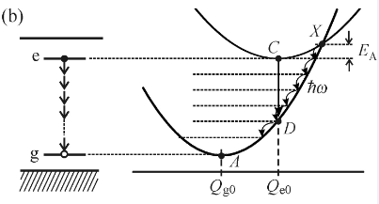
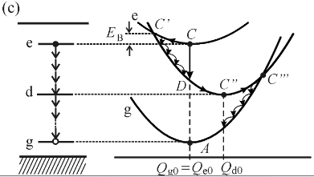
How non-radiative multiphonon transitions can be applied in a localized luminescence centre?
The ordinate of the intersection point X lowers with increasing difference Q_{g0}-Q_{e0} and so does the activation energy E_{A}. The excited centre then reaches point X easily and then, down the trajectory X → A, it may pass non-radiatively to the ground electronic state, emitting local phonons.
Shockley-Read recombination: from a gradual dissipation of the electron excitation energy via ‘cooling transitions’ C → C′ → C″, the remaining energy ‘spills’ into the matrix by a pathway of
similar character C″ → C‴ → A, thus completing the non-radiative relaxation of the excited luminescence centre via multiphonon emission.

Slide 24
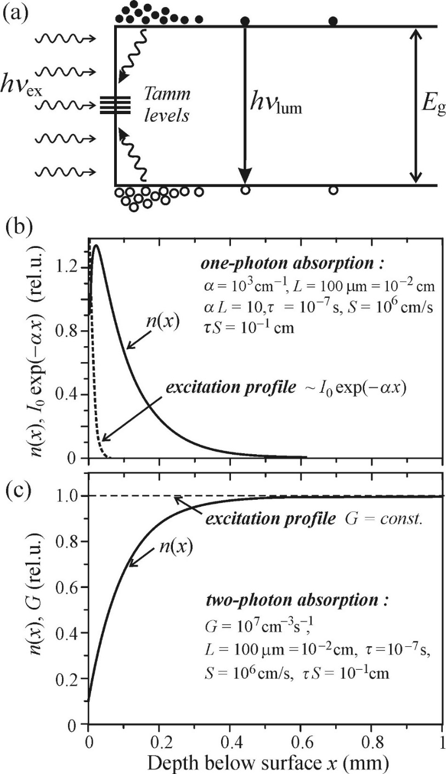
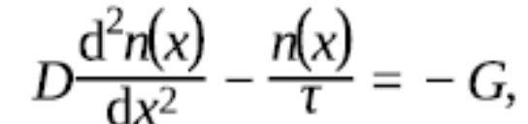
What is the microscopic basis of the non-radiative centre constituting the deep level?
It may be dislocations or vacancies in the bulk of the semiconductor, or recombination in the proximity of the interface between two materials may be involved.
Surface recombination is a specific non-radiative recombination in solidstate phosphors, which takes place only in a thin subsurface layer and is conditioned by the occurrence of deep localized levels located within the forbidden gap.
Illustration of surface nonradiative recombination:
Schematic of photoexcitation and deep levels within the forbidden gap in the proximity of the surface: the photocarrier concentration n(x) just under the surface will decrease significantly, thus creating a concentration gradient driving photocarriers to the surface.
the diffusion current density: |j|=– D∂n(x)/∂x
D - the diffusion coefficient of the carriers
through Fick’s second law:

Slide 25
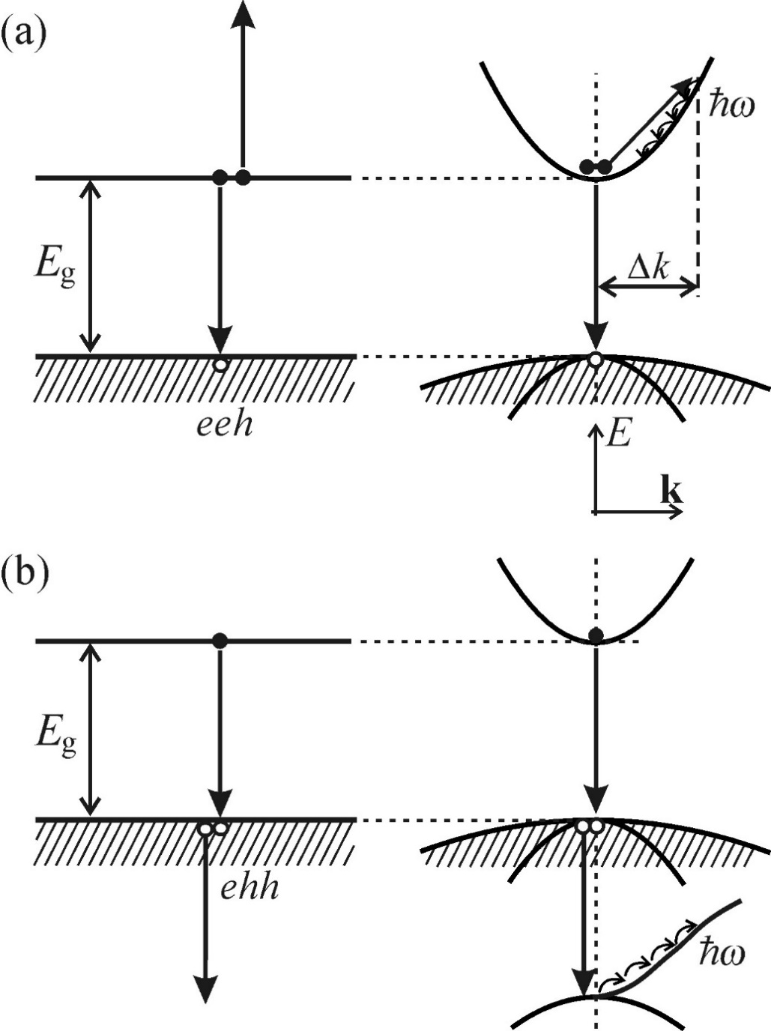
Transformation of the exciation energy into heat - Auger and bimolecular recombination
an incident high-energy electron ejects another electron from an atomic core level;
if some electron from an outer shell falls into the created vacancy, one X-ray photon is emitted;
However, the filling process of the vacant state can also result in another outcome: the excitation energy is handed over to another electron from the same outer shell, ejecting it out of the atom.
electron-electron-hole
The Auger mechanisms can be called intrinsic because their occurrence is not conditioned by the presence of a defect or impurity.
electron-hole-hole
Intrinsic non-radiative Auger recombination

Slide 26
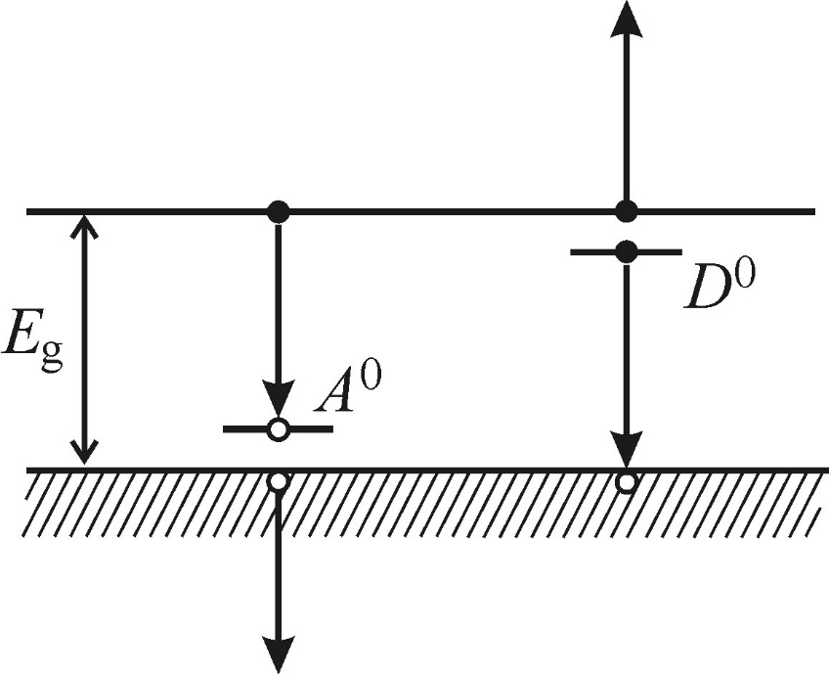
Notes:
The intrinsic Auger effect occurs mainly for high concentrations of free carriers.
The (eeh) is type is expected to be found mainly in n-type semiconductors.
The (ehh) is predominantly in p-type materials.
The luminescence of narrow-bandgap semiconductors is weak in intrinsic Auger recombination.
(reason: easy thermal generation of free carriers across the bandgap leads to a relatively high free carrier concentration already in unexcited material.)
Extrinsic Auger recombination: carriers localized at impurities also play a role.
a nonradiative process accompanying luminescence originating in the transitions (e-A0 ) and (h-D0 )
the efficiency decreases.

Slide 27
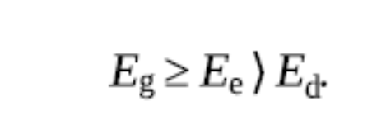
Creation of lattice defects
Mechanism: An electronic excitation is localized at some atom occupying a regular lattice position. Relaxation of such an excited atom into the ground state can proceed through the released excitation energy is transferred to the relevant atom as a whole, creating a Frenkel defect.
The criteria to realize this non-radiative recombination process:
Localization of the electronic excitation must occur
Energy criterion
Protection against degradation to heat-phonons
Orientation criterion
Photochemical changes

Slide 28
Outline
Radiative recombination
- Overview of luminescence processes in crystalline semiconductors
- Recombination of free electron-hole pairs
- Recomination of a free electron with a neutral acceptor and of a free hole with a neutral donor
- Recombination of donor-acceptor pairs
- Luminescence excited by two-photon absorption
- Luminescence from transition mental and rare earth ion impurities
Non-radiative recombination
- Transformation of the excitation energy into heat
- Creation of lattice defects
- Photochemical changes
Luminescence of excitons: Wannier exciton

Slide 29
Luminescence of excitons
An exciton - a couple consisting of an electron and the associated hole, attracted to each other via Coulomb forces.
Three excitions types:
Frenkel exciton or a small-radius exciton. (in molecular crystals)
A charge transfer exciton. (in ionic crystals.)
Wannier exciton or a large-radius exciton. (in semiconductors)
The Wannier exciton - a weakly bound electron-hole pair at which an electron and a hole circulate around each other.

Slide 30
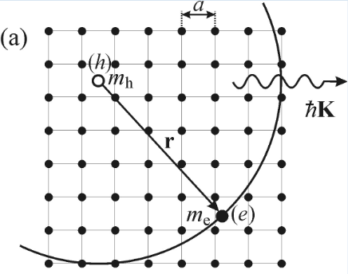
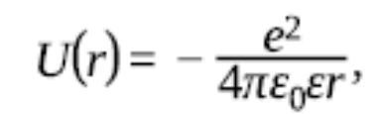

Wannier exciton
the attractive force results from the Coulomb potential:
r - the electron-hole distance
ε - the dielectric constant of the substance.
binding energy:
A typical value of E_{X} thus amounts to E_{X} ≈ 13meV.
Schematic of the Wannier exciton in a two-dimensional crystal lattice with lattice constant a.
The Wannier exciton binding energy is therefore of the order of tens of meV.

Slide 31
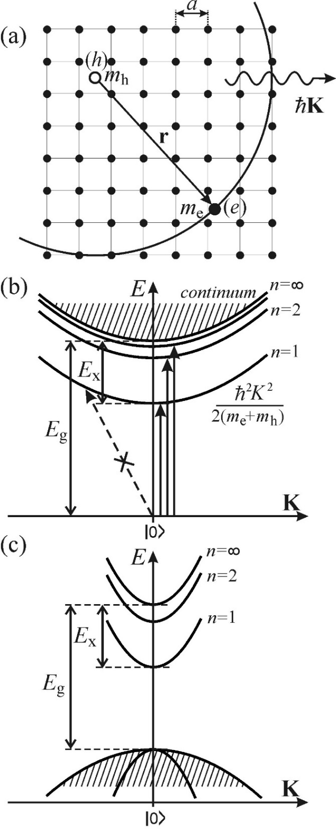

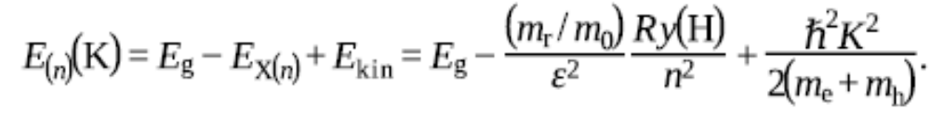
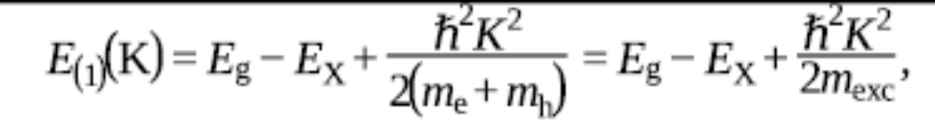
Two factors impacting the calculation of orbital radius:
a substantially different ratio of the (effective) masses
the attractive electrostatic force between the electron and hole
Where, n = 1,2,3… - the principal quantum orbit number
m_{r} = (m_{e}+ m _{h})/(m _{e} + m _{h}) - the reduced mass of the exciton
m₀ - the free electron mass
the total exciton energy:
For the ground state, n = 1,

Slide 32
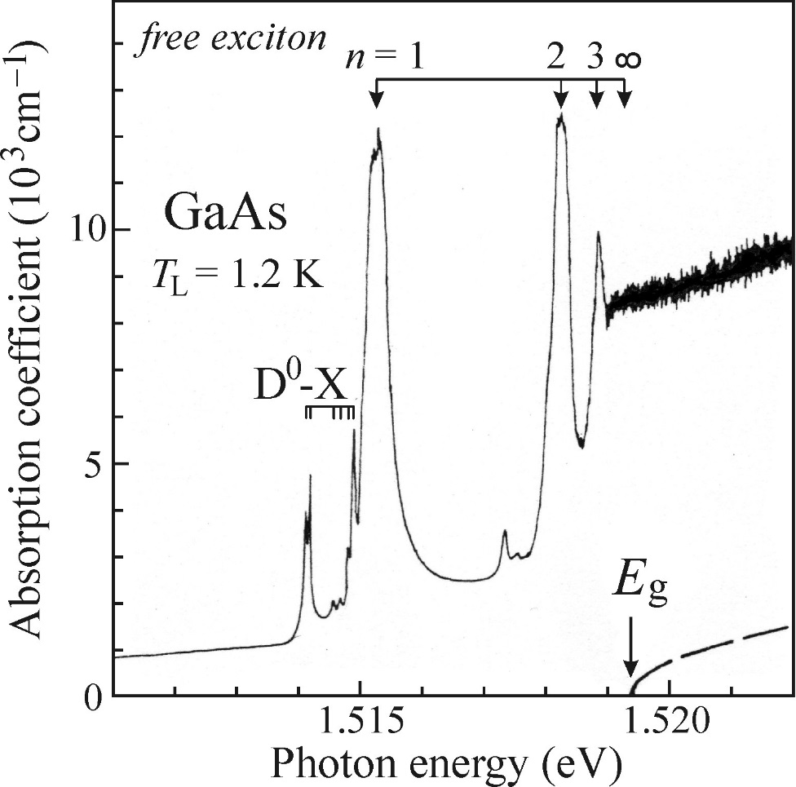

Absorption spectrum of the Wannier exciton
In a direct-bandgap semiconductor, the absorption edge
The photons possessing energy hν smaller than the bandgap width Eg therefore should not be absorbed at all.
Marked absorption lines, leading to the creation of the free exciton in the state n = 1, 2 and 3, dominate the spectrum.
Absorption into higher exciton states merges gently into the absorption continuum.
the value of the forbidden gap Eg = 1.5194eV is determined by extrapolating the series to n = ∞.
Two facts from the direct absorption spectrum:
the intensity of the absorption lines drops with increasing n
the optical absorption for hν ≥ Eg becomes enhanced under the influence of excitons
Optical absorption spectrum of a very pure GaAs sample at T = 1.2K in the vicinity of the absorption edge

Slide 33
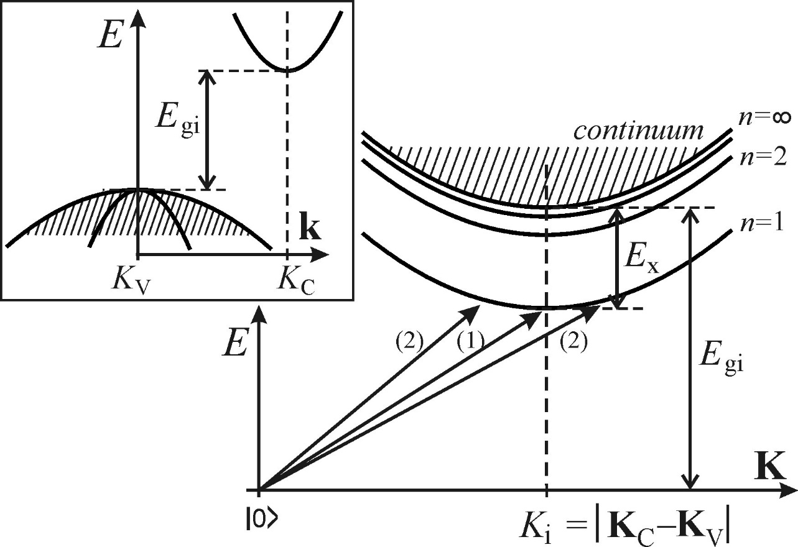
In indirect-bandgap semiconductors, however, a substantially different spectral dependence around the onset of the intrinsic absorption edge occurs.
A stable exciton can be created only when the group velocities of the electron and hole are the same; only in this case can the electron and hole move together as a bound pair.
This transition results in the appearance of excitons with non-zero kinetic energy.
Excitons with non-zero kinetic energy can be created easily by optical absorption in the ‘non-resonant’ way.
Exciton dispersion relations in a semiconductor with indirect bandgap of width Egi.

Slide 34
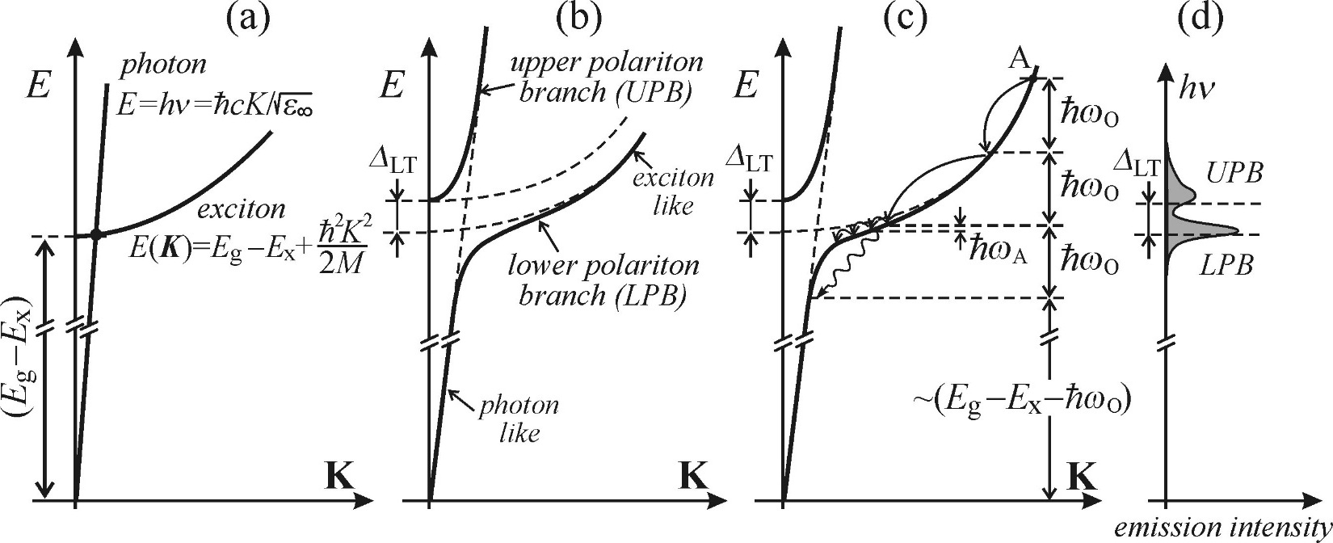
Direct bandgap: resonant luminescence of free exciton-polaritons
(a) Dispersion curve of a ‘bare’ exciton and ‘bare’ photon;
(b) Schematic of the exciton-polariton dispersion curves;
(c) Thermalization of LPB polaritons owing to the cascade emission of optical (ħωO) and acoustic (ħωA) phonons;
(d) Schematic of the luminescence spectrum of polaritons.

Slide 35
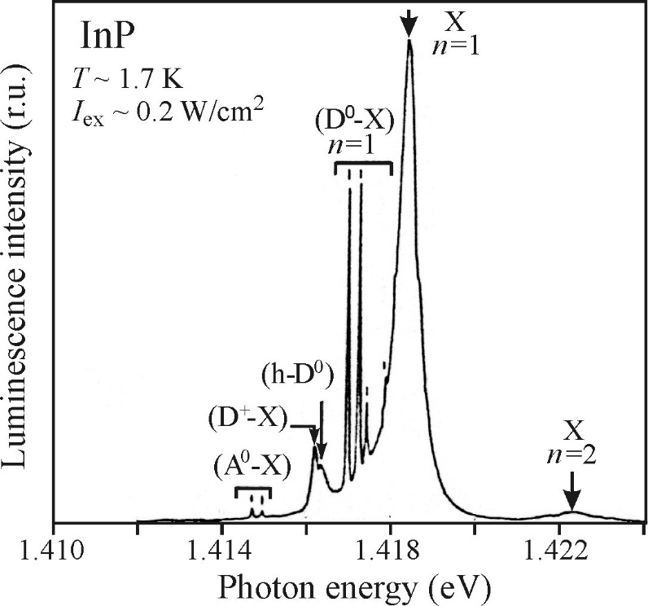
The thick arrow marks the position of the absorption line n = 1.
The line labelled (h-D⁰) is caused by the recombination of a hole with a neutral donor.
Lines (D⁰-X) and (A⁰-X) are due to recombination of bound excitons.
On the right, a weak indication of a line arising from recombination of the n = 2 state of the exciton-polariton is observed.
Luminescence spectrum of free exciton-polariton X in very pure GaAs at T = 4.2K

Slide 36
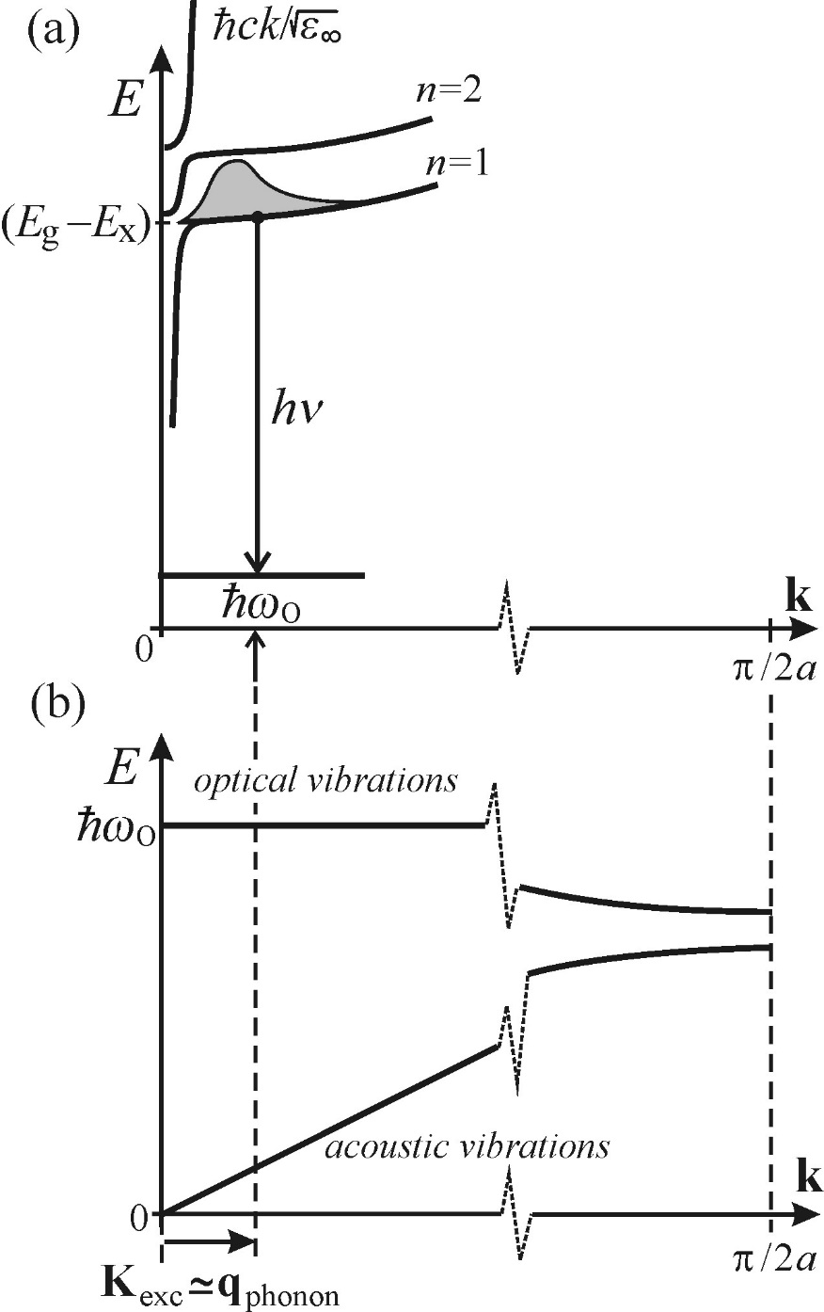
(a) Radiative recombination of a free exciton accompanied by emission of
one optical phonon.
The photon energy is hν ≈ (E_{g} - E_{X}) – ħω_{0.}
The quasi-momentum conservation law K_{exc} ≅ q_{photon} is satisfied.
The shaded area labels the Maxwell-Boltzmann distribution of the exciton kinetic energies.
(b) Corresponding phonon dispersion curves.

Slide 37
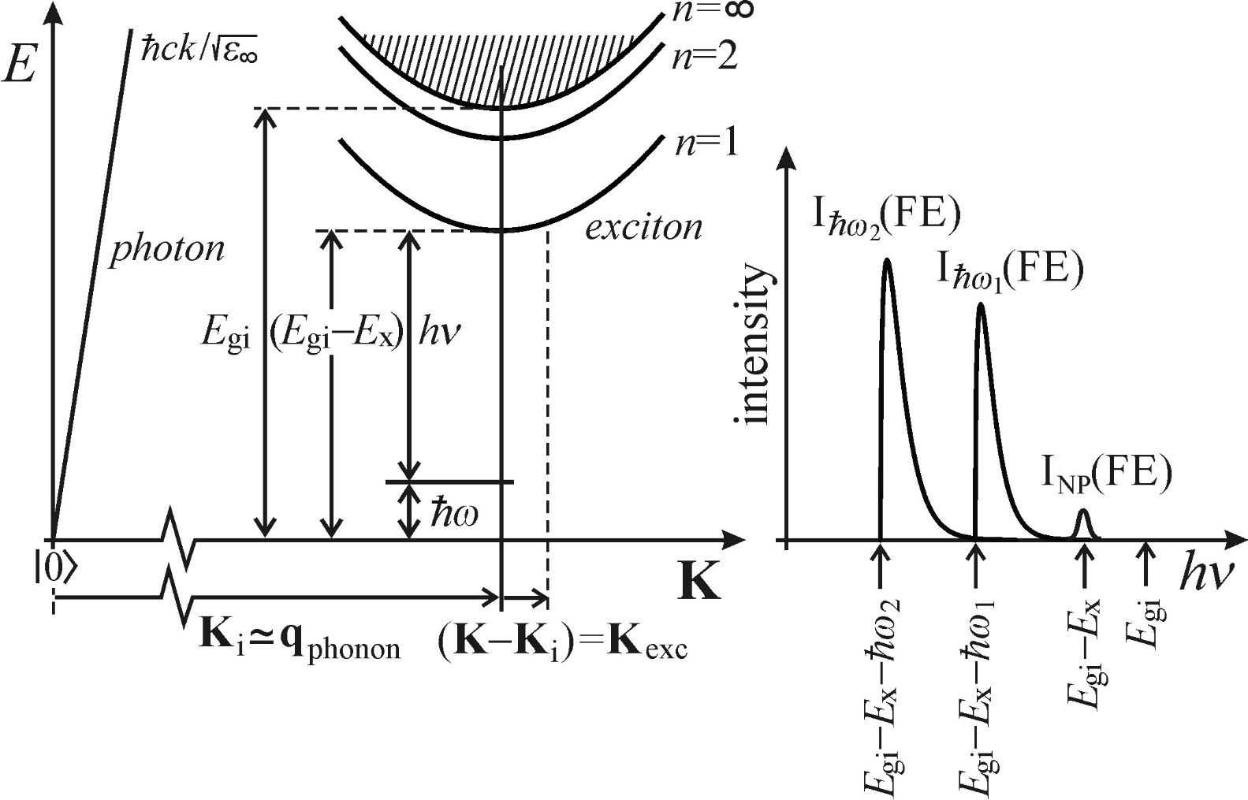

Luminescence of free excitons in indirect-bandgap semiconductors
The factors affecting quite essentially luminescence processes in indirect-bandgap semiconductors:
the absence of polariton states
the indispensability of participation of non-zero q_{phonon} = K_{i} phonons in the radiative recombination process.
In this case, the approximate equality q_{phonon} ≅ K_{excis} is invalid.
Reason: the K_{i} point is de facto in all known indirect semiconductors situated at the first Brillouin zone boundary or in its close vicinity, thus
|q_{phonon}| ≅ |K_{i}| ≫ |K_{exc}|,
The spectral shape of luminescence can be rewritten as:
Dispersion curves of a free exciton and a photon in an indirect bandgap semiconductor. The polariton states do not exist. On the right: schematic of the exciton luminescence spectrum.

Slide 38
Thank you for your patience!

