Slide 1
Hello Dolly
ID1206 Operating systems

Slide 2
Intro - processes
A process is a running program, an execution of instructions and a set of resources
Can be represented by a unique number called process id (pid)

Slide 3
fork()
Function that creates a new process
Creates a copy (child process) of the current process (parent process)
Returns twice
- child’s pid to the parent
- 0 to the child
Child process has its own address space

Slide 4
Example – fork()
int pid = fork();
if (pid == 0) {
printf(”I’m the child”);
}
else {
printf(”I’m the parent ”);
}

Slide 5
Zombie
Child process that has finished executing but still exists in the process table
Happens if parent does not call wait()
else { //parent process
printf(”I’m the parent”);
wait(NULL); //wait for child process to terminate, prevent zombie
}

Slide 6
Orphan
Child process that is still running but the parent process has finished executing or terminated
Will be ”adopted” by another process, get a new parent process
In UNIX the new parent process is the init or systemd process
  - parent of all processes
  - process id 1

Slide 7
Daemon
Process that runs automatically in the background instead of under direct control of a user
Performs operations at predefined times or in response to events
Runs most of the tasks in a system

Slide 8
exec()
Runs an executable file in the context of an existing process, replacing the previous execution context
execlp(”ls”, ”ls”, NULL);
- check if ’ls’ exists
- run it with the rest of the arguments
exec functions do not return when successful

Slide 9
exec() family of functions
execl, execlp, execle, execv, execvp, execvpe
- e: pass an array of pointers to environment variables
- l: arguments are passed individually to the function
- v: arguments are passed as an array of strings
- p: uses PATH environment variable to find the file that is to be executed

Slide 10
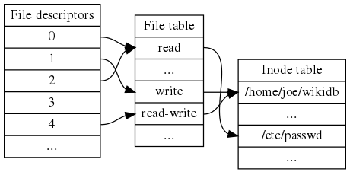

Slide 11
Pipes
Sends the output of one program to another programs input
Denoted by symbol ’|’
Piping in the shell: combine several commands
- Ex: cat countries.txt | grep a | sort

