Slide 1
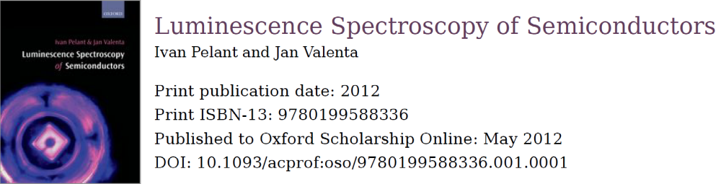
Bound excitons and highly excited semiconductors
p. 180 – p. 239
Thomas Lettner

Slide 2
Overview
  7.2 Bound excitons
8 Highly excited semiconductors
  8.1 Experimental considerations
  8.2 Excitonic molecule or biexciton
  8.3 Collisions of free excitons
  8.4 Electron–hole liquid (EHL)
  8.5 Electron–hole plasma (EHP)
  8.6 Bose–Einstein condensation of excitons

Slide 3
Bound excitons
Lattice defects, especially impurity atoms
Intentional: doping
Unintentional: residual impurity
Very efficient potential wells (traps) for free excitons (FE)
Localization: FE loses its kinetic energy
Result: Bound excitons (BE)
Extrinsic luminescence with high efficiency

Slide 4
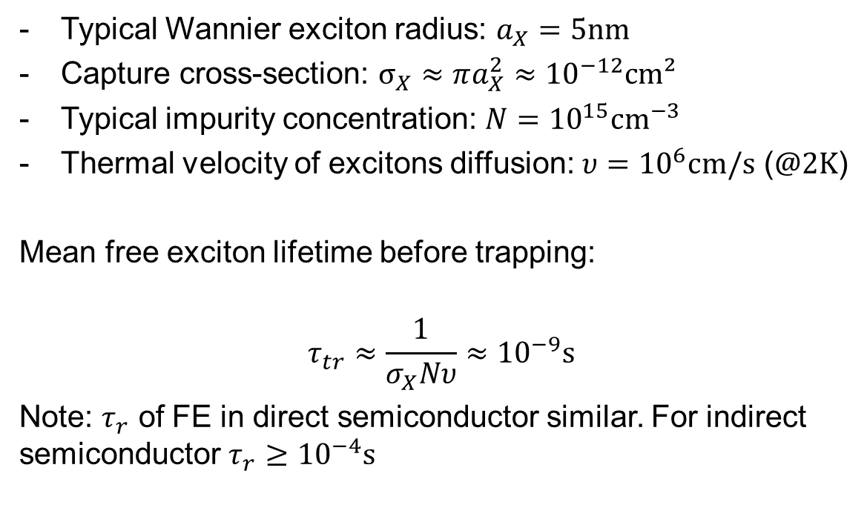
Capture of excitons
Typical Wannier exciton radius: $a_{X}=5\text{nm}$
Capture cross-section: $σ_{X}≈πa_{X}^{2}≈{10}^{−12}\text{cm}²$
Typical impurity concentration: $N={10}^{15}{\text{cm}}^{−3}$
Thermal velocity of excitons diffusion: $υ={10}^{6}\text{cm}\text{/}\text{s}$ ($@2\text{K}$)
Mean free exciton lifetime before trapping:
$$τ_{tr}≈\frac{1}{σ_{X}Nυ}≈{10}^{−9}\text{s}$$
Note: $τ_{r}$ of FE in direct semiconductor similar. For indirect semiconductor $τ_{r}≥{10}^{−4}\text{s}$

Slide 5
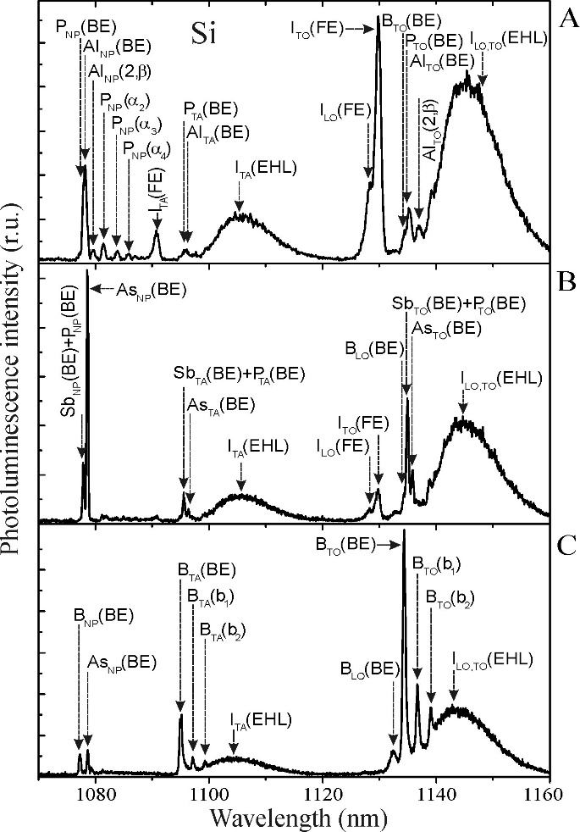

Bound excitons in Si
Nominally pure Si
Doped with (B + As)
$$N≈8×{10}^{15}{\text{cm}}^{−3}$$

Slide 6
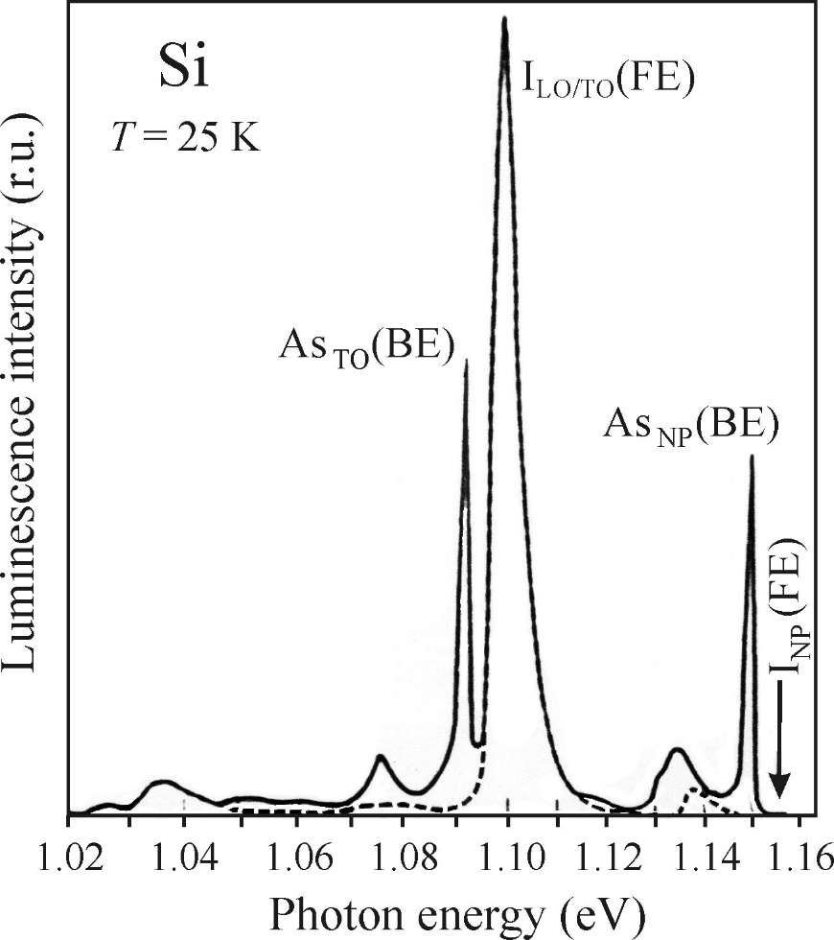
Typical BE characteristics
Phonon assisted
Strong emission and low lifetime (Giant oscillator strength)
Narrow emission lines
(Spread excited area)
No broadening with temperature (Kinetic energy = 0)
Intensity linear with excitation power (Saturation at high power)
Red-shifted with respect to FE
No phonon

Slide 7
Types of bound excitons
Excitons bound to
shallow impurities (neutral, ionized)
Isoelectronic impurities
Bound multiexciton complexes (BMEC)
Self-trapped excitons

Slide 8
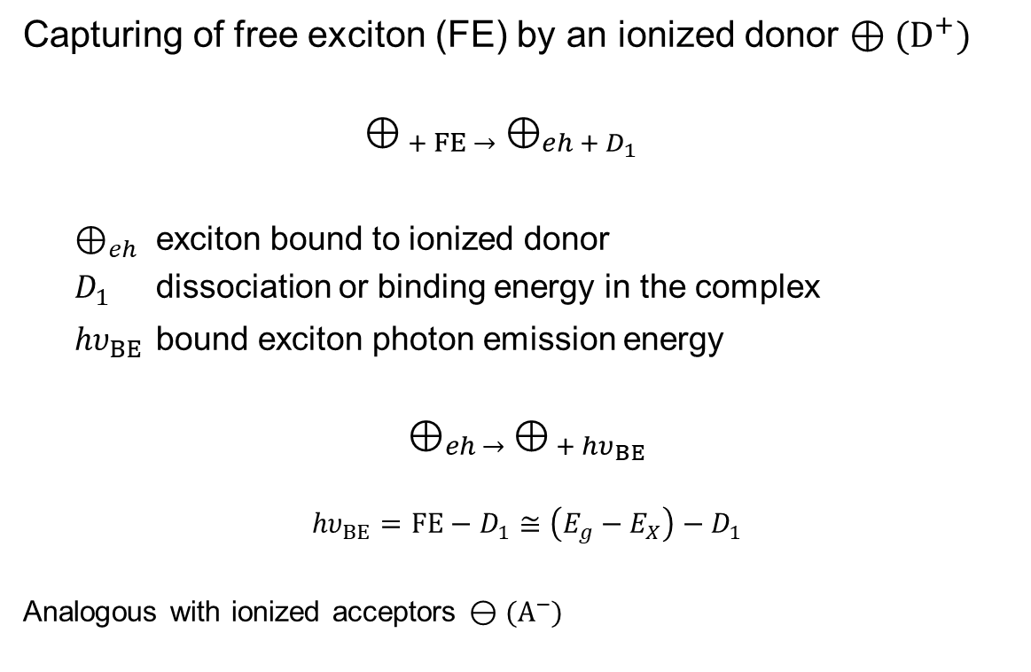
Excitons bound to ionized impurities
  Capturing of free exciton (FE) by an ionized donor $⊕({\text{D}}^{+})$
  $$⊕_{ + FE →} ⊕_{eh + D_{1}}$$
  $⊕_{eh}$ exciton bound to ionized donor
  $D_{1}$ dissociation or binding energy in the complex
  ${hυ}_{BE}$ bound exciton photon emission energy
$$⊕_{eh → }⊕_{ + {hυ}_{BE}}$$
$${hυ}_{BE}=FE−D_{1}≅\left(E_{g}−E_{X}\right)−D_{1}$$
Analogous with ionized acceptors $⊖({\text{A}}^{−})$

Slide 9
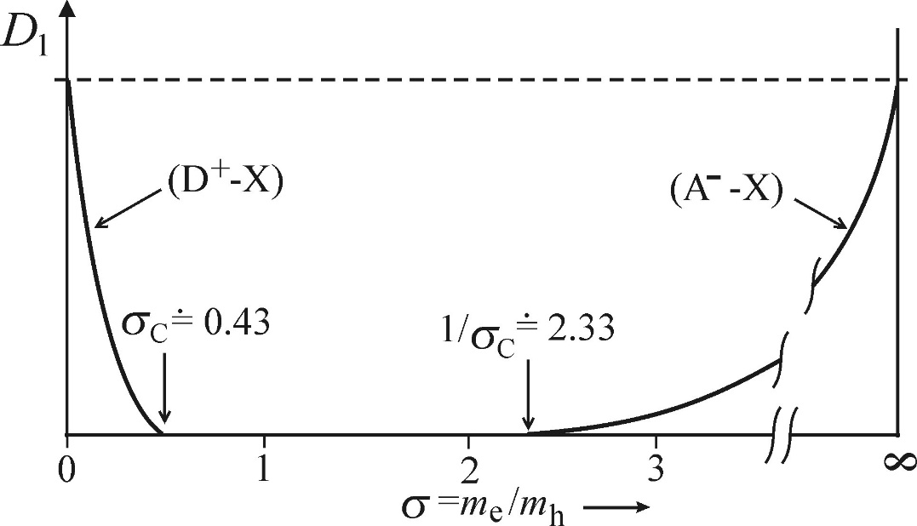







Stability of BE ionized impurity complexes
$⊕_{eh }$: the hole can escape easier
$⊖_{eh}$: the electron can escape easier
neutral remainder: $⊕_{e}$
neutral remainder: $⊖_{h}$
$${≡ ⊕}_{eh }$$
$$⊖_{eh}≡$$
Hole heavier
Electron heavier
Stable for $D_{1}>0$

Slide 10
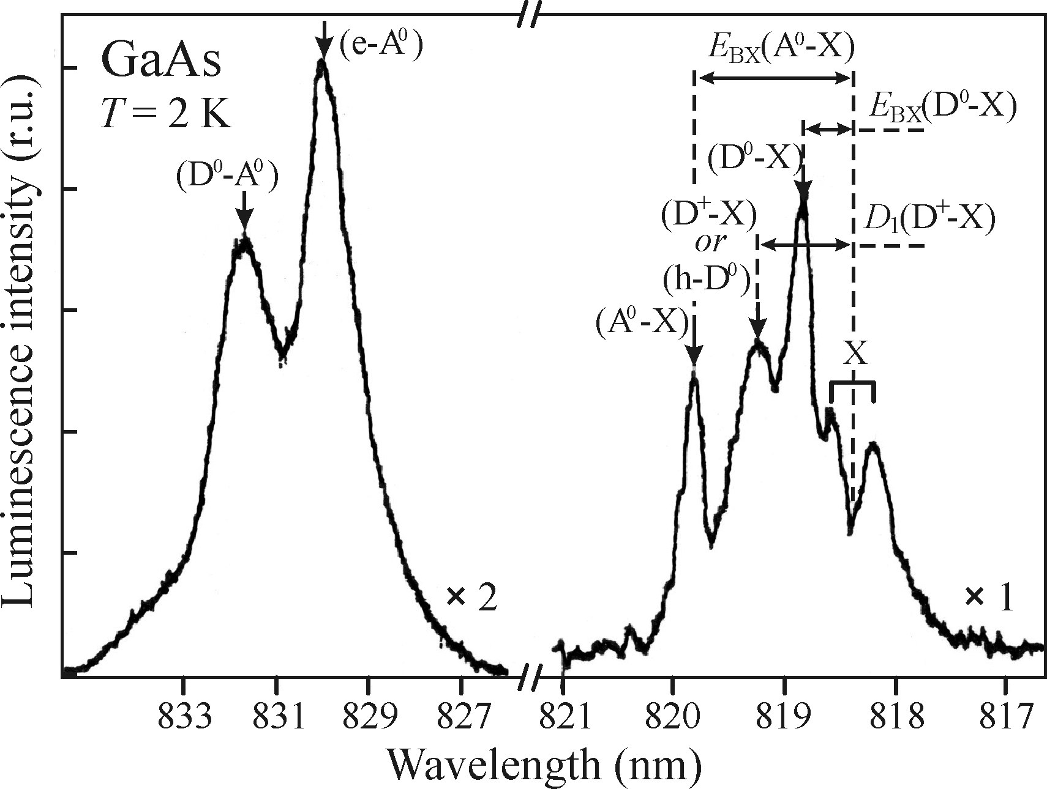
Thin layer of GaAs at 2 K

Slide 11
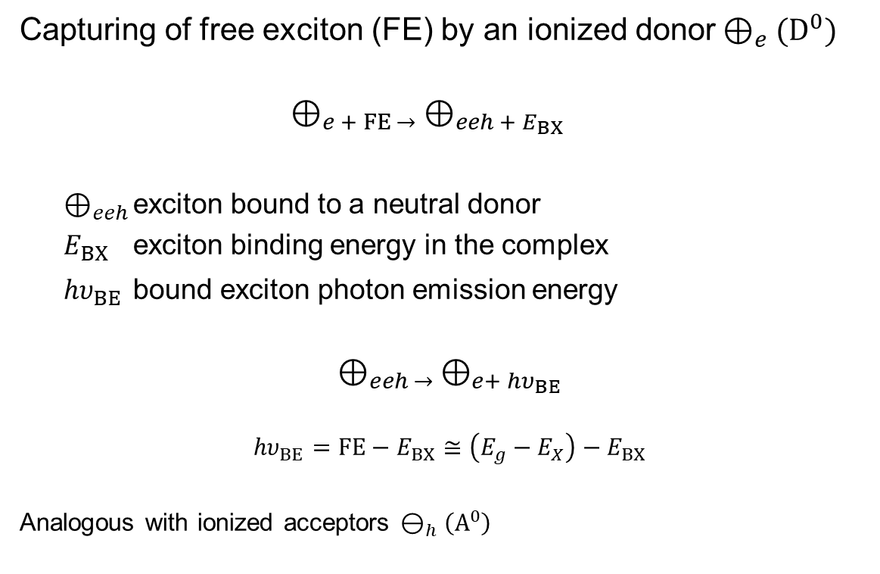
Excitons bound to neutral impurities
  Capturing of free exciton (FE) by an ionized donor$⊕_{e}({\text{D}}^{0})$
  $$⊕_{e + FE →} ⊕_{eeh + E_{BX}}$$
  $⊕_{eeh}$ exciton bound to a neutral donor
  $E_{BX}$ exciton binding energy in the complex
  ${hυ}_{BE}$ bound exciton photon emission energy
$$⊕_{eeh → }⊕_{e+ {hυ}_{BE}}$$
$${hυ}_{BE}=FE−E_{BX}≅\left(E_{g}−E_{X}\right)−E_{BX}$$
Analogous with ionized acceptors $⊖_{h}\left({\text{A}}^{0}\right)$
Notes:
Indirect bandgap semiconductor needs a phonon hw

Slide 12

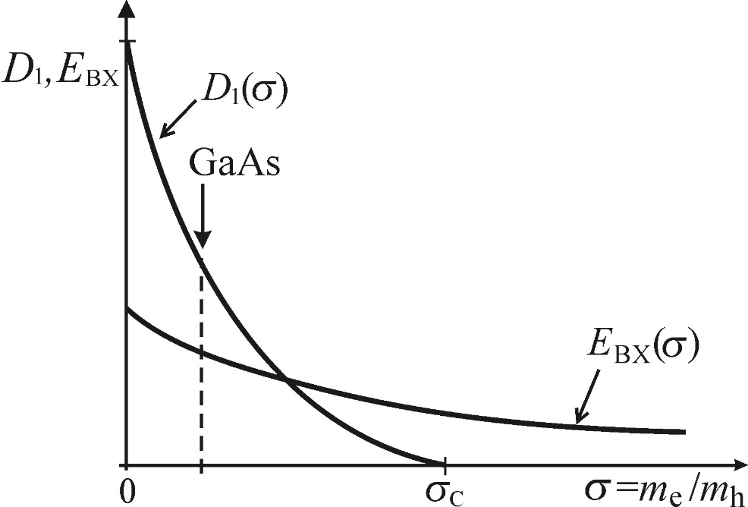
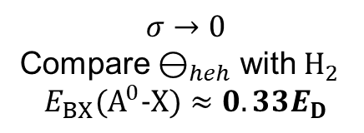
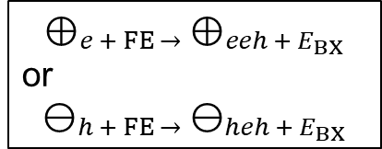
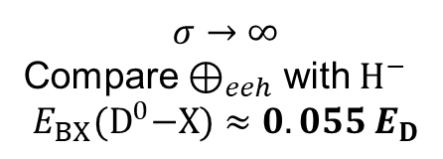
Stability of BE neutral impurity complexes
$$⊕_{e + FE →} ⊕_{eeh + E_{BX}}$$
or
$$⊖_{h + FE →} ⊖_{heh + E_{BX}}$$
Thin GaAs at 2K
$$σ→0$$
Compare $⊖_{heh}$ with $H_{2}$
$$E_{BX}({\text{A}}^{0}\text{−}X)≈0.33E_{D}$$
$$σ→∞$$
Compare $⊕_{eeh}$ with $H^{−}$
$$E_{BX}({\text{D}}^{0}\text{−}X)≈0.055 E_{D}$$

Slide 13
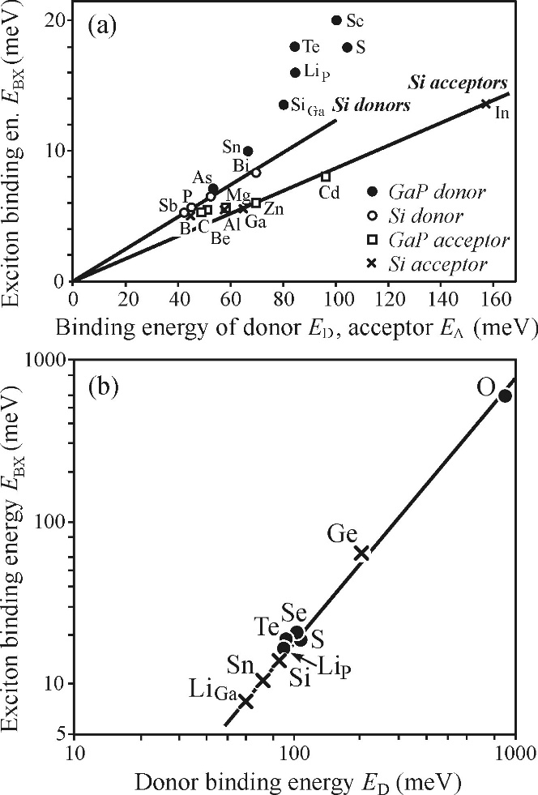
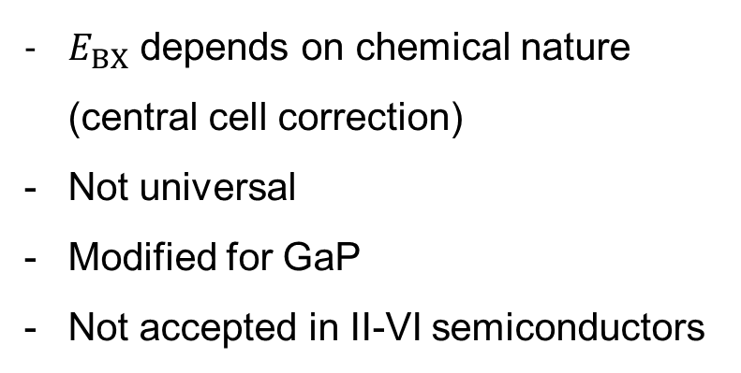
Haynes rule
$E_{BX}$ depends on chemical nature
(central cell correction)
Not universal
Modified for GaP
Not accepted in II-VI semiconductors
Modified for GaP

Slide 14
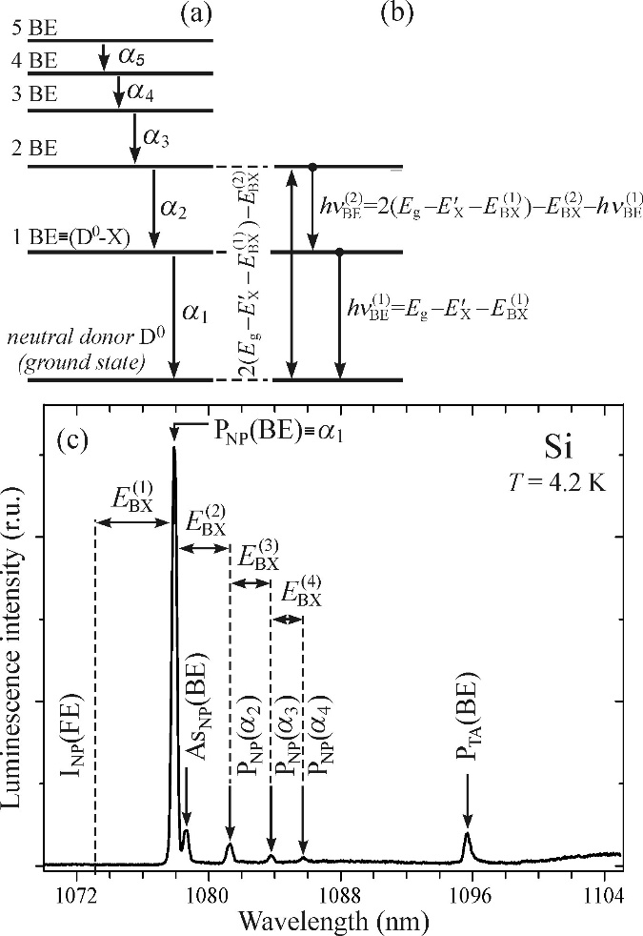
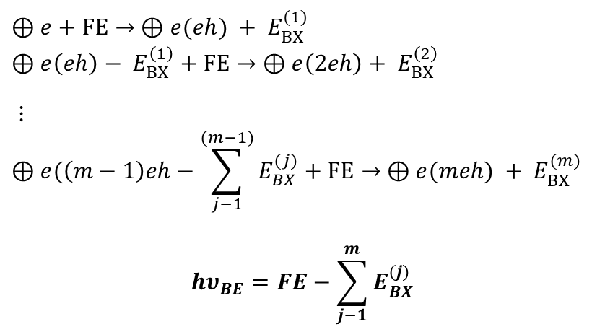

Bound multiexciton complexes (BMEC)
“shell model”
Multiple (m) excitons localized
Neutral donor or acceptors
Less localization with increasing m
$$⊕e+FE→ ⊕e(eh) + E_{BX}^{(1)}$$
$$⊕e\left(eh\right)− E_{BX}^{\left(1\right)}+FE→ ⊕e\left(2eh\right)+ E_{BX}^{\left(2\right)}$$
$⋮$
$$⊕e(\left(m−1\right)eh−\sum_{j−1}^{(m−1)}{E_{BX}^{(j)}}+FE→ ⊕e(meh) + E_{BX}^{(m)}$$
$${hυ}_{BE}=FE−\sum_{j−1}^{m}{E_{BX}^{(j)}}$$
Note: Level splitting due to higher number of electron and hole states adds weaker emission lines $β_{m}$

Slide 15
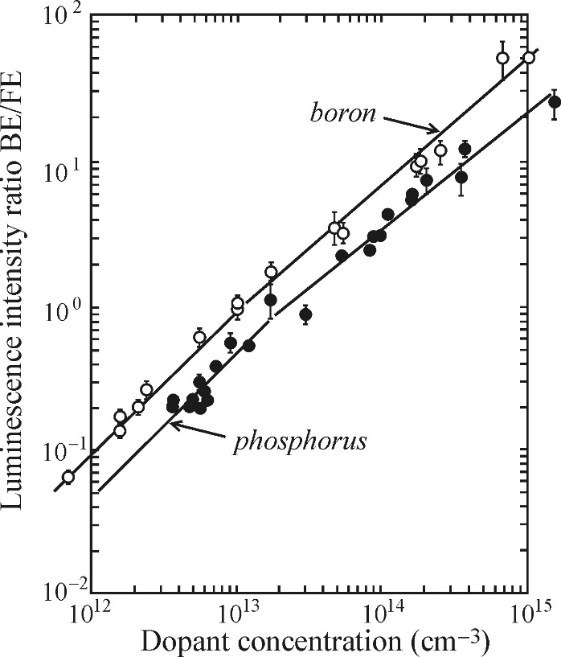
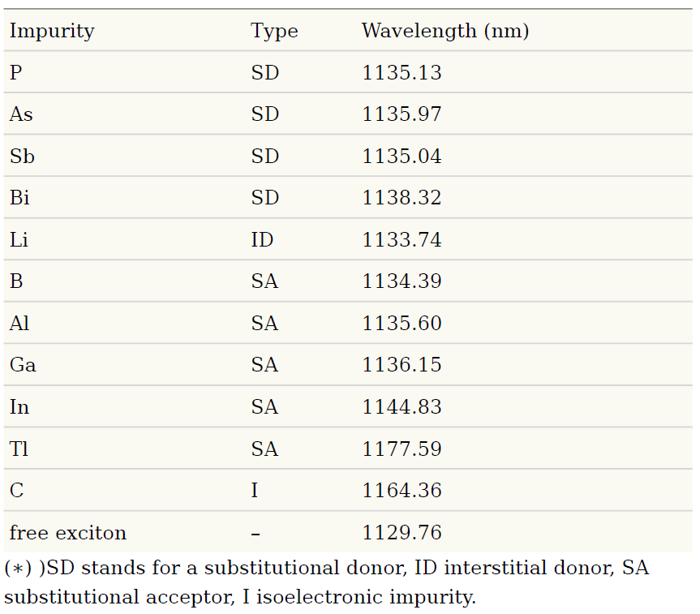
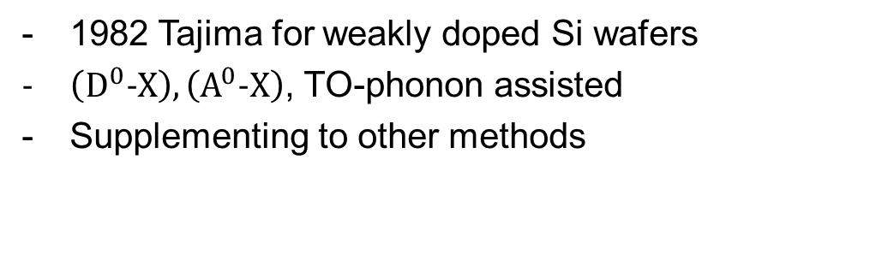
Quantitative luminescence analysis in Si
1982 Tajima for weakly doped Si wafers
$\left({\text{D}}^{0}\text{−}X\right), \left({\text{A}}^{0}\text{−}X\right)$, TO-phonon assisted
Supplementing to other methods
P_{TO}(BE)/I_{TO}(FE) ~ N_{P}
B_{TO}(BE)/I_{TO}(FE) ~ N_{B}
Notes:
Strong pumping (EHL)
Sample cooling (evaporation of BE)
High accuracy Fourier approach (increased S/N ratio)
Calibration curves also for Al, Ga and As
Materialrs CdTe, and GaAs tricky (residual impurities)

Slide 16
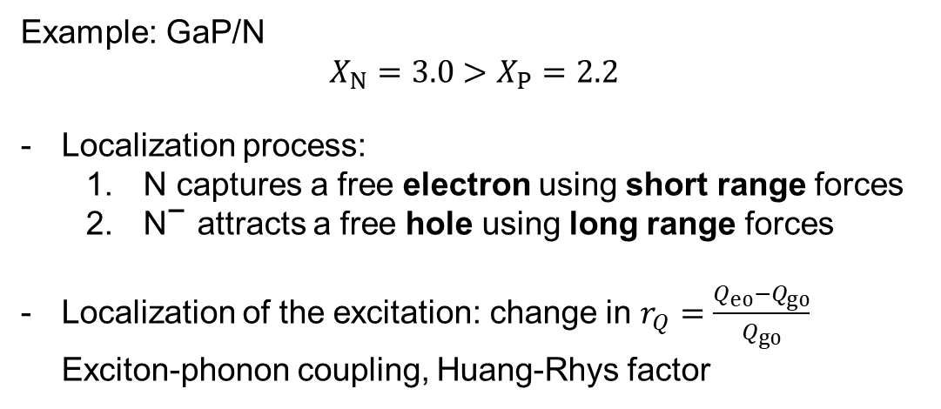
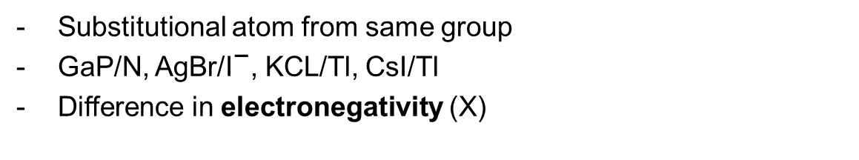
Excitons bound to isoelectronic impurities
Substitutional atom from same group
GaP/N, AgBr/${\text{I}}^{\text{−}}$, KCL/Tl, CsI/Tl
Difference in electronegativity (X)
Example: GaP/N
$$X_{N}=3.0>X_{P}=2.2$$
Localization process:
  $\text{N}$ captures a free electron using short range forces
  ${\text{N}}^{\text{−}}$ attracts a free hole using long range forces
Localization of the excitation: change in $r_{Q}=\frac{Q_{e0}−Q_{g0}}{Q_{g0}}$
Exciton-phonon coupling, Huang-Rhys factor

Slide 17
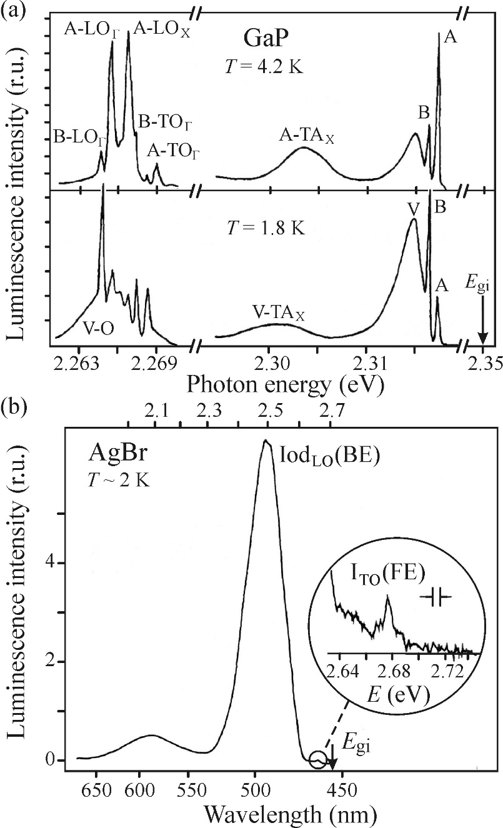
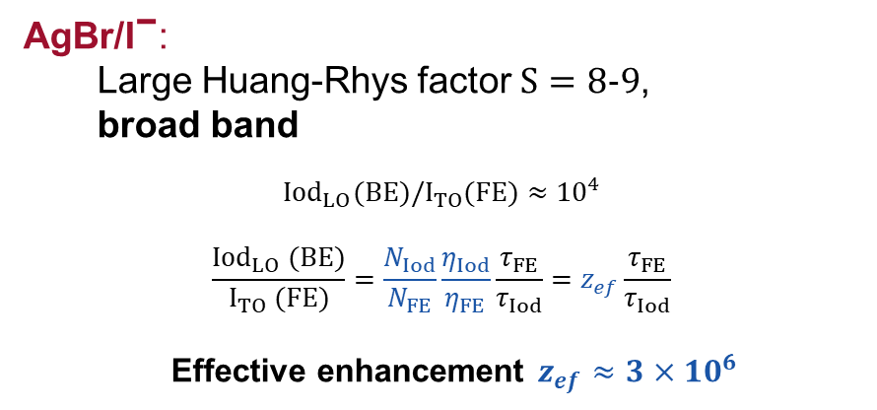
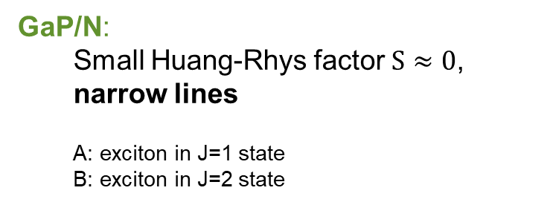
GaP and AgBr
GaP/N:
  Small Huang-Rhys factor $S≈0$,
  narrow lines
  A: exciton in J=1 state
  B: exciton in J=2 state
AgBr/${\text{I}}^{\text{−}}$:
  Large Huang-Rhys factor $S=8\text{−}9$,
  broad band
$${Iod}_{LO}(BE)/I_{TO}(FE)≈{10}^{4}$$
$$\frac{{Iod}_{LO} (BE)}{I_{TO} (FE)}=\frac{N_{Iod}}{N_{FE}}\frac{η_{Iod}}{η_{FE}}\frac{τ_{FE}}{τ_{Iod}}=z_{ef}\frac{τ_{FE}}{τ_{Iod}}$$
Effective enhancement $z_{ef}≈3×{10}^{6}$
Notes:
Absence of Auger recombination (only two quasi particles)
Strong delocalization = large uncertainty in k-space, hence transition becomes allowed
Quasi-direct radiative recombination

Slide 18
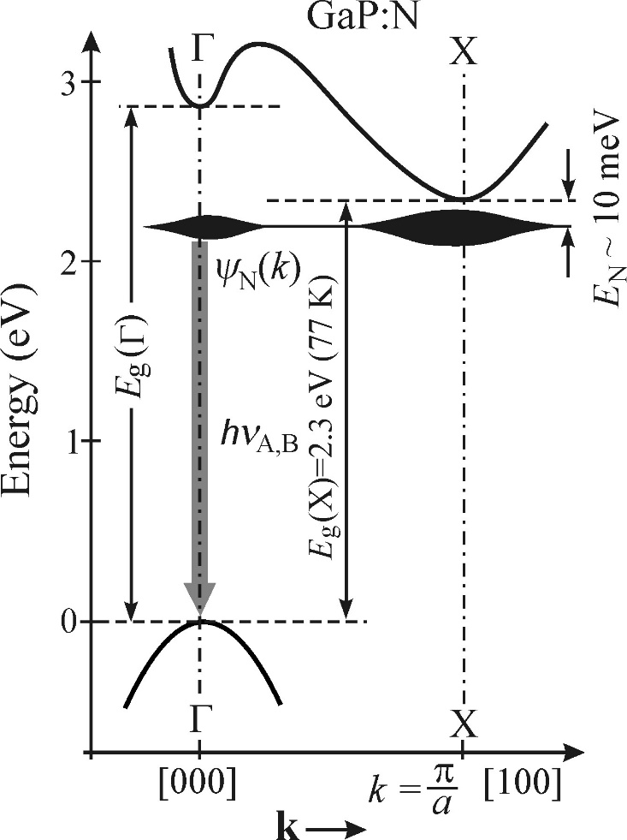
Enhancement for isoelectric impurities
Extremely high enhancement
(in indirect bandgap semiconductors)
Reasons:
Efficient trapping
Absence of Auger non-radiative recombination (only two quasi particles involved)
Strong localization in real space (Δx Δk ≥ ½)
quasi-direct radiative recombination
Compare exciton bound to shallow impurity:
Long-range coulomb forces
Auger recombination for neutral donor/acceptors
Always narrow lines (weak localization)

Slide 19
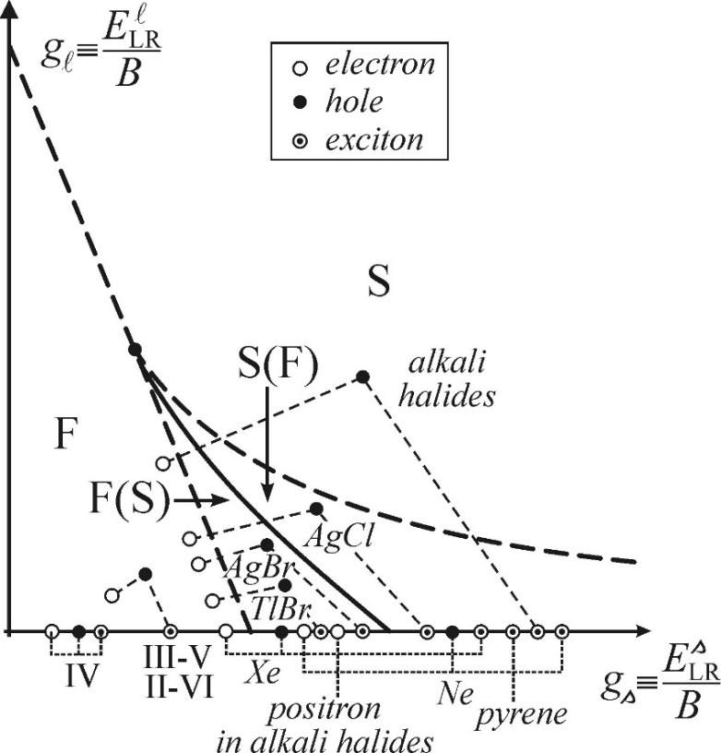
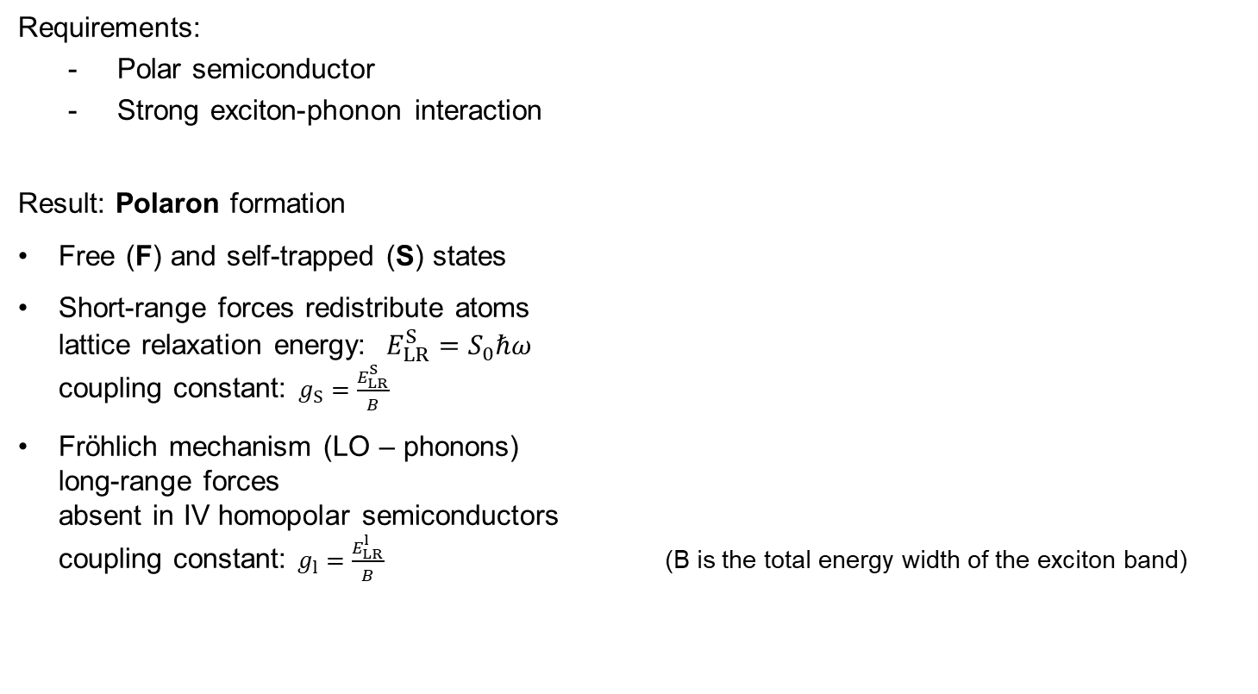
Self-trapped excitons (STE)
Requirements:
  Polar semiconductor
  Strong exciton-phonon interaction
Result: Polaron formation
Free (F) and self-trapped (S) states
Short-range forces redistribute atoms
lattice relaxation energy: $E_{LR}^{S}=S_{0}ℏω$
coupling constant: $g_{S}=\frac{E_{LR}^{S}}{B}$
Fröhlich mechanism (LO – phonons)
long-range forces
absent in IV homopolar semiconductors
coupling constant: $g_{l}=\frac{E_{LR}^{l}}{B}$ (B is the total energy width of the exciton band)

Slide 20
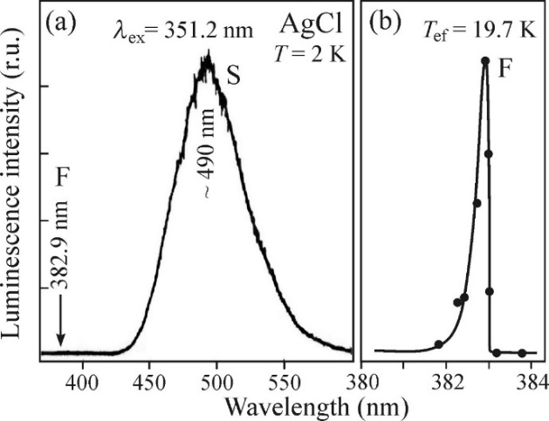
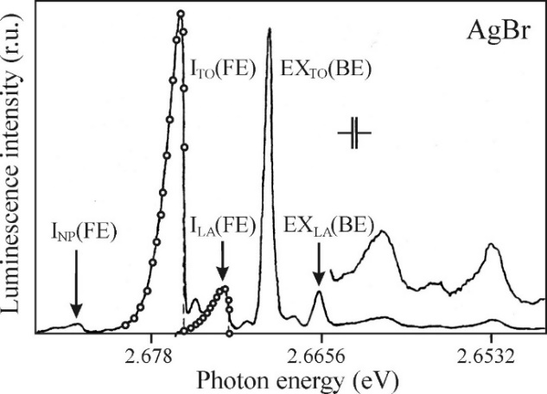
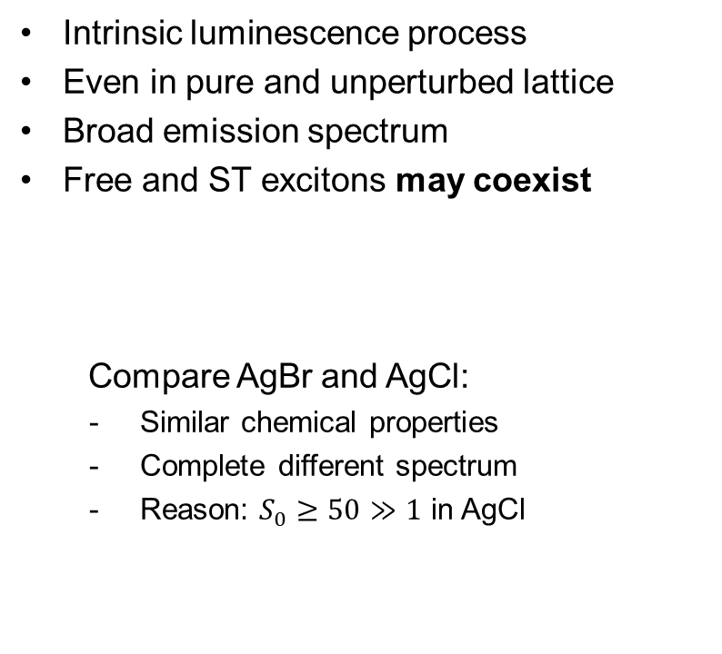
Self-trapped exciton luminescence
Intrinsic luminescence process
Even in pure and unperturbed lattice
Broad emission spectrum
Free and ST excitons may coexist
Compare AgBr and AgCl:
Similar chemical properties
Complete different spectrum
Reason: $S_{0}≥50≫1$ in AgCl
Group 7
9
F
17
Cl
35
Br

Slide 21
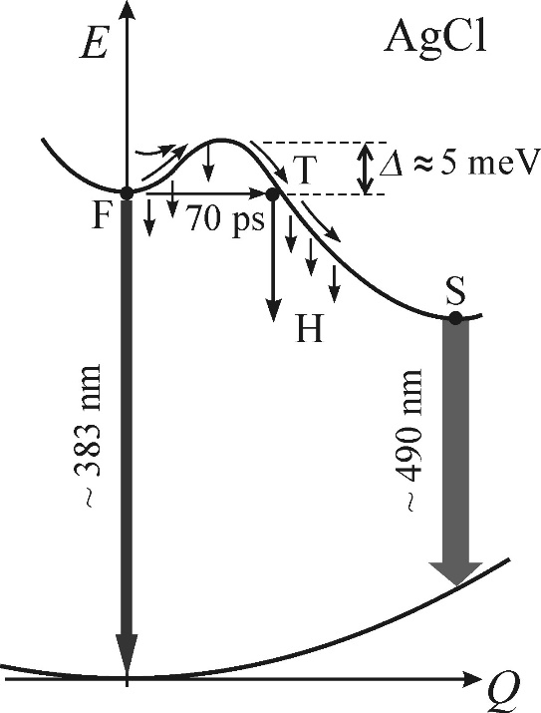
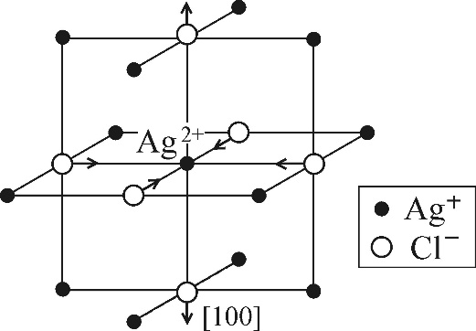
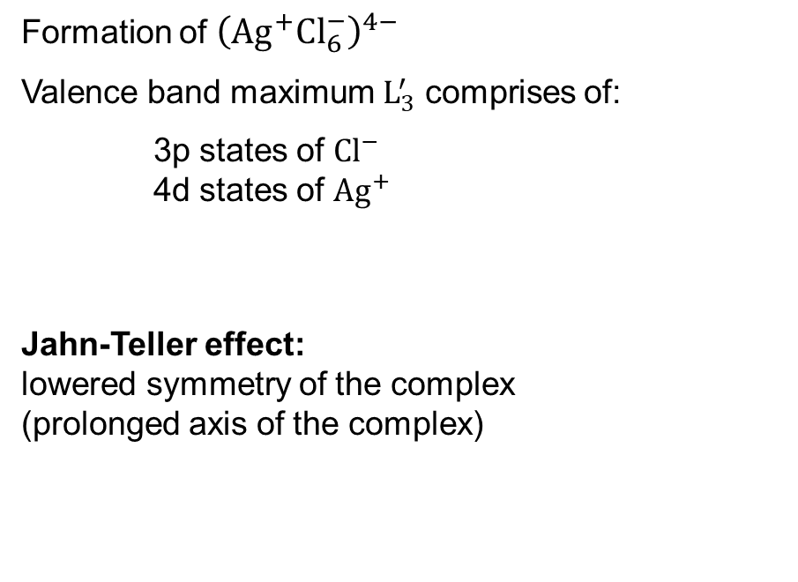

Self-trapping mechanism in AgCl
Formation of ${\left({Ag}^{+}{Cl}_{6}^{−}\right)}^{4−}$
Valence band maximum $L_{3}^{′}$ comprises of:
3p states of ${Cl}^{−}$
4d states of ${Ag}^{+}$
Jahn-Teller effect:
lowered symmetry of the complex
(prolonged axis of the complex)
Contribute to self-trapped
hole wavefunction
Various other microscopic mechanisms of hole self-trapping exist.
Q = Separation of ${Cl}^{−}$ ligands

Slide 22
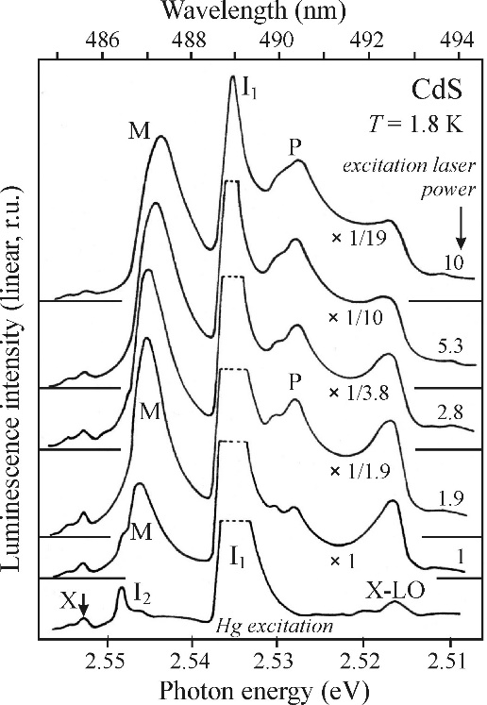
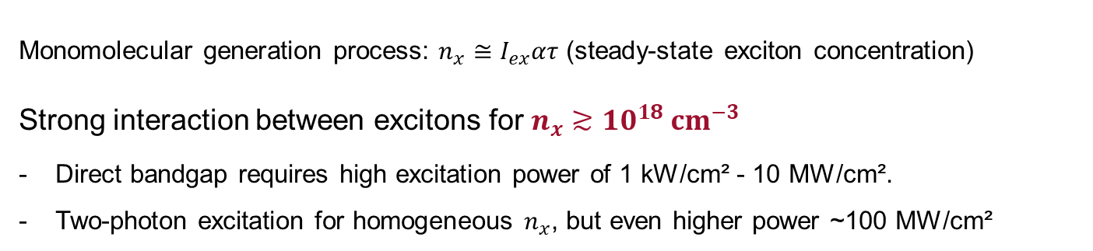
Highly excited semiconductors
Excitonic molecule (biexciton)
Free electron collisions
Electron-hole liquid (EHL) and plasma (EHP)
Bose-Einstein condensation of excitons
Monomolecular generation process: $n_{x}≅I_{ex}ατ$ (steady-state exciton concentration)
Strong interaction between excitons for $n_{x}≳{10}^{18} cm^{−3}$
Direct bandgap requires high excitation power of 1 kW/cm² - 10 MW/cm².
Two-photon excitation for homogeneous $n_{x}$, but even higher power ~100 MW/cm²

Slide 23
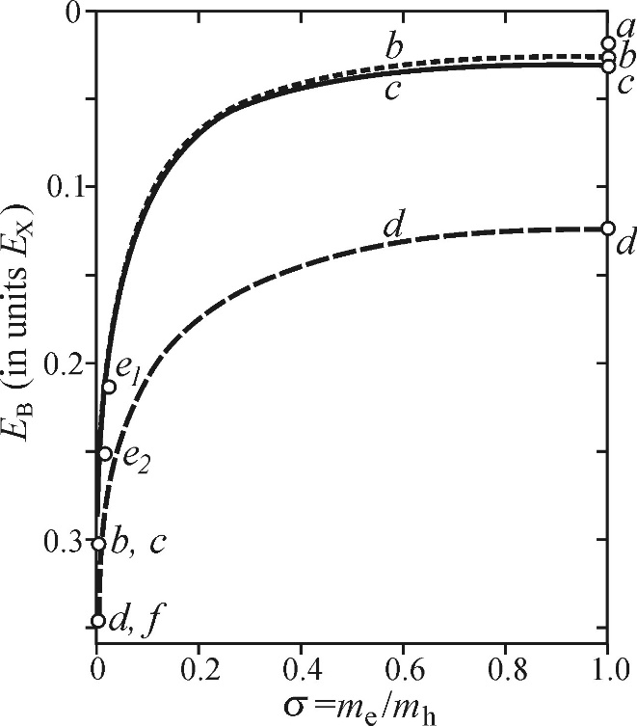
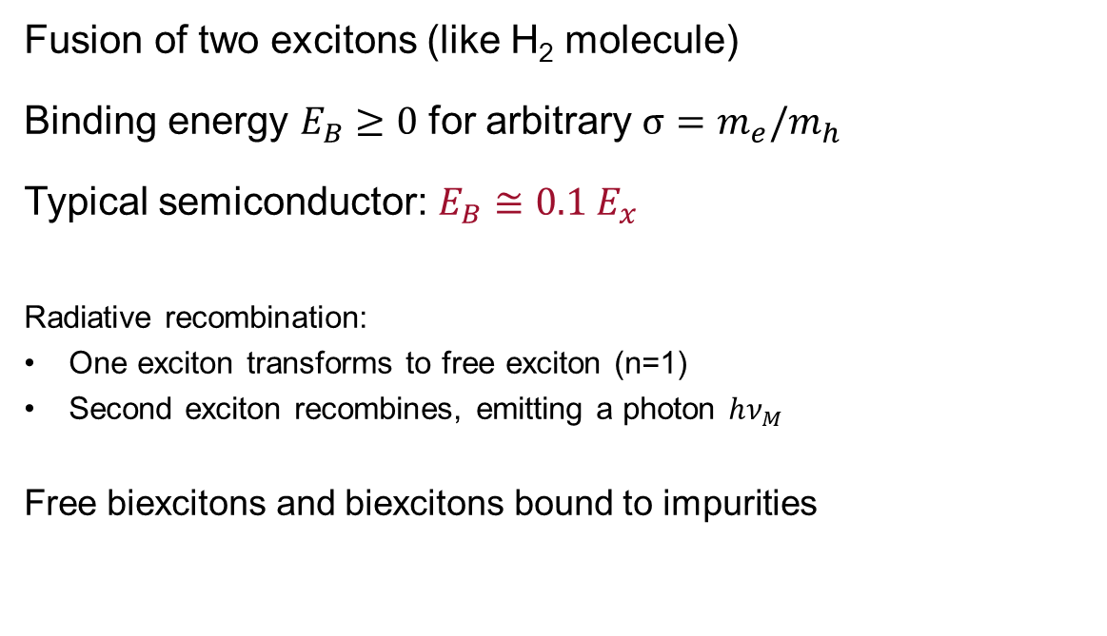

Excitonic molecule (EM, biexciton)
typical
Fusion of two excitons (like H₂ molecule)
Binding energy $E_{B}≥0$ for arbitrary $σ=m_{e}/m_{h}$
Typical semiconductor: $E_{B}≅0.1 E_{x}$
Radiative recombination:
One exciton transforms to free exciton (n=1)
Second exciton recombines, emitting a photon $hν_{M}$
Free biexcitons and biexcitons bound to impurities
Some theoretical values for $E_{B}$ calculated by different authors

Slide 24
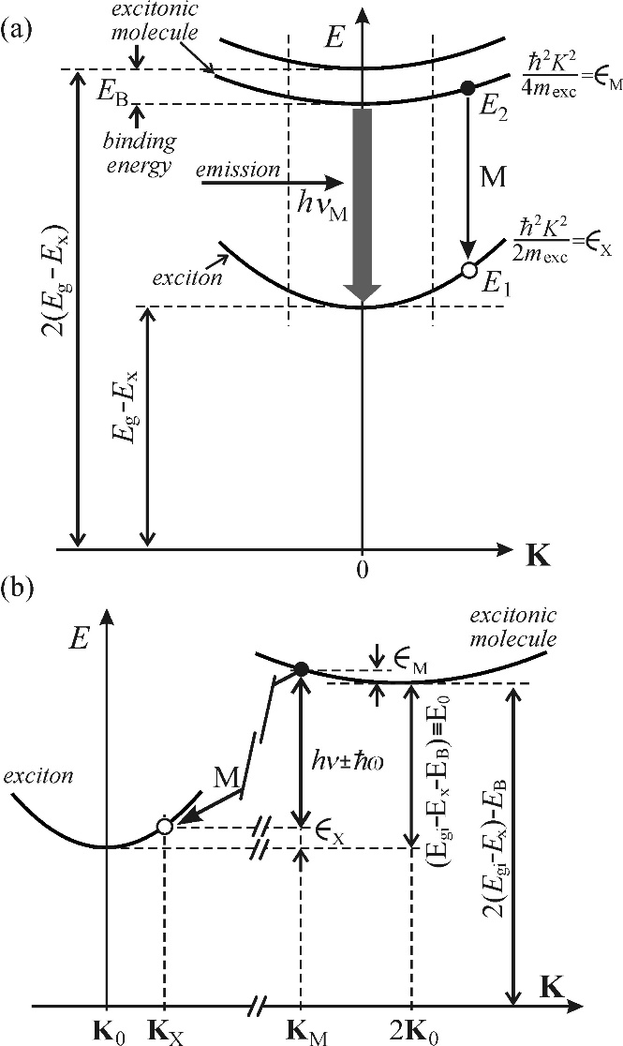
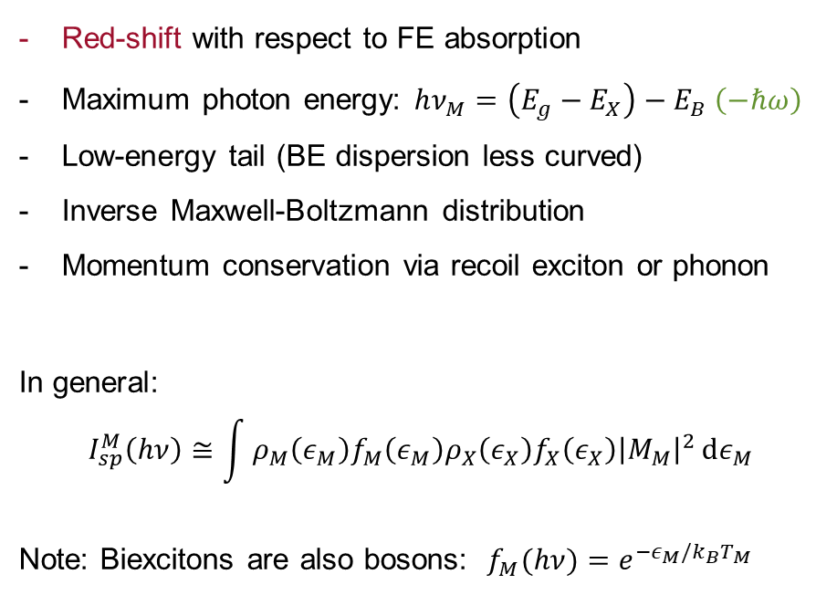
Luminescence of free biexcitons
Red-shift with respect to FE absorption
Maximum photon energy: $hν_{M}=\left(E_{g}−E_{X}\right)−E_{B} \left(−ℏω\right)$
Low-energy tail (BE dispersion less curved)
Inverse Maxwell-Boltzmann distribution
Momentum conservation via recoil exciton or phonon
In general:
$$I_{sp}^{M}\left(hν\right)≅\int{ρ_{M}\left(ε_{M}\right)f_{M}\left(ε_{M}\right){ρ_{X}\left(ε_{X}\right)f_{X}\left(ε_{X}\right)\left|M_{M}\right|}^{2}}dε_{M}$$
Note: Biexcitons are also bosons: $f_{M}(hν)=e^{−ε_{M}/k_{B}T_{M}}$
DIRECT
INDIRECT

Slide 25
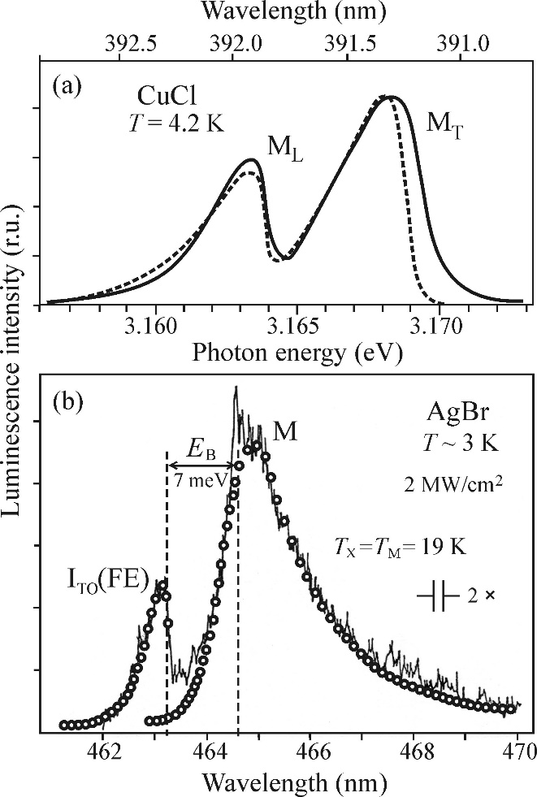
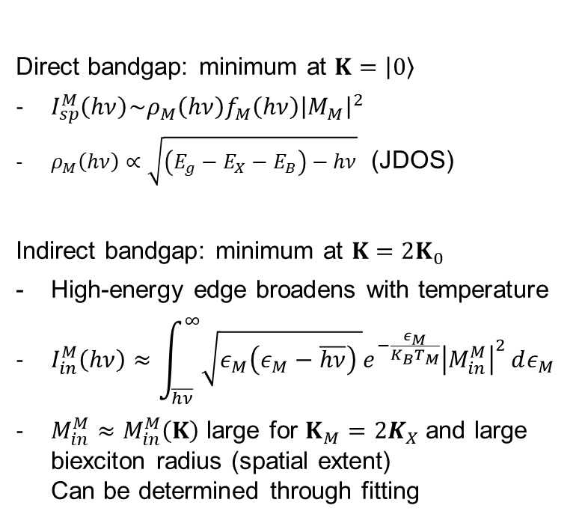
Emission lineshape of excitonic molecules
Direct bandgap: minimum at $K=\left|\left.0\right\rangle \right.$
$I_{sp}^{M}\left(hν\right)\sim ρ_{M}\left(hν\right)f_{M}\left(hν\right){\left|M_{M}\right|}^{2}$
$ρ_{M}\left(hν\right)∝\sqrt{\left(E_{g}−E_{X}−E_{B}\right)−hν}$ (JDOS)
Indirect bandgap: minimum at $K=2K_{0}$
High-energy edge broadens with temperature
$I_{in}^{M}\left(hν\right)≈\int_{\overline{hν}}^{∞}{\sqrt{ε_{M}\left(ε_{M}−\overline{hν}\right) }e^{−\frac{ε_{M}}{K_{B}T_{M}}}{\left|M_{in}^{M}\right|}^{2}ⅆε_{M}}$
$M_{in}^{M}≈M_{in}^{M}\left(K\right)$ large for $K_{M}=2K_{X}$and large biexciton radius (spatial extent)
Can be determined through fitting

Slide 26
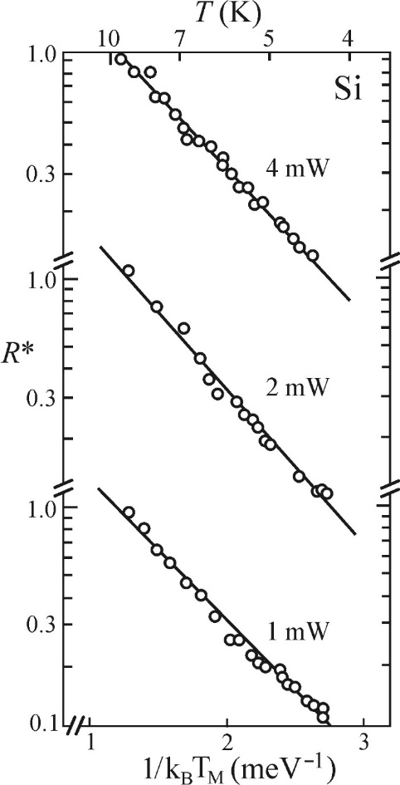
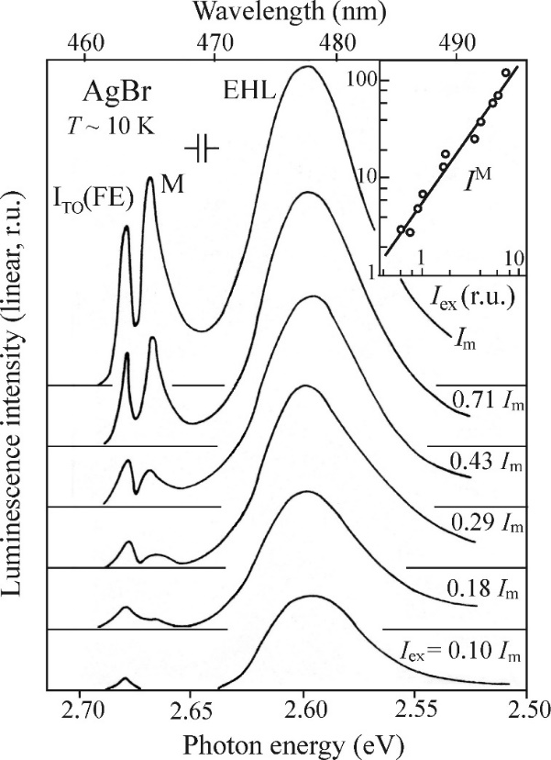


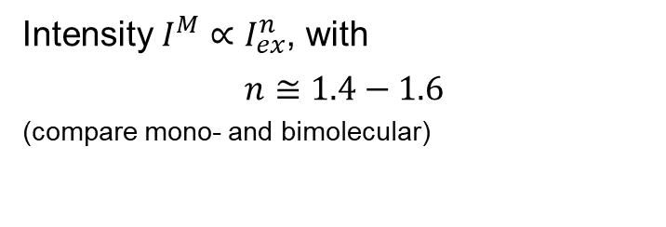

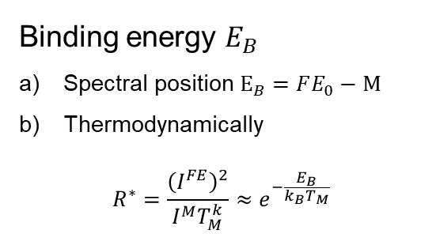
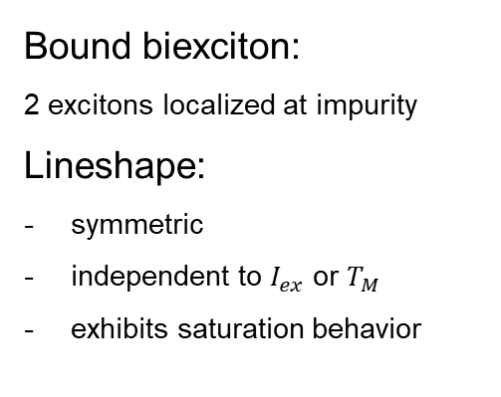
Properties of excitonic molecule emission
Binding energy $E_{B}$
Spectral position$E_{B}=FE_{0}−M$
Thermodynamically
$R^{∗}=\frac{{\left(I^{FE}\right)}^{2}}{I^{M}T_{M}^{k}}≈e^{−\frac{E_{B}}{k_{B}T_{M}}}$
Intensity $I^{M}∝I_{ex}^{n}$, with
$$n≅1.4−1.6$$
(compare mono- and bimolecular)
$$n=1.5$$
$$E_{B}$$
Bound biexciton:
2 excitons localized at impurity
Lineshape:
symmetric
independent to $I_{ex}$ or $T_{M}$
exhibits saturation behavior
Exciton/Biexciton gas in potential well. $n≅2,k=3$

Slide 27
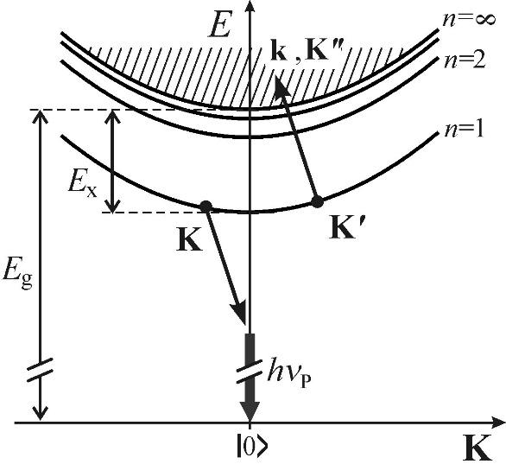

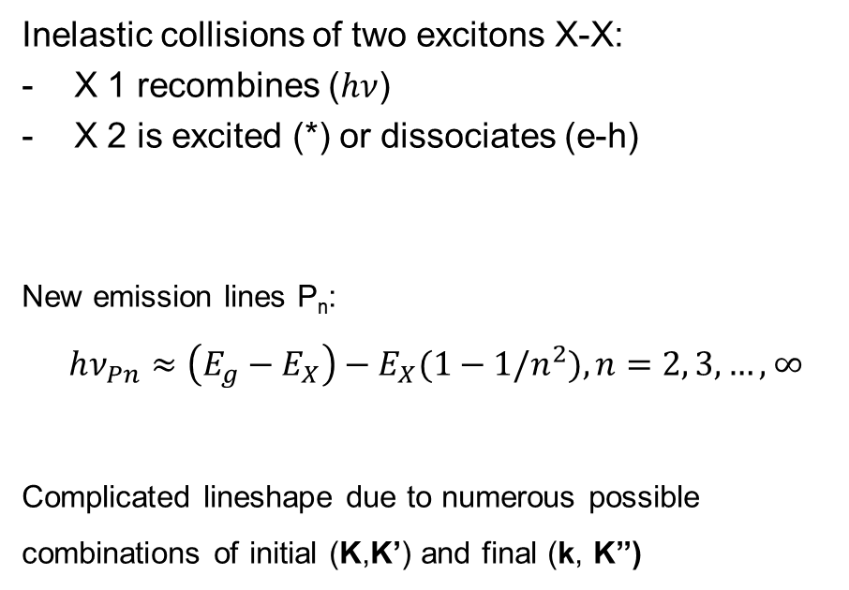

Collisions of free excitons
Inelastic collisions of two excitons X-X:
X 1 recombines ($hν$)
X 2 is excited (*) or dissociates (e-h)
New emission lines P_{n}:
$$hν_{Pn}≈\left(E_{g}−E_{X}\right)−E_{X}(1−1/n^{2}), n=2, 3,…,∞$$
Complicated lineshape due to numerous possible combinations of initial (K,K’) and final (k, K’’)
or
*
$$2 FE →hν+\text{(}\text{e}\text{−}\text{h}\text{) }\text{pair}$$
$$2 FE →hν+\text{FE}\text{∗}$$

Slide 28
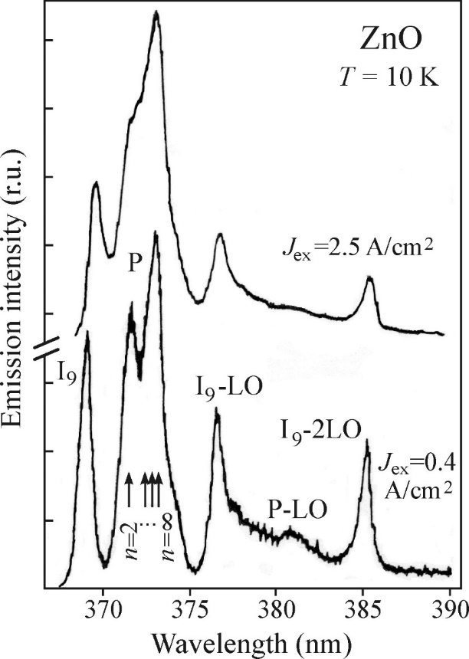
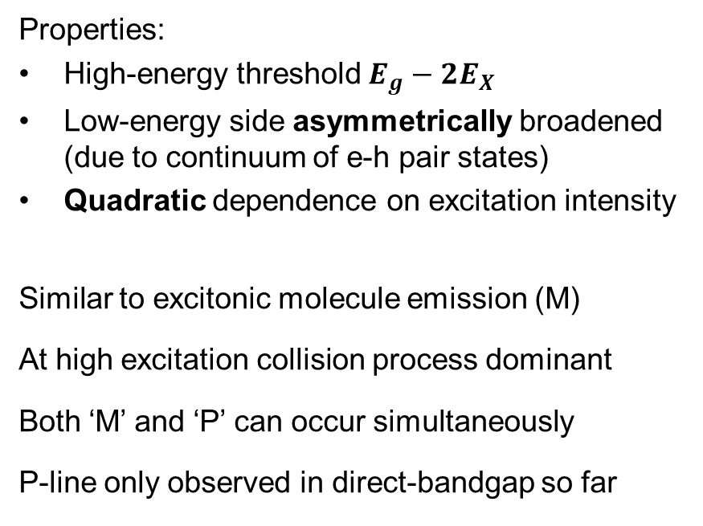
Collision of free excitons luminescence
Properties:
High-energy threshold $E_{g}−2E_{X}$
Low-energy side asymmetrically broadened
(due to continuum of e-h pair states)
Quadratic dependence on excitation intensity
Similar to excitonic molecule emission (M)
At high excitation collision process dominant
Both ‘M’ and ‘P’ can occur simultaneously
P-line only observed in direct-bandgap so far

Slide 29




Electron-hole liquid (EHL)
Condensation of an exciton gas
New state of matter (Fermi liquid)
Spherical e-h drops (EHD)
Critical density of e-h pairs $n_{C}$ and critical temperature $T_{C}$
Ground state $E_{G}$= Σ of kinetic, exchange and correlation energies (at equilibrium $n_{0}$)
Condensate binding energy $φ=\left|E_{G}\left(n_{0}\right)\right|−E_{X}$
Very stable in polar semiconductors (LO phonons) with indirect bandgap

Slide 30




Electron-hole liquid luminescence
Properties:
Increased probability (correlations of e-h, enhancement)
Broad band (Pauli exclusion principle)
Only for $T<T_{C}$ and sufficient excitation
Bandgap renormalization (low re-absorption)
Liquid density $n_{0}$ constant at fixed T
Lineshape:
Low-energy limit: $hν= E_{g}^{′}<E_{g}$
High-energy limit (T=0): $hν= μ^{′}$
Full width (T=0): $E_{F}^{3/2}\sim n_{0}$
$μ^{′}=E_{g}^{′}+F_{e}+F_{h}=E_{G}(n_{0})$ i.e. the ground state energy of the EHL at T=0

Slide 31




Electron-hole liquid experiments
Broad band in Ge when crossing an excitation threshold at low T.
Stressing of Si along [100] in order to break number of equivalent conduction band valleys and reduce $φ$
Coexistence of EHL and M in AgBr (biexciton pocket)
EHL emission decays faster than FE due to Auger recombination

Slide 32

Highly excited indirect semiconductor

Slide 33





Electron-hole plasma (EHP)
Mott insulator-metal transition
Gradual transition FE gas to e-h plasma
Metallic character (Fermi statistics)
Coulomb screening length $λ_{S}<$ exciton radius $a_{X}$
Renormalization $E_{g}^{′}\left(N\right)<E_{g}$, bandgap shrinkage
Typical properties:
Low-energy emission boundary $E_{g}^{′}$ red-shifts with $N$ i.e. with excitation intensity
EHL formation can prevent $N>N_{M}$
No critical temperature
Wide emission band, gets broader with $N$
$N↑ :both E_{g}^{′}$ and $E_{X}$ drop

Slide 34



Electron-hole plasma spectra - examples
$$N_{M}$$

Slide 35





Bose-Einstein condensation
Macroscopic population of $E=0 \text{or} k=0$, fundamental consequence of quantum mechanics. Requires bosons (integer spin).
Bosonic statistics:
$$f_{BE}\left(E,T\right)=\frac{1}{\exp\left(\frac{E−μ}{k_{B}T}\right)−1}, \text{with} μ<0$$
Total boson number $n_{tot}\sim T^{3/2}$ finite.
Excess particles condense to the ground state $E=0$(in k-space)
$$n_{tot}=n_{E=0}+n_{CB}\left(T\right)$$
$$\frac{n_{0}}{n_{tot}}=1−{\left(\frac{T}{T_{CB}}\right)}^{3/2}$$
With critical temperature $T_{CB}≅2.9×{10}^{−11}\left(\frac{m_{0}}{m}\right)n_{tot}^{2/3}$ (K)
($m_{0}$ is the free electron mass)
$$\frac{n_{0}}{n_{tot}}$$
$$1$$
$$T_{CB}$$
$$T$$

Slide 36




Bose-Einstein condensation of excitons
Difficult for atomic gases ($T_{CB}≅100$mK)
‘Easy’ for excitons: $T_{CB}≅6.3$K for $n_{tot}≅{10}^{17}$cm⁻³
Expected luminescence:
Very narrow
Low-energy edge = free exciton line
Gradual transformation (Bose narrowing)
Ideal: non-interacting excitons, $∞$ lifetime, therm. dyn. equ.
Cu₂O promising due to repulsive interaction and no EHP
Challenges: sample purity, high optical excitation levels
In low-dimensional systems: phase-coherent superfluid movement of a bosonic system
$$α=\frac{−μ}{k_{B}T}$$
($\text{FWHM}\text{= }1.8{ k}_{B}T$)

Slide 38
Thin layer of GaAs at 2 K

