Slide 1
Electroluminescence. Low-dimensional structures I: quantum wells
Qingyun
2017-12-04

Slide 2
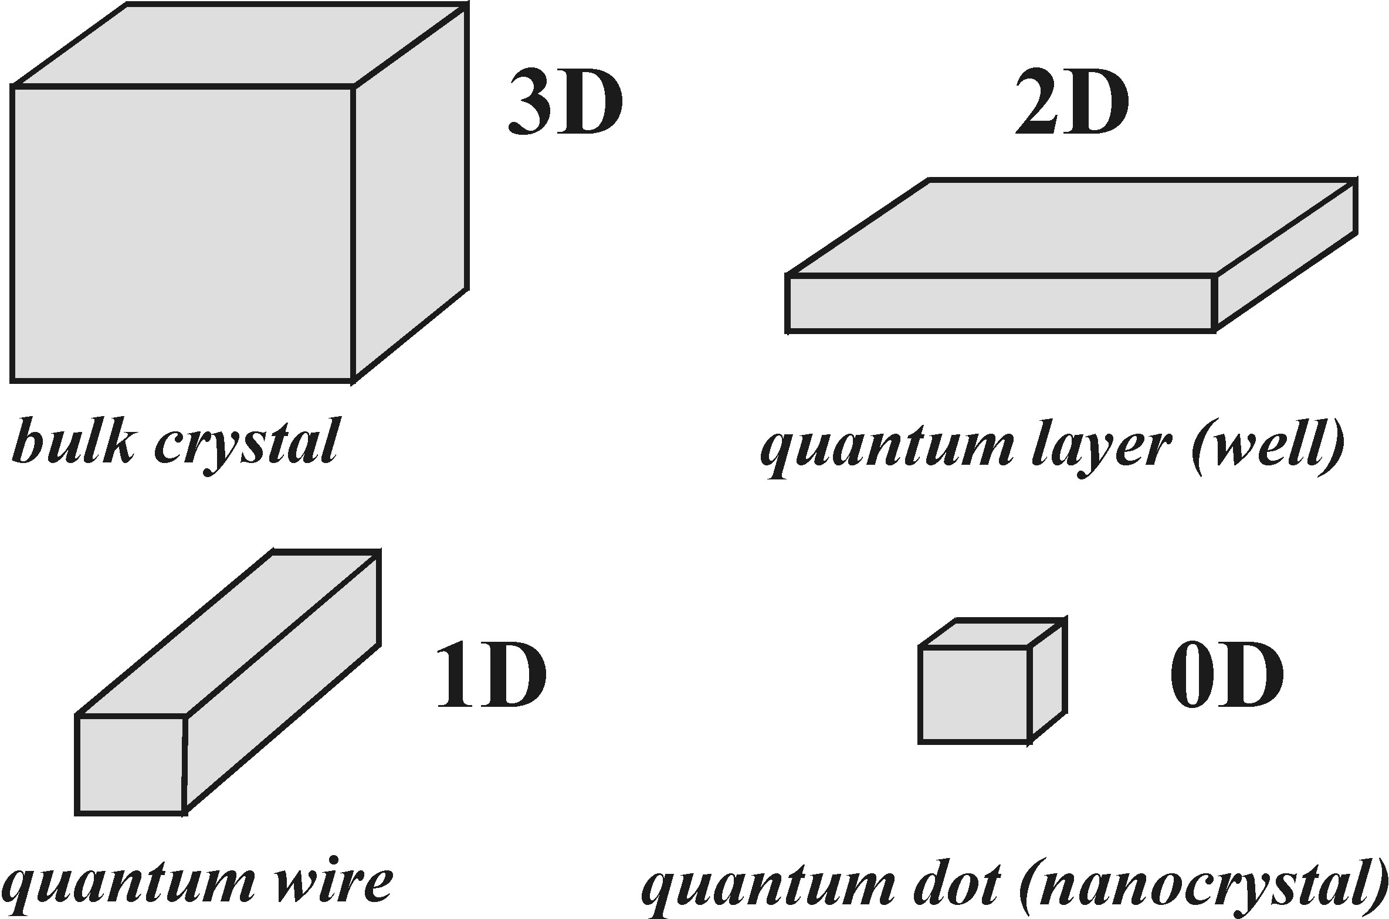
1.1 Basic types of low-demensioanl semiconductors
Tens of nanometers
Fig. 12.1 Basic types of low-dimensional semiconductor nanostructures
characterized by the number of dimensions which are restricted to the
size where quantum confinement effects start to play an important role.
Notes:
Low-dimensional semiconductors can be divided into groups according to the number of dimensions in which the charcteristic size is small enough to fit into the quantum confinement limit. The structures confined in one, two or three dimensions are called quantum layers (or quantum wells), quantum wires, and quantum dots or nanocrystals. For the quantum confinement effect starts to work, the size should be in the order of tens of nanometers or less the fabrication is based on two approaches: bottom-up growth and top-down growth. Top-growth example: lithography.

Slide 3
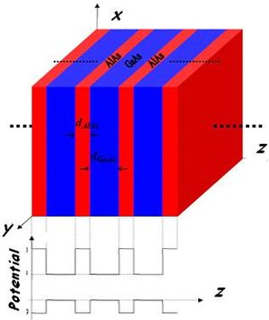
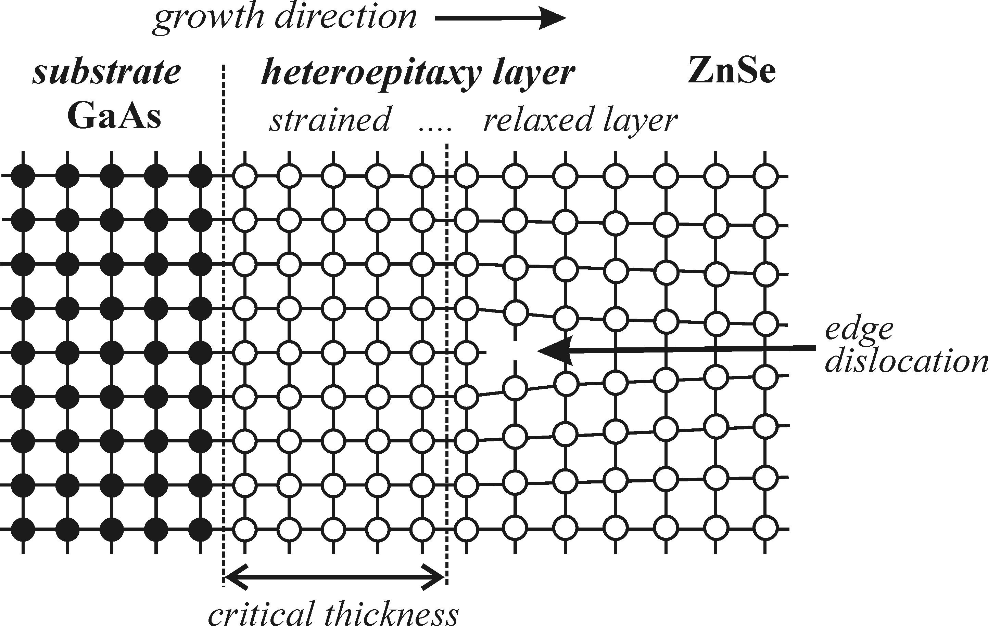
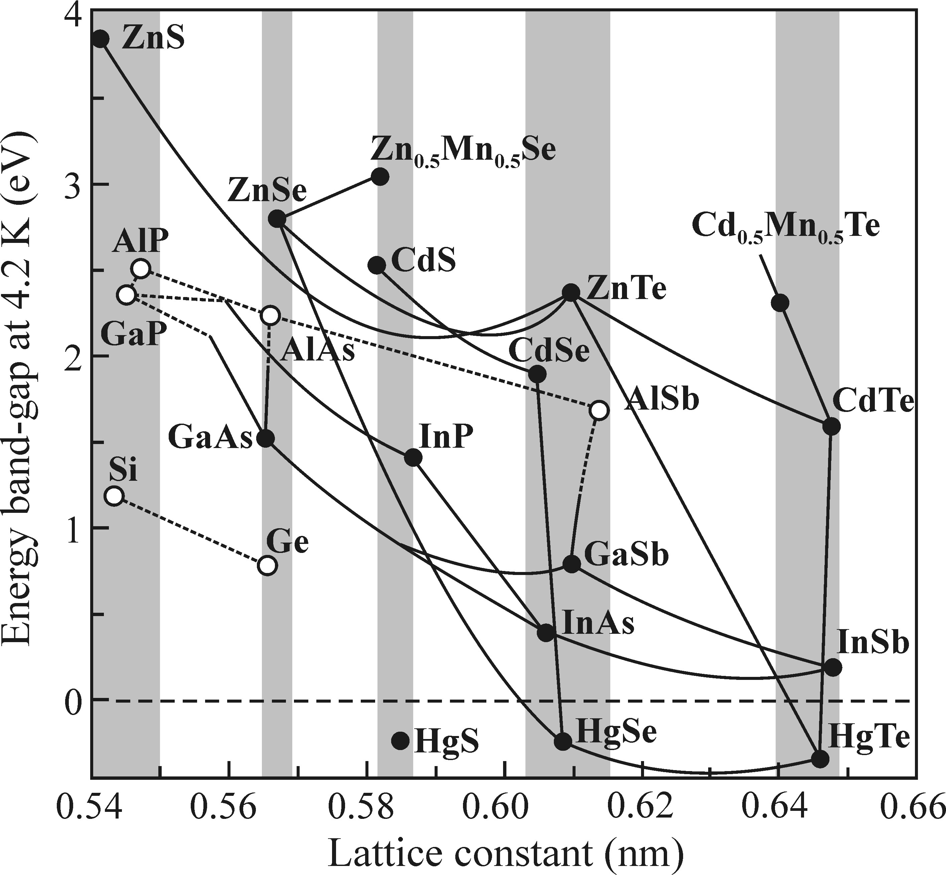
Semiconductor heterostructures
(a)
(b)
Special case: superlattice
Accpe the crystal structure of seed layer
Fig. 12.2 Simplified scheme of epitaxial growth of a ZnSe layer on a GaAs substrate. The epitaxial layer is strained due to the lattice mismatch (∼ 0.27%) and the difference in thermal expansion coefficients of the two materials. When the layer becomes thicker than a certain critical thickness (around 150 nm in this case), the strain is released as a result of forming dislocations; a layer with a thickness of about 1 μm is already fully relaxed. Adapted from Yao et al. [2].
Notes:
Low-demensional semiconductor structures usually do not contain a single type of material confined into small dimensions but they tend to combine several types of semiconductors of various composition. Such compound materials are comonly referred to as heterostructures. The reasons for this: passivatrion, protection of the nanostructure, to fabricate the appropriate energy structure for specific function requirements. The simplest example of a low-dimensional heterostrucutre is a quantum well-a small segment of semiconducto surrounded by a different semiconductor with wider bandgap. The basic technology to fabricate the heterosttttructure is by epitaxial growth with same or a different semoconductor. Like grow YAG crystal based on a seed crystal bar. If a semiconductor is forced to grow on the a structure which is not its nature form, mechanial strain will exist. When is reaches certain thickness, the strain will be relaxed through the formation of structral defects.
Figure b Fig. 12.3 Overview of semiconductor materials sorted by their low-temperature lattice constants and bandgap values. The materials forming stable alloys are connected by lines. White circles and dashed lines indicate indirect-bandgap materials, while black circles and solid lines denote direct-bandgap materials.
(The negative bandgap values in HgS, HgSe, and HgTe signify that these materials are near the border between metals and semiconductors.) The grey vertical rectangles highlight groups of materials with close lattice constants, suitable for the fabrication of heterostructures. Adapted from Davies [1] and Yu and Cardona [4].

Slide 4
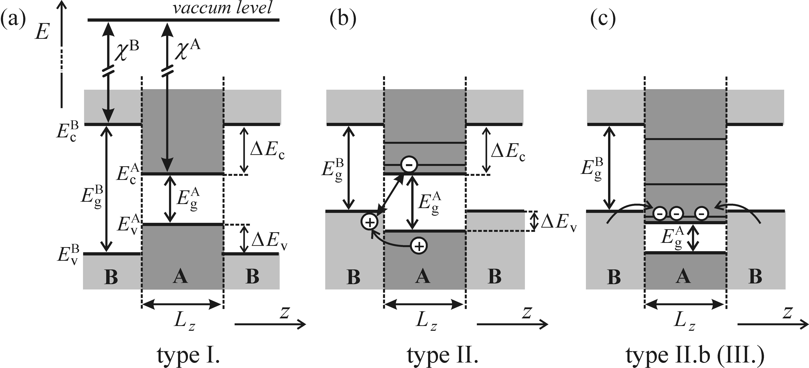

Basic types of quantum-well heterostructures
Fig. 12.4 Basic types of quantum wells and illustration of the band-offset
calculation from electron affinities—the Anderson rule: (a) type I, (b) type II, and (c) type IIb, sometimes called type III.
Notes:
The essential factor which determins the properties of a heterostrucutre is the relative shift bewteen the conduction and valence bands, the so-called band offset.And the semiconductor is divied into two types according to the band offset. If the minimum of conduction band and maximum of valance band are both in the same layer, then type one, if located in different layers, then type two. Type two, the electons and holes are partically seprated. Type three is a specail case of type two. The conduction and valance bands of neihbouring layers overlap, then the electron and freely transfer from one layer to another to combine until reach a balance state to create a local electric field, Semiconductor A and B have electron affinities ( i.e. The energy required to release an electron from the bottom of the conduction band into vacuum-out of crystal) χA, χB. And band gap of EgA and EgB. Then band offset is ΔEc, ΔEv are: But in the real situation, the exact determination of band offset is quite diffcult.

Slide 5
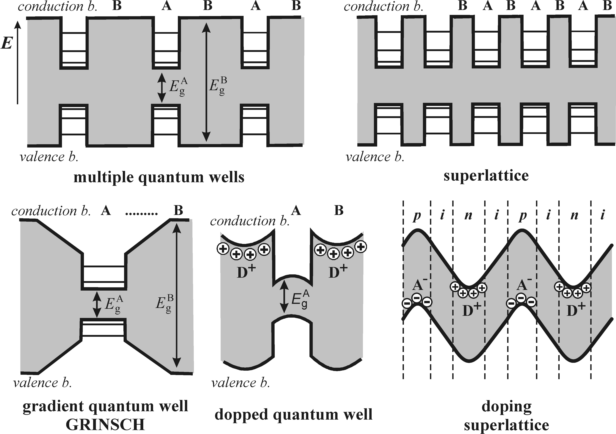
Basic types of quantum-well heterostructures
Notes:
Fig. 12.5 Selected types of heterostructures with quantum wells: The upper row shows multiple (noninteracting) quantum wells and a superlattice. The lower row illustrates a quantum well with a gradual transition between two materials, the so-called GRINSCH structure (graded index separate confinement heterostructure), a modulation doping quantum well and a doping superlattice (or nipi structure) formed within one semiconductor via alternating the type of doping (D+ and A−indicate ionized donors and acceptors,respectively). Adapted from Klingshirn[6]. Doping superlattice consists of a periodic sequence n- and p-doped layers with undoped intrinsic regions in between.

Slide 6
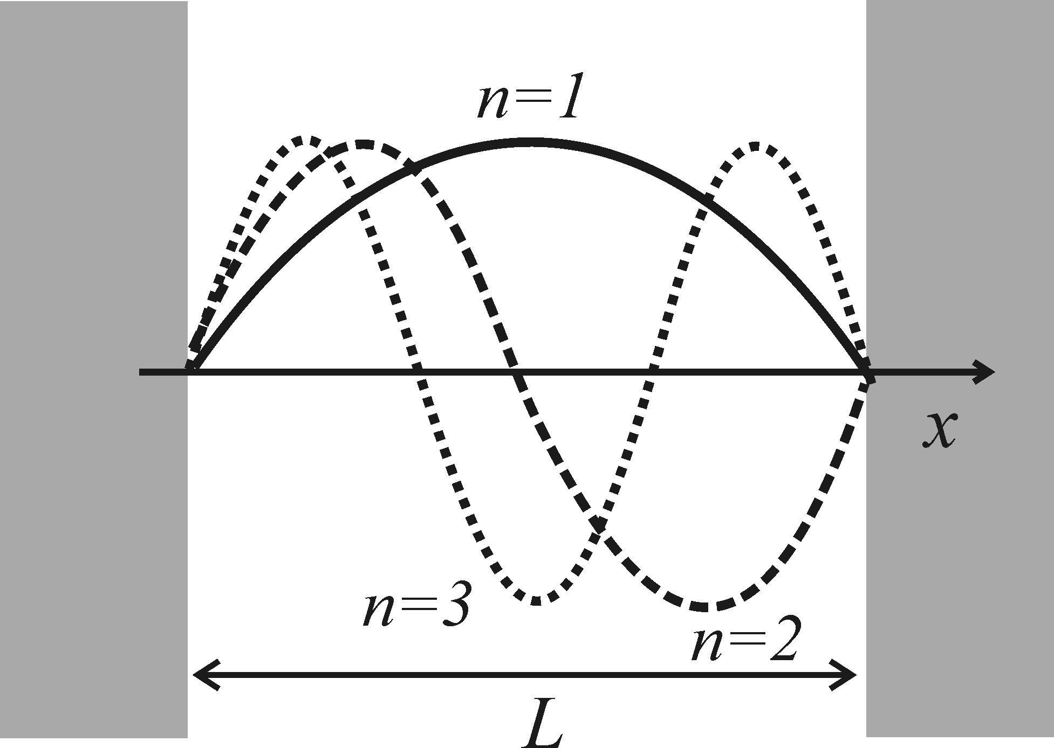



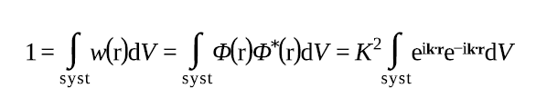


Dnesity of states in low-dimensional semiconductor
Fig. 12.6 A particle in a box of length L: Possible wavefunctions of a particlebconfined within impenetrable barriers are harmonic functions with nodes at the barrier walls and periods equal to an integer multiple of π/L.
Notes:
Let us take the quasi-particle wavefunction (electron or hole?) in the form of plane wave. The the complex conjugate represents the possibility to find the particel inside the volume dV. The integretion of the possible density of the whole system must equal to 1. In the case of an infinite system with a infinite V, the K becomes infinitely small. In the case of 3D, 2D and 1D systems with fnite volumes L3,L2,L, K euqals to L^{-3/2}, L⁻¹ and L^{-1/2}.
If the motion of the quasi-particles is restricted in the direction of coordinate x to a segment of length L. The probability to fine the particel ouside the region is zero. So the wavefunction reaches zero at the wall of the region. This condition only satisfied by the standing waves whose integer multiplies of half-wavelength equal to the length L.

Slide 7
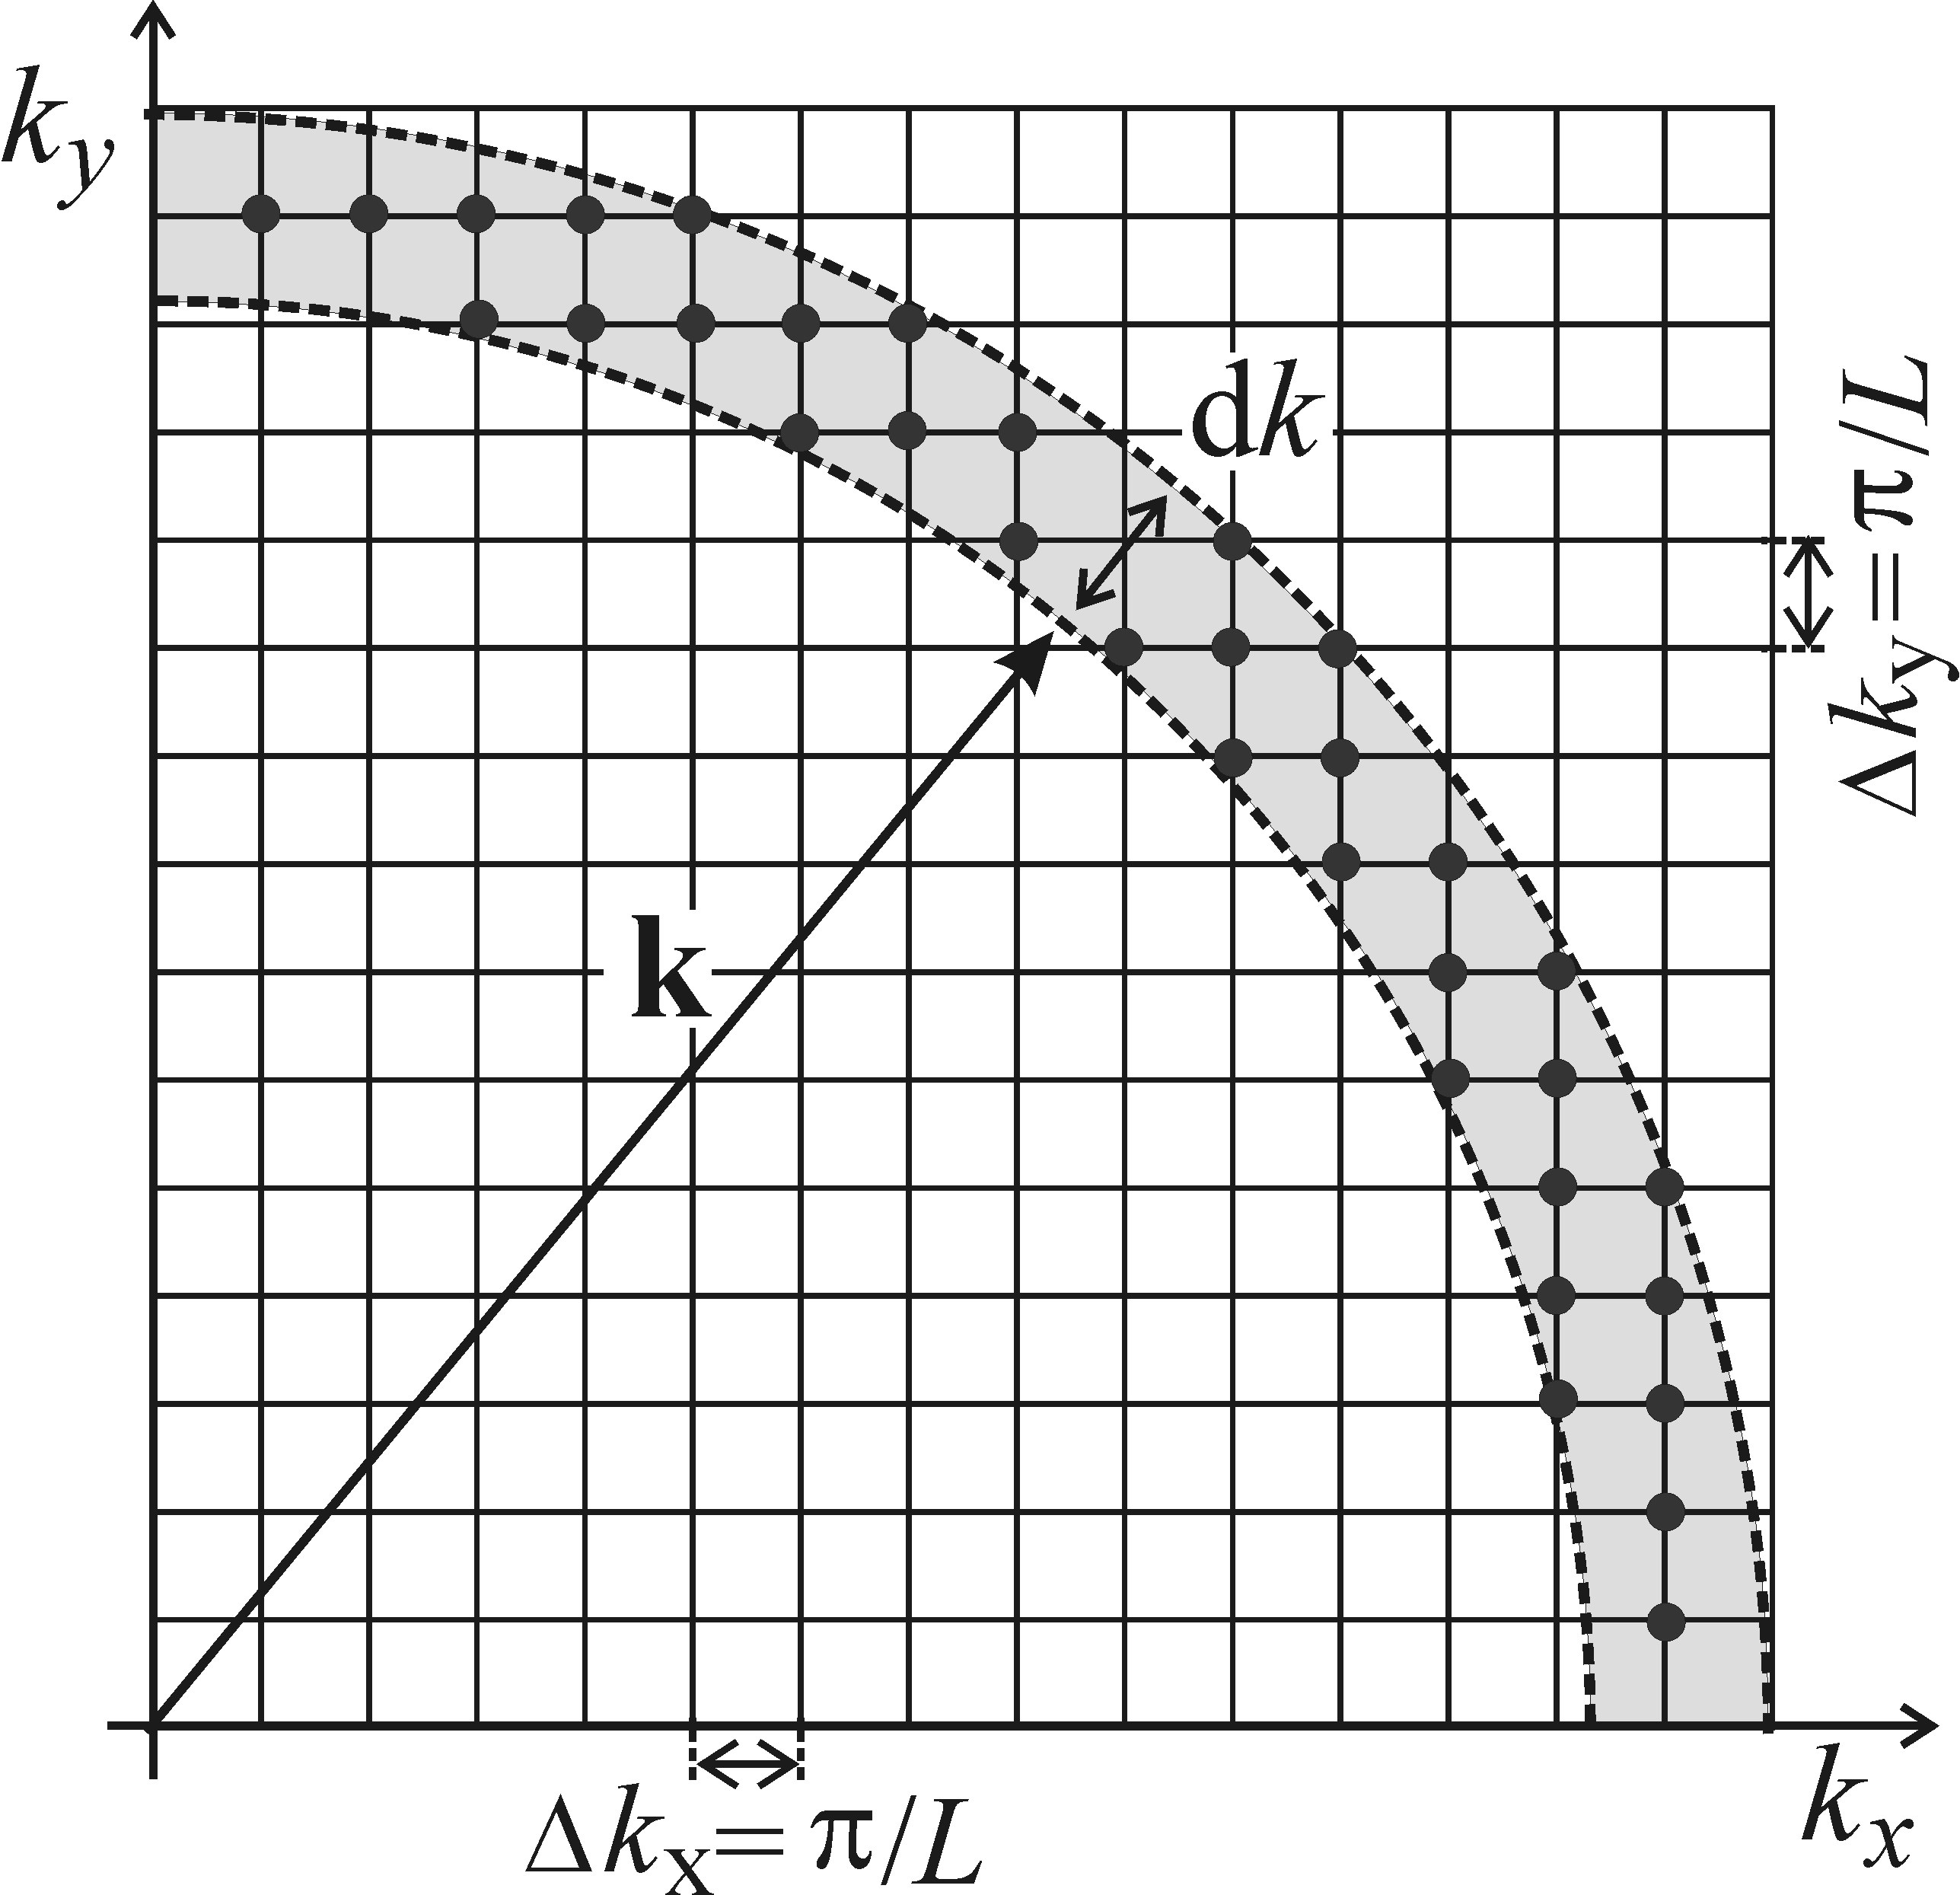


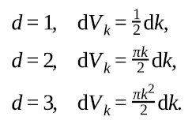
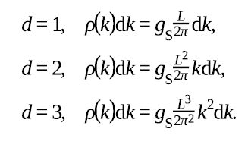
Dnesity of states in low-dimensional semiconductor
Illustration to the calculation of the density of
states in two-dimensional k-space. One state
occupies a volume of (π/L)2.
Notes:
In k-space, the allowed states are distributed along the Kx, Ky and Kz axes with a period of π/L, so one state occupy a volume of (π/L)d. Now we can calculate the density of states ρ(k) (which is the number of avaible states with wavevector modulus k to k+dk) in k-space. gs is the degeneracy factor, dVk is the volume of k space. For 1D, 2D and 3D cases, the relevant elemental volumes read:
d = 1, .

Slide 8

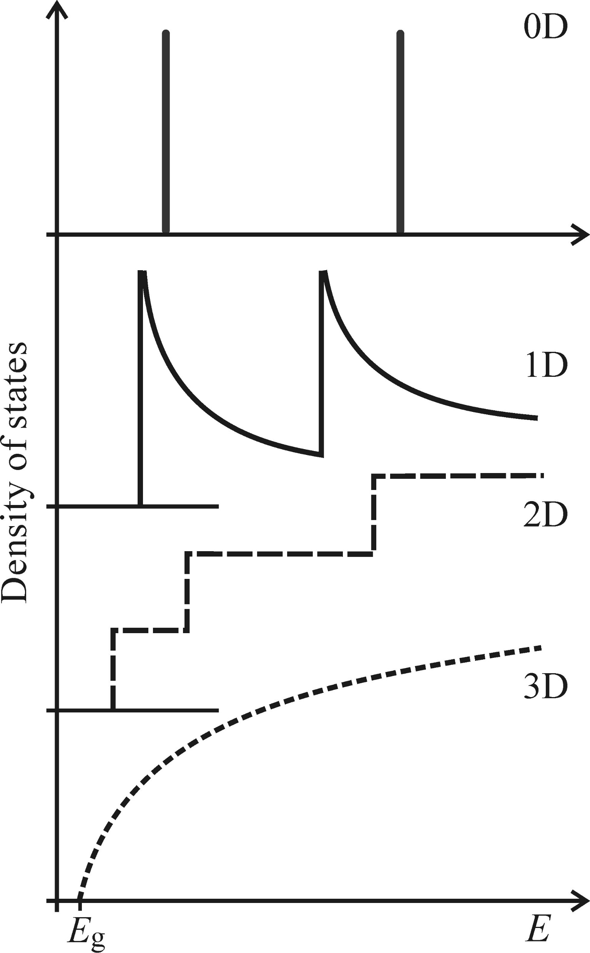

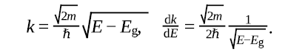
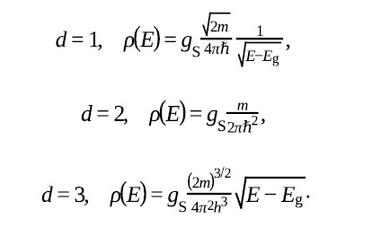
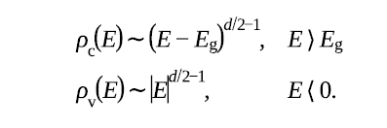
Dnesity of states in low-dimensional semiconductor
In the simple parabolic shape of Ec and Ev
Notes:
Now the density of states in k space is transformed to density of states in ’energy space’, which is the number of states per interval of energy at each energy level. For the simple parabolic shape of the conduction and valance bands in the effecitve mass approximation, the energy of conduction and valance energy is . Generally, the density of states of an electron in the conduction band and holes in the valence band ca be written as. The fugure is the sketch of the density of states in the condcution band of 3D,2D,1D and 0D semiconductor structures. We assume that there are several exsiting conduction bands.

Slide 9
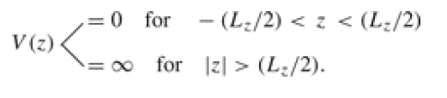


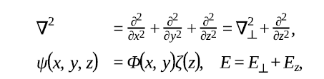

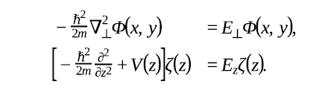

Quantum wells−two-dimensional semiconductors
Single quantum well with infinite barriers
Schrödinger equation
In xy plane, plane wave abd parabolic bands
Seperate into xy plane and z direction
In direction perpendicular to xy plane
?
Notes:
Let the layer be oriented in parallel to the x,y axes and let its thickness be Lz. If the well is placed symmetrically with resperct to the origin of the coordinate system, the potential energy of a quasi-particle V(z) within the well is descirbed by:
The stationary schrödinger euqation for a quasi-particle confined inside the well is. The eigenvalues of the wave equation were shown to be the energy level of the system- wavefuntion is the probability distribution of a particle at a certain position. In order to solve this equation, we seperate the movement into (x,y) plane, where particle moves freeely and z-plane, where the potential confinment works. We seperate the Laplace operator, wavefunction, energy eigenvalues into xy plane and z plane: in xy plane, it is free motion, the solution is plane waves and the dispersion relation has the well-known form od parabolic bands:

Slide 10

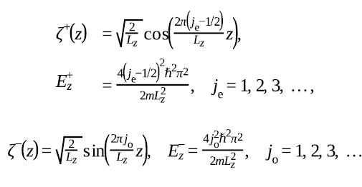

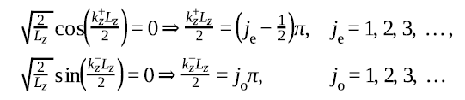
Quantum wells−two-dimensional semiconductors
In z direction: inside the well, V=0
Normalization condition
Notes:
This equation resembles the equation of motion of a harmonic oscillator. Therefore, we can look for the solution in the form of a combination of sines and cosines.
The normalization condition (the overall probability of finding the particle is equal to unity) allows the coefficients A and B to be specified. Therefore, the wavwfunction and energy eigenvalues of the particle is:

Slide 11

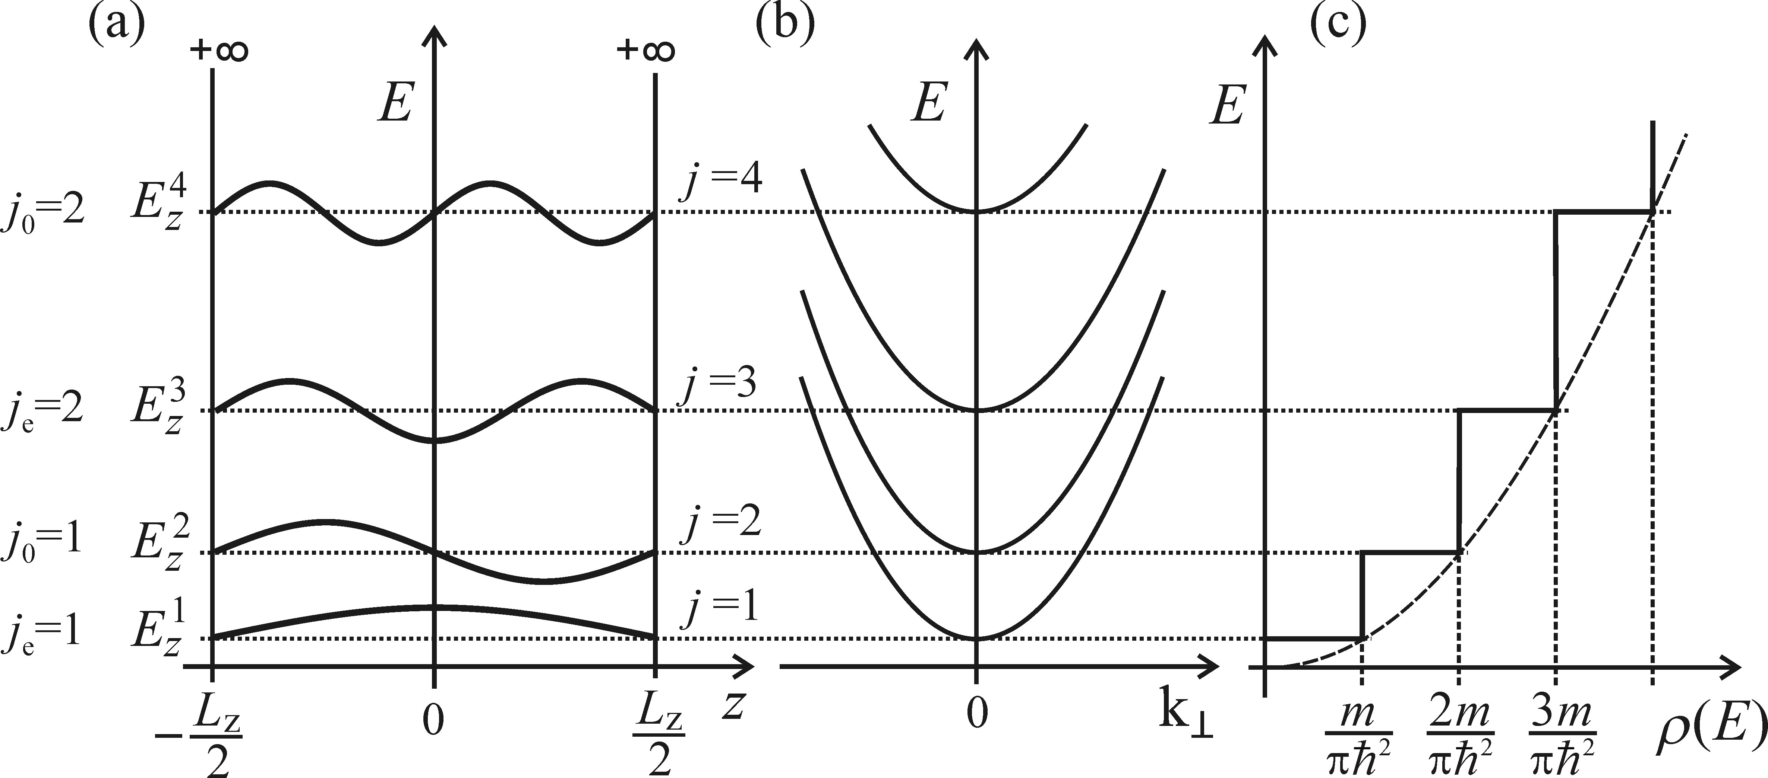




Quantum wells−two-dimensional semiconductors
The groud state
First excited state
second excited state
Third excited state
Total energy of particle
Notes:
The overall energy of a quasi-particle in an infinitely deep quantum well is then obtained by summing both partial energies and by
introducing a quantum number j. Ezj is the kinetic energy with the movement perpenticur to the layer of well. H= 0 for E<Ezj, and H=1 for E>Ejz.

Slide 12
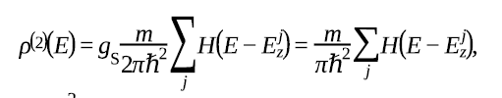


Quantum wells−two-dimensional semiconductors
Total energy of particle
When
where
Joint density of states.
Notes:
The overall energy of a quasi-particle in an infinitely deep quantum well is then obtained by summing both partial energies and by
introducing a quantum number j. Ezj is the kinetic energy with the movement perpenticur to the layer of well. H= 0 for E<Ezj, and H=1 for E>Ejz. Joint density of states, which drives optical absorption, is then divied by comnbinging the density of electron and holes. Mr is the reduced mass of electron and hole.

Slide 13
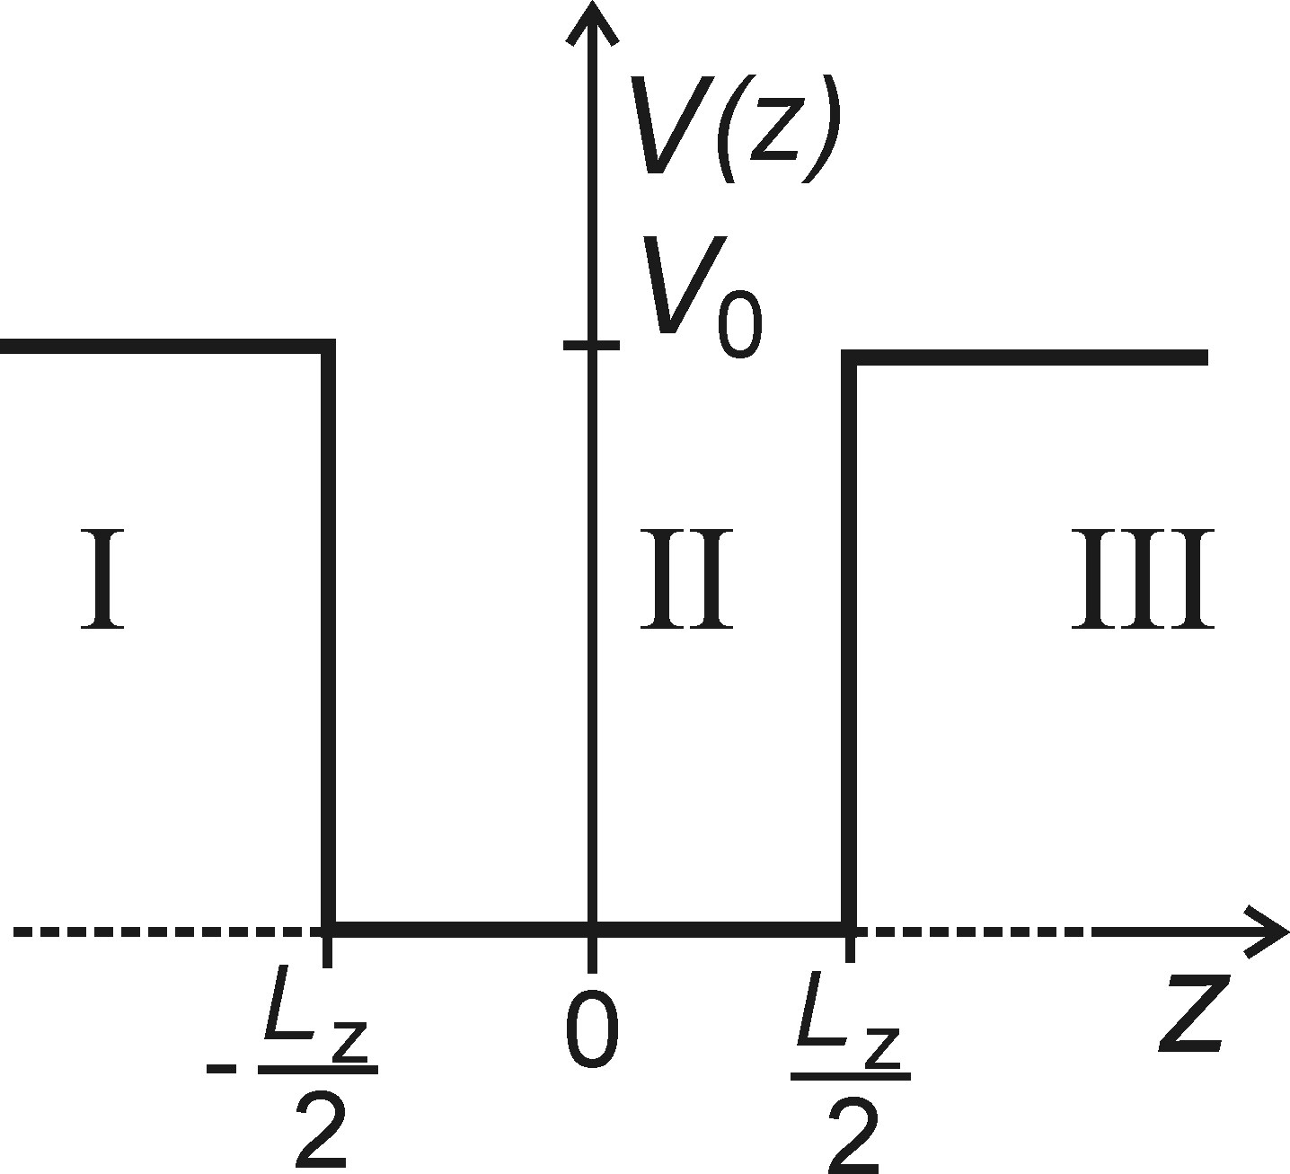
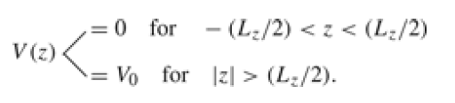

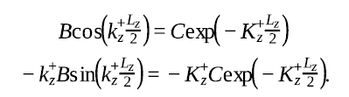
Quantum wells−two-dimensional semiconductors
Quantum well with finite barriers
Region II:
Boundary contiunous condition
Notes:
IN a real quatum wall, the barriers are of finite height, so the probbbility to find the particle outside the well is non-zero, which is in the form of exponationlly decaying wave. And the solution inside the well is unaltered. the wavefunctions are continuous and differentiable on the wall boundary.
In region I and III, V(z)=Vo.
And also according to the symmetry, the solution can be even or odd. If it is even, A=0, C=D. If it is odd, B=0 and C=-D. As the the wavefunctions are continuous and differentiable on the wall boundary.
Then boundary condition:

Slide 14
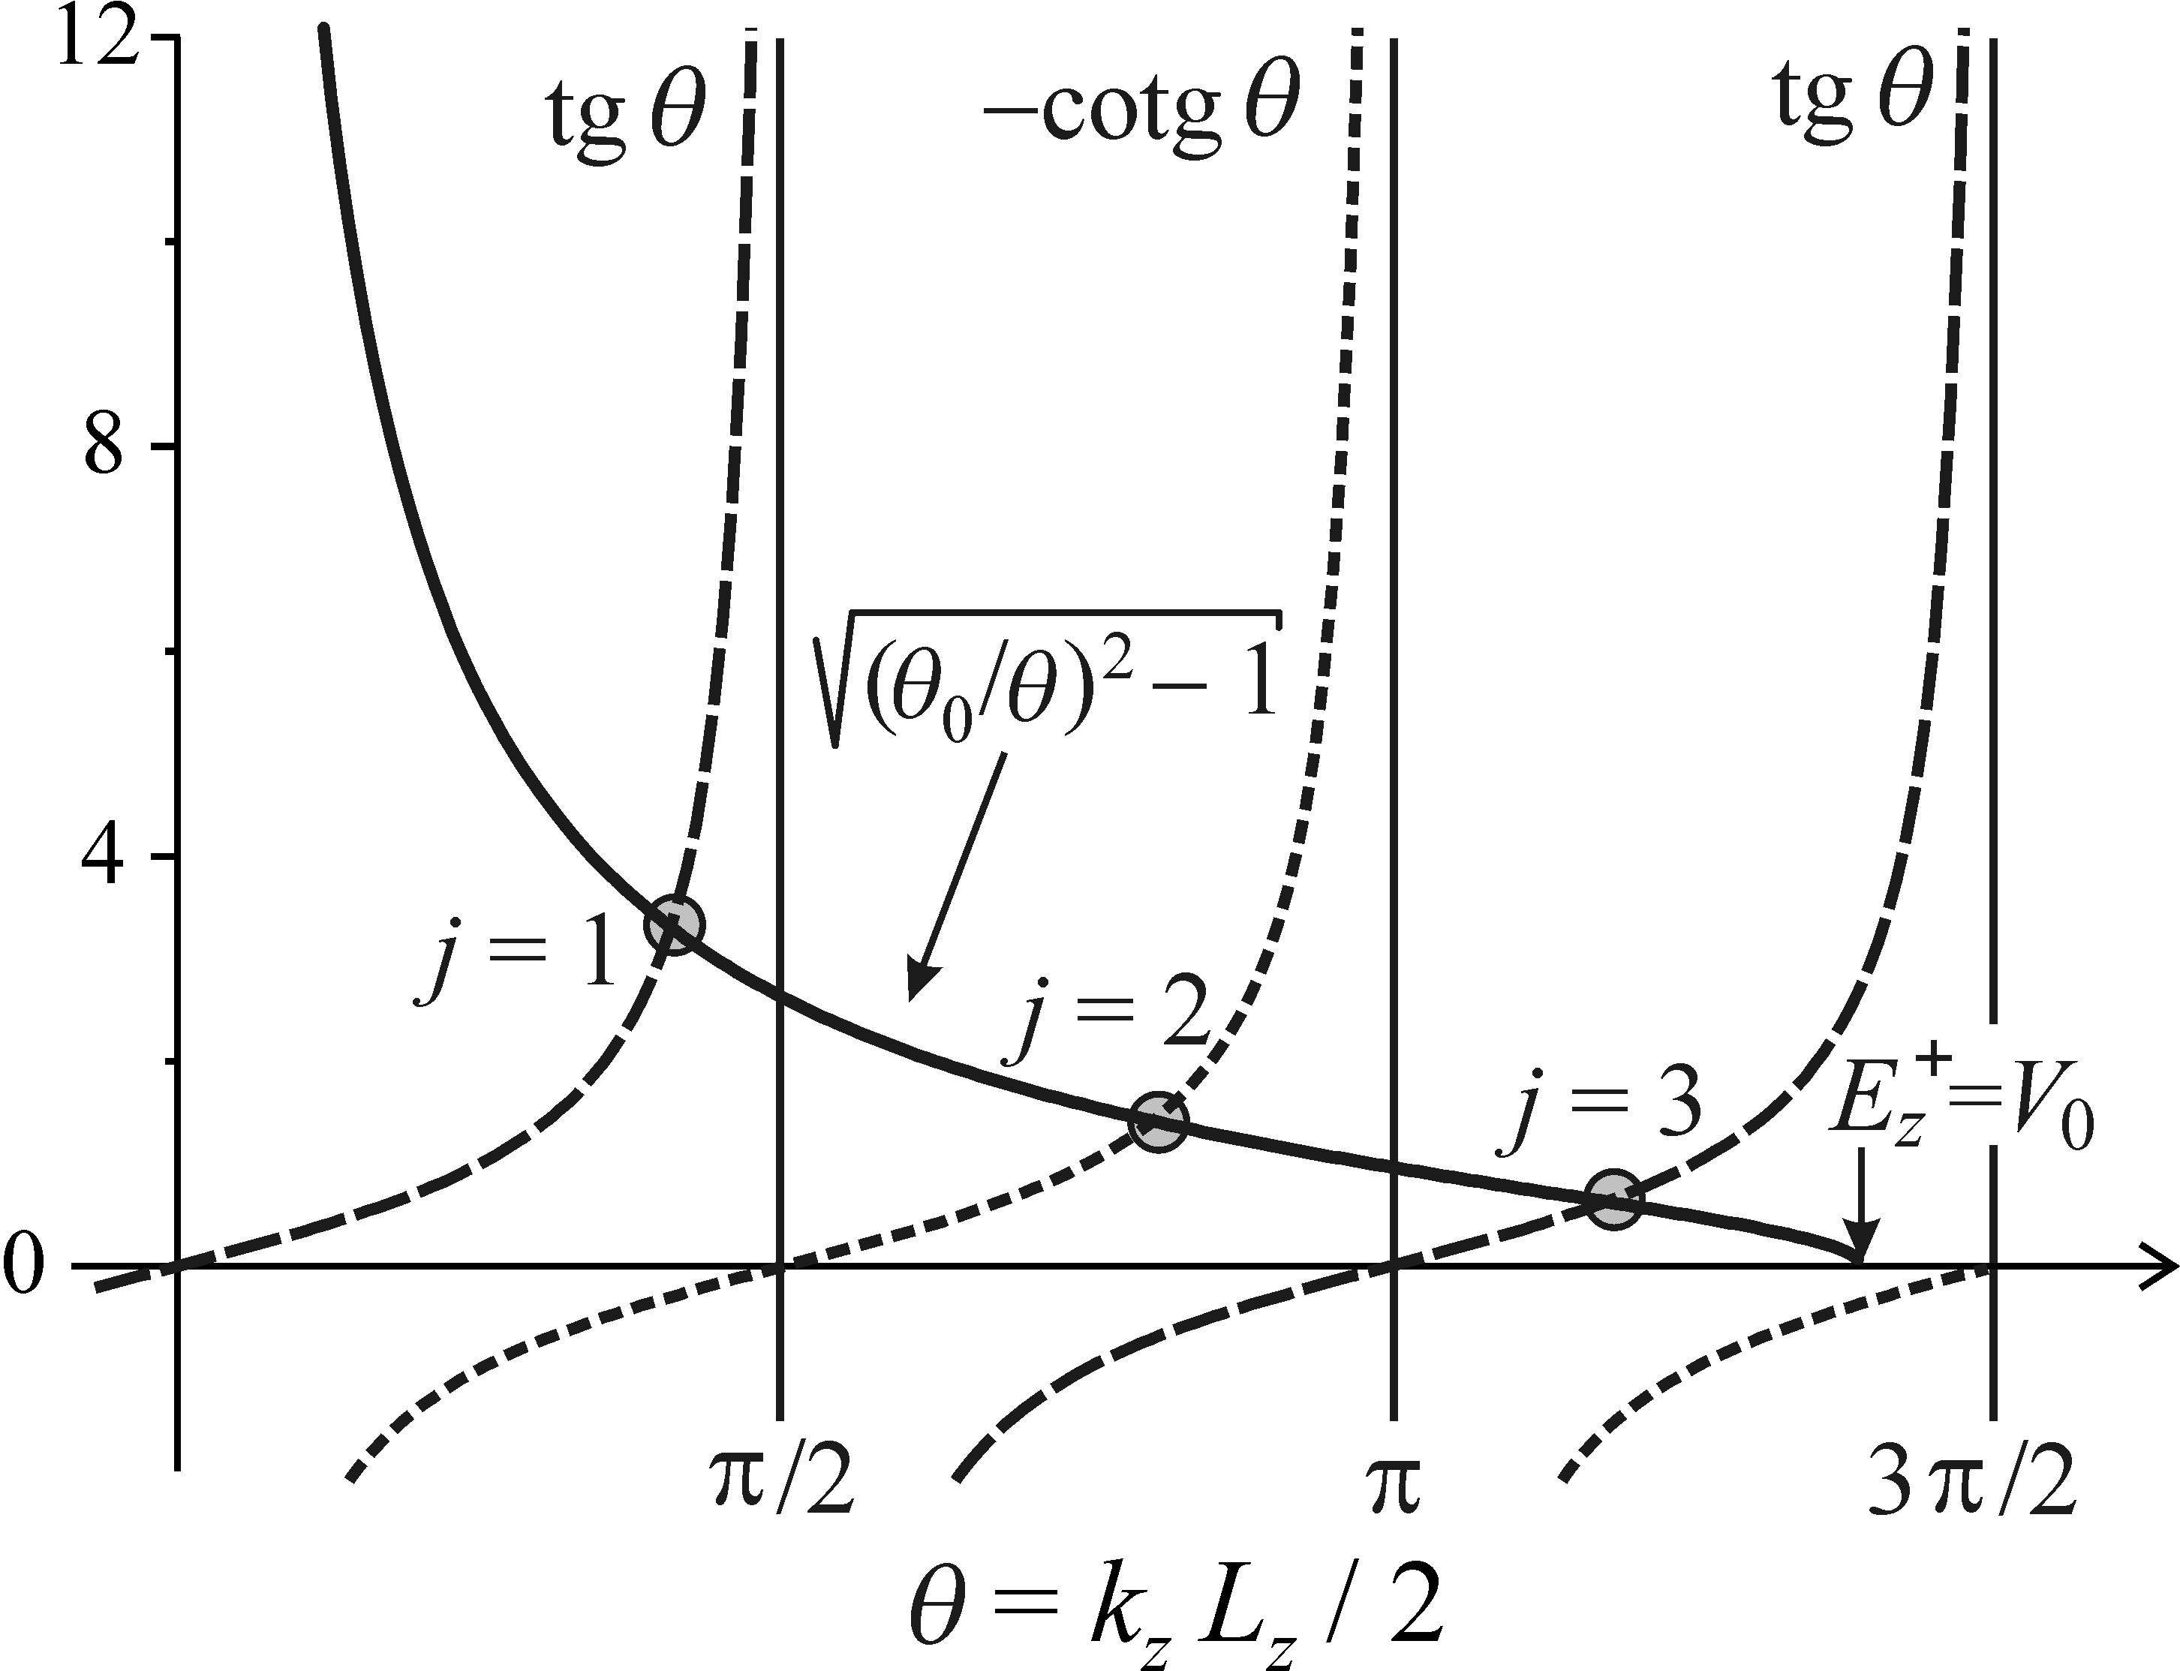



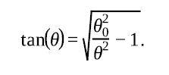
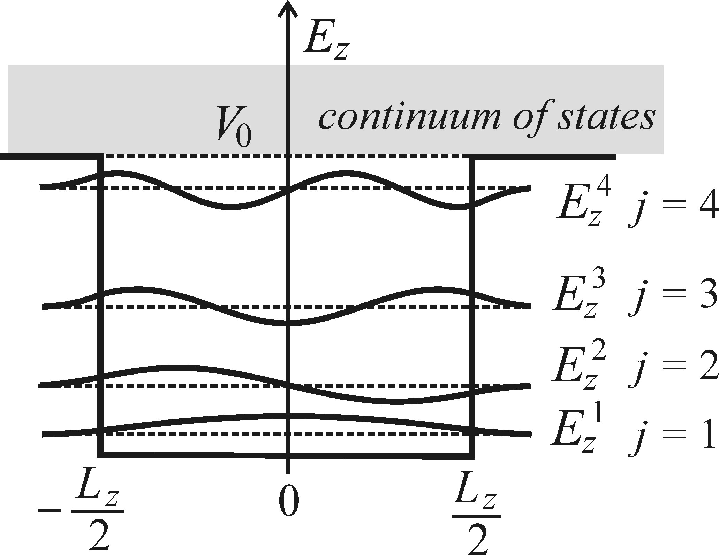



Quantum wells−two-dimensional semiconductors
Even solution: A=0 C=D
Odd solution: B=0, C=-D
Notes:
In roder to make it clear and concise, we introduce two dimensionless variables. In figure, a example of GaAs with thickness of 12-nm, barrier height of 0.3 eV, effective mass 0.067m0 are given, it plots the left and right side of the equation. The solutions are the intersection points. The number of solutions depends on the barrer height V0. if Vo is higher, than before it reaches θ=θo, i.e. Vo=Ez+. There are more joint points, which represents more localized states. So deeper well, more localized states. For the odd solution, one localized state to exist, the θo>pi/2. the fisrt four localized states of a particle inside a finite well are plotted in next figure.

Slide 15




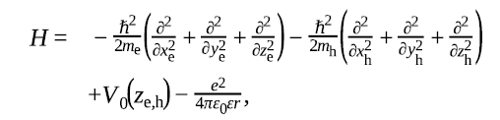


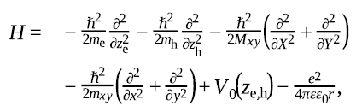
•Excitions in a quantum well: take into Coulomb interaciton between electron and hole.
Quantum wells−two-dimensional semiconductors
For 3D,
Notes:
The previous description was based on the effective mass approximation , and quasi-particel interactions, Coulomb interaction, were neglected. Such a simple description enebles us to understand the basic feature of low-dimensional quantum confinement phenomenon- the quantization of the quasi-particle kinetic energy in a narrow potential well. We want to take into Coulomb interaction between electron and hole in a two-particle Hamiltonian, which contains the kinetic enegy of eletron, hole, quantum well confinement potential, and Coulomb interaction. The confinement potential descibe the depth of the quamtum well seperatly for electron and hole, as they may be significantly different depends on the particular semiconductor materials forming the well and the barrier. R is the distance between the exciton, and relies on the formulation of the electron and hole motion in the xy plane by means of the exciton center of mass. Simplification treatment of the equation to ignore the Coulomb interaction along the Z direction, in a assumption of strong quantum confinement limit.. Thus the Hamoltionian is. Mxy is the total mass of the exciton. And mxy is the reduced exciton. The subscript xy emphasized that the excitonic effects manifest themselves only in the xy plane. The coordinate of exciton mass center is represntated as XY. Adn the relative coordinate of the elctron and hole are lower-case letters xy. And then also seperate the Shrödinger equation into xy and z direction. The first term describs the quasi-free motion of the exciton with principle quantum number n and wavevector Kxy in xy plane. The resulting energy level of exciton in a two-dimensioanl quantum well is :
Ex is the free exciton binding energy in bulk semiconudtor. For 2D, the exciton binding energy is increased. As an electron and hole are squeezed closer together in a realtively narrow well than the equilibrum Bohr radius. And also osillator strength f is inreased.

Slide 16
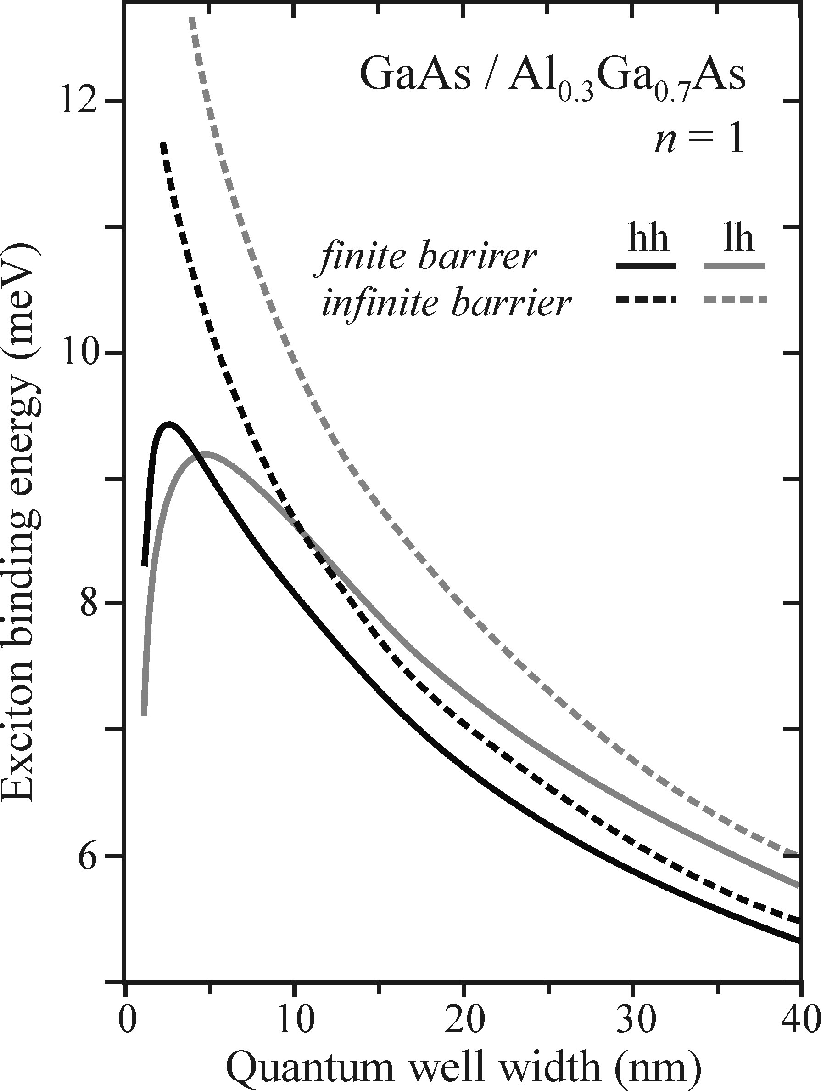
•Excitions in a quantum well: take into Coulomb interaciton between electron and hole.
Quantum wells−two-dimensional semiconductors

Slide 17
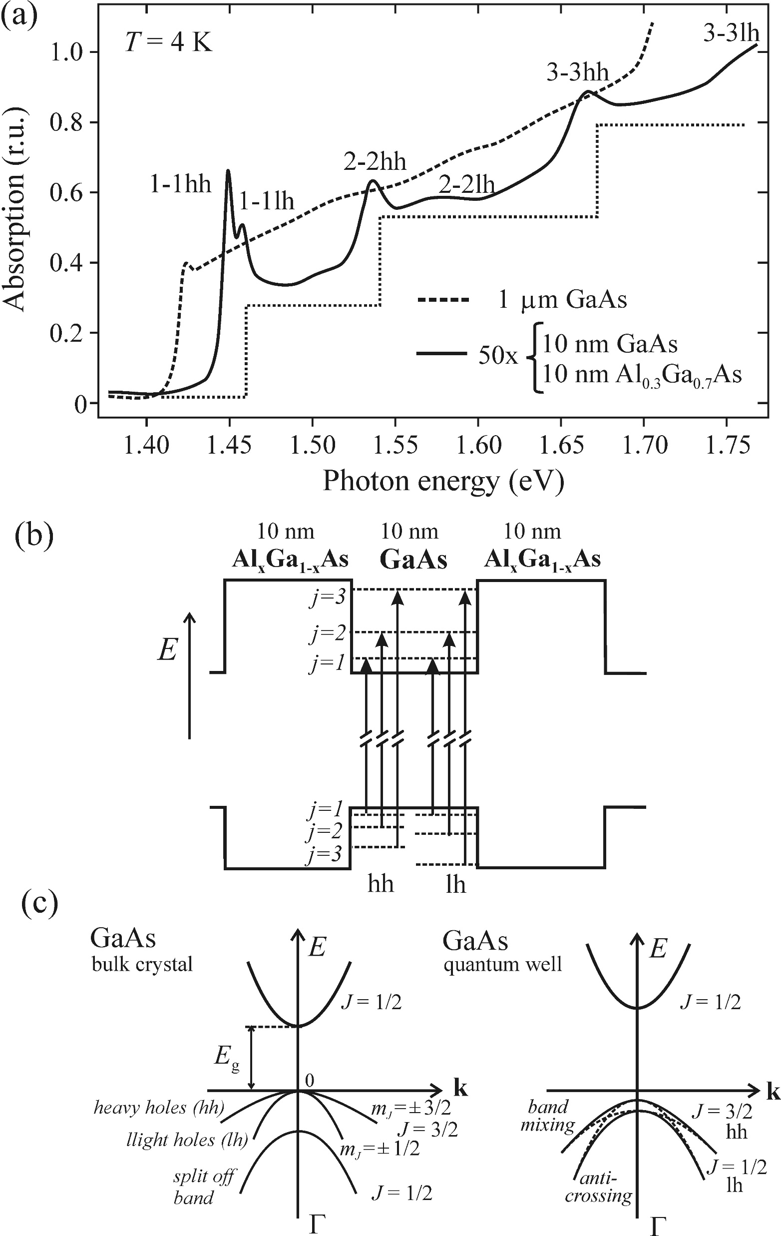


Quantum wells−two-dimensional semiconductors
•Optical transition in a quamtum well
The selection rule for the change of quantum number
Infiite wall
finite wall
Notes:
The transitions are allowed only between quantized electron and hole in sub-bands with the same quantum number j. For finite wall, the transition between same quantum number states is highest. Experimental absorption sepctra of quantum wells confirm the validity of the selection rule. Fig. 12.14 (a) Absorption of a multiple (50×) quantum well 10 nm GaAs/10 nm Al_{0.3}Ga_{0.7}As (solid line) compared to the absorption of a 1-μm-thick layer of GaAs (dashed line). The dotted line indicates an approximate shape of the joint density of states. The interpretation of peaks is given in panel (b): the transitions take
place between electron and hole states with identicaln quantum number j. The splitting of transitions is due to complex´intermixing and splitting of the degenerate states of the uppermost valence band, as shown in panel (c).

Slide 18
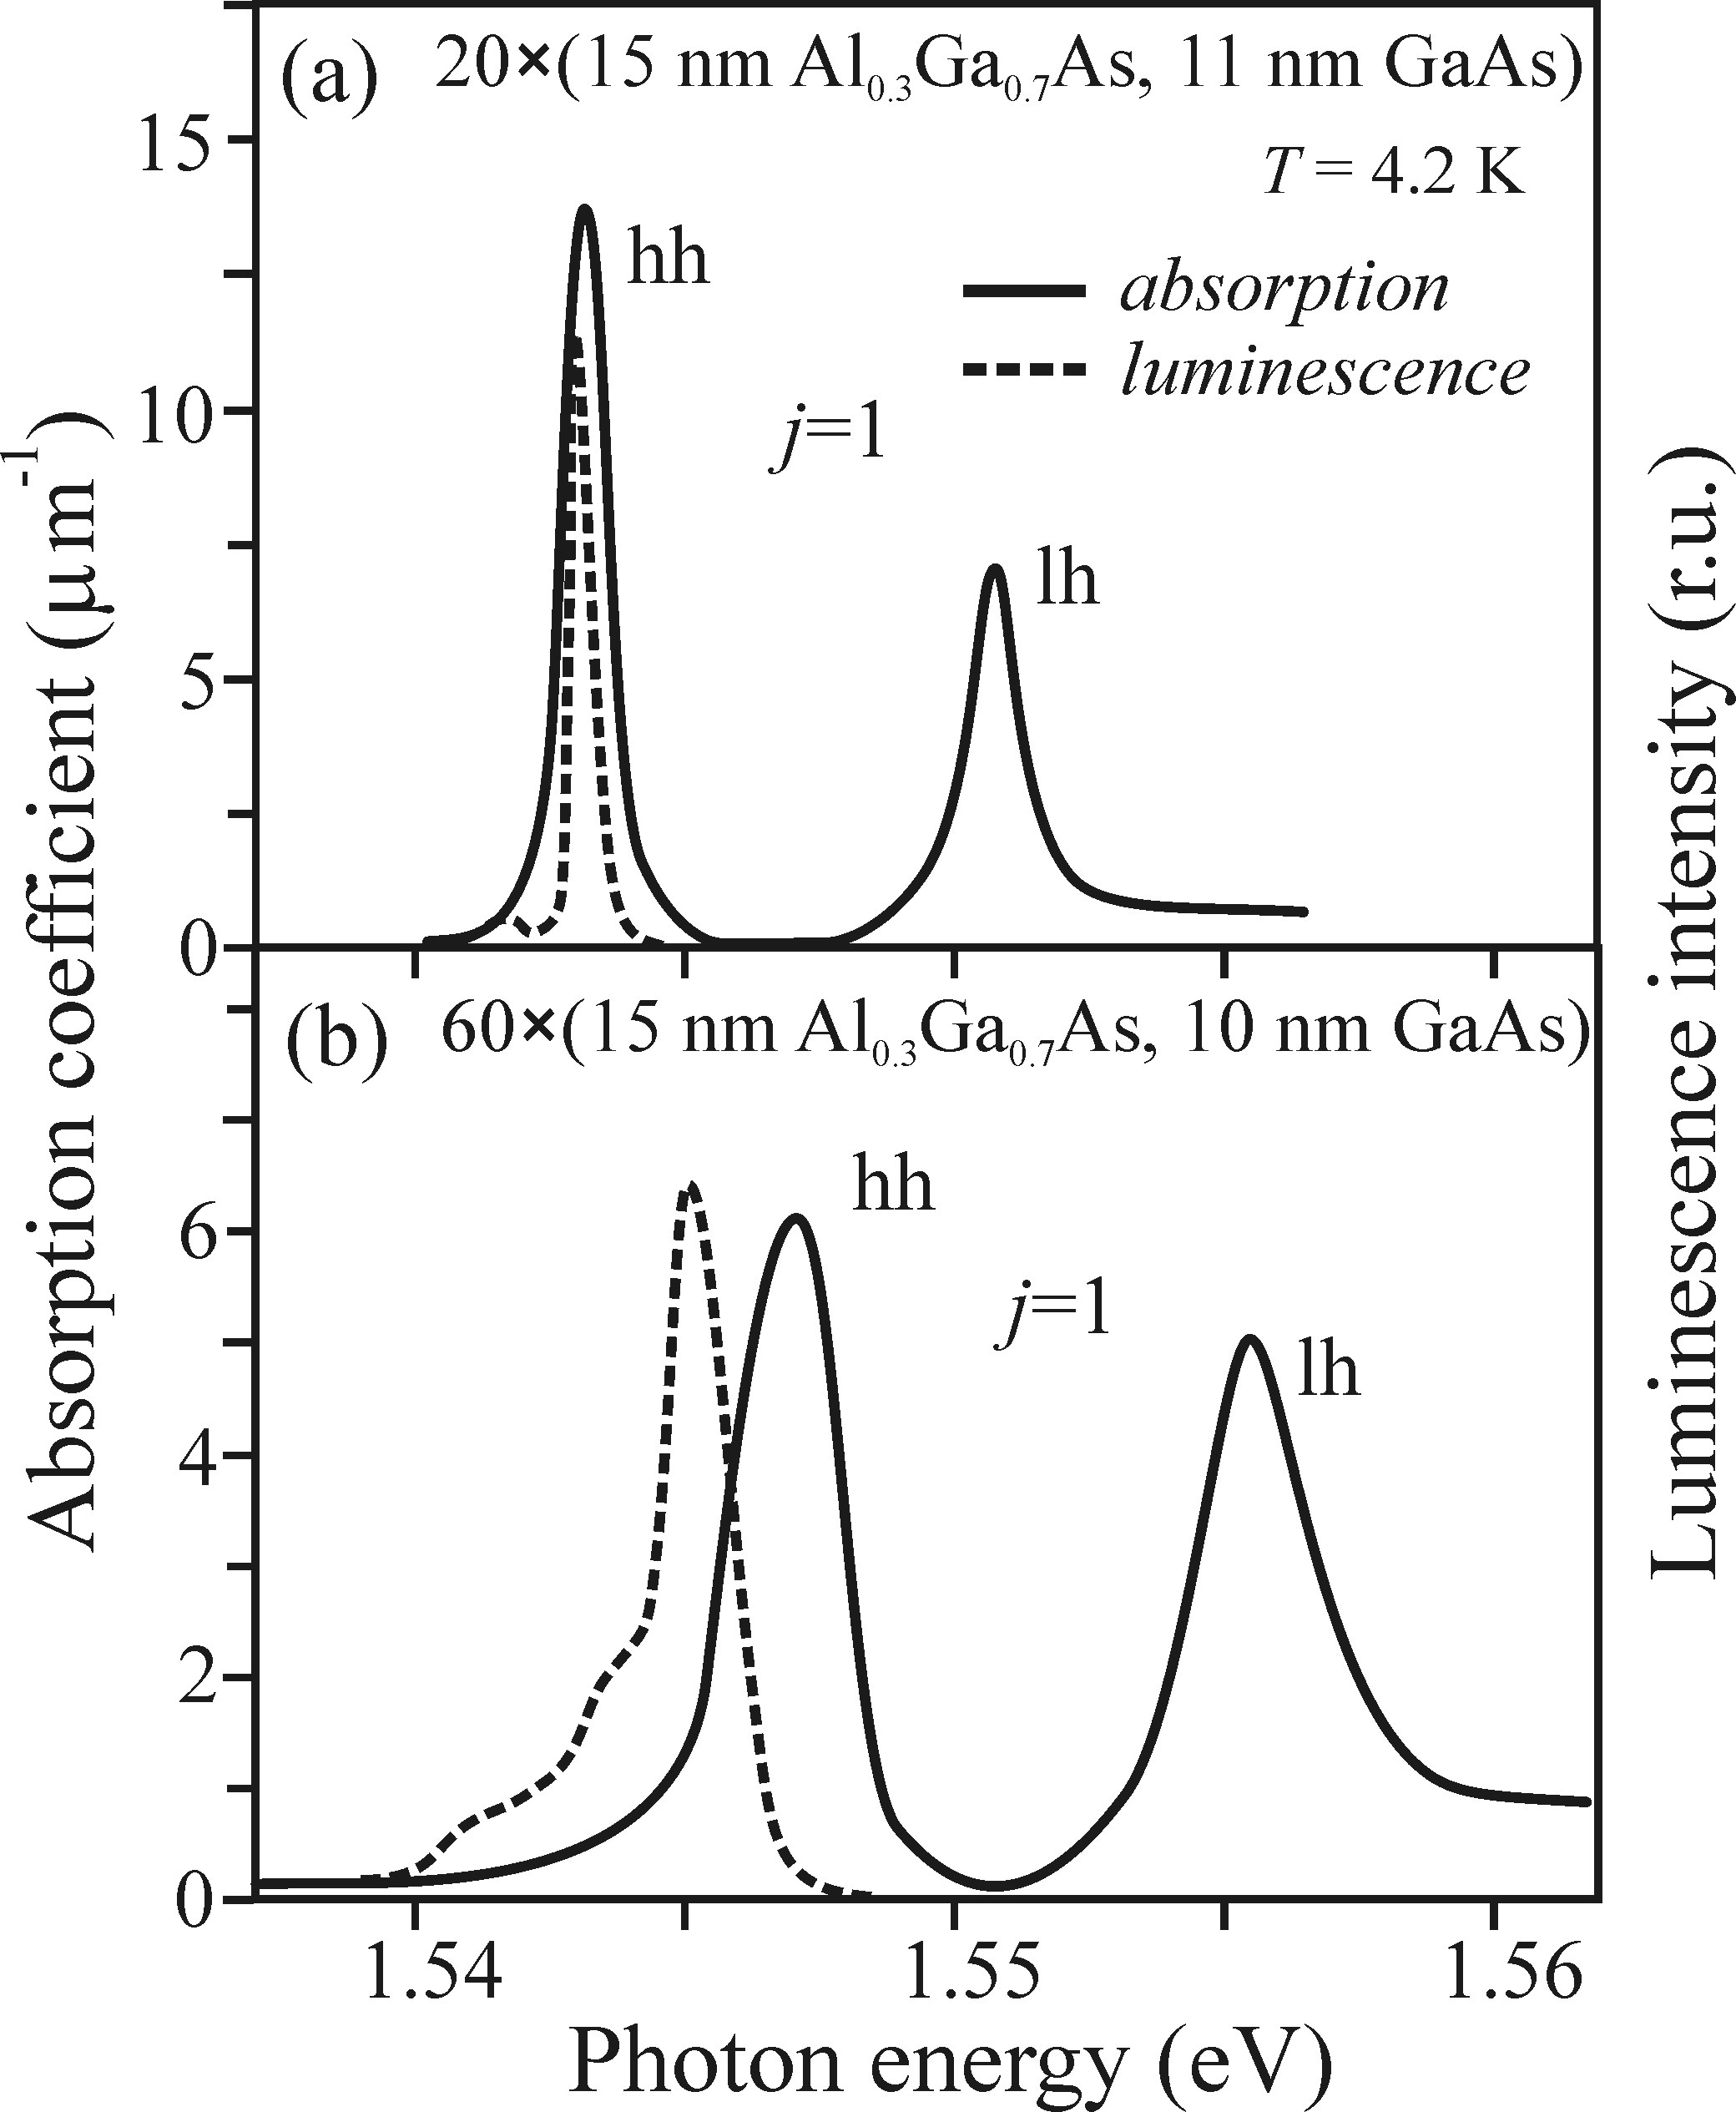
Quantum wells−two-dimensional semiconductors
• Luminescence of quantum well
Luminescence spectra differ from absorption
spectra in several freatures:
Only one single emisiton band, coresponding
to the lowest transition.
The lumineescence peak is generally shifted
to lower energies (Stroke shift) and broden.
Notes:
Only one single emisiton band, coresponding to the lowest transition. This follows from effcient realxation of higher excited states to lowest state.
The lumineescence peak is generally shifted to lower energies (Stroke shift). The reason is energy relaxation. And also it is brodened compared to the absorption range. As the width of the wells are not homogeneous, which cause different confinement strengh, and the local energy levels vary, resulting in a smearing of energy level. And this brodening is expected to be more obvious in a larger ensemble of quantum wells.

Slide 19
Quantum wells−two-dimensional semiconductors
• Luminescence of quantum well
The differences in luminescence properties of a ”free” exciton in a bulk and 2D well structure:
(1) The wavelength of excitonic luminescence from a 2D well, in contrast to 3D crystals, depends on the size of the structure (well thickness).
(2) The ‘free-exciton’ emission linewidth should be more than twice as narrow in a 2D structure compared to a 3D crystal.
(3) Excitonic phenomena are more pronounced and may be observable at higher temperatures (as compared to 3D crystals).
(4) Nonlinear optical phenomena tend to be much stronger and take place for much lower excitation power densities.

Slide 20
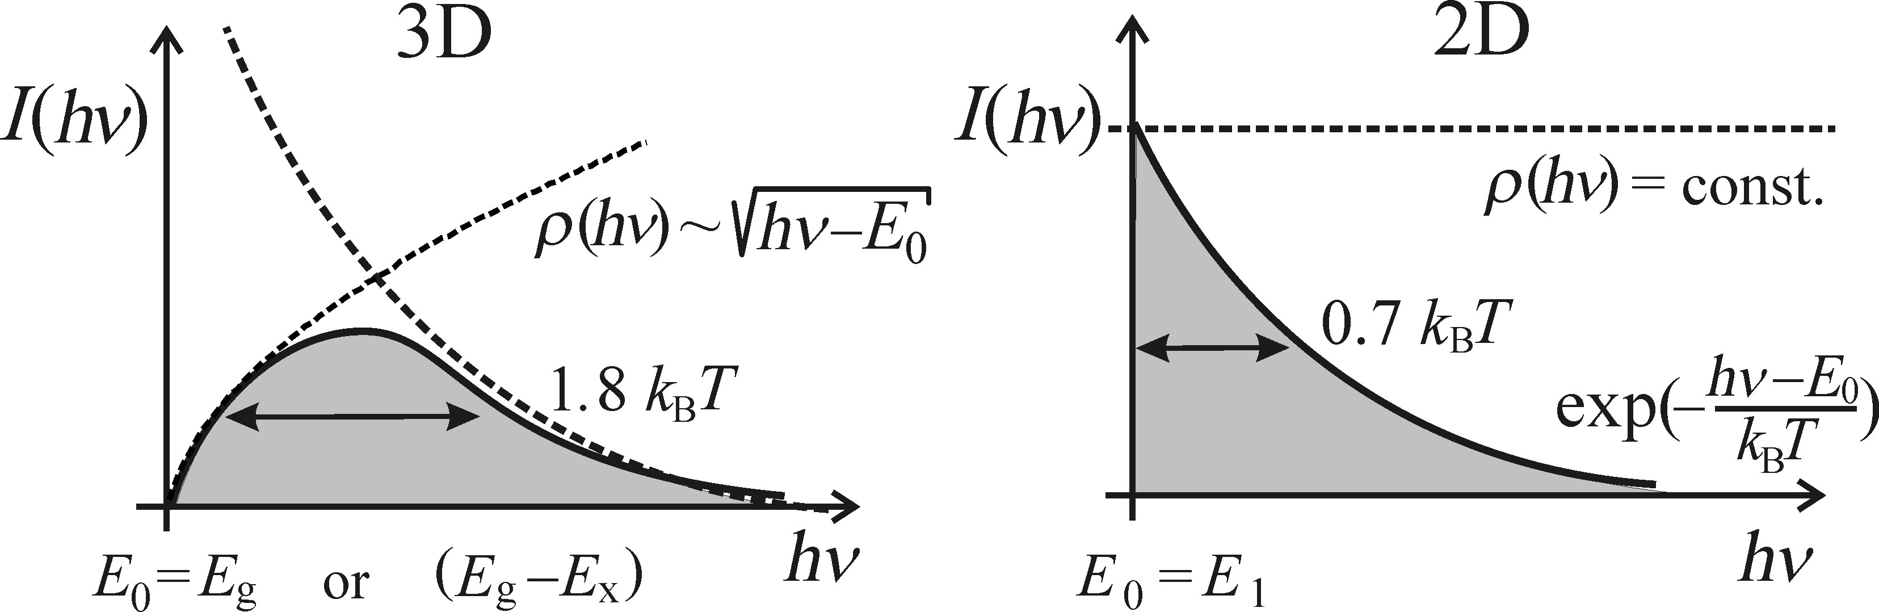
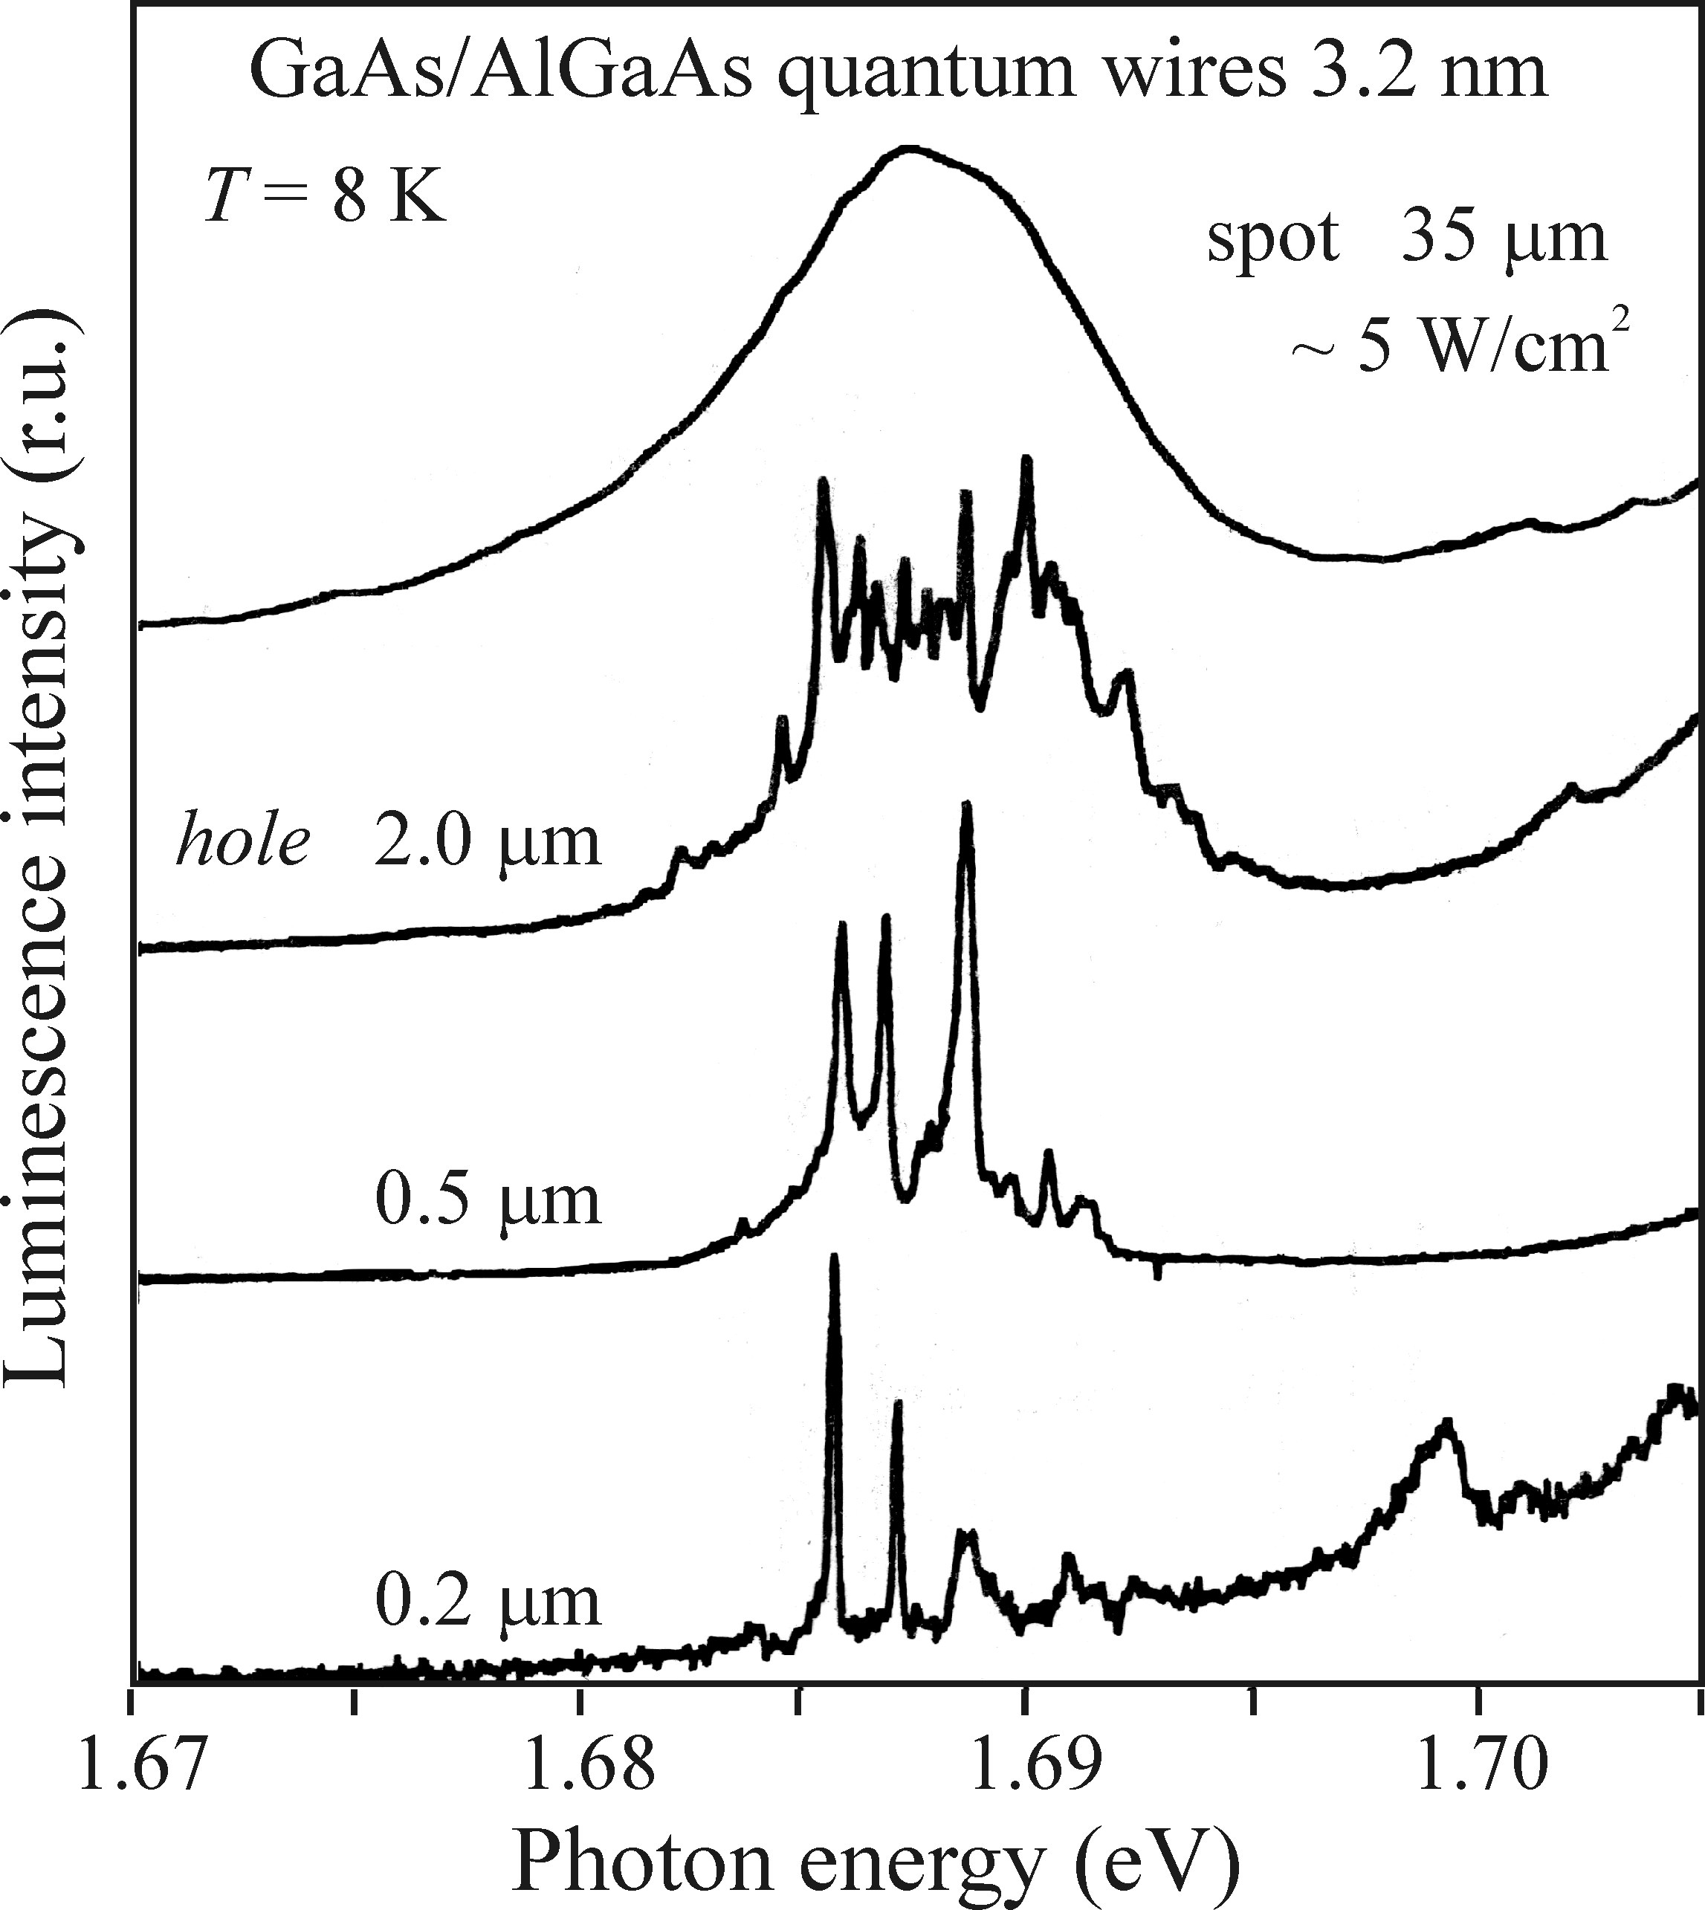
Quantum wells−two-dimensional semiconductors
• Luminescence of quantum well
• Optical transmition in quantum well

Slide 21
Electroluminescence−high-field Electroluminescence
High-field electroluminescence can be divided into three subcategories:
• electroluminescence of powder phosphors (the original discovery by Destriau falls into this category—the phosphor particles were dispersed in a dielectric);
• electroluminescence of thin films (a homogeneous thin layer of a phosphor filling up the space between capacitor plates—electrodes);
• electroluminescence of a reverse-biased p-n junction.
Notes:
High field eelctroluminescens is based on excitaiton of luminescence center by free carriers accerated in a high electric field. Both DC and AC (direct and alternating field)

Slide 22
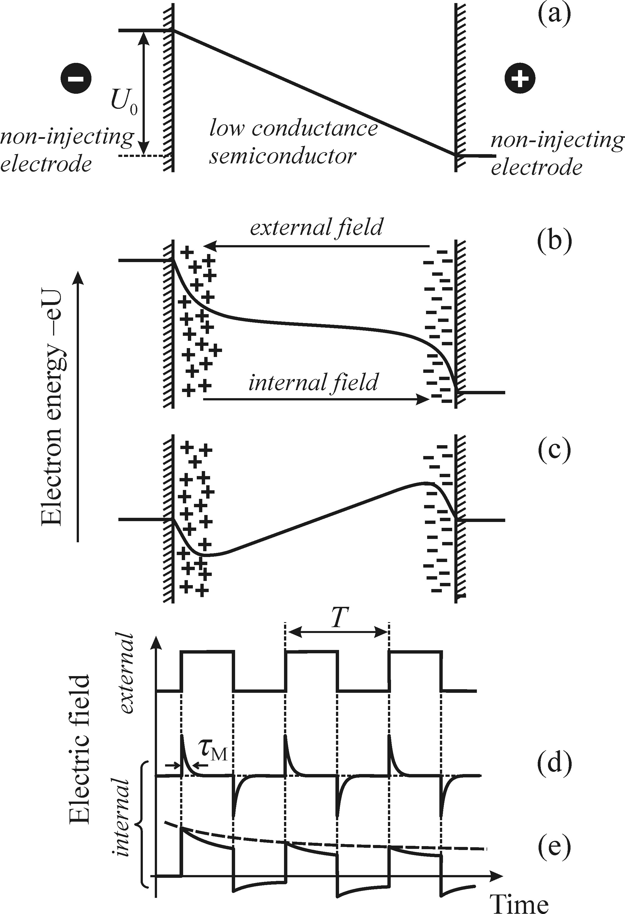
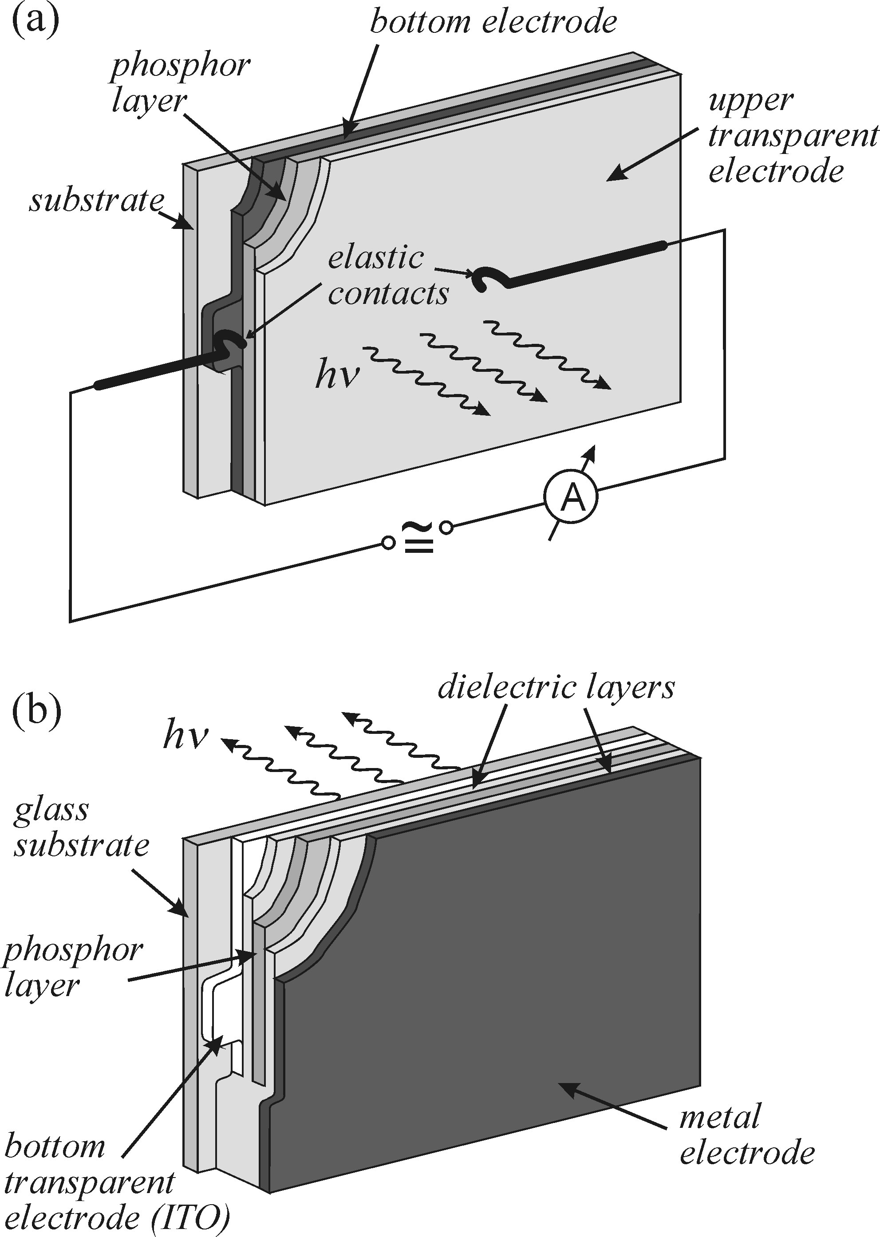

• Experimetnal consideration
Electroluminescence−high-field Electroluminescence
Electrical conductivity:
Notes:
A typical corss section of a sample for high-field electroluminescence measurement. The impact on the electric field distribution of semiconducting phorsohor polarization by free carriers in the case of non-injecting electrodes. (a) spatical contribution of the electron potential energy at the moment of applying an external voltage. Polarization hast not set in yet. There is still a homegeneous electric field distribution. (b) the voltage is switched on, the phosphor becomes polarized after an elapsed time tM (dieelctric realxation time, mean time necessary for an extra volume charge in a insulator or semiconductor to disperse-due to the DC eelctric conductivity, not due to the combination) due to the free carriers displacement and the formation of space charge near the electrodes (c) moment of switching off the voltage. A transient field of opposite polarity decayign with time constant tm. (d)time dependence of the internal electric field under a periodic external pulsed voltage. Tm<< T (e) same as d but tm>>T

Slide 23
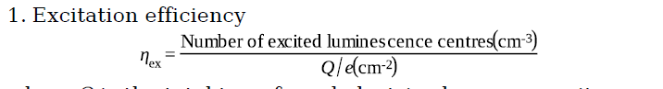
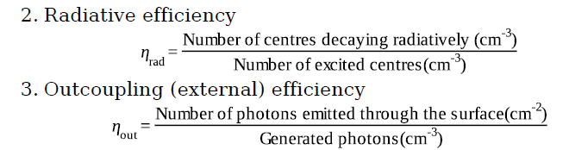
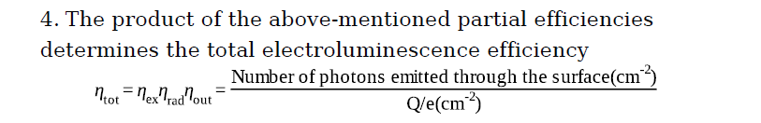
Electroluminescence−high-field Electroluminescence
• The electroluminescence efficiency
Notes:
(3) The number of photons emitted from the surface is limited mainly by the optical transmission of the semitransparent output electrode, total internal reflection and by the surface morphology.

Slide 24
Electroluminescence−high-field Electroluminescence
• Mechanism of high-field electroluminescence
• Impact ionization and excitation
• Generation of free carriers

Slide 25
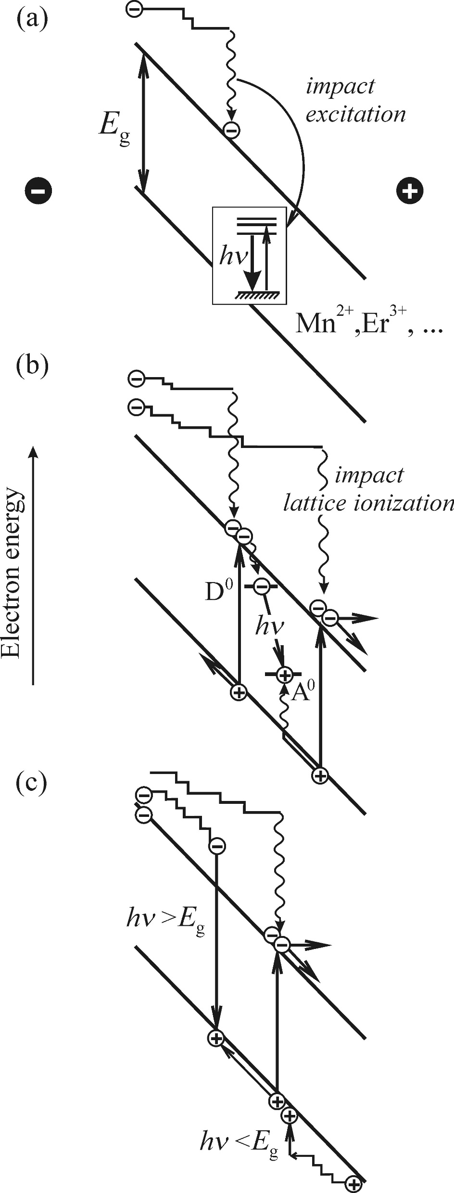

Electroluminescence−high-field Electroluminescence
• Mechanism of high-field electroluminescence
Impact ionization and excitation
Notes:
Typical luminescence centerr are transition metal owiing to the electron transitions bettern levels of not fully occupied 3d shell. A similar role can also be played by bi- and trivalant rare earth ions.
Figure: Possible electroluminescence processes in high fields. (a) Impact excitation of an extrinsic luminescence centre (the transition metals or rare earth type of ions) by an accelerated electron: the most important electroluminescence process in Most common in electroluminescence materal ZnS:Mn. (b) Excitation of a neutral donor–acceptor pair via impact ionization of the lattice. The prerequisite here is that the ionization energy of donor and acceptors is sufficiently high for the impurities to stay in neutral states at room temperature.
(c) Intrinsic electroluminescence process: Impact ionization of the pure semiconductor lattice. With a certain probability, it is possible to detect luminescence photons with energy.
The condition necessary for HF EL is there is free carriers.

Slide 26

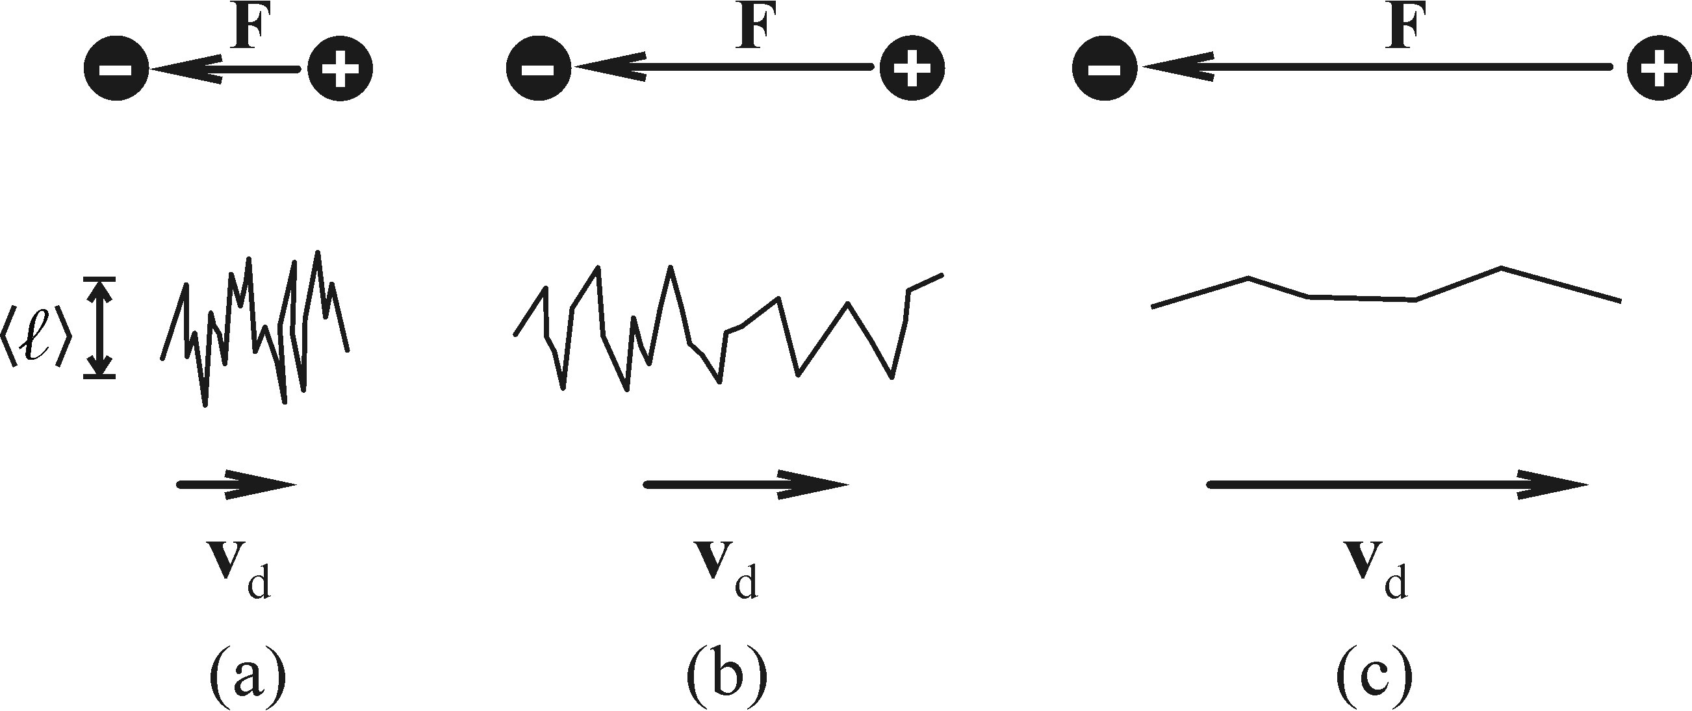





Electroluminescence−high-field Electroluminescence
• Mechanism of high-field electroluminescence
Impact ionization and excitation
Electron travel mean free path
According to Ohm’s law:
Notes:
Hot electron: the Tef, participating in the energy distribution function of the electrons, is much higher than the lattice temT. Hot electron is with energy higher than the radiation emitted photon.
In week fields F, the statistical energy distribution of the electrons at the bottom of the conduction is described by the Boltzmann distribution. Under these condition (low concentration, high temperature), free path is . Tm, is the mean time between collisions due to electron scattering and vt is the mean velocity of the thermal motion. The electrnic field affects the equilibrium distribution of velocity only as a small perturbation. The drfit velocity of electrons vd in the field direction is much smaller than vt.
is the electrical conductivity, n stands for the electron concentration. Un is the mobility (迁移率).
Then increase F, vT incrrease. Start from a certain field F0, the electons start to feel a accelerating pull of the eletrci field and along their free length, and mean velocity between collisions Vt’ arise. Vd rise. As long as the energy is not too high, still remain the machnism remains the scattering on acoustic phonons. Mean free length remains constant. Then tm decrease and mobility un.

Slide 27
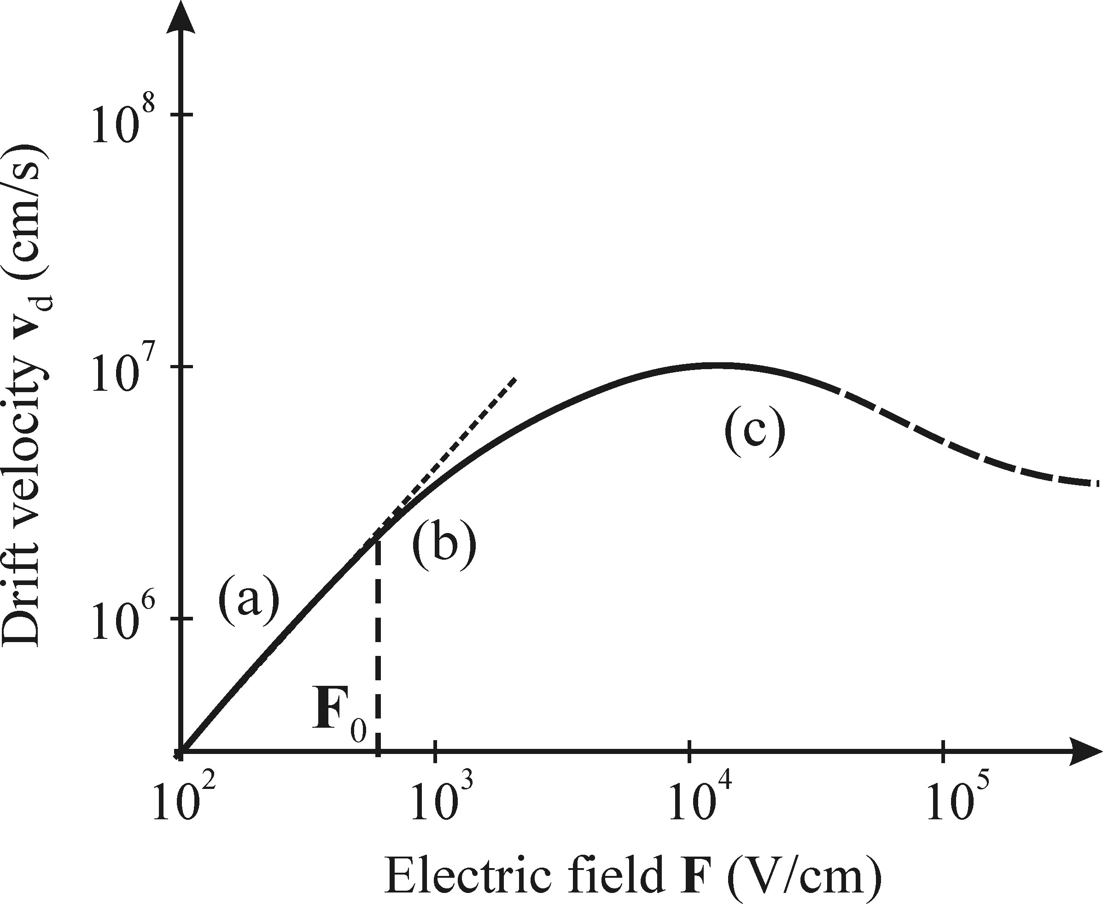
Electroluminescence−high-field Electroluminescence
• Mechanism of high-field electroluminescence
Impact ionization and excitation
Notes:
Further increase the electric field, once the free electron energy becomes comparable with the energy of the optical vibrations hwo, the generation of optical phonons becomes the previaling mechanism of electron scattering. Since wo is rather high, the electron lost almost all its energy duing the collsion or inelastic scatering. Therfore, a further incrase in vd with increasing F isnow slow and approaches saturation. Only a very small number of hot electrons manage to retain an energy exceeding hwo.

Slide 28
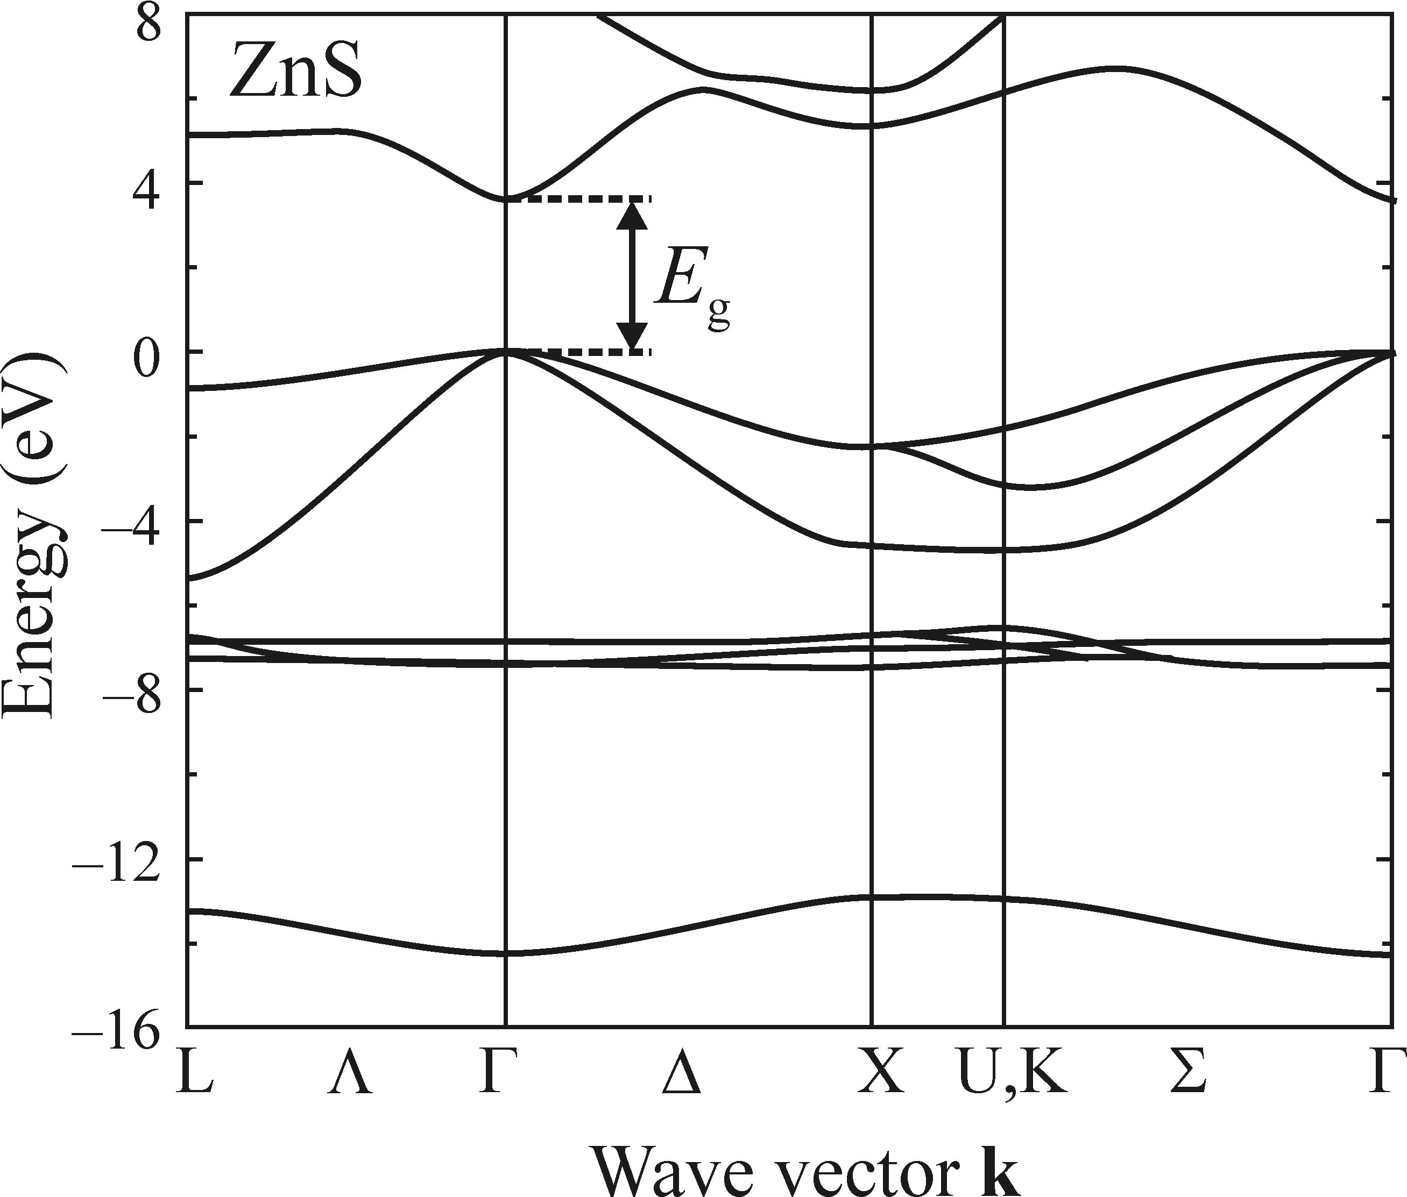

Electroluminescence−high-field Electroluminescence
• Mechanism of high-field electroluminescence
Impact ionization and excitation
Notes:
Negative differantial conductivity, arising from transitions of the accerated electrons from the abolute minimum of the conduction band at the T(0,0,0) to a higher-situated minimum with smaller band curvature and thus higher effective mass, at some point in the first Brillouin zone. The energy seperation between the minima is higher than KBT but smalle than bandgap width Eg, otherwise elecron-hole pair generation will happen by impact ionization. Whether this transfer is of any importance of electrolmn process is quantitatively descibed by impact excitaion cross-section:
Ege is the energy loss of electrons corresponding to the excitation of luminesence center from ground to excited state. A heavy mass me and low velocity vd in the side valleys leas to the increase in σim.

Slide 29
Electroluminescence−high-field Electroluminescence
• Mechanism of high-field electroluminescence
Generation of free carriers
• Injection of majority carriers from electrodes
• Relase of carriers from deep traps.
• Release of carriers from traps on the boundary between a dielectric and a phosphor
Notes:
Mechanism of free carrier generation for impact excitation of luminescence:

Slide 30
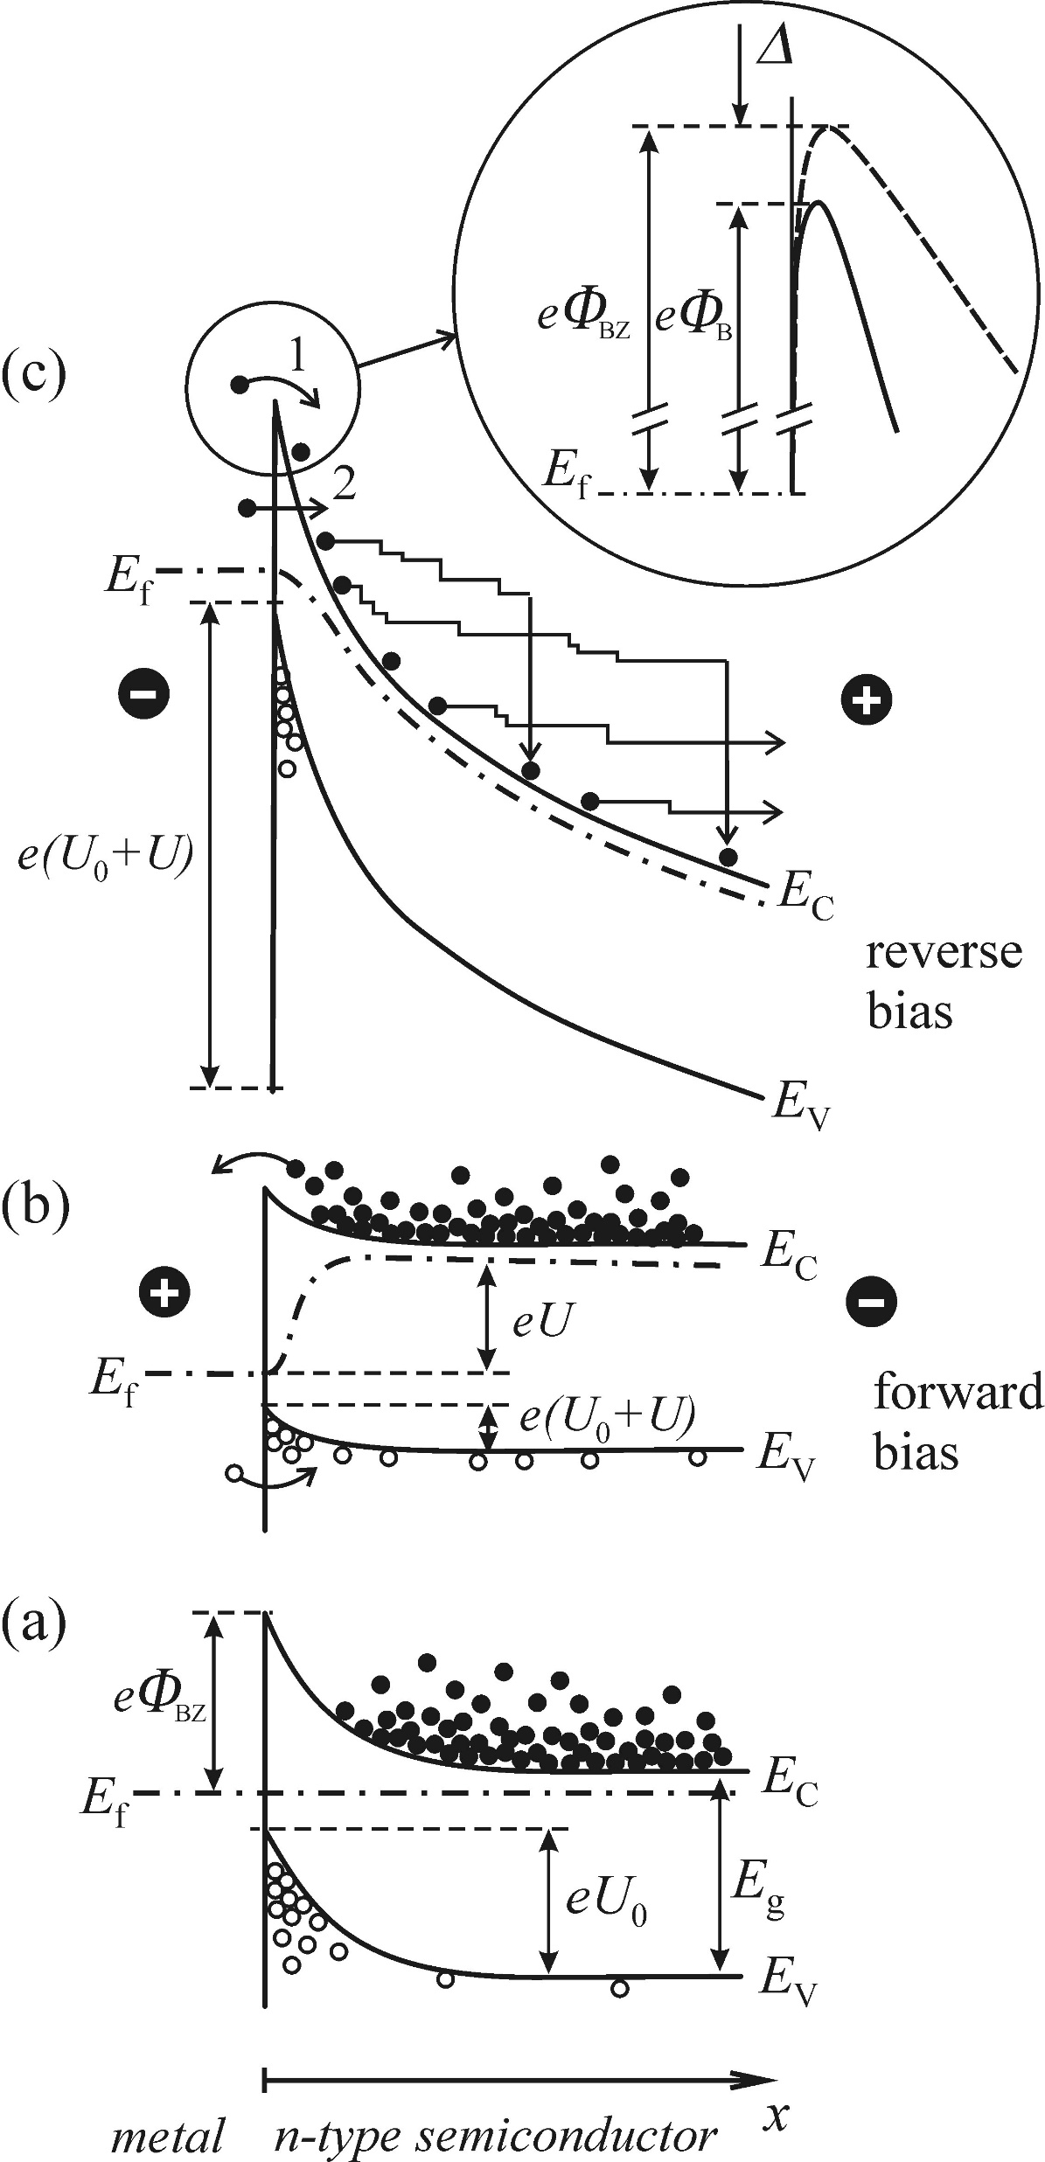

Electroluminescence−high-field Electroluminescence
• Mechanism of high-field electroluminescence
Generation of free carriers: Injection of majority carriers from electrodes
electroluminescence
Notes:
A disturbance of the equilibrium space distribution of carriers by a local increase of their concentration beneath the surface, or at the inerface.
(a) Stady state without any external bias with a build in potential barrier. (b) Bias U applied in the forward direction. Minority carriers are injected into the semconductor. (c) Bias U applied in the reverse direction, majority carriers are injected in through thermally across the lowered barrier or tunnelling. In case c, the electron injection current density is
εs is the dieelctric constant of the semiconductor. The current density increases exponetianlly with the square root of the applied bias U= Fd.

Slide 31
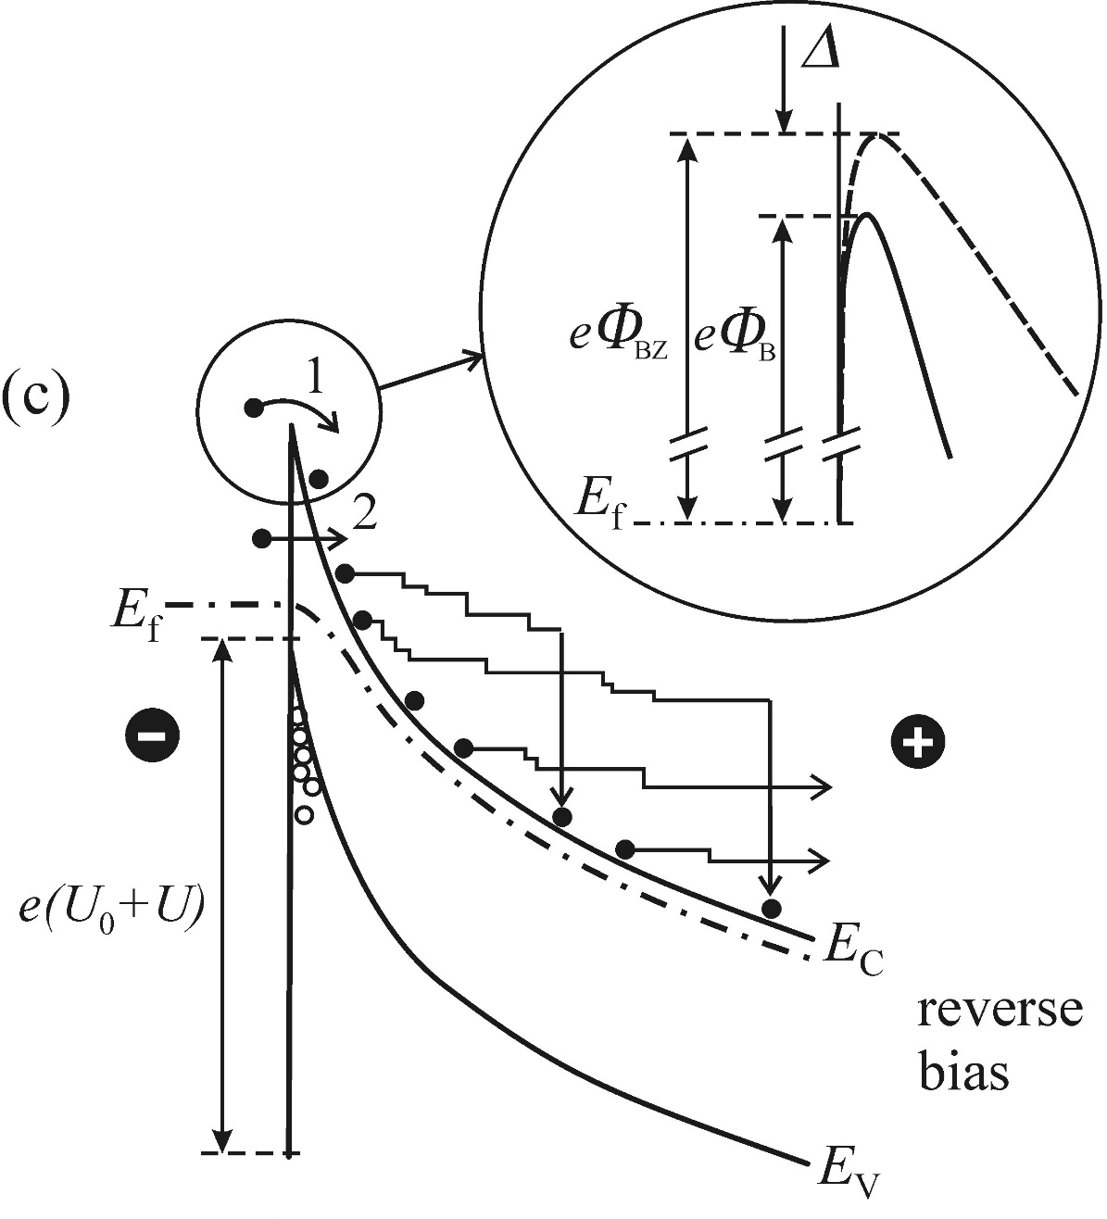
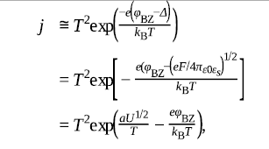
Electroluminescence−high-field Electroluminescence
• Mechanism of high-field electroluminescence
Generation of free carriers: Injection of majority carriers from electrodes
• Arrow 1 : Schottky effect
• Arrow 2 : Fowler-Nordheim tunnelling
Notes:
The impact of field F: sustain the stability of the electron concentration and play a role in impact excitation of lM center by accerating electrons

Slide 32
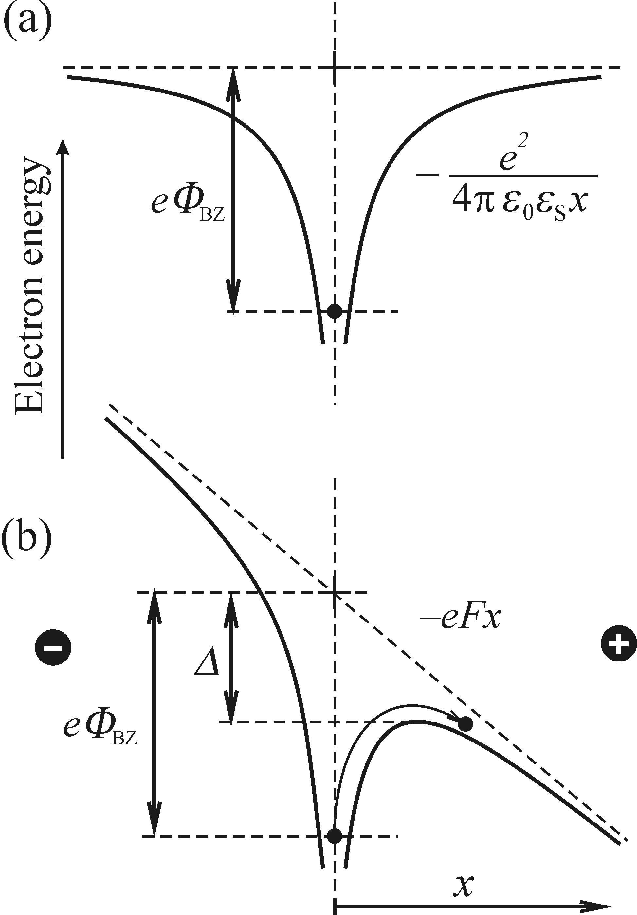
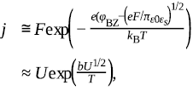

Electroluminescence−high-field Electroluminescence
• Mechanism of high-field electroluminescence
Generation of free carriers: Release of carriers from deep traps.
• Poole-Frenkel effect
• Tunnelling
Notes:
Lattice defect in semiconductors act as deep traps (potential well) for charge carriers. And electrons are trapped by the potenial. After applying of an electric field, the potenial of the well is decreased. This leads to the thermal realease of trapped electrons into the conduction band. And the current density is. Moreover, the electron can be injected rom the trap into the conduction band via direct tunnelling thorugh narrowed barrier.

Slide 33
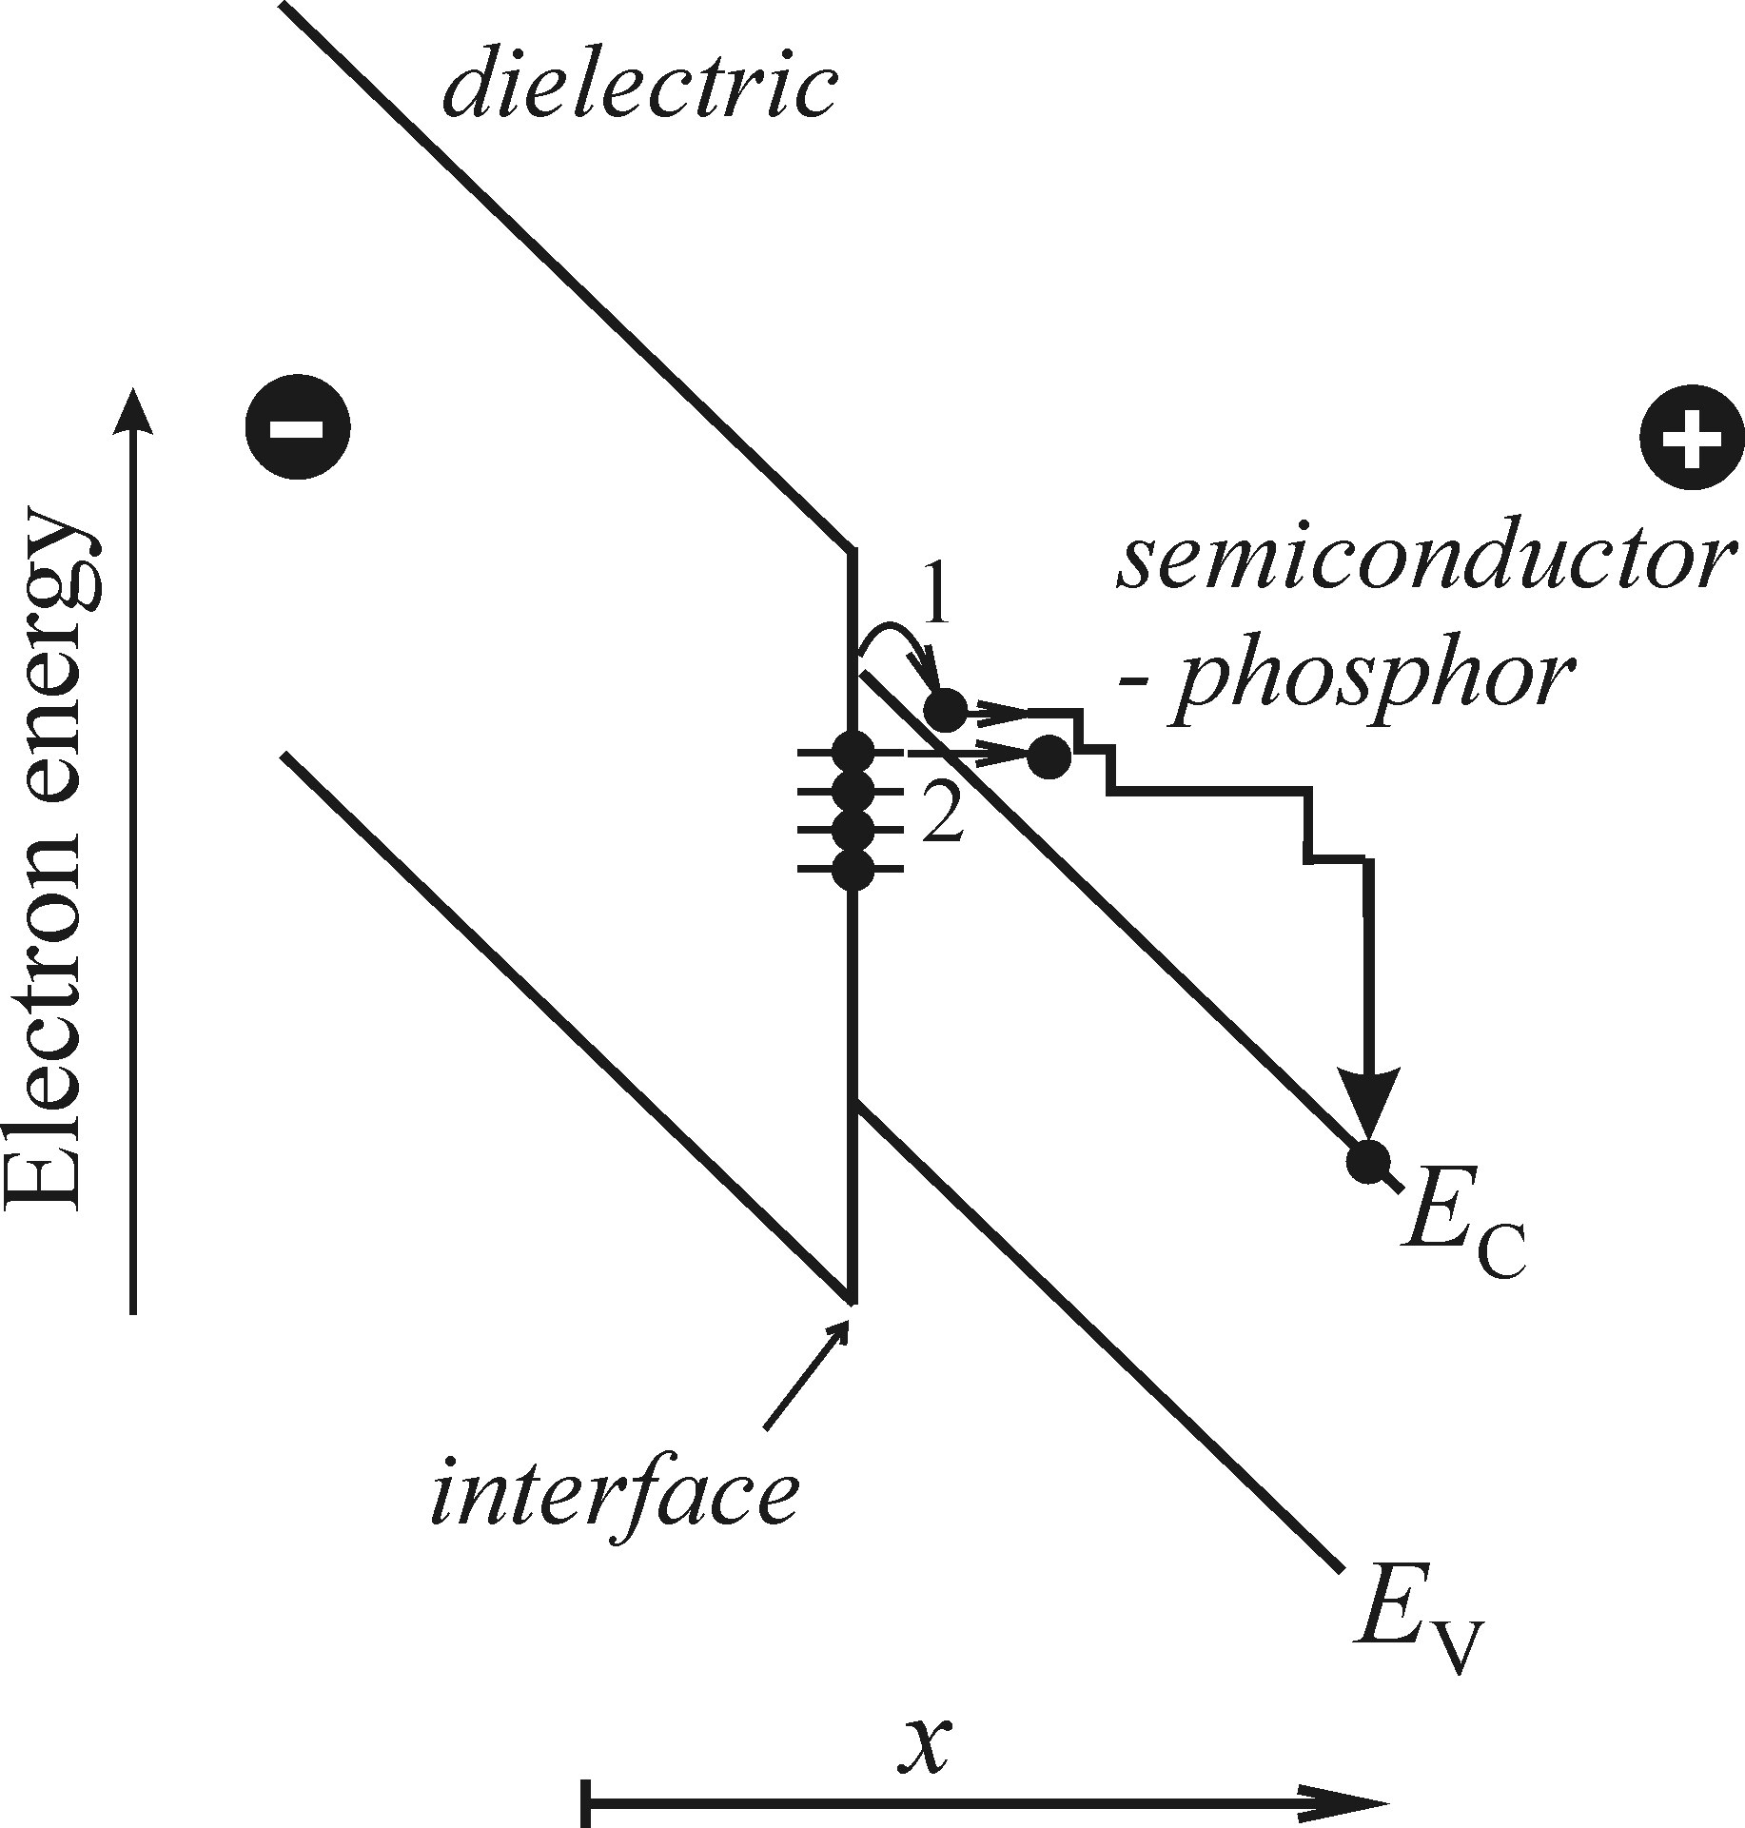
Electroluminescence−high-field Electroluminescence
• Mechanism of high-field electroluminescence
Generation of free carriers: Release of carriers from traps on the boundary between dielectric and a phosphor.
Notes:
If a semiconductor phosphor is in contact with an insulator and lattice defects are formed at the interface. The coresponding electronic states are localized withing the forbidden field, electrons captured in these traps can be injected into the conduction band via thermally as Poole-Frenkel effect or tunnelling.

Slide 34


Electroluminescence−high-field Electroluminescence
• Intenity, spectral and temporal characteristics
Notes:
Figure left, the dependence of the high-field electroluminescence brightness B on the applied voltage U for three different mechanisms.the inset shows the same curves in a different way to make it sepreatable. This can be used to identify the ELM mecahnism. Middle figure is an example of if you plot the curves in the linear scale, it is hard to tell the mechanism when these happens simultaneously. But if we plot in the logarithmic scale, like right figure, then we can identify the mencahnism.

Slide 35

Electroluminescence−Injection electroluminescence
Radiative recombination induced by the injection of minority carriers into a semiconductor p-n junction.
Notes:
The energy band scheme of a semiconductor p-n junction is depicted in Fig. If the p and n doped semiconductor contact, the diffusion of electrons from n region to p region as well as the diffusion of holes from p region to n region occur and recombiantion occured. An electric filed, preventing the further diffusion of carriers arise in the middle narrow region where is close to the interface. Asteady state is reached. When a voltage U is applied. Minority injection happened to both sides and the radiatively recombine with the majority.

Slide 36




• Electrical properties of a p-n junction
Electroluminescence−Injection electroluminescence
Reverse bias: majjority injection
Forward Bias: minority injection
Notes:
Ud is the diffusion voltage in the depletion layer. Nd, Na are the free electron and hole concentration when fully ionized. ni is the intrinsic carrier concentration without dopant. Dn and Dp stands for the diffusion coefficient of electrons or holes, tn and tp represents the life time of electrons and holes as minority carrieres. Js is called the saturation current.

Slide 37


• Electrical properties of a p-n junction
Electroluminescence−Injection electroluminescence
Reverse bias: majority injection
eU/k_{B}t << 1
Notes:
Ud is the diffusion voltage in the depletion layer. Nd, Na are the free electron and hole concentration when fully ionized. ni is the intrinsic carrier concentration without dopant. Dn and Dp stands for the diffusion coefficient of electrons or holes, tn and tp represents the life time of electrons and holes as minority carrieres. Js is called the saturation current. Js is dependent on the number of holes recombing per second, therefore, in steady state it means the rate of thermal genreation of holes. Holes genrate in this way diffuse from their birth place and combine after traveling a mean distance Lp. Consequaently, the electrons in n region do not contribute to the current.only those generated in s distance shorter than Lp from the depletion layer contribute to the current. So the curent is decided by the diffusion length and lifetime of minority carriers.

Slide 38




Electroluminescence−Injection electroluminescence
• Electrical properties of a p-n junction
If U>>k_{B}T
When current edges of conduction and valance bands begin to equalize on both side .
Notes:
This means the current does not occur until it reaches UD. UD is called threshold bias. With highly doped semiconductor, Ec-Efn and Efp-Ev are negligible. And then

Slide 39

Electroluminescence−Injection electroluminescence
• Intensity, spectral and temporal characteristics of LEDs
Intensity

Slide 40


Electroluminescence−Injection electroluminescence
• Intensity, spectral and temporal characteristics of LEDs
Spectral
Notes:
Totaly external efficiency of injection electroluminescence in GaAs1-xPx as a fuction of x.

Slide 41


Electroluminescence−Injection electroluminescence
• Intensity, spectral and temporal characteristics of LEDs
Temporal characteristics
Notes:
Radiative interband recombination of majority and minority carriers injected into a semiconductor p-n juction. YAG works as a yellow luminescence, and work with blue GaInN to convertto white light. The speeds of the rise and decay of electroluminescence are very important parameters.

Slide 42


Electroluminescence−Injection electroluminescence
• Intensity, spectral and temporal characteristics of LEDs
Temporal characteristics
Notes:
The rise and decay under an pulsed excitation can be descirbed as. Lower figure: an example of frequency responce of an LED diode.

Slide 43





Electroluminescence−Injection electroluminescence
• Intensity, spectral and temporal characteristics of LEDs

Slide 44


Electroluminescence− Electroluminescence of a p-n junction biased in the reverse direction
Notes:
Elm spectrum of a silicon p-n junction, biased in the reverse direction at room temperture. Figure right, the light emission in a reverse biased p-n junction. (a) the current- voltage characterize (b) energy band cheme which demonstrates current amplilficatoin due to impact ionization and depicts rediative recombination of an e-h pair. When U is big enough, the accerated electron or hole ionizes the lattice, a free e-h pair is created and an avalanche-like increase in the number of free carriers occurs. The current is increasing substantially. As the total number of carrers involved in this process is low, the device is not destroyed. E-h pairs with substantial excess energy gained by the acceration can recombine radiaticely. Luminescence is believed to be ceated by band-to-band recombiantion of hot e-h pairs.

