Slide 1

Low-dimensional structures II:
Quantum wires and dots
Electron-hole plasma and lasing
Katharina Zeuner
Based on I. Pelant & J. Valenta
ˈLuminescence Spectroscopy of Semiconductorsˈ
Chapters 12-14, pp. 359-420

Slide 2
Table of contents
Luminescence of low-dimensional structures
  Quantum wires
  Quantum dots
  Exciton-phonon bottleneck
  Special phenomena
High excitation in low-dimensional structures
  Excitonic molecule, trion in a quantum well
  Collisions of free excitons in a quantum well
  Electron–hole plasma (EHP) and electron–hole liquid (EHL) in 2D and 1D structures
  Effects of high excitation in quantum dots (nanocrystals)
Stimulated emission in low-dimensional structures
  Stimulated emission in quantum wells, wires, nanocrystals
  Random lasing

Slide 3
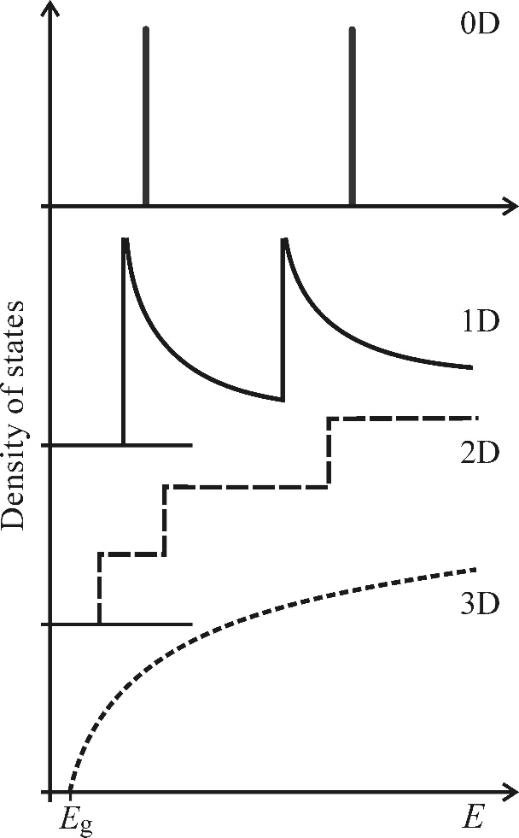
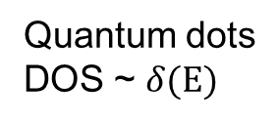
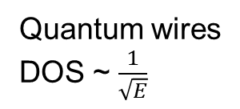
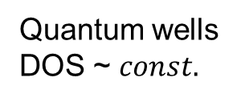
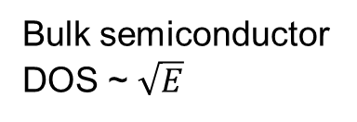
Reminder: DOS in low-dimensional structures
Quantum dots
DOS ~ $δ(E)$
Quantum wires
DOS ~ $\frac{1}{\sqrt{E}}$
Quantum wells
DOS ~ $const.$
Bulk semiconductor
DOS ~ $\sqrt{E}$
Notes:
Reminder to last week: going from bulk semiconductor to low-dimensional structure changes density of state

Slide 4
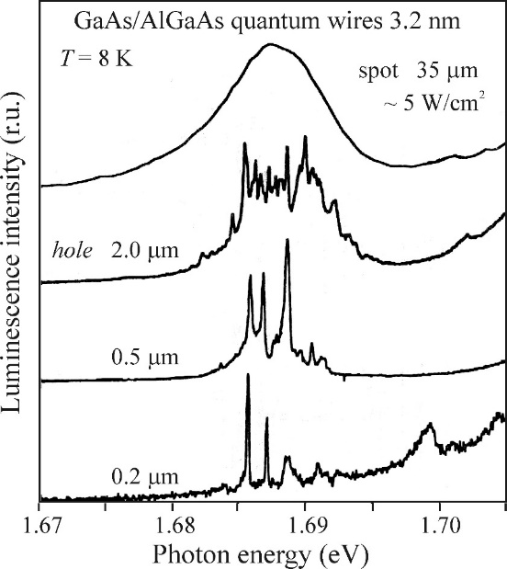
Quantum wires
Confinement of carriers in two dimensions
Lateral dimensions: ~10nm
Fabrication via etching or
bottom-up growth
Typical properties due to
density of states (DOS)
1D
3D
2D
0D
Notes:
Motion of electrons and holes is confine in two dimensions
Spectra recorded for different opening sizes of non-transparent masks covering the wires

Slide 5
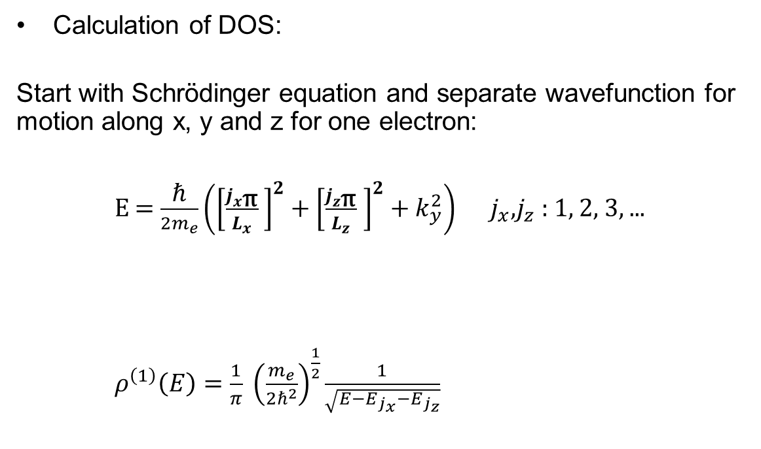
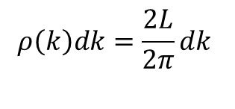
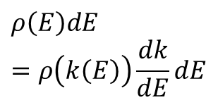


Quantum wires – Density of states
x
z
Calculation of DOS:
Start with Schrödinger equation and separate wavefunction for motion along x, y and z for one electron:
E = $\frac{\text{ℏ}}{2m_{e}}\left({\left[\frac{j_{x\text{π}}}{L_{x}} \right]}^{2}+{\left[\frac{j_{z\text{π}}}{L_{z}} \right]}^{2}+k_{y}^{2}\right)$ $j_{x}$,$j_{z}$ : 1, 2, 3, ...
$ρ^{\left(1\right)}\left(E\right)=\frac{1}{π} {\left(\frac{m_{e}}{2ℏ^{2}}\right)}^{\frac{1}{2}}\frac{1}{\sqrt{E−E_{j_{x}}−E_{j_{z}}}}$
y
$$L_{x}$$
$$L_{z}$$
$$ρ\left(k\right)dk=\frac{2L}{2π}dk$$
$$ρ\left(E\right)dE=ρ\left(k\left(E\right)\right)\frac{dk}{dE}dE$$
Notes:
Energy is quantized in x and z direction, in y-direction: still like bulk seminconductor
Important, when going from energy space to k-space we need to include the partial derivative

Slide 6
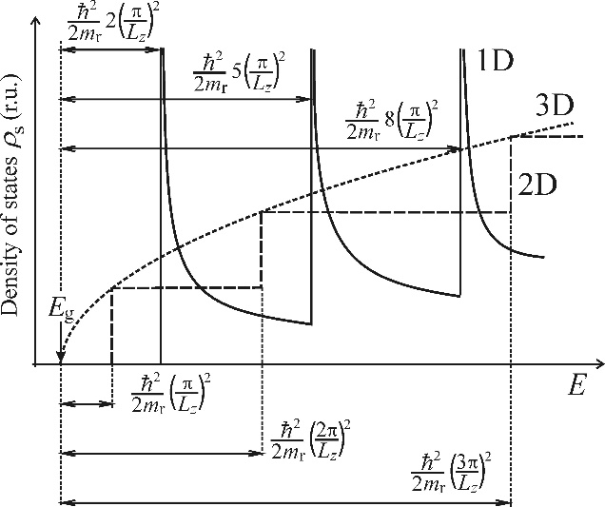
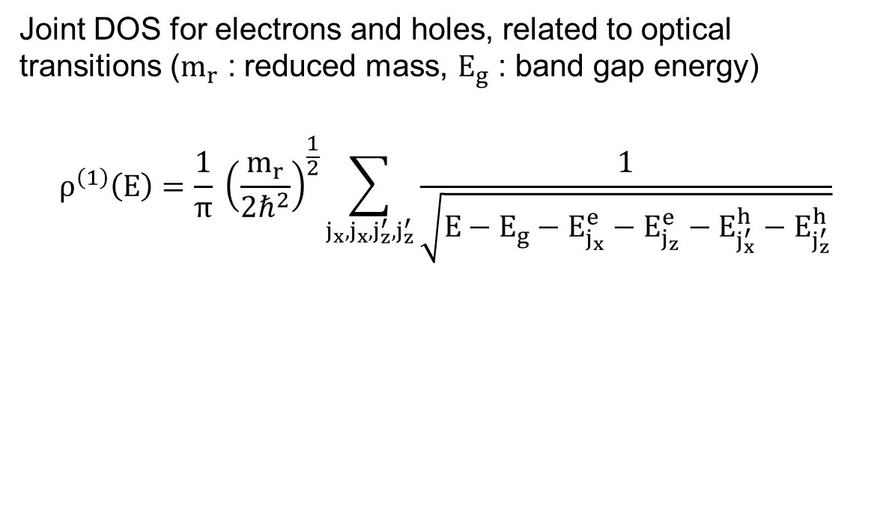
Quantum wires – Density of states
Joint DOS for electrons and holes, related to optical transitions ($m_{r}$ : reduced mass, $E_{g}$ : band gap energy)
$$ρ^{\left(1\right)}\left(E\right)=\frac{1}{π} {\left(\frac{m_{r}}{2ℏ^{2}}\right)}^{\frac{1}{2}}\sum_{j_{x}, j_{x}, j_{z}^{′}, j_{z}^{′}}{\frac{1}{\sqrt{E−E_{g}−E_{j_{x}}^{e}−E_{j_{z}}^{e}−E_{j_{x}^{′}}^{h}−E_{j_{z}^{′}}^{h}}}}$$
Energy shift when going from 3D to 1D due to squeezed wavefunction
Notes:
Joint DOS: determines the number of electronic states in CB and VB, similar structure, but not, summation over all allowed pairs of quantum numbers jx and jz

Slide 7
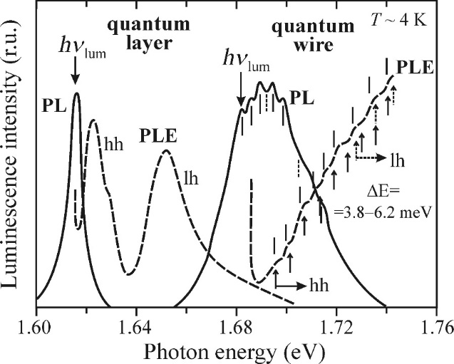
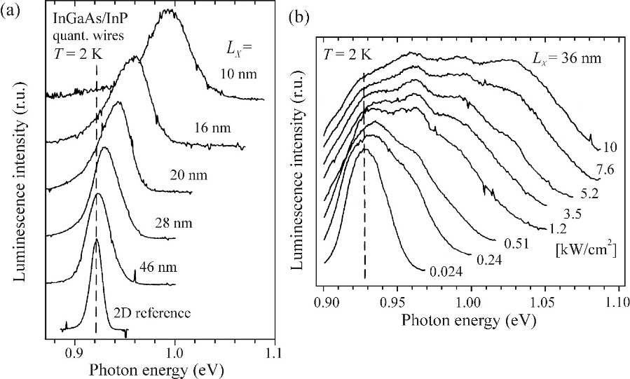
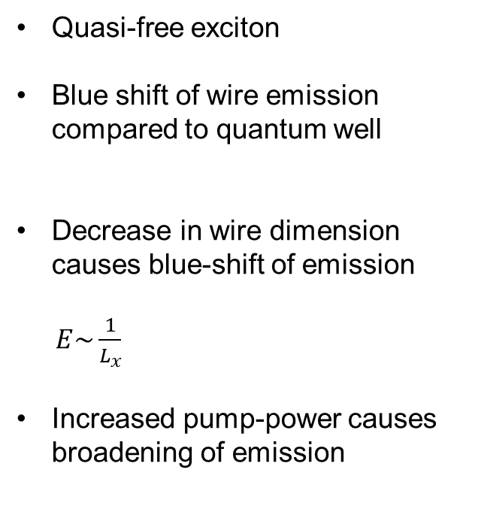
Quantum wires – Luminescence
Quasi-free exciton
Blue shift of wire emission compared to quantum well
Decrease in wire dimension causes blue-shift of emission
$E\sim \frac{1}{L_{x}}$
Increased pump-power causes broadening of emission
Notes:
Free exciton: can move freely in 1D (along the wire)
Singularities in DOS are not observed in absorption spectrum
Wire blueshift compared to quantum well, difference in shape: „fine-structure“ modulation of the emission via density of states
Small distance between maxima: relatively week confinement in one direction (x or z)
In both cases splitting of heavy and light hole band
Broadening reflects pauli principle

Slide 8
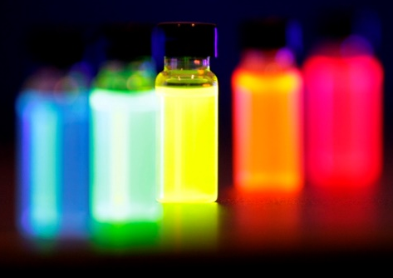
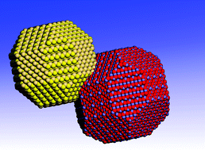
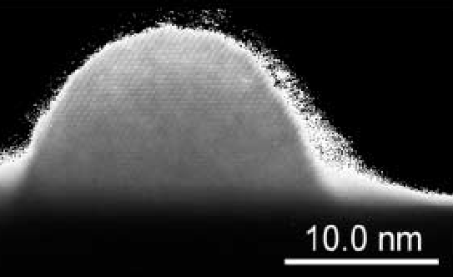
Quantum dots (QDs)
Quasizero dimensional structures or ‘artifical atoms‘
QDs
Nano
crystals
vs
Pyramidal or hemispherical shape
Self-assembled on planar substrate
Quantum confinement!
Close to spherical shape
Homogeneously dispersed in liquid or solid matrix
[1]
[2]
[3]
[1] P. Michler: Single Quantum dots, Springer
[2] https://commons.wikimedia.org/wiki/File:EFluor_Nanocrystal_Vials.jpg
[3] http://pubs.rsc.org/en/content/articlelanding/2006/cs/b517790c#!divAbstract
Notes:
Nanocrystals now in „quantum dot“ displays

Slide 9
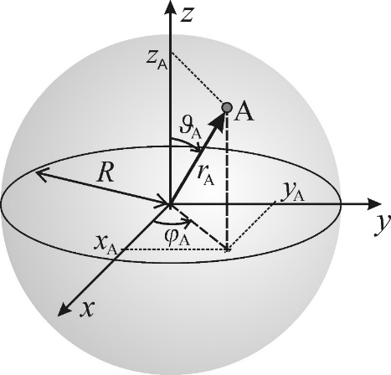
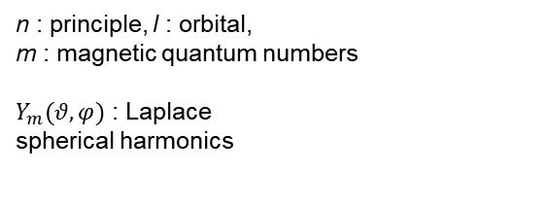
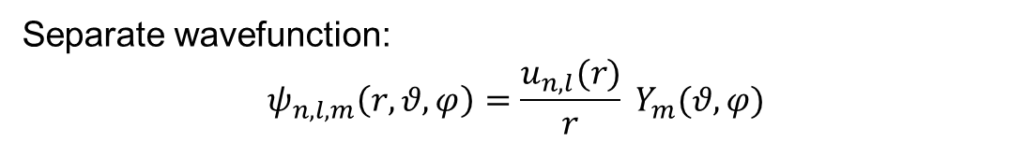
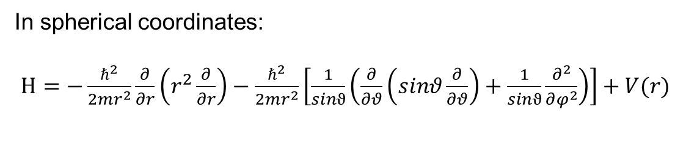
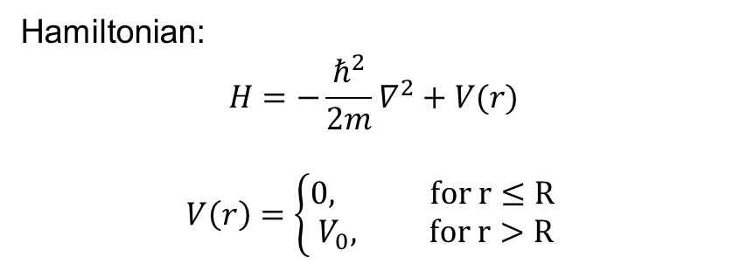
Quantum dots – Energy levels
Hamiltonian:
$$H=−\frac{ℏ^{2}}{2m}∇^{2}+V(r)$$
$$V\left(r\right)=\left\{\begin{aligned}0, for r≤R \\ V_{0}, for r>R\end{aligned}\right.$$
Spherical potential
In spherical coordinates:
$H=−\frac{ℏ^{2}}{2mr^{2}}\frac{∂}{∂r}\left(r^{2}\frac{∂}{∂r}\right)−\frac{ℏ^{2}}{2mr^{2}}\left[\frac{1}{sinϑ}\left(\frac{∂}{∂θ}\left(sinθ\frac{∂}{∂θ}\right)+\frac{1}{sinϑ}\frac{∂^{2}}{∂φ^{2}}\right)\right]+V(r)$
Separate wavefunction:
$$ψ_{n,l, m}\left(r, θ, φ\right)=\frac{u_{n,l}(r)}{r} Y_{m}(θ,φ)$$
n : principle, l : orbital,
m : magnetic quantum numbers
$Y_{m}(θ,φ)$ : Laplace
spherical harmonics
Notes:
Assume a QD with radius R, describe quantum confinement in all directions via spherically symmetric potential
Use symmetry to simplify the problem: go to spherical coordinated, wavefunction can be separated in functions of the individual variables.

Slide 10
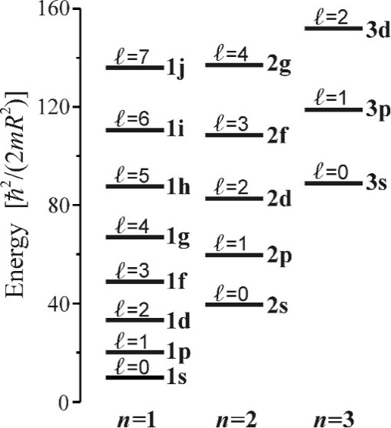
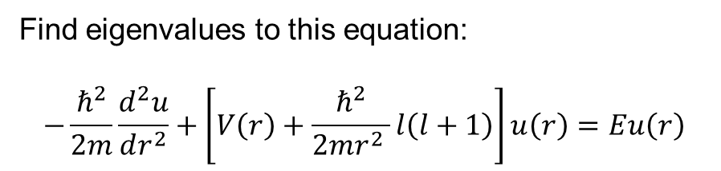

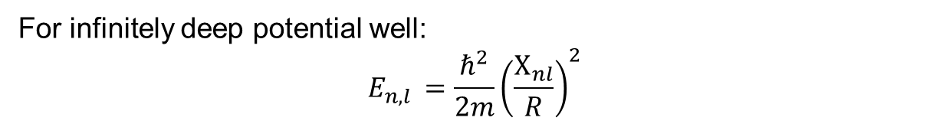
Quantum dots – Energy levels
Find eigenvalues to this equation:
$$−\frac{ℏ^{2}}{2m}\frac{d^{2}u}{dr^{2}}+\left[V\left(r\right)+\frac{ℏ^{2}}{2mr^{2} }l\left(l+1\right)\right]u\left(r\right)=Eu\left(r\right)$$
For infinitely deep potential well:
$$E_{n,l }=\frac{ℏ^{2}}{2m}{\left(\frac{Χ_{nl}}{R}\right)}^{2}$$
$Χ_{nl}$ : roots of Bessel functions
Note: no bound state for shallow QD with $V_{0}<\frac{πℏ^{2}}{8mR^{2}}$
Notes:
Calculate eigenvalues for energy from this equation.
(2l-1) degeneracy in magnetic quantum number, can be lifted in magnetic field
Orbital quantum numbers are also labled s, p, d, f,... As in atoms
No bound state for shallow QDs -> encapsulation with wider bandgap

Slide 11
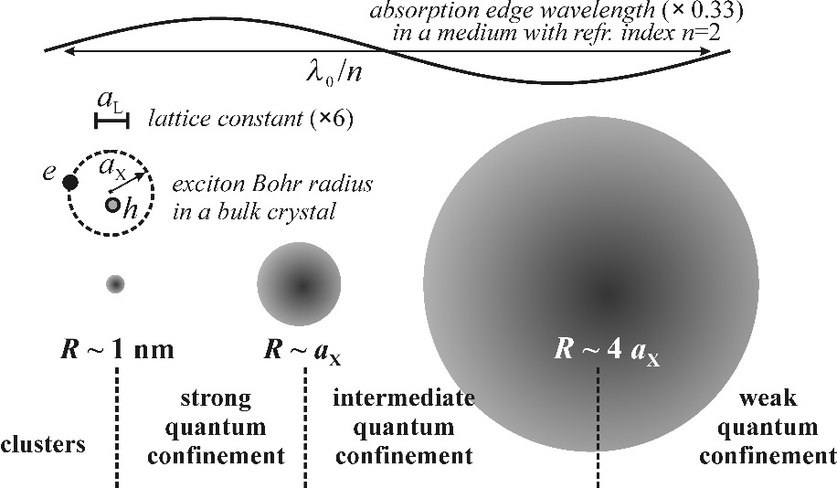
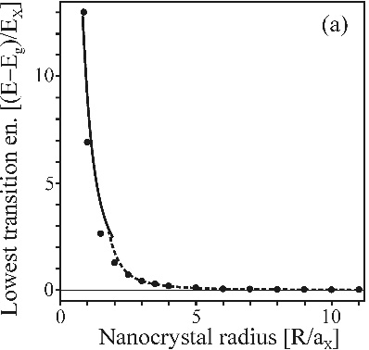
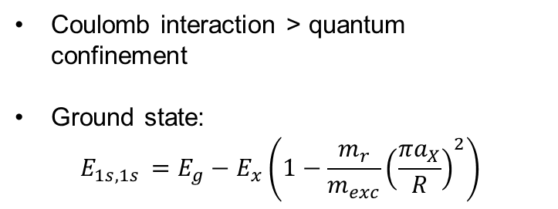
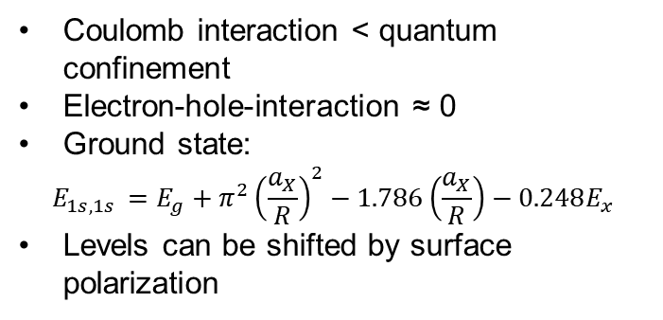
Strong vs. weak confinement
R
Coulomb interaction < quantum confinement
Electron-hole-interaction ≈ 0
Ground state:
$$E_{1s,1s }=E_{g}+π^{2}{\left(\frac{a_{X}}{R}\right)}^{2}−1.786\left(\frac{a_{X}}{R}\right)−0.248E_{x}$$
Levels can be shifted by surface polarization
Coulomb interaction > quantum confinement
Ground state:
$$E_{1s,1s }=E_{g}−E_{x}\left(1−\frac{m_{r}}{m_{exc}}{\left(\frac{{πa}_{X}}{R}\right)}^{2}\right)$$
Notes:
Type of confinement depends on quantum dot size in comparison to lattice constant and exciton Bohr radius
Strong confinement for QD radius much smaller than exciton Bohr radius (typically a few nanometers), but still larger than the lattice constant
For stong confinement only transisions between electron and hole states with the same quantum number allowed
Ground state: Eg, infinite potential well, effective coloumb interaction, correlation energy
Surface polarization: can cause self-trapping, localization of wave-function at surface
Weak confinement: excitonic effects dominate, quantum confinement is weak and only causes the kinetic energy of the exciton center-of-mass motion to be quantized, start with bulk exciton dispersion
X ground state is shifted towards higher energy compared to bulk , but shift is smaller than X binding energy -> „weak“ confinement

Slide 12
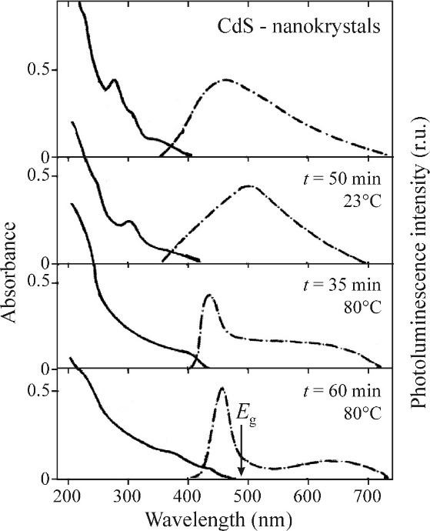
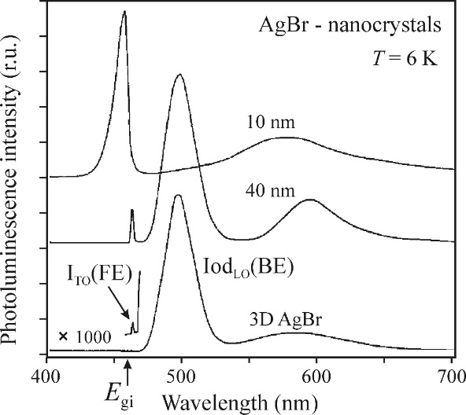
Quantum dots - Luminescence
Unifiying features:
Emission is blueshifted compared to bulk
Enhanced edge emission compared to bulk
Luminescence not only at low temperatures
Inhomogeneous broadening
Strong confinement
Weak confinement
Notes:
Highly studied in the past 30 years, every sample has it‘s own characteristic
Blueshift increases with decreasing size of the crystal
Inhomogeneous broadening, because ensemble comprises of differently sized qds, differnt lifetimes,
Silver bromide shows points 1 and 2, iodine peak disappears: due to small size of nanocrystals the concentration of Iodine atomes can be neglected, due to this, also emission from free excitons, because they are no longer bound by the impurity
Cadmium Selenite crystals: heated to increase size, bold line: absorption, dashed: emission, increase in size causes red shift, absorption becomes smoother, like solid, coulomb interaction prevails, narrower emission

Slide 13
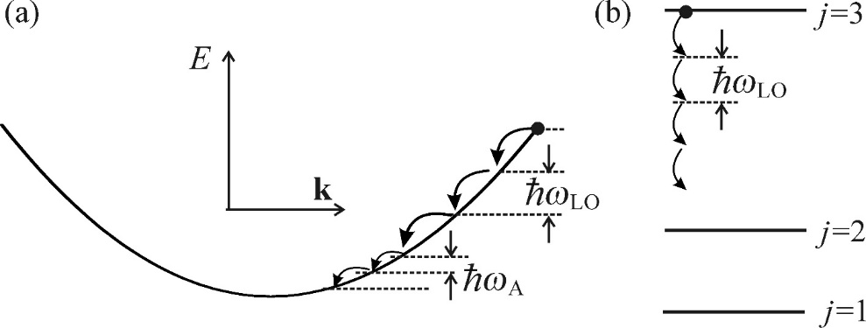
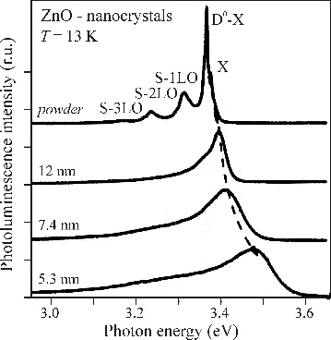
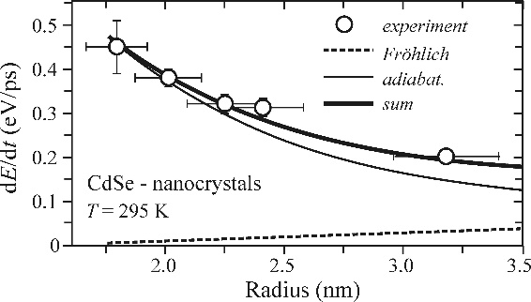
Exciton-phonon interaction – Phonon bottleneck
Reduced dimensionality
→ changed probability for emission of phonons
Bulk (a) → continuous
rapid relaxation
Nanocrystal (b)→ discrete
slow relaxation
ˈphonon bottleneckˈ
Experimentally ambiguous results:
disappearing phonon lines vs.
growing energy loss rate
Notes:
In bulk: rapid cooldown of hot carriers: quasi continous spectrum of carriers allows cascaded emission of LO-phonons with large energy, emission of accoustic phonons is not very important
This concept fails in QDs, carriers can only release energy to energy spacing between discrete levels, can be larger than energy of LO phonon, relaxation only via combination of optical an accoustic phonons
ZnO: decrease in size causes S-1LO... Lines to dissappear, which are phonon replicas for free X and donor bound X emission. Decrease in intensity corresponds to decreasing strength of exciton binding energy in smaller crystals
other interpretation: smaller dipole moment
Increased energy loss rate for smaller crystal, experimental data can be fitted by adiabatic relaxation and Fröhlich interaction (in polar semiconductors, opposite oscillations of opposedly charged ions, long-wavelength LO-phonons induce a long-range macroscopic e-field , this field has interaction with charges)
Phonon bottleneck can be broken or counteracted by a special type of Auger recombination in which the Coulomb e—h interaction applies, electron transfers energy to the hole and then relax to bottom of conduction band via interband transition

Slide 14
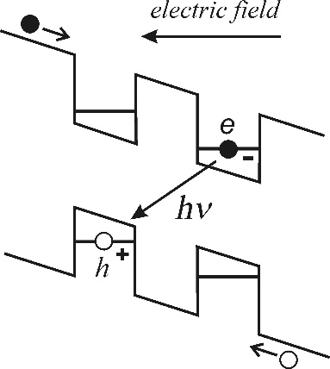
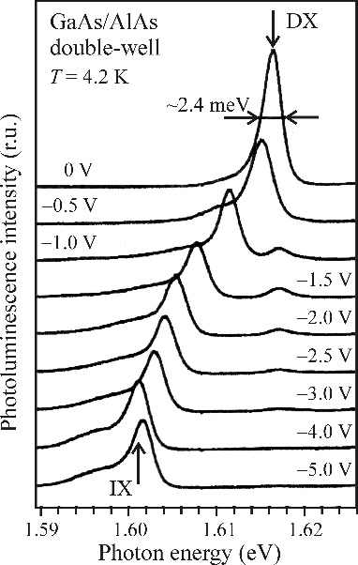
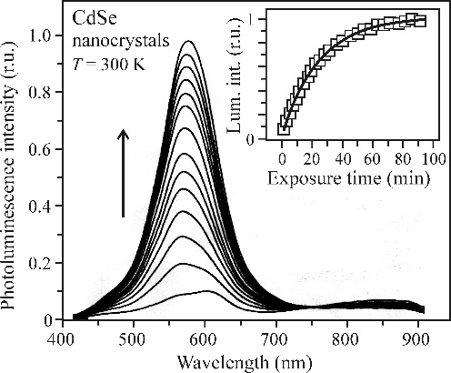
Unusual luminescence phenomena
Excitons indirect in real space
Indirect exciton via spatial separation of electron and hole
Allows to influence X energy and recombination rate
Possibilities: Bose-Einstein Condensation, X based circuit
PL enhancement during measurement
Proposed mechanism: passivation of surface defects, e.g. by water molecules
Not fully understood yet
Notes:
Realization in double-quantum well, incline via external electric field, electrons and holes are spacially separate. Slower recombination rate due to lower overlap of wavefunctions
Emission shifts with applied voltage, saturation due to shielding by sufficient concentration of indirect excitons

Slide 15
Unusual luminescence phenomena
PL enhancement via metal nanoparticles
Based on strong E-fields due to surface plasmons and Purcell effect
Can only be observed with nanoparticles
Plasmonic oscillations in nanoparticle enhance excitation rate, Purcell effect enhances emission
Effect depends strongly on used materials, sizes, wavelengths
Carrier (X) multiplication
Quantum efficiency < 1 (1:1 absorption and emission ratio)
Relaxation and thermalization are faster than e-h-pair creation
Possible in some systems, inverse Auger effect
Possibilities: increased external efficiency for lasers, LEDs, photovoltaic
Notes:
Purcell: spontaneous emission depends on interaction between emitter and EM field, can increase the radiative decay rate due to enhanced availability of states
Plasmon, quasiparticle that consists of quantizations of the plasma
Generally accepted concept: if a single photon is emitted by the single semiconductor, a single e-h pair is created, excess energy is lost, not matter how large
No ban against generating 2 e-h pairs from a photon with enough energy, which could emit 2 photons. But relaxation is too fast, only 1 photon is emitted.
Ideally this is attempted in nanocrystals, small volume for carriers
Inverse Auger: 1 hot carrier for the primary pair falls to bottom of CB and releases excess energy to generate second pair via coulomb interaction
Especially effective in photovoltaics due to applied voltage that separates the carriers before they can recombine

Slide 16
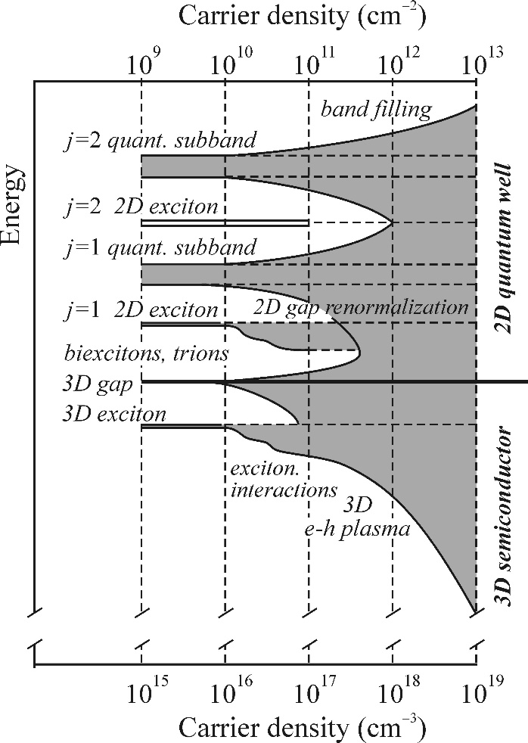
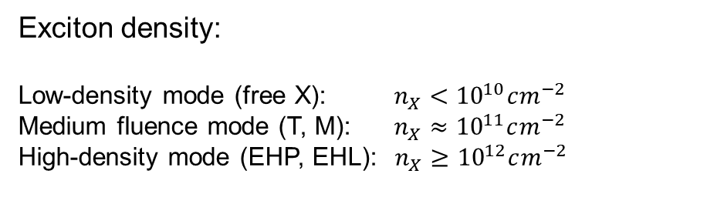
High excitation in low-dimensional structures
Low-dimensional structures are ideal systems to study luminescence phenomena:
  Sample preparation allows tailoring
  Tunable excitation lasers
  Amplification of certain features due to increase binding X energy
Exciton density:
Low-density mode (free X): $n_{X}<{10}^{10}cm^{−2}$
Medium fluence mode (T, M): $n_{X}≈{10}^{11}cm^{−2}$
High-density mode (EHP, EHL): $n_{X}≥{10}^{12}cm^{−2}$
Notes:
Regimes for the occurence of various luminescence processes depends on surface density of X.
Low-density: radiative decay of bosons (e.g. Free X)
Medium density: luminescence originating from trions and XX and inelastic X collisions
High-density: ionization of excitons and bandgap renomalization, luminescence from radiative decay of a system of fermions e.g. EHP, EHL
Band gap renormalization: typically bandgap shrinks for high e-h densities due to addiontal correlation and exchange energy

Slide 17
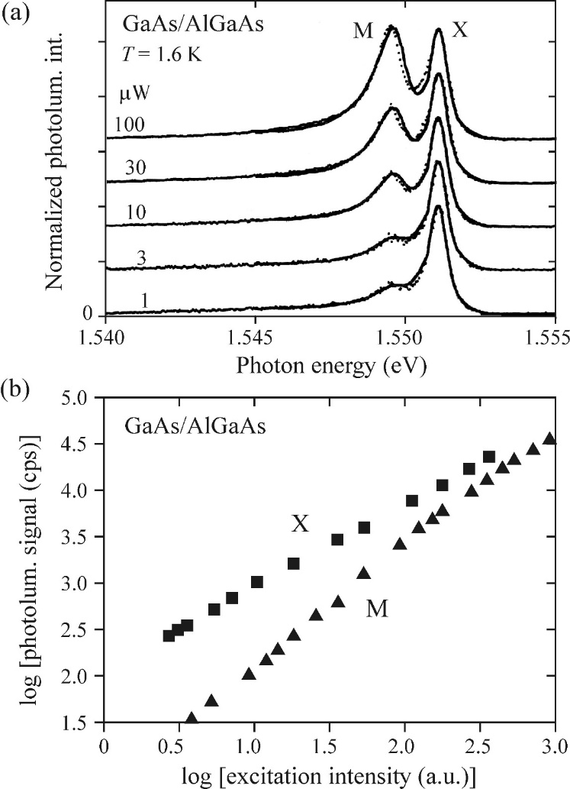
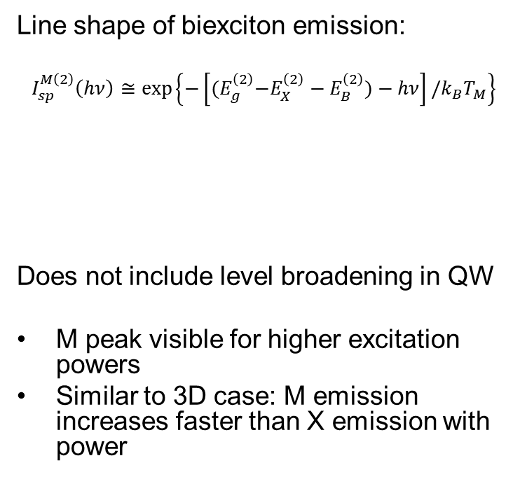

Biexcitons in a quantum well (QW)
Line shape of biexciton emission:
$$I_{sp}^{M\left(2\right)}\left(hν\right)≅exp⁡\left\{−\left[{(E}_{g}^{\left(2\right)}−E_{X}^{\left(2\right)}−E_{B}^{\left(2\right)})−hν\right]/k_{B}T_{M}\right\}$$
Does not include level broadening in QW
M peak visible for higher excitation powers
Similar to 3D case: M emission increases faster than X emission with power
$E_{B}^{2}:biexciton binding energy$,
$T_{M}$: M gas temperature
Notes:
Higher X binding energy (compared to 3d), ~1meV, lowered density of electron states in 2D system, effects of high excitation can already be seen for relatively low laser intensities
Lineshape is derived from 3d case from direct semiconductor, and constant DOS for x and XX for photon energy larger than bandgap, however this is not observed experimentally
Broadening because the real QW has insufficiently planar surface

Slide 18
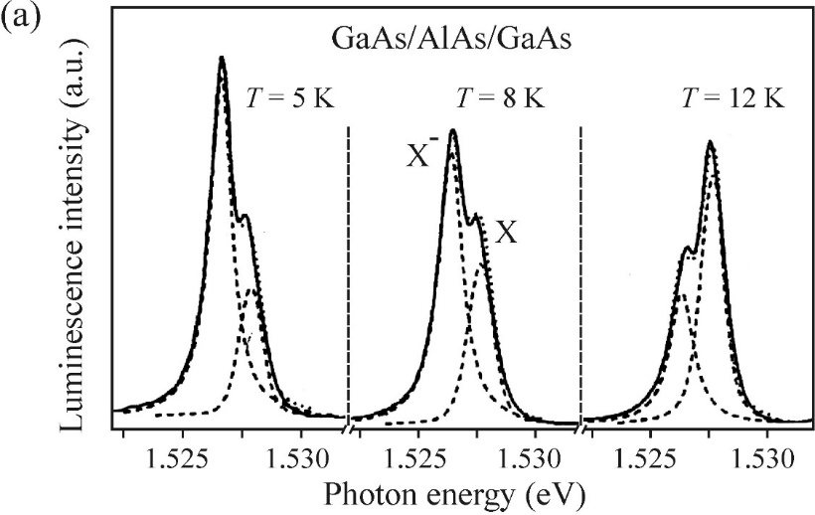

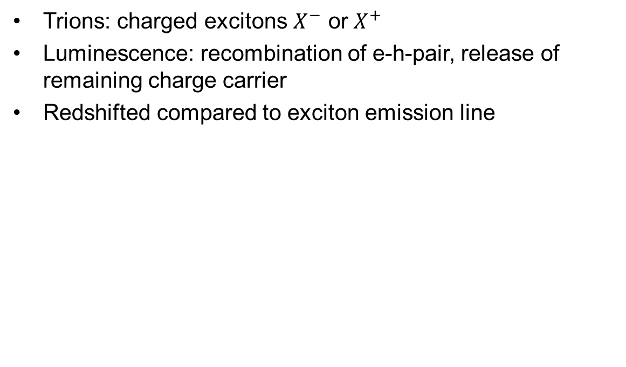
Trions in a quantum well
Trions: charged excitons $X^{−}$ or $X^{+}$
Luminescence: recombination of e-h-pair, release of remaining charge carrier
Redshifted compared to exciton emission line
Notes:
New emisison line, on the low emission side of X, red shifted
Higher temperature -> T line disappears: overcome of T binding energy, also non-linear increase of intensity in log log plot

Slide 19
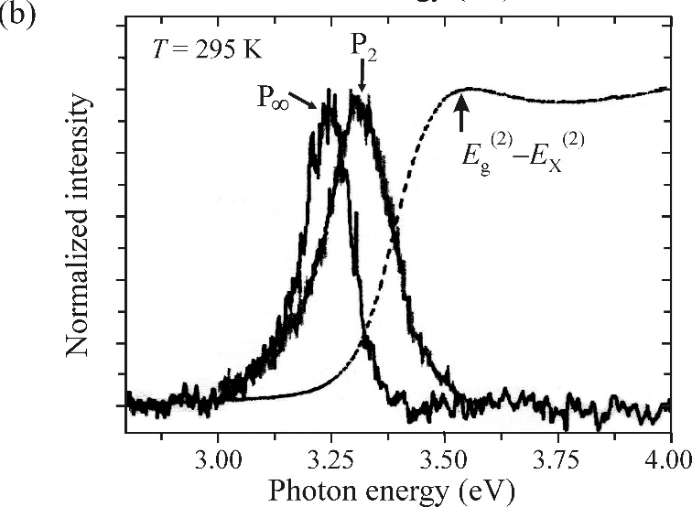
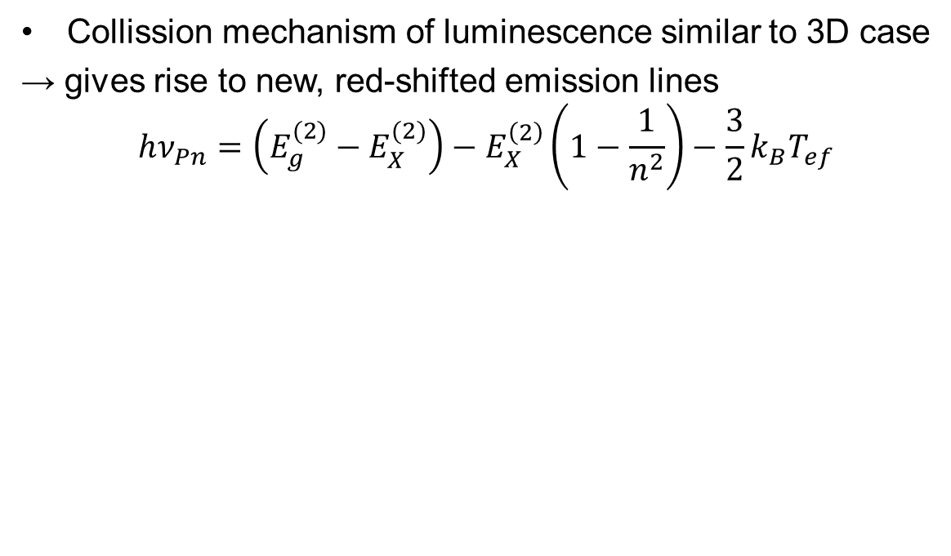
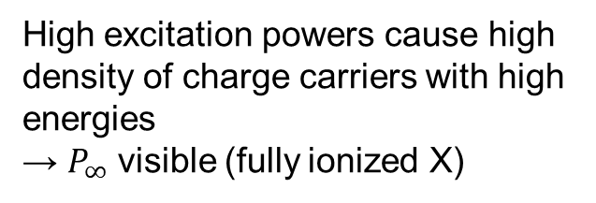
Collisions of free excitons in a QW
Collission mechanism of luminescence similar to 3D case
→ gives rise to new, red-shifted emission lines
$$hν_{Pn}=\left(E_{g}^{(2)}−E_{X}^{(2)}\right)−E_{X}^{\left(2\right)}\left(1−\frac{1}{n^{2}}\right)−\frac{3}{2}k_{B}T_{ef}$$
High excitation powers cause high density of charge carriers with high energies
→ $P_{∞}$ visible (fully ionized X)
Notes:
N is main quantum number of remaining exciton, 3/2KbT is its kinetic energy

Slide 20
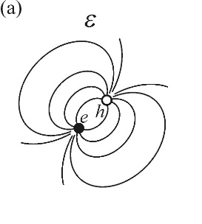
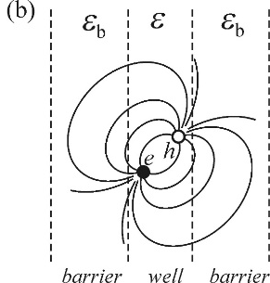
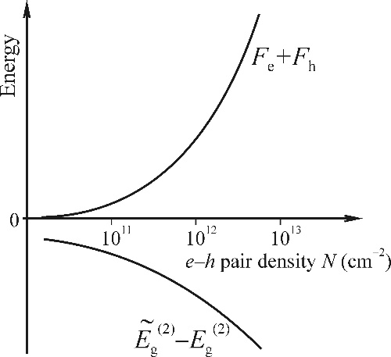
EHP in 2D structures
High rates of carrier generation causes screening of excitons and creation of e-h-plasma
→bandgap renormalization, band filling with free carriers
In 3D: screening based on surrounding free carriers
In 2D: additionally ˈphase space fillingˈ
→ reduded DOS
→ weaker screening
→ increased X binding energy
Carrier density can be observed experimentially via luminescence
Notes:
Phase space filling: consequence of reduced DOS in 2D. Since each X, even though a boson, consists of 2 fermions. With increasing excitation intensity, all available states are filled, which limits the highest attainable X concentration.
In 3D, field lines between e and h are homogenously screened in 3D by dielectric constrat of the material.
In 2D, for QW, the field lines go through the barrier, with diel. Constant eb -> weaker coulomb interaction screening
Stronger binding energy, because charges feel each other more strongly

Slide 21
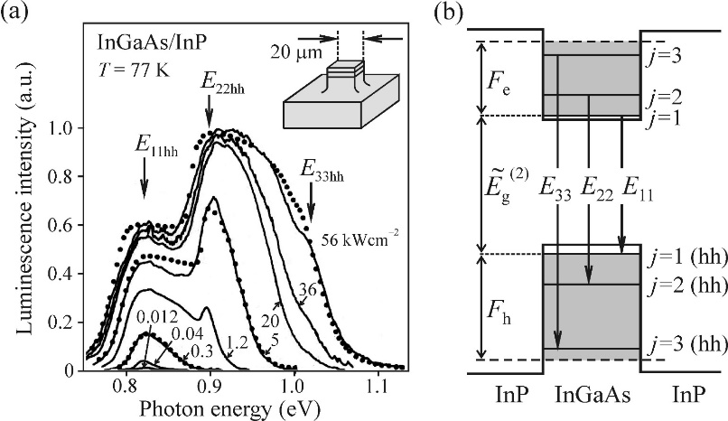

EHP and EHL in 2D structures
Gradual filling of subbands with increased excitation intensity
Broadened spectrum
  EHP
Mesa structure to prevent plasma diffusion
Critical nucleation radius for EHL can be similar to QW width
Favorable nucleation condition in thinner layer (surface to volume ratio)
Notes:
Further filling than to j=3 is not possible, because then the electrons could pass into the conduction band of the barrier
Broadedning to high energy side: increased value of sum of fermi energies ()
Low energy side: result of band gap normalization
Carrier density via fit to data -> lineshpae including 2D DOS, ...
EHL: gradually formed as e-h paris coalesce in nucleation centers, when critical size is reached, it grows to final diameter. Citrical radius ~10nm, similar to QW thickness -> can EHL exist in QWs?
Study of thicker QW structures (less ambiguous), observation of free X emission and for higher powers also EHL, but only in thinner sample.
Interface between Si and SIO2 or Si and air plays a role, different surface to volume ratios for the different samples
Below 15nm thicknessL EHL character lost, transformation into EHP with varying density

Slide 22


Biexcitons, EHP and EHL in quantum wires
So far rarely observed in experiment, however similar to phenomena in 3D and 2D:
X luminescence
M/T luminescence
Mott transition to EHP
Experimental observation of EHL:
→ invariable halfwidth and clear temperature threshold
Increasing intensity
Notes:
Rarely seen because of difficulty in fabrication
Preparation of quantum wires: intersections of panar 2D materials (width: ~10nm)
Left images: first X, then XX, then both peaks grow into 1, this corresponds to gradual Mott transition into EHP
How about EHL: observed in different direct semiconductor InAs
Asymmetric lineshape of trion at onset of EHL: when EHL nucleates, the liquid volume increases and suppressed trion gas, trion localization causes broadening of linewidth towards lower energies

Slide 23
Effects of high excitations in QDs
Strong localization of Xs within the nanocrystal and isolation from interaction with other Xs
Collectiv excitation (EHL, EHP) do not dominate optical properties of ensembles of nanocrystals
Number of Xs in QD depend on excitation density and absortion cross-section
Lifetime is dependent on excitation density → Auger
Experimental observation of X (Si), T (CdS) and M (CuCl)
Notes:
Increasing polarity in Si, CdS, CuCl, increasing binding energy and decreasing radiative lifetimes
Auger recombination is negligible in I-VII nanocrystals, luminescence from multiexciton complexes is not observed at all

Slide 24
Stimulated emission and lasing in low-dimensional structures
Easily acchievable in numerous semiconductor structures
Favorable features in view of stimulated emission of semiconductor structures:
  Tunable emission wavelength
  Suppression of non-radiative transitions
  Pronounced X luminescence
  Reduced DOS → achievement of population inversion

Slide 25



Stimulated emission in quantum wells
Mechanism of optical gain based on population inversion for bound X
Free X $|X⟩$ is quickly localized
Localization causes inhomogenous broadening $D_{i}\left(E\right)$
Higher excitation: bound X $|X′⟩$ occupy higher states
Population inversion between $|X′⟩$ and ground state $|0⟩$
Optical gain:
$$g\left(E\right)≈D_{i}\left(E\right)\left[2f\left(E\right)−1\right]=D_{i}(E)\left[\frac{2}{\exp\left[\frac{E−μ}{k_{B}T_{ef}}\right]+1}−1\right]$$
Notes:
Formation of free X due to optical or electrical excitation, which get bound to traps, e.g. Composition fluctuations or fluctuations in the width of the quantum well, inhomogenous broadening of emission.
Occupation of of localized X states can be described by Fermi-Dirac function (analogy to e-h)

Slide 26



Localized Excitons
Stimulated emission emerges from exciton resonance
Constant spectral position
GRaded Index Separate Confinement Heterostructure
  Increase efficiency, decrease threshold
  Guiding of photons + localization of carriers
Notes:
Threshold current depends on volume of the material where population inversion is to be achieved
-> one well is better than multiple wells, but efficient localization of electrons requires well width of maximally 10nm. However, this can no longer properly localize EM radiation, as the width is much smaller than the wavelength of the light.
Width at the end of the funnel is comparable to wavelength, photons are guided there, well is still narrow enough to localize e- and holes
Inclined walls to help efficient collection of charge carriers in PIN structure

Slide 27



Radiative decay of an X with emission of an X-LO phonon
Above threshold: superlinear growth of X-LO peak
Energy conservation satisfied:
$$ℏω≅E_{X}−ℏω_{LO}$$
Energy difference between spontaneous and stimulated emission = 27meV
$ℏω_{LO}≅30meV$ experimentally verified for quantum wells with different width
27meV

Slide 28




Stimulated emission in EHP
Red-shift of stimulated emission compared to spontaneous emission
Shift < $ℏω_{LO}$
Broad width of optical gain
1kW/${cm}^{2}$
10-100kW/${cm}^{2}$
Lasing of X-LO type
Lasing via
X-X collisions
Lasing via ensembles of localixed X
Stimulated emission from EHP
Notes:
Rules out localized X
Rules out X-LO mechanisms
Indication that stimulated emission originates from EHP where gain at low temp is given by the sum of the fermi energies
radical change in slope of intensity depending on excitation intensity, onset of stimulated emission
Further analysis in magnetic field to distinguish localized X from EHP: free X behaves as an atom -> Langevin shift , weak effect, emission is not influenced in magnetic field. For free electrons: measurable diamagnetic shift. Data shown here really stems from free carriers

Slide 29


Stimulated emission in quantum wires
Advantage:
Geometrical shape = cylindrical cavity
Limitations:
Fabrication
Wire diameter
Lasing mechanism:
ZnO: localized X
GaN: EHP + bandgap renormalization
Notes:
Fabrication limitations: shape, length, crystal quality and suitable reflectivity at their ends
Also wire diameter plays important role:diffraction losses if the diameter is on the order of magnitude of the wavelength, reflectivity of the ends decreases slowly with thinning diameter, lower Q of the resonator
ZnO: almost no spectral shift with increasing pump power -> localized excitons
GaN: spectra shift: dominat mechanism of optical gain is radiative recombination of EHP
Both in agreement with the fact that binding energy in GaN is laess then half of ZnO

Slide 30

Stimulated emission in nanocrystals
Easy preparation (chemically, epitaxially, ...)
Quantum confinement in small structures
  Easy-to-reach and temperature independent lasing threshold
Widely tunable emission wavelength
Emission from macroscopic ensemble
Narrow size distribution important for efficiency
Competing process: intrinsic Auger recombination ($τ^{A}>τ_{stim}$)
Notes:
Confinement: -> energy separation of electronic states lagers than kbT, reduced interaction strength between excitons and phonons (LO), thermal quenching of excited levels is more difficult
Lasing not only from one nanocrystal, but ensemble (like in ruby laser with Cr impurities).
Nanocrystals have to be embedded in glass, semiconductor, waveguides...
Concentration of active centers has to reach certain level for collective stimulated emission to happen
Auger: strongly concentration dependent process, rate increases with decreasing volume. Criterion for optical gain is that the stimulated emission lifetime is shorter than Auger recombination rate -> go for direct band semiconductors with lifetimes below 1ns

Slide 31



Stimulated emission in nanocrystals
Surface passivation of QD samples required to avoid localization at surface
Stimulated emission usually red-shifted to luminescence
Criterion for optical gain:
$τ_{stim}=\frac{n}{cg}$ $τ_{stim}=\frac{4πR^{3}}{3}\frac{n}{ρξσ_{0}c} τ^{A}=βR^{3}$
$g=ρn_{0}σ_{0}$
$τ^{A}>τ_{stim}$ $ξ>\frac{4πn}{3cρβσ_{0}}=ξ_{m}$
n: refractive index, g:gain,
$ρ:$nanocrystals in excited state
$n_{0}$: density of nanocrystals
$σ_{0}:$gain cross-section
R: nanocrystal radius
$ξ=\frac{4π{n_{0}R}^{3}}{3}:$filling factor
$ξ_{m}$: minimum filling factor
Notes:
Localization causes shift in absorption line wuth respect to luminescence line, disturbs balance between absorption and stimulated emission
Stimulated decay time depends on gain and speed of light in gain medium, can also be written including filling factor (how many nanocrystals in volume), fraction of nanocrystals in excited state, gain cross-section
From earlier we know that if the stimluated life time is shorter than the auger recombination rate, stimulated emission will occur, putting everything together: minimum filling factor
Smaller gain cross section: nanocrystals need to be packed more densely, and strong pumping is required, Typical dot densities: 10^18/cm^3

Slide 32



Stimulated emission in nanocrystals
Laser mechanism:
Ratio between inhomogeneous broadening $ΔE_{n}$ and energy separation ($E_{biexc}−E_{exc}$)
a) exciton mechanism
b) biexciton mechanism
Biexcition lasing shows dependence on stripe length

Slide 33


Stimulated emission with ordered QDs
Spontaneous growth via epitaxial techniques (MBE, MOVPE), ˈStransky-Krastanovˈ-growth
Strain creates ˈislandsˈ → QDs
Vertical stacking possible → high effective QD density

Slide 34



Stimulated emission with ordered QDs
Surface passivation
High gain (${10}^{5}cm^{−1}$) and temperature stability
High effective QD density → stimulated emission
Electrical control possible (low threshold)
Notes:
Broad gain: higher states of QDs are involved
Bottom QW : one order lower gain, less states to be filed in QW, more efficient quantum confinement in QDs

Slide 35


Random lasing
Usually lasing requires active medium and resonator
Random scattering analogous, but modes determined by multiple scattering events
Fully coherent scattering in optical material
Observable in materials with many tiny
scattering and amplifying centers
E.g. By focusing laser onto ZnO nanorods
Contrast to ASE: defined optical modes
Notes:
Active medium provides stimulated emission, resonator determins direction of emission, wavelength and mode
Random lasing: spectrally narrow, can be directed into full 4pi angle
Coherent scattering: phase of each optical wave is define, interference may occur
At this point, no clear theory for random lasing

Slide 36

EHP and ELP in 2D structures
Single-component plasma in QWs
Creation via modulation doping
Band bending
Electron plasma with controlled density
  High mobility transistors
Notes:
Modulation doping: insertion of monolayers of donor or acceptor atoms into barrier close to the well
Released electrons from ionized atoms flow into well and this causes band bending
Gas of free electrons appears in the well -> plasma
Plasma is separated from ionized donors

