Slide 1
Information for newly arrived students in autum term of 2018

Slide 2
Central study- and career counselling service
Lunch seminars
Career coaching
Career group – coaching in the evenings
Drop in
Help with CV, cover letter and other career related questions
www.kth.se/career
karriar@kth.se
Notes:
The lunchseminars have different subjects, lika visit from alumnis (former students) The Swedish Associate of Engineers (Sveriges Ingenjörer). We discuss subjects lika networking and how to plan your career. For the full program visit our website. There you will find more information about our other activities.
The seminars are open for everybody, and you don´t need to sign up before. We are serving lunchsandwiches to first arrived from 12.00.

Slide 3
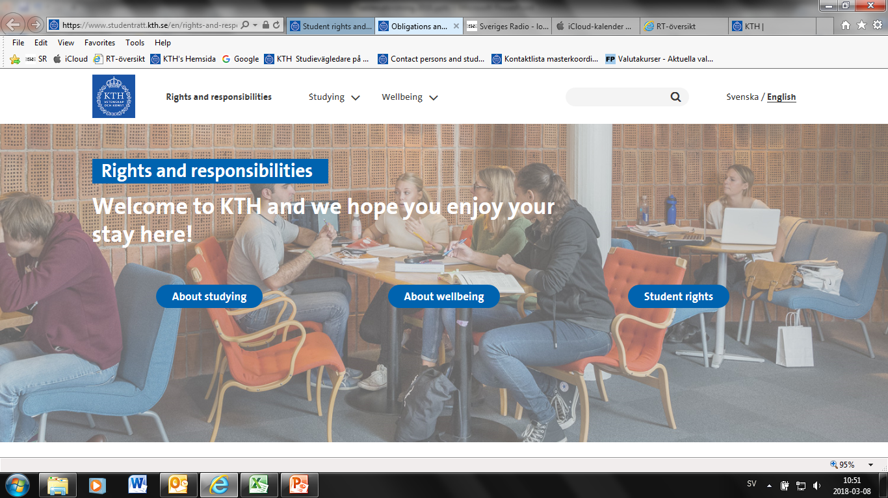
Rights and responsibilities
Notes:
Rights and responsibilities is a kind of webtraining on our websight and its divided in three different areas
About studying: is about planning and structuring the studies, practical information about how it works regarding examination rules, course registration, data accounts etc.
About wellbeing: Information on different support functions at KTH, Studenthealth and equal rights.
Student rights: Links to swedish laws, KTH’s own regulations and insurance.

Slide 4



Examples of support
Extended time at exams
Note support
Mentor
Classmates can also be asked to be a note assistent
Notes:
Students can also be asked to be a note assistant and mentor. Financial compensation is paid. If the student wishes to be a note assistant and / or mentor, they are welcome to contact us at Funka. In mentorship, they are introduced with a three-hour mentoring course. There are also spelling programs and speech synthesis for students to download via KTH's software download.

Slide 5
Who can apply for support?
Students that have a documented permanent disability.
Please apply through the web:
www.kth.se/applyforsupport
Do you have any questions, please contact us at Funka.
funka@kth.se

Slide 6

KTH University has a campus license for TorTalk that covers all students and employees.
You can download the installation: https://www.kth.se/student/kth-it-support
Notes:
KTH gives free access to TorTalk which is an easy to use reading tool that can read out all kinds of text from paper and screen. The software can be useful for both students and teachers. It works for all ebooks, locked PDF files and text within scanned images. Of course also for webpages and word processing tools. For those with dyslexia or other reading difficulties, a text-to-speech program like TorTalk makes a big difference in everyday life. In a few minutes you can listen and understand text that might have taken hours to read with your eyes.

Slide 7

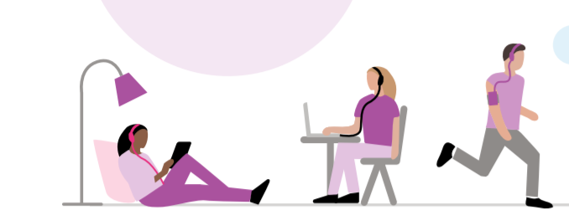
Do you have a reading disability?
Welcome to KTH Library!
E-mail: ask-kthb@kth.se
You can read audio books in several different ways: using mobile phone, tablet or a computer.
Notes:
If you have a reading disability you can get your course literature in another format. There are many reasons why you might need adapted books, like dyslexia, visual impairment, physical disability or something else that makes it difficult to read printed text. The most common format is talking books, but there are other formats as well, like Braille. You can listen to talking books using mobile phone, tablet or your computer,
Contact the library if you need talking books. We want to meet you so we can show how to download books and give you an account.

Slide 8
Information for new students on gender equality, diversity and equal opportunity at KTH
Alice Marshall

Slide 9
KTH’s values and JML (gender equality, diversity and equal opportunity)
"KTH has values based on democracy, the equal value of all people, human rights and a free and open discussion. Equality between men and women as well as prevention of all forms of discrimination is both an issue of quality and an obvious part of KTH's values. Gender equality and diversity among employees and students is also an important resource for KTH.
KTH's activities are based on the conviction that education and research can and should contribute to better living conditions and to an ecologically, socially and economically sustainable social development. As a technical university, KTH has a special responsibility for developing and communicating the knowledge needed to promote such sustainable development."

Slide 10
KTH’s Code of Conduct for studenter
I take into account the equal value of all people.
Equal opportunity at KTH includes a respectful and inclusive working environment and study environment free from harassment, sexual harassment, discrimination and bullying. I have a responsibility to treat others with respect.
I interact professionally with others in meetings and in my communication.
I am aware that discrimination, harassment, sexual harassment, bullying and violation of KTH's values ​​and KTH’s guidelines may lead to disciplinary action.
https://www.kth.se/student/studentliv/studentratt/uppforandekod-for-studenter-1.796562

Slide 11
Contacts for students in the case of harassment, sexual harassment, discrimination or bullying
ABE: Cecilia Månson Blom
CBH: Annelie Fredriksson, My Lönn, Sara Sabrie
EECS: Agnieszka Stasiak, Alicja Lissenko, Anneli Åkesson, Kathy Hammar, Nilgun Tosun
ITM: Andreas Alm Arvidsson
SCI: Hannasara Karlsson
KTH’s central point of contact, Student Services: Lena Salomonson or Nina Holmsten
THS, Head of Student Welfare: studiesocialt@ths.kth.se
Student Health: studenthalsan-skoterska@avonova.se, 08-120 125 00
For more information, go to: https://www.kth.se/student/studentliv/likabehandling-jams/om-nagot-hander-dig/stod-och-anmalan-1.514516

Slide 13
Information about medical matters for guest students
At the Student Health Service at Avonova you can get counseling and help for problems related to your studies from a Nurse and a Social counsellor
All appointments must be reserved.
Our Service is free of charge.
We are bound to secrecy.

Slide 14

What do we mean by study related problems?
With study related problems we mean the disorders and disturbances that have a negative effect on the ability to study.

Slide 15
Opening hours, visiting address
Monday – Thursday
Friday
08:00 – 16:30
08:00 – 15:30
Visiting address: Sergels Torg 1
Metro: T-centralen

Slide 16
Staff
Nurse:
studenthälsan-skoterska@avonova.se
Social counsellor:
studenthalsan-kurator@avonova.se

Slide 17
In case of medical emergency call 112
If you get medical problems during your stay in Stockholm you can contact the nearest medical centre, usually called ”husläkarmottagningen” or ”vårdcentralen”.
They usually close around 5 PM on weekdays and are closed during weekends. You can get help at the Emergency clinic, usually called ”Närakuten”.

