Slide 1
Welcome to the
School of Electrical Engineering and Computer Science
(EECS)
2019-08-22

Slide 2
2019-08-22 Program
Introduction - 9:00
          Welcome to KTH and EECS -Markus Hidell -9:15
Practical informations – Cristina La Verde, Sofia Norlander, Lina Lehn – 9:30
Break – 10:00
Rights and Responsibilities – Mats Bengtsson – 10:15
Code of Conduct – 10:45
Information from School’s Chapters – 11:00

Slide 3
Master program coordinators at EECS are:
Cristina La Verde
E-mail: ee-master@kth.se
Tel: 08- 790 7315
Drop-in: Tuesday and Thursday 12:30 and 14:30
Lindstedtsvägen 3, 4th floor.
Friday 23/08 12:30-14:30
Week 35, 26-30/08 12:30-14:30

Slide 4
Lina Lehn
E-mail: media-master@eecs.kth.se
Tel: 08- 790 84 77
Drop-in: Tuesday and Thursday 12:30 and 14:30
Lindstedtsvägen 3, 4th floor.
Also available by appointment.

Slide 5
Sofia Norlander
E-mail: cs-master@kth.se
Tel: 08- 790 8422
Drop-in: Tuesday and Thursday 12:30 and 14:30
Lindstedtsvägen 3, 4th floor.
Friday 23/08 12:30-14:30
Week 35, 26-30/08 12:30-14:30

Slide 6
KTH Schools
School of Architecture and the Built Environment
School of Engineering Sciences
School of Industrial Engineering and Management
School of Engineering Sciences in Chemistry Biotechnology and Health
Electrical Engineering and Computer Science

Slide 7
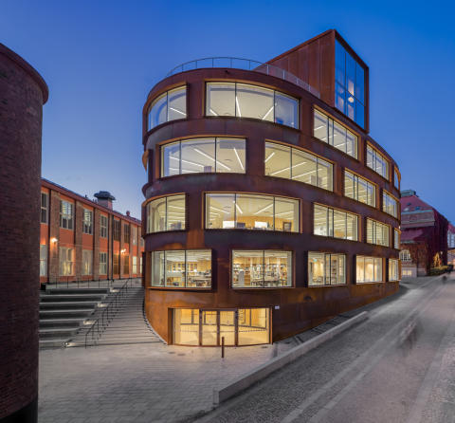
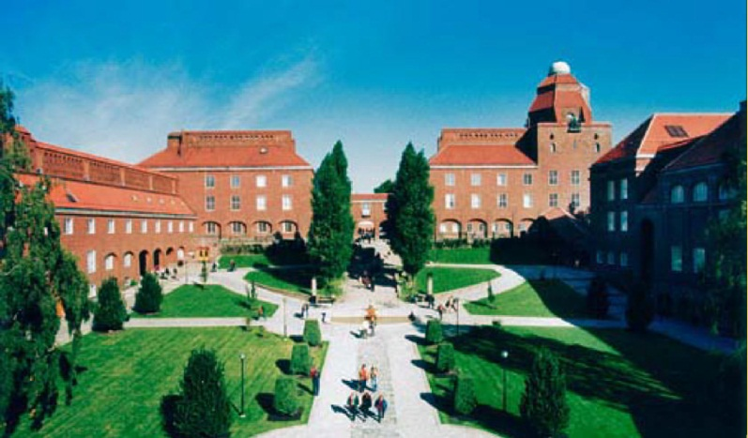
KTH in numbers
13 000 full-time students
2 000 doctoral students
3 656 full-time employees
305 professors
283 associate professors
Around 100 nationalities represented

Slide 8
We are your program coordinators…
…your contact person at EECS School and can help you with:
Add/change courses
Visa extension and other kinds of certificates
Official transcripts
Study planning
Master’s thesis application and info
Degree application and transfer of credits
Other administrative, practical issues

Slide 9
Academic calendar 2019/20
Autumn term: 2019-08-26 until 2020-01-14
Spring term: 2020-01-15 until 2020-06-01
Every academic year is divided into 2 terms (Autumn and Spring) and in 4 periods.
Exams are held at the end of each period

Slide 10
Courses
Normally each course at KTH has a name and a course code
For ex. EG2080
All courses starting with the letter E, D and I are offered from EECS school.

Slide 11
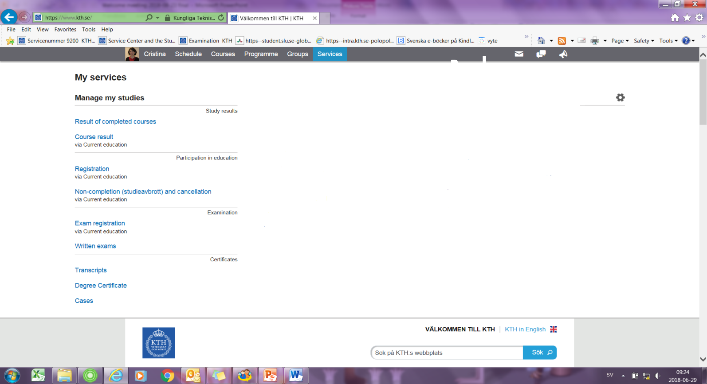
Personal Menu: administrate your own studies on-line (IT-account needed)

Slide 12
Course selection (May and November)
You will select courses for the coming terms (not this term Ht19) online via universityadmission.se or antagning.se
I will send you an email to explain how, when and what to do
Use TimeEdit to check course schedule:
Personal menu (schedule) – schedule search
Swedish language courses can not be selected online (contact me)

Slide 13
More about course selection
Think about the limit-120 credits REGISTERED COURSES!!!
Max 8 courses / 35 credits per term.
Keep always the compulsory courses on the highest priorities in your application.

Slide 14
Course registration
Registration to a course implies course selection
Registration to a course is necessary so that you can get access to the course in Canvas (on-line platform for course material).

Slide 15
Course registration / interruption
Course registration: personal menu - services – manage my studies
You can withdraw (early interruption) from a course up to 3 weeks from the course start (no consequences): personal menu - services – manage my studies.

Slide 16
Autumn term 2019
As soon as you get IT-account you will be able to
access your personal menu
Under Services, you will find compulsory courses for P1 and P2 (admission)
If you want to add courses
Please submit a web form study plan
(programme web)
Latest 27th August.
The 2nd of September 2019
will be last day to register for courses selected for P1

Slide 17
Registration to exams
You need to be admitted and registered to the course first.
It is compulsory to be registered to the exams at KTH, at least 14 days prior to the exam.
Registration is made through your personal menu – services - manage my studies

Slide 18
Language courses
Apply through me (Swedish), NOT this term
Compulsory attendance
SWELL open (self-instructive practice basic Swedish course online)
Make sure language courses can be included in your degree.

Slide 19
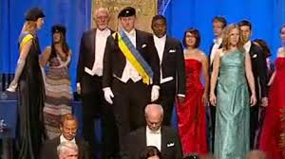
Degree and graduation
You will apply for it online using your personal menu
Degree of Master of Science
Graduation Ceremony at the City Hall (twice a year)

Slide 20
Other important places at KTH
KTH -Entré (address: DKV 4) Accommodation, Int. study advisor, IT-support
Student Health Service
Student Union (THS) at Nymble building
FUNKA, study support for person with disabilities

Slide 21
Enjoy your time at KTH and keep yourself updated
Don’t forget to regularly
check your KTH-email account!
I will use it to inform you about important matters concerning your studies!
Write always your KTH number/Swedish personal reg. number in your emails (YYMMDD-TXXX)

Slide 22

Temporary registration number (T-number)

Slide 23
Take the opportunity to study abroad!
For further questions please contact EECS international Coordinators:
Out.exchange@eecs.kth.se

Slide 24
Program Meetings 13:00 following locations:
Electric Power Engineering (TELPM) at
Salong 1 (Osquars backe 31, 2nd floor, KTH Library)
Information and Network Engineering (TINNM) at Q2 (2nd floor, Malvinas väg 10)
Systems, Control and Robotics (TSCRM) at Q33 (entrance floor, Malvinas väg 6)
Electromagnetics, Fusion and Space Engineering (TEFRM) at
E33 (3rd floor, Lindstedtsvägen 3)
Computer Science (TCSCM) at D34 (3rd floor Lindstedtsvägen 5)
Machine Learning (TMAIM) at D3 (3rd floor, Lindstedtsvägen 5)
Interactive Media Technology (TIMTM) at E35 (3rd floor, Lindstedtsvägen 3)
Media Management (TMMTM) at E32 (3rd floor, Lindstedtsvägen 3)

Slide 25

Questions?

