Slide 1
Welcome!

Slide 2



Notes:
More of these things might need to be included in this slide or another:
How is the student organisations structured?
Is THS a KTH thing? No.
Where does a chapter fit into THS?
What is the purpose of THS?
What chapter do I belong to? Se länk https://docs.google.com/spreadsheets/d/e/2PACX-1vRBIcNbmG1vW0L47mWMuLZHwui7QHFuIz8RlkTrKtgIUh21nwcyDRdkFi56i1O2j1EvkmFlEqJ4yw0i/pubhtml

Slide 3

What is a chapter
Notes:
*Add more images and things to this slide (that are relevant to the bullets below)*
Part of the student union THS
By students - for students
Works for the students and that the education keeps a good quality
Organizes activities
Reception of new students
Sport events
Parties
Board games

Slide 4
What is a chapter?
Board
Associations
Committees
Clubs

Slide 5

Why should I join the chapter?
Student rights
  Courses
  Study environment
  JML
Study social engagement
Notes:
Why should I join a Chapter?
It a student group that organises events for students.
It keeps track of your education.
Bilder: Quarnevalen, Different pictures from pubs, parties and other events.

Slide 6


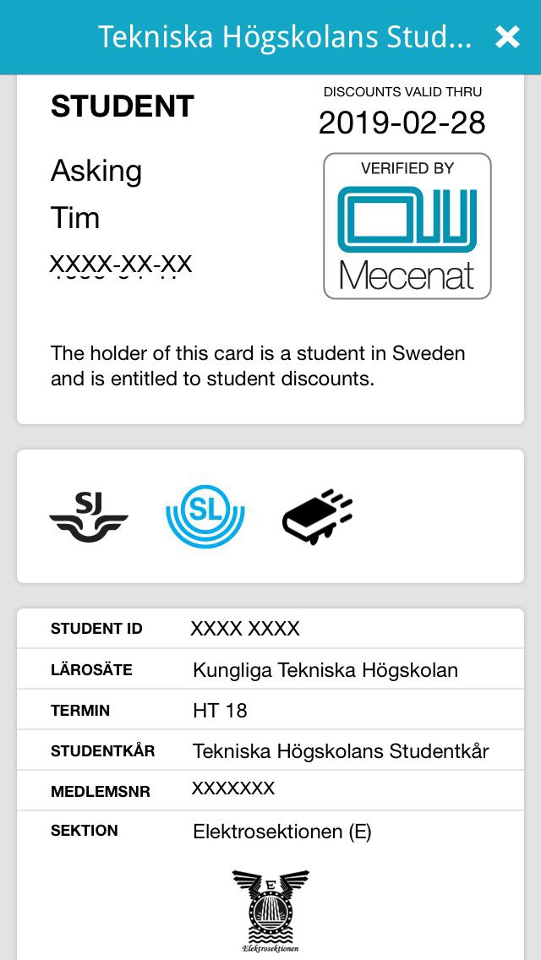
XXXX
XXXX
XXXX
XXXX
Make sure you have the right logo for your chapter
Notes:
Mecenat
What is it?
What can you do with it?
How does it work?
When do they get the T-number?
https://www.kth.se/social/group/exchange-studies-eec/page/kth-registration-number-t-number/

Slide 7






Member benefits
Notes:
How much does membership cost?
Vad kan Mecenat användas till?
När man går med i sektioner och THS får man THS fördelar.

Slide 8


Pub - Thursday/Friday
Notes:
IN Specific stuff
Vilka master tillhör denna sektion?

Slide 9



Committees
Notes:
IN Specific stuff
Vilka master tillhör denna sektion?

Slide 10
The reception - what is it?
3 weeks of incredibly fun activities
Gasques
Alumni mingle
Overnight stay
Naturhistoriska och Cosmonova
The nØllegasque
Mottagningen.nu

Slide 11
The reception - Who are we?
Planning group - MUX
NØlle-groups - NØllan
Group leaders - FADDER
Documentation - DOQ

Slide 12
Goodie bag
Information from KTH
NØlle-folder
NØlle-cap

Slide 13
NØlle-poll
Fill it out now and give to MUX after the presentation

Slide 14
Contact
The reception Ingen@insektionen.se
The board Kommunikation@insektionen.se
JML Studiesocialt@insektionen.se
Study rights Sno@insektionen.se
QMISK Qm@qmisk.com
TMEIT Tm@tmeit.se
ITK Itk@insektionen.se
Notes:
IN Specific stuff

Slide 15
The president has the floor

Slide 17
The president has the floor

