Slide 1
KTH Systems

Slide 2
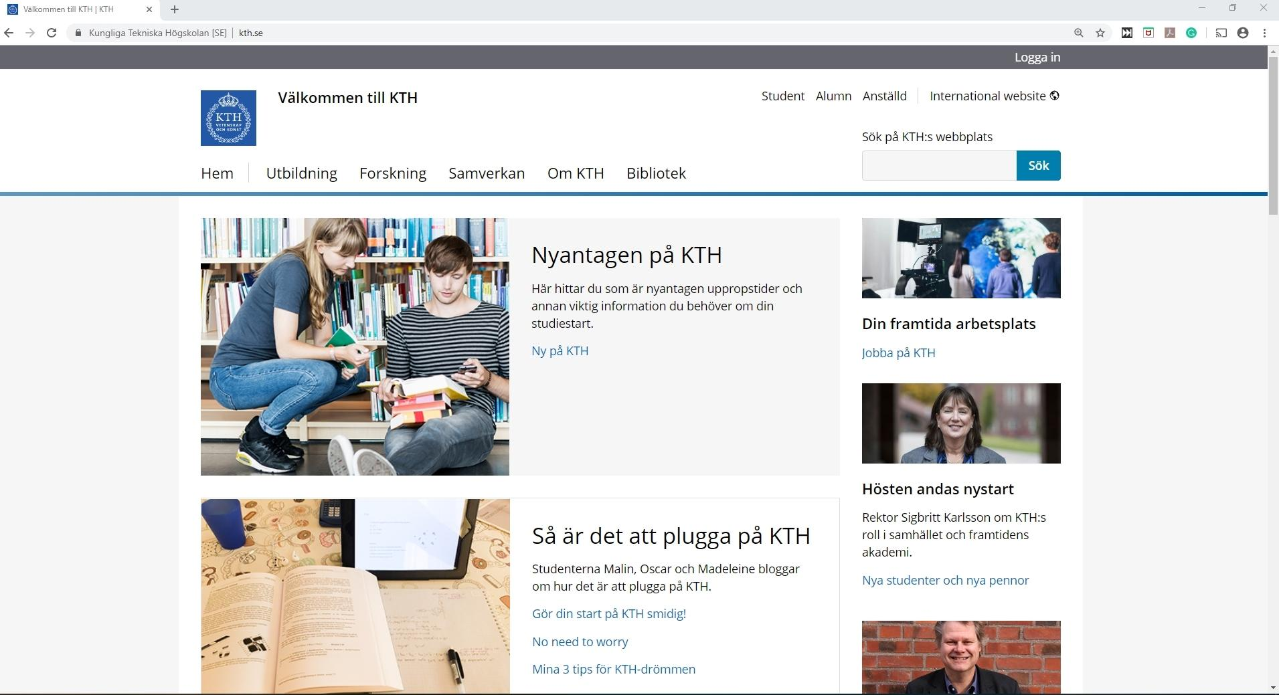

Slide 3
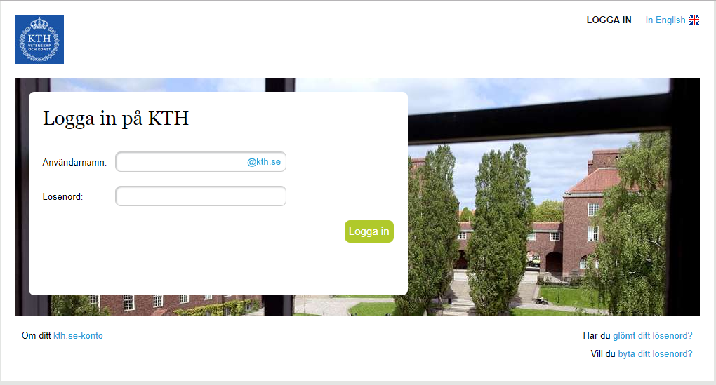

Slide 4
KTH Social
Static information
Schedule
Services
Registration
Semester
Course
Exam

Slide 5
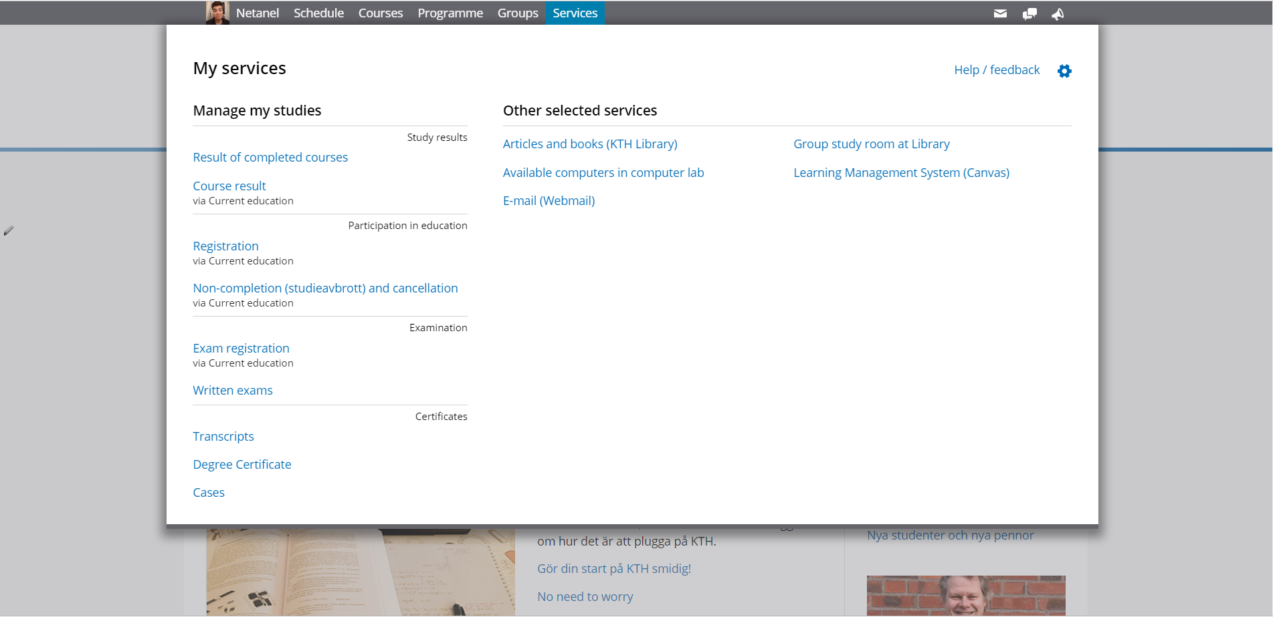

Slide 6
Ladok
Registration
Completed education
Grades
Certificates

Slide 7
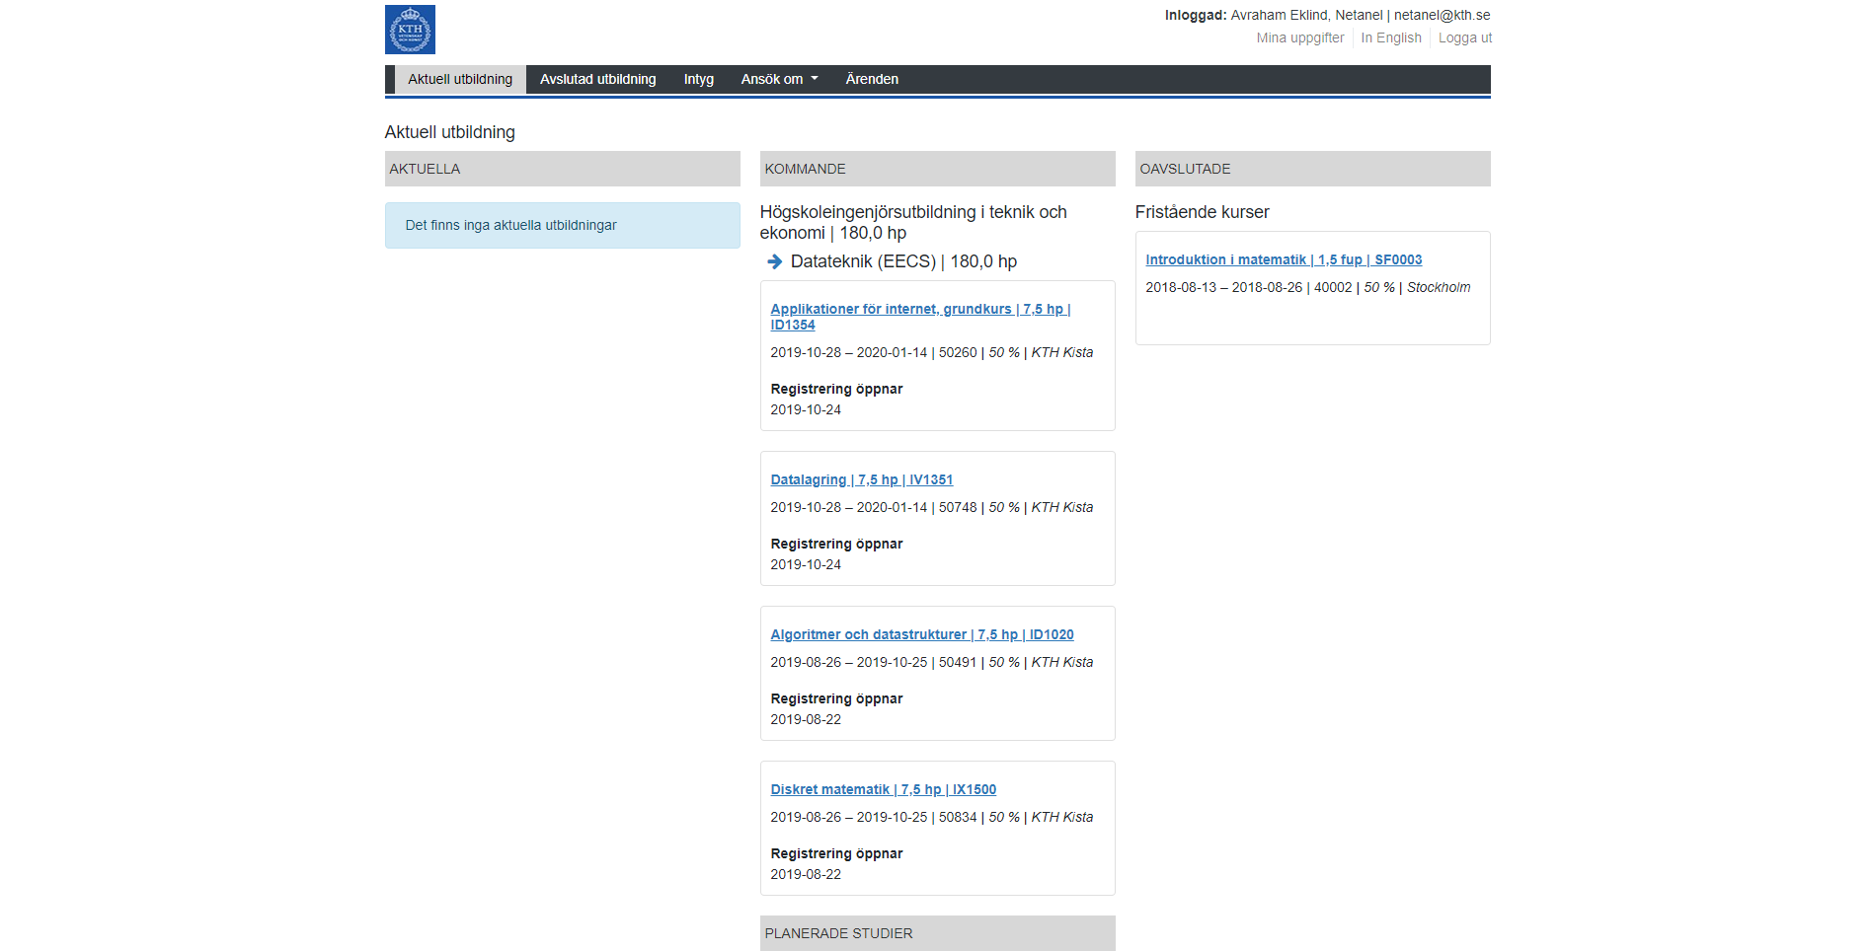

Slide 8
Canvas
Course content
Discussion forum
kth.instructure.se

Slide 9
