Slide 1
SK3889 Luminescence Spectroscopy of Semiconductors: Theory and Experiment
Lecture 2: Time-resolved photoluminescence, kinetic description of processes, and phonons
Axel Strömberg

Slide 2
Seminar Outline
Time-resolved photoluminescence
  Applications/overview
  Experimental setups and methods
Kinetic description of processes
  Overview
  Recombination Probability
  Process examples
Phonons
  Overview
  Classical treatment
  Phonon interactions: piezoelectric and Frölich mechanisms
  Point defects and thermal quenching

Slide 3
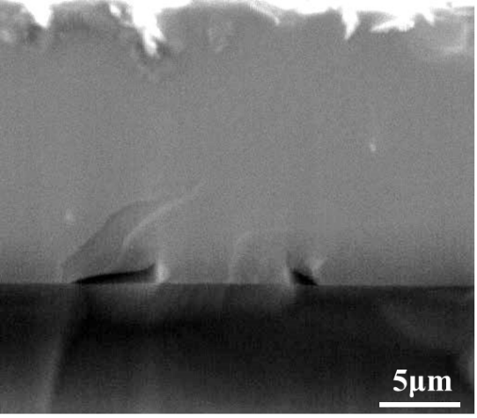
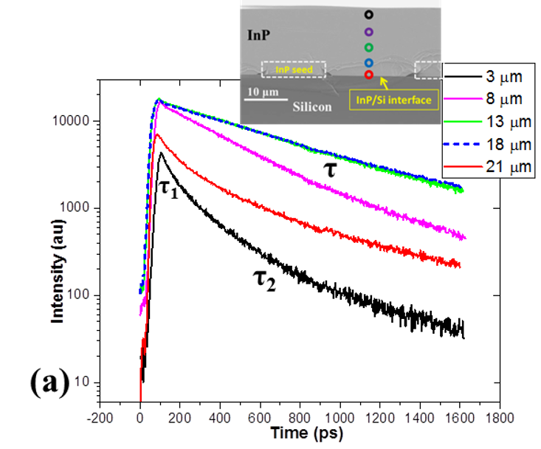
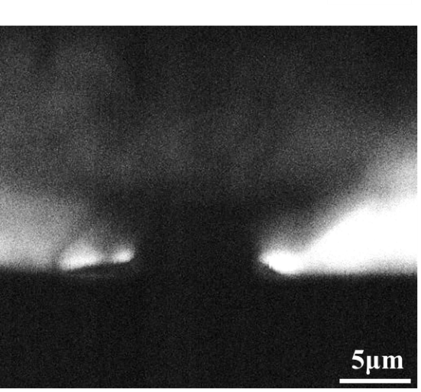
Time-resolved photoluminescence
Experimental setups and methods
An important characteristic of PL is that is it a slow process
  Material properties influence how the material relaxes
The temporal behaviour of this relaxation provides information about the material
InP-seed
InP/Si TD-free
Heterojunction
Si substrate
SEM
CL

Slide 4



Time-resolved photoluminescence
Experimental setups and methods
Simple case
Real case
Basic setup
  Single channel detector (PMT/APD)
  Pulsed or chopped laser source
  Monochromator in front of detector
  Oscilloscope
Basic response: simple exponential
High demands on experimental setup
  Sensitive, fast, highly linear response
  These are hard to satisfy simultaneously
  Oscilloscopes and pre-amplifiers have frequency ranges
  The temporal shape of the excitation pulse needs to be deconvoluted from the results
Decay curves can be more complicated
  Decay time still defined analogous to the simple decay case
$$i_{λ}\left(t\right)=i_{λ}\left(0\right)e^{\left(−\frac{t}{τ}\right)}$$
Mean decay time:
$$\overline{t}=τ , { i}_{λ}\left(τ\right)=\frac{i_{λ}\left(0\right)}{e}$$
Decay time:
$$i\left(τ\right)=\frac{i_{λ}\left(0\right)}{e}$$

Slide 5
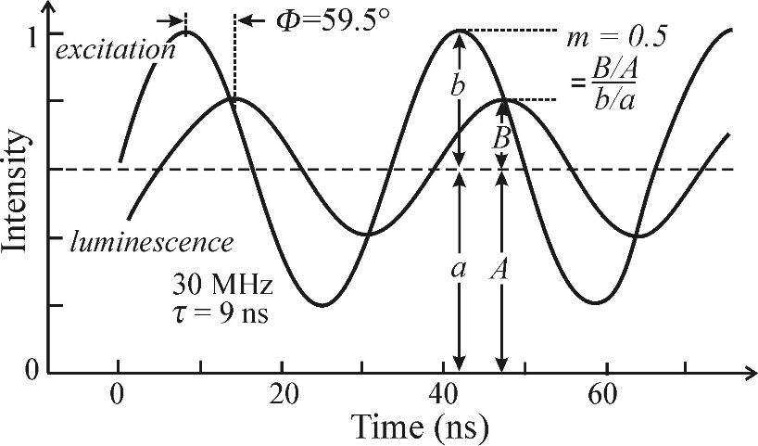
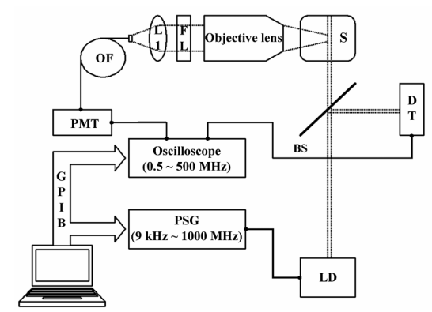

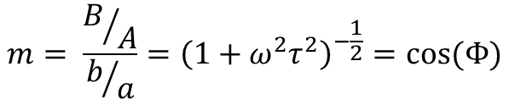
Time-resolved photoluminescence
Experimental setups and methods
Phase shift method
Sinusodially modulate excitation
  The response will have a phase delay and a modulation depth change
  These are related to the material parameters
$$tan\left(Φ\right)=ωτ$$
$$m= \frac{B/A}{b/a}={\left(1+ω^{2}τ^{2}\right)}^{−\frac{1}{2}}=cos⁡(Φ)$$
These are valid in the single exponential decay case. Otherwise the decay times extracted from them will differ slightly.
Kyu Han Shim, Bog G. Kim, “Simple Frequency-Domain Fluorescence-Lifetime Measurement System Using Violet Laser Diode”, Journal of the Korean Physical Society 2006, 49,, pp. S647∼S651

Slide 6
Time-resolved photoluminescence
Experimental setups and methods
Phase shift method
Benefits
Can measure relatively fast luminescence kinetics with simple setup
  Only needs light modulation, no need for short excitation sources.
Has seen a lot of use
Drawbacks
Short and ultrashort excitation pulse sources are now readily available
Can only be used on single exponential decay systems
  Unclear physical meaning of the response signal
Kyu Han Shim, Bog G. Kim, “Simple Frequency-Domain Fluorescence-Lifetime Measurement System Using Violet Laser Diode”, Journal of the Korean Physical Society 2006, 49,, pp. S647∼S651

Slide 7
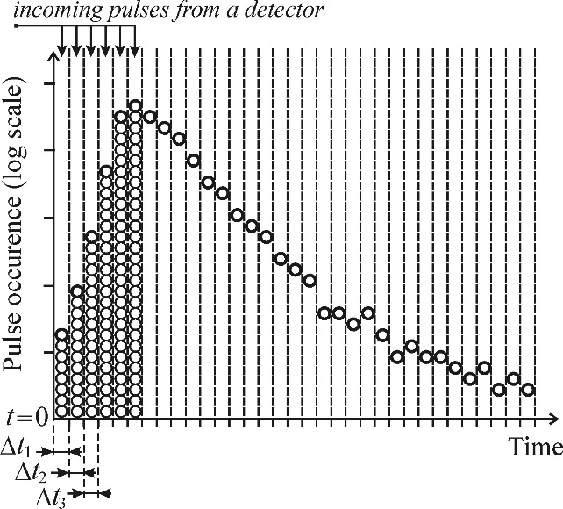
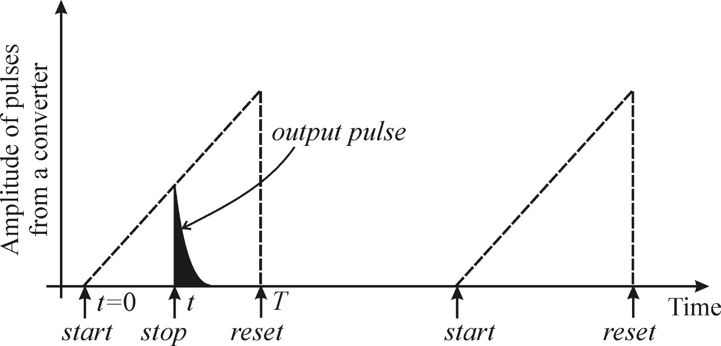
Time-resolved photoluminescence
Experimental setups and methods
Time-correlated photon counting
  The sample is excited repeatedly
    10 kHz – 100 MHz depending on setup
  Emitted photons are counted
    The excitation and detection occur in time-correlated cycles.
    Over many cycles, a statistical image is bulit up of when along the excitation cycle emission is likely to occur.
    The time it takes to collect enough data ranges from minutes to hours
  This requires a low luminescence intensity
    If more than one photon can be detected per cycle, it will distort the distribution
    1 in 10-100 excitation cycles should result in a photon counting event

Slide 8
Time-resolved photoluminescence
Experimental setups and methods
Time-correlated photon counting
Benefits
Very sensitive and accurate
Produces the temporal profile of the luminescence response
Drawbacks
Time-consuming
Sometimes requires special deconvolution methods when very high repetition rates are used.

Slide 9
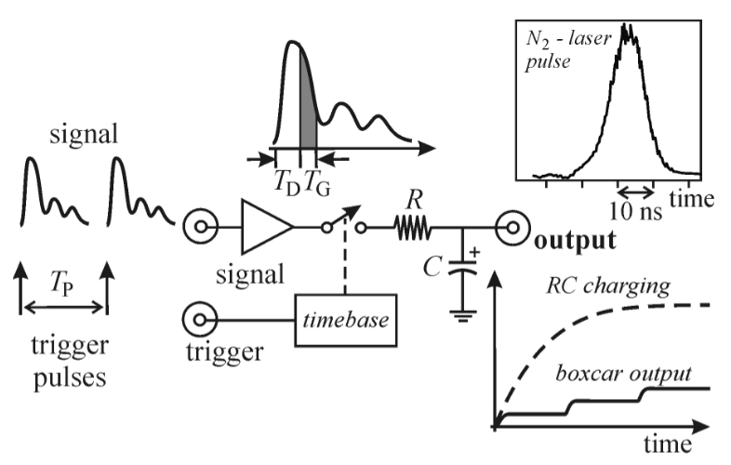
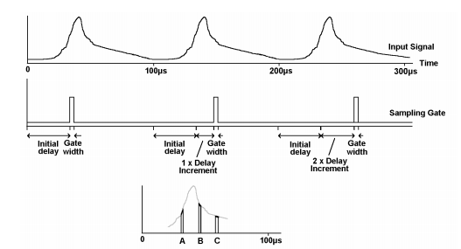
Time-resolved photoluminescence
Experimental setups and methods
Boxcar integrator
  Measures a periodic signal over several periods
    Done by performing the measurement over a time interval T_{G} (gate width) each period.
    This sampling time can be delayed (T_{D}) to focus in on different parts of the periodic signal, enabling temporally resolved measurements
  Enables temporally resolved spectra to be measured
    A monochromator can be included to scan wavelengths for different T_{D}
  S/N ratio is very good
    Similar principle as a lock-in amplifier
http://123.physics.ucdavis.edu/week_1_files/Boxcar_Averager.pdf

Slide 10
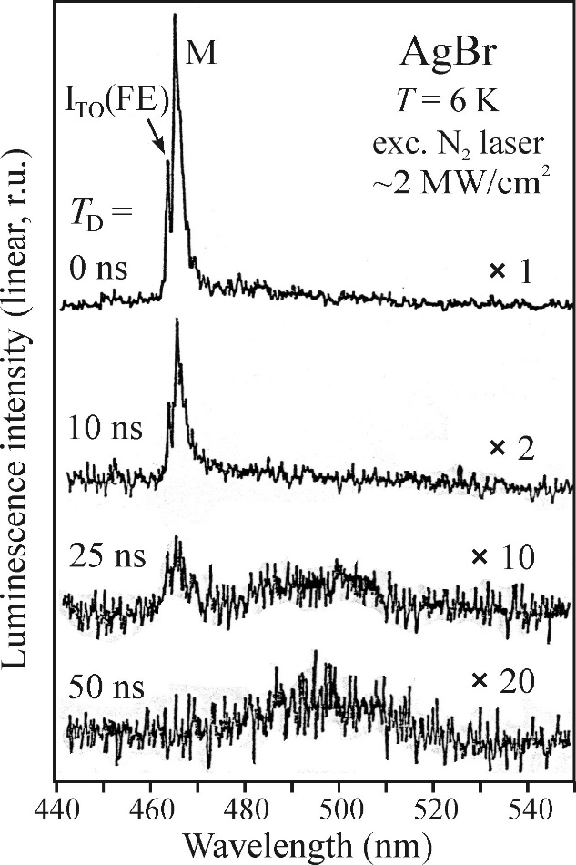
Time-resolved photoluminescence
Experimental setups and methods
Boxcar integrator
http://123.physics.ucdavis.edu/week_1_files/Boxcar_Averager.pdf

Slide 11
Time-resolved photoluminescence
Experimental setups and methods
Boxcar integrator
Benefits
Enables spectral information to be exctracted
Good S/N ratio
Drawbacks
Need to consider optimal gate scanning speed.Too fast scanning distorts the pulse shape, while too slow scanning might lead to problems associated with drift of experimental parameters
Boxcar electronics too slow for processes in the 100 ps range and faster.
http://123.physics.ucdavis.edu/week_1_files/Boxcar_Averager.pdf

Slide 12
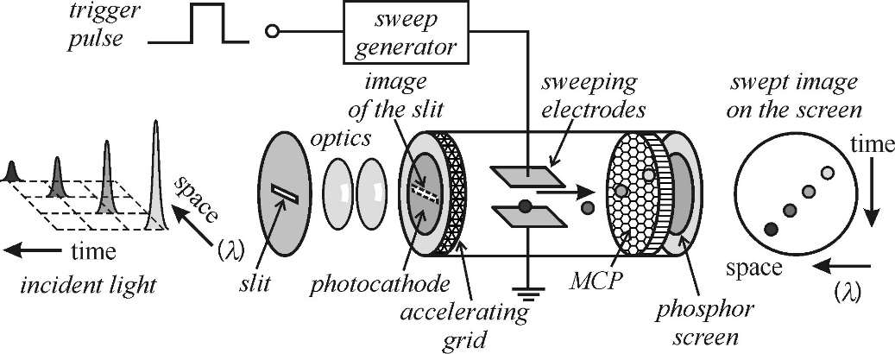
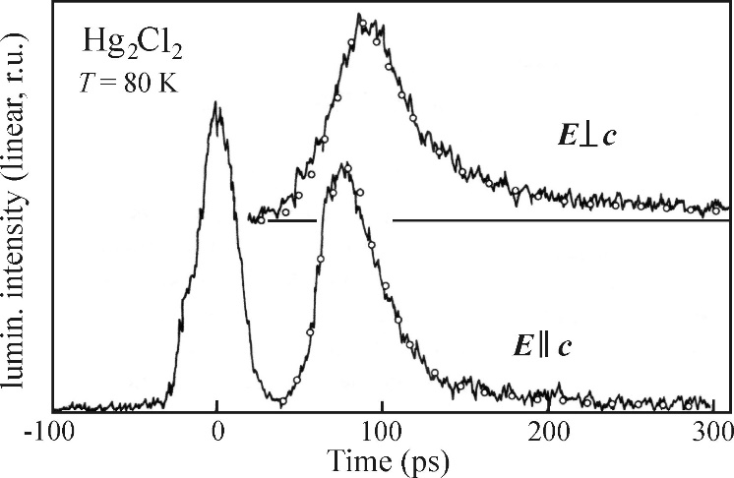
Time-resolved photoluminescence
Experimental setups and methods
Streak camera
  Converting a temporal phenomenon to a spatial one
    Enables measurements of very fast processes
    Emitted light causes electrons to be ejected, which are accelerated and swept by strong electric field
    Spatial distribution of electrons is recorded by 2D detector (CCD or other array)
  Sweeping E-field is time-correlated with incoming pulses of light
  For such fast processes deconvolution is often necessary
    The temporal profile of the excitation pulse affects the shape of the response curve, since they are of similar width
Excitation pulse

Slide 13
Kinetic description of processes
Overview
Many processes related to photoluminescence can be understood and described by relatively simple kinetic equations
Such equations are used to describe monomolecular (extrinsic) and bimolecular (intrinsic) processes.
These take the form of first order differential equations in time. It is possible to study the luminescence decay as well as steady state.
This mathematical treatment utilizes concepts of probabilities for radiative and non-radiative recombination as well as quantum yield

Slide 14
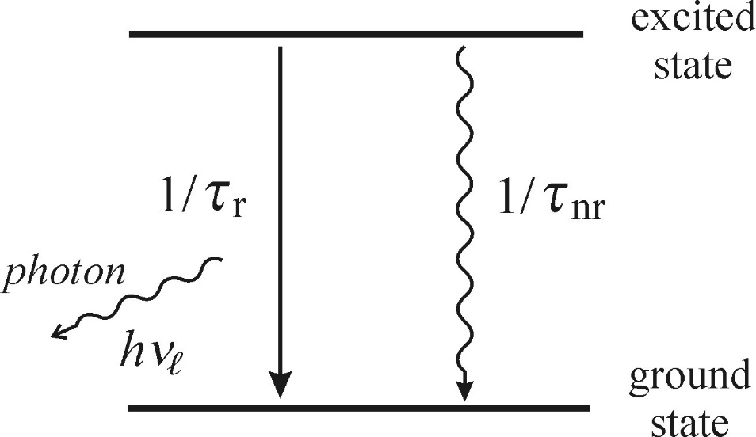

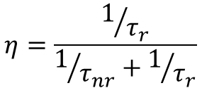
Kinetic description of processes
Recombination probability
An excited luminescence centre can return to the ground state in 2 ways
  Transmitting energy to the crystal as heat (phonon vibration)
  Losing energy by emitting a photon
These processes each has a characteristic lifetime
  The inverse of these represent the probability of the transition occuring per unit time
  The total probability of any transition occuring is given by the sum of their inverse.
They are also used to define luminescence quantum efficiency
  Defined as the fraction of the total transition events that are radiative
$$\frac{1}{τ}=\frac{1}{τ_{nr}}+\frac{1}{τ_{r}}$$
(1)
$$η=\frac{1/{τ_{r}}}{1/{τ_{nr}}+1/{τ_{r}}}$$
(2)

Slide 15




Kinetic description of processes
Recombination probability
These two equations can be combined
  Quantum efficiency expressed as ratio of lifetimes
Even for strongly luminescent materials in nature, η is usually quite small (0.1)
A lot of physical information can be extracted from these simple fractions
  Equation 3 relates two measurable quantities to a really important one
  However, the external quantum efficiency is very difficult to measure
  The extreme cases of (1) and (2) are also interesting to consider
$$\frac{1}{τ}=\frac{1}{τ_{nr}}+\frac{1}{τ_{r}}$$
(1)
$$η=\frac{1/{τ_{r}}}{1/{τ_{nr}}+1/{τ_{r}}}$$
(2)
$$η→0$$
For
$$τ_{r}≫τ_{nr} ,$$
$$τ→τ_{nr}$$
$$η=\frac{τ}{τ_{r}}$$
(3)

Slide 16
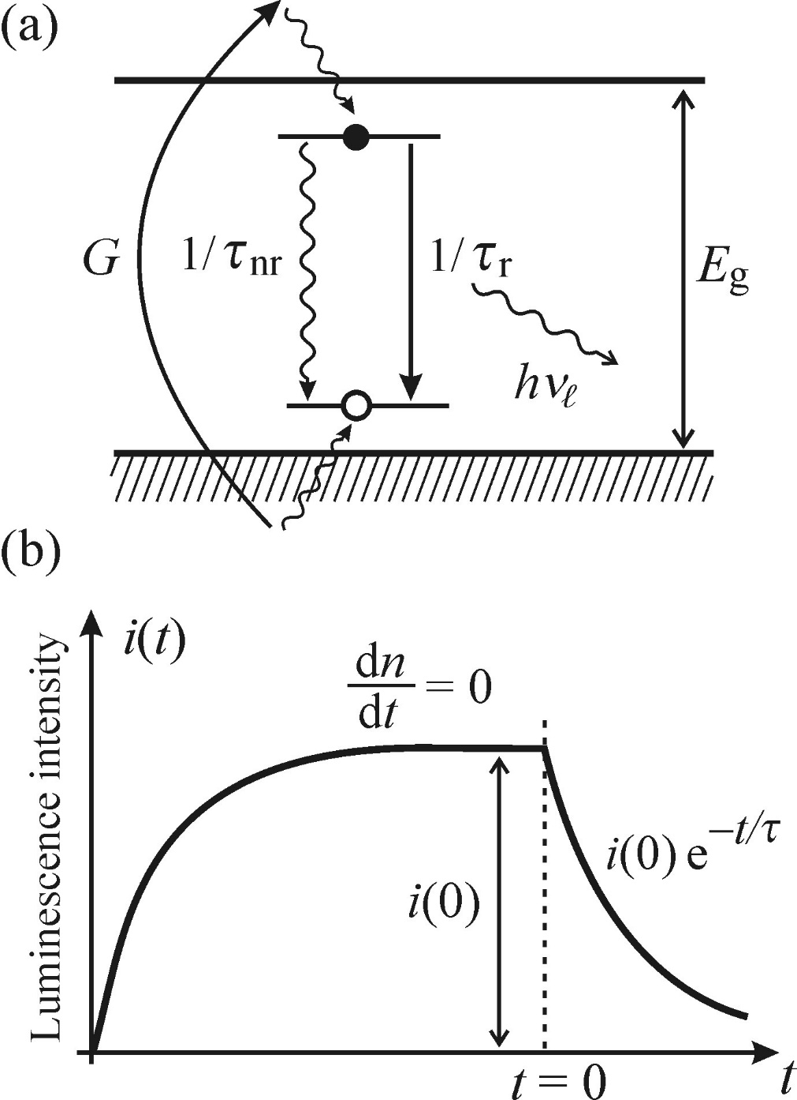



Kinetic description of processes
Process examples
Monomolecular process
Localised luminescence centre
  Extrinsic luminescence
Luminescence decay (G=0):
$$\frac{dn}{dt}=G−\frac{n}{τ}$$
$$n\left(t\right)={n\left(0\right)e}^{−\frac{t}{τ}}$$
G=0
i$\left(t\right)=\frac{n\left(t\right)}{τ_{r}}={i\left(0\right)e}^{−\frac{t}{τ}}$
Strictly single exponential

Slide 17


Kinetic description of processes
Process examples
Monomolecular process
In steady state:
  Generation term non-zero
  Generation and recombination balance out
$$G=\frac{n\left(0\right)}{τ_{r}}+\frac{n\left(0\right)}{τ_{nr}}=i\left(0\right)+\frac{n\left(0\right)}{τ_{nr}}$$
This can be linked to the excitation intensity and absorption of the sample
  It can be shown that, for a monomolecular process, the steady-state emission intensity is directly proportional to the excitation intensity
i$\left(0\right)=ηαI_{ex}$

Slide 18
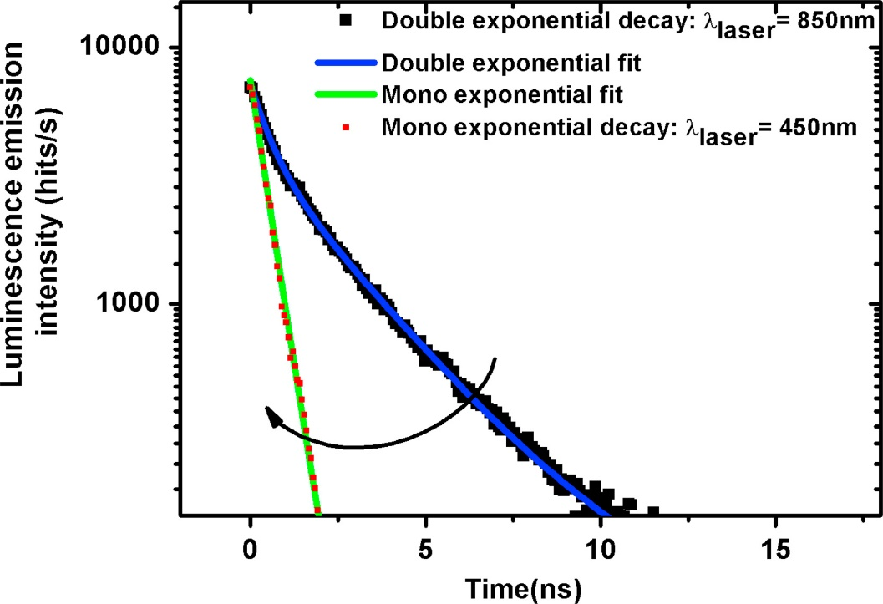

Kinetic description of processes
Process examples
Monomolecular process
Double exponential:
  Two kinds of sources of monomolecular recombination
  Modelled as a sum of two exponential decays with different amplitudes and decay times
$$i\left(t\right)=a_{1}e^{−\frac{t}{τ_{1}}}+a_{2}e^{−\frac{t}{τ_{2}}}$$
Useful when different mechanisms for recombination are dominant at different times
Triple or higher exponential fits are usually not useful
  Too many fitting parameters to carry useful information
In this paper, they report how surface defects get activated at lower wavelengths of excitation, explaining the transition from double to single exponential behaviour
G. El-Hajje, D. Ory, M.Paire, J. -F. Guillemoles, L. Lombez,“Contactless characterization of metastable defects in Cu(In,Ga)Se2 solar cells using time-resolved photoluminescence”, Solar Energy Materials and Solar Cells (2016), 143, p.462

Slide 19
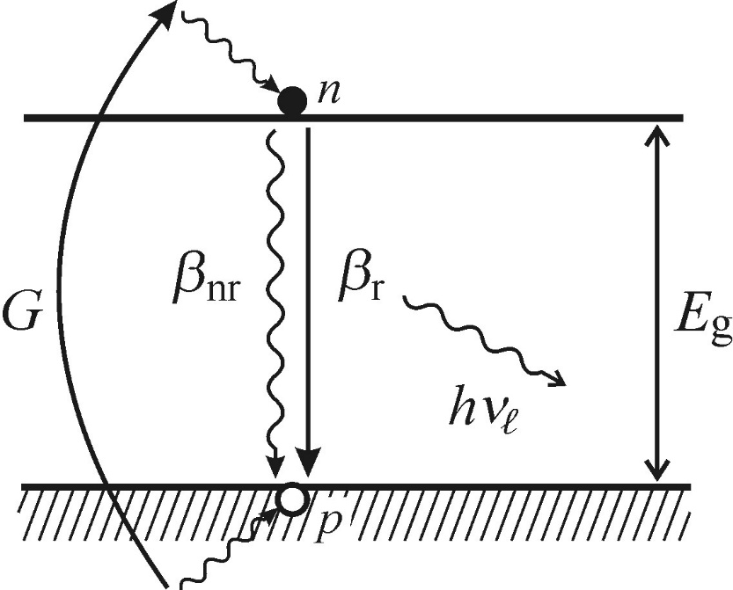



Kinetic description of processes
Process examples
Bimolecular process
Absence of defects: intrinsic process
  Rather than a localised luminescence centre, this involves the recombination of electrons and holes
  The free electrons and holes generated will diffuse along the band edge until they find a carrier to recombine with
  This depends on the electron and hole densities of the material
  These are taken to be equal for simplicity
$$\frac{dn}{dt}=G−βnp=G−\left(β_{r}n^{2}+β_{nr}n^{2}\right)=G−βn^{2}$$
Luminescence decay:
$$\frac{dn\left(t\right)}{dt}=−βn^{2}$$
$$n\left(t\right)=\frac{n\left(0\right)}{βtn\left(0\right)+1}$$

Slide 20

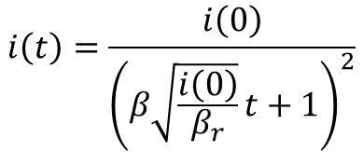


Kinetic description of processes
Process examples
Bimolecular process
Luminescence decay:
$$\frac{dn\left(t\right)}{dt}=−βn^{2}$$
$$n\left(t\right)=\frac{n\left(0\right)}{βtn\left(0\right)+1}$$
The emitted intensity is given by:
$$i\left(t\right)=β_{r}n^{2}\left(t\right)=\frac{β_{r}n^{2}\left(0\right)}{{\left(βtn\left(0\right)+1\right)}^{2}}$$
$$i\left(t\right)=\frac{i\left(0\right)}{{\left(β\sqrt{\frac{i\left(0\right)}{β_{r}}}t+1\right)}^{2}}$$
This is very different from the monomolecular case
  Power law of t⁻²

Slide 21

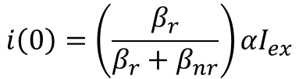
Kinetic description of processes
Process examples
Bimolecular process
Steady state:
Applying the steady-state condition
$$\frac{dn\left(t\right)}{dt}=0$$
Yields, after some algebra:
$$i\left(0\right)=\left(\frac{β_{r}}{β_{r}+β_{nr}}\right){αI}_{ex}$$
Generation term
The steady state intensity still varies linearly with excitation intensity

Slide 22
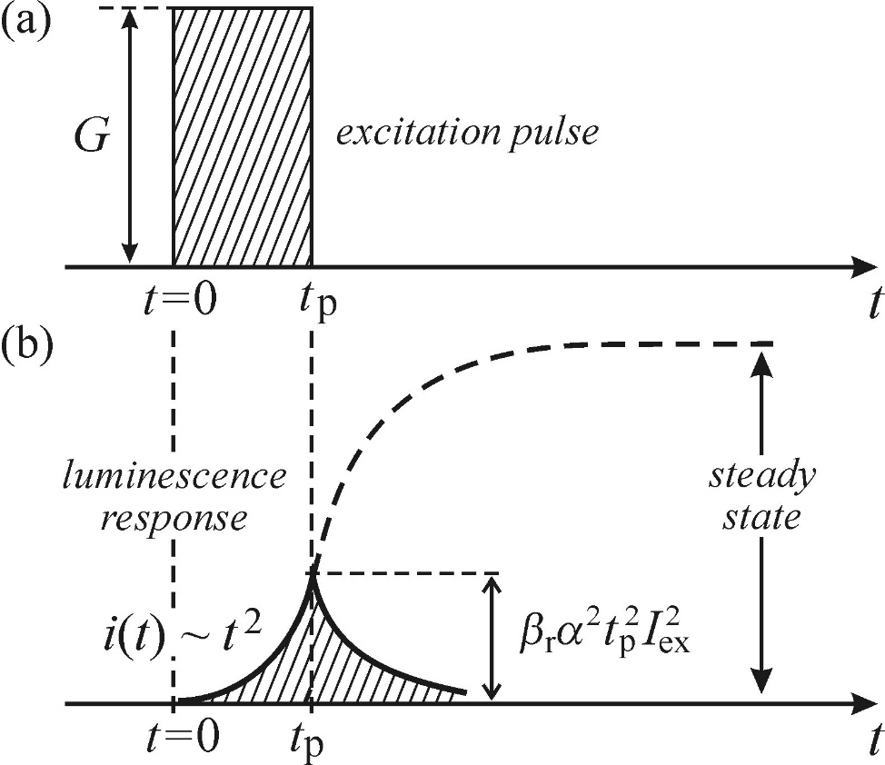
Kinetic description of processes
Process examples
Bimolecular process
Steady state:
  Depends highly on carrier density
  Usually needs powerful laser pulses for excitation for this reason
For short pulses, a different dependence emerges:
  The emitted intensity depends on the square of the excitation intensity

Slide 23
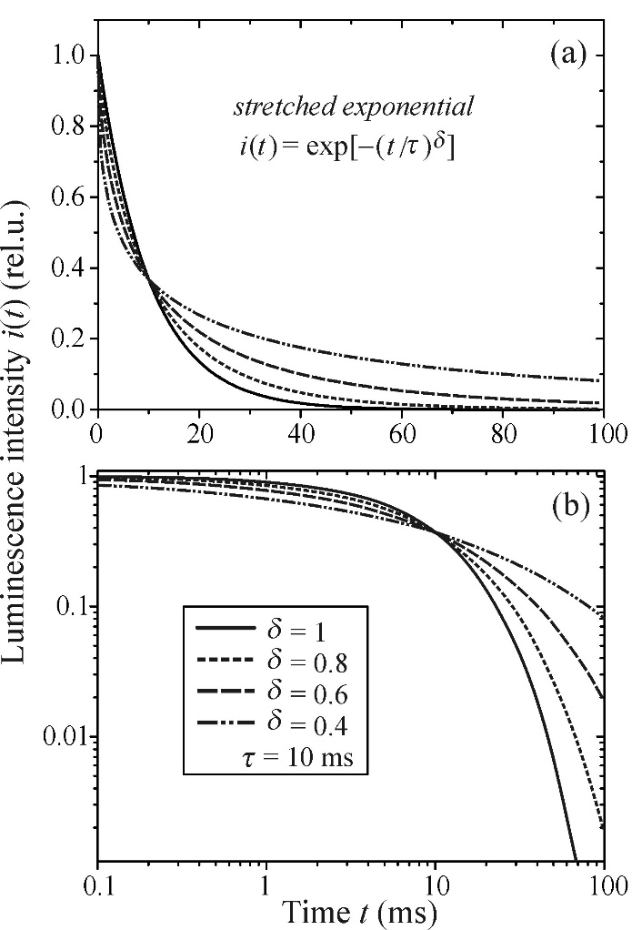

Kinetic description of processes
Process examples
Stretched exponenial
In some cases, when none of the previously mentioned models apply, luminescence decay can be described by the ”stretched exponential”:
$$i\left(t\right)=i\left(0\right)e^{−{\left(\frac{t}{τ}\right)}^{δ}}$$
Common in disordered systems
  Attributed to the dispersive diffusion of photoexcited carriers (separation of holes and electrons)
  Very good fit for amorphous semiconductors

Slide 24
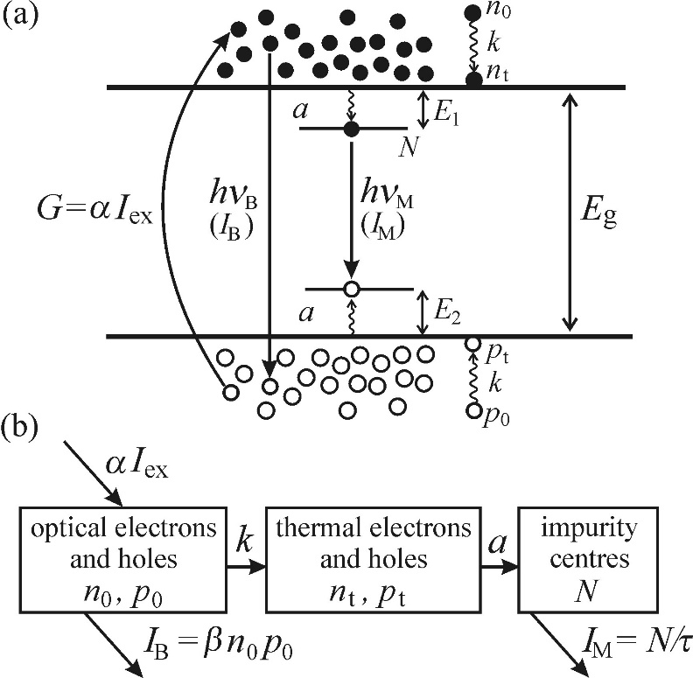
Kinetic description of processes
Process examples
Multiple simulatenous processes
Consider both monomolecular and bimolecular processes
  Free electron and hole recombination (intrinsic)
  Recombination of impurity states (extrinsic)
These processes can be distinguished
  Intrinsic and extrinsic recombination processes have different intensity dependencies
  These can be determined by considering the kinetic equation for each process

Slide 25







Kinetic description of processes
Process examples
Multiple simulatenous processes
Processes:
Recombination of optical electrons and holes
  Generation term: αI_{ex}
  Recombination coefficient: β
Generation of thermal carriers by thermalization of optical carriers
  Generation rate: k
Capture of thermal electron and hole by impurity, exciting it.
  Capture coefficient: a
  Conc. of impurities: N₀
  Conc. of excited impurities: N
Excited impurities luminesce
  Recombinations/volume: N/τ
$$\frac{dn_{0}}{dt}=αI_{ex}−βn_{0}p_{0}−kn_{0}$$
$$\frac{dn_{t}}{dt}=kn_{o}−a\left(N_{0}−N\right)n_{t}$$
$$\frac{dN}{dt}=a\left(N_{0}−N\right)n_{t}−\frac{N}{τ}$$
ALSO
$$η=1$$
$$β=β_{r}$$
$$τ=τ_{r}$$
$$n_{0,t}=p_{0,t}$$

Slide 26




Kinetic description of processes
Process examples
Multiple simulatenous processes
In the steady state, after some algebra, we obtain expressions for the mono- and bimolecular intensities as functions of excitation intensity
There are two distinct sets of behaviours – one for weak excitation and one for strong excitation.
Weak excitation:
Strong excitation:
$$I_{B}=\frac{α^{2}β }{k^{2}}I_{ex}^{2}$$
Bimolecular
$$I_{B}=αI_{ex}$$
Monomolecular
$$I_{M}=αI_{ex}$$
$$I_{M}=\frac{N_{0}}{τ}$$

Slide 27
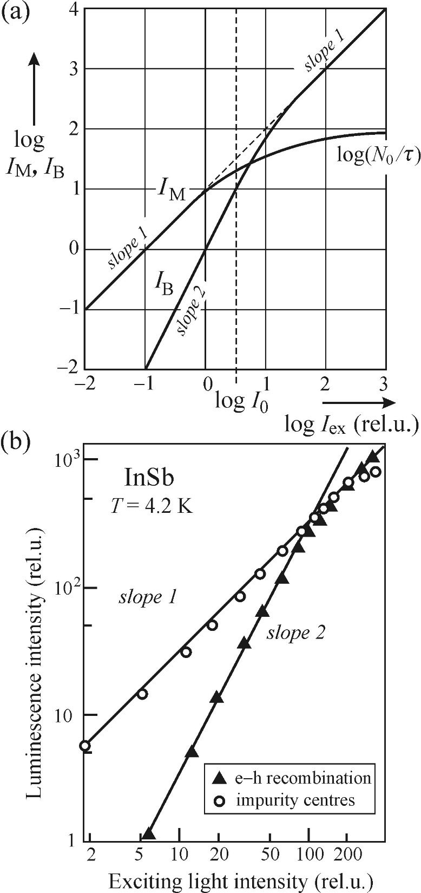




Kinetic description of processes
Process examples
Multiple simulatenous processes
Weak excitation:
Strong excitation:
$$I_{B}=\frac{α^{2}β }{k^{2}}I_{ex}^{2}$$
$$I_{B}=αI_{ex}$$
$$I_{M}=\frac{N_{0}}{τ}$$
$$I_{M}=αI_{ex}$$
For weak excitation, almost all exctied carriers recombine at impurities
The carrier density is too low for efficient bimolecular recombination
Most exctied carriers are trapped at impurities
For strong excitation, the monomolecular recombination saturates and becomes independent on the excitation intensity
The bimolecular recombination becomes linearly dependent on the exciation density, in the same way as I_{M} for weak excitation

Slide 28
Kinetic description of processes
Concluding remarks
Kinetic equations are helpful in that they can offer a basic idea about what type of recombination processes are present, both in the temporal character of the decay curve and in the excitation dependence of the radiated intensity
However, there are limits to the usefulness of the approach. For instance, high excitation can substantially alter the behaviour of carrier kinetics. For very high excitation, there are even situations where distinguishing between monomolecular and bimolecular processes does not make sense.

Slide 29
Phonons
Overview
Luminescence occurs primarily due to transitions between energy levels originating from the electronic configuration outer shells
However, optical effects due to the interaction with lattice vibrations are readily observeable.
Lattice vibrations can be described as vibrational quanta, called phonons, stemming from a collective behavior of the crystal.
The role of lattice vibrations in luminescence can be described in terms of phonons interacting with other particles or partaking in processes

Slide 30
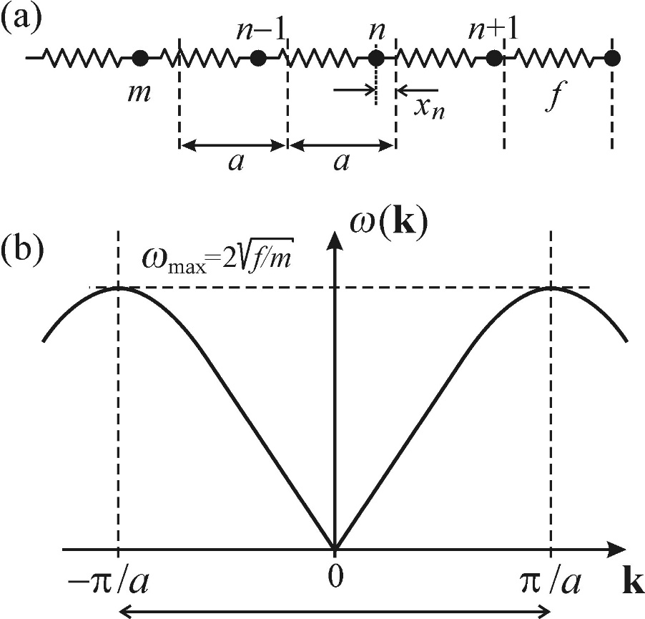
Phonons
Classical treatment
Atoms in a lattice:
  Can be described as a string of masses that oscillate around their equilibrium points (in 1D)
  If oscillations are small (low T), these can be modelled as masses connected by springs – harmonic oscillators
  The equations of motion of this set of masses can be solved by considering the collective behaviour of the system, resulting in a solution in the form of a wave running along the string
  This also yields the dispersion relation for the system, which is periodic with a period of 2π/a.

Slide 31
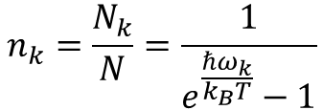
Phonons
Classical treatment
The vibrational behavior can be quantized and we can define a phonon distribution function:
$$n_{k}=\frac{N_{k}}{N}=\frac{1}{e^{\frac{ℏω_{k}}{k_{B}T}}−1}$$
Which describes the mean number of phonons in a given quantum state.
This shows a strong dependence of the phonon population on temperature.

Slide 32
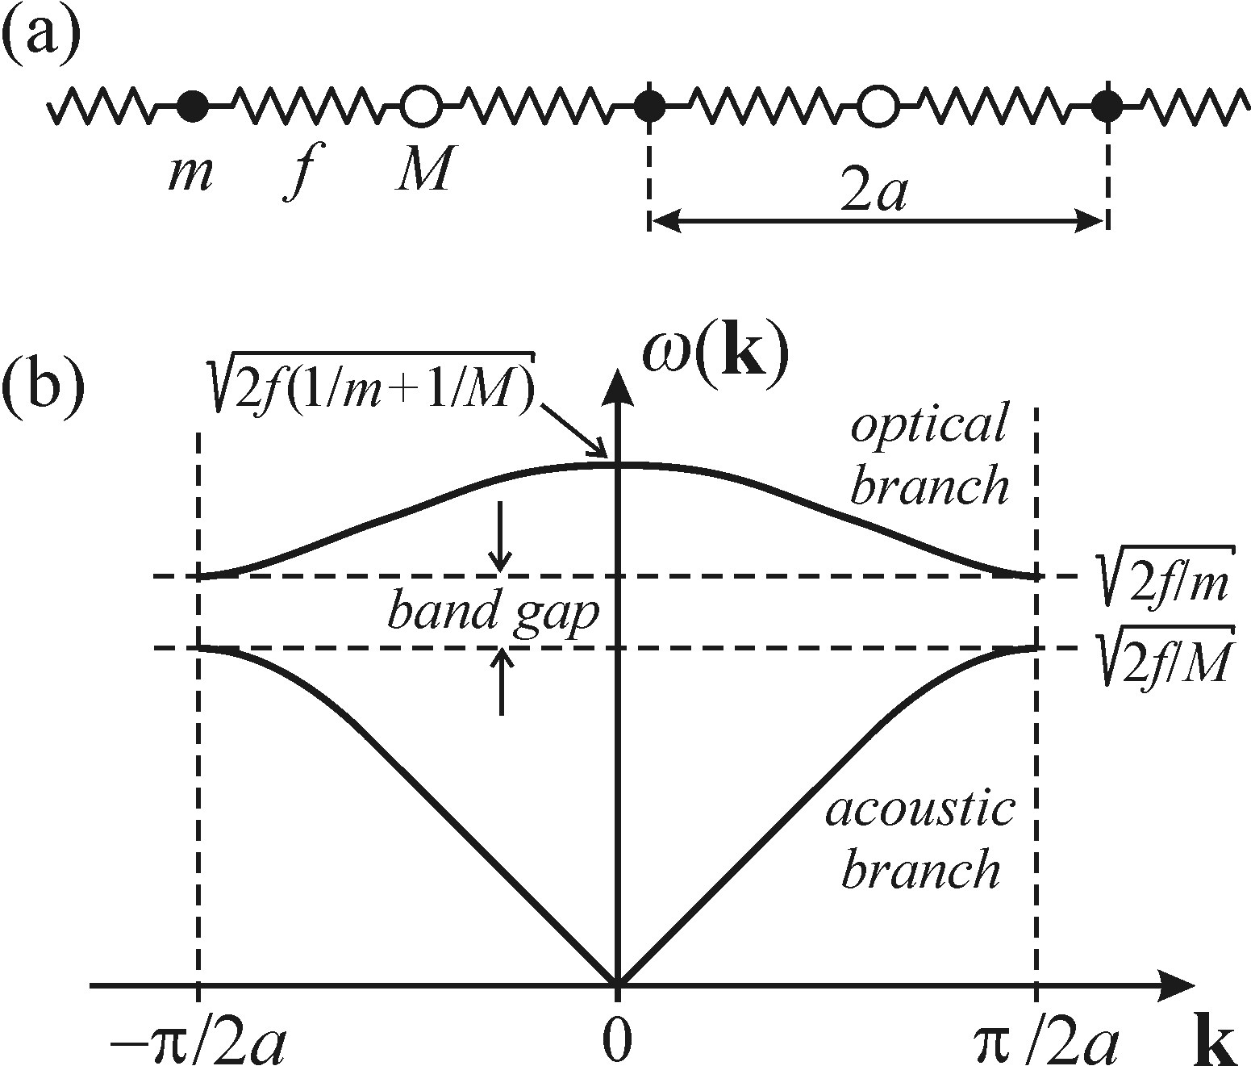
Phonons
Classical treatment
The 1D model can be applied to a 3D system
  A second type of particle with different mass is added to the string
  The resulting model can be used to describe the basic features of vibrations in a 3D crystal
  This includes the optical and acoustic phonon modes
  Transverse modes can also be modelled, where the masses on the string are allowed to vibrate perpendicularly to the direction of the wave motion

Slide 33
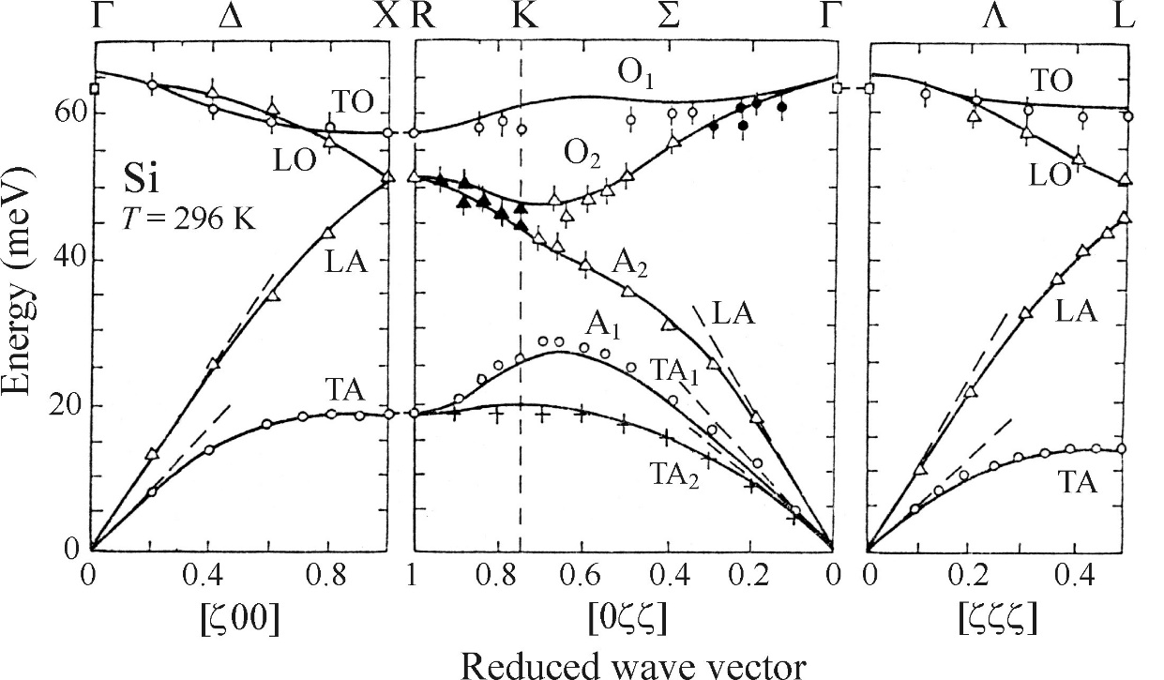
Phonons
Classical treatment
In a real 3D crystal:
  Concepts of TO, TA, LO, and LA modes are still valid
  Dispersion relations become more complicated
  This is due to various effective spring constants being present along different directions with different electron densities et.c.

Slide 34
Phonons
Exciton-phonon and electron-phonon interactions
There are 3 main ways in which phonons interact with excitons and electrons:
The deformation potential
The piezoelectric mechanism
The Fröhlich mechanism

Slide 35

Phonons
Exciton-phonon and electron-phonon interactions
The Deformation Potential
Electron-hole energies are sensitive to interatomic distance
  External forces on a semiconductor cause changes in its bandgap
  Similar effects exist due to lattice vibrations
  In the case of a long-wavelength longitudinal acoustic phonon, it can be expressed in terms of the relative change in volume of the sample:
Volume deformation potentials are usually given as relative between two energy levels
  This is because they are very hard to measure individually
Such values can be negative or positive
  For a positive value, a higher pressure increases the band gap and blue-shifts edge emission luminescence lines.
$$δE_{kn}=a\left(k,n\right)\left(δV/V\right)$$
n: indicates valence or conduction band
a(k,n): Volume deformation potential at k. Usually taken at the Γ point, where k=0.

Slide 36
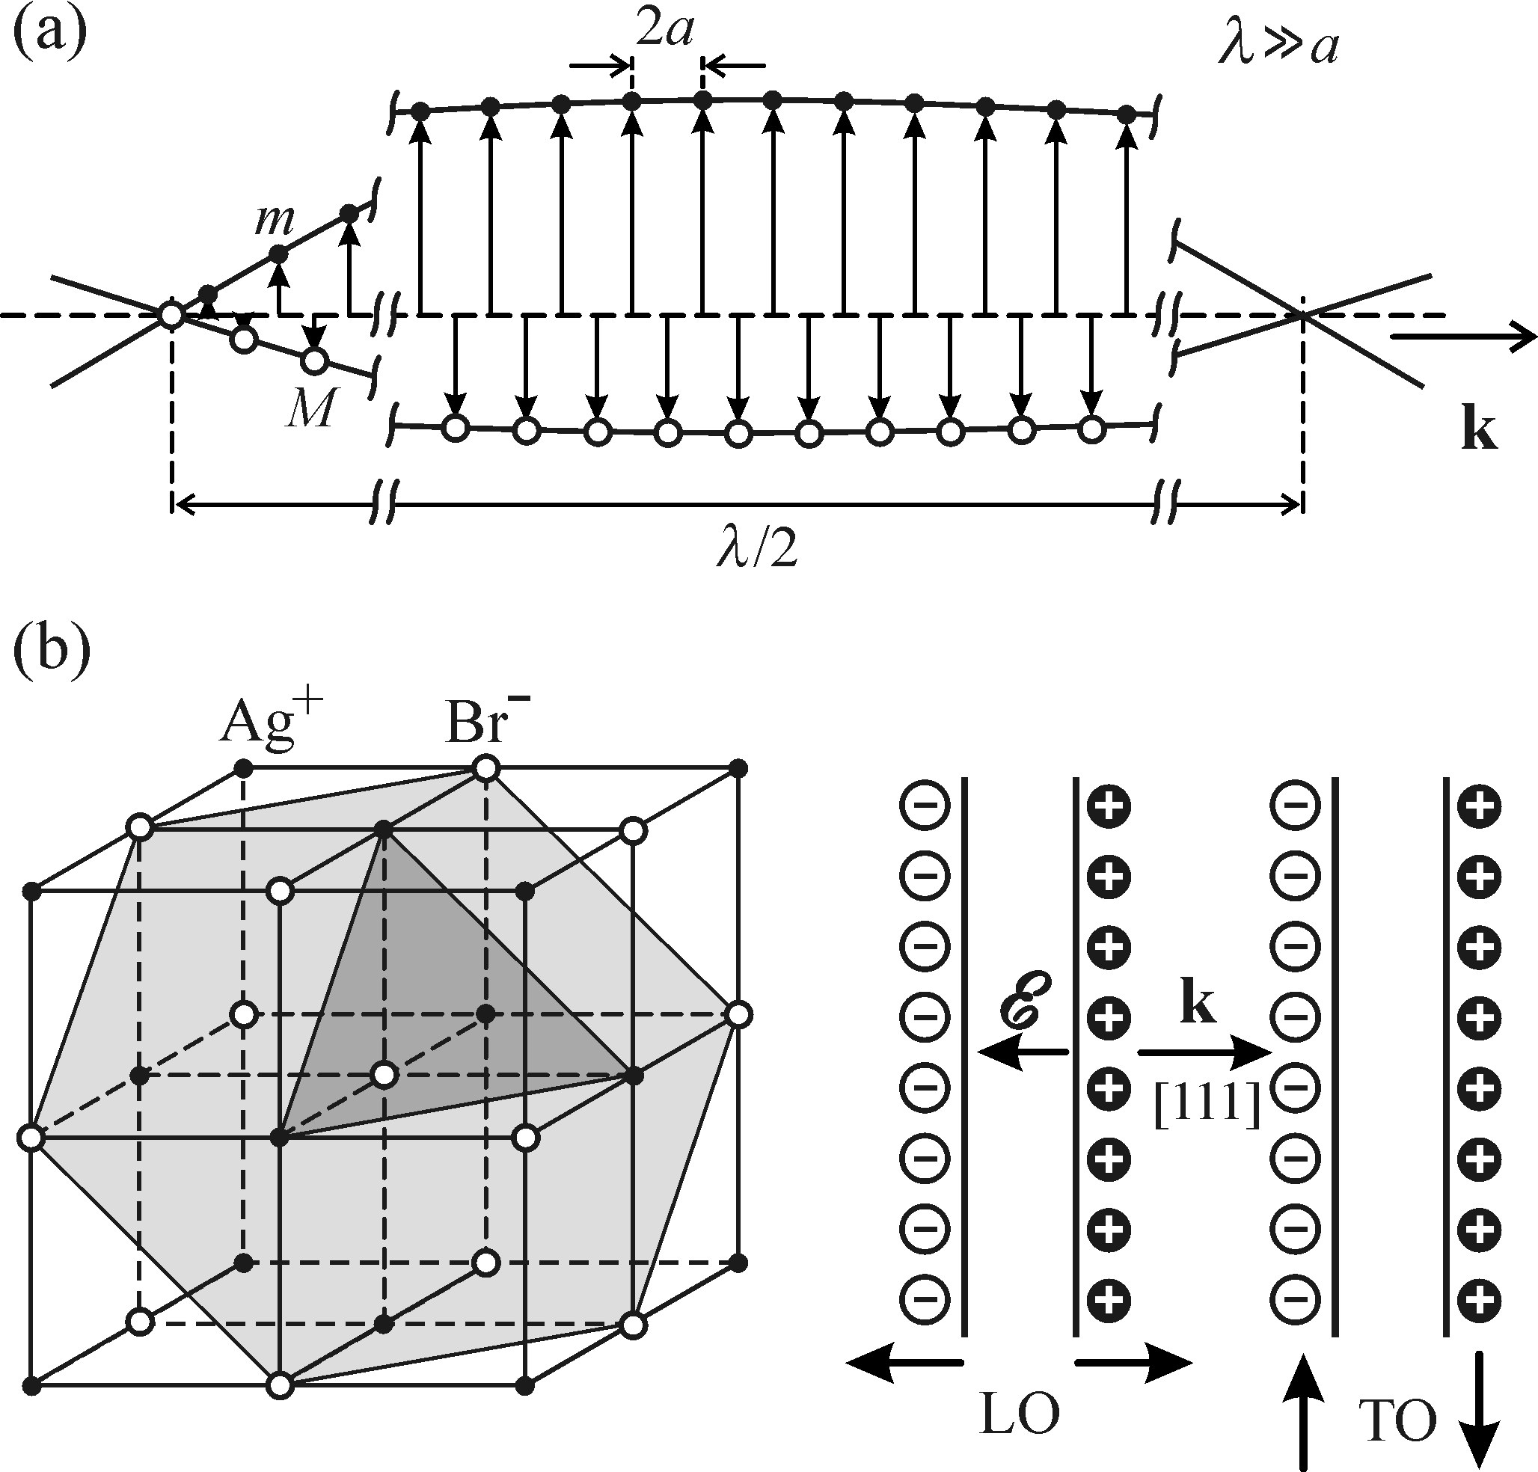
Phonons
Exciton-phonon and electron-phonon interactions
The piezoelectric mechanism
In some materials, mechanical deformation can result in an electric field building up inside the material
This can also happen for deformations varying in time, shifting the distance between interatomic layers.
LA phonons can cause such motion. This is particularly true for longer wavelengths.
This effect is quite weak and usually screened by free carriers.

Slide 37
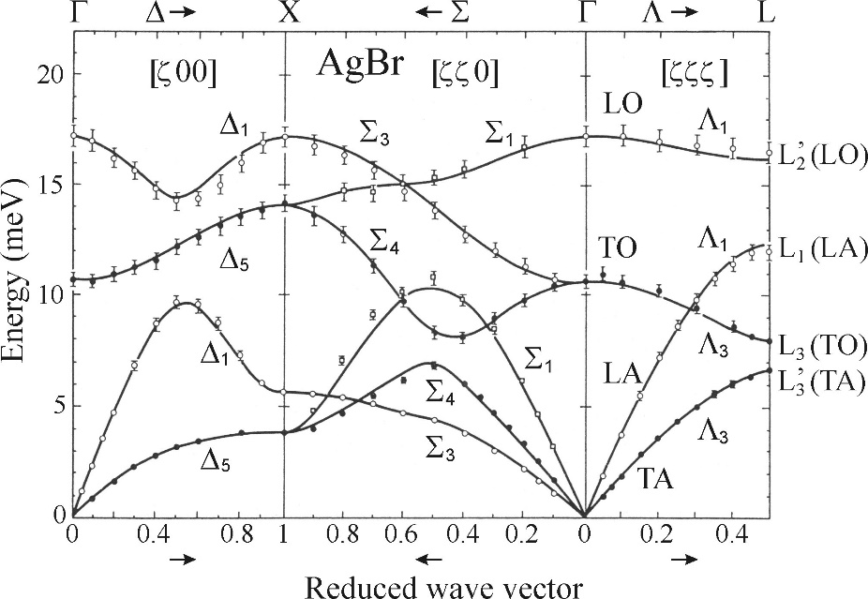
Phonons
Exciton-phonon and electron-phonon interactions
The Fröhlich Mechanism
Long wavelength LO phonons inducing long range electric field
  The most important phonon-exciton interaction
  The electric field polarizes the crystal, which manifests as increased effective electron and hole masses
  Only happens in ionic crystals, and only for LO phonons
  Because of this, long wavelength LO phonons always have higher energies than TO phonons in ionic crystals
  The Fröhlich electron-phonon coupling increases with the bond ionicity of the material.

Slide 38
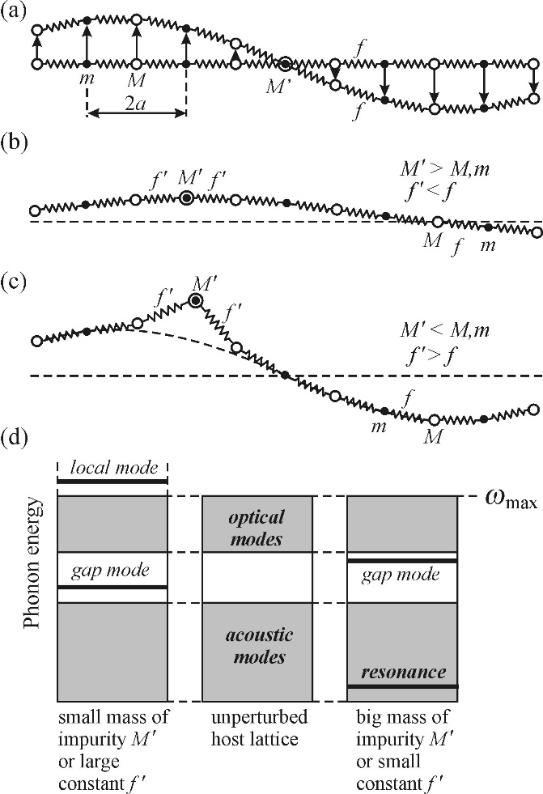
Phonons
Point defects
Vibrations near impurity
Impurity atom mass M’ - 3 cases:
Lattice vibrations are undisturbed as long as the impurity is situated at a node
Resconance mode – if the impurity is heavy, a lower frequency mode appears to which vibrational energy gets transferred by surrounding unperturbed areas.
Local mode – if the impurity is light, a mode appears with a frequency higher than allowed for the unperturbed system. The energy of this mode decreases rapidly away from the impurity
The presence of these types of impurities breaks the lattice symmetry and can affect raman measurements

Slide 39
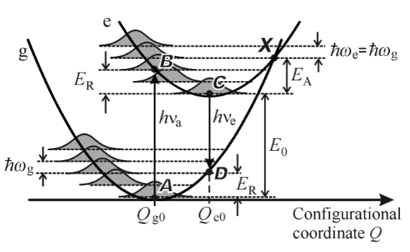
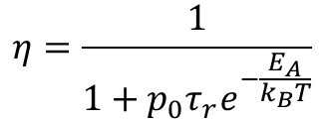
Phonons
Point defects
Thermal quenching
At low T, transitions from the excited state to the ground state via point X is unlikely due to the lack of thermal vibrations.
As the temperature increases, the system is more likely to reach point X through thermal vibrations supplying the activation energy E_{A}.
This leads to a dependence of the luminescence quantum efficiency on temperature such that:
$$η=\frac{1}{1+{p_{0}τ}_{r}e^{−\frac{E_{A}}{k_{B}T}}}$$
Where p₀ is the frequency factor.

