Slide 1

Radiative and non-radiative recombination in semiconductors
Hui Chen
20190924
Wallenberg Wood Science Center
Department of Fiber and Polymer Technology

Slide 2
Introduction
An excited luminescence center loses its electron excitation energy after a certain relaxation time and goes into the ground state. The transition can occur in two ways:
Radiative recombination
The excitation energy is radiated away in the form of a luminescence photon
Non-radiative recombination
The excess energy is transmitted in the form of heat (vibrations) to the crystal lattice or it can possibly cause photochemical changes in the crystal matrix or generate a lattice defect.

Slide 3
Introduction
Classification of luminescence processes (according to the intensity of excitation)
low-fluence or weak excitation processes
a gas-discharge lamp, an incandescent lamp or a continuous-wave gas laser with the output power of the order of 0.01–10W/cm²
high-fluence (strong) excitation processes
a pulsed laser with excitation intensity of the order of 1 kW–10MW/cm²

Slide 4
Radiative recombination in semiconductors
Radiative recombination in semiconductors
The excitation energy is radiated away in the form of a luminescence photon
Recombination of
free electron—hole pairs
a free electron with a neutral acceptor (e-A⁰) and of a free hole with a neutral donor (h- D⁰)
donor—acceptor pairs (D⁰—A⁰)
Luminescence excited by two-photon absorption
Luminescence from transition metal and rare earth ion impurities

Slide 5
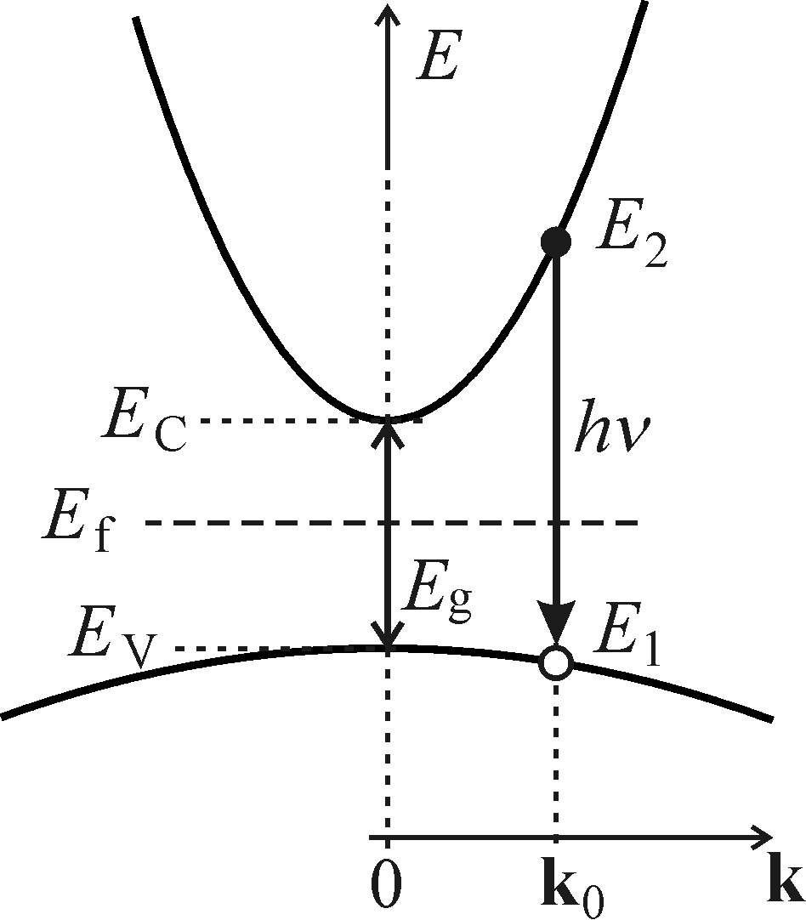
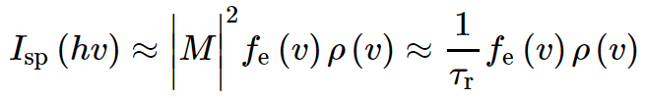
Radiative recombination in semiconductors electron—hole pairs
Recombination of free electron—hole pairs
Direct bandgap case
Probability density Isp(hν) of the spontaneous emission of a photon with energy hν = E2-E1
Based on Fermi's golden rule
1. the probability of occupancy of conduction and valence band states fe(ν);
2. the quantum-mechanical probability of this transition described by the square of the matrix element of the transition |M|²;
3. the joint density of electron and hole states ρ(ν) in the corresponding bands.
Notes:
An electron with energy E ₂ situated close to the minimum of the conduction band spontaneously recom-bines with a hole situated at the top of the valence band with energy E ₁ and wavector k ₀ via a direct vertical transition.

Slide 6


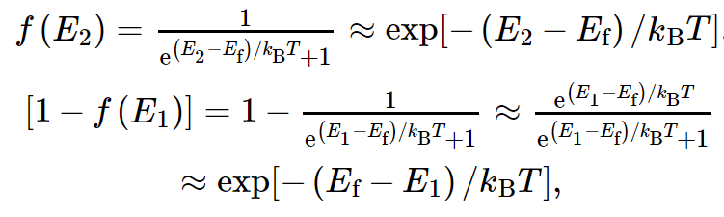

Radiative recombination in semiconductors electron—hole pairs
Factor 1: The probability of occupancy - fe(ν)
where
Fermi-Dirac distribution function
If: low temperature and
k _{B} T ≪ (E _{g}/2) ≈ E ₂-E _{f} ≈ E _{f}-E ₁
Notes:
Fc: The probability of occupancy for an electron at conduction band. Fv: The probability of occupancy for a hole at valence band. At low-fluence excitation, the semiconductor can be treated as if it is still in thermal equilibrium, i.e. the Fermi level stays localized in the middle of the bandgap at low temperature . 1.380649 × 10^-23 J/K

Slide 7
Radiative recombination in semiconductors electron—hole pairs
Factor 2: The quantum-mechanical probability (described by the square of the matrix element of the transition - in the dipole approximation |M|²)
M can be considered to be constant to a very good approximation over a wide range of wavevectors close to the extremes of the bands.
Bebb, H. B. and Williams, E. W. (1972). Photoluminescence I. Theory. In Semiconductors and Semimetals (ed. R. K.Willardson and A. C. Beer), Vol. 8, p. 181. Academic Press, New York.
Notes:
the strength of the coupling between the initial and final states of the system (described by the square of the matrix element of the perturbation)

Slide 8
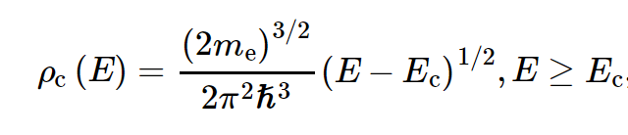
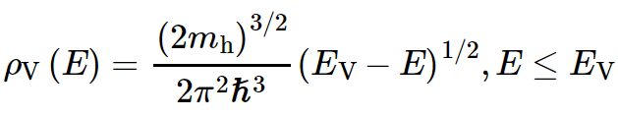
Radiative recombination in semiconductors electron—hole pairs
Factor 3: The joint density of states ρ(ν)
The densities of states in the individual bands:
Kittel, C. (1976). Introduction to Solid State Physics, 5th edn. John Wiley, NewYork.
Saleh, B. E. A. and Teich, M. C. (1991). Fundamentals of Photonics. John Wiley, New York.
Notes:
m e and m h stand for the effective masses of an electron and a hole, respectively

Slide 9
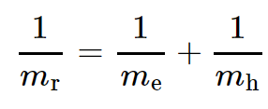

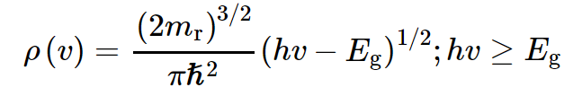
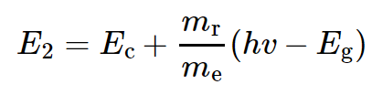
Radiative recombination in semiconductors electron—hole pairs
Using the incremental relation
ρ_{c}(E 2)dE 2 = ρ(ν)dν
Notes:
Mr reduced mass of the electron and hole

Slide 10
Radiative recombination in semiconductors electron—hole pairs
The shape of the luminescence spectrum is also called the Maxwell-Boltzmann distribution
is a parameter independent of the photon energy hν
Notes:
The factor ν² comes from the photon density of states in three dimensions, which equals 4ν ²/c ³ in free space. ,Taking into account the already mentioned narrow spectral width and high optical frequencies (FWHM/hν) ≤ 0.01, how-ever, makes it possible to consider ν ² a constant, and thus to neglect the influence of this term on the spectral lineshape.

Slide 11
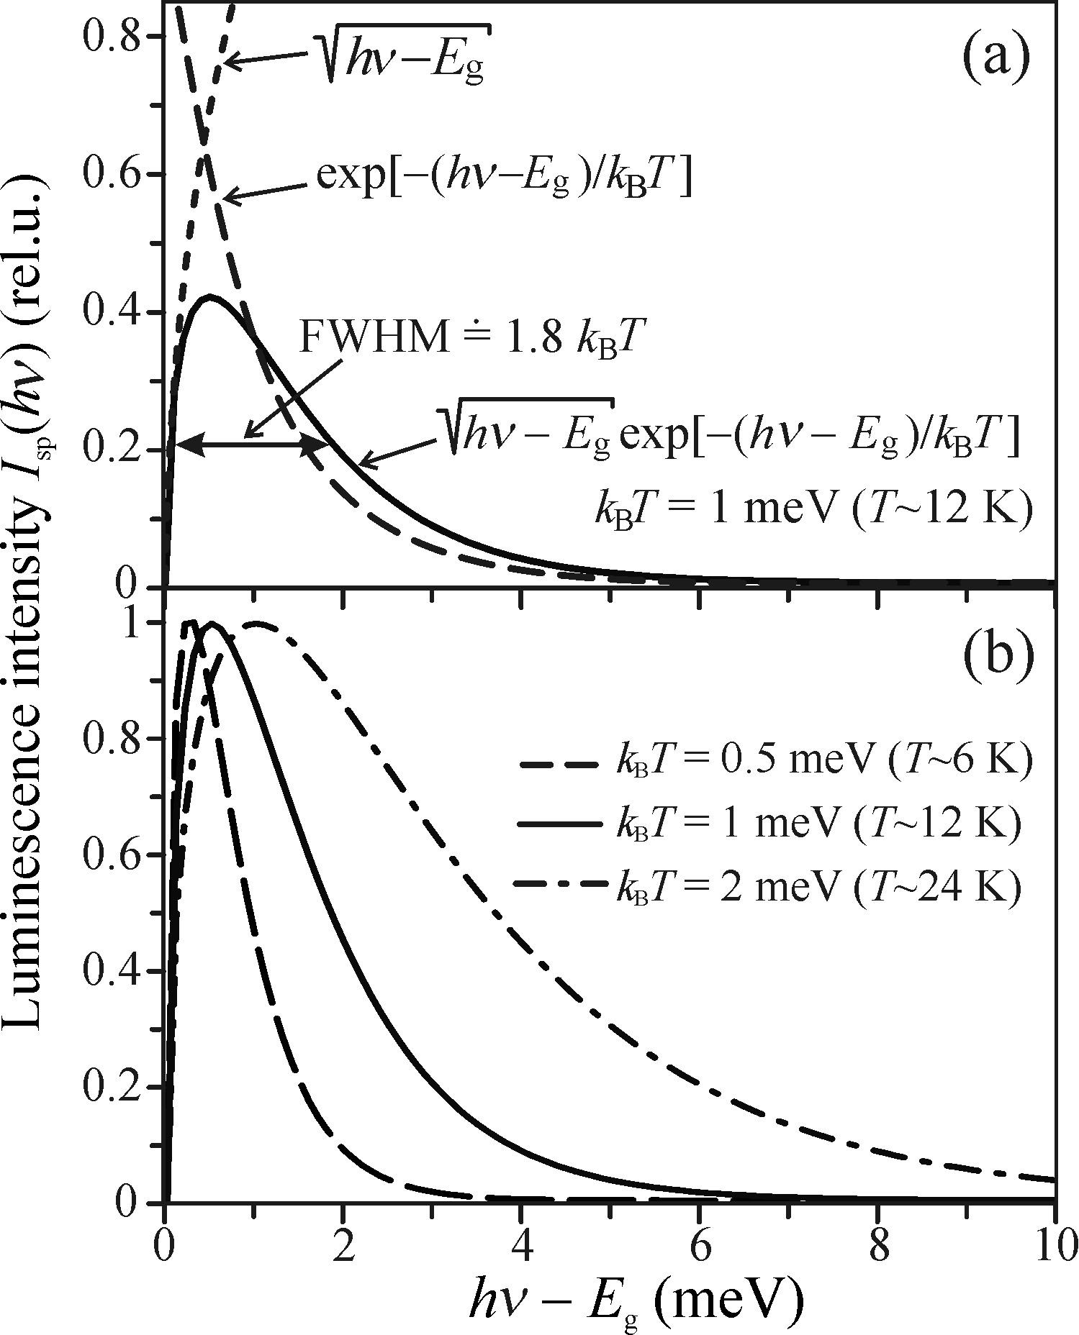

Example 1
Radiative recombination in semiconductors electron—hole pairs
Asymmetric curve with a tail towards the high-energy photon side
Reason: stems from the kinetic energy of recombining free electrons and holes/described by exponential distribution function
The Boltzmann tail of the Fermi-Dirac distribution broadens with increasing temperature
Notes:
Thus, photons with higher energy are generated by these higher-energy electron-hole pairs, while the low-energy onset of the spectral line is determined by E _{g} and its position remains fixed.

Slide 12
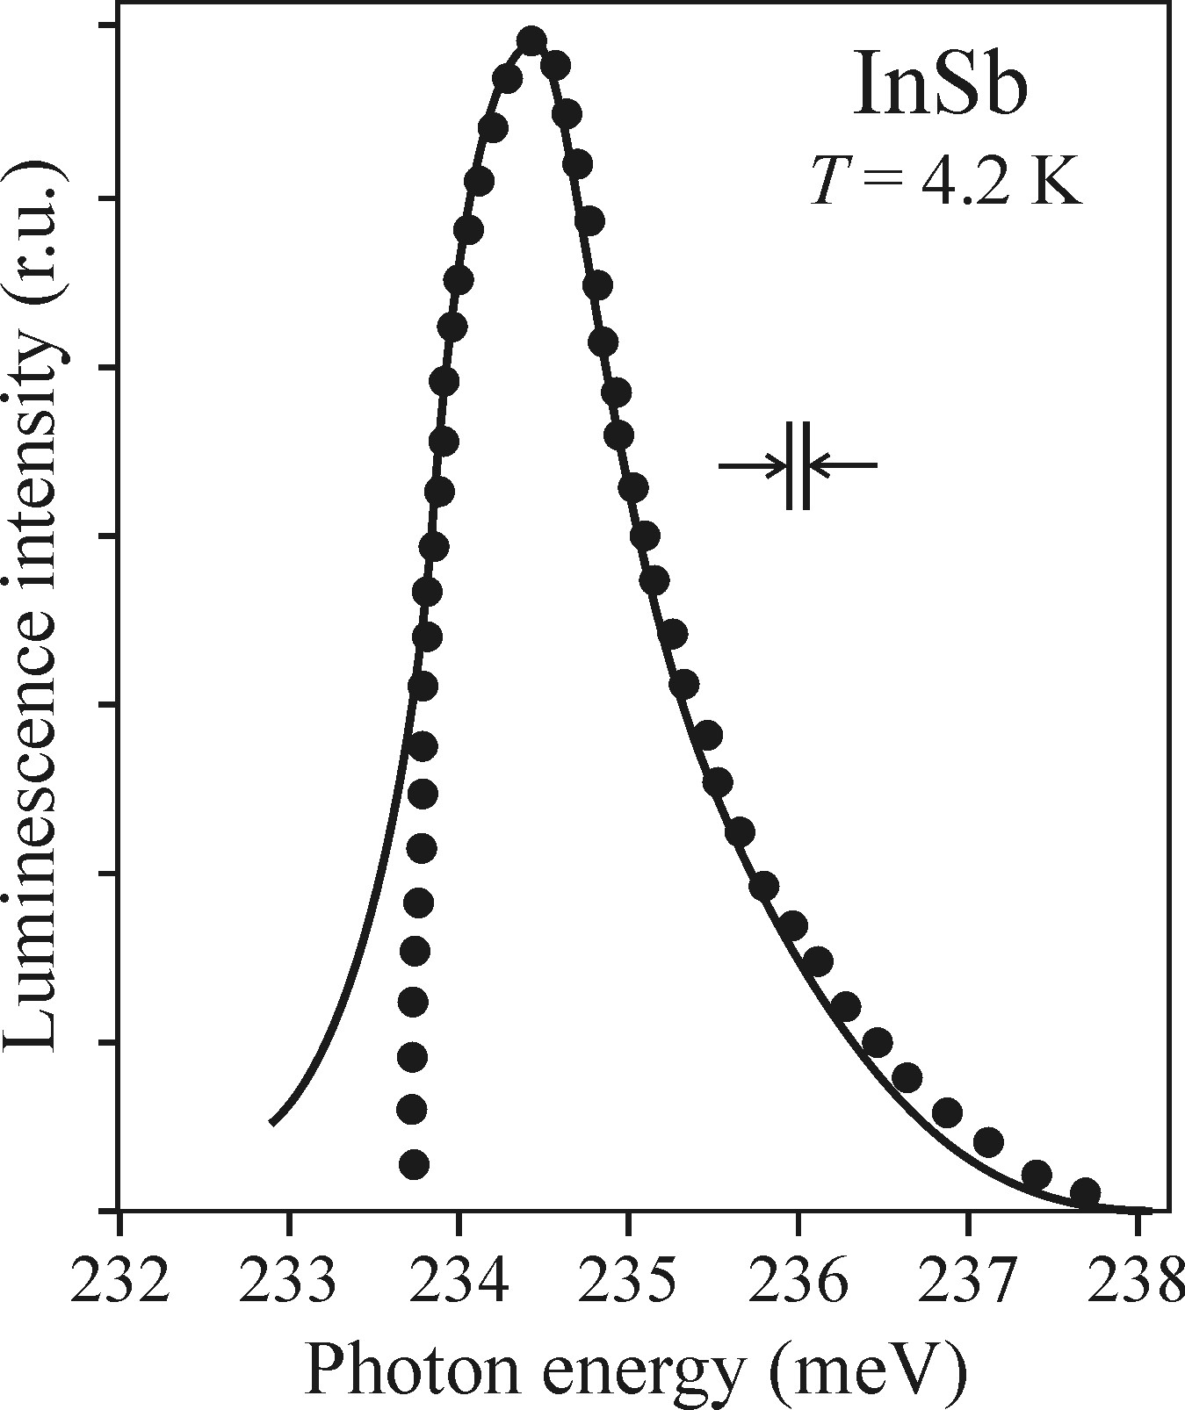
Radiative recombination in semiconductors electron—hole pairs
Example 2
Mooradian, A. and Fan, H. Y. (1966). Phys. Rev., 148, 873.
Luminescence of electron-hole pairs in Indium antimonide (InSb) at 4.2K
One possible reason for the difference at the low-energy side: influence of the slit of the monochromator, which smears the sharp onset of luminescence
Notice: for InSb, very narrow bandgap (E _{g} ~ 0.23eV at T = 4.2K), low exciton binding energy
ensure that even at low temperatures excitons are thermally dissociated.
In nearly all other semi-conductive compounds, free electrons and holes and their luminescence are practically absent.
Soldid curve—experiment
Circles—theoretical lineshape
Notes:
the radiative recombination of free electrons and holes is a scarcely encountered process
low-temperature luminescence is dominated by excitonic effects,

Slide 13
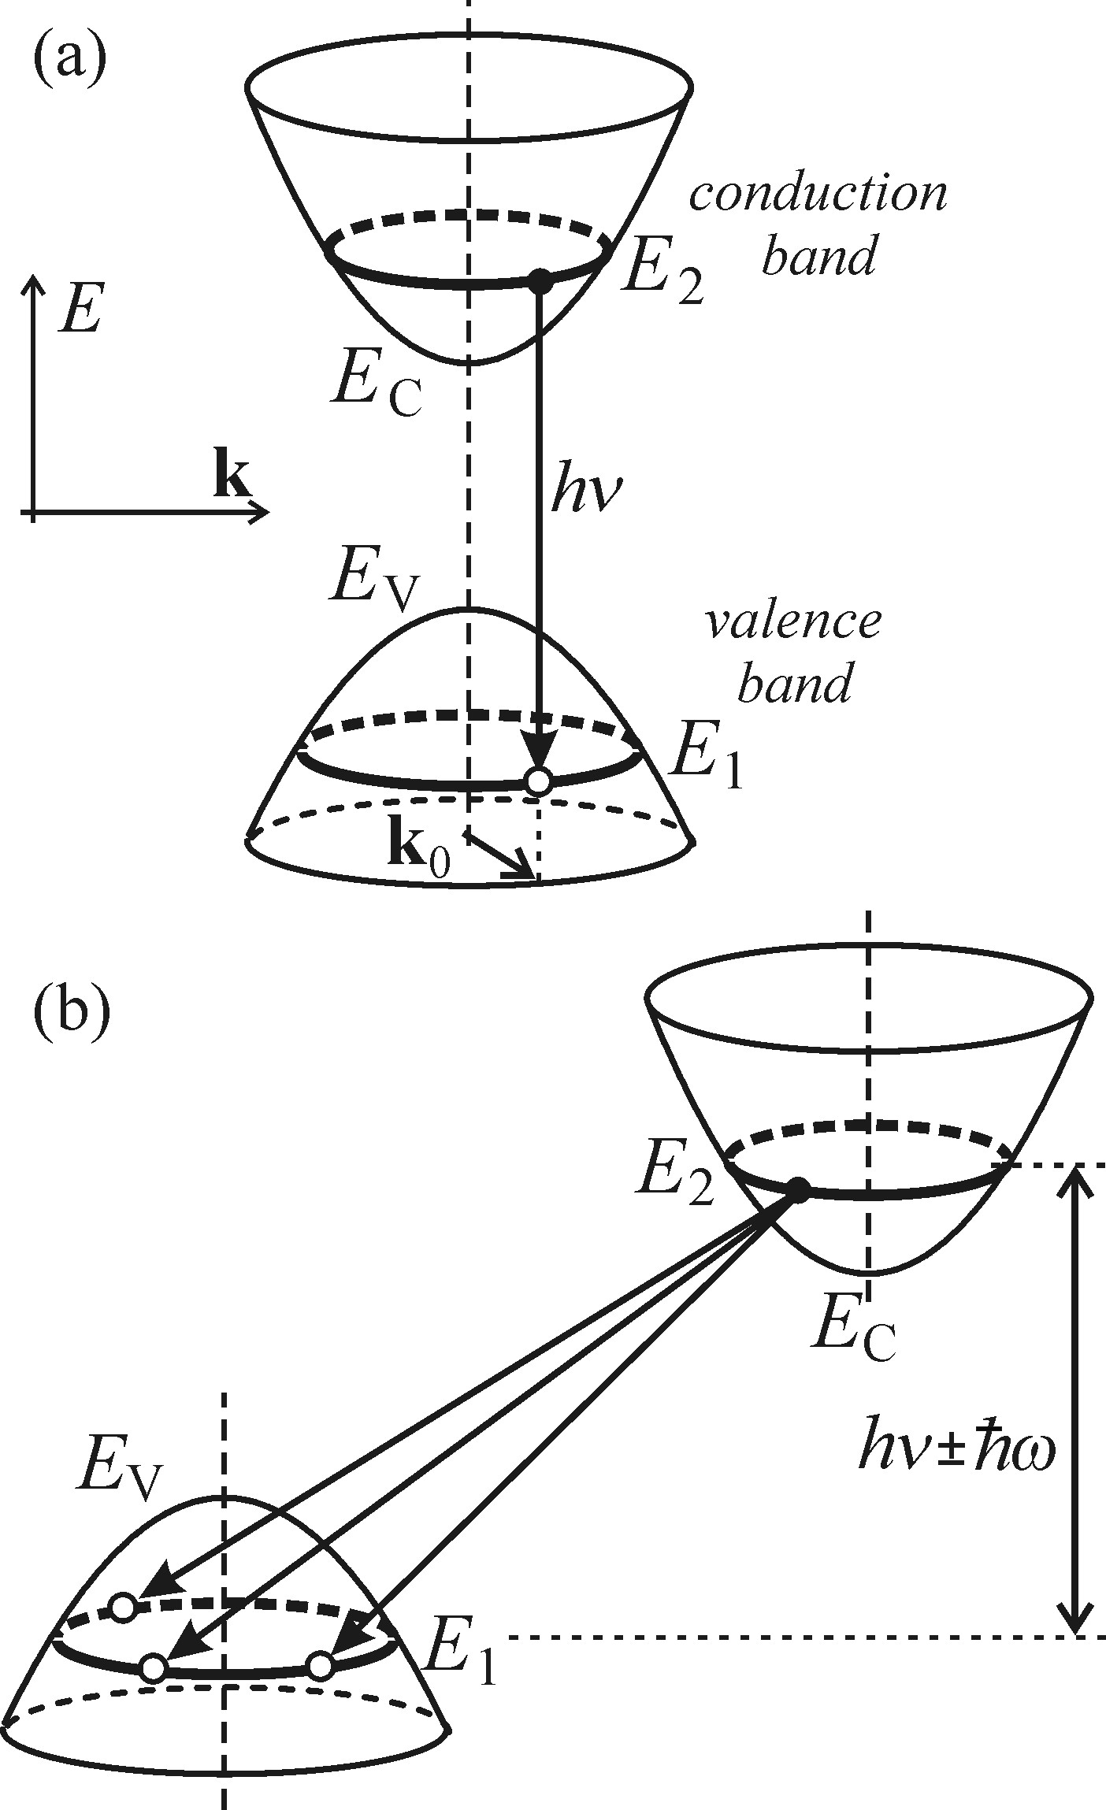
Indirect bandgap case
Radiative recombination in semiconductors electron—hole pairs
Direct-bandgap - same wavevector k ₀
Indirect-bandgap - varying values of k
The electron excitation energy is released both in the form of luminescence and as an additional vibration energy of the lattice: E ₂-E ₁ = hν + hω
The probability density of spontaneous emission of a luminescence photon with energy hν = (E ₂-E ₁)-hω is then carried out by summing all of the contributions over the curves
Notes:
hω denotes the energy of a phonon, which is to ensure the conservation of quasi-momentum: k _{hω} = |k(E ₂)-k(E ₁)|

Slide 14
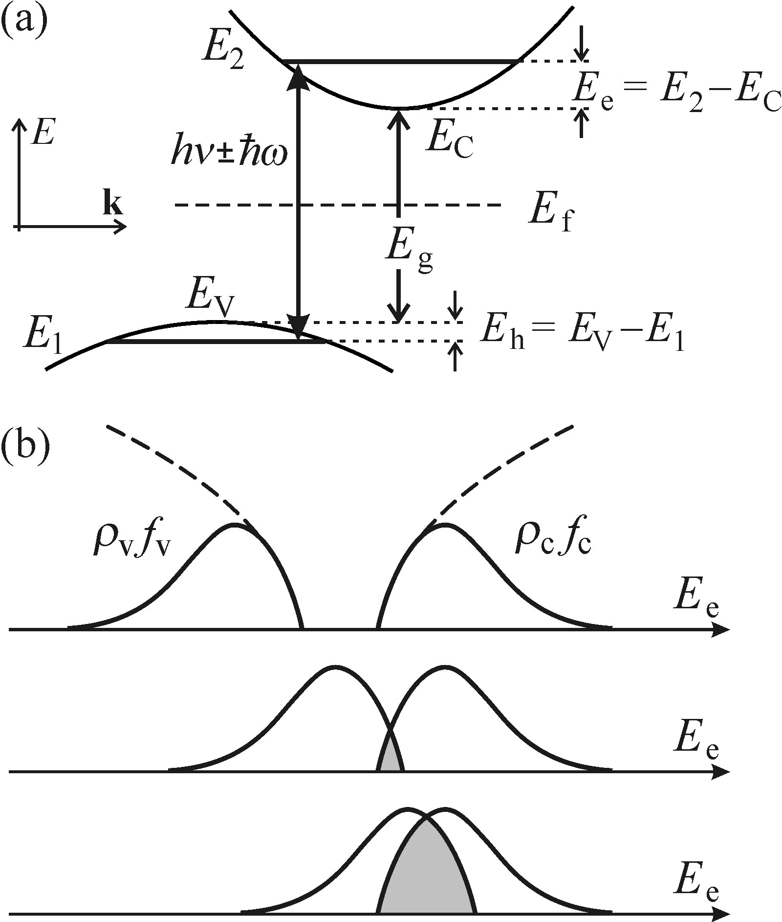
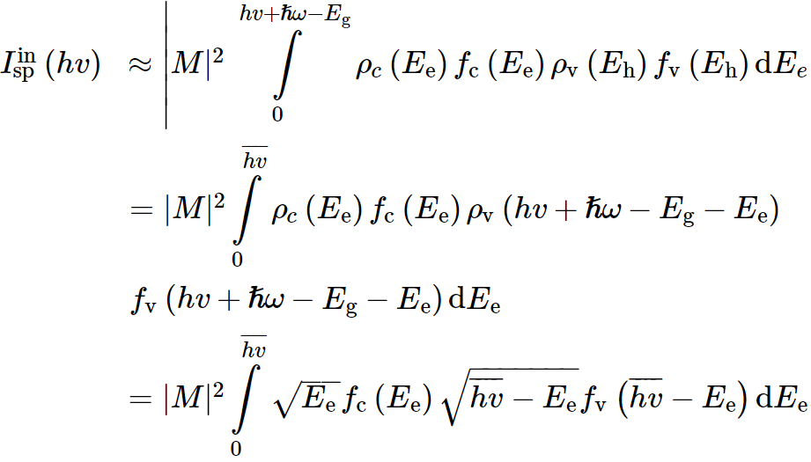


Radiative recombination in semiconductors electron—hole pairs
This is obviously influenced by following factors:
1, the occupancy factors f _{c}, f _{v}
2, square of the absolute value of the matrix element of the optical transition |M|²
3, the densities of states ρc and ρν
Energies relative to the corresponding band edges
E _{e} = E ₂-E _{c} for the electron and E _{h} = E _{v}-E ₁ for the hole
(Ee+Eh)
reflects the summation of all contributions to the flux of emitted photons hν.
Notes:
This procedure leads to the integration over all pairs of states in the conduction and valence
The upper integration limit: Ee+Eh

Slide 15
Radiative recombination in semiconductors electron—hole pairs
The convolution-based calculation
The matrix element of the optical transition |M|²
1, vertical transitions
2, electron-phonon scattering
Ensure the indispensable alteration of quasi-momentum in the recombination event

Slide 16
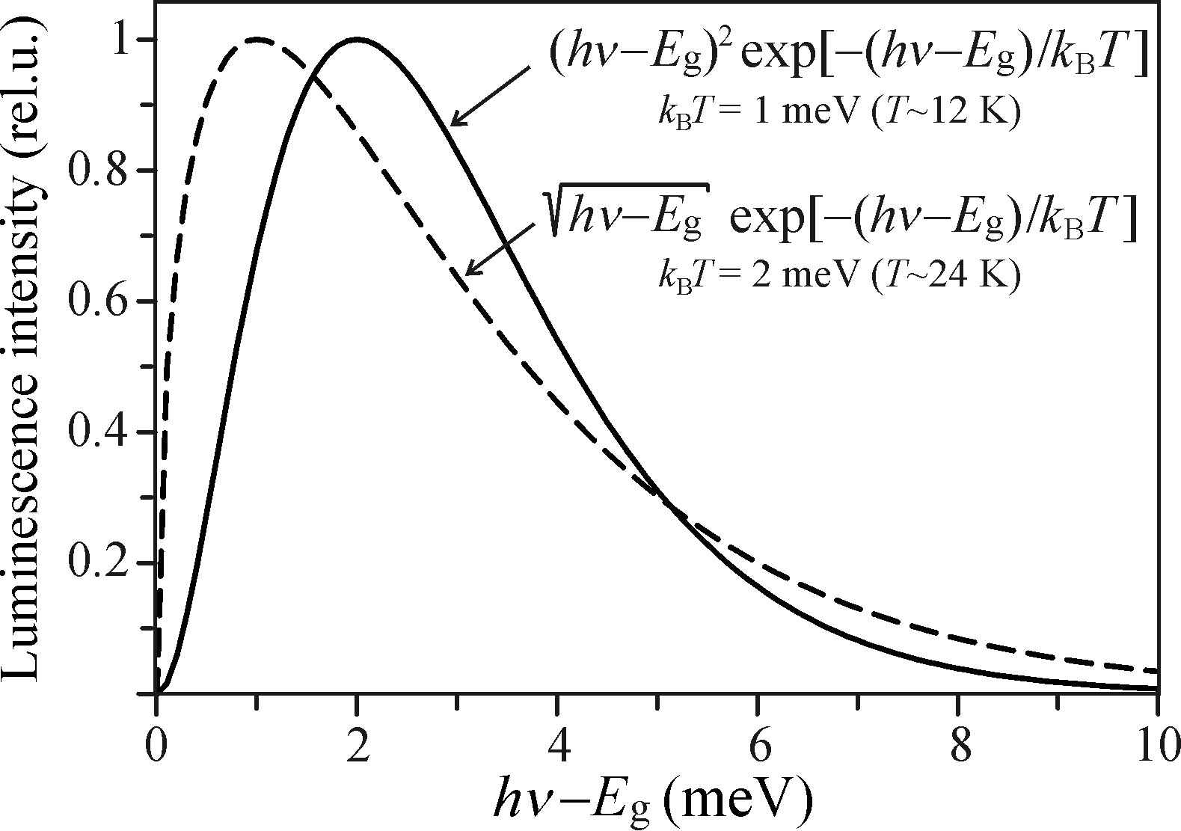
Radiative recombination in semiconductors electron—hole pairs
For direct bandgap
For indirect bandgap
Difference compare with the direct bandgap:
1, the red-shift of the low-energy side of the spectrum by hω
2, the replacement of the square-root dependence of the pre-exponential factor by a quadratic dependence, which slightly modifies the low-energy onset of the spectrum
the shape of the high-energy tail is most significantly influenced by the exponential factor
Notes:
This luminescence process scarcely occurs in reality. Because of that the excited electrons and holes in an indirect-bandgap semiconductor live much longer than in direct-bandgap materials causes nearly all electrons and holes at low temperatures to be bound in excitons.

Slide 17
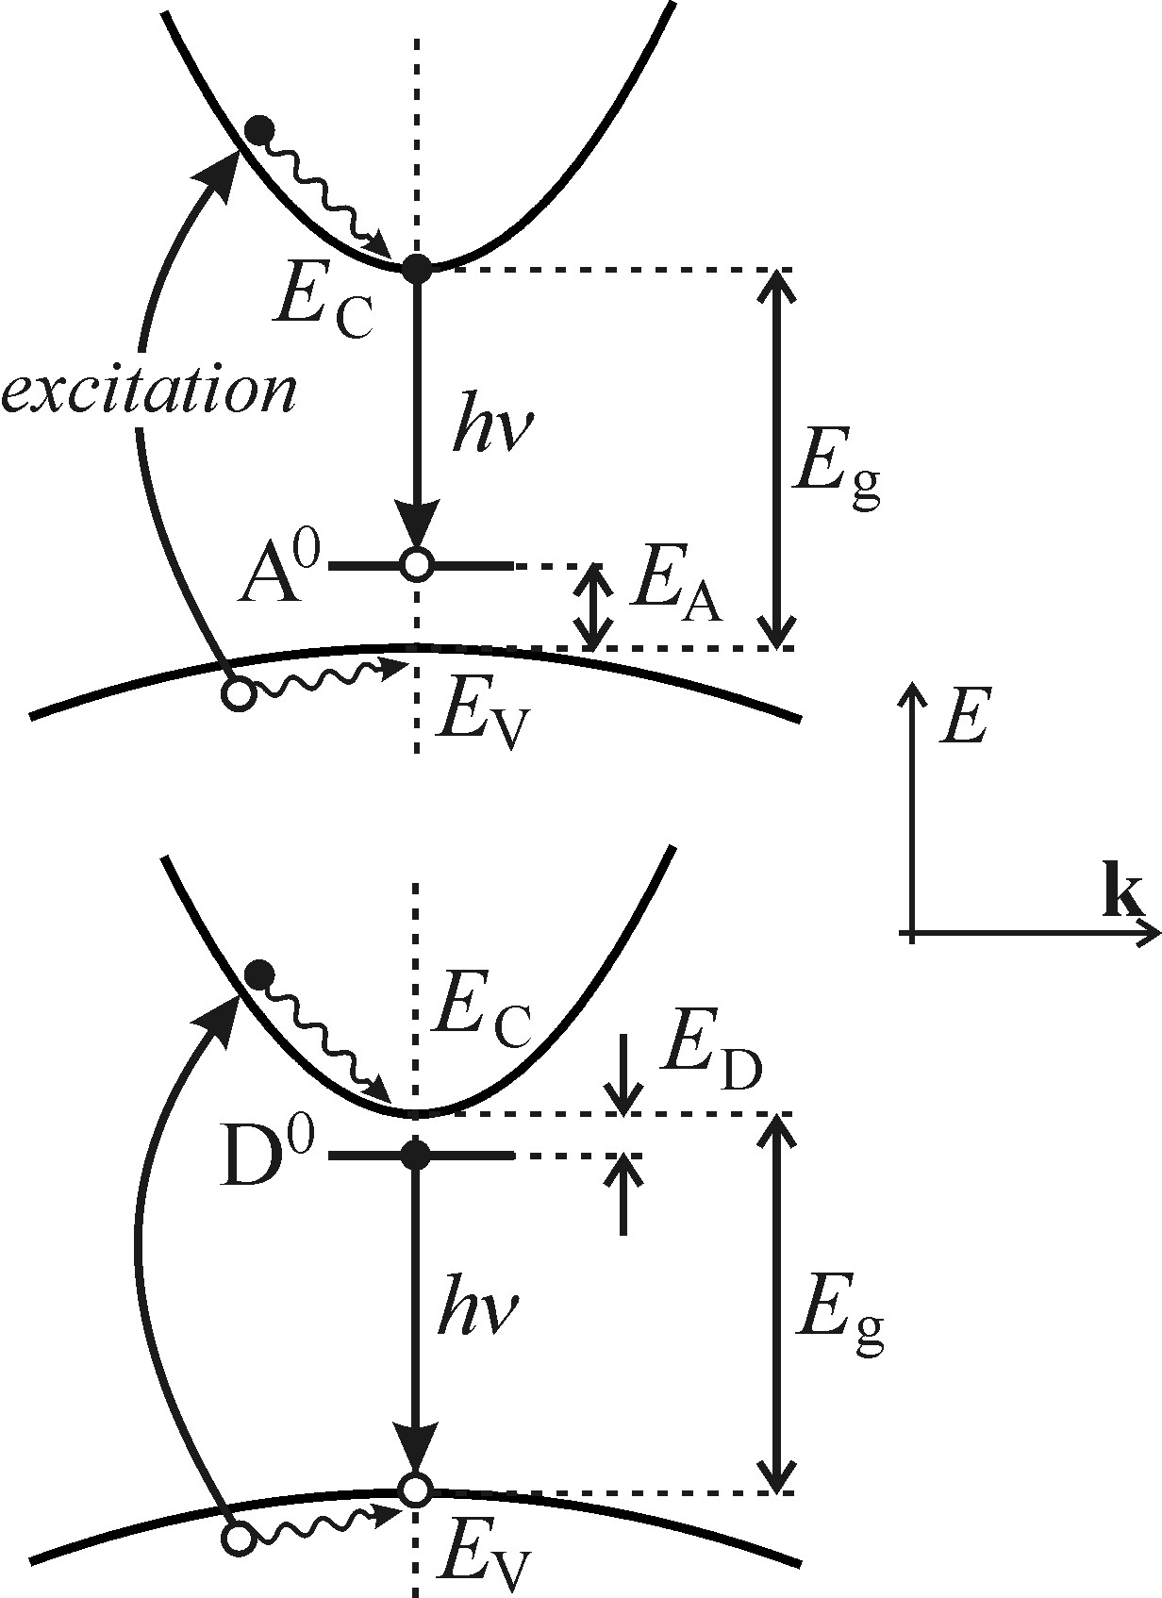
Radiative recombination in semiconductors (e-A⁰) and (h-D⁰)
Recombination of a free electron with a neutral acceptor (e-A⁰) and of a free hole with a neutral donor (h-D⁰)
Acceptor: an impurity atom in a semiconductor, whose valence is smaller by one electron than that of the main constituent of the crystal lattice, for example: boron atoms in silicon, hν ≈ E _{g}-E _{A}
Donor: an impurity atom in a semiconductor, whose valence is larger by one electron than that of the main constituent of the crystal lattice, for example: phosphorus atoms in silicon, hν ≈ E _{g}-E _{D}
What is the probability of this recombination?

Slide 18


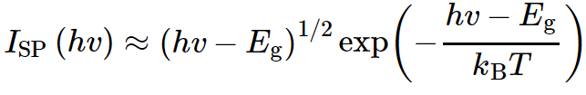
Radiative recombination in semiconductors (e-A⁰) and (h-D⁰)
Starting from recombination of free electron—hole pairs in the direct bandgap
Assuming a high hole effective mass m _{h} → ∞ and thus m _{h} ≫ m _{e}
Optical transitions across the bandgap do not carry information regarding the values of effective masses m _{e}, m _{h} themselves
Notes:
Infinity， 无穷

Slide 19


Radiative recombination in semiconductors (e-A⁰) and (h-D⁰)
For the recombination of the type (e-A⁰) the hole bound to an acceptor can be viewed as an immobile quasiparticle with an effective mass m _{h} → ∞, (while the low-energy onset is determined by (E _{g}-E _{A}) instead of E _{g})
Similar for the neutral donor (h-D⁰) case

Slide 20
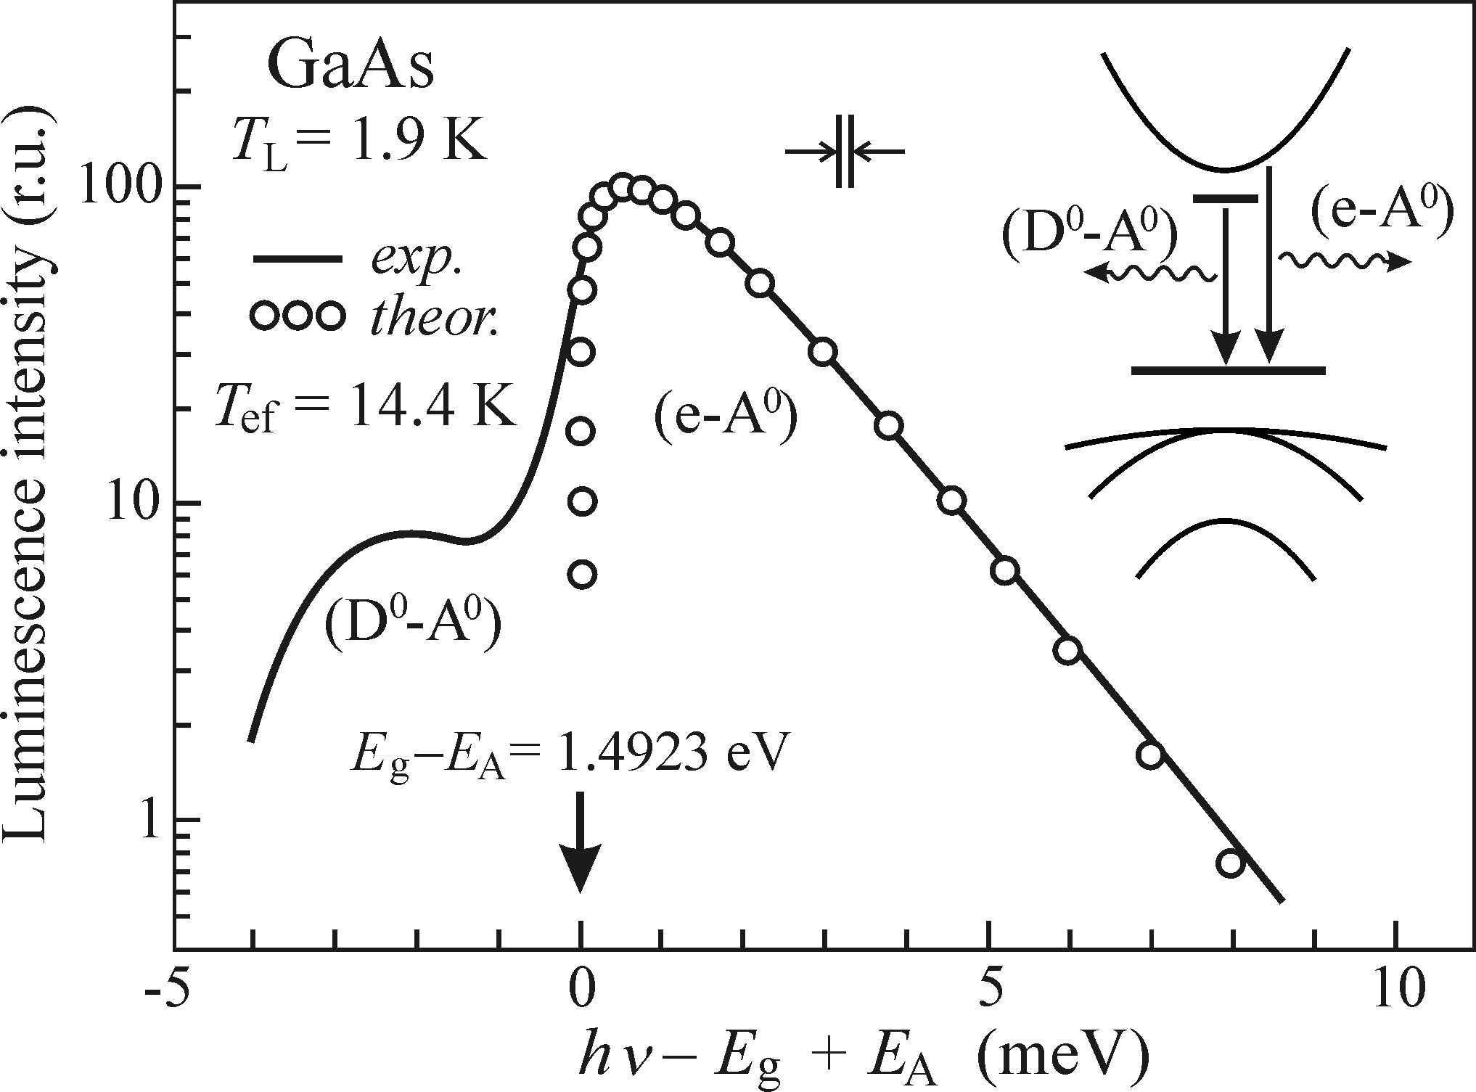
Radiative recombination in semiconductors (e-A⁰) and (h-D⁰)
Example
High-purity epitaxial Gallium arsenide GaAs layer at T = 1.9K
Conditions: high purity and low temperature
1, If the semiconductor is not highly pure, another emission band (D⁰-A⁰) will clearly appear at the low-energy edge
2, Low temperatures: not only due to the effect of thermal quenching, but also to prevent the ionization of donors by the thermal energy k_{B}T
The lattice (bath) temperature (T_{L})
The effective temperature of a gas of free quasiparticles (T_{ef}）
Because: the subsystem of atoms (ions) vibrating in the lattice.
Ulbrich, R. (1973). Phys. Rev. B, 8, 5719.
Notes:
However, radiative recombination (e-A⁰), (h-D⁰) is difficult to observe in an indirect-bandgap semiconductor due to the negligible concentration of free electrons and holes with respect to the concentration of excitons.
The drop of luminescence intensity with increasing temperature is called thermal quenching.
Naturally, the difference between the temperatures T _{ef} and TL increases if a high-power excitation source is used or when the energy difference between the exciting photons and the bandgap E _{g} rises.

Slide 21
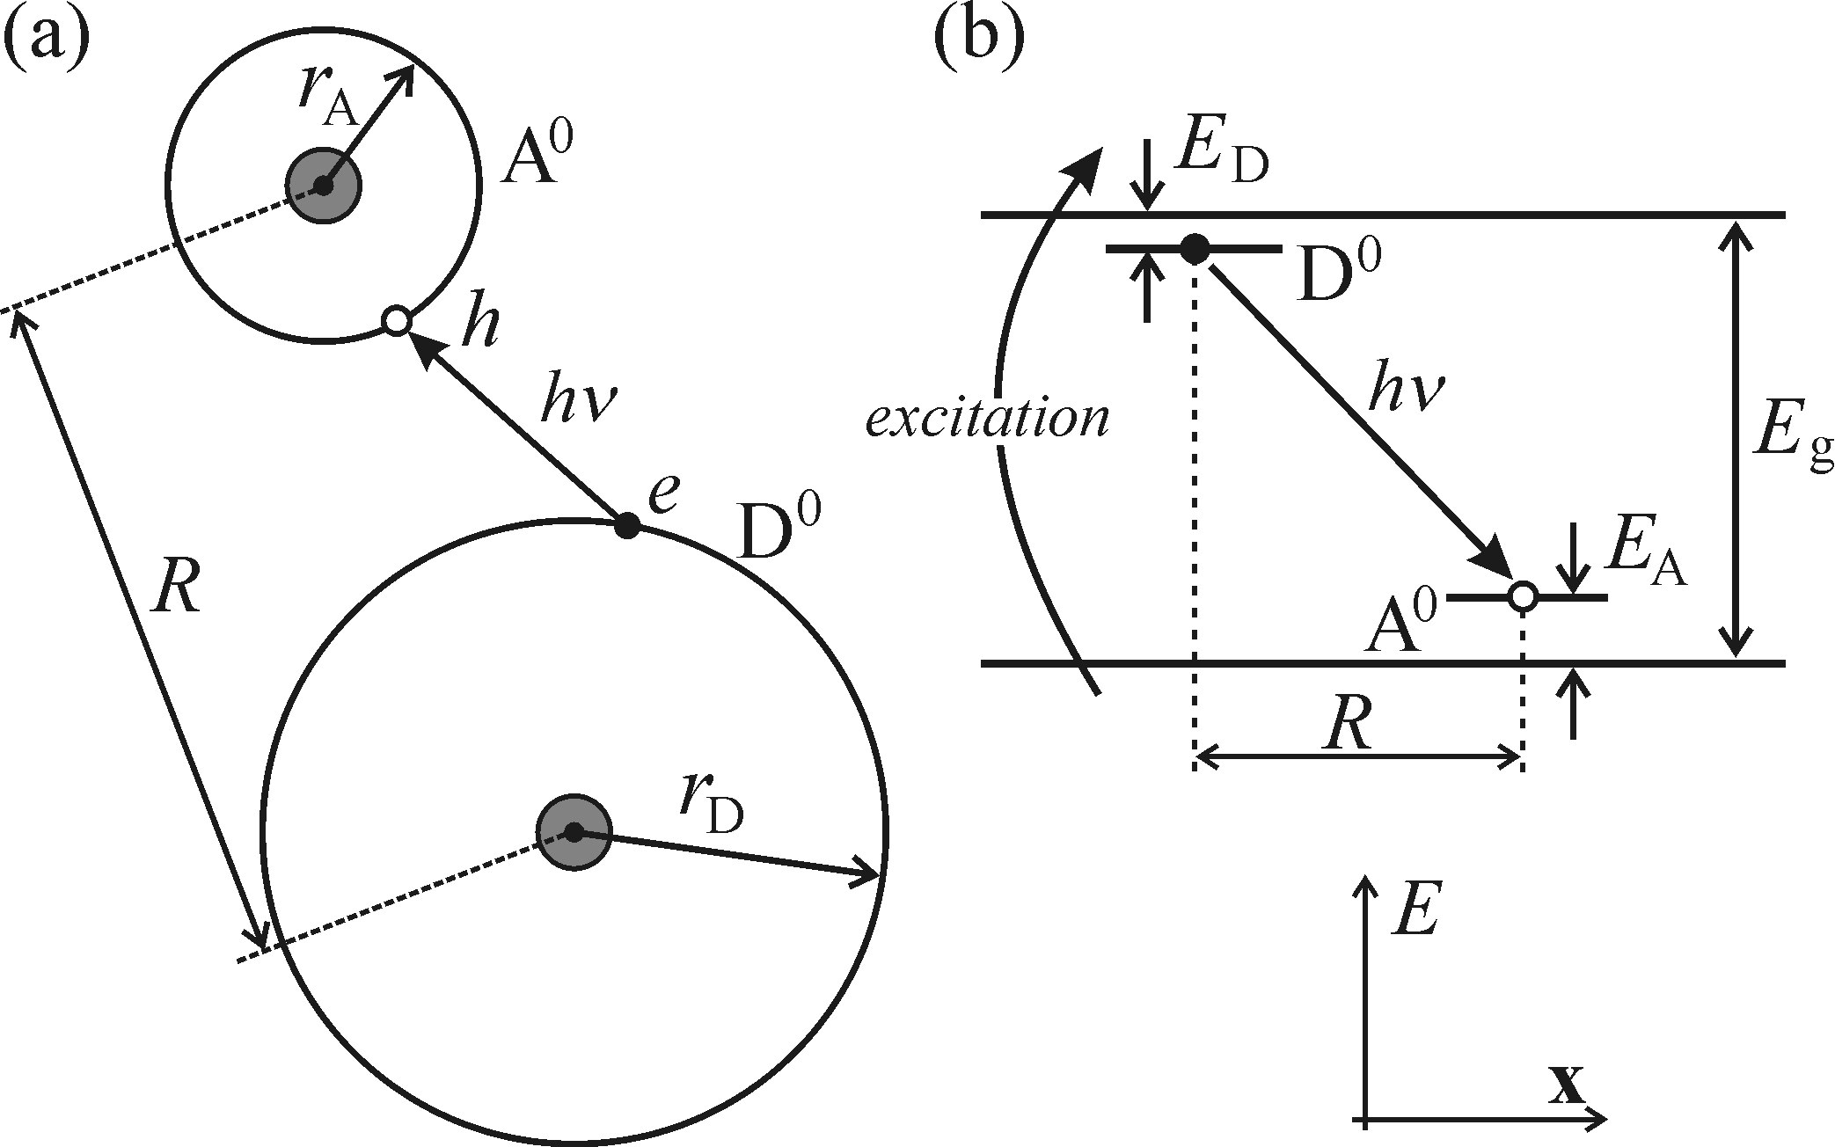


Radiative recombination in semiconductors (D⁰—A⁰)
Recombination of donor and acceptor (D⁰-A⁰)
Both neutral donor and acceptors are present in a semiconductor
Donor D⁰ can be considered as an ‘extra’ electron orbiting all the remaining parts of the atom, i.e. the atomic nucleus
Acceptor A⁰ can be treated analogously, the extra electron is substituted with a hole
donor +
acceptor
ionized
(D⁺, A⁻)
neutralized
(D⁰, A⁰)
Notes:
free electron-hole pairs generated by the band to band excitation quickly neutralize these ionized donors and acceptors and the whole process resumes.

Slide 22

Radiative recombination in semiconductors (D⁰—A⁰)
Because of the additional energy of its (D⁺, A⁻) mutual electrostatic attraction
Valid when the donor and the acceptor represent point charges, R ≫ r _{D}, r _{A}
J(R) — constitutes a non-Coulomb term, correcting for the overlap of the wavefunctions in the case of small distance R and decreasing the additional Coulomb energy. This term disappears when R is sufficiently large.
The (D⁰-A⁰) recombination manifests itself in the emission spectrum in various ways, depending on the strength of the electron-phonon coupling.
Notes:
far greater than
Dielectric coefficient

Slide 23
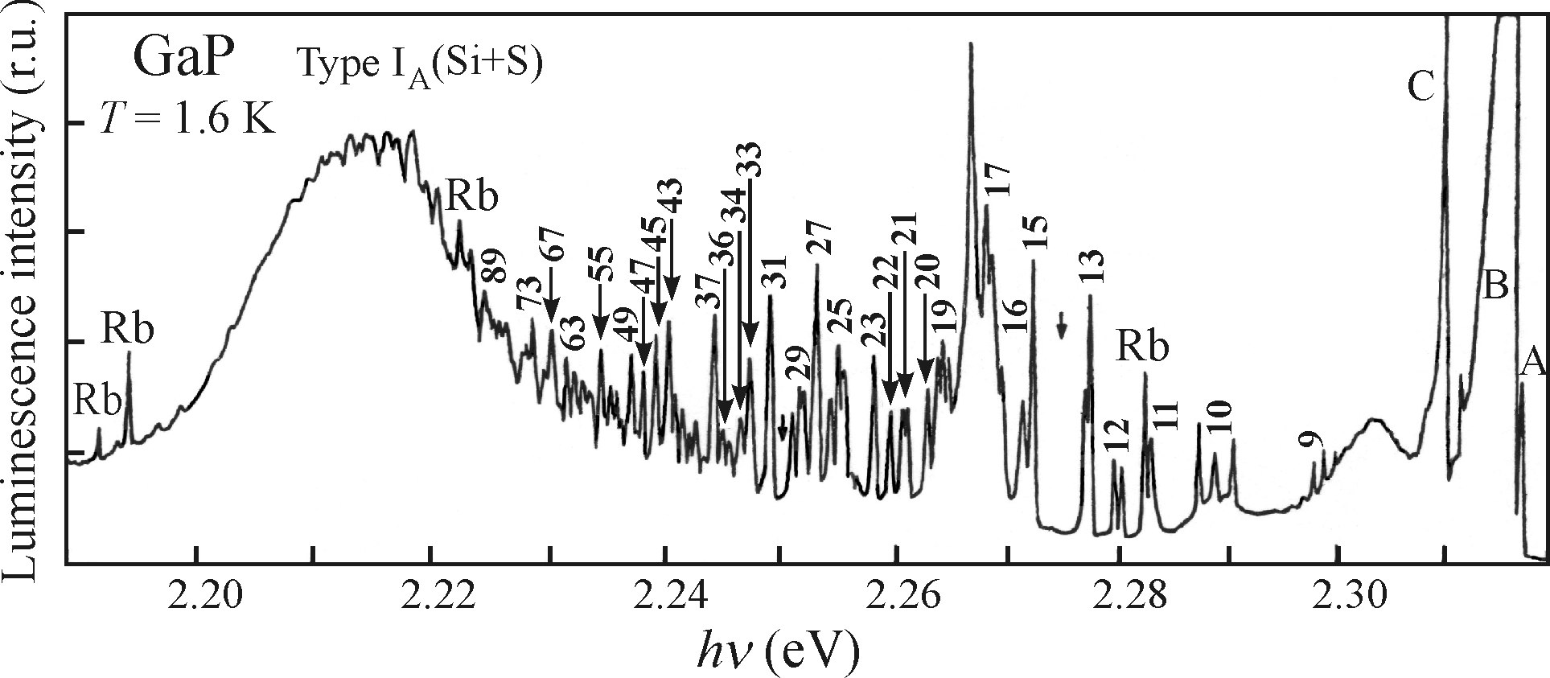

Radiative recombination in semiconductors (D⁰—A⁰)
Example
Luminescence spectrum: silicon- and sulphur-doped gallium phosphide, GaP, at liquid helium temperature (1.6K)
Thomas, D. G., Gershenzon, M., and Trumbore, F. A. (1964). Phys. Rev. A, 133, 269.
1, High photon energies (small R):
-The number of suitable neighbors (low)
-Discrete values of R are relatively scarce
sparse and weak lines
2, R increases:
-More partners
-The shells located closer to one another lines become more intense and more densely packed
3, R becomes larger
-Suitable shells nearly merge
the probability of radiative recombination W(R) decrease
Low-energy end of the spectrum gets smeared into a broad band and drops to zero somewhere above the energy limit of E_{g}-(E_{A} + E_{D})
a = max(r _{D}, r _{A})
Notes:
silicon and sulphur are the so-called substitution donors and acceptors of type I: substitute atoms only in one of the sublattices of the crystal
Substitution donors and acceptors of type II: substitute atoms in both sublattices of the crystal, Zinc and oxygen, ZnGa-OP
The numbers next to the lines denote the number of the shell,
The lattice positions occupied by D and A in the crystal are discontinuously distributed, so the distance r between D-A can only be non-continuous values.

Slide 24
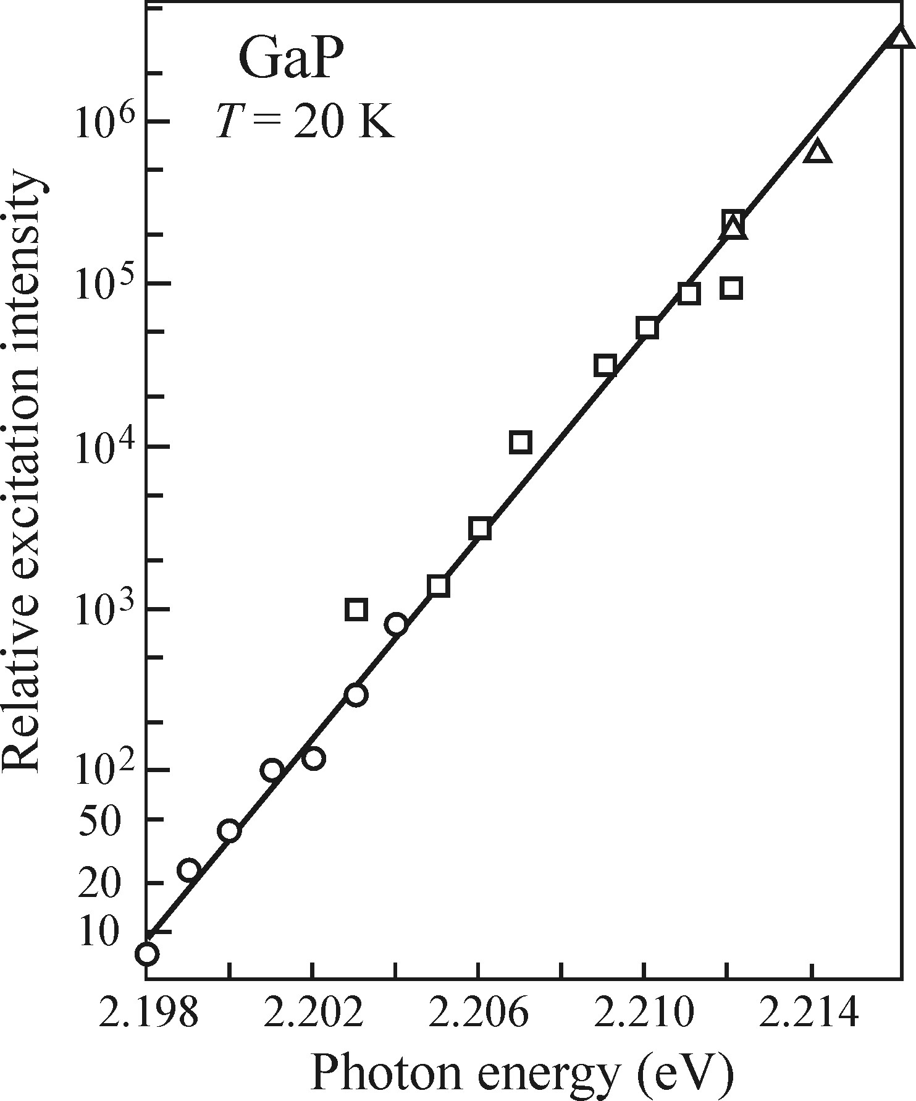
Radiative recombination in semiconductors (D⁰—A⁰)
Additional characteristic features of this type of luminescence spectrum
blue-shift
Increasing excitation intensity
R
red-shift
the closest pairs with the lower R are the first ones to recombine, while pairs further and further apart start to send out luminescence in longer time delays
in time-resolved luminescence experiments: the increasing delay after the excitation impulse gives rise to a pronounced red-shift (low energy) of the emission spectrum
Notes:
overall blue-shift of the broad band with increasing excitation intensity: gallium phosphide

Slide 25
Radiative recombination in semiconductors (D⁰—A⁰)
The (D⁰-A⁰) recombination manifests itself in the emission spectrum in various ways, depending on the strength of the electron-phonon coupling.
Semiconductors with weak electron-phonon coupling
How narrow lines can be observed?
Experimental conditions
Too low: D⁰ and A⁰ in the pairs will be too far apart from one another and no recombination will take place
1, A suitable level of concentration
of both dopants
Too high: the simple Coulomb interaction of D⁰ and A⁰ ceases to be valid and concentration quenching can set in.
2, Low temperatures
GaP: the only material in which a large number of narrow (D⁰ - A⁰) lines can be observed
3, The number of competing radiative recombination channels should be minimized
Notes:
gallium phosphide

Slide 26
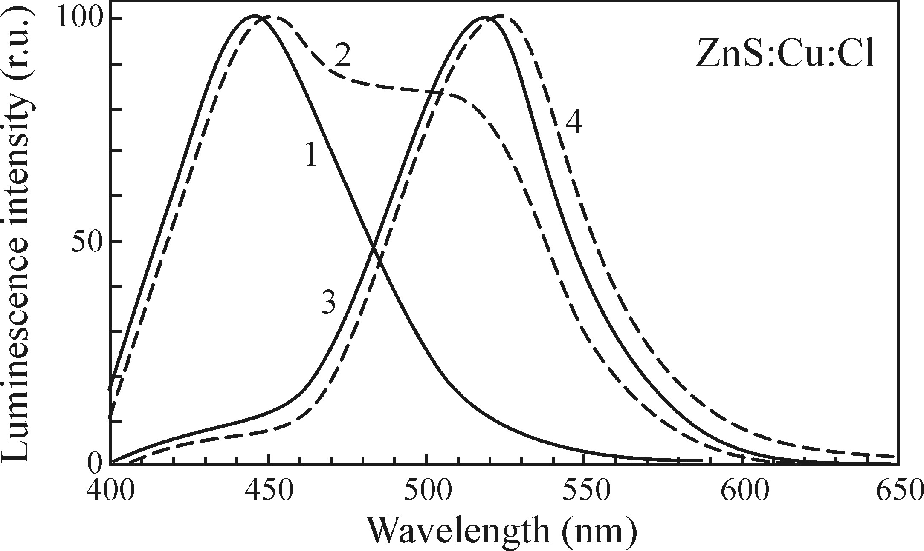
Radiative recombination in semiconductors (D⁰—A⁰)
Semiconductors with strong electron-phonon coupling
Direct-bandgap zinc sulphide ZnS with E _{g} ~ 3.8eV
Cu_{Zn} acceptors and Cl_{S} donors leads to intense green emission
The electron-phonon coupling in this material is particularly strong, the luminescence band is broad, lacks any structure and is located far from edge emission (with large Stokes shift), near 520nm
1-4, increased concentration of copper
Espe, W. (1954). Luminescent Substances in Electrical Engineering (in Czech:Luminiscenční látky v elektrotechnice. Výroba, vlastnosti a použití). SNTL, Prague.

Slide 27

Radiative recombination in semiconductors
absorption of a single (suitable) photon with energy hν _{ex} 〉 E _{g}
Photoluminescence
processes
generation of electron-hole pairs or excitons
electron—hole pairs
radiative recombination
(e-A⁰) and (h-D⁰)
Radiative recombination
(D⁰—A⁰)
influenced by
Surface and subsurface states
The surface oxide layer
α(hν _{ex}) ≈ 10⁴-10⁵cm⁻¹
d ≈ α⁻¹ = 10⁻⁵-10⁻⁴ cm = 100nm-1 μm
Under such conditions, the obtained spectra might not in fact reflect the properties of the studied material!!!
Solution: compare the emission spectra excited via one-photon and two-photon process

Slide 28
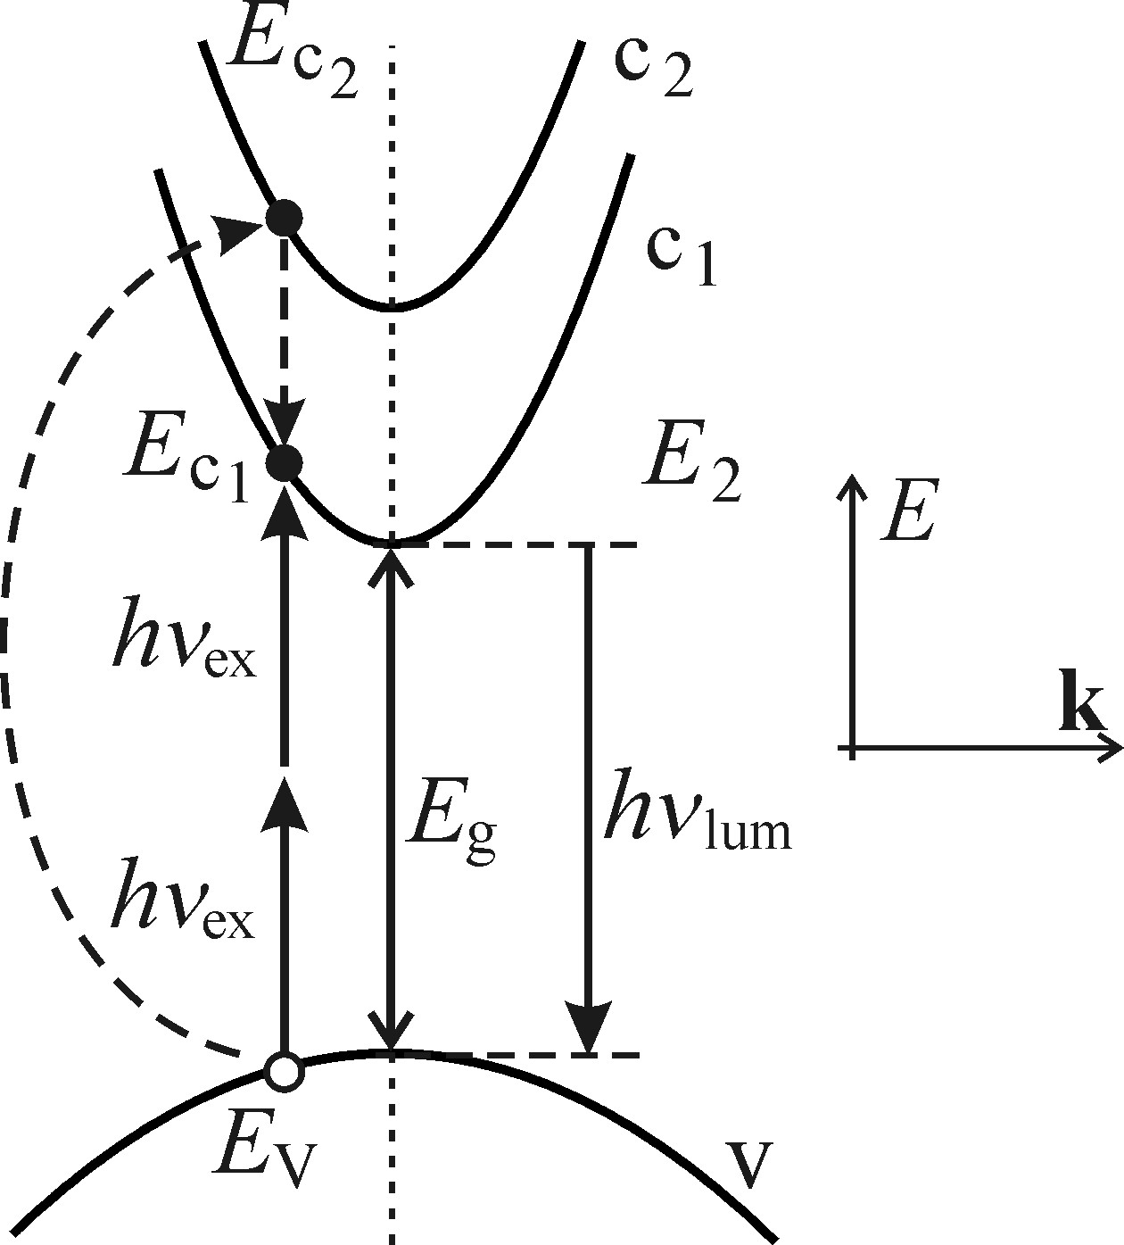

Luminescence excited by two-photon absorption
Luminescence excited by two-photon absorption
Two-photon absorption: two photons are absorbed at the same time in a single elemental act.
Compare with the single-photon absorption (hνex>Eg)
energy-conservation law
Virtual intermediate level (Ec2):
mediates the transition between the ground (Ev) and final (Ec1) states
2hν _{ex} = E_{c1}-E _{v}.
Notes:
since two-photon absorption is described in second-order perturbation theory of quantum mechanics, implying that this process is several orders of magnitude weaker than the conventional one-photon absorption (first-order perturbation theory). Thus, were the condition hνex > Eg fulfilled, intense single-photon absorption over the bandgap would set in and two-photon absorption would cease to be detectable.

Slide 29

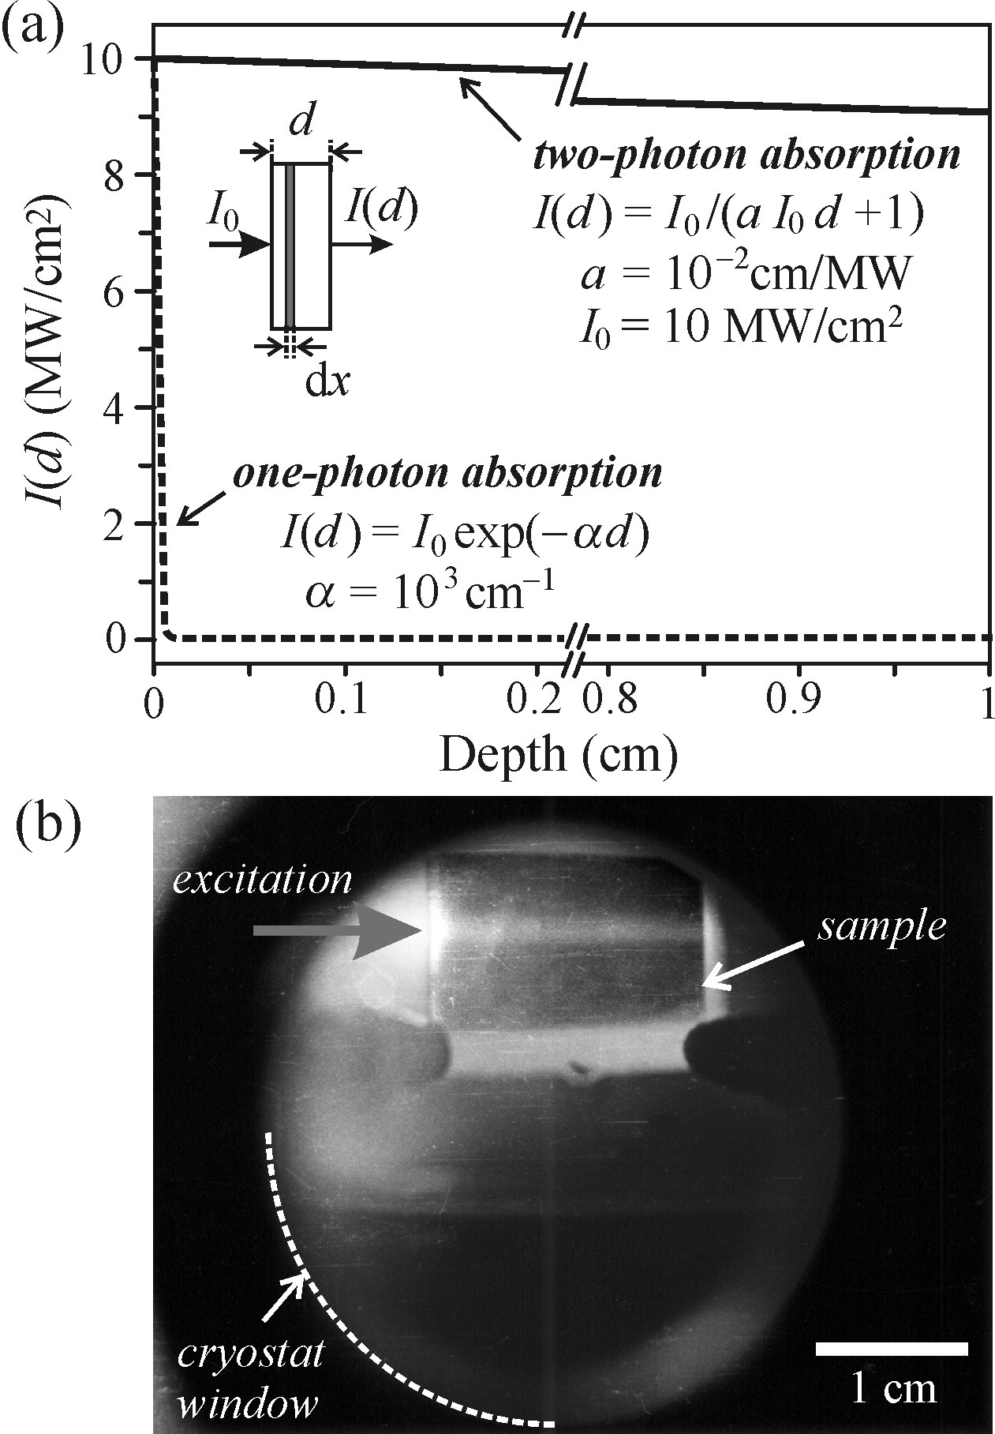



Luminescence excited by two-photon absorption
How to describe the decrease in light intensity as it passes through a semiconductor?
two-photon absorption coefficient
Material constant
The decrease in the intensity of the light beam
dx: travel distance in a sample
The hyperbolic decrease is incomparably slower
Thick sample is needed, for the obvious decrease of intensity
Basov, N. G. (1966). International Conference on Physics of Semiconductors, Kyoto 1966. J. Phys. Soc. Japan, 21, Supplement, p. 277.
Notes:
the typical value of coeffi-cient a(~ 10⁻³ cm/MW) and the power density of the incident beam I ₀ = 10MW/cm², one can immediately see that—according to (5.23)—a sample length of 1cm(!) is needed so that the intensity could decrease by a single per cent (i.e. I(d)/I ₀) ≈ 0.99)! Two-photon excited luminescence coming from thick samples is then, without doubt, a phenomenon connected with the bulk of the material.

Slide 30
Luminescence excited by two-photon absorption
Example
Bulk AgCl sample (1.5 cm) at T ≅ 80K
Forbidden gap width E _{g} ≅ 3.2eV
Ruby laser beam (hν _{ex} = 1.78eV)
brightness only minutely decreases
Laibowitz, R. L. and Sack, H. S. (1966). phys. stat. sol., 17, 353.

Slide 31
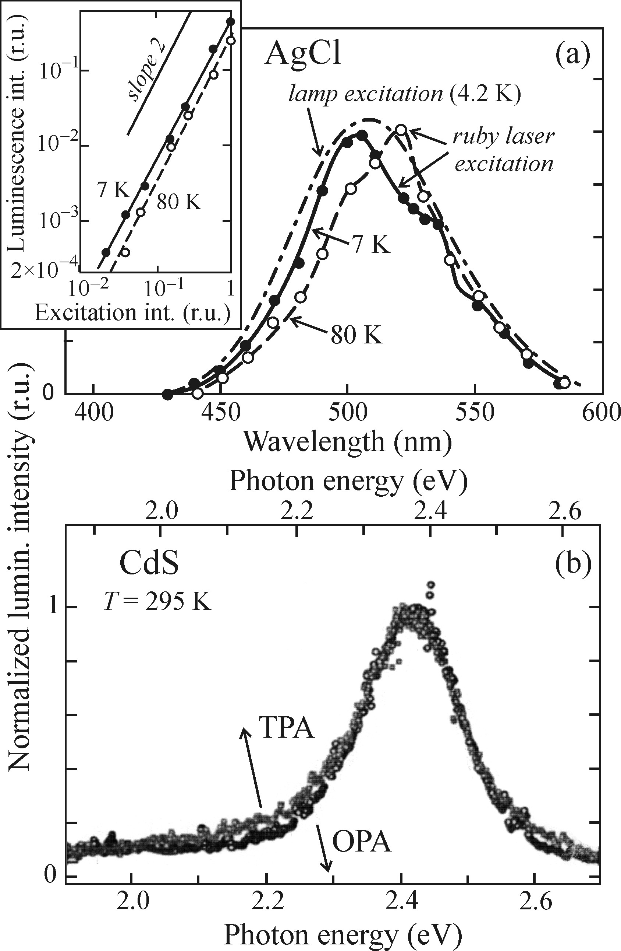
Luminescence excited by two-photon absorption
Luminescence spectrum of one- and two-photon excitation
Emission spectra are almost identical
Influence of surface states on luminescence is not so pronounced
Laibowitz, R. L. and Sack, H. S. (1966). phys. stat. sol., 17, 353.
Yano, S. and Ulbrich, B. (2003). Thin Solid Films, 444, 295.
Notes:
Cadmium sulphide film: The spectra are shifted with respect to one another because the penetration depth of the femtosecond laser was larger than the thickness of the sample (1.58 μm); that is why the luminescence in this case is strongly influenced by reabsorption and consequently shifted to lower energies.

Slide 32


Luminescence excited by two-photon absorption
How to recognize the observed luminescence is two and not one-photon excited?
1, ‘anti-stokes’ shift
Stokes’ law
λ_{lum}
>
λ_{ex}
OR
λ_{ex} = 694 nm
λ_{lum} ≈ 500nm
hν _{ex} ≥ hν _{lum}

Slide 33
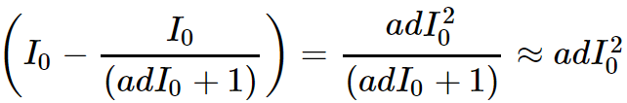
Luminescence excited by two-photon absorption
2, quadratic intensity dependence
From
Power density: I ₀ = 10MW/cm²
a ≤ 10⁻³ cm/MW
adI ₀ ≪ 1
Assume that luminescence is proportional to the absorbed power
Luminescence is proportional to the squared incident laser intensity (I0)²
Notes:
Log-Log scale

Slide 34
Luminescence from transition metal and rare earth ion impurities
Luminescence from transition metal and rare earth ion impurities
1, Impurities introduced into solids primarily in order to boost the luminescence efficiency and achieve a particular emission wavelength.
2, Cannot be easily classified from the point of view of their electrical activity as donors or acceptors, active also in the luminescence of semiconductors.
transition metal ions (from the fourth period of the periodic table)
Impurities
rare earth ions

Slide 35
Luminescence from transition metal and rare earth ion impurities
Transition metal ions
exhibit luminescence as a result of transitions of electrons between the levels of the partially filled 3d shell.
3d^{n∗} → 3d^{n} (∗ stands for an excited state) transitions are dipole-forbidden (Azimuthal quantum number: l = 2)
When the ions are embedded into the crystal lattice, the interaction with the electric field of the crystal makes the transitions partially allowed.
Notes:
Zinc Sulphur： Manganese ion, Chromium, in aluminium oxide
Notice that 3d^{n∗} → 3d^{n} (∗ stands for an excited state) transitions are, from the atomic point of view, dipole-forbidden, Because they do not comply with the condition ∆ℓ = ±1. azimuthal quantum number

Slide 36
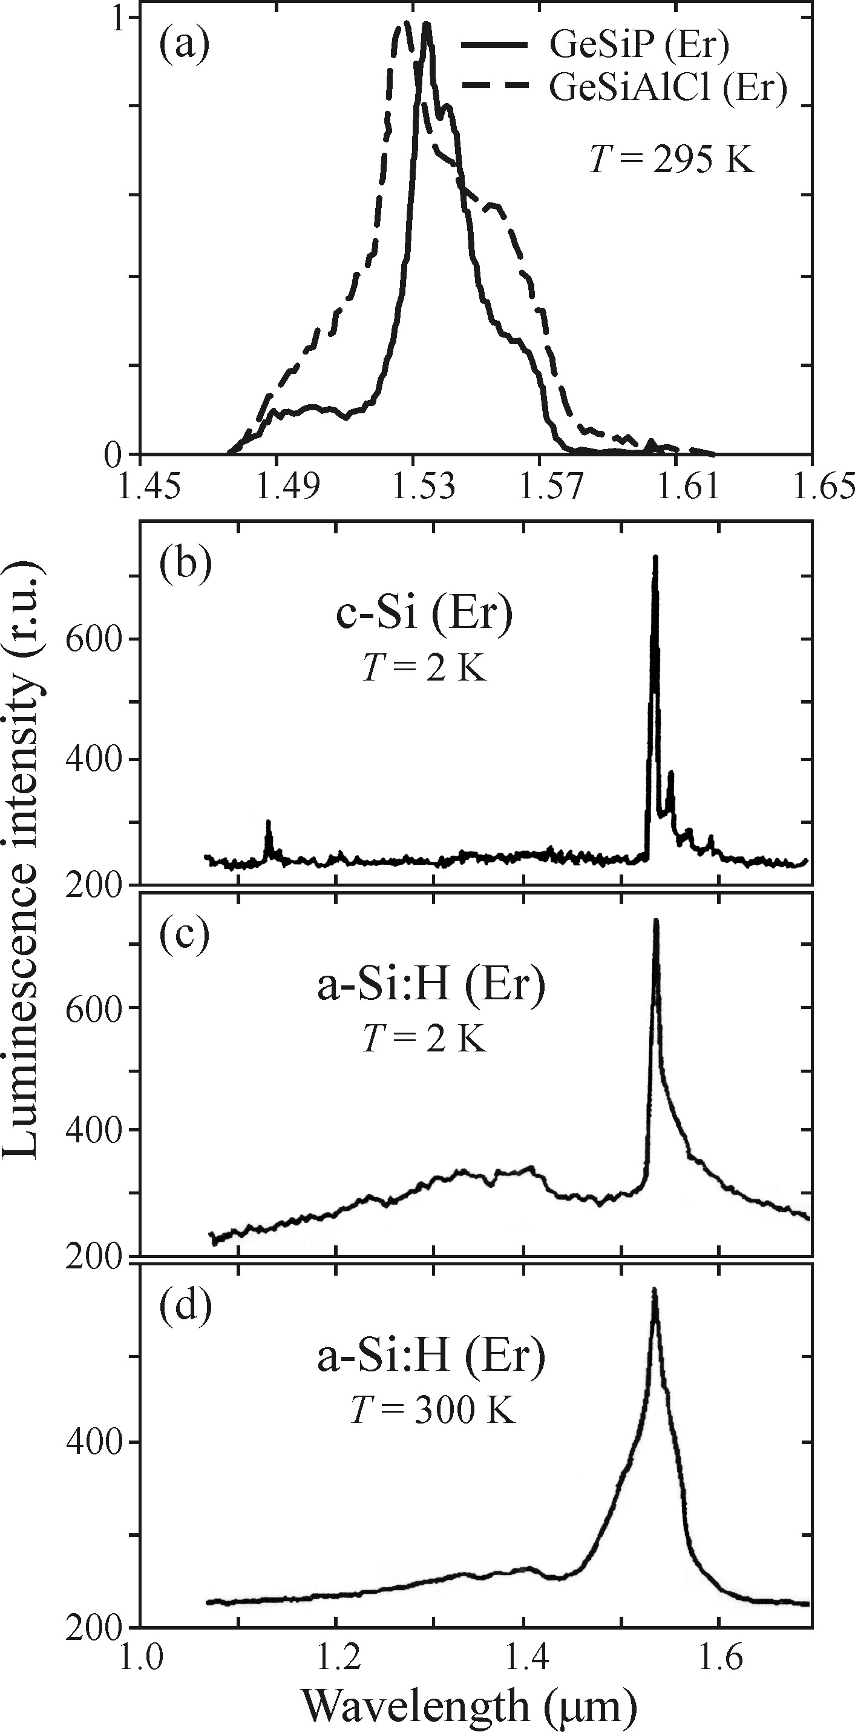
Luminescence from transition metal and rare earth ion impurities
rare earth ions
4f^{n∗} → 4f^{n} (∗ stands for an excited state) transitions are dipole-forbidden
the crystal field makes them partially allowed
difference with 3d^{n∗} → 3d^{n} transitions: the 4f shell is strongly screened from the influence of the crystal field by the external filled orbitals (5s² 5p⁶)
Example: luminescence of Er³⁺ ions built into various matrices
1, line peak approximately at 1530nm (from a, b, c)
regardless of whether they are incorporated in a matrix or in crystalline (matrix-independent)
2, the intensity of luminescence (from c, d) of Er³⁺ in hydrogenated amorphous silicon decreases by only about 20% when the temperature increases from 2K to 300K (temperature-independent emission)
Notes:
trivalent ions of lanthanides From Cerium ions to Ytterbium ions
Example: Erbium. The emission is due to 4f^{11∗} → 4f¹¹transitions from the excited state 4I _{13/2} to the ground state 4I _{15/2}.

Slide 37
Luminescence from transition metal and rare earth ion impurities
More information about luminescence from transition metal and rare earth ion impurities could be found from:
1, Shionoya, S. (1998). Photoluminescence. In Luminescence of Solids (ed. D. R.Vij), p. 95. Plenum Press, New York.
2, Shionoya, S. and Yen, W. M. (eds.) (1999). Phosphor Handbook, p. 141. CRC Press, Boca Raton.
3, Tanabe, Y. and Sugano, S. (1954). J. Phys. Soc. Japan, 9, 753.
Martucci, A., Guglielmi, M., Strohhöfer, C., Fick, J., Pelli, S., and Righini, G. C.(1999). Germania based sol-gel waveguides doped with Er ³⁺. In Innovative LightEmitting Materials. Advances in Science and Technology (ed. P. Vincenzini and G. C. Righini), Vol. 27, p. 197. Techna, Faenza.
4, Bresler, M. S., Gusev, O. B., Kudoyarova, V. Kh., Kuznetsov, A. N., Pak, P. E.,Terukov, E. I., Yassievich, I. N., Zakharchenya, B. P., Fuhs, W., and Sturm, A. (1995). Appl. Phys. Lett., 67, 3599.
5, Kaiser, W. and Garrett, C. G. B. (1961). Phys. Rev. Lett., 7, 229.

Slide 38
Non-radiative recombination in semiconductors
Non-radiative recombination in semiconductors
----transformation of the electronic excitation energy into other types of energy than light
Multi-phonon recombination
(i) transformation into heat
Auger recombination
Non-radiative
recombination
(ii) creation of lattice defects
(iii) photochemical changes of the electronically excited material.
Result in local overheating and mechanical damage of the material
Notes:
Luminescence efficiency or quantum yield almost never reaches η = 1; so where is the extra energy?

Slide 39
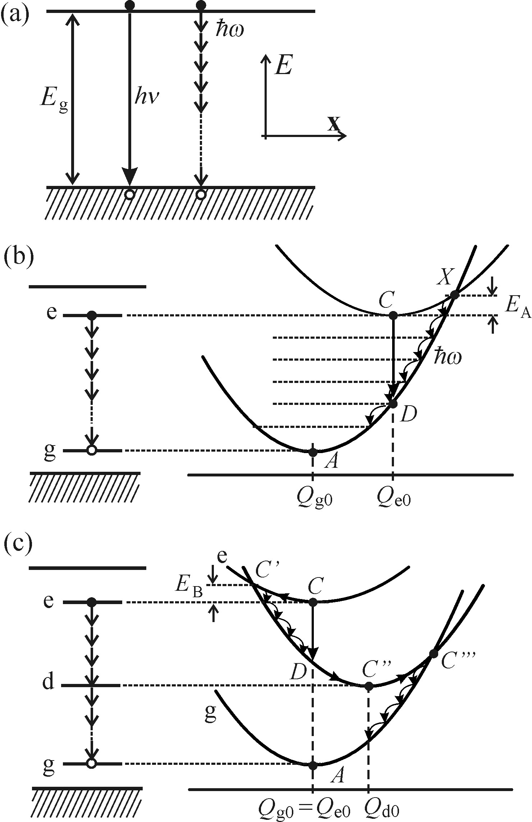
Transformation of the excitation energy into heat
Transformation of the excitation energy into heat
Multi-phonon recombination
Emitted in the form of photons hν ≅ E _{g}
Energy handed over to the lattice through n phonons with energy ℏω: E_{g} = nℏω
Probability for the process:
1/τ _{nr}≈ exp(– E_{g} /ℏω) ≈ exp(–n)
typical semiconductor
Very low
E _{g}≈ 2 eV and ℏω ≈ 25 meV we obtain n = 80
Wide-bandgap semiconductors outperform those with a narrow bandgap.
increases strongly in this case with the value of hν(≈ E _{g})
Notes:
The probability of radiative transition proportion to ν ², increases strongly in this case with the value of hν(≈ E _{g}).

Slide 40
Transformation of the excitation energy into heat
Non-radiative multi-phonon transitions applied in localized luminescence centre
Strong interaction with the lattice case
Q_{e0}– Q_{g0}: the displacement from the equilibrium position
intersection point X and activation energy E_{A}
Non-radiative bimolecular recombination
Non-radiative transition in a localized luminescence center C → X → A through the emission of many local phonons
ℏω(‘cooling transitions’).
Sequential application of one-phonon processes with participation of a real intermediate level
Difference
mediated by ‘virtual’ electron levels
(like two-photon absorption)
Notes:
Q _{g0} the equilibrium distance between the impurity and its nearest neighbours

Slide 41
Transformation of the excitation energy into heat
Weak interaction with the lattice case
Q_{e0} ≈ Q_{g0}
Improbable
Because
Probability for the process:
1/τ _{nr}≈ exp(– E _{g} /ℏω) ≈ exp(–n)
( Similar to bimolecular recombination)
Deep level lying approximately in the middle of the bandgap (defect) mediating non-radiative recombination*
Defect associated with the deep level is always in strong interaction with the surrounding lattice
Gradual dissipation of the electron excitation energy via ‘cooling transitions’ C → C′ → C″ (defect, or deep level)
The remaining energy ‘spills’ into the matrix by a pathway of similar character C″ → C‴ → A
Shockley–Read recombination
Notes:
That’s why rare earth ions represent efficient luminescent centers if embedded into any lattice
The non-radiative recombination mediated by a defect is sometimes called Shockley–Read recombination.

Slide 42
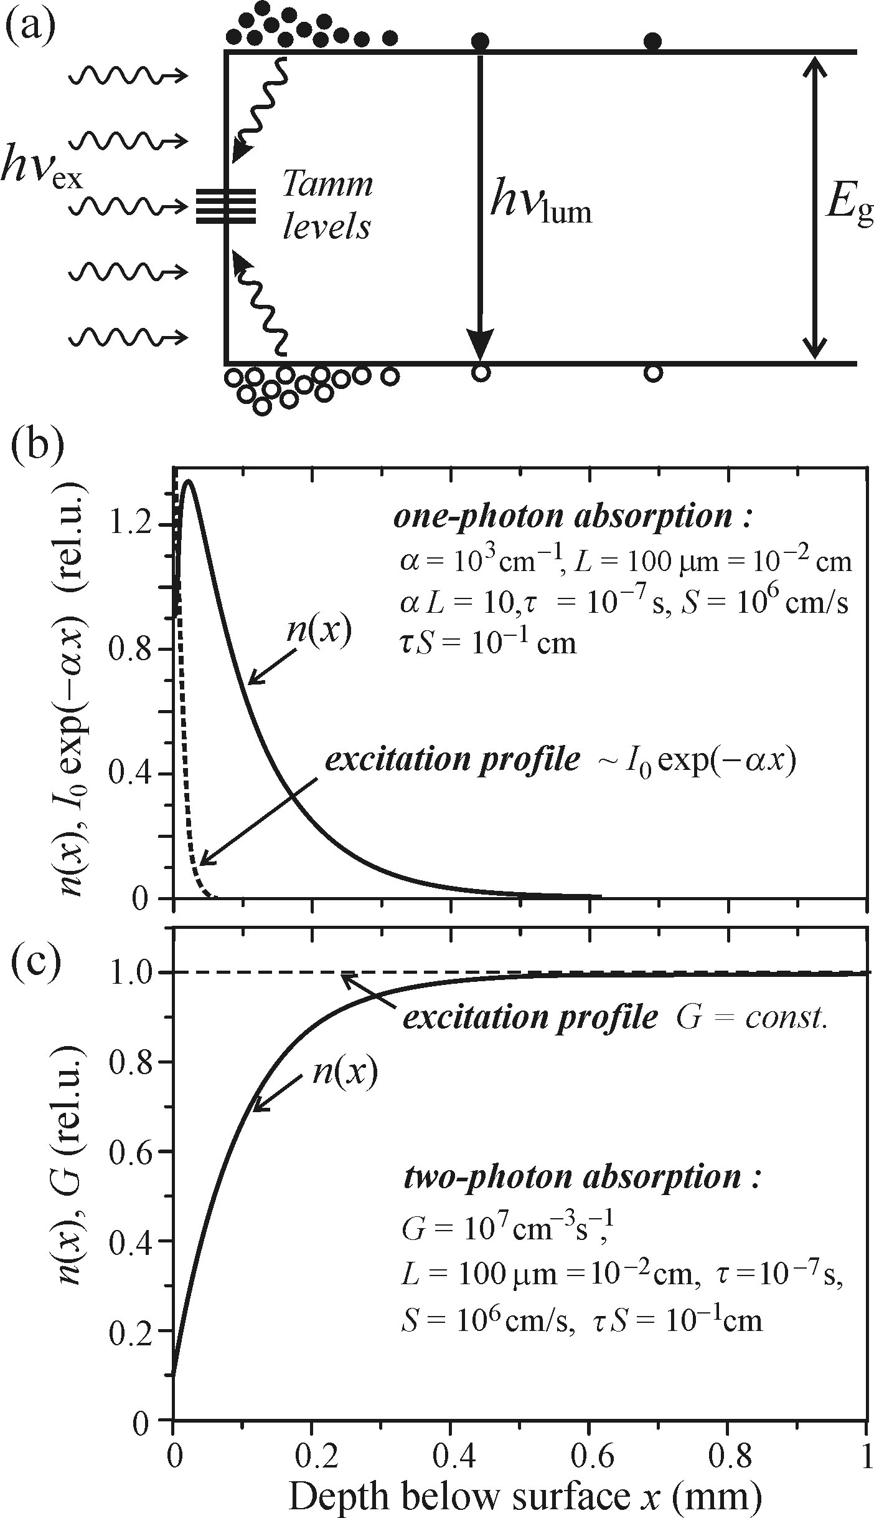


Transformation of the excitation energy into heat
Example of deep level - Surface recombination
-Takes place in a thin subsurface layer
-Conditioned by the occurrence of deep localized levels (Tamm levels)
The photocarrier concentration n(x) just under the surface will decrease significantly, thus creating a concentration gradient driving photocarriers to the surface.
Kinetic equations describing the generation and recombination processes
D-diffusion coefficient of the carriers
G-generation rate
n(x)-photocarrier concentration
τ-(total) non-equilibrium carrier lifetime
1, The marked decrease of the concentration n(x) close beneath the surface occurs may give rise to a luminescent ‘dead layer’ with strongly reduced luminescence intensity.
2, In Figure c, the subsurface decrease of n(x) is more prominent and penetrates deeper. (Can be favorable in two-photon luminescence spectroscopy because it contributes to suppressing the spurious surface extrinsic radiative channels)
The surface recombination described by the recombination rate S determines the value of the derivative of n(x) at x = 0
Notes:
unoccupied bonds of surface atoms in a semiconductor give rise to these levels.
Because of the existence of the deep levels, the non-radiative recombination will be strongly inhomogeneous along the x-coordinate normal to the surface, assuming a maximum at x = 0. The photocarrier concentration n(x) just under the surface will decrease significantly, thus creating a concentration gradient driving photocarriers to the surface.
an additional term arising from the diffusion current density

Slide 43
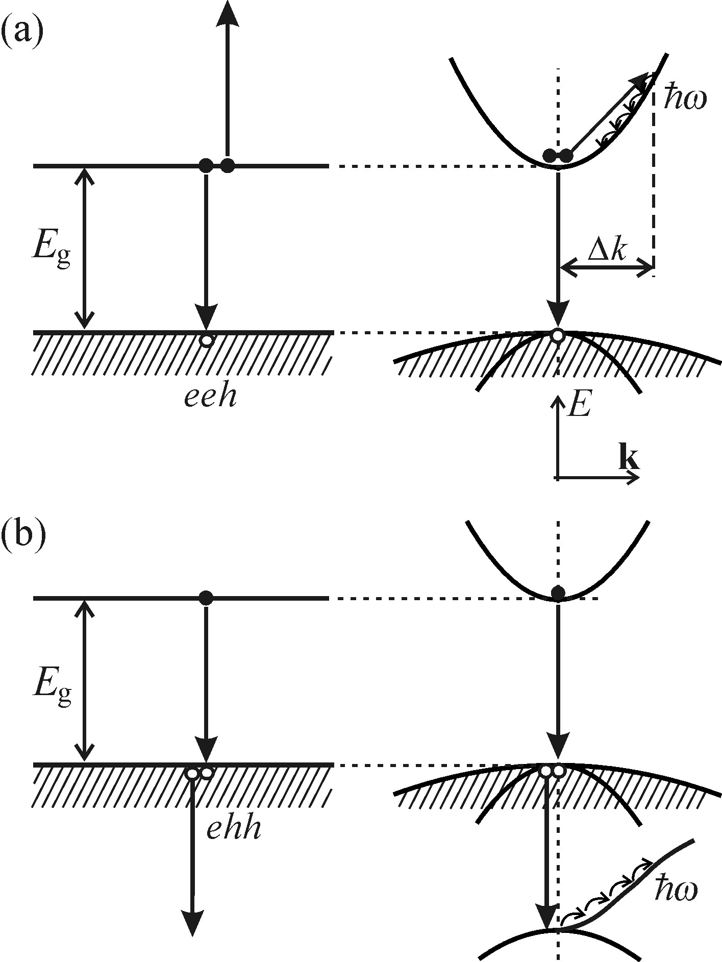
Transformation of the excitation energy into heat
Auger and bimolecular recombination
Intrinsic Auger recombination
no influence from a defect or impurity
Energy of the recombining pair
luminescent photon
Passed to the third quasi-particle
Based on energy and quasi-momentum conservation laws: Auger process can occur both with (a) and without (b) involvement of a quasi-momentum conserving phonon ℏΔk
For a new electronic excitation
Multi-phonon emission
Final form: heat
Notes:
the no-phonon Auger process becomes feasible provided the ejected quasi-particle has to its disposal a suitable energy band, attainable without the alteration of wavevector of the (i.e.Δk= 0).

Slide 44






Transformation of the excitation energy into heat
Kinetic equation for bimolecular recombination
1, The quadratic dependence on the carrier concentration signifies an important fact: the intrinsic Auger effect occurs mainly for high concentrations of free carriers. (Typical values of the Auger coefficient: A ~ 10⁻³¹ –10⁻²⁹ cm⁶/s)
β _{r} (β _{nr}): bimolecular recombination coefficient
Auger effect is a three-particle process, will be described by a term ~ np ²
A _{n}, A _{p}: Auger coefficients
2, Intrinsic Auger recombination contributes to the fact that luminescence of narrow-bandgap semiconductors is weak.
(The easy thermal generation of free carriers across the bandgap leads to a relatively high free carrier concentration already in unexcited material)
The rate of the non-radiative process
Notes:
d/dt denotes the derivative with respect to time,
G: the generation term,
β _{r} (β _{nr}) stands for the radiative (nonradiative) bimolecular recombination coefficient,
n: the concentration of electrons,
p: concentration of holes
!!!a rate of the non-radiative process (τAnr)−1
The reason is that easy thermal generation of free carriers across the bandgap leads to a relatively high free carrier concentration already in unexcited material.

Slide 45
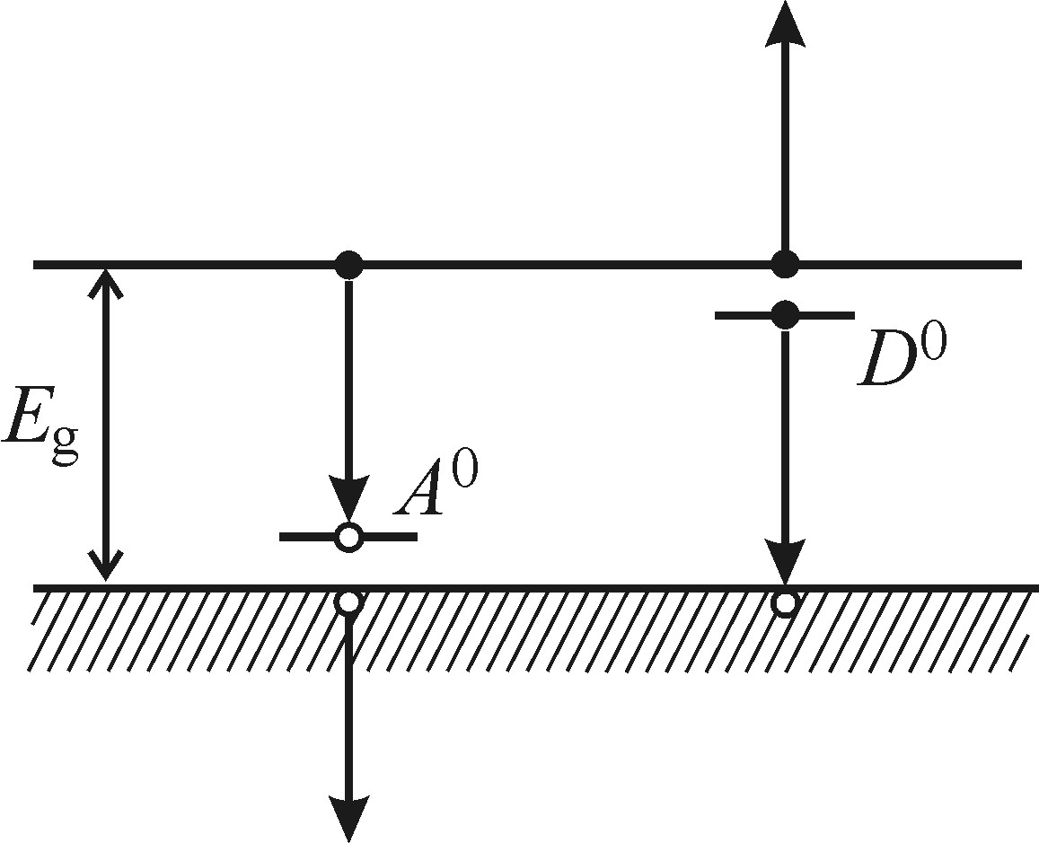
Transformation of the excitation energy into heat
Extrinsic Auger recombination
carriers localized at impurities
A non-radiative process accompanying luminescence originating in the transitions (e–A⁰ ) and (h–D⁰ ) and therefore decreasing its efficiency.
Condition: high concentration of free carriers or impurity atoms
(for example, to make sure the interaction of the free electron and the electron localized on a donor)

Slide 46
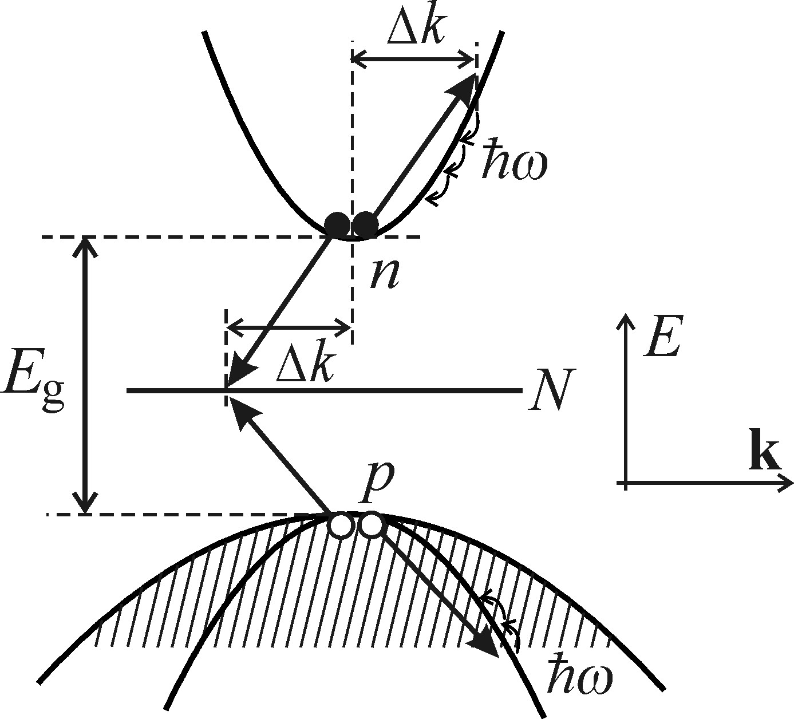



Transformation of the excitation energy into heat
N: the concentration of the localized states
n = p the concentration of the excited free carriers
n _{N:} the momentary concentration of electrons on the localized level
Kinetic equations for electrons and holes
Conditions:
1, a relatively high concentration of the deep traps, because there has to be a positive value (N – n _{N})
2, a relatively high excitation to make sure n, p〉 N
Notes:
the process depicted in Fig has a bimolecular character, as reflected in the quadratic dependence ~ n ²
in order to ensure a sufficient concentration of electrons and holes in the extremes of the bands during rapid carrier capture in the deep trap.

Slide 47

Creation of lattice defects
Creation of lattice defects
Requirements:
An electronic excitation is localized at some atom occupying a regular lattice position.
(a) Localization of the electronic excitation must occur
The released excitation energy is transferred to the relevant atom as a whole, which is thus ‘kicked off’ into an interstitial lattice position, creating a so-called Frenkel defect
(b) Energy criterion.
(c) Protection against degradation to heat—phonons.
The defect can be either transient or permanent depending on whether the interstitial atom does or does not return into its original lattice site once the excitation is terminated
(d) Orientation criterion.
Luščik, Č. B. and Luščik, A. Č. (1989). Decay of electronic excitations with defect formation in solids (in Russian: Raspad elektronnych vozbužděnij s obrazovaniem defektov v tverdych telach). Nauka, Moskva.
Notes:
b) energy of the self-trapped exciton E _{e,} energy E _{d} of formation of the defect
c) self-trapped exciton gets localized must have a frequency ω _{ℓ} higher than the highest LO-phonon frequency ωLOmax,
d) Orientation criterion. The self-trapped exciton (its charge density) should have a suitable symmetry in the crystal lattice so that the creation of the interstitial atom is energetically favourable.

Slide 48
Photochemical changes
Photochemical changes
Requirements
Silver halides AgCl, AgBr and AgI
1, Sufficient mobility both of the electrons and of the interstitial metal ions
Interstitial Ag⁺ ion
2, Sufficiently high temperature
T ≥ 200 K
A hole gets localized on a Cl⁻ ion
A photoelectron becomes captured at a certain ‘photosensitivity center’
T ≤ 100 K
The motion of the interstitial Ag+ becomes strongly limited (‘freezes’), the formation of the latent image fades away
+
100–200 K
Radiative recombination, defect formation and photochemical reaction, may coexist.
Neutralized by the captured holes
Neutral Ag⁰ atom
Cl2
Trapping of other electrons
The growth of a metallic silver cluster
photochemical dissociation of the solid occurs
Latent photographic image

Slide 49
Non-radiative recombination in semiconductors
More information about non-radiative recombination in semiconductors could be found from:
1. Abakumov, V. N., Perel, V. I., and Yassievich, I. N. (1991). Nonradiative recombination in semiconductors. In Modern in Condensed Matter Sciences, Vol. 33 (ed. V. M. Agranovich and A. A. Maradudin). North Holland, Amsterdam.
2. Pilkuhn, M. H. (1981). Light emitting diodes. In Handbook on Semiconductors (ed. T. S. Moss), Vol. 4 (ed. C. Hilsum), p. 539. North Holland, Amsterdam.
3. Juška, G., Viliunas, M., Arlauskas, K., and Kočka, J. (1995-I). Phys. Rev. B, 51, 16668.
4. Luščik, Č. B. and Luščik, A. Č. (1989). Decay of electronic excitations with defect formation in solids (in Russian: Raspad elektronnych vozbužděnij s obrazovaniem defektov v tverdych telach). Nauka, Moskva.
5. Dziewior, J. and Schmid, W. (1977). Appl. Phys. Lett., 31, 346; Benz, G. and Conradt, R. (1977). Phys. Rev. B, 16, 843.

Slide 50
Thanks for your attention!

Slide 51
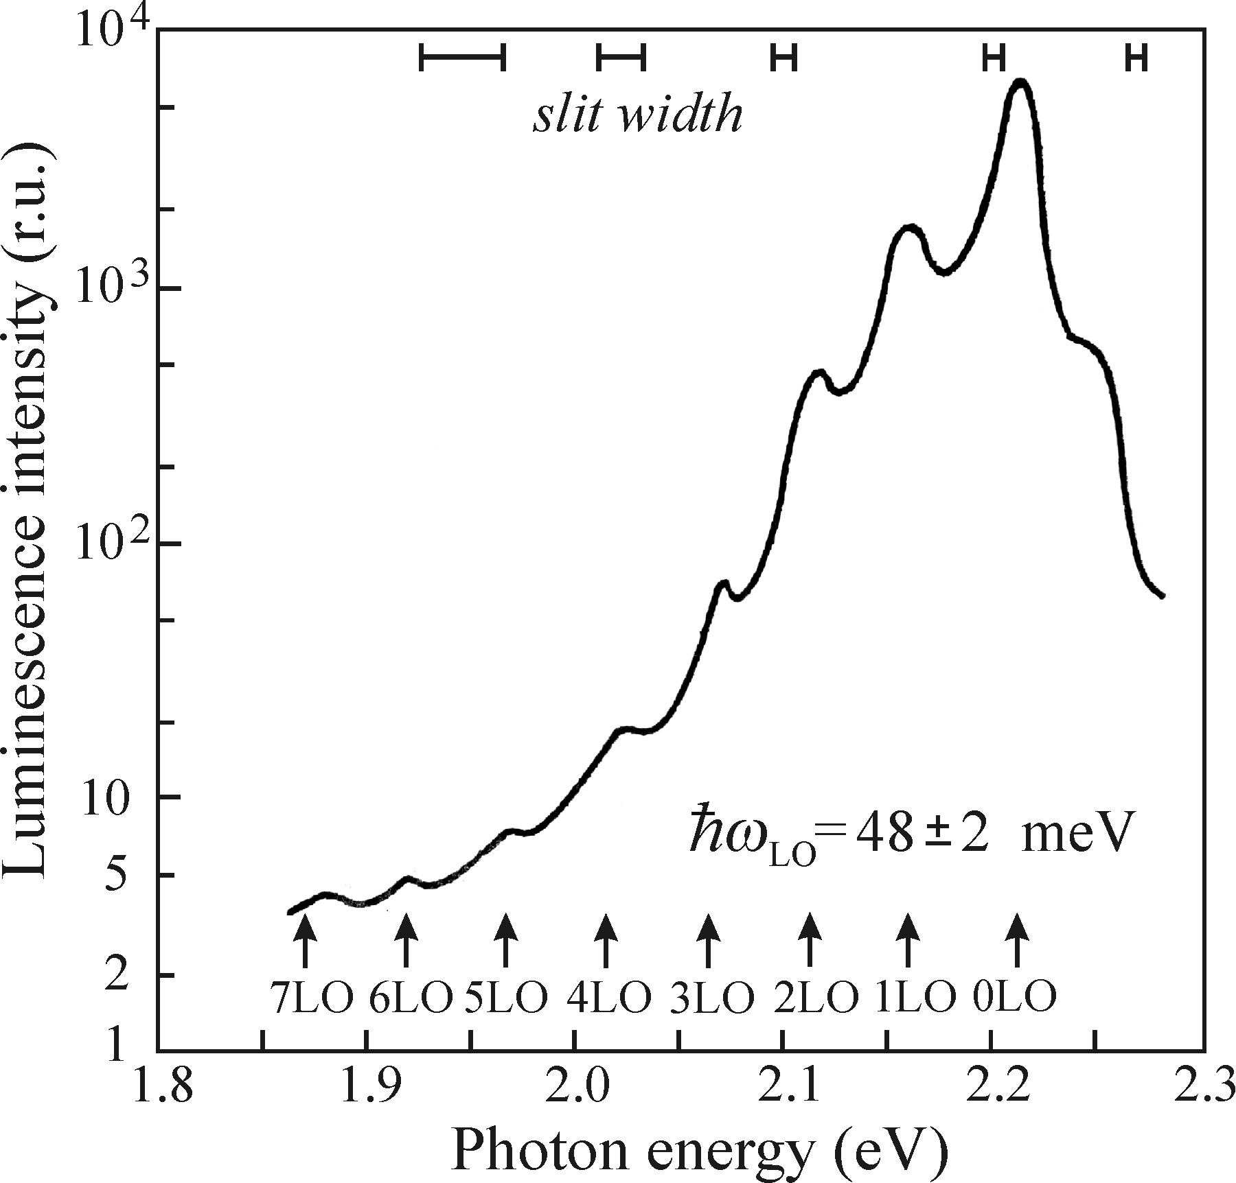
Radiative recombination in semiconductors (D⁰—A⁰)
(D⁰-A⁰) radiative recombination: special example of ‘localized excitation’ without the contribution of the kinetic energy of free carriers.
1, The densely packed lines are hidden in the unresolved shoulder at 2.25eV
Intense zero-phonon component
2, The wide low-energy band originally located at 2.215eV (Fig. left) is shifted to 2.20eV (in Fig. right), as a result of the thermally induced decrease in E _{g}.
Phonon sideband
‘zero-phonon’ lines
luminescence spectrum of GaP at T = 20K
Notes:
At this time, ∆R is 0, which means the overlap of the vibration between energy levels are maximum, non-phonon transition
To justify the application of such terminology ‘zero-phonon’ lines
weak electron-phonon coupling.
longitudinal-optical (LO) phonon energy

