Slide 1
SK3889 Luminescence Spectroscopy of Semiconductors
Lecture 3: Excitons and highly excited semiconductors
Felix Vennberg

Slide 2
Overview
Luminescence of excitons
  Wannier exciton
  Free exciton luminescence
  Bound exciton
  Bound exciton luminescence
Highly excited semiconductors
  Experimental consideration
  Exciton molecule (Biexcitons)

Slide 3
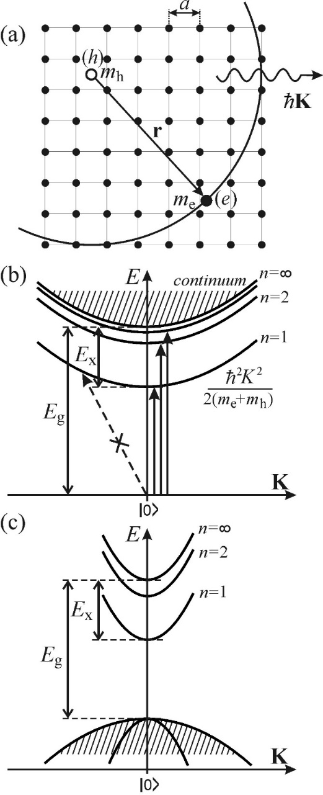
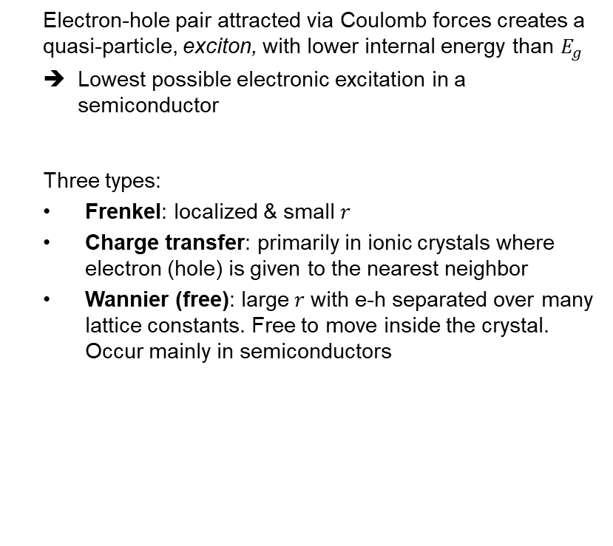
Exciton
  Electron-hole pair attracted via Coulomb forces creates a quasi-particle, exciton, with lower internal energy than $E_{g}$
  Lowest possible electronic excitation in a semiconductor
  Three types:
  Frenkel: localized & small $r$
  Charge transfer: primarily in ionic crystals where electron (hole) is given to the nearest neighbor
  Wannier (free): large $r$ with e-h separated over many lattice constants. Free to move inside the crystal. Occur mainly in semiconductors

Slide 4
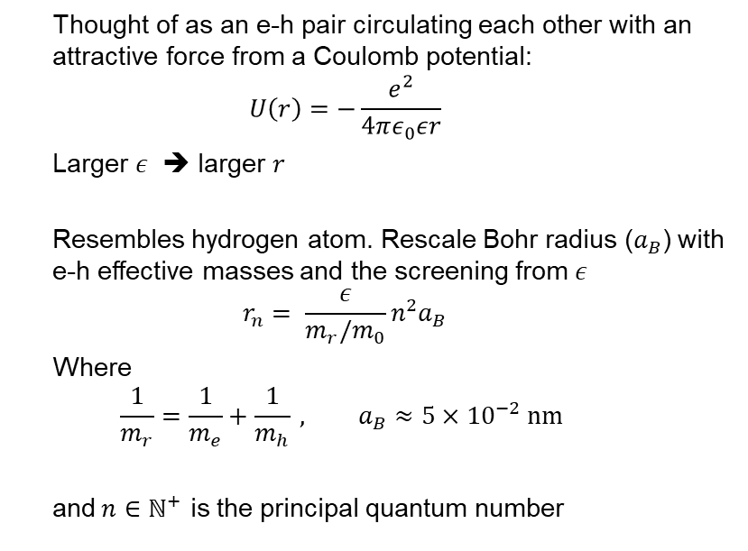
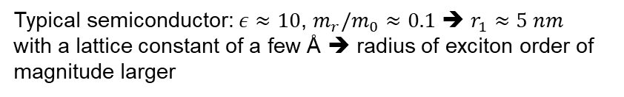
Free excitons
  Thought of as an e-h pair circulating each other with an attractive force from a Coulomb potential:
  $$U\left(r\right)=−\frac{e^{2}}{4πε_{0}εr}$$
  Larger $ε$ ➔ larger $r$
  Resembles hydrogen atom. Rescale Bohr radius ($a_{B}$) with e-h effective masses and the screening from $ε$
  $$r_{n}= \frac{ε}{m_{r}/m_{0}}n^{2}a_{B}$$
  Where
  $$\frac{1}{m_{r}}=\frac{1}{m_{e}}+\frac{1}{m_{h}} , a_{B}≈5×{10}^{−2} nm$$
  and$n∈ℕ^{+}$ is the principal quantum number
Typical semiconductor: $ε≈10$, $m_{r}/m_{0}≈0.1$ ➔ $r_{1}≈5 nm$
with a lattice constant of a few Å ➔ radius of exciton order of magnitude larger
Notes:
Can directly see influence of dielectric constant, high epsilon as In normal semiconductors means large r, i.e “free” exciton
Two Particles with opposite elementary charge resembles hydrogen atom.
Bohr radius = ground state of H atom
Regading radius the book simply states: “Turns out we can write”
Again, “free exciton” in the example

Slide 5
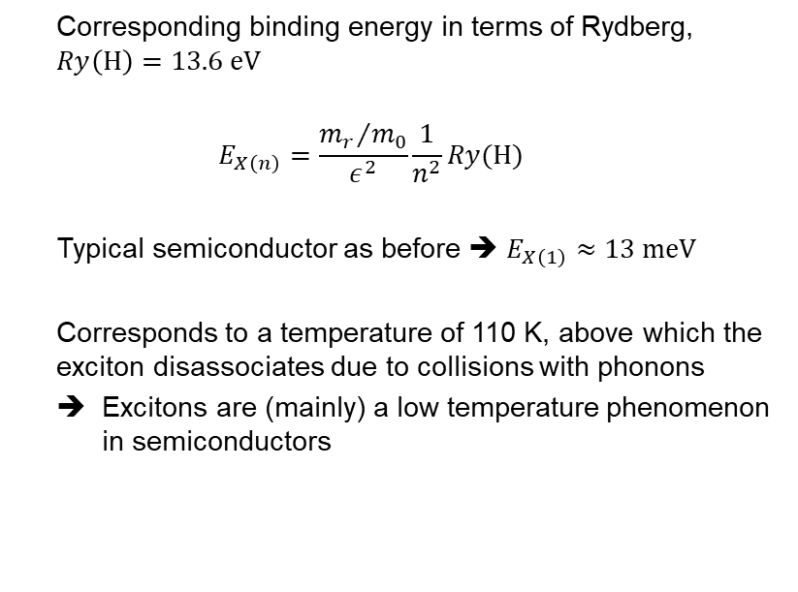
Free excitons
  Corresponding binding energy in terms of Rydberg, $Ry\left(\text{H}\right)=13.6 \text{eV}$
  $$E_{X\left(n\right)}=\frac{{m_{r}}/{m_{0}}}{ε^{2}}\frac{1}{n^{2}}Ry(\text{H})$$
  Typical semiconductor as before ➔ $E_{X\left(1\right)}≈13 \text{meV}$
  Corresponds to a temperature of 110 K, above which the exciton disassociates due to collisions with phonons
  Excitons are (mainly) a low temperature phenomenon in semiconductors
Notes:
Rydberg constant : ground energy of H atom
High epsilon and lower reduced mass lowers stability of exciton as compared to H atom
With the same parameters as on the last slide we get 13 meV of binding energy for the ground state.
In (b) we see exciton band diagram and (c) is the regular band diagram with excitons levels drawn in
Succesively lower binding energies for higher states. Get lines

Slide 6
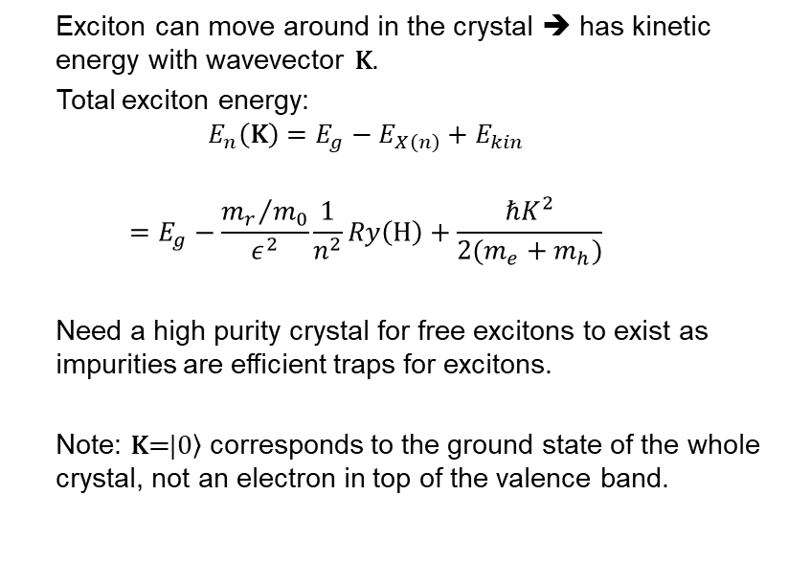
Free excitons
  Exciton can move around in the crystal ➔ has kinetic energy with wavevector $\text{K}$.
  Total exciton energy:
  $$E_{n}\left(\text{K}\right)=E_{g}−E_{X\left(n\right)}+E_{kin}$$
  $$=E_{g}−\frac{{m_{r}}/{m_{0}}}{ε^{2}}\frac{1}{n^{2}}Ry\left(\text{H}\right)+\frac{ℏK^{2}}{2(m_{e}+m_{h})}$$
  Need a high purity crystal for free excitons to exist as impurities are efficient traps for excitons.
  Note: $\text{K}\text{=}\left.|0\right\rangle$ corresponds to the ground state of the whole crystal, not an electron in top of the valence band.
Notes:
Get the dispersion curves
Will have a distribution of energies
Free excitons only possible in defect free materials
Note: ground state not equivalent to top of valence band.

Slide 7
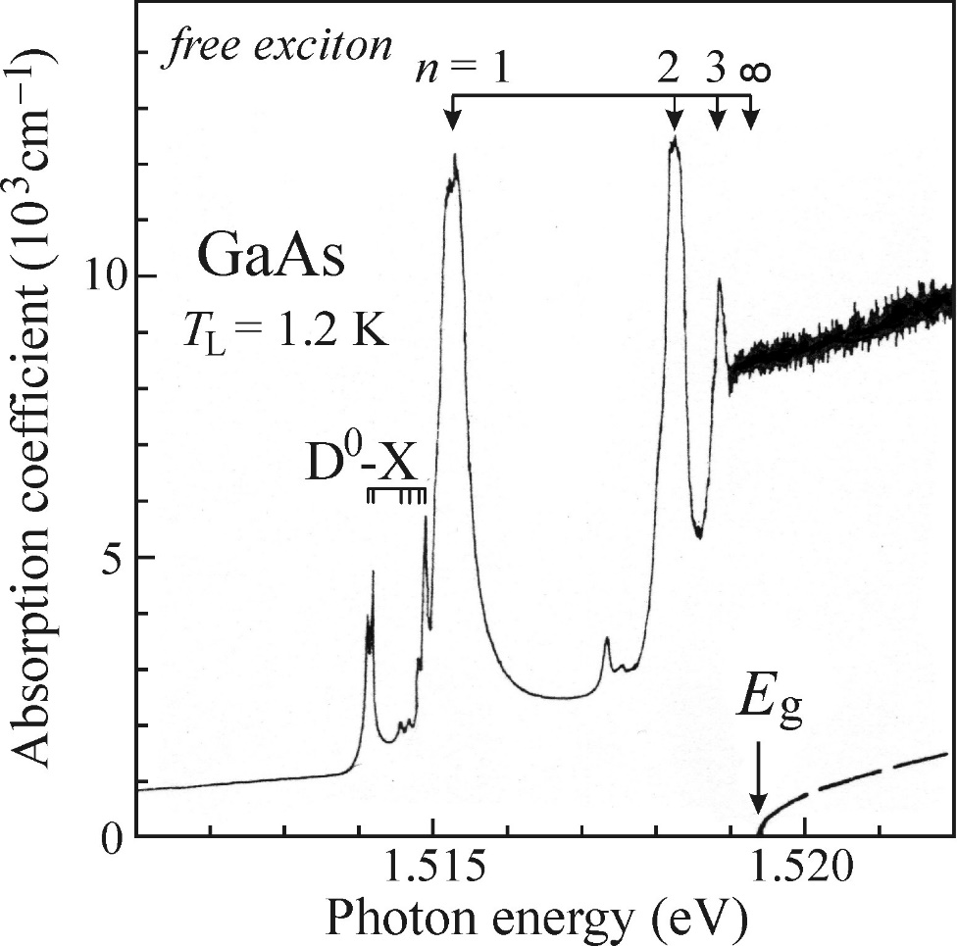
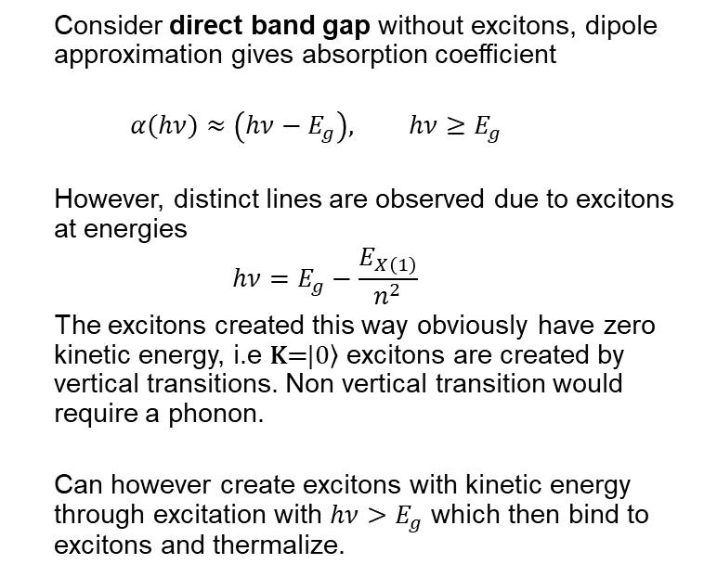
Free excitons: Absorption
  Consider direct band gap without excitons, dipole approximation gives absorption coefficient
  $$α\left(hν\right)≈\left(hν−E_{g}\right), hν≥E_{g}$$
  However, distinct lines are observed due to excitons at energies
  $$hν=E_{g}−\frac{E_{X\left(1\right)}}{n^{2}}$$
  The excitons created this way obviously have zero kinetic energy, i.e $\text{K}\text{=}\left.|0\right\rangle$ excitons are created by vertical transitions. Non vertical transition would require a phonon.
  Can however create excitons with kinetic energy through excitation with $hν>E_{g}$ which then bind to excitons and thermalize.
Notes:
Should get the familiar square root dependence if we neglect excitons.
Dipole approximation: Set incoming EM field (LIGHT) constant (since wvl often much larger than size of atom) & compute selection rules (matrix elemtent) => probability of transition
See lines before onset of band gap.
The lines before n=1 are due to excitons bound to impurities, which we will get to later.
Also, higher abs due to exciton states after band gap onset!
transitions involving phonon much less likely
On last note: so we can have excitons populating higher states in the dispersion curve, important for luminescence later.

Slide 8
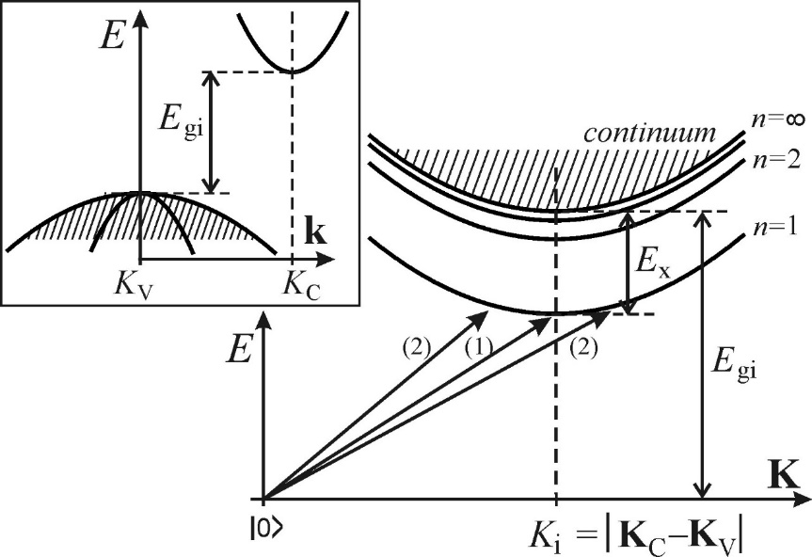
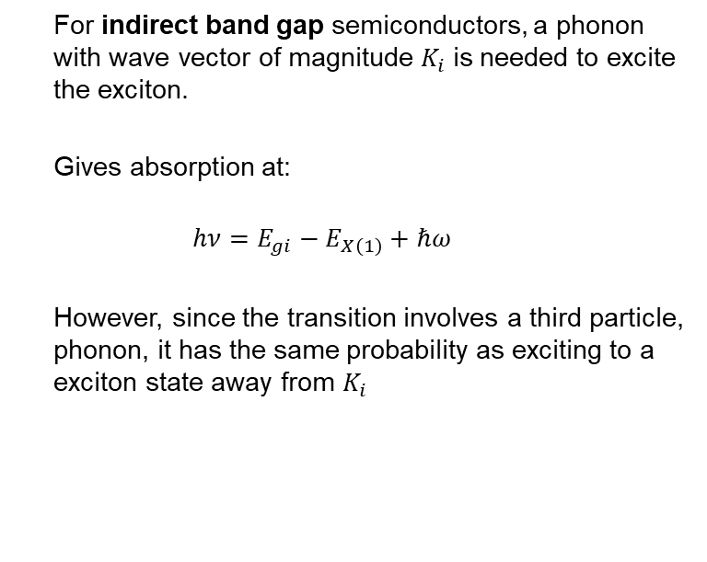
Free excitons: Absorption
  For indirect band gap semiconductors, a phonon with wave vector of magnitude $K_{i}$ is needed to excite the exciton.
  Gives absorption at:
  $$hν=E_{gi}−E_{X\left(1\right)}+ℏω$$
  However, since the transition involves a third particle, phonon, it has the same probability as exciting to a exciton state away from $K_{i}$
Notes:
Show Ki in figure
Same probability for (1) And (2) transitions in fig

Slide 9
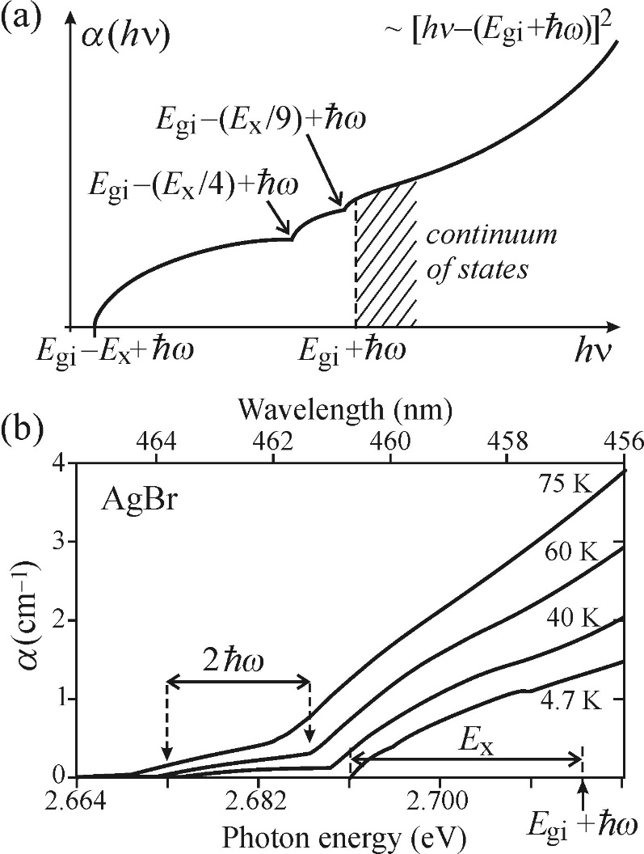
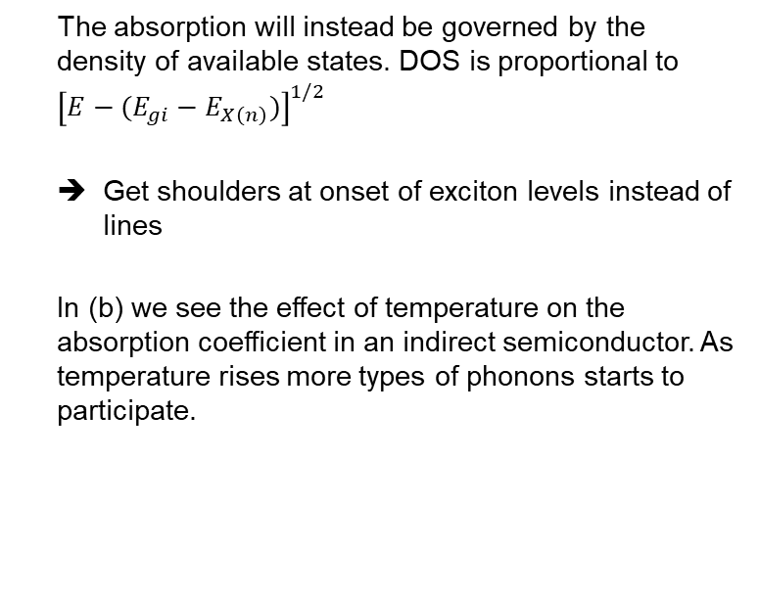
Absorption spectrum of free excitons
  The absorption will instead be governed by the density of available states. DOS is proportional to ${\left[E−(E_{gi}−E_{X\left(n\right)})\right]}^{1/2}$
  Get shoulders at onset of exciton levels instead of lines
  In (b) we see the effect of temperature on the absorption coefficient in an indirect semiconductor. As temperature rises more types of phonons starts to participate.
Notes:
Get square root dependent absorption below band gap.
Curve in (a) corresponds to 4.7 K curve in (b)

Slide 10
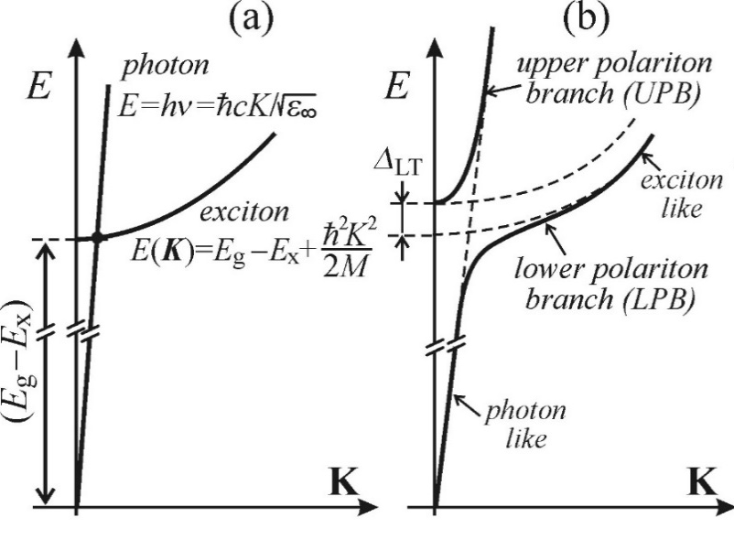
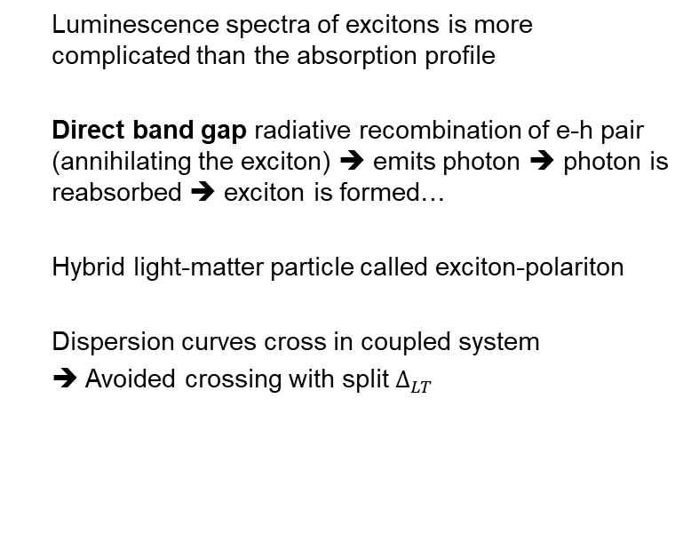
Direct: Resonant luminesence of free exciton-polaritons
  Luminescence spectra of excitons is more complicated than the absorption profile
  Direct band gap radiative recombination of e-h pair (annihilating the exciton) ➔ emits photon ➔ photon is reabsorbed ➔ exciton is formed…
  Hybrid light-matter particle called exciton-polariton
  Dispersion curves cross in coupled system
  ➔ Avoided crossing with split $Δ_{LT}$
Notes:
Hard for photon to get out as it is reabsorbed very quickly
light line, exciton line and polariton region

Slide 11

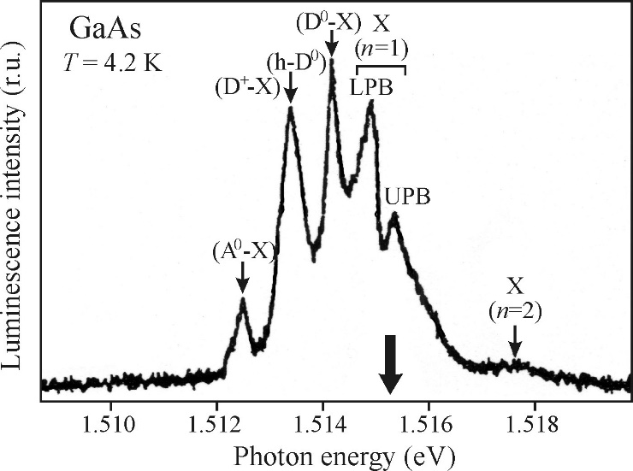
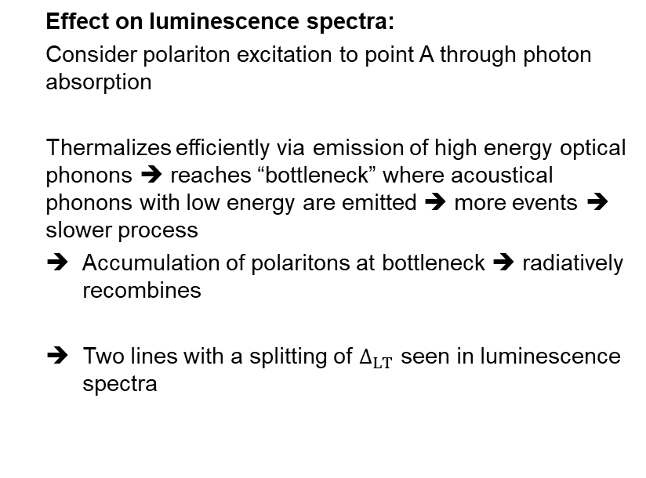
Direct: Resonant luminesence of free exciton-polaritons
  Effect on luminescence spectra:
  Consider polariton excitation to point A through photon absorption
  Thermalizes efficiently via emission of high energy optical phonons ➔ reaches “bottleneck” where acoustical phonons with low energy are emitted ➔ more events ➔ slower process
  Accumulation of polaritons at bottleneck ➔ radiatively recombines
  Two lines with a splitting of $Δ_{LT}$ seen in luminescence spectra
Notes:
For a given lifetime of exciton it is more likely for it to recombine at the bottleneck as it spends more time there.
The luminescence spectra is for very pure GaAs, See upper and lower branch. Big arrow indicates position of absorption line.
Also, the center part (in between) corresponds to the light that is reabsorped in the exciton explanation we introduced earlier.

Slide 12
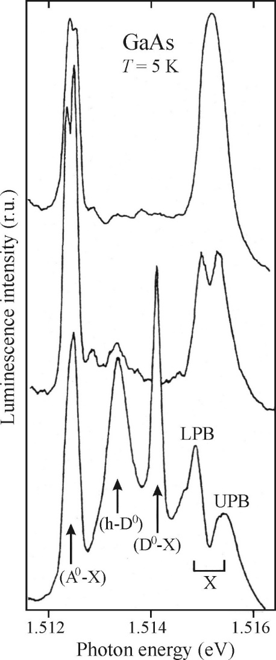
Direct: Resonant luminesence of free exciton-polaritons
  Observed: The splitting of the exciton-polariton line is influenced by the impurity concentration in the sample, especially shallow donors.
  Proposed mechanism:
  Shallow donors scatters polaritons elastically, preventing them from reaching the surface ➔ More time for inelastic processes ➔ Polaritons have time to reach the “bottleneck” ➔ Split between LPB and UPB is observed
Notes:
Figure: Highest impurity concentration in lowest curve, can be seen through the peaks corresponding to bound excitons to neutral donors.

Slide 13
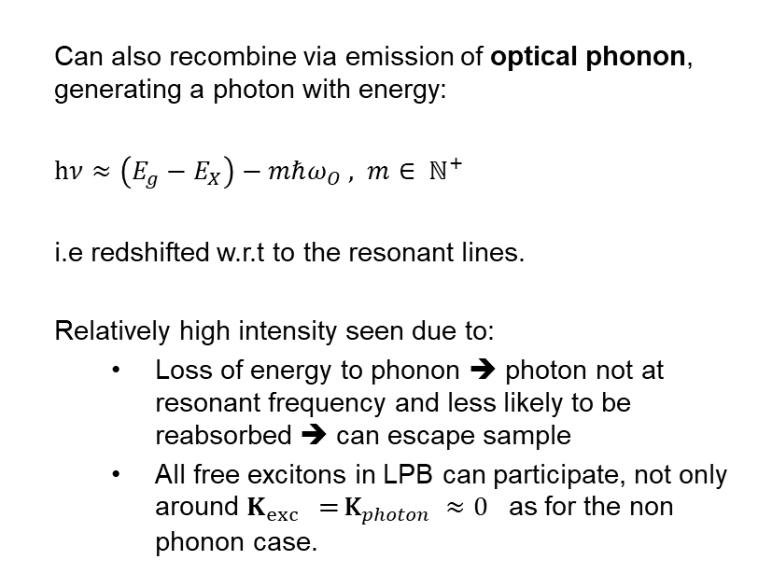
Direct: Luminesence of free excitons with emission of optical phonons
  Can also recombine via emission of optical phonon, generating a photon with energy:
  $hν≈\left(E_{g}−E_{X}\right)−mℏω_{O} , m∈ ℕ^{+}$
  i.e redshifted w.r.t to the resonant lines.
  Relatively high intensity seen due to:
    Loss of energy to phonon ➔ photon not at resonant frequency and less likely to be reabsorbed ➔ can escape sample
    All free excitons in LPB can participate, not only around $K_{exc}\text{ =} {\text{K}}_{photon} ≈0$ as for the non phonon case.
Notes:
An additional channel for radiative recombination for excitons in direct band gap is of course with the help of a phonon. In this case an optical phonon.
In fig: by emission of optical phonon from bottleneck we reach the light line
Can escape sample because not at resonant frequency anymore
Also, all excitons can deexcite this way.

Slide 14
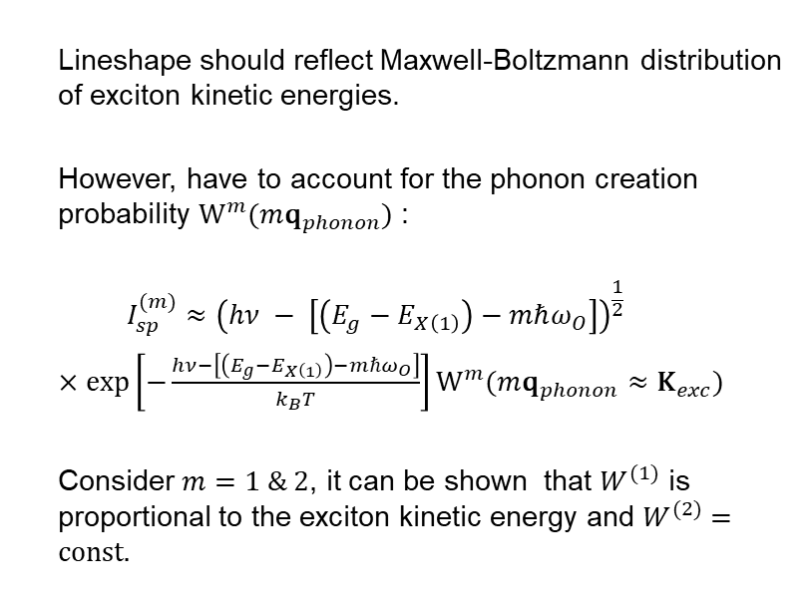
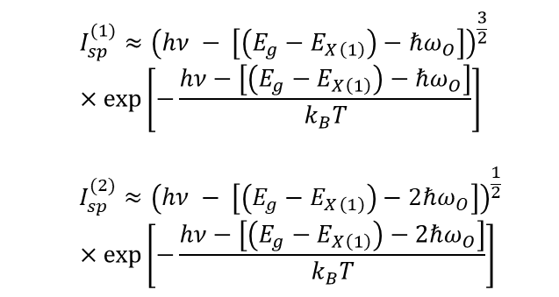
Direct: Luminesence of free excitons with emission of optical phonons
  Lineshape should reflect Maxwell-Boltzmann distribution of exciton kinetic energies.
  However, have to account for the phonon creation probability $W^{m}(m{\text{q}}_{phonon})$ :
  $$I_{sp}^{(m)}≈{\left(hν − \left[\left(E_{g}−E_{X\left(1\right)}\right)−mℏω_{O}\right]\right)}^{\frac{1}{2}}$$
  $×\text{exp}\left[−\frac{hν−\left[\left(E_{g}−E_{X\left(1\right)}\right)−mℏω_{O}\right]}{k_{B}T}\right]W^{m}(m{\text{q}}_{phonon}≈{\text{K}}_{exc})$
  Consider $m=1 \& 2$, it can be shown that $W^{(1)}$ is proportional to the exciton kinetic energy and $W^{(2)}=\text{const}\text{.}$
  $$I_{sp}^{(1)}≈{\left(hν − \left[\left(E_{g}−E_{X\left(1\right)}\right)−ℏω_{O}\right]\right)}^{\frac{3}{2}}$$
  $$×\text{exp}\left[−\frac{hν−\left[\left(E_{g}−E_{X\left(1\right)}\right)−ℏω_{O}\right]}{k_{B}T}\right]$$
  $$I_{sp}^{(2)}≈{\left(hν − \left[\left(E_{g}−E_{X\left(1\right)}\right)−2ℏω_{O}\right]\right)}^{\frac{1}{2}}$$
  $$×\text{exp}\left[−\frac{hν−\left[\left(E_{g}−E_{X\left(1\right)}\right)−2ℏω_{O}\right]}{k_{B}T}\right]$$
Notes:
Maxwell Boltzmann because “all” excitons can participate,
However, need to account for phonon creation probability.
Get different exponents , i.e different lineshapes

Slide 15
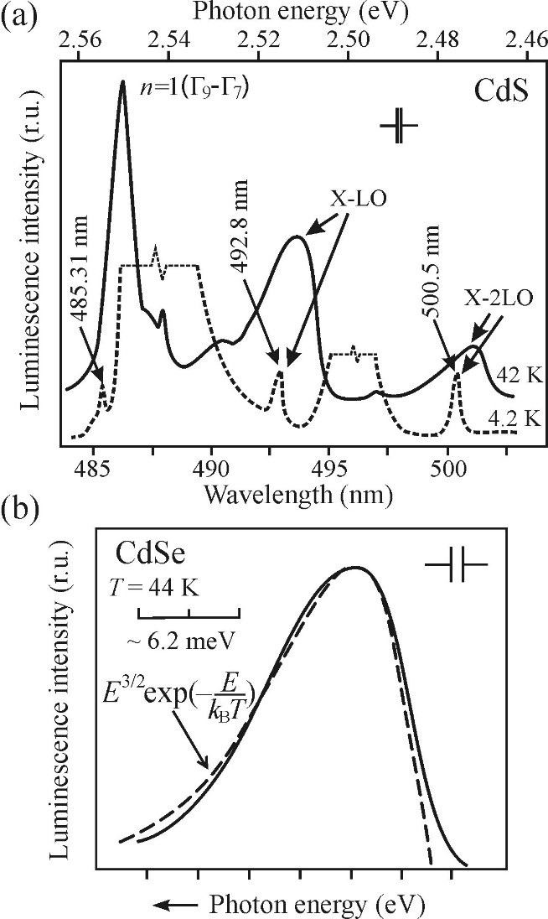
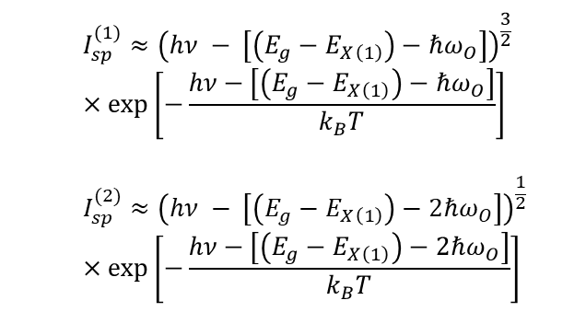
Direct: Luminesence of free excitons with emission of optical phonons
  $$I_{sp}^{(1)}≈{\left(hν − \left[\left(E_{g}−E_{X\left(1\right)}\right)−ℏω_{O}\right]\right)}^{\frac{3}{2}}$$
  $$×\text{exp}\left[−\frac{hν−\left[\left(E_{g}−E_{X\left(1\right)}\right)−ℏω_{O}\right]}{k_{B}T}\right]$$
  $$I_{sp}^{(2)}≈{\left(hν − \left[\left(E_{g}−E_{X\left(1\right)}\right)−2ℏω_{O}\right]\right)}^{\frac{1}{2}}$$
  $$×\text{exp}\left[−\frac{hν−\left[\left(E_{g}−E_{X\left(1\right)}\right)−2ℏω_{O}\right]}{k_{B}T}\right]$$
Free exciton recombination process varies linearly with excitation intensity as other intrinsic monomolecular processes, no saturation
Notes:
In (a) we see the X-LO, ie m=1 at around 493 nm, and the line corresponding to m=2 at 500
With increasing temperature the phonon assisted lines becomes more pronounced while out of scale lines in low temp corresponding to bound exciton transitions almost disappear.
The phonon assisted lines are assymetrical according to the relations we just derived.
In lower figure we see the theoretical fit (dashed) and the experimental, solid, in good agreement.
With regards to the depence on excitation intensity, we should note that this in an intrinsic process as thus varies linearly

Slide 16
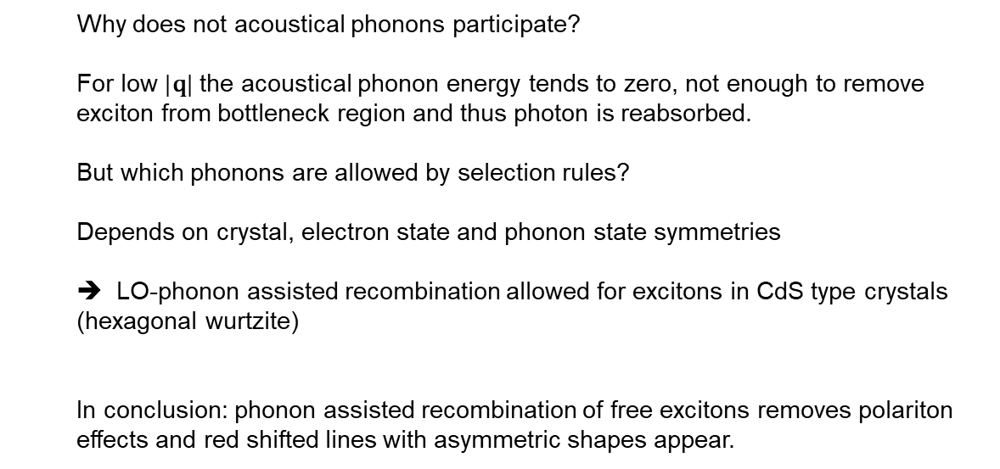
Direct: Luminesence of free excitons with emission of optical phonons
  Why does not acoustical phonons participate?
  For low $|\text{q}\text{|}$ the acoustical phonon energy tends to zero, not enough to remove exciton from bottleneck region and thus photon is reabsorbed.
  But which phonons are allowed by selection rules?
  Depends on crystal, electron state and phonon state symmetries
  ➔ LO-phonon assisted recombination allowed for excitons in CdS type crystals (hexagonal wurtzite)
  In conclusion: phonon assisted recombination of free excitons removes polariton effects and red shifted lines with asymmetric shapes appear.
Notes:
The conclusion: Because the excitons are removed from the polariton region by the emission of optical phonon.
Depends on the exciton-phonon coupling in the material. Strong coupling -> no polariton effects (free exciton line)

Slide 17
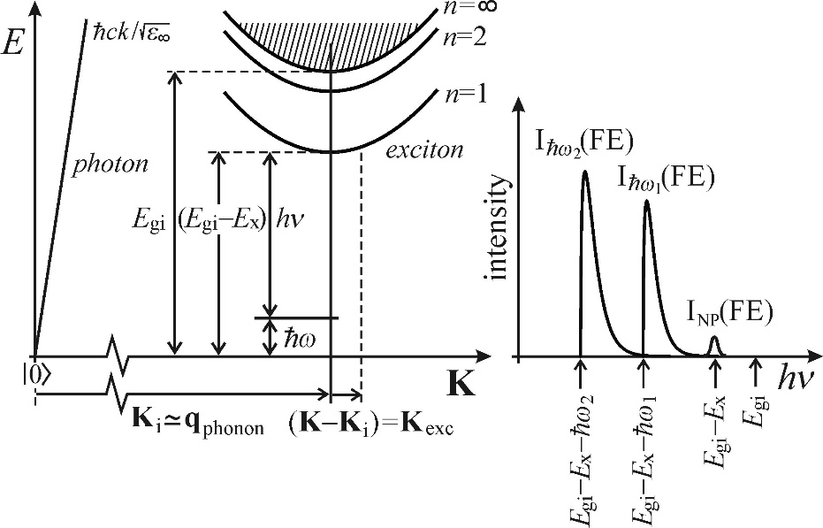
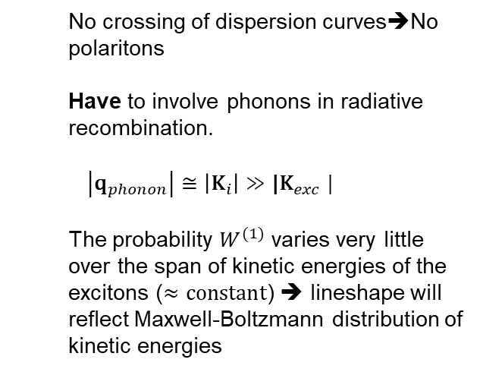
Indirect: Luminesence of free excitons
  No crossing of dispersion curves➔No polaritons
  Have to involve phonons in radiative recombination.
  $$\left|{\text{q}}_{phonon}\right|≅\left|{\text{K}}_{i}\right|{≫\text{|}\text{K}}_{exc}|$$
  The probability $W^{(1)}$ varies very little over the span of kinetic energies of the excitons ($≈constant$) ➔ lineshape will reflect Maxwell-Boltzmann distribution of kinetic energies
Notes:
The phonon momentum must be enough to get from the 0 state to the exciton line. Point to figure.
In the emission spectra NP means no phonon

Slide 18
Indirect: Luminesence of free excitons
  What types of phonons take part in the process?
  Like before: Depends on the symmetry of the crystal, e states and phonon states
  …
  AgBr: LA and TO
  Si: All types
  Ge: LA and TO

Slide 19
Free exciton luminescence summary
  Low temperature (<110 K)
  Hydrogen like spectra below band gap & contributes to increased absorption above band gap
  Polariton effects seen in direct band gap semiconductors with high shallow donor concentrations and low exciton –phonon coupling
  Indirect bandgap semiconductors: Emission lines with Maxwell-Boltzmann characteristics
  Intrinsic process ➔ linear with excitation intensity

Slide 20
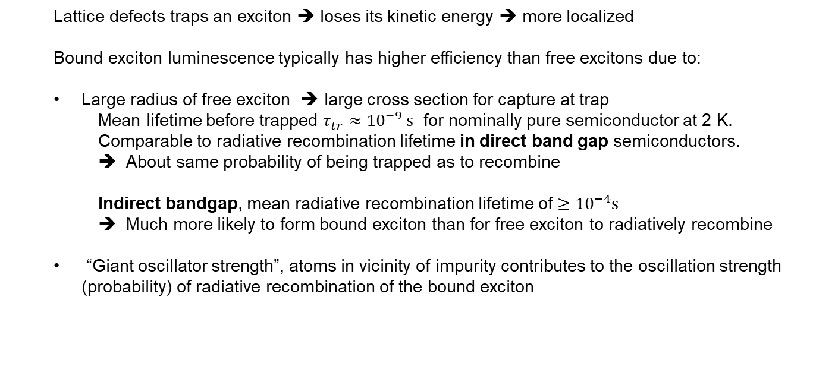
Bound excitons
  Lattice defects traps an exciton ➔ loses its kinetic energy ➔ more localized
  Bound exciton luminescence typically has higher efficiency than free excitons due to:
  Large radius of free exciton ➔ large cross section for capture at trap
    Mean lifetime before trapped $τ_{tr}≈{10}^{−9} \text{s}$ for nominally pure semiconductor at 2 K.
    Comparable to radiative recombination lifetime in direct band gap semiconductors.
    About same probability of being trapped as to recombine
    Indirect bandgap, mean radiative recombination lifetime of $≥{10}^{−4}\text{s}$
    Much more likely to form bound exciton than for free exciton to radiatively recombine
  “Giant oscillator strength”, atoms in vicinity of impurity contributes to the oscillation strength (probability) of radiative recombination of the bound exciton
Notes:
Rembember: typical exciton radius was 5 nm

Slide 21
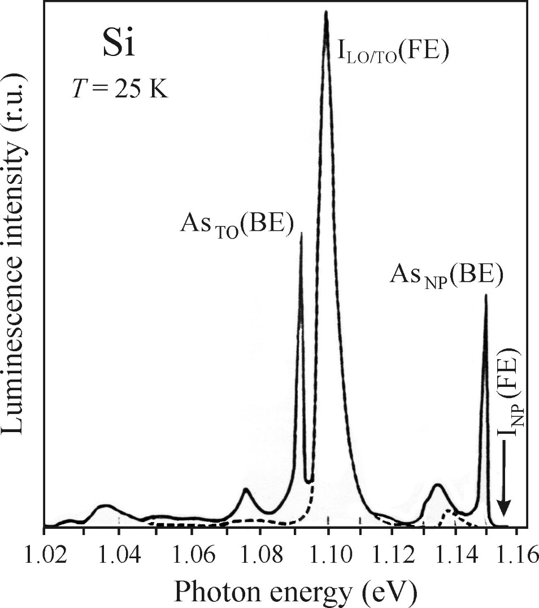
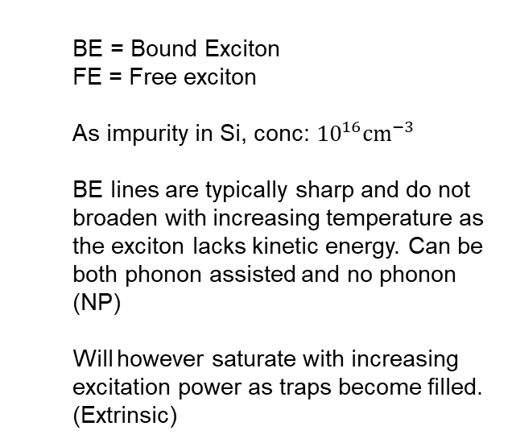
Bound excitons
  BE = Bound Exciton
  FE = Free exciton
  As impurity in Si, conc: ${10}^{16}\text{c}{\text{m}}^{−3}$
  BE lines are typically sharp and do not broaden with increasing temperature as the exciton lacks kinetic energy. Can be both phonon assisted and no phonon (NP)
  Will however saturate with increasing excitation power as traps become filled. (Extrinsic)
Notes:
Example of emission spectrum of Si with arsenic impurities (full line) compared to undoped dashed line.
See the Free exciton phonon assisted line at around 1.10 and a line attributed to phonon assisted recombination of bound excitons to As and a smaller line for the non phonon assisted recombination.
The Bound exciton lines are clearly sharper than the free exciton line.

Slide 22
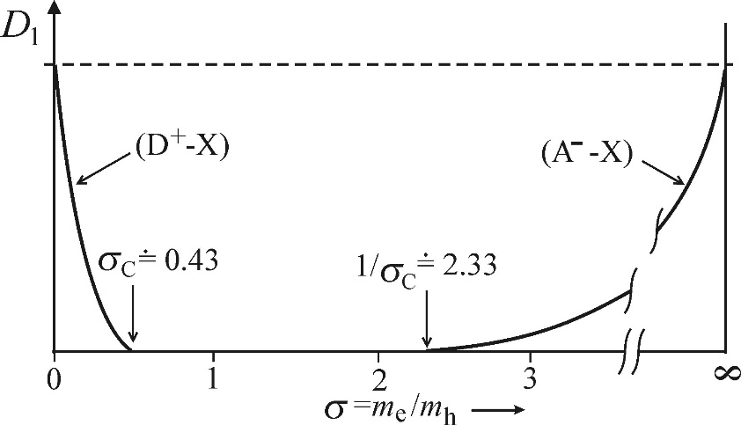
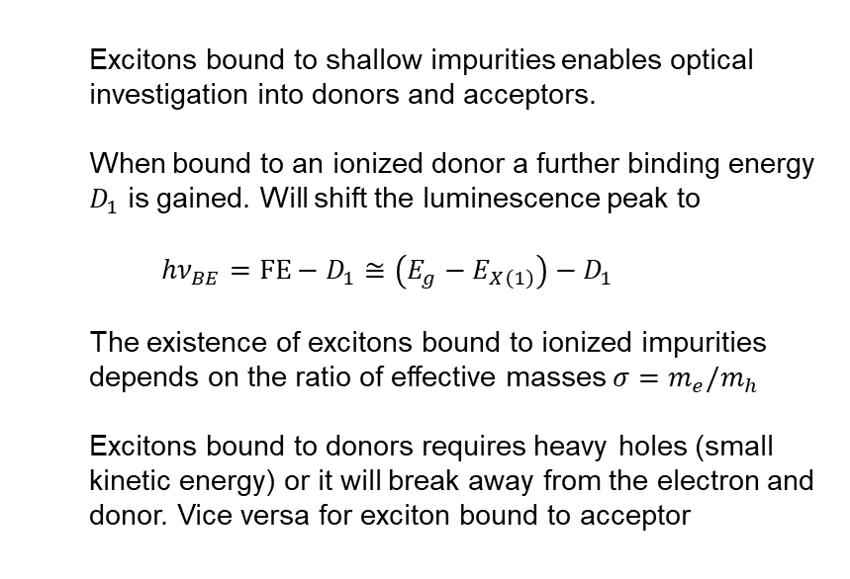
Bound excitons: ionized impurities
  Excitons bound to shallow impurities enables optical investigation into donors and acceptors.
  When bound to an ionized donor a further binding energy $D_{1}$ is gained. Will shift the luminescence peak to
  $$hν_{BE}=\text{FE}−D_{1}≅\left(E_{g}−E_{X\left(1\right)}\right)−D_{1}$$
  The existence of excitons bound to ionized impurities depends on the ratio of effective masses $σ=m_{e}/m_{h}$
  Excitons bound to donors requires heavy holes (small kinetic energy) or it will break away from the electron and donor. Vice versa for exciton bound to acceptor
Notes:
Ionized impurity + exciton -> neutral donor + extra hole or electron charge.
There is a critical dependence on sigma for stable exciton + ionized donor to exist.
Below 0.43 we can have a stable exciton-donor complex and above 2.33 we can have a stable exciton acceptor complexs.

Slide 23
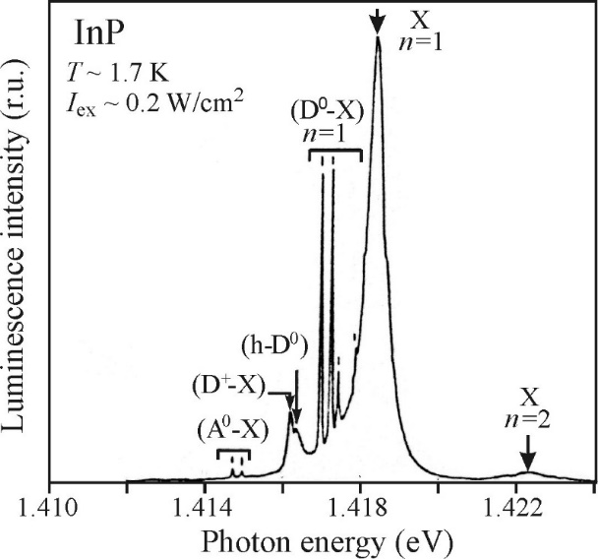
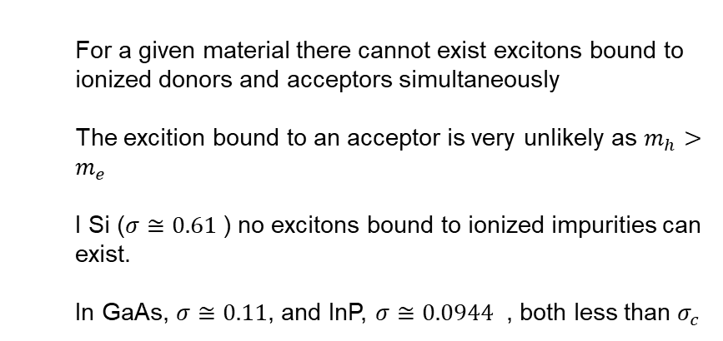
Bound excitons: ionized impurities
  For a given material there cannot exist excitons bound to ionized donors and acceptors simultaneously
  The excition bound to an acceptor is very unlikely as $m_{h}>m_{e}$
  I Si ($σ≅0.61$) no excitons bound to ionized impurities can exist.
  In GaAs, $σ≅0.11$, and InP, $σ≅0.0944$ , both less than $σ_{c}$
Notes:
In the InP figure we see the exciton bound to positive donor line. The luminescence photon has lower energy than the ground state free exciton as expected.
We see no exciton- negative acceptor line as expected from our considerations about effective masses.

Slide 24
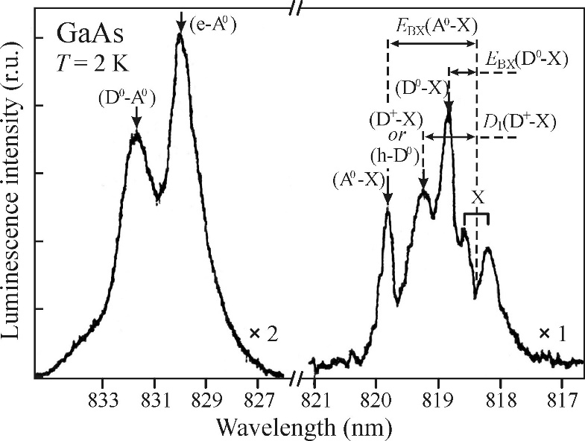
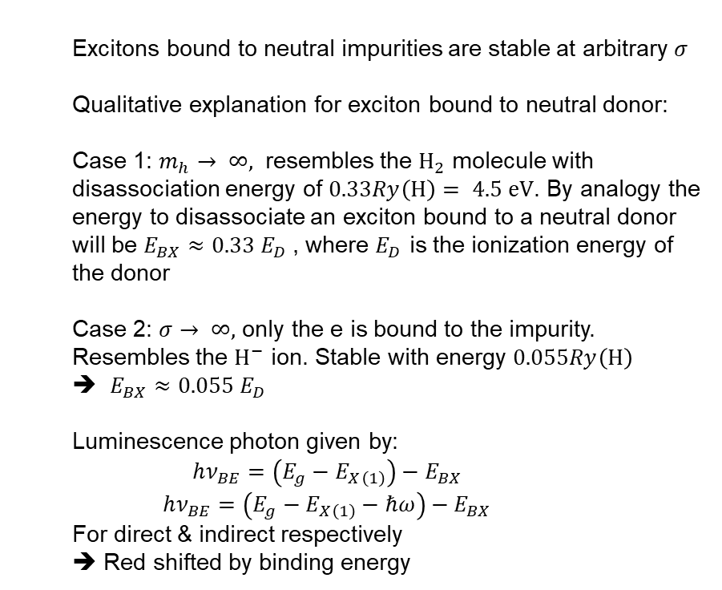
Bound excitons: neutral impurities
  Excitons bound to neutral impurities are stable at arbitrary $σ$
  Qualitative explanation for exciton bound to neutral donor:
  Case 1: $m_{h}→ ∞,$ resembles the ${\text{H}}_{2}$ molecule with disassociation energy of $0.33Ry\left(H\right)= 4.5 \text{eV}$. By analogy the energy to disassociate an exciton bound to a neutral donor will be $E_{BX}≈0.33 E_{D}$, where $E_{D}$ is the ionization energy of the donor
  Case 2: $σ→ ∞,$ only the e is bound to the impurity. Resembles the ${\text{H}}^{−}$ ion. Stable with energy $0.055Ry\left(H\right)$
  $E_{BX}≈0.055 E_{D}$
  Luminescence photon given by:
  $$hν_{BE}=\left(E_{g}−E_{X\left(1\right)}\right)−E_{BX}$$
  $$hν_{BE}=\left(E_{g}−E_{X\left(1\right)}−ℏω\right)−E_{BX}$$
  For direct & indirect respectively
  ➔ Red shifted by binding energy
Notes:
For m goes to inf case we say that the exciton resembles a H atom even more. The neutral donor can also be thought of as a H atom with active electron and one positive unnacounted charge in the nucelous.
In the figure we see a lot of lines attributed to various impurities.
The most red shifted is the Donor to acceptor line, which we discussed in earlier lectures, then you have the electron to acceptor line.
Closer to the band gap edge we have the exciton lines, starting with exciton and neutral acceptor, then the exciton-ionized donor, then neutral donor and finally the exciton state which has split due to polaritons.
Now, why is the binding energy of the neutral donor + exciton smaller than the ionoized donor + exciton?

Slide 25
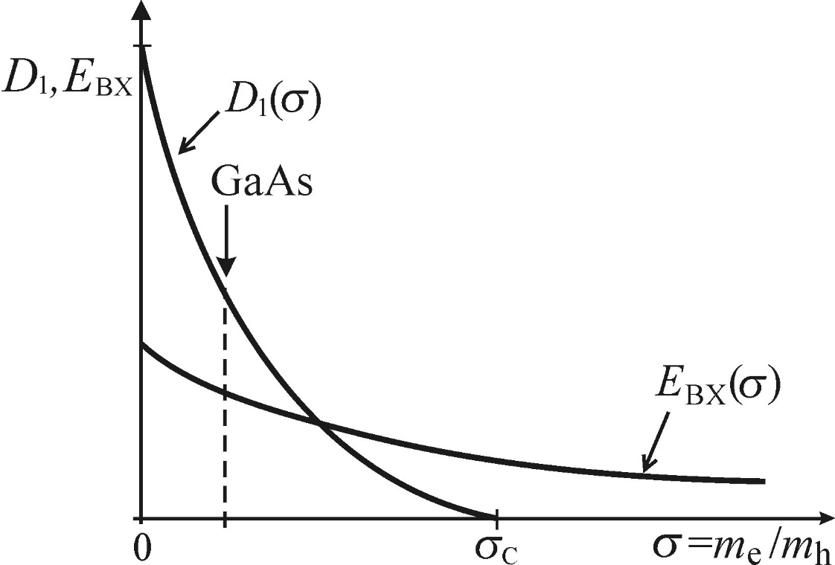

Bound excitons: neutral impurities
  Binding energy depends on $σ$
Notes:
And as we can see, for GaAs which has considerable higher hole mass than electron mass, the binding energy is larger for the ionized than for the neutral.
So the order of the bound exciton lines in the emission spectrum is material dependent.

Slide 26
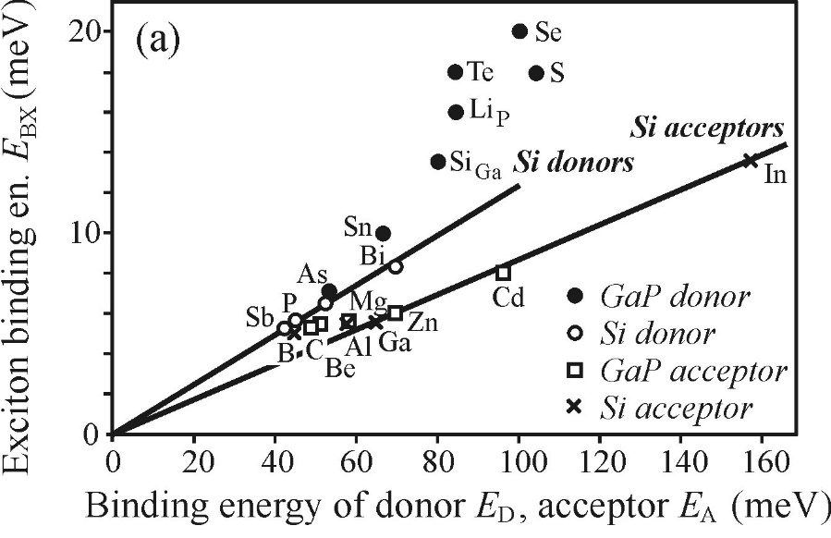
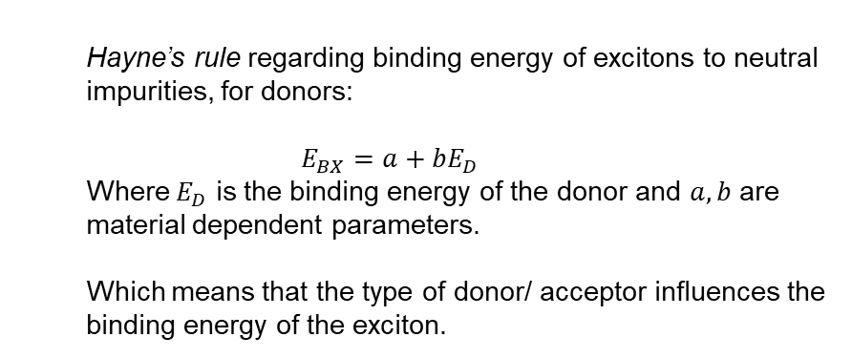
Bound excitons: neutral impurities
  Hayne’s rule regarding binding energy of excitons to neutral impurities, for donors:
  $$E_{BX}=a+bE_{D}$$
  Where $E_{D}$ is the binding energy of the donor and $a,b$ are material dependent parameters.
  Which means that the type of donor/ acceptor influences the binding energy of the exciton.
Notes:
Fig: As we can see in figure here, the exciton binding energy depends on the donor or acceptor binding energy.

Slide 27
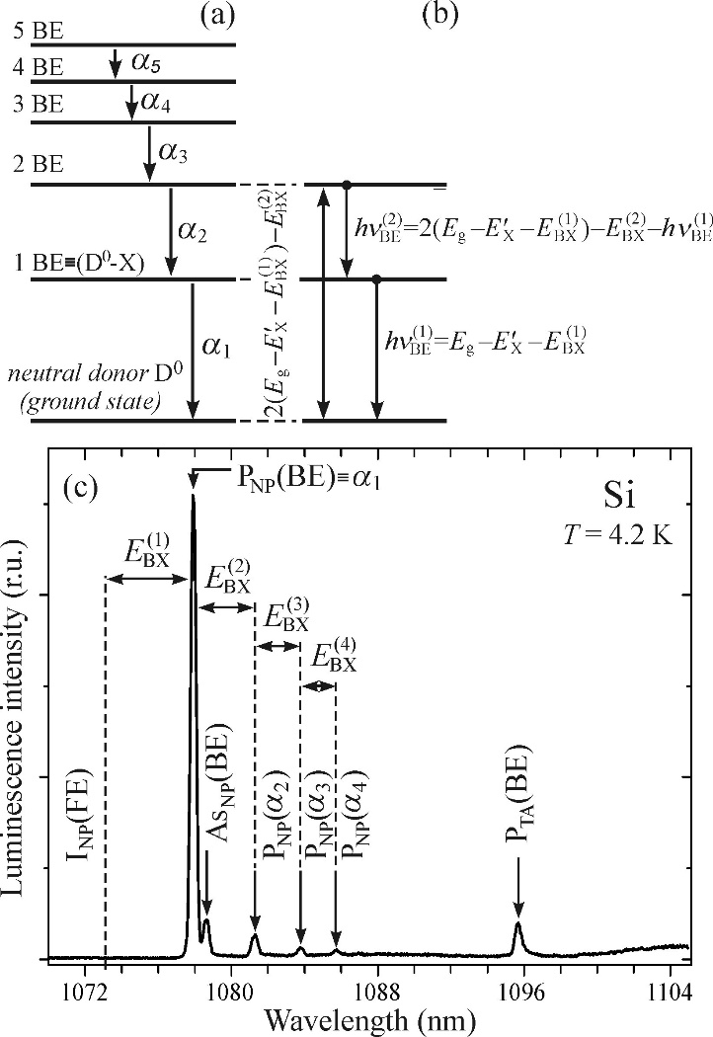
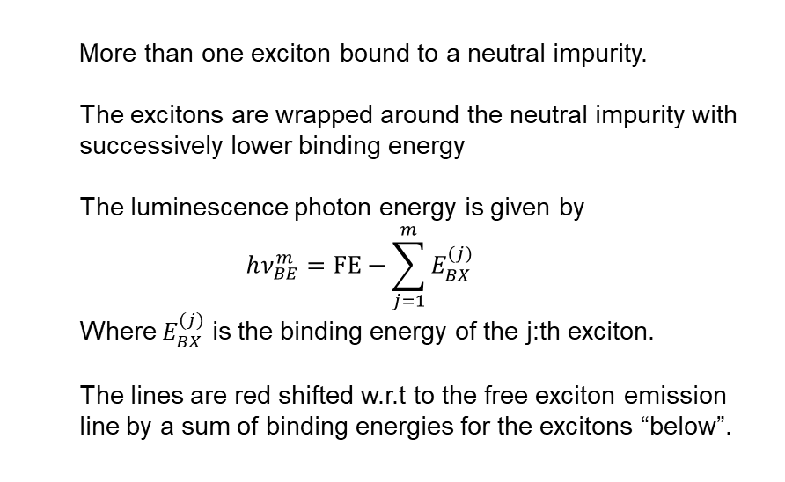
Bound excitons: neutral impurities - multiexciton complexes
  More than one exciton bound to a neutral impurity.
  The excitons are wrapped around the neutral impurity with successively lower binding energy
  The luminescence photon energy is given by
  $$hν_{BE}^{m}=FE−\sum_{j=1}^{m}{E_{BX}^{(j)}}$$
  Where $E_{BX}^{(j)}$ is the binding energy of the j:th exciton.
  The lines are red shifted w.r.t to the free exciton emission line by a sum of binding energies for the excitons “below”.
Notes:
Here FE stands for the free exciton energy and m is the total number of excitons bound to the impurity.
Can be seen in the figure, the 2 line has energy
In the figure wee see the effect of phosphorous doping in Si. We have the usual bound exciton line, denoted by alpha 1 and then a succession of lines in diminishing intensity corresponding to the higher level state of the multiexciton complex.

Slide 28
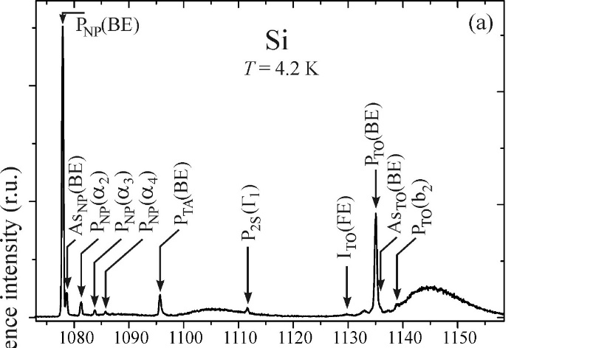
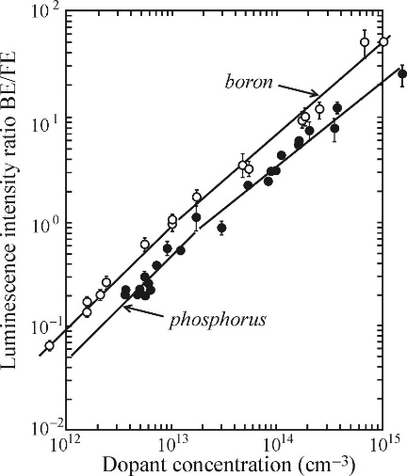
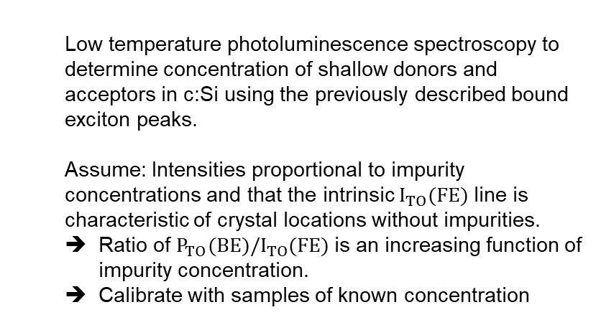
Quantitative luminescence analysis of shallow impurities in Si
  Low temperature photoluminescence spectroscopy to determine concentration of shallow donors and acceptors in c:Si using the previously described bound exciton peaks.
  Assume: Intensities proportional to impurity concentrations and that the intrinsic $I_{TO}(FE)$ line is characteristic of crystal locations without impurities.
  Ratio of ${P_{TO}(BE)/I}_{TO}(FE)$ is an increasing function of impurity concentration.
  Calibrate with samples of known concentration

Slide 29
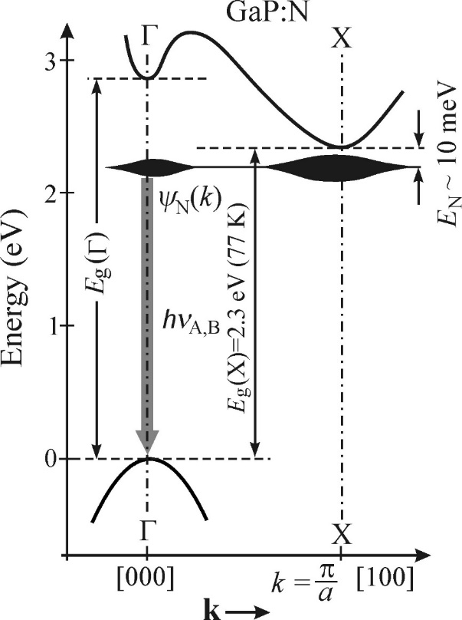
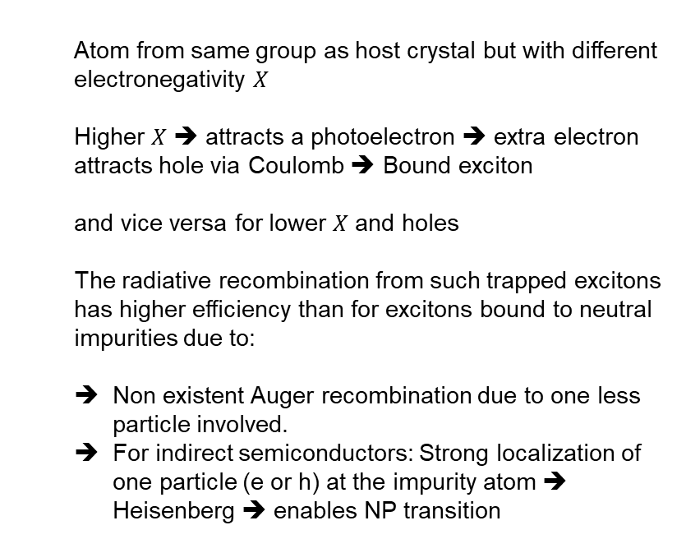
Bound excitons: isoelectronic impurities
  Atom from same group as host crystal but with different electronegativity $X$
  Higher $X$ ➔ attracts a photoelectron ➔ extra electron attracts hole via Coulomb ➔ Bound exciton
  and vice versa for lower $X$ and holes
  The radiative recombination from such trapped excitons has higher efficiency than for excitons bound to neutral impurities due to:
  Non existent Auger recombination due to one less particle involved.
  For indirect semiconductors: Strong localization of one particle (e or h) at the impurity atom ➔ Heisenberg ➔ enables NP transition
Notes:
Photoelectron: electron excited over band gap
The strong localization of exciton leads to large uncertainty in momentum and the exciton can recombine without the help of a phonon. A much more probable process than involvning a phonon.

Slide 30
Bound exciton luminescence summary
    Impurities form efficient traps for excitons
    Efficient recombination centers
    Sharp lines without thermal broadening
    Extrinsic process, will saturate with increasing excitation intensity
    Can be bound to ionized and neutral impurities as well as atoms with different electronegativity
Notes:
Photoelectron: electron excited over band gap
The strong localization of exciton leads to large uncertainty in momentum and the exciton can recombine without the help of a phonon. A much more probable process than involvning a phonon.

Slide 31
Highly Excited semiconductors

Slide 32
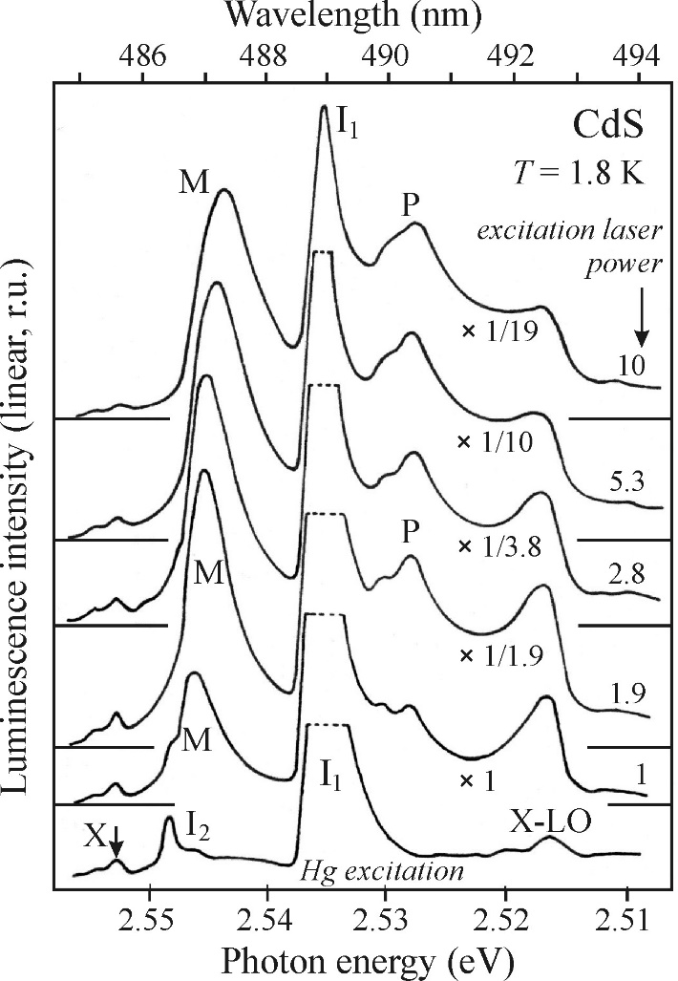
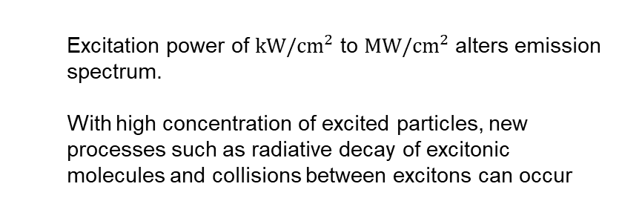
Highly excited semiconductors
  Excitation power of $kW/cm^{2}$ to $MW/cm^{2}$ alters emission spectrum.
  With high concentration of excited particles, new processes such as radiative decay of excitonic molecules and collisions between excitons can occur
Notes:
In figure we see CdS (cadmium sulfide ) with increasing excitation power.
In the lowest curve we see the two lines I1 and I2 which are attributed to excitons bound to residiual impurities and two lines attributed to free excitons, one with phonon assisted recombination and one direct.
As the excitation power increases, the M and P lines appears and the impurity lines saturate.
Laser wvl = 337 nm

Slide 33
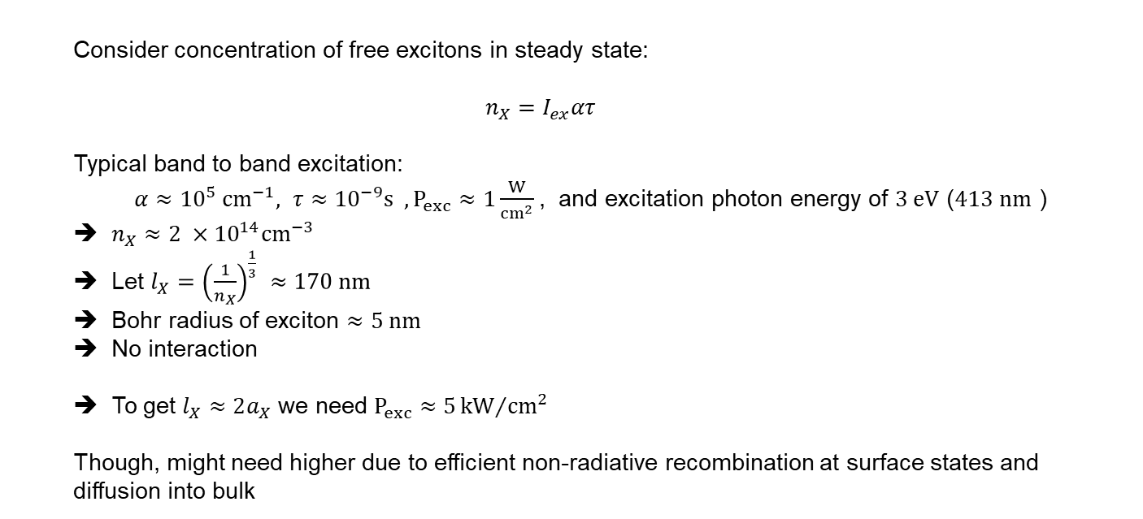
Highly excited semiconductors: Experimental considerations
  Consider concentration of free excitons in steady state:
  $$n_{X}=I_{ex}ατ$$
  Typical band to band excitation:
  $α≈{10}^{5} cm^{−1}, τ≈{10}^{−9}s , P_{exc}≈1\frac{W}{cm^{2}}$, and excitation photon energy of $3 eV$ ($413 nm$ )
  $n_{X}≈2 ×{10}^{14}{cm}^{−3}$
  Let $l_{X}={\left(\frac{1}{n_{X}}\right)}^{\frac{1}{3}} ≈170 nm$
  Bohr radius of exciton $≈5 nm$
  No interaction
  To get $l_{X}≈2a_{X}$ we need $P_{exc}≈5{kW}/{cm^{2}}$
  Though, might need higher due to efficient non-radiative recombination at surface states and diffusion into bulk
Notes:
The creation of excitons is exactly balanced by the total recombination rate.
Lx is the mean interexciton separation
Lx much larger than bohr radius of excitons.
Difusion into bulk means that the concentration of excitons decreases. Local high density of a particle connected to a system will ofcourse naturally diffuse.

Slide 34
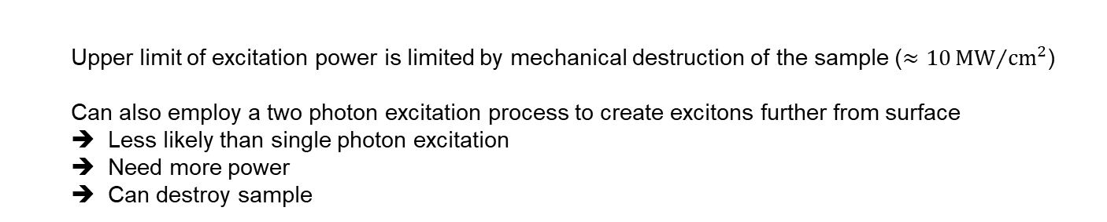
Highly excited semiconductors: Experimental considerations
  Upper limit of excitation power is limited by mechanical destruction of the sample ($≈10{MW}/{cm^{2}}$)
  Can also employ a two photon excitation process to create excitons further from surface
  Less likely than single photon excitation
  Need more power
  Can destroy sample
Notes:
Further from surface => less surface states to recombine at.

Slide 35
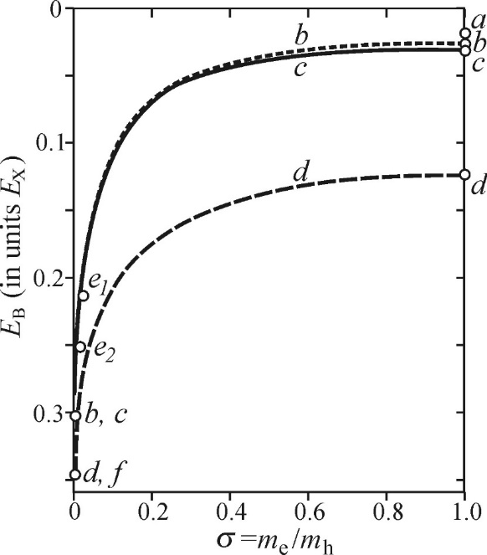
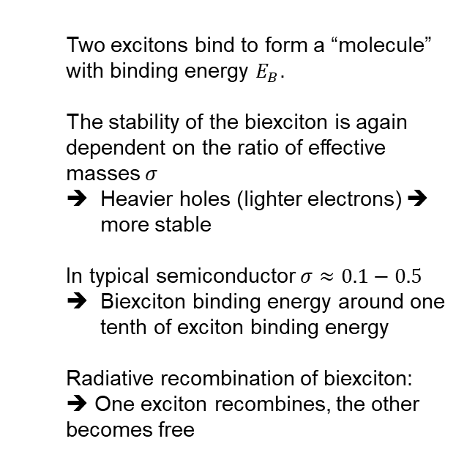
Highly excited semiconductors: Excitonic molecule (Biexciton)
  Two excitons bind to form a “molecule” with binding energy $E_{B}$.
  The stability of the biexciton is again dependent on the ratio of effective masses $σ$
  Heavier holes (lighter electrons) ➔ more stable
  In typical semiconductor $σ≈0.1−0.5$
  Biexciton binding energy around one tenth of exciton binding energy
  Radiative recombination of biexciton:
  ➔ One exciton recombines, the other becomes free
Notes:
Figure, theoretical biexciton binding energy in terms of sigma. The different curves corresponds to different authors.

Slide 36



Highly excited semiconductors: Excitonic molecule (Biexciton)
  How to identify biexciton emission line?
  For direct band gap:
  $hν_{M}=\left(E_{g}−E_{X}\right)−E_{B}$
  $$I_{sp}^{M}\left(hν\right)≈{\left[\left(E_{g}−E_{X}−E_{B}\right)−hν\right]}^{\frac{1}{2}}$$
  $$×exp[{−\left(\left(E_{g}−E_{X}−E_{B}\right)−hν\right)}/{k_{B}T_{M}}]$$
  Inverse Maxwell-Boltzmann: Low energy tail due to larger curvature of single exciton dispersion relation
  All biexctions can radiatively recombine as the resultant free exciton can ensure momentum conservation, unlike the free exciton case
  Effective channel of radiative recombination
Notes:
Figure: exciton dispersion curve has higher curvature due to lower effective mass. Highest energy will be achievied In middle here and then we have lower energy for direct transitions at the sides.
Creates this low energy tail of the luminescence line. The split is because of different energy levels of the longitudinal and transverse exciton levels. Dashed = theory
Also, we do not see polariton effects because they are effectively drowned out by the effective recombination outside of the polariton region.

Slide 37

Highly excited semiconductors: Excitonic molecule (Biexciton)
  Indirect bandgap:
  Also inverted Maxwell Boltzmann for transition from biexciton minimum ($2K_{0}$), but shifted due to phonon energy
  However, as temperature rises, transitions from biexcitons away from their minimum can dexcite to the exciton band minium
  High energy tail
  All biexcitons can participate in recombination
Notes:
Need phonon to deexcite.
Figure: Again higher mass for biexciton. Highest energy from bottom of biexciton to bottom of exciton.
Note that the spectra in the lower figure has an inverted x axis as comparet to the previous slide. Here we have wvl whereas there we had energy.

Slide 38


Highly excited semiconductors: Excitonic molecule (Biexciton)
  Line intensity as function of excitation power
  $I^{M}≈C{\left(\sqrt{1+{I_{exc}}/{{ I}_{0}}}−1\right)}^{2}$ , $C=const.$
  $I_{0}$: material dependent characteristic intensity
  For $I_{exc}≪I_{0}$ ➔ $I^{M}\sim I_{exc}^{2}$
  For $I_{exc}≫I_{0}$ ➔ $I^{M}\sim I_{exc}$
Notes:
In Figure we she log log plot to show the power dependence. Here it is actually a raised to 1.5 dependence on excitation intensity

Slide 39
Summary of highly excited semiconductors
  High excitation power ➔ high density of excitons ➔ can interact with each other
  All biexcitons can radiatively recombine ➔ effective recombination channel
Notes:
In Figure we she log log plot to show the power dependence. Here it is actually a raised to 1.5 dependence.

