Slide 1
Welcome to KTH!
School Reception – spring semester 2020
School of Electrical Engineering and Computer Science (EECS)
Notes:
Presentatiation of International Coordinators

Slide 2
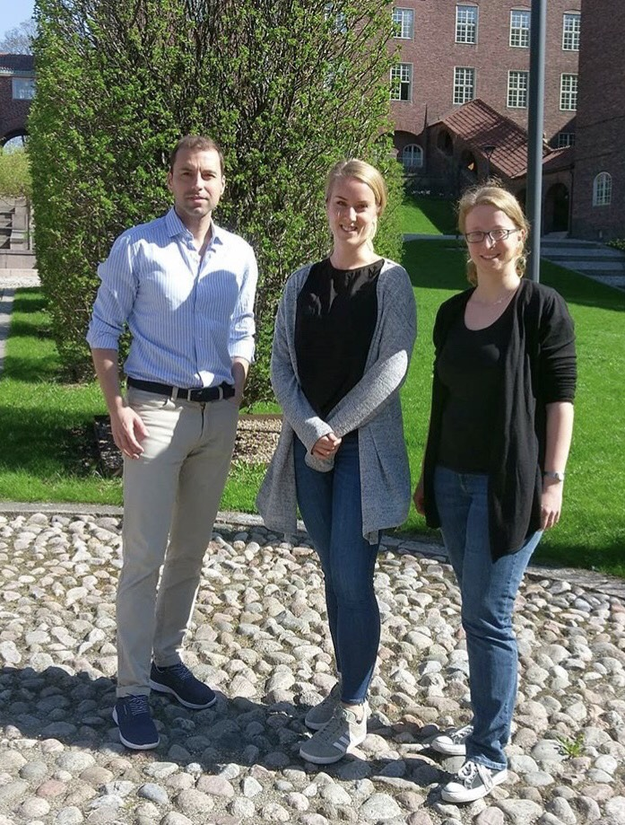
International Office at EECS
Manja Schubert
International Coordinator, Main Campus
Sara Sjögren
International Coordinator, Main Campus and KTH Kista
Christian Todoran
International Coordinator, Main Campus
exchange.in@eecs.kth.se
Notes:
Här får ni själva lägga in information om introschema samt eventuell kontaktinformation

Slide 3
Agenda – School Reception
Fika!
Sweden, Stockholm and KTH
Support and Services
Safety and Insurance
Studies and Administration
Student Union & Chapters
Access Cards
Document signing
Notes:
Presentationsrunda?

Slide 4
How are you and who are you?
www.menti.com
71 37 73
10 good things to know about Sweden
Sweden

Slide 5

Stockholm
Capital of Sweden
Biggest city in Sweden
Home to 2.1 million people
Around 85,000 students (24 universities)
Built on 14 islands (24.000 in the archipelago) connected by 57 bridges
Notes:
Stockholm is the capital of Sweden
Home to around 2.1 million people.
And to around 85,000 students.
Built on 14 islands with an archipelago of 24.000 islands stretching out into the Baltic Sea.

Slide 6
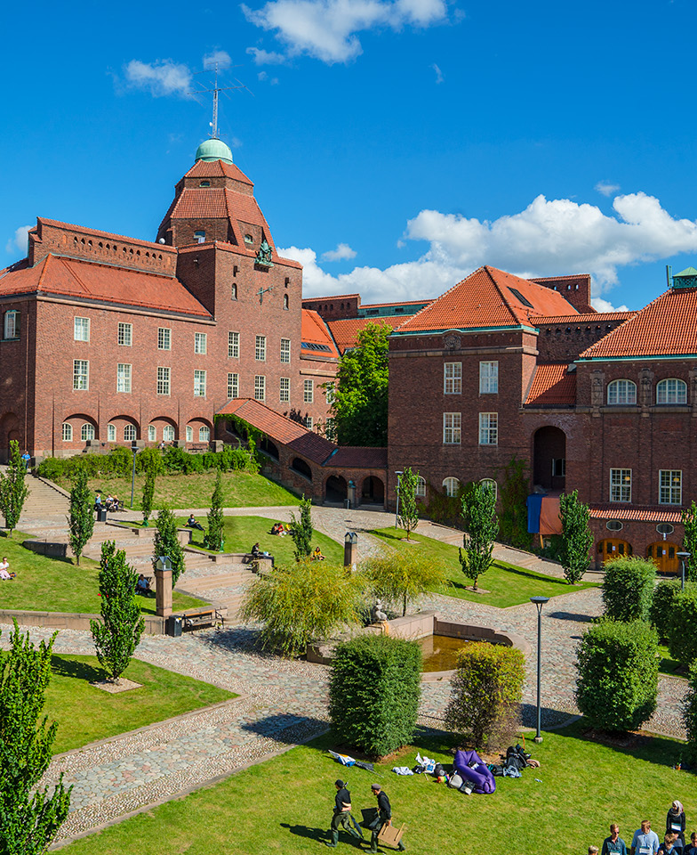
KTH
Established in 1827
13,000 full-time students
3700 full-time employees, 305 professors (46 women, 259 men)
5 schools
Around one third of all students are from outside of Sweden
Notes:
KTH was established 1827. The reigning Swedish King Carl XVI (sixteenth) Gustaf is the guardian of the university.
KTH has over 13,000 full-time students from all over the world.
3700 full-time employees, 305 professors (46 women, 259 men)
KTH has 4 campuses in and around Stockholm.
The university consists of 5 schools.
Around one third of all students are from outside of Sweden. The two most common countries of previous studies are China and India.

Slide 7
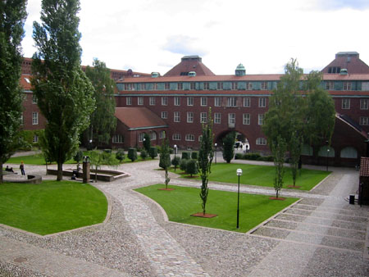
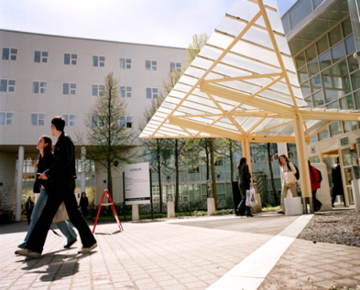
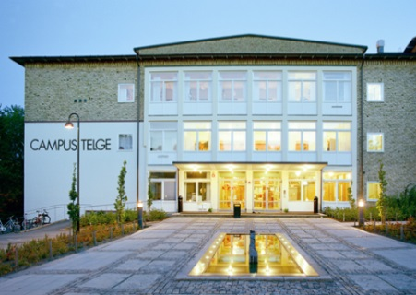
KTH Campus Areas
KTH Campus
Main campus, Valhallavägen
KTH Kista
Former School of Information- and Communication Technology (ICT)
KTH Syd
Flemingsberg and Södertälje
School of Technology and Health (Medical Engineering, Bachelor of science programs)

Slide 8
5 KTH Schools
School of Architecture and the Built Environment (ABE)
School of Biotechnology, Chemical Science and Technology and Health (CBH)
School of Electrical Engineering and Computer Science (EECS)
School of Industrial Engineering and Management (ITM)
School of Engineering Sciences (SCI)

Slide 9
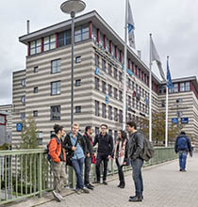
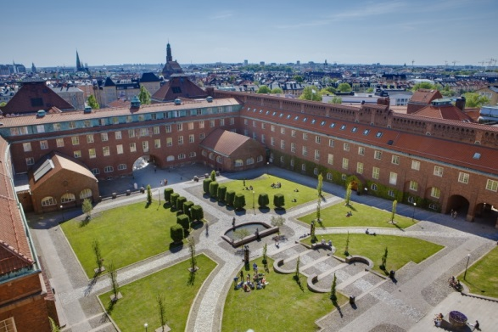
The School of Electrical Engineering and Computer Science - EECS
Started the 1st of January 2018
Biggest School at KTH, located at two campuses
15 master’s programmes, 4 Master of Science
4 departments (16 divisions), 200 faculty members, 500 doctoral students, 4400 students.
Notes:
The school offers one bachelor's programme, four master of science programmes, 15 master's programmes and doktoral studies in four fields in English. We also offer several bachelor's programmes in Swedish. In total, we educate about 4400 people within our programmes
Our research is internationally recognized and places high in international rankings within our field. The school conducts research at sixteen departments and seven competence centres. The school has 200 faculty members, 500 doctoral students and 140 researching and teaching staff.

Slide 10
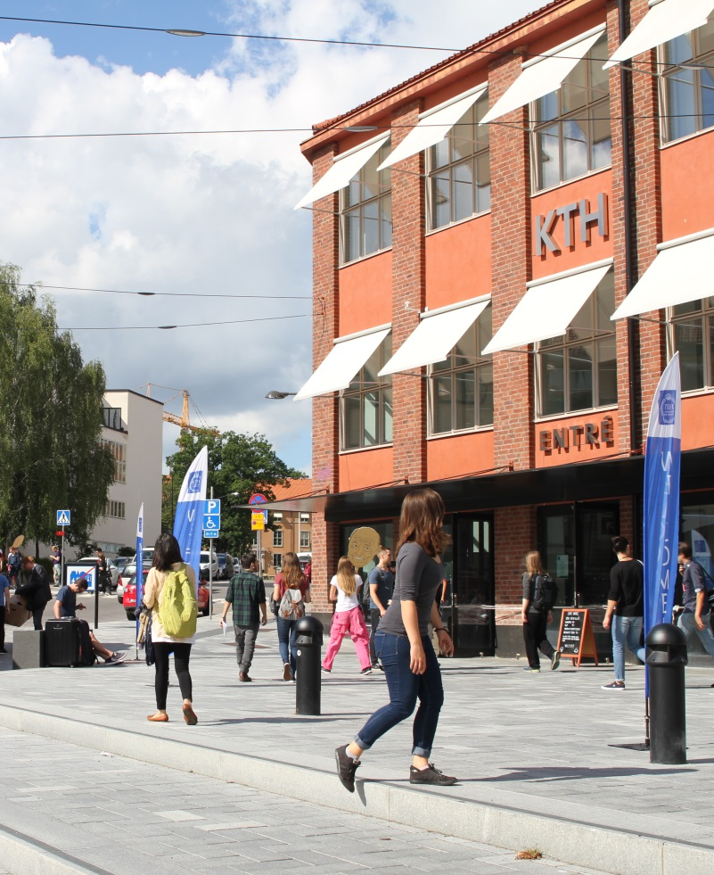
KTH Entré
Central meeting point for service and information at Main Campus
Help with KTH account, access card
Accommodation Office
Drottning Kristinas väg 4
Monday - Friday 8:00 - 16:30
Notes:
KTH Entré is a central meeting point for service and information on main campus.
As a student at KTH you can for example get help with your KTH account, access card and study certificates.
KTH Entré is located in the first KTH house you see after you exit the metro, on Drottning Kristinas väg 4.
The regular opening hours are Monday - Friday 8:00 - 16:30. Other opening hours apply during holidays and breaks.

Slide 11
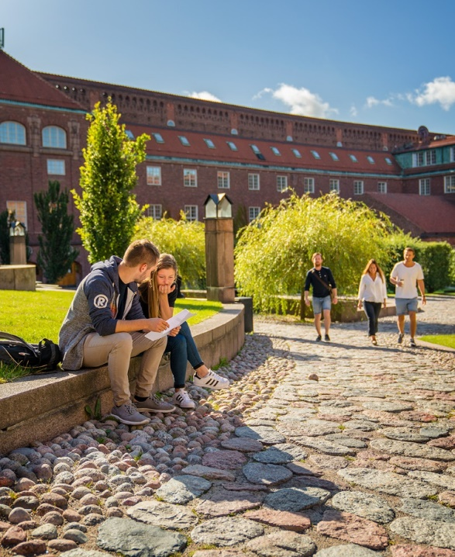
Health Service
Study related:
Stockholm Student Health Services,
(Studentpalatset at Norrtullsgatan 2)
nurse, therapist and counsellor services
bound to confidentiality
free of charge
Injury/illness:
Health care guide – call 1177 for advice
Support for students with disabilities:
KTH strives to provide equal opportunities to all students.
Students with disabilities are offered the support necessary to enable them to carry out their studies on the same terms as other students.
Contact: funka@kth.se
Notes:
The Student Health Service at Avonova provides support and counselling for problems related to your studies at KTH, such as stress, nutrition, anxiety and mood swings.
You can talk to a nurse, counsellor or a doctor depending on your problems/issues.
They are bound to confidentiality and to visit them is free of charge.
Search for ”student health service” on the KTH website to find out more.
https://www.kth.se/en/student/studentliv/kropp-sjal/studenthalsan/valkommen-till-studenthalsan-1.409886
KTH strives to provide equal opportunities to all students and offer students with disabilities the support necessary to enable them to carry out their studies on the same terms as other students.
The most common support:
Longer time allowed at exams.
Help with taking notes. A fellow student takes notes and photocopies his/her notes for you.
Course literature transferred to another media.
Access to a study room where the computers are equipped with various support applications.
A mentor (an experienced student) helps with the planning and organisation of your studies.
Sign language interpreter.
Search for ”support for students with disabilities” on the KTH website to find out more.
https://www.kth.se/en/student/studentliv/studentratt/stod-for-studenter-med-funktionsnedsattning-1.324605

Slide 12
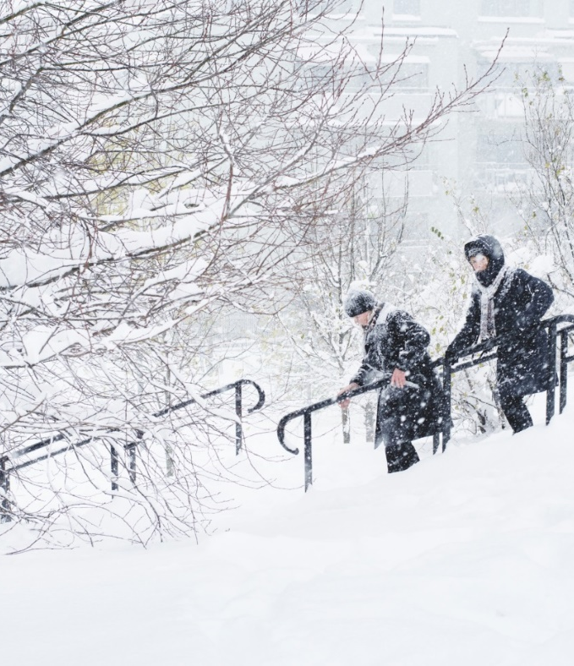
Insurance:
All students are insured via KTH on the
school premises and during travel to
and from these. Make sure you have
sufficient medical insurance coverage.
Safety:
In case of emergency, call 112 (Ambulance, police and fire brigade)
Within KTH 08-790 7700
When you are on campus, always keep your ID with you.
Notes:
In case of emergency, call 112 (Ambulance, police and fire brigade)
Within KTH 08-790 7700
When you are on campus, always keep your ID with you

Slide 13
Rights and Responsibilities
Disciplinary actions may be taken against students who:
For example:
try to mislead
  by using aids during an examination that is not allowed
  by plagiarizing someone else’s essay/homework
  by letting someone else add their name to an attendance list, despite not being present
act in a disruptive manner at the university
subject another student or employee at the university to harassment or sexual harassment
Examples of rights: student counseling, course evaluations, Student Union, …
More information on www.kth.se (search for Rights and responsibilities)
Notes:
Swedish law and KTH’s regulations give you a lot of rights as a student, but also some responsibilities.
For example, disciplinary action may be taken against students who:
1. try to mislead
− by using aids during an examination that are not allowed
− by plagiarising someone
− by letting someone else add their name to an attendance list, despite not being present
2. act in a disruptive manner during a lesson, exam, test or other activity during a course of education at the university
3. subject another student or employee at the university to harassment or sexual harassment
Examples of rights for students is the right to influence a course via course evaluations and KTH’s education at large through participation in the Student Union.
Students also have the right to study counselling, certain health care and insurance.
Read more about all student rights and responsibilities by searching for “Rights och responsibilities” on the KTH website.

Slide 14
KTH Code of Conduct for students
The KTH Code of Conduct clarify some of the expectations of you as a student at KTH. In short:
  All students and staff at KTH have the same rights, opportunities and obligations, regardless of sex, transgender identity or expression, ethnicity, religion or other belief, disability, sexual orientation or age
  Equal treatment at KTH implies a respectful and inclusive work and study environment
  Discrimination, harassment, sexual harassment and victimization may be grounds for disciplinary action
  More information on www.kth.se (search for Code of Conduct)
  JML - equality, diversity and equal opportunities
  https://play.kth.se/media/JML-6.mp4/0_ogw0qxbd
Notes:
KTH’s goal is to offer you as a student a good education, as well as a good study environment from which you can obtain useful knowledge and experience for your professional life.
KTH therefore considers it of the utmost importance that you, during your studies, maintain a professional attitude to your studies, fellow students, teachers and other staff at KTH.
The KTH Code of Conduct for Students is to clarify some of the expectations of you as a student at KTH.
All students and staff at KTH have the same rights, opportunities and obligations, regardless of sex, transgender identity or expression, ethnicity, religion or other belief, disability, sexual orientation or age.
Equal treatment at KTH implies a respectful and inclusive work and study environment
I am aware that discrimination, harassment, sexual harassment and victimisation, as well as any contravention of KTH’s core values and guidelines, may be grounds for disciplinary action.
Read the full code by searching for “KTH Code of Conduct for Students” on the KTH website.

Slide 15
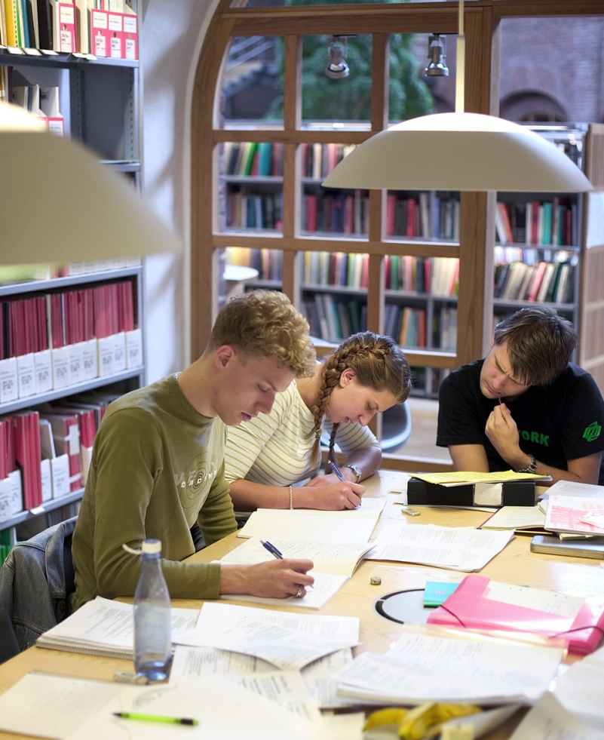
Libraries and academic support
Main library at KTH Campus (KTHB)
Sweden's largest library for technology with a vast selection of books, scientific journals and databases.
KTH Kista and Södertälje have local libraries.
Academic Resource Centre (ARC) offers academic support
Tutorials on information management
Career Development
Language Café
Study technique
Open 08:00 – 21:00 Monday-Thursday;
8:00-19:00 Fridays; 10:00-16:00 Saturdays
Notes:
The main library at KTH Campus is Sweden's largest library for technology with a vast selection of books, scientific journals and databases.
With it's study spaces, group rooms that are booked online and cafe, the library is a popular meeting place for students.
In addition to the main library, KTH Kista and KTH Södertälje have local libraries.
Academic Resource Centre (ARC) offer academic support through individual coaching and a great number of interesteing lunch seminars. You can get support on:
Academic Writing
Tutorials on information management
Career Development
Language Café
Tandem Language Learning
Talking Books Centre
Study technique
The main library usually opens at 08:00 and closes sometime between 18:00 and 21:00. Opening hours and booking of group rooms are found at www.kth.se/kthb

Slide 16

KTH account
  Your KTH account is the personal identity in the KTH central user database.
  E-mail account
  Access to computers in computer rooms
  Access to wireless network
  Access to IT-services such as the personal menu
Notes:
Your KTH account is the personal identity in the KTH central user database.
Your KTH account will give you access to your KTH e-mail. It is imoportant that you check this e-mail regularly or forward it to another email.
The account also gives you access to the computers in the computer rooms, to the wireless network and to IT-services such as the personal menu on the KTH website. More about your personal menu later on in this presentation.

Slide 17

Access cards
The KTH access card gives you access to computer rooms and relevant entrance doors
24 hours
Card + code from 18:00-07:00
KTH print
Notes:
The KTH access card gives you access to computer rooms and relevant entrance doors
More information is found in your binder

Slide 18

Course administration process
Selection → Admission → Registration
You should be admitted to the courses that you have selected before you came to KTH. Check your pages.
For changes/updates contact your coordinator!
No later than 28th of January!

Slide 19
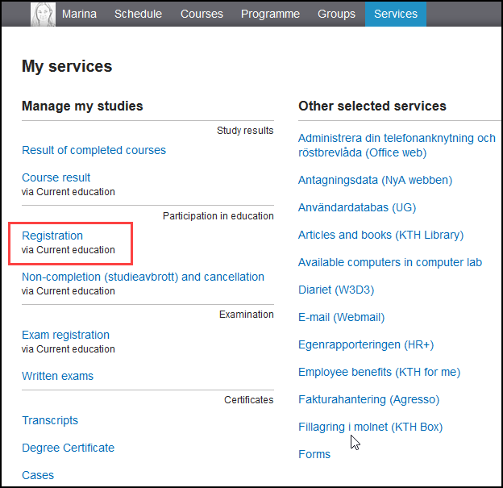
Registration to courses
Study period 3:
From January 9 through January 20
Study period 4:
From March 12 through March 23
More information on www.kth.se

Slide 20
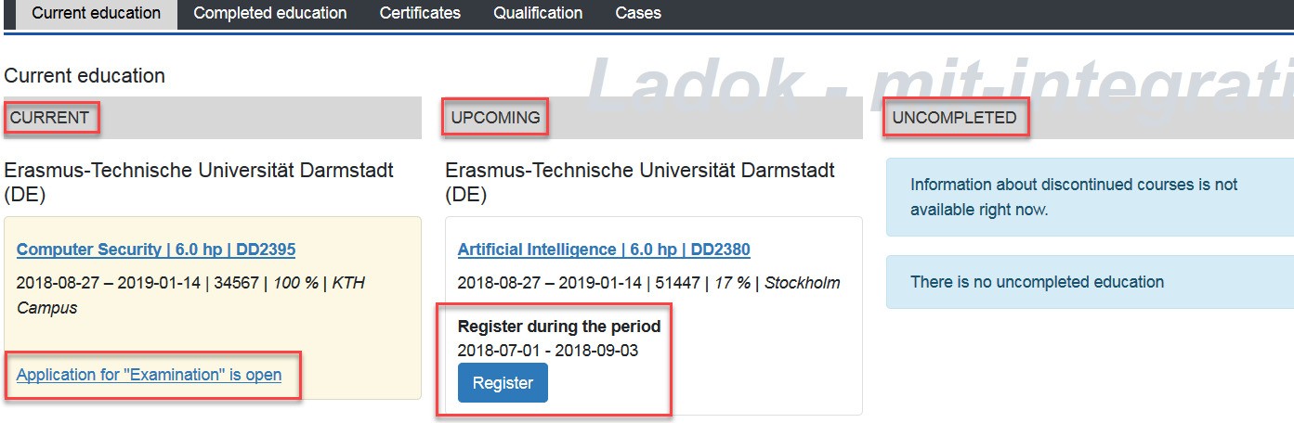
My pages
KTH-email under ”My pages”
Overview your studies, register for courses
Three headlines: current, upcoming and uncompleted.
Create transcripts of your studies.
Notes:
When you have your KTH acoount you can log on to the personal menu on the KTH website and access ”my pages”.
Through my pages you will be able to overview your studies and create transcripts of your studies.
The homepage will show three headlines:
Current show the courses that you are registered to
Upcoming show the courses that you are admitted to have not yet registered for
Uncompleted show the courses that are uncompleted after the last date of the course
Within the registration period for a course the blue field Register shows for the courses you are admitted to
Within the application period for examination the link Application for Examination is open”for all courses that you are register to

Slide 21
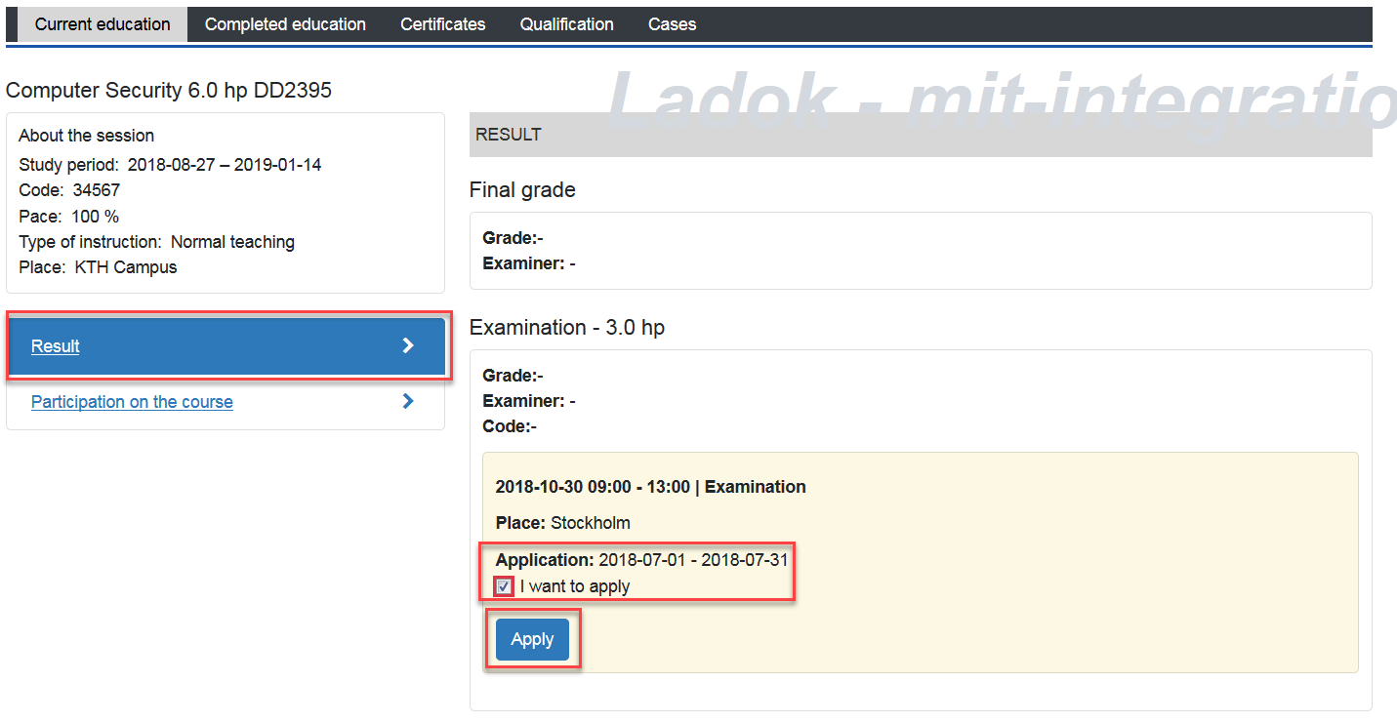
Apply for examination
You must sign up for the examination to a course.
Application to the examination is to be done 2 weeks prior to the exam period.
Always bring your Photo-ID to the exam (passport/National ID)
Written exams scanned to your pages
Notes:
The registration period for the examination is between four to two weeks before the examination.

Slide 22

Schedule & Places
Schedule:
kth.se/en/student/schema
Contact course responsible with course or schedule specific questions
Places:
Can’t find that lecture hall?
www.kth.se/places
Going between campuses
www.sl.se or the SL app
Notes:
If you want to find scheduled courses, for example, before applying to courses or to find exams, you can use Schedule Search.
There you can search schedules both for courses and programs.
You can view your timetables in calendar programs, such as Google calendar, Outlook or Webmail.
Contact course responsible with course or schedule specific questions

Slide 23

Temporary registration number (T-number)
Your T-number consist of your date of birth, the letter T and three digits (YYMMDD-TXXX)
T-number is only used by KTH, the Student Union and student housing queue.
Stated on your pages.
Notes:
At KTH you will be given a T-number. This number is used to identify you in our systems. Your T-number consist of your date of birth, the letter T and three digits (YYMMDD-TXXX)
It looks similar to a personal identity number that can be issued by the Swedish Tax Agency but should not be confused.
The personal identity number is obtained when a person is entered in the Swedish population register by the Swedish Tax Agency.
Only international students who have a residence permit for at least 12 months or are admitted to studies for 13 months or more, can apply for a Swedish personal identity number from the Swedish Tax Agency.
T-number is only used by KTH, the Student Union and student housing queue.

Slide 24
Introduction Programme
Check https://www.kth.se/en/student/newatkth
Some events require signing up in advance!

Slide 25
International Office at KTH Campus
Lindstedsvägen 3, floor 4
Office hours during the semester
Tuesdays and Thursdays 12:30-14:30
Appointments possible other hours.

Slide 26
International Office at KTH Kista
Electrum building, Kistagången 16
Mondays, Wednesdays and Fridays
Available for booked meetings:
E-mail Sara Sjögren: exchange.in@eecs.kth.se

Slide 27
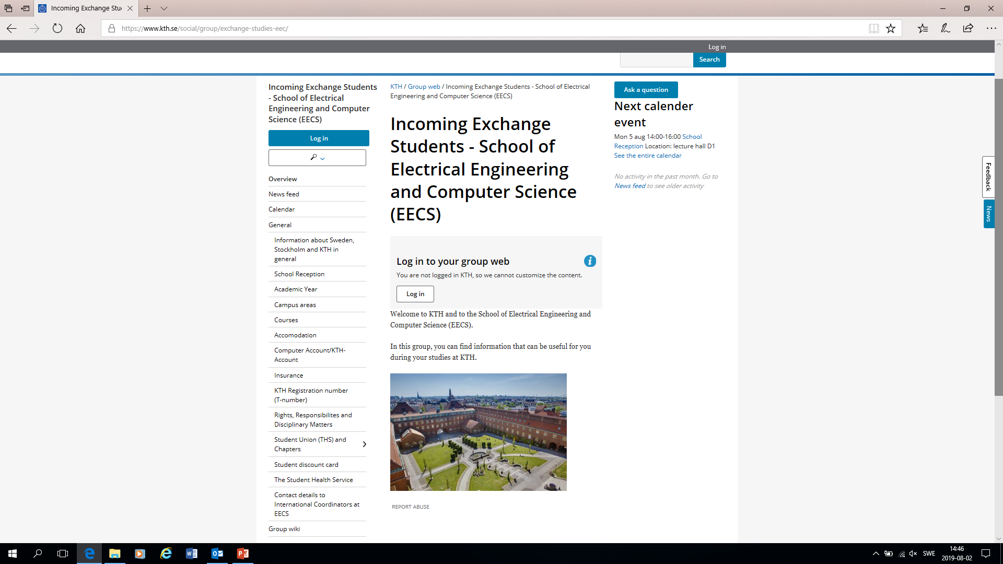
Group web https://www.kth.se/social/group/exchange-studies-eec/

Slide 28
Student Union & Chapters
Chapters related to EECS:
Chapter for Computer Science (Datasektionen)
Chapter for Media Technology (Sektionen för Medieteknik)
Chapter for Electrical Engineering (Elektrosektionen)
Chapter for Information- and Nanotechnology (Sektionen för Informations- och Nanoteknik)

Slide 29
www.menti.com
71 60 26

Slide 30
Have a nice stay at KTH!

