Slide 1
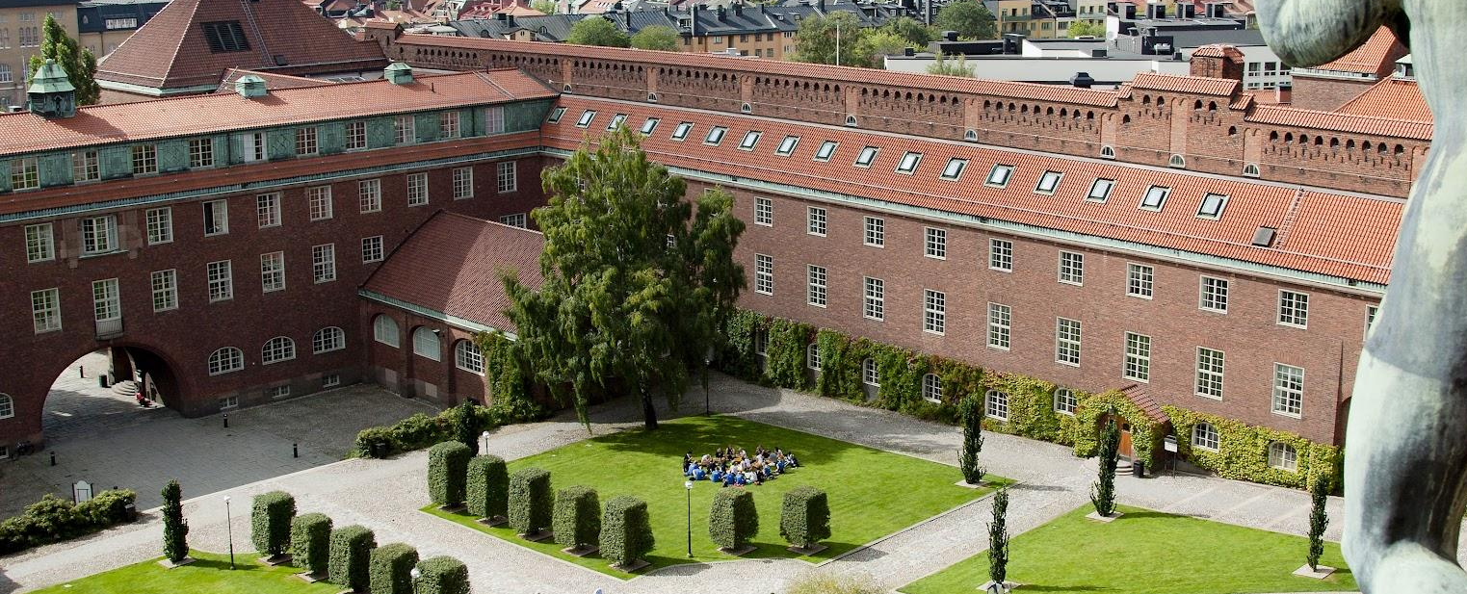
Welcome to the KTH School of Electrical Engineering and Computer Science!

Slide 2
Agenda
10:00-10:15 Welcome to EECS by Markus Hidell, Deputy Director of First and Second Cycle Education
10:15-11:15 Practical information and introduction to KTH
11:15-11:30 Information from the Student Union Chapters
This afternoon Programme introduction and information meetings
Notes:
(Click the icon in the square to add a picture of the programme director)

Slide 3
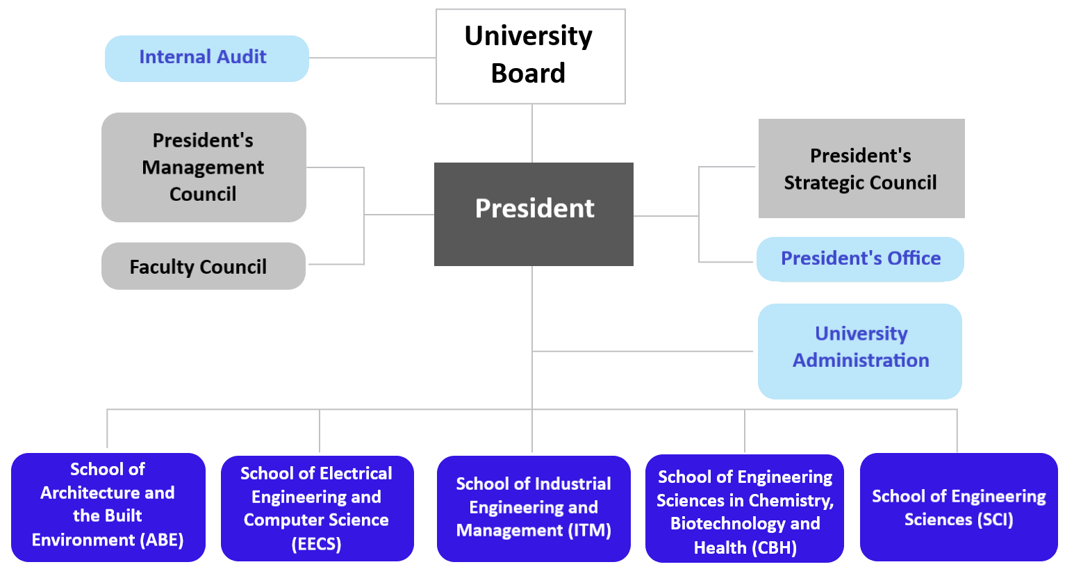
KTH Organisation
Notes:
Skapa en org.karta på engelska
Visa stud. att det finns olika skolor och att det finns en koppling mellan skola och kurskod ex. M = ITM, D,E,I = EECS, S= SCI etc…

Slide 4
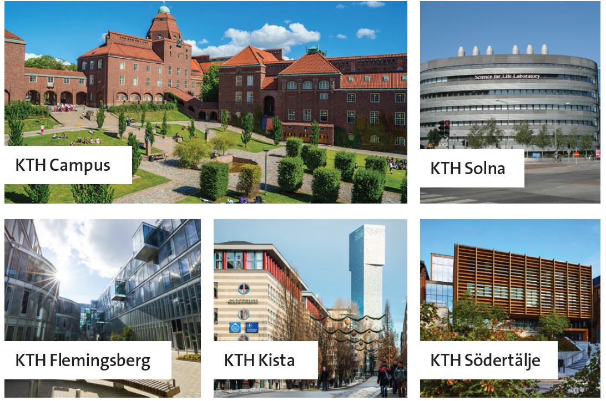
KTH:s campuses
KTH has five campuses spread in and around Stockholm. KTH Campus is located in central Stockholm, while KTH's other campus areas are strategically located close to industry and research.
KTH's different campuses:
KTH Campus (central Stockholm)
KTH Flemingsberg
KTH Kista
KTH Solna
KTH Södertälje
Notes:
KTH has five campuses spread in and around Stockholm. KTH Campus is located in central Stockholm, while KTH's other campus areas are strategically located close to industry and research.
KTH's different campuses:
KTH Campus (central Stockholm)
KTH Flemingsberg
KTH Kista
KTH Solna
KTH Södertälje
Your education is mainly given at…
Extra info if it feels relevant:
KTH Flemingsberg
Flemingsberg is one of northern Europe's most important areas in medical technology, both in terms of research and industrial activities. KTH Flemingsberg is located next door and closely collaborates with Karolinska University Hospital in Huddinge.
KTH Kista
At KTH Kista, education and research are offered in all the areas that make up today's information society. Kista has international technology companies such as Ericsson, IBM, and Microsoft and a myriad of exciting startup companies.
KTH Solna
KTH Solna is located north of Stockholm and is an important national hub for research in various life sciences. Here is the Science for Life Laboratory, a national centre for molecular biotechnology focusing on health and environmental research. The centre is a collaboration between KTH, Karolinska Institutet, Stockholm University and Uppsala University.
KTH Södertälje
Södertälje is one of Sweden's most important industrial strongholds and accounts for around 10 per cent of Swedish exports. Here are world-leading companies in modern industrial production, such as Scania and AstraZeneca.

Slide 5
Programme Coordinators & Student Desk
Programme Coordinators
Study planning
Course admission
Official transcripts and certificate of registration
Letters/statements for housing, permits etc.
Master’s degree project information and application
Degree application and transfer of credits
Student Desk
For help with registrations, re-registrations, results, exams etc., find more information here: Student desk offices
Courses offered by EECS starts with D, E or I.
Notes:
(Click the icon in the square to add a picture of the coordinator)

Slide 6
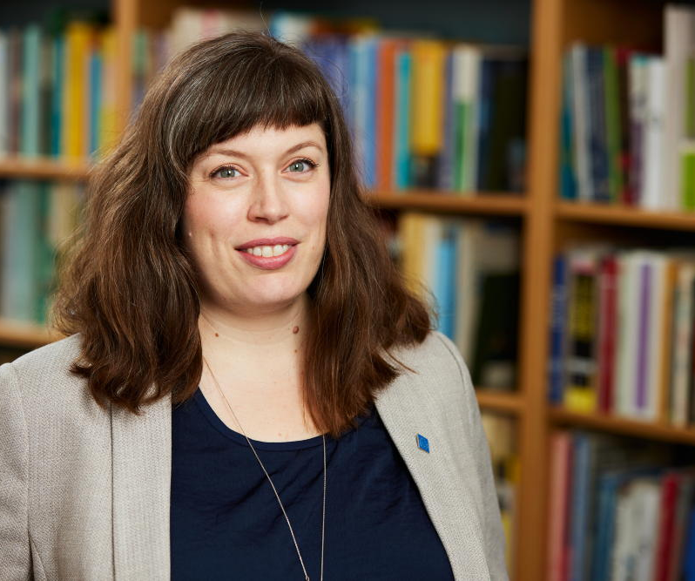
Master’s Programme Coordinator
Bianca Lanciai
Coordinator for Machine Learning (TMAIM) programme.
cs-master@kth.se
Notes:
(Click the icon in the square to add a picture of the coordinator)

Slide 7

Master’s Programme Coordinator
Erik Ceder Göransson
Coordinator for Interactive Media Technology (TIMTM)
media-master@eecs.kth.se
ICT Innovation (TIVNM) – HCID/HCIN and VCCN track
ictinnovation-master@eecs.kth.se
Notes:
(Click the icon in the square to add a picture of the coordinator)

Slide 8

Master’s Programme Coordinator
Johanna Pirttikoski
Coordinator for:
Computer Science (TCSCM)
Cybersecurity (TCYSM)
cs-master@kth.se
Notes:
(Click the icon in the square to add a picture of the coordinator)

Slide 9

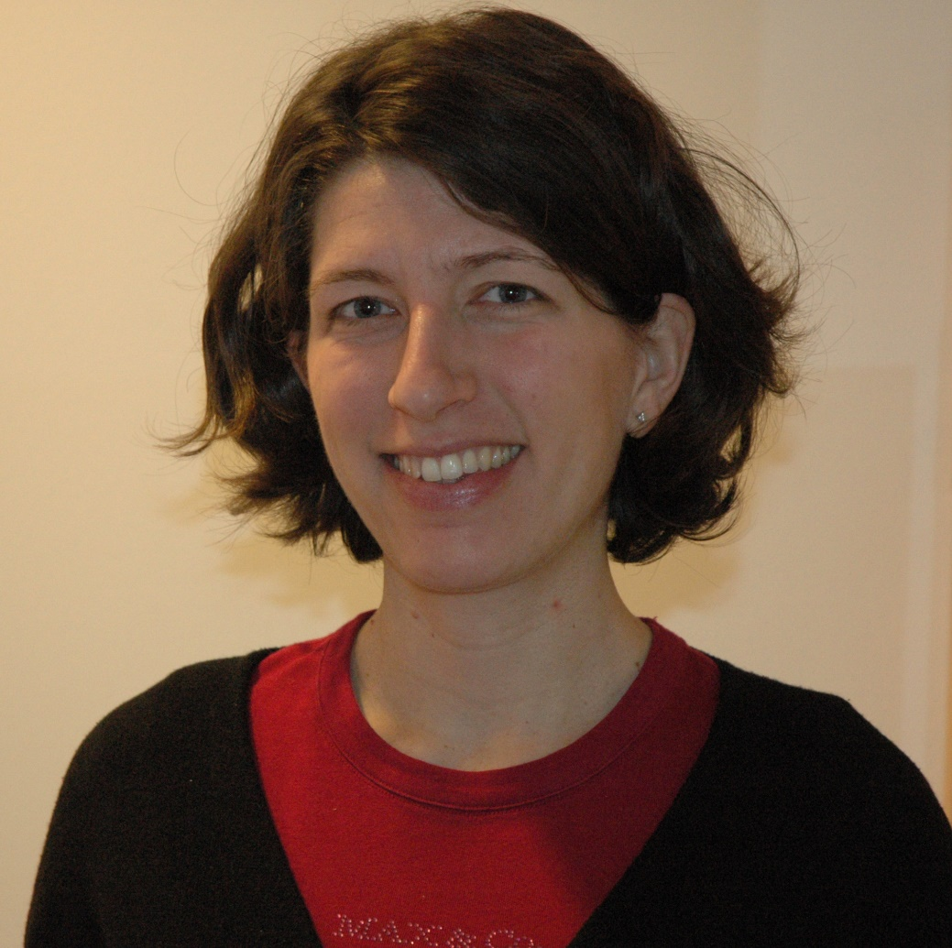
Master’s Programme Coordinator
Cristina Janland La Verde
Coordinator for:
Systems, Control and Robotics (TSCRM)
Information and Network Engineering (TINNM)
Electric Power Engineering (TELPM)
Electromagnetics, Fusion and Space Engineering (TEFRM)
EIT – Inno Energy (SENSE, EMINE, SMCS, RENE)
ee-master@kth.se
Notes:
(Click the icon in the square to add a picture of the coordinator)

Slide 10
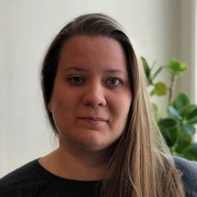
Master’s Programme Coordinator
Mia Boberg Winlöf
Coordinator for:
Embedded Systems (TEBSM)
Nanotechnology (TNTEM)
Software Engineering of Distributed Systems (TSEDM)
ens-master@eecs.kth.se
Notes:
(Click the icon in the square to add a picture of the coordinator)

Slide 11
Master’s Programme Coordinator
Sofi Fjellvind
Coordinator for
Communications Systems (TCOMM) - incl. SECCLO
com.secclo-master@eecs.kth.se
ICT Innovation (TIVNM) – tracks AUSM/AUSY, CLNI/CLNS, DASC/DASE and INSM/INSY.
ictinnovation-master@eecs.kth.se
Notes:
(Click the icon in the square to add a picture of the coordinator)

Slide 12
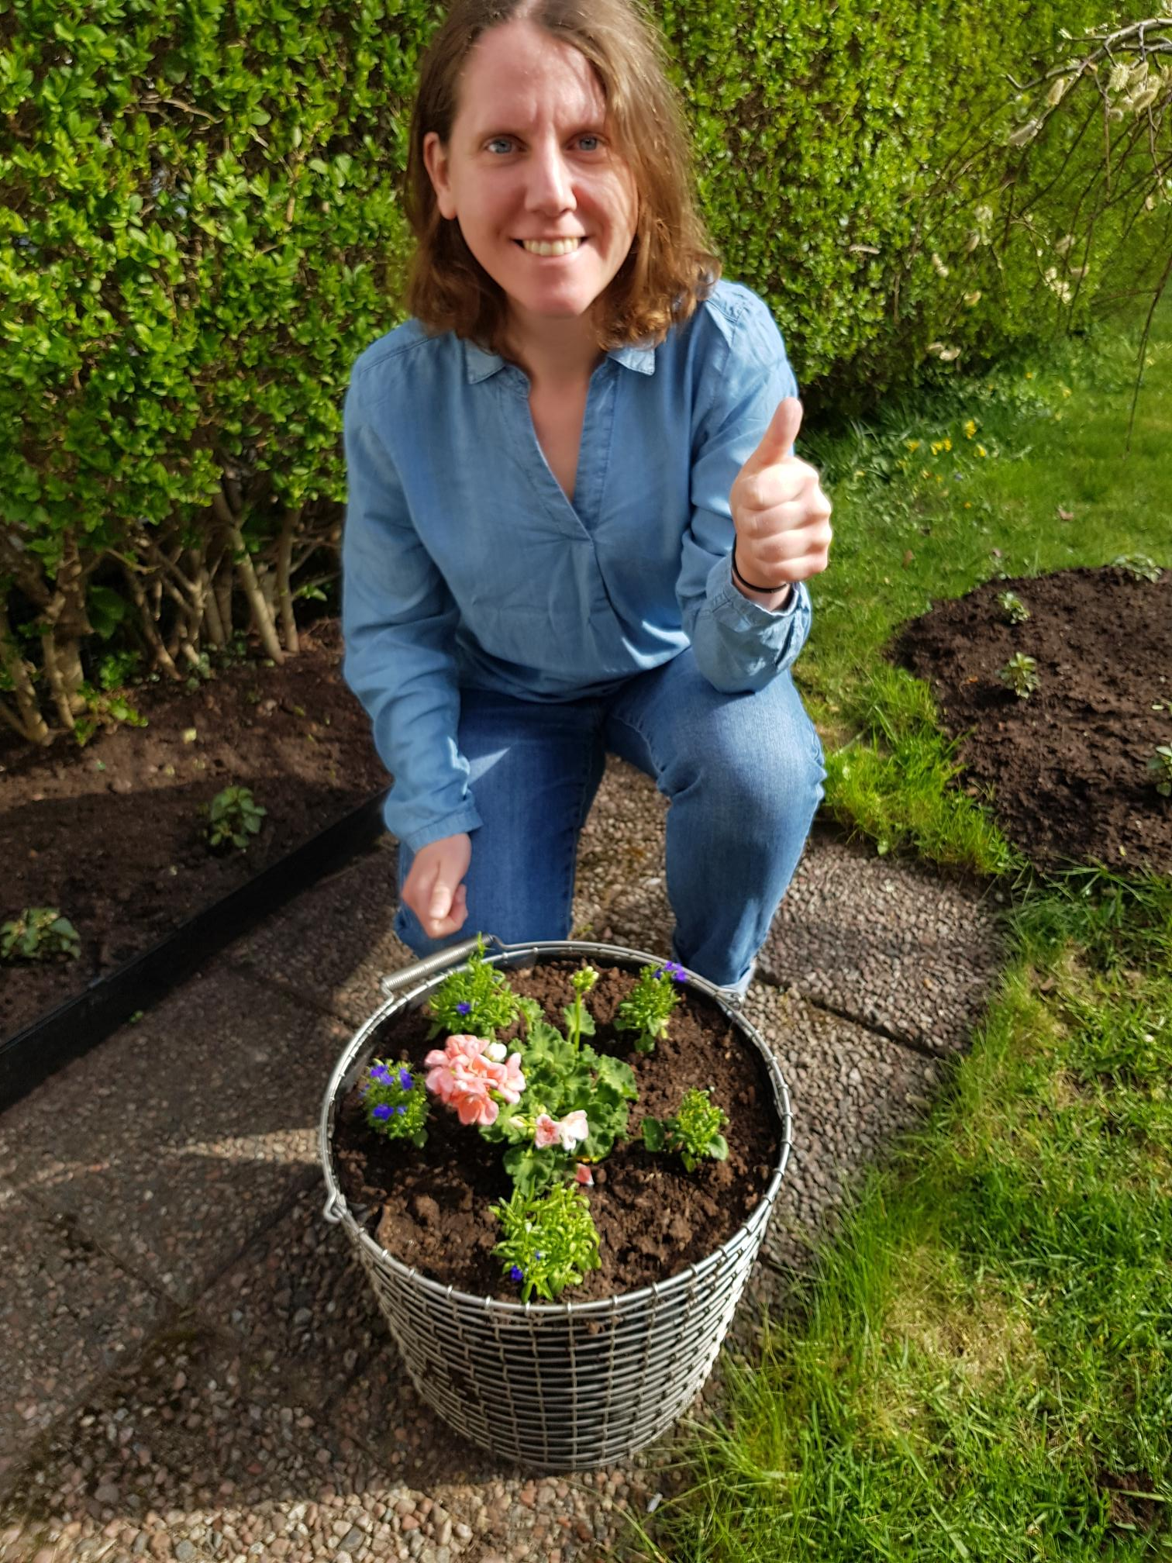
Master’s Programme Coordinator
Sabine Walter
Starting on staff soon and will start of Coordinating:
ICT Innovation (TIVNM)
ictinnovation-master@eecs.kth.se
Interactive Media Technology (TIMTM)
media-master@eecs.kth.se
Notes:
(Click the icon in the square to add a picture of the coordinator)

Slide 13

Getting started at KTH!

Slide 14
KTH account and access card
Activate your KTH account to access KTH's services, such as:
Personal menu
Ladok for students
Canvas
E-mail
More information is available at New at KTH: kth.se/en/student/studier/newatkth
Access card
Gives you access to KTH's premises
The card is personal and may not be lent to others
Need support? Email kortexp@kth.se, or visit KTH Entré or the local service centres in Flemingsberg, Kista or Södertälje
Notes:
Activate your KTH account
Your KTH account is your identity in KTH's central user database. Use your KTH account to access KTH's IT services and systems.
Examples of these systems are the personal menu, your digital course platform Canvas, Ladok for students, and much more. Your KTH email address is created together with your KTH account.
If you attended the Arrival Days, you hopefully received your KTH account and access card then.
If you haven't received your KTH account and access card, get in touch with:
KTH Entré (for students on KTH Campus)
The service centre (for students in Flemingsberg and Kista)
The service centre/student reception (for students in Södertälje)
More information on how to activate your KTH account can be found on New at KTH, kth.se/newatkth. If you need support, email KTH's IT support at it-support@kth.se .
Access card
The KTH access card was handed out together with the KTH account. Your access card gives you access to KTH's premises.
If you have not received your access card or need help with, for example, a lost card, email kortexp@kth.se. You can also receive support on KTH Entré or the service centres in Flemingsberg, Kista and Södertälje.

Slide 15
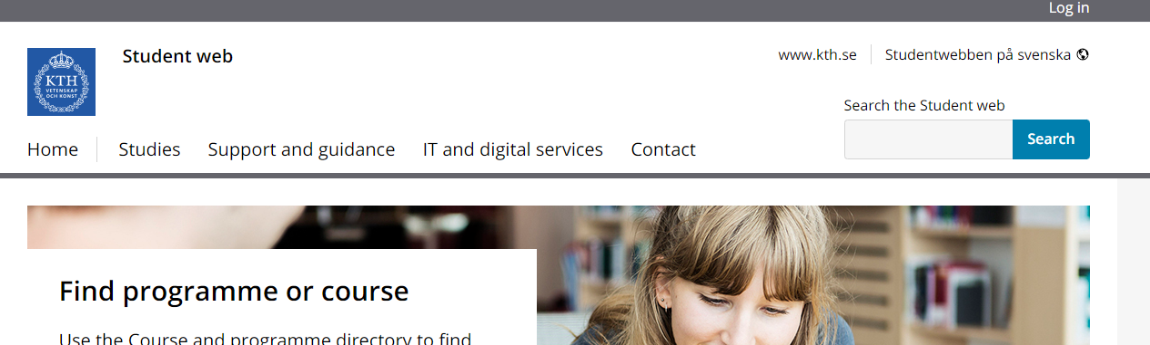
Update your student profile
Log in

Slide 16
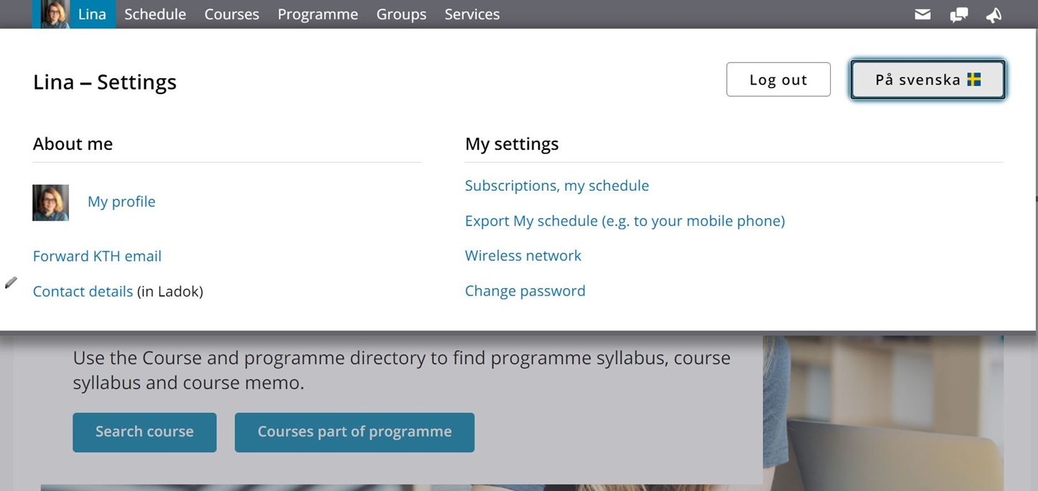
Update your student profile
Add your new address and KTH
e-mail address

Slide 17
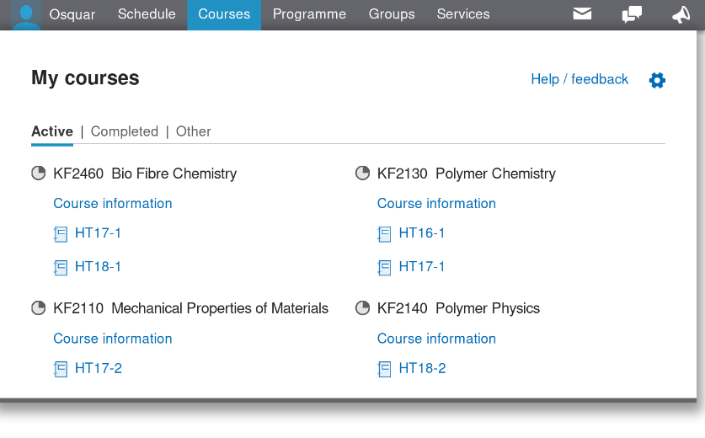
The personal menu and Canvas
The personal menu at kth.se gives you access to various essential services online, such as:
Your schedule
Your e-mail
The programme web
Canvas
Ladok for students
Canvas is KTH's learning platform for all courses.
Get access to course materials and read course pm
Carry out assignments
Keep in touch with teachers and other students
Notes:
Personal menu
The personal menu is the grey bar at the top of kth.se. Logged in, you see services such as your schedule, your KTH e-mail, course and examination registration and Canvas.
As a programme student, you can also find your programme web where your programme syllabus is located. It lists the programme's content and goals. There is also a news feed on the programme web where programme-specific messages are sometimes posted. You will receive notifications in your e-mail when any new news is published.
Canvas
Canvas is the learning platform used for all courses at KTH. Here you will find, among other things, course material, course memos and assignments.
In Canvas you can also keep in touch with teachers and fellow students.
You will find all your courses under the tab "Courses" in the personal menu. When you click on the course name, you will re-directed to the course's course room in Canvas.

Slide 18
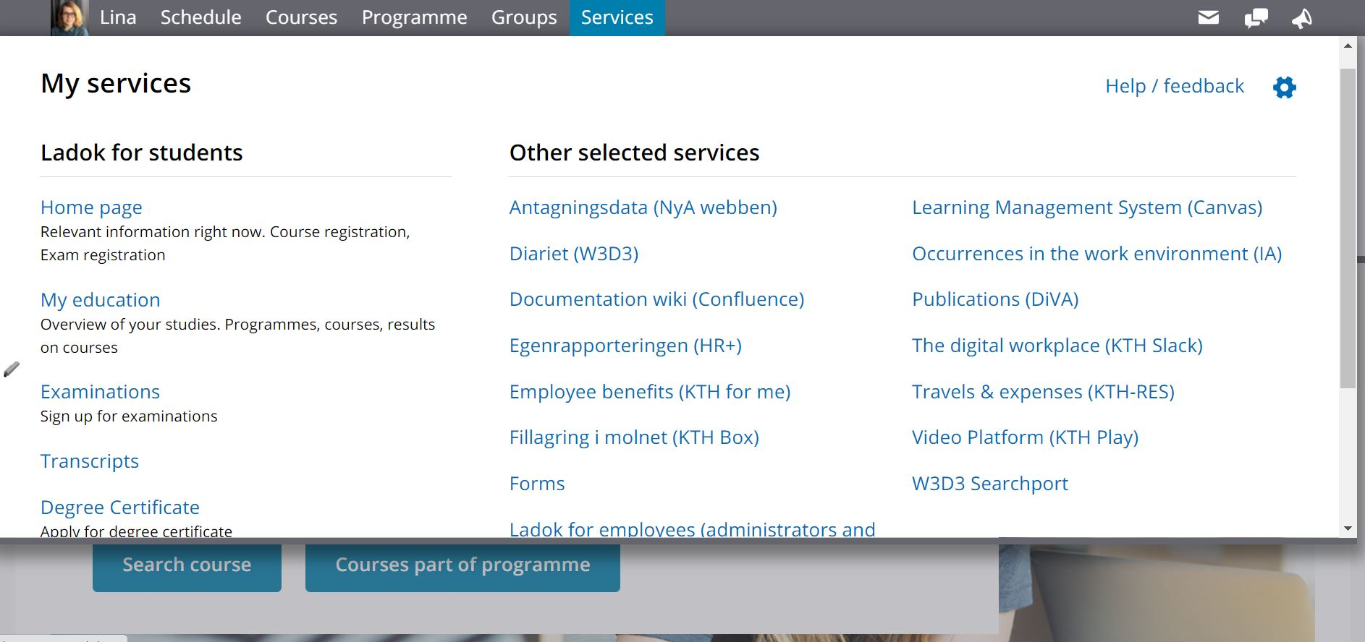
Your personal services menu
Ladok – student registry system

Slide 19
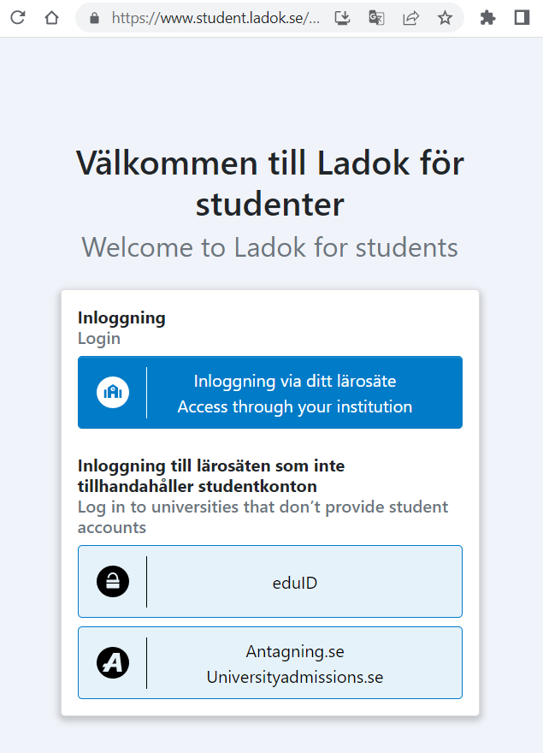
Ladok – student registry system
Register on courses
Overview of current and upcoming courses
Register for upcoming examinations
Drop courses
Results on completed courses

Slide 20
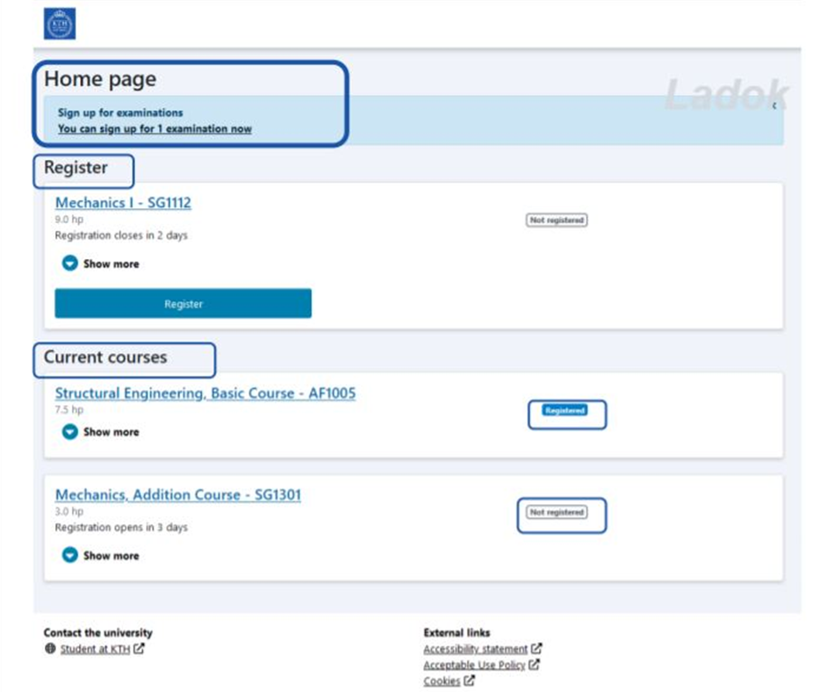
Course registration
Register for your courses as soon as possible!
Confirms that you will attend your courses
Course registration shall be done before each new course starts
Necessary for you to access the course in Canvas and to get results reported
Register for the course in the service Ladok for students.
You can find the service under the tab "Services" in the Personal menu, or on the page student.ladok.se.
Notes:
Register for the course
Every time you start a new course, you must register for the course.
The registration is open in connection with each new study period. The course registration, which is now open, closes on September XX
A course registration means that you confirm that you intend to take the course for which you have been admitted. Registration is necessary for you to be able to access the course in Canvas, to register for the exam and for KTH to be able to report your results.
Register for the course by logging in to the Ladok service for students. You will find links to Ladok for Students in the left column under the tab "Services" in the Personal menu. Another way is to go directly to student.ladok.se.

Slide 21
Exam registration
Register for the exam during the registration period​ (exam registration periods) through your personal menu.
​
If you have issues registering for an examination, please contact Student Desk: Student desk offices
For more information regarding rules and regulations please visit the following link: Examination regulations

Slide 22
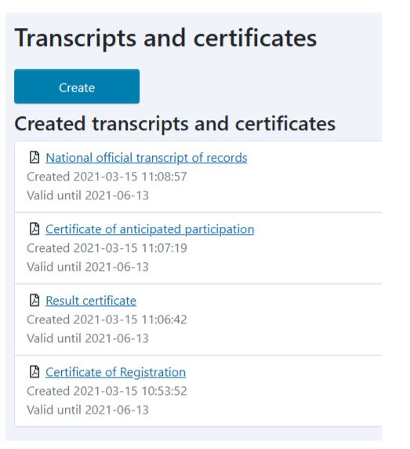
Generate transcripts and certificates
You can generate your own transcripts of results and certificate of registration
KTH’s transcripts contain a verification link to assure validity.
Find your T-number on the transcript (YYMMDD-TNNN)

Slide 23

Academic year and registration
The academic year is divided into two semesters (autumn and spring) and in four study periods:
- Autumn semester HT22: 29 August 2022 - 16 January 2023 (P1 and P2) ​
- Spring semester VT23: 17 January 2023 - 5 June 2023 (P3 and P4)​
Register on your courses in period 1 by 5 September.
You apply to the courses in spring semester via University Admissions, information will be published in late October.
You need to make an early discontinuation of a course you don’t want to take within three weeks of the period start (by 18 September).
Link to Academic Year
Notes:
Activate your KTH account
Your KTH account is your identity in KTH's central user database. Use your KTH account to access KTH's IT services and systems.
Examples of these systems are the personal menu, your digital course platform Canvas, Ladok for students, and much more. Your KTH email address is created together with your KTH account.
If you attended the Arrival Days, you hopefully received your KTH account and access card then.
If you haven't received your KTH account and access card, get in touch with:
KTH Entré (for students on KTH Campus)
The service centre (for students in Flemingsberg and Kista)
The service centre/student reception (for students in Södertälje)
More information on how to activate your KTH account can be found on New at KTH, kth.se/newatkth. If you need support, email KTH's IT support at it-support@kth.se .
Access card
The KTH access card was handed out together with the KTH account. Your access card gives you access to KTH's premises.
If you have not received your access card or need help with, for example, a lost card, email kortexp@kth.se. You can also receive support on KTH Entré or the service centres in Flemingsberg, Kista and Södertälje.

Slide 24
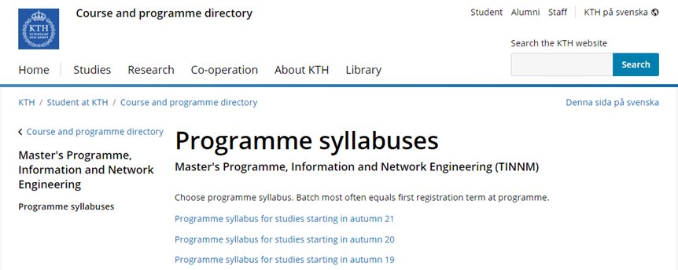
Credits and courses
You should not exceed 120 ECTS, which means approx. 30 ECTS per semester.
Language courses will be included in your programme credits.
The courses that are not discontinued within three weeks are expected to be completed.
You need to take courses according to your programme syllabus
Read your programmes syllabus!

Slide 25

Sources of information
New at KTH, the Student web, Programme web, and more

Slide 26
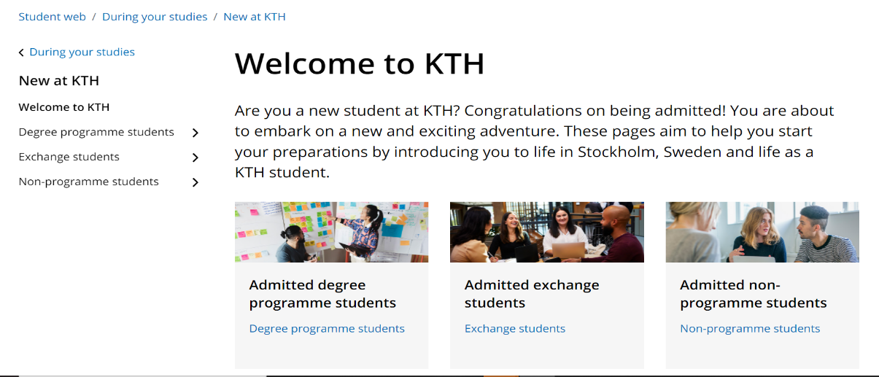
New at KTH
New at KTH is the web pages aimed at all newly admitted students.
Here you will find basic information before and during your first time at KTH.
The pages contain several different tips, guides and contact information.
You can find the pages at New at KTH
Notes:
You have hopefully already visited the New at KTH pages. Here you will find basic and essential information before and during your first time at KTH.
At New at KTH, there is, for example, contact information regarding your programme, tips and advice for your studies, guides for you to get started with KTH's various IT services, films on KTH's various support, and much more.
New at KTH is good to visit even during your first time at KTH.
You can find the pages at kth.se/newatkth.

Slide 27
The student web
The student web is the part of KTH's website with information specifically for students.
KTH's main channel for information to students.
Here you will find news, activities, support and contact information related to your studies.
Once a month, you will also receive a newsletter to your email with the latest news and upcoming events.
Web address: kth.se/en/student
Notes:
The student web is the part of KTH's website specifically aimed at you students. It is KTH's main channel for information to students.
On these pages, you will find news, upcoming activities and events, and contact information to, for example, KTH's programmes and staff. Here is information on various support you can get regarding IT services, career support, student health services, etc.
Once a month, you will receive a newsletter from KTH with the essential information and activities from the Student Web.
You can find the Student Web at the address kth.se/en/student.

Slide 28
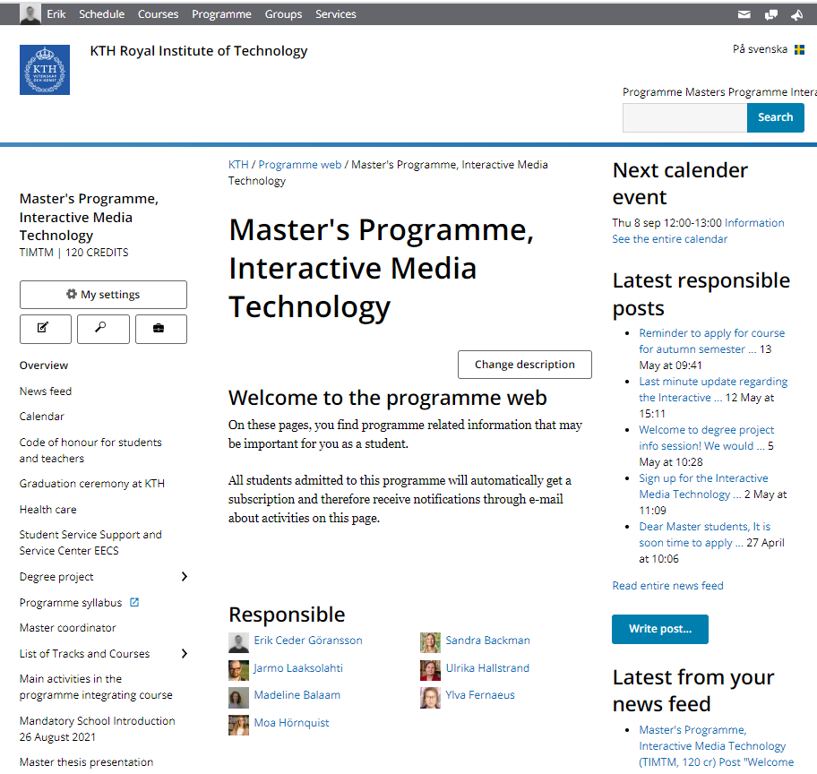
Programme web
Programme specific information
Quick links to syllabus
News feed and friendly reminders

Slide 29
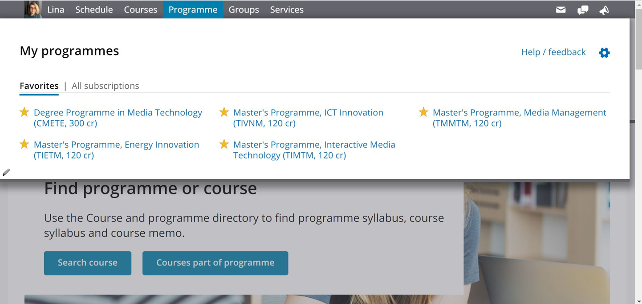
Programme web
Stay updated via the programme web

Slide 30
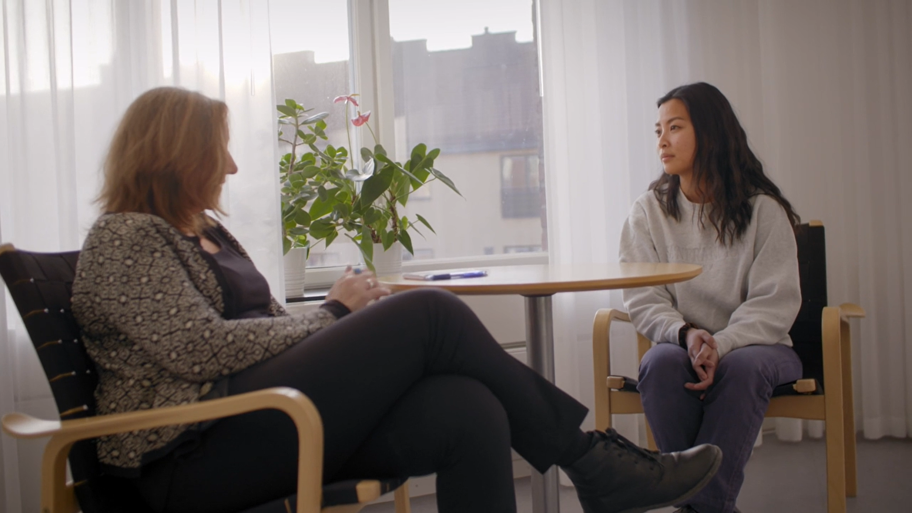
Service and support at KTH
Student health services, compensatory support, student rights, and more

Slide 31
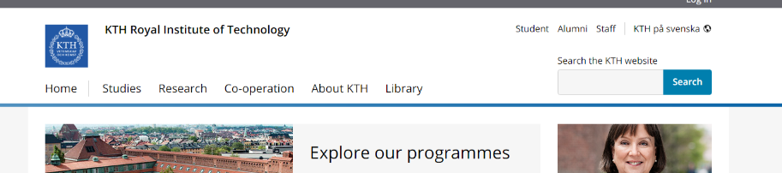


KTH.se
Click here

Slide 32

The student health services
The student health services can support you if you are not feeling well and need to talk to someone.
Via the Student health services, you can meet a company nurse, psychologist and counsellor.
The services are free of charge, and the staff has a duty of confidentiality.
Premises at Stockholm University.
If you become ill and need to get in touch with regular medical care, call 1177 to get in touch with the national health service. If you are in emergency, call 112.
The student health services in Stockholm also offer group activities and workshops.
Read more and find contact information at kth.se/studenthealth
Notes:
As a KTH student, you are welcome to the Student Health Services in Stockholm for consultation and various group activities to promote your health and your studies.
The student health services in Stockholm is available at Stockholm University, but you can also reach them by phone. Contact information can be found at kth.se/studenthealth.
You can get in touch with a company nurse, psychologist, and counsellor at the student health services. The services are free of charge, and the staff has a duty of confidentiality.
The student health services offer individual conversational contacts. They can help you with stress, depression, anxiety, alcohol habits and other lifestyle issues. They can also help you with various study-related problems, such as performance anxiety, procrastination and the anxiety of speaking in front of an audience.
If you become ill and need to get in touch with regular medical care, call 1177. F you are in an emergency, call 112.
The student health services also offer group activities and workshops all year round. The workshops can focus on how to talk in front of a group or quit smoking. They also have group activities on how to get started with physical exercises.

Slide 33
Video Student health services
Johanna delar video via ONEDRIVE

Slide 34
Funka
If you have a documented, permanent disability, you can receive compensatory support in your studies at KTH. The group coordinating the support is called Funka. Read more about the support offered and how to apply for them at kth.se/en/funka.
Examples of permanent disabilities:
Dyslexia
Physical disabilities
Neuropsychiatric disabilities: e.g. autism / Asperger's, ADHD, ADD
Permanent mental illness
Examples of support:
Longer writing time for exams and partial exams
Help with taking notes
Resources from the KTH Library, such as talking books, Braille or e-textbooks.
Notes:
If you have a documented, permanent disability, you can receive compensatory support in your studies at KTH. The group coordinating the support is called Funka. Read more about the support offered and how to apply for them at kth.se/en/funka.
Examples of permanent disabilities:
Dyslexia
Neuropsychiatric disabilities: such as autism, Asperger's, ADHD, ADD
Permanent mental illness
Physical disabilities
Examples of support you can get if you have a permanent disability:
Longer writing time for exams and check writing
Help with taking notes
Resources from the KTH Library, such as talking books, Braille or e-textbook
Funka is looking for students who want to work as note-takers. It is a paid job in addition to your studies. If you are interested, visit kth.se/en/funka and read more.

Slide 35

KTH Library
The KTH Library offers:
Books (of course) and audio books.
Workshops in study technique
Writing workshops
Study rooms
Language cafés
And more!
Visit: https://www.kth.se/en/biblioteket

Slide 36
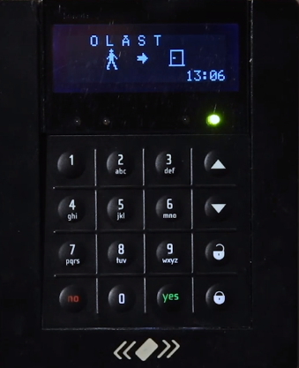
Safety during your studies
KTH has a security and crisis organisation working for you to feel safe during your studies. Here are some simple general tips:
Never leave your valuables without supervision.
Do not write your PIN code on your access card, and do not lend the card to others.
Do not let unauthorised persons in through locked doors.
Keep track of escape routes in case the fire alarm goes off. Evacuation plans are available in all buildings.
In the evenings and nights, guards check KTH's buildings, so remember to have a valid ID or passport if you study late on KTH's premises.
Notes:
KTH has a safety and crisis organisation working for you to feel safe during your studies. Here are some simple general tips:
Never leave your valuables unattended. Computers, bags and mobile phones left alone are often stolen.
Your access card is personal. Do not write your PIN code on your access card or lend it to others.
Do not let in unauthorised persons through locked doors that require access with your access card. Unauthorised people also include friends who do not have the right to stay on the premises.
Keep an eye on escape routes if the fire alarm goes off. Evacuation plans are available in all buildings.
Guards patrol KTH's campus around the clock. In the evenings and nights, security guards check KTH's buildings, so remember to bring a valid ID or passport if you study late on KTH's premises. Otherwise, you risk being evicted from the premises.
If you happen to trigger a burglary alarm by accidentally opening an alarmed door, stay and identify yourself to the security guard. In this way, the security guard does not have to spend time and resources looking for unauthorised persons in KTH's premises. When exiting locked doors, use the door key button to avoid burglar alarms.

Slide 37

Emergency contact information
In case of emergency, we need your next of kin/ICE contact information. For this purpose we have created an electronic form to be filled in by all students.
We will take a few minutes break now for everyone to use the link in the chat to fill in your emergency contact information.

Slide 38
Rights and obligations
You have the right and opportunity to influence your education and study situation.
You can do this by, for example, filling in course evaluations and/or becoming active in your student union.
As a student, you also have obligations, such as:
To avoid cheating and plagiarism
Not to harass other students and staff
Keeping yourself informed regarding your programmes requirements
Notes:
As a student, you have, by law, the right to influence your education and study situation, which you can do through your student union THS and your section. A common way is by filling in course evaluations. You can also engage in your section to influence your education quality for the better. Read more at ths.kth.se.
On the Student Web, which you will find on the web address kth.se/en/student, there is information on how to report complaints and wrong-doings to KTH. For example, you can submit complaints regarding your education or study environment.
You can also report if you have been a victim of harassment, discrimination or victimization at KTH. The report can be made anonymously. You can also turn to an employee you have confidence in to make your report. On the student web, you can also find what to do if you want to appeal decisions or report errors on KTH's premises.
As a student, you also have obligations, such as:
You should avoid cheating and plagiarism.
Don't harass other students and staff.
Such events can lead to disciplinary consequences.

Slide 39

Tips to avoid plagiarism
Examples of cheating are exchanging information with other people under examination.
Examples of plagiarism are submitting parts of others' work under your own name.
Discovering plagiarism is easier than many people believe with the help of technical tools.
Here are some common forms of plagiarism:
Students copy wording or ideas from published sources.
Students copy from other students.
Students cooperate so much that each other's work becomes
almost identical.
Remember:
Enter sources when using others' ideas, arguments or results!
Learn to read and summarise information from sources.
Read, process, rewrite and refer to information from your sources.
Notes:
To cheat means that you use unauthorised methods or aids in order to gain an advantage. Exchange information with any other person during an examination can also be considered cheating. Plagiarism means you submit someone else's work or parts of someone else's text or code in your own name.
It is easier to detect plagiarism than many people believe. Many Swedish universities use automated text matching tools.
Here are some common forms of plagiarism:
Students copy wording or ideas from published sources.
Students copy from other students.
Students cooperate so much that each other's work and results are almost identical.
Remember the following to avoid plagiarism:
Specify sources as soon as you use other people's ideas, arguments or results!
Learn to read and summarise information from sources. Do not copy formulations straight off. Instead, write and refer from any text and describe where your source is available in each text.
Summarised: Read, process, rewrite and refer to information from your sources.

Slide 40
Video KTH equality policy
Johanna har video

Slide 41
Zero tolerance for discrimination and harassment
KTH has adopted zero tolerance of all forms of discrimination, harassment, sexual harassment or victimization. This rule applies to all student to student, student to teacher, and teacher to student interactions.
If you need support when you feel that you have been discriminated, harassed, sexually harassed or victimized contact your appointed contact person at EECS, Sofia Norlander (sofiano@kth.se), group manager, office of student affairs.
Further information and contact details can be found here: Discrimination complaint and support

Slide 42




Quick tips about Swedish Culture
Punctuality
First name basis
Asking for help is ok!
Fika!
Enjoy nature
”Fredagsmys”
Big on free culture,
check out tips here and here
Tip: Student health services workshop on dealing with Swedish winters!

Slide 43

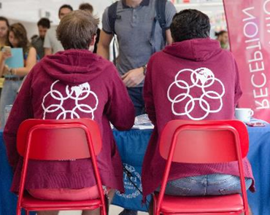
THS, Student Union at KTH
The student union exists to represent the students and has a unique status with a legal right to influence KTH. THS exists both as a central organisation based in the union building Nymble (Drottning Kristinas Väg 15-19) and through the chapter linked to your field of study.
THS:
helps you influence your education and conditions for studies
coordinates a diverse association life with social activities
is democratically structured and governed by you and other members
You can get more information at ths.kth.se - where you can also become a member!
Notes:
We will now meet some representatives from THS.

Slide 44
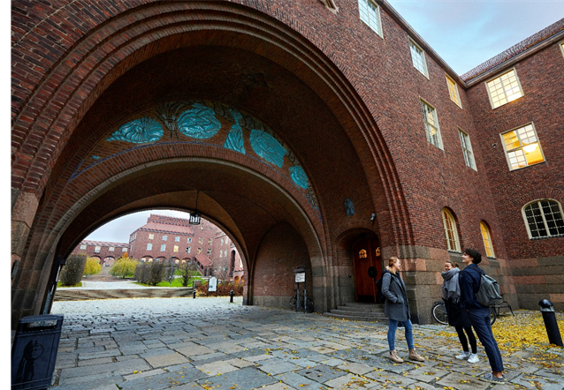
Enjoy your time at KTH and remember…
Keep yourself updated through the programme web and regularly check your KTH
e-mail address. This is how we will inform you of important matters regarding your studies.
Always include your personal identification number or t-number when e-mailing your coordinator.
Attend your programme specific information meeting. For most of
you it takes place this afternoon.

Slide 45

How to contact KTH
For questions concerning your programme, study-related issues or social matters related to your studies: Contact your master coordinator.
For questions concerning registration, results, exams please get in touch with Student desk.
For questions concerning tuition fees and all other questions on which you don’t know where to turn, email info@kth.se.
Questions regarding international exchange studies please contact the international coordinators at exchange.out@eecs.kth.se
Notes:
If you have questions regarding your programme, you can contact your master’s coordinator. These can be questions about your studies, such as questions about courses. You can also contact the master’s coordinator for social matters connected to your studies, for example, if you do not feel well during your studies.
If you have questions that do not concern your programme and do not know where to turn specifically, you can always email info@kth.se. Your question will then be forwarded to the right person or group.

