Slide 1
KEX-info CINEK, CFATE, CTFYS
Examensarbete i Tillämpad Matematik, VT23
Matematisk Statistik
Mykola Shykula
Kursansvarig och ansvarig för matst projekt
shykula@kth.se
Optimeringslära och Systemteori
Jan Kronqvist
Opt&Syst projekt
jankr@kth.se

Slide 2
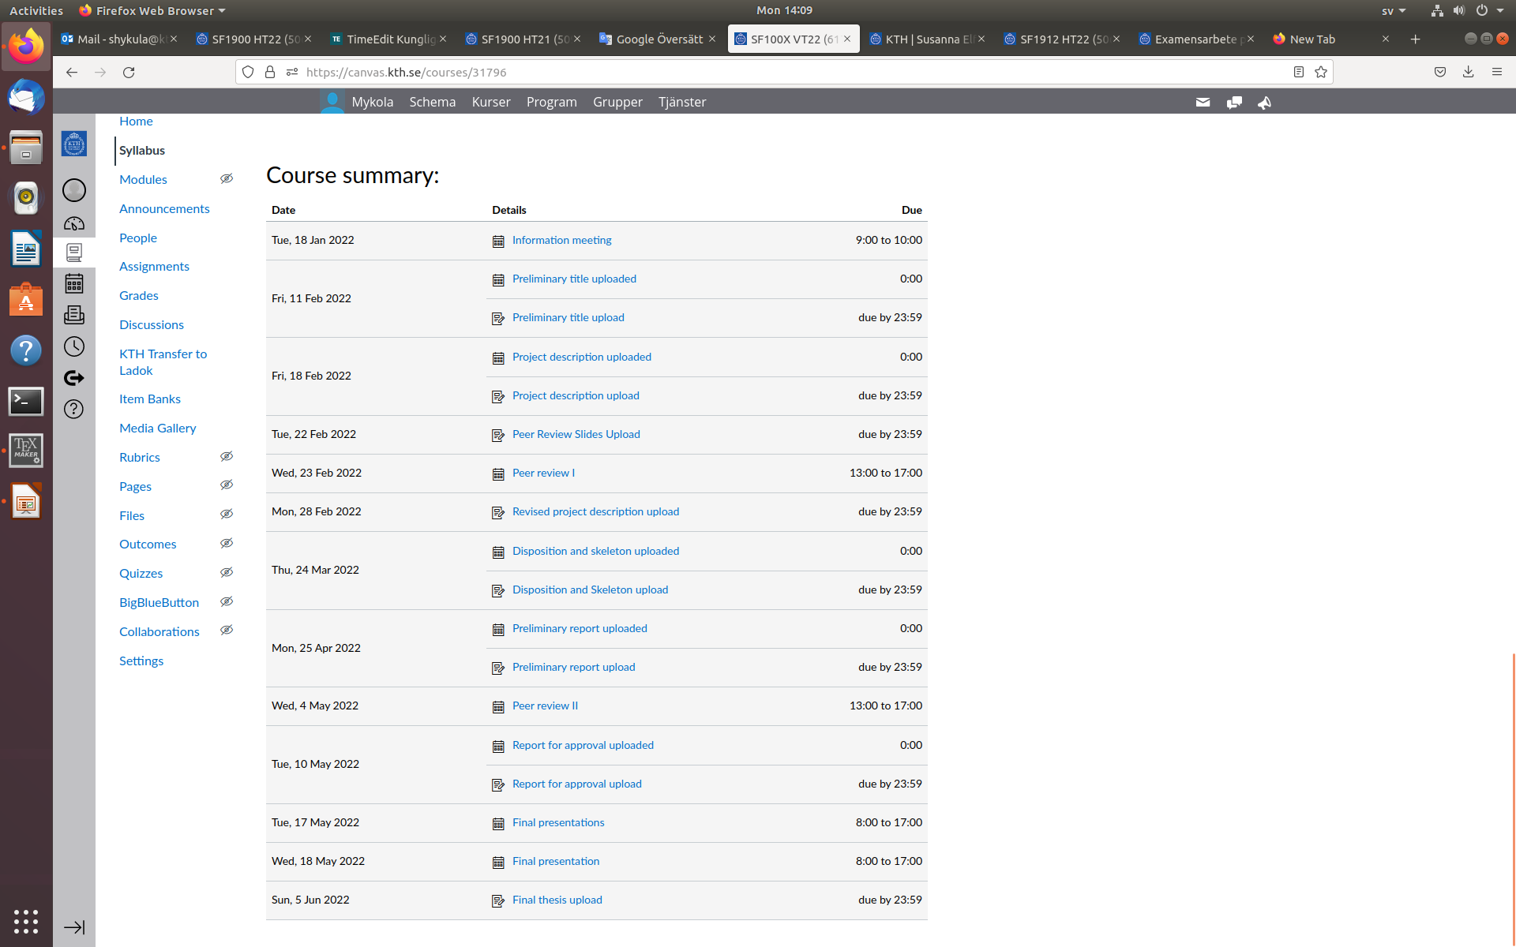
Viktig information hittas på Canvas sidan
Alla datum i följande slides är preliminära (detta är från VT22) .
Följ med Canvas sidan för uppdateringar om KEX VT23 som publiceras snart!
10/6/2022
2

Slide 3
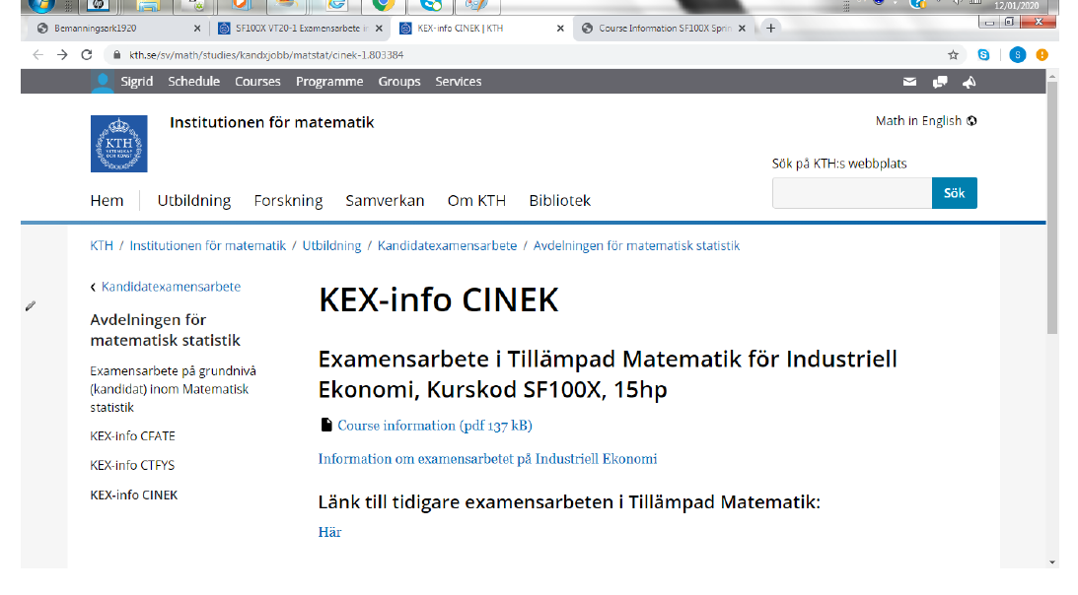
Länk till kurssida med den ”magiska PDF filen” och tidigare KEX jobb
10/6/2022
3

Slide 4
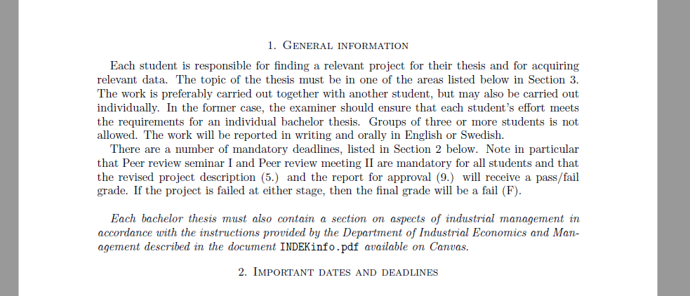
Den ”magiska PDF filen” innehåller all viktig information och datum!
10/6/2022
4

Slide 5
Practical information
As the course goes along you need to keep track of the canvas page for the next steps and potential updates on dates etc.
There are mandatory modules etc. provided by INDEK (Bo Karlsson) which you need to pass (keep track!)
Work in groups of two (exception only in very special cases)
Examiner: Mykola Shykula,for Opt. Syst. projects Jan Kronqvist
After uploaded preliminary Project Description each group will be distributed a supervisor from Math. Stat. or Opt. Syst. depending on their subject. Your selected supervisor provide feedback on your Project Description.
Important! "Each student is responsible: for finding a relevant project for their thesis, for acquiring relevant data, and writing a preliminary project description“ - this is an important part of the course.
10/6/2022
5

Slide 6
What you need to do now! (preliminary dates)
you need to find a partner!
you need to find a project!
Preliminary, by February 7, upload the preliminary project description in Canvas containing i) tentative title, ii) names of authors (which is then fixed), iii) specification of which "class" the project will fall within.
Preliminary, by February 14, you need to upload the Project Description
Examiner will then send out a list with "who peer reviews who"; it is your responsibility to email your peer-reviewers your project description and you need to do this asap (note that there is a short time interval between project proposal submission and first peer review)
At this stage you will (finally) be given a supervisor
The forthcoming steps are outlined in canvas and in the pdf. Updated info will be given on the canvas page as we go along.
10/6/2022
6

Slide 7
How to find and formulate a project?
Tip of the day: Look in DiVA data base for old projects...
Some more concrete tips for the various classes will now follow.
Note that complementary info is available in the “magiska pdf filen”.
The word "prerequisite" is to be understood in a generous sense. Be sure to choose a project of suitable difficulty level!
10/6/2022
7

Slide 8
Mathematical Statistics - Applied Mathematical Statistics
The real title of this slide should be: Regression Analysis
Maybe easiest way to find projects
Key idea: Find some data set you find interesting and then use tools from Regression Analysis to Investigate it.
About the data:
  Anything... Ex from this year: prices of football players
  For financial data you can use Quantlab (Qns to Adam Lindhe)
  Make sure to find your data set in time!
NB: To make sure you meet the right level it is preferable to work not only with linear regression but also some more sophisticated method. Natural steps: Start by analyzing the data using linear regression, this will allow you to get into the work, handle the data, get your first results and start writing the thesis. Then (when the Regression course comes to its end) you add another chapter with more advance analysis.
10/6/2022
8

Slide 9
Mathematical Statistics - Markov processes
SF 1914 Markov processes.
Used to model anything where the model of future behavior does not depend on the past but only on the present state of thing, for example, spreading of diseases.
10/6/2022
9

Slide 10
Mathematical Statistics - Financial Mathematics
In SF2701 we spoke about how to create sensible models of a financial market (sensible models do not allow for arbitrage).
We looked at two specific models: Black Scholes model and the Binomial model (the latter the discrete version of the former). For both one needs to "calibrate" the parameter to the market data one has at hand (check in Hull-White how to do this).
One idea is therefore to get hold of some data set, try to calibrate the to that data and then use the model to compute something of interest - there are variants of this question.
Data available e.g. from Quantlab (questions Adam Lindhe)
Financial data can naturally also be combined with some regression analysis! I.e. simply looking at prices for something you can try to investigate some ideas about how they relate to various factors.
10/6/2022
10

Slide 11
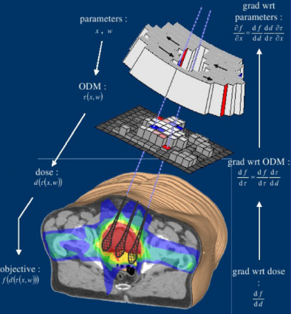


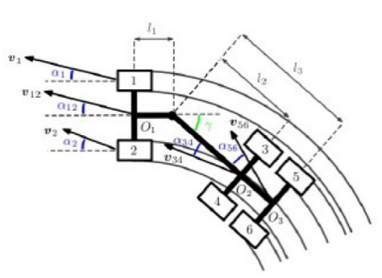
Optimeringslära och systemteori
Kort info om oss från opt&syst
Optimeringslära och systemteori är ett tillämpat matematiskt ämne
Konsten att göra något så bra som möjligt under givna förutsättningar
Teorin om matematisk modellering, optimeringsalgoritmer, analys och styrning av dynamiska system, utveckla metoder och lösare.
Verktyg från t.ex. linjär algebra, programmering, mekanik, differentialekvationer, optimeringslära, och stokastiska processer,….
Tillämpningar inom
Operationsanalys, Ekonomi, Maskin inlärning
Reglerteknik och signalbehandling, Robotik
Biologi
Exempel på tillämpningar
Strålbehandling av cancer, Analys av AI system, Mobila manipuleringar, Schemaläggning, Formationsflygning, …
10/6/2022
11

Slide 12
Exempel på tidigare KEX jobb i opt&syst
- Sök på DiVA-portalen
Lageroptimering: Minimera tiden till leverans med begränsat lagerutrymme
Portfolio Optimization: Approaches to determining VaR and CVaR
Optimering av antal flygplanssäten: Modellering med avseende på yta, intäkt och efterfrågan
Optimal löptidsallokering av bostadslån
Optimering av ett kösystem på IKEA Kungens Kurva
Recommend Songs With Data From Spotify Using Spectral Clustering
Modelling and optimizing transaction fees in a proof-of-stake cryptocurrency
Optimering av Schemaläggning
10/6/2022
12

Slide 13
Exempel på tidigare KEX jobb i opt&syst
- Sök på DiVA-portalen
Crowd Evacuation Control Using Machine Learning Techniques
Resursplanering - att använda ledtider som parameter vid bemanning av förretag i drift
Optimering av ett patientflöde inom svensk veterinärvård
Optimal inköpsstrategi för spotkontrakt på elcertifikat: En fallstudie hos Elverket Vallentuna
Portföljoptimering med courtageavgifter
Optimering av leverantörsval: En studie av Spinactor ABs leverantörsval vid byggnationsprojekt på olika orter i Sverige
Optimering av lagernivåer vid distributionscentralen Bygg Ole
10/6/2022
13

Slide 14
KEX project vid opt&syst
Typiska delmoment för optimeringsfokuserade KEX projekt
Identifiera och formulera optimeringsproblemet
  Hör problemet till en klassisk typ av optimeringsproblem? T.ex. travelling salesman problem, knapsack problem, shortest-path problem, job-shop problem, cutting stock problem, portföljoptimeringsproblem, scheduleringsproblem, …
Modellera och lös problemet
  Matlab, GAMS, Python, Gurobi, …
Analysera lösningen
10/6/2022
14

