Slide 1




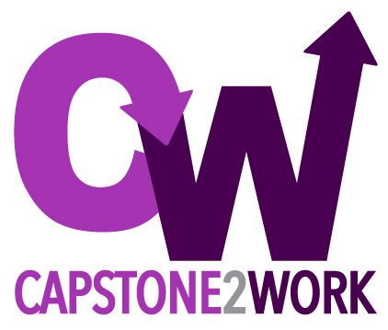

From School to Work:
Findings from a Multi-University Study
of Engineers’ First Year of Work
to Enhance Design Education
Contact:
mparetti@vt.edu
C2W Team: Marie Paretti, Julie Dyke Ford,
Susannah Howe, Daria Kotys-Schwartz, Robin Ott
This material is based upon work supported by the National Science Foundation under Grant No. 1607811. Any opinions, findings, and conclusions or recommendations expressed in this material are those of the author(s) and do not necessarily reflect the views of the National Science Foundation.
Icons made by Smashicons and Freepik from www.flaticon.com; design by J. Deters
Notes:
Marie

Slide 2
Some framing thoughts
“The objective [of engineering education] should be the development of intellectual power and judgment rather than the continuous or exhaustive coverage of a field of knowledge. In such rapidly expanding fields as science and technology, there is a natural tendency to increase the coverage of individual subjects until they become overcrowded with material of doubtful educational value. This tendency must be resisted firmly.” The Lewis Report, cited in Edström (2018)
“The main challenge, then, is to find a productive relationship between academic and professional values, when making decisions regarding practical matters.” Edström (2018)

Slide 3




C2W Study Overview
Key Site Characteristics
~400 students
~50 projects
3-Month Interview
(n=82*)
Authentic projects
Workplace Environment
Guided Mentorship
~150 students
~20 projects
Weekly Journal
6-Month Interview
(n=81*)
~30 students
~8 projects
Anticipatory Interview
12-Month Interview
(n=71*)
Weekly Survey
~250 students
~30 projects
Graduation
n=132*
Months 1-3
n=105*
Four Sites
Months 3-12
Slide design adapted from J. Deters;
Icons made by Becris, Freepik, and Smashicons from www.flaticon.com
This material is based upon work supported by the National Science Foundation under Grant No. 1607811. Any opinions, findings, and conclusions or recommendations expressed in this material are those of the author(s) and do not necessarily reflect the views of the National Science Foundation.
*Excludes participants who entered graduate school
Notes:
Marie
Interview - Becris
School and Survey - Freepik
Notebook - Smashicons

Slide 4
Key Site Characteristics
Notes:
Susannah

Slide 5


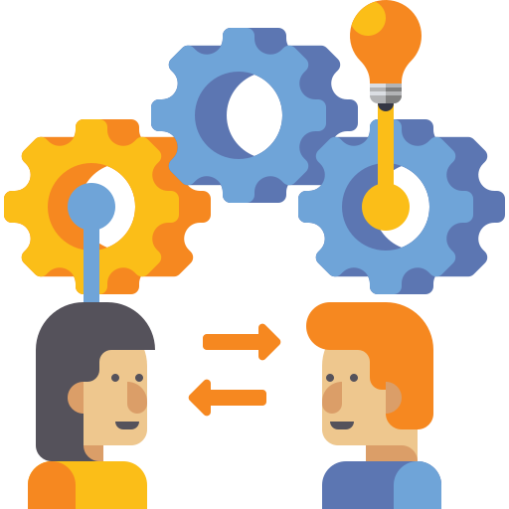
Key Site Characteristics
Authentic Projects
  Industry partnership
  Complete design cycle (year-long projects)
  Frequent, regular stakeholder/client interaction
  Impacts beyond classroom
Workplace Environment
  Project management
  Professional communication
  Common documents
  Justifications for decisions
  Project budgeting
Guided Mentorship
  Industry liaisons
  Faculty scaffolding
  Lifelong learning
Icons made by Freepik, photo3idea_studio, and Flat Icons from https://www.flaticon.com/
Notes:
Susannah

Slide 6
Key Site Characteristics
Authentic Projects
  Industry partnership
  Complete design cycle (year-long projects)
  Frequent, regular stakeholder/client interaction
  Impacts beyond classroom
Workplace Environment
  Project management
  Professional communication
  Common documents
  Justifications for decisions
  Project budgeting
Guided Mentorship
  Industry liaisons
  Faculty scaffolding
  Lifelong learning
Icons made by Freepik, photo3idea_studio, and Flat Icons from https://www.flaticon.com/
Notes:
Susannah

Slide 7
Key Site Characteristics
Authentic Projects
  Industry partnership
  Complete design cycle (year-long projects)
  Frequent, regular stakeholder/client interaction
  Impacts beyond classroom
Workplace Environment
  Project management
  Professional communication
  Common documents
  Justifications for decisions
  Project budgeting
Guided Mentorship
  Industry liaisons
  Faculty scaffolding
  Lifelong learning
Icons made by Freepik, photo3idea_studio, and Flat Icons from https://www.flaticon.com/
Notes:
Susannah

Slide 8
Key Findings
Notes:
Marie

Slide 9
Key Findings
Self-Directed Learning
Teamwork & Communication
Technical Work
Identity
  Lack of knowledge
  Finding resources
  Finding work/keeping busy
  Time management
  Mindset for grind
  Formal/informal presentations
  Formal/informal reports
  Interactions with colleagues
  Interactions with supervisors
  Client meetings
  Team meetings & processes
  CAD Modeling
  Software
  Calculations
  Design concepts
  Problem definition
  Prototyping/testing
  Tools & equipment
  Project budgeting
  Learning role
  Feeling competent
  Belonging
  Thinking like an engineer
Notes:
Marie

Slide 10
Key Findings
Self-Directed Learning
Teamwork & Communication
Technical Work
Identity
  Lack of knowledge
  Finding resources
  Finding work/keeping busy
  Time management
  Mindset for grind
  Formal/informal presentations
  Formal/informal reports
  Interactions with colleagues
  Interactions with supervisors
  Client meetings
  Team meetings & processes
  CAD Modeling
  Software
  Calculations
  Design concepts
  Problem definition
  Prototyping/testing
  Tools & equipment
  Project budgeting
  Learning role
  Feeling competent
  Belonging
  Thinking like an engineer
Notes:
Marie

Slide 11
Key Findings
Self-Directed Learning
Teamwork & Communication
Technical Work
Identity
  Lack of knowledge
  Finding resources
  Finding work/keeping busy
  Time management
  Mindset for grind
  Formal/informal presentations
  Formal/informal reports
  Interactions with colleagues
  Interactions with supervisors
  Client meetings
  Team meetings & processes
  CAD Modeling
  Software
  Calculations
  Design concepts
  Problem definition
  Prototyping/testing
  Tools & equipment
  Project budgeting
  Learning role
  Feeling competent
  Belonging
  Thinking like an engineer
Notes:
Marie

Slide 12
Key Findings
Self-Directed Learning
Teamwork & Communication
Technical Work
Identity
  Lack of knowledge
  Finding resources
  Finding work/keeping busy
  Time management
  Mindset for grind
  Formal/informal presentations
  Formal/informal reports
  Interactions with colleagues
  Interactions with supervisors
  Client meetings
  Team meetings & processes
  CAD Modeling
  Software
  Calculations
  Design concepts
  Problem definition
  Prototyping/testing
  Tools & equipment
  Project budgeting
  Learning role
  Feeling competent
  Belonging
  Thinking like an engineer

Slide 13
Further explorations

Slide 14
Transfer in Self-Directed Learning
Managing Knowledge
Lack of knowledge
Finding resources
Managing Time
Staying focused
Balancing multiple tasks
Handling pressure
People
Documents
Web
Paretti, M. C., Kotys-Schwartz, D., Ford, J. D., Howe, S., & Ott, R. (2020). Leveraging capstone design experiences to build self-directed learning. International Journal of Engineering Education, 36(2), 664-674. https://www.ijee.ie/latestissues/Vol36-2/14_ijee3903.pdf

Slide 15
Transfer in Self-Directed Learning
Managing Knowledge
Lack of knowledge
Finding resources
Managing Time
Staying focused
Balancing multiple tasks
Handling pressure
People
Documents
Web
Paretti, M. C., Kotys-Schwartz, D., Ford, J. D., Howe, S., & Ott, R. (2020). Leveraging capstone design experiences to build self-directed learning. International Journal of Engineering Education, 36(2), 664-674. https://www.ijee.ie/latestissues/Vol36-2/14_ijee3903.pdf

Slide 16
Lack of Transfer in Self-Directed Learning
Extended work on routine tasks
The constraints of the work day

Slide 17
How do professional communication skills transfer?
Ford, J. D., Paretti, M., Kotys-Schwartz, D., Howe, S., & Ott, R. New engineers’ transfer of communication activities from school to work (2021). IEEE Transactions on Professional Communication. 64(2): 105-120.

Slide 18
Transfer in Writing Skills
- Genre
Knowledge
- Audience
Awareness
Ford, J. D., Paretti, M., Kotys-Schwartz, D., Howe, S., & Ott, R. New engineers’ transfer of communication activities from school to work (2021). IEEE Transactions on Professional Communication. 64(2): 105-120.

Slide 19
Lack of Transfer in Writing Skills
- Genre
Knowledge
- Audience
Awareness
- Unfamiliar Genres
- Information
Sources
- Networks of
Relationships
Ford, J. D., Paretti, M., Kotys-Schwartz, D., Howe, S., & Ott, R. New engineers’ transfer of communication activities from school to work (2021). IEEE Transactions on Professional Communication. 64(2): 105-120.

Slide 20
Challenges in Interpersonal Communication
Building working relationships with diverse individuals
Managing negative relationships
Interacting with appropriate confidence
Paretti, M., Ford, J. D., Kotys-Schwartz, D., Howe, S., & Ott, R. (2022) Preparing for Engineering Work: Interpersonal Relationships in the School to Work Transition. Proceedings of the IEEE/ASEE Frontiers in Education Conference. Uppsala.

Slide 21
Some broader thoughts on being prepared for work
Notes:
Marie

Slide 22


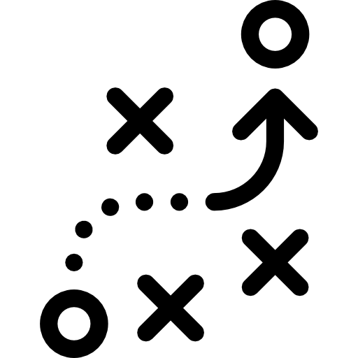
Being Prepared For Work: Graduate Perspectives
Correspondence
  Direct transfer of skills (e.g. CAD, software, calculations)
Familiarity
  Similar situations at school and work
Strategies
  Ways to approach new challenges
Icons made by Freepik, photo3idea_studio, and Flat Icons from https://www.flaticon.com/
Notes:
Marie

Slide 23
Being Prepared For Work: Graduate Perspectives
Correspondence
  Direct transfer of skills (e.g. CAD, software, calculations)
Familiarity
  Similar situations at school and work
Strategies
  Ways to approach new challenges
Icons made by Freepik, photo3idea_studio, and Flat Icons from https://www.flaticon.com/
Notes:
Marie

Slide 24
Being Prepared For Work: Graduate Perspectives
Correspondence
  Direct transfer of skills (e.g. CAD, software, calculations)
Familiarity
  Similar situations at school and work
Strategies
  Ways to approach new challenges
Icons made by Freepik, photo3idea_studio, and Flat Icons from https://www.flaticon.com/
Notes:
Marie

Slide 26
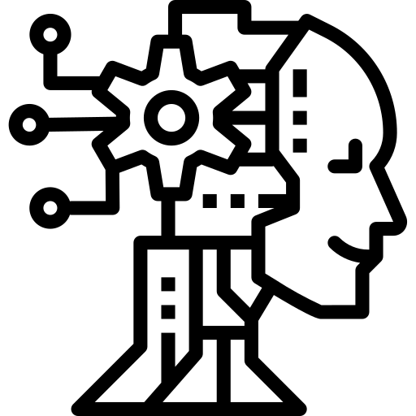


The Aims of Education
Icons by Freepik, photo2idea_studio, from Flaticons.com

Slide 27
Learning in Communities of Practice
Learning as belonging
Community
Learning
Learning as becoming
Identity
Practice
Learning as doing
Meaning
Learning as experience
(Wenger, Communities of Practice, 1998)

Slide 28
Activities, tasks, functions, and understandings do not exist in isolation; they are part of broader systems of relations in which they have meaning. These systems of relations arise out of and are reproduced and developed within social communities, which are in part systems of relations among persons. The person is defined by as well as defines these relations. Learning thus implies becoming a different person with respect to the possibilities enabled by these systems of relations. To ignore this aspect of learning is to overlook the fact that learning involves the construction of identities.
(Lave & Wenger, Situated Learning, 1991)
Learning as belonging
Community
Learning as becoming
Learning
Practice
Identity
Learning as doing
Meaning
Learning as experience

Slide 29
Identity in practice is defined socially not merely because it is reified in a social discourse of the self and of social categories, but also because it is produced as a lived experience of participation in specific communities. (Wenger 1998)
Learning as belonging
Community
Learning as becoming
Learning
Practice
Identity
Learning as doing
Meaning
Learning as experience

Slide 30
Identity as ongoing improvisation
Structure
Agency
Historical
Socially organized
Socially maintained
Distributed over landscapes of action
Ability to decide
Structures as externally constrained or internally persuasive
Draws on identity resources
Holland, D., Lachicotte, W. J., Skinner, D., & Cain, C. (1998). Identity and agency in cultural worlds. Harvard University Press.

Slide 31
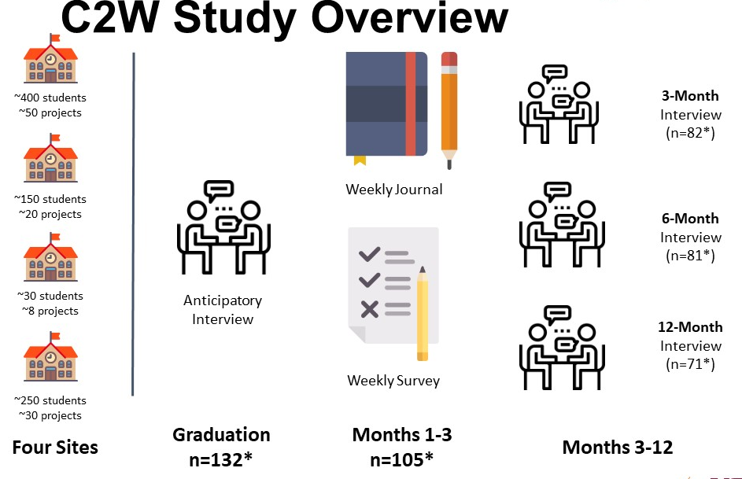
Becoming After College: Agency and Structure in Transitions to Engineering Work
“Catherine”
Gewirtz, C. (2021). Twelve Tales of Engineering in the “Real World:” Narratives of Newcomers’ Agency in Transitions to Engineering Work. [Doctoral Dissertation, Virginia Tech]. Blacksburg, VA. https://vtechworks.lib.vt.edu/handle/10919/104897

Slide 32
Narrative Analysis
Listening & Emotion Coding (audio/transcript review)
Narrative coding (purpose, character, setting plot)
Structure & Agency coding
Construction of narratives and narrative summaries
Analysis (thematic synthesis across narratives)

Slide 33
Emergent Themes Beyond Catherine
Persistent sexism: Gender biases as consistently salient within organizational structures
Objectification: Organizations objectifying employees
Alienation: Distancing between engineering work and engineering impacts
Dissonance: Disjunctions between participants’ descriptions of experiences and subsequent actions or interpretations

