Slide 1
Luminescence Spectroscopy of Semiconductors: Theory and Experiment
Time-resolve luminescence, kinetic description of processes, and phonons
Xi Lu

Slide 2
Outline
Time resolved luminescence measurements
  Overview
  Experimental setups and methods
Kinetic description of luminescence processes
  Radiative and non-radiative recombination
  Recombination process
Phonons
  Description of phonons
  Phonon interactions
  Localized center and thermal quenching

Slide 3
Outline
Time resolved luminescence measurements
  Overview
  Experimental setups and methods
Kinetic description of luminescence processes
  Radiative and non-radiative recombination
  Recombination process
Phonons
  Description of phonons
  Phonon interactions
  Localized center and thermal quenching

Slide 4


Time resolved luminescence measurements
Temporal behavior of the luminescence signal
-the shape of the luminescence decay curve after the excitation is switched off
Basic case
Real case
Simplest setup
Single channel detector (PMT/APD)
Pulsed or chopped laser source
Monochromator in front of detector
Oscilloscope
Basic response: simple exponential
High demands on experimental setup
Highly sensitive, fast enough, perfectly linear response
Hard to satisfy simultaneously
Can study relatively slow decay
The temporal shape of the excitation pulse needs to be deconvoluted from the results
Decay curve can be more compicated
$$i_{λ}\left(t\right)=i_{λ}\left(0\right)e^{\left(−\frac{t}{τ}\right)}$$
Mean decay time:
$$\overline{t}=τ , { i}_{λ}\left(τ\right)=\frac{i_{λ}\left(0\right)}{e}$$

Slide 5
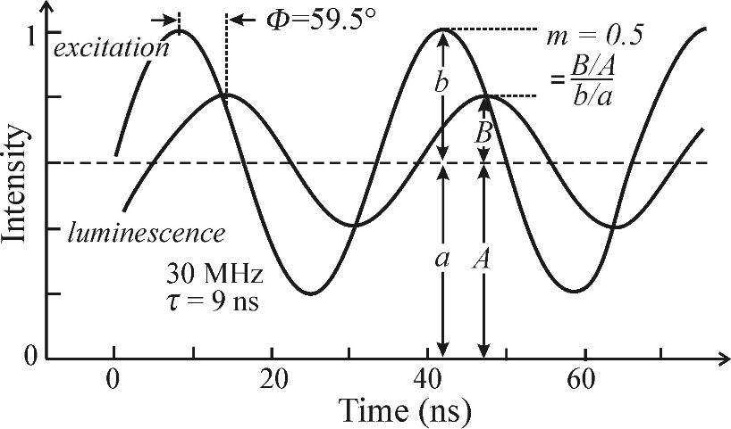
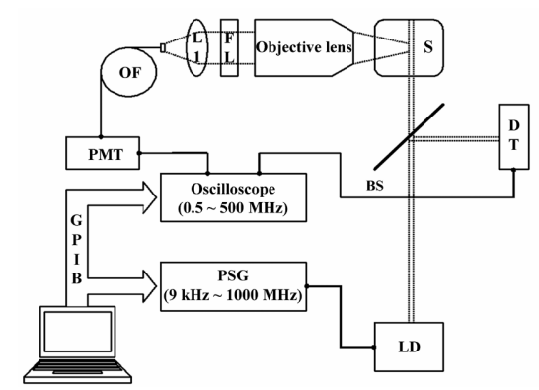
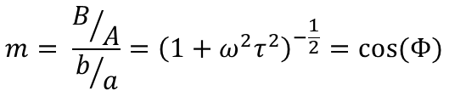

Time resolved luminescence measurements
Experimental setups and methods
- Phase shift method
Sinusodally modulate excitation
The response will have a phase delay and a modulation depth change
These are related to the material parameters
Frequency ω must be comparable to 1/τ
Allows decay times from 10⁻¹ s to 10⁻⁹ s
Benefit: Relatively fast with simple setup
Drawback: Can only be used on single exponential decay systems
$$tan\left(Φ\right)=ωτ$$
$$m= \frac{B/A}{b/a}={\left(1+ω^{2}τ^{2}\right)}^{−\frac{1}{2}}=cos⁡(Φ)$$

Slide 6
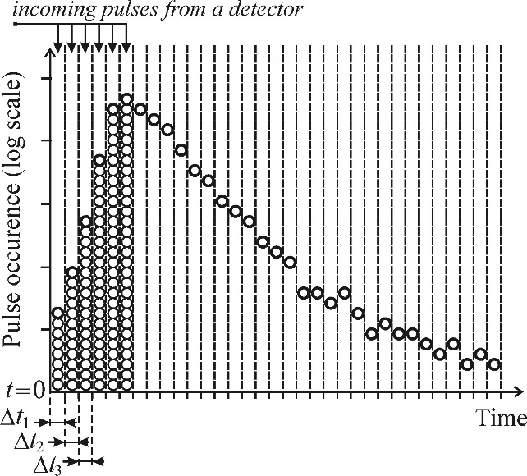
Time resolved luminescence measurements
Experimental setups and methods
-Time-correlated photon counting
The sample is excited repeatedly
10 kHz – 100 MHz depending on setup
Emitted photons are counted
The excitation and detection occur in time-correlated cycles.
Over many cycles, a statistical image is bulit up of when along the excitation cycle emission is likely to occur.
Requires one photon be detected per cycle
The time it takes to collect enough data ranges from minutes to hours
Allows decay times from 10⁻⁶ s to 10⁻¹⁰ s
Benefits: Very sensitive and accurate
Drawback: Time-consuming, requires special deconvolution methods when high repetition rates are used

Slide 7
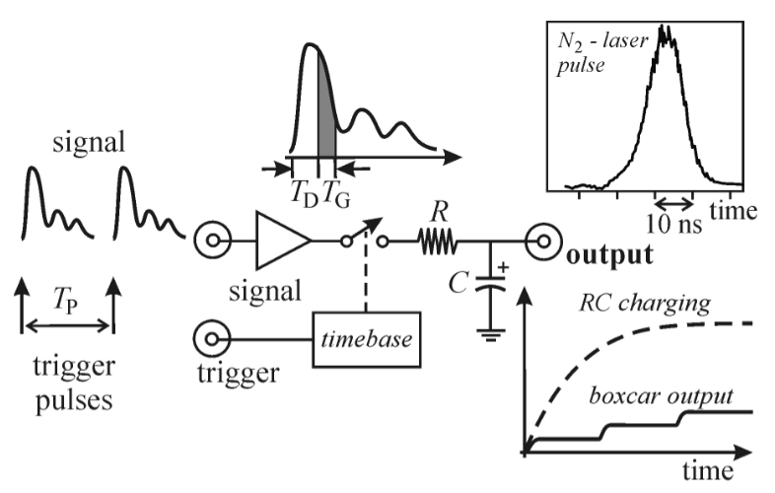
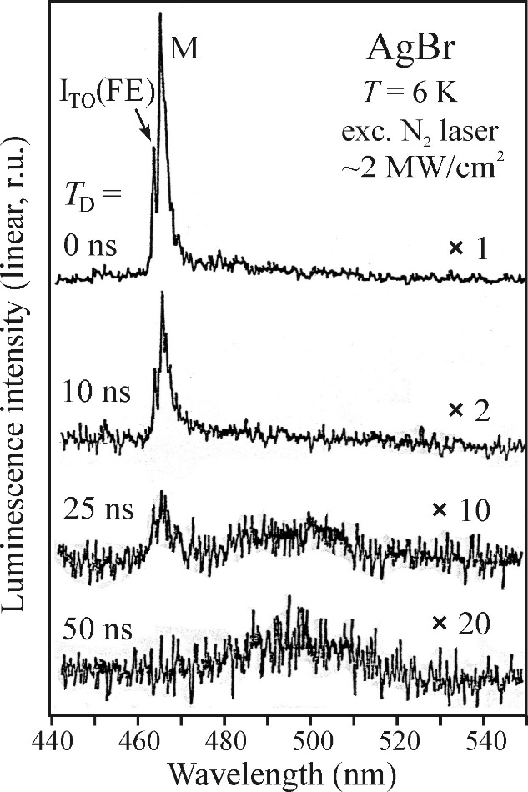
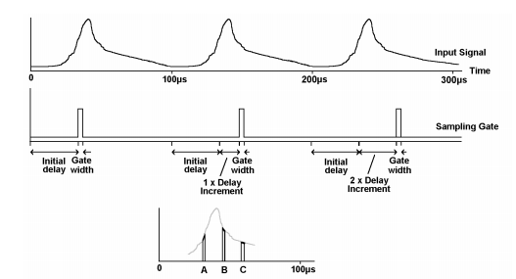
Time resolved luminescence measurements
Experimental setups and methods
-Boxcar integrator
Measures a periodic signal over several periods
Done by performing the measurement over a time interval T_{G} (gate width) each period.
This sampling time can be delayed (T_{D}) to focus in on different parts of the periodic signal, enabling temporally resolved measurements
Enables time-resolved spectra to be measured
Monochromator can be included to scan wavelengths for different TD.
Allows decay times around 500ps
Benefits: Good S/N ratio
Drawback:Too slow for processes in the 100 ps range and faster.

Slide 8
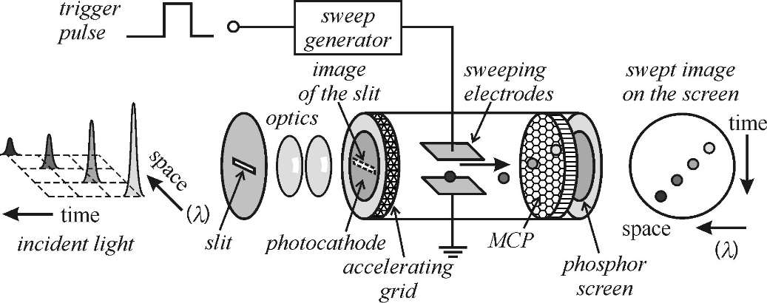
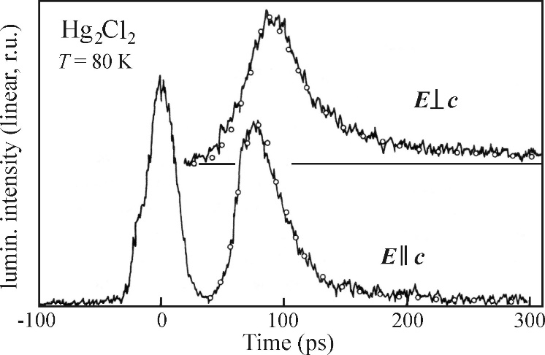
Time resolved luminescence measurements
Experimental setups and methods
-Streak camera
Converting a temporal information to spatial information
Emitted light causes electrons to be ejected, which are accelerated and swept by strong electric field
Spatial distribution of electrons is recorded by 2D detector (CCD or other array)
Sweeping E-field is time-correlated with incoming pulses of light
Deconvolution is necessary
Time resolution: 1ps
Excitation pulse

Slide 9
Outline
Time resolved luminescence measurements
  Overview
  Experimental setups and methods
Kinetic description of luminescence processes
  Radiative and non-radiative recombination
  Recombination process
Phonons
  Description of phonons
  Phonon interactions
  Localized center and thermal quenching

Slide 10
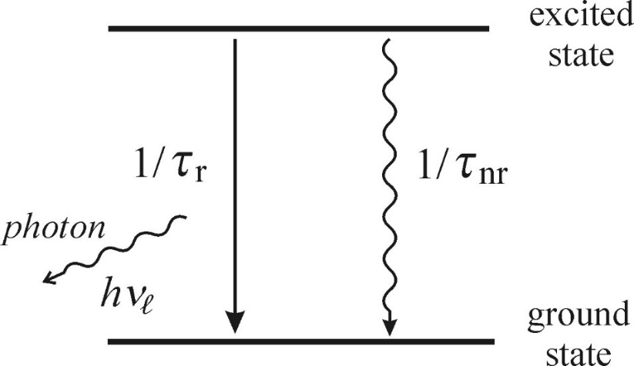

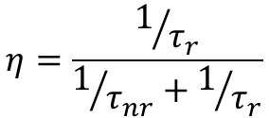







Kinetic description of luminescence processes
Radiative and non-radiative recombination
An excited luminescence center can return to the ground state in 2 ways
-Transmitting energy to the crystal as heat (phonon vibration)
-Losing energy by emitting a photon
The total probability of any transition occuring is given by the sum of their inverse
They are also used to define luminescence quantum efficiency
$$\frac{1}{τ}=\frac{1}{τ_{nr}}+\frac{1}{τ_{r}}$$
$$η=\frac{1/{τ_{r}}}{1/{τ_{nr}}+1/{τ_{r}}}$$
$$η→0$$
For
$$τ_{r}≫τ_{nr} ,$$
$$τ→τ_{nr}$$
$$η→1$$
$$η=\frac{τ}{τ_{r}}$$
$$τ_{r}≪τ_{nr} ,$$
$$τ→τ_{r}$$

Slide 11
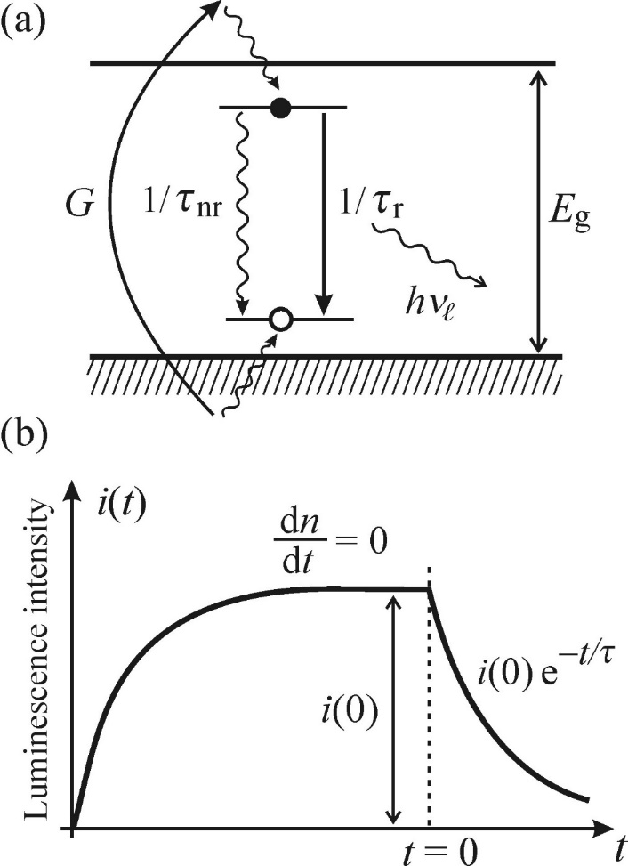





Time resolved luminescence measurements
Recombination process
-Monomolecular process
A localized luminescence center in a crystal or a matrix, typically represented by an impurity atom
Extrinsic luminescence
Strictly single exponential
Steady state: dn/dt=0
Proportional to the excitation intensity
Strong indications that the microscopic origin of the examined luminescence might lie with in a localized center
$$n\left(t\right)={n\left(0\right)e}^{−\frac{t}{τ}}$$
$$\frac{dn}{dt}=G−\frac{n}{τ_{nr}}−\frac{n}{τ_{r}}=G−\frac{n}{τ}$$
G=0
i$\left(t\right)=\frac{n\left(t\right)}{τ_{r}}={i\left(0\right)e}^{−\frac{t}{τ}}$
$$G=\frac{n\left(0\right)}{τ_{r}}+\frac{n\left(0\right)}{τ_{nr}}=i\left(0\right)+\frac{n\left(0\right)}{τ_{nr}}$$
G $≈αI_{ex}$ i$\left(0\right)=ηαI_{ex}$

Slide 12

Time resolved luminescence measurements
Recombination process
-Monomolecular process
Double exponential:
Two kinds of sources of monomolecular recombination
Modelled as a sum of two exponential decays with different amplitudes and decay times
Useful when different mechanisms for recombination are dominant at different times
Triple or higher exponential fits are usually not useful
Too many fitting parameters to carry useful information
$$i\left(t\right)=a_{1}e^{−\frac{t}{τ_{1}}}+a_{2}e^{−\frac{t}{τ_{2}}}$$

Slide 13
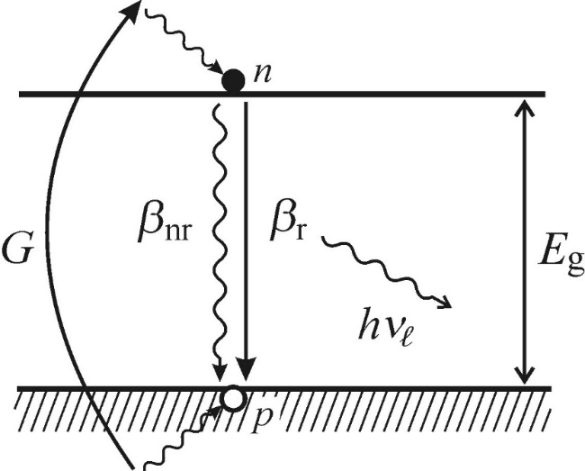

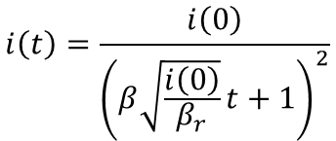


Time resolved luminescence measurements
Recombination process
-Bimolecular process
Free electron-hole pairs are produced by absorbing photon
Intrinsic luminescence
Rather than a localised luminescence centre, this involves the recombination of electrons and holes
The free electrons and holes generated will diffuse along the band edge until they find a carrier to recombine with
This depends on the electron and hole densities of the material
These are taken to be equal for simplicity
Luminescence decay
This is very different from the monomolecular case
$$\frac{dn}{dt}=G−βnp=G−\left(β_{r}n^{2}+β_{nr}n^{2}\right)=G−βn^{2}$$
G=0
$$n\left(t\right)=\frac{n\left(0\right)}{βtn\left(0\right)+1}$$
$$\frac{dn\left(t\right)}{dt}=−βn^{2}$$
$$i\left(t\right)=\frac{i\left(0\right)}{{\left(β\sqrt{\frac{i\left(0\right)}{β_{r}}}t+1\right)}^{2}}$$

Slide 14
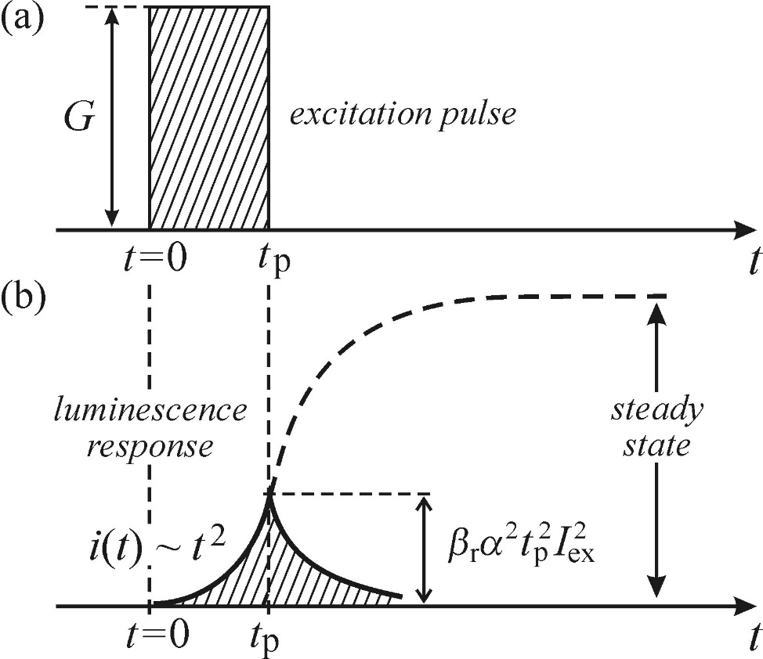


Time resolved luminescence measurements
Recombination process
-Bimolecular process
Steady state: dn/dt=0
The steady state intensity still varies linearly with excitation intensity
When the excitation is not strong enough
$$i\left(0\right)=\left(\frac{β_{r}}{β_{r}+β_{nr}}\right){αI}_{ex}$$
$$i\left(t\right)=β_{r}n^{2}(t)≈β_{r}α^{2}t^{2}I_{ex}^{2}$$

Slide 15
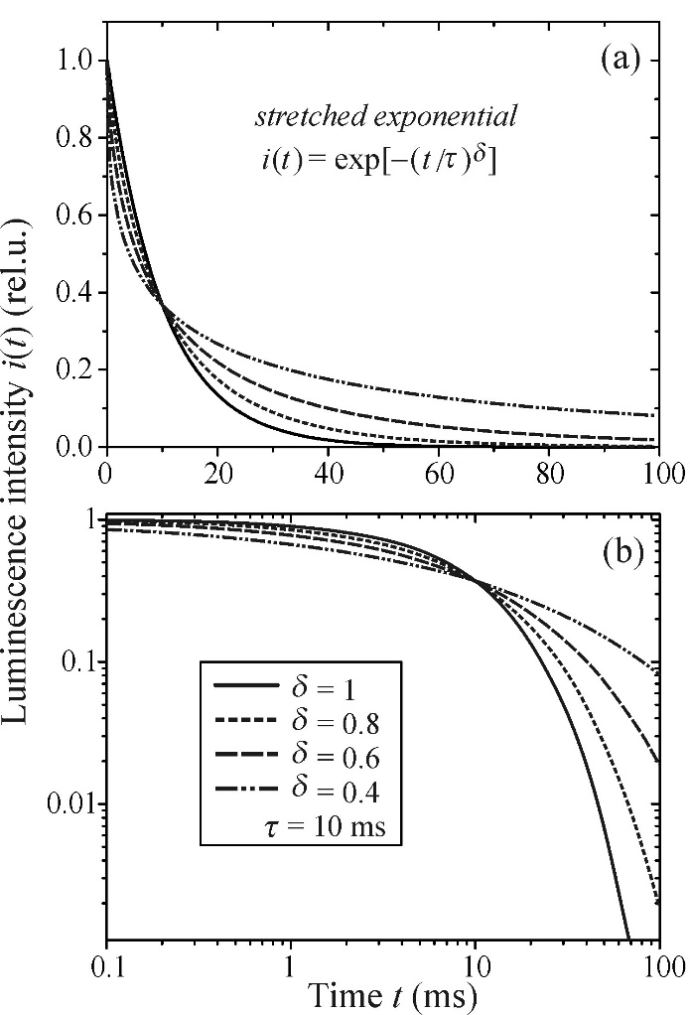

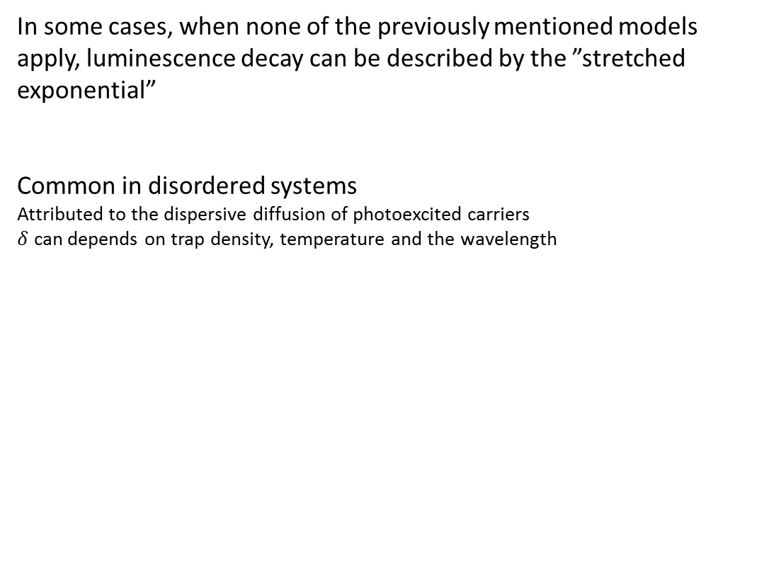
Time resolved luminescence measurements
Recombination process
-Stretched exponential
In some cases, when none of the previously mentioned models apply, luminescence decay can be described by the ”stretched exponential”
Common in disordered systems
Attributed to the dispersive diffusion of photoexcited carriers
$δ$ can depends on trap density, temperature and the wavelength
$$i\left(t\right)=i\left(0\right)e^{−{\left(\frac{t}{τ}\right)}^{δ}}$$

Slide 16
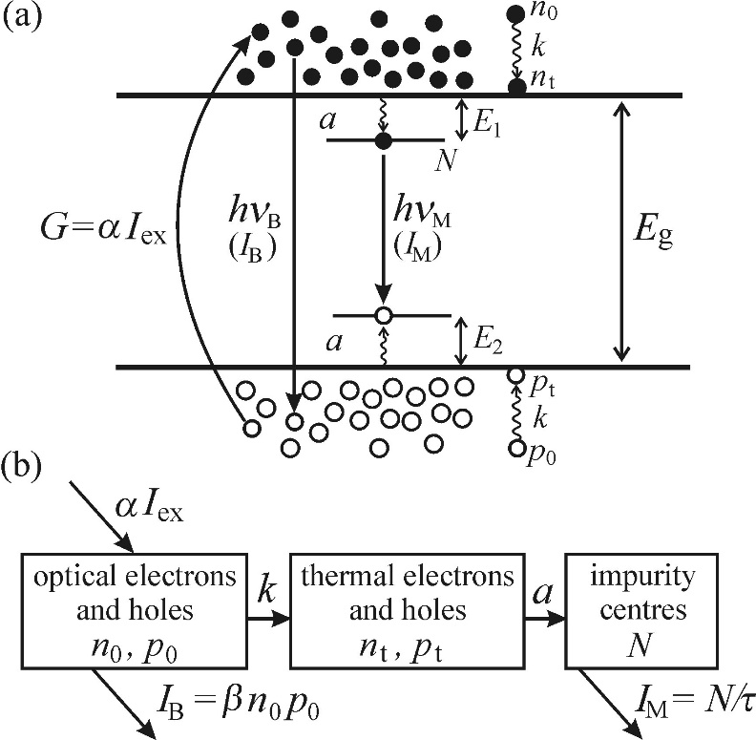



Time resolved luminescence measurements
Recombination process
-Multiple simultaneous processes
Consider both monomolecular and bimolecular processes
Free electron and hole recombination (intrinsic)
Recombination of impurity states (extrinsic)
Intrinsic and extrinsic recombination processes have different intensity dependencies
Process
Recombination of optical electrons and holes
  Generation term: αI_{ex}
  Recombination coefficient: β
Generation of thermal carriers by thermalization of optical carriers
  Generation rate: k
Capture of thermal electron and hole by impurity, exciting
  Capture coefficient: a
  Conc. of impurities: N₀
  Conc. of excited impurities: N
Excited impurities luminesce
  Recombinations/volume: N/τ
$$\frac{dn_{0}}{dt}=αI_{ex}−βn_{0}p_{0}−kn_{0}$$
$$\frac{dn_{t}}{dt}=kn_{o}−a\left(N_{0}−N\right)n_{t}$$
$$\frac{dN}{dt}=a\left(N_{0}−N\right)n_{t}−\frac{N}{τ}$$

Slide 17
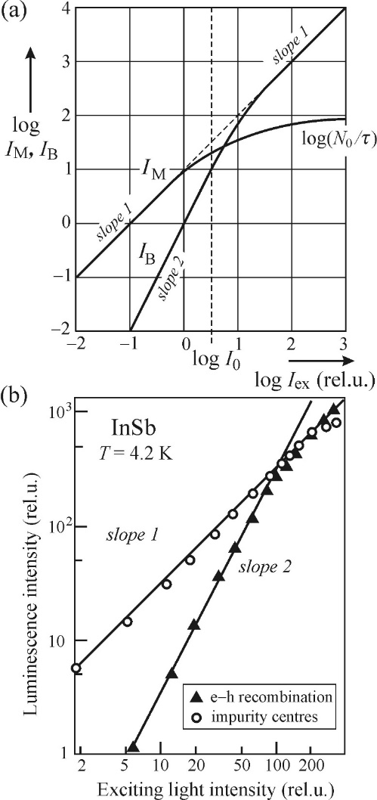




Time resolved luminescence measurements
Recombination process
-Multiple simultaneous processes
Weak excitation
Strong excitation
$$I_{B}=\frac{α^{2}β }{k^{2}}I_{ex}^{2}$$
$$I_{B}=αI_{ex}$$
Bimolecular
Monomolecular
$$I_{M}=\frac{N_{0}}{τ}$$
$$I_{M}=αI_{ex}$$
For weak excitation, almost all exctied carriers recombine at impurities
The carrier density is too low for efficient bimolecular recombination
Most exctied carriers are trapped at impurities
For strong excitation, the monomolecular recombination saturates and becomes independent on the excitation intensity
The bimolecular recombination becomes linearly dependent on the exciation density, in the same way as I_{M} for weak excitation
Kinetic equations are helpful in that they can offer a basic idea about what type of recombination processes are present, both in the temporal character of the decay curve and in the excitation dependence of the radiated intensity.However, there are limits to the usefulness of the approach.

Slide 18
Outline
Time resolved luminescence measurements
  Overview
  Experimental setups and methods
Kinetic description of luminescence processes
  Radiative and non-radiative recombination
  Recombination process
Phonons
  Description of phonons
  Phonon interactions
  Localized center and thermal quenching

Slide 19
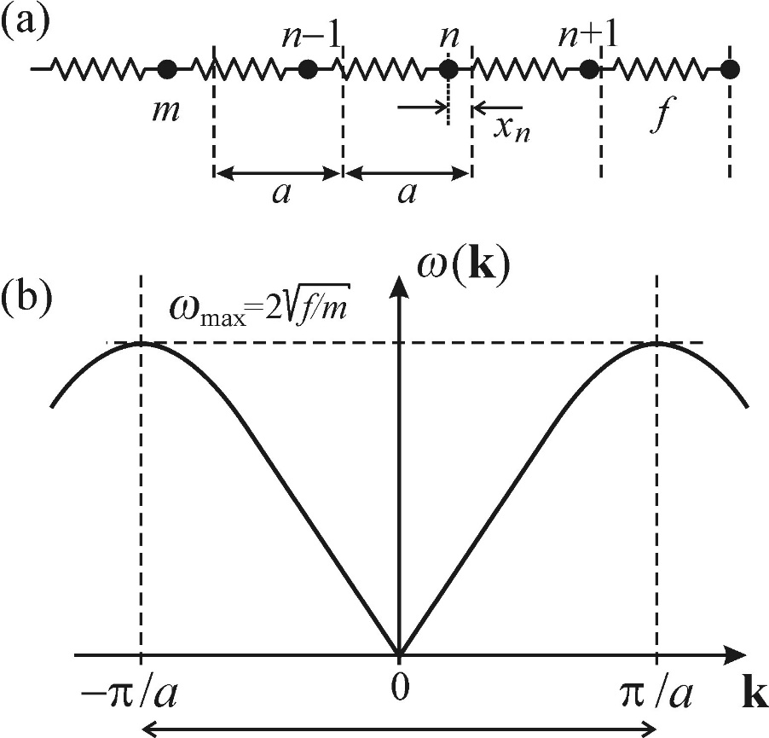
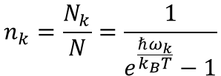
Time resolved luminescence measurements
Phonons
-Lattice vibrations
Atoms in a lattice
Can be described as a string of masses that oscillate around their equilibrium points (in 1D)
If oscillations are small (low T), these can be modelled as masses connected by springs – harmonic oscillators
The equations of motion of this set of masses can be solved by considering the collective behaviour of the system, resulting in a solution in the form of a wave running along the string
This also yields the dispersion relation for the system, which is periodic with a period of 2π/a.
The vibrational behavior can be quantized and we can define a phonon distribution function:
Which describes the mean number of phonons in a given quantum state.
This shows a strong dependence of the phonon population on temperature.
$$n_{k}=\frac{N_{k}}{N}=\frac{1}{e^{\frac{ℏω_{k}}{k_{B}T}}−1}$$

Slide 20
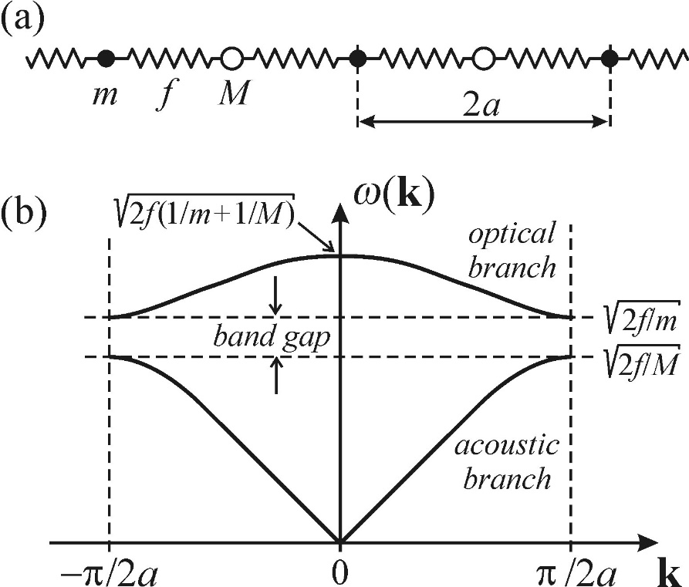
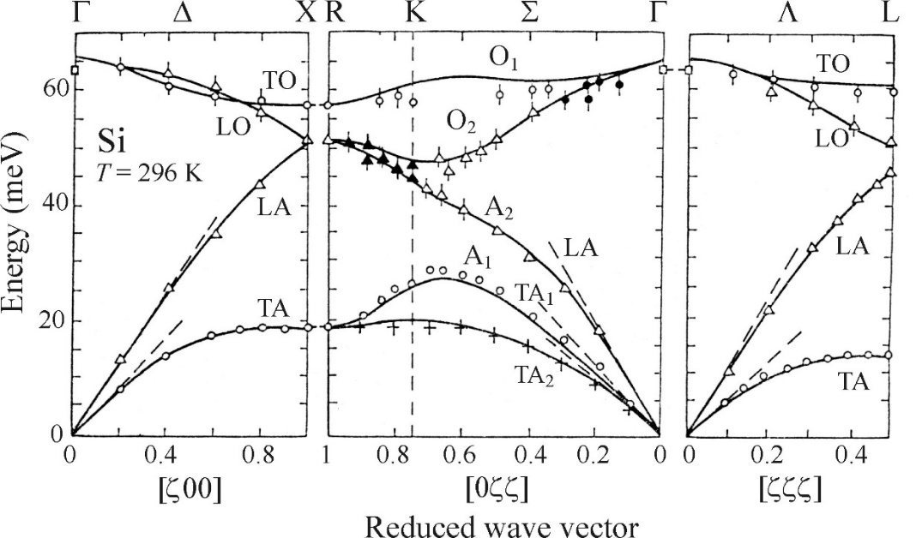
Time resolved luminescence measurements
Phonons
-Lattice vibrations
The 1D model can be applied to a 3D system
A second type of particle with different mass is added to the string
The resulting model can be used to describe the basic features of vibrations in a 3D crystal
This includes the optical and acoustic phonon modes: Transverse acoustic(TA),longitudinal acoustic(LA), transverse optical(TO) and longitudinal optical(LO).

Slide 21
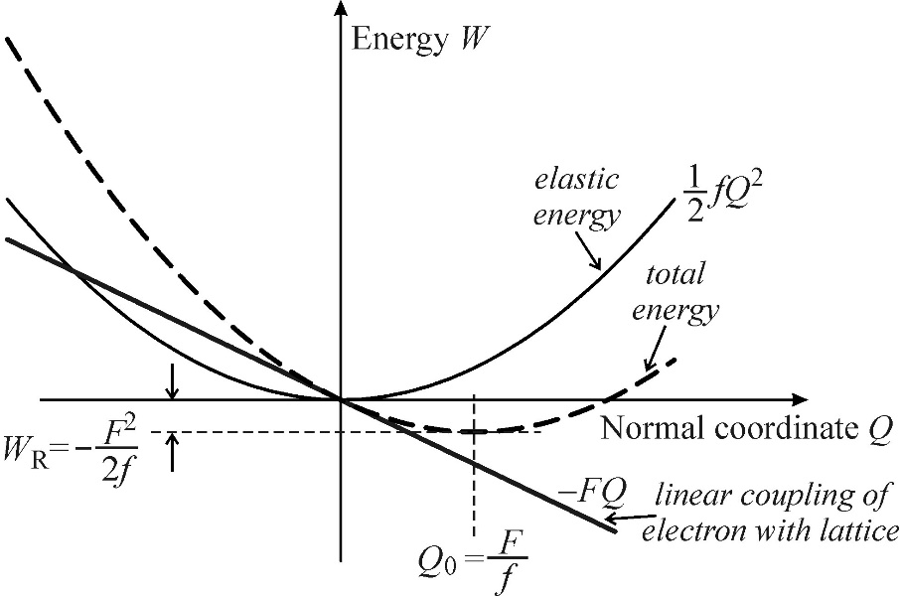
Time resolved luminescence measurements
Exciton-phonon and electron-phonon interactions
-The deformation potential
Electron-hole energies are sensitive to interatomic distance
External forces on a semiconductor cause changes in its bandgap
Similar effects exist due to lattice vibrations
In the case of a long-wavelength longitudinal acoustic phonon, it can be expressed in terms of the relative change in volume of the sample
Volume deformation potentials are usually given as relative between two energy levels
This is because they are very hard to measure individually
Such values can be negative or positive
For a positive value, a higher pressure increases the band gap and blue-shifts edge emission luminescence lines.
$$δE_{kn}=a\left(k,n\right)\left(δV/V\right)$$
n: indicates valence or conduction band
a(k,n): Volume deformation potential at k. Usually taken at the Γ point, where k=0.

Slide 22
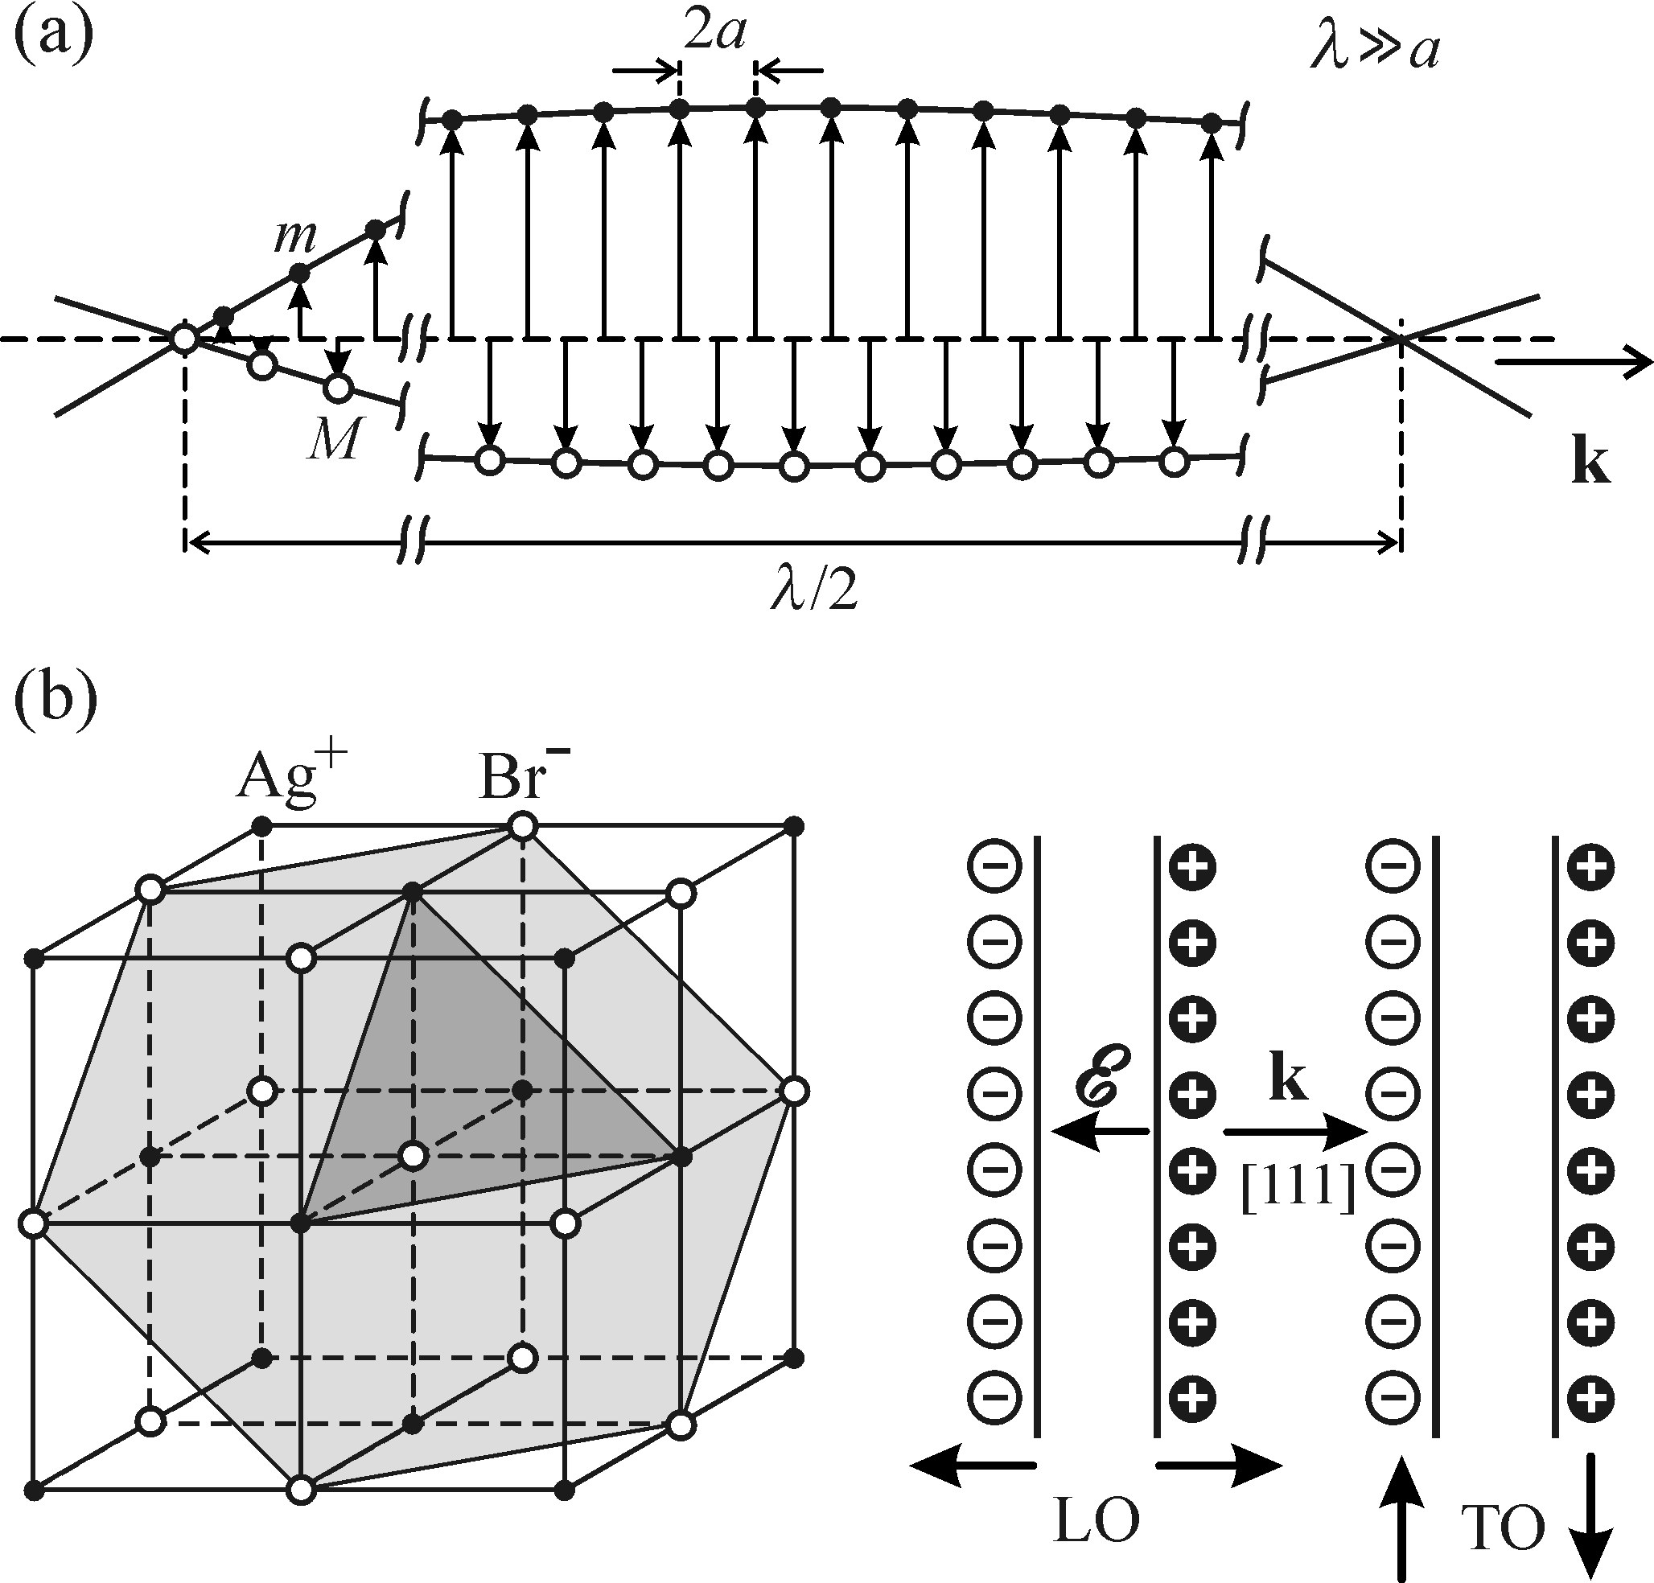
Time resolved luminescence measurements
Exciton-phonon and electron-phonon interactions
-The piezoelectric mechanism
In some materials, mechanical deformation can result in an electric field building up inside the material
LA phonons can cause such motion. This is particularly true for longer wavelengths.
This effect is quite weak and usually screened by free carriers.

Slide 23
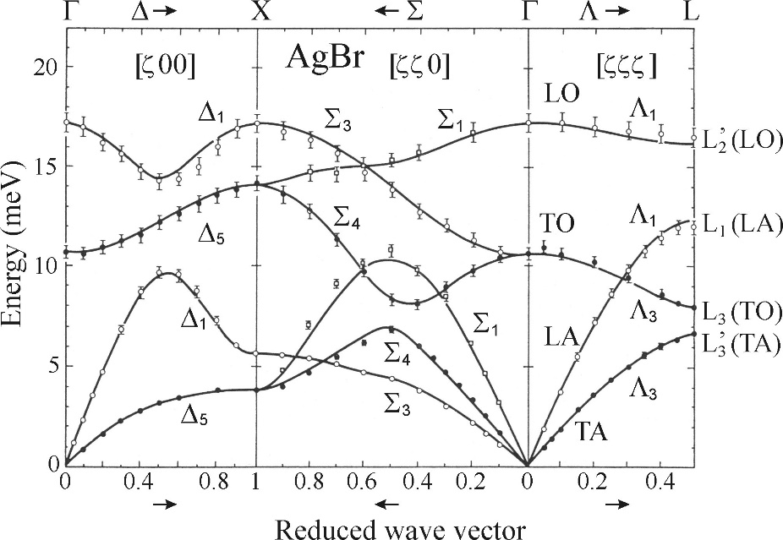
Time resolved luminescence measurements
Exciton-phonon and electron-phonon interactions
-The Fröhlich Mechanism
Long wavelength LO phonons inducing long range electric field
The most important phonon-exciton interaction
Only happens in ionic crystals, and only for LO phonons
The Fröhlich electron-phonon coupling increases with the bond ionicity of the material

Slide 24
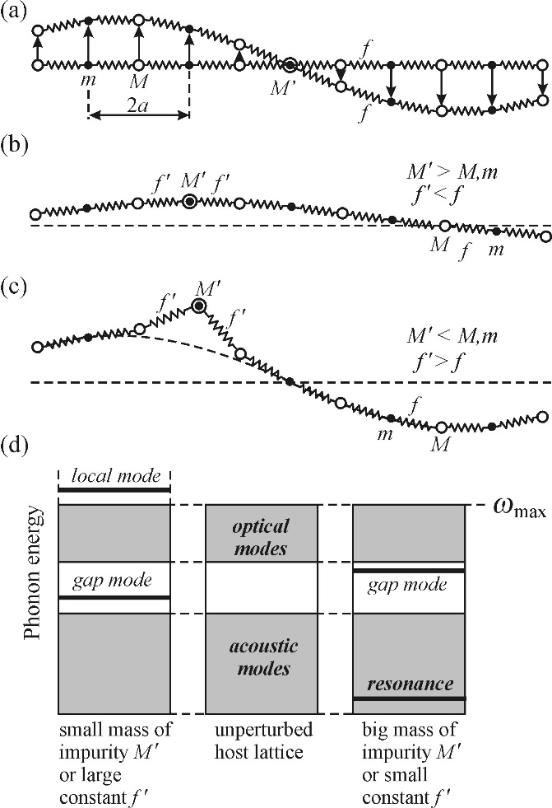
Time resolved luminescence measurements
Localized center and thermal quenching
-Point defects
Impurity atom mass M’ - 3 modes of vibrational
Lattice vibrations are undisturbed as long as the impurity is situated at a node
Resconance mode – if the impurity is heavy, a lower frequency mode appears to which vibrational energy gets transferred by surrounding unperturbed areas.
Local mode – if the impurity is light, a mode appears with a frequency higher than allowed for the unperturbed system. The energy of this mode decreases rapidly away from the impurity
The presence of these types of impurities breaks the lattice symmetry and can affect raman measurements

Slide 25
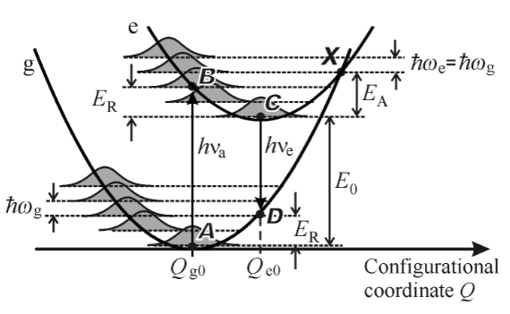
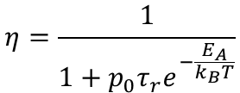
Time resolved luminescence measurements
Localized center and thermal quenching
-Thermal quenching
At low T, transitions from the excited state to the ground state via point X is unlikely due to the lack of thermal vibrations.
As the temperature increases, the system is more likely to reach point X through thermal vibrations supplying the activation energy E_{A}.
This leads to a dependence of the luminescence quantum efficiency on temperature such that:
$$η=\frac{1}{1+{p_{0}τ}_{r}e^{−\frac{E_{A}}{k_{B}T}}}$$

