Slide 1
SK3889 Luminescence Spectroscopy of Semiconductors: Theory and Experiment
(7.5 credits)
Radiative and non-radiative recombination in semiconductors
Zheheng (Johan) Song
zheheng@kth.se

Slide 2
Outline
Chapter 5: Radiative recombination processes
Free electron-hole pairs in direct and indirect bandgap
Free electron/hole with neutral acceptor/donor
Two-photon absorption
Luminescence from transition metal and rare earth ion impurities
Chapter 6: Non-radiative recombination processes
Heat generation: Multiphonon recombination
Heat generation: Auger and bimolecular recombination
Creation of lattice defects
Photochemical changes
How the energy will dissipate after the photon excitation?

Slide 3
Classification of luminescence by intensity
Low-fluence (Weak) excitation (0.01- 10 W/cm²): gas-discharge lamp, incandescent lamp, continuous-wave gas laser
- Recombination of free excitons (FE or X; FE-LO phonon)
- Recombination of a bound exciton (BE): (D⁰-X; A⁰-X; D⁺-X; A—X, isoelectronic impurity)
- Recombination of donor-acceptor pairs (D⁰-A⁰)
- Recombination of free hole/electron with neutral donor/acceptor (h-D⁰; e-A⁰; e-h)
High-fluence (Strong) excitation (1 kW-10 MW/cm²):
- Radiative decay of excitonic molecule (EM or XX)
- Luminescence from inelastic collisions of excitons (X-X collisions)
- Luminescence of electron-hole liquid (EHL) or electron-hole plasma (EHP)
- Bose-Einstein condensation of excitons or excitonic molecules
1 sun = 0.1 mW/cm² = 0.1 W/cm² = 1 kW/m²
These excitations can occur simultaneously, in these two chapters we focus on low-fluence excitation and neglecte luminescence from excitons
Notes:
Under certain conditions, such as at high densities and low temperatures, these electron-hole pairs can exhibit collective behavior and form a phase that behaves analogously to a liquid. This phase is termed as Electron-Hole Liquid (EHL).(The pairs can move freely)

Slide 4
Classification of luminescence by intensity
Low-fluence (Weak) excitation (0.01- 10 W/cm²): gas-discharge lamp, incandescent lamp, continuous-wave gas laser
- Recombination of free excitons (FE or X; FE-LO phonon)
- Recombination of a bound exciton (BE): (D⁰-X; A⁰-X; D⁺-X; A—X, isoelectronic impurity)
- Recombination of donor-acceptor pairs (D⁰-A⁰)
- Recombination of free hole/electron with neutral donor/acceptor (h-D⁰; e-A⁰; e-h)
High-fluence (Strong) excitation (1 kW-10 MW/cm²):
- Radiative decay of excitonic molecule (EM or XX)
- Luminescence from inelastic collisions of excitons (X-X collisions)
- Luminescence of electron-hole liquid (EHL) or electron-hole plasma (EHP)
- Bose-Einstein condensation of excitons or excitonic molecules
1 sun = 0.1 mW/cm² = 0.1 W/cm² = 1 kW/m²
These excitations can occur simultaneously, in these two chapters we focus on low-fluence excitation and neglecte luminescence from excitons
Notes:
Under certain conditions, such as at high densities and low temperatures, these electron-hole pairs can exhibit collective behavior and form a phase that behaves analogously to a liquid. This phase is termed as Electron-Hole Liquid (EHL).(The pairs can move freely)

Slide 5
Some definitions
- Free electron and hole: Free electrons and holes are independent particles that do not form coupled states like excitons and are not bound to impurities or defects. (e, h)
- Free exciton: free exciton are coupled states of an electron and hole that can move freely in the material without being bound to impurities or defects. (FE or X)
- Bound exciton: bound exciton are also coupled states of an electron and hole, but they are bound to specific impurities or defects in the material and cannot move freely. (BE, usually lower energy than the free exciton, with more stability, give longer emission wavelength)
Notes:
Under certain conditions, such as at high densities and low temperatures, these electron-hole pairs can exhibit collective behavior and form a phase that behaves analogously to a liquid. This phase is termed as Electron-Hole Liquid (EHL).(The pairs can move freely)

Slide 6
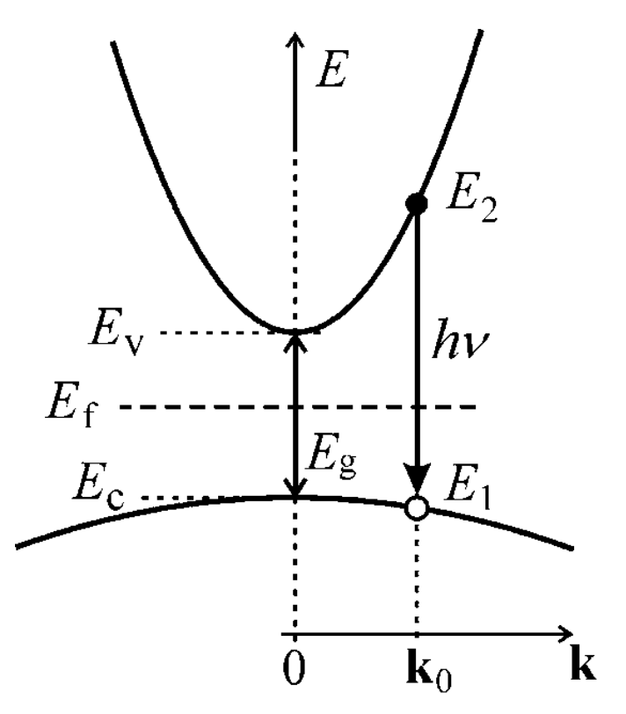
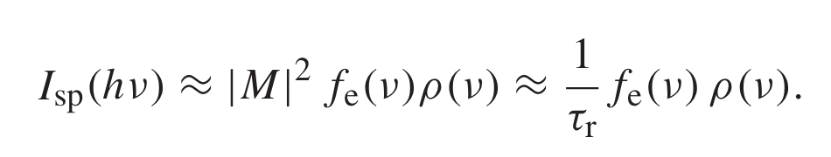

Free electron-hole pairs recombination: Direct bandgap case
- Distribution probability: The probability of a suitable configuration of occupancy of conduction and valence band states f_{e}(𝛎) (emission)
- Interaction probability: The quantum-mechanical probability of this transition in the form of the square of the absolute value of the matrix element of the transition (in the dipole approximation) |M|²
⁻ Density of state: The joint density of electron and hole states ρ(ν) in the corresponding bands.
Direct bandgap
Distribution probability, interaction probability, density of state
Notes:
How many PhD students in Sweden?
How many PhD students are eager to attend this course?
How many seats we have in this classroom?

Slide 7
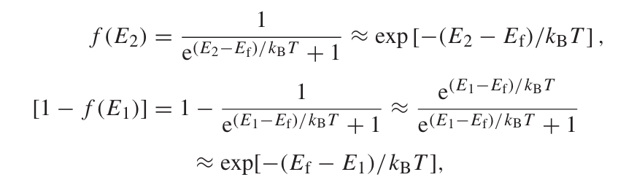


Free electron-hole pairs recombination: Direct bandgap
f_{e}: the occupancy factor for emission
f_{c}: the occupancy factor in conduction band
f_{v}: the occupancy factor in valence band
Low temperature and wide bandgap: Fermi level sits in the middle of bandgap
Fermi-Dirac distribution
- What’s is the Fermi-Dirac distribution?
- Particles are indiscernible
- Pauli exclusion principle
- Electron, neutron
Emission occupancy factor

Slide 8
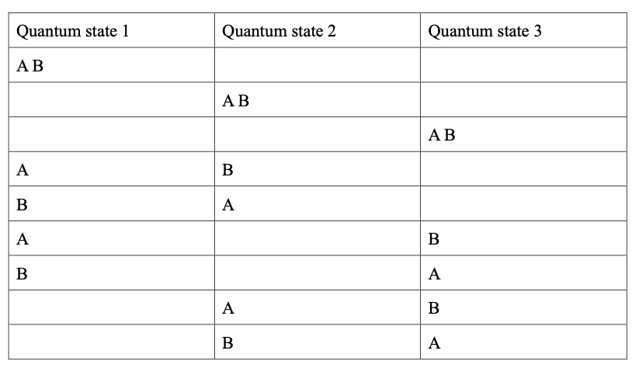
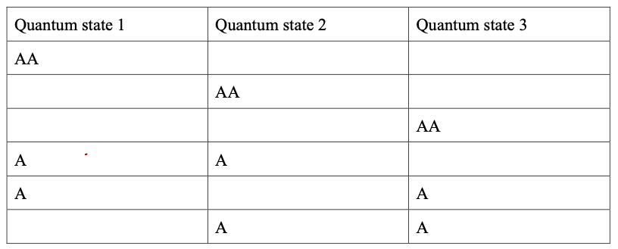
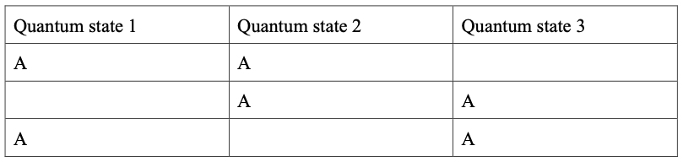
Free electron-hole pairs recombination: Direct bandgap
0. Basic assumption
- Particles conservation law
- Energy conservation law
- Boltzmann’s equal probability principle
- The most probable distribution
Two particle, three energy states, how many possibility?
1. Boltzmann Distribution
- Classic particles
- Particles are discernable
2. Bose-Einstein distribution
- Particles are indiscernible
- Photon, phonon
3. Fermi-Dirac distribution
- What’s is the Fermi-Dirac distribution?
- Particles are indiscernible
- Pauli exclusion principle
- Electron, neutron
Energy and statistical expression make difference
Notes:
Boltzmann’s equal probability principle: if an isolated system is in equivalent, it is equally like to be in any of its accessible states. the macro phenomenon is a mean value of the parameters

Slide 9
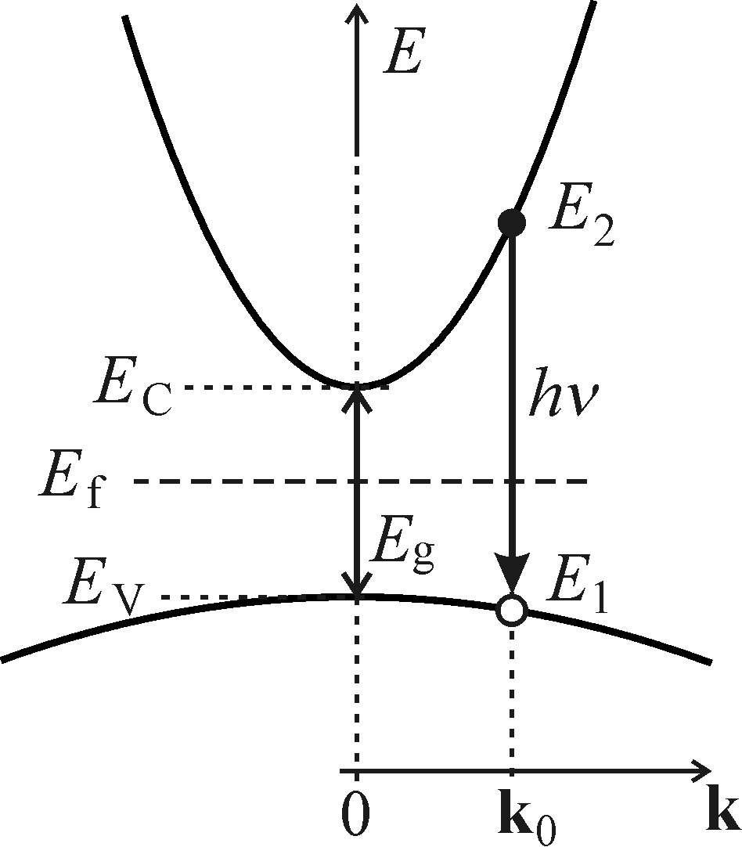
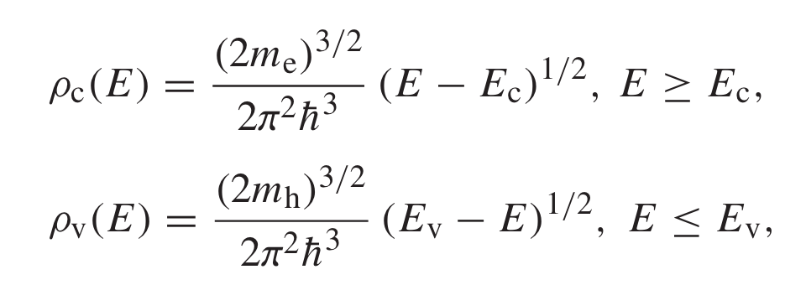
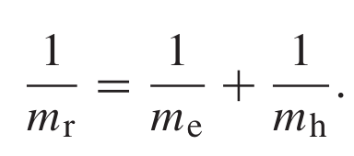
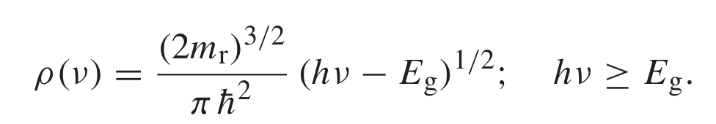
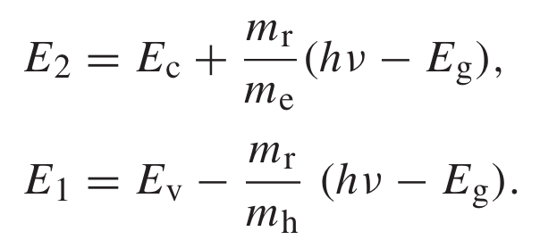

Free electron-hole pairs recombination: Direct bandgap
Density of states: How many states for specific energy?
Using the incremental relation
m_{r} is the reduced electron-hole mass
Interaction probability: The quantum-mechanical coupling probability
𝜏_{r} means the radiative lifetime, which is inversely proportional to the square of matrix element 𝜏_{r} ~ |M|⁻²

Slide 10
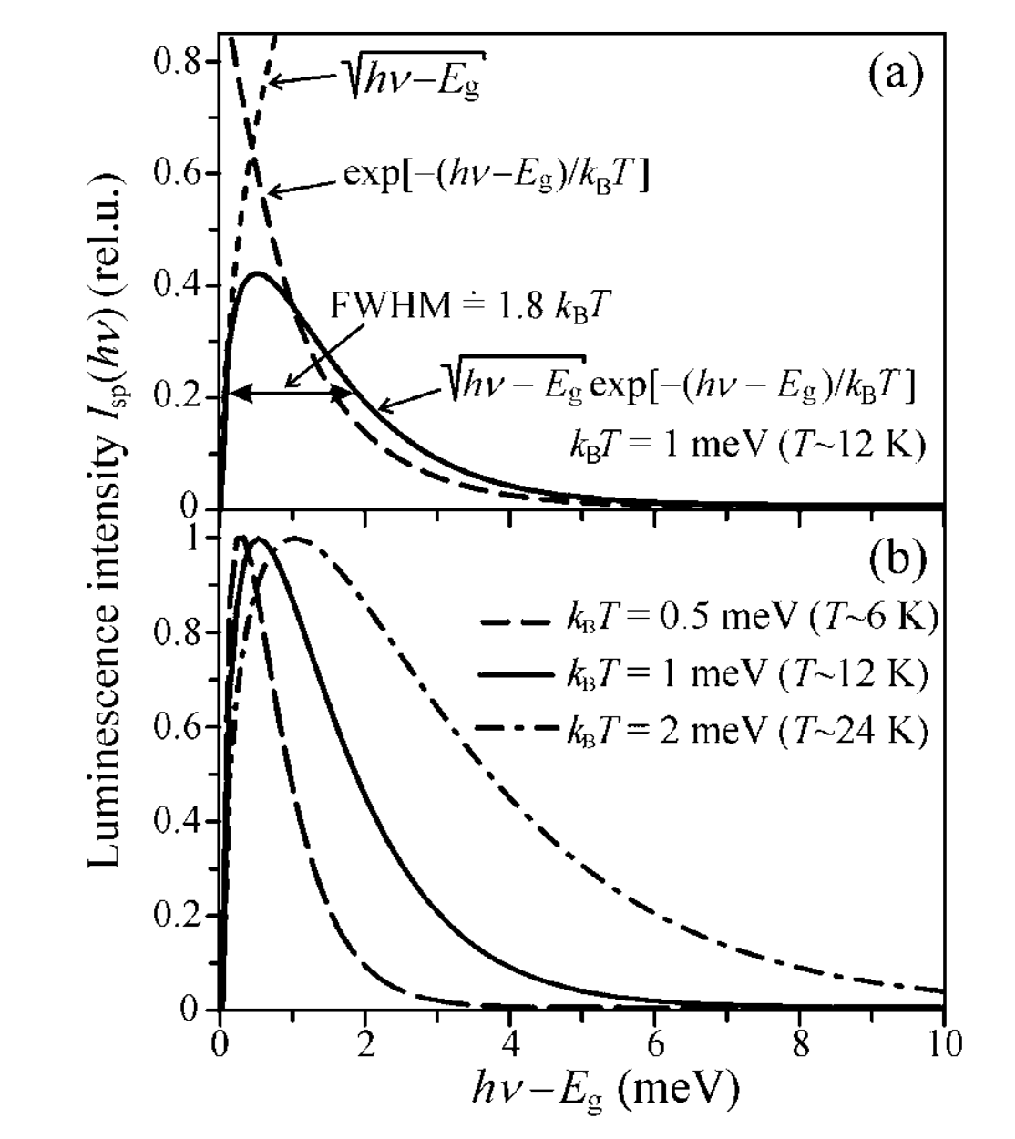
Free electron-hole pairs recombination: Direct bandgap
The spectra shape distribution (not electron)
- Maxwell-Boltzmann distribution (low temperature, wide bandgap)
- Asymmetric curve with a tail towards the high-energy photon side
- By solving the integration, we can find the FWHM
Temperature dependence
- Higher temperature larger FWHM
Why these peaks are broaden?
- Higher temperature creates larger energy of photoexcited electron and hole, this will cause larger luminescence
- The low-energy onset is decided by the bandgap, so there is less difference

Slide 11
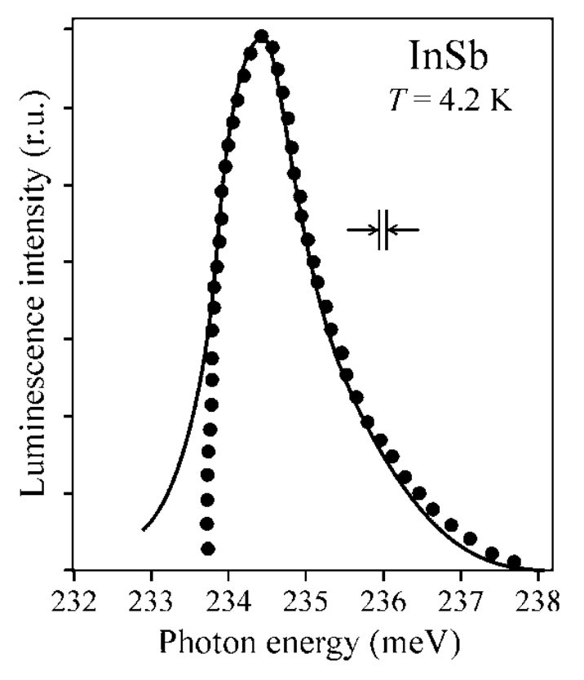
Free electron-hole pairs recombination: Indirect bandgap
Free electrons and holes emission (not excitons)
- It’s hard to observe free electron-hole emission, most of time, excitons recombination and non-radiative recombination will dominate
- In order to observe e-h, lower temperature is required, but low T hardly create free electrons and holes for most materials
- InSb ~0.23 eV is easy to produce free electron-hole pair under low temperature
- Indium antimonide detectors are sensitive to infrared wavelengths between 1 and 5 μm (quite small bandgap)
Why there is a mismatch?
- influence of the slit of the monochromator, which smears the sharp onset of luminescence
Different expression
- Experimentally observed luminescence of free electron–hole pairs in InSb (Indium antimonide) at 4.2 K
- Dotted curve: theoretical luminescence
- Black curve: experimental data
FWHM/hν ≤ 0.01, the ν² can be regarded as a constant, the corresponding wavelength should be lower than 12.4 μm or energy larger than 100 meV

Slide 12
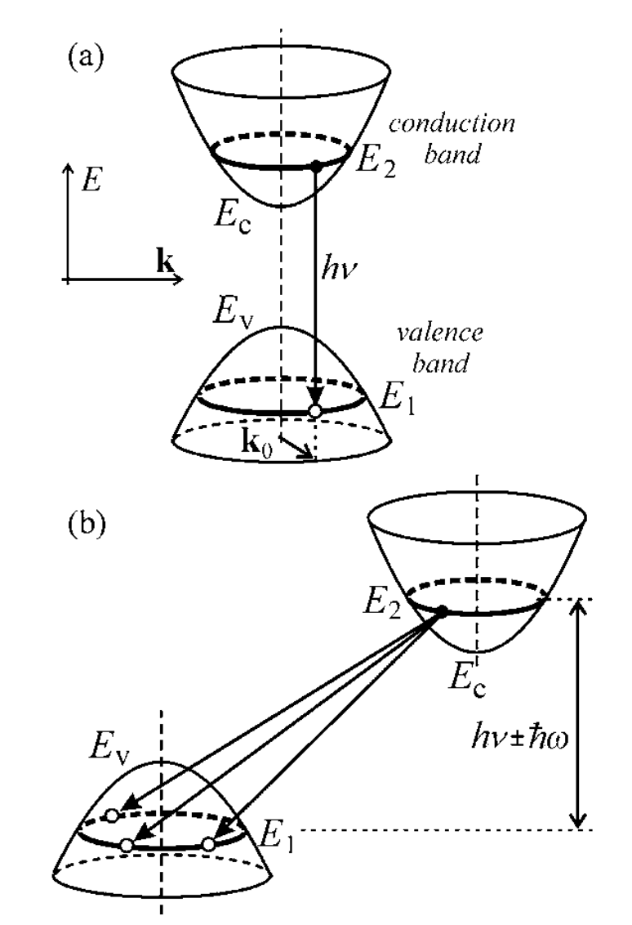


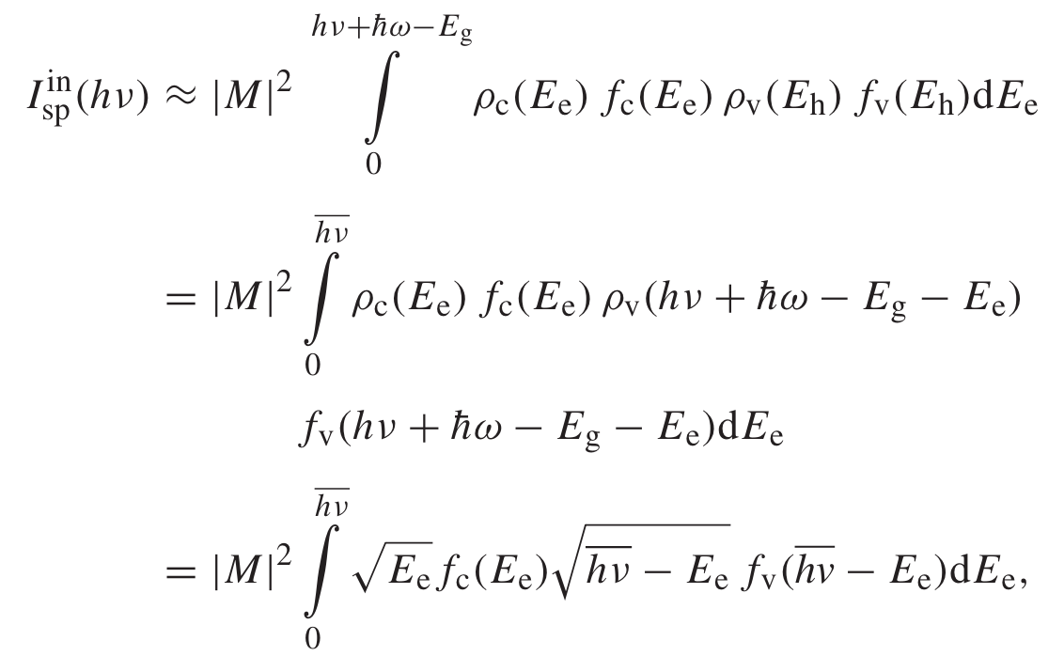


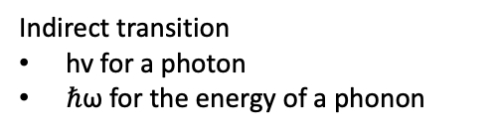
Free electron-hole pairs recombination: Indirect bandgap
Direct transition: same k wavevector
=(E_{e}+E_{h})
Indirect transition
hv for a photon
$ℏ$ω for the energy of a phonon
- It’s easier for indirect bandgap transition meet the momentum conservation by interaction with phonon

Slide 13

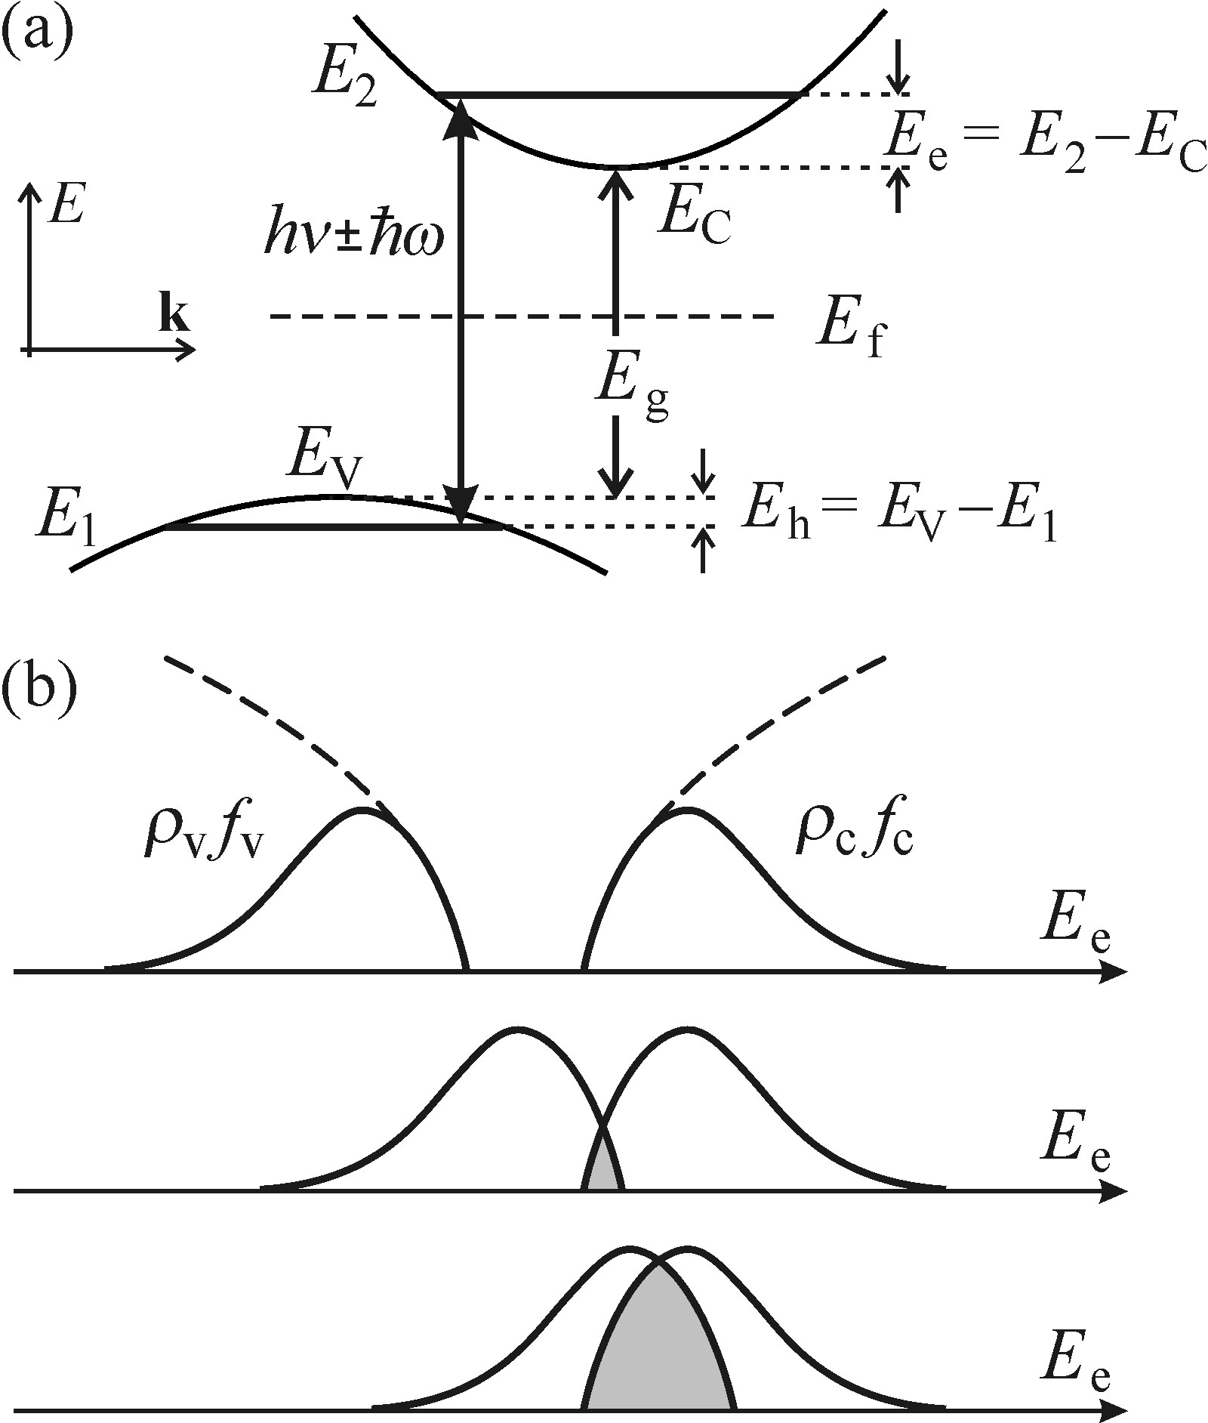
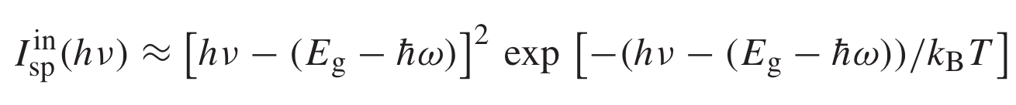
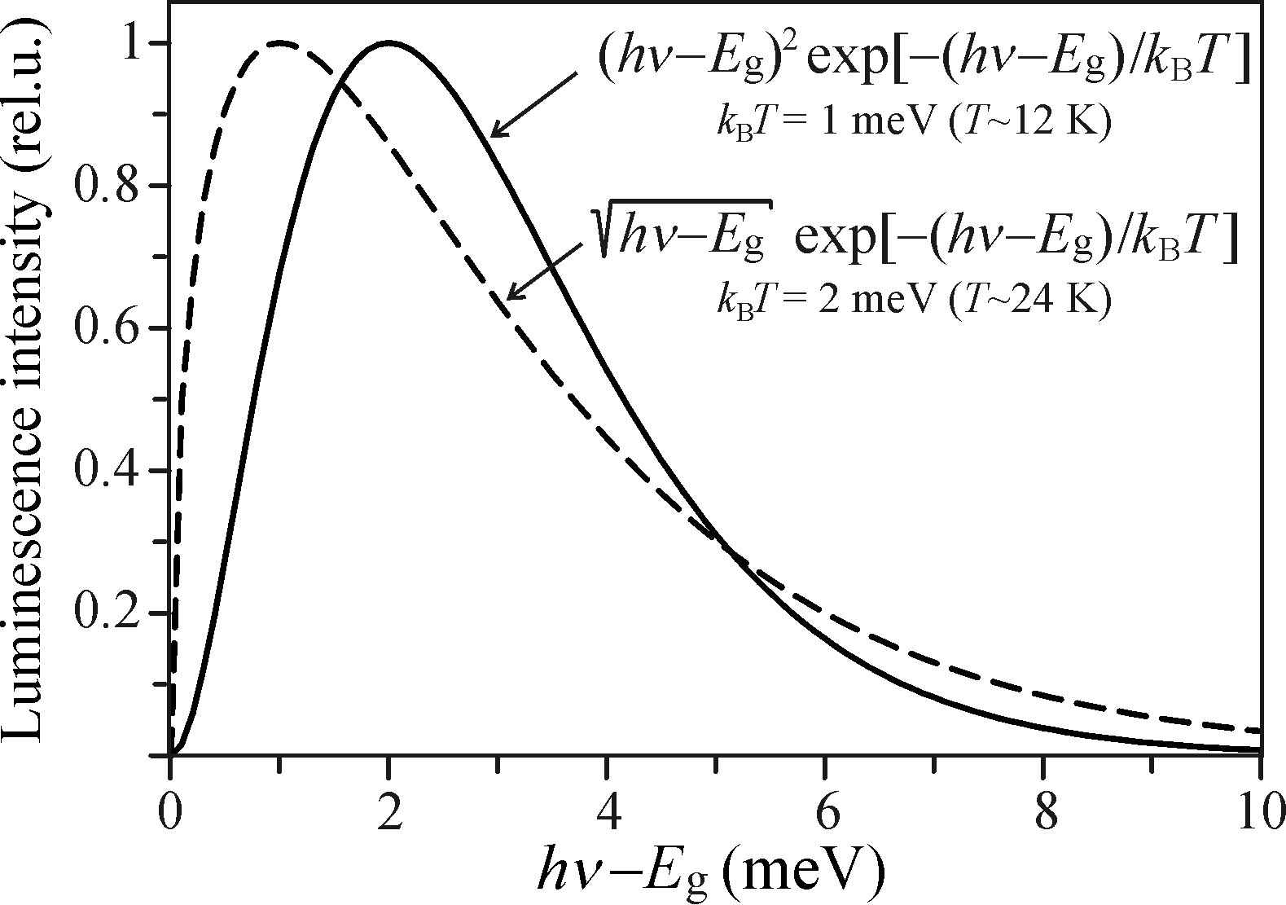
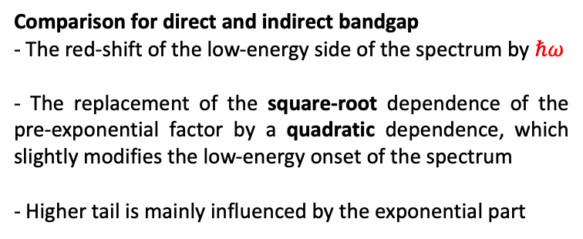
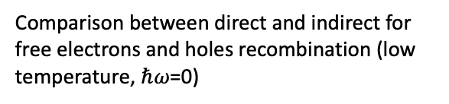
Free electron-hole pairs recombination: Indirect bandgap
The convolution-based calculation
Comparison for direct and indirect bandgap
- The red-shift of the low-energy side of the spectrum by $ℏ$𝜔
- The replacement of the square-root dependence of the pre-exponential factor by a quadratic dependence, which slightly modifies the low-energy onset of the spectrum
- Higher tail is mainly influenced by the exponential part
Comparison between direct and indirect for free electrons and holes recombination (low temperature, $ℏ$𝜔=0)

Slide 14
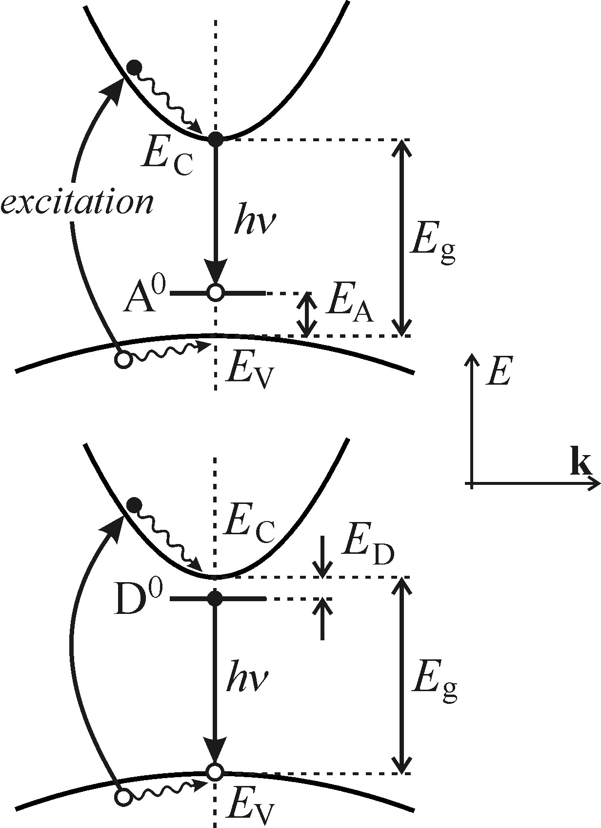

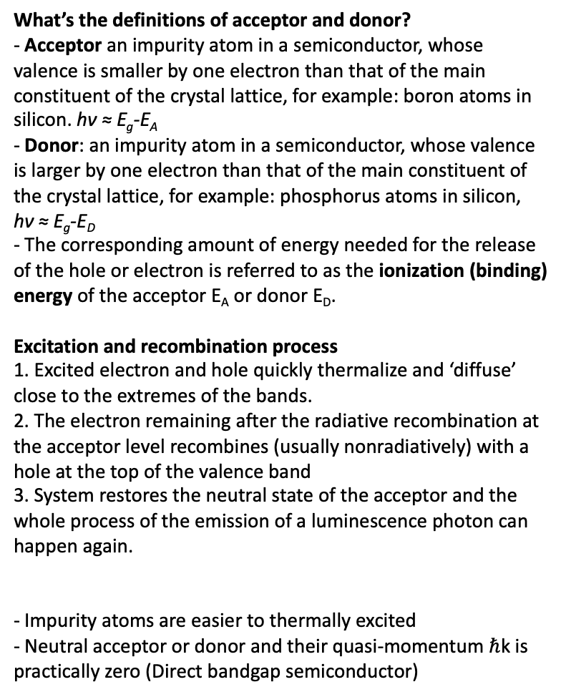
Free electron/hole with neutral acceptor/donor
What’s the definitions of acceptor and donor?
- Acceptor an impurity atom in a semiconductor, whose valence is smaller by one electron than that of the main constituent of the crystal lattice, for example: boron atoms in silicon. hν ≈ E_{g}-E_{A}
- Donor: an impurity atom in a semiconductor, whose valence is larger by one electron than that of the main constituent of the crystal lattice, for example: phosphorus atoms in silicon, hν ≈ E_{g}-E_{D}
- The corresponding amount of energy needed for the release of the hole or electron is referred to as the ionization (binding) energy of the acceptor E_{A} or donor E_{D}.
Excitation and recombination process
1. Excited electron and hole quickly thermalize and ‘diffuse’ close to the extremes of the bands.
2. The electron remaining after the radiative recombination at the acceptor level recombines (usually nonradiatively) with a hole at the top of the valence band
3. System restores the neutral state of the acceptor and the whole process of the emission of a luminescence photon can happen again.
- Impurity atoms are easier to thermally excited
- Neutral acceptor or donor and their quasi-momentum $ℏ$k is practically zero (Direct bandgap semiconductor)
e − A⁰
h − D⁰

Slide 15


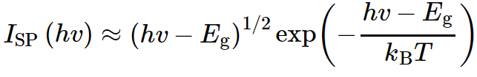
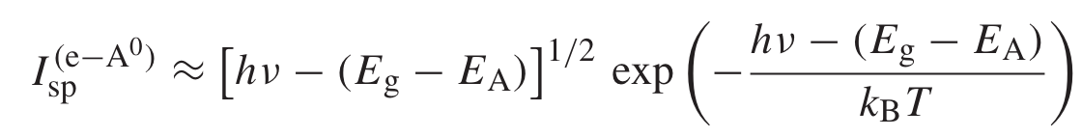
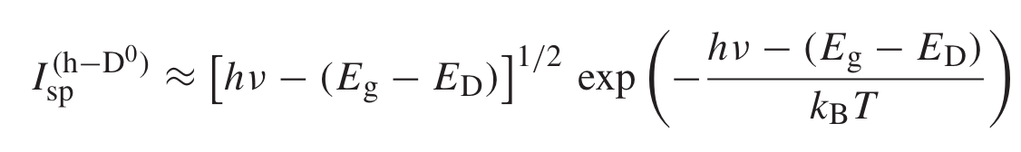
Free electron/hole with neutral acceptor/donor
Starting from recombination of free electron—hole pairs in the direct bandgap
Assuming a high hole effective mass m _{h} → ∞ and thus m _{h} ≫ m _{e}

Slide 16
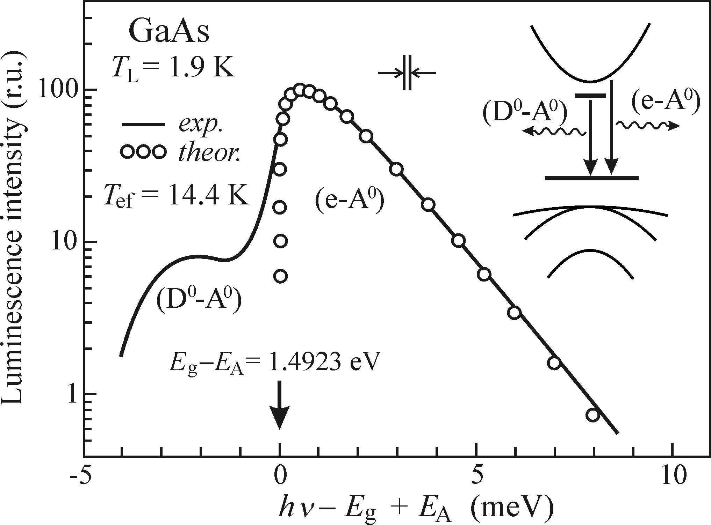
Recombination of donor-acceptor pairs (D⁰-A⁰)
Left GaAs example
- Luminescence spectrum (e–A⁰) coming from a high-purity epitaxial GaAs(Gallium arsenide) layer at T = 1.9K
- D⁰-A⁰ luminescence results in the other peak
Condition for measurements
- High purity, high purity for GaAs stands for the concentration of unintentional (residual) acceptors and donors of the order less than 10¹⁵ cm⁻³
- Low temperature, not only due to the effect of thermal quenching, but also to prevent the ionization of donors by the thermal energy k_{B}T
For indirect bandgap
- Radiative recombination (e-A⁰), (h-D⁰) is difficult to observe in an indirect-bandgap semiconductor due to the negligible concentration of free electrons and holes with respect to the concentration of excitons.
Two different temperature
- The lattice (bath) temperature (T_{L})
- The effective temperature of a gas of free quasiparticles (T_{ef})
- The difference between the temperatures T_{ef} and T_{L} increases if a high-power excitation source is used or when the energy difference between the exciting photons and the bandgap E_{g} rises.

Slide 17
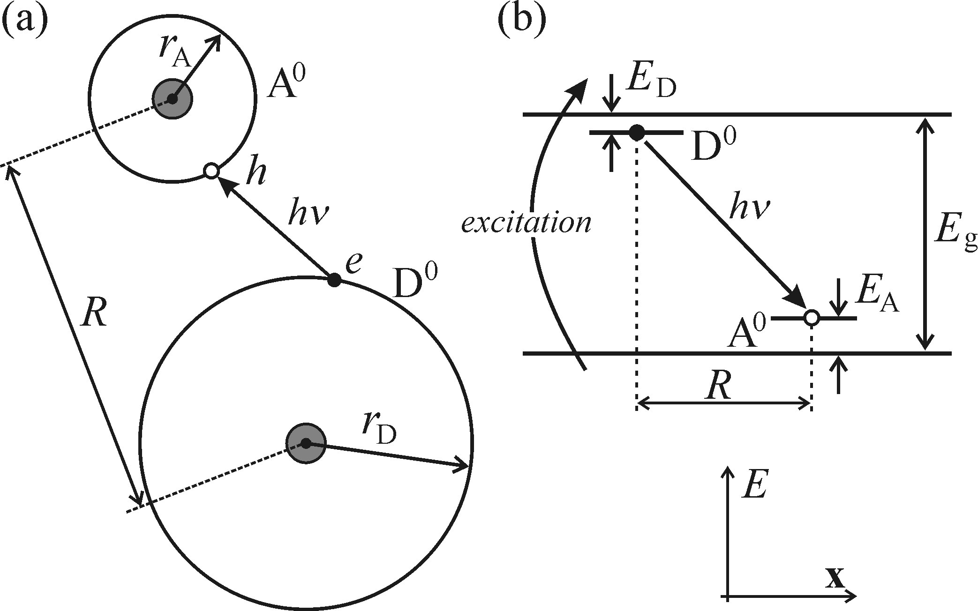



Recombination of donor-acceptor pairs (D⁰-A⁰)
Assumption
- Donor(D⁰): an electron with remaining part of atom
- Acceptor(A⁰): a hole with remaining part of atom
- Electron from donor will recombine with hole from acceptor
- After the recombination, both the donor and the acceptor become ionized (D⁺, A⁻)
excitation+neutralized
r_{D} stands for the radius of the electron shell in D₀
r_{A} stands for the radius of the electron shell in A₀
R denotes the distance between the donor and the acceptor
(D⁺, A⁻)
(D⁰, A⁰)
Emission h𝜈
- J(R) constitutes a non-Coulomb term, correcting for the overlap of the wavefunctions in the case of small distance R and decreasing the additional Coulomb energy. This term disappears when R is sufficiently large
- Since the donors and acceptors replace the main constituents of the crystal lattice in their sites, the values of R can only be discrete and, thus, so will the energies of the emitted photons
Since a charged pair (D⁺, A⁻) is generated as a result of the recombination process, the additional energy of its mutual electrostatic attraction e²/4πε₀ε_{r}R needs to be added to
Notes:
free electron-hole pairs generated by the band to band excitation quickly neutralize these ionized donors and acceptors and the whole process resumes.

Slide 18
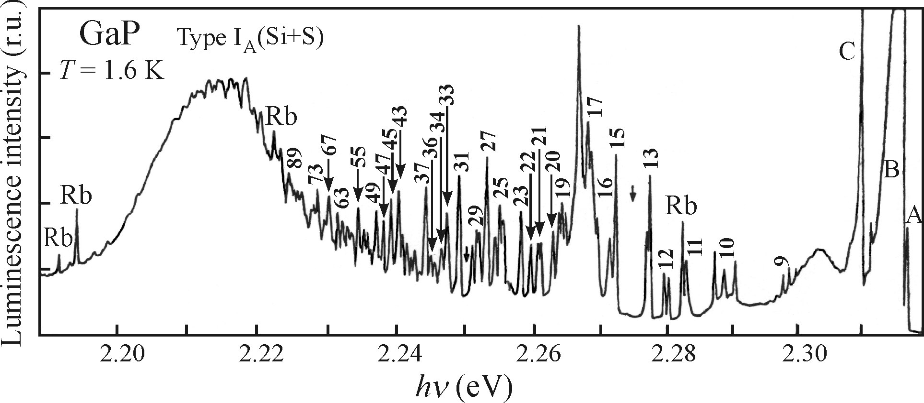

Recombination of donor-acceptor pairs (D⁰-A⁰)
- The depicted luminescence spectrum is that of Silicon- and Sulphur-doped gallium phosphide, GaP, at liquid helium temperature (1.6 K)
- A phosphorus atom is replaced with a Sulphur (donor S_{P})or silicon (acceptor Si_{P}) atom
- Lines A, B, C are due to bound excitons.
- High energy (small R): relatively sparse correspond to small R, the number of suitable neighbors in the nearest shell being low, discrete values R are scare, sparse and weak
- Middle (R increase): more choices for recombination, densely packed and their intensity increases
- Low-energy edge (R becomes larger): radiative recombination probability decrease due to the large distance
a = max(r_{D}, r_{A})

Slide 19
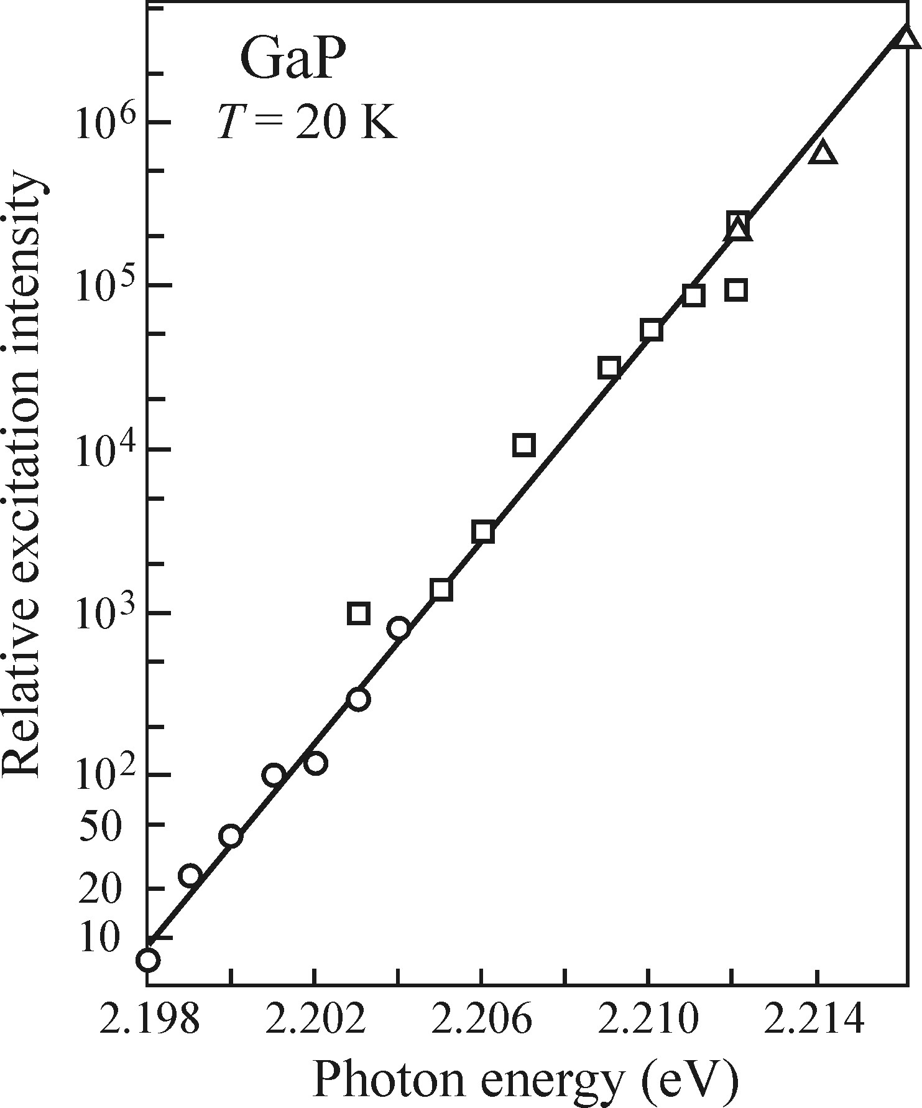

Recombination of donor-acceptor pairs (D⁰-A⁰)
- Blue-shift (R decrease): Higher excitation intensity, the maximum emission peak is move towards to higher photon emission. Higher excitation energy, lower distance D-A will be excited. The Coulomb term will be affected.
- Low energy peak red-shift: The increasing delay in time-resolved luminescence experiments. The closest pairs with the lower R are the first ones to recombine, while pairs further and further apart start to send out luminescence in longer time delays.
Position of the maximum of the broad (D₀ − A₀) band as a function of excitation intensity
Condition for observing the emission from D⁰-A⁰
Too low: D⁰ and A⁰ in the pairs will be too far apart from one another and no recombination will take place
1. A suitable level of concentration
of both dopants
Too high: the simple Coulomb interaction of D⁰ and A⁰ ceases to be valid and concentration quenching can set in.
2. Low temperatures
3. The number of competing radiative recombination channels should be minimized
GaP: the only material in which many narrow (D⁰ - A⁰) lines can be observed

Slide 20
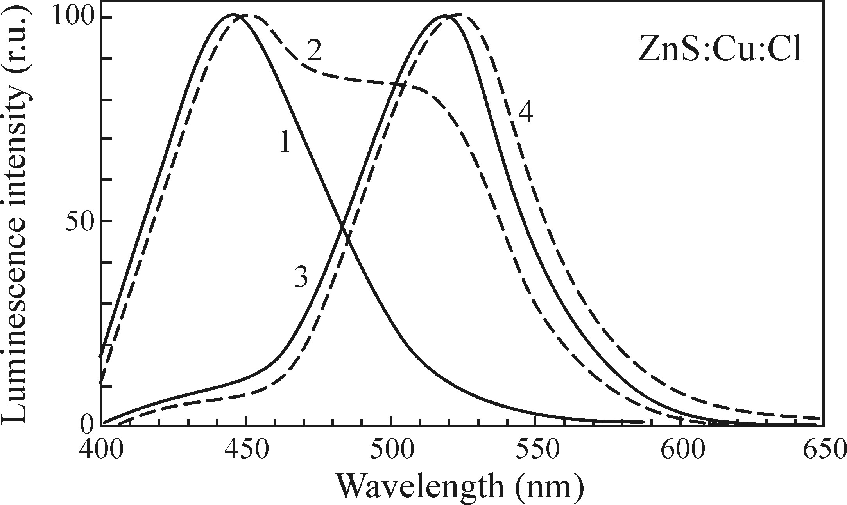
Recombination of donor-acceptor pairs (D⁰-A⁰)
The interaction between electron-phonon coupling affects the emission intensity
Semiconductors with strong electron-phonon coupling
- Direct-bandgap zinc sulphide ZnS with E_{g} ~ 3.8eV
- This results in the luminescence of donor (Cl_{S})–acceptor (Cu_{Zn}) pairs, giving rise to the emission band at ∼ 520 nm.
- The electron-phonon coupling in this material is particularly strong, the luminescence band is broad, lacks any structure and is located far from edge emission (with large Stokes shift), near 520nm
- When the D⁰-A⁰ mechanism is not clear, the Cl⁻ ion was not known as ‘donor’, but as ‘co-activator’.
Curves enumerated 1–4 correspond to increasing concentration of copper, Measured at room temperature, curves are normalized. 1 is normal
ZnS (without Cu)

Slide 21
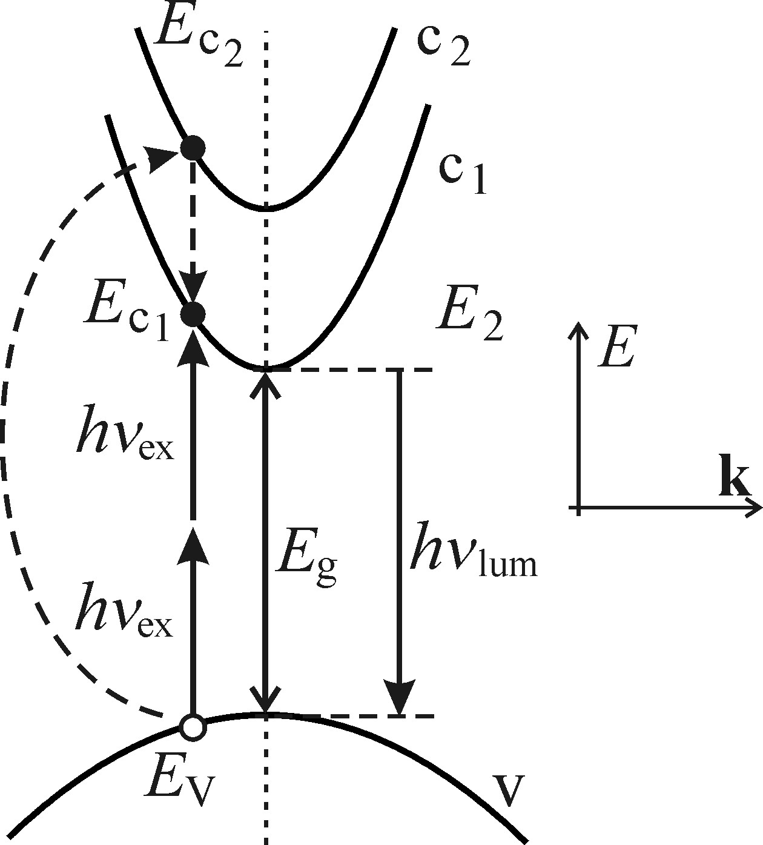




Luminescence excited by two-photon absorption
Conventional absorption
- Leads to electron–hole pairs or excitons
Absorption law for one-photon process
- This kind of absorption is governed by Lambert-Beer law
- α(hν_{ex}) is the absorption coefficient (≈ 10⁴–10⁵ cm⁻¹) and d stands for the depth under the surface of the sample to which the light penetrates(100 nm–1 μm).
- Surface states cause either quench or oxidation, lower luminescence signals. The obtained spectra might not in fact reflect the properties of the studied material
Nonlinear optical: Two-photon process
- Virtual intermediate level (Ec2): mediates the transition between the ground (Ev) and final (Ec1) states
- Energy-conservation law (right inequality)
- The two-photon process is weak (left inequality)

Slide 22
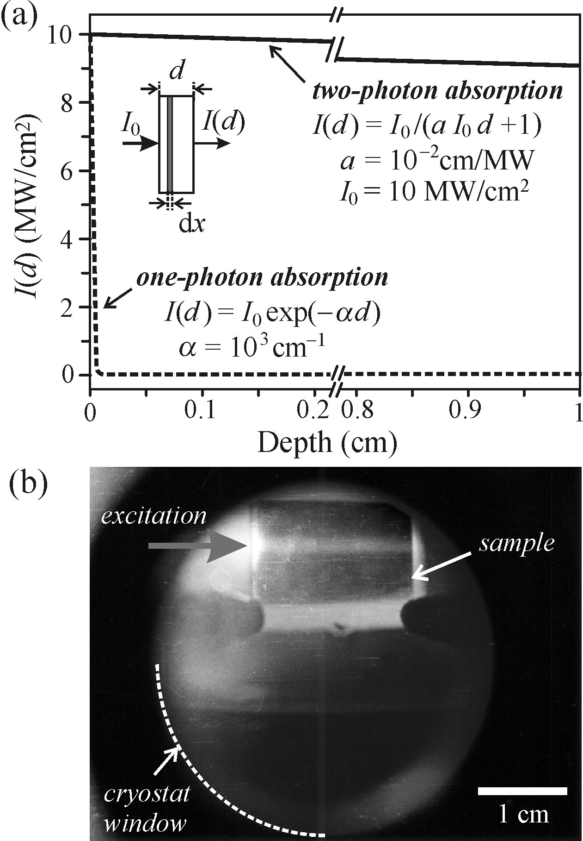




Two-photon process
bulk AgCl sample
two-photon absorption coefficient
Material constant
The decrease in the intensity of the light beam
dx: travel distance in a sample
- The decrease of light intensity during two-photon absorption is only hyperbolic instead of exponential
- Thick sample is needed, for the obvious decrease of intensity
- Bulk AgCl sample (1.5 cm) at T ≅ 80K
- Forbidden gap width E _{g} ≅ 3.2eV
- Ruby laser beam (hν _{ex} = 1.78eV)
- brightness only minutely decreases
- the trace of luminescence across the sample is blue-green (λ_{lum} ≈ 500 nm), while the exciting laser beam is red (λ_{ex} = 694 nm)

Slide 23
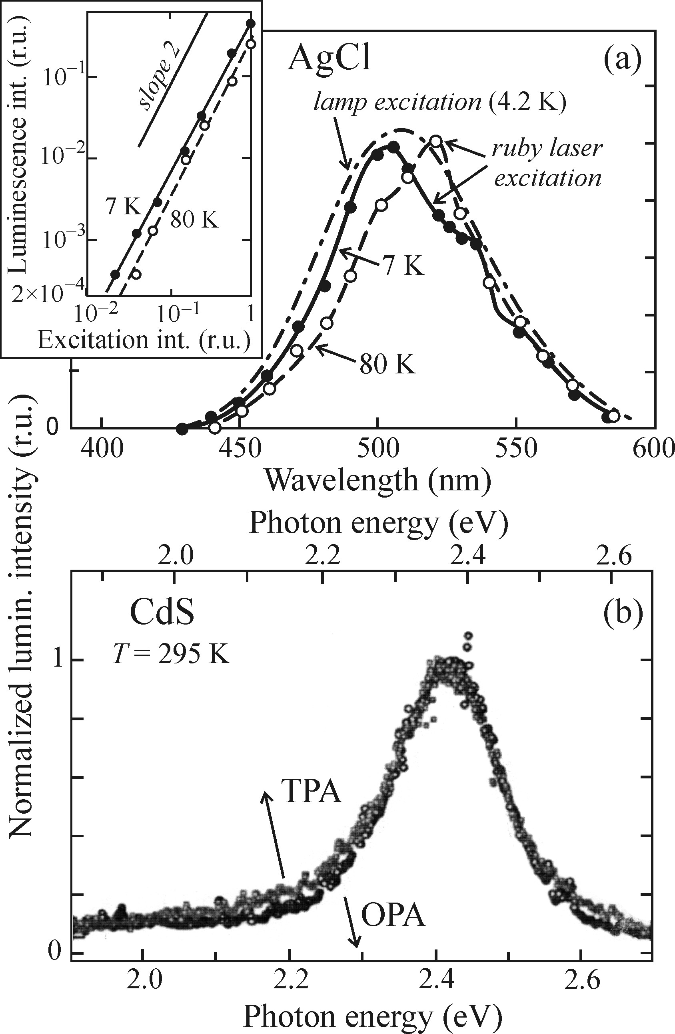
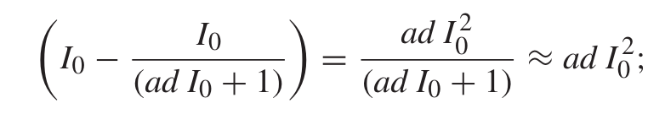
Two-photon process
What’s the difference for two-photon excited spectrum compared to one-photon excitation?
- Emission spectra are almost identical
- CdS excited at RT by one-photon process
- AgCl excited by one- and two-photon process
How to recognize the observed luminescence is from two- and not one-photon excited?
- Anti-Stokes shift of luminescence: 2hν_{ex} ≥ hν_{lum} or λ_{lum} ≥ λ_{ex}/2 and, in particular, the condition λ_{ex} ≥ λ_{lum} ≥ λ_{ex}/2
- Quadratic intensity dependence: Luminescence is proportional to the squared incident laser intensity (I₀)2
Notes:
Cadmium sulphide film: The spectra are shifted with respect to one another because the penetration depth of the femtosecond laser was larger than the thickness of the sample (1.58 μm); that is why the luminescence in this case is strongly influenced by reabsorption and consequently shifted to lower energies.

Slide 24
Luminescence from transition metal
Transition metal
- A transition element is an element whose atoms have an incomplete d subshell or which can give rise to cations with an incomplete d subshell.
- Transition metal ions from the fourth period of the periodic table and rare earth ions.
- These impurities which cannot be easily classified from the point of view of their electrical activity as donors or acceptors
- Uncommon semiconductors, with channels of radiative recombination
Examples:
- ZnS : Mn²⁺ has been a material commonly exploited for the preparation of electroluminescent thin film for quite some time
- Cr³⁺ ions (chromium) present in sapphire(Al₂O₃), which is quite important for Ruby laser to realize population inversion to emission laser
Mechanism
- Some dipole-forbidden crystal lattice under the interaction of transition metal impurity ions produce transition.
- 3d^{n∗} → 3d^{n} (∗ stands for an excited state) transitions are dipole-forbidden (Azimuthal quantum number: l = 2), When the ions are embedded into the crystal lattice, the interaction with the electric field of the crystal makes the transitions partially allowed
- The interaction is so-called ligand-field theory
- The shape of the spectrum can be predicted on the basis of Tanabe-Sugano diagram
transition metal ions (from the fourth period of the periodic table)
Impurities
rare earth ions

Slide 25
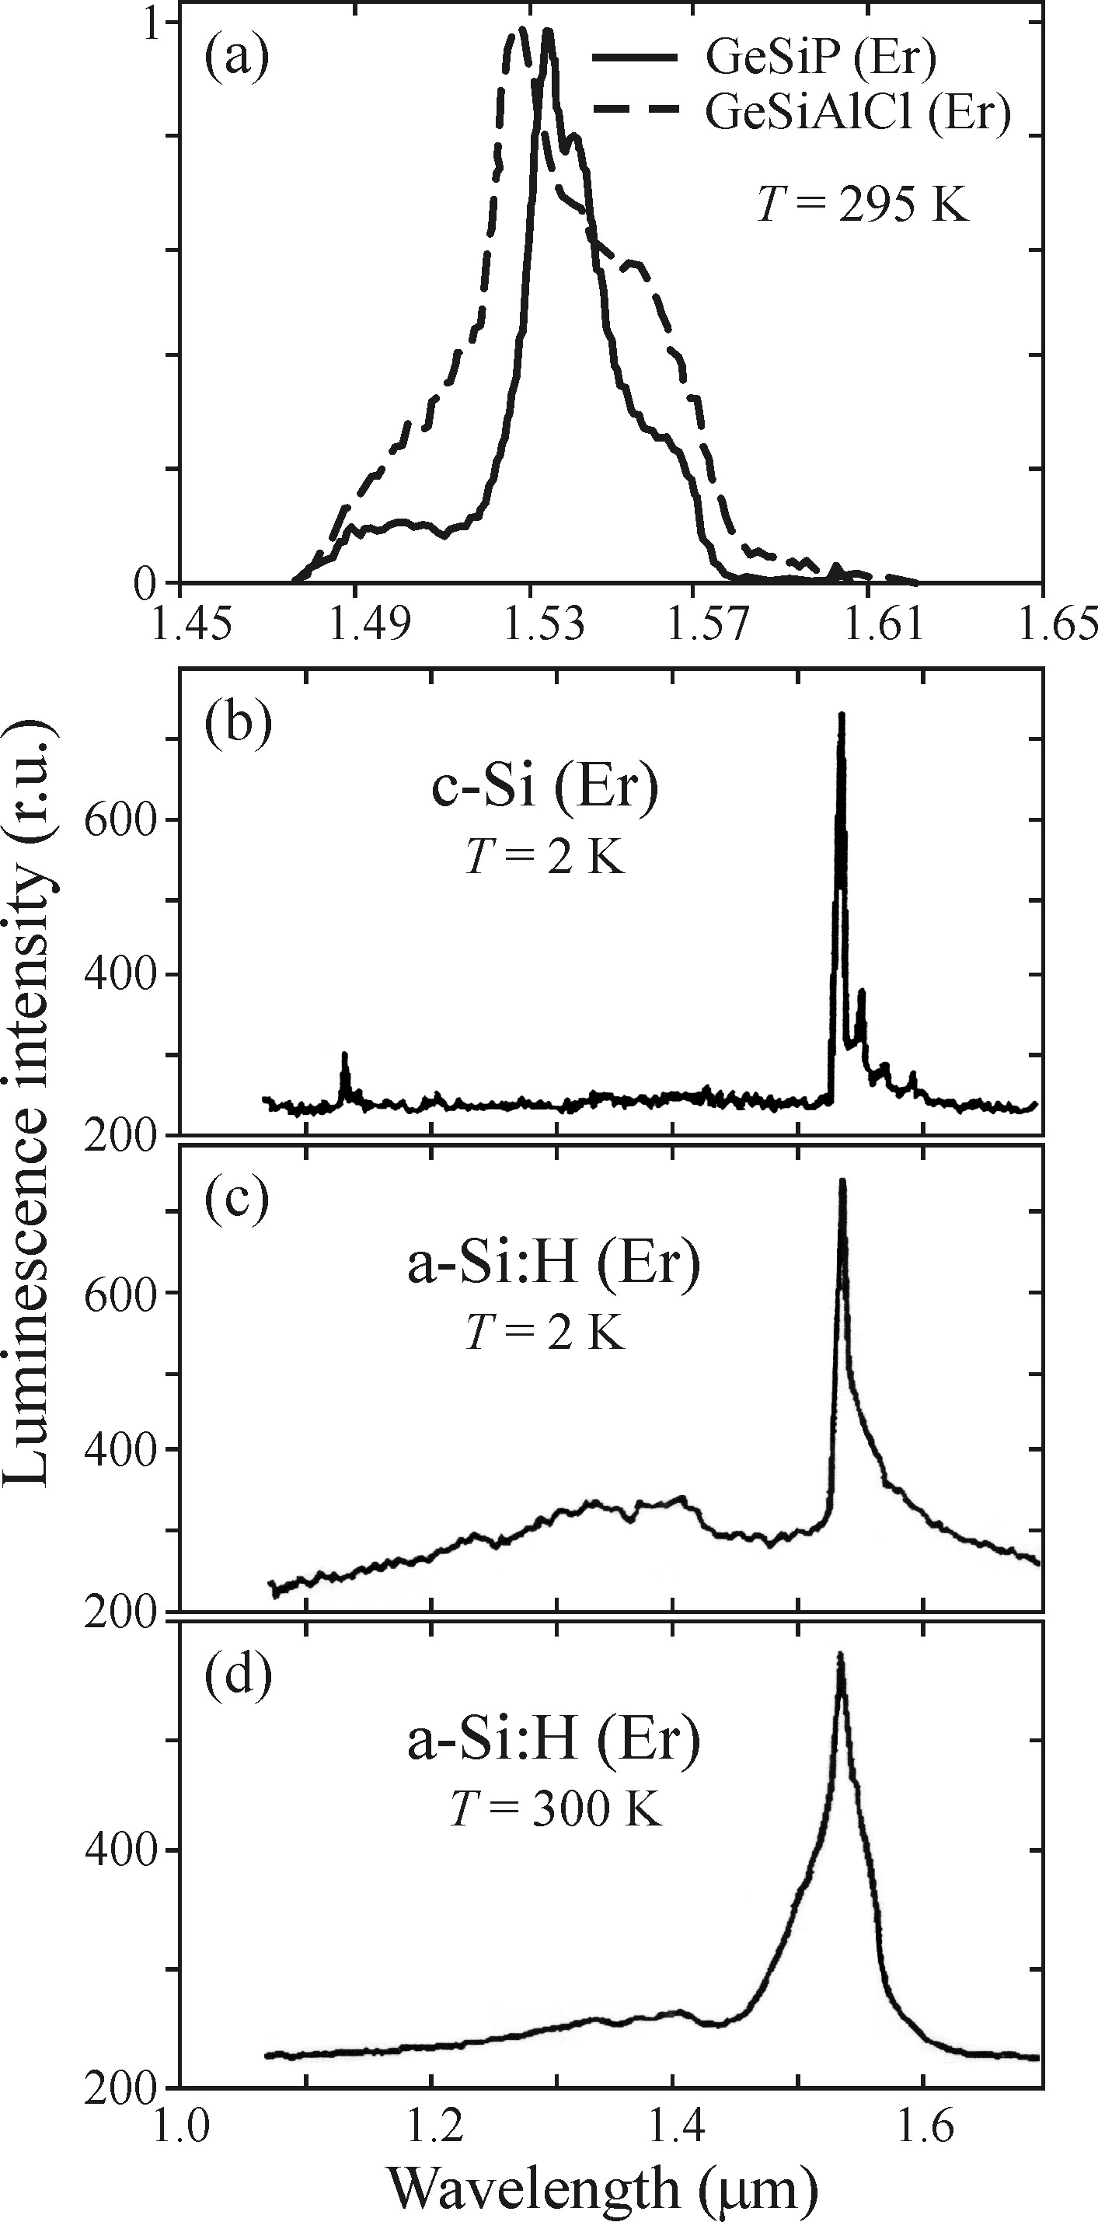
Luminescence from rare earth ions
- The most commonly applied rare earth ions are trivalent ions of lanthanides Ce³⁺–Yb³⁺, in which luminescence comes from 4fn∗ → 4fn transitions. Similarly to the previous case, these transitions are also dipole-forbidden, while the crystal field makes them partially allowed.
- Different from 3d shell, the 4f shell is strongly screened from the influence of the crystal field by the external filled orbitals 5s²5p⁶.
Emission characters
- The emission(absorption) spectra is independent of the chemical nature and periodic arrangement of the matrix
- The activation energy of the thermal quenching of luminescence will be high, giving rise to more or less temperature-independent emission
For Er³⁺ (trivalent ions)
- (a) (b) (c) these ions is represented by a relatively narrow line peaking approximately at 1530 nm, regardless of whether they are incorporated in a glass GeO₂–SiO₂ matrix or in crystalline or amorphous silicon.
- (c) and (d) further suggests that the intensity of luminescence of Er³⁺ in hydrogenated amorphous silicon decreases by only about 20% when the temperature increases from 2 K to 300 K.
Notes:
lanthanides lan the nides

Slide 26
Outline
Chapter 5: Radiative recombination processes
Free electron-hole pairs in direct and indirect bandgap
Free electron/hole with neutral acceptor/donor
Two-photon absorption
Luminescence from transition metal and rare earth ion impurities
Chapter 6: Non-radiative recombination processes
Heat generation: Multiphonon recombination
Heat generation: Auger and bimolecular recombination
Creation of lattice defects
Photochemical changes
How the energy will dissipate after the photon excitation?

Slide 27
Non-radiative recombination
Except for the radiative recombination process
- Luminescence efficiency or quantum yield almost never reaches η = 1
- Stokes’ law implies that a portion of the supplied excitation energy is not transformed into luminescence radiation but, during relaxation to the system ground state, changes into other types of energy instead.
Definition of non-radiative transition
- The relevant transition are called non-radiative transitions, Non-radiative transitions refer to processes where the excitation energy of a system is released into forms other than luminescence radiation, such as heat or phonons, during relaxation to the ground state, leading to a less-than-ideal luminescence efficiency or quantum yield.

Slide 28
Non-radiative recombination
Multi-phonon recombination
1. Transformation into heat
Auger recombination
Non-radiative
recombination
2. Creation of lattice defects
3. Photochemical changes of the electronically excited material.
How the energy will dissipate after the photon excitation?

Slide 29
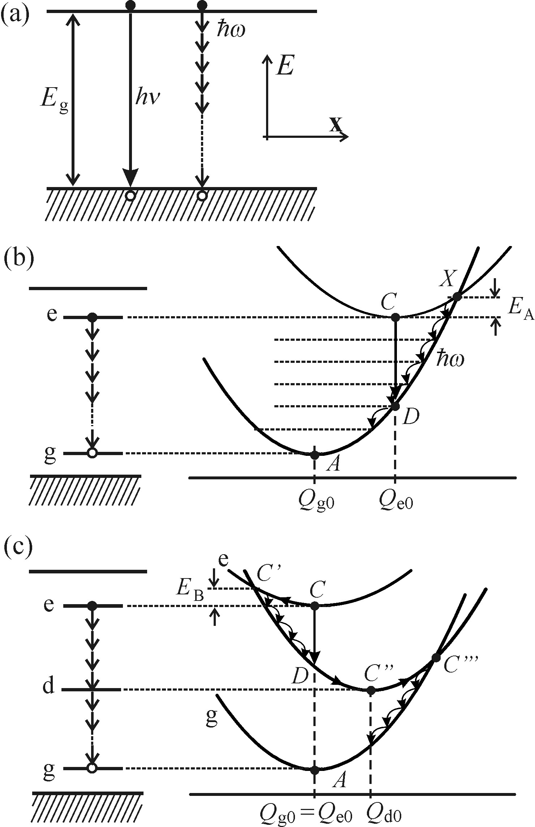
Non-radiative recombination
Multi-phonon recombination
Emitted in the form of photons hν ≅ E _{g}
Energy handed over to the lattice through n phonons with energy ℏω: E_{g} = nℏω
this process is highly improbable
Nonradiative factor
Probability for the process:
1/τ _{nr}≈ exp(– E_{g} /ℏω) ≈ exp(–n)
typical semiconductor
Very low
E_{g}≈ 2 eV and ℏω ≈ 25 meV we obtain n = 80
Radiative factor
Wide-bandgap semiconductors outperform those with a narrow bandgap in radiative process.
increases strongly in this case with the value of hν(≈ E_{g})

Slide 30
Non-radiative recombination
Non-radiative multi-phonon transitions applied in localized luminescence centre
Strong interaction with the lattice case
Q_{e0}– Q_{g0}: the displacement from the equilibrium position
intersection point X and activation energy E_{A}
Non-radiative bimolecular recombination
Non-radiative transition in a localized luminescence center C → X → A through the emission of many local phonons
ℏω(‘cooling transitions’).
Sequential application of one-phonon process with participation of a real intermediate level
mediated by ‘virtual’ electron levels
(like two-photon absorption)
Notes:
Q _{g0} the equilibrium distance between the impurity and its nearest neighbours

Slide 31
Non-radiative recombination
Weak interaction with the lattice case
Q_{e0} ≈ Q_{g0}
Improbable
because
Probability for the process:
1/τ _{nr}≈ exp(– E _{g} /ℏω) ≈ exp(–n)
( Similar to bimolecular recombination)
Deep level lying approximately in the middle of the bandgap (defect) mediating non-radiative recombination*
Defect associated with the deep level is always in strong interaction with the surrounding lattice
Gradual dissipation of the electron excitation energy via ‘cooling transitions’ C → C′ → C″ (defect, or deep level)
Shockley–Read recombination
The remaining energy ‘spills’ into the matrix by a pathway of similar character C″ → C‴ → A
Notes:
That’s why rare earth ions represent efficient luminescent centers if embedded into any lattice
The non-radiative recombination mediated by a defect is sometimes called Shockley–Read recombination.

Slide 32
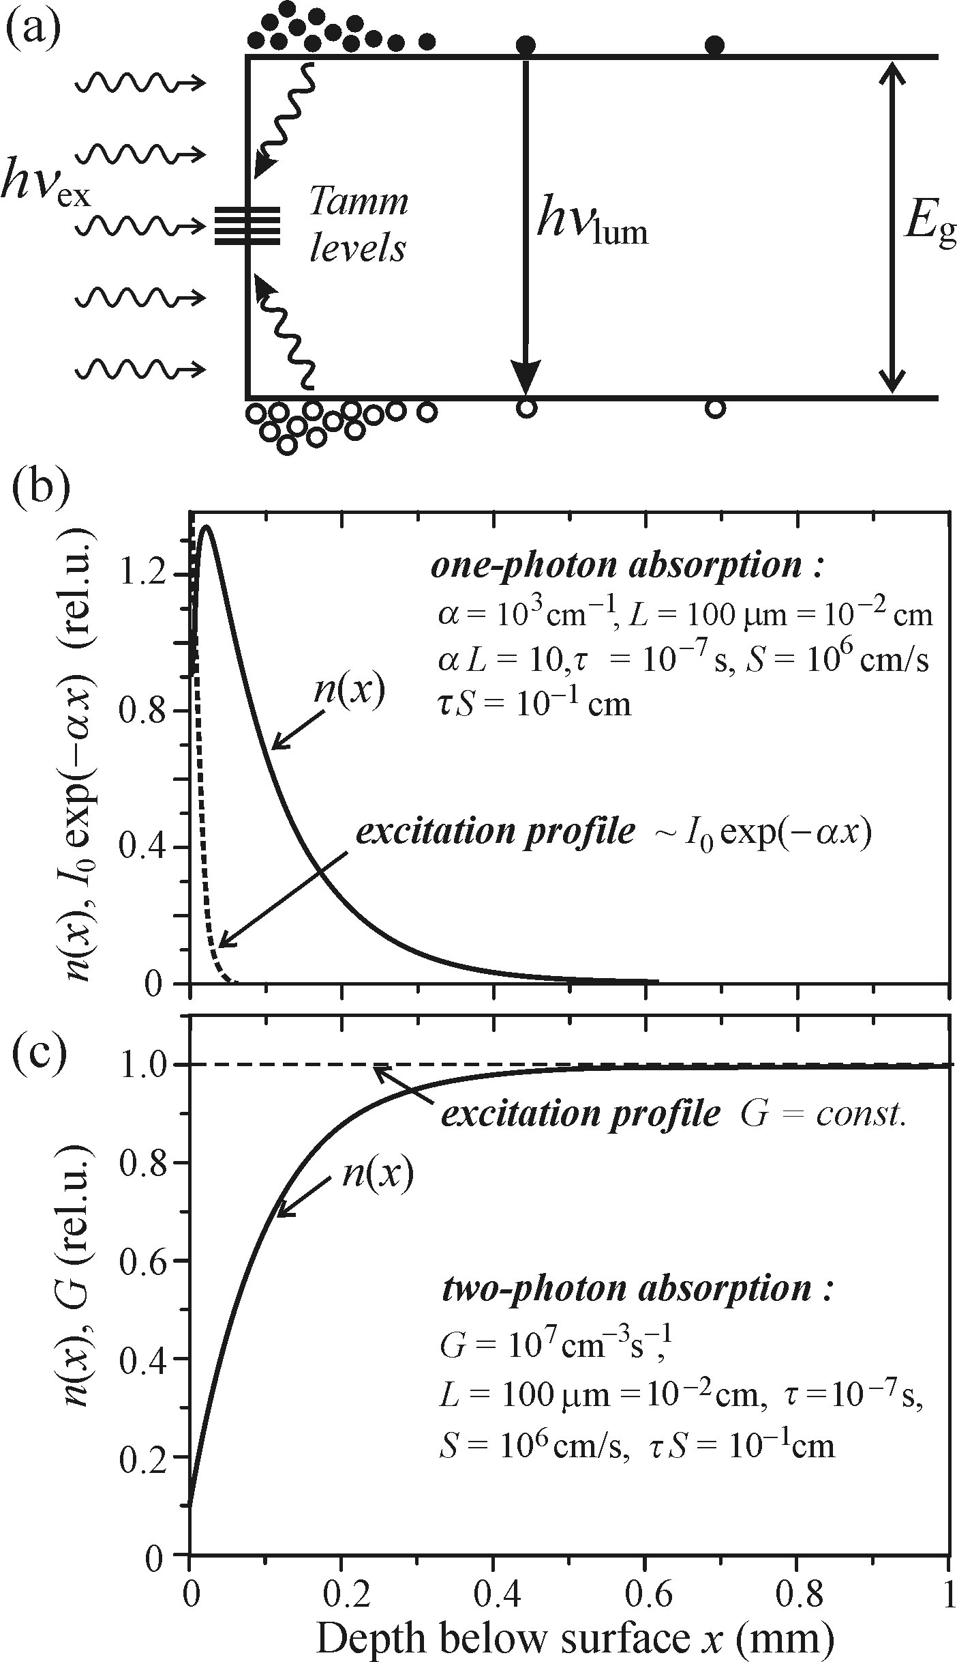


Non-radiative recombination
Example of deep level - Surface recombination
-Takes place in a thin subsurface layer
-Conditioned by the occurrence of deep localized levels (Tamm levels)
The photocarrier concentration n(x) just under the surface will decrease significantly, thus creating a concentration gradient driving photocarriers to the surface
Kinetic equations describing the generation and recombination processes
D-diffusion coefficient of the carriers
G-generation rate
n(x)-photocarrier concentration
τ-(total) non-equilibrium carrier lifetime
Different excitation profile
1, The marked decrease of the concentration n(x) close beneath the surface occurs may give rise to a luminescent ‘dead layer’ with strongly reduced luminescence intensity.
2, In Figure c, the subsurface decrease of n(x) is more prominent and penetrates deeper. (Can be favorable in two-photon luminescence spectroscopy because it contributes to suppressing the spurious surface extrinsic radiative channels)
The surface recombination described by the recombination rate S determines the value of the derivative of n(x) at x = 0
Notes:
unoccupied bonds of surface atoms in a semiconductor give rise to these levels.
Because of the existence of the deep levels, the non-radiative recombination will be strongly inhomogeneous along the x-coordinate normal to the surface, assuming a maximum at x = 0. The photocarrier concentration n(x) just under the surface will decrease significantly, thus creating a concentration gradient driving photocarriers to the surface.
an additional term arising from the diffusion current density

Slide 33
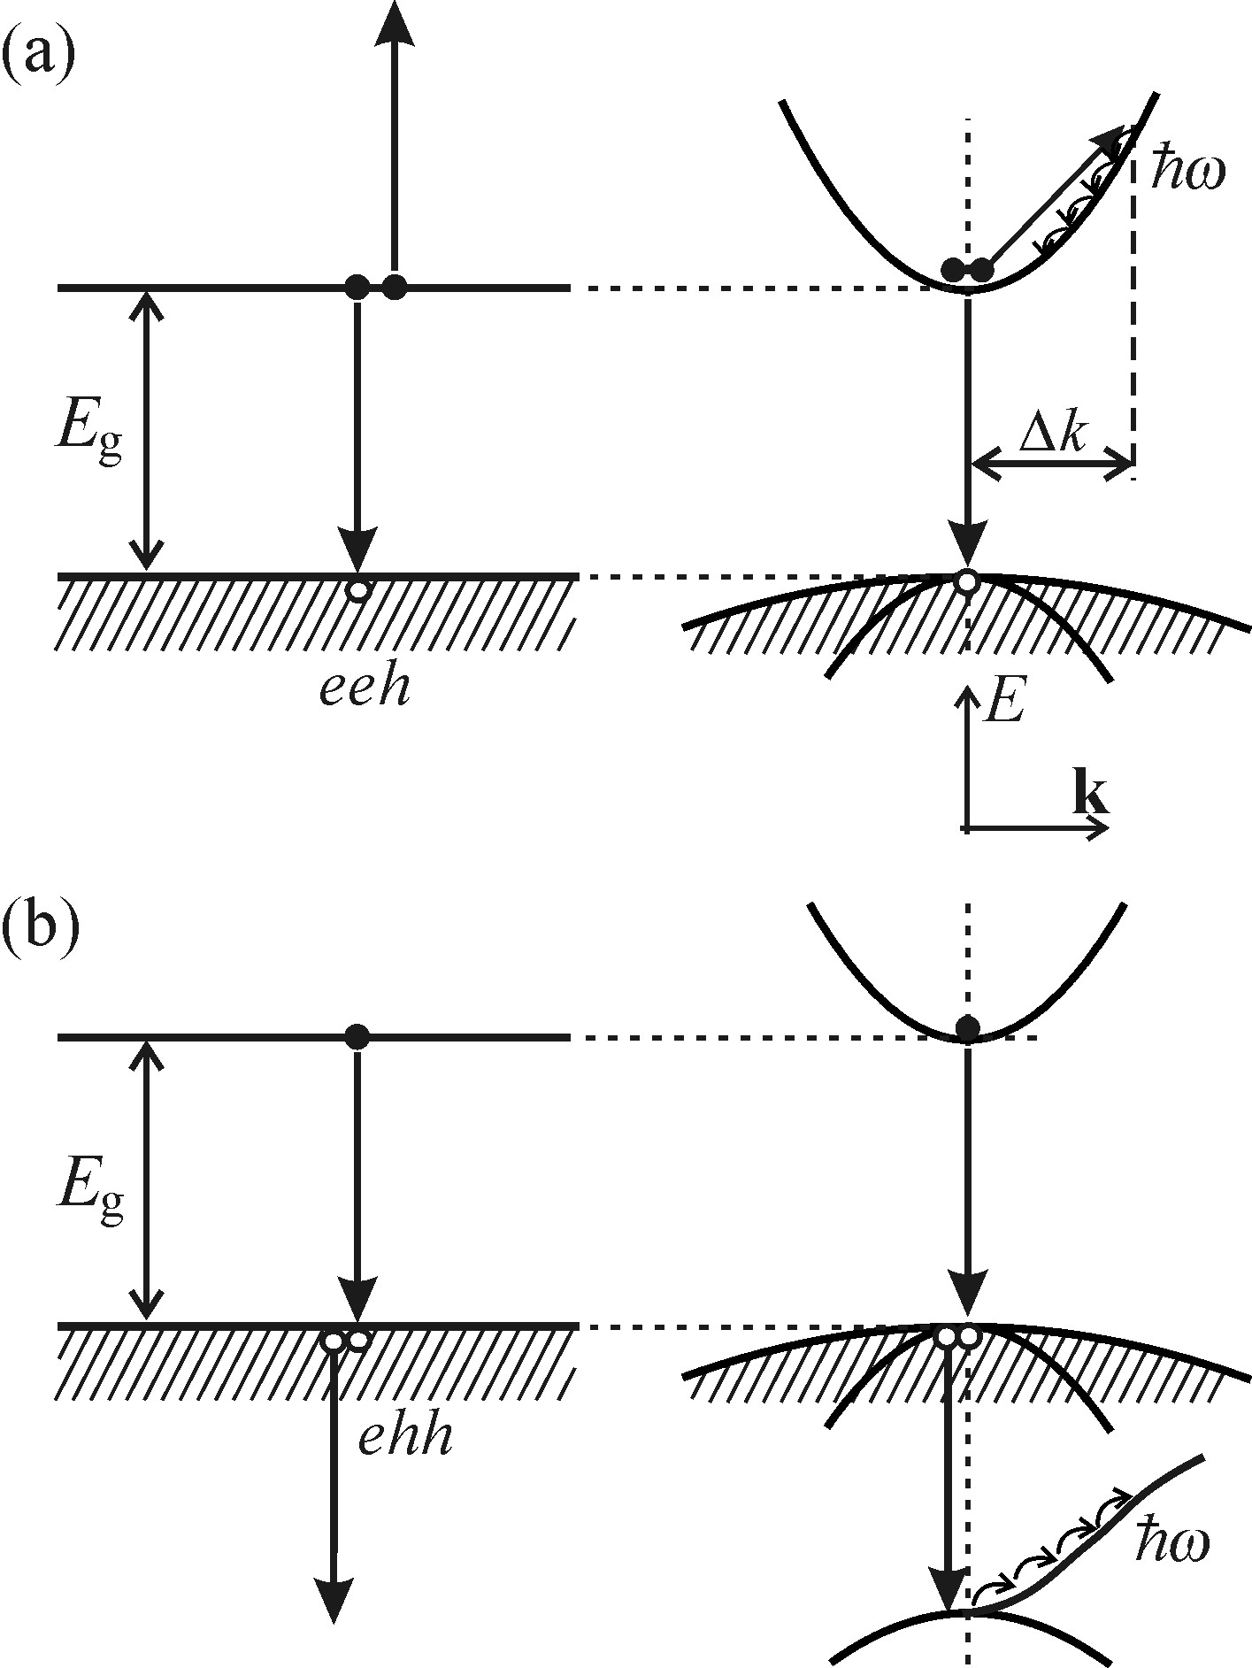
Non-radiative recombination
Auger and bimolecular recombination
Intrinsic Auger recombination
no influence from a defect or impurity
Energy of the recombining pair
luminescent photon
Passed to the third quasi-particle
Based on energy and quasi-momentum conservation laws: Auger process can occur both with (a) and without (b) involvement of a quasi-momentum conserving phonon ℏΔk
For a new electronic excitation
Multi-phonon emission
Final form: heat
Notes:
the no-phonon Auger process becomes feasible provided the ejected quasi-particle has to its disposal a suitable energy band, attainable without the alteration of wavevector of the (i.e.Δk= 0).

Slide 34






Non-radiative recombination
Kinetic equation for bimolecular recombination
1, The quadratic dependence on the carrier concentration signifies an important fact: the intrinsic Auger effect occurs mainly for high concentrations of free carriers. (Typical values of the Auger coefficient: A ~ 10⁻³¹ –10⁻²⁹ cm⁶/s)
β _{r} (β _{nr}): bimolecular recombination coefficient
Auger effect is a three-particle process, will be described by a term ~ np ²
A _{n}, A _{p}: Auger coefficients
2, Intrinsic Auger recombination contributes to the fact that luminescence of narrow-bandgap semiconductors is weak.
(The easy thermal generation of free carriers across the bandgap leads to a relatively high free carrier concentration already in unexcited material)
The rate of the non-radiative process

Slide 35
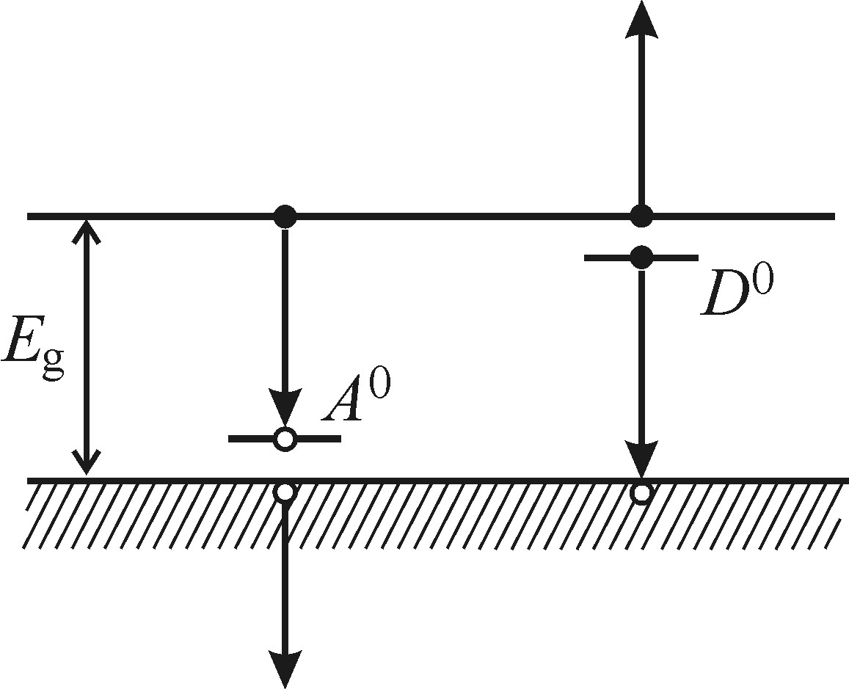
Non-radiative recombination
Extrinsic Auger recombination
Impurity level affect the Auger process
A non-radiative process accompanying luminescence originating in the transitions (e–A⁰ ) and (h–D⁰) and therefore decreasing its efficiency.
Condition: high concentration of free carriers or impurity atoms
(for example, to make sure the interaction of the free electron and the electron localized on a donor)

Slide 36
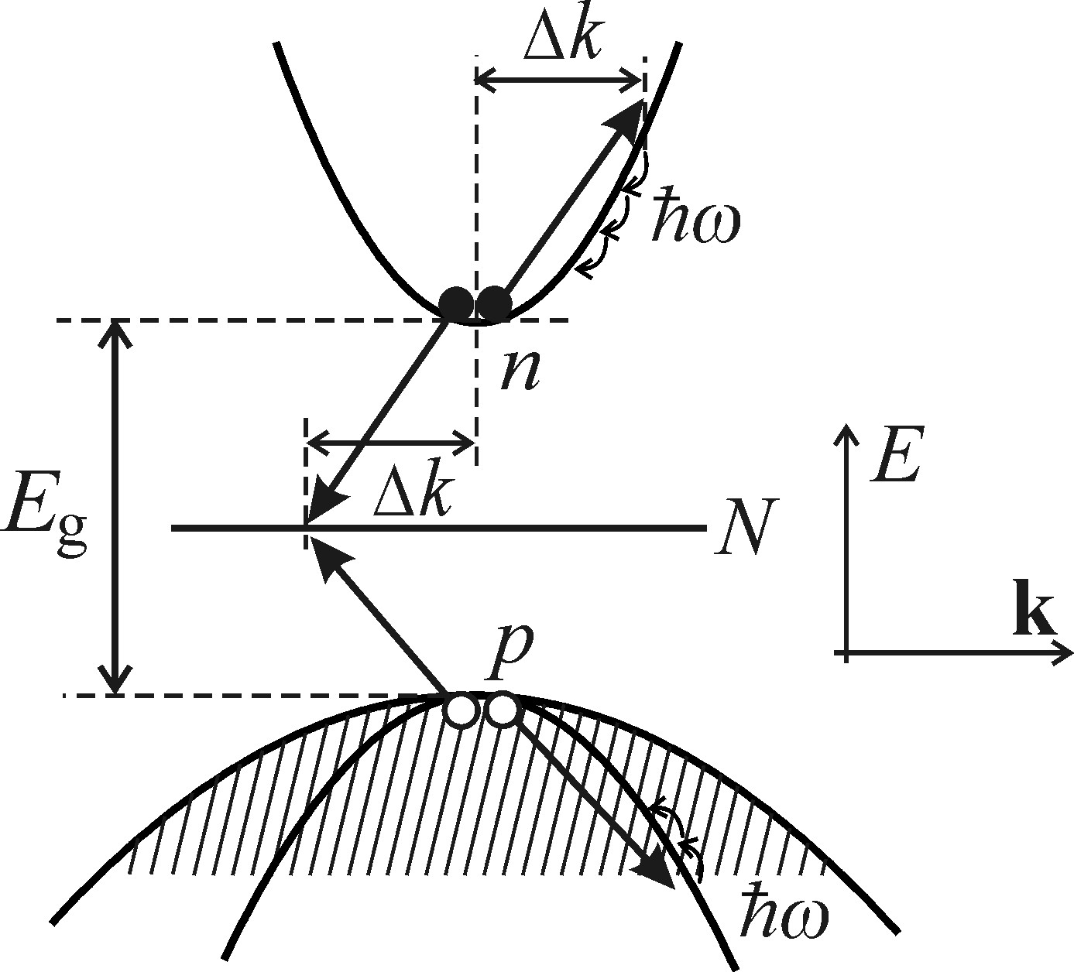



Non-radiative recombination
Localized states affect the Auger process
N: the concentration of the localized states
n = p the concentration of the excited free carriers
n _{N:} the momentary concentration of electrons on the localized level
Kinetic equations for electrons and holes
Conditions:
1, a relatively high concentration of the deep traps, because there has to be a positive value (N – n_{N})
2, a relatively high excitation to make sure n, p>N

Slide 37

Non-radiative recombination: creation of lattice defects
Creation of lattice defects
Requirements:
An electronic excitation is localized at some atom occupying a regular lattice position.
(a) Localization of the electronic excitation must occur
The released excitation energy is transferred to the relevant atom as a whole, which is thus ‘kicked off’ into an interstitial lattice position, creating a so-called Frenkel defect
(b) Energy criterion.
(c) Protection against degradation to heat—phonons.
The defect can be either transient or permanent depending on whether the interstitial atom does or does not return into its original lattice site once the excitation is terminated
(d) Orientation criterion.
Notes:
b) energy of the self-trapped exciton E _{e,} energy E _{d} of formation of the defect
c) self-trapped exciton gets localized must have a frequency ω _{ℓ} higher than the highest LO-phonon frequency ωLOmax,
d) Orientation criterion. The self-trapped exciton (its charge density) should have a suitable symmetry in the crystal lattice so that the creation of the interstitial atom is energetically favourable.

Slide 38
Non-radiative recombination: photochemical change
Photochemical changes
Requirements
Silver halides AgCl, AgBr and AgI
1, Sufficient mobility both of the electrons and of the interstitial metal ions
T ≥ 200 K
Interstitial Ag⁺ ion
2, Sufficiently high temperature
A hole gets localized on a Cl⁻ ion
A photoelectron becomes captured at a certain ‘photosensitivity center’
+
T ≤ 100 K
The motion of the interstitial Ag+ becomes strongly limited (‘freezes’), the formation of the latent image fades away
100–200 K
Radiative recombination, defect formation and photochemical reaction, may coexist.
Cl₂
Neutralized by the captured holes
Neutral Ag⁰ atom
Trapping of other electrons
The growth of a metallic silver cluster
Latent photographic image
photochemical dissociation of the solid occurs

Slide 39
Thanks for your time!

