Slide 1
Luminescence Spectroscopy of Semiconductors: Theory and Experiment
Electoluminescence. Quantum wells
Jianyu Wu

Slide 2
Outline
High-field Electroluminescence
  Experimental considerations
  Mechanisms of high-field electroluminescence
  Intensity, spectral and temporal characteristics
Injection electroluminescence
  Electrical properties of a p-n junction
  Intensity, spectral and temporal characteristics of LEDs
Electroluminescence of a p-n junction biased in the reverse direction
Quantum Well
  Single quantum well with infinite barriers
  Quantum well with finite barriers
  Excitons in a quantum well
  Optical transitions in a quantum well
  Luminescence of quantum wells

Slide 3
Outline
High-field Electroluminescence
  Experimental considerations
  Mechanisms of high-field electroluminescence
  Intensity, spectral and temporal characteristics
Injection electroluminescence
Electroluminescence of a p-n junction biased in the reverse direction
Quantum Well

Slide 4
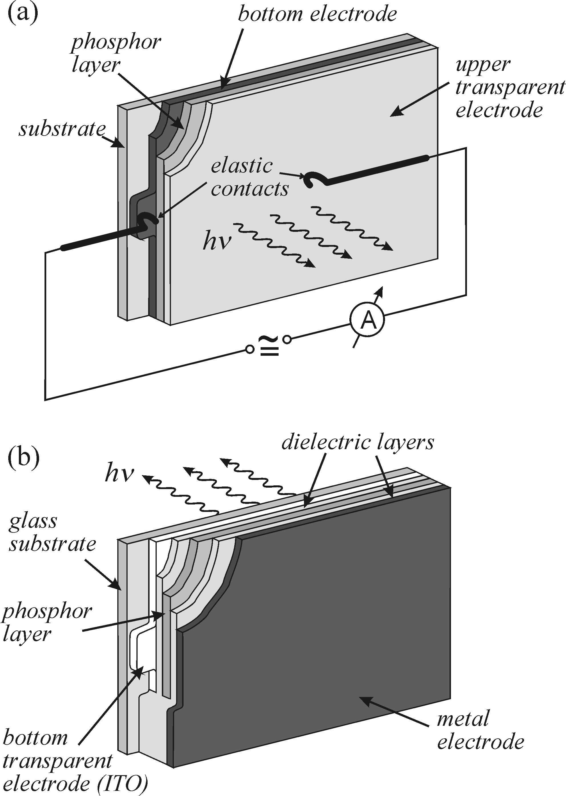
High-field Electroluminescence--Experimental considerations
sample subcategories:
powder phosphors
thin films
p-n junction
The structure of sample :
non-conductive solid slab
metal electrode
active layer (~micrometres)
Transparent electrode (SnO2 , ITO, thin film metals)
preparation of samples
evaporation, sputtering, plasma-enhanced chemical vapour
deposition (PECVD) , spin-coating
AC and DC fields
DC-- fast degradation of the sample
AC--polarization effects.
No need of low temperature
of both the free electron n and hole p concentrations affect the efficiency of excitation of luminescence centres
High-field Electroluminescence
Fig. 11.1 Principal schematic of a sample for high-field electroluminescence studies. (b) capacitance coupling

Slide 5
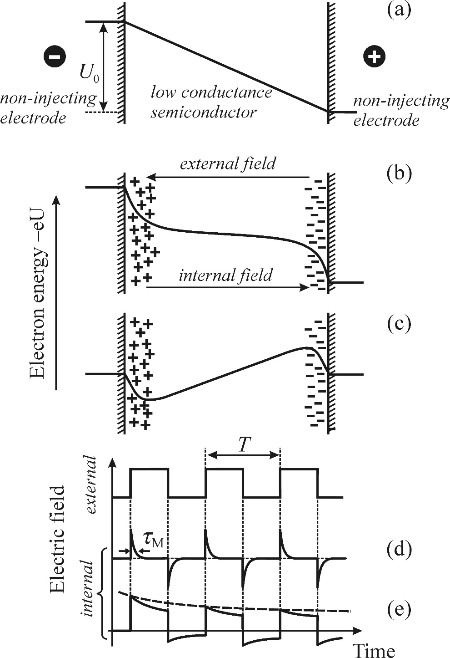
High-field Electroluminescence--Experimental considerations
electric-field shielding
free carrier displacement and the
formation of the space charge near electrodes
ideal rectangular voltage pulse→ considerably different shape
τ_{M} the dielectric relaxation time
the mean time necessary for an extra volume charge in an insulator or semiconductor to disperse
τM = ε∞ε0/σ_{DC}
ε∞ Dielectric constant， σ_{DC} electric conductivity
ps → strongly conductive materials
us to ms → less conductive samples (typical)
Fig. 11.2 Impact on the electric field distribution of semiconducting phosphor polarization by free carriers

Slide 6
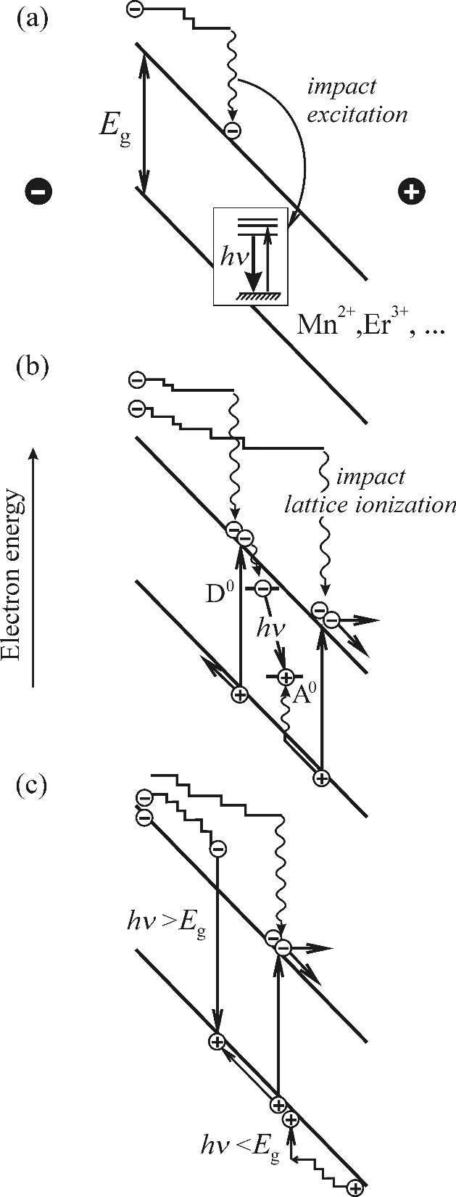
High-field Electroluminescence--Mechanisms
Impact ionization and excitation
three potential radiative recombination channels
1. Extrinsic luminescence of localized centres (ions )
2. Recombination processes involving the participation of neutral donors and acceptors (donor–acceptor pairs )
3. Intrinsic recombination of free electron–hole pairs (very low at room temperature)
Processes of excitation of luminescence centres
electric field accelerates the free carriers
↓
inelastic collisions transfer their energy to the luminescence centres
↓
photons are emitted owing to the electron transitions between levels
(3d shell for Mn²⁺ ions ）
Fig. 11.3
Possible electroluminescence processes in high fields. extrinsic luminescence centre , donor–acceptor pair , Intrinsic electroluminescence process

Slide 7
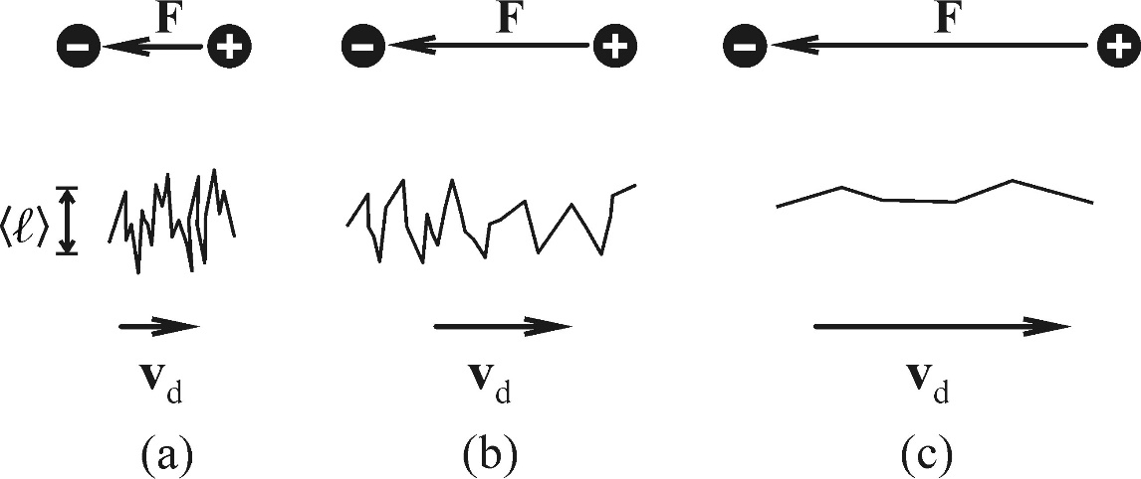

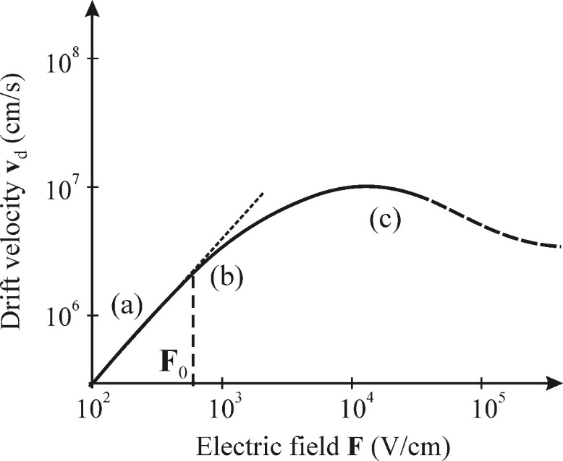
High-field Electroluminescence--Mechanisms
Impact ionization and excitation
electrons travel for the mean free path
V_{d} drift velocity of electrons
V_{T} is the mean velocity
τ_{m} is the mean time between collisions
Fig. 11.4 Path evolution of an electron that is ‘heated up’ in a semiconductor in an electric field
(a) V_{d} << V_{T} collision mechanism in that case remains the scattering on acoustic phonons
(b) electron system heats up, V_{d} Increase
mobility of electrons decrease μn, μn = μn(F).
(c) generation of optical phonons becomes the prevailing mechanism of electron scattering
Fig. 11.5 dependence of the electron drift velocity on the electric field intensity

Slide 8
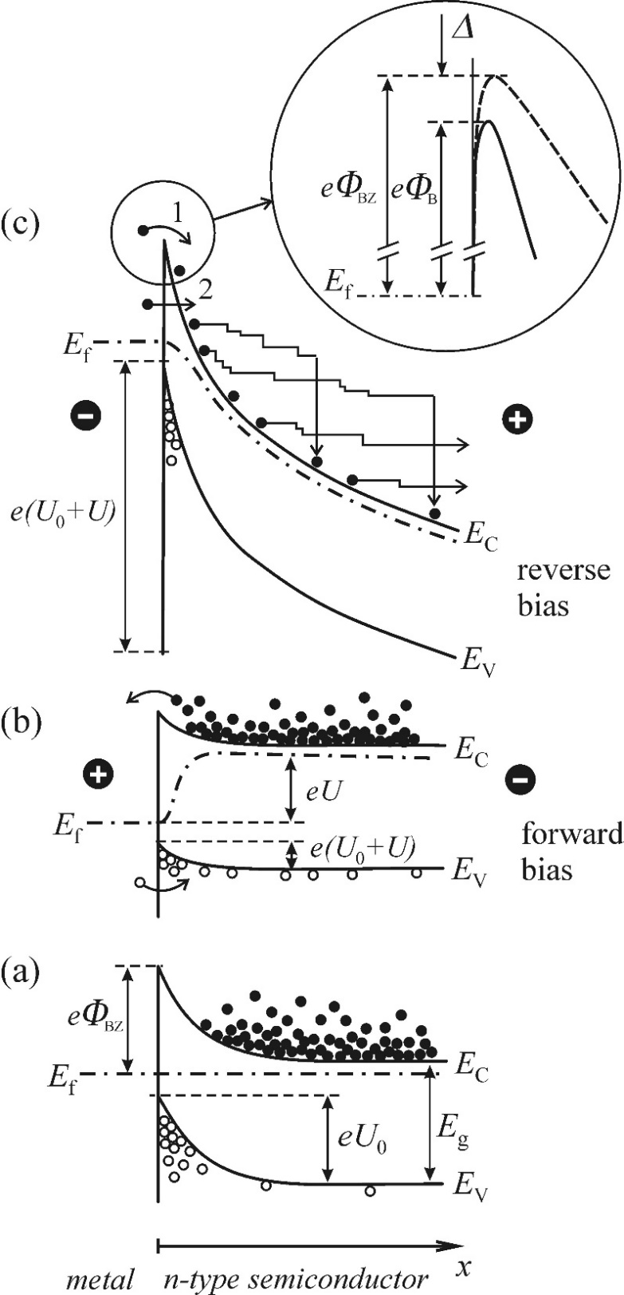
High-field Electroluminescence--Mechanisms
Generation of free carriers
mechanisms of free carrier generation
1. injection of majority carriers from electrodes;
2. release of carriers from deep traps localized in the phosphor
3. release of carriers from traps on the boundary between a dielectric and the phosphor
metal and an n-type semiconductor Schottky structure
forward bias
concentration of minority remains stable
reverse bias
keeps the injected electron current
      lowered potential barrier
      tunnelling effect
accelerated electrons
Fig. 11.7 Energy band scheme of a metal–semiconductor junction (Schottky barrier)

Slide 9
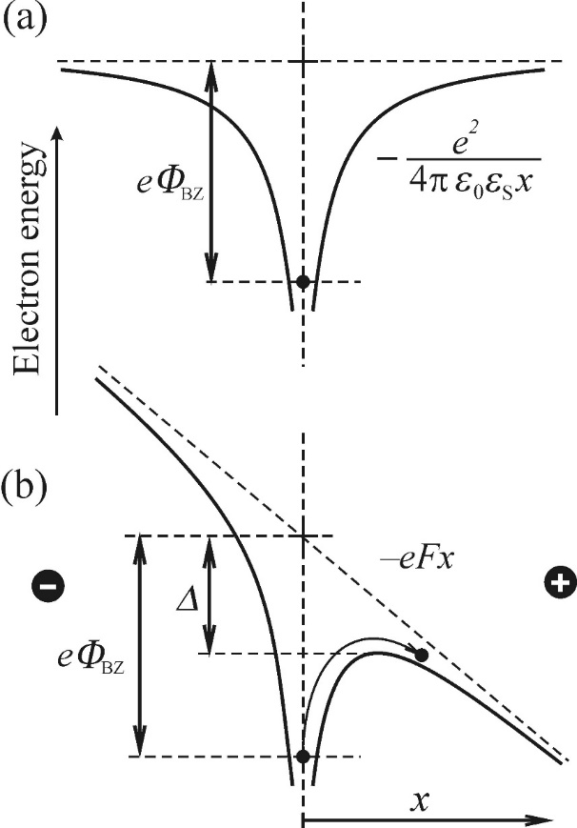
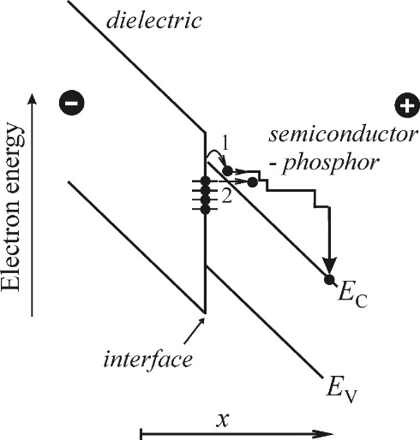
High-field Electroluminescence--Mechanisms
Generation of free carriers
Lattice defects in semiconductors act as deep traps (potential wells) for charge carriers
application of an electric field decrease the potential barrier of the trap
thermal release of trapped electrons into the conduction band, (Poole–Frenkel effect)
tunnelling through the narrowed barrier (Fowler–Nordheim tunnelling)
lattice defects are formed at the interface. electronic states are localized within the forbidden band
Fig. 11.8 Energy band scheme of an electron in a deep trap
Fig. 11.9 Band scheme of the interface between a dielectric and a luminescent layer

Slide 10

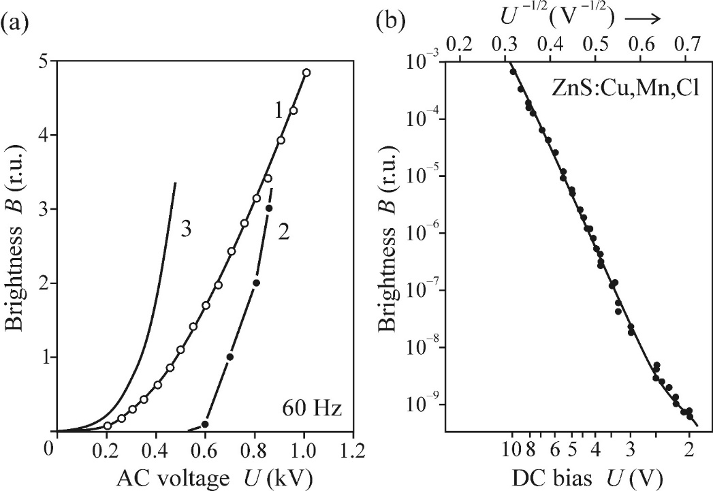
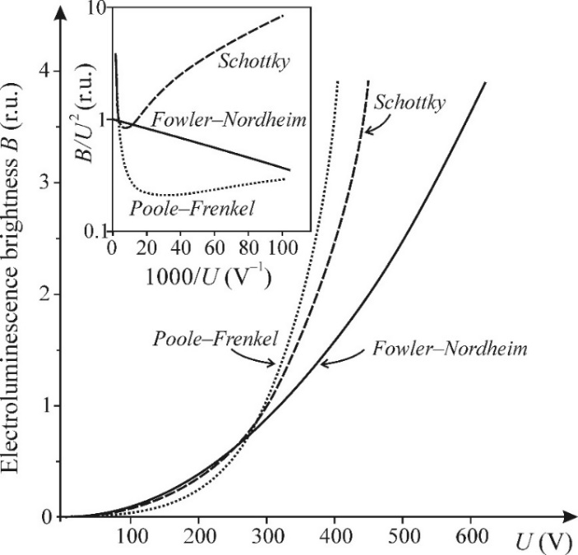
High-field Electroluminescence-- characteristics
electroluminescence intensity
the differences between the overall curve shapes are not too important
plot in a logarithmic scale B/U 2 ∼ j/U 2 as a function of 1/U
specific case of Fowler–Nordheim tunnelling:
Fig. 11.10 Dependence of the high-field electroluminescence brightness B on the applied voltage U
Fig. 11.11 experimental curves of the electroluminescence brightness B against the applied voltage U

Slide 11
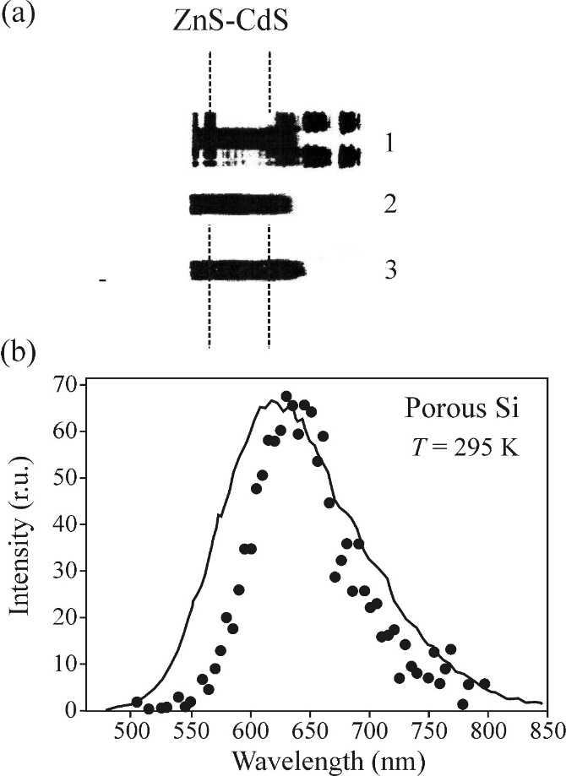
High-field Electroluminescence-- characteristics
spectral composition of electroluminescence
we cannot expect complete identity of both spectra because
photoluminescence emission spectrum
depend on the excitation wavelength,
Electroluminescence spectrum can depend on the applied voltage, frequency of the AC field
Fig. 11.12 Comparison of photoluminescence emission spectrum of mixed ZnS/CdS crystals (1, 2) with their electroluminescence spectrum (3). 1940
(b)EL (points) and PL spectra of an electroluminescence diode, 1995.

Slide 12
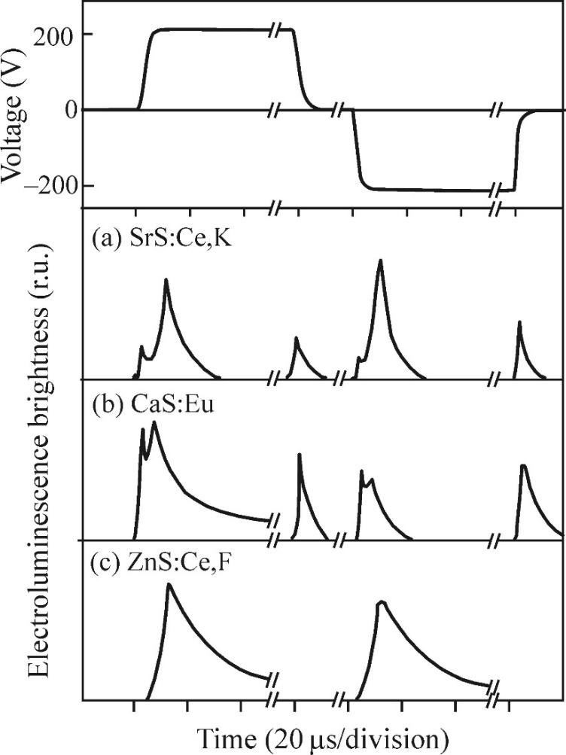
High-field Electroluminescence-- characteristics
temporal characteristics of electroluminescence
short flashes both during switching on and off the voltage
Infer the excitation mechanism:
pulsed voltage is switched on,
impact excitation of the Ce3+ and Eu2+
creating Ce4+ and Eu3+ ions in high electric field
Electrons released into the conduction band get subsequently localized in traps
pulsed voltage is switched off,
electrons are again released into the conduction band
captured back by ionized centres
photon is emitted due to the radiative transition inside the luminescence centre
Fig. 11.13 Time behaviour of electroluminescence of thin films (a) SrS:Ce,K, (b) CaS:Eu and (c) ZnS:Ce,F.

Slide 13
Outline
High-field Electroluminescence
Injection electroluminescence
  Electrical properties of a p-n junction
  Intensity, spectral and temporal characteristics of LEDs
Electroluminescence of a p-n junction biased in the reverse direction
Quantum Well

Slide 14
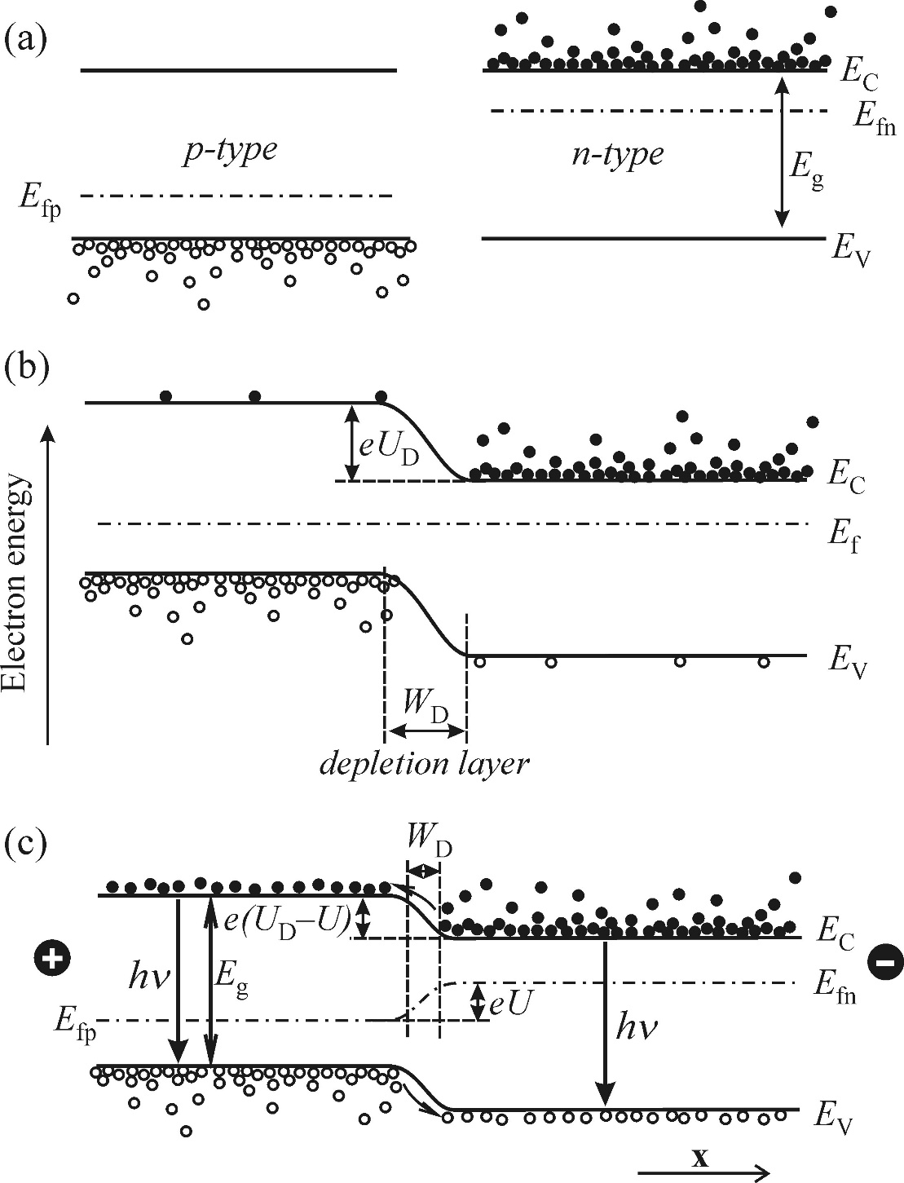
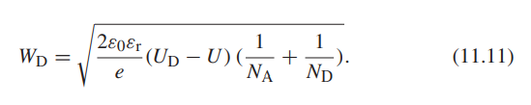
Injection electroluminescence-- Electrical properties of a p-n junction
injection electroluminescence:
the radiative recombination induced by the injection of minority carriers into a semiconductor p-n junction.
applying a suitable external voltage U
Excess electrons are injected from the n region to the p region
WD will decrease with increasing U
Fig. 11.15 Energy band scheme of a p-n junction

Slide 15
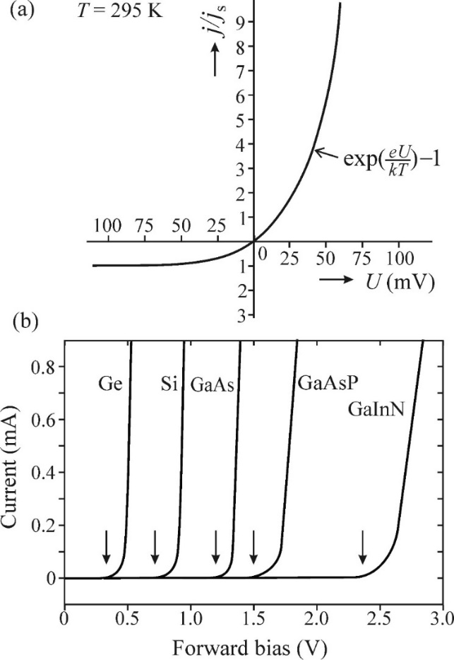
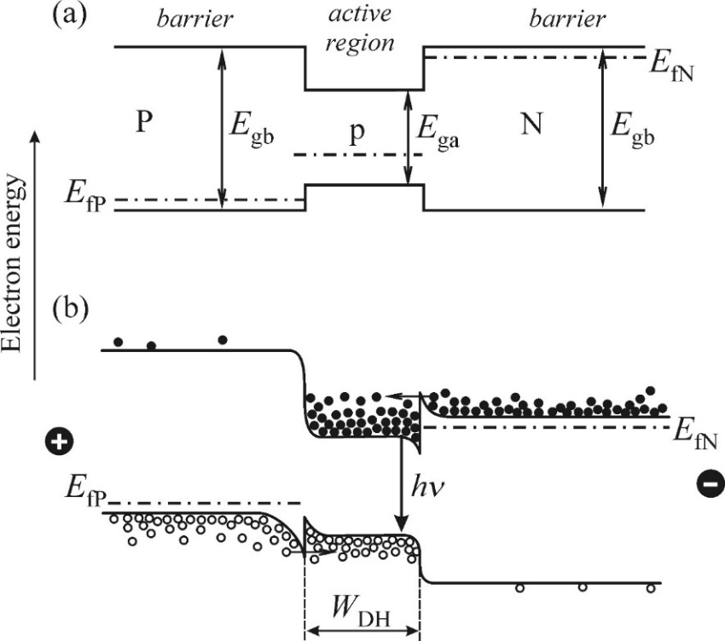
Injection electroluminescence-- Electrical properties of a p-n junction
rectifying properties
reverse bias
forward bias
js is saturation current
threshold bias Uth(≈ UD).
heterojunction: an active (luminescent) region with narrower bandgap (e.g. GaAs) and a barrier region with wider bandgap
significantly improve the luminescence performance of p-n junctions:
injected electrons and holes in a narrow active region
waveguiding effect in the active region (higher refractive index)
Fig. 11.16
Current–voltage characteristic of a p-n junction
Fig. 11.17
Double heterostructure of P-p-N type.

Slide 16
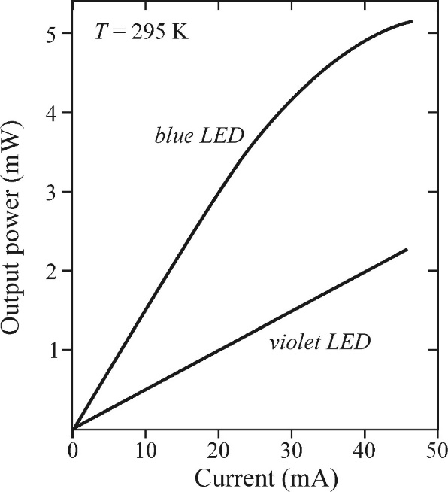
Injection electroluminescence-- characteristics of LEDs
Intensity characteristics
The onset of photon emission threshold bias ∼ Eg/e
linear increase saturation often occurs at higher current values.
blue emission is due to the recombination of donor–acceptor pairs
violet emission originates from band-to-band intrinsic bimolecular recombination
carrier overflow: leakage of injected carriers from the fully occupied potential well represented by the active layer
Fig. 11.18 Output light power of LED diodes as a function of the forward current.

Slide 17
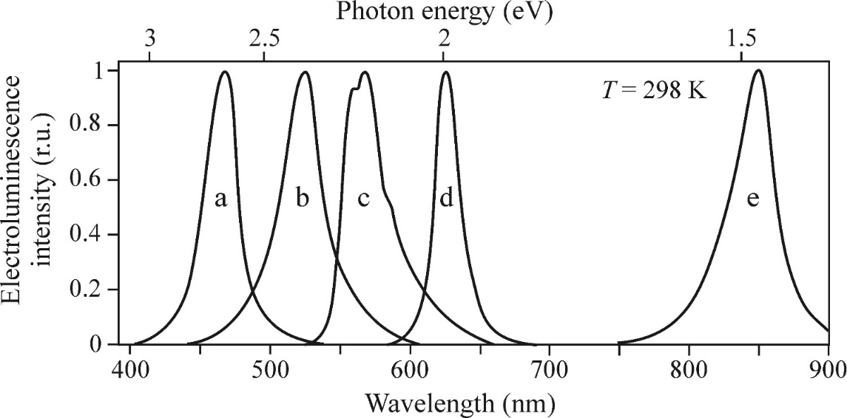
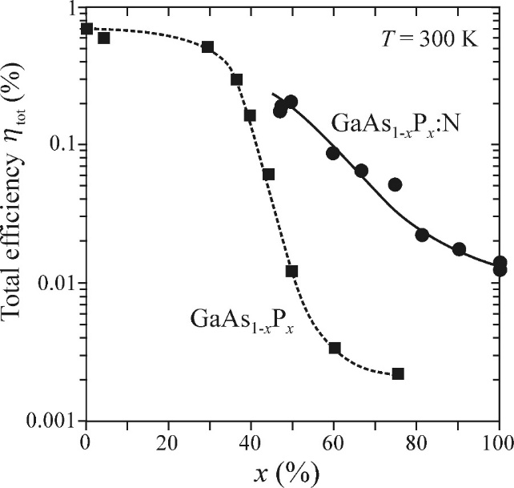
Injection electroluminescence-- characteristics of LEDs
Spectral characteristics
Minimum wavelength λm is determined by the bandgap
emission band is shifted towards longer wavelengths
extrinsic luminescence due to donor–acceptor pairs
light absorption and scattering at impurities
random fluctuations in the chemical composition of
the active layer
not a smooth curves
the X–TO type and the neighbouring peak to the X–LO process.
Fig. 11.19 Normalized emission spectra of LEDs by different manufacturers
A sharp decrease of the efficiency
due to direct → indirect bandgap Transformation
Doping with nitrogen compensates to a large degree for this inconvenient effect
luminescence converters
phosphors covering the active p-n junction of a blue LED diode in the form of a thin layer, White emission can be obtained
Fig. 11.20Total (external) efficiency of injection electroluminescence in GaAs1-x Px

Slide 18
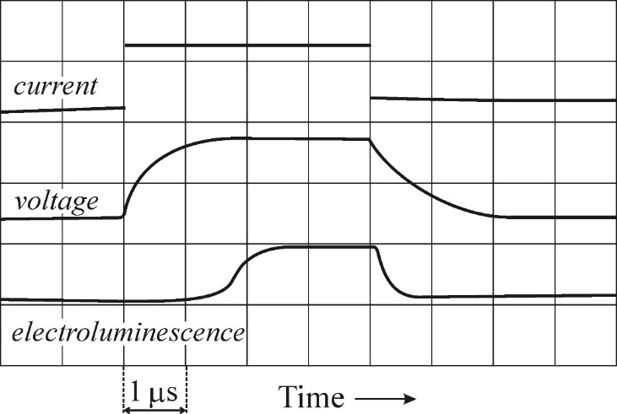
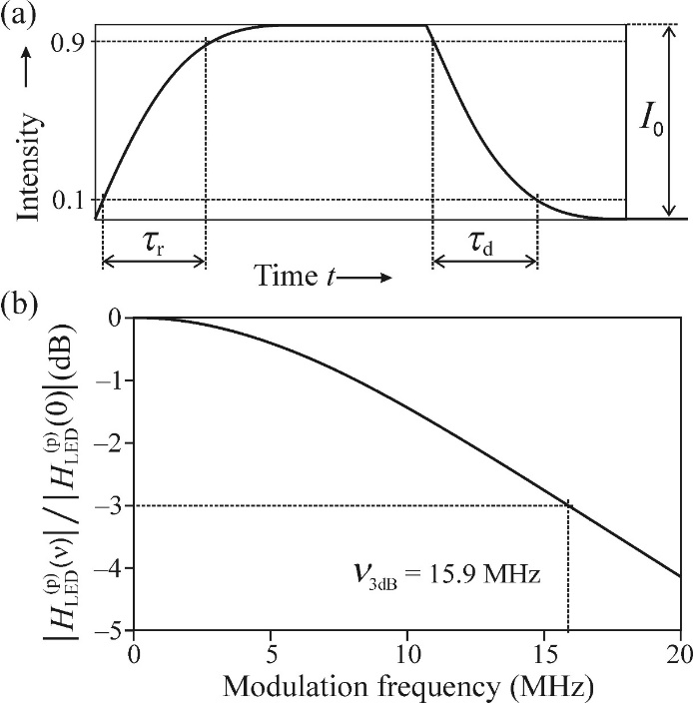

Injection electroluminescence-- characteristics of LEDs
Temporal characteristics
the time of recombinations:
minority carrier injection, filling traps and carrier capture
electrical parameters
p-n junction represents a capacitance load for the external source
geometry of the p-n junction
Fig. 11.22 Example of temporal behaviour of the characteristic quantities of an LED diode:
rise time τr and the decay time τd as time intervals between the points corresponding to the 90% and 10% levels of signal
Fig. 11.23 Definition of the rise time τr and decay time τd; An example of the frequency response of an LED diode
cut-off frequencies of LED diodes range from 10 MHz to 1 GHz

Slide 19
Outline
High-field Electroluminescence
Injection electroluminescence
Electroluminescence of a p-n junction biased in the reverse direction
Quantum Well

Slide 20
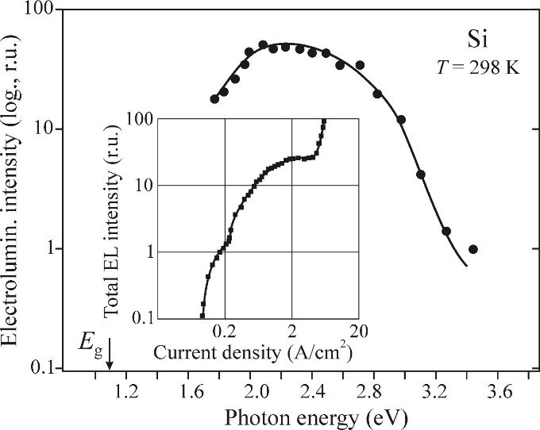
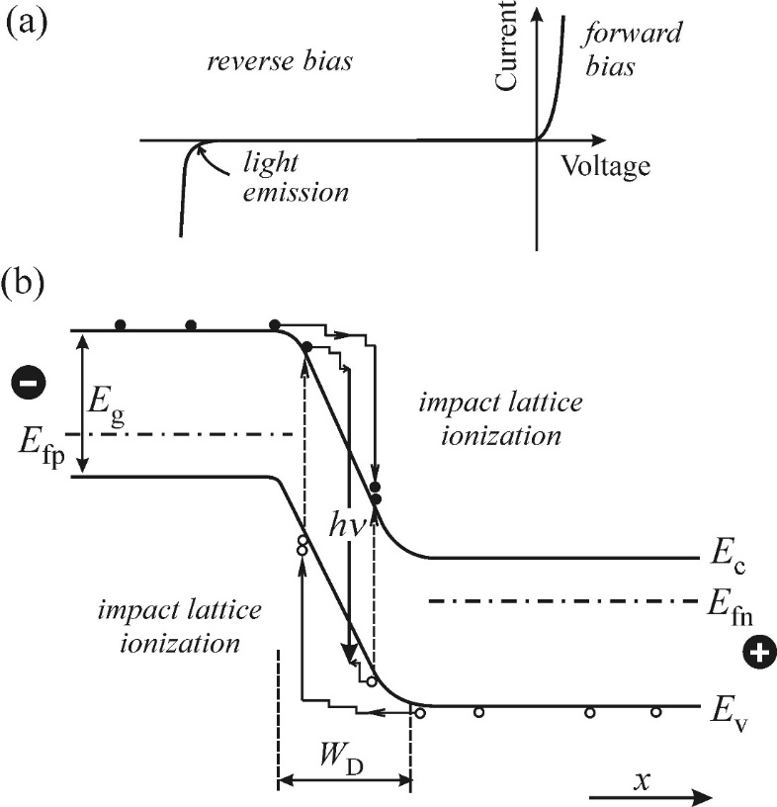
Electroluminescence of a p-n junction biased in the reverse direction
Emission spectrum is quite broad and located photon energies substantially exceeding the bandgap width.
The random and highly nonlinear character of avalanche ionization is reflected in a log-log scale
Electrical (pre-)breakdown of a reverse-biased p-n junction
via the band-to-band recombination of hot e–h pairs
Fig. 11.24 Electroluminescence spectrum of a silicon p-n junction
Fig. 11.25
Light emission in a reverse biased p-n junction

Slide 21
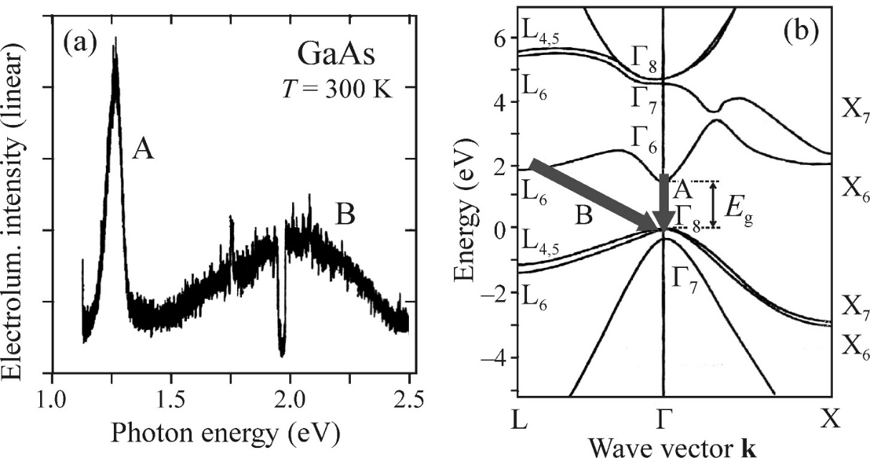
Electroluminescence of a p-n junction biased in the reverse direction
In p-n junctions made of GaAs
component due to both direct and indirect interband transitions of hot electrons and holes
Fig. 11.26 Electroluminescence spectrum of a commercial GaAs LED diode biased in the reverse direction.

Slide 22
Outline
High-field Electroluminescence
Injection electroluminescence
Electroluminescence of a p-n junction biased in the reverse direction
Quantum Well
  Single quantum well with infinite barriers
  Quantum well with finite barriers
  Excitons in a quantum well
  Optical transitions in a quantum well
  Luminescence of quantum wells

Slide 23
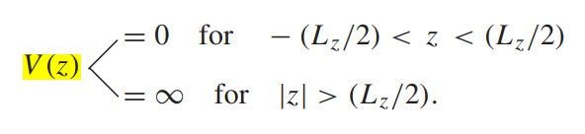
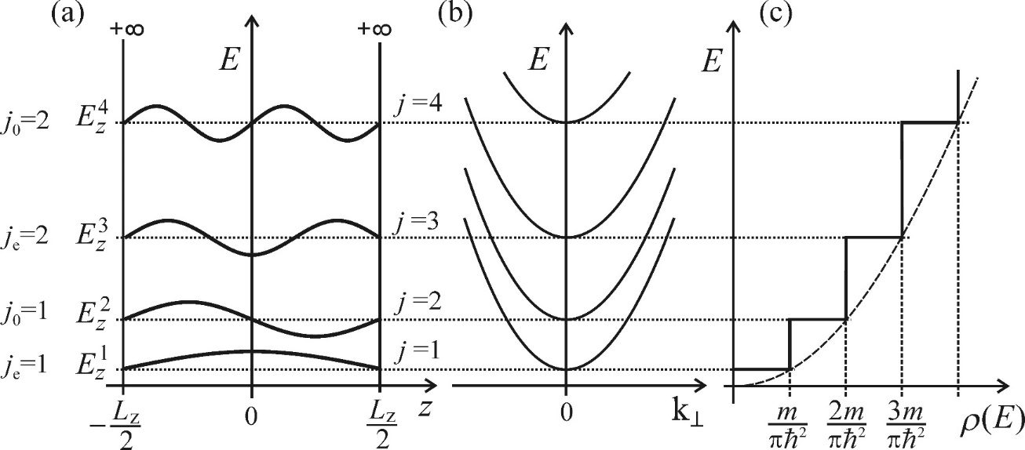
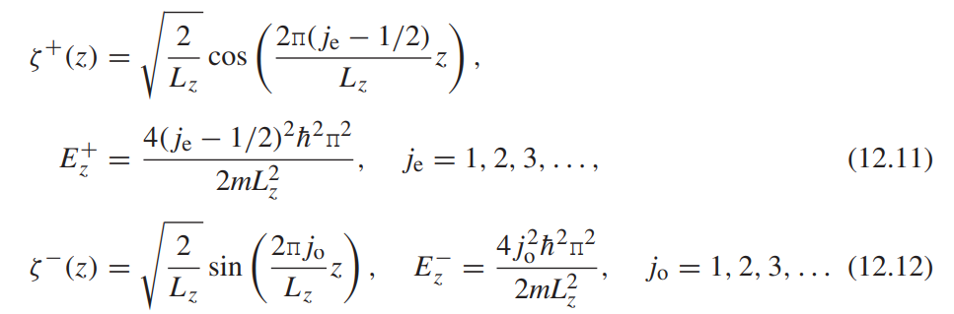
Quantum Well--Single quantum well with infinite barriers
potential energy of a quasi-particle V (z) within the well
wavefunctions and the corresponding energies:
Fig. 12.9 (a) wavefunctions, (b) dispersion relation, and (c) density of states of the four lowest quantum states.

Slide 24
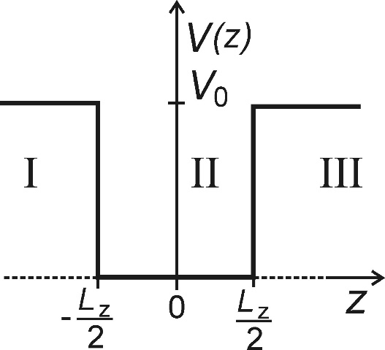
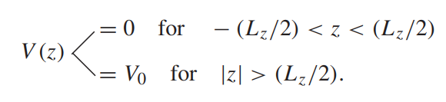
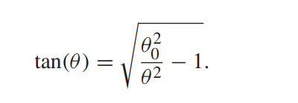

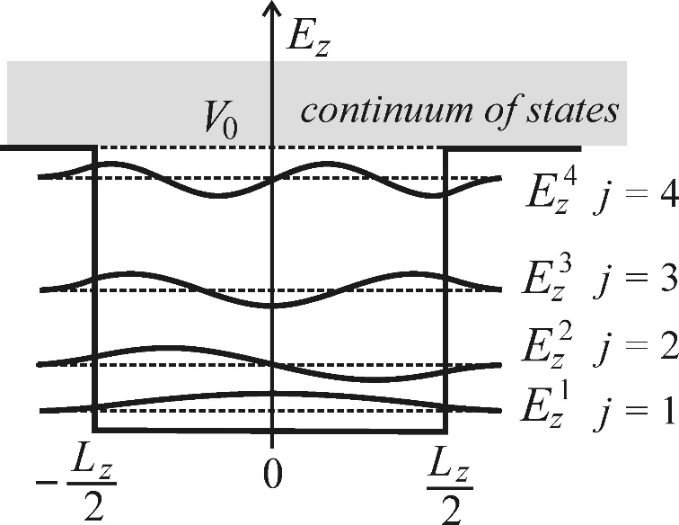
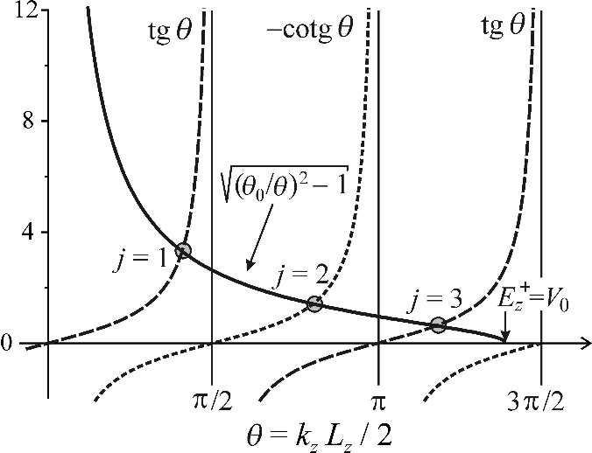
Quantum Well--Quantum well with finite barriers
In a real quantum well, the barriers are of finite height only
introduce a dimensionless variable θ and a dimensionless parameter θ0 :
Fig. 12.10 The shape of the potential of a quantum well with finite barriers
the number of solutions (possible localized states) depends on the barrier height V0
the deeper the well, the larger the number of localized states that can be reached
Fig. 12.11 Graphical solution by the points of intersection
Fig. 12.12 Wavefunctions of the first four states localized in a finite-barrier quantum well.

Slide 25

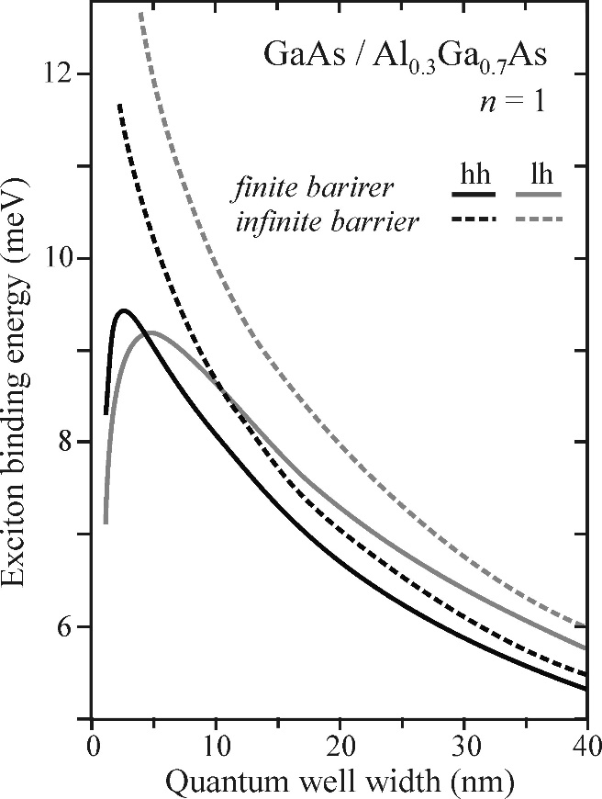

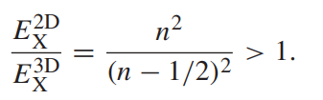

Quantum Well--Excitons in a quantum well
we should consider two-particle Hamiltonian:
Containing the kinetic energies of the electron and hole, the quantum well confinement potential and the potential of the Coulomb interaction
in the case of real wells, one can find an optimum thickness value at which the exciton stability is maximized.
energy levels of excitons in a two-dimensional quantum well:
Bohr radius
2D structures compared to 3D crystals :
exciton radius is decreased and the electron–hole binding interaction is increased
an electron and hole are ‘squeezed’ closer together in a
relatively narrow well
Fig. 12.13 Theoretical values of the exciton binding energy in a GaAs quantum layer

Slide 26
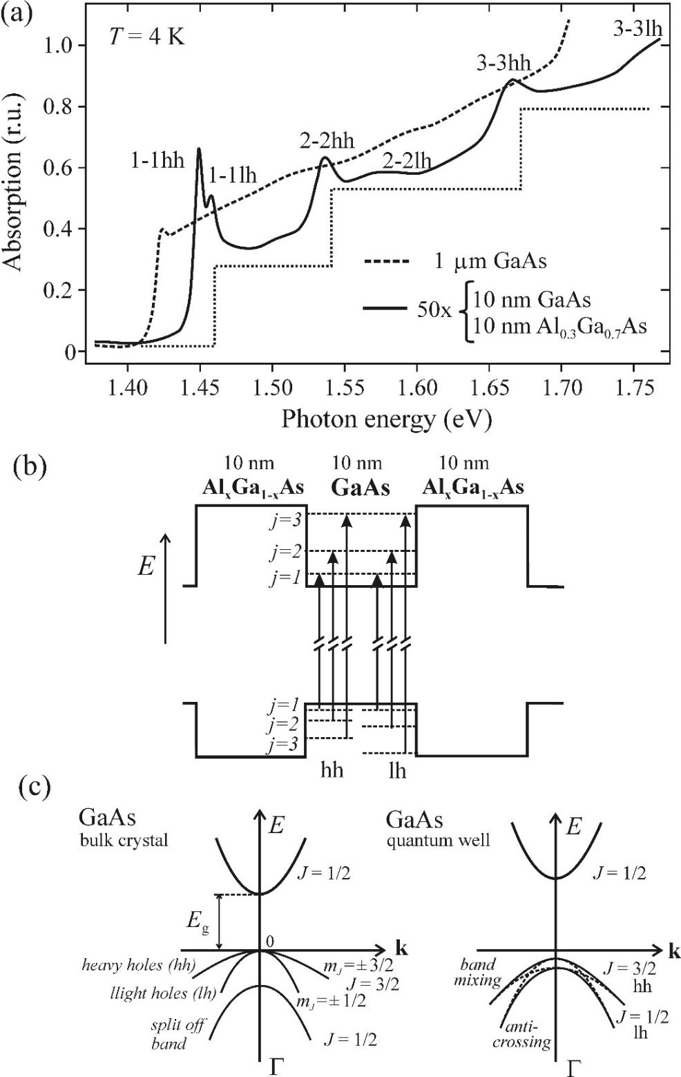
Quantum Well--Optical transitions in a quantum well
absorption band undergoes a blue-shift with decreasing well width;
strengthening of excitonic effects ;
a step-like increase in the absorption background obviously take place in the well
j = 0 selection rule:
the transitions are allowed only between quantized electron
and hole sub-bands with the same quantum number j.
The splitting of transitions is due to complex intermixing and splitting of the degenerate states of the uppermost valence band
In bulk:
the two uppermost valence bands A and B are degenerate at the point.
in quantum wells:
the confinement potential lifts this degeneracy as a result of symmetry breaking
Fig. 12.14

Slide 27
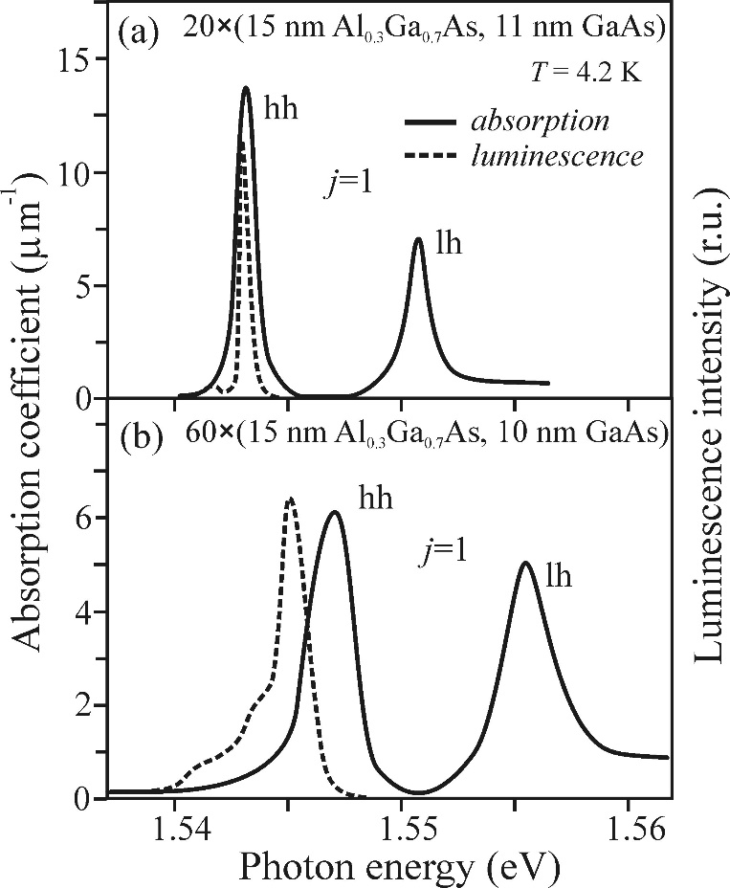
Quantum Well--Luminescence of quantum wells
Luminescence spectra typically differ from absorption spectra
Only a single emission band. from the efficient relaxation of higher excited states into the lowest state,
The luminescence peak is generally shifted to lower energies: width of a real quantum well is not perfectly constant, local energy levels vary accordingly, resulting in the ‘smearing’ of energy levels
Broader spectral bands due to well thickness fluctuations
*width of luminescence bands can thus be used to characterize the quality and homogeneity of the fabricated structure.
Fig. 12.15 Comparison of absorption (solid lines) and luminescence (dashed lines) spectra of GaAs/AlGaAs multiple quantum wells.

Slide 28
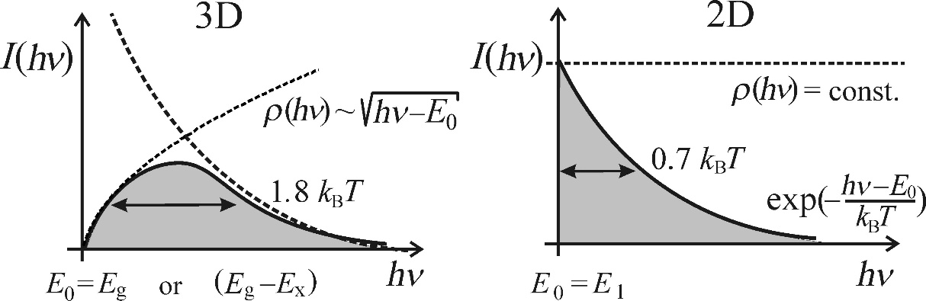
Quantum Well--Luminescence of quantum wells
Differences in luminescence properties of a ‘free’ exciton in a bulk semiconductor and in a 2D quantum well
1. The wavelength of excitonic luminescence from a 2D well, depends on the size of the structure (well thickness).
*quick method to extract the value of the well thickness
2. The ‘free-exciton’ emission linewidth should be more than twice as narrow in a 2D structure
*results from the differing shape of the density of states
*lowering the threshold current density for lasing
3. Excitonic phenomena are more pronounced, may be observable at room temperatures (compared to 3D crystals)
4. Nonlinear optical phenomena is much stronger and take place for much lower excitation power densities. (because of the confinement of the excited electron–hole pairs)
Fig. 12.16 Narrowing the ‘free’ exciton luminescence line when going from a 3D to a 2D structure, as a consequence of the modified shape of the density of states ρ(E) = ρ(hν).

Slide 29
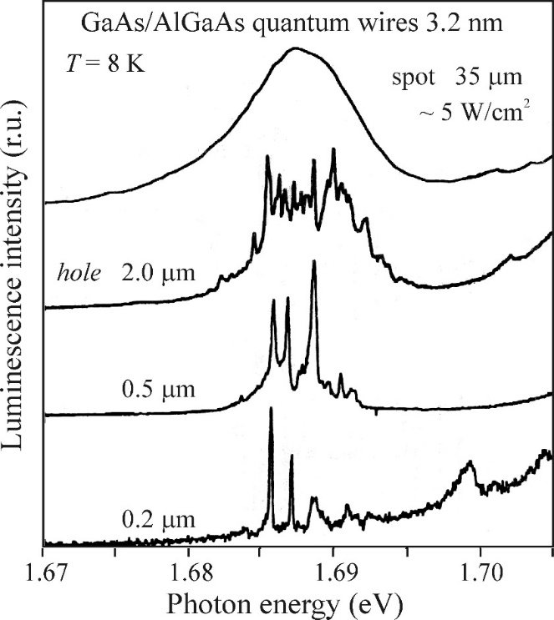
Quantum Well--Luminescence of quantum wells
Fluctuations in the well width, chemical composition, impurity atoms, act as possible localization traps for excitons.
Excitonic emission band should be considered as inhomogeneously broadened due to the superposition of the radiative recombination of ‘free’ excitons and excitons localized in the tail states
Micro-photoluminescence technique
Fig. 12.17 Photoluminescence spectra of GaAs/AlGaAs quantum wires

Slide 30
Luminescence Spectroscopy of Semiconductors: Theory and Experiment
Electoluminescence. Quantum wells
Jianyu Wu

