Slide 1

EH2750 Computer application in Power Systems, Advanced Course
Guest Lecture I
Cybersecurity & Architeture
Rune Gustavsson
ICS

Slide 2
Overview
Setting the scene
Important time dependencies
Targeted Persistent Threats (TPT)
Report on Shadow Remote Access Tools (RATs)
Role Based Access Control
Case Study - Stuxnet
Defense in Depth
State-of-The Art Technologies
The role of Cyber Security at KTH
Discussion

Slide 3
Setting the Scene
External attack
Motive
Opportunity
Method
.
Internal dysfunctions
Breakdowns
Faulty behaviour
System
Smart Grid
Risks
Exploits of vulnerabilities
Technical
Organizational
Societal
No well defined system boundaries in a connected world!

Slide 4


Basic Time Frames
Basic equation:
P = Protection, D = Detection, R= Response
The Exposure time E should be as small as possible!
May be very long in cases of TPAs!

Slide 5
Advanced Persistent Threats (APT)
Recent advanced and targeted cyber attacks on infra stuctures (sabotage, business intelligence, thefts)
  Stuxnet – industrial sabotage of Siemens DCS in Iran
  Ghostnet – theft of diplomatic information
  Aurora – theft of source code and IPR at Google
  Night Dragon – industrial and commercial intelligence of large oil companies
  PS3/PSN attack – business sabotage on Sony Play Station Networks
Also under attack
  RSA
  Intellicorp
Complements short term goals of Cyber crime
  Money Laundry

Slide 6
Revealed: Operation Shady RAT (I)
White paper from McAfee August 2011
  http://www.mcaffe.com/
Logs from a C&C server used by intruders since 2006
Conclusions:
  Vast amounts of data (petabytes) has been lost to (unknown) users
  Represent a massive economic threat to individual companies and industries and even countries that face the prospect of decreased economic growth un a suddenly more competitive landscape ad the loss of jobs in industries that lose out to unscrupulous competitors in other part of the world

Slide 7
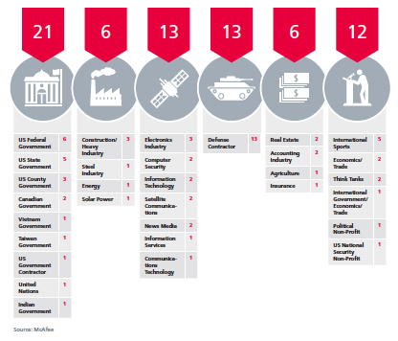
Revealed: Operation Shady RAT (II)
.

Slide 8
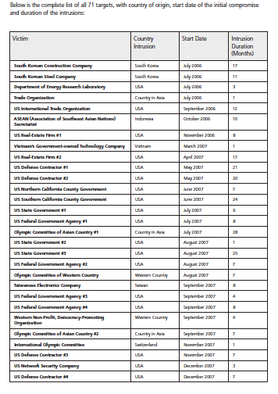
Revealed: Operation Shady RAT (III)
.
Note the logged
duration times since
2006!

Slide 9
Role Based Access Control (RBAC)
The strategy of role-based access control includes restriction to minimally required rights and functions for users, operators, devices, network and software components. Close consultation on the following aspects is required to achieve effective protection with this strategy without restricting normal activities:
Access control for the respective plant and its area protection
Intended use of individual devices and software components
Organization of the production and its areas of responsibility and thereby for the plant manager
Administration of the plant
Responsibilities of the operator

Slide 10
US Strategy for Trusted Identities in Cyber Space
Background to NSTIC Proposal for Trusted Identities in Cyberspace (April 2011)
  Identity theft is costly, inconvenient and all-too common
    In 2010, 8.1 million U.S. adults were the victims of identity theft or fraud, with total costs of $37 billion.
    The average out-of-pocket loss of identity theft in 2008 was $631 per incident
    Consumers reported spending an average of 59 hours recovering from a “new account” instance of ID theft.

Slide 11
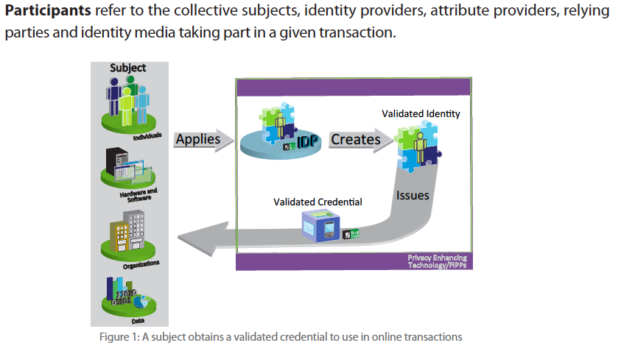
The Identity Ecosystem (NSTIC)
Supports revocations of Identities and Credentials!

Slide 12
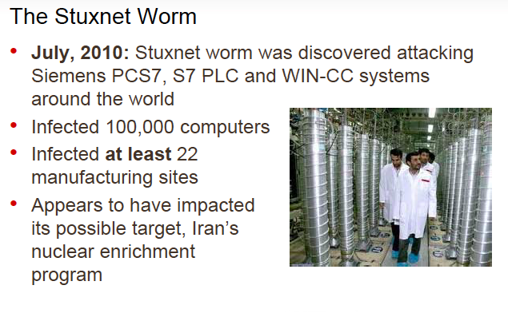
Case Study Stuxnet (I)
.

Slide 13
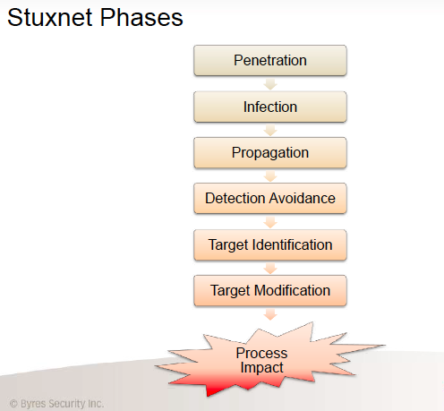
Case Study Stuxnet (II)
.

Slide 14
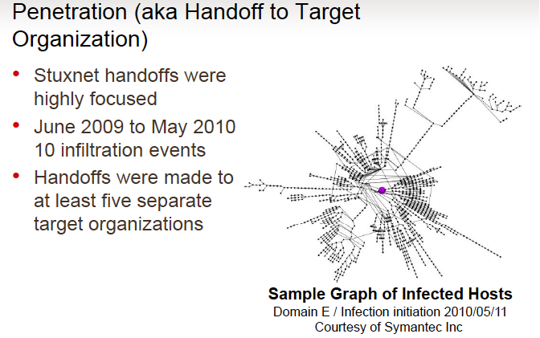
Case Study Stuxnet (III)
.

Slide 15
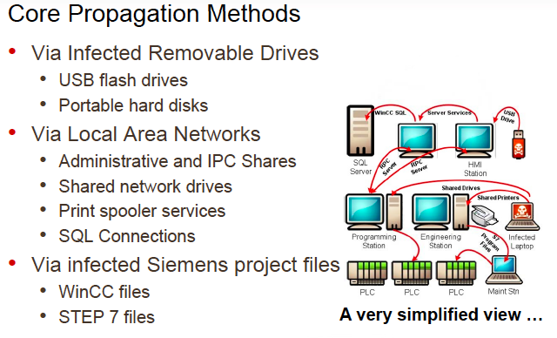
Case Study Stuxnet (IV)
.

Slide 16
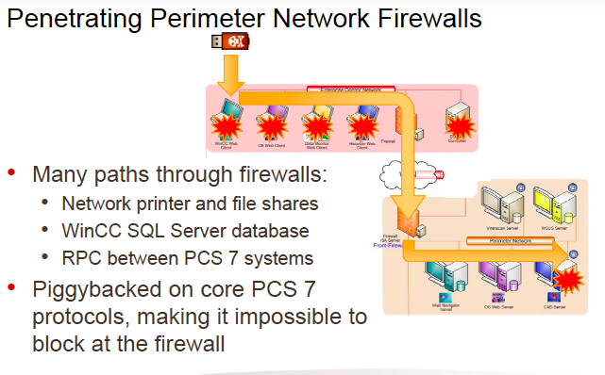
Case Study Stuxnet (V)
.

Slide 17
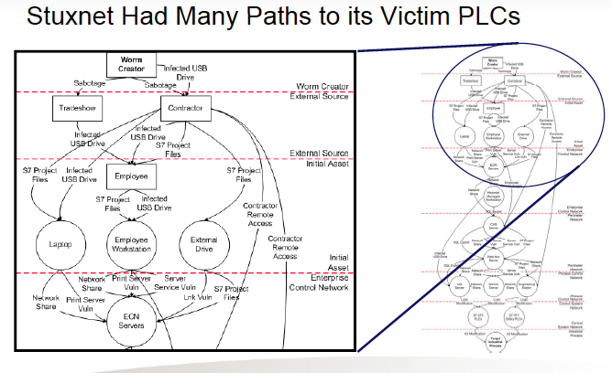
Case Study Stuxnet (VI)
.

Slide 18
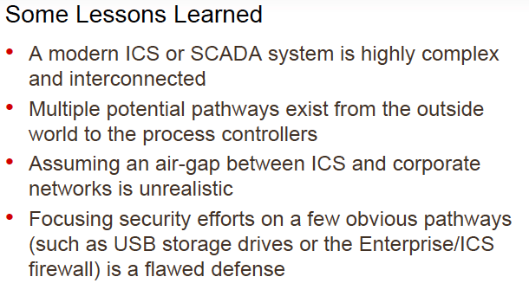
Case Study Stuxnet (VII)
.

Slide 19
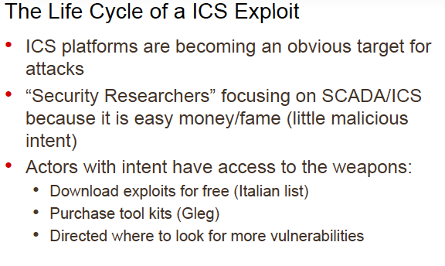
Case Study Stuxnet (VIII)
.

Slide 20
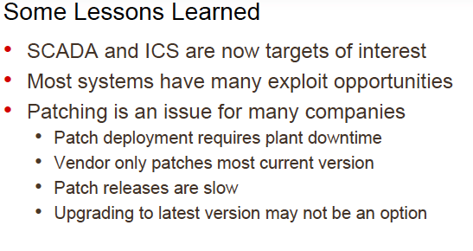
Case Study Stuxnet (IX)
.

Slide 21
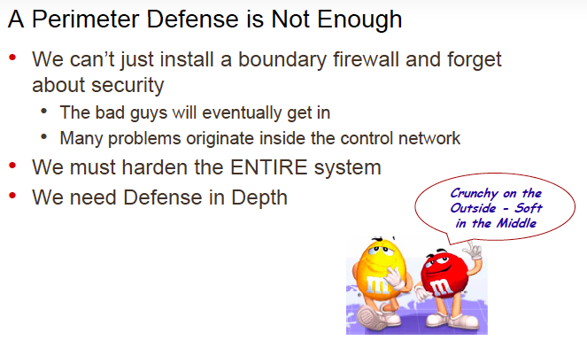
Case Study Stuxnet (XI)
.

Slide 22
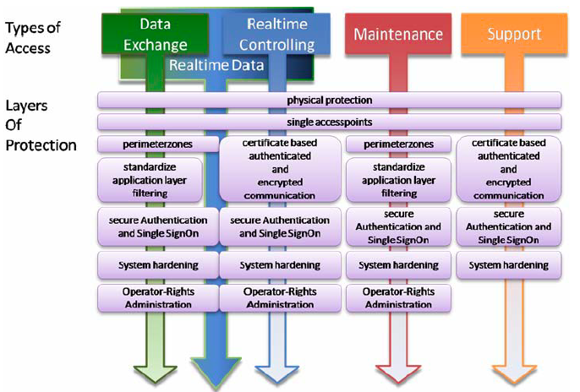
Defense in Depth
.

Slide 23
State-of-The-Art Technologies (I)
Detection
With thousands of workstations and servers under management, most enterprises have little to no way to effectively make sure they are free of malware and Advanced Persistent Threats (APTs).
APTs are broadly defined as sophisticated, targeted attacks (as opposed to botnets, banking Trojans and other broad-based threats) that rely heavily on unknown (zero-day) vulnerabilities and delivery via social engineering.
Multiple recent hacking events made public have highlighted the vulnerabilities of even the most renowned security companies, government contractors and Fortune 500 enterprises.
This problem can affect any enterprise and a new approach to combat these threats must be implemented in order to deal with it effectively.

Slide 24
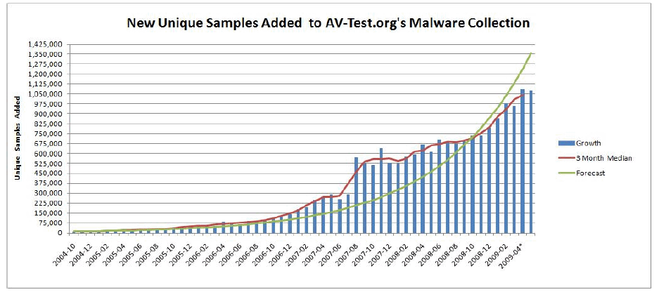
State-of-The-Art Technologies (II)
Using Signatures to detect attacks (malware) is hard (impossible)!

Slide 25
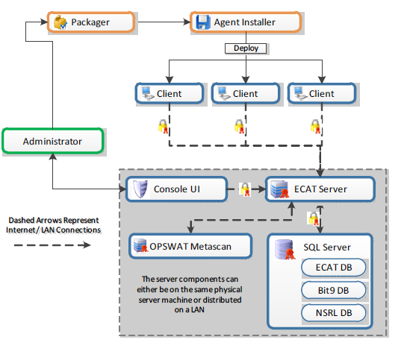
State-of-The-Art Technologies (III)
Using the ECAT tool on-line monitoring of system memories to address APT threats (http://www.siliciumsecurity.com/)

Slide 26
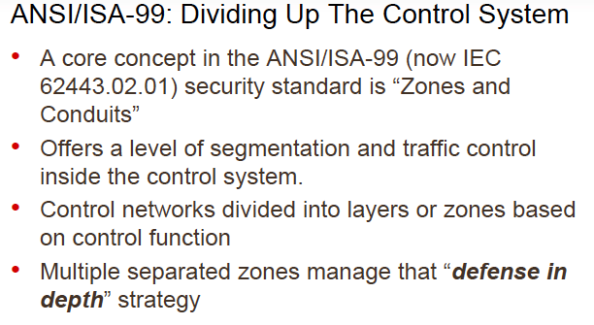
State-of-The-Art Technologies (IV)
.

Slide 27
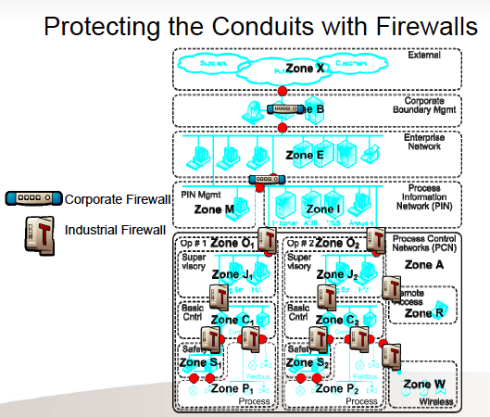
State-of-The-Art Technologies (IV)
.
Defining zones and conduits by virtualizations

Slide 28
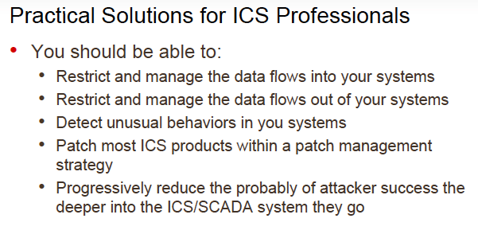
State-of-The-Art Technologies (V)
.

Slide 29
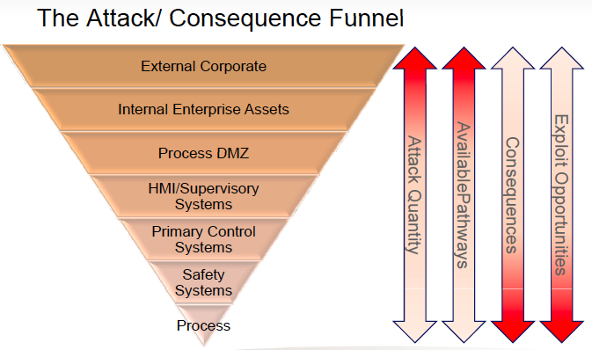
State-of-The-Art Technologies (VI)
.

Slide 30
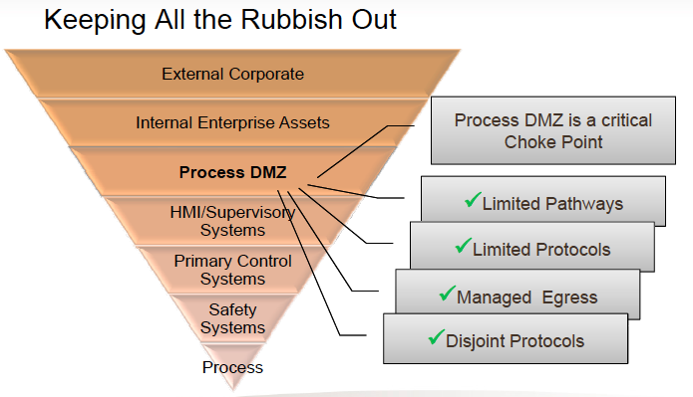
State-of-The-Art Technologies (VII)
.

Slide 31
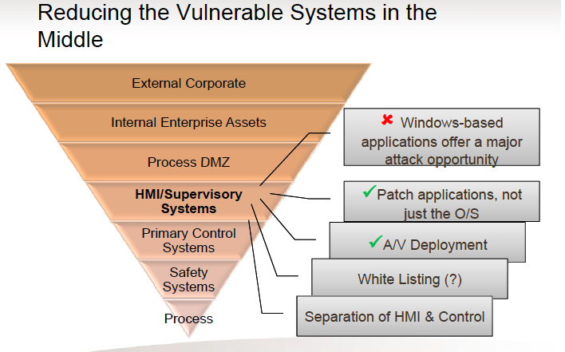
State-of-The-Art Technologies (VIII)
.

Slide 32
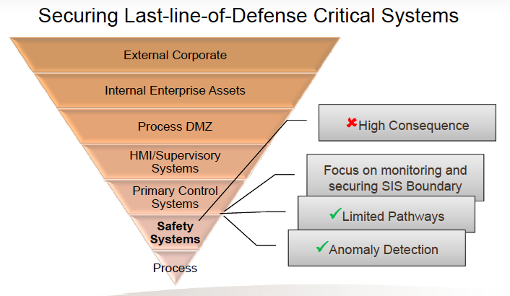
State-of-The-Art Technologies (IX)
.

Slide 33
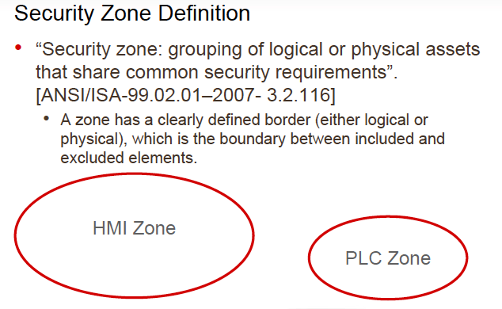
State-of-The-Art Technologies (X)
.

Slide 34
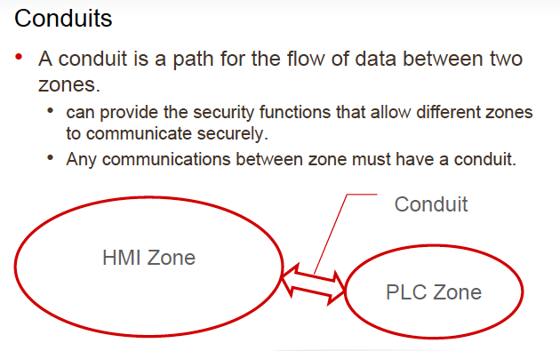
State-of-The-Art Technologies (XI)
.

Slide 35
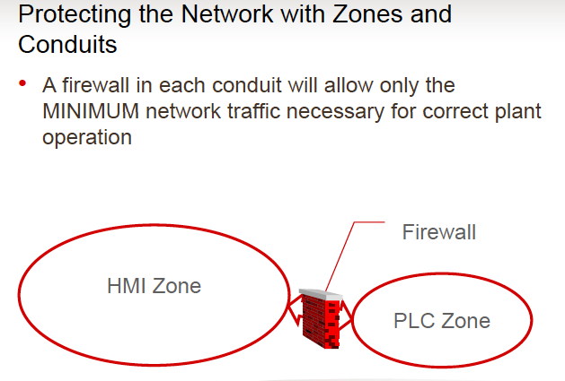
State-of-The-Art Technologies (XII)
.

Slide 36
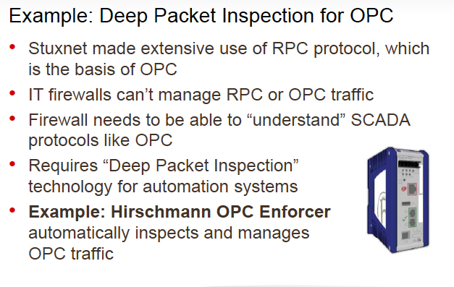
State-of-The-Art Technologies (XIII)
.

Slide 37
The Role of Cyber Security at KTH
Ongoing EU sponsored Projects on Smart Grids
  Grid4EU
    Total budget about 55 MEURO
    Kick-OFF November 21st – 22nd November 2011
    Swedish partners: KTH, Vattenfall, and ABB
  KIC InnoEnergy
    INSTINCT

Slide 38
Discussion
Thanks!

