Slide 1
Fråga 71
Hål är minoritetsbärare i ett n-typ kisel lager.
Hålen injeceras från en sida och diffunderar in i n-typ lagret och en koncentrationsprofil upprättshåls (steady-state)
Inget ljus faller på kiselbiten och hålens driftström är försumbar.
Skriv ner en diffrentialekvation som om den löses ger överskottskoncentrationen av hålen som funktion av x.

Slide 2
Fråga 72
En p⁺n övergång i kisel framspänns. Vilken strömkomponent är lättast att beräkna och bestämmer strömmen?
Diffusionströmmen av hål på n-sidan
Driftström av elektroner på n-sidan
Driftström av hål på n-sidan
Diffusionströmmen av elektroner på p-sidan

Slide 3
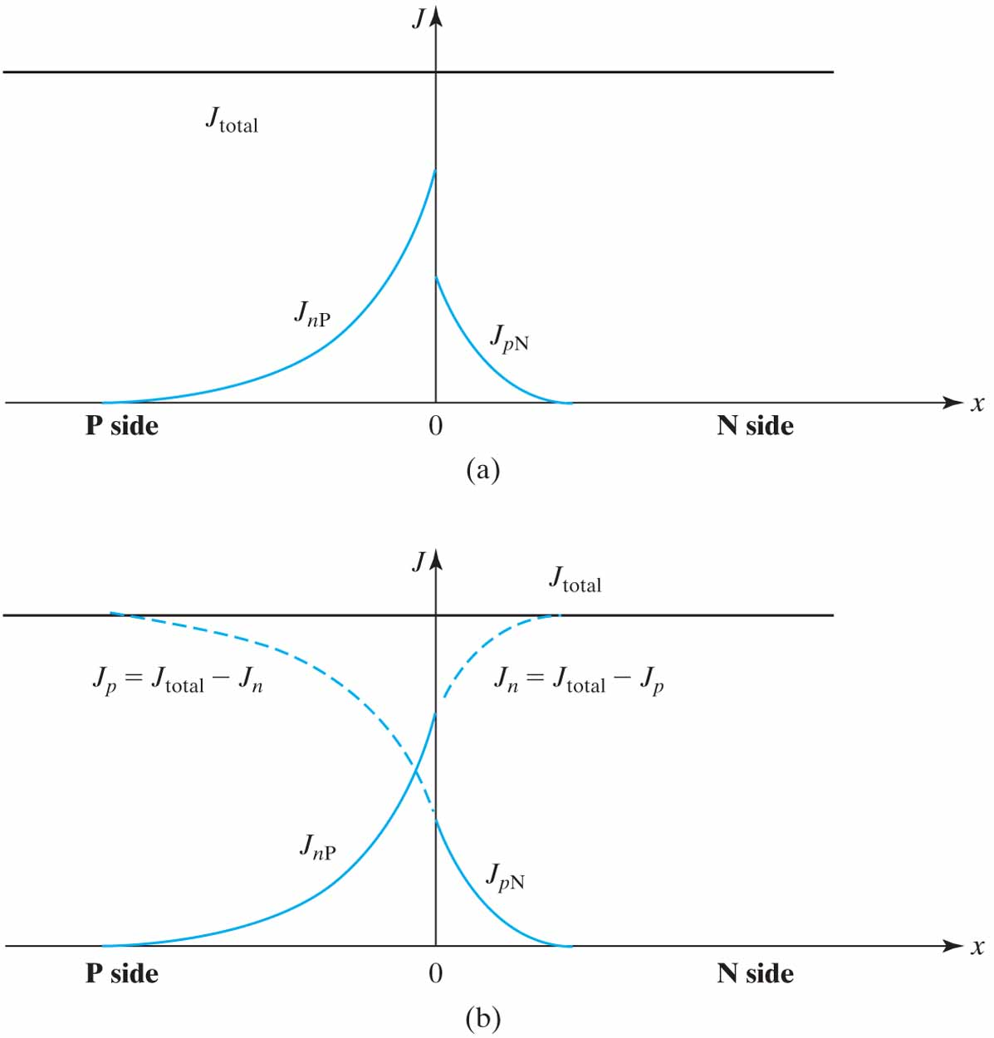
Figure 4.20 (a) Total J can be determined by summing J_{nP} and J_{pN} at the junction where both are known; (b) the other majority current components can now be determined.

Slide 4
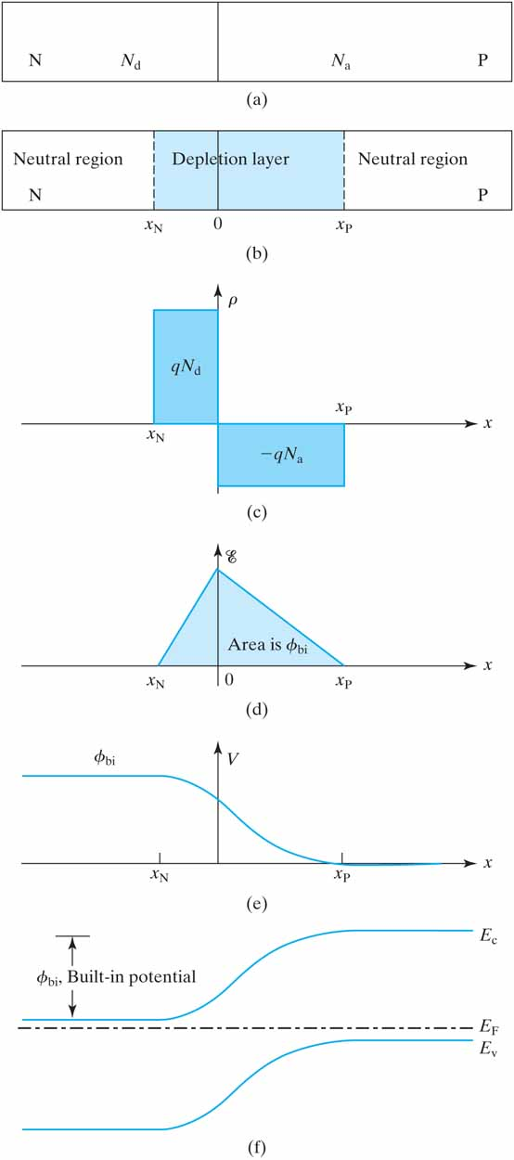

Slide 5
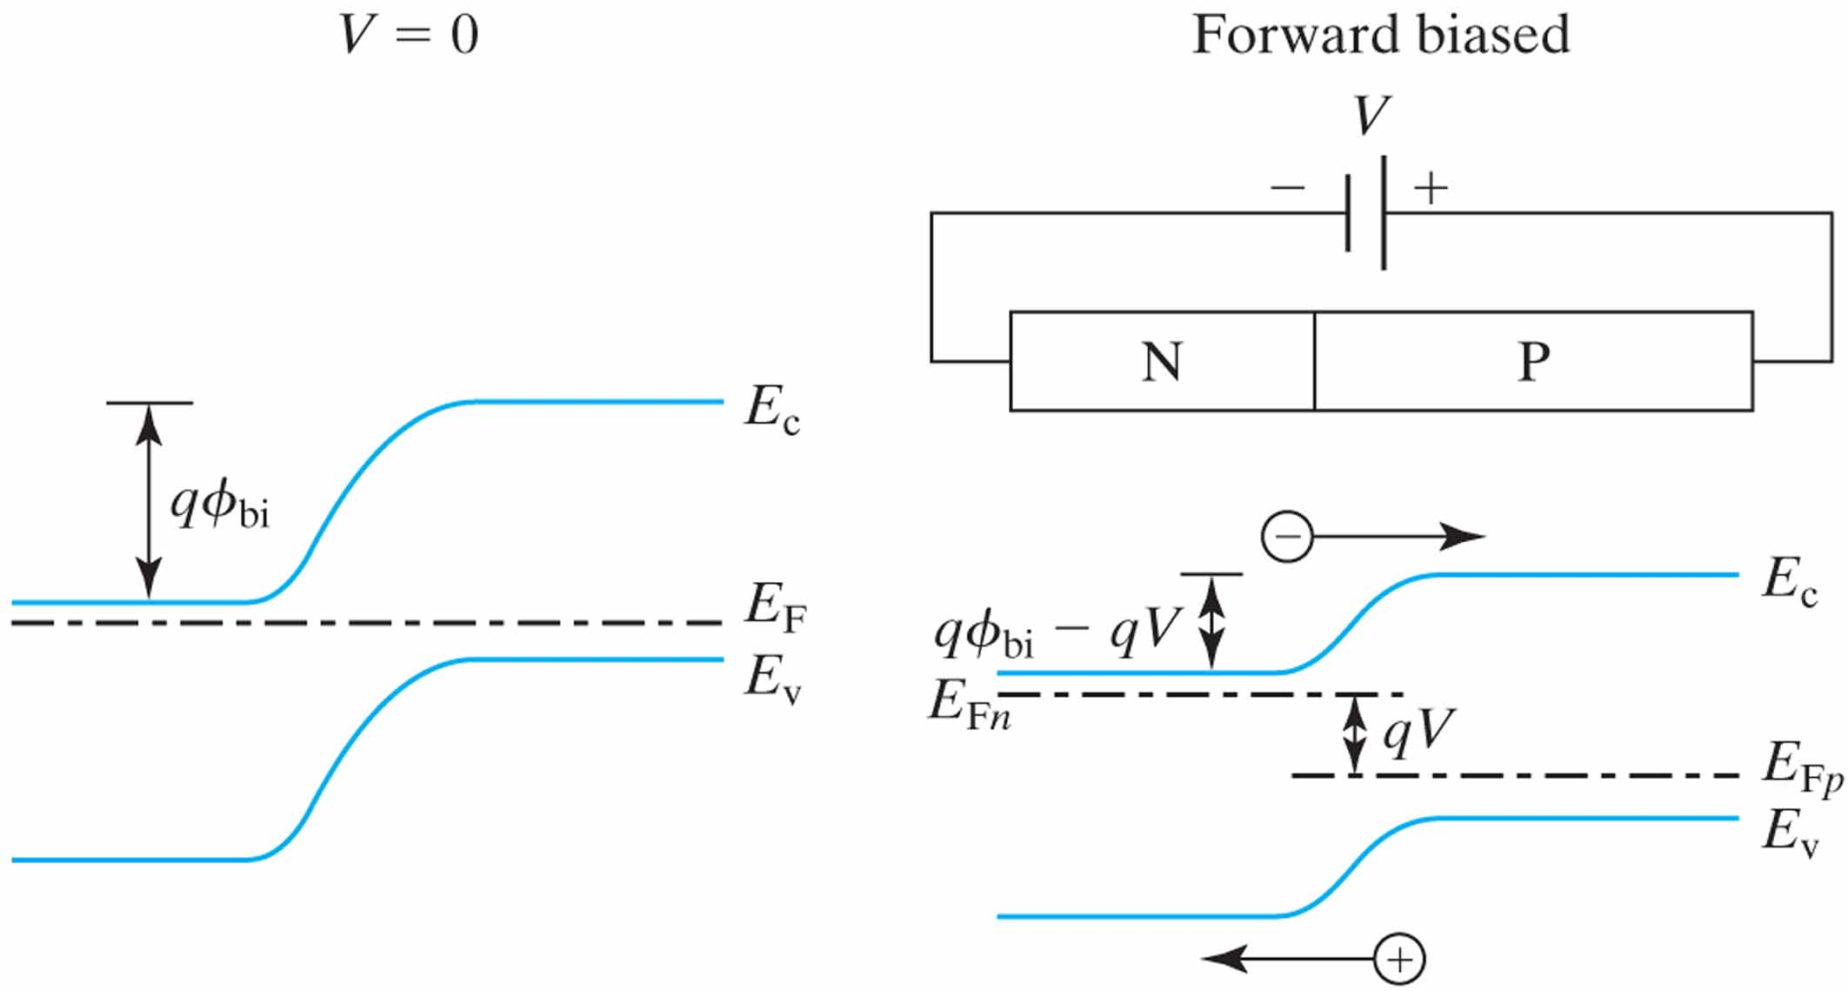
Figure 4.14 A forward bias reduces the junctionbarrier to ϕ_{bi}–V and allows electrons and holes to be injected over the reduced barrier.

Slide 6
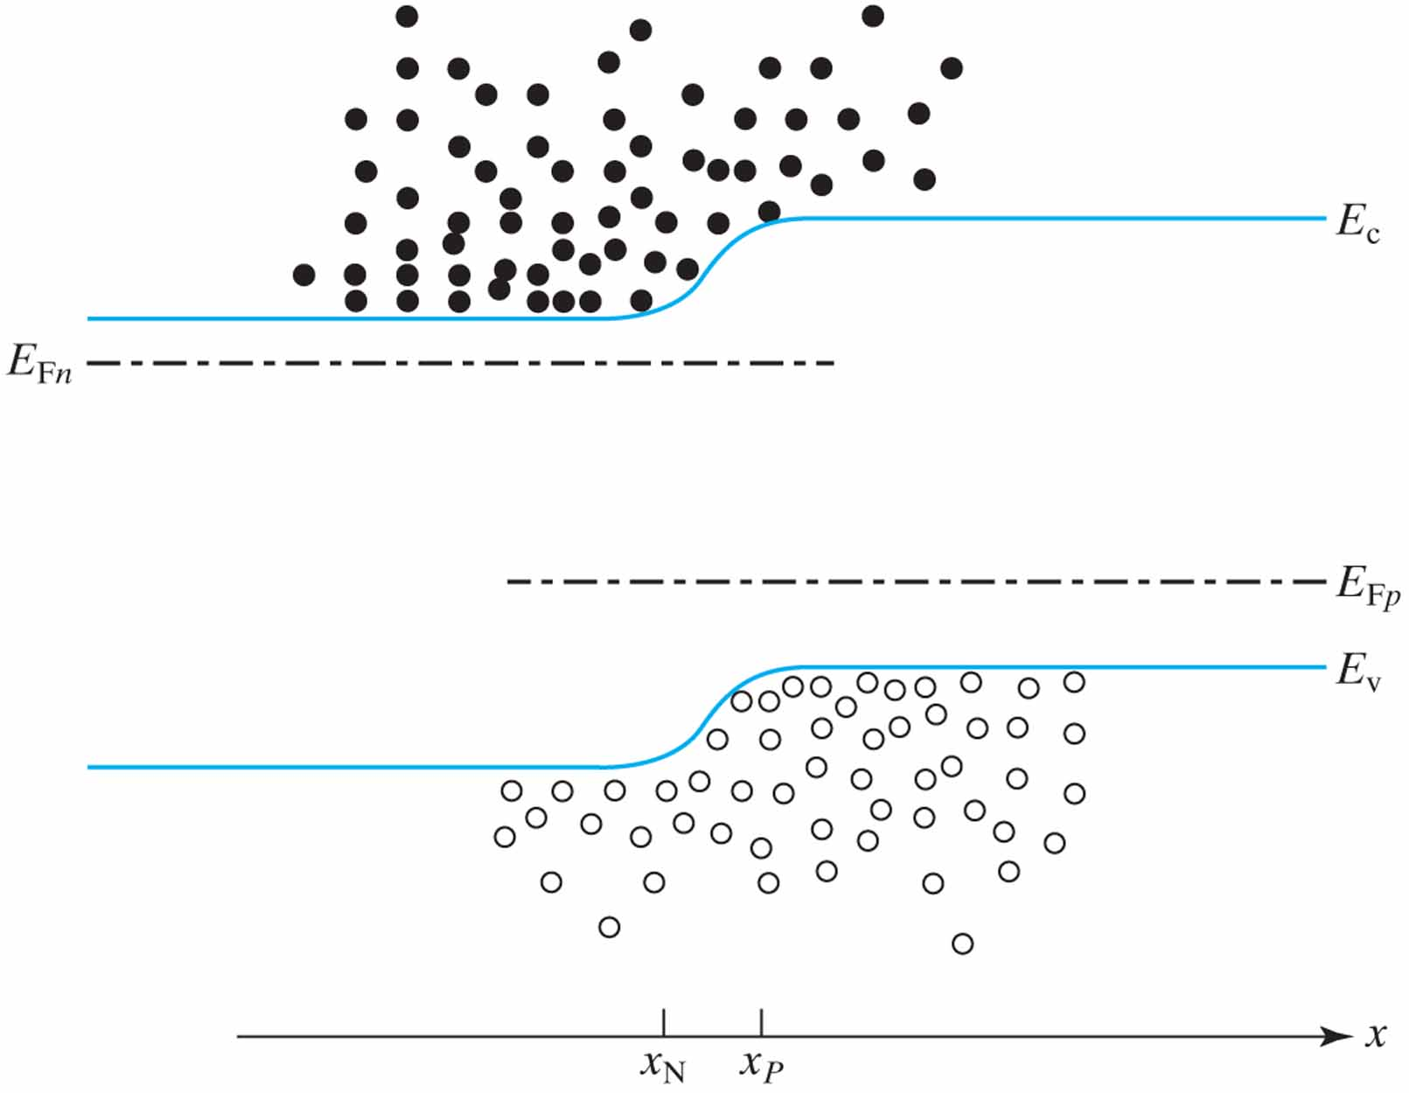
Figure 4.15 n at x_{p} (electron density at the edge of the neutral P region) is determined by E_{c} – E_{Fn}. Similarly, p at x_{N} is determined by E_{v} – E_{Fp}.

Slide 7
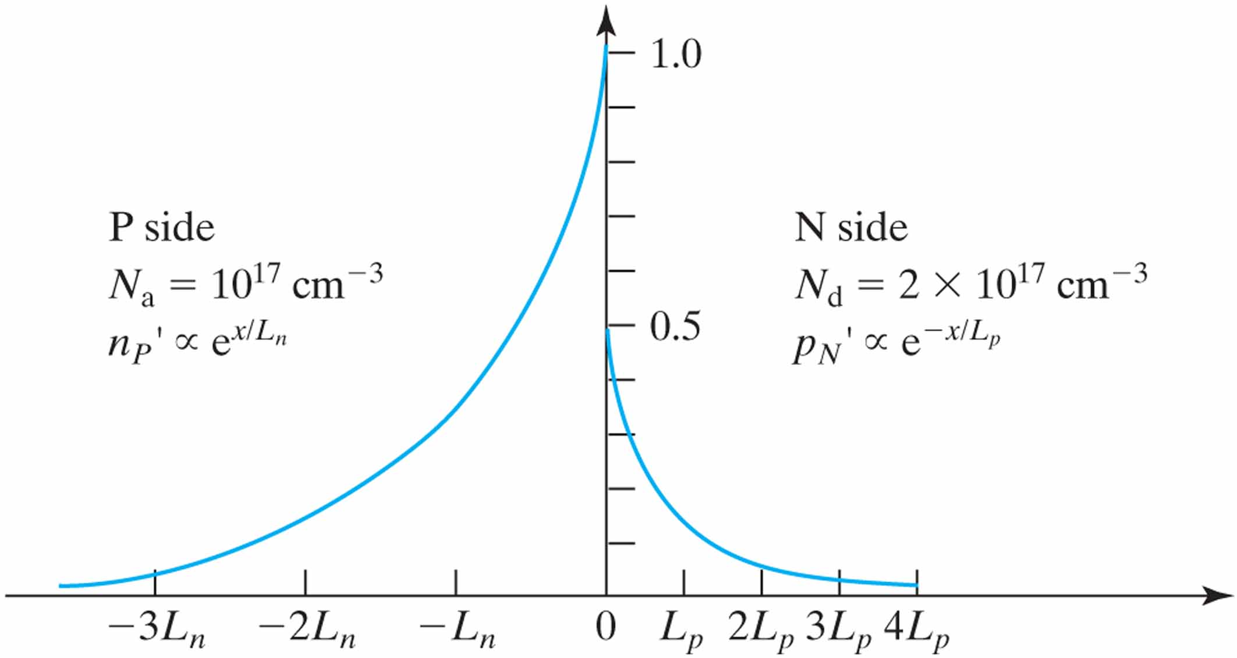
Figure 4.18 Normalized n' and p'. n'(0) = 2p'(0) because N_{d} = 2N_{a}. L_{n} = 2L_{p} is assumed.

Slide 8
Neutral Region
increasing
N
+
N
reverse bias
P
a
x
0
p
⎡
⎤
1
/
2
(a)
2
qN
E
=
E
(
0
)
=
⎢
(
φ
+
|
V
|)
⎥
E
p
ε
bi
r
E
⎣
s
⎦
p
increasing reverse bias
ε
E
2
V
=
s
crit
−
φ
x
B
2
qN
bi
x
p
(b)

Slide 9
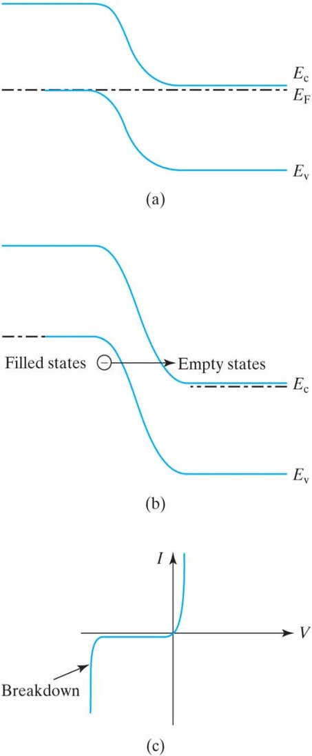
E
=
E
≈
10
6
V/cm
p
crit

Slide 10
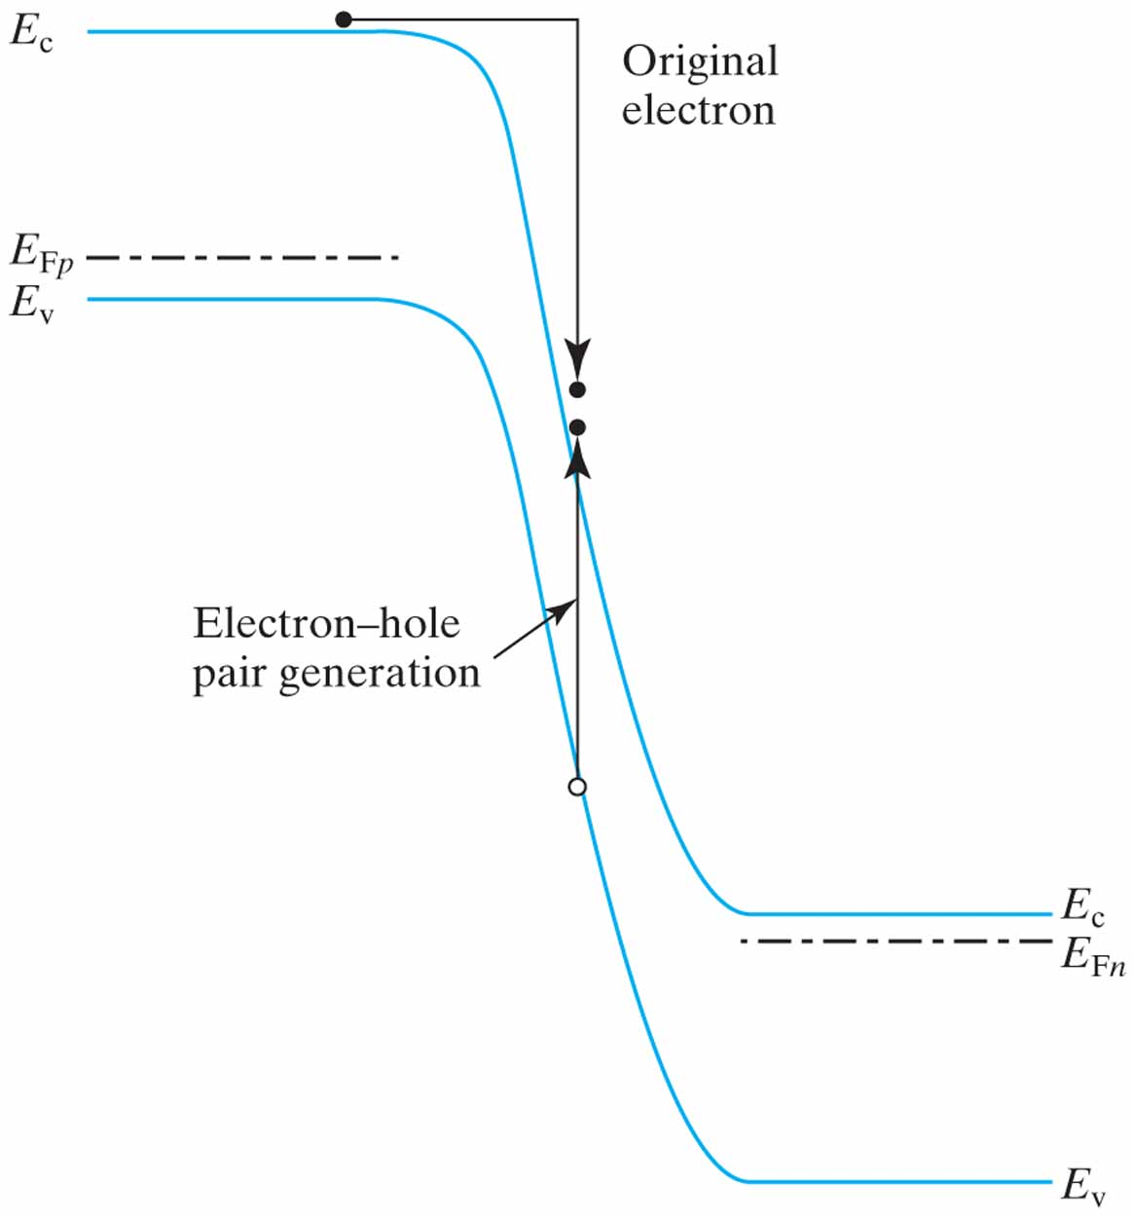
ε
E
2
V
=
s
crit
B
2
qN

Slide 11
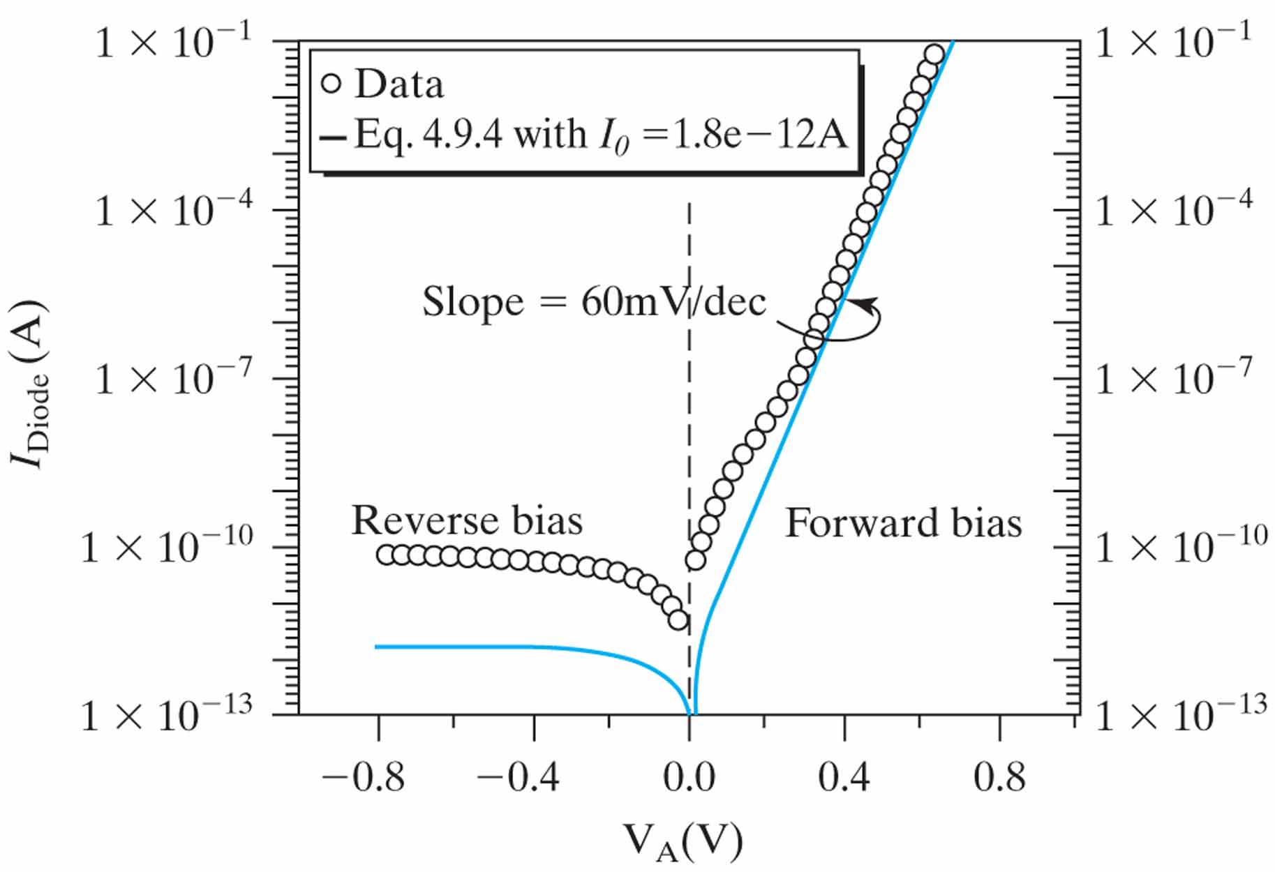

Slide 12
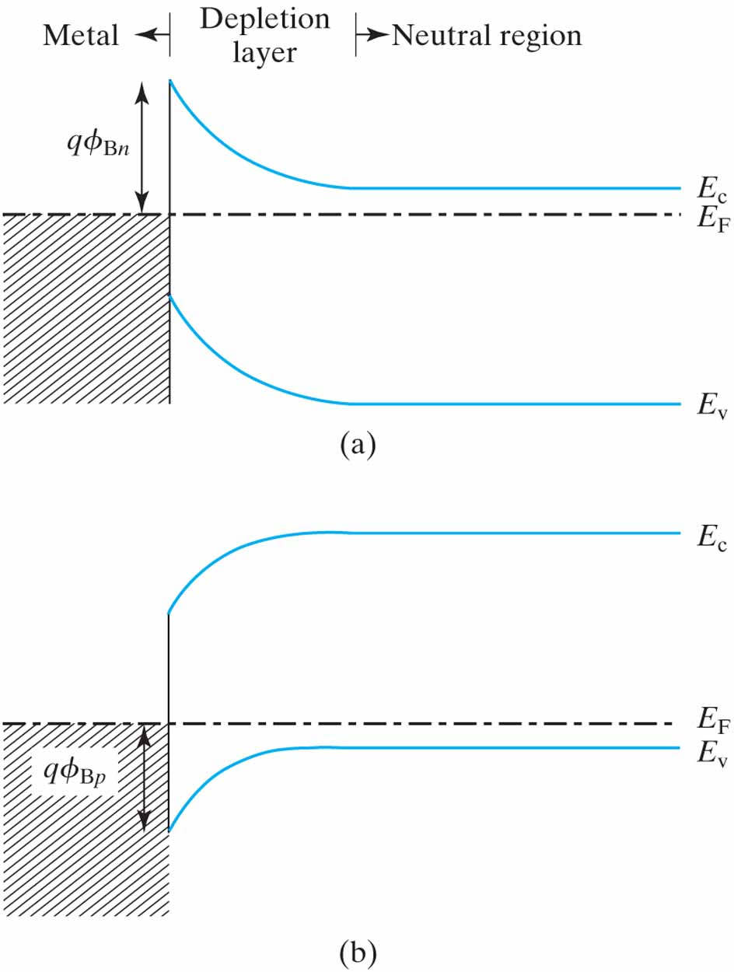
Figure 4.34 Energy band diagram of a metal–semiconductor contact. The Schottky barrier heights depend on the metal and semiconductor materials. (a) ϕ_{Bn} is the barrier against electron flow between the metal and the N-type semiconductor; (b) ϕ_{Bp} is the barrier against hole flow between the metal and the P-type semiconductor.

Slide 13
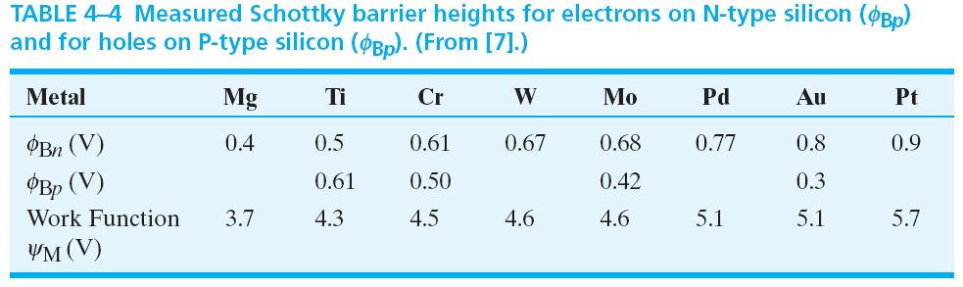
Table 4.4 Measured Schottky barrier heights for electrons on N-type silicon (ϕ_{Bp}) and for holes on P-type silicon (ϕ_{Bp}). (From [7].)

Slide 14
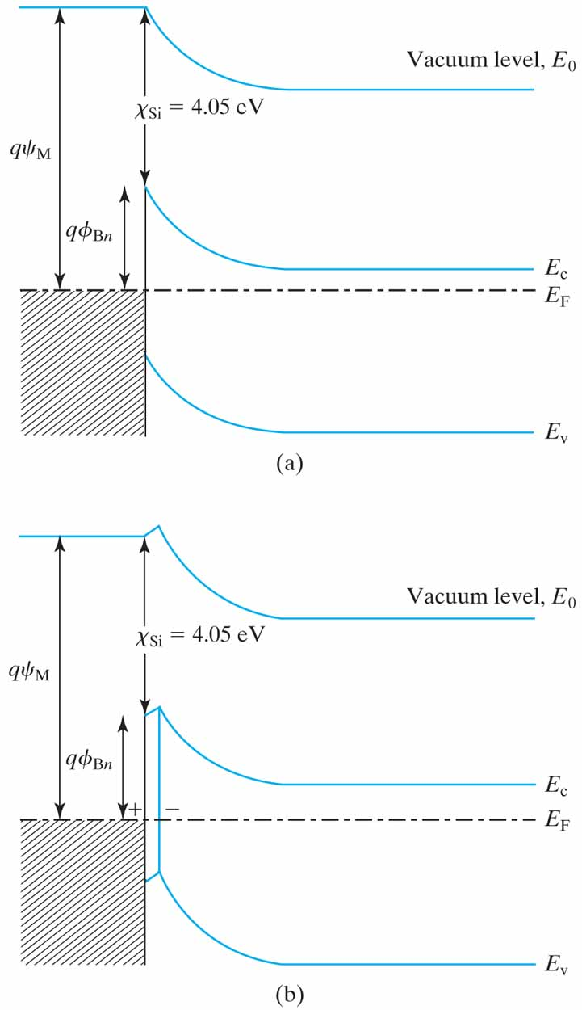
Figure 4.35 (a) An “ideal” metal–semiconductor contact and (b) in a real metal–semiconductor contact, there is a dipole at the interface.

Slide 15
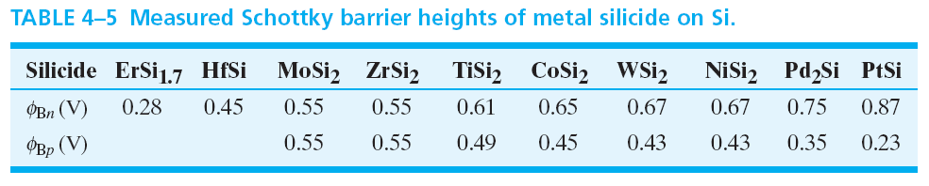
Table 4.5 Measured Schottky barrier heights of metal silicide on Si.

Slide 16
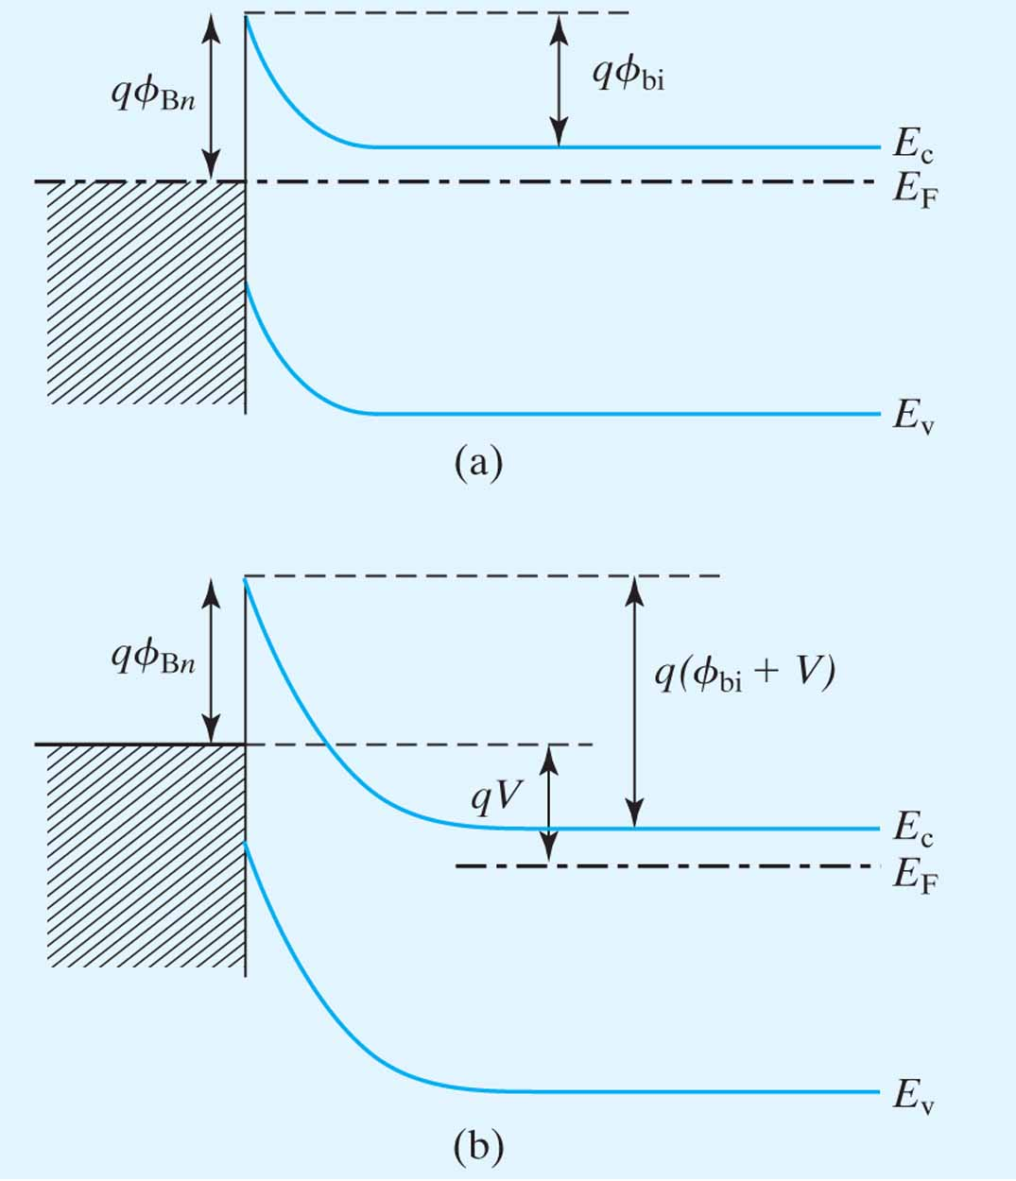
Figure 4.36 The potential across the depletion layer at the Schottky junction. (a) No voltage applied; (b) a negative voltage (reverse bias) is applied to the metal.

Slide 17
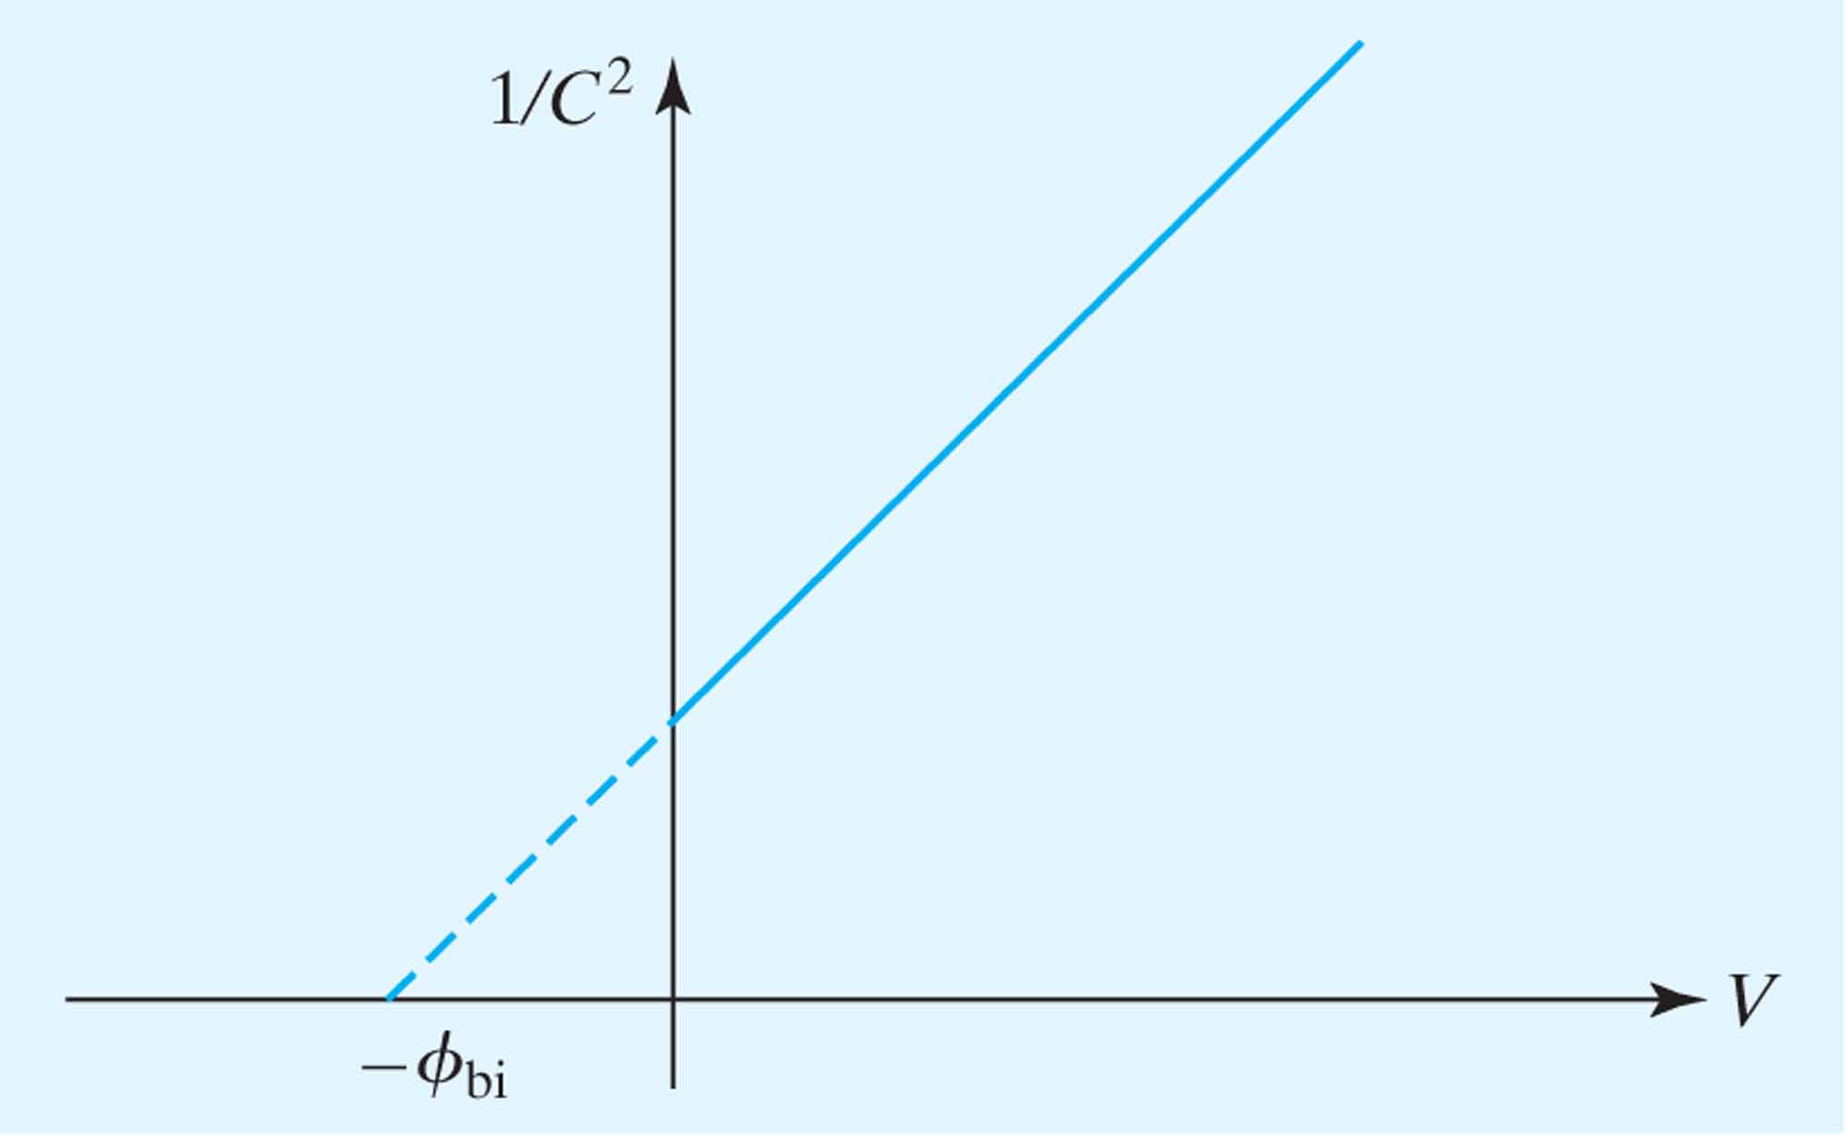
Figure 4.37 ϕ_{bi} (and hence ϕ_{B}) can be extracted from the C–V data as shown.

Slide 18
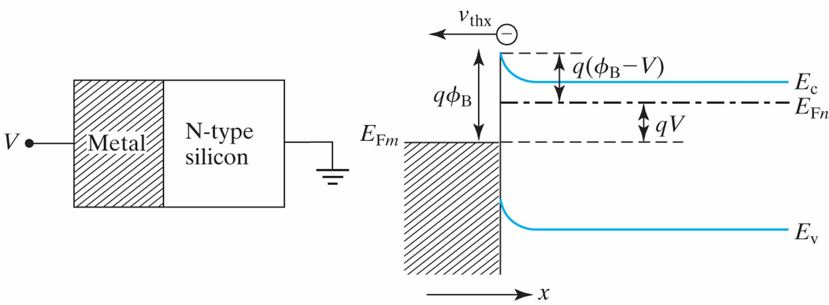
Figure 4.38 Energy band diagram of a Schottky contact with a forward bias V applied between the metal and the semiconductor.

Slide 19
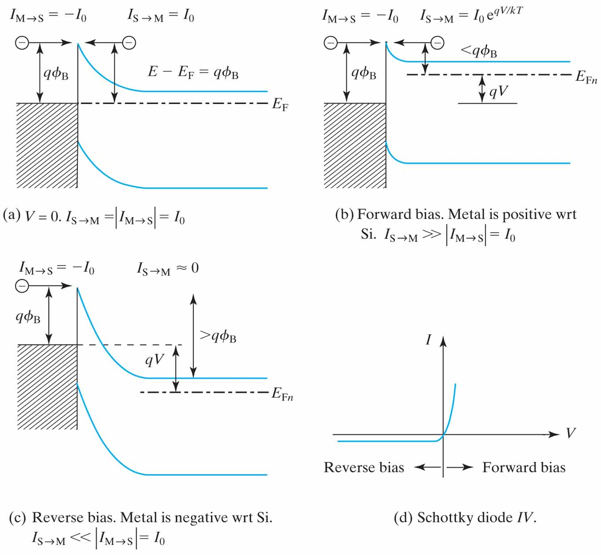
Figure 4.39 Explanation of the rectifying IV characteristics of Schottky diodes. The arrows in the subscripts indicate the direction of electron flows.

Slide 20
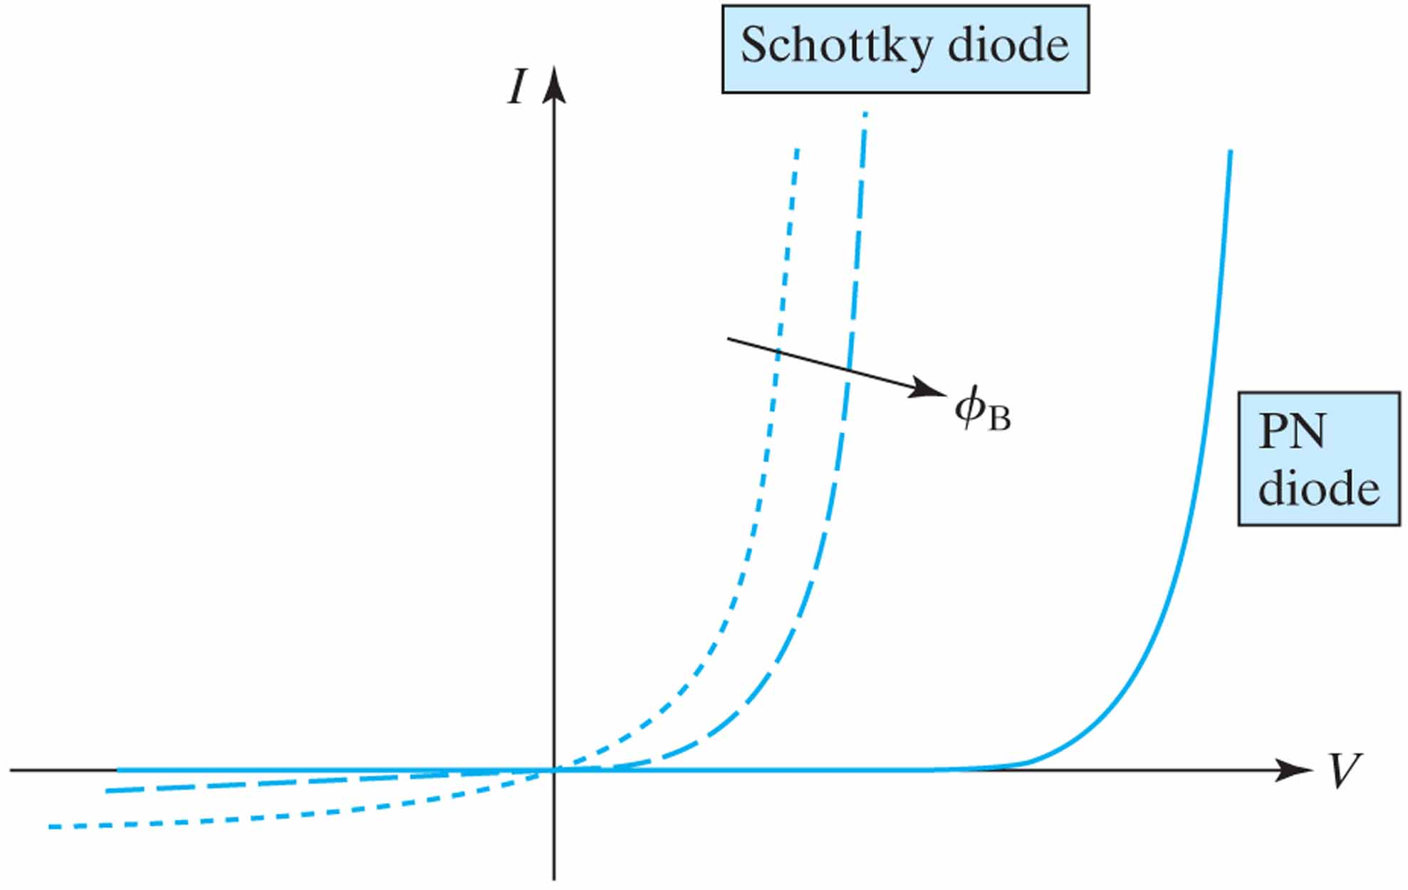
Figure 4.40 Schematic IV characteristics of PN and Schottky diodes having the same area.

Slide 21
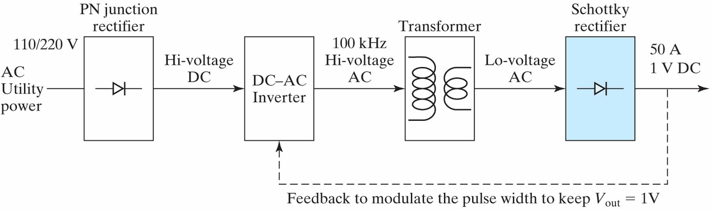
Figure 4.41 Block diagram of a switching power supply for electronic equipment such as PCs.

Slide 22
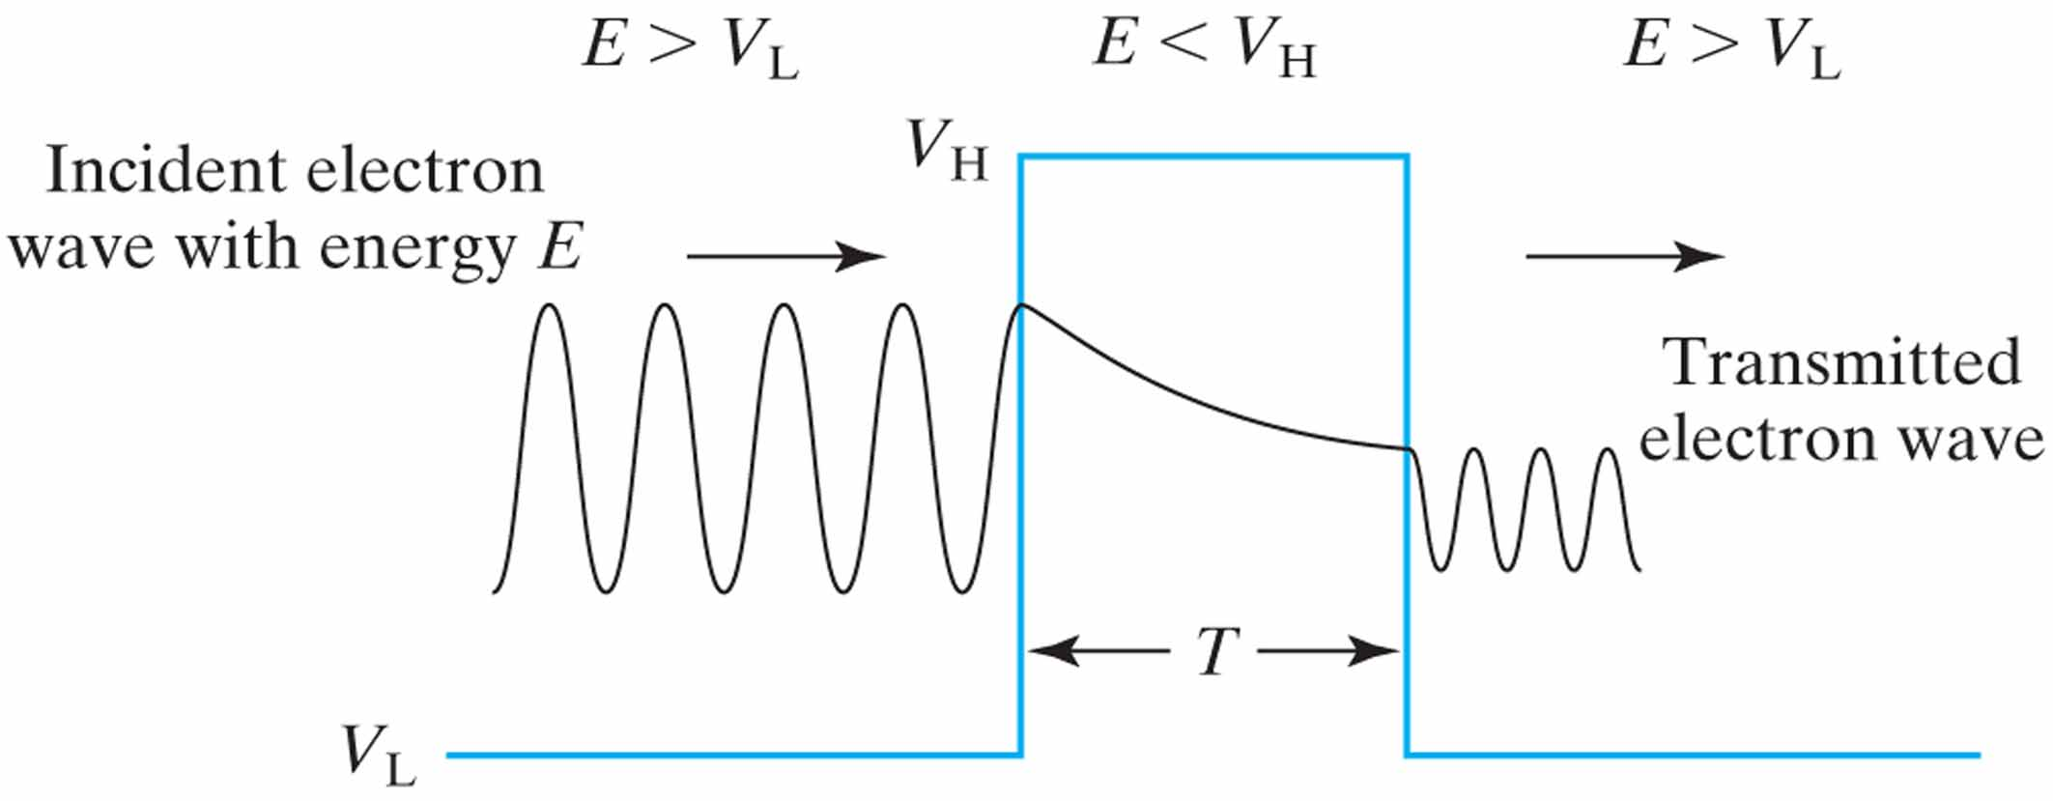
Figure 4.42 Illustration of quantum mechanical tunneling.

Slide 23
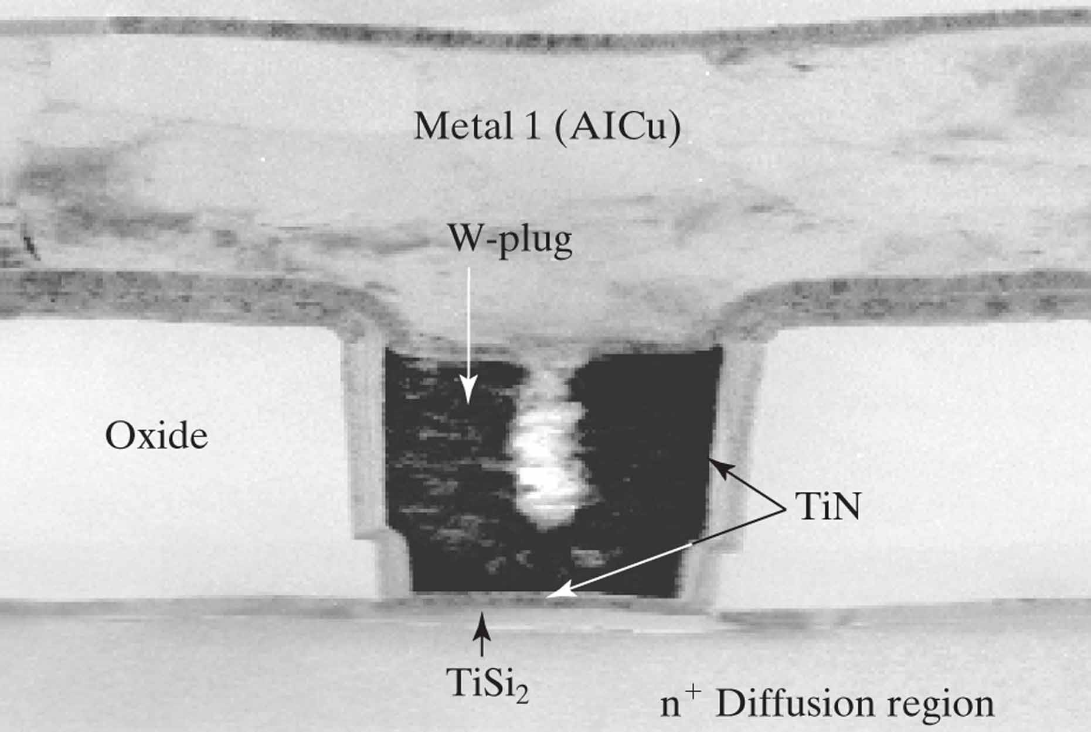
Figure 4.43 A contact structure. A film of metal silicide is formed before the dielectriclayer deposition and contact-hole etching. (From [11]. © 1999 IEEE.)

Slide 24
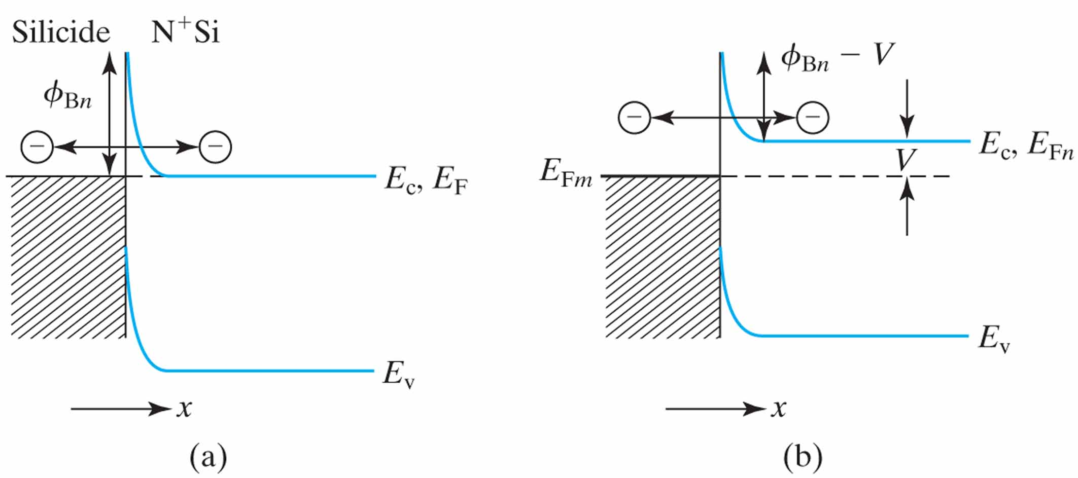
Figure 4.44 (a) Energy band diagram of metal–N⁺ Si contact with no voltage applied and (b) the same contact with a voltage, V, applied to the contact.

Slide 25
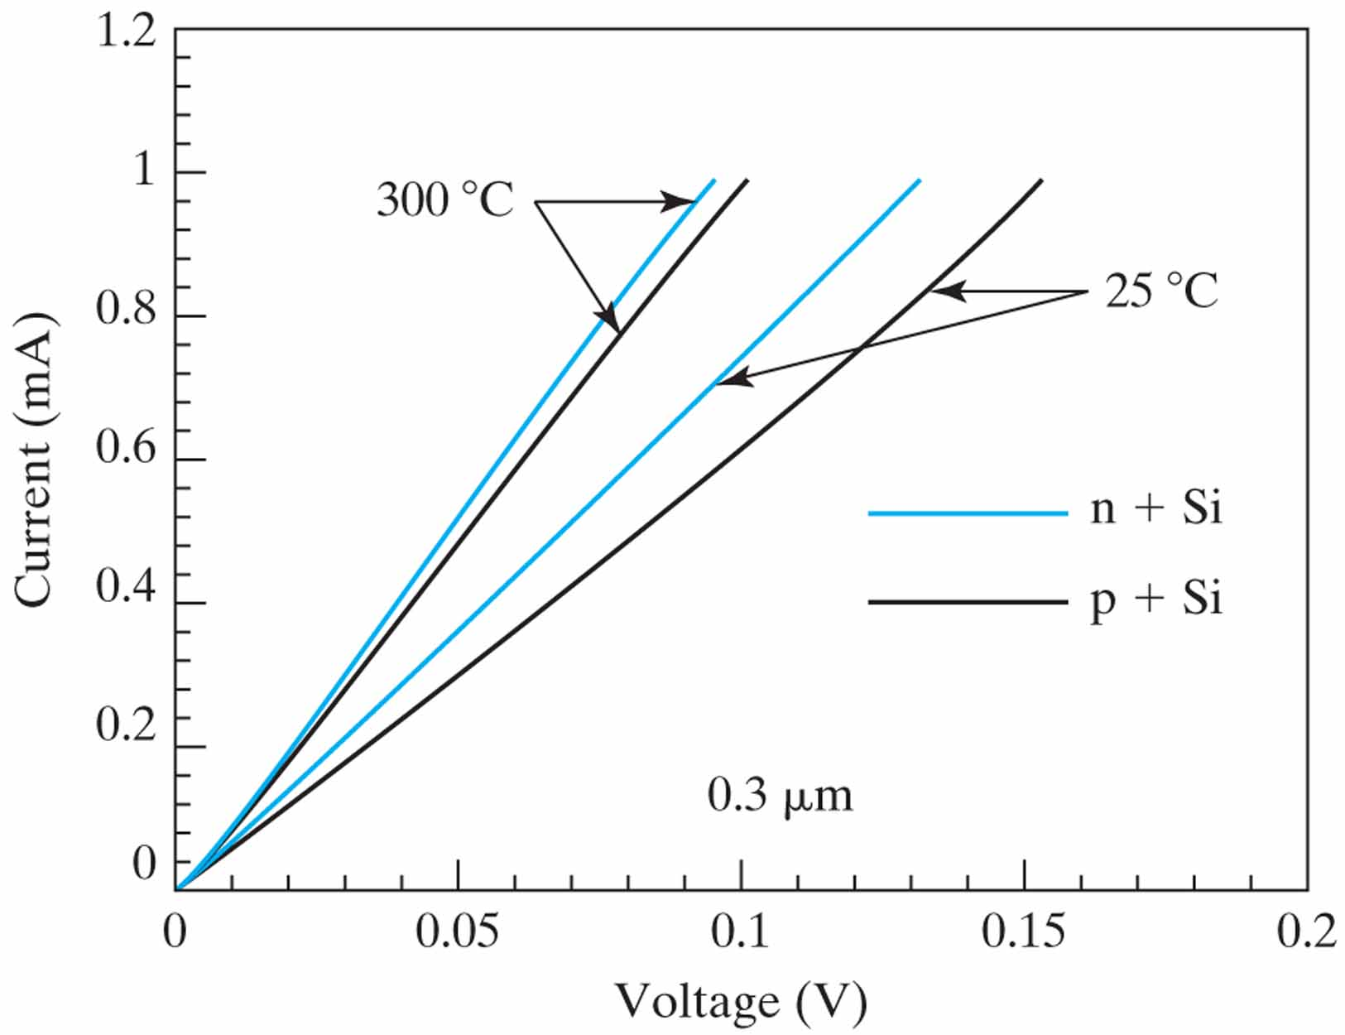
Figure 4.45 The IV characteristics of a 0.3 µm (diameter) TiSi₂ contact on N⁺-Si and P⁺-Si. (From [11]. ©1999 IEEE.)

Slide 26
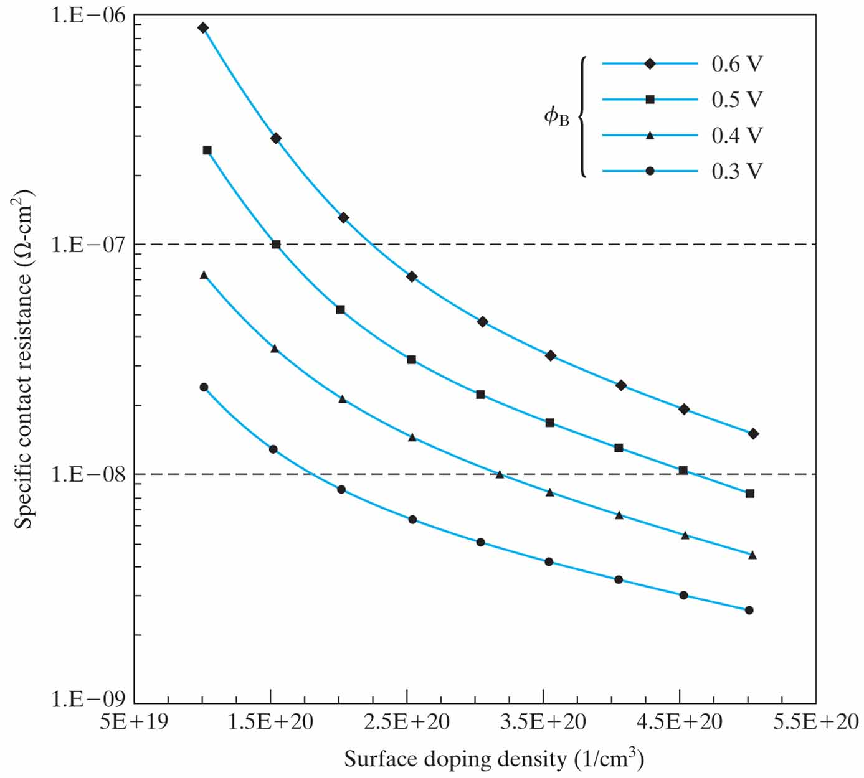
Figure 4.46 Theoretical specific contact resistance. (After [12].)

