Slide 1
Fråga 12.1
Vilket randvillkor gäller vid x=L₂ om diffusionskonstanten är 18 cm²/s
p’(x=L₂)=0
p’(x=∞)=0
n’(x=L₂)=0
n’(x= ∞)=0

Slide 2
Fråga 12.2
Vad är sant för en struktur med n-p-n dopning. När går en stor ström från första n- till andra n-området?
Om det första n-området ansluts till positiv potential och det andra till negativ.
Om det första n-området ansluts till negativ potential och det andra till positiv.
Om p-området ansluts till positiv potential och det andra n-området till negativ.
Om p-området ansluts till positiv potential och det andra n-området till postiv.

Slide 3
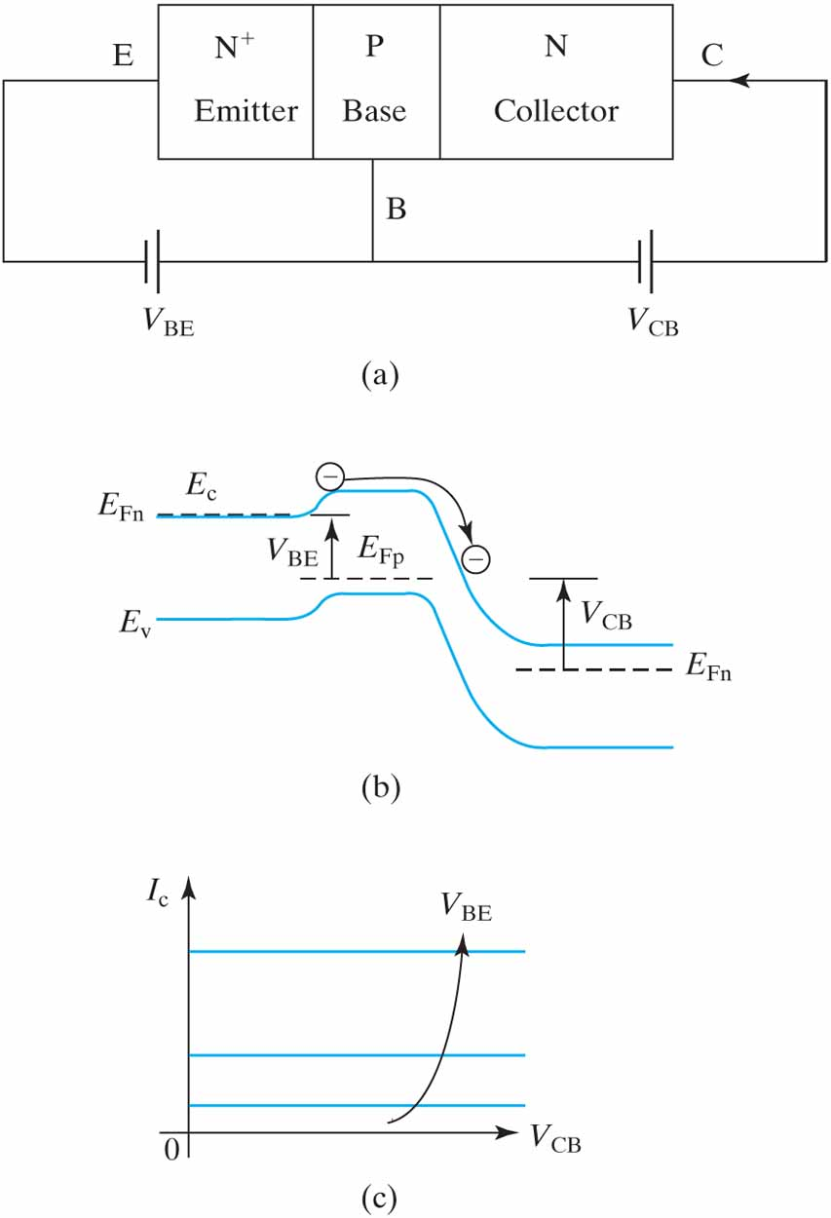
Figure 8.1 (a) Schematic NPN BJT and normal voltage polarities; (b) electron injection from emitter into base produces and determines I_{C} ; and (c) I_{C} is basically determined by V_{BE} and is insensitive to V_{CB}.

Slide 4
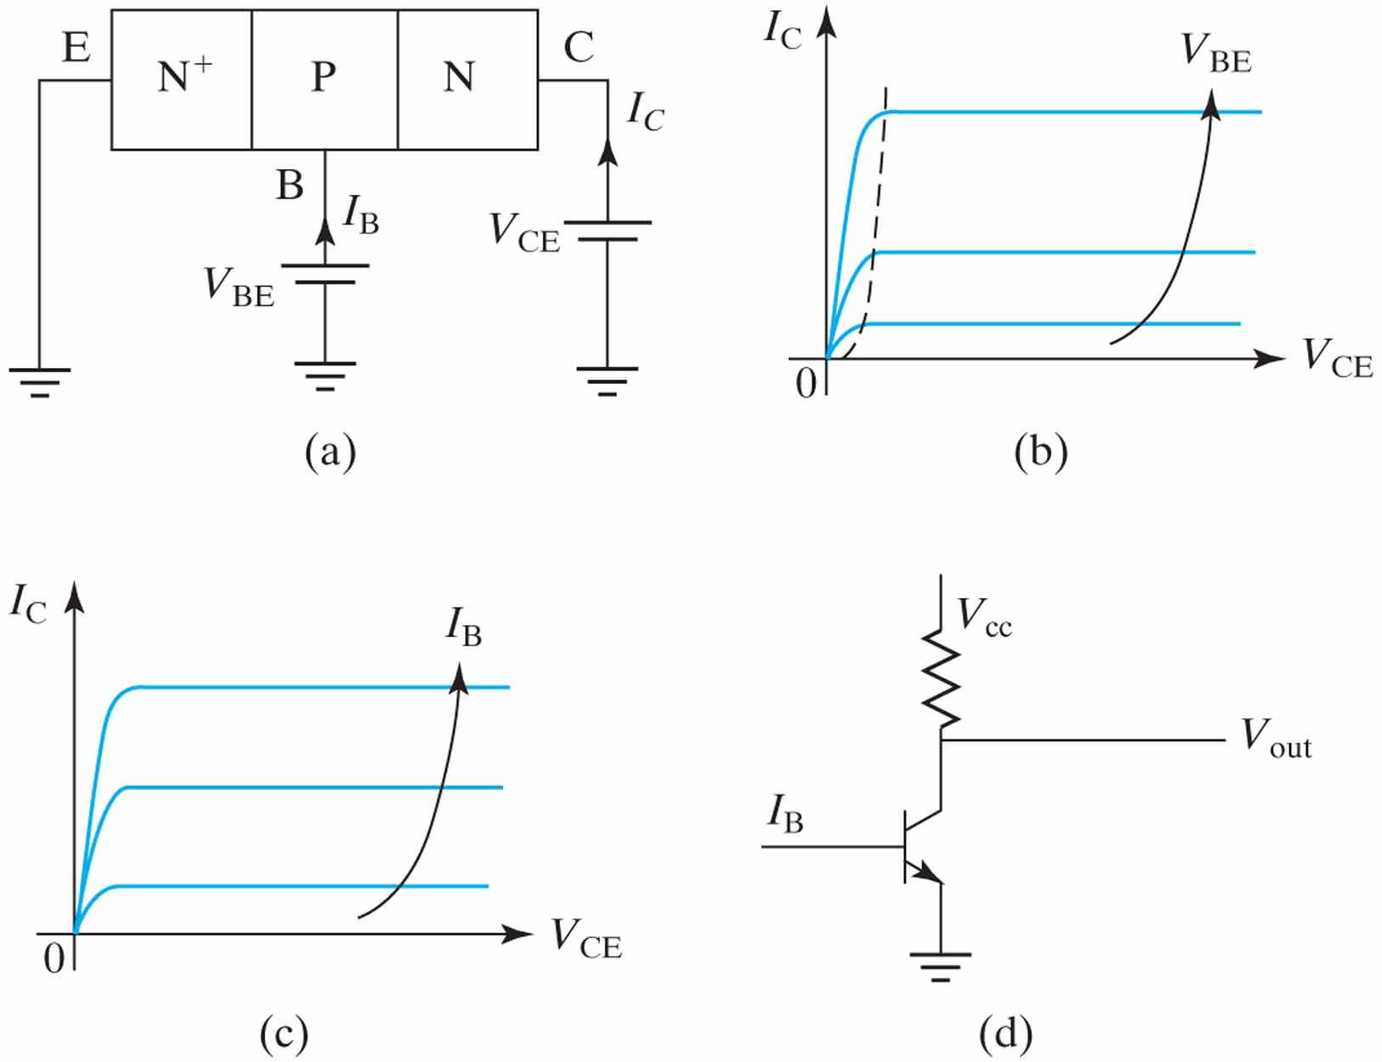
Figure 8.2 (a) Common-emitter convention; (b) I_{C} vs. V_{CE}; (c) I_{B} may be used as the parameter instead of V_{BE}; and (d) circuit symbol of an NPN BJT and an inverter circuit.

Slide 5
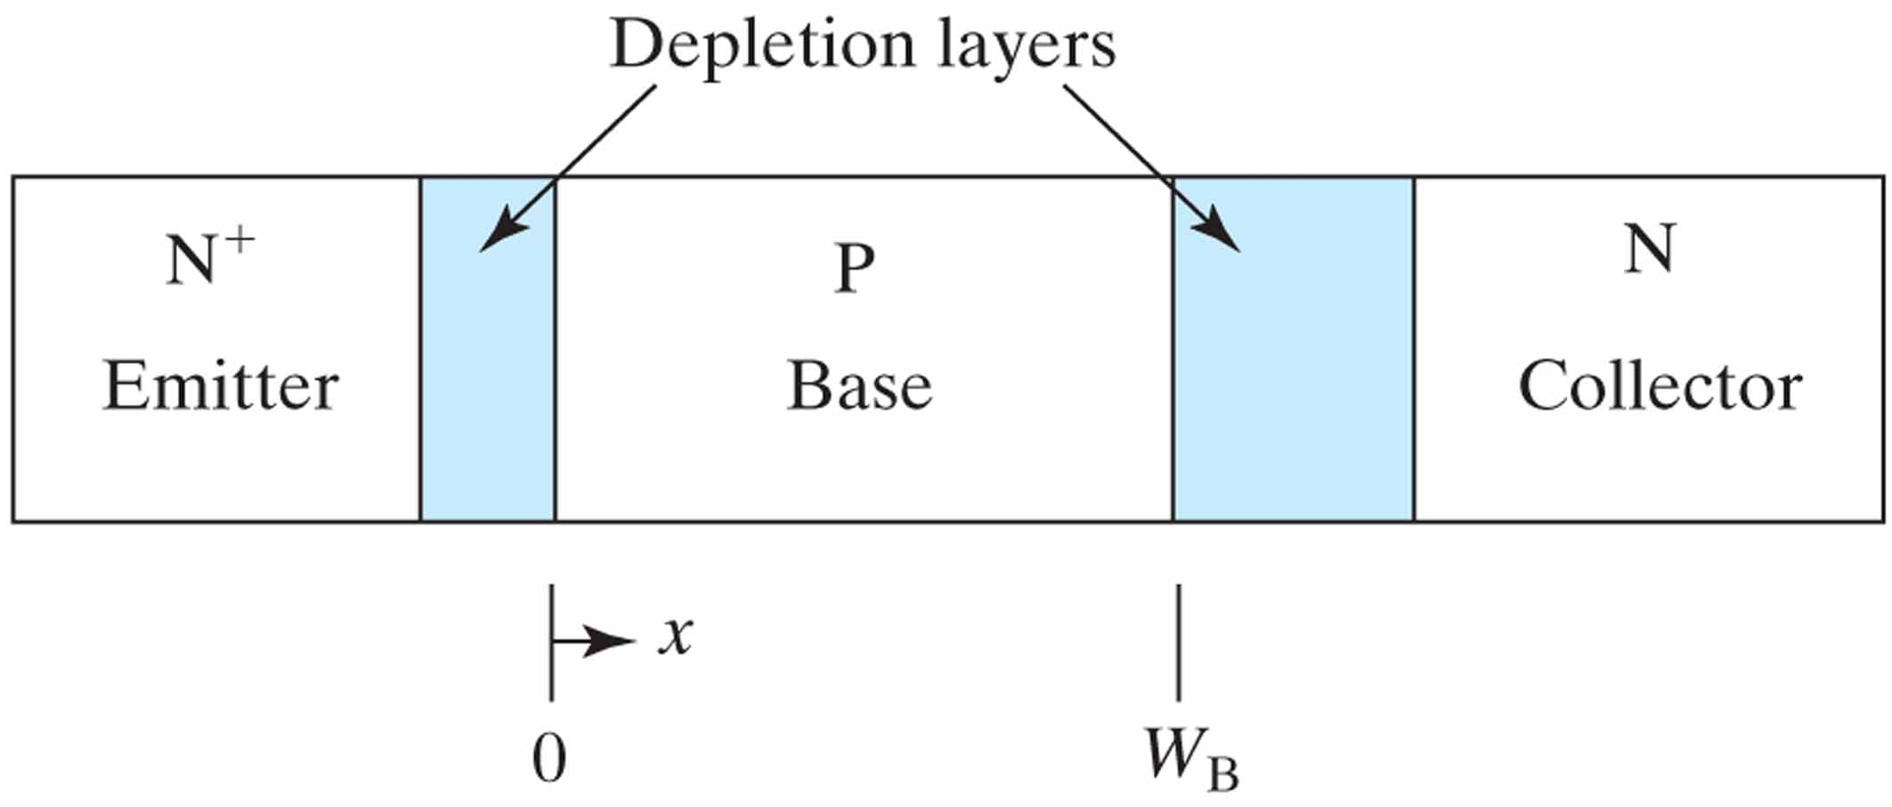
Figure 8.3 x = 0 is the edge of the BE junction depletion layer. W_{B} is the width of the base neutral region.

Slide 6
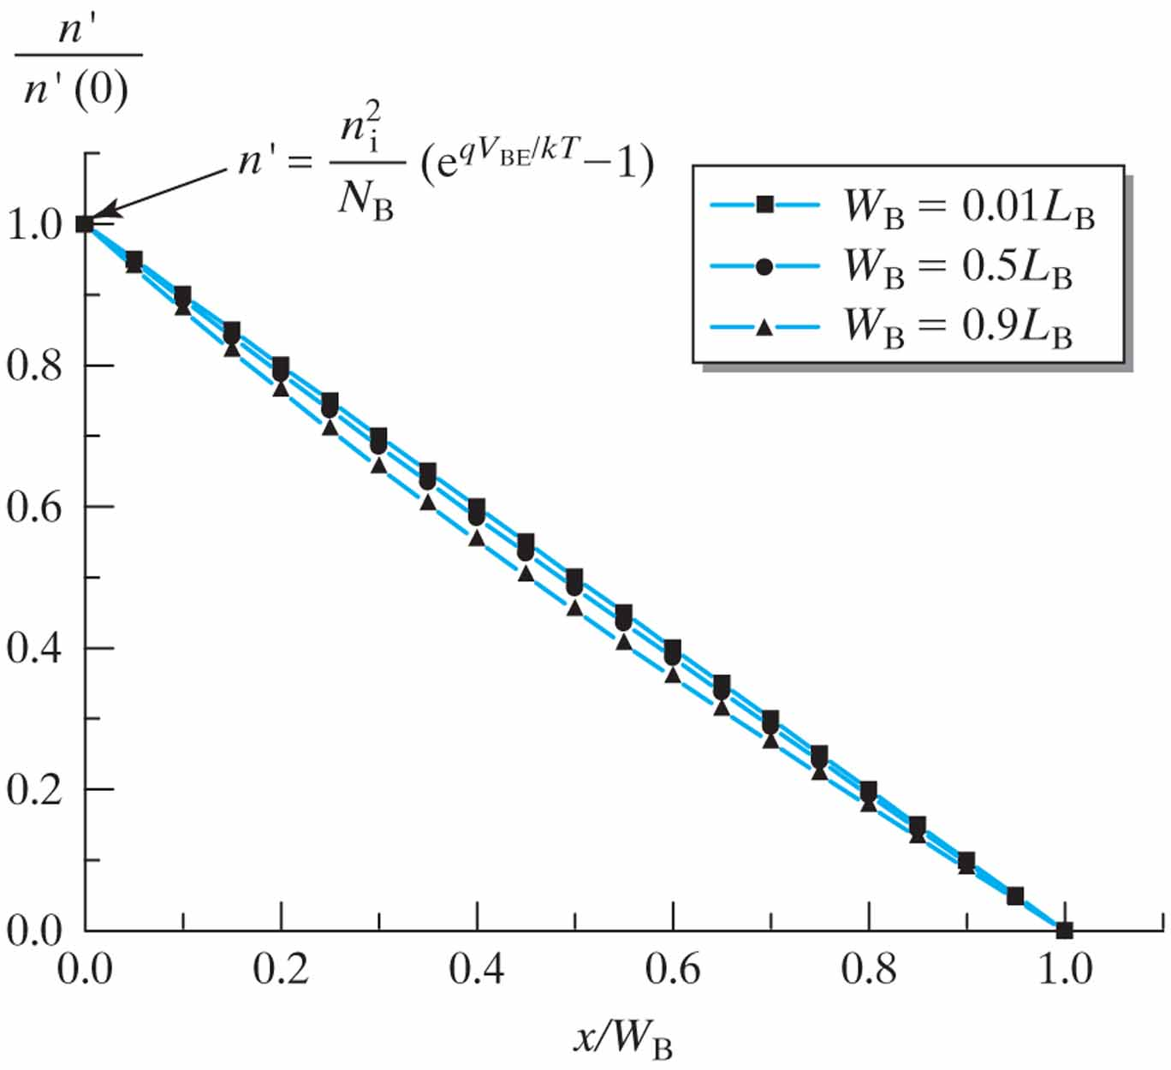
Figure 8.4 When W_{B} << L_{B}, the excess minority carrier concentration in the base is approximately a linear function of x.

Slide 7
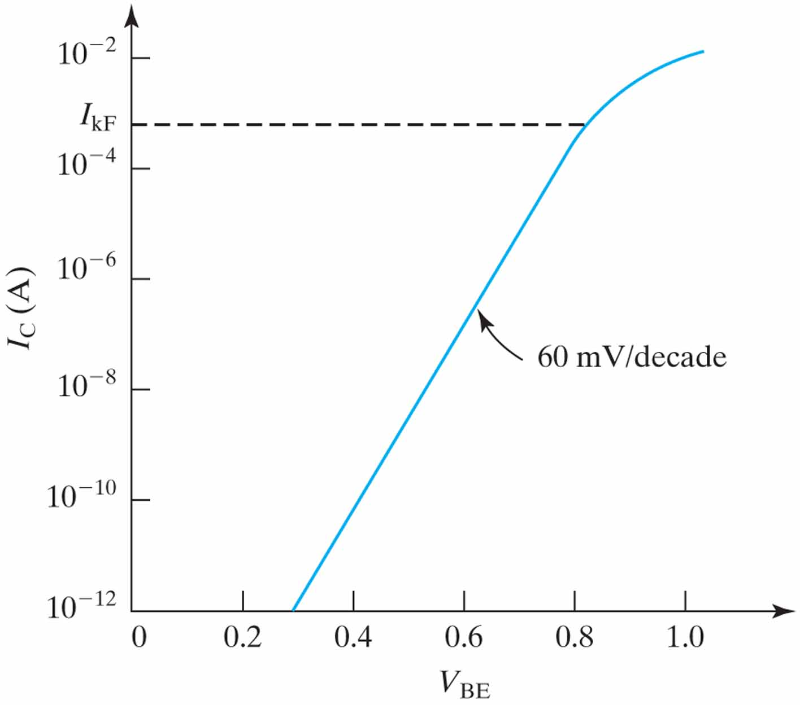
Figure 8.5 I_{C} is an exponential function of V_{BE}.

Slide 8
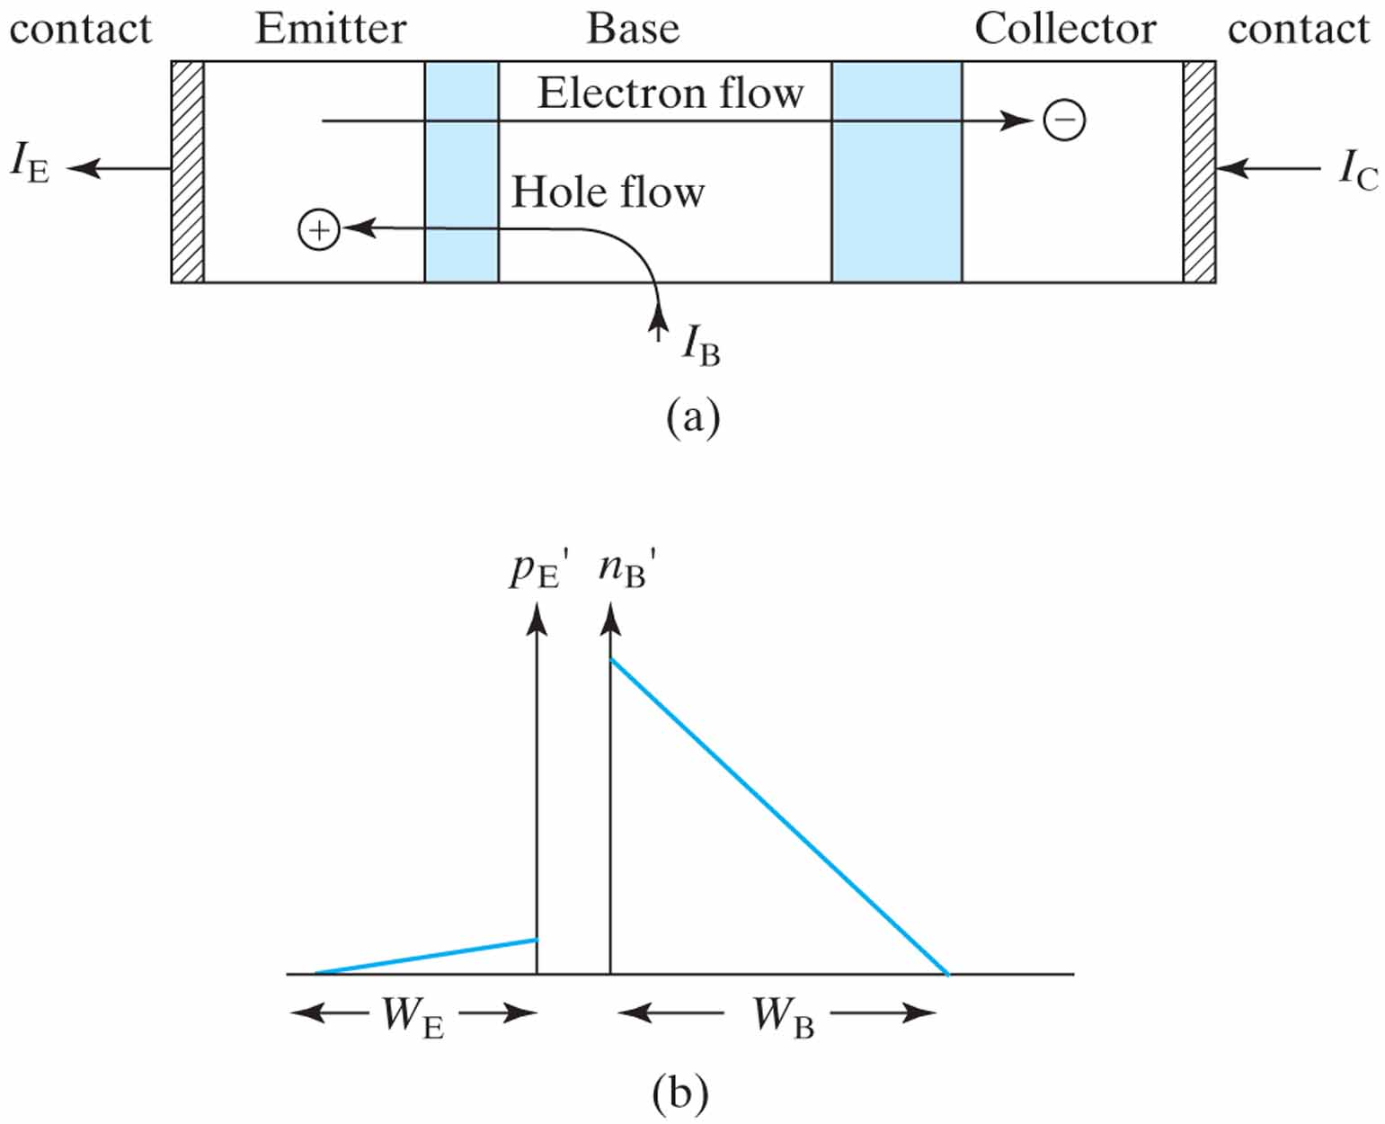
Figure 8.6 (a) Schematic of electron and hole flow paths in BJT; (b) hole injection into emitter closely parallels electron injection into base.²
¹ A good metal–semiconductor ohmic contact (at the end of the emitter) is an excellent source and sink of carriers. Therefore, the excess carrier concentration is assumed to be zero.

Slide 9
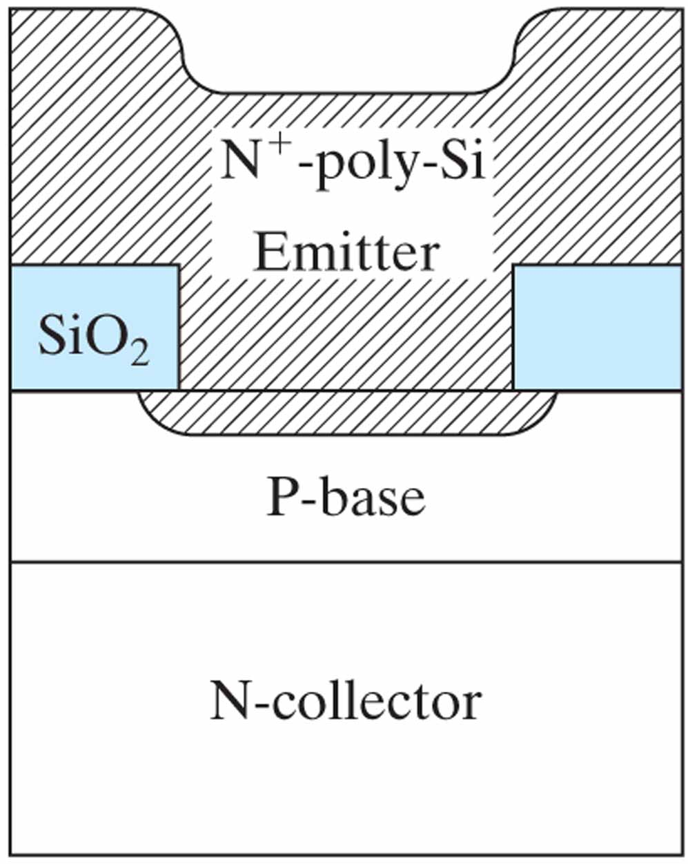
Figure 8.7 Schematic illustration of a poly-Si emitter, a common feature of high-performance BJTs.

Slide 10
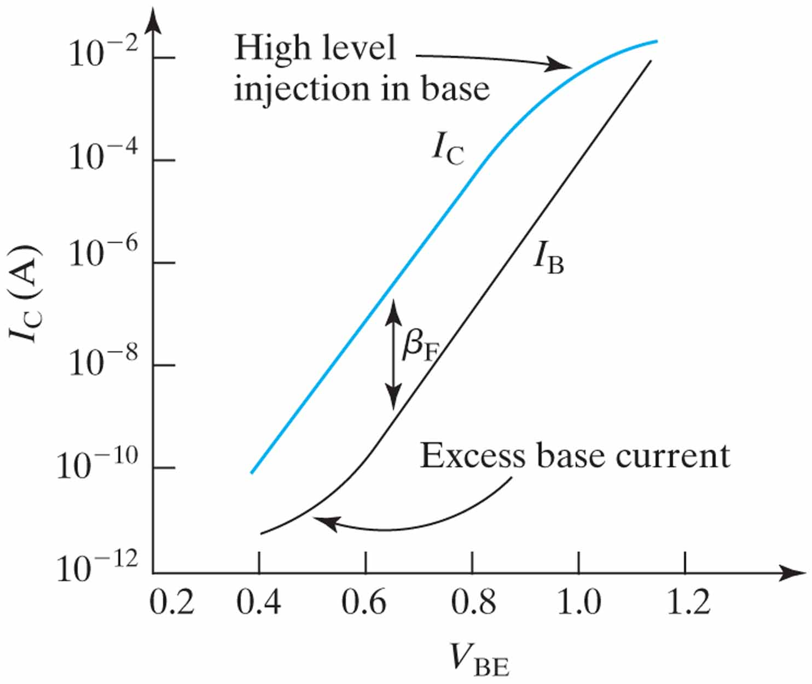
Figure 8.8 Gummel plot of I_{C} and I_{B} indicates that β_{F} (= I_{C}/I_{B}) decreases at high and low I_{C}.

Slide 11
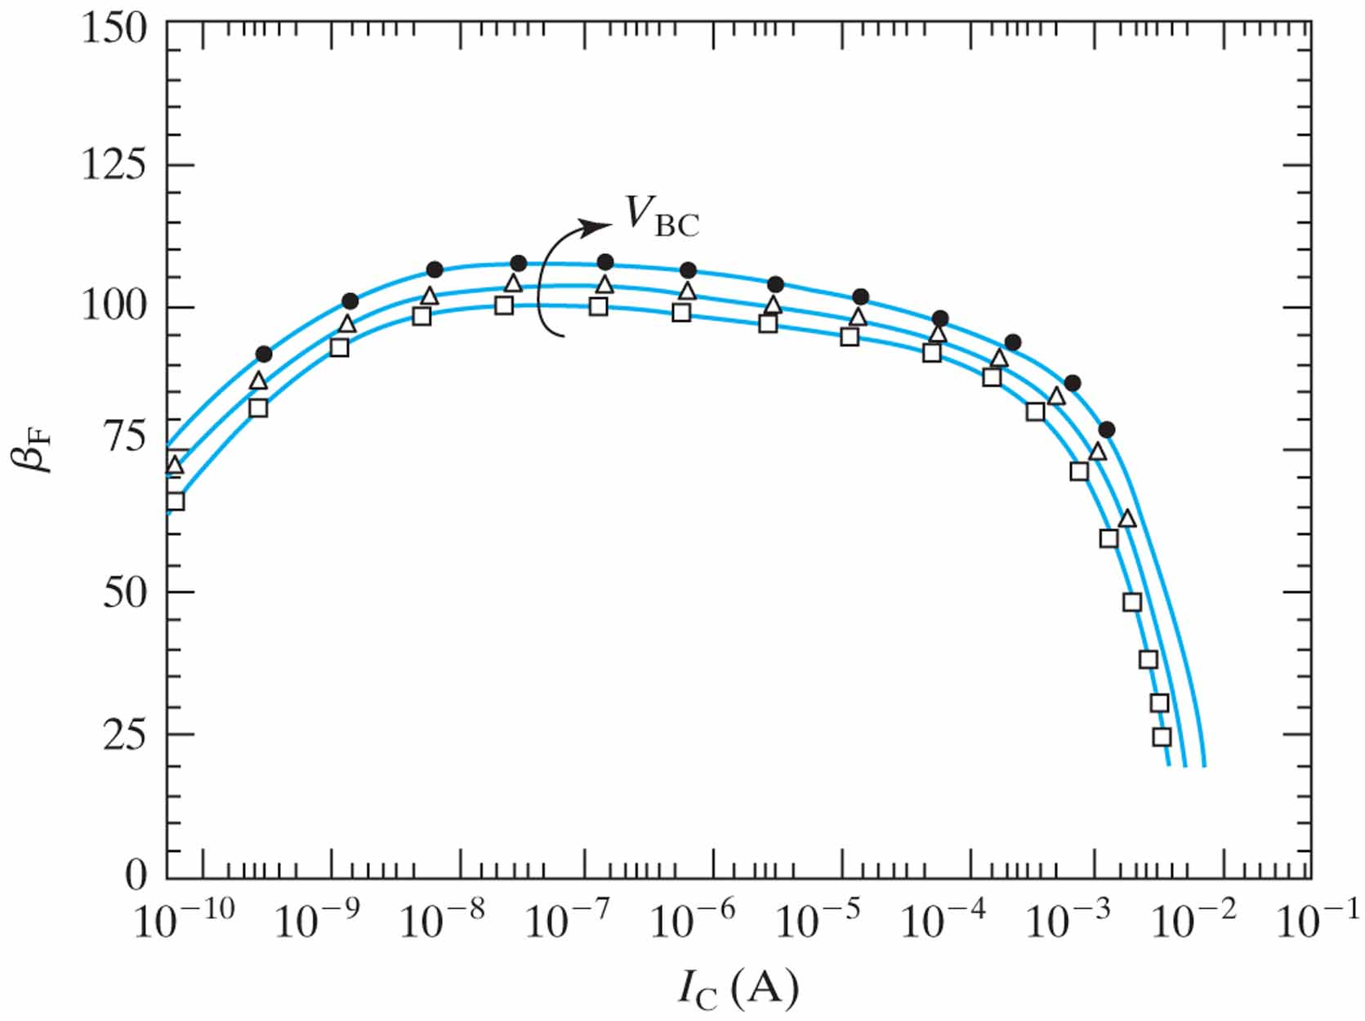
Figure 8.9 Fall-off of current gain at high- and low-current regions. A_{E} = 0.6 × 4.8 µm2. From top to bottom: V_{BC} = 2, 1 and 0 V. Symbols are data. Lines are from a BJT model for circuit simulation. (From [3].)

Slide 12
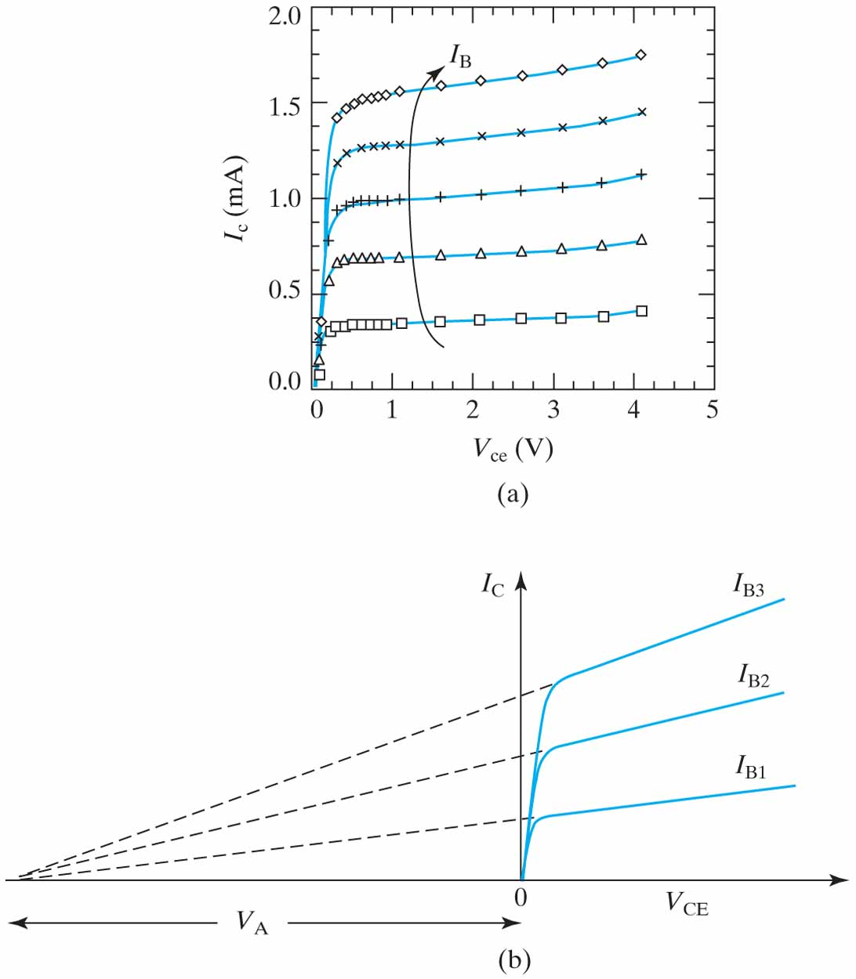
Figure 8.10 BJT output conductance: (a) measured BJT characteristics. I_{B} = 4, 8, 12, 16, and 20 µA. (From [3].);
(b) schematic drawing illustrates the definition of Early voltage, V_{A}.

Slide 13
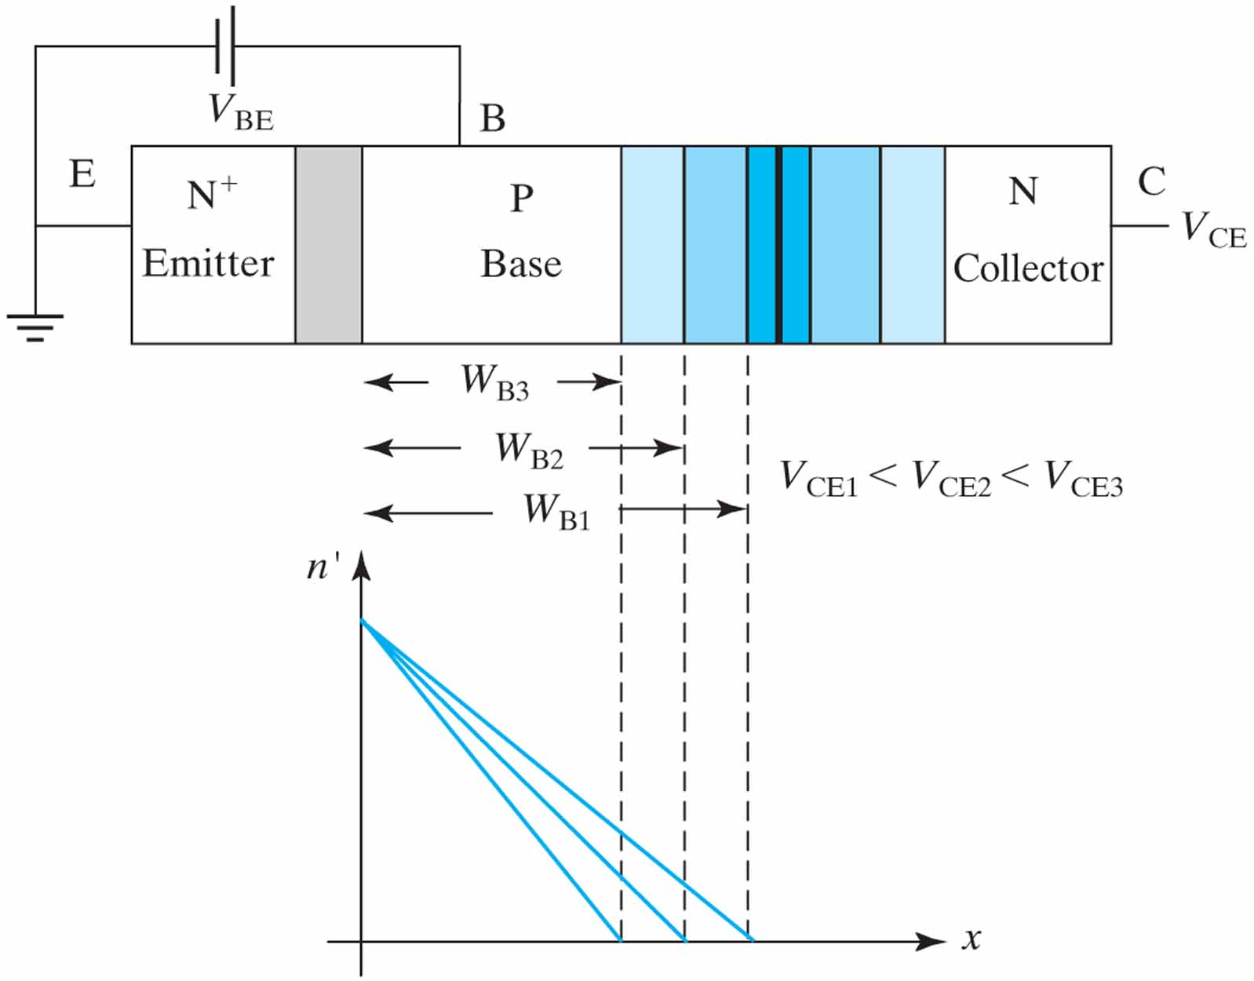
Figure 8.11 As V_{C} increases, the BC depletion layer width increases and W_{B} decreases causing dn’/dx and I_{C} to increase. In reality, the depletion layer in the collector is usually much wider than that in the base.

Slide 14
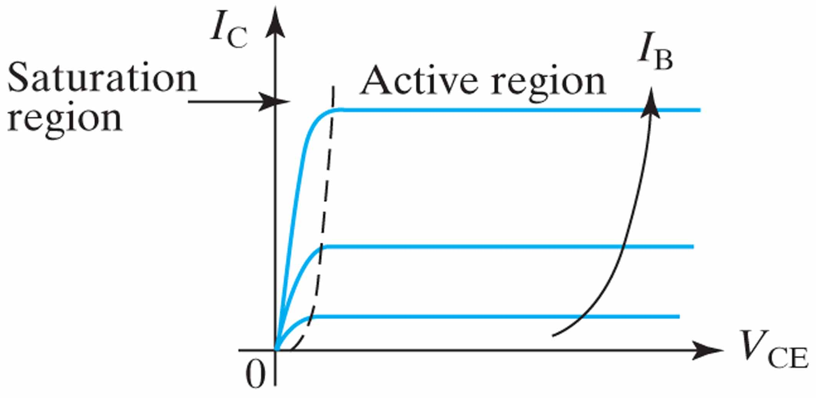
Figure 8.12 In the saturation region, I_{C} drops because the collector–base junction is significantly forward biased.

Slide 15
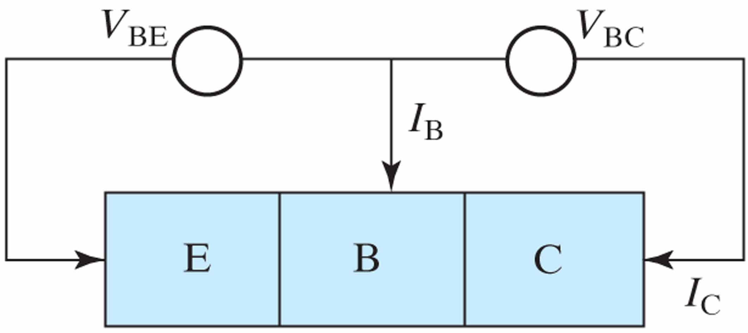
Figure 8.13 I_{C} is driven by two voltage sources, V_{BE} and V_{BC}.

Slide 16
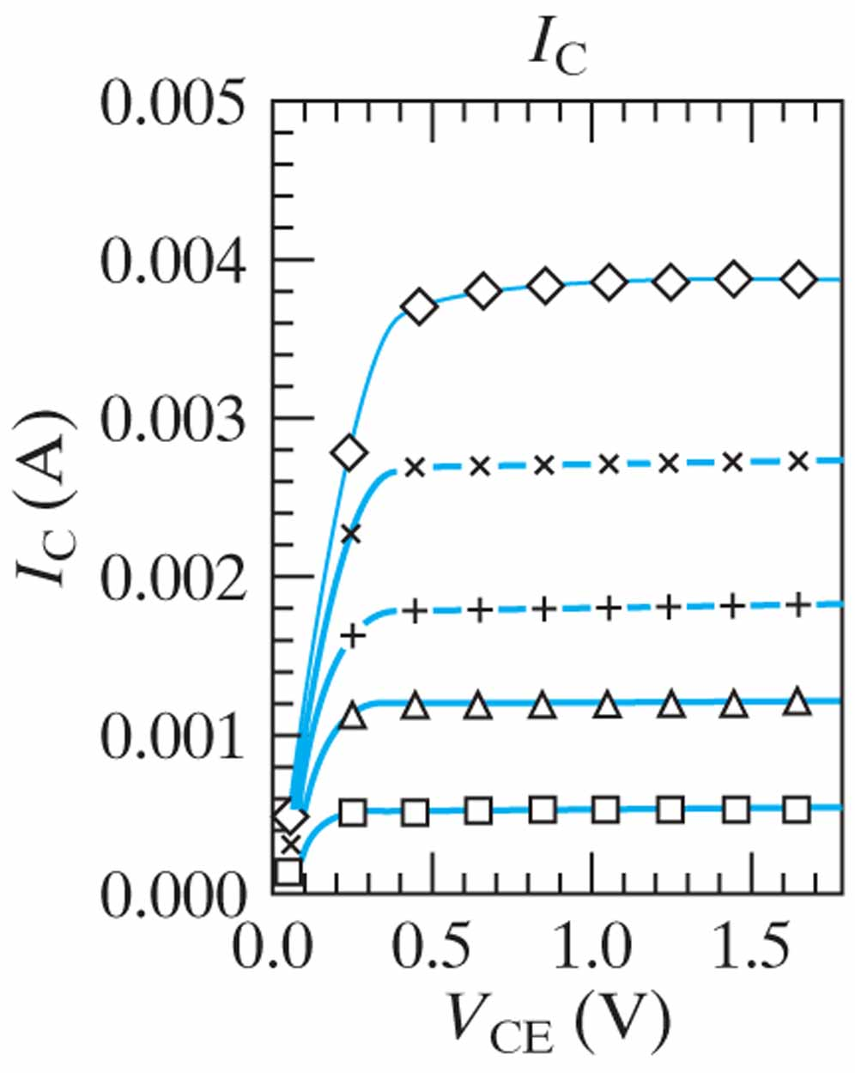
Figure 8.14 Ebers–Moll model (line) agrees with the measured data (symbols) in both the saturation and linear regions. I_{B} = 4.3, 11, 17, 28, and 43 µA. High-speed SiGe-base BJT. A_{E} = 0.25 × 5.75 µm². (From [3].)

Slide 17
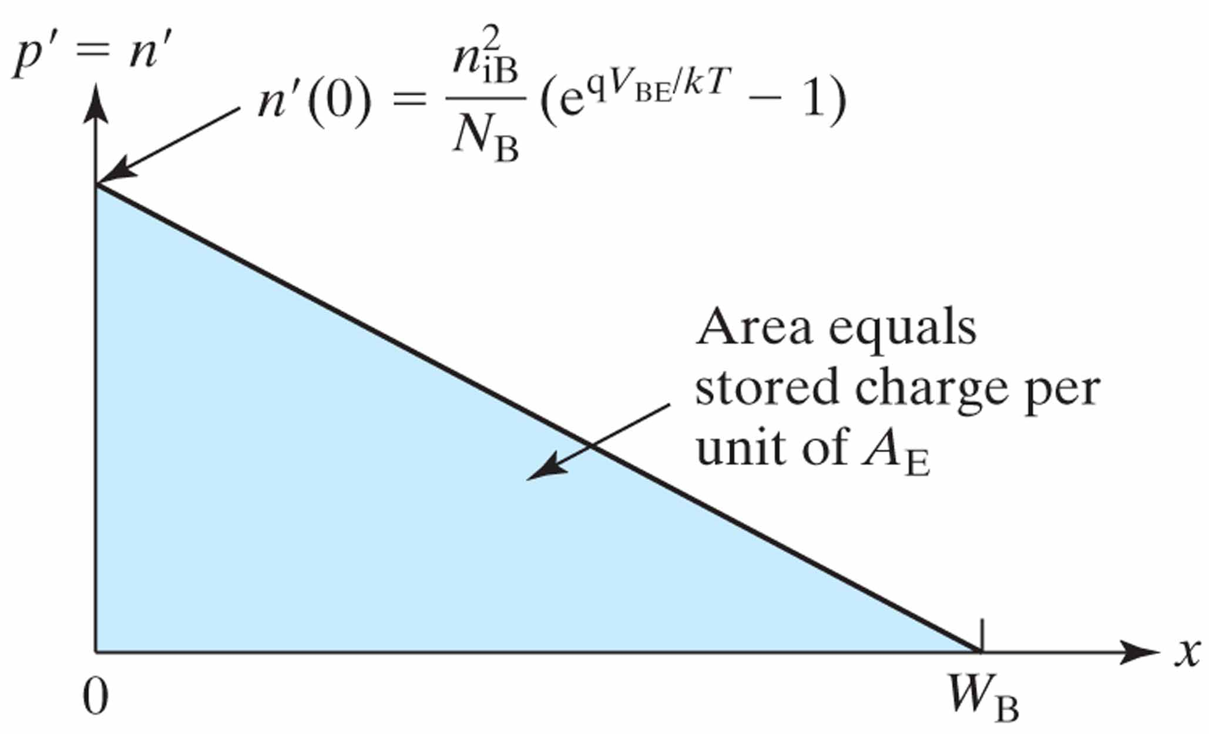
Figure 8.15 Excess hole and electron concentrations in the base. They are equal due to charge neutrality [Eq. (2.6.2)].

Slide 18
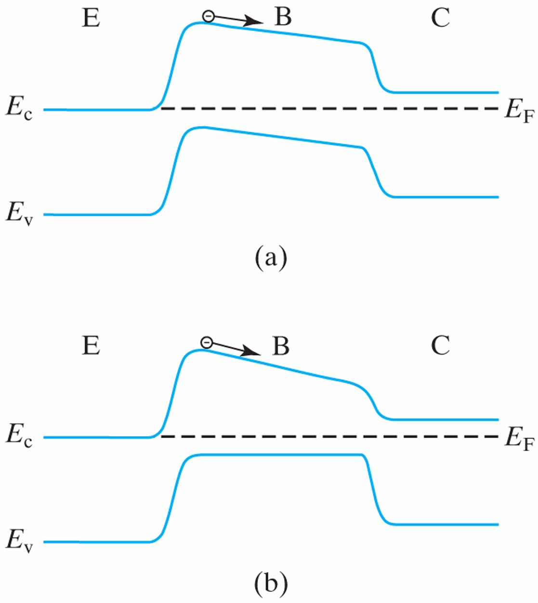
Figure 8.16 Two ways of building dE_{C}/dx into the base. (a) E_{gB} fixed, N_{B} decreasing from emitter end to collector end; (b) N_{B} fixed, E_{gB} decreasing from emitter end to collector end.

Slide 19
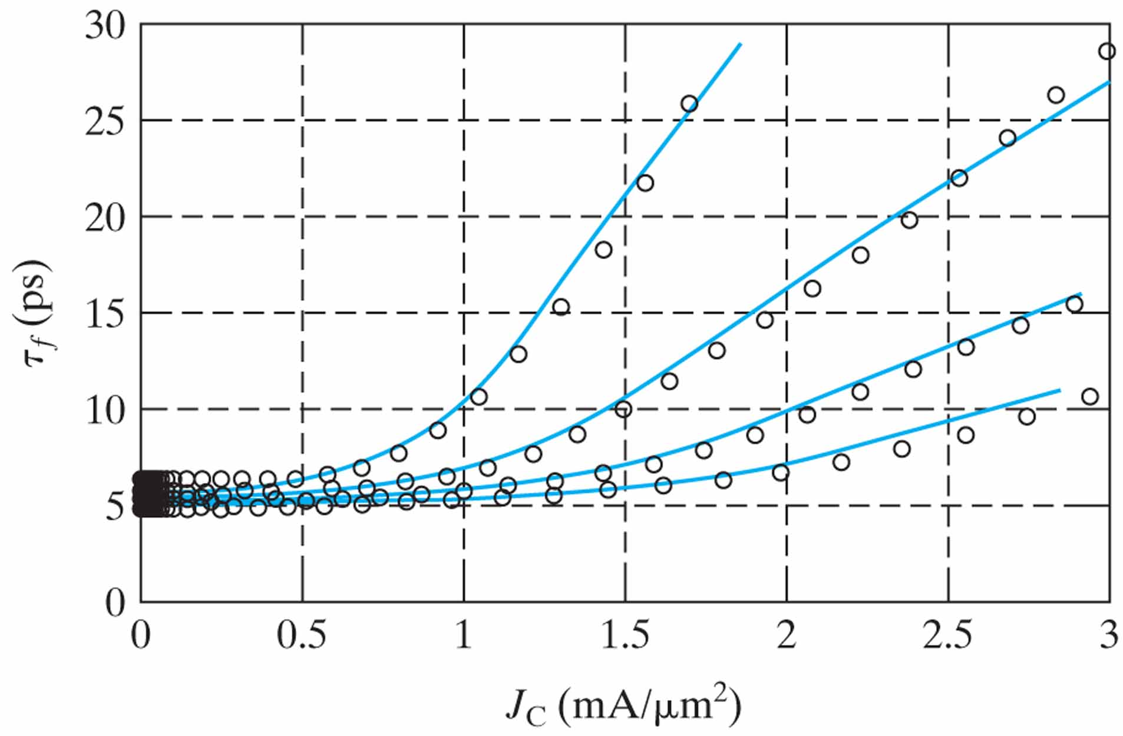
Figure 8.17 Transit time vs. I_{C}/A_{E}. From top to bottom: V_{CE} = 0.5, 0.8, 1.5, and 3 V. The rise at high I_{C} is due to base widening (Kirk effect). (From [3].)

Slide 20
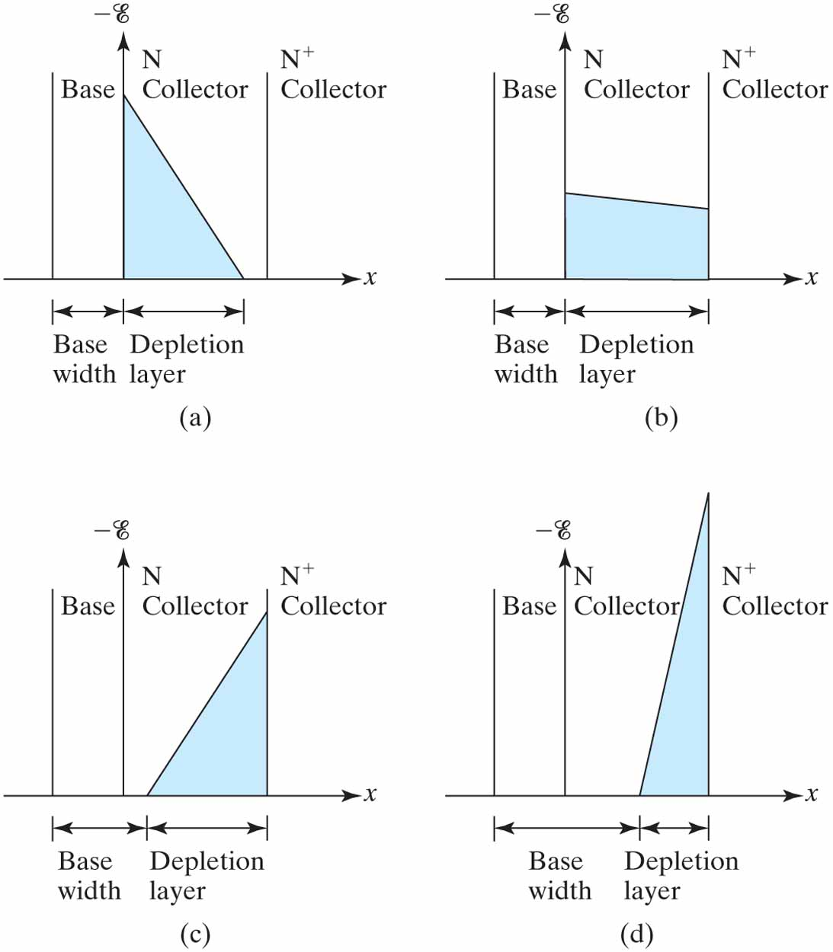
Figure 8.18 Electric field E (x), location of the depletion layer, and base width at (a) low I_{C} such as 0.1 mA/µm² in
Fig. 8–17; (b) larger I_{C}; (c) even larger I_{C} (such as 1 mA/µm²) and base widening is evident; and (d) very large I_{C} with severe base widening.

Slide 21
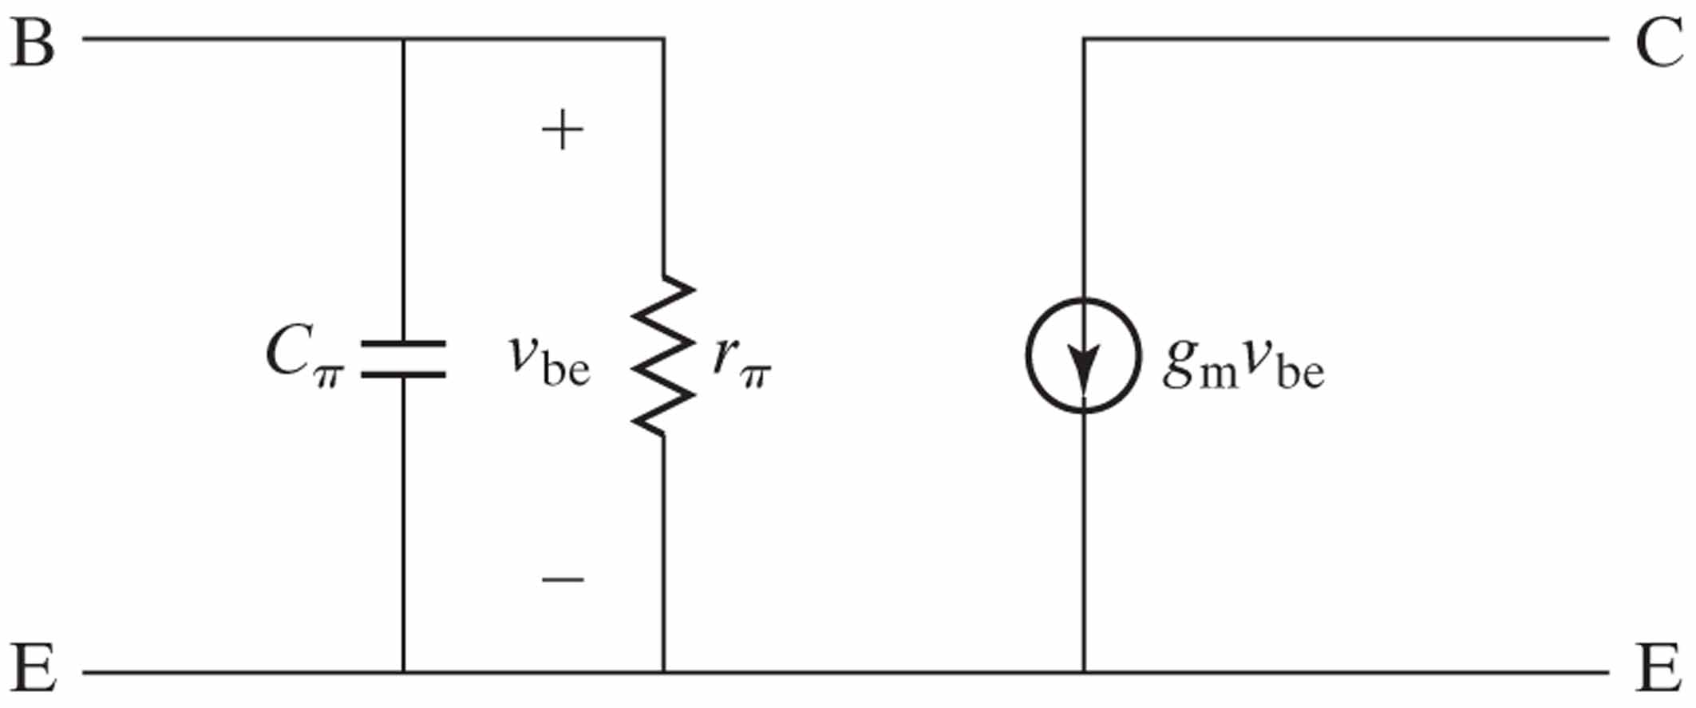
Figure 8.19 A basic small-signal model of the BJT.

Slide 22
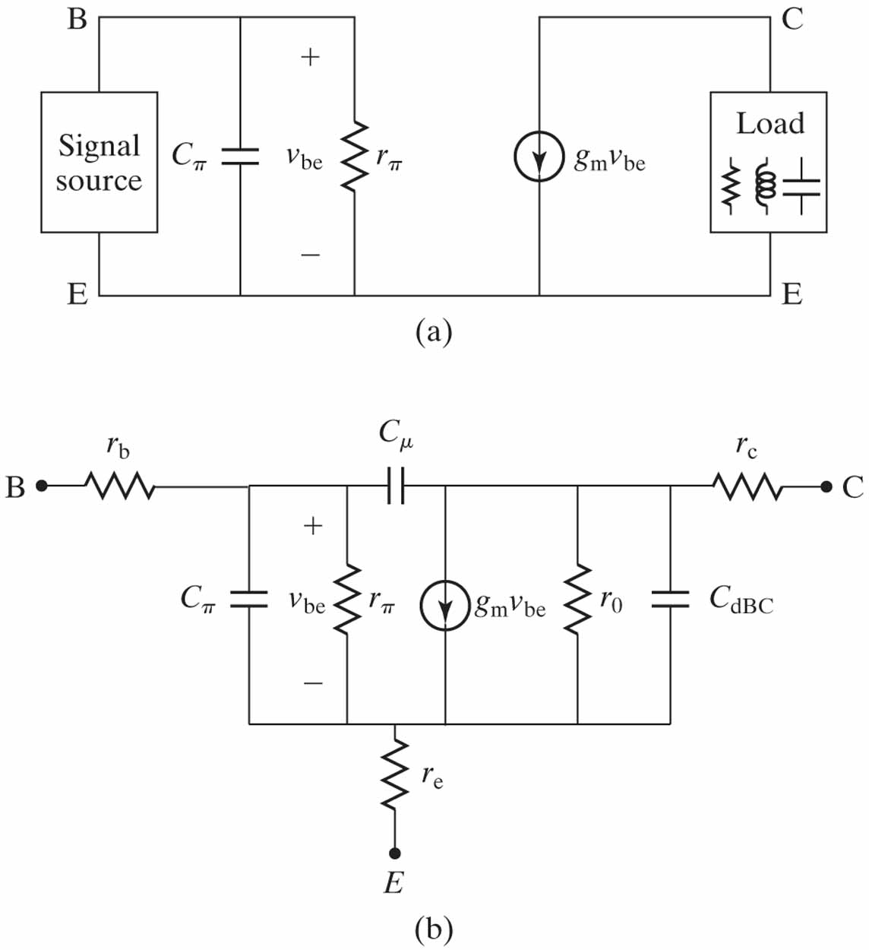
Figure 8.20 (a) The small-signal model can be used to analyze a BJT circuit by hand; (b) a small-signal model for circuit simulation by computer.

Slide 23
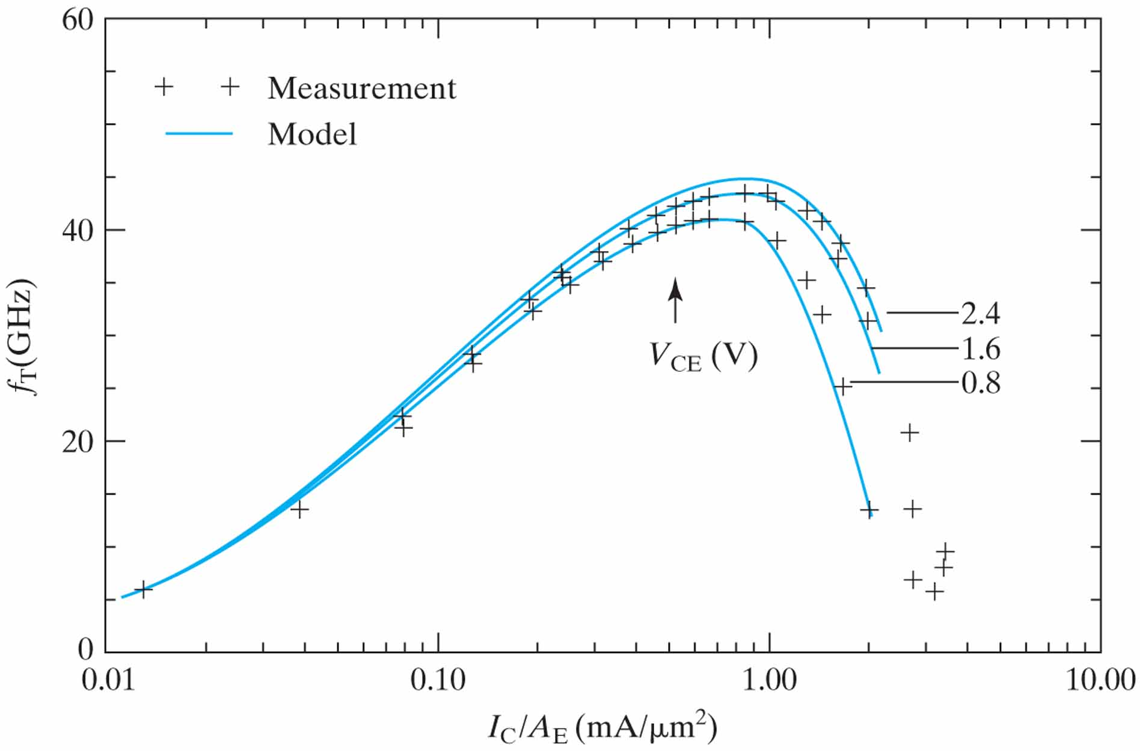
Figure 8.21 Cutoff frequency of a SiGe bipolar transistor. A compact BJT model matches the measured f_{T} well.
(From [6]. © 1997 IEEE.)

Slide 24
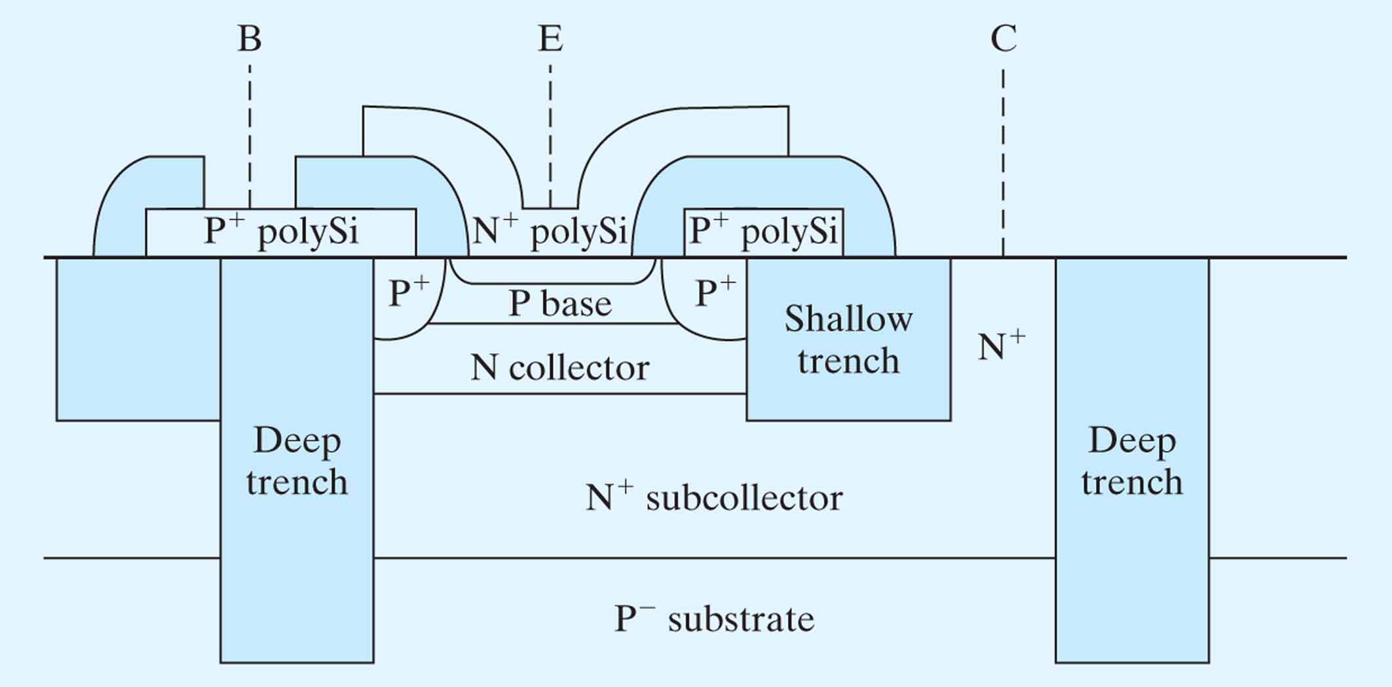
Figure 8.22 Schematic of a BJT with poly-Si emitter, self-aligned base, and deep-trench isolation. The darker areas represent electrical insulator regions.

Slide 25
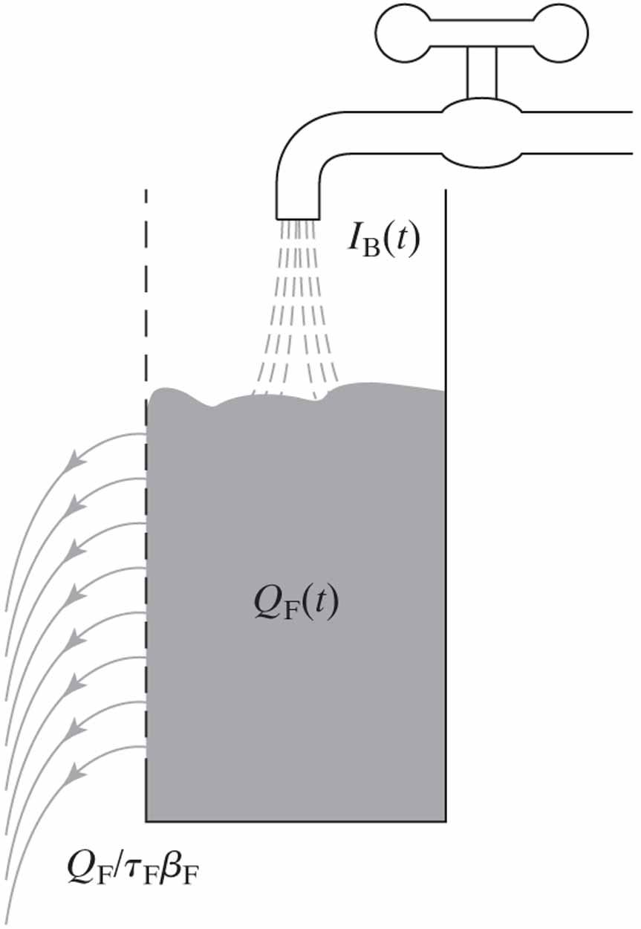
Figure 8.23 Water analogy of the charge control model. Excess hole charge (Q_{F}) rises (or falls) at the rate of supply
(I_{B}) minus loss (∝ Q_{F}).

Slide 26
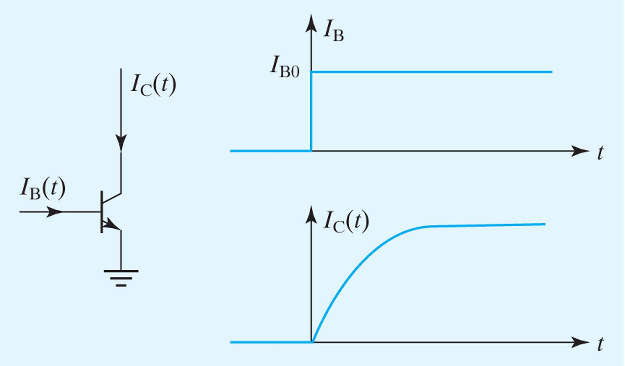
Figure 8.24 From the given step-function I_{B}(t), charge control analysis can predict I_{C}(t).

Slide 27
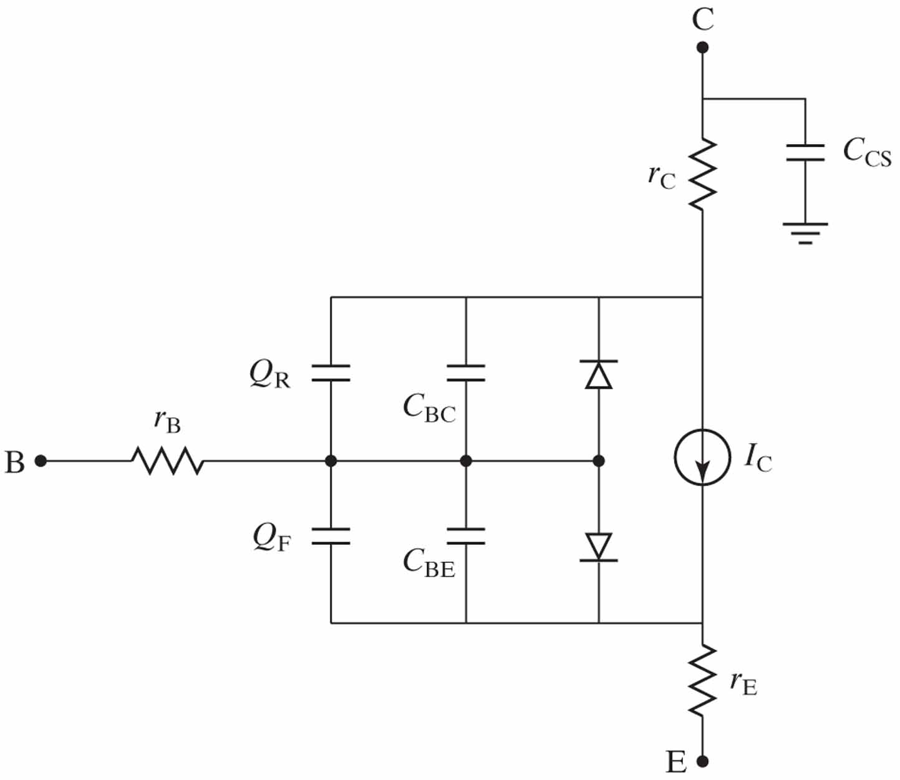
Figure 8.25 Illustration of a BJT model used for circuit simulation.

Slide 28
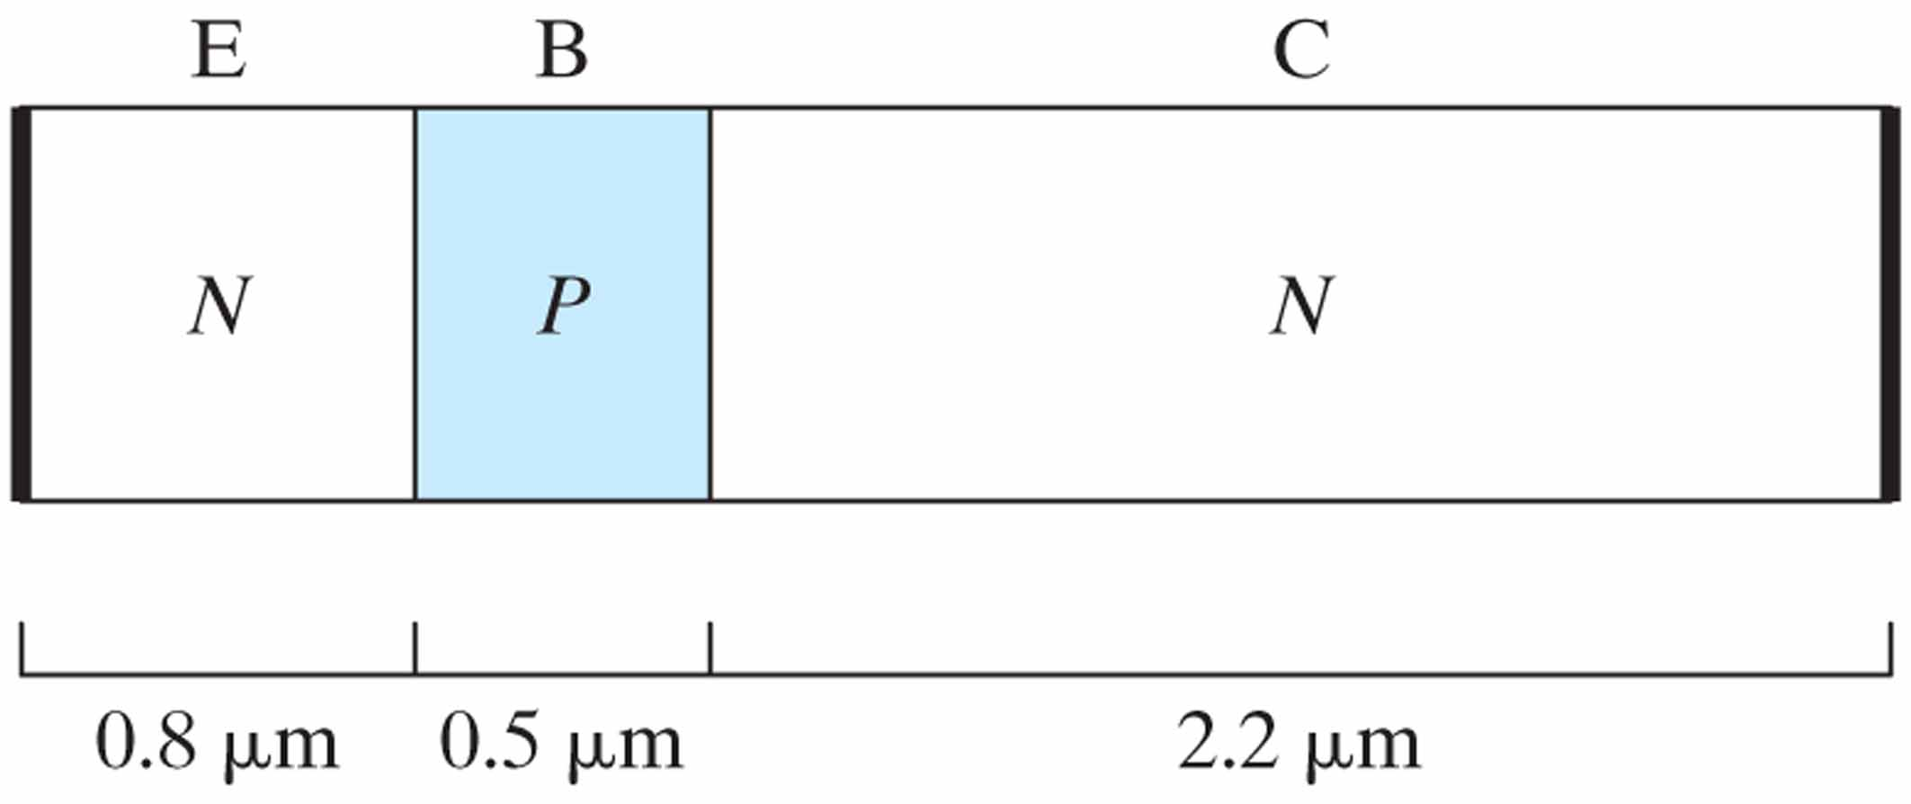
Figure 8.26

Slide 29
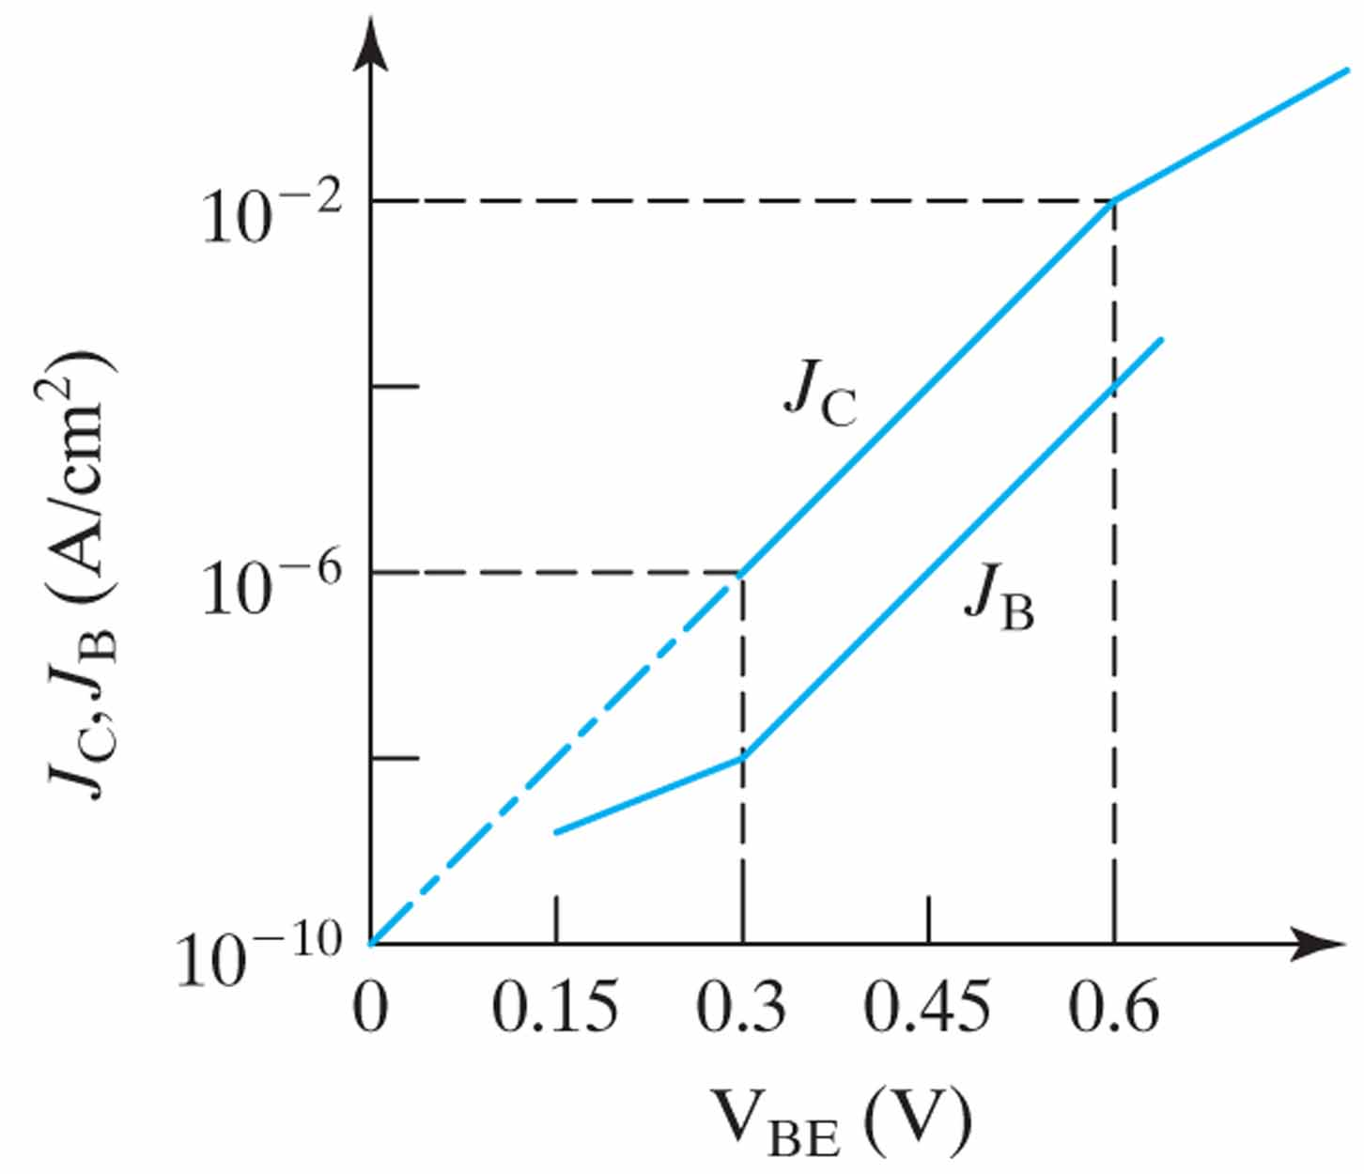
Figure 8.27

Slide 30
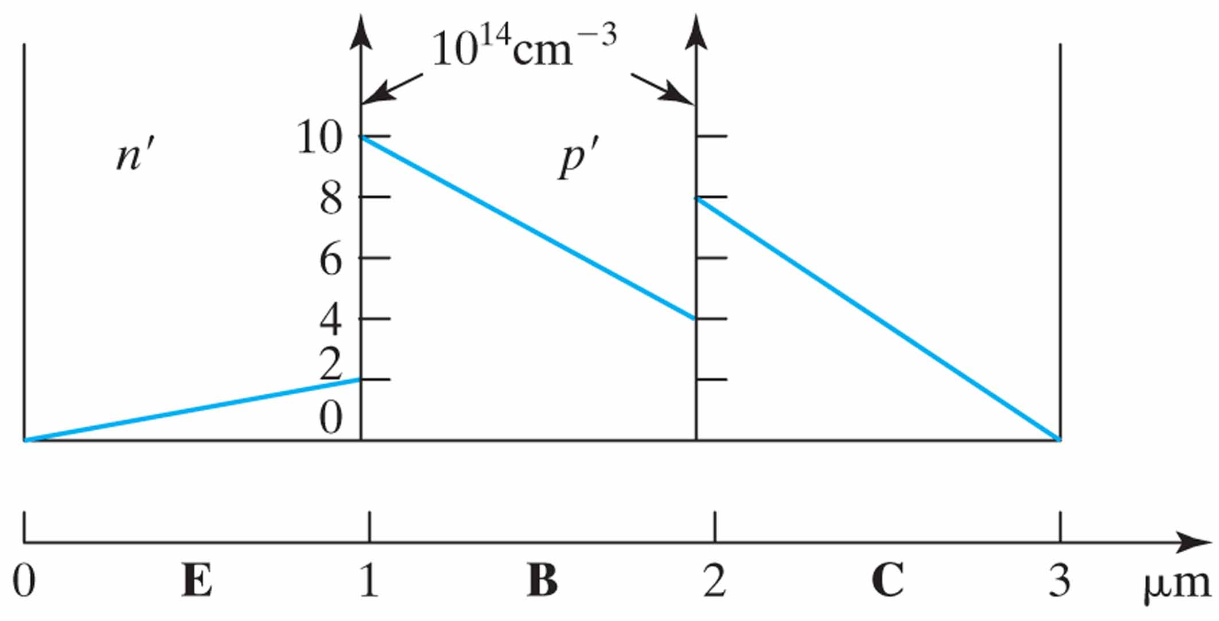
Figure 8.28

Slide 31
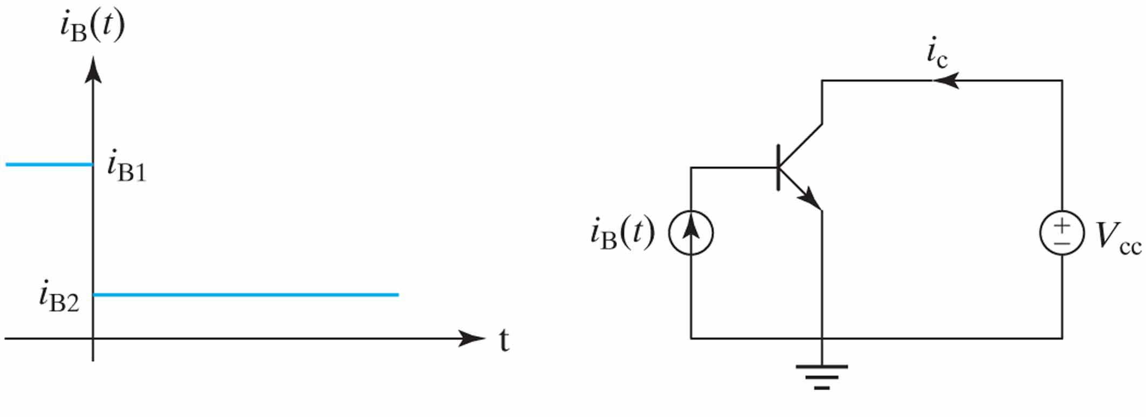
Figure 8.29

