Slide 1
EP2210 Fairness
Lecture material:
  Bertsekas, Gallager, Data networks, 6.5
  L. Massoulie, J. Roberts, "Bandwidth sharing: objectives and algorithms,“ IEEE Infocom 2000, Sec. II.B.1, III.C.3.
  J-Y Le Boudec, “Rate adaptation, congestion control and fairness: a tutorial,” Nov. 2005, 1.2.1, 1.4.
  MIT OpenCourseWare, 6.829
Reading for next lecture:
  L. Massoulie, J. Roberts, "Bandwidth sharing: objectives and algorithms,“ IEEE Infocom 2000.

Slide 2
Control functions in communication networks
fairness concept
X
X
X
X
congestion control
rate control
admission control
error control
delay control
medium access control
scheduling
(congestion control)
(error control)
(admission control)

Slide 3
Fairness
Scheduling: means to achieve fairness on a single link
  E.g., GPS provides max-min fairness
Networks?
  How to define fairness
  How to achieve fairness

Slide 4
Fairness - objectives
How to share the network resources among the competing flows? (“parking lot scenario”)
0
1
n
Equal rate:
Maximum network
throughput (Th=n would be nice):
Equal network resource:
l₀*r₀=l_{i}*r_{i}, l_{i} is the path length

Slide 5
Fairness - objectives and algorithms
Step 1: what is the “optimal” share?
  What is optimal – a design decision
  Fairness definitions
  Centralized algorithms to calculate fair shares
Step 2: how to ensure fair shares?
  Traffic control at the network edges (congestion or rate control)
  Scheduling at the network nodes
This lecture:
  max-min fairness definition and allocation algorithm
  proportional fairness, other fairness definitions
Student presentation:
  distributed control for fairness

Slide 6
Max-Min Fairness
Simplest case:
  without requirements on minimum or maximum rate
  constraints are the link bandwidths
Definition: Maximize the allocation for the most poorly treated sessions, i.e., maximize the minimum.
Equivalent definition: allocation is max-min fair if no rates can be increased without decreasing an already smaller rate
0
1
3
2

Slide 7
Max-Min Fairness
Formal description:
  allocated rate for session p: r_{p}, r={r_{p}}
  (maximum and minimum rate requirements not considered)
  allocated flow on link a: F_{a}=∑_{p∈a}r_{p}
  capacity of link a: C_{a}
Feasible allocation r: r_{p}≥0, F_{a}≤C_{a}
Max-min fair allocation r:
  consider r max-min fair allocation and r* any feasible allocation
  for any feasible r*≠r for which r*_{p}>r_{p}
  (if in r* there is a session that gets higher rate)
  there is a p’ with r_{p’}≤r_{p} and r*_{p’}<r_{p’}
  (then there is a session that has minimum rate in r and has even smaller rate in r*.)

Slide 8
Max-Min Fairness
Simple algorithm to compute max-min fair rate vector r
  Idea: filling procedure
    increase rates for all sessions until one link gets saturated
    (the link with highest number of sessions if there are no max. rates)
    2. consider only sessions not crossing saturated links,
    go back to 1
  Formal algorithm in B-G p.527
  Note, it is a centralized algorithm, it requires information about all sessions.

Slide 9
Max-Min Fairness
4
1
1
4
5
5
3
2
2
3
  Filling procedure:
  increase rates for all sessions until one link gets saturated
  (the link with highest number of sessions if there are no max. rates)
  consider only sessions not crossing saturated links, go back to 1

Slide 10
Max-Min Fairness
4
1
1
4
5
5
3
2
2
3
All sessions get rate of 1/3, link(2,3) saturated, r2=r3=r5=1/3
Sessions 1 and 4 get rate increment of 1/3, link(3,5) saturated, r1=2/3
Session 4 gets rate increment of 1/3, link(4,5) saturated, r4=1
What happens with the rates if session 2 leaves?

Slide 11
Max-Min Fairness
Proposition: Allocation is max-min fair if and only if each session has a bottleneck link
Def: a is a bottleneck link for p if F_{a}=C_{a} and r_{p}≥r_{p’} for all p’≠p
Find the bottleneck links for p1,p2,p3,p4,p5.
4
1
1
4
5
5
3
2
2
3
r2=r3=r5=1/3, r1=2/3, r4=1
* : bottleneck link

Slide 12
Max-Min Fairness
Proposition: Allocation is max-min fair if and only if each session has a bottleneck link
If r is max-min fair then each session has a bottleneck link
If each session has a bottleneck link then r is max-min fair
Why do we like this proposition: given allocation r it is easy to check if a session has a bottleneck link or not, and this way we can see if r is max-min fair or not.

Slide 13
Max-Min Fairness
Proof:
If r is max-min fair then each session has a bottleneck link
  Def: a is a bottleneck link for p if F_{a}=C_{a} and r_{p}≥r_{p’} for all p’≠p
  Proof with contradiction: assume max-min, but p does not have bottleneck link.
  For all link a on the path, define σ_{a}:
  if F_{a}=C_{a}, then there is at least one session with rate r_{pa} higher than r_{p}, and let σ_{a} = r_{pa}-r_{p} and
  if F_{a}<C_{a}, then the link is not saturated, and let σ_{a} = C_{a}-F_{a.}
  Possible to increase r_{p} with min(σ_{a}) without decreasing rates lower than r_{p}. This contradicts the max-min fairness definition.
1
4
F_{a}=C_{a}, σ_{a} = r_{pa}-r_{p}
5
F_{a}<C_{a}, σ_{a} = C_{a}-F_{a}
2
3

Slide 14
Max-Min Fairness
Proof:
If each session has a bottleneck link then r is max-min fair
  Proof: consider the following for each session.
  Consider session p with bottleneck link a (F_{a}=C_{a})
  Due to the definition of bottleneck link r_{pa} ≤ r_{p} and consequently r_{p} can not be increased without decreasing a session with lower rate.
  This is true for all sessions, thus the allocation is max-min fair.
4
1
1
4
5
5
3
2
2
3

Slide 15
Utility function
Utility function: to describe the value of a resource.
E.g.,
  Application requires fixed rate: r*
  Allocated rate: r
  Utility of allocated rate:
  u(r)=0 if r<r*
  u(r)=1 if r>=r*
Typical utility functions:
  Linear u(r)=r
  Logarithmic u(r)=log r
  Step function – as above

Slide 16
Rate-proportional fairness
Name: rate proportional or proportional fairness
Note! Change in notation! Rate: λ, flow: r, set of flows: R
Def1: Allocation Λ ={λ_{r}} is proportionally fair if for any Λ’ ={λ’_{r}} :
thus, for all other allocation the sum of proportional rate changes with respect to Λ are negative.
Def2: The proportionally far allocation maximizes ∑_{R}logλ_{r} – maximizes the overall utility of rate allocations with a logarithmic utility function.

Slide 17
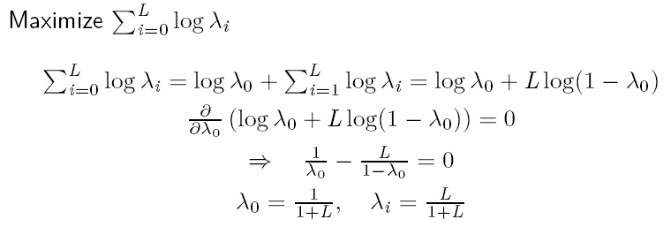
Rate-proportional fairness
Example: parking lot scneario
L links, R₀ crosses all links, others only one link
0
1
L

Slide 18
Rate-proportional fairness
Long routes are penalized
The same as the “equal resources scenario on the first slides.

Slide 19
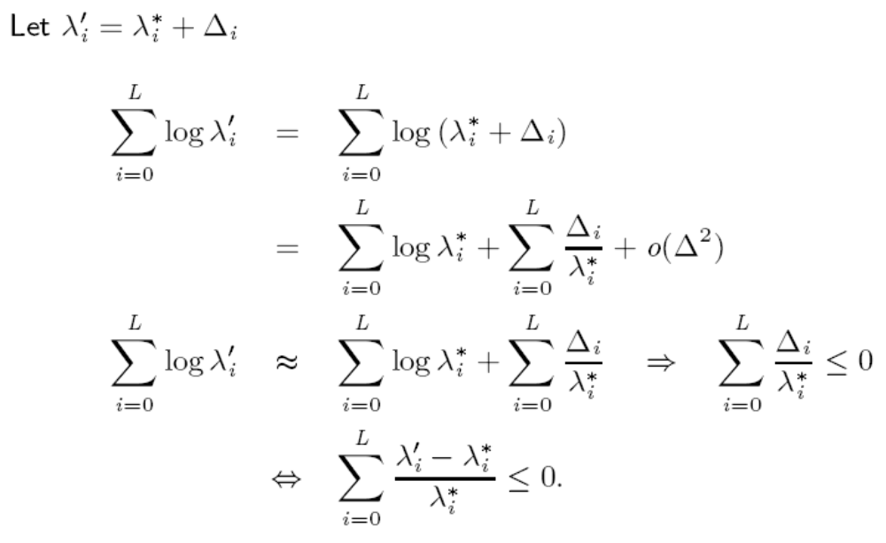
Rate-proportional fairness – equivalence of definitions
Let {λ_{i}*} be the optimal rate allocation and an other {λ_{i}’} allocation.

Slide 20
Other fairness definitions
L. Massoulie, J. Roberts, "Bandwidth sharing: objectives and algorithms,“ IEEE Infocom 2000, sections I and II.
Max-min
Proportional
Potential delay minimization
Weighted shares for various fairness definitions

Slide 21
Fairness - summary
What is a fair allocation?
  E.g., max throughput allocation may be very unfair, equal rate allocation may lead to low throughput
Max-min fairness
  Definition 1: Maximize the smallest allocated rate
  Definition 2: No rates can be increased without decreasing an already smaller one
  Proposition: allocation max-min fair iff all sessions have a bottleneck link
Utility based fairness definitions
Rate proportional fairness
  for all other allocation the some of relative changes is negative
  maximizes the sum of log(r)

Slide 22
Home reading
Bertsekas, Gallager, Data networks, 6.5
L. Massoulie, J. Roberts, "Bandwidth sharing: objectives and algorithms,“ IEEE Infocom 2000, sections I and II.

Slide 23
Fairness – distributed control
We have seen a number of fairness definitions.
Fair allocation for a given set of flows can be calculated (filling, or solving the related optimization problem).
How can fair allocation be provided in a distributed way?

Slide 24
Traffic control for max-min fairness
GPS provides max-min fairness for a single node.
What happens in networks with GPS nodes but without any end-to-end control? Is max-min fairness achieved?
Multiple node example:
  1 flow from S1 to D1
  10 flows from S2 to D2
Calculate the max-min fair rates for the entire network.
Flow to D1: 10
Flows to D2: 0.1
S1
C=10
D1
C=∞
C=11
X
Y
C=1
C=∞
S2
D2

Slide 25
Traffic control for max-min fairness
GPS provides max-min fairness for a single node.
What happens in networks with GPS nodes but without any rate control? Is max-min fairness achieved?
Multiple node example:
  1 flow from S1 to D1
  10 flows from S2 to D2
Calculate the per flow rates on the links when node X and Y provides GPS, independently from each other.
(X considers the traffic that arrives to it from S1 and S2, Y considers the traffic arriving from X.)
S1
C=10
D1
C=∞
C=11
X
Y
C=1
C=∞
S2
D2

Slide 26
Traffic control for max-min fairness
GPS provides max-min fairness for a single node.
What happens in networks with GPS nodes but without any rate control? Is max-min fairness achieved?
Multiple node example:
  1 flow from S1 to D1
  10 flows from S2 to D2
Without rate control:
  X: rate 1 to all flows
  Y: rate 0.1 to flows to D2
  Result:
    Flow to D1: 1
    Flows to D2: 0.1
Fair rates would be:
  Flows to D1: 10
  Flows to D2: 0.1
S1
C=10
D1
C=∞
C=11
X
Y
C=1
C=∞
S2
D2
Thus, max-min fairness is not achieved without end-to-end control.

Slide 27
Traffic control for fairness
Student presentation on how to achieve fairness with distributed control –

Slide 28
Traffic control for fairness
How to achieve fairness with distributed control –
other results from Massoulie and Roberts
With fixed window size:
  FIFO achieves proportional fairness
  longest queue first achieves maximum throughput
  service proportional to the square root of the buffer content achieves minimum potential delay
With dynamic window:
  additive increase multiplicative decrease achieves proportional fair allocation (case of TCP)
  logarithmic increase multiplicative decrease achieves minimum potential delay
  max-min fair rate can not be achieved with increase-decrease algorithms

Slide 29
Fairness - objectives and algorithms - summary
Step 1: what is the “optimal” share?
  What is optimal – a design decision
  Fairness definitions: max-min, proportional fair, etc.
  Centralized algorithms to calculate fair shares
Step 2: how to ensure fair shares?
  Traffic control at the network edges (congestion or rate control)
  Scheduling at the network nodes
  E.g:
    fixed window based congestion control + GPS: max-min
    AIMD + FIFO: proportional fair

