Slide 1
Innovation and Product Management
October 2012

Slide 2
My background
Magnus Bergman
  M.Sc. KTH, Aerospace Engineering, 1987
  Ph.D in Physics, INP Toulouse, 1990
  Post-Doc KTH NADA, 1990-1994
  Co-founder, Parallel Consulting Group, 1992 (acquired by IconMedialab, 1999)
  Co-founder of Coin, 1996 (aquired by Framtidsfabriken 1997)
  Chief Operating Officer, IconMedialab Intl AB, 1999
  Chief Operating Officer IconMedialab Asia Pty, 2000
  Co-founder of Venture Capital firms Springboard (1999), SOHO (2000) and Boathouse (2000)
  Co-founder of CrossConnect Network Group, 2003
  Member at STING Business Angel Network, 2003
  Owner and Board Member of several high-tech IT companies
  Co-founder and CEO of NASP Plingm

Slide 3
Company background
Plingm is a Swedish company with its HQ in Stockholm Sweden. Plingm has 25 employees and local representatives in China, US, India, Japan and Singapore. The Plingm staff consists of ten different nationalities
The company was founded by successful entrepreneurs with expertise in three different areas, the Telecommunication, Internet and Online Gaming industry and the company has a long list of successful entrepreneurs as investors and advisors
The company has reached a position as technology leader in the emerging field of mobile communication and passed 1 million downloads in August 2012

Slide 4
Dagens teman
Omvärld, en värld i allt snabbare förändring, vad betyder det
Entrepenörskap, i företag eller start-up, vad innebär det, vilka drivkrafter finns det
Nya produkter eller tjänster, hur planerar man dessa, vilka metoder finns
Framgångsfaktorer, produkter som gör livet enklare, roligare eller billigare?
Ett antal exempel

Slide 5
Overview of the technology area

Slide 6
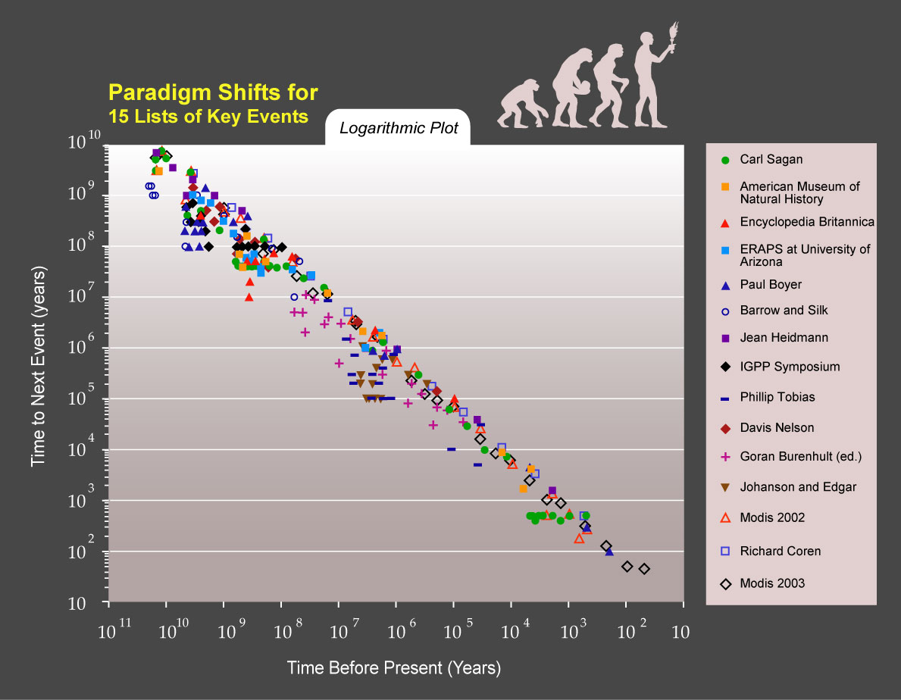
The Law of Accelerating Returns
Notes:
USA hade en workshop i dec 2001 sponsrade av Directory of Commerce och National Science Foundation.
Nano är längder mindre än 100 nm.

Slide 7
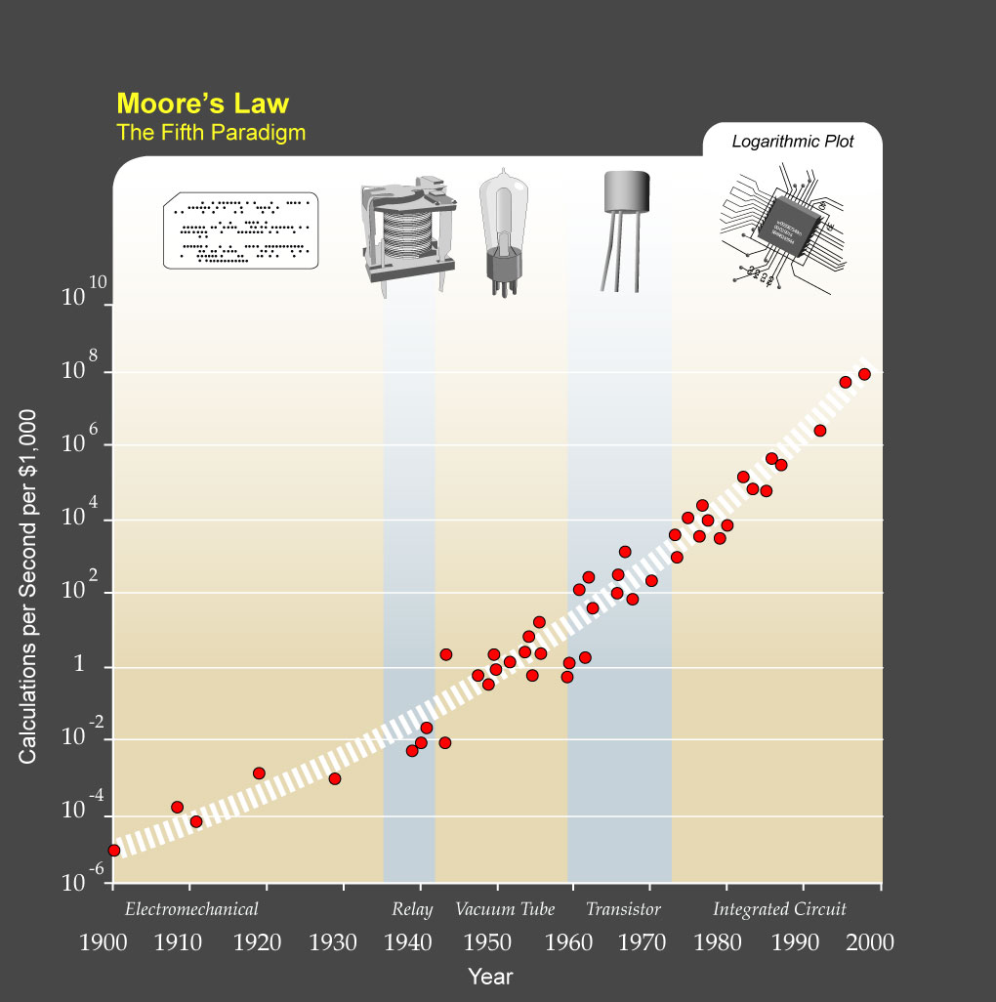
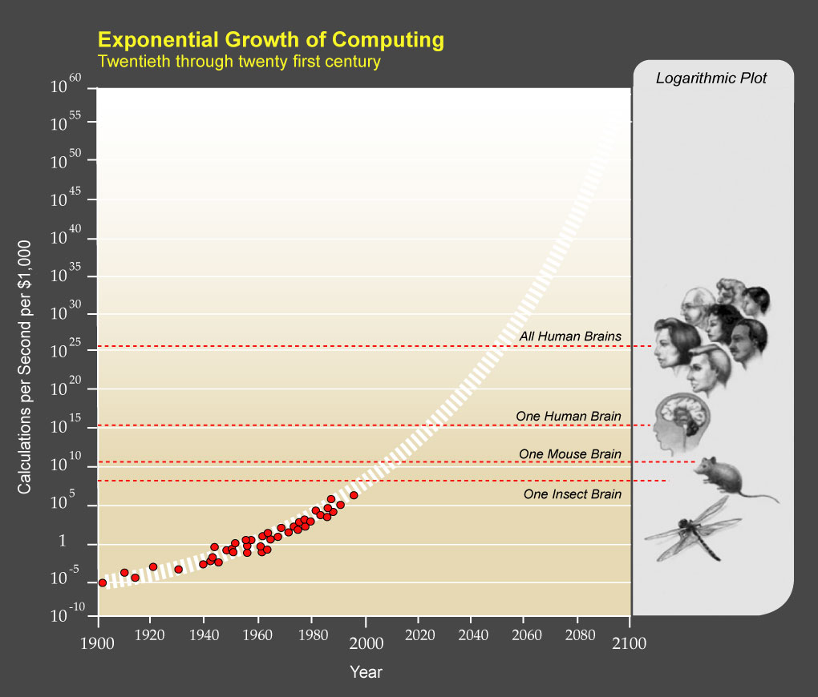
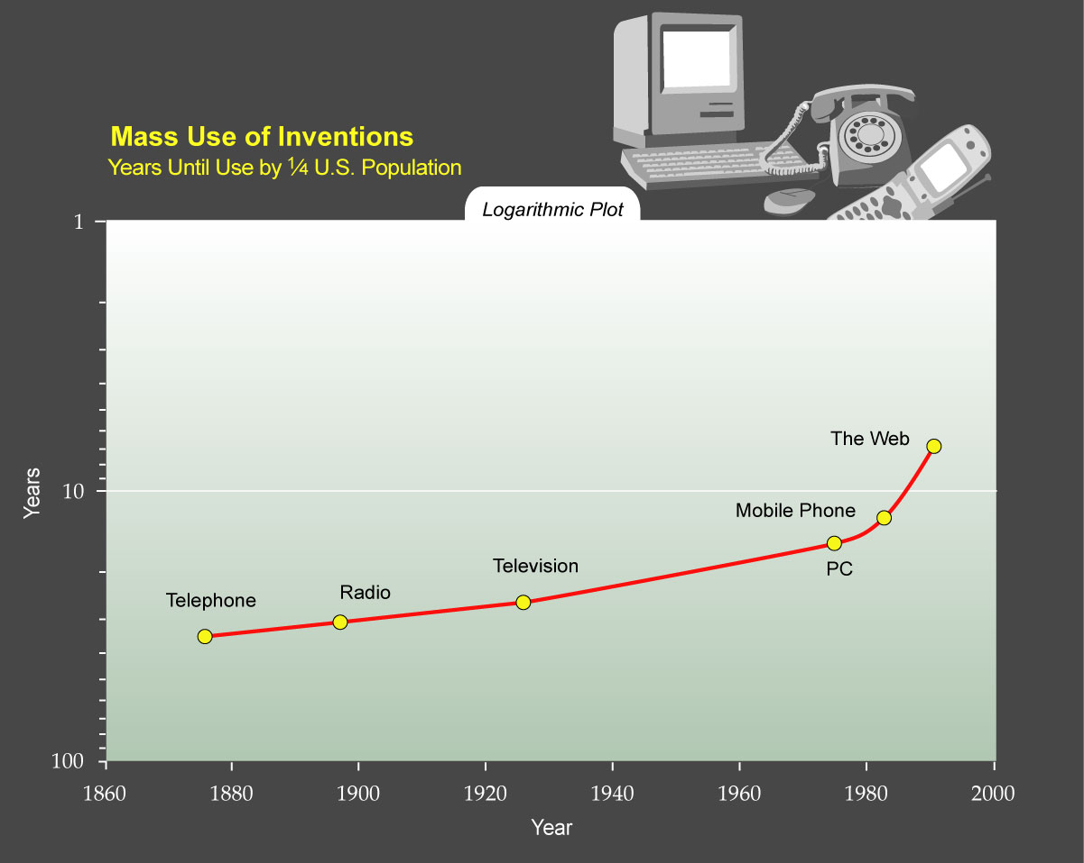
The Singularity – Ray Kurzweil
Notes:
USA hade en workshop i dec 2001 sponsrade av Directory of Commerce och National Science Foundation.
Nano är längder mindre än 100 nm.

Slide 8
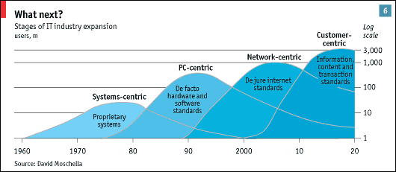
The Economist analysis
Notes:
Economist har en liknanade analys. Denna figur visar uppbyggnaden av användare för olika teknologier.
Nästa våg kommer att innefatta 3 miljarder användare, mycket tack vare mobila plattformar.
Deras analys säger att nästa våg kommer att vara centrerad kring kunden. Samma analys känns igen
Från början av 90 talet. Då sades inget om att Internet skulle generera en ny våg utan även då
Fanns ingen framtid i tillverkning av hårdvara, utan i framtiden skulle kundanpassningen vara styrande.
Det har varit sant sedan PC-n och tillför egentligen inget nytt. Frågan kvarstår därför: Vilka teknologier
Kommer att vara cntrala i nästa expansion i ICT industrin!

Slide 9

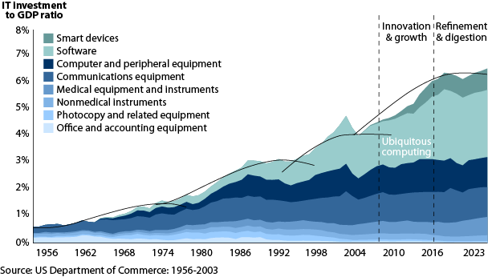
IT Spending Outlook: 2004 To 2008 And Beyond
Notes:
Inspirerade från en talare från COMDEX: Brian Halla, Ledare för National Semiconductor,
som beskrev utvecklingskurvan av intäkterna från Kretskortsindustrin, och som är drivare i all typ av elektronisk utrustning.
Halla beskrev 3 bust, boom and built . Samma förlopp
Boom: Teknikdrivet, Stora förväntningar, Många satsar
Bust: Överetablering, Marknaden mätt
Built up: Billig teknik och arbetskraft
Övergång till Mainframedatorer – konvertering till DRAM och timesharing
(Minnesrevolution!) - AMD, Fairchild, Motorola
- 1975, Marknaden 6 B$.(Processor revolution!)
200 PC ville ha 20% av marknaden.
1985, Marknaden 26 B$.
Internetboomen. (kommunikationsrevolution!)
2000, Marknaden 210 B$.
4:e vågen – built up
- Med erfarenhet från 2000 och historiens likhet med de andra (och andra områdens likartade utvecklingskurvor) så lär uppbyggnaden.
Minne, processor och kommunikation har förbättrats radikalt!
Minne: Kan tillverkas billigt även i små enheter
Processor Kan även nu tillverkas billigt
Kommunikation. Kan göras trådlös. Bredband när fast anslutning finns.
Vad blir utmärkande för nästa våg?
Integratioin av minne, processor och kommunikation
Bättre av alla tre
Bättre kommunikatioin med människan

Slide 10
Innovator’s Dilemma
“Good management was the most powerful reason that they failed to stay atop of their industries. Precisely because these firms listened to their customers, invested aggressively in new technologies that would provide their customers more and better products of the sort they wanted, and because they carefully studied market trends and systematically allocated investment capital to innovations that promised best returns, they lost their position of leadership.”
C.Christensen: The Innovator’s Dilemma, 1997
Notes:
Growth is important because companies create shareholder value through profitable growth
Equity markets demand that companies grow, but it is hard to know how to grow.
A company must deliver the rate of growth that the market is projecting just to keep its stock price from falling. It must exceed the consensus forecast rate of growth in order to boost its share price

Slide 11
Sustaining versus Disruptive Innovation
Pace of Technological Progress
Sustaining Innovation
Breakthrough
Product Performance
Incremental
Performance that customers
can utilize or absorb
New performance trajectory
Sustaining technologies:
New technology that foster
improved product performance
Disruptive technology:
Different value proposition -
Cheaper, smaller, simpler, easier
Disruptive Innovation
Source: The Innovator’s Dilemma, 1997
Time
Notes:
Basic Parts of the Model – Understanding the Interaction between innovation and market needs
Ability to absorb
Pace of Technological Progress – improvement cycle _ companies overshoot, becoming vulnerable to down-market competition.
An innovation which brings about a new business model
Disruptive Innovation Examples
Table Top Copiers
Mechanical Excavator
Personal Computer
#1: Companies depend on customers and investors for resources
#2: Small markets don’t solve the growth needs of large companies
#3: Markets that don’t exist can’t be analyzed
#4: Technology supply may not equal market demand
- The pace of progress that markets demand or can absorb may be different from the progress offered by technology.
- Do not expect your customers to lead you toward innovations that they do not need.
- Managing innovation mirrors the resource allocation process
- Matching the market to the technology
- Disruptive technology should be framed as a marketing challenge, not a technological one
- The capabilities of most organizations are far more specialized and context specific than most managers are inclined to believe.
- The information required to make large and decisive investments in the face of disruptive technology does not exit in many instances
- Do not adopt a technology strategy to be always a leader or always a follower
- here are powerful barrier to entry and mobility. The most powerful protection for small firms is that they are doing something that it simply does not make sense for the established leader to do.

Slide 12
In Fact, Established Markets Continue
to Grow even as the Disruptive Markets Take Root
Minicomputers Disrupt Mainframes
Sustained Revenue Lead
15000
First Revenue Lead
14000
Minicomputer
13000
Market
12000
11000
10000
Dollars ($000)
9000
8000
Mainframe Computer
7000
Market
6000
5000
4000
3000
2000
Phase I
Phase II
Phase III
1000
0
1965
1975
1981
1983
1985
1987
1989
1991
1993
1995
1997
1999
2001
Source: ITI, Industry Statistics Programs; U.S. Microcomputer
Statistics Committee Forecast, Data Analysis Group

Slide 13
Disruptive Innovations – Examples
Earlier innovations
Future examples
  Graham Bell
  Henry Ford
  DRAM
  PC
  Ethernet/IP
  E-mail
  Open Source
  IP-telephony
  Broadband music
  IP-TV
  Mobile payments
  Mobile content
  Webbased services
  And many more…
Going on right now

Slide 14
Strategic Road Mapping
History Present Near Future Future Vision
TIME
Market/Business
TID
Pull’
’Market Pull”
’Market
Products and Services
Push’
Technology
’Technology Push ”
’Technology
Resources
Notes:
Utvecklat på Cambridge University. Är en del av ett 3 års forskningsarbete hos UK Engineering and Physical Science research Council som påbörjades 1998.
Stöd i programvara finns från bland annat ett Amerikanskt företag: LearningTrust, med t.ex. Motorola som kund.
Ursprungligen utvecklad för tillverkande industri ; Är nu anpassad för många andra branscher!
Testats hos över ett tjugotal industriapplikationer med olika inriktningar.

Slide 15
Vision, Mission and Targets
Plingm’s vision is that basic mobile communication should be simple, efficient and free.
Plingm’s mission is to liberate the way we communicate with family, friends and business contacts.
Plingm’s target is to become a global mobile solution for communication, that is very profitable.

Slide 16
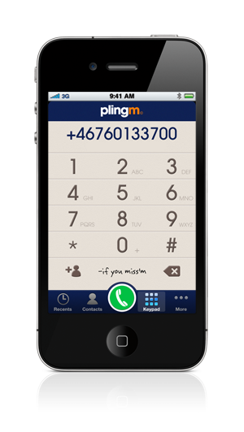
Plingm is Unique
Unique crystal clear sound – Super HD
Socially connected, call Facebook and LinkedIn users for free with just one click!
High quality app with the highest reviews among similar apps
True hybrid that combines free calls with low cost traditional calls
Available on iPhone, iPad, iPod Touch and Android devices
Starts within seconds, no username needed, contact book preloaded

Slide 17
Thank you!

