Slide 1
Outline
Main definitions. Specific case of semiconductor luminescence
Photoluminescence (PL) and photoluminescence excitation (PLE) techniques
Photodetectors: photomultiplier tube (PMT), avalanche photodiode (APD), CCD
Monochromators and spectrographs: resolution, throughput and signal-to-noise ratio
Spectral and resolution corrections
Other methods: lock-in amplifier, photon counting and Fourier spectroscopy

Slide 2
Main definitions. Specific case of semiconductor luminescence
1. Thermal radiation. Black-body source.
Wien’s law: λ [nm]= 2.9·10⁶/T[K], human thermal radiation peak is ~ 10 μm
Thermally provided energy gives rise to the emission
2. Scattering and reflected radiation.
Raman scattering (interaction of initial photons with phonons)
Rayleigh scattering (interaction of inital photons with particles smaller than λ₀)
Brillouin scattering (interaction of initial photons with refractive index variations)
These processes are fast and almost elastic (very small energy loss for initial photons)
THIS IS NOT LUMINESCENCE

Slide 3
Main definitions. Specific case of semiconductor luminescence
LUMINESCENCE:
”slow” relaxation of extra energy provided to the system through light emission
(”slow” compared to light wave oscillations (fs): from nanoseconds to hours)
Classified by the source of extra energy:
Classified by the decay rate:

Slide 4
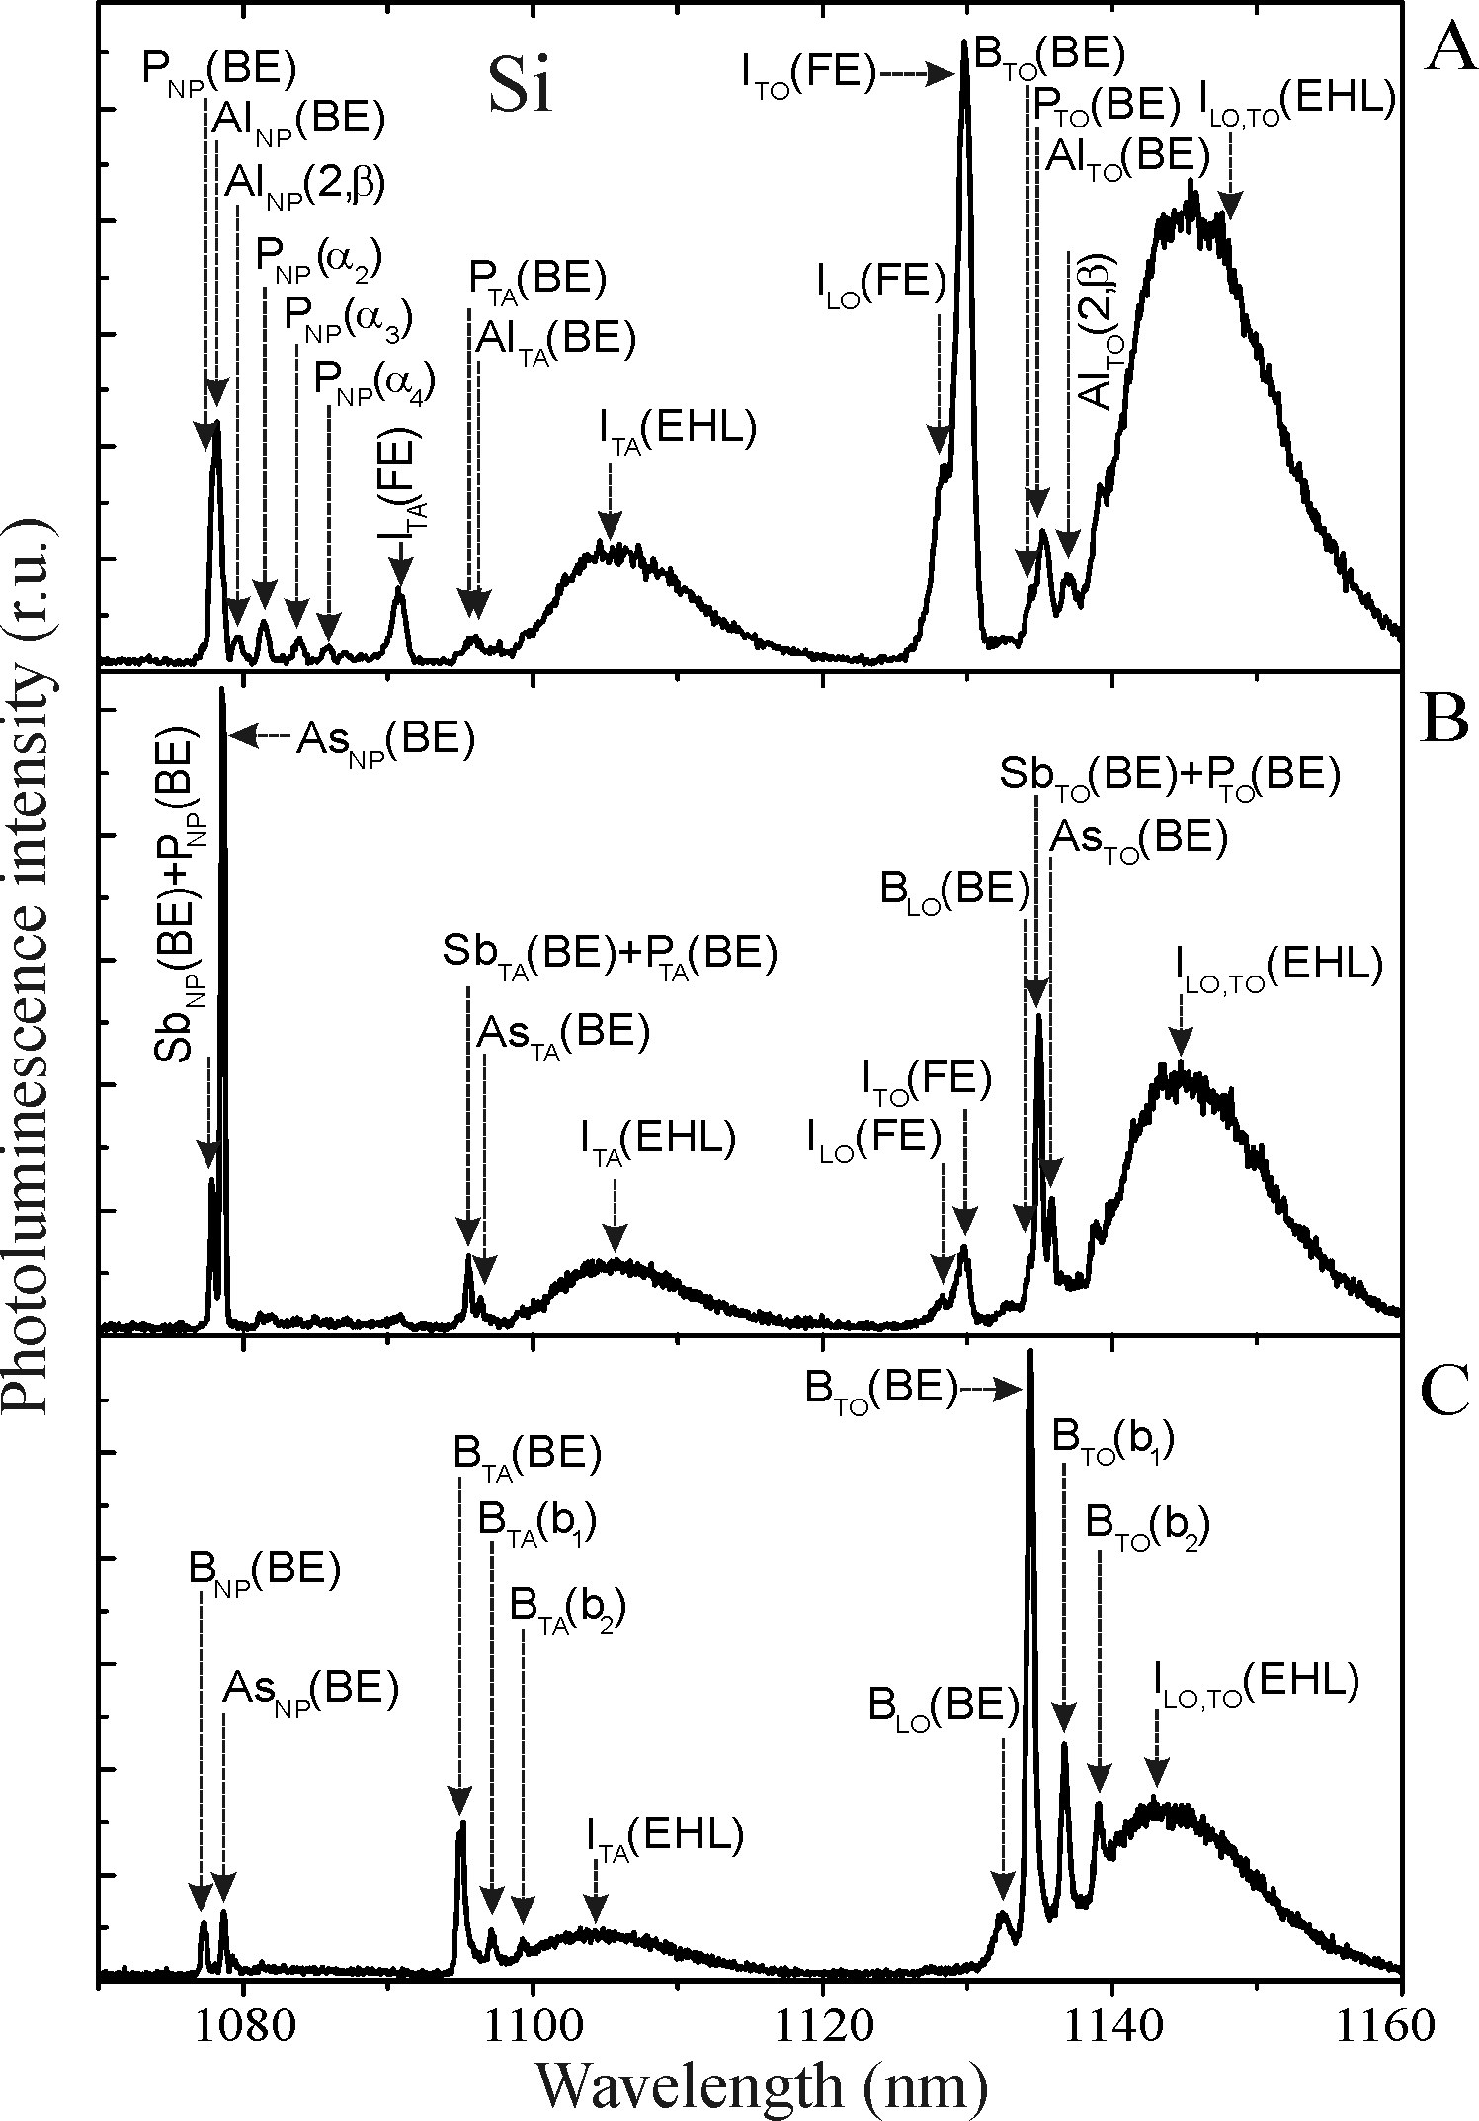
Main definitions. Specific case of semiconductor luminescence
For a solid-state object luminescence can be caused by the material itself or by impurities
Low-temperature luminescence spectra of Si crystal:
I – intrinsic components
P, Al ,B, Sb, As – common impurities/dopants
NP – no-phonon line
TA, LO, TO – specific phonon modes (transverse,
longitudinal, acoustic and optical)
EHL – electron-hole liquid
BE, FE – bound and free excitons
LUMINESCENCE for impurity analysis

Slide 5
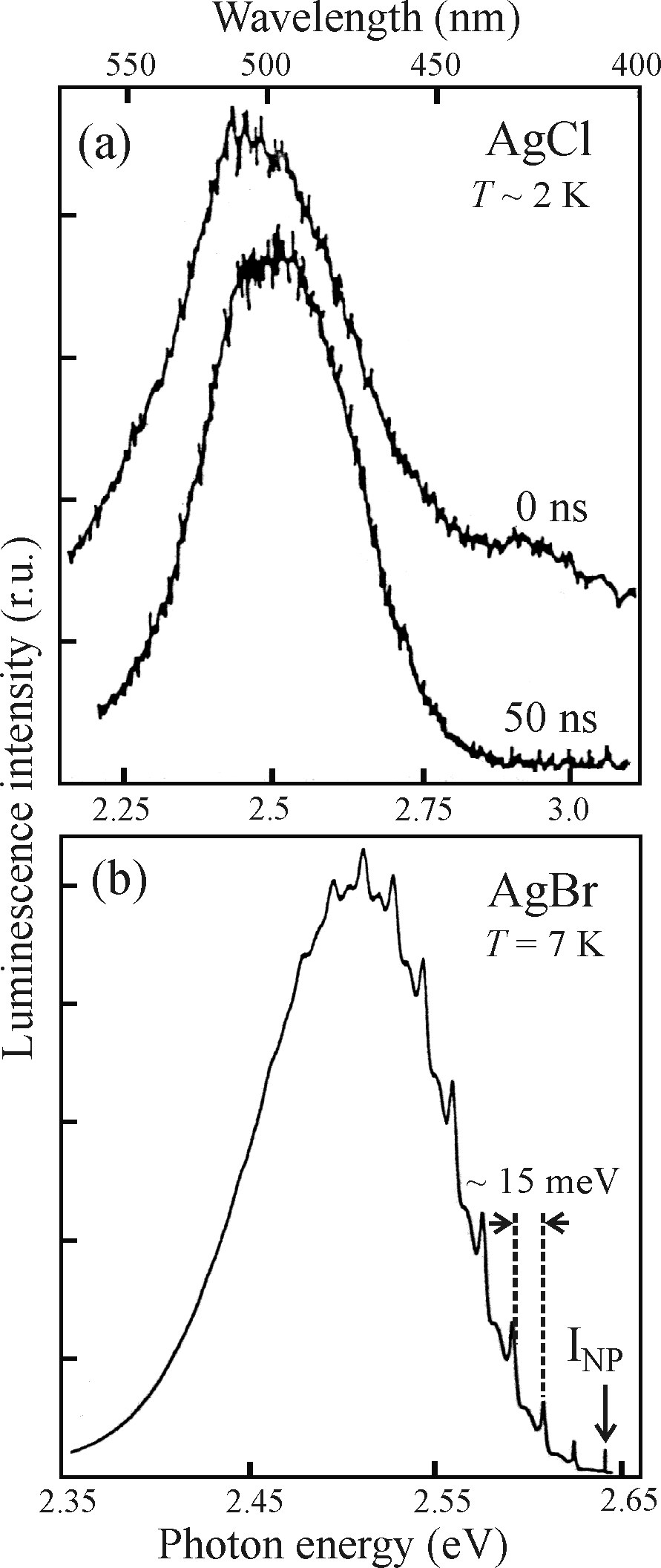
Main definitions. Specific case of semiconductor luminescence
Peak identification can be ambiguous sometimes, especially for broad lines
Intrinsic spectra
Extrinsic spectra

Slide 6
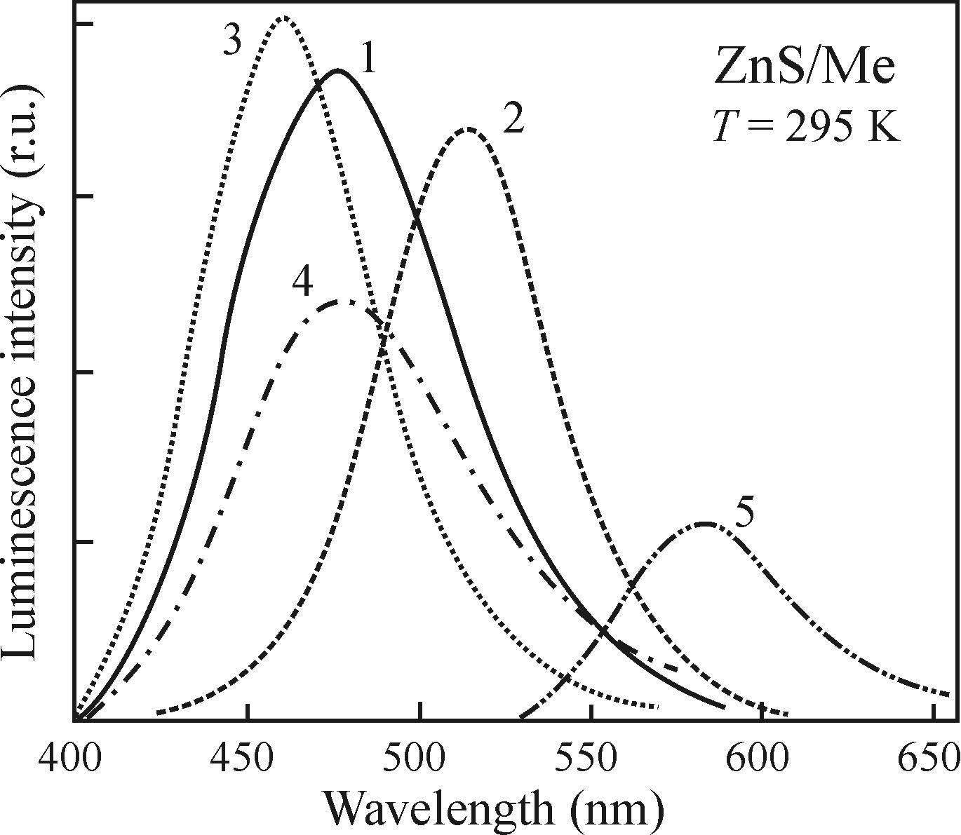
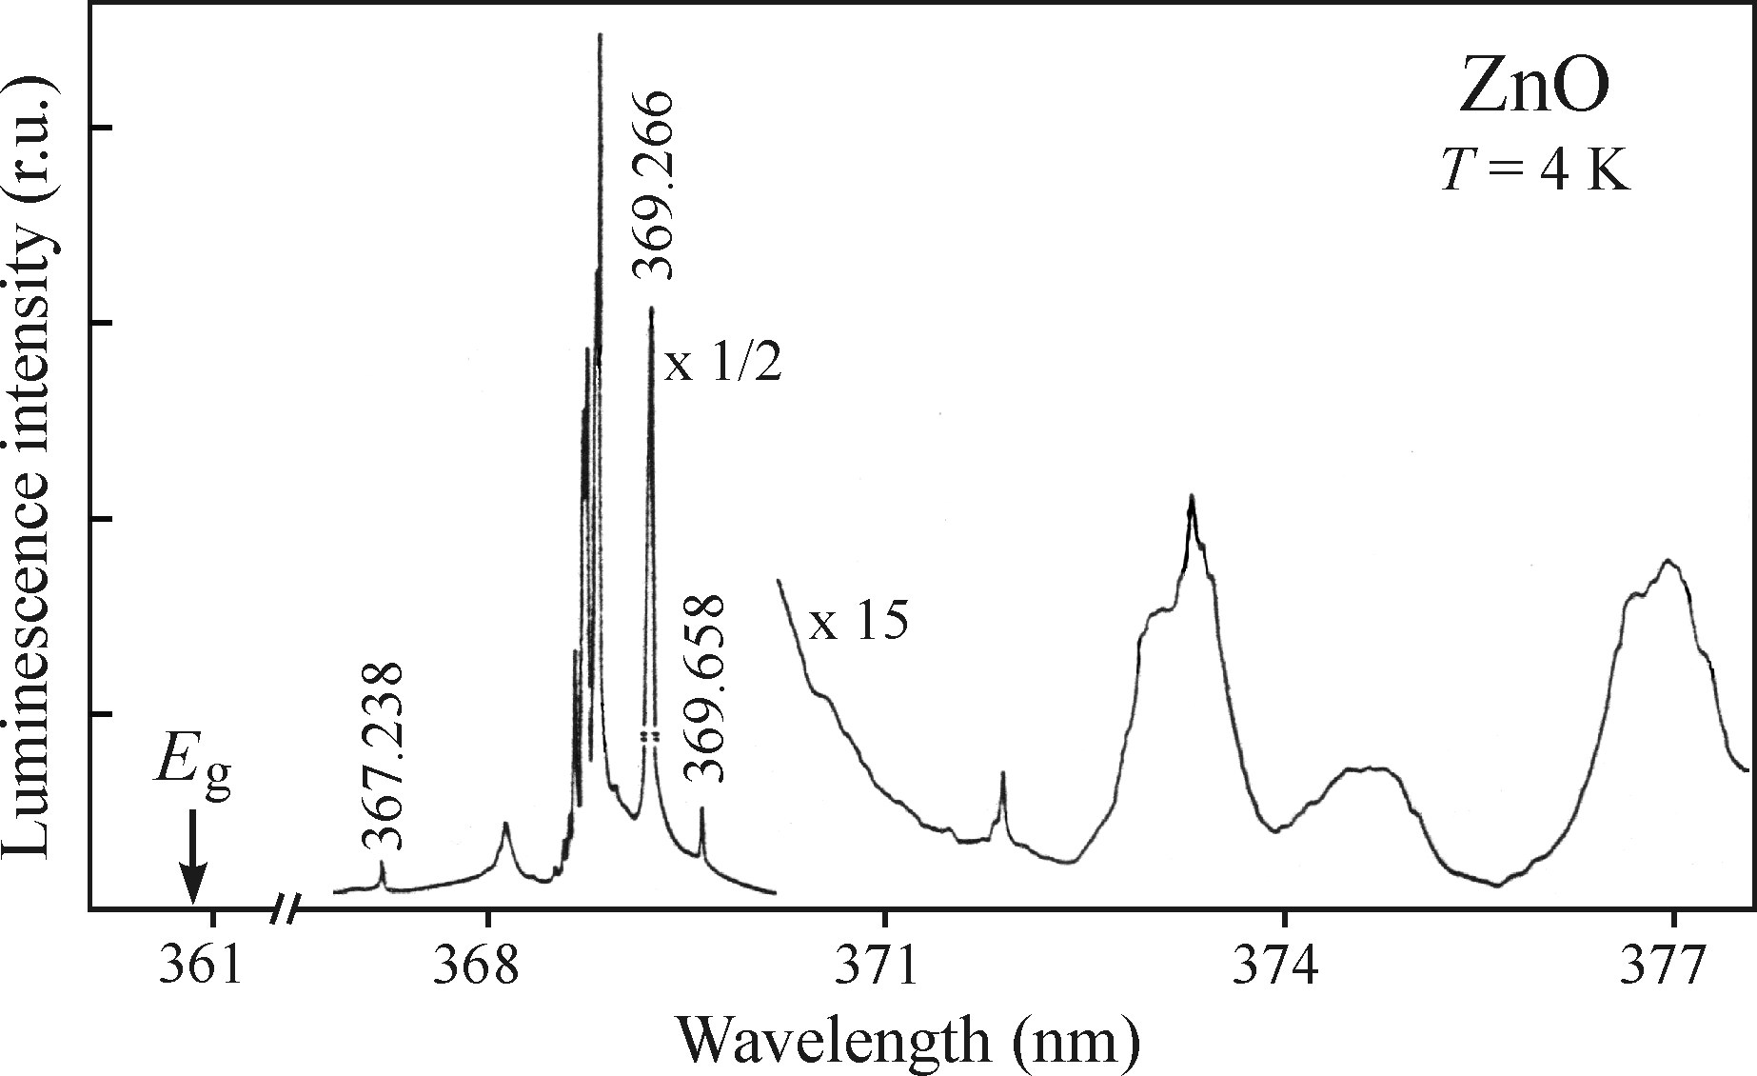
Main definitions. Specific case of semiconductor luminescence
Low-temperature measurements give a better picture – sharper lines, higher intensity:
linewidth depends on interaction with phonons, less phonons at low-temperature
diffusion to non-radiative centers is suppressed at low temperature
Room temperature PL of ZnS with
1. Zn 2. Cu 3. Ag 4. Au 5. Mn
Low temperature CL of ZnO:
sharp excitonic transitions

Slide 7
Outline
Main definitions. Specific case of semiconductor luminescence
Photoluminescence (PL) and photoluminescence excitation (PLE) techniques
Photodetectors: photomultiplier tube (PMT), avalanche photodiode (APD), CCD
Monochromators and spectrographs: resolution, throughput and signal-to-noise ratio
Spectral and resolution corrections
Other methods: lock-in amplifier, photon counting and Fourier spectroscopy

Slide 8
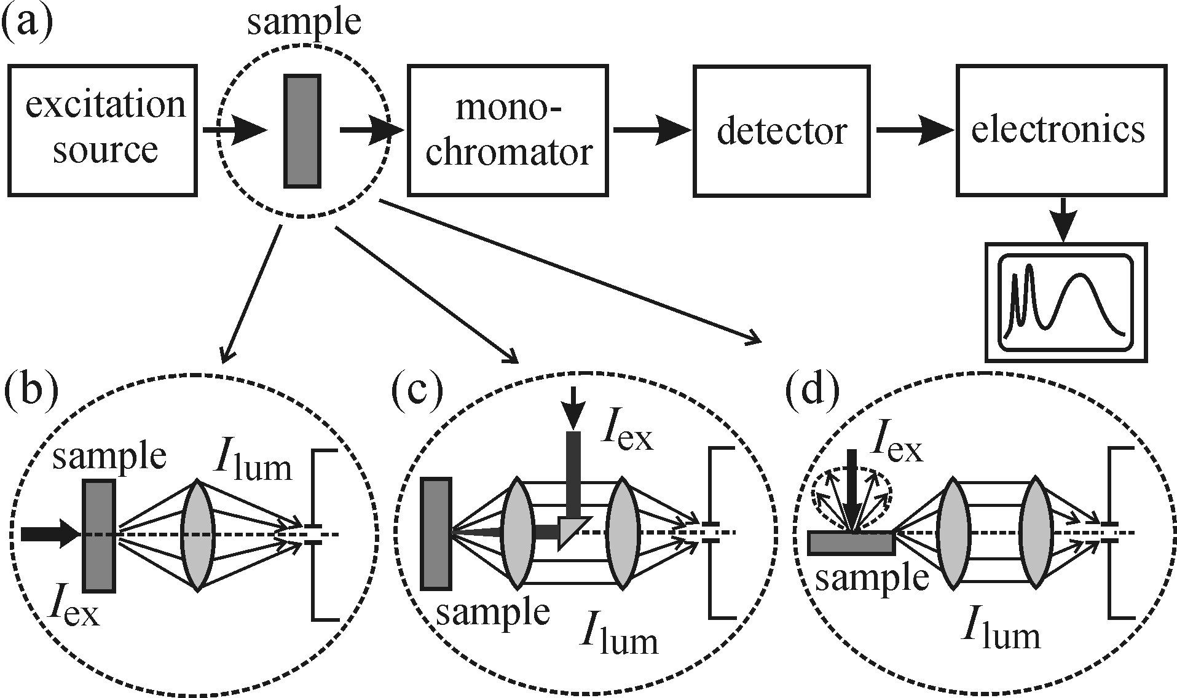
Photoluminescence (PL) and photoluminescence excitation (PLE) techniques
Photoluminescence is a practical, convenient method of luminescence measurements
fixed excitation and spectrally dispersed emission I_{lum}(λ_{em}) for λ_{ex0} – PL
fixed detection wavelength under variable excitation I_{lum}(λ_{ex}) for λ_{em0} - PLE
General geometrical configuration
(scanning monocromator with fixed λ_{ex} is PL; varying λ_{ex} with fixed monochromator is PLE)
configuration (c) with a dichroic filter is the most typical one

Slide 9
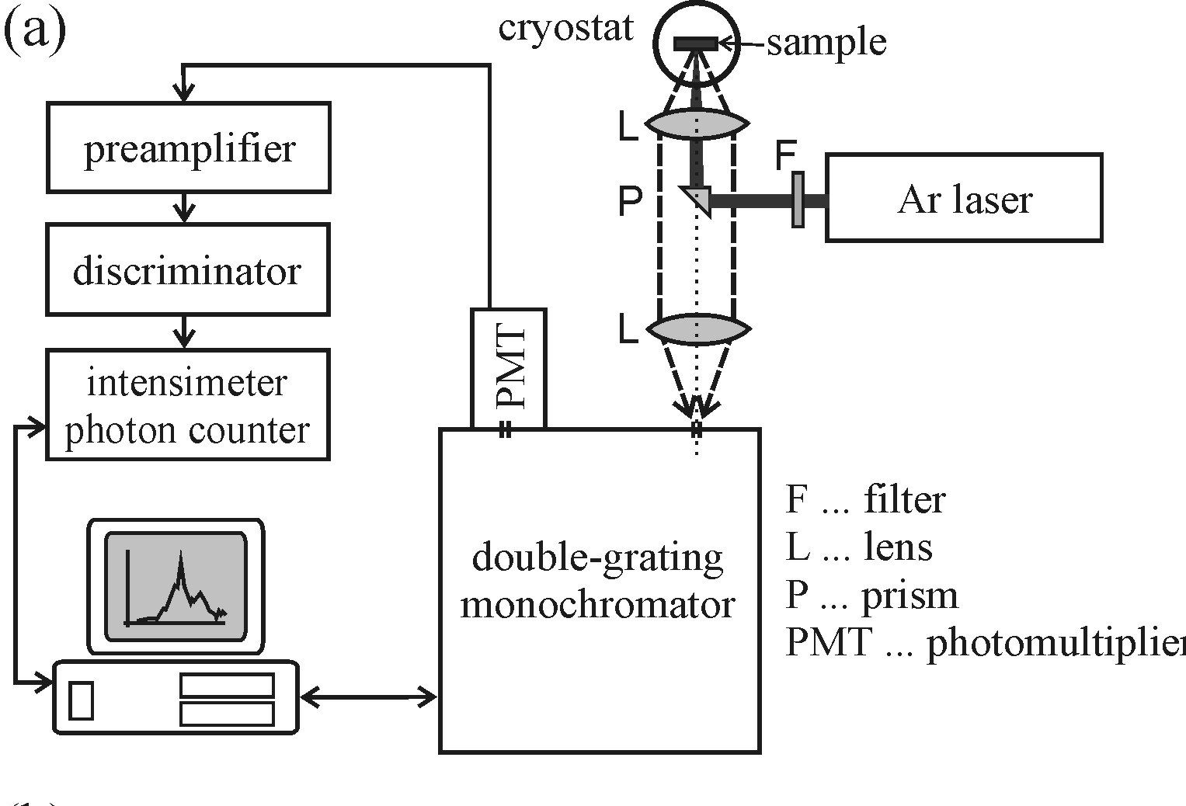
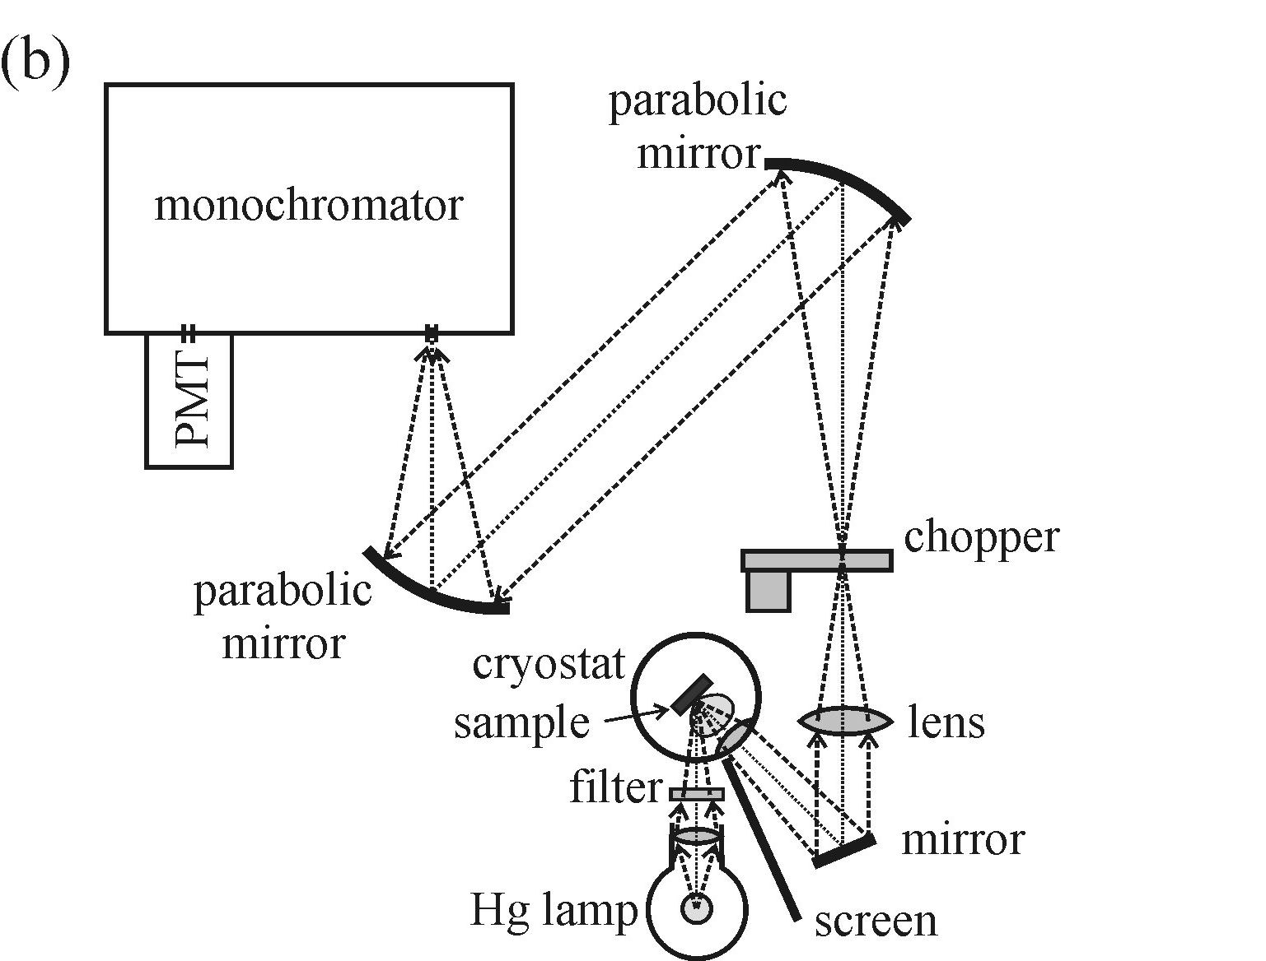
Photoluminescence (PL) and photoluminescence excitation (PLE) techniques
PL setup examples
laser as an excitation source, λ_{ex} = 488 nm
sample in the cryostat
excitation and collection through the same
optical path with a dichroic filter – bright field
Hg lamp with a filter as an excitation source
sample in the cryostat
collection through a different path than excitation -
dark field configuration
mechanical beam chopper for lock-in amplification
Radiation must be focused on the entrance slit of monochromator

Slide 10
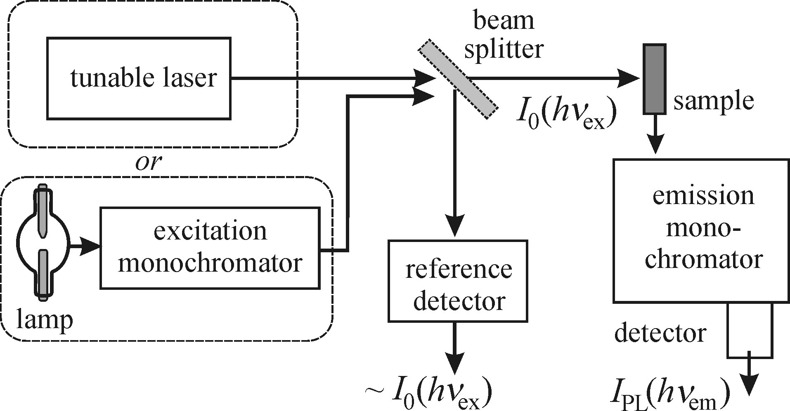
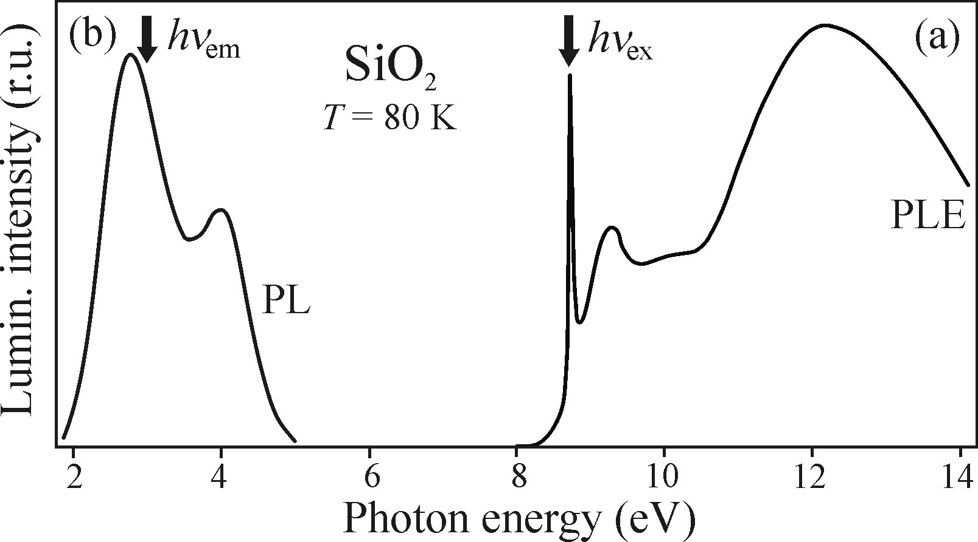
Photoluminescence (PL) and photoluminescence excitation (PLE) techniques
PLE setup example
- for weakly absorbing sample:
I_{PL}(hν_{em})/I₀(hν_{ex}) ~ α (hν_{ex})
PLE gives an absorption spectrum,
related to the density of states
PLE is an alternative to transmission measurements,
where e.g. substrates are non-transparent
also gives you best excitation wavelength
for PL measurements
Stokes shift between PL and PLE peaks contains
information about material structure

Slide 11
Outline
Main definitions. Specific case of semiconductor luminescence
Photoluminescence (PL) and photoluminescence excitation (PLE) techiques
Photodetectors: photomultiplier tube (PMT), avalanche photodiode (APD), CCD
Monochromators and spectrographs: resolution, throughput and signal-to-noise ratio
Spectral and resolution corrections
Other methods: lock-in amplifier, photon counting and Fourier spectroscopy

Slide 12
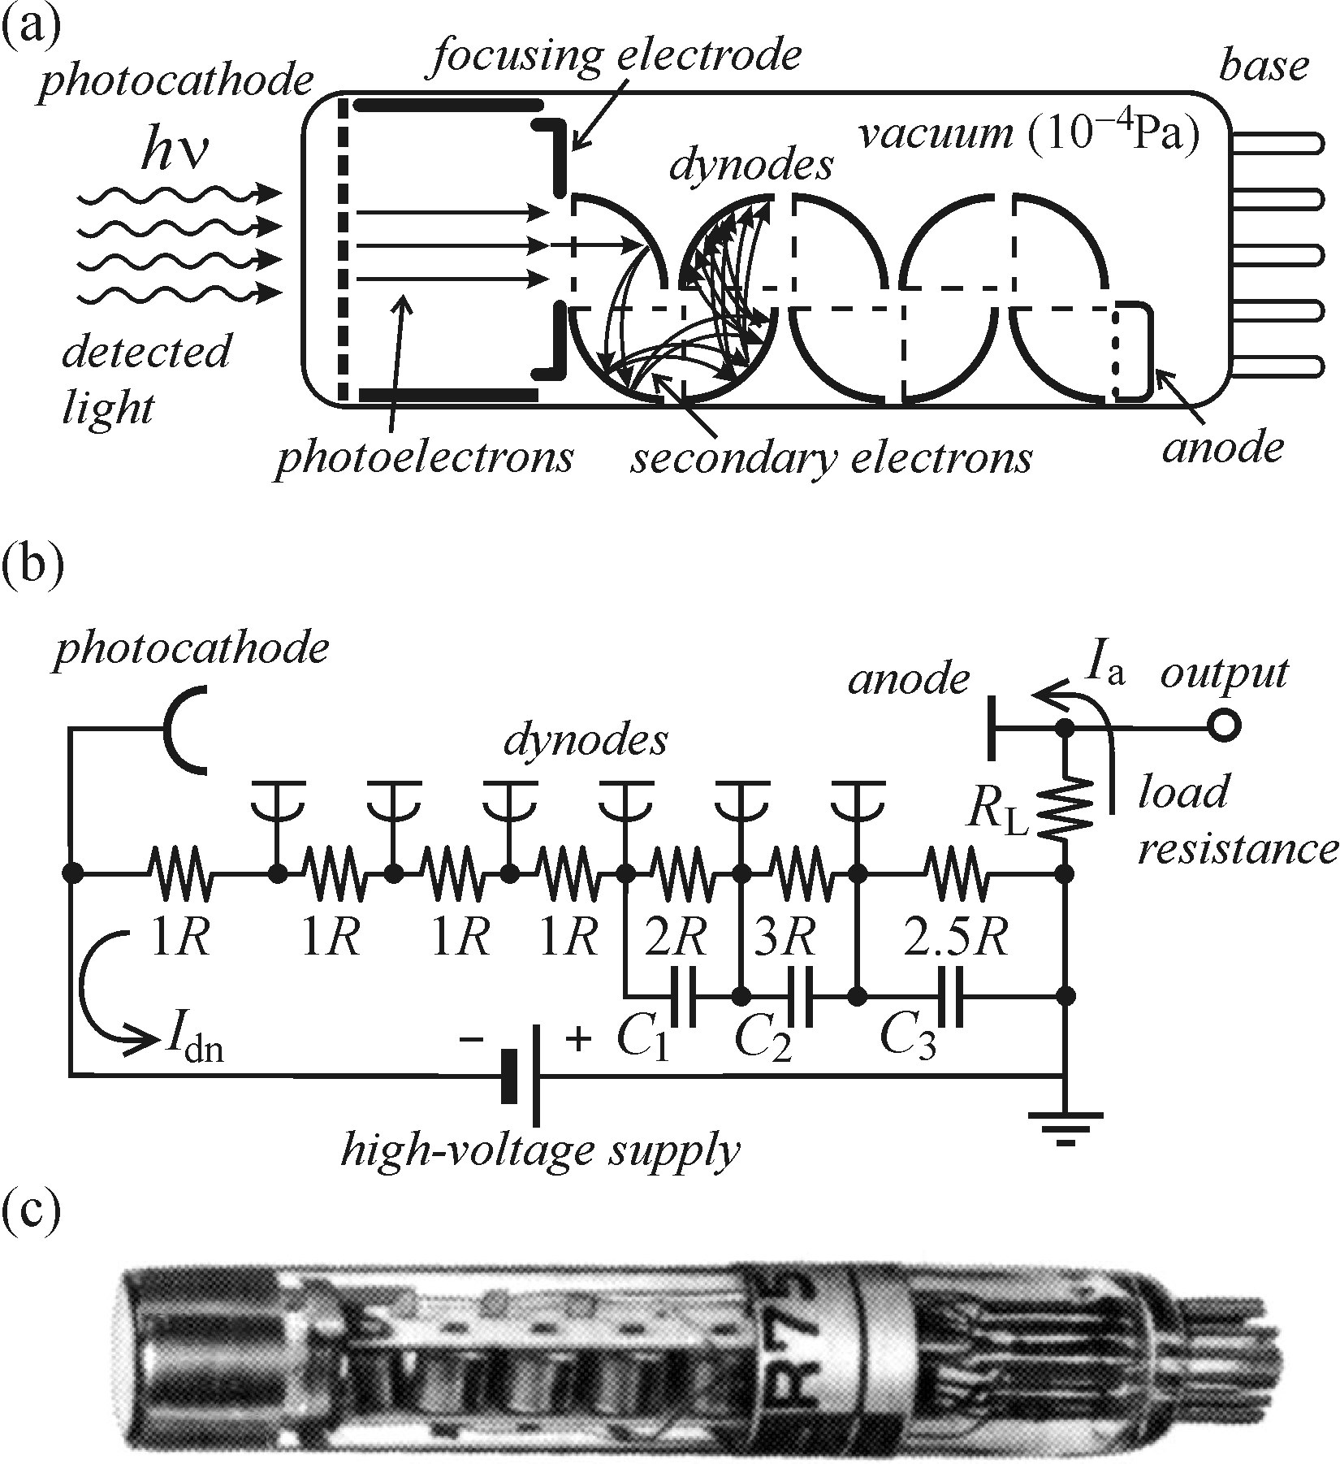
Photodetectors: photomultiplier tube (PMT), avalanche photodiode (APD), CCD
PMT operation principle
PMT is a single channel vacuum tube detector:
photoelectron emission from cathode with
a low work function φ < hν
electron is accelerated to the first dynode
secondary electron emission with coefficient
δ multiplies signal
voltage drop across array of n dynodes drives
and multiplies electrons to the anode
total final number of electrons (gain) G = δ^{n}

Slide 13
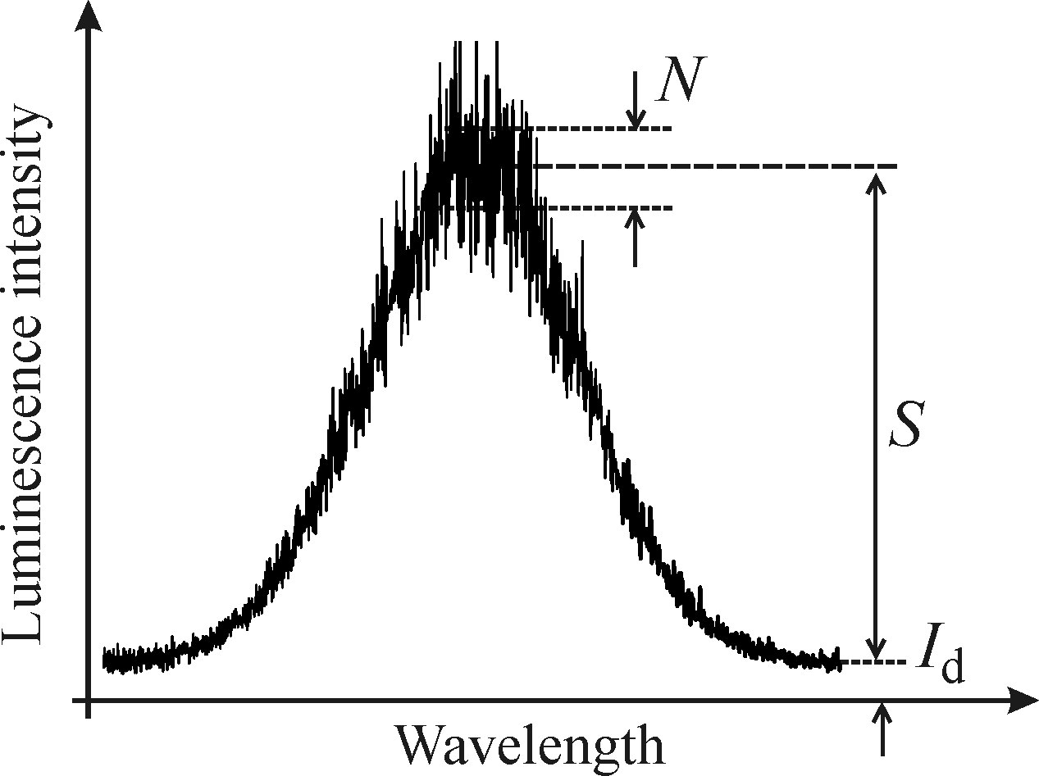
Photodetectors: photomultiplier tube (PMT), avalanche photodiode (APD), CCD
PMT main parameters
gain G ~ 10⁵⁻⁷
quantum efficiency (photon-to-electron conversion probability) η_{ph} ~ 0.1-20 %
anode sensitivity (output current per light power unit) k(λ) ~ 10³⁻⁵ A/W
maximum current I ~ 10-100 μA not to overheat and damage electrodes
PMT background and noise
dark current I_{d} (thermionic emission of electrons from photocathode) can be reduced by cooling of the PMT with a Peltier element or LN2
the main problem is not the background itself but the noise associated with it
lowest detectable signal level (noise equivalent power) NEP ~ 10⁻¹⁵⁻¹⁶ W
Shot noise
random nature of the incident photon flux and photoemission
at any given time the output signal value fluctuates around <S>
shot noise: N =S^{1/2}

Slide 14
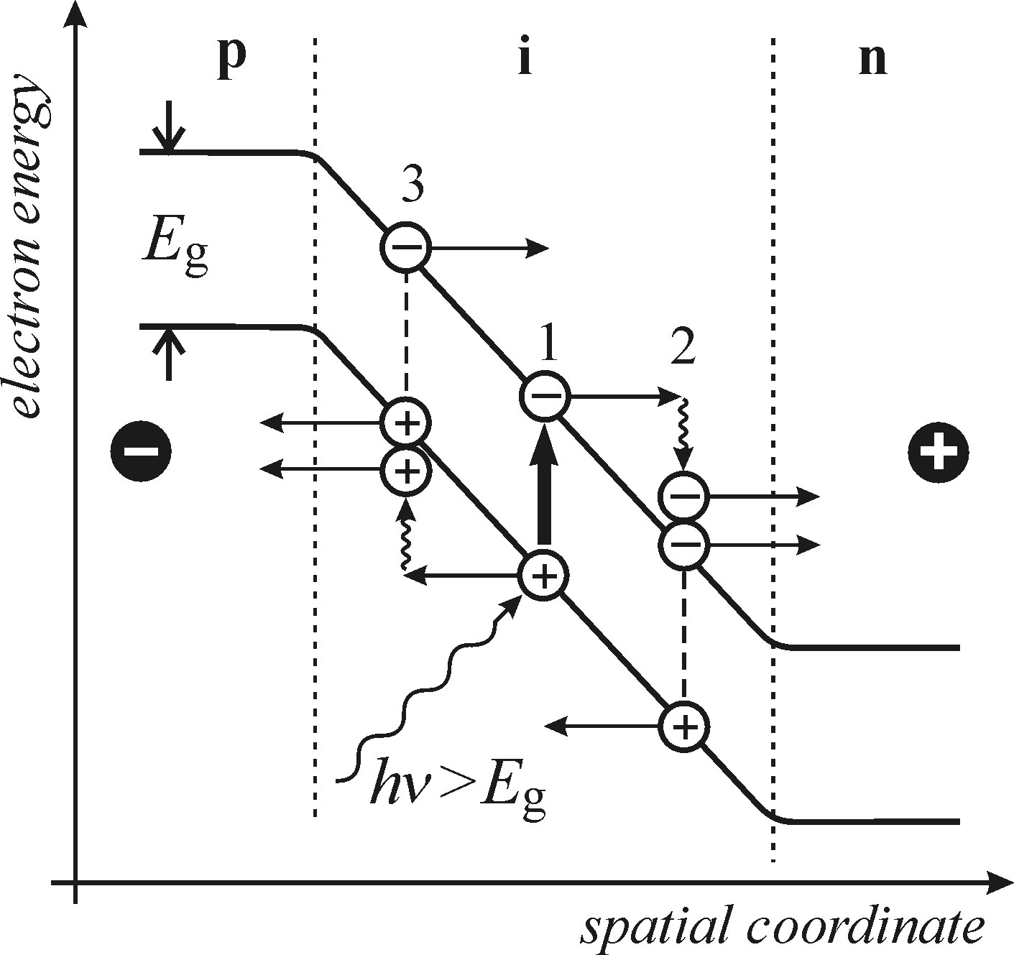
Photodetectors: photomultiplier tube (PMT), avalanche photodiode (APD), CCD
APD operation principle
APD is a single channel solid state detector:
photon absorption generates an electron-hole pair (E_{g} < hν)
the pair is dissolved by external bias of the diode
carriers are accelerated to electrodes
impact ionization creates an avalanche of carriers
APD main parameters
ionization coefficient (number of ionization events per unit distance) α_{e} or α_{h}
practically only one type of carriers is used for signal, so ionization ratio α_{e}/α_{h} → 0 or ∞
photodiode gain G = α_{e}·w, w – width of the multiplication region
for fast response a small size of the sensitive area is used ~ 1 mm² (downto 4·10⁻⁴ mm²)

Slide 15
Photodetectors: photomultiplier tube (PMT), avalanche photodiode (APD), CCD
Comparison of single channel detectors
PMT
APD
smaller, more robust
lower dark noise
higher detectivity (1/NEP)
larger sensitive area (~3x12 mm²)
suitable for spectroscopy
fast response suitable for
single photon counting

Slide 16
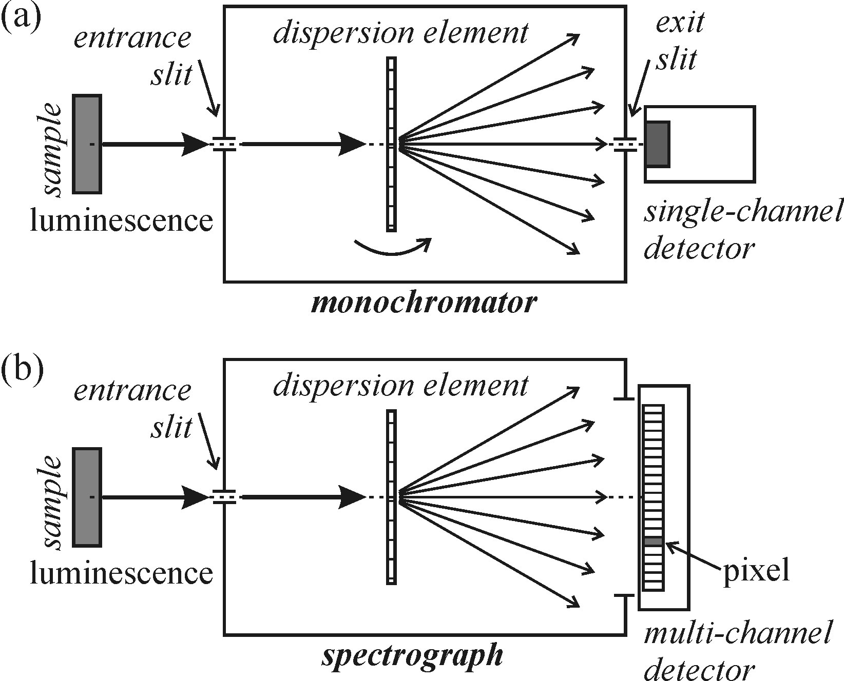
Photodetectors: photomultiplier tube (PMT), avalanche photodiode (APD), CCD
CCD history
Nobel prize in physics 2009: ”…In 1969 Willard S. Boyle and George E. Smith invented
the first successful imaging technology using a digital sensor, a CCD (Charge-Coupled
Device). The CCD technology makes use of the photoelectric effect, as theorized by
Albert Einstein and for which he was awarded the 1921 year's Nobel Prize.
By this effect, light is transformed into electric signals. The challenge when designing
an image sensor was to gather and read out the signals in a large number of image
points, pixels, in a short time.”
CCD is a multi-channel solid state detector

Slide 17
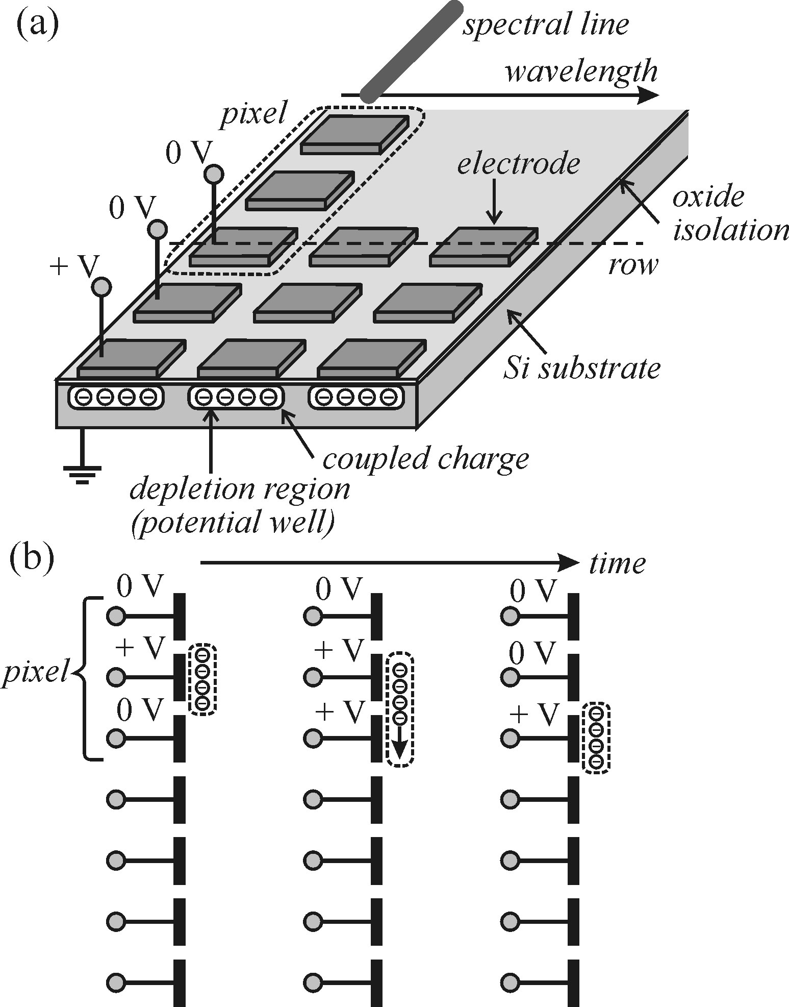
Photodetectors: photomultiplier tube (PMT), avalanche photodiode (APD), CCD
CCD operation principle
generation of electron-hole pairs by incident light
electrons are stored in a potential well for each pixel
collected charge is transferred row-by-row to the
readout register by gradual variation of individual biases
ampification of the collected signal, visualization
pixel size is 20x20 μm, 12x12 μm…
array size is 1024x256, 1024x1024,…

Slide 18
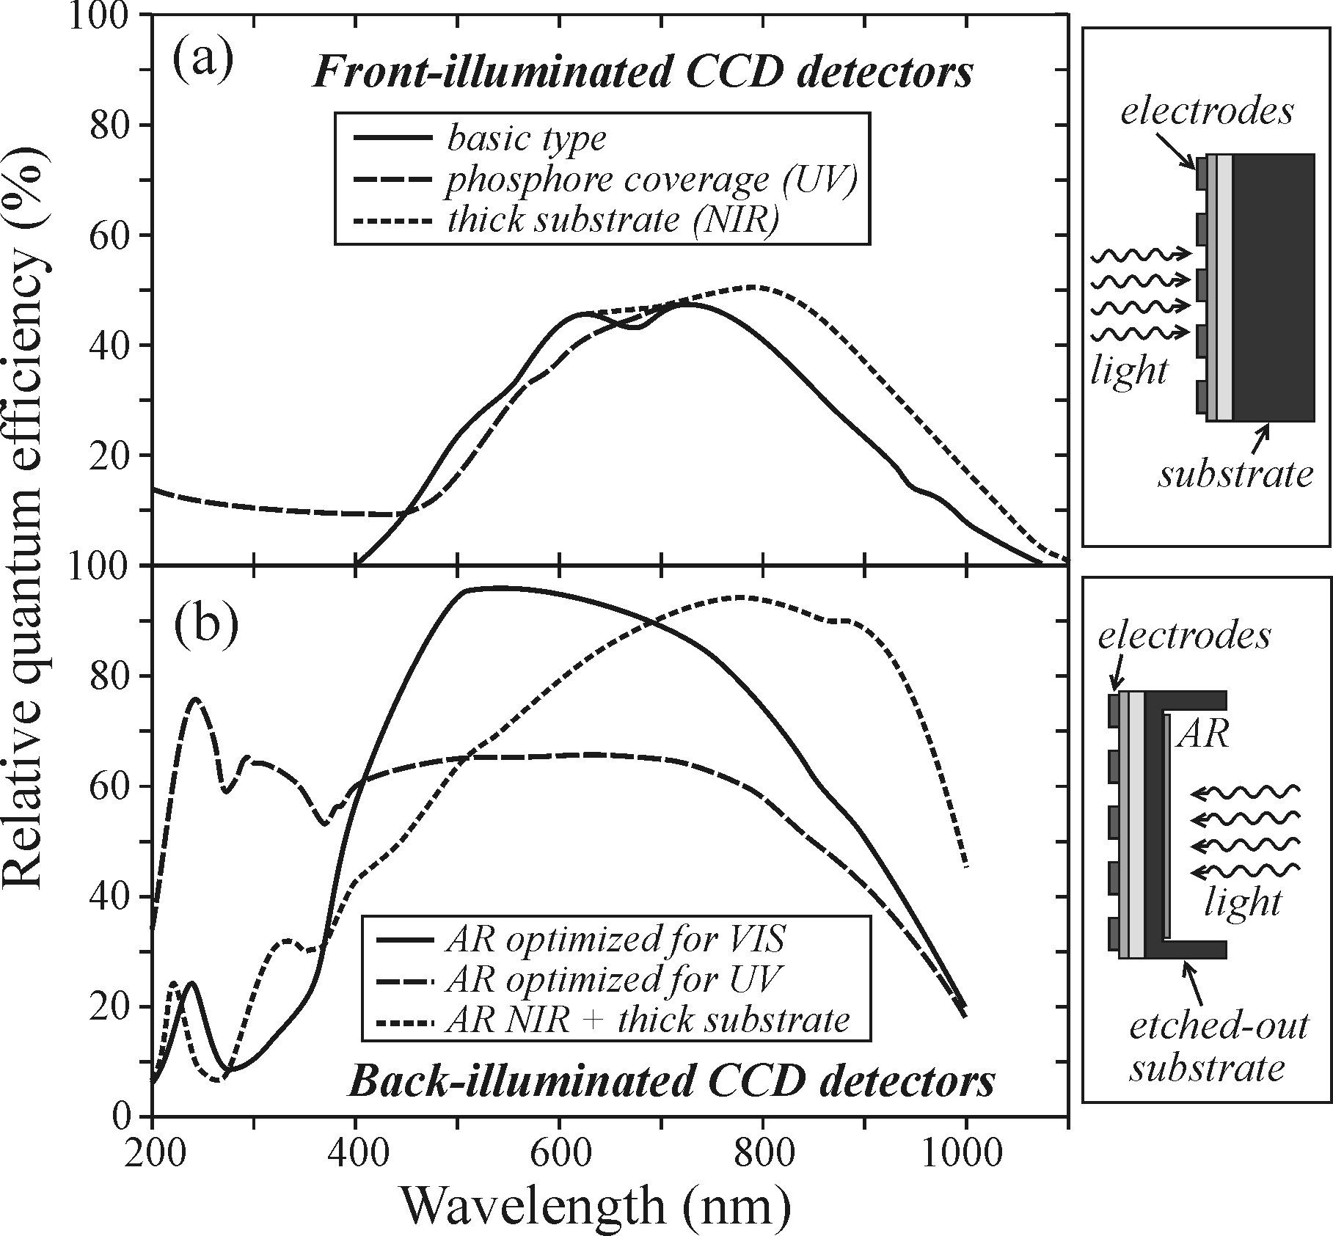
Photodetectors: photomultiplier tube (PMT), avalanche photodiode (APD), CCD
CCD main parameters
multiplexing advantage: parallel acquisition form n channels reduces signal-to-noise
ratio by n^{1/2} compared to serial read-out, like in PMTs (1/n faster total readout)
spectral sensitivity is silicon sensitivity: 400-1000 nm
spectral coverage (range of wavelength detectable with one shot) from 30 to 300 nm
quantum efficiency is wavelength dependent
dark current is very low for cooled detectors
total noise consists of shot noise, dark current
noise and readout noise (constant)
signal grows linearly with time, while shot noise
as a square root – longer acquisition time can yield
S/N>1

Slide 19
Outline
Main definitions. Specific case of semiconductor luminescence
Photoluminescence (PL) and photoluminescence excitation (PLE) techiques
Photodetectors: photomultiplier tube (PMT), avalanche photodiode (APD), CCD
Monochromators and spectrographs: resolution, throughput and signal-to-noise ratio
Spectral and resolution corrections
Other methods: lock-in amplifier, photon counting and Fourier spectroscopy

Slide 20
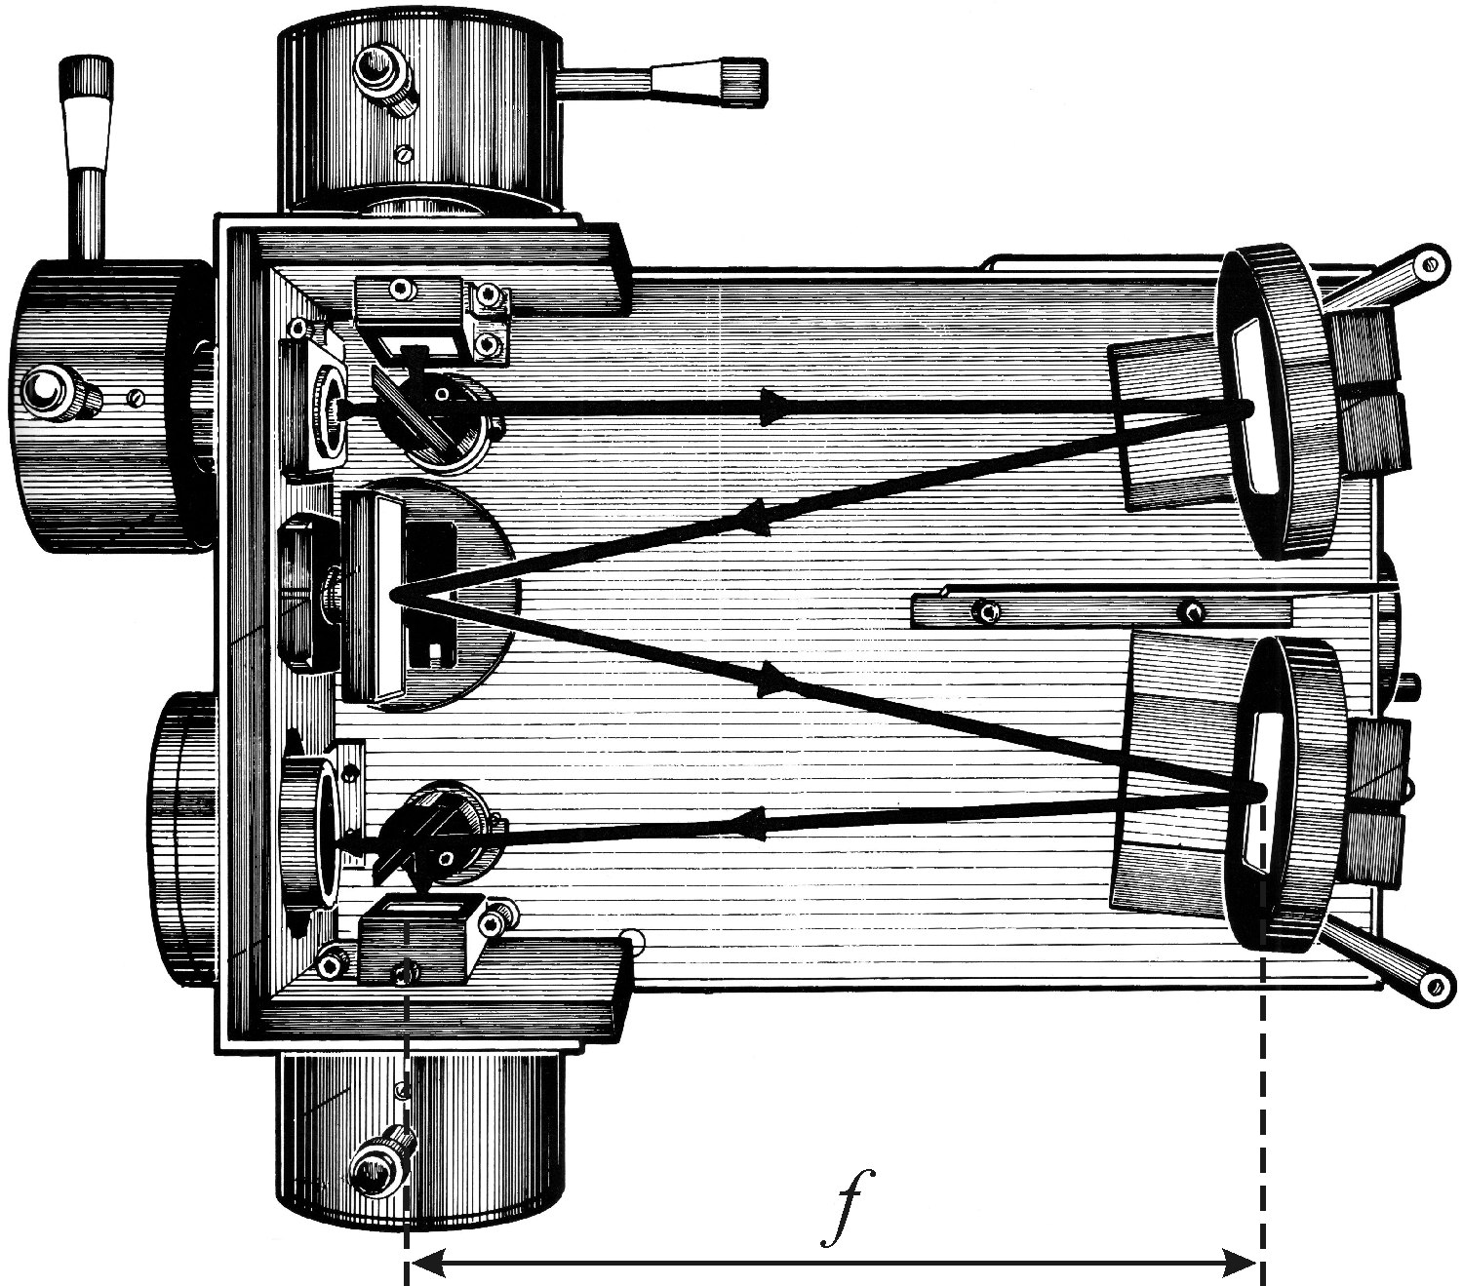
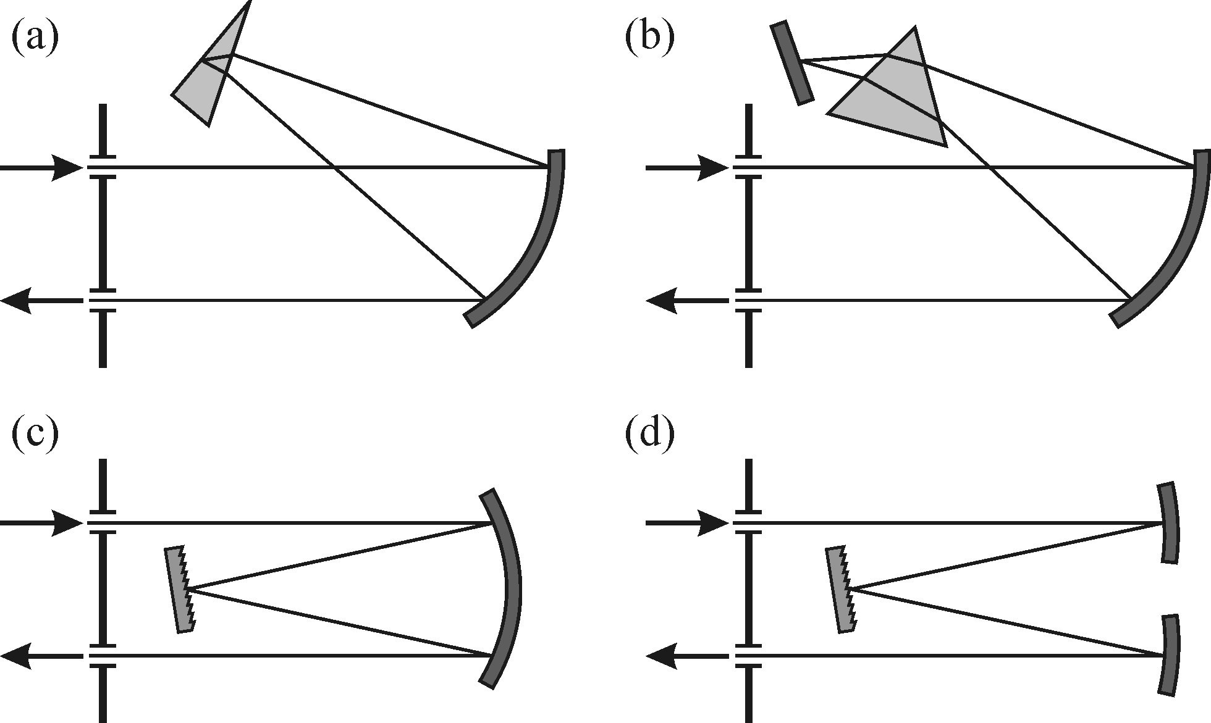
Monochromators and spectrographs: resolution, throughput and signal-to-noise ratio
Definitions and types
monochromator focuses signal with a
specific wavelength at the output slit for a
single channel detector
spectrograph produces spectrum focused
at the output port for a multichannel detector
They both contain a light dispersion element
(prism or grating) and focal planes coincide with
input and output ports
Different geometries, Czerny-Turner type (d)
is the most common nowadays

Slide 21
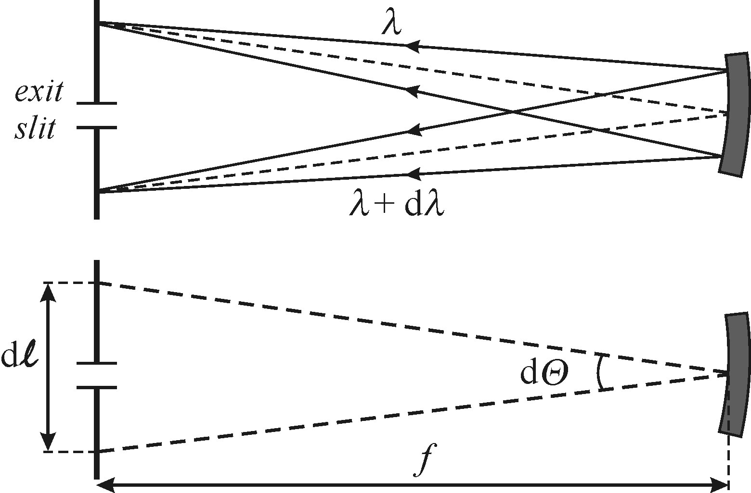
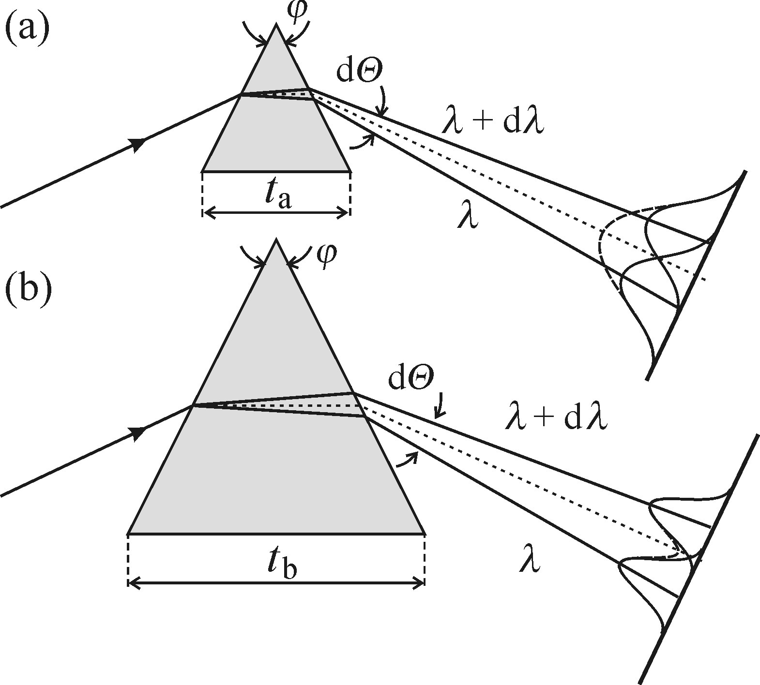
Monochromators and spectrographs: resolution, throughput and signal-to-noise ratio
Dispersion - how far different wavelengths end up from each other at the output plane
linear dispersion: L = f·dθ/dλ,
dθ/dλ – angular dispersion defined by grating (prism)
f – focal length the monochromator/spectrometer
typical reciprocal linear dispersion L⁻¹ ~ 1-10 nm/mm
Resolving power – ability to distinct between two closely spaced lines
R = λ/Δλ,
R ~ number of grooves for the grating, R ~ prism base length
limited by diffraction of the light beam defined by
the entrance slit and dispersion element size (for a prism)
or a groove density (for a grating):
Δλ = L⁻¹ · Δl, Δl is a slit width (defines source size)
- small source size and large dispersive element – best resolution

Slide 22
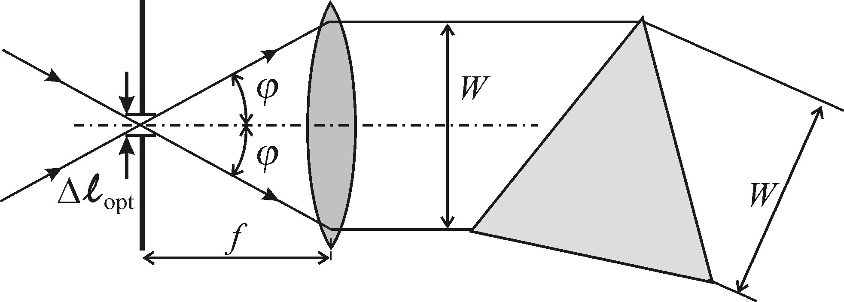
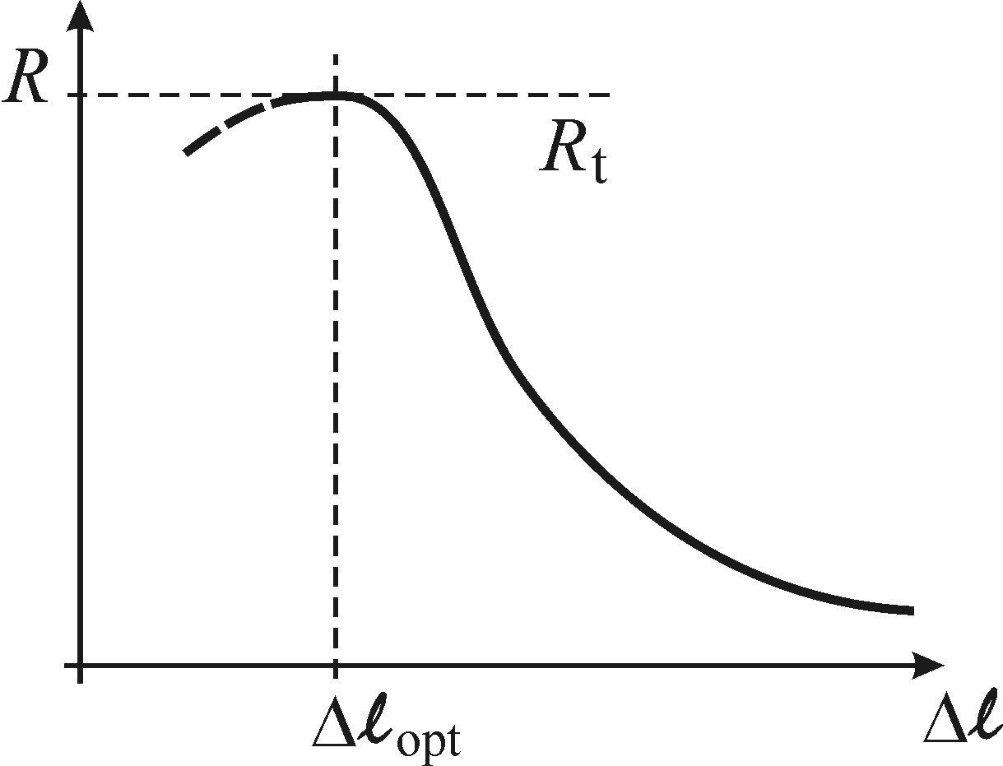
Monochromators and spectrographs: resolution, throughput and signal-to-noise ratio
Optimal slit width (source size)
slit diffraction angle ϕ_{d} = λ/ Δl
there is an optimal value of the slit Δl_{opt}
below which the incoming light missing the
collimating lens
practical values for Δl are 10-100 μm
thus optimal resolution R corresponds to this value
Optimal dispersive element
holographic gratings are usually used these days;
several gratings mounted on a rotating turrent provide different resolution and
spectral range;

Slide 23
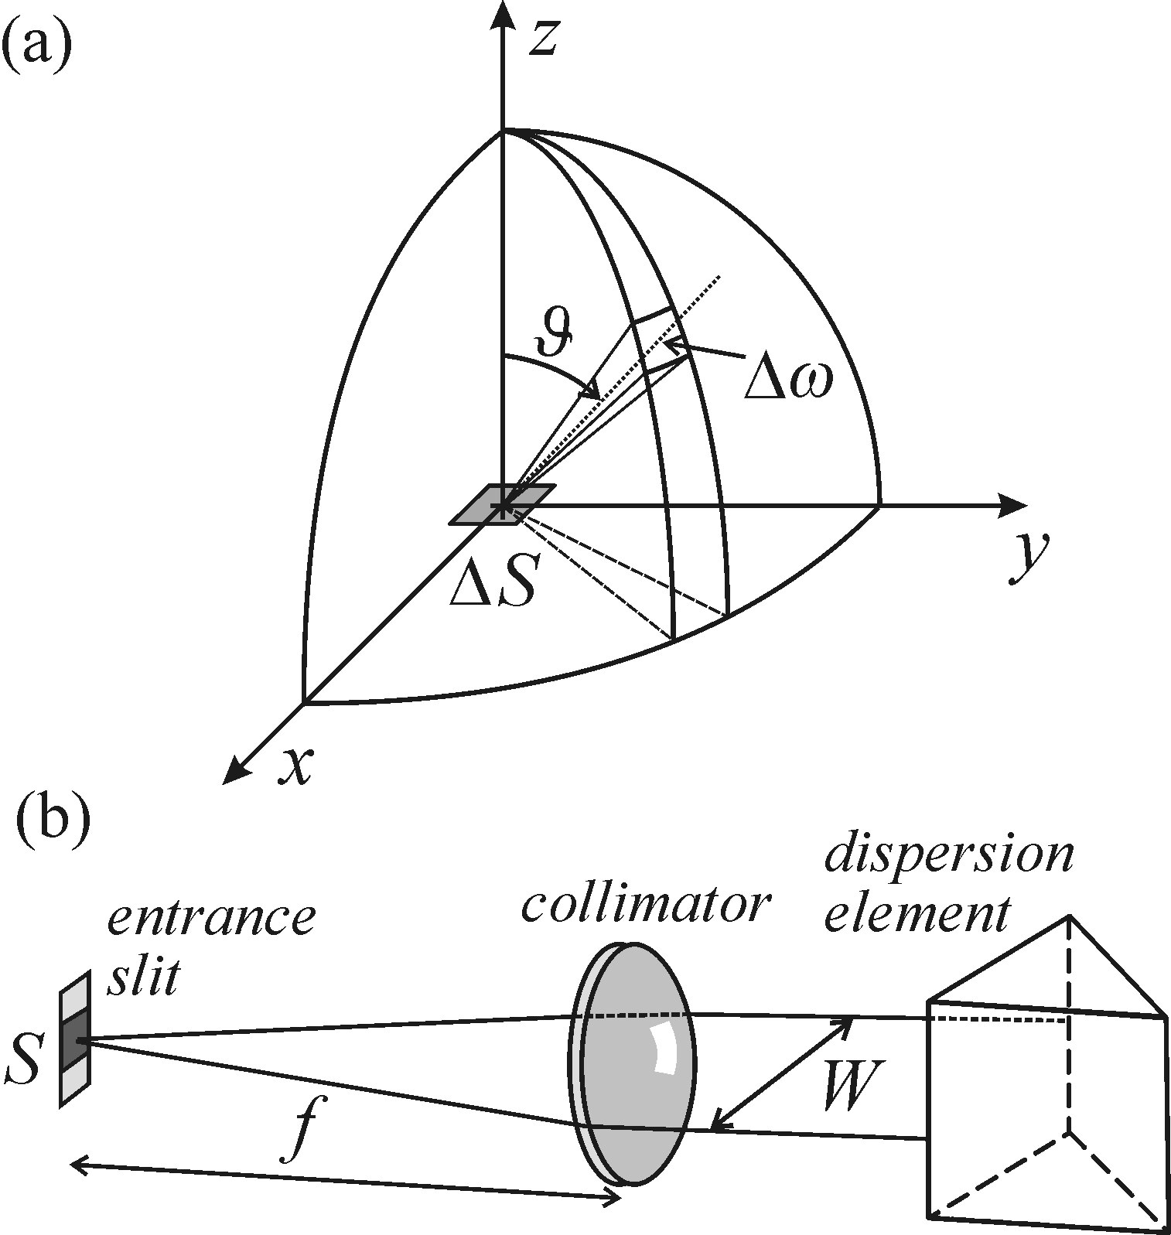
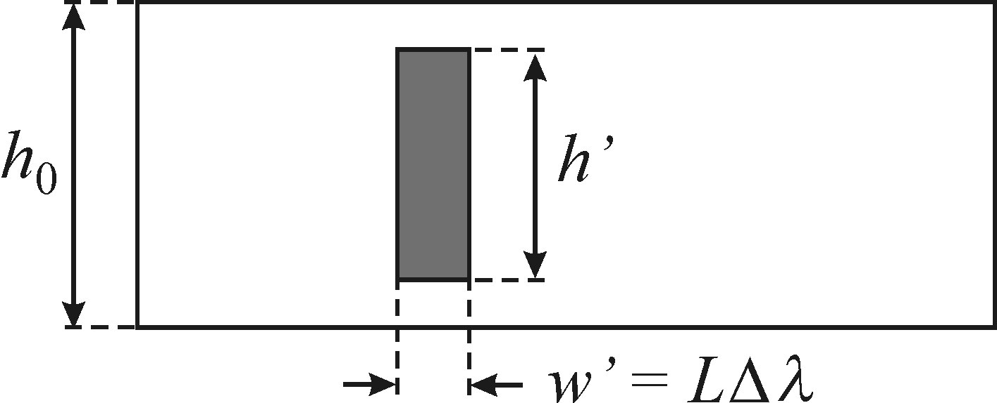
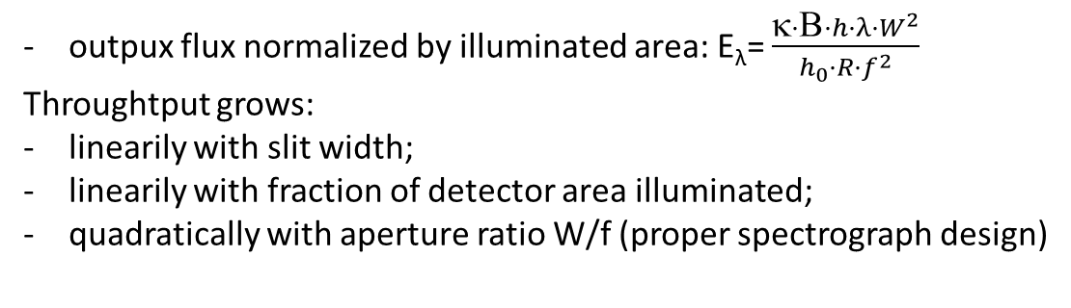
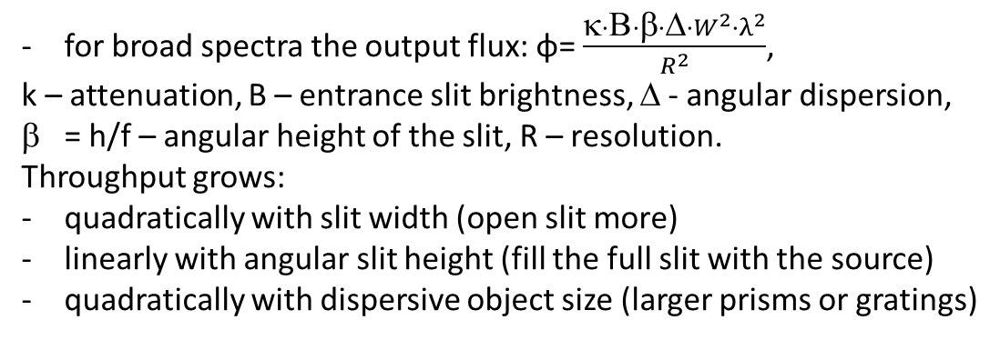
Monochromators and spectrographs: resolution, throughput and signal-to-noise ratio
Throughput of monochromators
for broad spectra the output flux: φ= $\frac{κ·Β·β·Δ·W^{2}·λ^{2}}{R^{2}}$,
k – attenuation, B – entrance slit brightness, Δ - angular dispersion,
= h/f – angular height of the slit, R – resolution.
Throughput grows:
quadratically with slit width (open slit more)
linearly with angular slit height (fill the full slit with the source)
quadratically with dispersive object size (larger prisms or gratings)
Throughput of spectrographs
outpux flux normalized by illuminated area: E_{λ}= $\frac{κ·Β·h·λ·W^{2}}{h_{0}·R·f^{2}}$
Throughtput grows:
linearily with slit width;
linearily with fraction of detector area illuminated;
quadratically with aperture ratio W/f (proper spectrograph design)

Slide 24
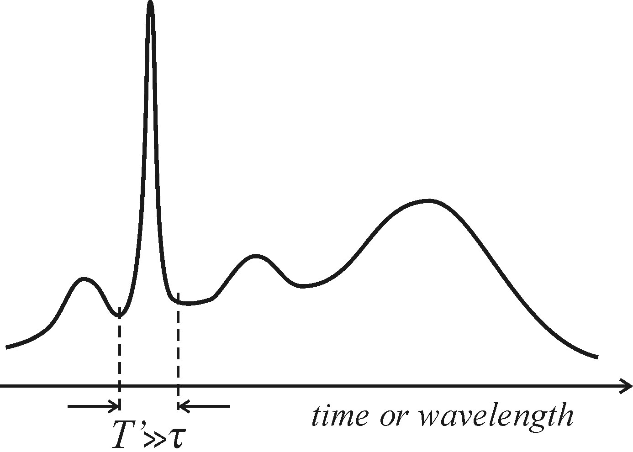
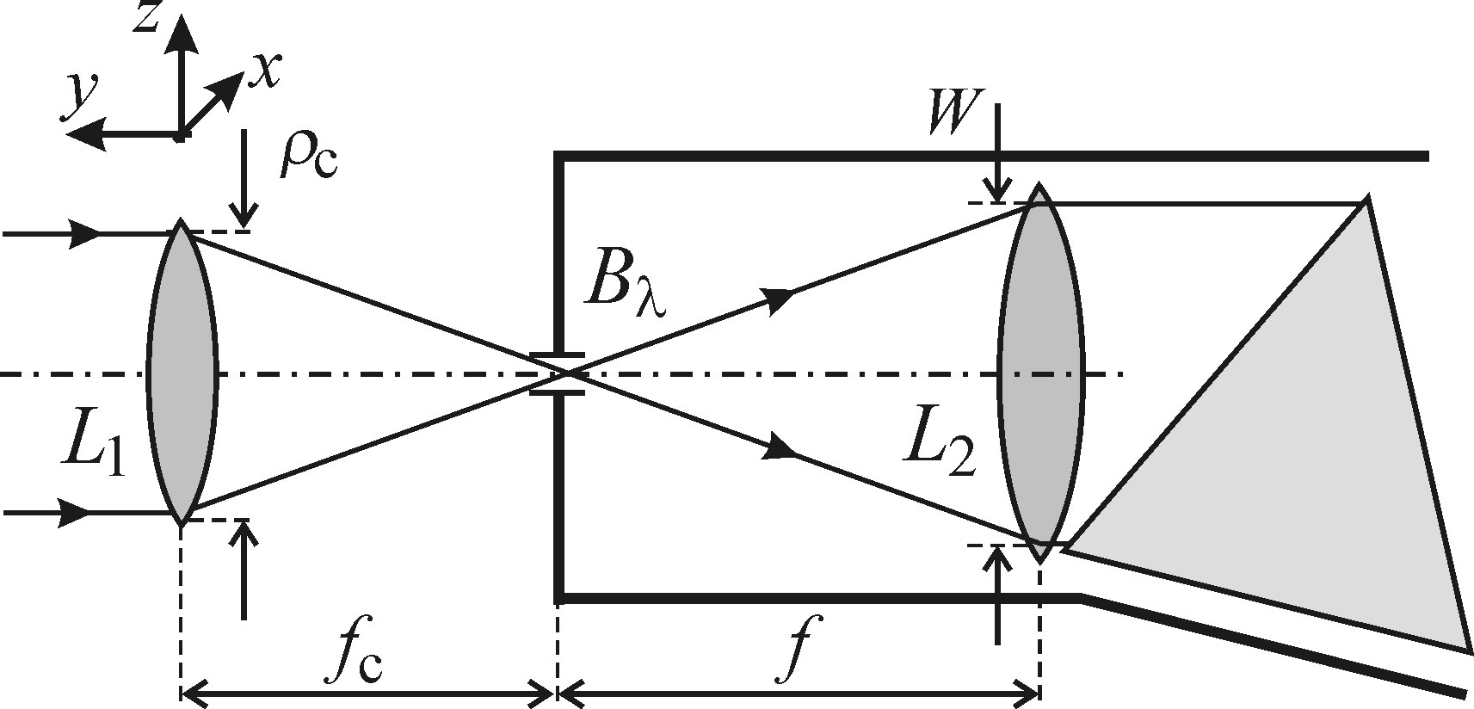
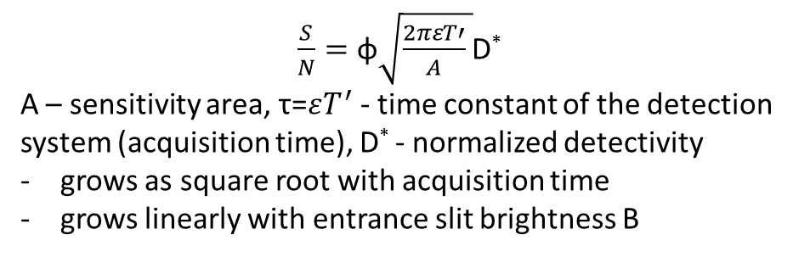
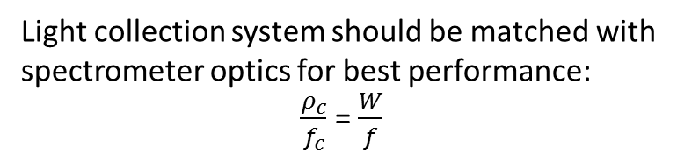
Monochromators and spectrographs: resolution, throughput and signal-to-noise ratio
Signal-to-noise ratio in a scanning monochromator
$\frac{S}{N}=\text{φ}\sqrt{\frac{2πεT′}{A} }$D*
A – sensitivity area, τ=$εT^{′}$ - time constant of the detection
system (acquisition time), D* - normalized detectivity
grows as square root with acquisition time
grows linearly with entrance slit brightness B
Light collection system should be matched with
spectrometer optics for best performance:
$\frac{ρ_{c}}{f_{c}}$ = $\frac{W}{f}$

Slide 25
Outline
Main definitions. Specific case of semiconductor luminescence
Photoluminescence (PL) and photoluminescence excitation (PLE) techiques
Photodetectors: photomultiplier tube (PMT), avalanche photodiode (APD), CCD
Monochromators and spectrographs: resolution, throughput and signal-to-noise ratio
Spectral and resolution corrections
Other methods: lock-in amplifier, photon counting and Fourier spectroscopy

Slide 26
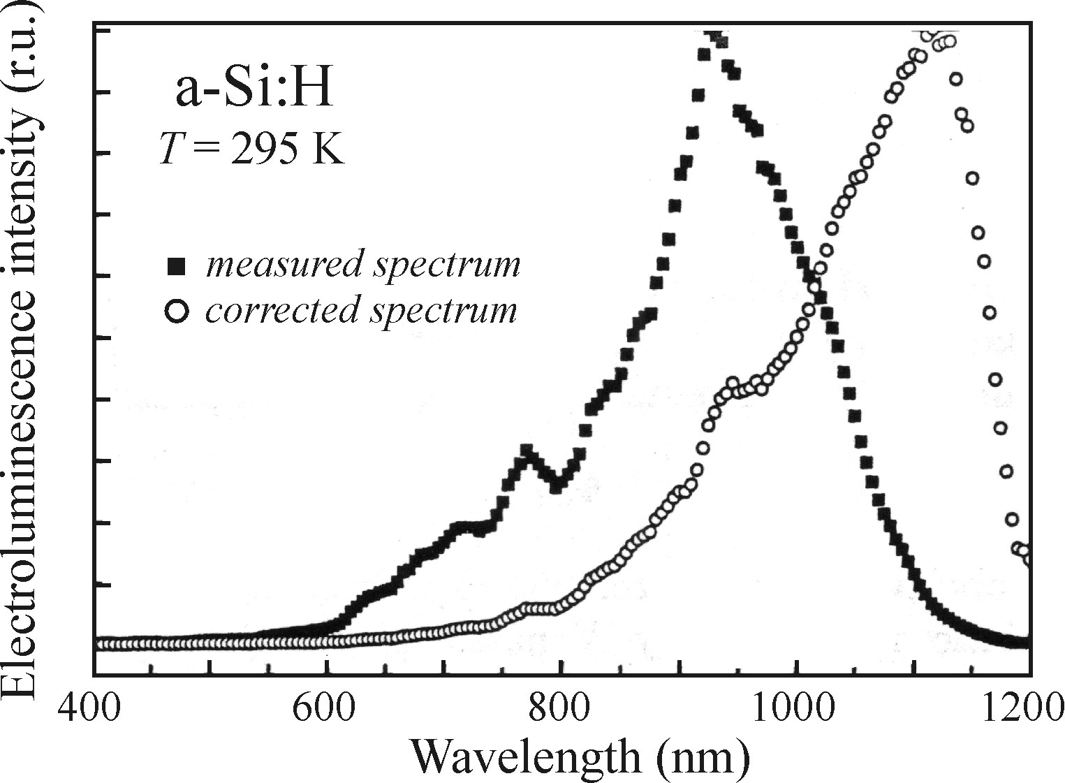
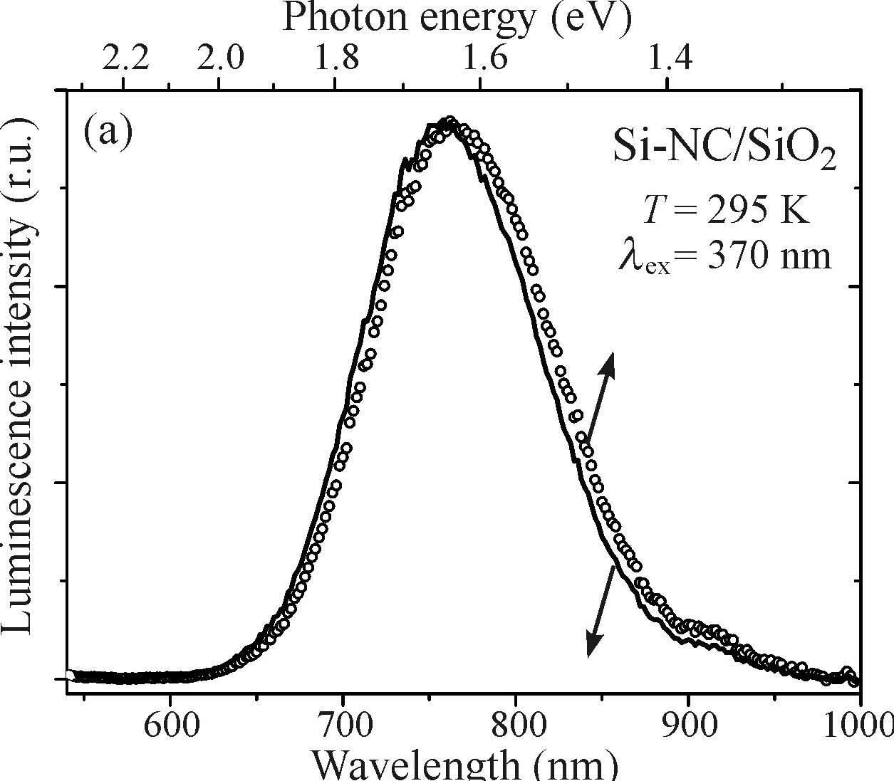
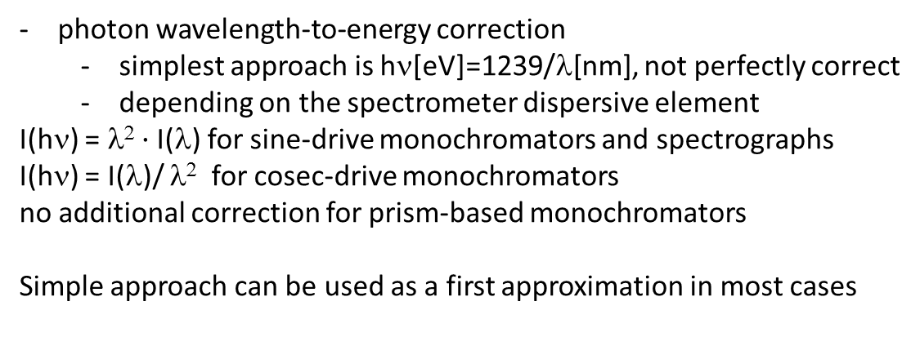
Spectral and resolution corrections
Even the best spectrometer/detector system distorts the signal
Spectral corrections
non-uniform spectral response of all optical components: system correction function Q (λ):
  can be measured with a black body radiation source of known temperature
  all measured broad spectra must be corrected with Q (λ)
  especially important for the edges of detection sensitivity
photon wavelength-to-energy correction
  simplest approach is hν[eV]=1239/λ[nm], not perfectly correct
  depending on the spectrometer dispersive element
    I(hν) = λ² $·$I(λ) for sine-drive monochromators and spectrographs
    I(hν) = I(λ)/ λ² for cosec-drive monochromators
    no additional correction for prism-based monochromators
    Simple approach can be used as a first approximation in most cases

Slide 27
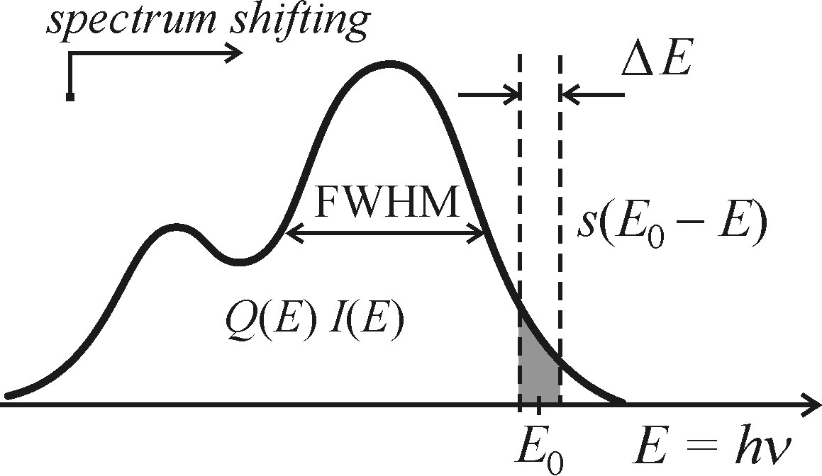
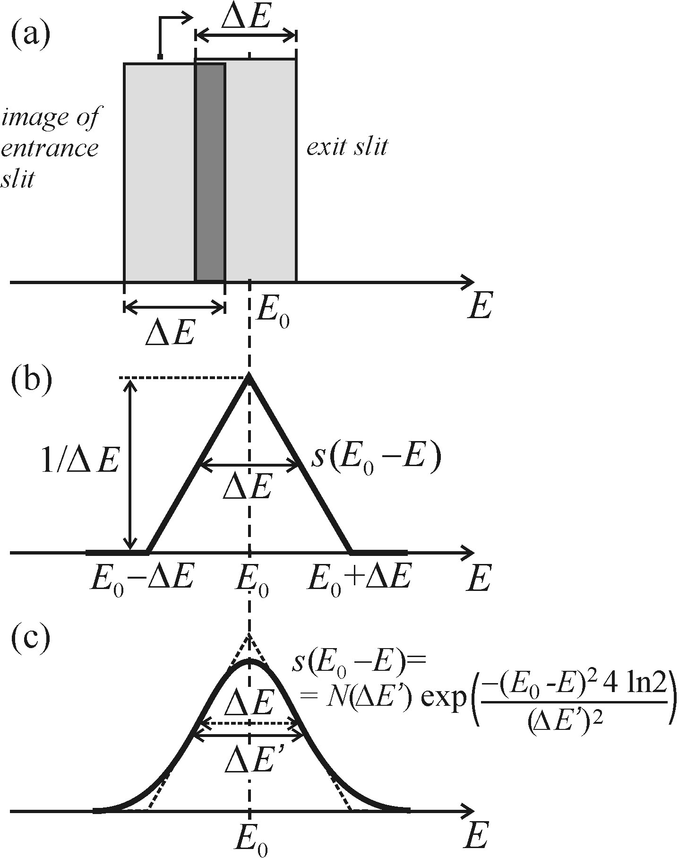
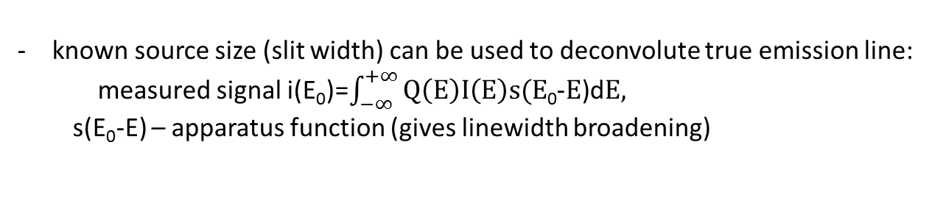
Spectral and resolution corrections
Even the best spectrometer/detector system distorts the signal
Resolution corrections
known source size (slit width) can be used to deconvolute true emission line:
  measured signal i(E₀)=$\int_{−∞}^{+∞}{Q\left(E\right)I\left(E\right)s(E\text{0}}$-$E$)d$E,$
  s(E₀-E) – apparatus function (gives linewidth broadening)
this function can be measured with a source of atomic lines:
the dominant broadening is the one introduced by the spectrometer
can be neglected for very broad spectra
can be taken into account for narrow spectra assuming Gaussians:
Δλ²_{meas}=Δλ’²+ Δλ²_{real}

Slide 28
Outline
Main definitions. Specific case of semiconductor luminescence
Photoluminescence (PL) and photoluminescence excitation (PLE) techiques
Photodetectors: photomultiplier tube (PMT), avalanche photodiode (APD), CCD
Monochromators and spectrographs: resolution, throughput and signal-to-noise ratio
Spectral and resolution corrections
Other methods: lock-in amplifier, photon counting and Fourier spectroscopy

Slide 29
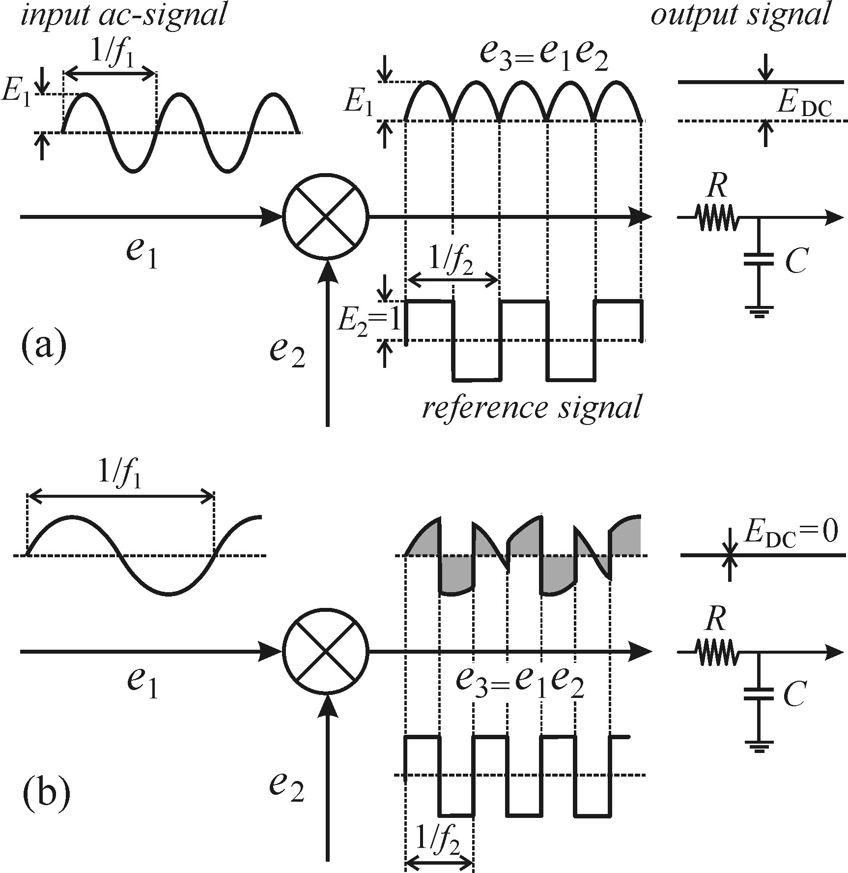
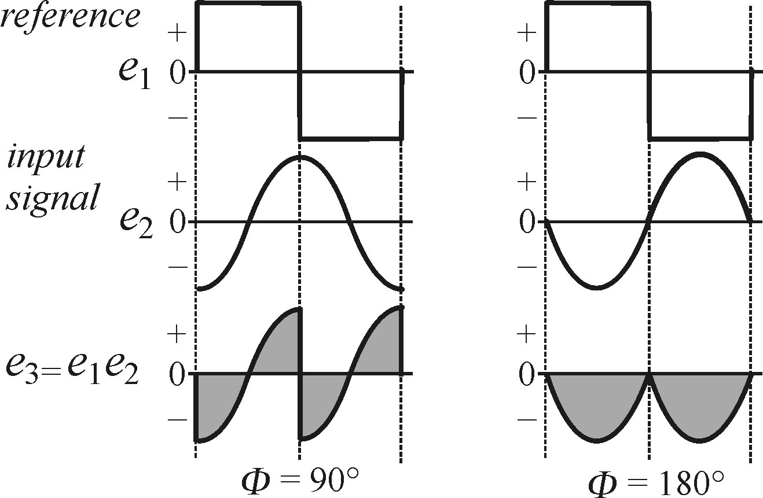
Other luminescence detection methods
Lock-in amplifier
enhancement of weak signals using modulation synchronized amplification:
- signal is modulated with a mechanical chopper
- external modulation source is synchronized with it
- as a result only frequency-matching signal is amplified
small shifts in phase can be easily detected
  this is a tuning parameter for achieving maximum
  amplification compensating for delays in lines of two signals

Slide 30
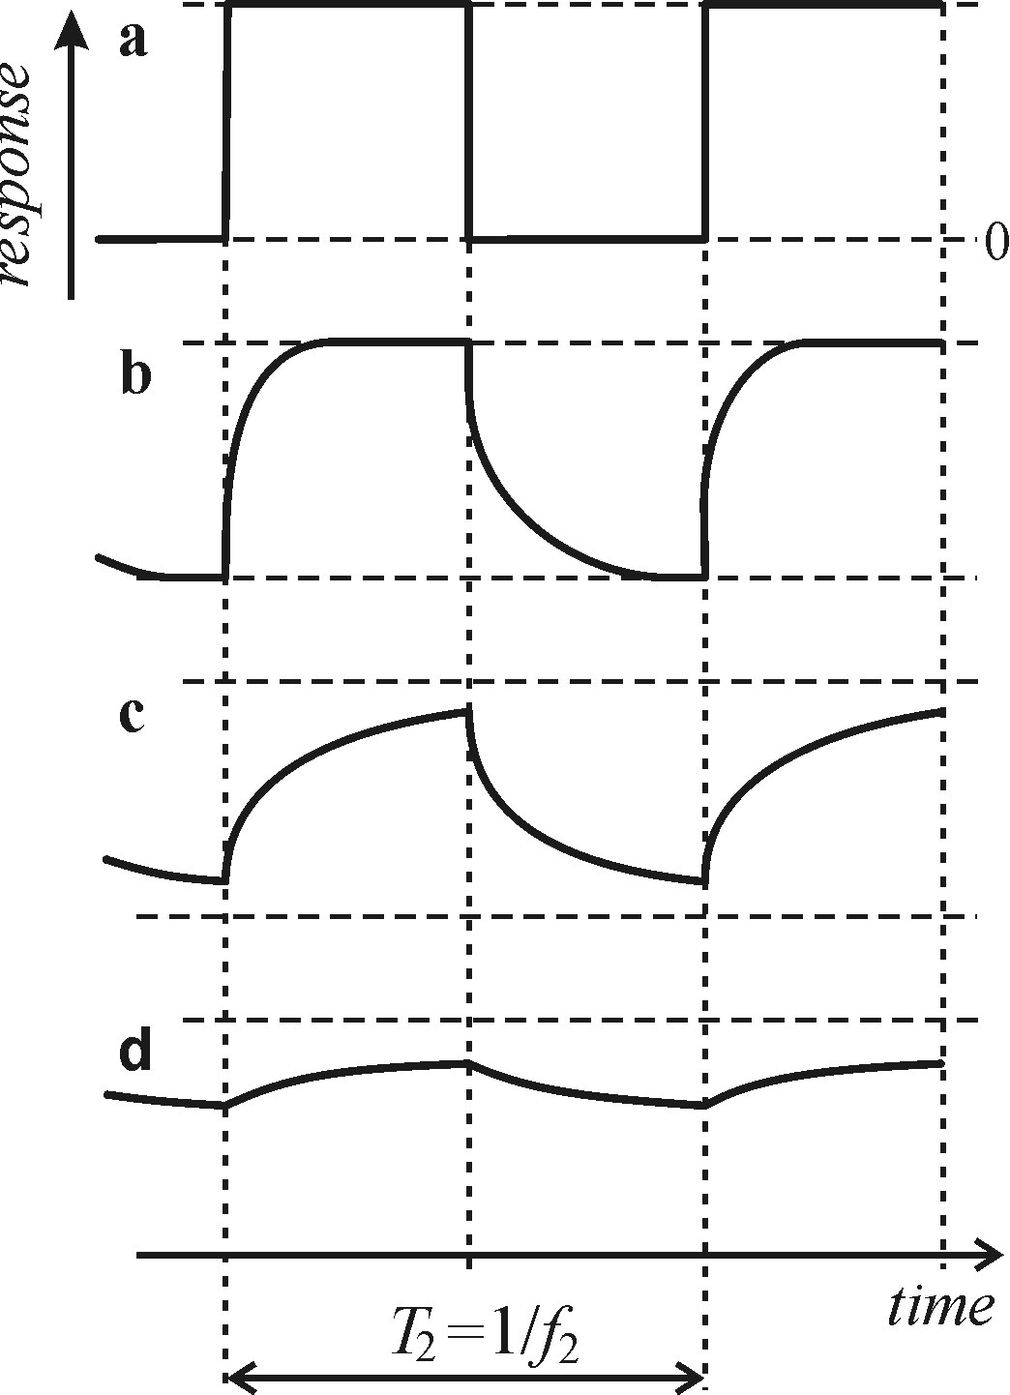
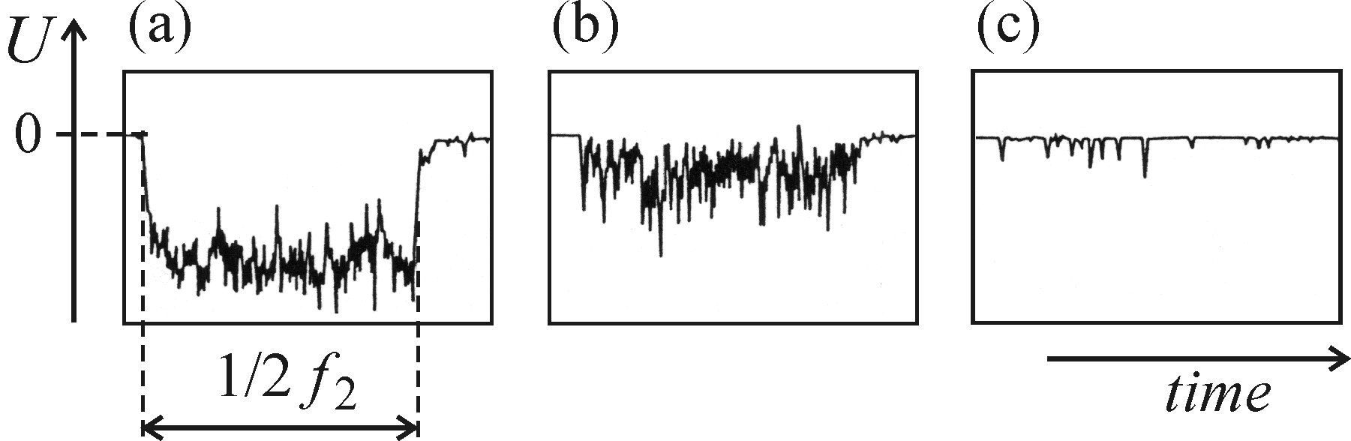
Other luminescence detection methods
Lock-in amplifier
not suitable for luminescence with long lifetimes
(weak signal in the “window” between excitation pulses)
not suitable for extremely weak signals, where
discrete nature of photons becomes apparent

Slide 31
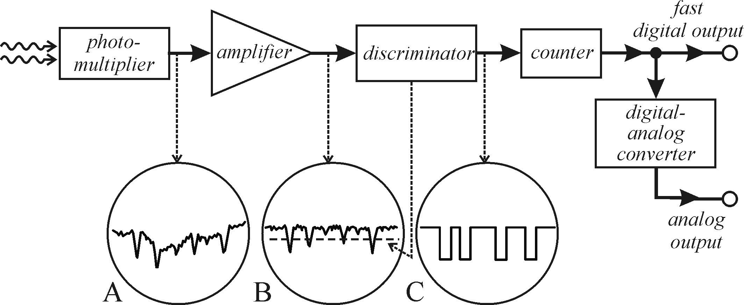
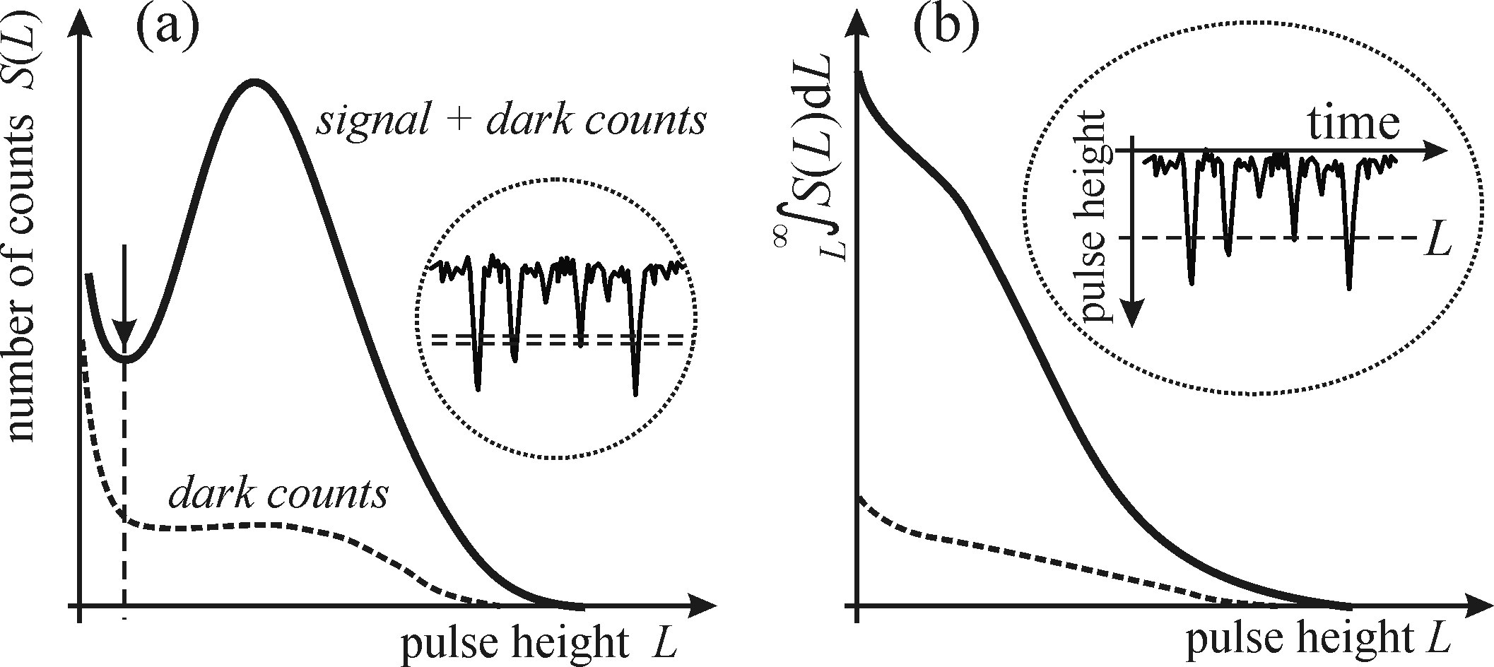
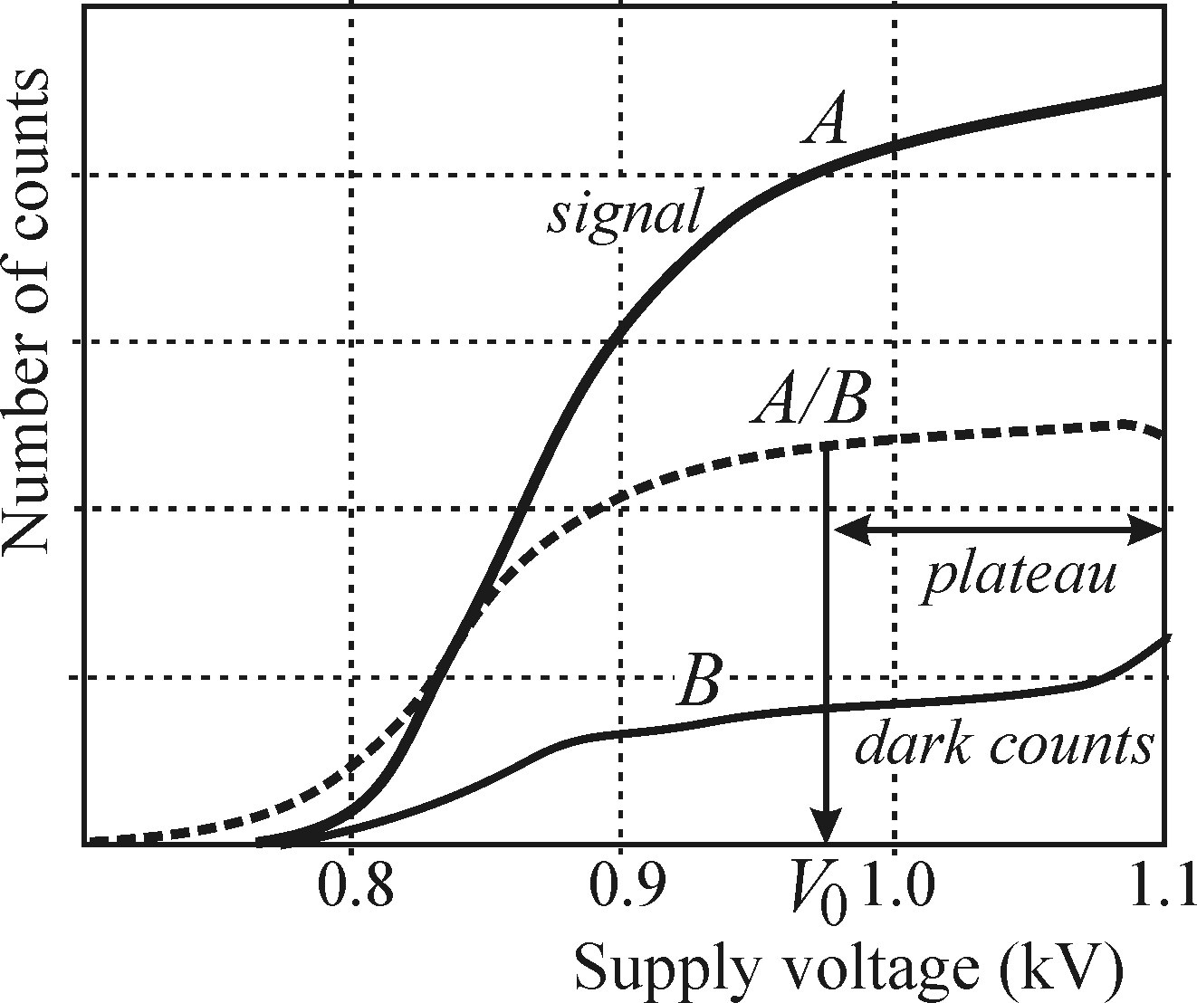
Other luminescence detection methods
Photon counting
PMT, APD and CCD can work in photon counting mode
the result is the pulse train of incoming photons vs time
important parameters for PMTs:
fast response time (< 10 ns)
high quantum efficiency (> 20%)
narrow response counts distribution
proper operation voltage (plateau region)

Slide 32
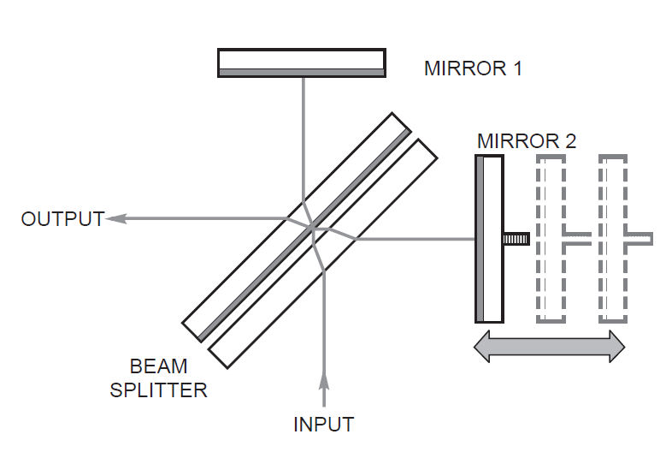
Other luminescence detection methods
Fourier luminescence spectroscopy
applied for high spectral resolution (Δλ<0.001 nm) spectroscopy in the infrared region
Michelson interferometer with a varying arm length
Temporal interference signal is Fourier processed
Multiplexing and high throughput are advantages

