Slide 1
Time-resolved luminescence: equipment and kinetic description of processes. & Phonons.
Course title: Luminescence spectroscopy of Semiconductors, Lecture 2 (chapter 2, 3 & 4 of the book)
Given by: Mahtab Sangghaleh, 30 Oct. 2012

Slide 2
Out line:
Time- resolved luminescence measurements, Set up & techniques
Kinetic description of luminescence processes
Phonons and their participation in optical phenomena

Slide 3
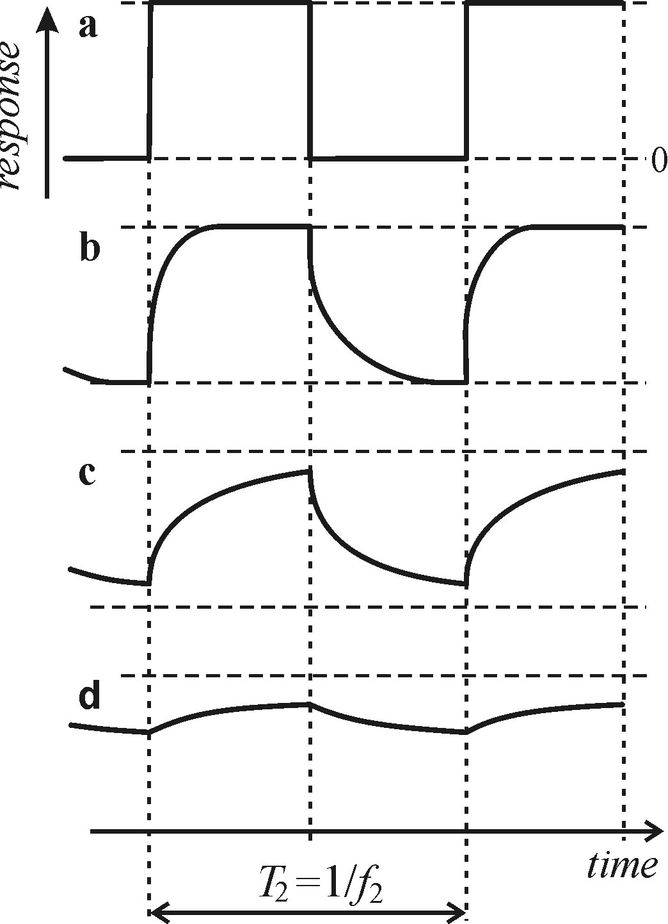
Time- resolved luminescence measurements, Set up & techniques
Direct imaging of the luminescence
1. Single- channel detector (PM or Photodiode)
2. Oscilloscope
3. Cw excitation beam (chopped) / pulsed source
(a lamp or laser)
4. Monochromator/ Band interference filter

Slide 4
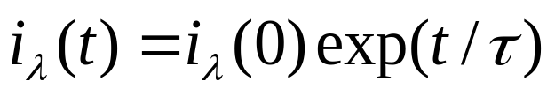

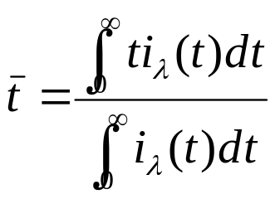



In the simplest case: single-exponential function
Where is luminescence
decay time (lifetime)
Mean decay time: mean value of continuous stochastic variable:
Single-exp.
Occurrence probability density of a time interval t which an elementary emitter is found in an excited state
The time at which the initial intensity decreases to the value

Slide 5
Difficulties & potential Limitations:
The Whole experimental set up ( pulsed excitation source, photomultiplier or photodiode, and the oscilloscope) should be fast enough, highly sensitive and linearly responding to the optical signals.
Insufficient response speed of the photomultiplier
A fast p-i-n photodiode is less sensitive and preamplifier must be used in connection with oscilloscope
The frequency bandwidth of the oscilloscope

Slide 6
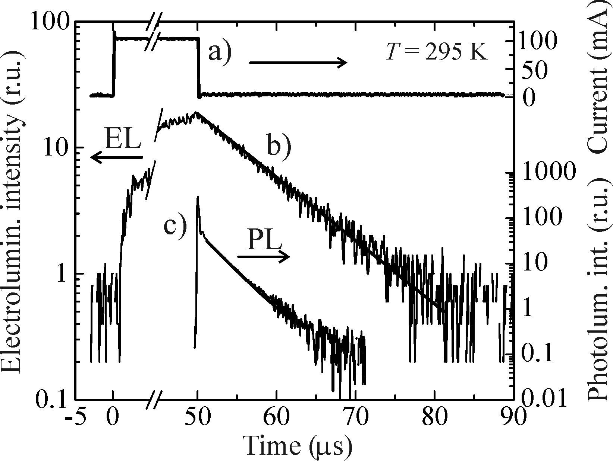
Direct measurements of the luminescence response suitable for relatively slow decays (Pulsed source below 1us & for chopped excitation beam below 50 us)

Slide 7
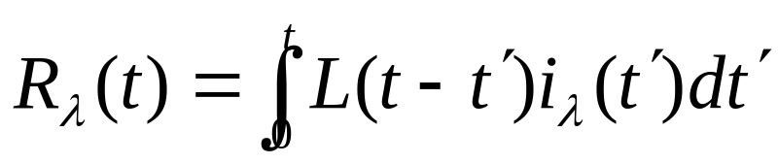





Complementary mathematics treatments
Experimental decay response
Actual time response
Temporal profile of the excitation pulse
General: Excitation duration comparable with the decay time to the
luminescence Response
Finite temporal width of the excitation, the exact initial point of the decay cannot
be determined (t=0)
Is much shorter than the decay time: and

Slide 8


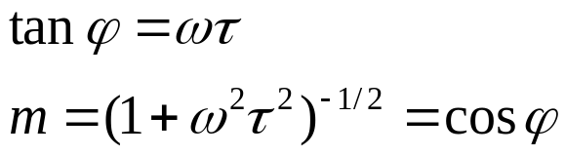
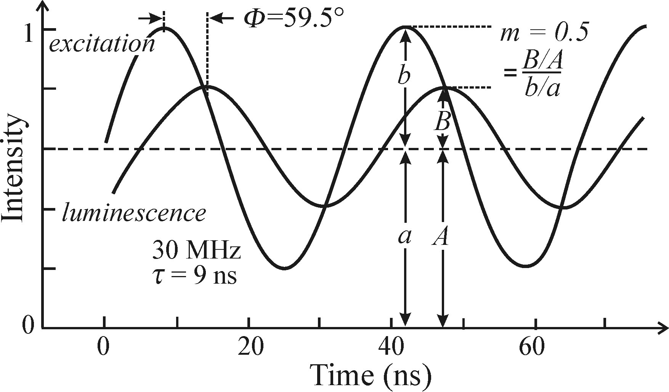
Phase-shifted method
Excitation Intensity sinusoidally modulated in time with angular frequency of
Luminescence response is phase shifted by angle
Modulation depth is decreased.
m is ratio of modulation depth
For pure single- exponential decay

Slide 9







The frequency must be comparable to the decay rate
If then
If then and cannot be reliably determined
Range decay time of
Fast luminescence kinetics, no need to short or ultrafast sources
Excitation cw lamp, output is modulated
Improvement in lasers, other methods more favorable

Slide 10
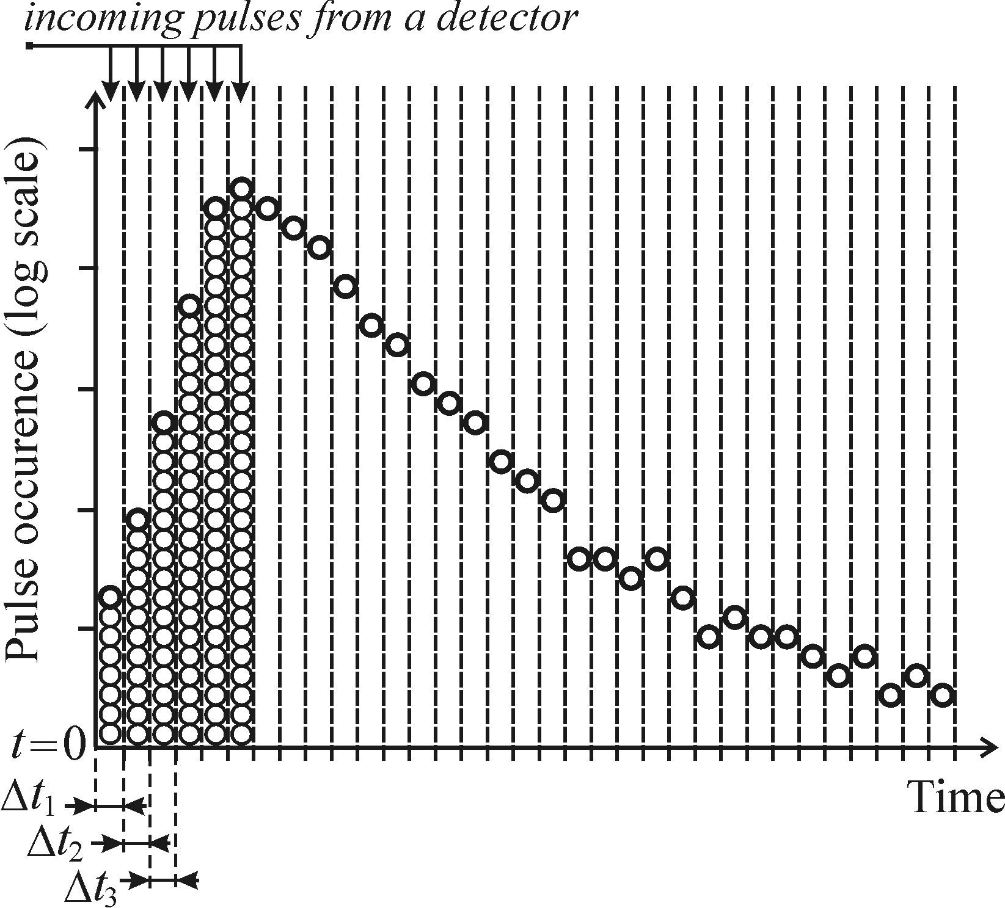
Time-correlated single photon counting
Statistical character of luminescence photon emission
During decay: decrease of the number of emitted photons
Circular aperture : narrow
solid angle
Detector: photomultiplier
Arrival time of the single
photons

Slide 11
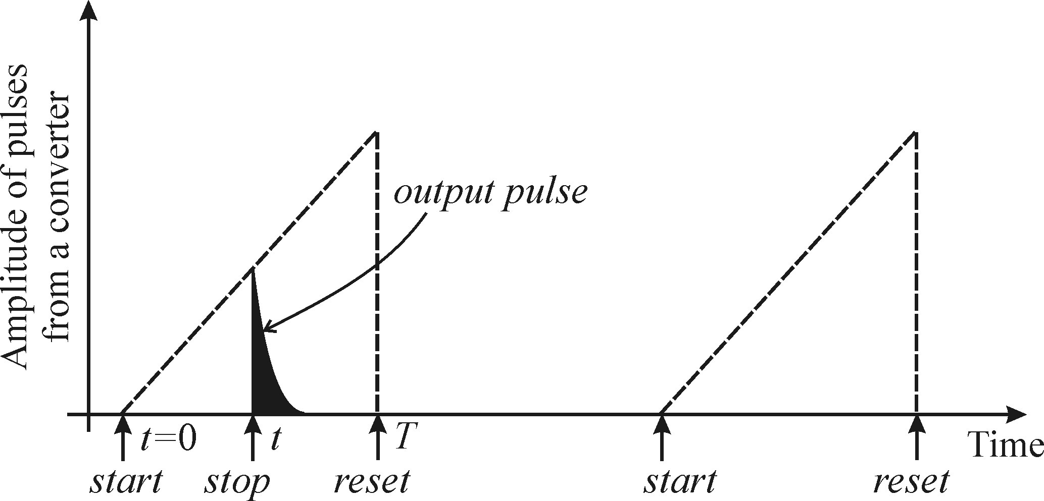
Two basic requirements:
Low Luminescence intensity: single photon detection
Catching high No. of photons to have good statistics

Slide 12
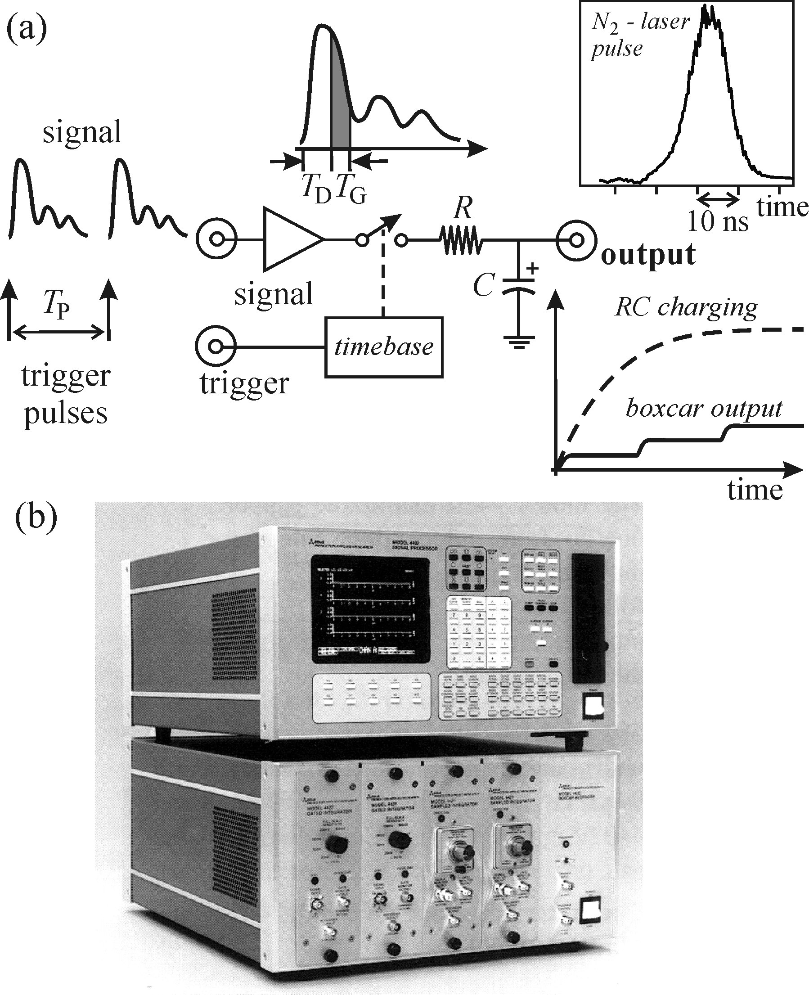


Boxcar integrator
Complete time-resolved luminescence
Spectra, e. g. Emission spectra at a delay
after excitation pulse
Principle of the device:
Two inputs:
Photomultiplier output/detector
with a time period of
(ii) Trigger pulse (synchronous with
the signal)
Signal channel: Broadband preamplifier
Fast sampling unit (gate), low pass RC filter
Optimum scanning time

Slide 13
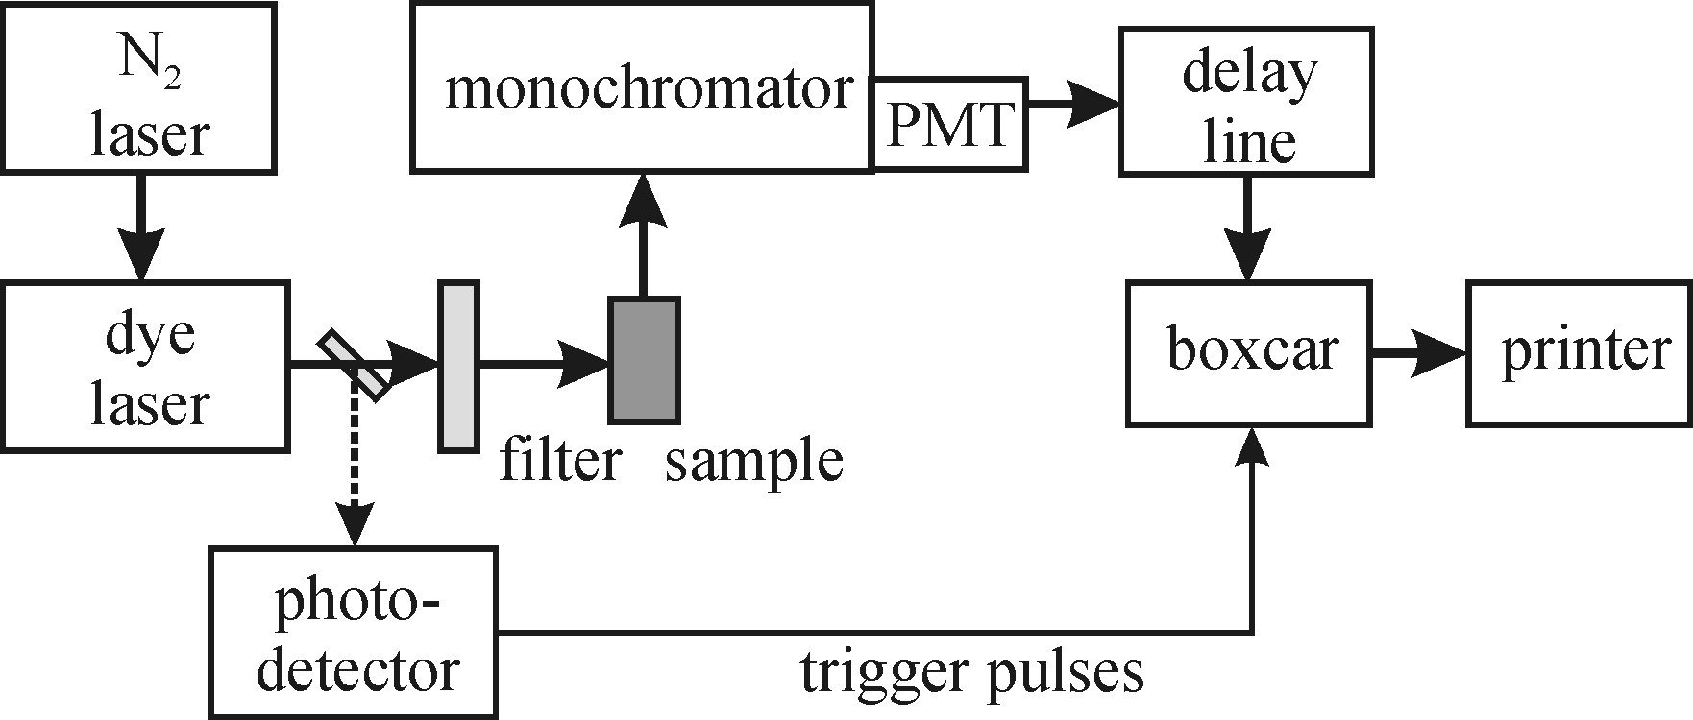
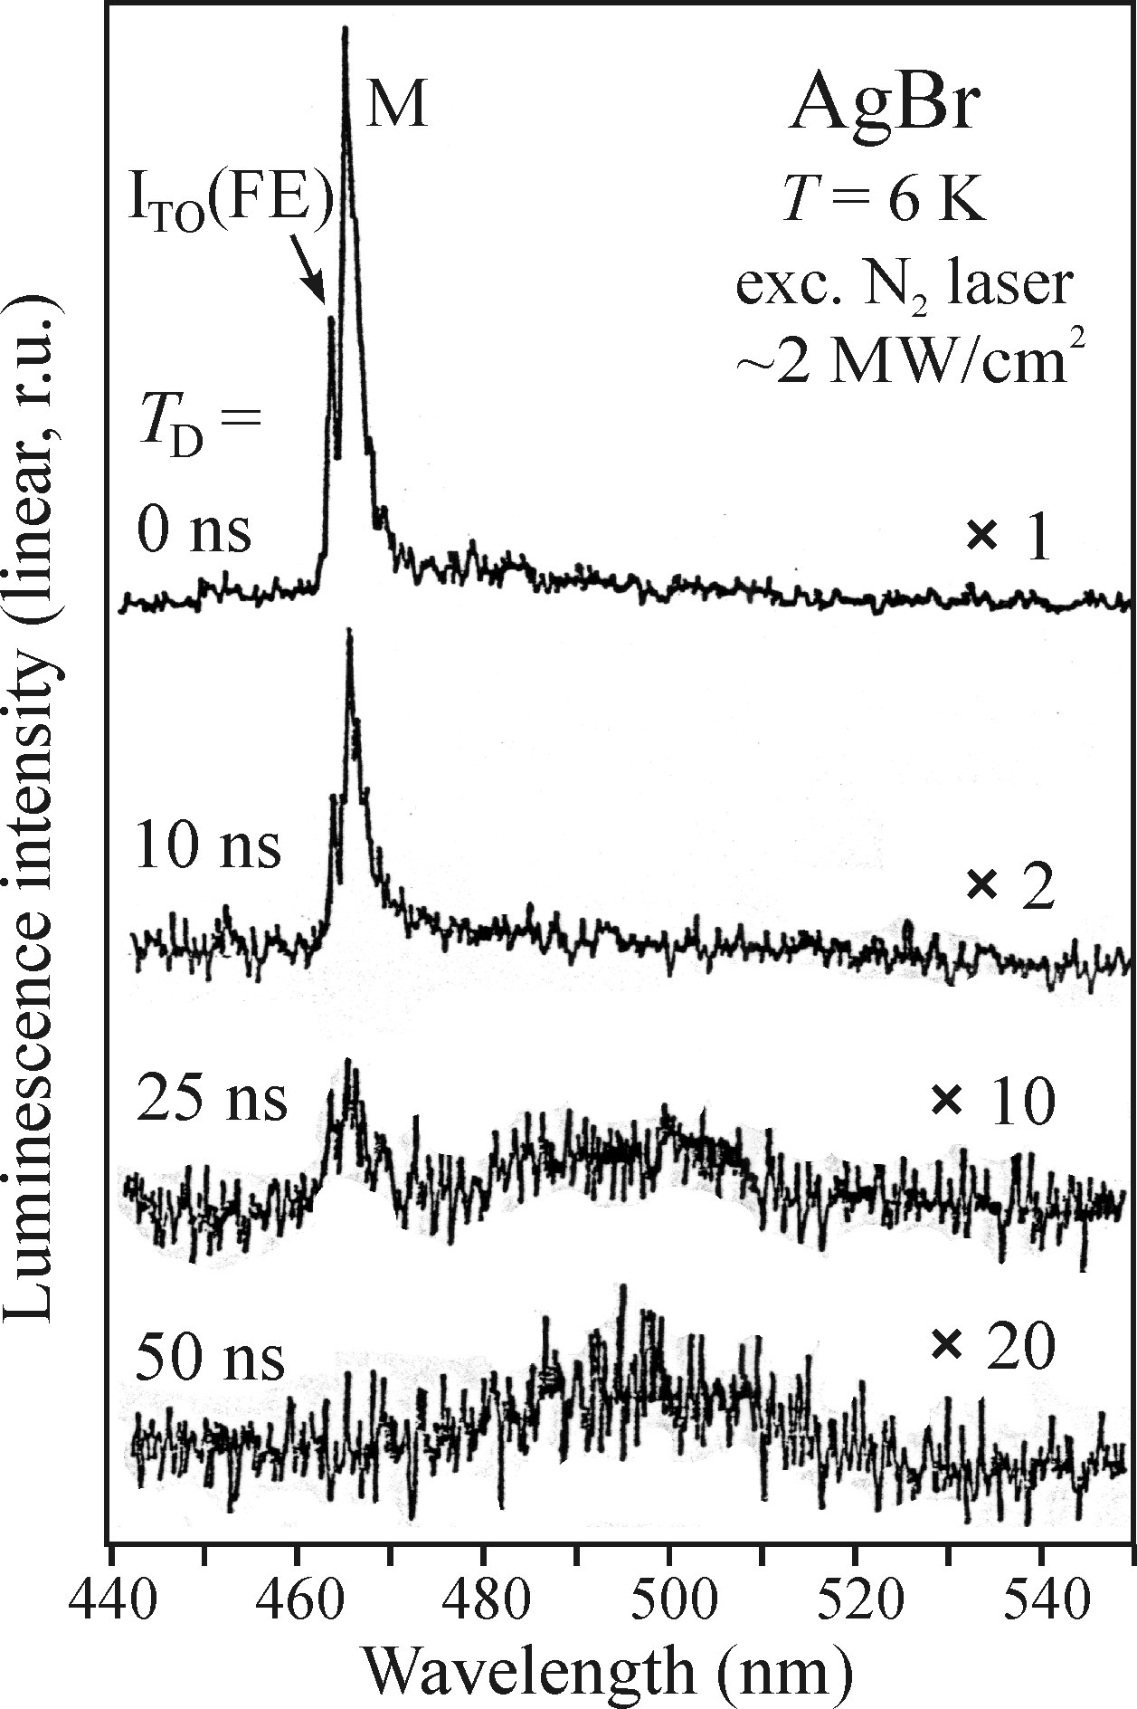

Single channel luminescence spectrometer
Constant mode (several discrete values of )
Boxcar integrator
Luminescence kinetics
and decay times from
500 ps to hundreds of ns
Limitation in electronic circuits
Low response of photomultipliers
Input amplifier (not fast enough)
Time-resolved luminescence spectra of AgBr

Slide 14
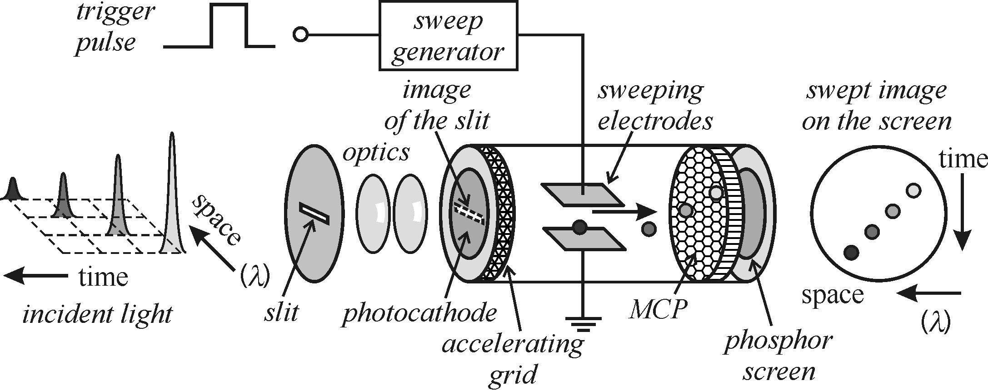
Streak camera
Luminescence transients occurring at ps & fs time scale: non-linear optics
(up conversion): Streak camera

Slide 15
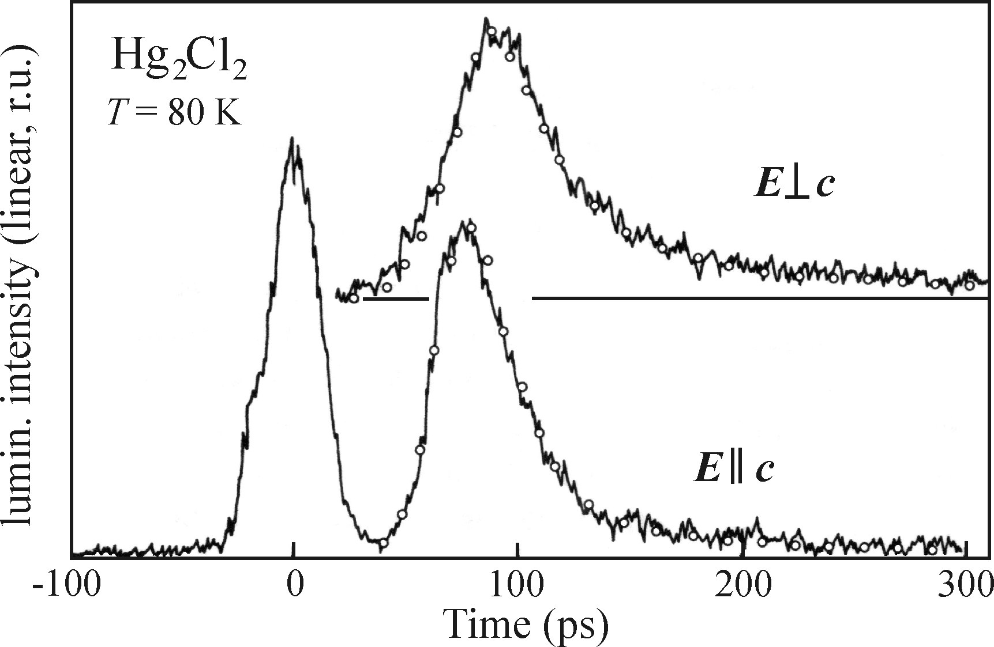
Luminescence transient: Streak camera
Excitation: 35 ps
Pulsed second harmonic frequency from ND: YAG laser (532 nm)
Appropriate setting of an optical delay time it is possible to record
luminescence and reflected fraction of the excitation light (left peak)

Slide 16
Kinetic description of luminescence processes
Radiative & non-radiative recombination and luminescence quantum yield
Kinetic equations for several luminescence phenomena (monomolecular and bimolecular, stretched exponential and multiple processes

Slide 17


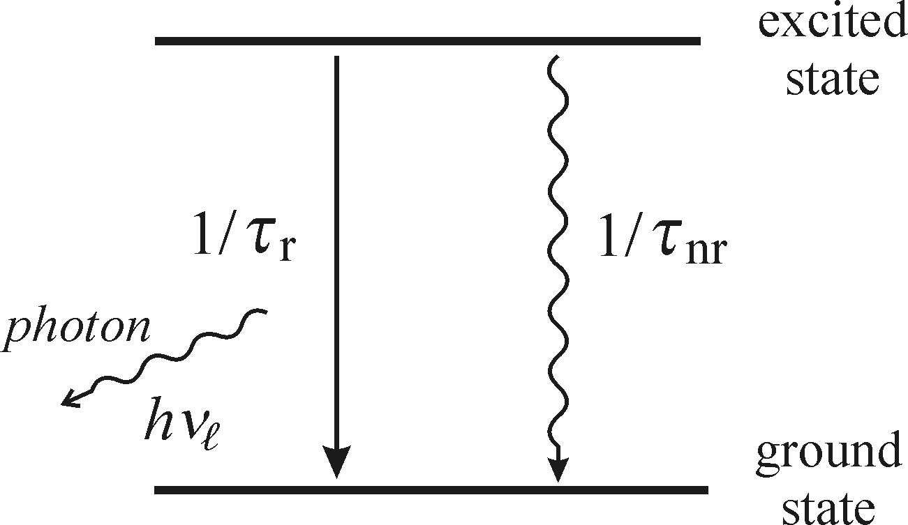
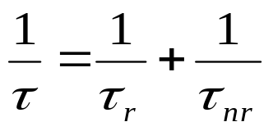
Radiative & non-radiative recombination
Excited luminescence
center
loses its electron excitation
energy (relaxation time)
Ground state
Radiate luminescence photon (after mean lifetime )
Transmit heat (vibrations) to the crystal lattice (after time )
Probability of transition to
the ground state:

Slide 18
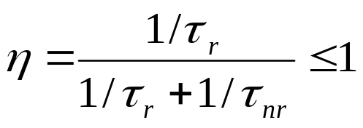




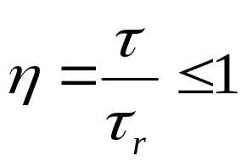
Relations:
The luminescence quantum yield or quantum efficiency
Strong luminescence: neglecting
(QE:100%)
Power efficiency
Relate two measureable quantities to a quantum
mechanical characterizing parameter

Slide 19
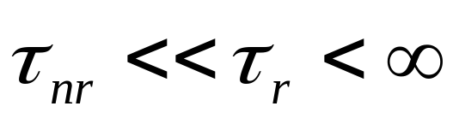
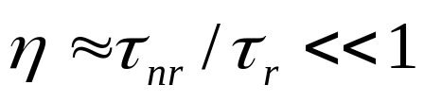
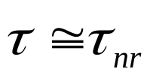
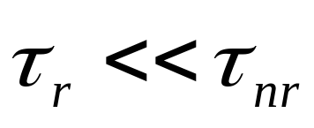
Situations in practice:
Weak luminescence, QE very low
The total No. of the photons emitted per unit of time, Intense luminescence, porous silicon and silicon naocrystals, non-radiative recombination are prevented through passivation of unoccupied surface bonds

Slide 20
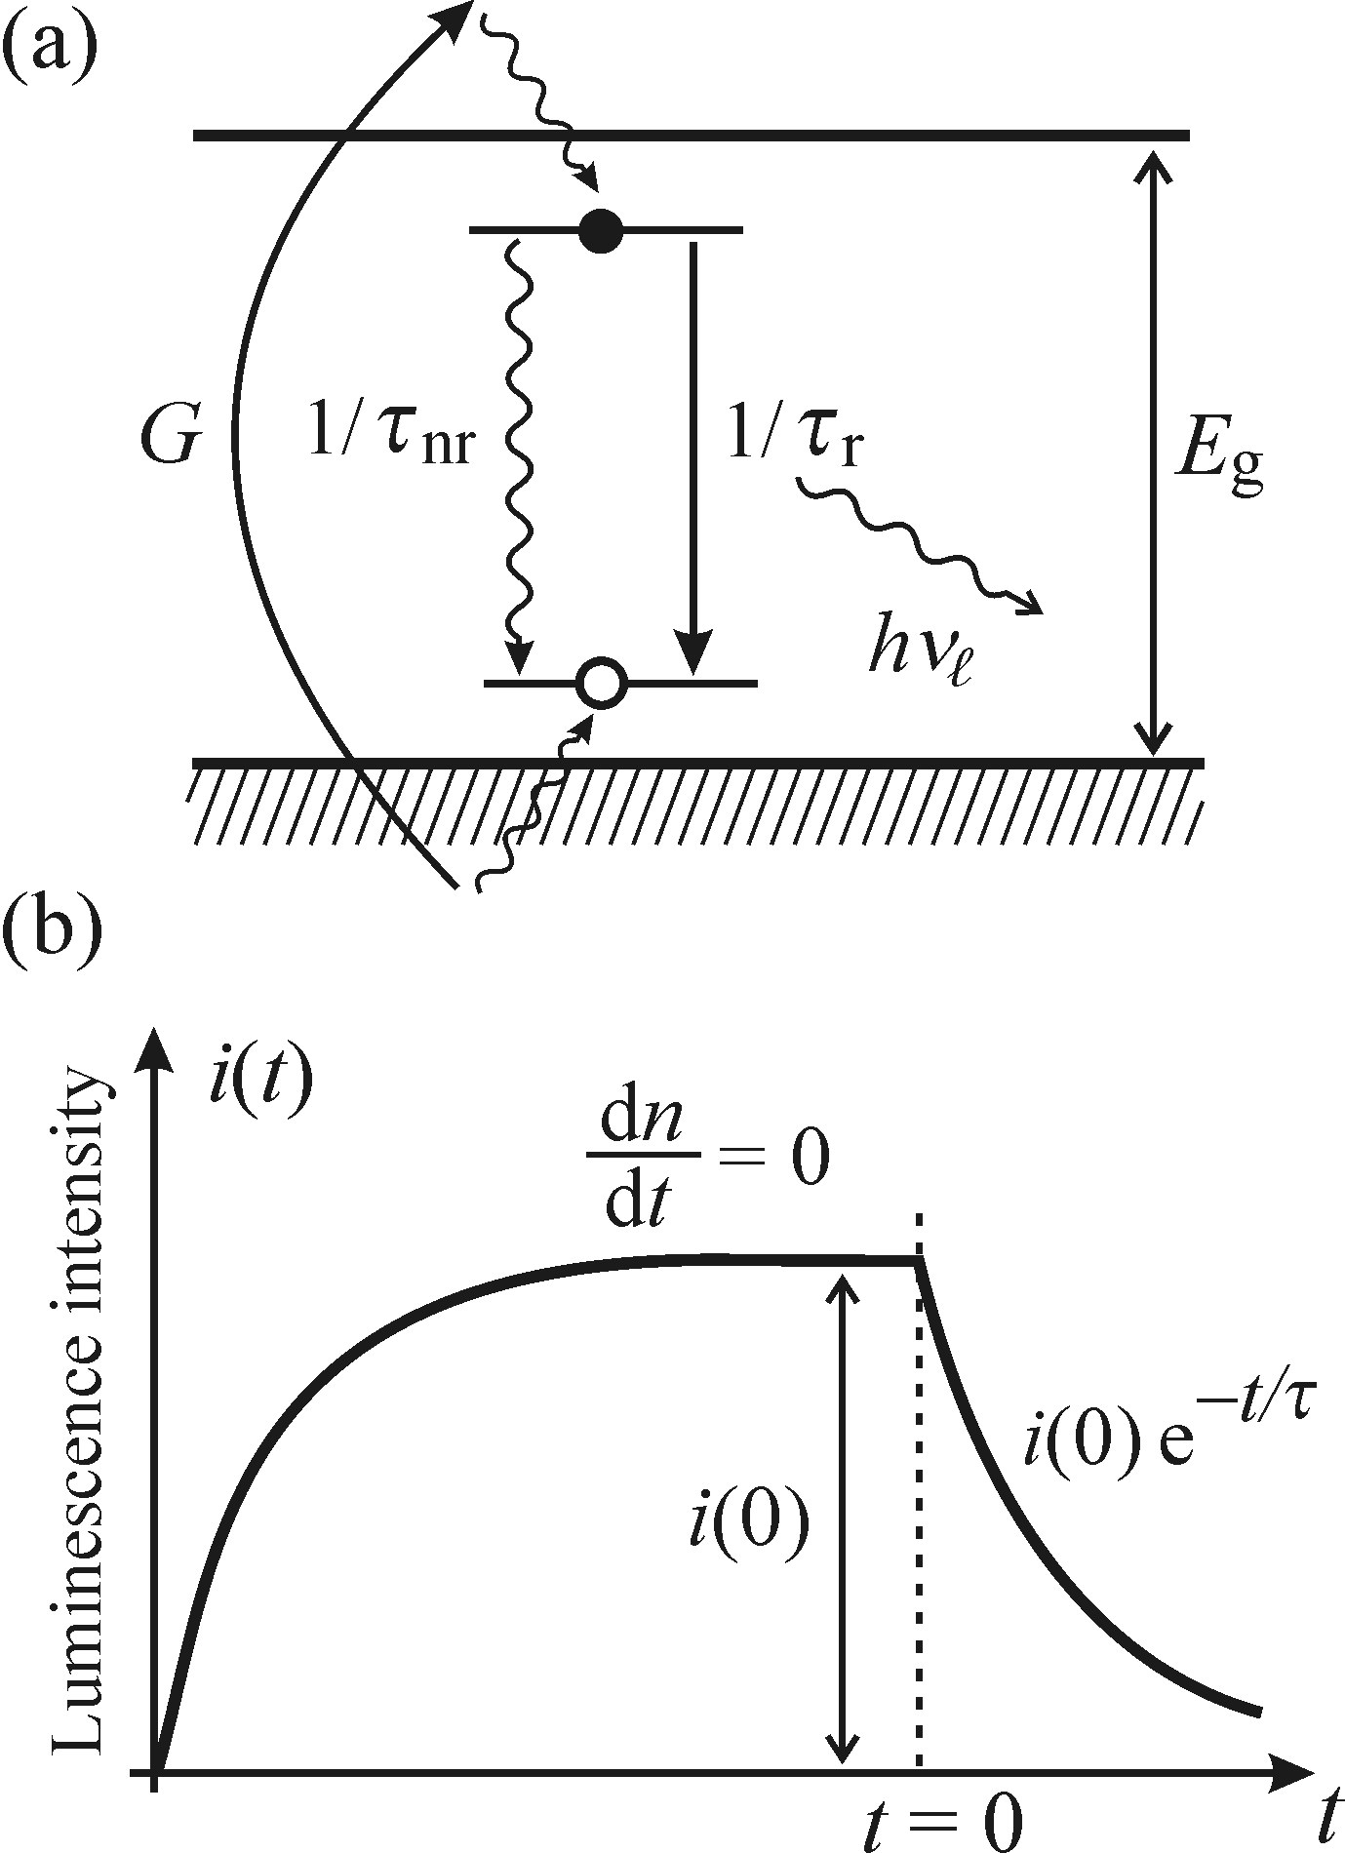
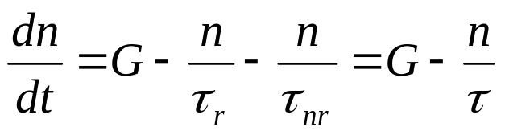
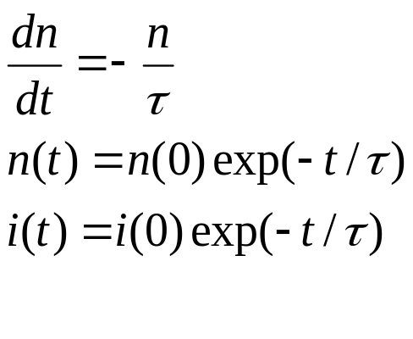

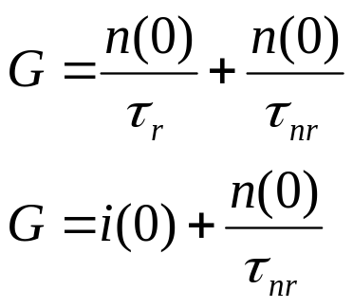
Monomolecular process
Localized luminescence center
G= Number of photons absorbed in
unit volume per unit time (Generation term)
Luminescence
decay
at t=0, G=0,
i(t) at times t 0
Steady state, the increase of luminescence intensity (G:ON)

Slide 21


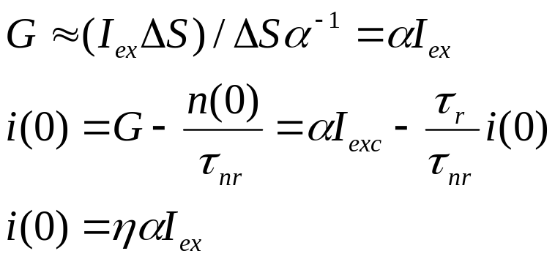
The stationary value of the luminescence intensity i(0) is directly proportional to the excitation intensity
Consider: All the excitation is absorbed, at the depth of absorption which is roughly equal ,and is the excited luminescence center
Two kind of localized luminescence center: Double-exponential decay

Slide 22
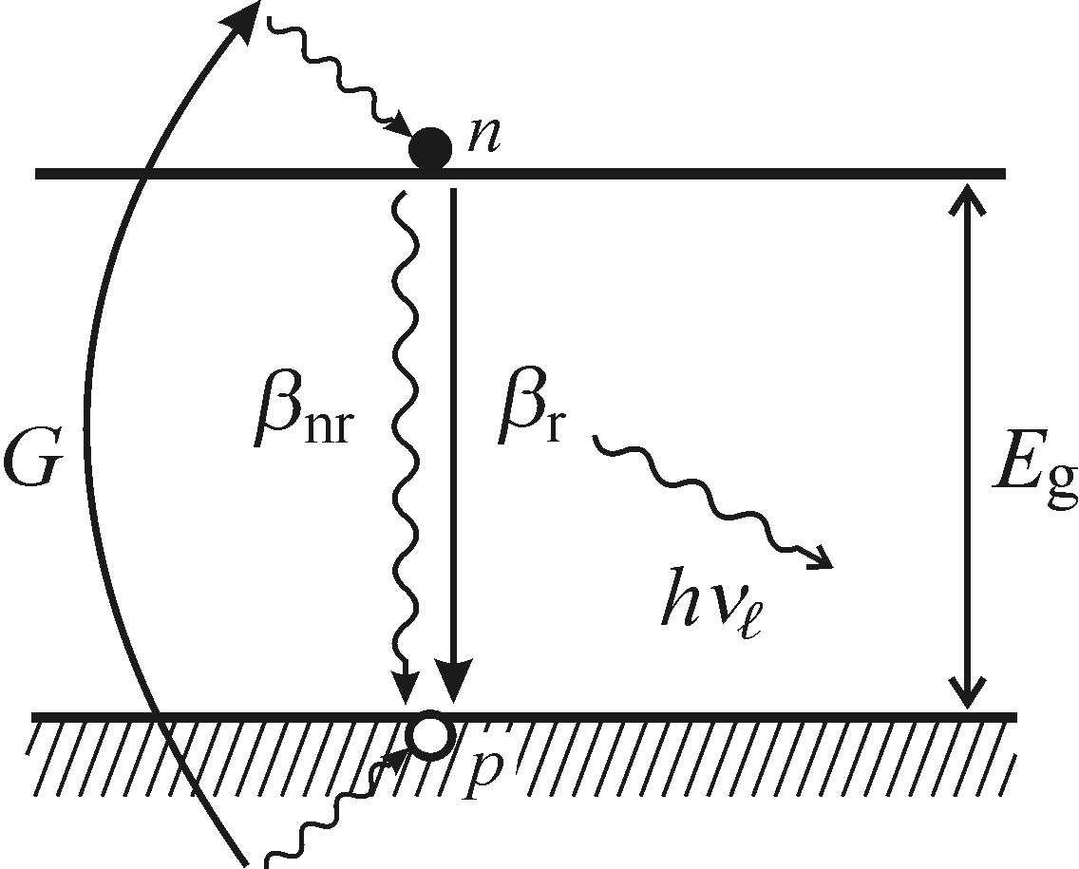
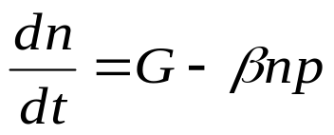


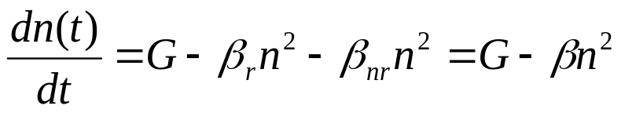
Bimolecular process
Semiconductor absorbs photons with
energies above band gap: electron-hole
pair (exciton): No defect, diffuse along
the band edges, radiative/non-radiative
recombination
Where bimolecular
recombination coefficient
Consider intrinsic semiconductor at low temperatures, so n=p

Slide 23
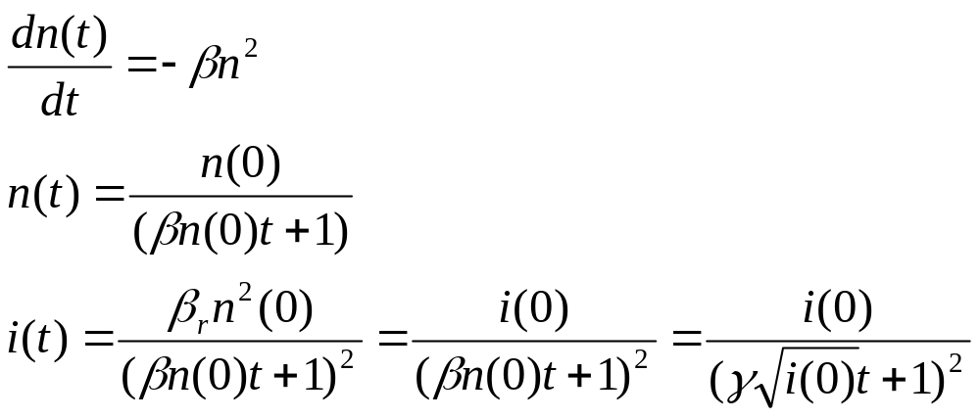

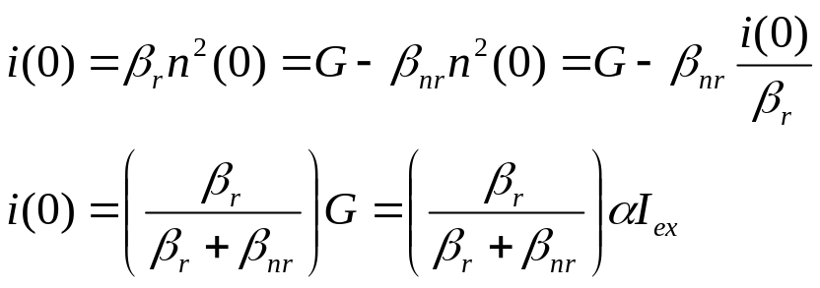
Luminescence decay, G=0 (at t=0), boundary condition: n(t=0)=n(0)
Steady state dn/dt=0
Where i(0) is intensity at t=0 and

Slide 24
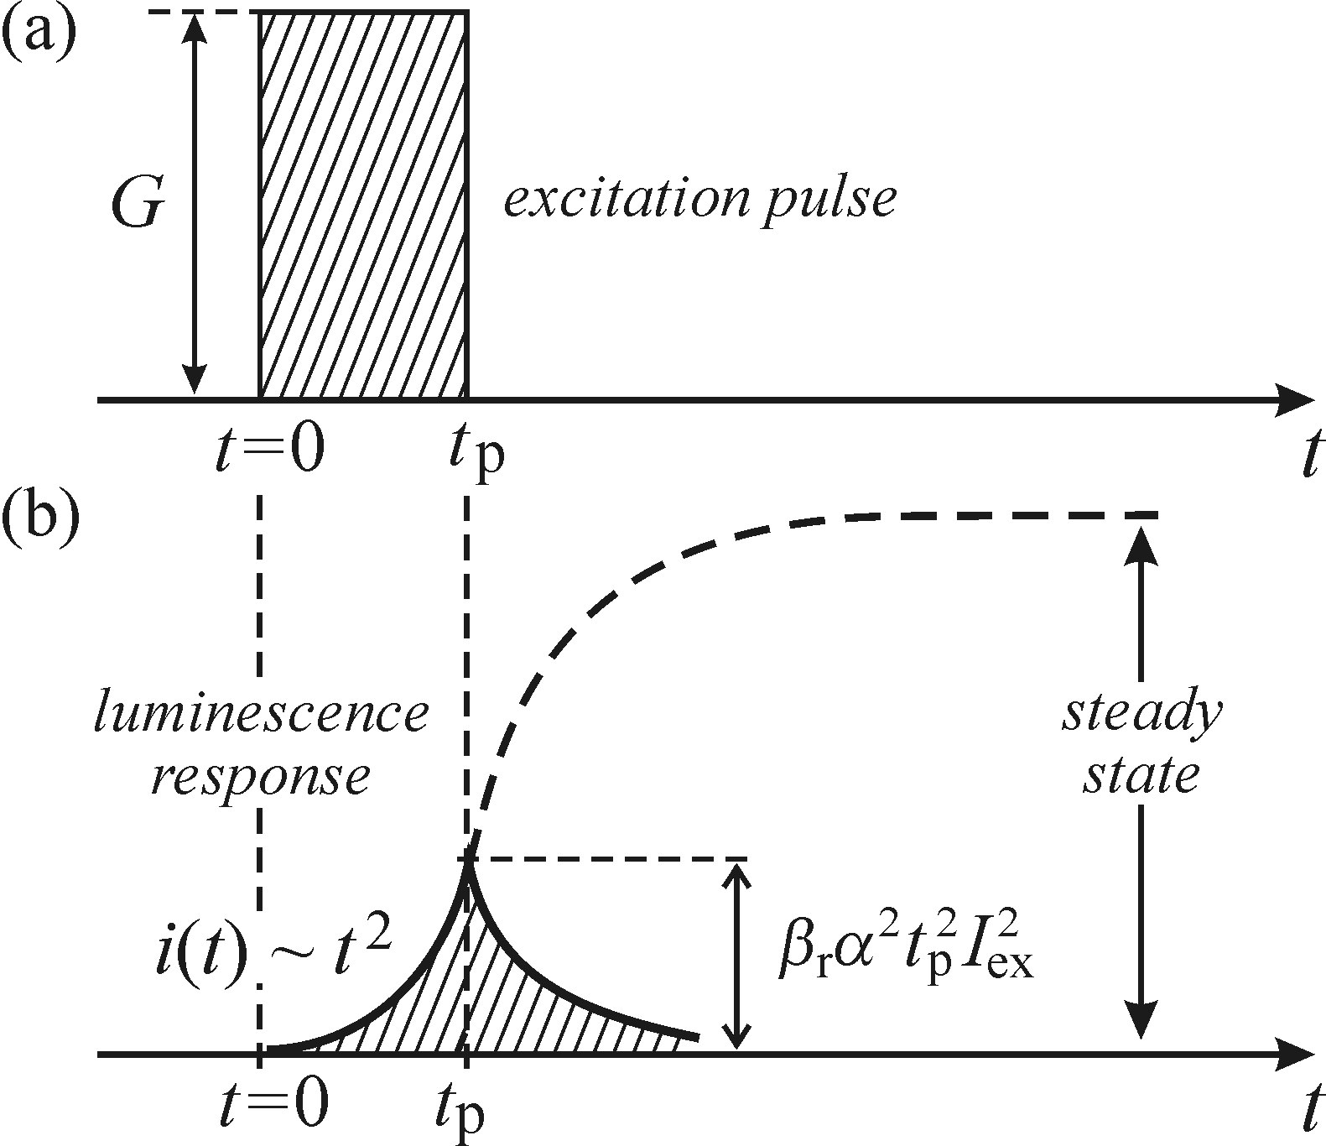
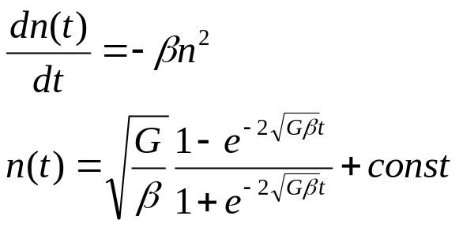


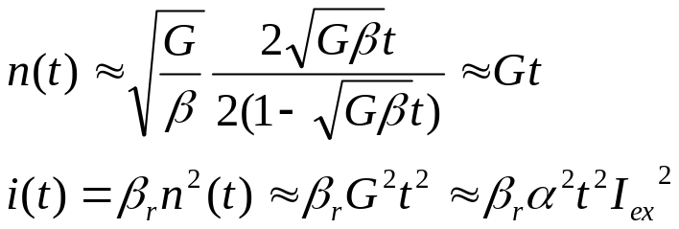
Bimolecular process under pulsed excitation
Boundary condition: n(t=0)=0
Exciation G: rectangular pulse of
duration
If the excitation pulse is sufficiently
Short
The luminescence response pulse is
proportional to the square of excitation
intensity

Slide 25
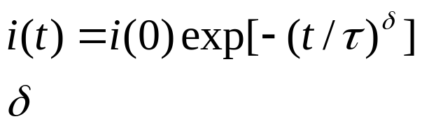
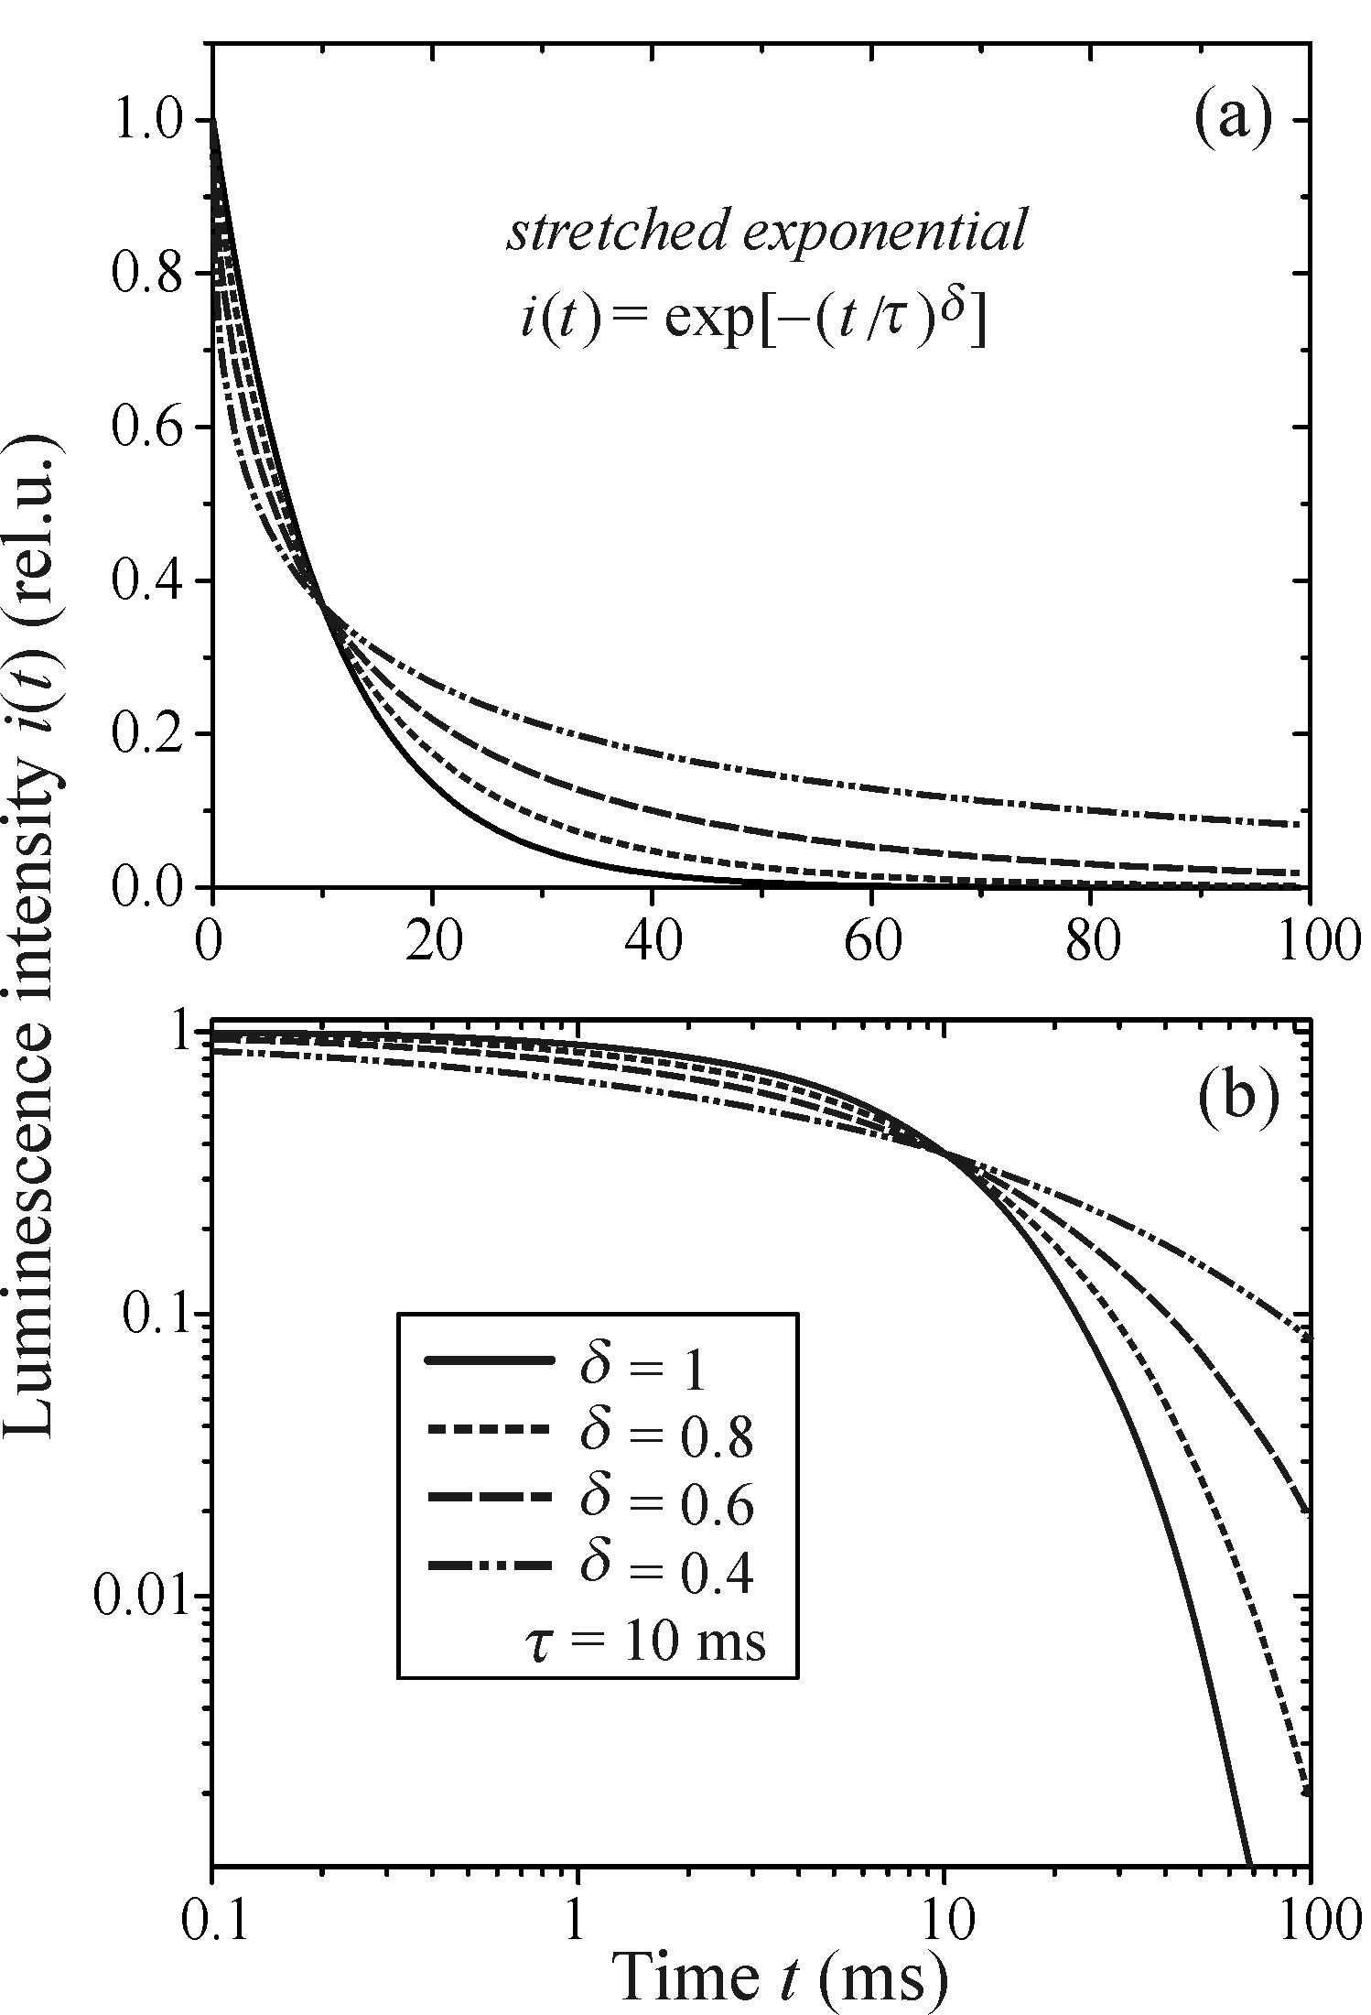
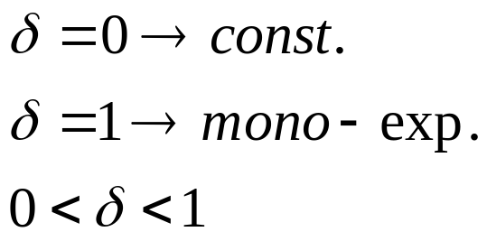
Stretched exponential
Dispersion factor
In distorted systems dispersion
diffusion of photo-excited carriers
Amorphous semiconductors and
porous silicon

Slide 26

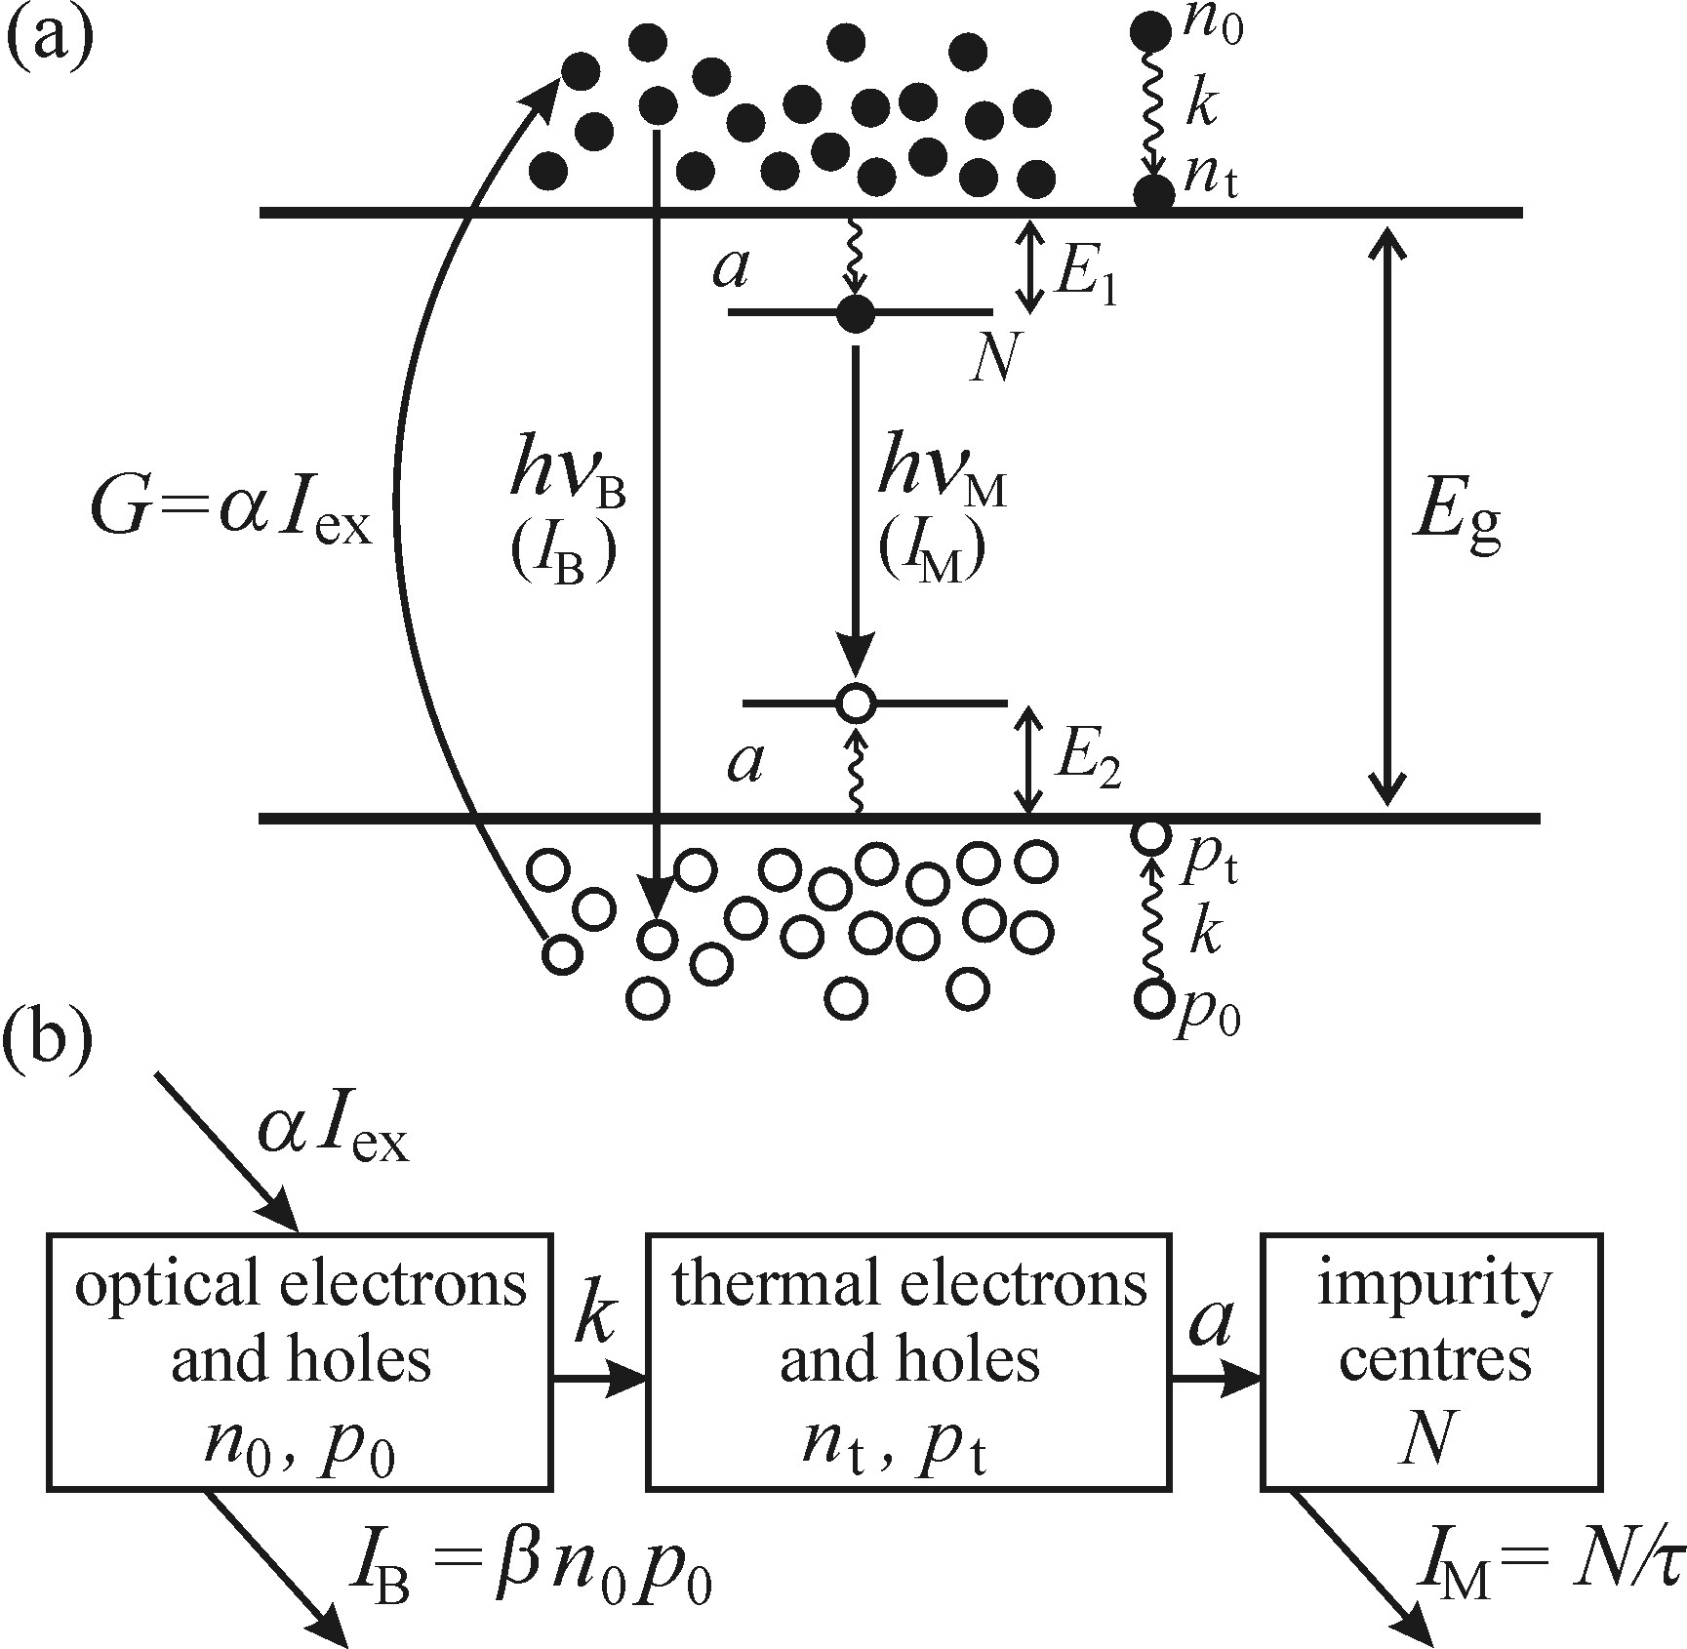


Multiple simultaneous processes
Two parallel recombination channels:
- Bimolecular (intrinsic) recombination of free
e/h pairs created by optical excitation
Monomolecular (extrinsic) recombination
of impurity atoms (total conc. of )
Optical and thermal e/h
N: Concentration of excited centers
a: Rate constant of e/h being captured in impurity
centers
k: Rate constant optical e/h generate thermal e/h

Slide 27
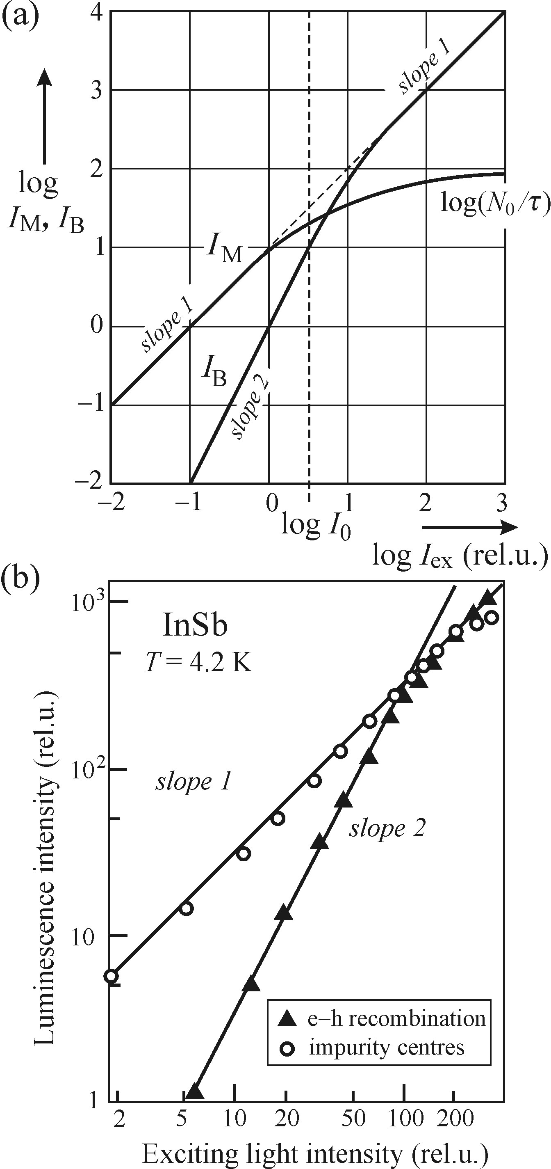

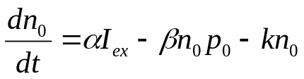
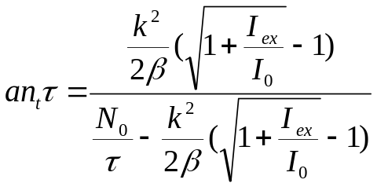
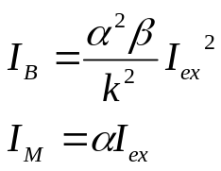

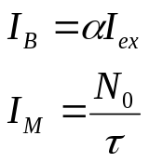
Relations
Simplicity: 100% QE so
Parallel occurrence of both phenomena
Kinetic equations:
Weak excitation ( )
Strong excitation

Slide 28
Phonons
Lattice vibrations- phonons
Electron-phonon and exciton-phonon interactions (deformation potential, piezoelectric mechanism, the Fröhlich mechanism
Lattice vibrations and point defects

Slide 29
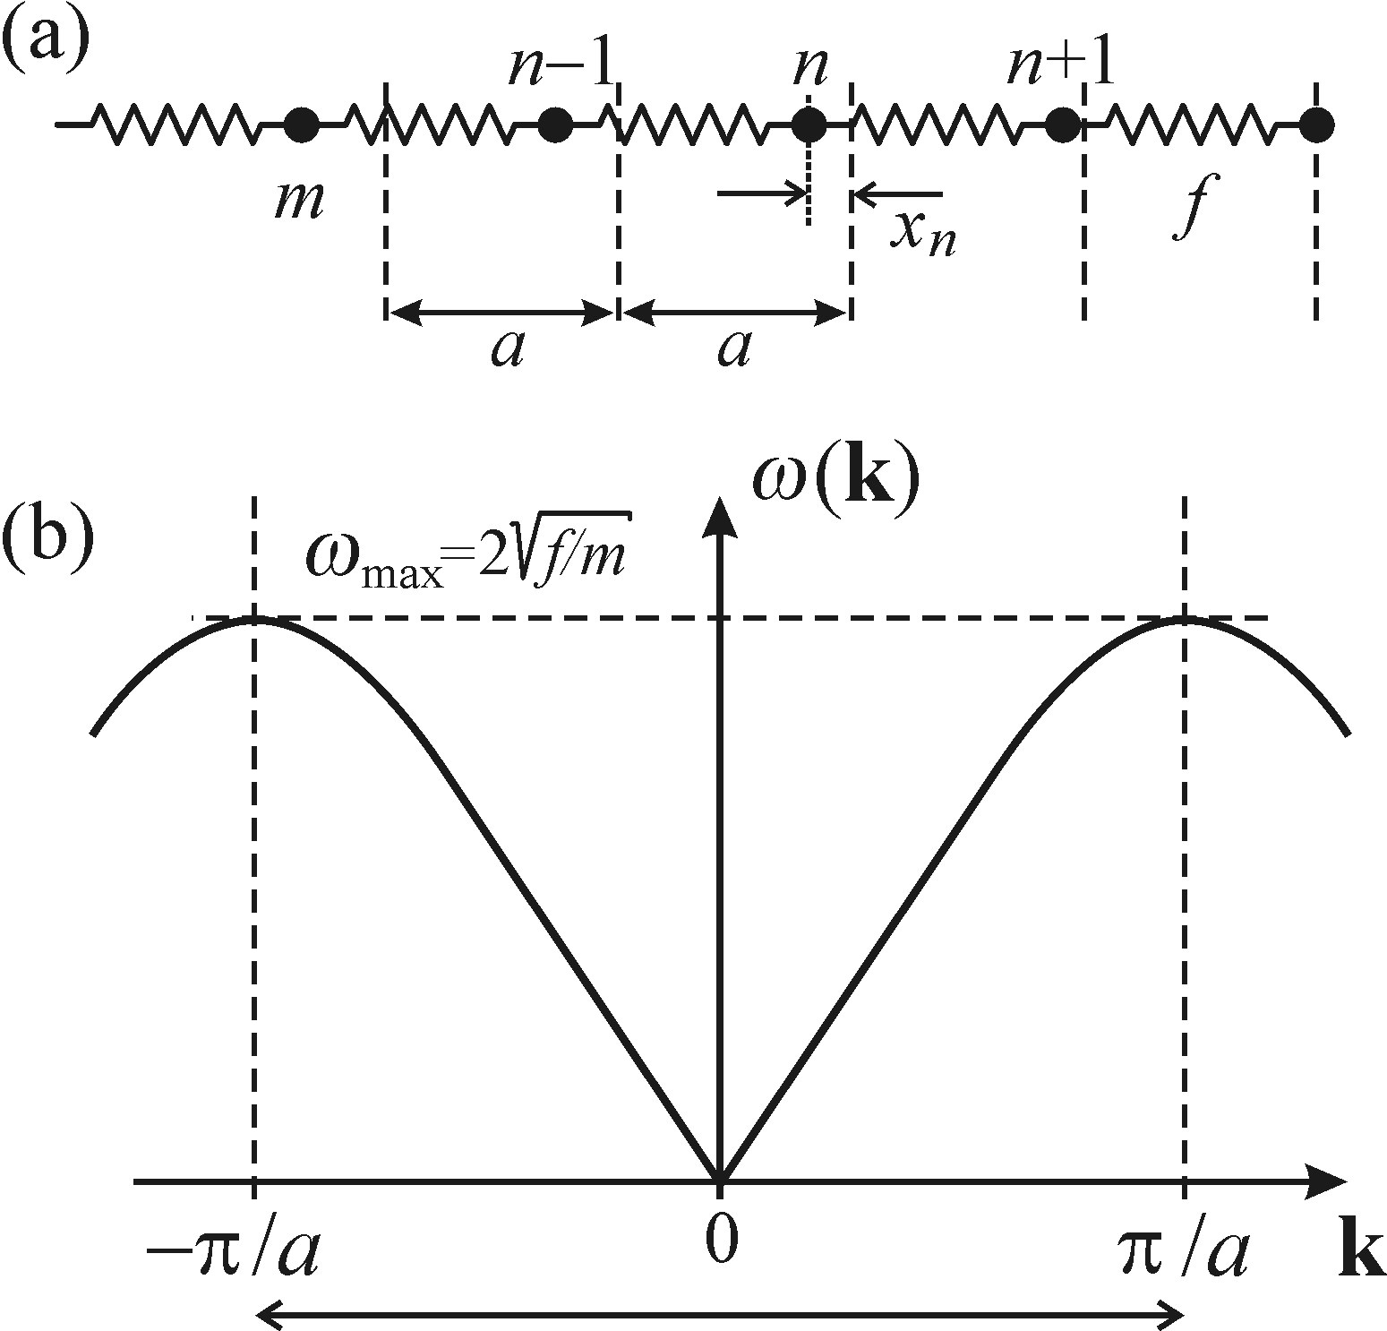
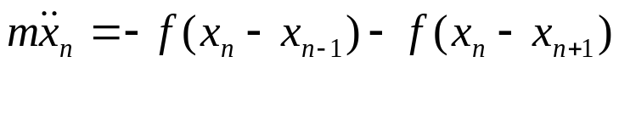
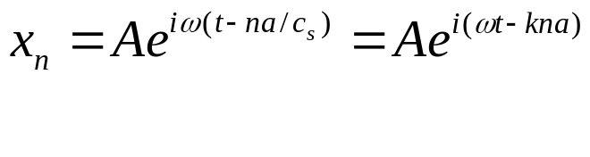
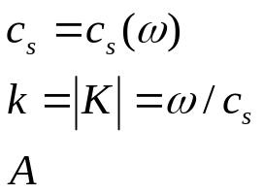




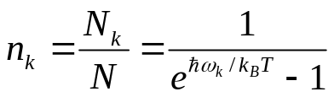
Lattice vibrations- phonons
Equation of motion (1 kind of atoms-1D):
Velocity of the wave motion
Magnitude of wave vector
Amplitude of the vibrations
Dispersion relation
periodic function, first BZ
Near the center of BZ (k=0) dispersion relation
becomes linear
Ensemble of N harmonic oscillator, mean energy of quantized harmonic oscillator at given T
Planck’s blackbody radiation Phonon distribution function

Slide 30
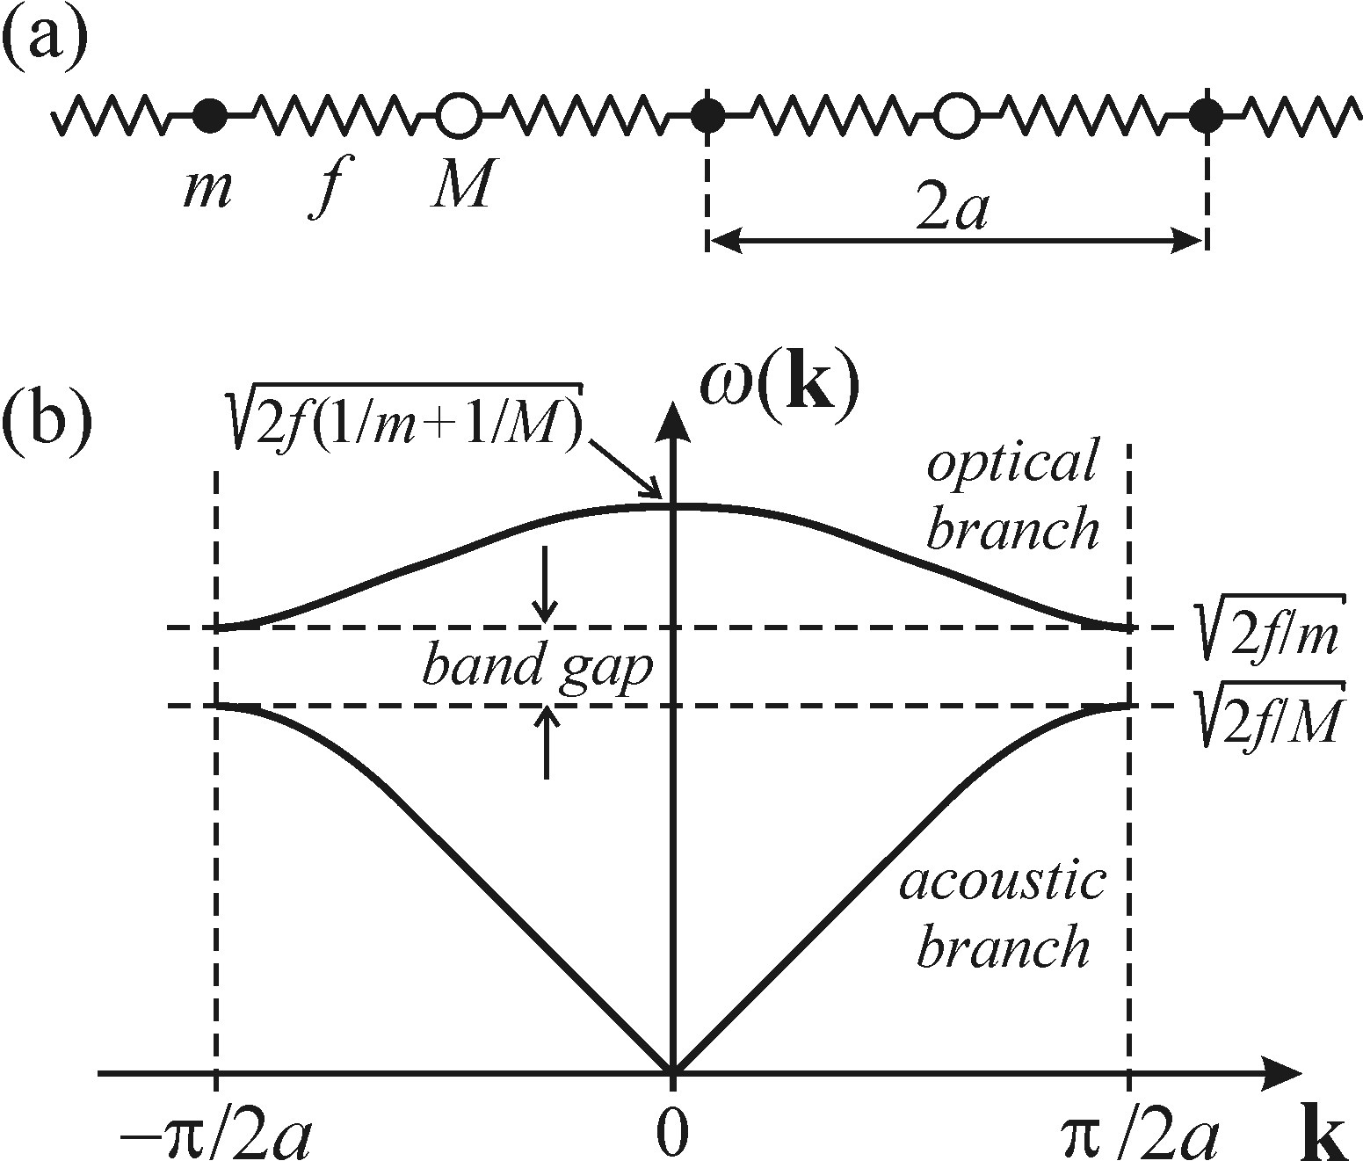




2 kind of atoms in1D chain, m<M
Solving equation motion: two branch of phonons
Optical branch, highest frequency at the
center of BZ
and
Acoustic branch and
Optical vibrations: light and heavy atoms move in a counter-phase vibrations
Acoustic vibrations: both atoms vibrate in phase, deformation wave traveling
through crystal
Near the BZ boundary, both branches are dispersionless
Near BZ center Optical branch is dispersionless; while acoustic branch has its
highest dispersion
longitudinal and transverse vibrations: along and vertical to the chain axis

Slide 31

Phonon dispersion curve of a crystalline silicon
In 3 Dim. n atom per unit cell: 3 types of acoustic vibrations and 3n-3 types of
Optical vibrations (LO & LA)
The gaps between optical and acoustic branches are disappears in certain directions
in BZ: two Si atoms per unit cell; m=M

Slide 32






Electron-phonon & exciton-phonon interactions
The total energy of harmonically oscillating lattice (2 kinds of ions)
where Q is normal coordinate and angular frequency of the mode
Insert a charge & variable change:
A shift of oscillator vibrations to a new
equilibrium position and
by relaxation energy release of

Slide 33



The deformation potential & The piezoelectric mechanism
The energy of e/h are sensitive to inter atomic distances
Long-wavelength, longitudinal acoustic vibrations induces periodic expansion and
Compressions where is the volume deformation potential of the energy level
In Materials with lower lattice asymmetry between opposite sample surfaces an electric voltage may develop by a mechanical deformation: piezoelectric effect
Between adjacent atomic layers, longitudinal acoustic modes of lattice vibrations
Since piezoelectric electron-phonon interaction is underlain by Coulomb force, it is stronger for smaller k (longer wavelengths)
The exciton-phonon interaction only occurs in the crystals whose crystallographic point group doesn’t contain the center of inversion

Slide 34

The Fröhlich mechanism
The most important exciton-phonon interaction
Occurs in ionic crystals & semiconductors with an ionic contribution to the lattice energy (polar semiconductors)
Completely absent in elementary
semiconductors (Si & Ge)
Opposite orientation of the oscillations
by oppositely charged ions

Slide 35

Phonon dispersion curves in a polar semiconductor

Slide 36


Lattice vibrations (point defects)
Unperturbed lattice; the harmonic force (spring)
constant remains unchanged, the modes with the
node located on the defect impurity will not feel
the vibrations.
Resonance mode; heavy impurity atom, force
decreases due to the different type of inter atomic
bond, or both effects, appears a mode with low
frequency.
Local mode; the impurity mass is lower than
unperturbed neighboring atoms, the frequency
of such mode is higher than the allowed frequency
of the typical lattice vibrations.

Slide 37

Localized optical center in a solid matrix

Slide 38

Absorption and emission spectra of a localized center

Slide 39


Slide 40

Thermal quenching of luminescence

