Slide 1


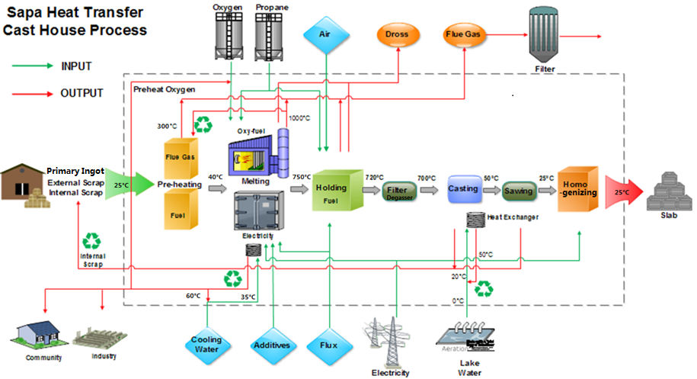
Energy Consumption and Carbon Footprint of Secondary Aluminum Cast House
WENJING WEI
Email: wenjingw@kth.se
TTMVM
Supervised by Docent Weihong Yang

Slide 2
OBJECTIVES
1
Background:
Aluminum is the second largest metal market
Highly recycled material
Problem:
What’s carbon footprint of secondary aluminum product
How to improve energy efficiency and decrease greenhouse gas
Objectives:
Energy and CO2 per ton of aluminum production,
Solution to increase energy efficiency and decrease carbon footprint
Developing a software to make energy efficiency indicators

Slide 3
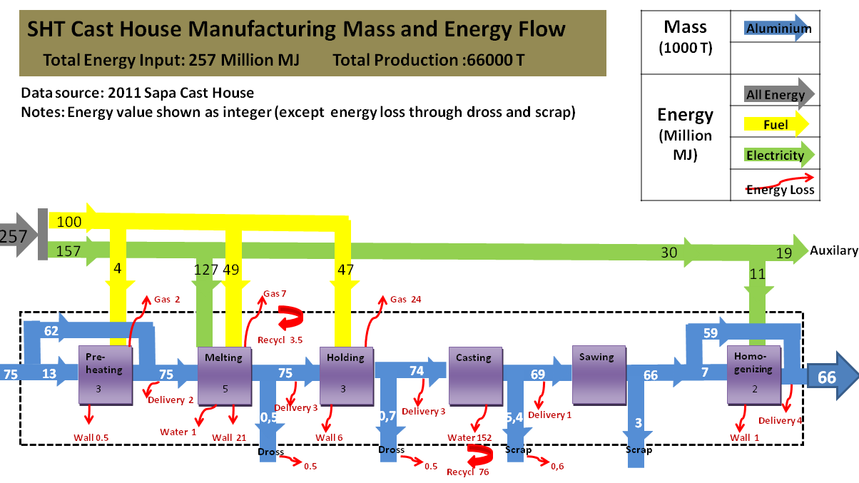
RESULTS&DISCUSSION
Higher energy efficiency
Decrease heat loss ( logistic, insulation etc.)
Waste heat recovery( utilize exhaust gas, cooling water heat for pre-heating loads)

Slide 4
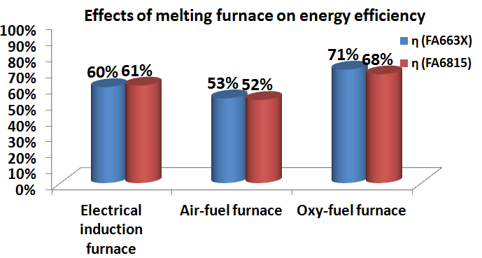
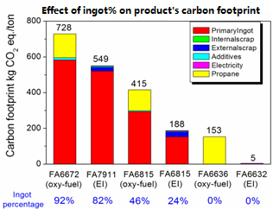
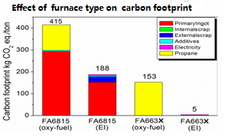
RESULTS&DISCUSSION
Carbon footprint
Melting Furnace Type
Raw Material
Lower environmental impact:
Charge more aluminum scrap instead of primary ingot
Applying nuclear power generated electricity ( much lower carbon footprint compare to fuel)

