Slide 1

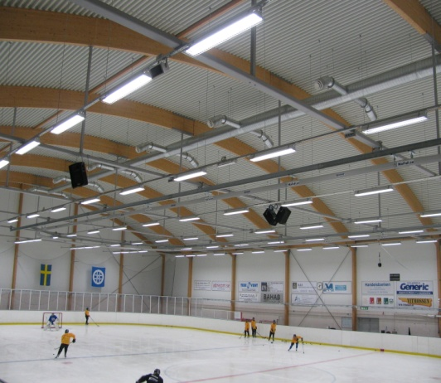
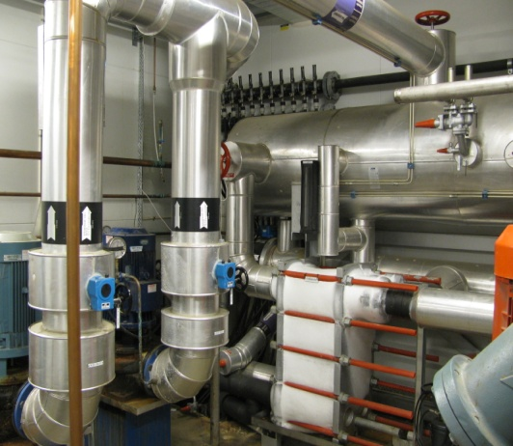
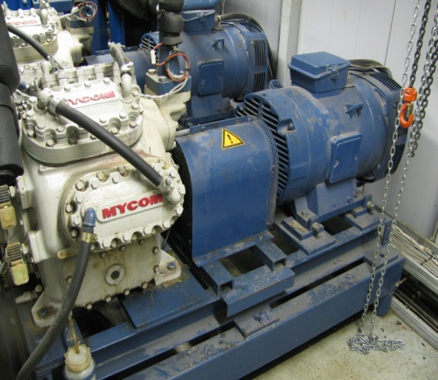
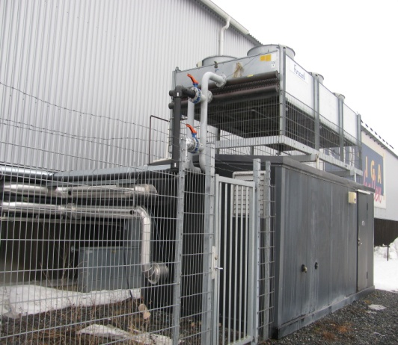
Measurement and Modelling of Ice Rink Heat Loads
Mazyar Karampour, mazyar@kth.se, TSUEM
Supervisor: Dr.Joachim Claesson, joachim.claesson@energy.kth.se
KTH, Energy Technology Department
Rapport available at: http://kth.diva-portal.org/smash/record.jsf?pid=diva2:478941

Slide 2

Introduction:
Energy Consumption in Ice Rinks
More than 350 indoor ice rinks
More than 300 Gwh annual energy consumption
The biggest consumer: Refrigeration System
Solution: less Heat Loads on the Refrigeration System

Slide 3
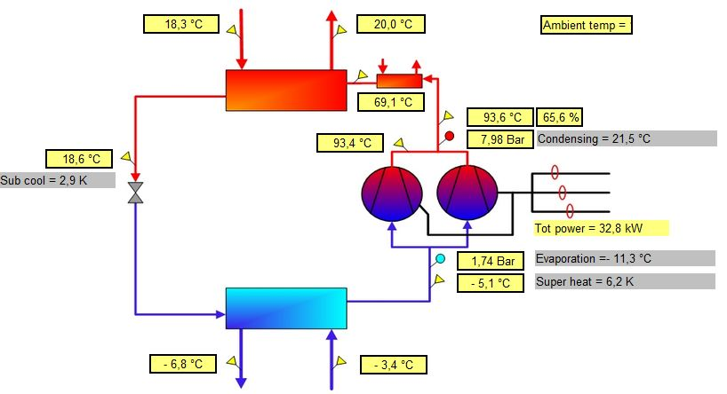

Method:
Refrigeration & Heat Loads Analysis
2
Heat Load Calculations based on Heat Transfer Correlations and Field Measurements
Brine pump
Skaters
Condensation
Ice resurfacing
Convection
Radiation
Lighting
Evaluation the Performance of Refrigeration by ClimaCheck Measurements
NH₃
Evaporator
1
Ice
Concrete
Insulation
NH₃
Brine
Brine headers
Ground conduction

Slide 4
Results:
Energy Consumption &Heat Load shares

