Slide 1


Modular Hybrid Solar Power Plants For Developing Nations
Mazen Darwish
Darwish@kth.se , TSUEM
KTH, Royal Institute of Technology
Department of Energy Technology
Supervisor : James Spelling
james.spelling@energy.kth.se

Slide 2
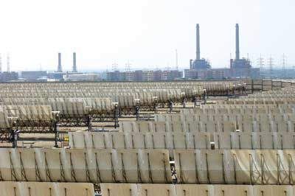
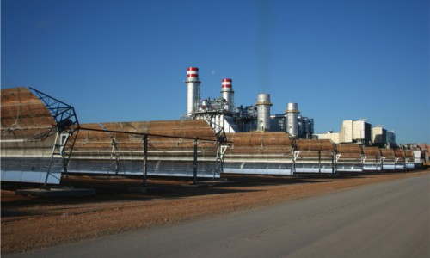
Proposed Option : Integrated Solar combined Cycle
Integrated Solar Combined Cycle (ISCC)
  Build and operated like a normal combined cycle plant.
  No solar-only operation : solar heat is added to the already running cycle.
Advantages of ISCC
  Cost advantages : only the steam turbine of the existing cycle need to be oversized.
  Efficiency advantages : CSP increases the efficiency of the bottoming cycle.
  Dispachibility.
ISCC Ain-Beni-Mathar-Morocco
ISCC kuraymat -Egypt

Slide 3
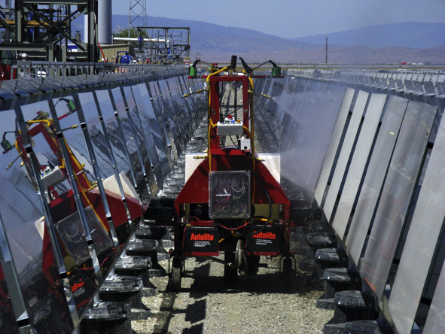
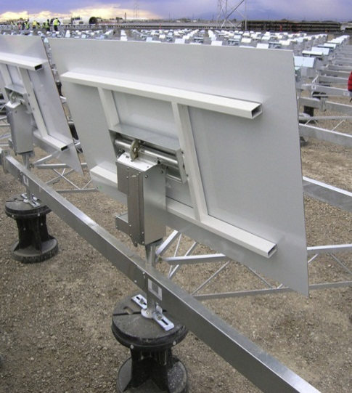
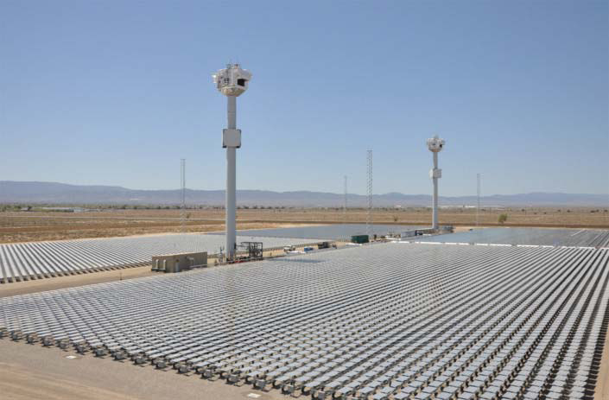
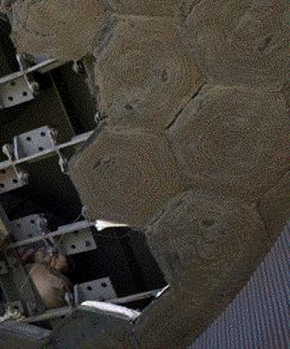
Design combination: New combination
Atmospheric solar tower in natural gas fired Combined cycle without Storage
Receiver design ( Phoebus concept) : Simple ( Atm Air HTF) , Stable opeartion ( Metalic absorber durable) ; highly modular.
Heliostat field / Tower ( eSolar concept): low cost , mass manufactured , low wind loads , easy cleaning.

Slide 4
Conclusions
ISCC plants offers low cost , highly dispatchable source of power.
ISCC offers a low risk option in a world of heavily subsidized fossil fuel systems.
Ability to benefit from incentives such as Hybrid feed in tariffs.
Integrating small solar shares in all newly built plant can help drive
down CSP costs.
Sends a green message to the public.

