Slide 1





Unit Commitment model with Wind Energy and Demand Response Integration
Development of an Energy System Planning tool
Erasmus Mundus masters program SELECT (Sustainable Energy Systems)
Thesis supervisor:
Prof. Carlos Silva – carlosaugusto.santossilva@mitportugal.org
Author:
Abhishek Shivakumar – ashi@kth.se

Slide 2
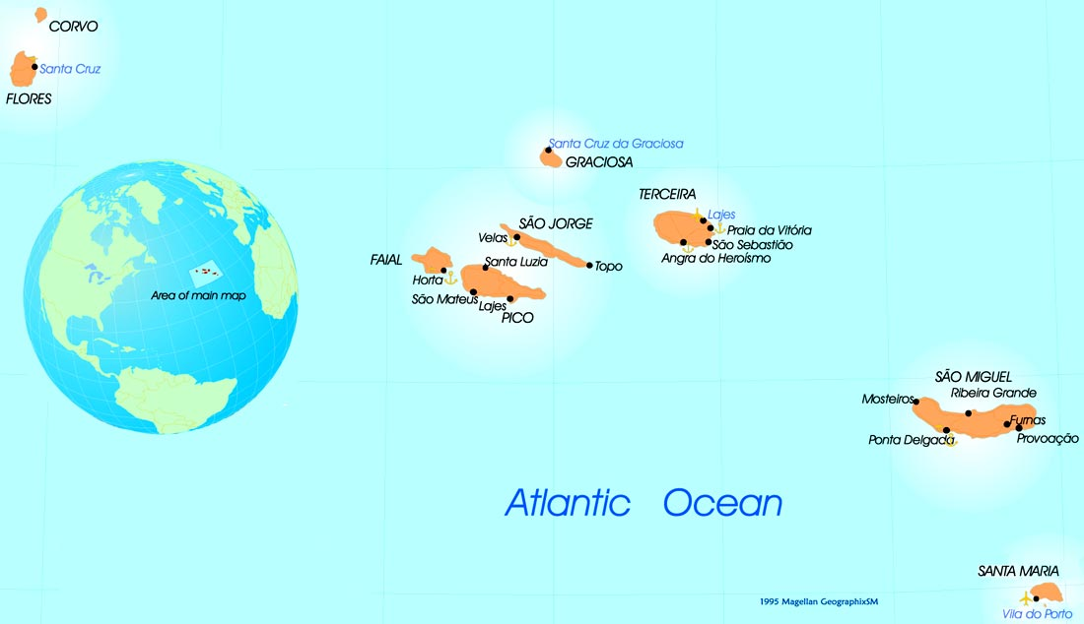
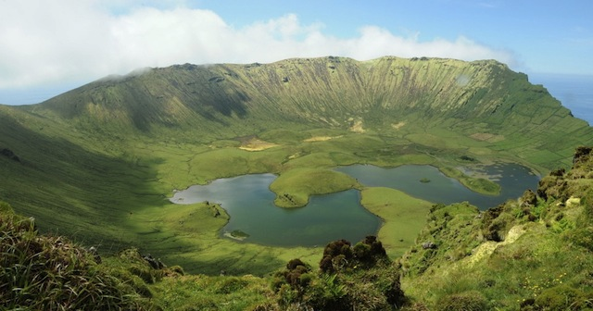
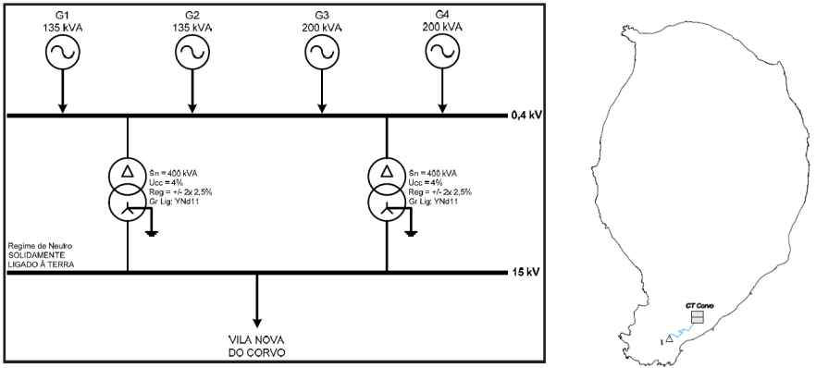
Island energy security:
Corvo (Azores), Portugal
Land area: 17 km²
Population (2008): 488
Primary energy consumption (TJ): 21
Electricity consumption (2010)= 1.4GWh
Number of vehicles: 93
Number of households: 145

Slide 3
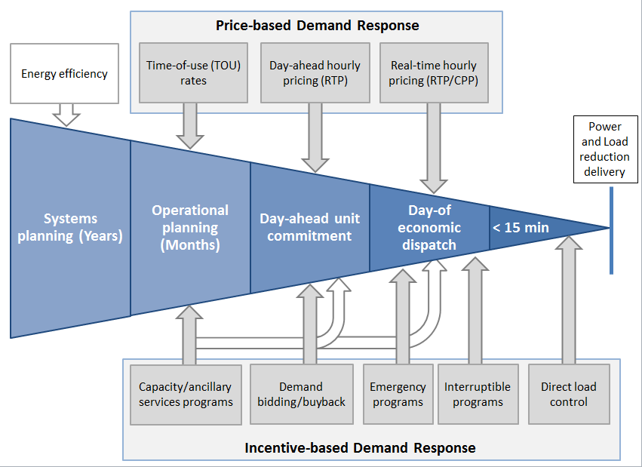
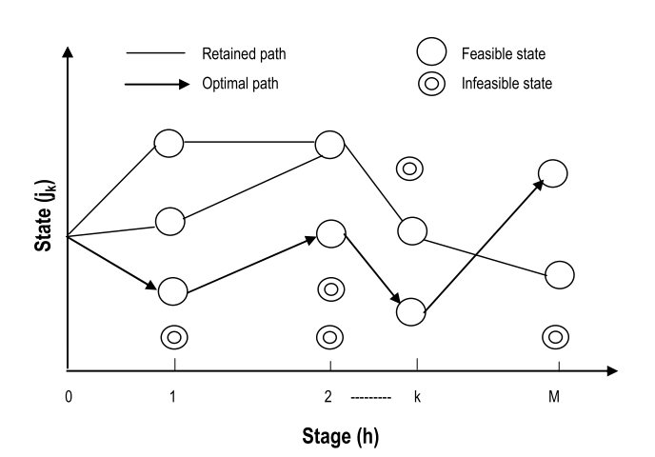
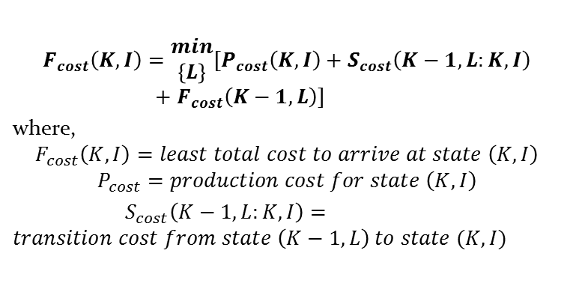
Unit commitment model:
Dynamic programming
Generation Capacity
Ramp-up Limit
Ramp-down limit
Minimum up-time constraint
Minimum down-time constraint
$$F_{cost}\left(K,I\right)=\begin{matrix}min \\ \left\{L\right\}\end{matrix}\left[P_{cost}\left(K,I\right)+S_{cost}\left(K−1,L:K,I\right)+F_{cost}\left(K−1,L\right)\right]$$
where,
$$F_{cost}\left(K,I\right)=least total cost to arrive at state \left(K,I\right)$$
$$P_{cost}=production cost for state \left(K,I\right)$$
$S_{cost}\left(K−1,L:K,I\right)=transition cost from state \left(K−1, L\right) to state (K,I)$

Slide 4
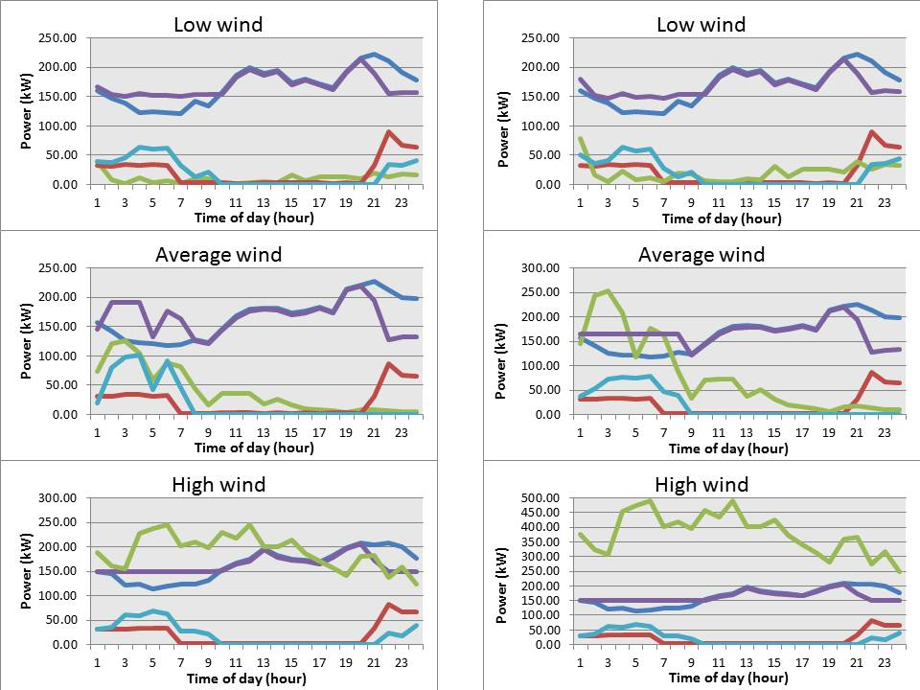
Wind energy + demand response:
Results
1 wind turbine
2 wind turbines

