Slide 1
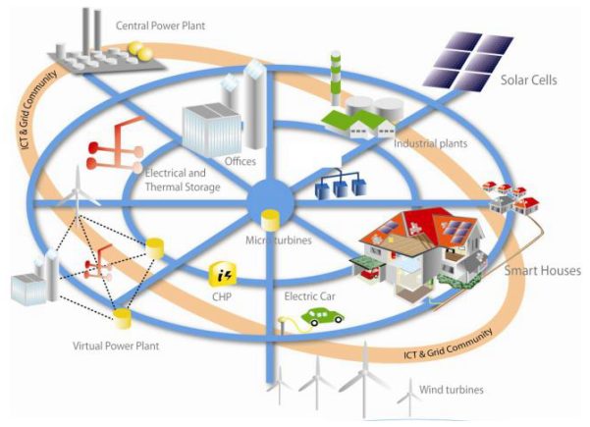




Vattenfall Energy Award Presentation
Name: Vignesh Sridharan (vsri@kth.se)
Program : M.Sc. SELECT (KTH & UPC)
Thesis Title: The integration and evaluation of intelligent PV setup in a smart house environment
Thesis Supervisor: Mr. Grietus Mulder (grietus.m ulder@vito.be)

Slide 2
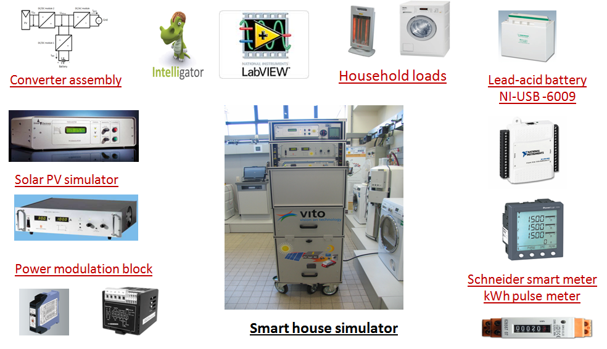
Vattenfall Energy Award Presentation
Thesis Background
Increase in individual PV plants on dwellings
Self consumption electricity tariff implementation in European countries (starting with Germany)
Need for sophisticated metering infrastructure due to the introduction of smart meters.
Demand Response management implementation; Peak shaving benefits
Project Environment
This thesis was carried out as a part of the European level ‘LINEAR’ framework project. It is a collaboration between many conglomerates like Sony, fifth play and research organizations and institutes like VITO and KU Leuven. The main objective of this project is the demonstration of smart grids philosophy in an existing typical Belgian residential scenario and implement it in various other European cities. As a part of the project, a smart house simulator was built to study how the different regular household equipments like the washing machines, dish washers and water boilers could be used smartly and the concept of Demand Response Management (DRM) implemented in a daily life situation. The smart house simulator was built from scratch and the software was built in the LabVIEW environment to make it function like a regular house with advanced control options.
Objectives
Integrate the household appliances (Washing machine & Room heater) with the smart house
setup in LabVIEW environment
Evaluate the functioning of the smart house in a cluster (including smart washing machines)
Study the Demand response functions and battery State of charge (SOC) behavior
Device new Energy measurement logics using smart meters
Experimental set-up

Slide 3
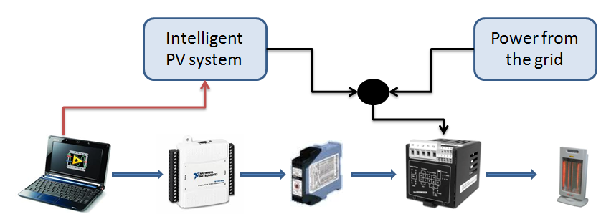
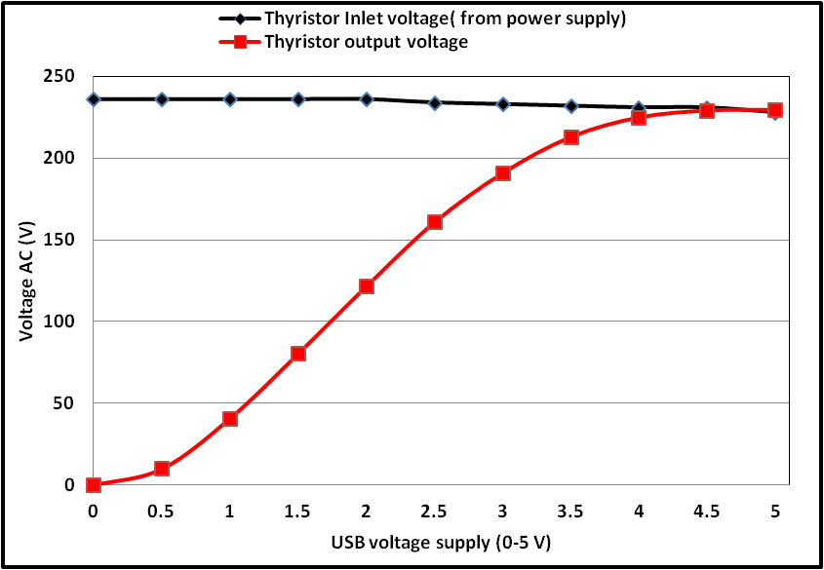
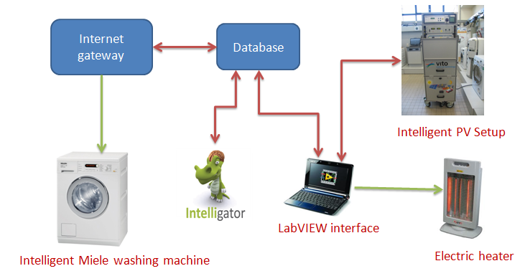
Vattenfall Energy Award Presentation
Experimental Methodology
Load Calibration procedure : Household loads like room heaters were first calibrated with the USB -6009 DAQ device for integration into the smart house setup
Transformer Error correction : Some power losses were noticed in the transformer between the grid connection and smart house setup. The error was measured and the necessary corrections implemented in the software structure.
Load Integration: Integration of the room heater into the setup
Bi-directional converter Power loss measurement : Power loss measurement inside the converter assembly was made and the necessary corrections made as look up tables in LabVIEW platform.
Test of new energy measurement logics : Two energy measurement logic were devised and successfully implemented in the smart house
    Energy measurement by steering the power from the grid to zero
    Net –zero energy measurement logic based measurement
Integration of washing machines with Demand Response Management software (Intelligator):
The intelligent washing machine and the demand response management software were integrated with the smart house.
7. Integration of new battery SOC algorithm and Cluster tests: A new algorithm for battery SOC measurement was developed in parallel. All the components of the smart house were tested for their functionality in a cluster at different battery SOC levels.
Load calibration setup
USB voltage calibration for load control
Cluster test setup

Slide 4
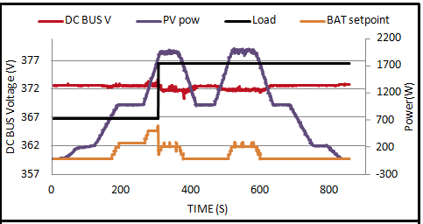
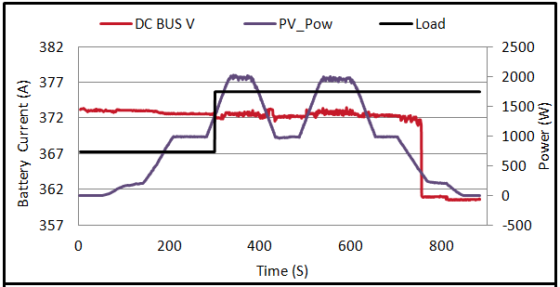
Vattenfall Energy Award Presentation
Change of washing machine start point based on availability of solar power and available battery capacity
0 % SOC Demand response tests
100 % SOC Demand response tests
What is new in this work ?
Two energy measurement logic using smart meters (which are being rolled out in every country in
Europe) were developed and tested successfully.
A simple logic to measure power consumption was developed with the help of low cost kWh pulse
meters. This logic could be used with cheap open source boards like Arduino to measure power
consumption in different applications for a very low price.
The study of the bi-directional logic in the cluster tests is being used by VITO to develop a robust
control system for solar inverters.
Why I feel that this thesis work will contribute to the challenge of creating a sustainable energy system ?
With the increasing demand for energy in residential houses, there is a necessity for the electricity infrastructure to be more robust and reliable. The electricity grid in many developing countries across the world fail often due to unevenly high energy demand during peak times. Demand response management is one of the potential answers to this problem. It will help us in managing this uneven energy demand without any heavy investment needed to upgrade grid infrastructure.
Though a lot of money and effort is being pooled into this area of research, not much information is available on how the deferrable loads (shift able loads like washing machines, dishwaters and water heaters) in houses can be automatically shifted to non peak hours and reduce the stress on the grid.
This thesis throws light upon different problems which could arise, when the loads are being shifted based on factors like availability of sun/wind and electricity pricing.
An electric vehicle, scooter and power generation source like micro CHP plant will be added to the smart house setup and the functionality of such a cluster will be tested at VITO as a continuation of this thesis. The software developed for this thesis is being used for further research in the same area. The study will also be used for the LINEAR project, which is one of KIC-Inno-Energy’s innovation projects.
Both KTH and Vattenfall are major contributors in this field of research. The ‘Stockholm royal sea port project’ and the ‘smart grid Gotland’ are some project where each of the partners have pooled their research capabilities.

