Slide 1
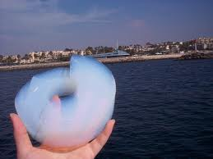

FEASIBILITY STUDY OF USING SILICA AEROGEL AS INSULATION FOR BUILDINGS
Lang Huang
TSUEM
(langh@kth.se)
Departement of Energy Technology
Kungliga Tekniska högskolan
Stockholm, Sweden

Slide 2
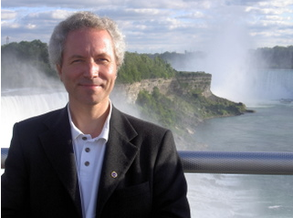

Examinar and Supervisor
Examinar: Björn Palm
(bpalm@energy.kth.se)
Supervisor: Ehsan Biaraf Haghighi
(ehsan.bitaraf@energy.kth.se)

Slide 3
Thesis Description
Silica aerogel Introduction
Comparison to traditional thermal insulation materials
Synthesis, Properties and applications of silica aerogel
Thermal conductivity measurement
TPS method and Guarded-hot-plate method
COMSOL simulation
Feasibility study and analysis
Life-cycle cost analysis method (LCCA) calculation
Conclusions

Slide 4

Contribution to Energy-saving
Short payback time
4.1 year
Annual heating cost of buildings reduced 50.3%
Lowest heat transfer coefficient
Energy efficiency of buildings improved 50.9%
Silica aerogel has proved to be perfect in thermal insulation buildings at present

