Slide 1
Smart Grid
Supervisor:
Nicholas Honeth
nicholash@ics.kth.se
Student:
Pengcheng Zhao (TELPM)
pengcheng.zhao@ics.kth.se
Examiner:
Lars Nordström
larsn@ics.kth.se
From the Vision to Implementation – IEC 61850-9-2

Slide 2
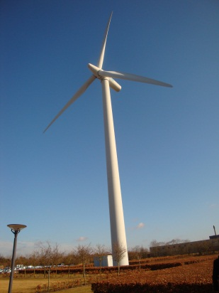
Smart Grid Vision ^{[1]}
Sustainable energy is preferred and a lot of green energy power plant is under construction
The increase in demand and distributed generation require a more intelligent power grid in the future
Smart Grid is the solution of future power grid

Slide 3
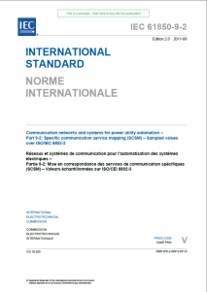

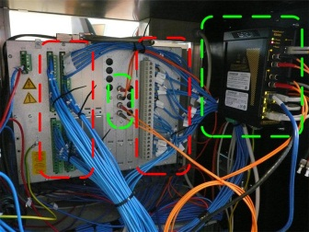
Challenges
New standards are introduced to achieve the vision (Such as IEC 61850 standard)
Unfamiliarity of the new standard for the utilities
Replacement of the old equipment with the new technology

Slide 4
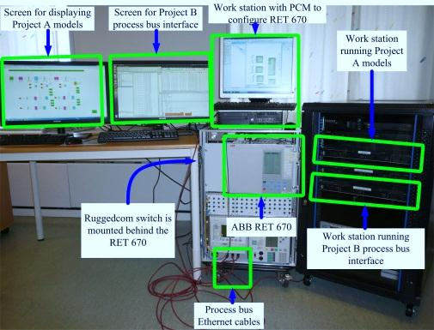
Solution
Find an easier way to introduce the new standard:
  A light-weight demonstration tool for the new IEC 61850-9-2 concept
Test the new standard properly before its implementation:
  The tool can be used as a testing environment
Report Summary:
  The concept of “light-weight tool”
  How the tool is developed
  How the tool can be used as a demonstration and testing environment

