Slide 1
Radiative and non-radiative recombination. Free excitons
Lecture 3 (chapter 5 & 6 of the book)
Given by: zahra Besharat, 5 Nov. 2012

Slide 2
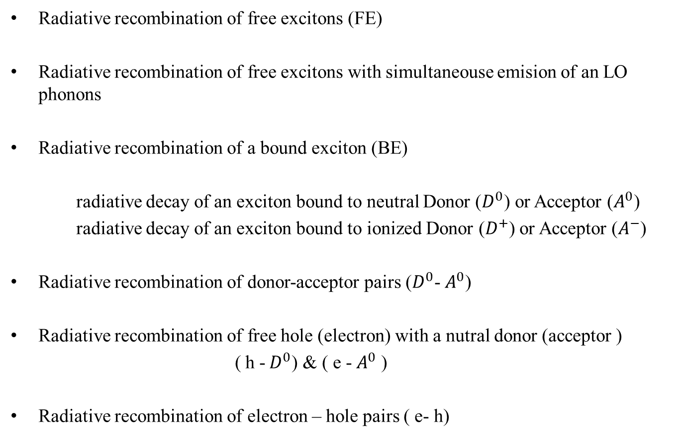
Overview of luminescence processes in crystalline semiconductors
Radiative recombination of free excitons (FE)
Radiative recombination of free excitons with simultaneouse emision of an LO phonons
Radiative recombination of a bound exciton (BE)
radiative decay of an exciton bound to neutral Donor ($D^{0}$) or Acceptor ($A^{0}$)
radiative decay of an exciton bound to ionized Donor ($D^{+}$) or Acceptor ($A^{−}$)
Radiative recombination of donor-acceptor pairs ($D^{0}$- $A^{0}$)
Radiative recombination of free hole (electron) with a nutral donor (acceptor )
( h -${ D}^{0}$) & ( e -${ A}^{0}$ )
Radiative recombination of electron – hole pairs ( e- h)
Notes:
Obviously 2 or more types of these processes can occur simultaneously in marterials

Slide 3
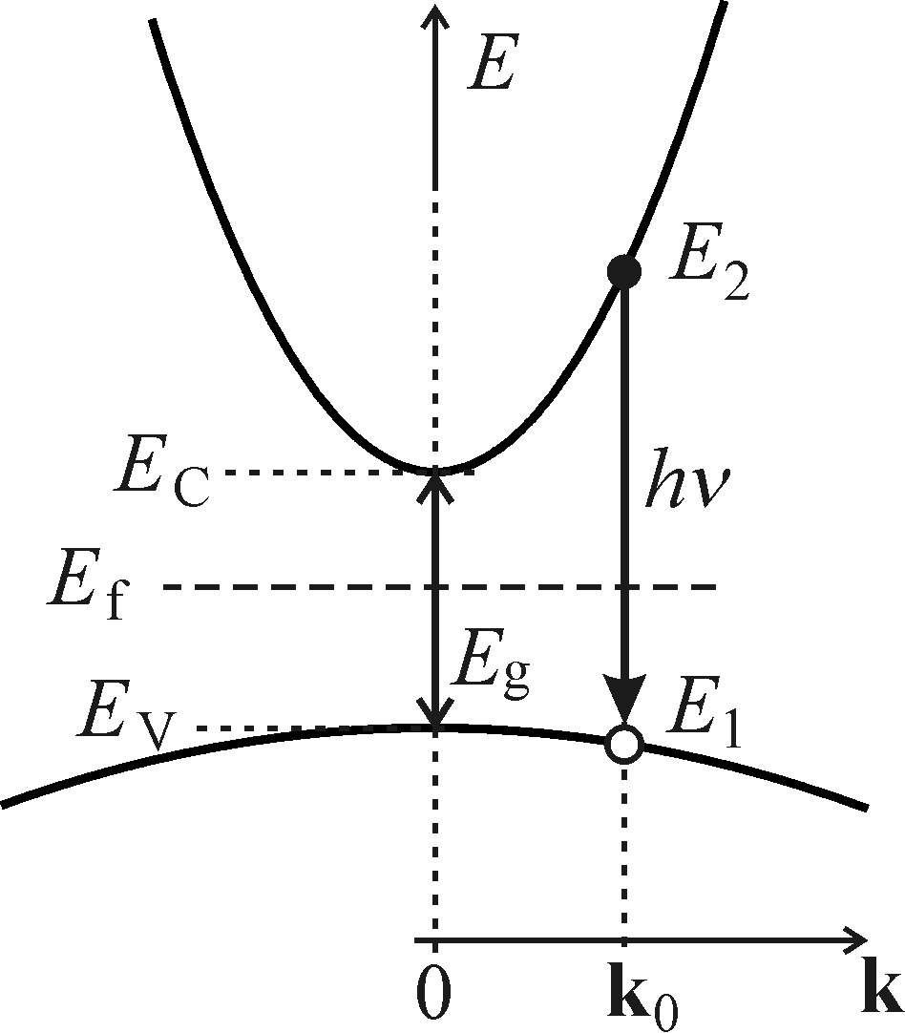



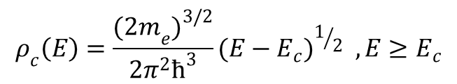
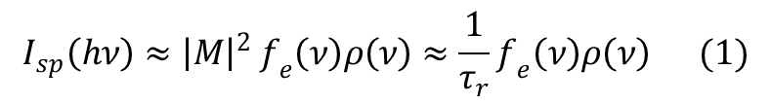
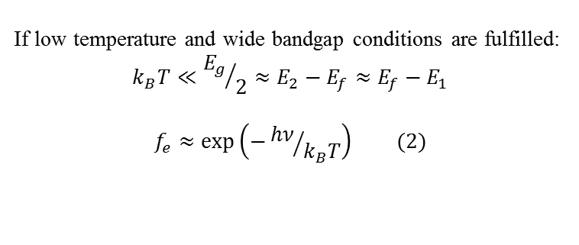
Recombination of free electron – hole pairs direct bandgap
$$I_{sp}\left(hν\right)≈{\left|M\right|}^{2 }f_{e}\left(ν\right)ρ\left(ν\right)≈\frac{1}{τ_{r}}f_{e}\left(ν\right)ρ\left(ν\right) (1)$$
$f_{e}\left(ν\right)$ probability of a suitable config of occupancy of conduction and valance band state
$$f_{e}\left(ν\right)=f_{c}f_{v}=f(E_{2})[1−f(E_{1})]$$
If low temperature and wide bandgap conditions are fulfilled:
$$k_{B}T≪{E_{g}}/2≈E_{2}−E_{f}≈E_{f}−E_{1}$$
$$f_{e}≈exp\left(−{hν}/{k_{B}T}\right) (2)$$
${\left|M\right|}^{2 }$ Quantum - mechanical probability of transition
$τ_{r}\sim {\left|M\right|}^{−2 }$ (3)
$ρ\left(ν\right)$Joint density of e&h states in corresponding bands
$$ρ_{c}\left(E\right)=\frac{{{(2m}_{e})}^{3/2}}{2π^{2}ћ^{3}}{(E−E_{c})}^{1/2} ,E≥E_{c}$$
$ρ_{v}\left(E\right)=\frac{{{(2m}_{v})}^{3/2}}{2π^{2}ћ^{3}}{(E_{v}−E)}^{1/2}{, E}_{v}≥$ E
Notes:
Bimolecular in ch (3) is not happening very often due excitons activity. Fermi dirac distribution $f(E_{1,2})$ . M matrix element of optical transition consider constant.p126 Tr radiative life time

Slide 4
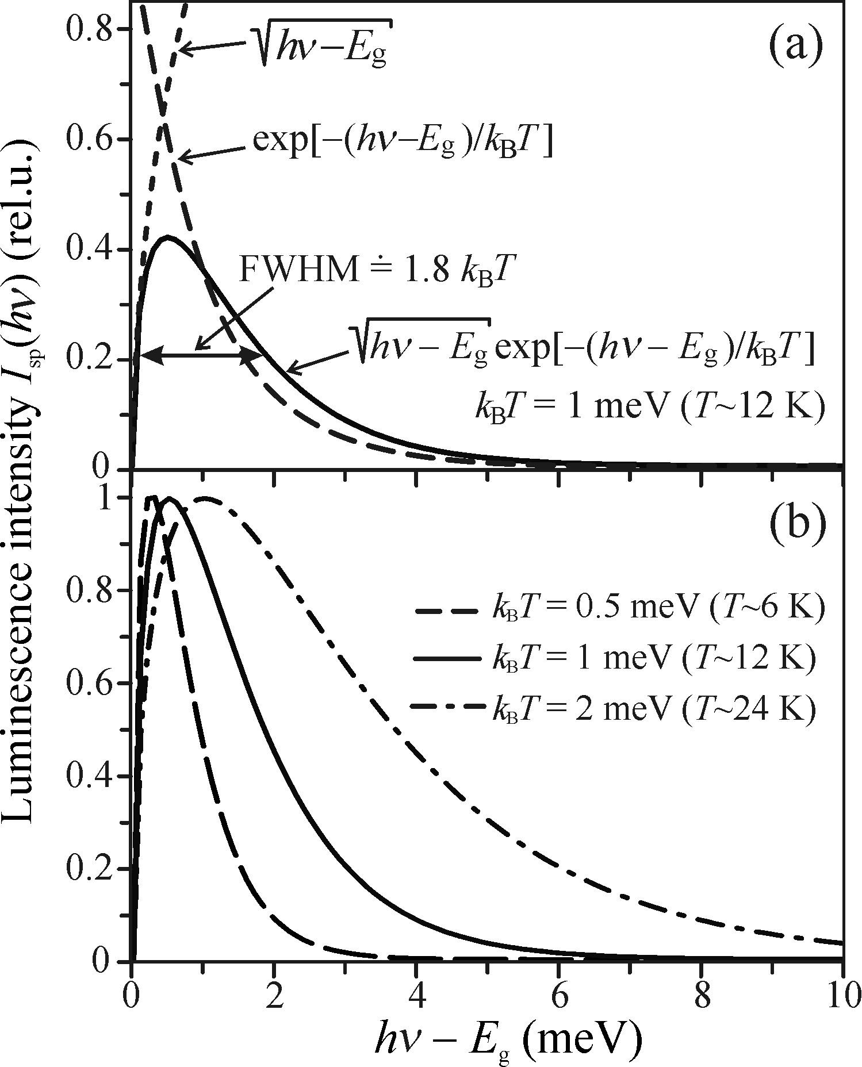

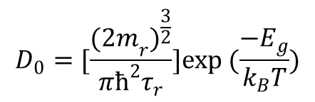
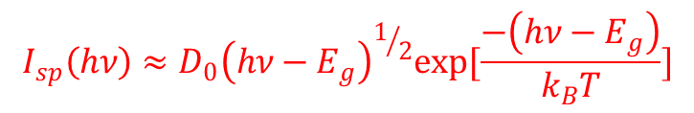


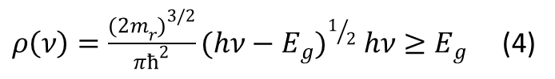
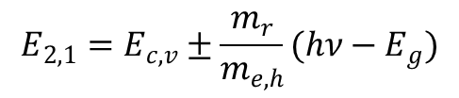
Recombination of free electron – hole pairs direct bandgap
$$E_{2,1}=E_{c,v}±\frac{m_{r}}{m_{e,h}}(hν−E_{g})$$
$$ρ_{c}\left(E_{2}\right)dE_{2}=ρ(ν)dν$$
$ρ\left(ν\right)=\frac{{{(2m}_{r})}^{3/2}}{πћ^{2}}{(hν−E_{g})}^{1/2} hν≥E_{g}$ (4)
If (2,3,4) $→(1)$
$$I_{sp}\left(hν\right)≈D_{0}{\left(hν−E_{g}\right)}^{1/2}exp[\frac{−\left(hν−E_{g}\right)}{k_{B}T}]$$
$$D_{0}=[\frac{{{(2m}_{r})}^{\frac{3}{2}}}{πћ^{2}τ_{r}}]exp (\frac{−E_{g}}{k_{B}T})$$
FWHM ~ 1.8$K_{B}$T
Notes:
BROADENING SINCE BOLTZMAN TAIL OF FERMI DIRAC DISTRIBUTION BRODENS BY T

Slide 5
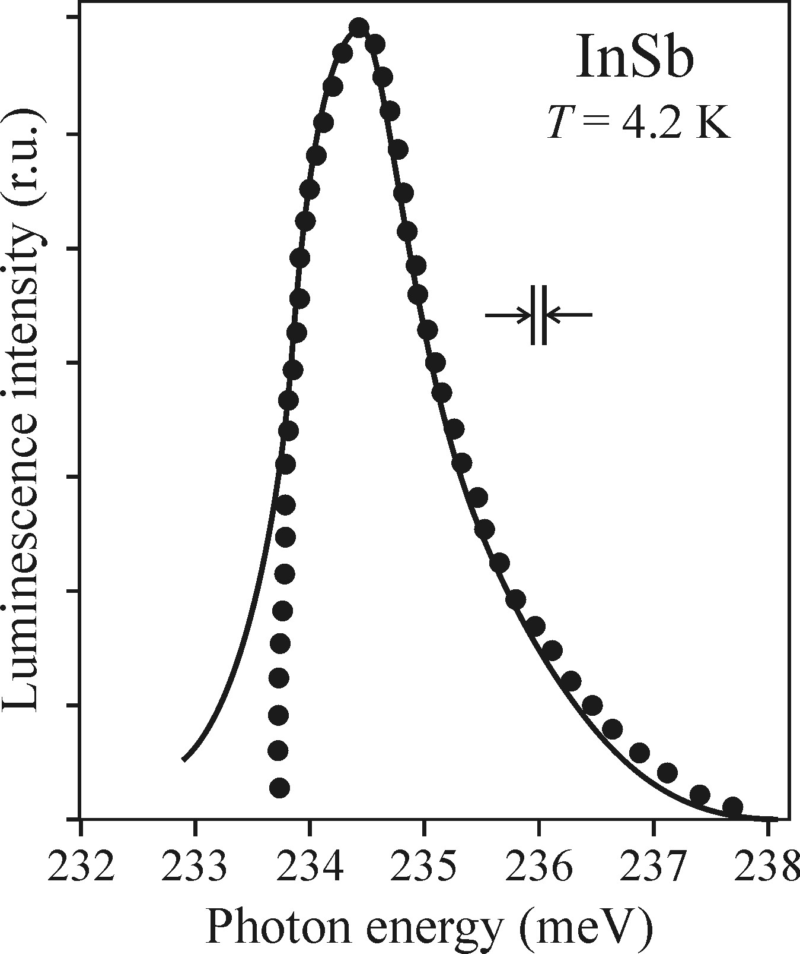

Recombination of free electron – hole pairs direct bandgap
The radiative recombination of free
electrons and holes is a scarcely
encountered process.
Low temperature luminescence
Is dominated by excitonic effects
Which means that free electrons
and holes and their luminescence
are practically absent.
Luminescence of electron hole pair in
$${InSb: E}_{g}\sim 0.23eV @ T=4.2K$$
Notes:
Experiment and theory are different in lower energy part Due to slit of monochromator . Indium antimonide InSb. Is exception and that proves the rule.narrow Eg and consequently low exciton binding energy which ensure the thermal dissociation of exciton at low T.

Slide 6
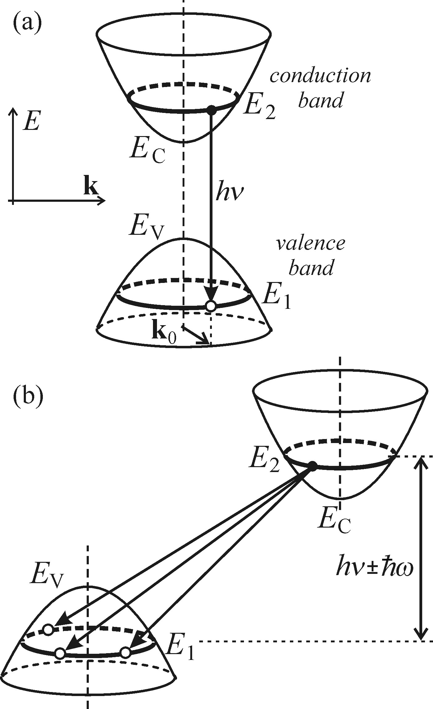

Indirect bandgap
Direct bandgap semi recombination
between electrons –holes happen with
the same wave vector but indirect bandgap
electron with energy E1 can recombine with
any hole with energy E2 with different K vector
since fulfil this equation.
$E_{2}$- $E_{1}$= ћω$±hν$
Phonon emission which cause
vibration energy in lattice
Notes:
Probability density of spontaneous emission Isp of luminecense photon

Slide 7
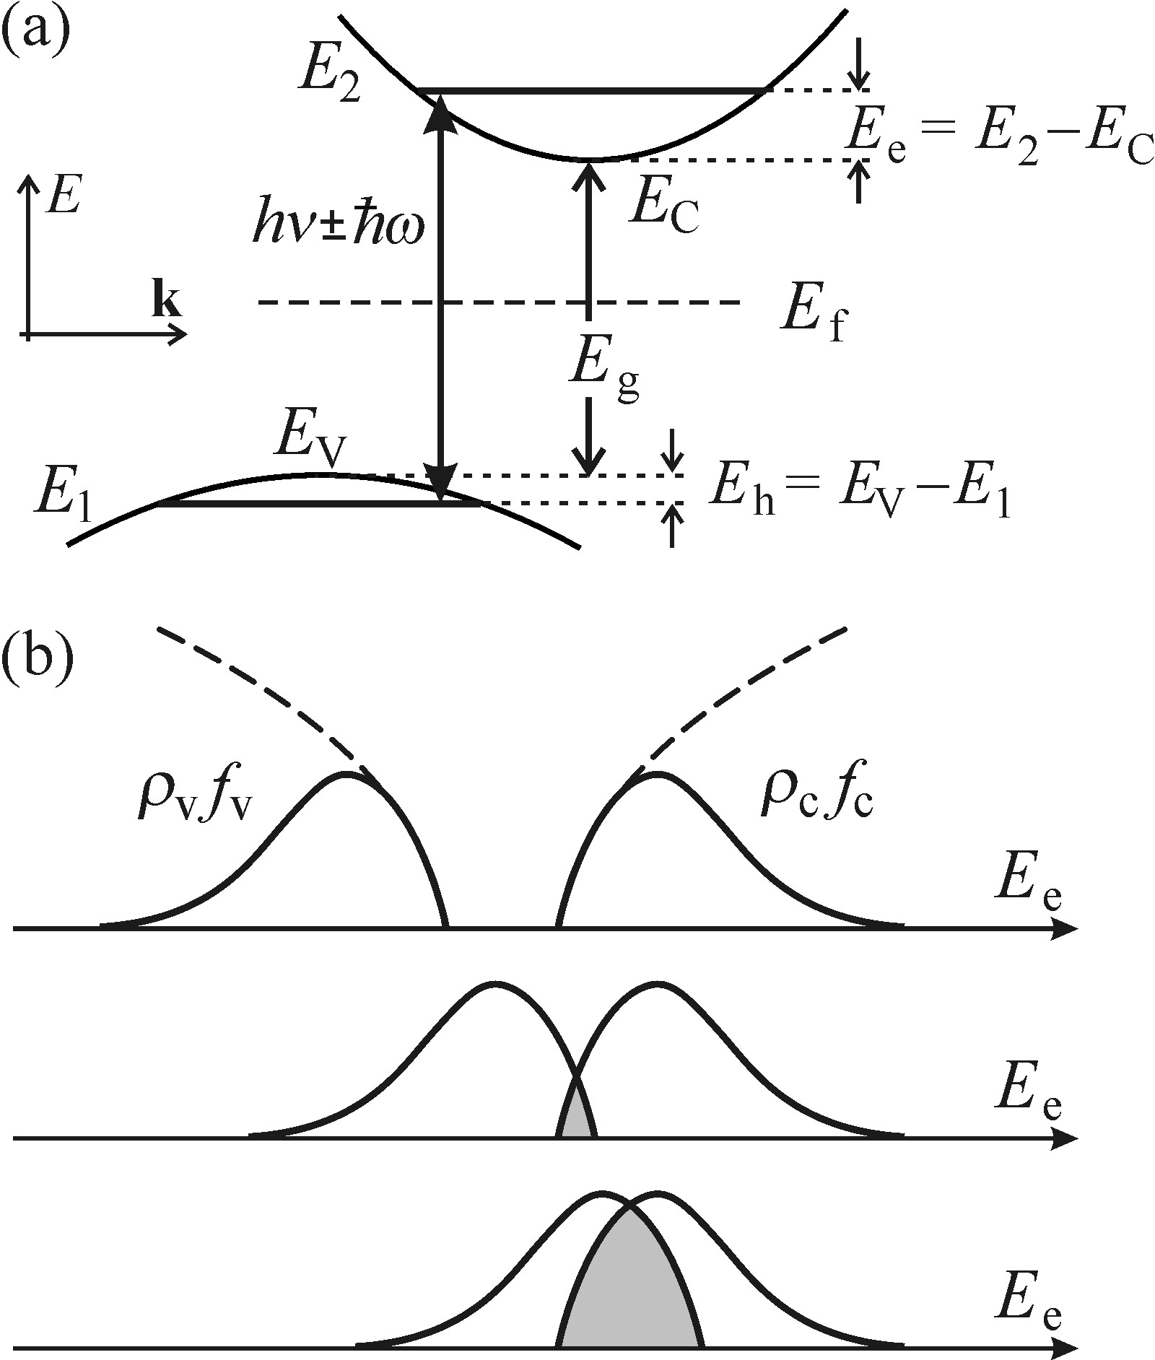
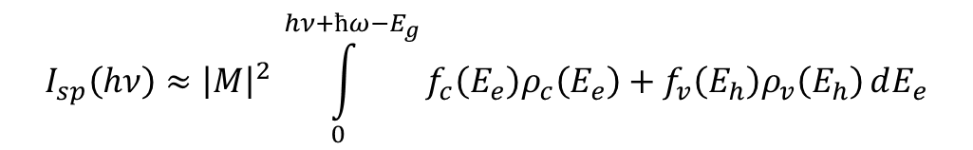


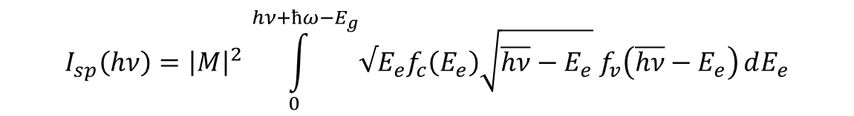
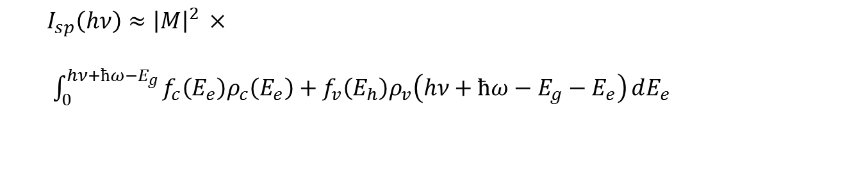
Indirect bandgap
$$I_{sp}\left(hν\right)≈{\left|M\right|}^{2 }\int_{0}^{hν+ћω−E_{g}}{f_{c}\left(E_{e}\right)ρ_{c}\left(E_{e}\right)+f_{v}\left(E_{h}\right)ρ_{v}\left(E_{h}\right)}dE_{e}$$
$$hν=E_{g}+E_{e}+E_{h}−ћω$$
$I_{sp}\left(hν\right)≈{\left|M\right|}^{2 }×$
$\int_{0}^{hν+ћω−E_{g}}{f_{c}\left(E_{e}\right)ρ_{c}\left(E_{e}\right)+f_{v}\left(E_{h}\right)ρ_{v}\left(hν+ћω−E_{g}−E_{e}\right)}dE_{e}$
$$I_{sp}\left(hν\right)={\left|M\right|}^{2 }\int_{0}^{hν+ћω−E_{g}}{√E_{e}f_{c}\left(E_{e}\right)\sqrt{\overline{hν}−E_{e}}{ f}_{v}\left(\overline{hν}−E_{e}\right)}dE_{e}$$
$$\overline{hν}=hν+ћω−E_{g}$$

Slide 8
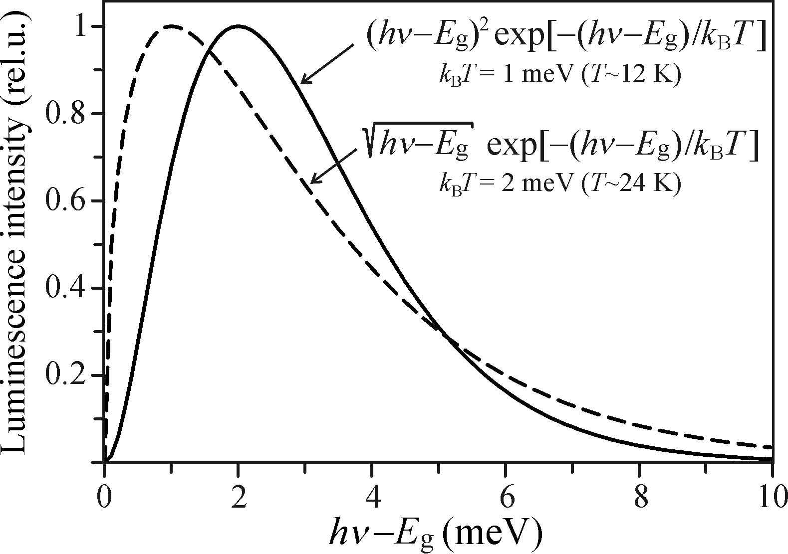
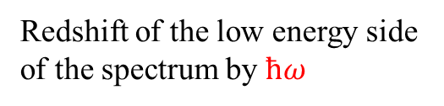
Indirect bandgap
$$I_{sp}\left(hν\right)≈[hν+ћω−E_{g}]^{2}exp [−(hν+ћω−E_{g})/k_{B}T$$
Redshift of the low energy side
of the spectrum by $ћω$
Replacement of the square root dependence of the pre exponential factor in by a quadratic dependence in above formula in compare with direct bandgap

Slide 9
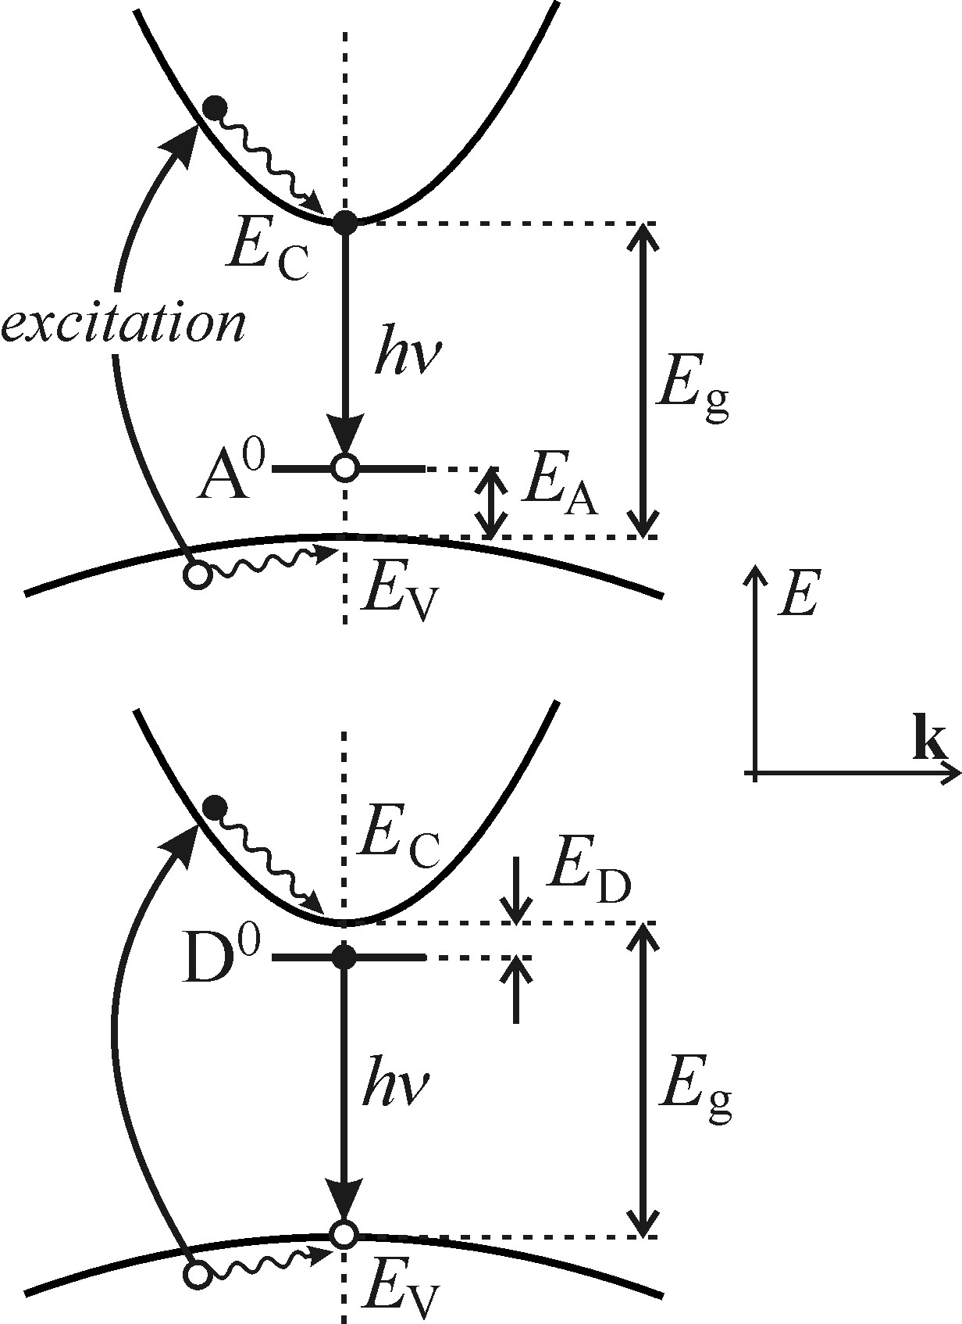
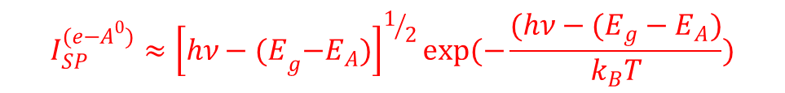

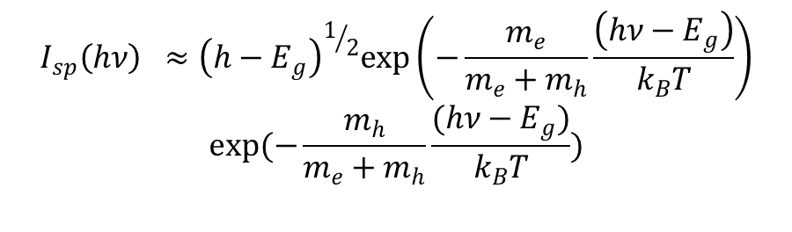
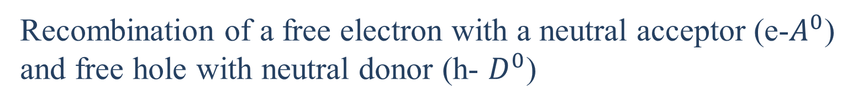
Recombination of a free electron with a neutral acceptor (e-$A^{0}$)
and free hole with neutral donor (h- $D^{0}$)
Neutral acceptor(donor) is a term used to describe
an acceptor (donor)with non ionized hole (electron)
$$I_{sp}\left(hν\right) ≈{\left(h−E_{g}\right)}^{1/2}exp\left(−\frac{m_{e}}{m_{e}+m_{h}}\frac{\left(hν−E_{g}\right)}{k_{B}T}\right)$$
$$exp(−\frac{m_{h}}{m_{e}+m_{h}}\frac{(hν−E_{g})}{k_{B}T})$$
$$m_{h}→∞ m_{h}≫m_{e}$$
$$I_{SP}^{(e−A^{0})}≈{\left[hν−{(E}_{g}−E_{A})\right]}^{1/2}exp(−\frac{(hν−(E_{g}−E_{A})}{k_{B}T})$$
Electron- hole Quasi momentum ћk
is practically zero
Notes:
Refer to book

Slide 10
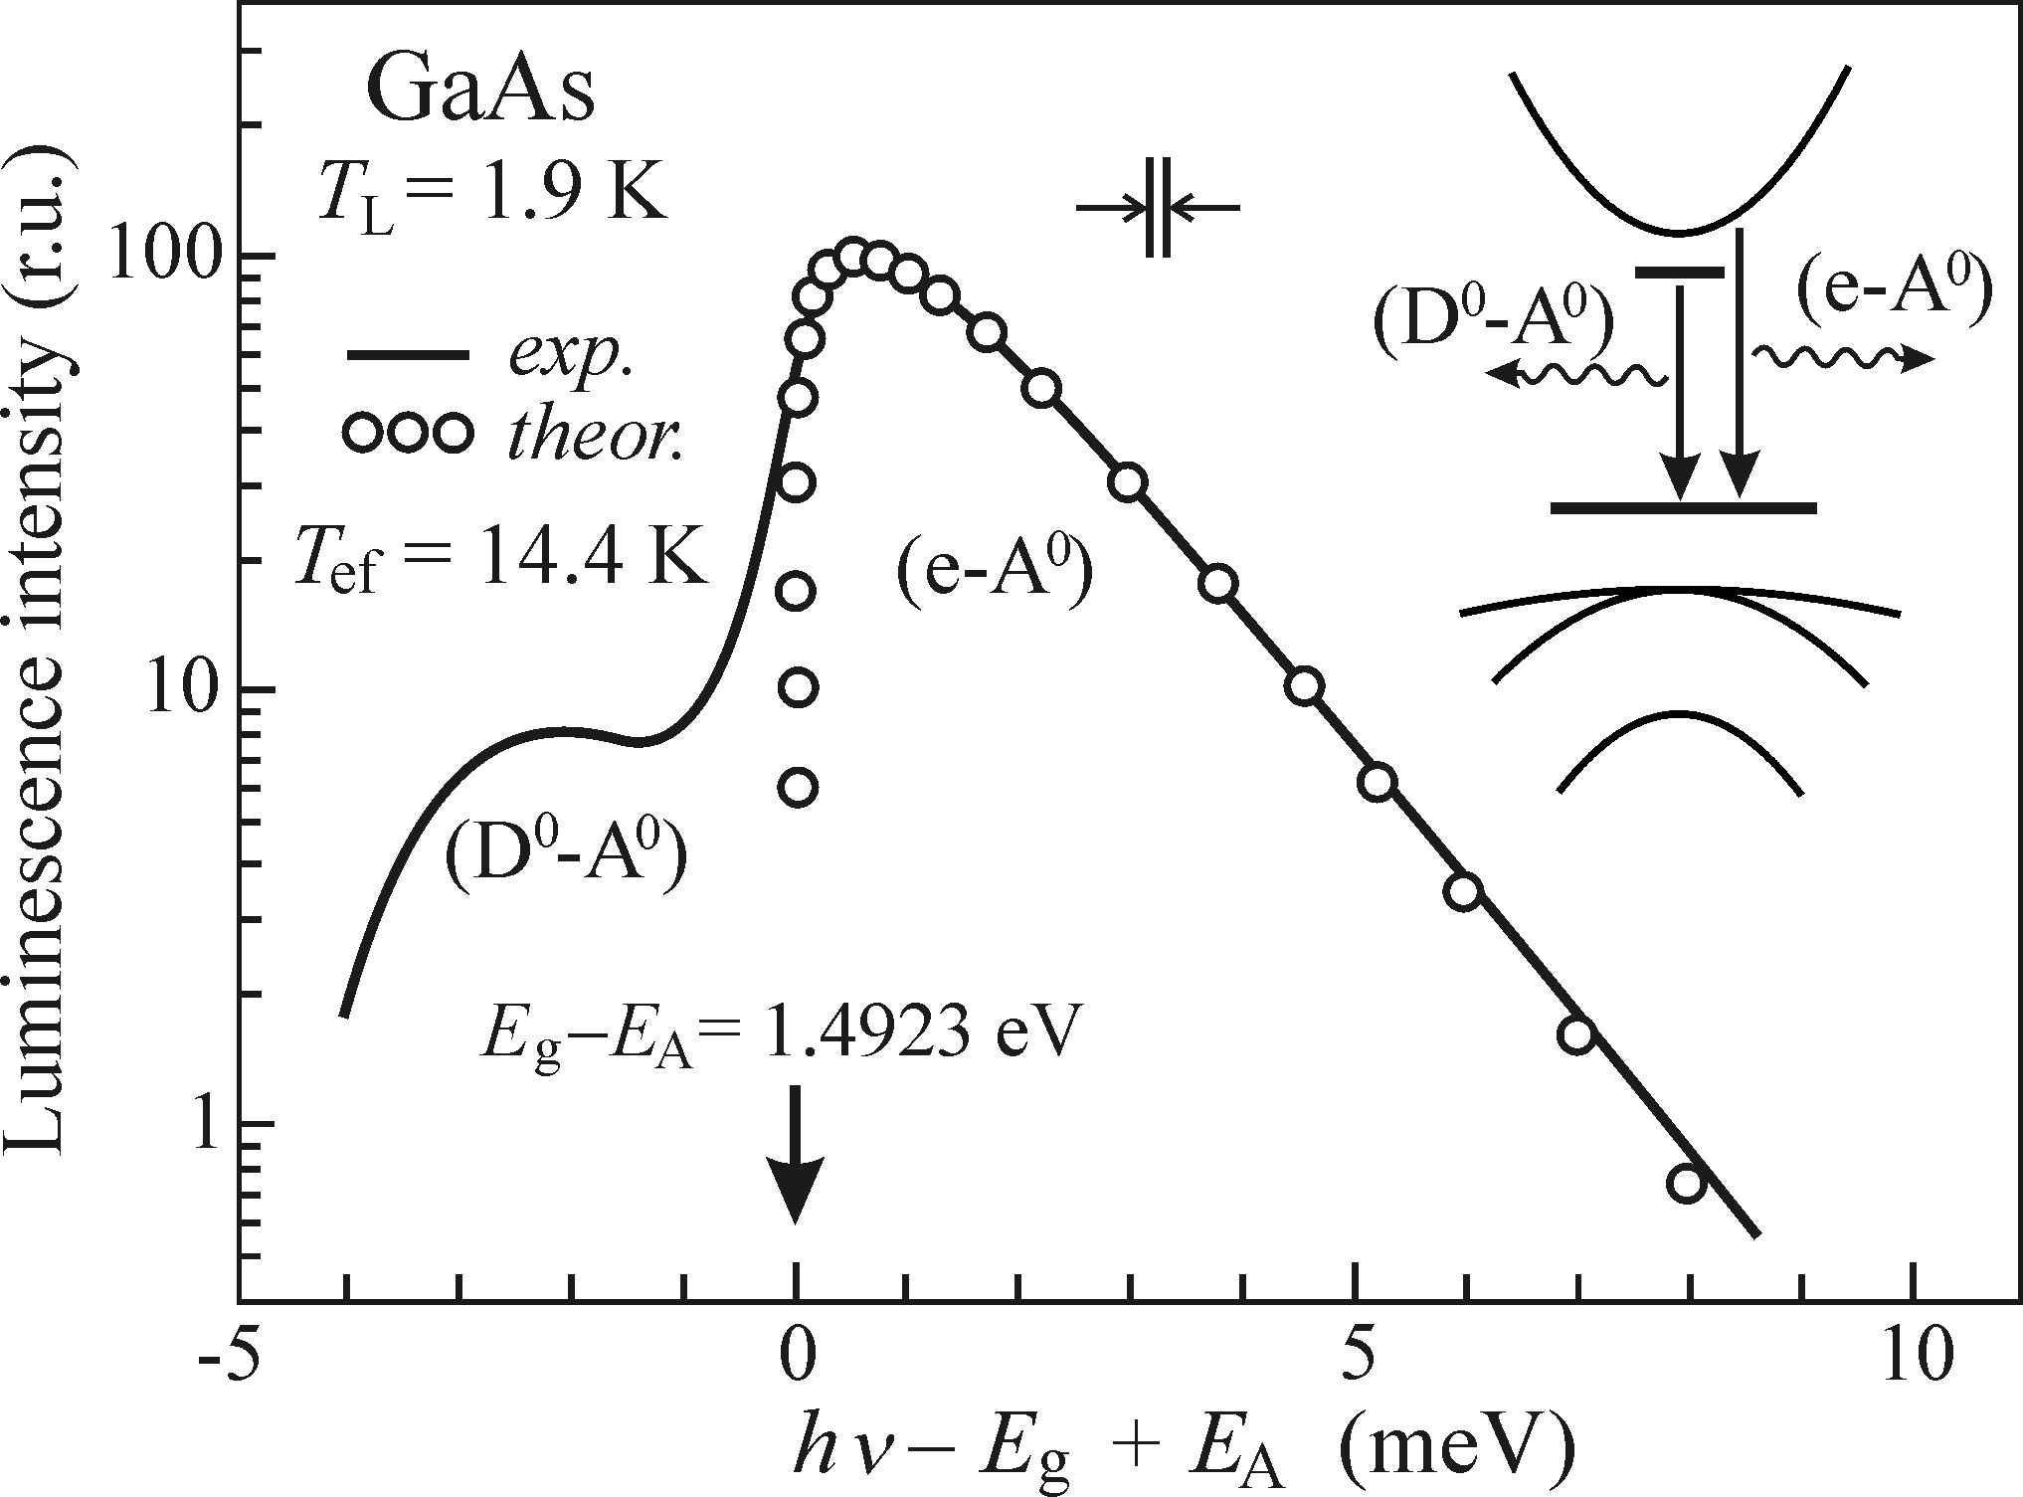
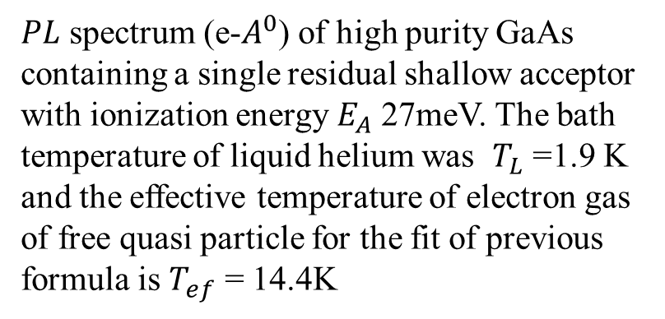
Recombination of (e-$A^{0}$) from GaAs layer at T=1.9 K
$PL$ spectrum (e-$A^{0}$) of high purity GaAs containing a single residual shallow acceptor with ionization energy $E_{A}$ 27meV. The bath temperature of liquid helium was $T_{L}$ =1.9 K and the effective temperature of electron gas of free quasi particle for the fit of previous formula is $T_{ef}$ = 14.4K
If impurity is very high, it will have several acceptor and donors with slightly varying ionization energies which are excising in the sample and their emission lines according the Isp formula becomes slightly shifted with regard to one another. This may result in occurrence of two inhomogeneously broaden line: unresolved acceptor transition as well as unresolved donor transition.
Notes:
Not equilberium with subsystem of atoms (ion ) vibrating in the lattice

Slide 11
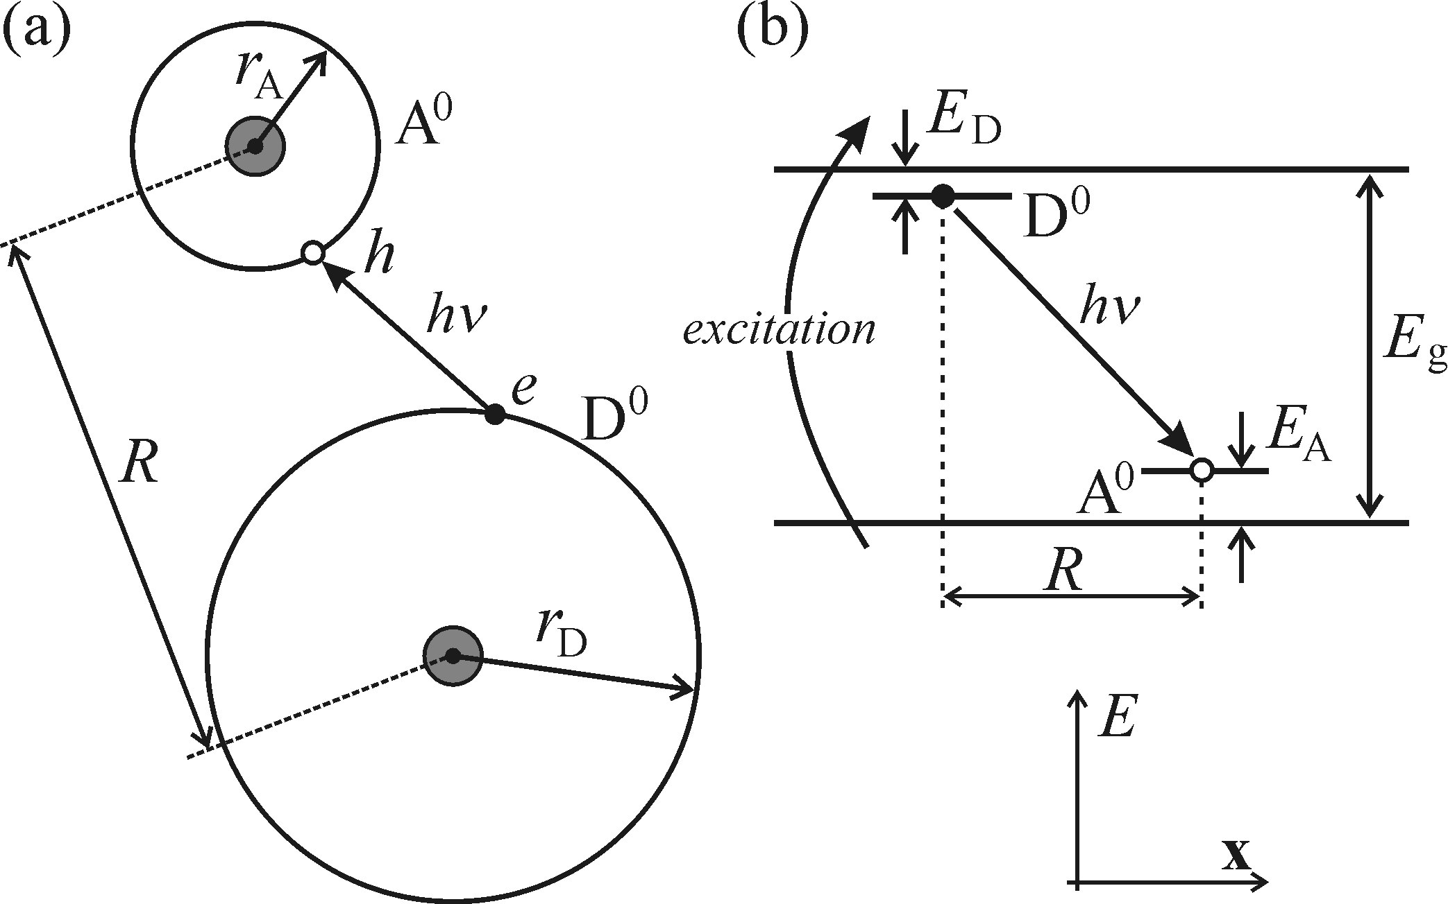
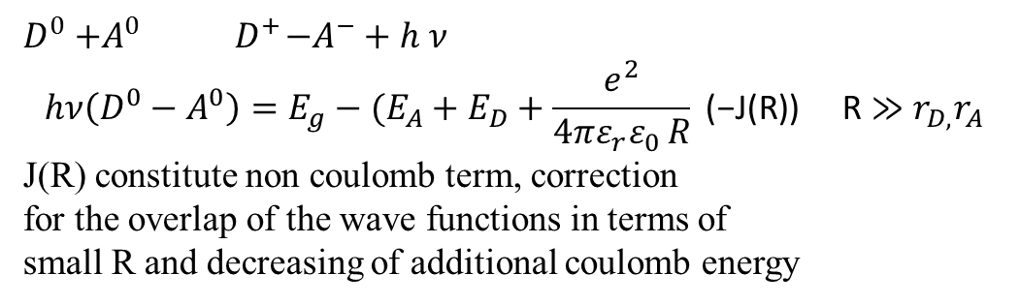
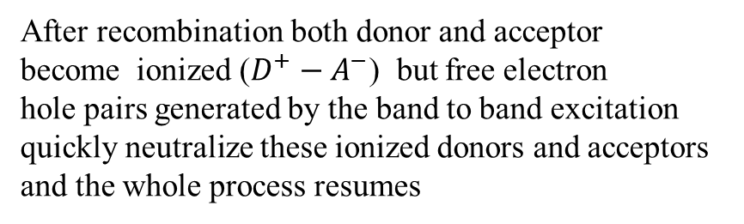
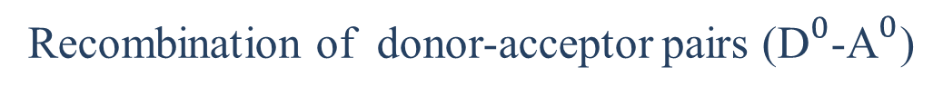
Recombination of donor-acceptor pairs (${\text{D}}^{0}$-${\text{A}}^{0}$)
The neutral donor can be consider as an extra
electron orbiting all the remaining part of the atom,
a neutral acceptor can then treated analogously.
After recombination both donor and acceptor
become ionized ($D^{+}−A^{−}$) but free electron
hole pairs generated by the band to band excitation
quickly neutralize these ionized donors and acceptors
and the whole process resumes
$D^{0}{+A}^{0}{ D}^{+}−A^{−}+ h$ $ν$
$$hν\left(D^{0}−A^{0}\right)=E_{g}−(E_{A}+E_{D}+\frac{e^{2}}{4πε_{r}ε_{0 }R}\text{ (−}\text{J}\text{(}\text{R}\text{)) }\text{R}≫r_{D,}r_{A}$$
J(R) constitute non coulomb term, correction
for the overlap of the wave functions in terms of
small R and decreasing of additional coulomb energy
Notes:
D0-A0 recombination manifest itself in the various way , depending on the strength of electron phonon coupling??

Slide 12
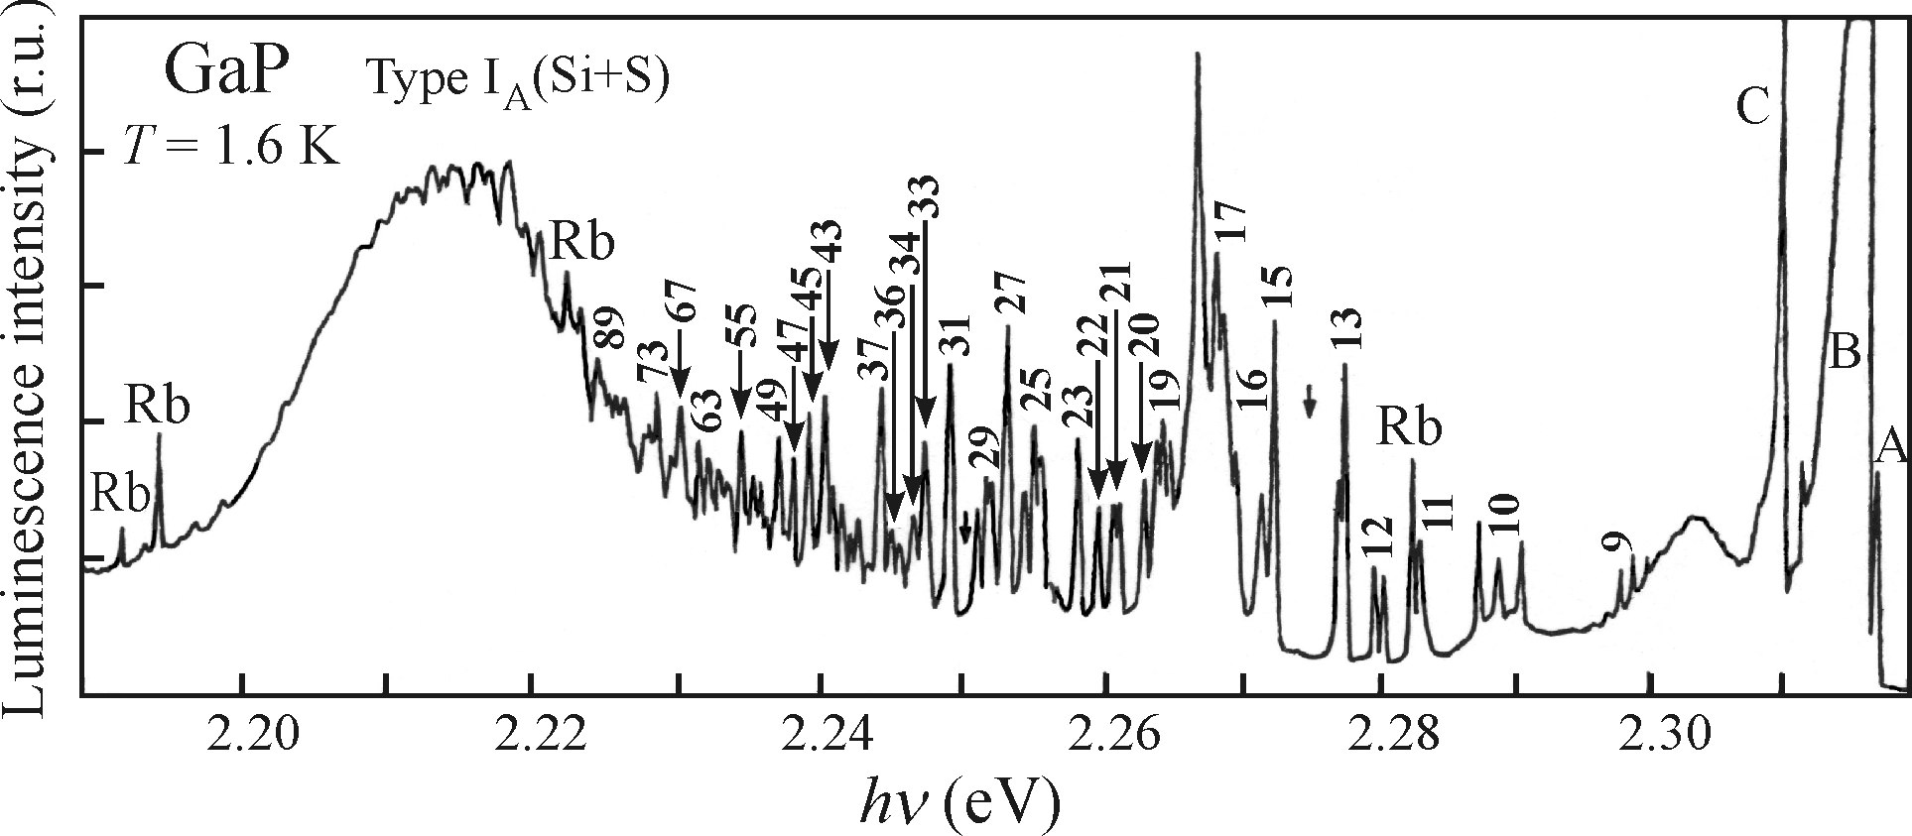
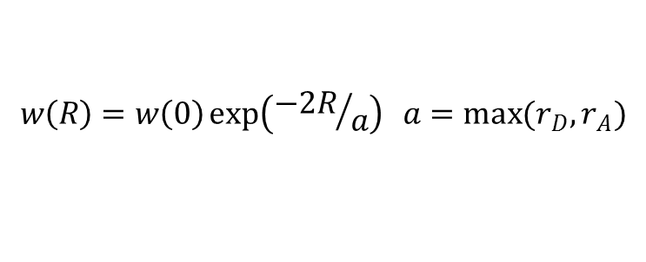
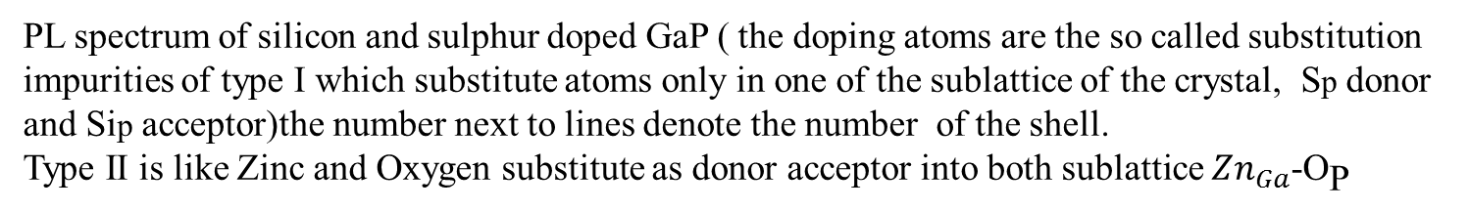

Recombination of donor-acceptor pairs (${\text{D}}^{0}$-${\text{A}}^{0}$)
R increase
PL spectrum of silicon and sulphur doped GaP ( the doping atoms are the so called substitution
impurities of type I which substitute atoms only in one of the sublattice of the crystal, Sp donor
and Sip acceptor)the number next to lines denote the number of the shell.
Type II is like Zinc and Oxygen substitute as donor acceptor into both sublattice ${Zn}_{Ga}$-${\text{O}}_{\text{P} }$
$$w\left(R\right)=w\left(0\right)\exp\left({−2R}/a\right) a=\max{(r_{D},r_{A})}$$
Notes:
High photon energy ,small R, the number of suitable neighbours in the nearest shell being low though the corresponding discrete value of R are relatively scarce, resulting in sparse and weak lines on high energy
When R increase ,more partners can found in given shell, the shells themselves are located closer to one another which means the lines become more intense and closely packed
R becomes even larger suitable shells nearly merge and decrease the probability of radiation W(R) owning the fact that electron and hole are too far apart.

Slide 13
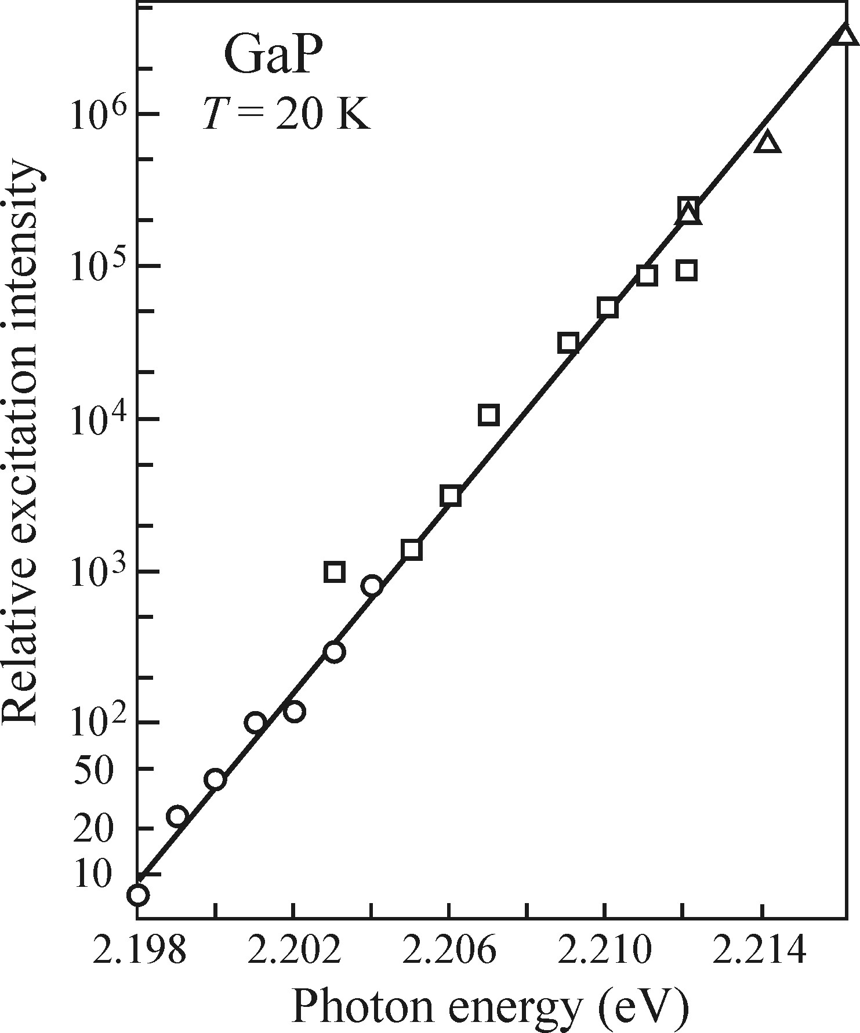
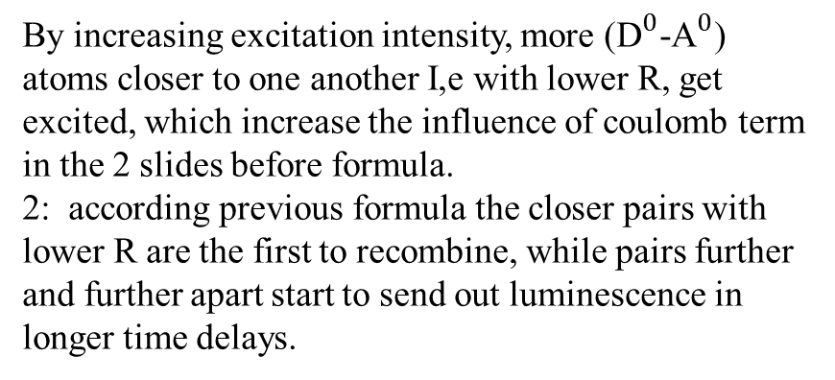
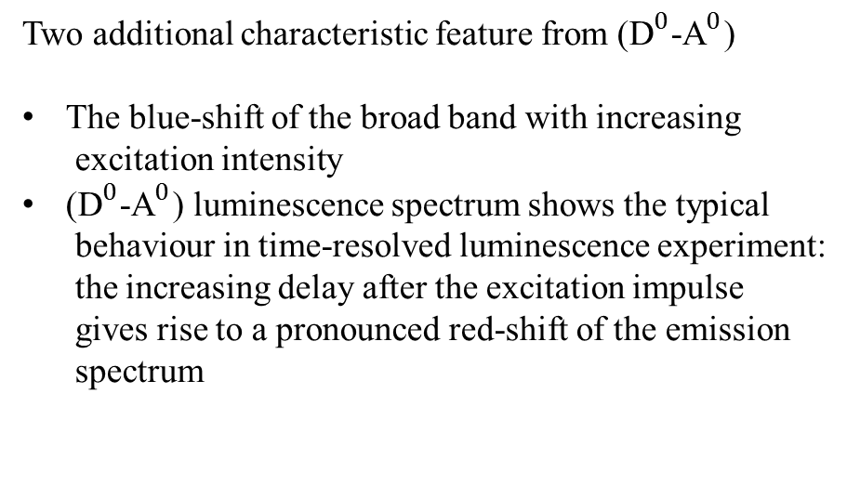
Recombination of donor-acceptor pairs (${\text{D}}^{0}$-${\text{A}}^{0}$)
Two additional characteristic feature from (${\text{D}}^{0}$-${\text{A}}^{0}$)
The blue-shift of the broad band with increasing
excitation intensity
(${\text{D}}^{0}$-${\text{A}}^{0}$) luminescence spectrum shows the typical
behaviour in time-resolved luminescence experiment:
the increasing delay after the excitation impulse
gives rise to a pronounced red-shift of the emission
spectrum
By increasing excitation intensity, more (${\text{D}}^{0}$-${\text{A}}^{0}$) atoms closer to one another I,e with lower R, get excited, which increase the influence of coulomb term in the 2 slides before formula.
2: according previous formula the closer pairs with lower R are the first to recombine, while pairs further and further apart start to send out luminescence in longer time delays.
Notes:
By increasing excitation intensity, more (${\text{D}}^{0}$-${\text{A}}^{0}$) atoms closer to one another I,e with lower R, get excited, which increase the influence of coulomb term in the 2 slides before formula.
2: according previous formula the closer pairs with lower R are the first to recombine, while pairs further and further apart start to send out luminescence in longer time delays.

Slide 14
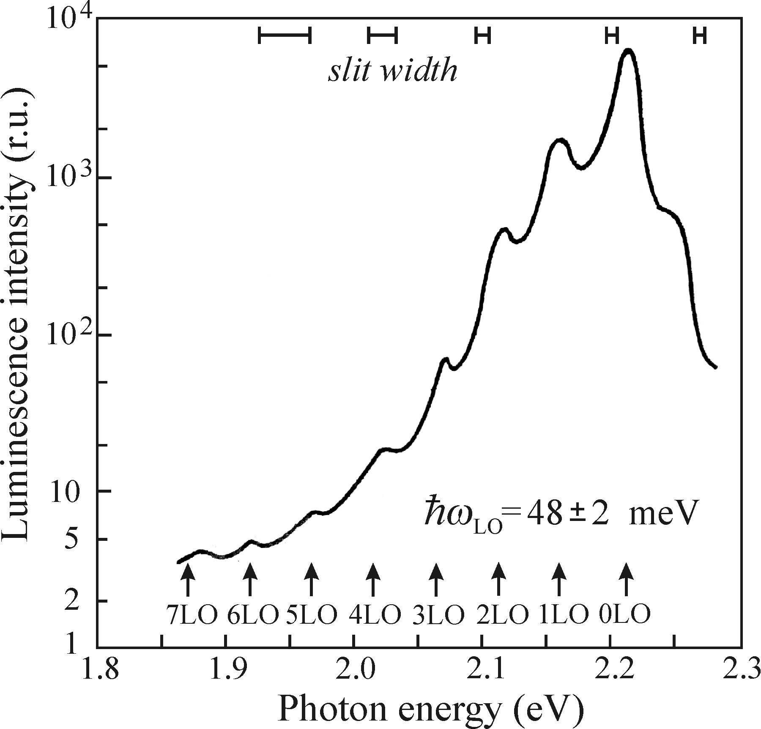
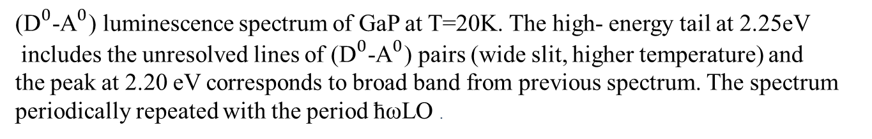
Recombination of donor-acceptor pairs (${\text{D}}^{0}$-${\text{A}}^{0}$)
(${\text{D}}^{0}$-${\text{A}}^{0}$) luminescence spectrum of GaP at T=20K. The high- energy tail at 2.25eV
includes the unresolved lines of (${\text{D}}^{0}$-${\text{A}}^{0}$) pairs (wide slit, higher temperature) and
the peak at 2.20 eV corresponds to broad band from previous spectrum. The spectrum
periodically repeated with the period ћωLO .
Notes:
Wider spectra than the previous spectrum at 20 K. the spectrum contains an intense zero phonon component near 2.20 ev and several satellites with decreasing intensities, shifted by multiples of the LO phonons energy. Which manifested weak electron phonon coupling.
The densely packed lines from previous spectrum are hidden in the unresolved shoulder at 2.25 ev and the wide low energy band originally located at 2.215 is shifted to 2,20ev as result of thermally induced decrease in Eg.

Slide 15
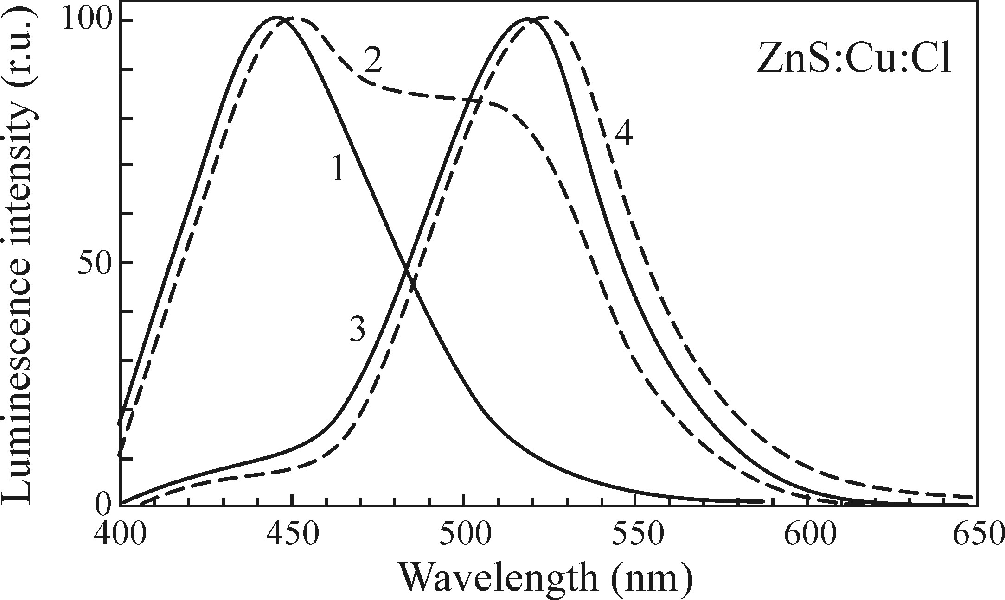
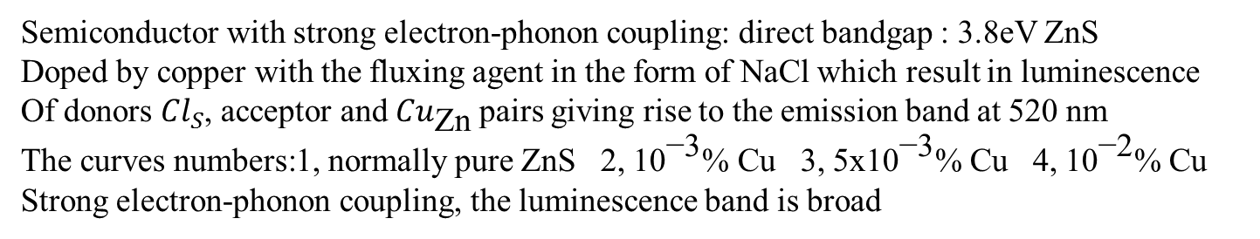
Recombination of donor-acceptor pairs (${\text{D}}^{0}$-${\text{A}}^{0}$)
Semiconductor with strong electron-phonon coupling: direct bandgap : 3.8eV ZnS
Doped by copper with the fluxing agent in the form of NaCl which result in luminescence
Of donors ${Cl}_{S}$, acceptor and ${Cu}_{\text{Zn}}$pairs giving rise to the emission band at 520 nm
The curves numbers:1, normally pure ZnS 2, ${\text{10}}^{\text{−3}}$% Cu 3, 5x${\text{10}}^{\text{−3}}$% Cu 4, ${\text{10}}^{\text{−}\text{2}}$% Cu
Strong electron-phonon coupling, the luminescence band is broad
Notes:
(${\text{D}}^{0}$-${\text{A}}^{0}$) can be observe in weak electron phonon coupling. And the suitable concentration of both donor acceptor guaranty this fact. If number of dopants are too low D0 and A0 in the pairs will be too far apart from one another and no recombination will take place. So (${\text{D}}^{0}$-${\text{A}}^{0}$) emission with densely packed lines can be observe in moderately high doped. Low temperature is essential and if possible the number of competing radiative recombination channels should be minimized.
Why is it important.
GaP only material in which number of narrow (${\text{D}}^{0}$-${\text{A}}^{0}$) line can be observe. Si (electron phonon coupling is lower than Gap and similarly indirect band gap, luminescence lines of this origin never observed) GaAs very close to GaP (${\text{D}}^{0}$-${\text{A}}^{0}$) emission manifested itself as a single unresolved line

Slide 16
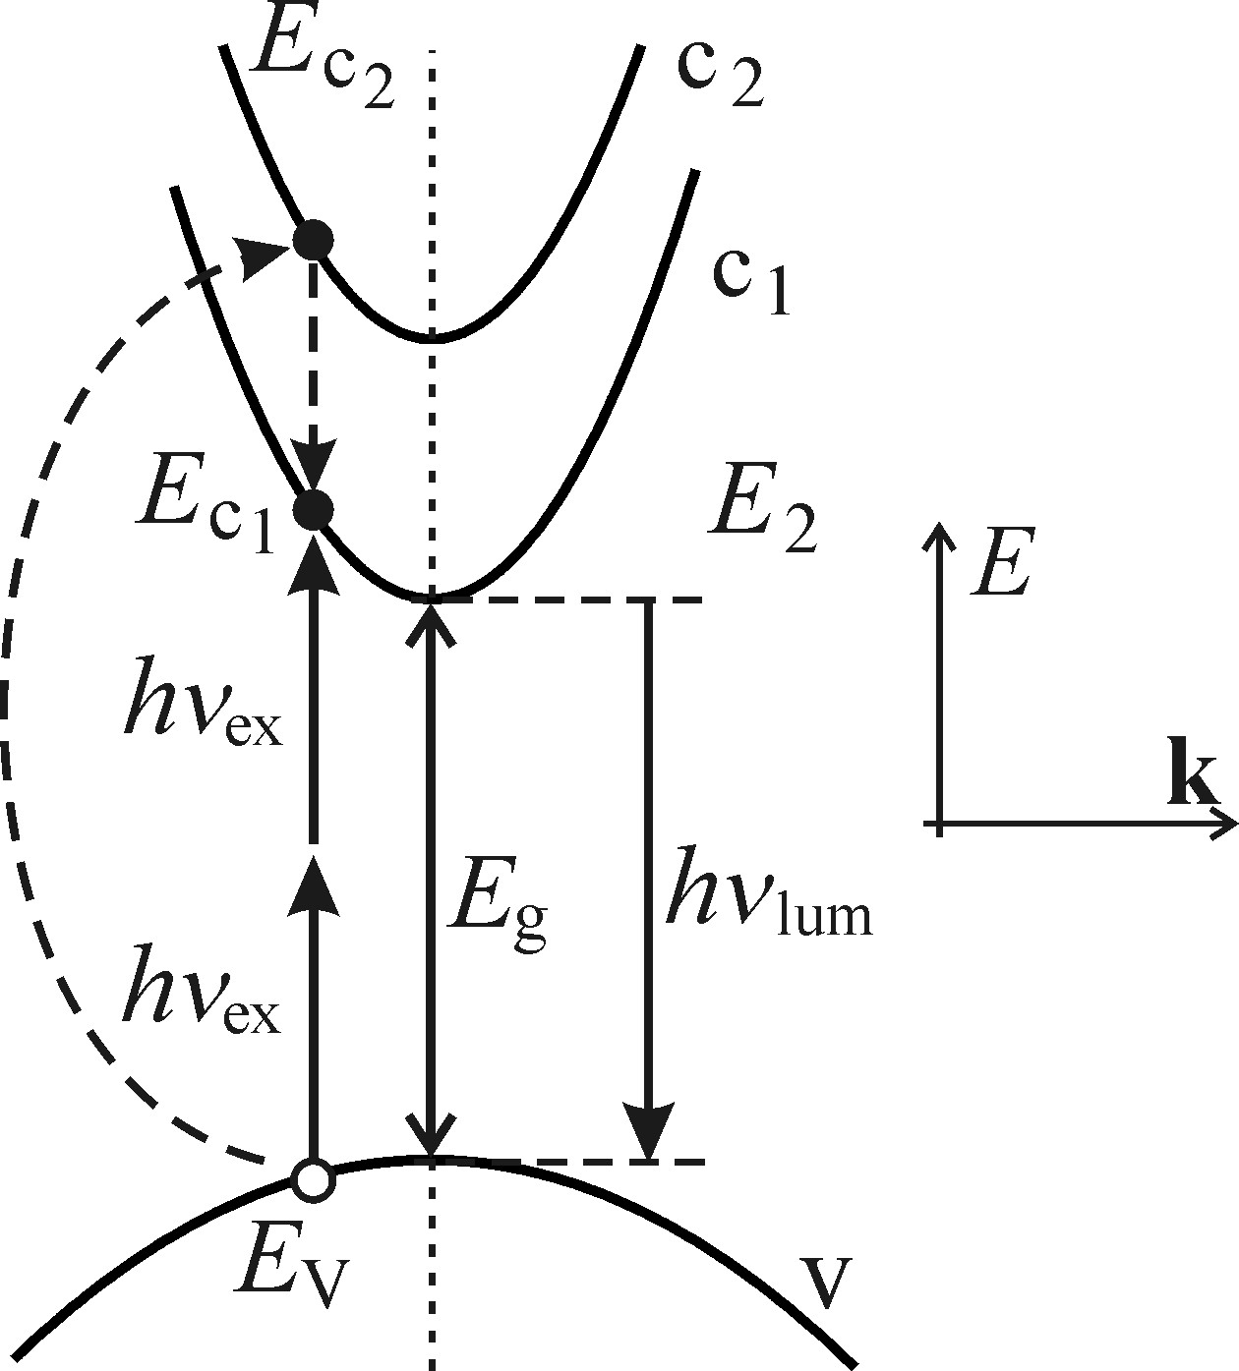

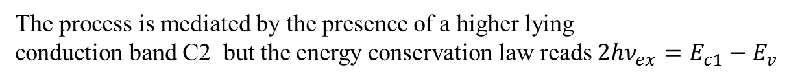


Luminescence excited by two photon absorption
One photon excitation ${hν}_{ex}>$ $E_{g}$
$$I_{{hν}_{ex}}\left(d\right)=I_{0}exp(−α({hν}_{ex})d)$$
Lambert Beer law
$$α\left({hν}_{ex}\right) is absorption coefficent, d is penetration depth$$
Two photon absorption is described in second order
Perturbation theory of quantum mechanics which
gives several order of magnitude weaker process than
conventional one photon absorption.
$$E_{g}>{hν}_{ex}≥{E_{g}}/2$$
It is nonlinear optical phenomena
The process is mediated by the presence of a higher lying
conduction band C2 but the energy conservation law reads ${2hν}_{ex}=E_{c1}−E_{v}$
Notes:
The excitation photons substantially exceeds Eg which guarantees high values of the absorption coefficient and in turn boost the luminescence intensity. Alfa is ${\text{10}}^{4}$-${\text{10}}^{5}$ cm-1 which allows the depth becomes ${\text{10}}^{−4}$-${\text{10}}^{−5}$ cm 100nm 1 micrometre which may cause problem. it can quench the luminescence or oxide layer can be source of luminescence.
Two photon absorption we will have virtual intermediate state

Slide 17
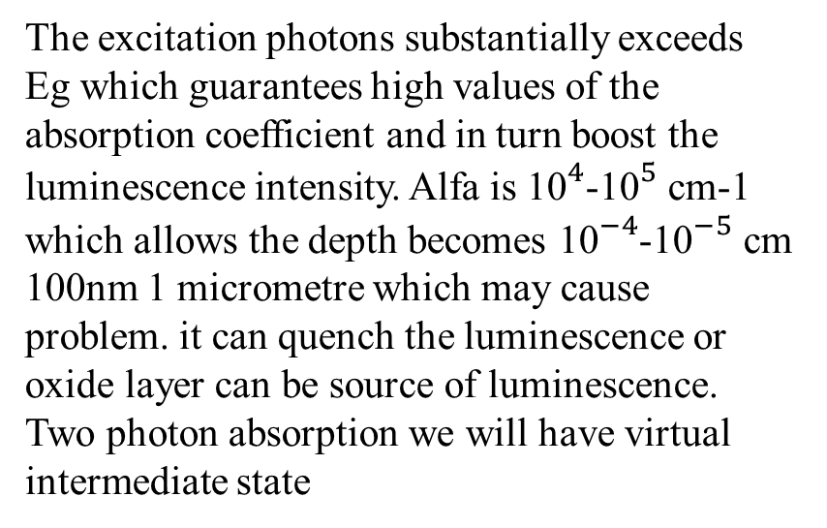
Luminescence excited by two photon absorption
The excitation photons substantially exceeds Eg which guarantees high values of the absorption coefficient and in turn boost the luminescence intensity. Alfa is ${\text{10}}^{4}$-${\text{10}}^{5}$ cm-1 which allows the depth becomes ${\text{10}}^{−4}$-${\text{10}}^{−5}$ cm 100nm 1 micrometre which may cause problem. it can quench the luminescence or oxide layer can be source of luminescence.
Two photon absorption we will have virtual intermediate state
Notes:
The excitation photons substantially exceeds Eg which guarantees high values of the absorption coefficient and in turn boost the luminescence intensity. Alfa is ${\text{10}}^{4}$-${\text{10}}^{5}$ cm-1 which allows the depth becomes ${\text{10}}^{−4}$-${\text{10}}^{−5}$ cm 100nm 1 micrometre which may cause problem. it can quench the luminescence or oxide layer can be source of luminescence.
Two photon absorption we will have virtual intermediate state

Slide 18
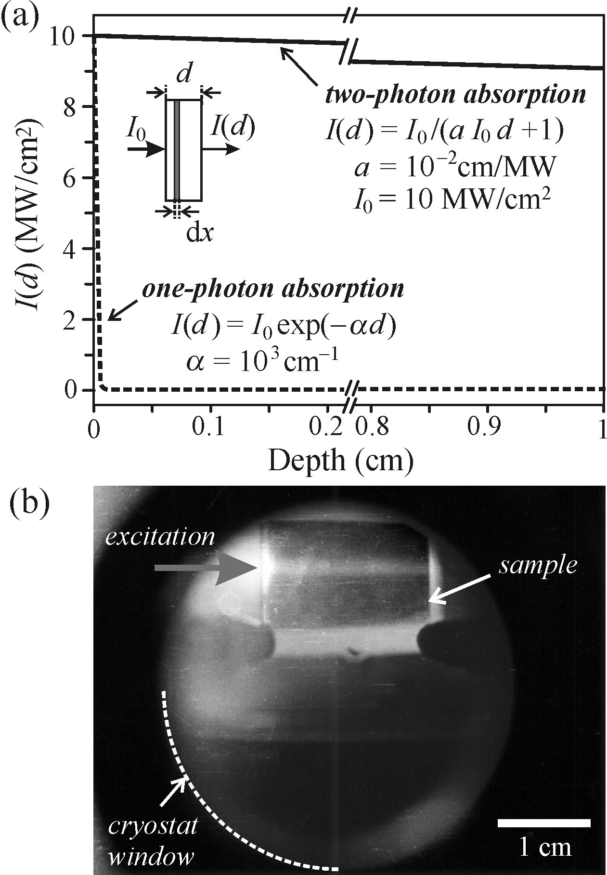
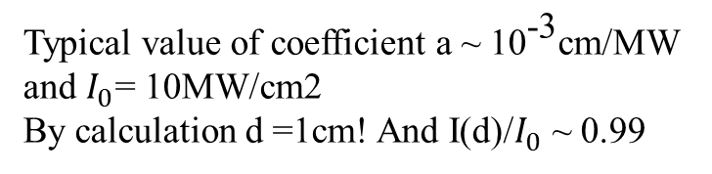
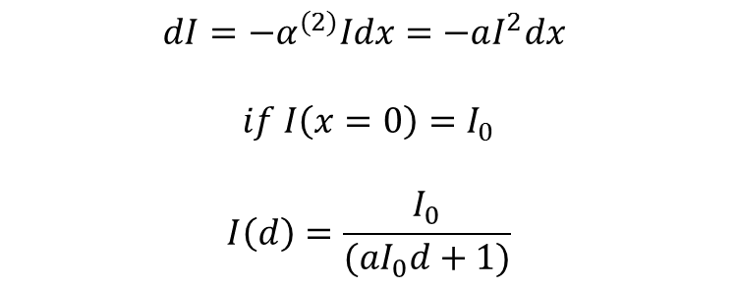
Two photon analogue of Lambert-Beer law
$$α^{(2)}\left(I\right)=aI a is material constant$$
$$dI=−α^{(2)}Idx=−aI^{2}dx$$
$$if I\left(x=0\right)=I_{0}$$
$$I\left(d\right)=\frac{I_{0}}{(aI_{0}d+1)}$$
Typical value of coefficient a ~ ${\text{10}}^{\text{−3}}$cm/MW
and $I_{0}$= 10MW/cm2
By calculation d =1cm! And I(d)/$I_{0}$ ~ 0.99

Slide 19
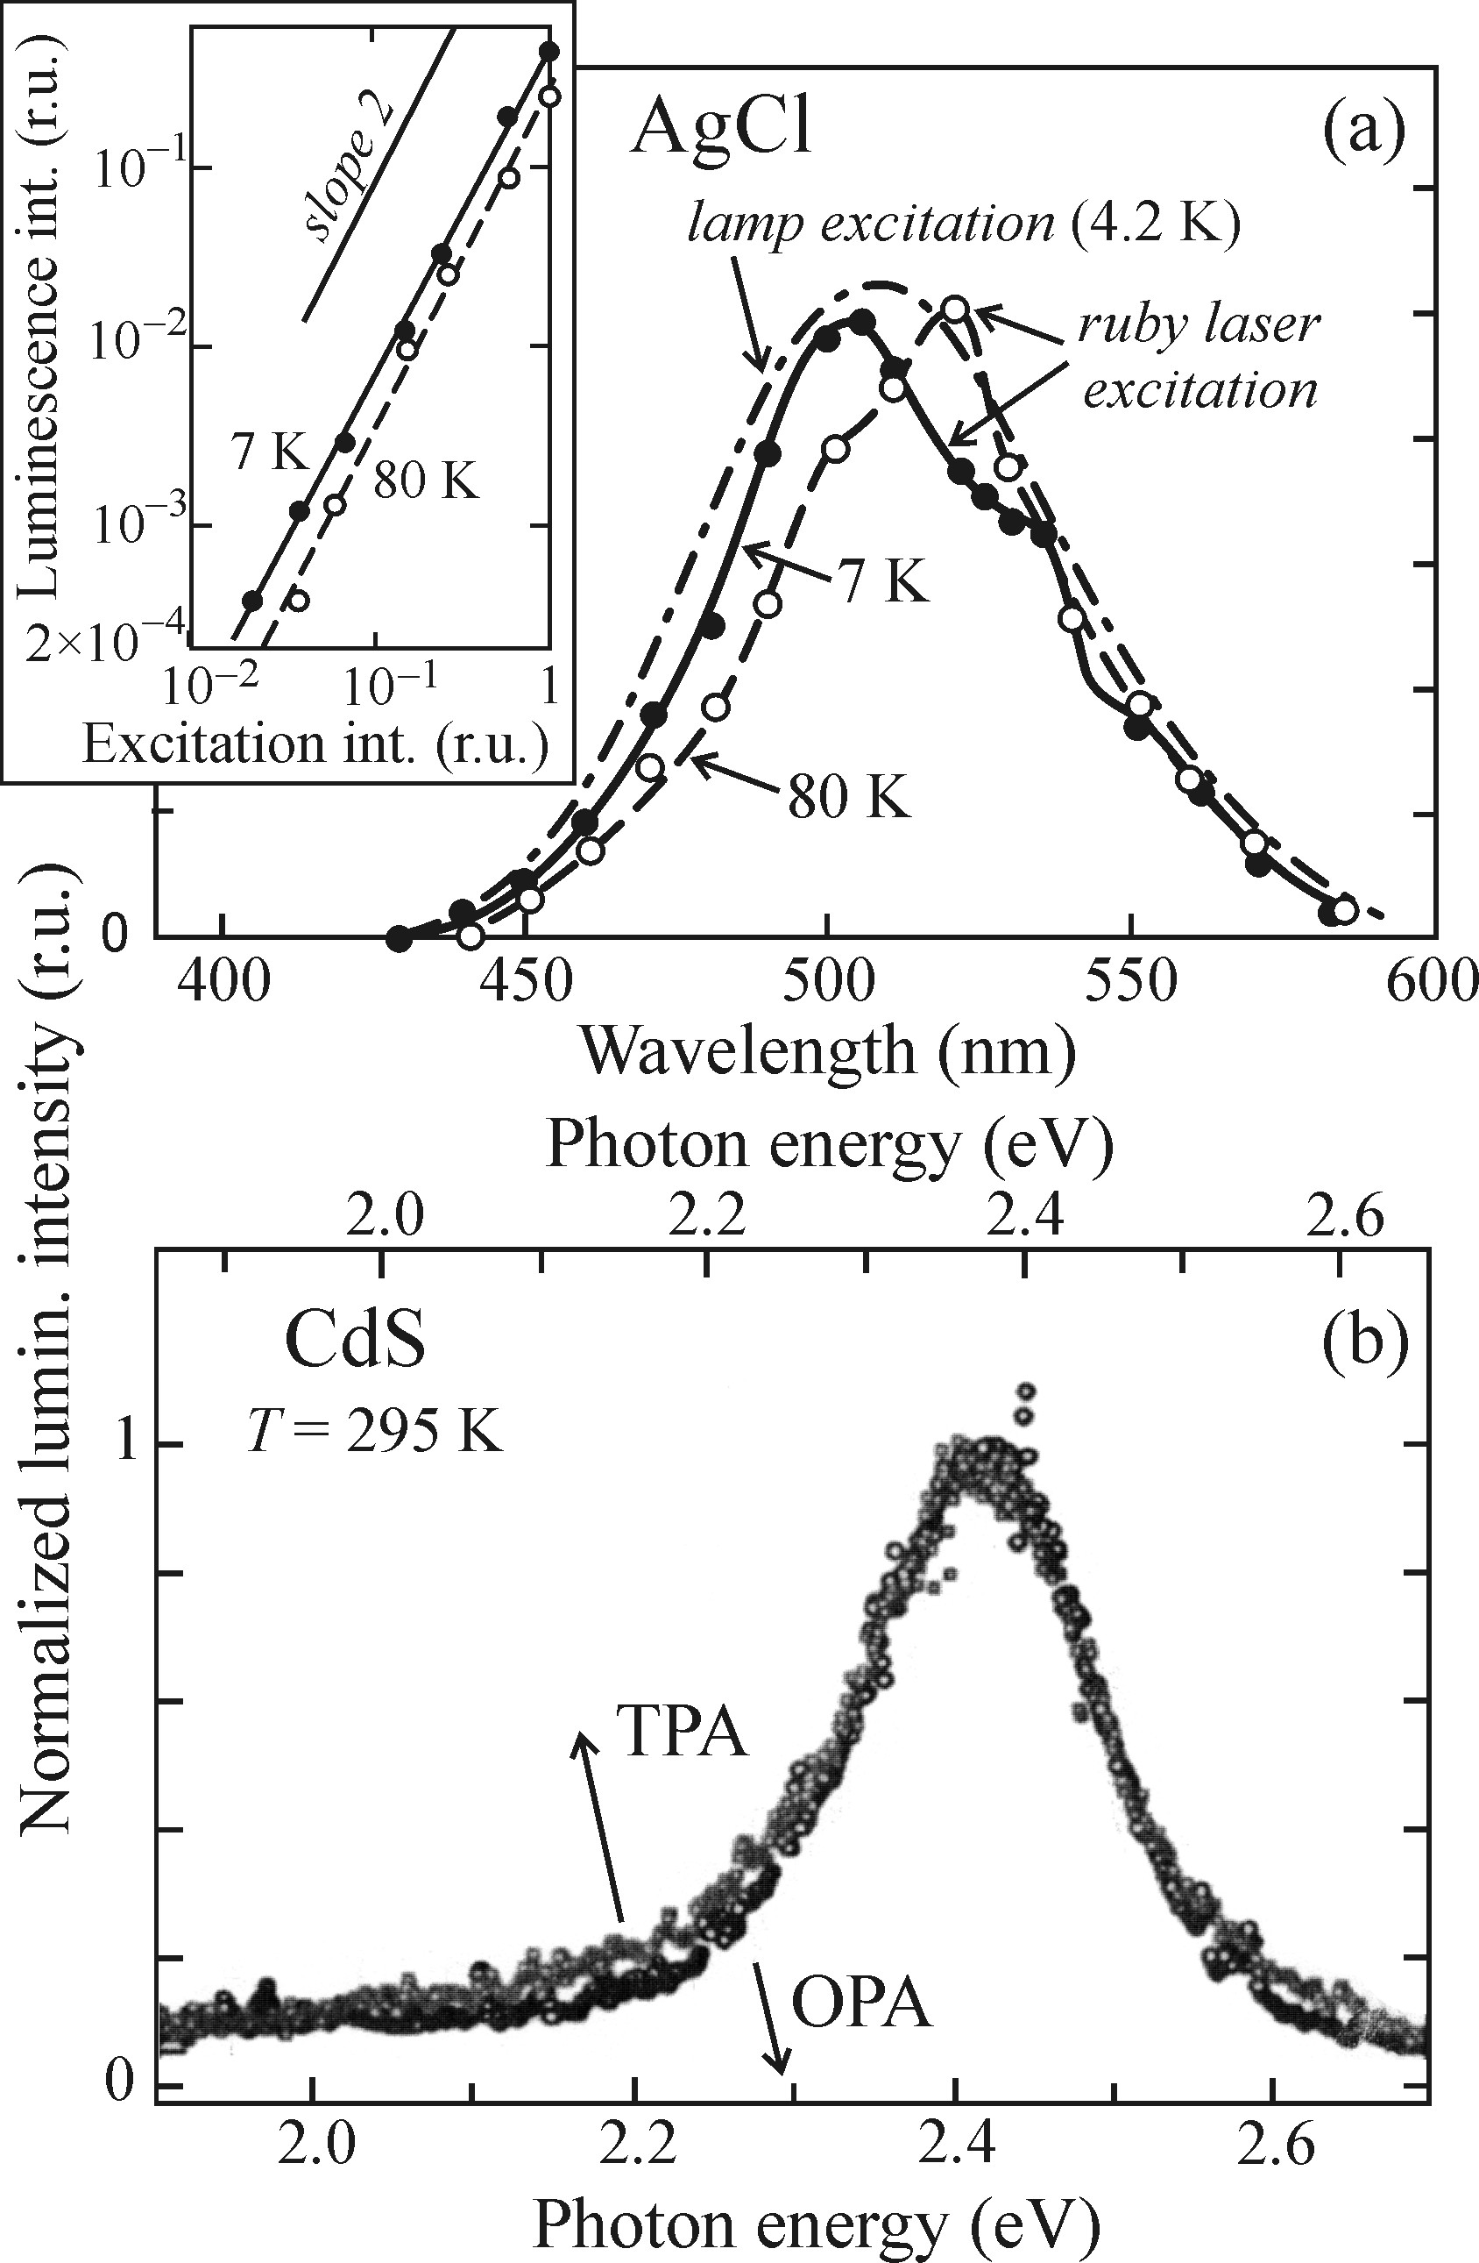
Luminescence excited by two photon absorption
Comparison of emission spectra with one and two photon
Excitation AgCl single crystal excited by One-photon absorption
with cw high pressure lamp and by two-photon absorption with
pulse ruby laser.
Thin film CdS excited at room temp and one-photon absorption
with Nd:YAG laser and two-photon absorption with 200fs laser.
The spectra shift with respect to one another because the
Penetration depth of fs laser was larger than the thickness of
the sample 1.58 𝜇m.
That is why the luminescence in this case is strongly influenced
by reabsorption and consequently shifted to lower energies.

Slide 20
Non radiative recombination
Depending on the final form of dissipated excitation energy, three basic type of non-radiative
recombination are defined:
Recombination when the excitation energy transform into heat (phonons)
Recombination leading to creation of new point defects in the lattice
Recombination transforming the excitation energy into photochemical changes
of the material under study
Notes:
Phonon and auger recombination
2. only limited case such as haliides of silve and thallium
Very rare in some large bandgap at the boarder between semi and ionic crystal

Slide 21
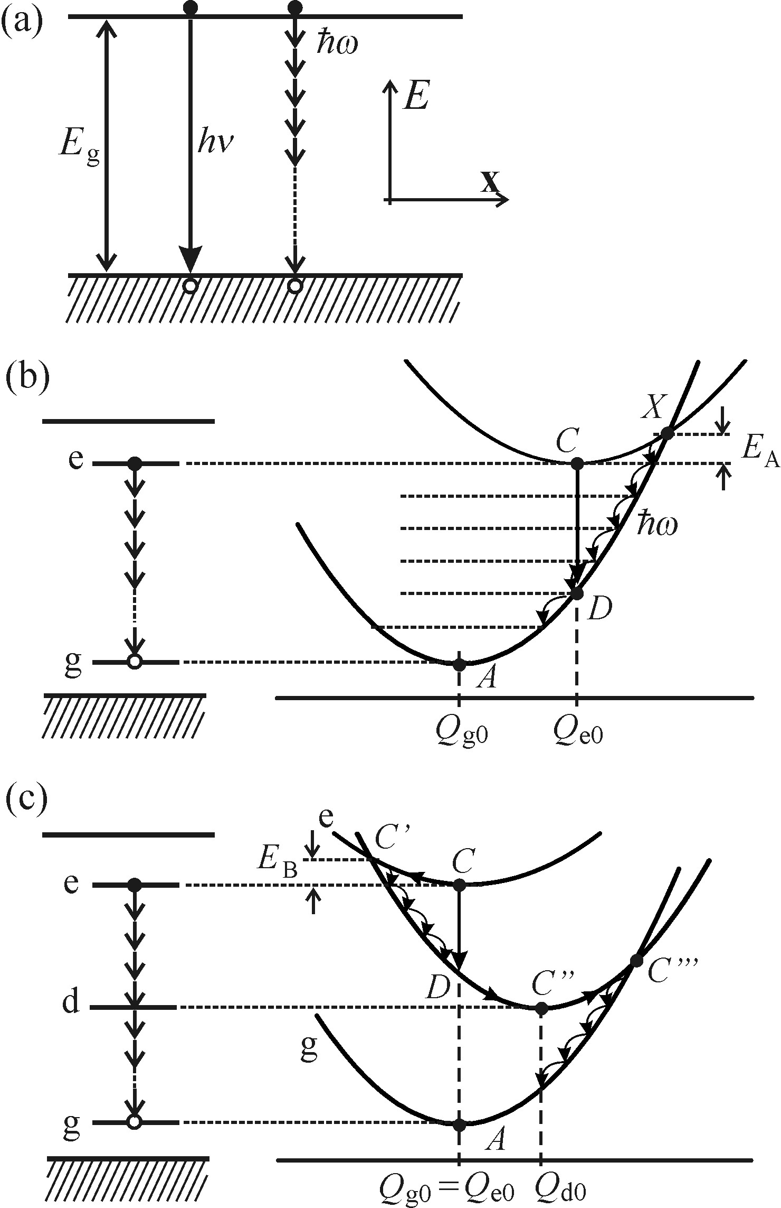
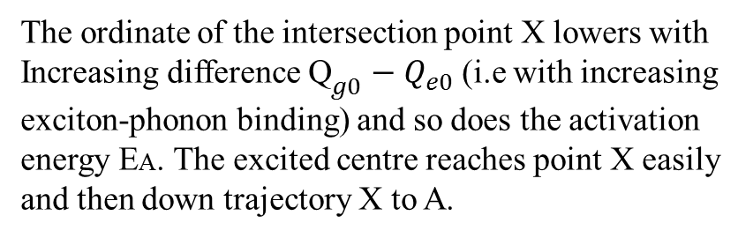
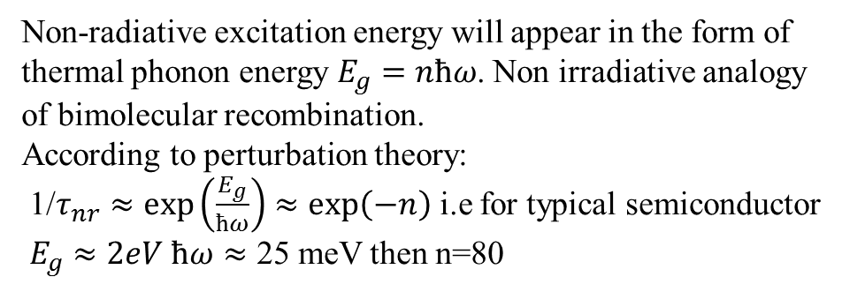
Non radiative recombination
Radiative e-h recombination excitation energy form of photons $E_{g}≅{hν}_{ex}$
Non-radiative excitation energy will appear in the form of
thermal phonon energy $E_{g}=nћω$. Non irradiative analogy
of bimolecular recombination.
According to perturbation theory:
1/$τ_{nr}$ $≈\exp\left(\frac{E_{g}}{ћω}\right)≈\exp\left(−n\right)$ i.e for typical semiconductor
$E_{g}$ $≈2eV$ $ћω≈$ 25 meV then n=80
The ordinate of the intersection point X lowers with
Increasing difference ${\text{Q}}_{g0}−Q_{e0}$ (i.e with increasing
exciton-phonon binding) and so does the activation
energy EA. The excited centre reaches point X easily
and then down trajectory X to A.
Notes:
Non irradiative analogy of bimolecular
Probability becomes high if the deep energy level occurs between bandgap
Multi phonon emission in a) would be mediated by virtual electron levels like two photon absorption and it would be a pure process of nth order perturbation theory.
In the case of localized centre , its process by sequential application of one phonon process with participation of a real intermediate level

Slide 22
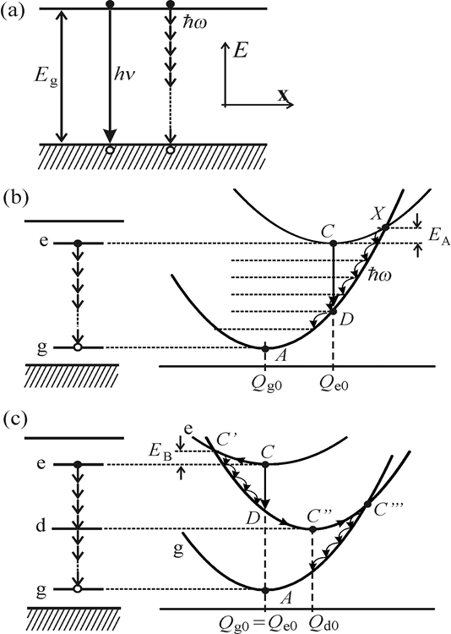
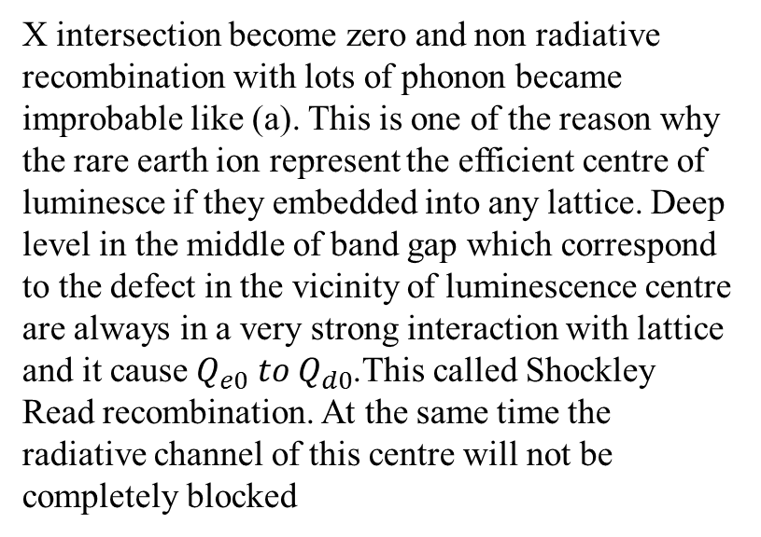

Non radiative recombination
Non radiative transition into the ground electronic
state c$→c^{′}→c^{′′}→c^{′′′}→A$inside the localized
centre that has only a weak interaction with the
lattice ($Q_{e0}≈Q_{go}$) the non radiative recombination
is mediated by a deep level d. the thermal activation
energy of the transition is denoted by $E_{b}$
X intersection become zero and non radiative recombination with lots of phonon became improbable like (a). This is one of the reason why the rare earth ion represent the efficient centre of luminesce if they embedded into any lattice. Deep level in the middle of band gap which correspond to the defect in the vicinity of luminescence centre are always in a very strong interaction with lattice and it cause $Q_{e0} to Q_{d0}$.This called Shockley Read recombination. At the same time the radiative channel of this centre will not be completely blocked
Notes:
c)X intersection become zero and non radiative recombination with lots of phonon became improbable like a). One of the reason why the rare earth ion represent the efficient centre of luminesce if they embedded into any lattice.
Deep level in the middle of band gap which correspond to the defect in the vicinity of luminescence centre always in a very strong interaction with lattice cause $Q_{e0} to Q_{d0}$. This called Shockley read recombination

Slide 23






Auger and bimolecular recombination
Non radiative Aguer recombination in semiconductor is similar
to electron spectroscopy of atoms and solid from X ray.
The kinetic energy of the third quasi particle spills very rapidly
in (picosecond) in to the crystalline or amorphous matrix by multi
phonon emission and the Ultimate form of energy is again heat.
Auger mechanism called intrinsic because their occurrence is not conditional by the presence of a defect or impurity
G is generation coef and $A_{n}$, $A_{p }$is Auger coef
$$\frac{dP}{dt}=G−\frac{P}{τ_{nr}^{A_{n}}}$$
$$\frac{dn}{dt}=G−\frac{n}{τ_{nr}^{A_{p}}}$$
$$\frac{1}{τ_{nr}^{A_{p}}}=A_{p}p^{2}$$
$$\frac{1}{τ_{nr}^{A_{n}}}=A_{n}n^{2}$$

Slide 24


Auger and bimolecular recombination
In addition to intrinsic Auger recombination, there also exist extrinsic Auger recombination which caused by impurity in the semiconductor. Non radiative process accompanying luminescence originating by (e-$A^{0}$)and (h-$D^{0}$) and therefore decreasing its efficiency

Slide 25
Thank you

