Slide 1
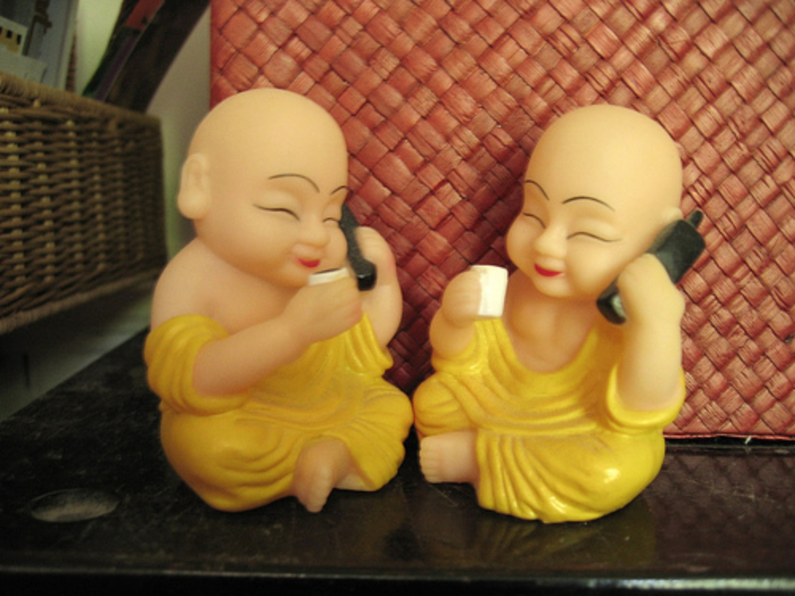
Programming of Mobile Services, Spring 2012
HI1017
Lecturer: Anders Lindström, anders.lindstrom@sth.kth.se
Lecture 4
Today’s topics
Intents
BroadcastReceivers
Introduction to Networking in Android

Slide 2
PreferencesActivity
Ta upp (saknas här): PreferencesActivity!

Slide 3
Configuration changes runtime
Unless you specify otherwise, a configuration change at runtime will cause your current activity to be destroyed
Examples:
- Change in screen orientation
- Language
- Input devices, …
(defined in android.content.res.Configuration)
If the activity had been in the foreground or visible to the user, a new instance of the activity will be created, and resource values reloaded
Save UI-state in onPause() or onSaveInstanceState
Notes:
! Screen orientation

Slide 4
Handle configuration changes in code
This surpresses the Activity to be destroyed and restarted
The application manifest:
<activity
android:label=”. . .”
android:configChanges=”orientation|keyboardHidden” />
In the activity:
@Override
public void onConfigurationChanged(Configuration newConfig) {
super. onConfigurationChanged(newConfig);
// Update any UI based on resource values, they might // have changed
if(newConfig.orientation ==
Configuration.ORIENTATION_LANDSCAPE) { . . .
Notes:
! Screen orientation

Slide 5
An Android application
The application
Activity 1
Activity 2
Service 1
SomeOtherObject
BroadcastReceiver
Notes:
Inget main. Komponenter (Act, Serv, …) instansieras när de behövs. Kan avallokeras av OS när användaren backar, finish, minnet behövs till annat
Hur dela data mellan flera komponenter, t.ex. någon form av modell?
Hur skicka meddelanden mellan de olika komponenter? Ex. starta en annan aktivitet eller lämna ett resultat till annan aktivitet
ContentProvider, göra data publikt

Slide 6
Intents – send message or start other component
Activity
Other Service
Activity
Other Activity
Intent
Intent
Notes:
Även starta komponenter i andra applikationer är ursprungliga är möjligt

Slide 7
Broadcast Intents
Some other application
Activity or Service
sendBroadcast(…)
BroadcastReceiver
BroadcastReceiver
BroadcastReceiver
Intent
Notes:
Broadcast messages system wide
Application component BroadcastReceiver registers on a specific type of message
E.g. an SMS arrived, change in network connection status, battery garge level. Multiple applications/components might have interest in such an event. These applications can “subrice” for such events.

Slide 8
Intents
An Intent (meaning aim, purpose, intention) is an asynchronous message sent between application components
Intents can be used to
Explicitly start a specific Activity or Service (together with some data)
Implicitly request that the best suited Activity or Service perform an action (together with some data)
Broadcast that something has ocurred
Notes:
Compare to communication between components in other OOP languages
2. Implicitly, the “best suited” app/activity. Could be a component in another application!!!
3. E.g. an SMS arrived, change in I-net connection status, battery garge level, multiple applications/components might have interest in such an event. These applications can “subrice” for such events.
- Data like Bundle: primitive, Parcable or Serializable (the two latter, copies, not the actual objects)

Slide 9
Explicit Intents
To start a new Activity explicitly, call
startActivity(intent)
Intent intent = new Intent(
MyCurrentActivity.this,
MyNextActivity.class);
startActivity(intent);
The new Activity is moved to the top of the Activity stack
Back button or finish() removes the Activity from the stack
By default, the application doesn’t receive any notification when the newly started Activity finishes!
Notes:
Starting a new Service is similar
To get notification: use startActivityForResult (or use a new Intent)

Slide 10
Explicit Intents
All Activities must be registered in the AndroidManifest.xml file
<application . . .>
<activity android:name=".MyMainActivity"
android:label="@string/app_name">
<intent-filter>
<action android:name="android.intent.action.MAIN" />
<category
android:name="android.intent.category.LAUNCHER" />
</intent-filter>
</activity>
<activity
android:name=".MyOtherActivity">
</activity>
</application>
Example: ExplicitIntent.zip
Notes:
Use the Android Manifest editor in Eclipse.
Notera intent-filters

Slide 11
Implicit Intents
Intent to perform a task, without specifying an Activity, Service or such
State the action to perform and, optionally,
the data to act upon – a URI
The Android OS finds the appropriate Activity!
Native actions: ACTION_DIAL, ACTION_EDIT, ACTION_PICK, ACTION_VIEW, ACTION_WEB_SEARCH, . . . .
URI’s:
“tel:+4687904813”
“content://contacts/people”,
“http://google.com”,
. . .
Notes:
!!!! ACTION_VIEW: Common; asks that the data be displayed in the most reasonable manner. http -> browser, tel -> dialer, geo -> Google maps, …

Slide 12
Implicit Intents
Start a new Activity implicitly
Intent intent = new Intent(
Intent.ACTION_VIEW,
Uri.parse("content://contacts/people/"));
startActivity(intent);
if(emergency && !helpInSight) {
Intent intent = new Intent(
Intent.ACTION_DIAL,
Uri.parse("tel:112"));
startActivity(intent);
}
Need not be a native Activity, third party apps can be registered to support actions (native or new ones)
Notes:
ACTION_VIEW, ACTION_EDIT are context sensitive – contact, internet resource, map, …
We use functionality from other applications!

Slide 13
Returning results, Sub-Activities
Sub-Activity
E.g. an (sub) Activity for user input (a form)
Started with startActivityForResult
Triggers an event in the parent Activity on finish
May return result to the parent Activity
Returned from the Sub-Activity: Intent with data, request code, result code
Notes:
Request code: Defined by developer to define request (e.g. to differentiate between multiple sub-activities).
Data: Primitive, Serializable or Paracable (for fast IPC, Inter-process communication)

Slide 14
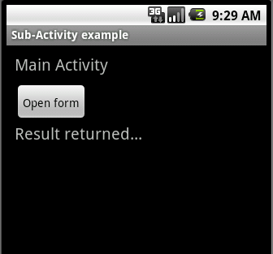
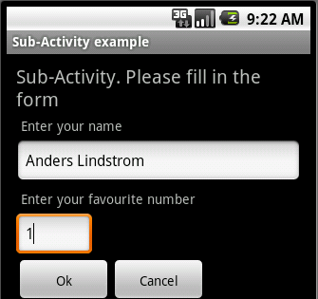
Returning results, Sub-Activities
1)
startActivityForResult(
intent,
requestCode);
3) Call back:
onActivityResult(
int requestCode, int resultCode, Intent result)
{ . . .
2)
setResult(
resultCode,
result);
finish();
Notes:
Result code: Activity.RESULT_OK, RESULT_CANCELED
DEMO:
- Return from Subactivity twice. Where did the information in Subactivity go?
NB: finish() and back button pops the Activity object from the stack

Slide 15
Returning results, Sub-Activities
Starting a sub activity from parent Activity:
private static final int SHOW_FORM = 0; // Request code(s)
. . .
private class OnStartSubListener implements View.OnClickListener {
public void onClick(View v) {
Intent intent = new
Intent(MainActivity.this,
SubActivity.class);
startActivityForResult(intent, SHOW_FORM);
}
}

Slide 16
Returning results, Sub-Activities
Call-back implementation in parent Activity:
public void onActivityResult(int requestCode,
int resultCode, Intent result) {
super.onActivityResult(requestCode, resultCode, result);
if(resultCode == Activity.RESULT_OK) {
switch(requestCode) {
  case SHOW_FORM:
  String name = result.getStringExtra(NAME);
  int number = result.getIntExtra(FAVOURITE_NUMBER, 42);
  // Process result and update view . . .
  break;
  case SHOW_SOMETHING_ELSE:
  // ...
  break;
}
. . .

Slide 17
Returning results, Sub-Activities
Returning result from Sub-Activity:
private class OnOkClickListener implements View.OnClickListener {
public void onClick(View v) {
String name = editName.getText().toString();
int number =
Integer.parseInt(editNumber.getText().toString());
Intent result = new Intent();
result.putExtra(MainActivity.NAME, name);
result.putExtra(MainActivity.FAVOURITE_NUMBER, number);
setResult(Activity.RESULT_OK, result);
finish();
}
}
}
Example code: SubActivity.zip
Notes:
Parsing should happen inside try with catch.

Slide 18
Intent filters
To inform the system which implicit intents they can handle, activities, services, and broadcast receivers can have one or more intent filters
Each filter describes a set of implicit intents that the component is willing to receive
An implicit intent is delivered to a component only if it can pass through one of the component's filters
An explicit intent is always delivered to its target, no matter what it contains; the filter is not consulted
Notes:
It, in effect, filters in intents of a desired type, while filtering out unwanted intents — but only unwanted implicit intents (those that don't name a target class).
4th bullet – NB!

Slide 19
Intent filters
AndroidManifest.xml file with intent-filter
<application . . .>
<activity android:name=".MyMainActivity"
android:label="@string/app_name">
<intent-filter>
<action android:name="android.intent.action.MAIN" />
<category
android:name="android.intent.category.LAUNCHER" />
</intent-filter>
</activity>
<activity
android:name=".MyOtherActivity">
</activity>
</application>
Notes:
Action: A string naming the action to be performed — or, in the case of broadcast intents, the action that took place and is being reported
ACTION_MAIN activity: Start up as the initial activity of a task, with no data input and no returned output.
Category: A string containing additional information about the kind of component that should handle the intent.
CATEGORY_LAUNCHER The activity can be the initial activity of a task and is listed in the top-level application launcher.
- Use the Android Manifest editor in Eclipse.

Slide 20
Broadcasting Intents
Broadcast messages between components with the sendBroadcast(…) method
This makes it possible to broadcast system wide
public static final String SOME_CUSTOM_EVENT = ”se.kth.anderslm.SOME_CUSTOM_EVENT”;
Intent intent = new Intent(
SOME_CUSTOM_EVENT);
intent.putExtra(...);
context.sendBroadcast(intent);
Notes:
Broadcast messages system wide. The EVENT must be systemwide detectable
Application component BroadcastReceiver registers on a specific type of message
E.g. an SMS arrived, change in network connection status, battery garge level. Multiple applications/components might have interest in such an event. These applications can “subrice” for such events.

Slide 21
Broadcasting Intents
Native Android broadcast events, examples
ACTION_TAME/DATE_CHANGED
ACTION_MEDIA_BUTTON
ACTION_CAMERA_BUTTON
ACTION_NEW_OUTGOING_CALL
ACTION_SCREEN_ON/OFF
ACTION_TIMEZONE_CHANGED
ACTION_PACKAGE_ADDED . . .
ACTION_MEDIA_EJECT
ACTION_MEDIA_MOUNTED/UNMOUNTED
ACTION_BATTERY_CHANGED
ACTION_POWER_CONNECTED/DISCONNECTED
ACTION_BOOT_COMPLETED
ACTION_SHUTDOWN
Notes:
Broadcast messages system wide
Application component BroadcastReceiver registers on a specific type of message
E.g. an SMS arrived, change in network connection status, battery garge level. Multiple applications/components might have interest in such an event. These applications can “subrice” for such events.

Slide 22
BroadcastReceivers
A BroadcastReceiver listens to broadcasted Intents
public class CameraButtonReceiver
extends BroadcastReceiver {
@Override
public void onReceive(
Context context, Intent intent) {
// To do...
}
}
Must be registered in the application manifest (or in code)
Intent Filters are used to specify which Intents the BroadcastReceiver is listening for
Notes:
Broadcast messages system wide
Application component BroadcastReceiver registers on a specific type of message
E.g. an SMS arrived, change in network connection status, battery charge level. Multiple applications/components might have interest in such an event. These applications can “subscribe” for such events.
Context = Activity eller Service (superklass). Här: ”the caller”

Slide 23
BroadcastReceivers
Register the BroadcastReceiver in the application manifest or in the source code
<receiver android:name=”.CameraButtonReceiver”>
<intent-filter>
<action android:name=
”android.intent.action.CAMERA_BUTTON”/>
</intent-filter>
</receiver>
Reciviers registered in the manifest file are always active, whether or not the application is running at the moment
Notes:
- Context = Activity eller Service (superklass). Här: ”the caller”

Slide 24
BroadcastReceivers
Registring a BroadcastReceiver in the source code
IntentFilter filter = new IntentFilter (
“se.kth.anderslm.CameraButtonReceiver”);
CameraButtonReceiver receiver = new CameraButtonReceiver();
registerReceiver(receiver, filter);
Reciviers registered in the source code are active only when the corresponding application is running, or until unregistered
unRegisterReceiver(receiver);
Useful e.g. when using it for updating the UI (unregister when the activity isn’t visible or active - in onPause)
Notes:
- Context = Activity eller Service (superklass). Här: ”the caller”

Slide 25
The Application class
The Application class may be sub-classed to
- Maintain application state
- Transfer/share objects between application components
- Manage and maintain resources used by multiple application components
Register a custom Application class in the manifest file
<application
android:icon="@drawable/ic_launcher”
android:name=”CustomApplication” >
<activity
...
</application>
Objects might also be shared between application components using the Singleton Design Pattern
Notes:
Hur komma åt data/objekt globalt i applikationen? (se första bilden igen)
Skapas då applikationen startas. Ett objekt.
Data som ska delas i appl skapas i on create
Metoder:
onCreate, onConfiguration changed (handle config changes att app)
The Application object is not killed on configuration changes (unlike Activities)
Dela data mellan olika komponenter i en applikation
Application class
Definiera Singletons
Använd inte Intents – datat som skickas är kopior (Parcable, Serializable)

Slide 26
The Application class
Implement the Application sub-class in a way similar to the Singleton design pattern
public class CustomApplication extends Application {
public static final CustomApplication singleton;
private SomeSortOfSharedData data;
public static CustomApplication getInstance() {
return singleton;
}
public final void onCreate() {
super.onCreate();
singleton = this;
// Create other, shared objects
data = new …;
}
public SomeSortOfSharedData getData() { …
public void setData(…) { …
}
Notes:
Skapas då applikationen startas. Ett objekt.
Data som ska delas i appl skapas i on create
Dela data mellan olika komponenter i en applikation
Application class
Definiera Singletons
Använd inte Intents – datat som skickas är kopior (Parcable, Serializable)

Slide 27
Android Networking
Packages
java.net: URL, URLConnection, HttpURLConnection, Socket, DatagramSocket…
java.io: InputStream, OutputStream (and wrapper/filter streams), IOException, …
java.nio – unblocking IO, channels
android.bluetooth: BluetoothSocket, BluetoothServerSocket, ...
Notes:
If you just intend to let the user google or such: use an implicit intent to open a browser window.
Serialization: Probably not a good idea Server(Java SE) <-> Client cell(Andriod java)
Third party XML-serilization libraries?

Slide 28
Android Networking
Add uses permission to the Android Manifest file, at least android.permission.INTERNET
<manifest . . .>
<application . . .>
. . .
</application>
<uses-permission
android:name="android.permission.INTERNET">
</uses-permission>
</manifest>
Notes:
Don’t forget this!!!

Slide 29
URLConnection
A connection to a URL for reading or writing
BufferedInputStream in = null;
try {
URL url = new URL("ftp://mirror.csclub.uwaterloo.ca/index.html");
URLConnection urlConnection = url.openConnection();
in = new BufferedInputStream(urlConnection.getInputStream());
readStream(in);
}
finally {
in.close();
}
Notes:
I many cases we can do without sockets, at a higher level of abstraction.

Slide 30
HttpURLConnection
Used to send and receive data over the web. Data may be of any type and length (here: downloading an image from the net, Networking1.zip)
HttpURLConnection http = null;
InputStream istream = null;
try {
URL text = new URL(urlStr);
http = (HttpURLConnection) text.openConnection();
istream = http.getInputStream();
Bitmap bmImg = BitmapFactory.decodeStream(istream);
imageView.setImageBitmap(bmImg);
}
finally {
if(istream != null) istream.close();
if(http != null) http.disconnect();
}
Notes:
In this case reading an image from an URL.
Consider download time and UI-response. Android: non-responsive for 5 seconds and Activity will be stopped.

Slide 31
HttpURLConnection
Reading from a HttpURLConnection, saving to file (Networking2.zip)
try {
URL text = new URL(urlStr);
http = (HttpURLConnection) text.openConnection();
istream = http.getInputStream();
byte[] buffer = new byte[1024];
fos = this.openFileOutput (fileName, Activity.MODE_PRIVATE);
int readSize = 0;
while (readSize != -1) {
readSize = istream.read(buffer);
if (readSize > 0) {
fos.write(buffer, 0, readSize);
}
}

Slide 32
XML
Extensible Markup Language (XML) is a set of rules for encoding documents in machine-readable form
Meta-data
Widely used for the representation of arbitrary data structures, for example in web services
An element can contain:
- other elements
- text
- attributes
(or a mix of all of the above...)

Slide 33
XML
<bookstore>
<book category="WEB">
<title>Learning XML</title>
<author>Erik T. Ray</author>
<year>2003</year>
<price>39.95</price>
</book>
<book>
. . .
</book>
</bookstore>

Slide 34
Parsing XML
Slogan: ”Don’t Superize Me”
Model parser – Reads the entire document and stores it as a tree-structure
Android: DocumentBuilder
Push parser - Set up callbacks, the SAX component pushes document events to you
Android: org.xml.sax
Pull parser – Pull data from the document using the pull parser component
Android: XMLPullParser
Pull/Push reads only the parts of the document needed
Notes:
Also: Read + store locally vs always update
Pull easier to use?

Slide 35
Parsing XML (pull parser)
XmlPullParser parser = XmlPullParserFactory.newInstance().newPullParser()
parser.setInput(inputStream, encoding);
int parseEvent = parser.next()
Event codes:
XmlPullParser.START_DOCUMENT, END_DOCUMENT, START_TAG, END_TAG, TEXT, …
Getting attributes:
int n = parser.getAttributeCount();
String attributeName = parser.getAttributeName(i);
String value = parser.getAttributeValue(i);

Slide 36
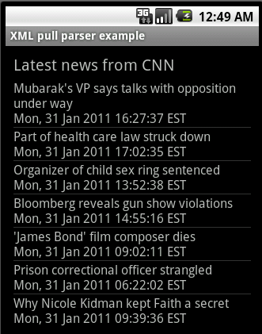
Parsing XML, example
RSS (Really Simple Syndication or Rich Site Summary) is an XML-based format for sharing and distributing Web content, such as news headlines
Example: CNN news RSS,
http://rss.cnn.com/rss/cnn_topstories.rss

Slide 37
Parsing XML, example
<?xml version="1.0" encoding="ISO-8859-1" ?>
<rss version="2.0">
<channel>
  <title>CNN.com</title>
  <link>http://edition.cnn.com/?eref=edition</link>
  <description>CNN.com delivers up-to-the-minute news.</description>
  <item>
  <title> Mubarak's VP says talks with opposition under way</title>
  <link> http://rss.cnn.com/~r/rss/cnn_topstories/~3/xXT6mhyGJWI/index.html</link>
  <description> Talks between opposition parties and Egyptian Vice. . .</description>
  <pubDate> Mon, 31 Jan 2011 16:27:37 EST</pubDate>
  </item>
  <item>
  <title>Why Nicole Kidman kept Faith a secret</title>
  <link>. . .
  </item>
  </channel>
</rss>
Notes:
An RSS news feed from CNN. We are just getting one xml/rss file
RSS (Really Simple Syndication or Rich Site Summary)

Slide 38
Parsing XML
private void updateNews() throws Exception {
HttpURLConnection http = null;
InputStream xmlStream = null;
try {
URL url = new URL(cnnUrl);
http = (HttpURLConnection) url.openConnection();
RSSParser parser = new RSSParser();
parser.parse(http.getInputStream(), newsItems);
adapter.notifyDataSetChanged();
}
finally {
if(xmlStream != null) xmlStream.close();
if(http != null) http.disconnect();
}
}
Notes:
In activity, update list (-view)
Might take some time – separate thread! (Android 5 seconds response)

Slide 39
Parsing XML, the parser class
XmlPullParser parser = XmlPullParserFactory.newInstance().newPullParser();
parser.setInput(inputStream, encoding);
int parseEvent = parser.getEventType();
while(parseEvent != XmlPullParser.END_DOCUMENT) {
switch(parseEvent) {
case XmlPullParser.START_DOCUMENT: . . .
case XmlPullParser.START_TAG:
String tagName = parser.getName();
if(tagName.equalsIgnoreCase(ITEM)) {
parseItem();
}
break;
case XmlPullParser.END_TAG: . . .
}
parseEvent = parser.next();
}
Notes:
XMLExceptions, IOExceptions
Separate class!!

Slide 40
Parsing XML, the parser class
private void parseItem() throws IOException, XmlPullParserException {
int parseEvent;
String name, item = "";
// Continue until end of </item>
do {
parseEvent = parser.next();
name = parser.getName();
if(parseEvent == XmlPullParser.START_TAG) {
if(name.equalsIgnoreCase(TITLE)) {
item += parser.nextText() + "\n";
}
else if(name.equalsIgnoreCase(PUBDATE)) {
item += parser.nextText();
}
}
} while(parseEvent != XmlPullParser.END_TAG || !name.equals(ITEM));
itemList.add(item);
}

Slide 41
Parsing XML
Example with push parser, SAX, in Meier chapter 5: Creating an Earthquake viewer
Notes:
Reasons: Fresh updates of data, data storage outside the device, communication e.g. social networking, gaming, …

