Slide 1
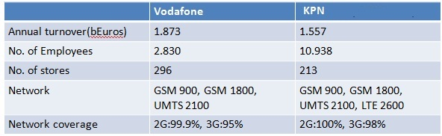
Business Strategy in Netherlands
Both offer fixed and mobile telephony, internet, TV, special
services to business customers.
Both concerned on retaining the customer.
Vodafone wants to grow in the business sector: specialized services
( Machine to Machine, VastOpMobiel ) and iPhone subscriptions.
Vodafone and KPN share mobile site towers (lower network costs, better coverage)

Slide 2
Pricing: Vodafone:65 min/SMS, 0.23 € Call/SMS - 5 €/m (11.25€)
KPN: 100 min/SMS, 0.25 € for Call/SMS - 6 € per month ( 0 €)
Improving the network:
Vodafone: improves network, prepares for 4G network.
KPN: improves the capacity by increasing the number of UMTS masts, expands optical fiber network (bought optical fiber co.), deploy LTE network.
Strategy:
Vodafone wants to become no. 1 in fixed telephony and mobile communications services-> bought fiber and communication service provider. Increased revenues by growth of mobile subscribers, smart phones and mobile data usage .
KPN needs capital for buying spectrum, upgrading the network-> sells mobile towers, cut dividend from €0.90 to €0.35 per share.

