Slide 1

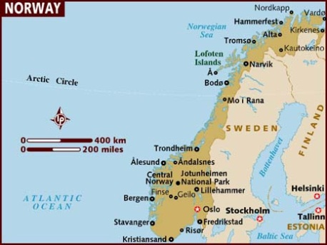
A comparison between
Telenor & NetCom two Norwegian MNOs with SMP
Amirhossein Ghanbari
15 November 2012
amigha@kth.se

Slide 2
Intro & Background
  First communication operator back in 1855 ,Telegrafverket
  21 active MNOs
  My focus: Mobile Network Operation segment
Market Leaders
  Telenor
  Incumbent with 3.2 million subs – always the leader in all segments
  NetCom (TeliaSonera)
  Established in 1989
  Broke the monopoly
  95% ownership by Telia in 2000
Business Strategies
    Leader vs. laggard
    Rules of the game
  Network Development and Sharing strategies
  Telenor: Maintain existing infrastructure (till 2010)*
  NetCom: Stay up to date
  *in 2010 Telenor replaced everything

Slide 3
  Spectrum Acquisition Strategies
    Telenor: Benefit existing spectrum* *till 2011 and 4G
    NetCom: Modernize through Spec. Acq.
  Services offered
    Telenor: Both MT & MBB (58.4% share) and MBB going up
    NetCom: Both MT & MBB, but not successful in MBB
  Target customers segments and marketing
    Telenor: Residential & enterprise focusing on Youngsters
    NetCom: Residential & enterprise family plans
  Pricing and customer management
    Telenor: forced to lower prices focus on CR
    NetCom: Lowering prices focus on CA
Final words
    Telecom Industry is complicated in comparison with other markets
    Not easy to defeat incumbent if they know how to change

