Slide 1
Luminescence of excitons
By: Yashar Hormozan
Chapters 7 of ”Luminescence Spectroscopy of Semiconductors”
by Ivan Plant & Jan Valenta

Slide 2
Basic types of excitons
Frenkel exciton or a small-radius exciton
  Highly localized at an atom or molecule
  Move only by a hopping mechanism
  Molecular crystals
Charge Transfer exciton
  In Ionic crystals
  Due to transfer of an electron from a lattice anion to the closest cation, creating a maximum of electron charge density
Wannier Exciton or large-radius exciton
  Electron and holes separated over many lattice constants
  Strongly delocalized wave function and free to move
  Transfer energy but not charge!

Slide 3
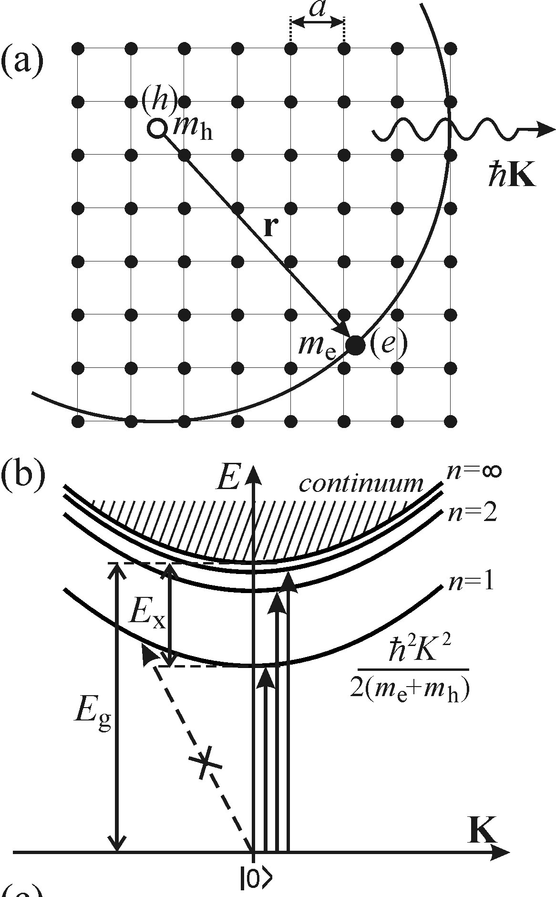
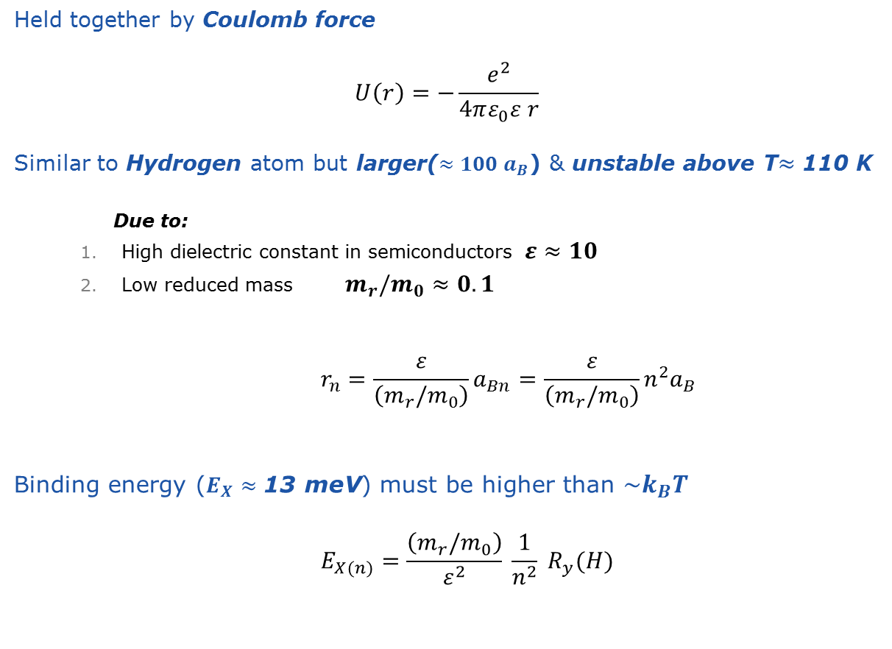
Wannier exciton
Held together by Coulomb force
          $$U\left(r\right)=−\frac{e^{2}}{4πε_{0}ε r}$$
Similar to Hydrogen atom but larger($≈100 a_{B}$) & unstable above T$≈$ 110 K
      Due to:
    High dielectric constant in semiconductors $ε≈10$
    Low reduced mass $m_{r}/m_{0}≈0.1$
          $$r_{n}=\frac{ε}{\left(m_{r}/m_{0}\right)}a_{Bn}=\frac{ε}{\left(m_{r}/m_{0}\right)}n^{2}a_{B}$$
Binding energy ($E_{X}≈\text{13 }\text{meV}$) must be higher than $\sim k_{B}T$
          $$E_{X(n)}=\frac{\left(m_{r}/m_{0}\right)}{ε^{2}} \frac{1}{n^{2}} R_{y}(H)$$

Slide 4
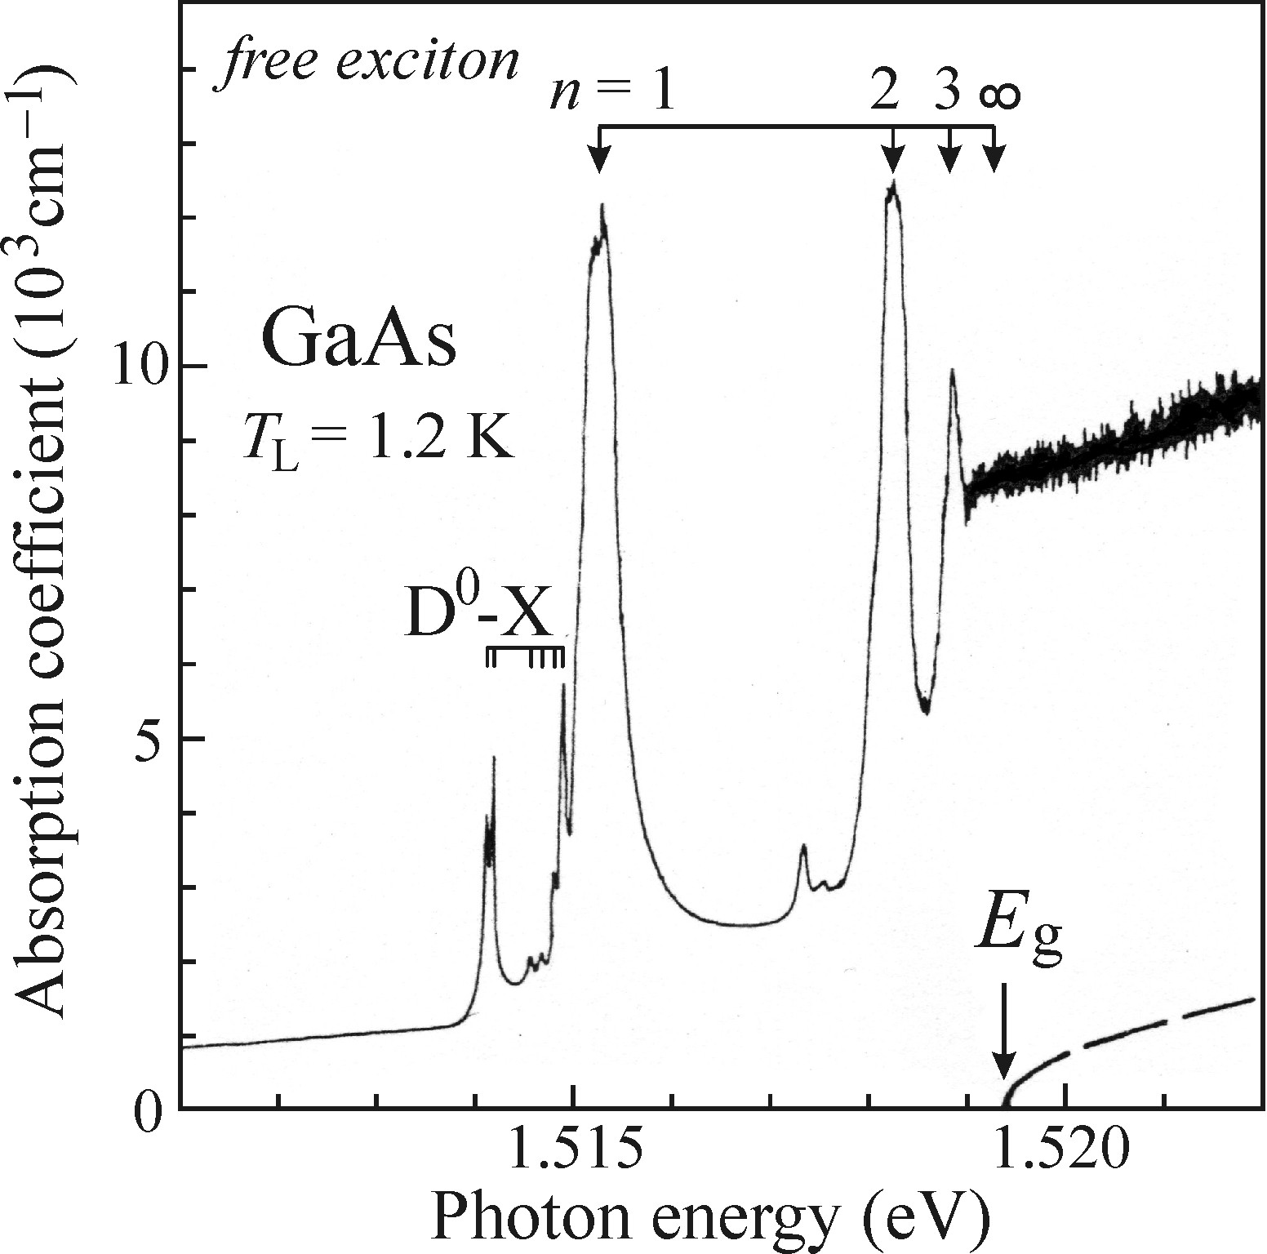
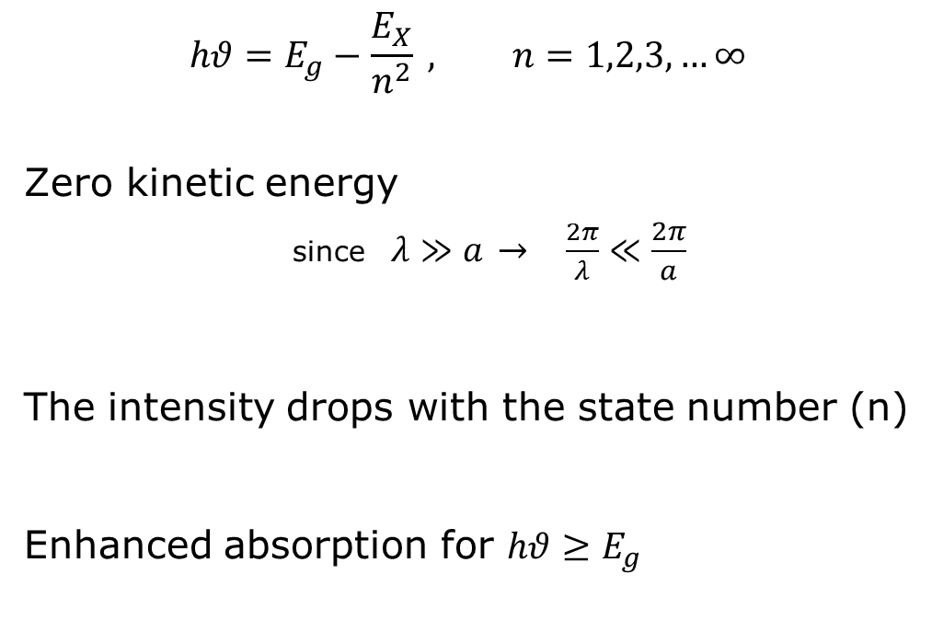
Absorption spectrum of Wannier exciton (Direct BG)
$$hθ=E_{g}−\frac{E_{X}}{n^{2}} , n=1,2,3,…∞$$
Zero kinetic energy
  since $λ≫a$ $→$ $\frac{2π}{λ}≪\frac{2π}{a}$
The intensity drops with the state number (n)
Enhanced absorption for $hθ≥E_{g}$

Slide 5
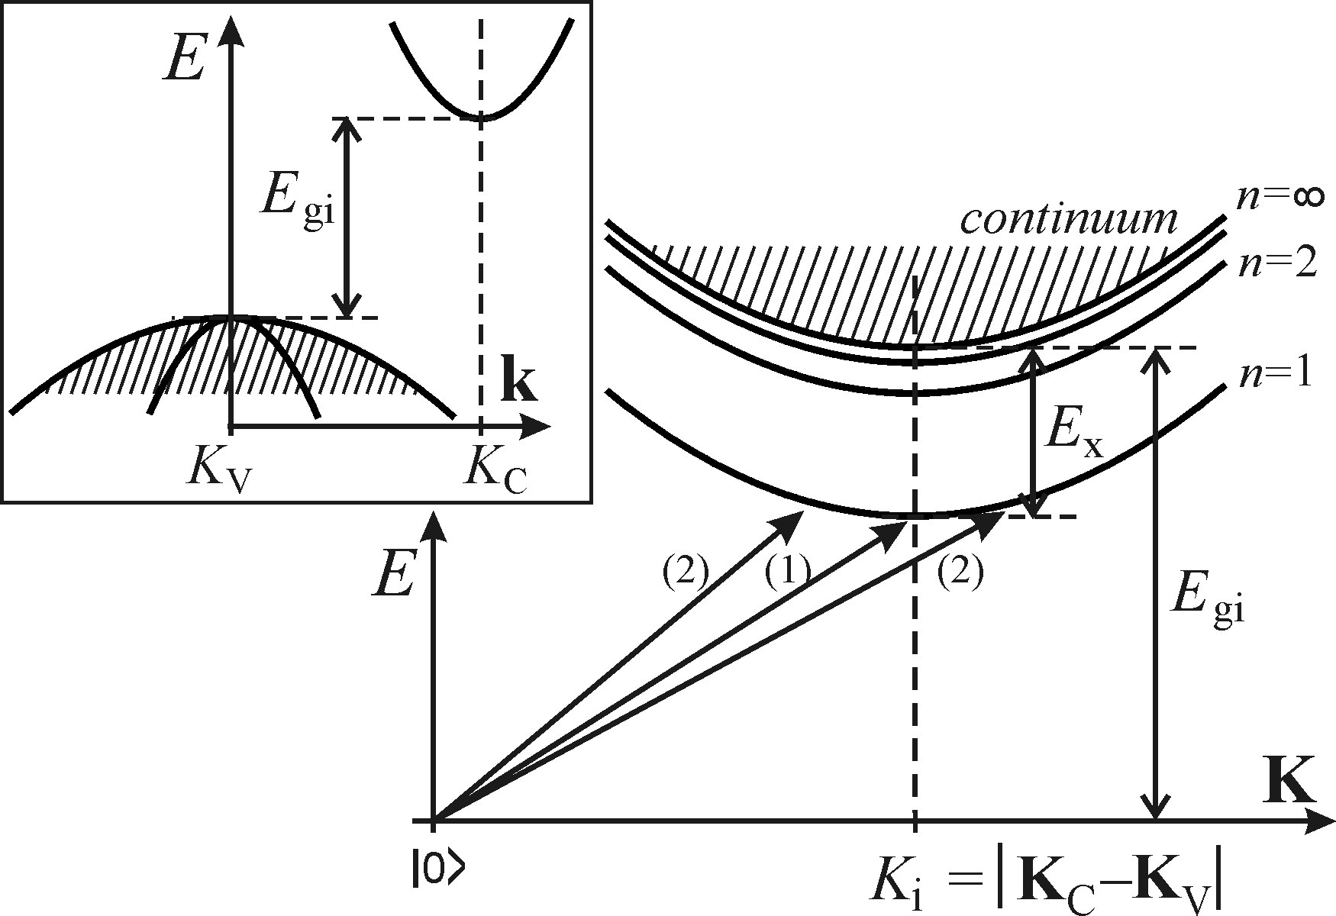
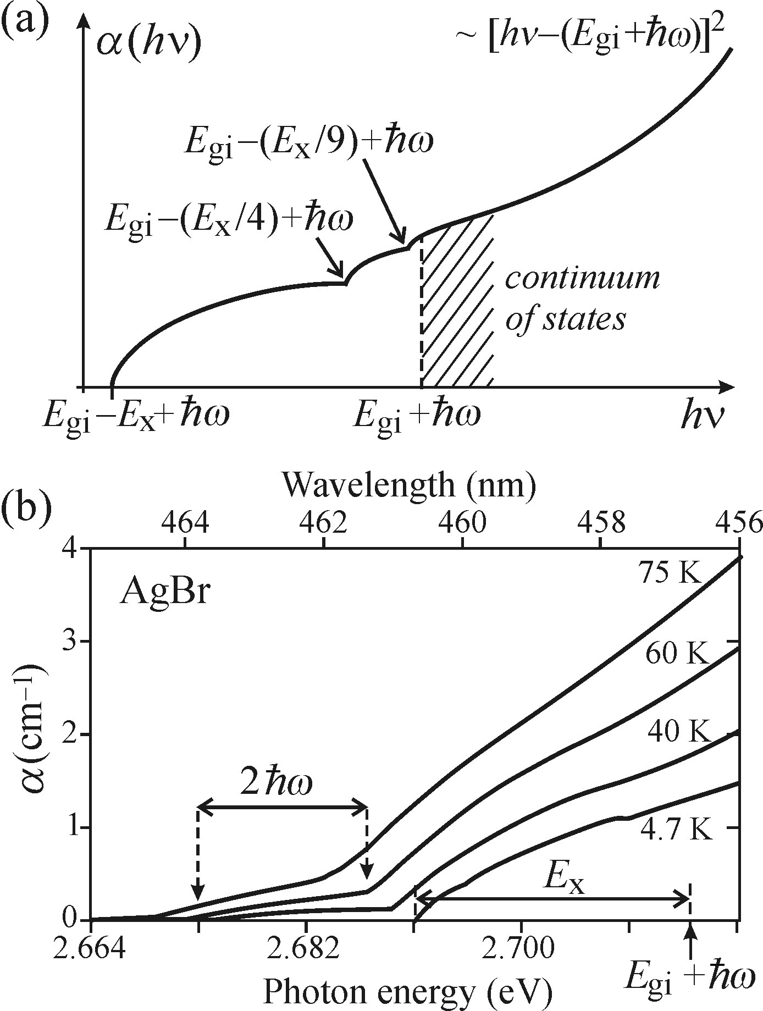
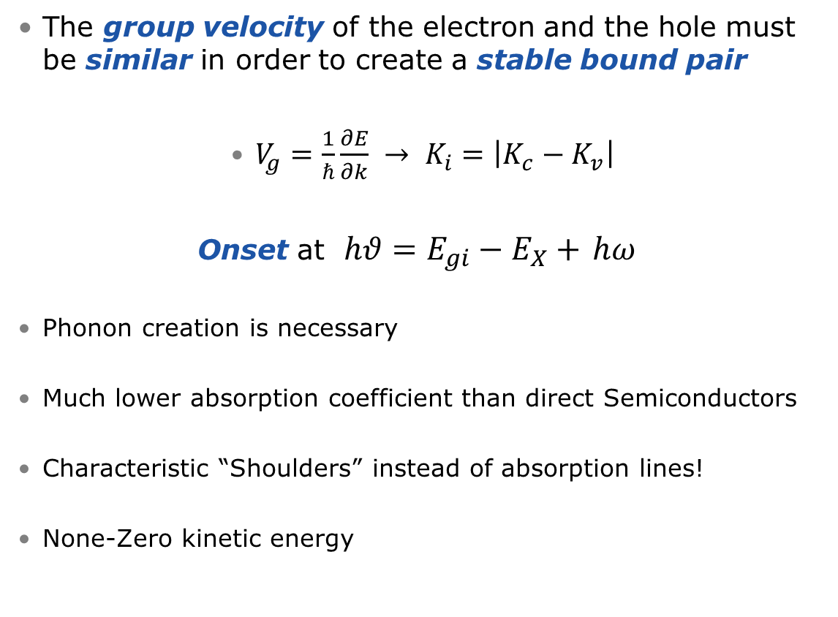
Absorption spectrum of Wannier exciton (Indirect BG)
The group velocity of the electron and the hole must be similar in order to create a stable bound pair
$V_{g}=\frac{1}{ℏ}\frac{∂E}{∂k} → K_{i}=\left|K_{c}−K_{v}\right|$
Onset at $hθ=E_{gi}−E_{X}+$ $hω$
Phonon creation is necessary
Much lower absorption coefficient than direct Semiconductors
Characteristic “Shoulders” instead of absorption lines!
None-Zero kinetic energy

Slide 6
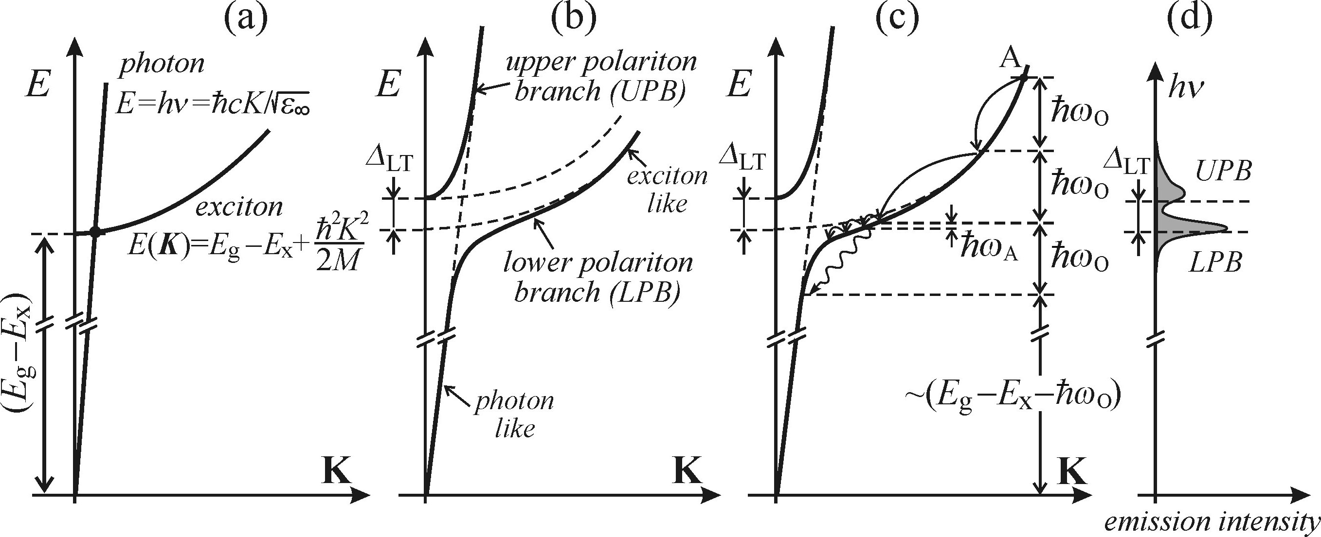
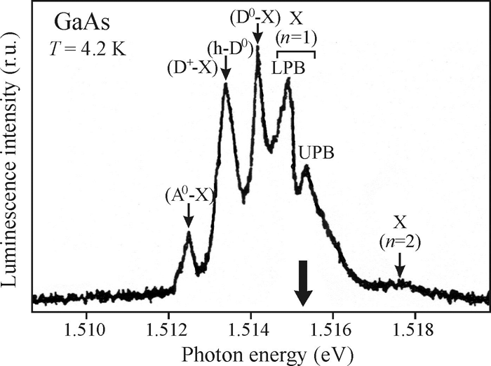
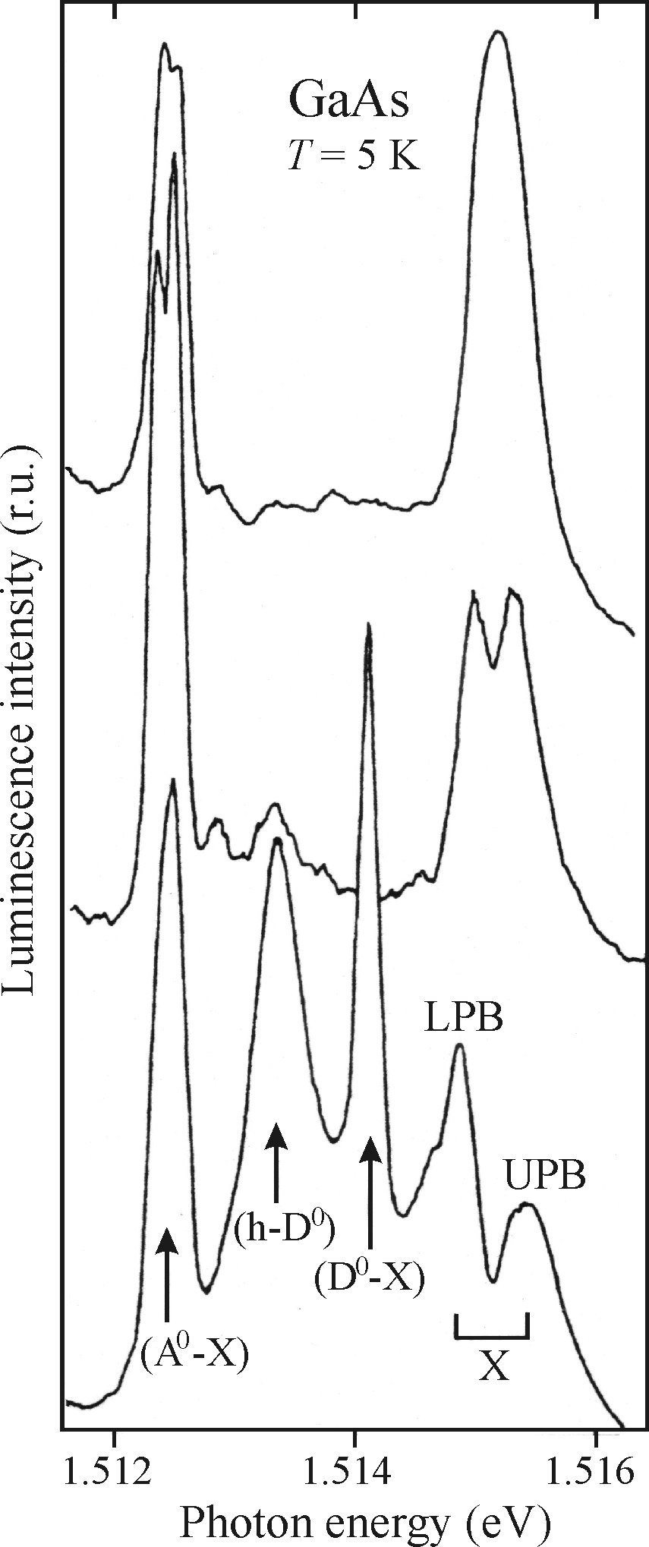
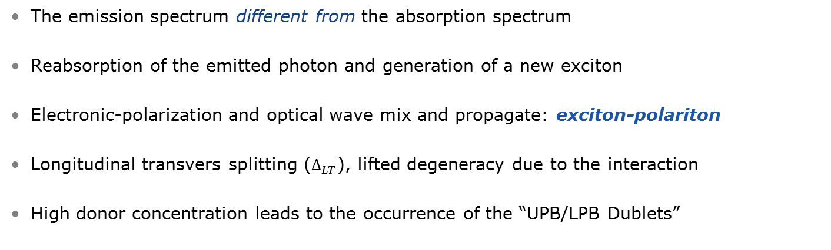
Direct bandgap:
Resonant luminescence of free exciton-polaritons
The emission spectrum different from the absorption spectrum
Reabsorption of the emitted photon and generation of a new exciton
Electronic-polarization and optical wave mix and propagate: exciton-polariton
Longitudinal transvers splitting ($∆_{LT}$), lifted degeneracy due to the interaction
High donor concentration leads to the occurrence of the “UPB/LPB Dublets”

Slide 7
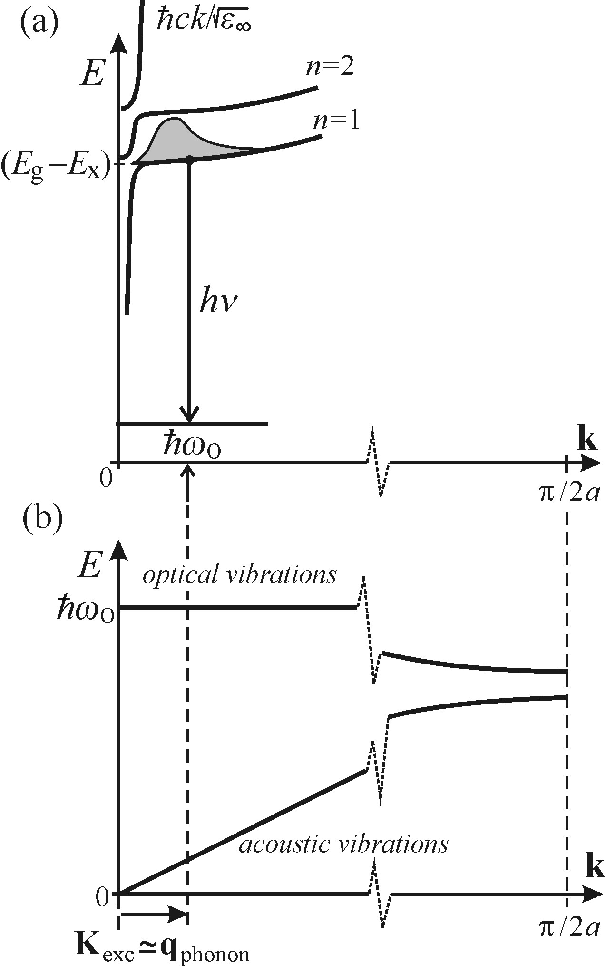
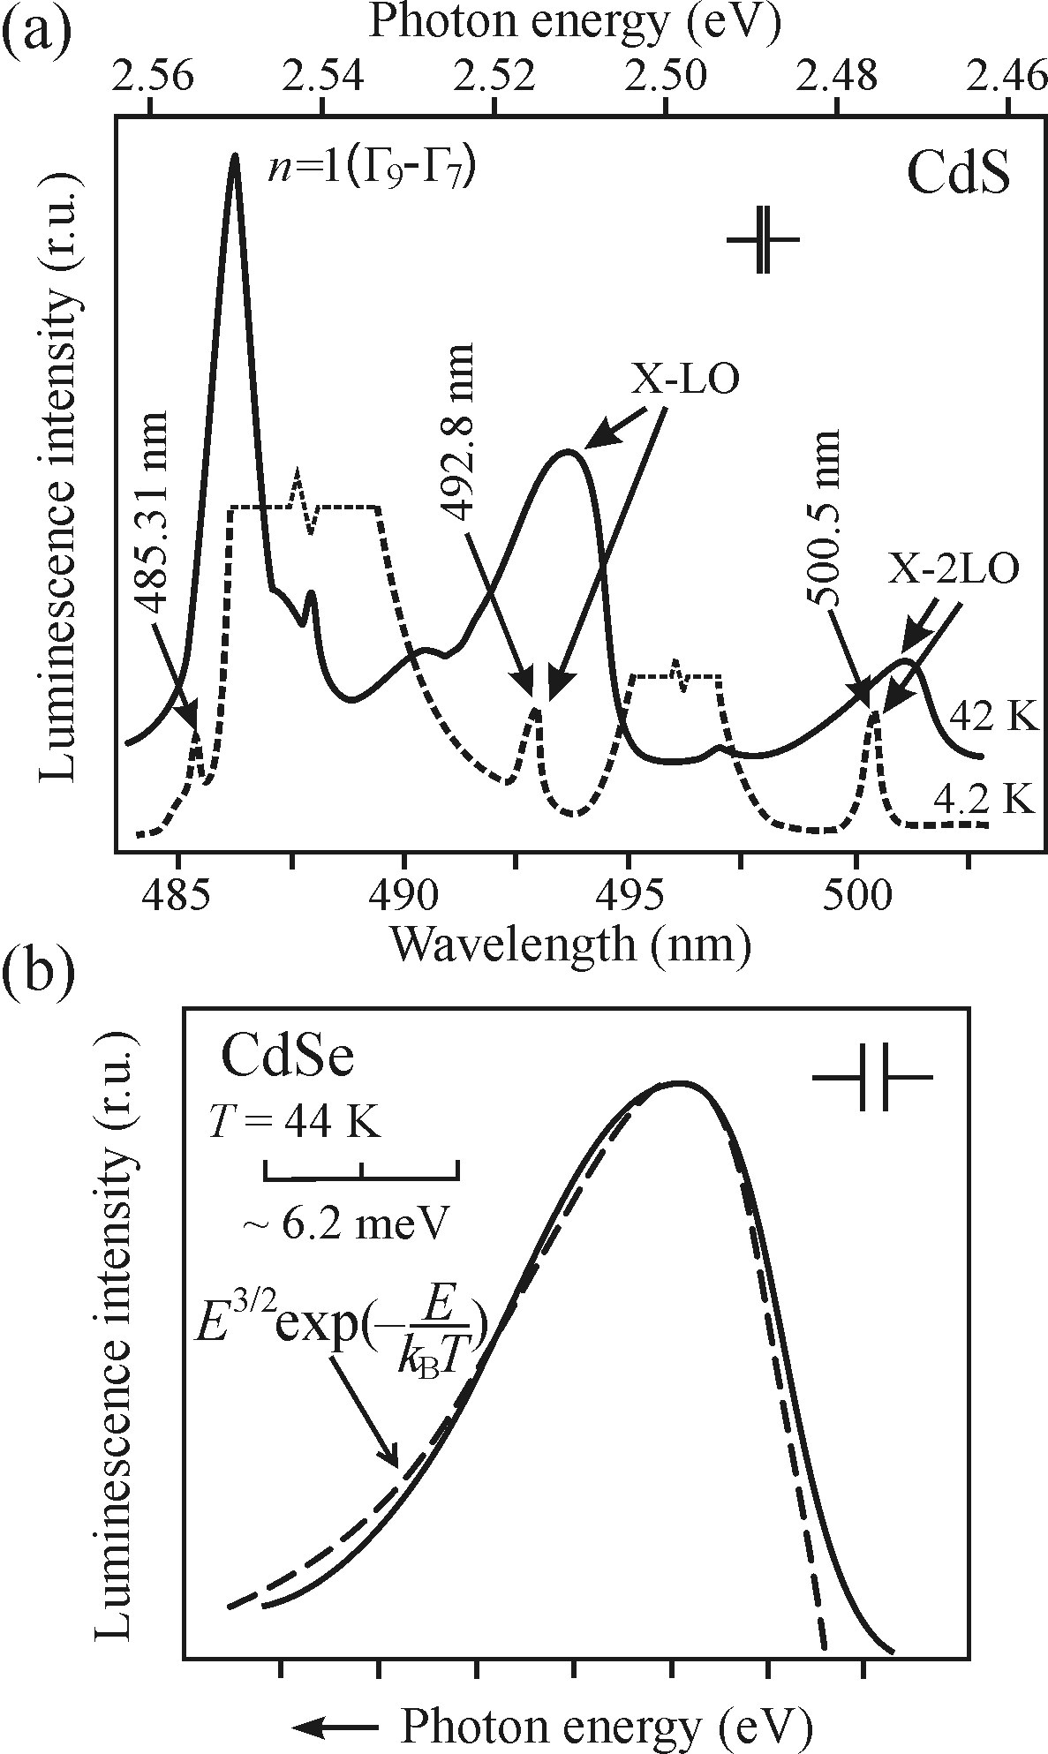
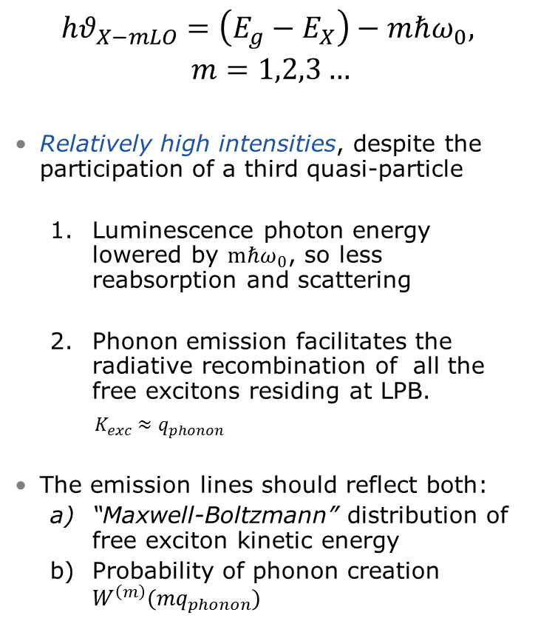
Direct bandgap:
Luminescence of free excitons with emission of optical phonons
$$hθ_{X−mLO}=\left(E_{g}−E_{X}\right)−mℏω_{0},$$
$$m=1,2,3…$$
Relatively high intensities, despite the participation of a third quasi-particle
  Luminescence photon energy lowered by $mℏω_{0}$, so less reabsorption and scattering
  Phonon emission facilitates the radiative recombination of all the free excitons residing at LPB.
    $K_{exc}≈q_{phonon}$
The emission lines should reflect both:
  “Maxwell-Boltzmann” distribution of free exciton kinetic energy
  Probability of phonon creation $W^{\left(m\right)}(mq_{phonon})$

Slide 8
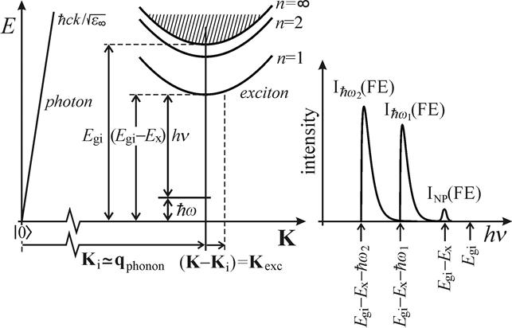

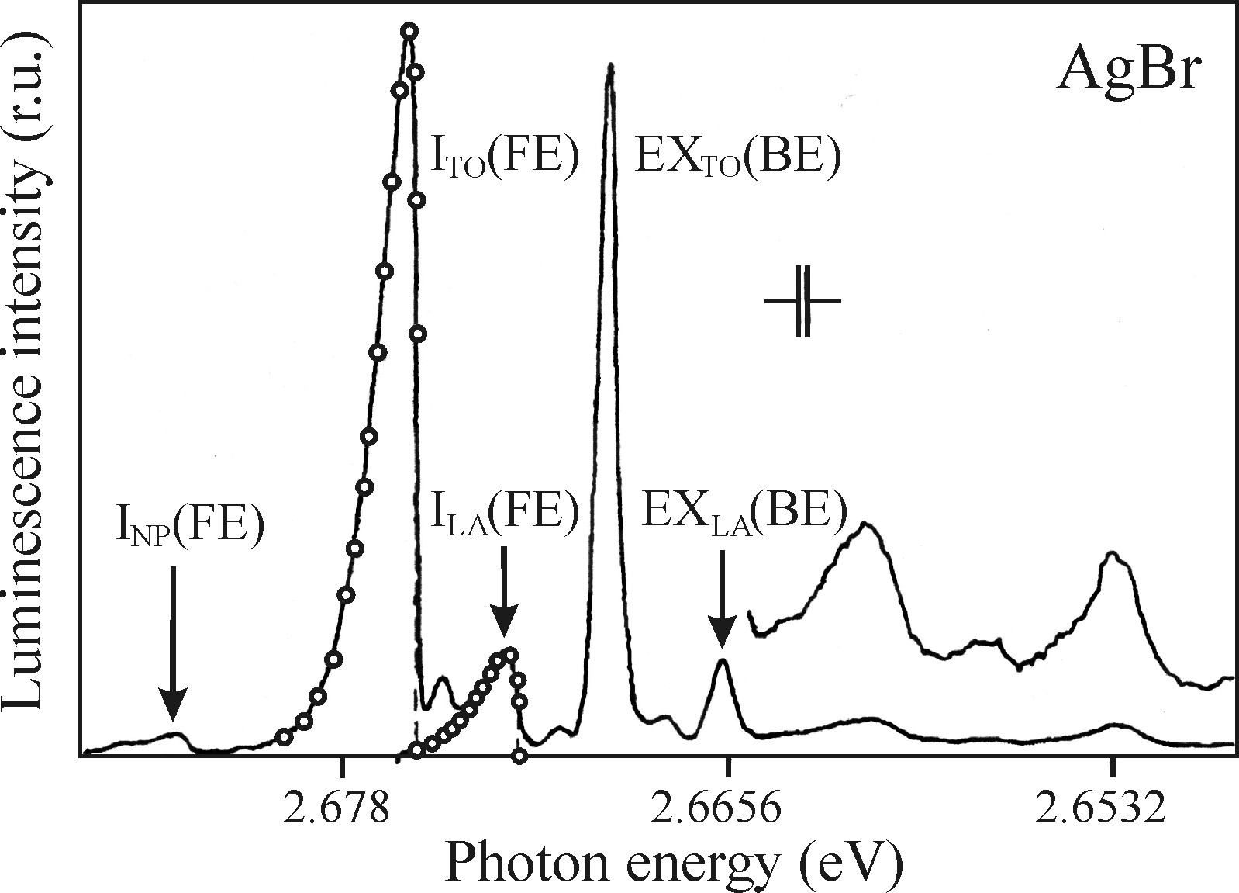
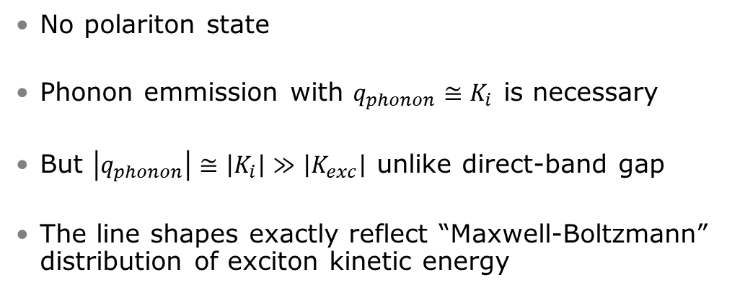
Luminescence of free excitons in indirect-bandgap semiconductors
No polariton state
Phonon emmission with $q_{phonon}≅K_{i}$ is necessary
But $\left|q_{phonon}\right|≅\left|K_{i}\right|≫\left|K_{exc}\right|$ unlike direct-band gap
The line shapes exactly reflect “Maxwell-Boltzmann” distribution of exciton kinetic energy

Slide 9
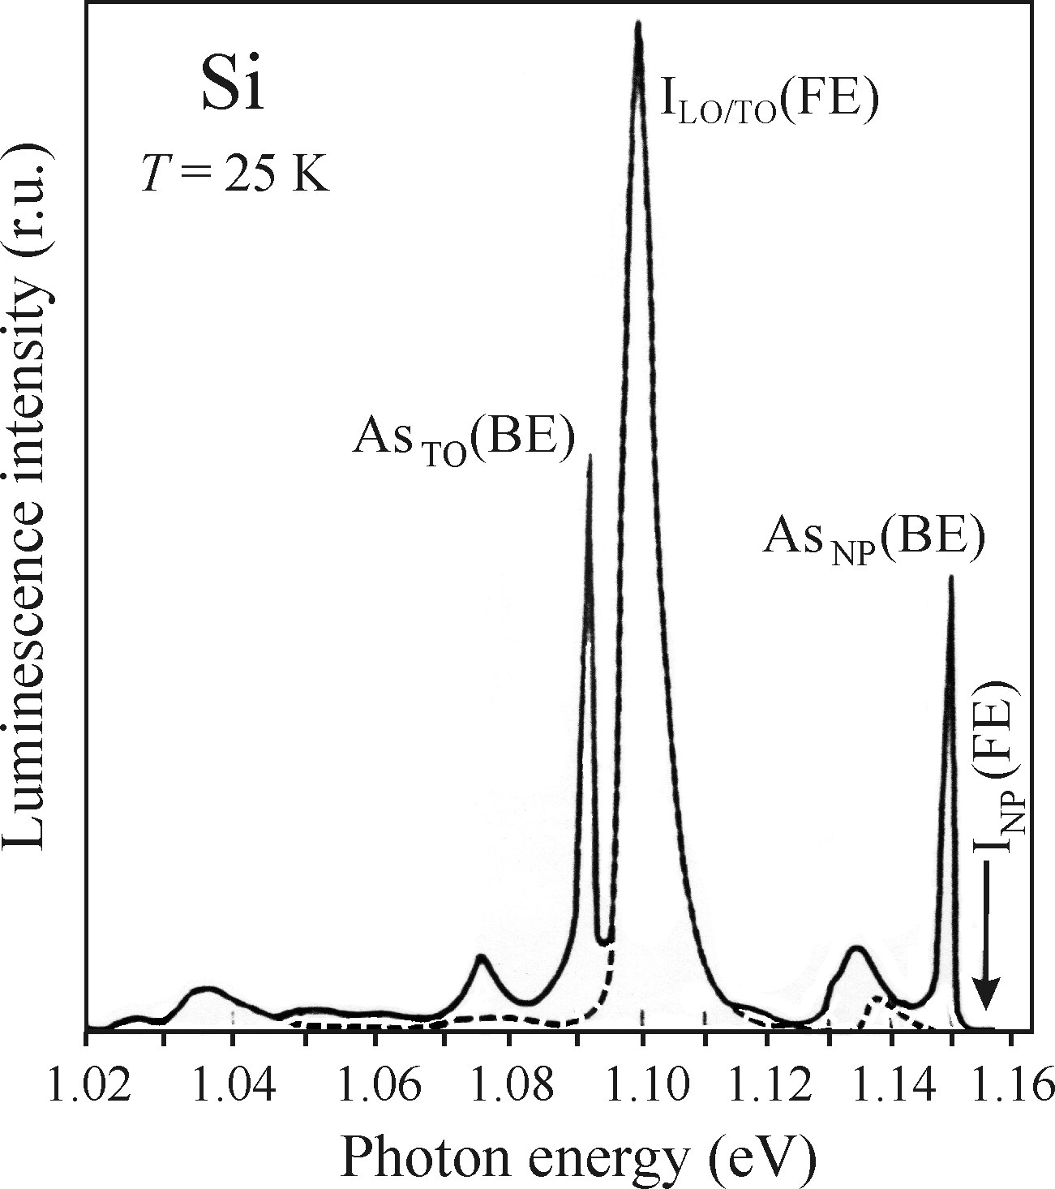
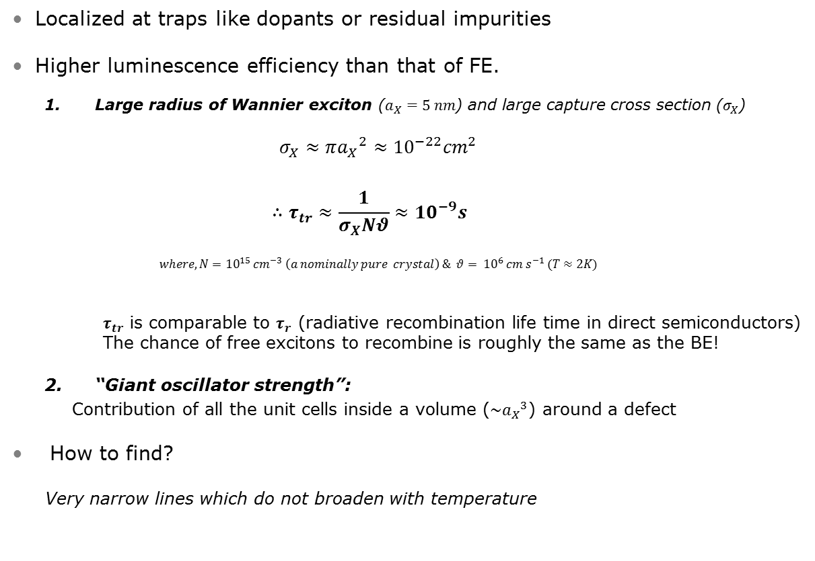
Bound excitons
Localized at traps like dopants or residual impurities
Higher luminescence efficiency than that of FE.
  Large radius of Wannier exciton ($a_{X}=5 nm$) and large capture cross section ($σ_{X}$)
    $$σ_{X}≈π{a_{X}}_{}^{2}≈{10}^{−22}{cm}^{2}$$
    $$∴τ_{tr}≈\frac{1}{σ_{X}Nθ}≈{10}^{−9}s$$
    $$where, N={10}^{15} {cm}^{−3} \left(a nominally pure crystal\right) \& θ= {10}^{6} cm s^{−1} (T≈2K)$$
      $τ_{tr}$ is comparable to $τ_{r}$ (radiative recombination life time in direct semiconductors)
      The chance of free excitons to recombine is roughly the same as the BE!
  “Giant oscillator strength”:
    Contribution of all the unit cells inside a volume ($\sim {a_{X}}^{3}$) around a defect
How to find?
  Very narrow lines which do not broaden with temperature

