Slide 1
Disordered semiconductors,
Stimulated emission
Mahtab Sangghaleh- 19 Nov. 2012

Slide 2
Luminescence of disordered semiconductors
Disordered semiconductor (amorphous) No order in atomic arranagement
e/h wavevector k, Bloch theorem, E=E(k): shouldn’t be used
Cunduction/Valenece bands, forbidden gap and density of states are conserved

Slide 3




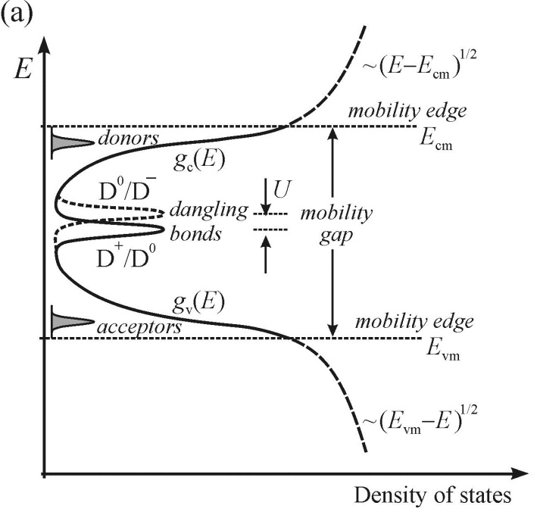

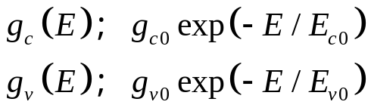
Densities of states in bands
Differing in bond lengths/angles from crystalline lattice
(mobility edge) Free electrons
Spatially localized in traps
Charge transport: through hopping mechanism/multiple
trapping
Energy bandgap in crystalline semicondutors
Correlation energy

Slide 4
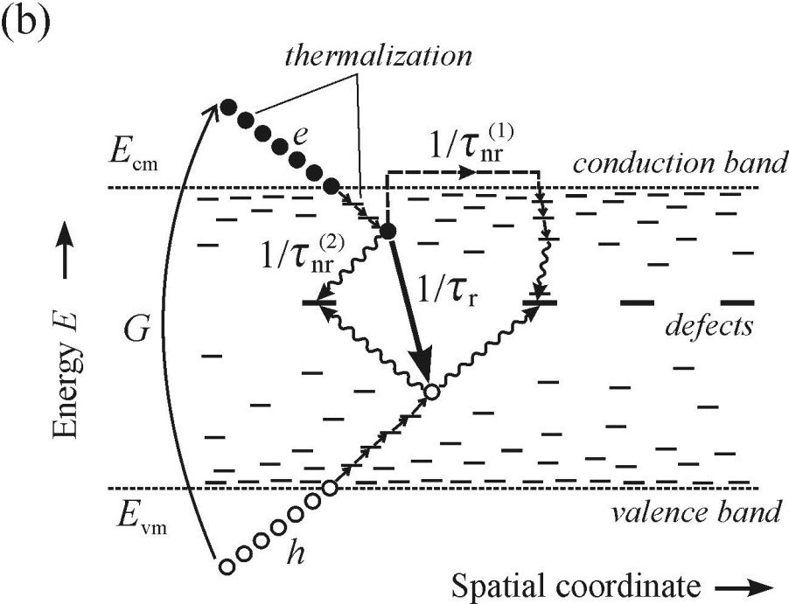
Disordered semiconductors: radiative and non-radiative recomibinations
Nonequilibrium e-h pairs (generation rate G)
Thermalize (ps) toward mobility edges
Fall down into tail states
Tunneling between neibouring
States radiative recombination
(longer time scale)

Slide 5
Disordered semiconductors: radiative and non-radiative recomibinations
Deflected covalent bonds in Neighbouring atoms
Mechanical strain
Dangling or
Unsaturated bonds
unpassivated bonds (ex. Through Hydrogen
passivation like a-Si:H) introduce deep localized
electron states in the middle of the BG- non-radiative centers

Slide 6
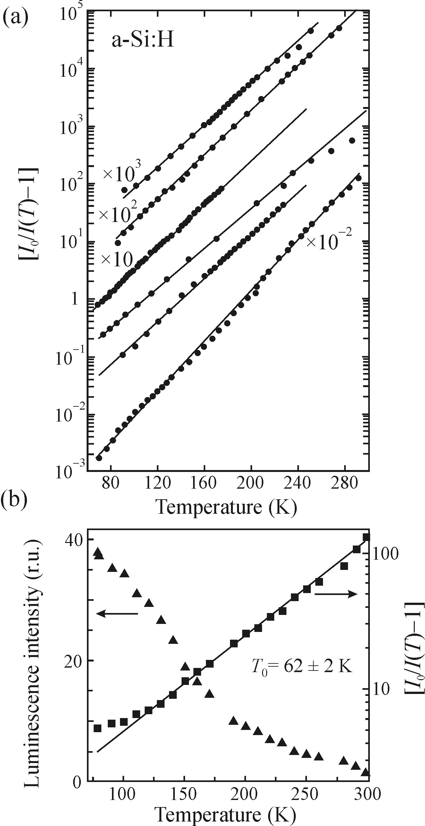




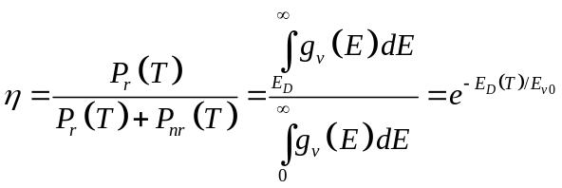
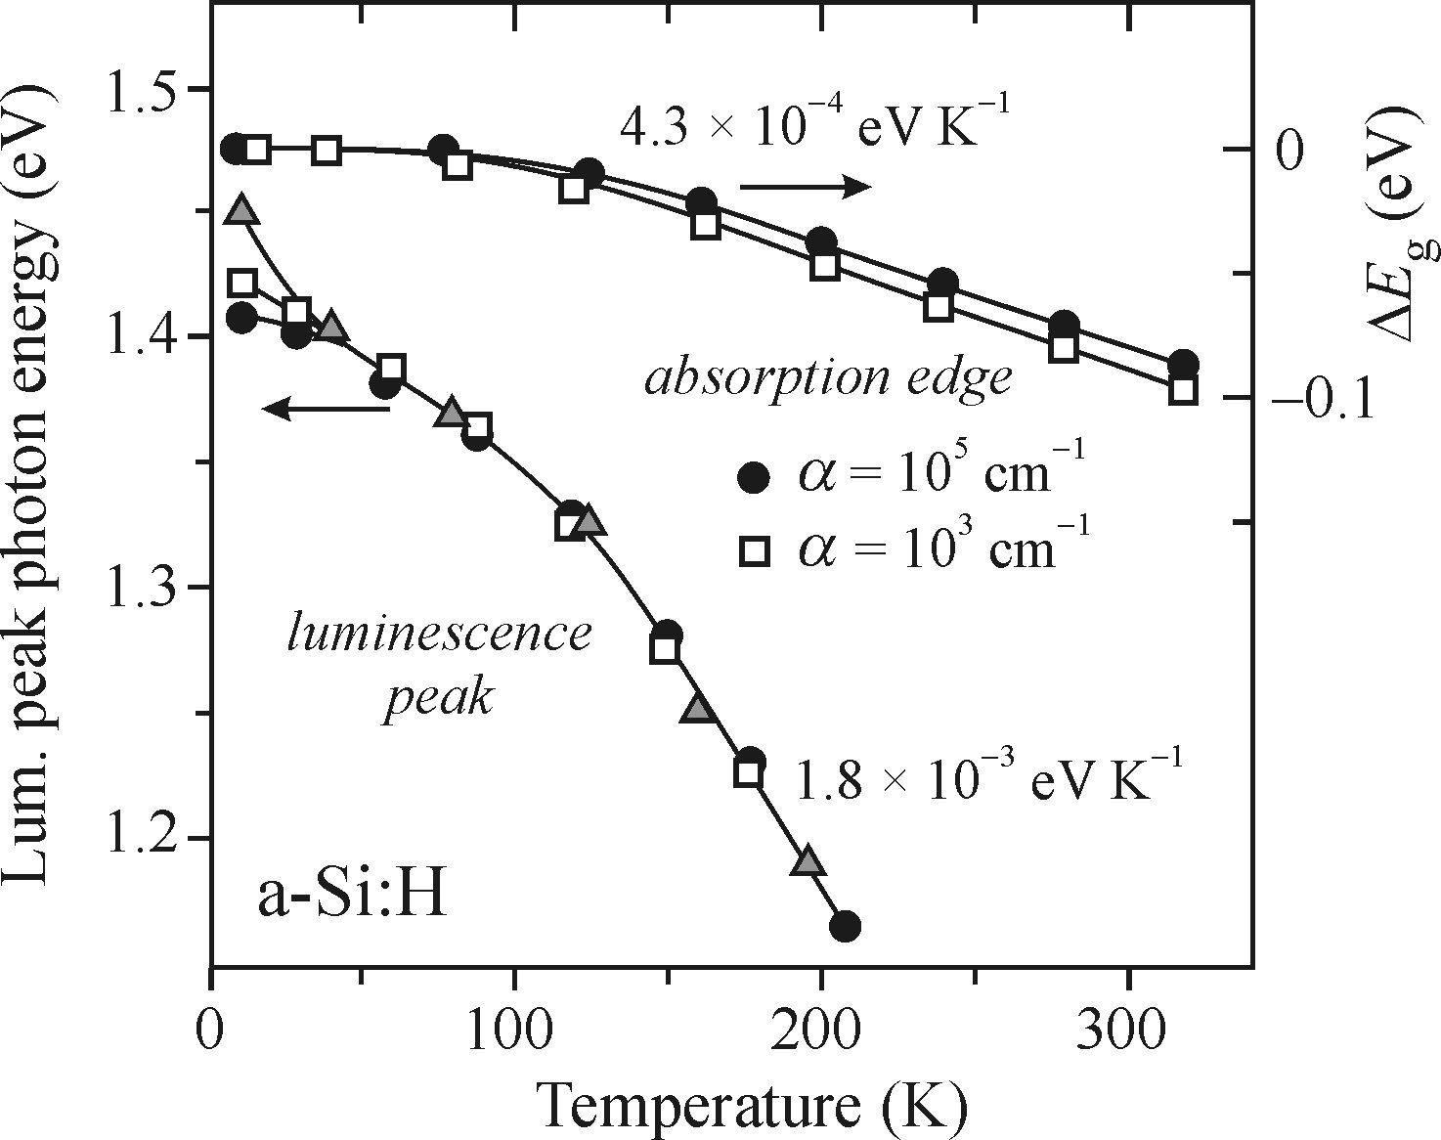
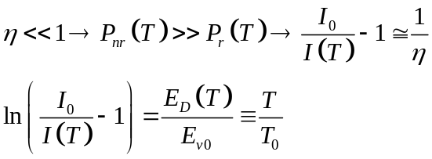

Temperature effect on luminescence
Probability of
thermal excitation
Frequency factor:
characterizes
The width of the
tail states

Slide 7

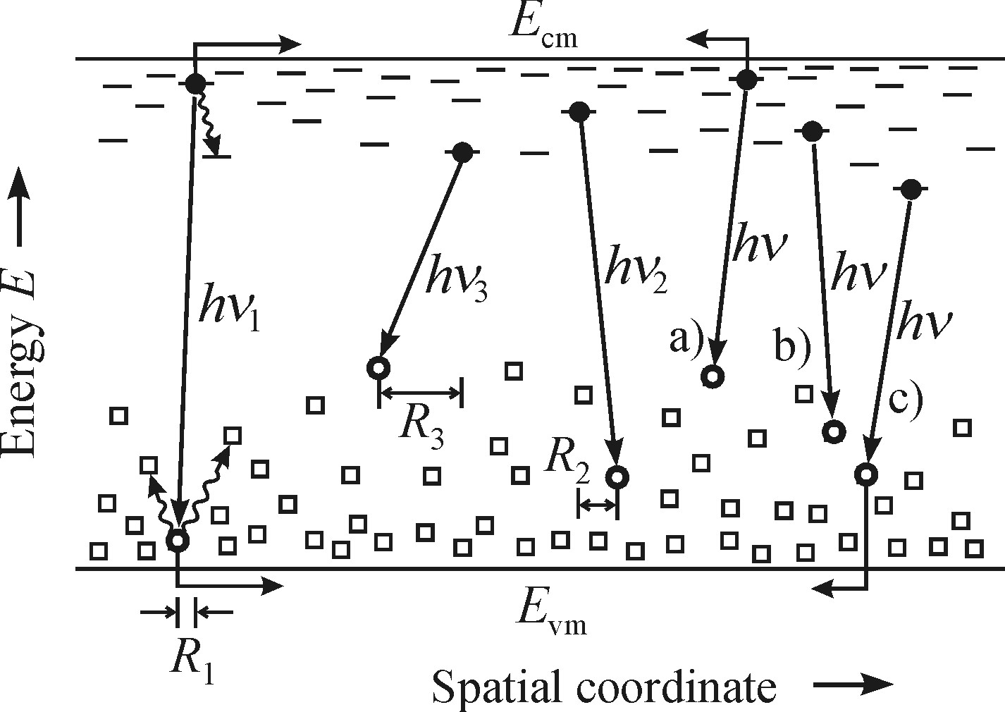

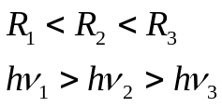
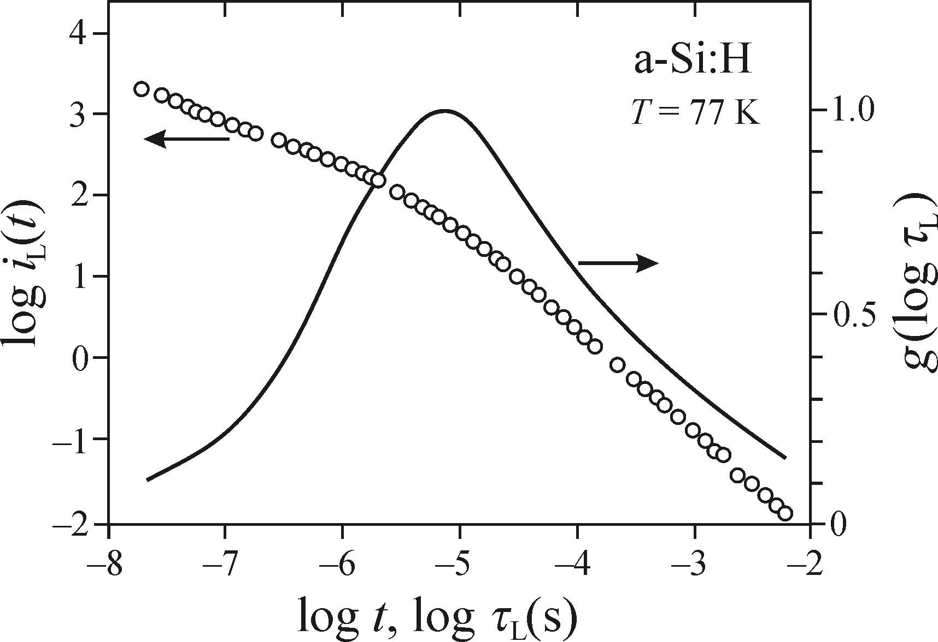


Distribution of luminescence lifetime
Large life time range (between )
Tail states are broad and have variable spatial density
Probabality of the radiative tunneling
Where R is separation between localized
electron and localized hole
Continuous distribution of luminescence
decay times
Because of the considerable width it is plotted
a function of logarithmic decy time

Slide 8
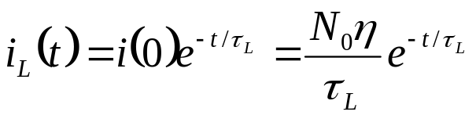
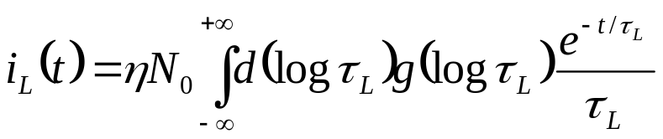

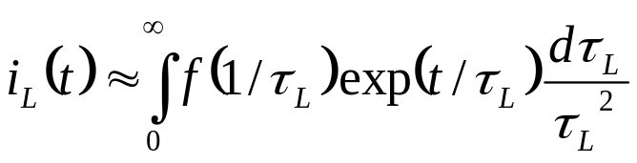
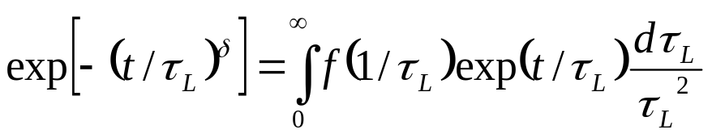
Distribution of luminescence lifetime
Number of excited centers
Laplace transform

Slide 9
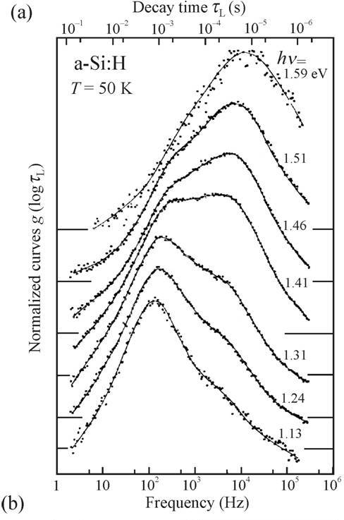
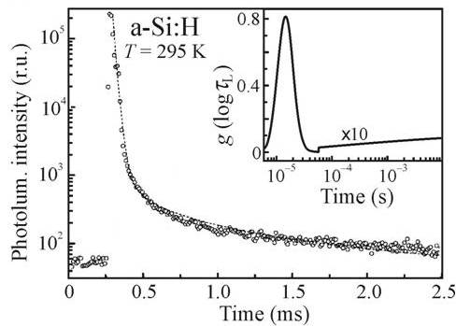
Distribution of luminescence lifetime
In materials with large tail state widths
The luminescence is present at RT

Slide 10
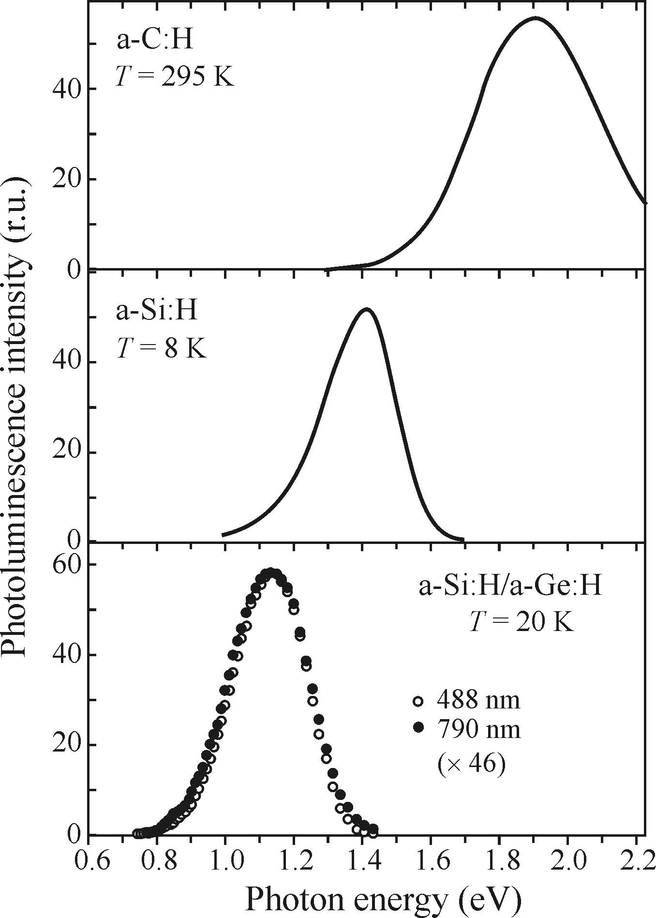


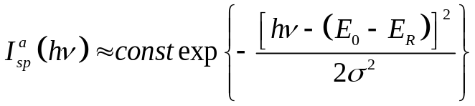
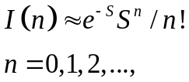

Spectral shape of the emission band
PL emission spectra of pure amorphous
Semiconductors, FWHM: 200-400 meV
To explain spectral shape:
Free e-h pairs ×
Radiative recombiantion type or ×
EHL and EHP ×
Electron-phonon coupling √
No-phonon energy
Spectral shape
Broad emissin band of a-Si:H
Phonon broadening model
Large Huang-Rhys factor S>>1
Emission peak: 1.4 eV
Band width: 1.9 eV
Shift:
Assumption of fixed value of no-phonon energy
Not symmetric emission band

Slide 11
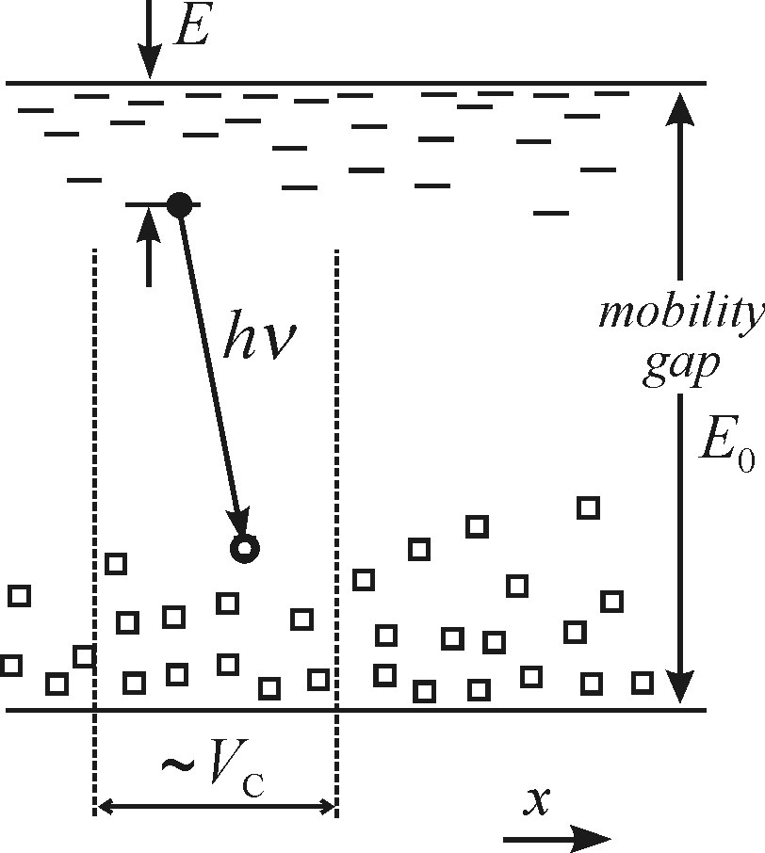

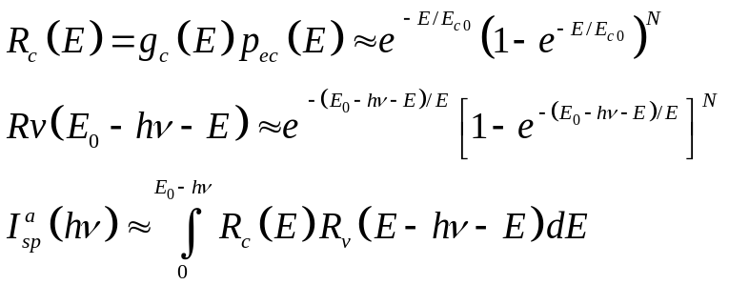
Spectral shape of the emission band
Opposite approach: disordered broadening by Boulitrop & Dunstan
Tail states: solid (without electron-phonon interaction)
Sizeable emission band width: wide distribution of tail states
Similar approach to free e-h pairs model in indirect bandgap:
convolution of occupied e-h states in the relevant tails states
Distribution function of carriers recombine radiatively in the
tail states ×
Reference e-h pair
Fast thermalization of non-equilibrium carriers down to the
lower states within a critical valume before recombination
Critical volume, driven by rate of hopping carrier diffusion (non-
Radiative tunnelling transitions to lower unoccupied states)
Shape of emission specta (holds for a singel value of )
N other
couples
of states

Slide 12
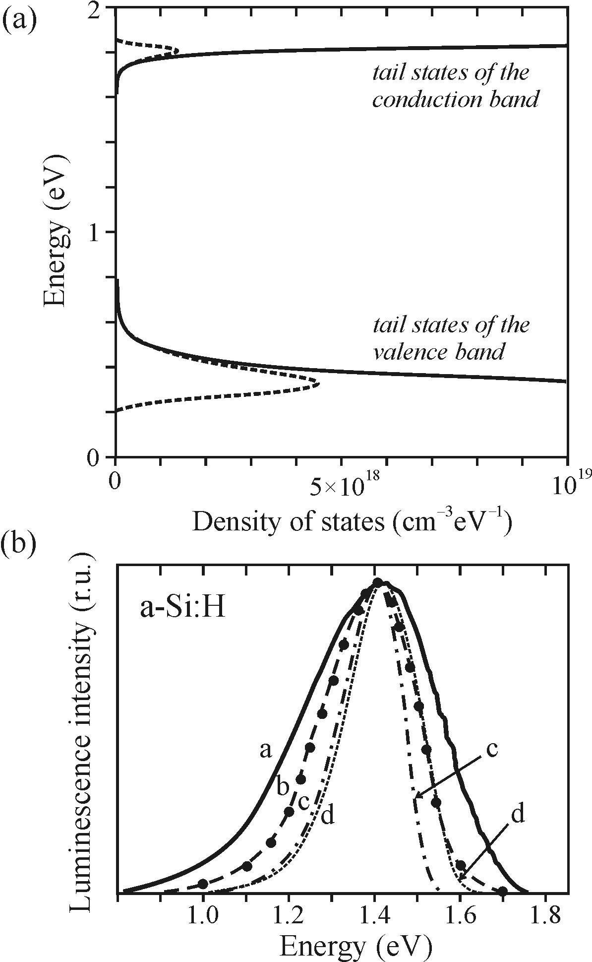

Spectral shape of the emission band
Values of occupied tail states densities
For a-Si:H
Unlike the recombination of free e-h pair in indirect BG
Here there is no arbitrary recombination
Calculaetd spectra narrower than measured spectra
Curve d: taking inot account experimental distribution
function of radiative lifetimes with zero-phonon width
(wider but still narrower than the experimental curves)
To improve disordered broadening model
exsictance of the hot luminescence
Comparision theoretical lineshape with
Two experimental spectra

Slide 13
Some properties of luminescence of disordered semiconductors
Correlation effects
Non-radiative recombination
Luminescence of impurities and defects
Luminescence ’fatigue’
Correlation effects
Non-radiative recombination
Luminescence of impurities and defects
Luminescence ’fatigue’
No Wannier exciton but
Geminate: Electron and hole couple created by the absorption of a given photon in a given site
Non-geminate: Electron and a hole that have originated in different parts of the sample as a
consequence of two absorption events
Photocarrier diffusion length are short:
Low excitations: Geminate pair recombination are dominates
High exciations: Non-geminate recombination is not negligible
Controversial discussion:
Radiative recombination takes place in arbitrary pairs or geminate pairs only?!
No injection EL in amorphous (all the electron hole pairs non-geminate)
In a-Si:H p-i-n low intensity EL
Proves non-radiative recobination of non-geminate e-h pairs

Slide 14
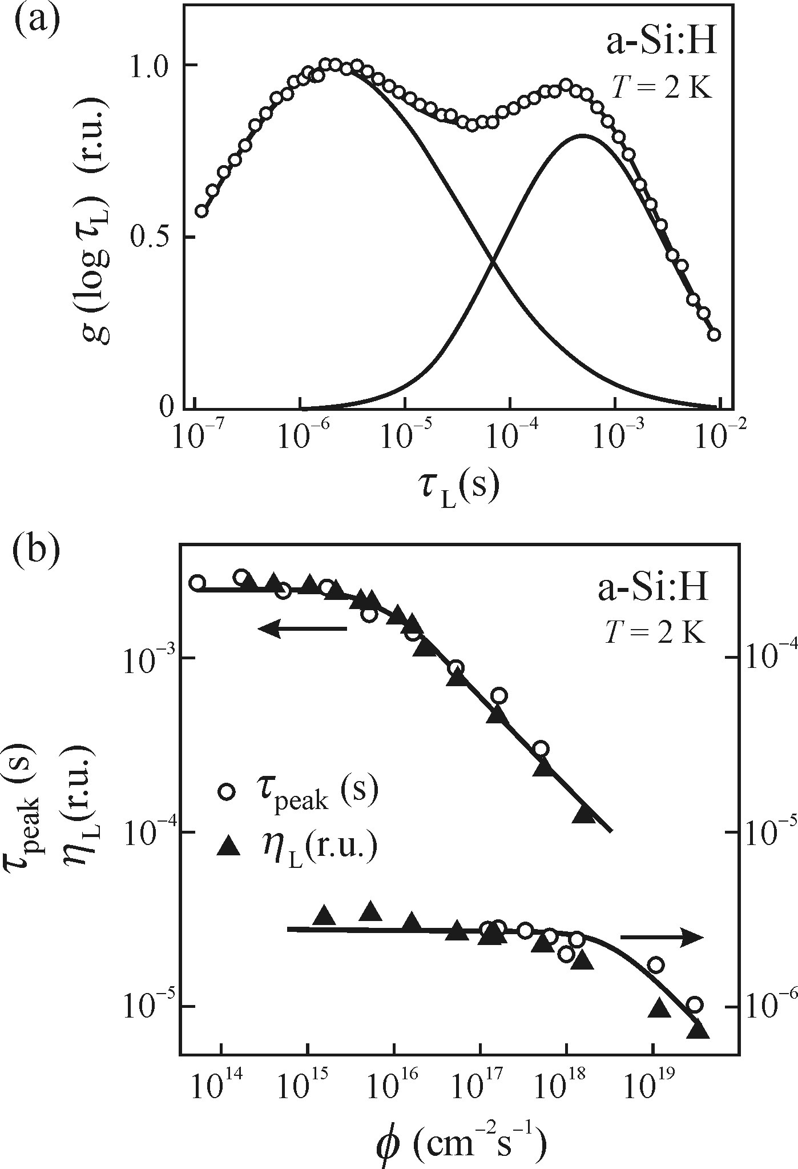
Some properties of luminescence of disordered semiconductors
Correlation effects
Non-radiative recombination
Luminescence of impurities and defects
Luminescence ’fatigue’
Possible paths of non-radiative recombination of
e-h pairs in amorphous ssemiconductors:
Recombination mediated by dangling bonds
(Shotckey-Read recombination of defects in
the middle of the bandgap
Thermal quenching
Recombination of non-radiative e-h pairs
Auger recombination
Surface recombination
Stachowitz et. al.
Non-radiative recombionation due to non-geminate e-h pairs
Small-radius localized exciton
Two maxima in lifetime distribution: singlet & triplet excitons
Reconciled with existence of EL

Slide 15


Some properties of luminescence of disordered semiconductors
Correlation effects
Non-radiative recombination
Luminescence of impurities and defects
Luminescence ’fatigue’
Surface recombination in thin surface layers: Unsaturated bonds near the surface
Thickness of non-luminescence layer
D Photocarrier diffusion coefficient (small in disordered semiconductors )
Although the concentration of surface defect is high , small contribuion in surface
non-radiative recombination (~ 10%)

Slide 16
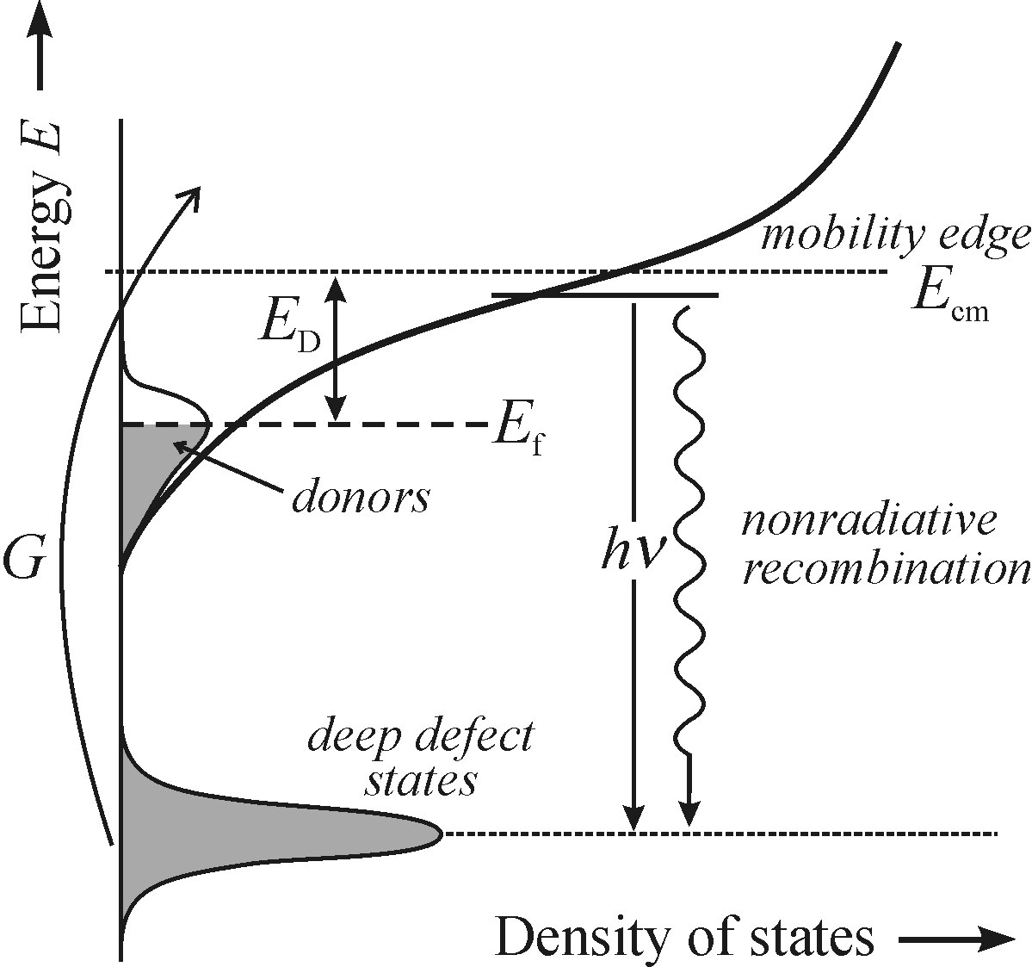

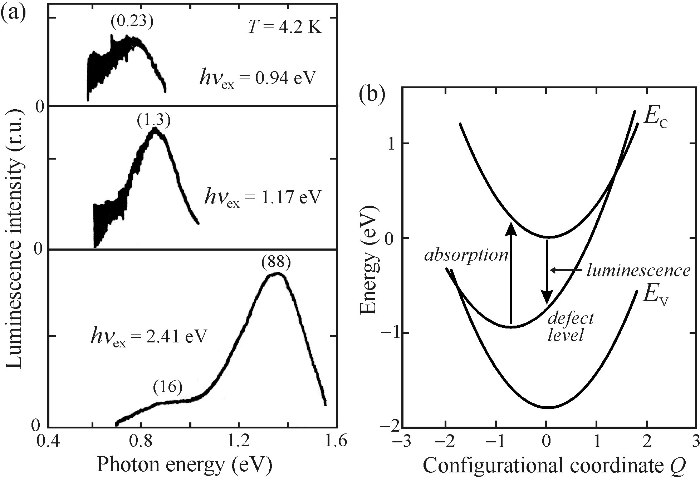

Some properties of luminescence of disordered semiconductors
Correlation effects
Non-radiative recombination
Luminescence of impurities and defects
Luminescence ’fatigue’
Distribution of binding energies
Impurities: new dangling bonds
Mainly non-radiative
High doping: weak luminescence
a-Si:H doped with phosphorus/boron
new emission band in Infrared ( ~ 0.8 eV)
Why radiative processes like
Hasn’t been observed in amorphous
Semiconductors?

Slide 17
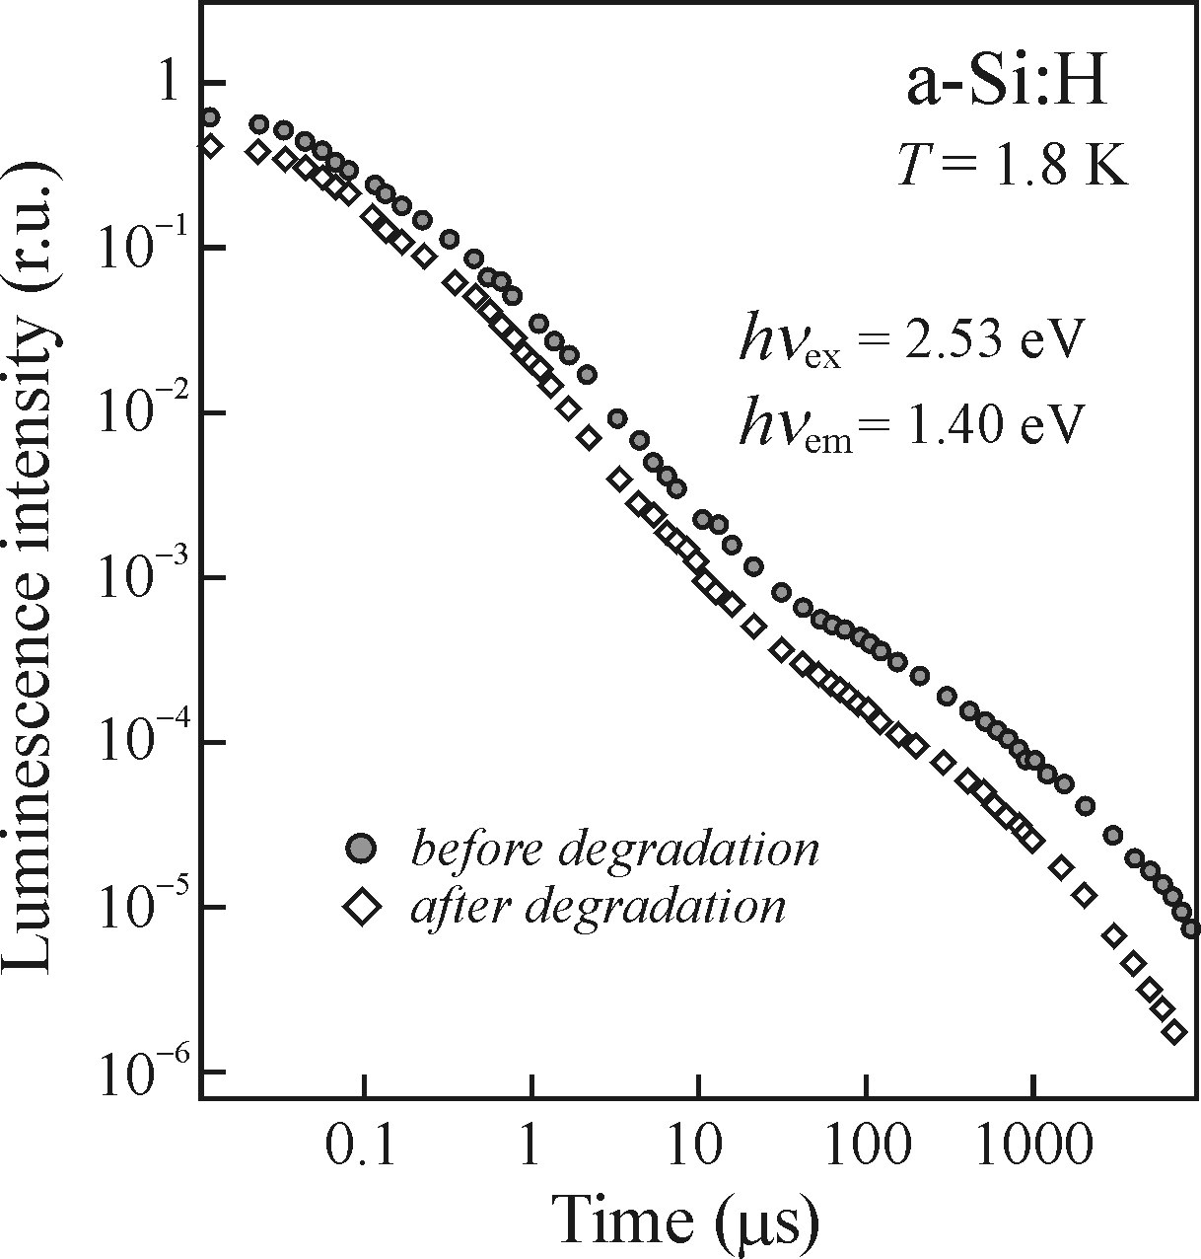
Some properties of luminescence of disordered semiconductors
Correlation effects
Non-radiative recombination
Luminescence of impurities and defects
Luminescence ’fatigue’
Gradual fading of main emission band under
high excitation
Staebler-Wronski or light- induced formation

Slide 18
Stimulated emission
Special case of luminescence
Different thermodynamic conditions needed for occurance
Polpulation inversion
Need to be based on different principles

Slide 19
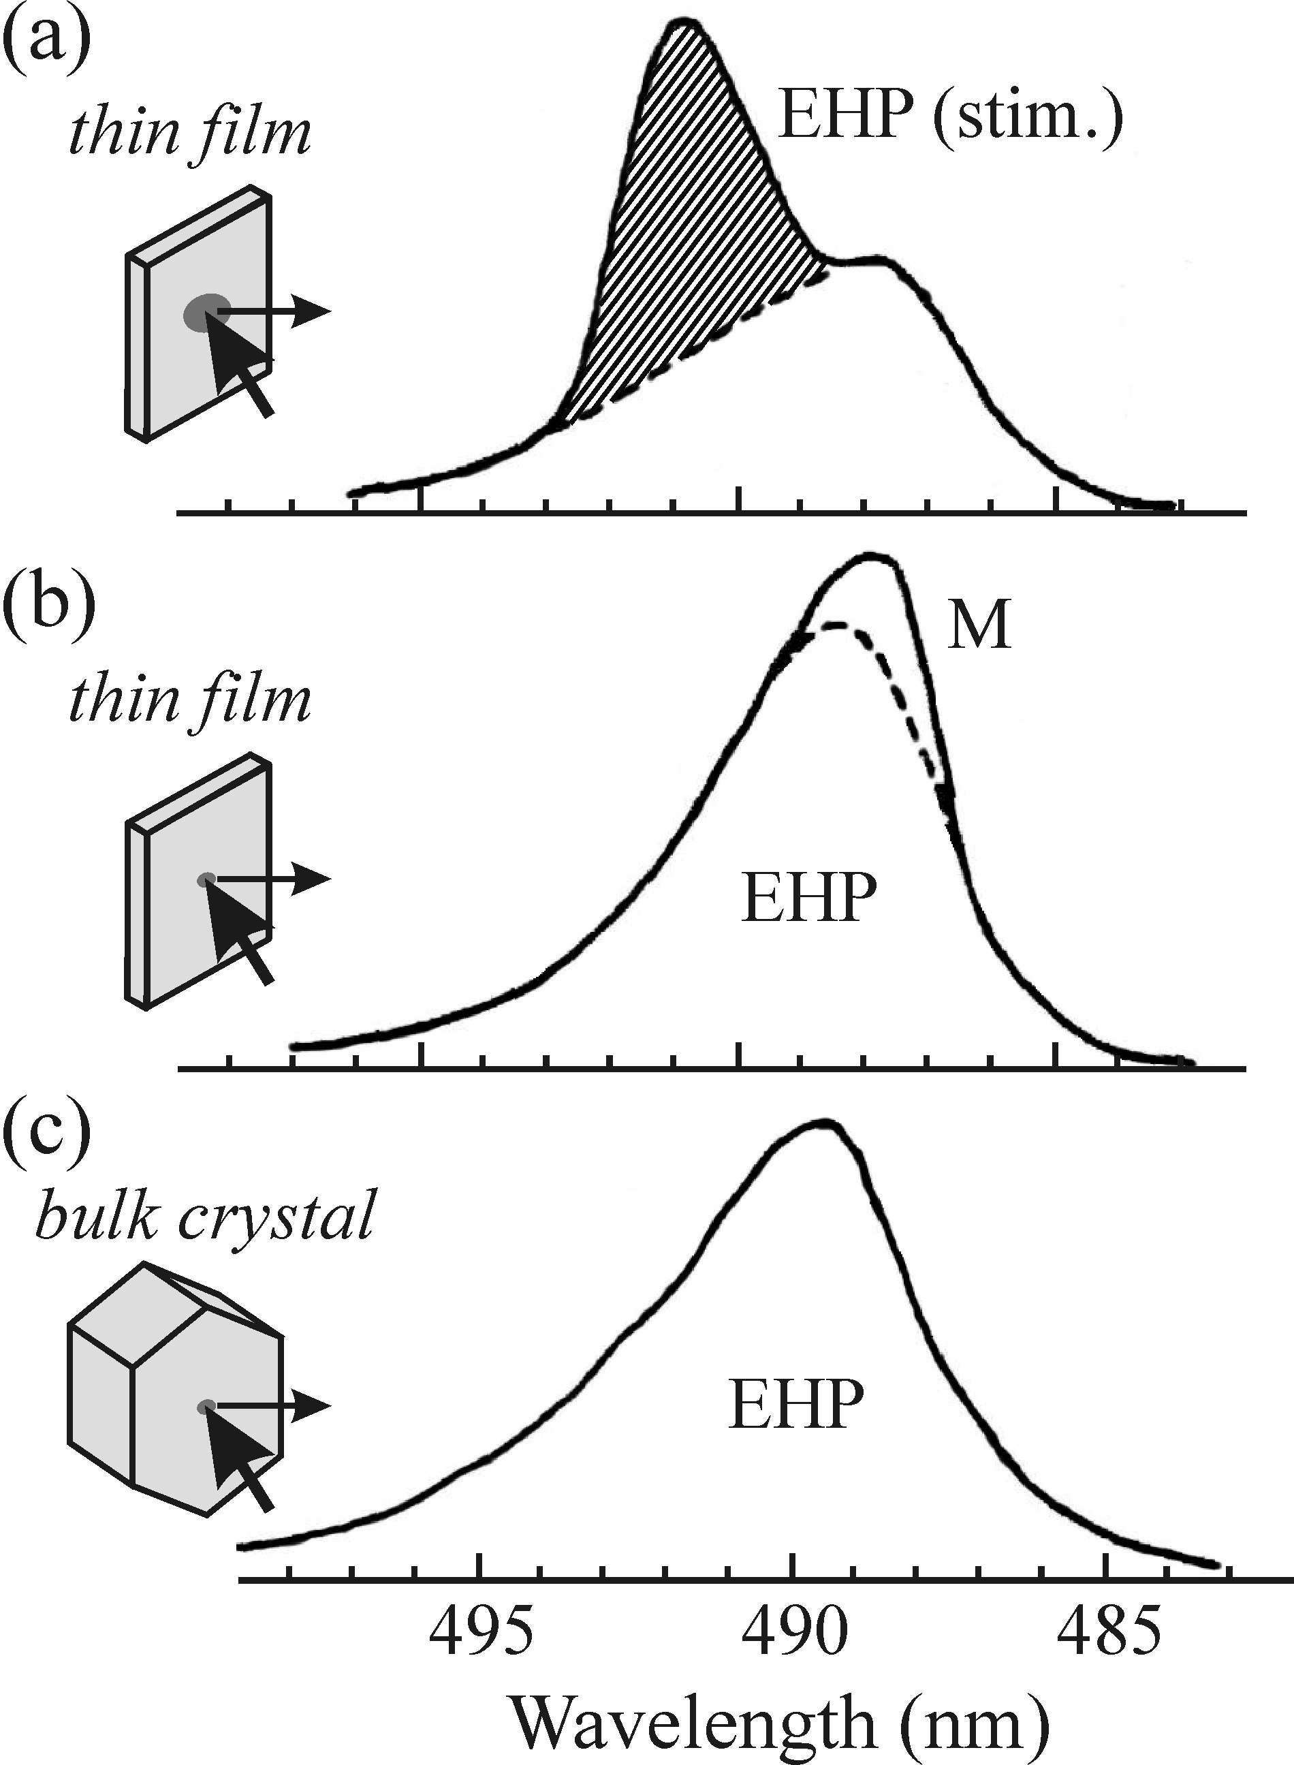
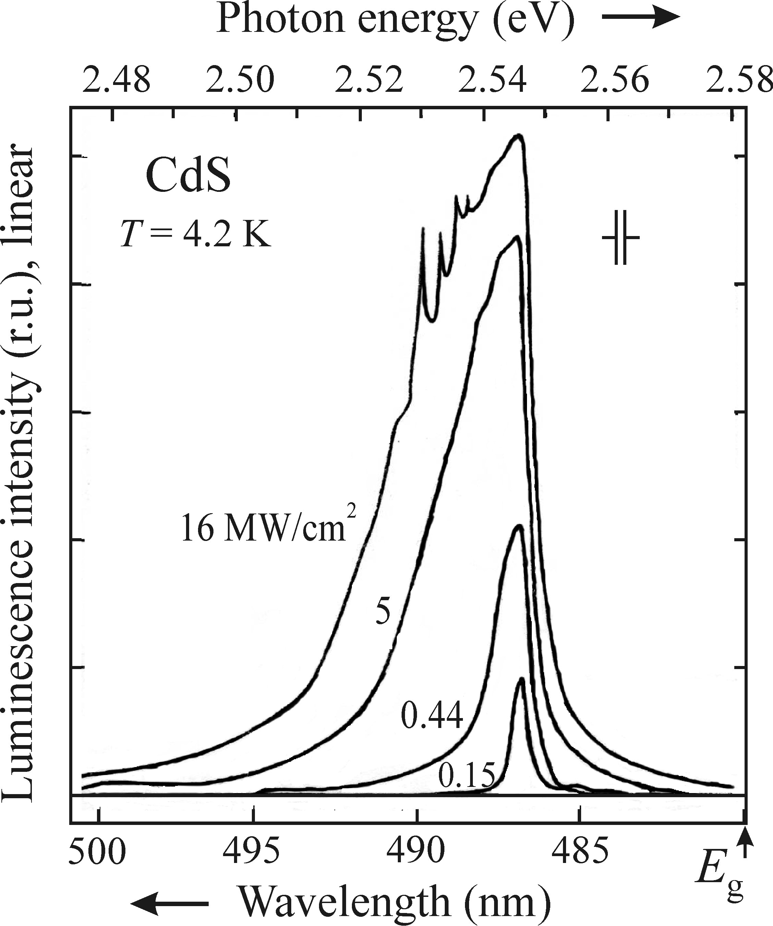
Spontaneous versus stimulated emission
Shape of the sample and the applied
geometery of experiment
Fundumental principle of lasers √
Basic resseach on radiative recombination ×
Large excited spot (~ 1mm) and high optical quality
surface: spontaneous emission will stimulate the
emission of other photons
Decreasing excited spot leads to suppression of
stimulated emission, new M line due to radiative decay
Of excitonic emission
High excitation/ excited area

Slide 20
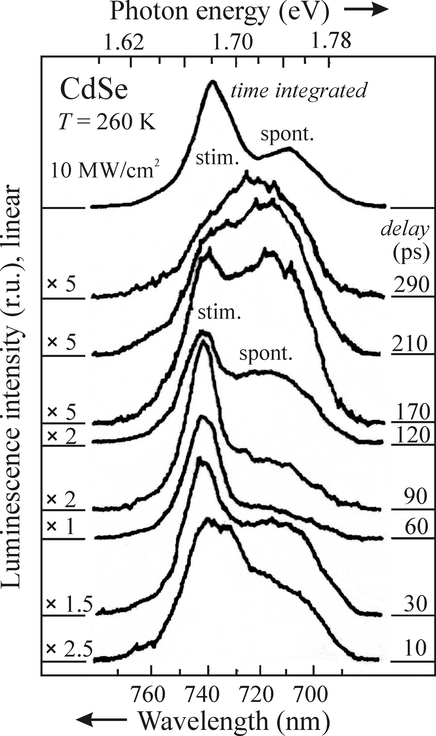







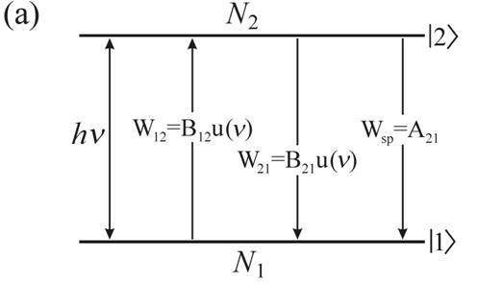
Spontaneous versus stimulated emission
Decay time of stimulated emission is much faster than
spontaneous emission
Rate of transitios from I2> to I1> by spontaneous emission:
( Einstein coefficient )
Rate of stimulated emission from I2> to I1> (or vice versa):
and
specral energy density of resonance radiation
Einestein coeficient of absorption and stimulated emission

Slide 21
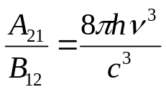
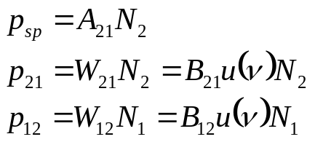
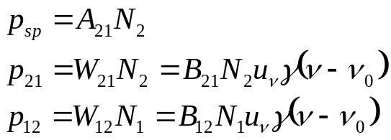





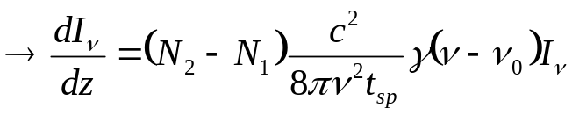
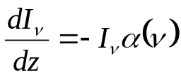
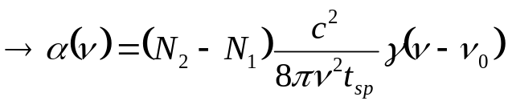
Absorption coeeficient
Introduction of
Lineshape function
Population of individual levels: N
Density of optical transition: p
Parallel beam of photons with power flux density (Intensity)
Impinging to the atomic system in the z-direction
Intensity variation
Contribution of spontaneous emission in given direction is much smaller than stimulated emission
For non-degenerate levels
Lambert-beer law satisfied

Slide 22

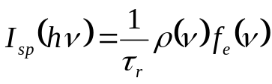
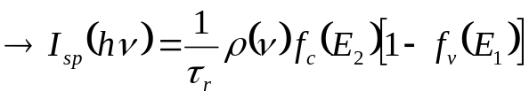
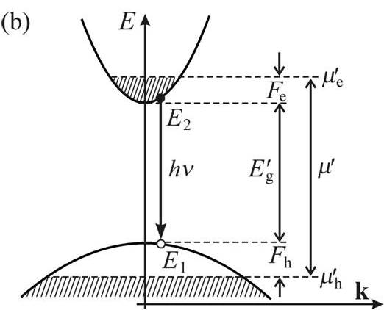

Optical gain
Nonlinear character of stimulated emission: it’s emission line shape is dependant on the
intensity of stimulating light
Spontaneous and stimulated emission occurs simultaneously in luminescence experiments
Density of states in the conduction and valence band
We had this (for band-to-bad spontaneous
emission under low excitation
f(v): probabilty of ’suitable occupancy states’
Occupied joint states per unit volume: to emit 1 photon
Light with a broad spectral distribution: u(v)

Slide 23

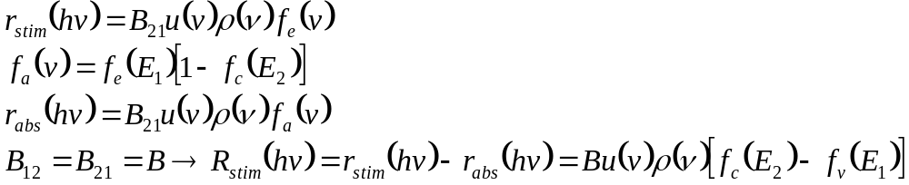
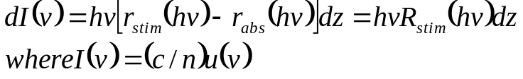

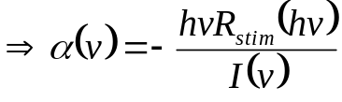
Optical gain
Probability density of stimulated emission
(Stimulated emission rate (the number of the photons) emitted per 1Hz & 1cm˄3)
The overall stimulated emission rate
Linewidth of energy levels in semiconductor is much smaller than the frequency band of
stimulated emission, approximation:
Occupancy condition for absorption
The role of the probe beam in luminescence experiment taken on by spontaneous emission in a given direction
Spectral distribution of the intensity
I(v) should satisfy Lambert-beer law

Slide 24
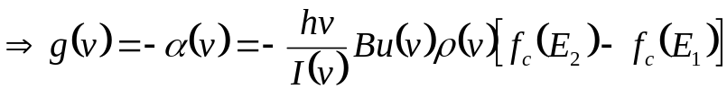
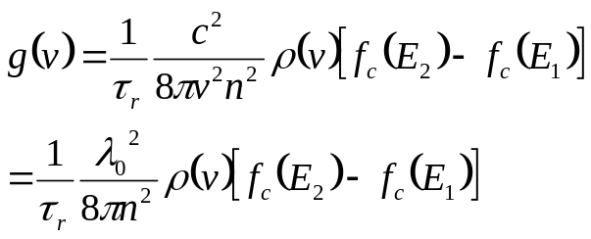

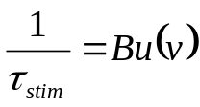
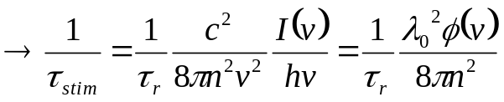
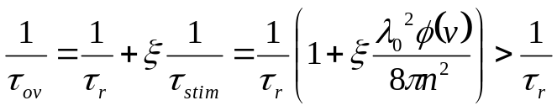

Optical gain
Light wavelength in vacuum
n refractive index
The specral shape of gainis influenced by occupancy of electron states in conduction band and hole states in valence band (Fermi inversion factor) or the pump intensity
Experiment: detected emission spectra: Both spontaneous & stimulated with overall radiative life
Relative part of the excited volume of material that takes part into stimulated emission

Slide 25
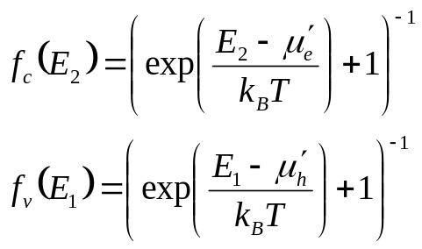



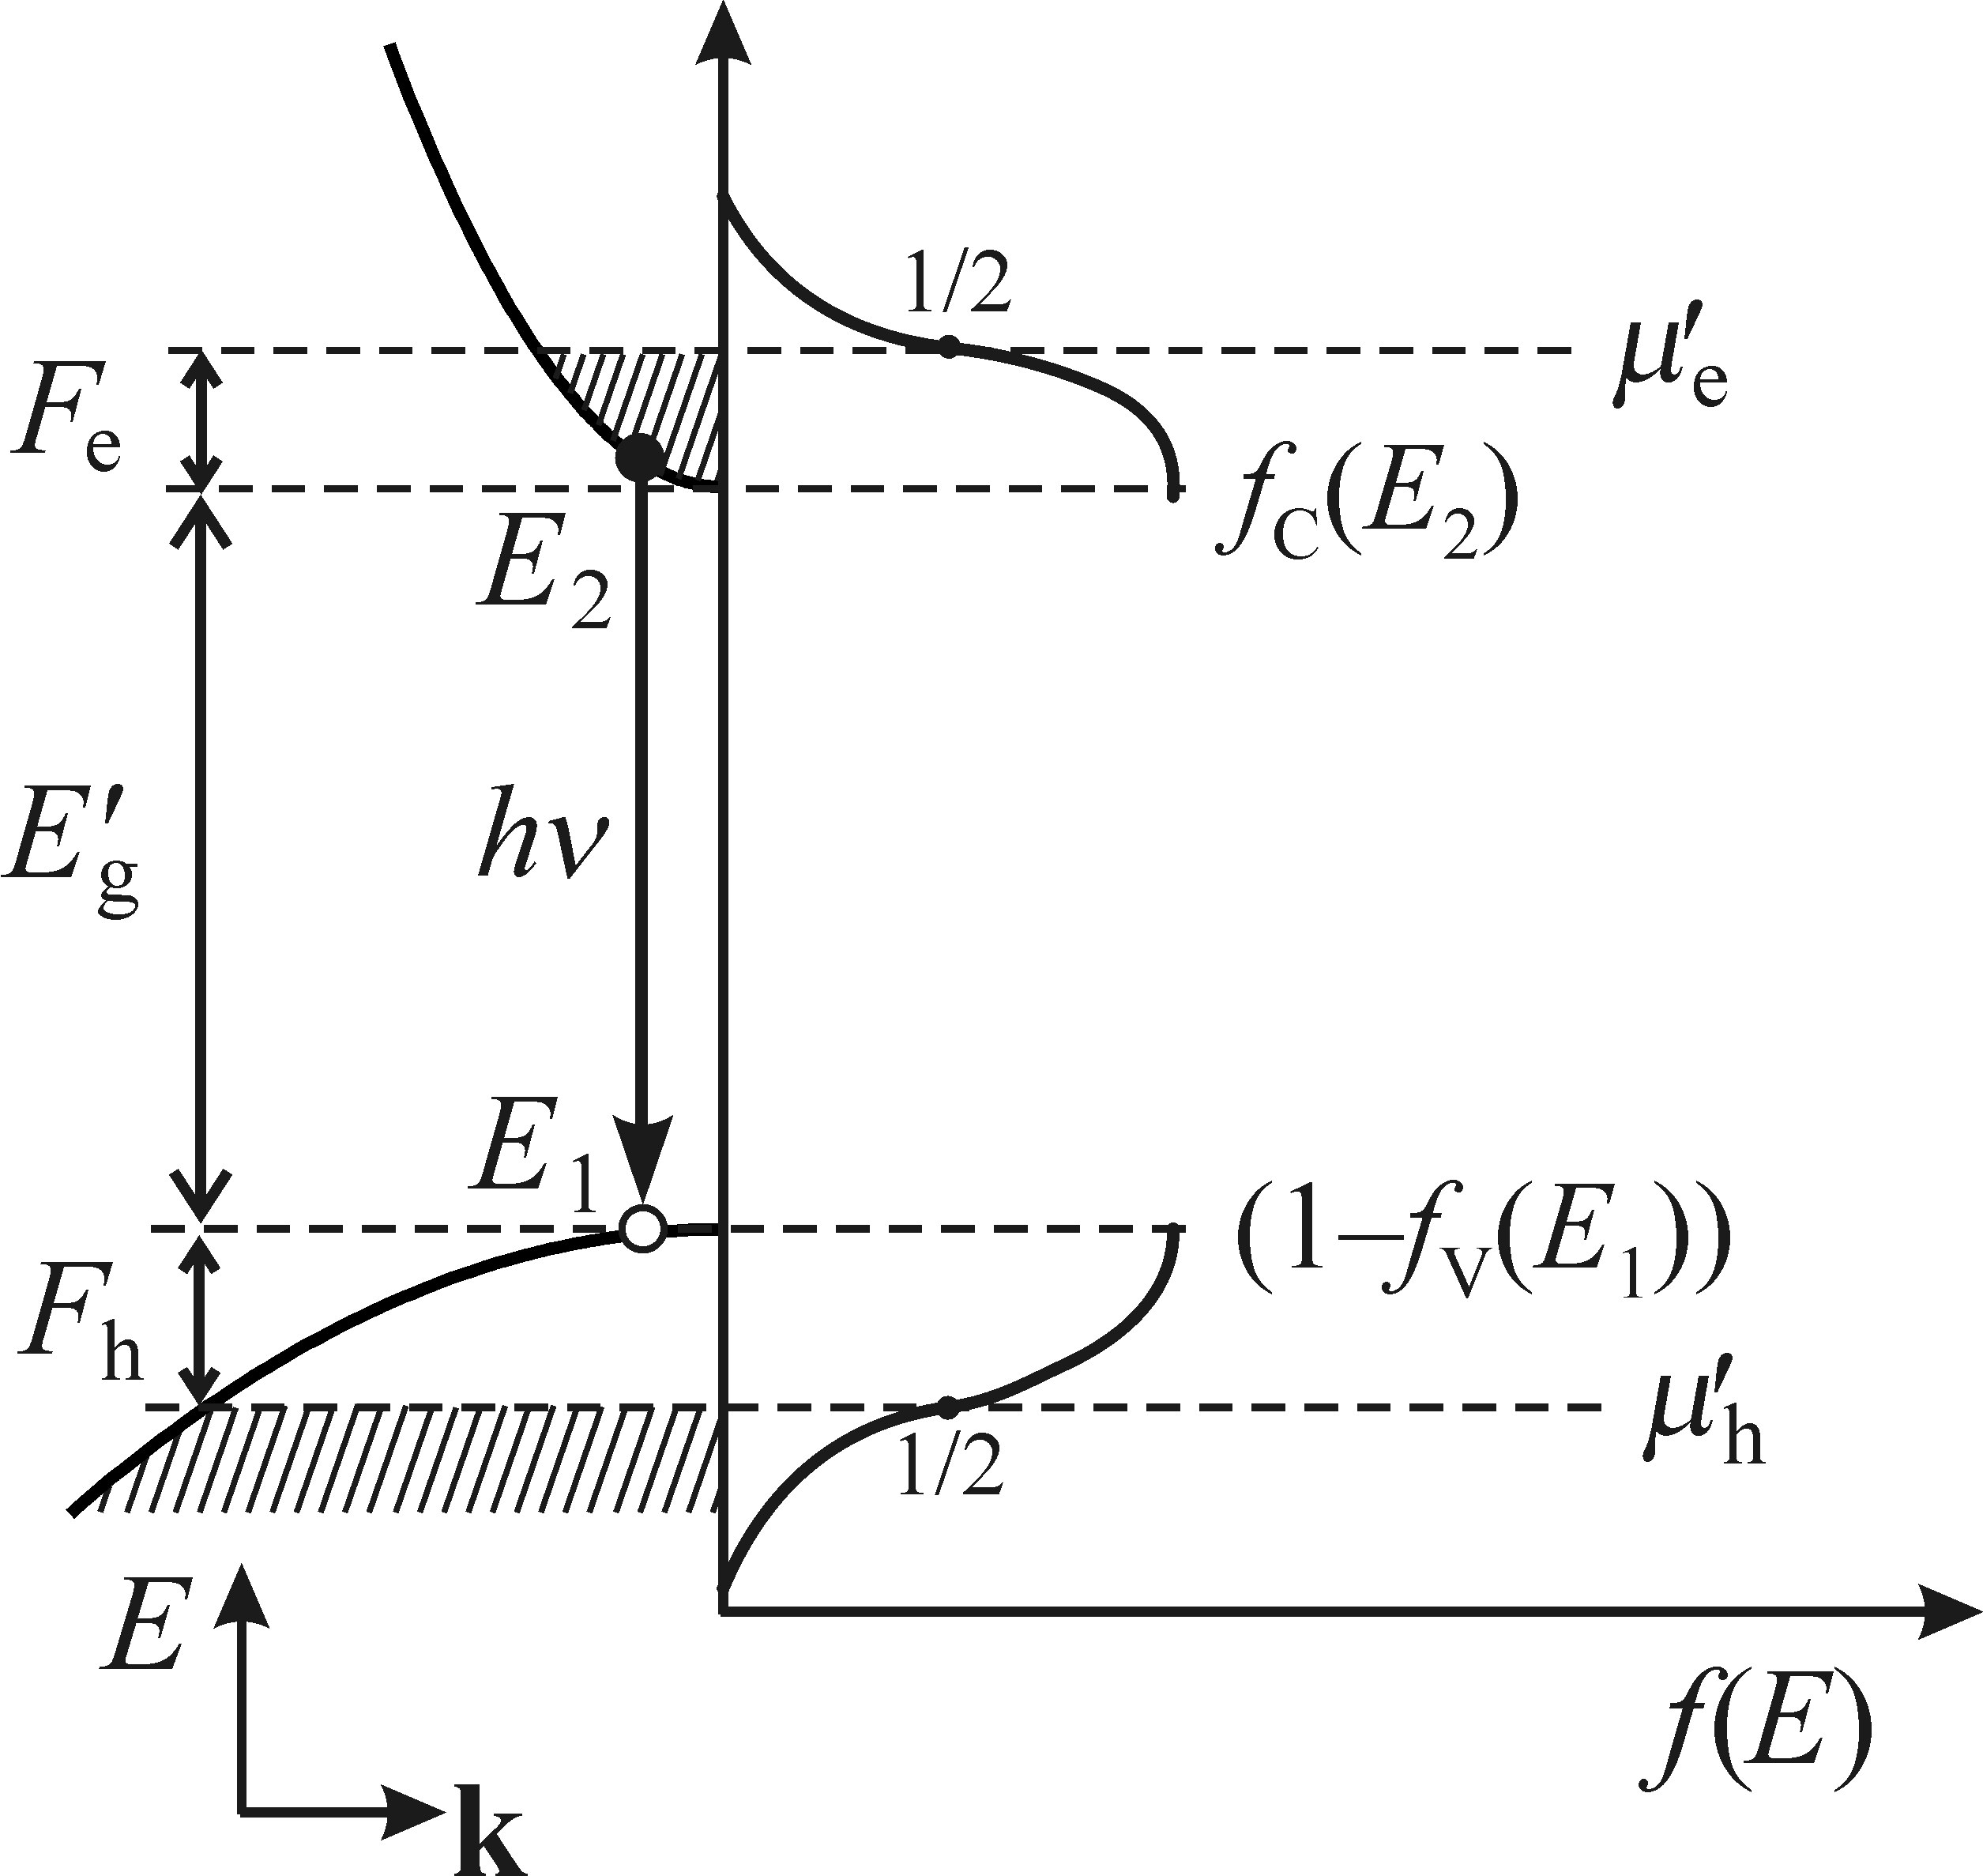


Spectral shape of the optical gain
Separate quasi-Fermi level for electrons/holes
Fermi inversion factor
Condition for the occurance of optical gain in semiconductors
Bernard-Duraffourg condition for inverse population of states for
a degenerate semiconductor
Inversion population in atomic levels:
In quasi-continua states:
Amplification of light through stimulated emission in semiconductors occurs only for photons arise from radiative transitions between states in CB with probabilty of being occupied by electrons larger than ½, and states in VB with the probability of being occupied by electrons lower than ½.

Slide 26
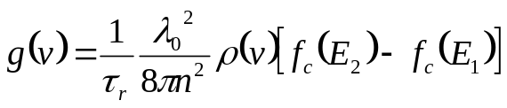


Spectral shape of the optical gain

Slide 27


Spectral shape of the optical gain
EHP: Ignoring k-conservation law
Inhomogeneousely distributed e-h pairs distorts the ideal translational symmetry of the lattice
The presence of impurity atoms
Radiative EHP recombination k conservation is hold locally through multiple collisions between electrons & holes
More precise calculation of Gain:
Transition Matrix
Numerical factor (effective mass-several VBs)

Slide 28



Spectral shape of the optical gain
High concentration of e-h pairs: relaxation of k conservation
Naturally: Gain would depend on pumping intensity
At transitions to negative gains: have to change to square root dependence
Experiment observation: Not consistent
Doping of the semiconductors
For highly impure semiconductors the characteristic shape of the gain shouldn’t be observed
which is not true in experiment
Gentel Increase of gain close to (instead of square root dependance) and overall asymmetry of the gain curve: two corrections factors
Final state damping in EHP
Excitonic enhancement
Dashed lines: theory calculations, considering k-conservation law and
Final states damping and excitonic enhancement

Slide 29



Spectral shape of the optical gain
Spectral position of the gain with respect to the maximum of the spontaneous emission band
The effect of temperature on gain
The frequency factor in gain shape
The higher the temperature more difficult:
Factor enhances gain curve magnitude, more pronounced at low frequencies

Slide 30






Stimulated emission in indirect bandgap semiconductors
Longer radiative recombination, lower values of optical gain
Free carrier absorption (FCA): Drude model
Free electron gas with free electron concentration
Optical radiation frequency
Imaginary part of dielectric constant

Slide 31


Stimulated emission in indirect bandgap semiconductors

Slide 32
Experimental techniques for measuring the optical gain
Variable stripe length (VSL) technique
Pump and Probe method (P&P)
- Both techniques are based on direct measurements of the amplification of a weak probe beam
Difference: methods in the origin of probe beam

Slide 33










VSL technique
FCA
Impurities
Increase of stripe
length dx
Mode confinement factor
Solution
Modal gain
g(v) is material gain

Slide 34



VSL technique
High optical gain in 1970’s
Deviation between fitted line with
experimental data gets shorter with increasing excitation intensity: Gain saturation
Spectral narrowing by increase of l
High gain value
Low gain values, VLS is less reliable

Slide 35


VSL technique
In the case
Several parameters should be considered:
If t is too large
Const. pump intensity along stripe:
rectangular beam profile & uniformly
distributed pump energy
Part of Gaussian beam can be used
Constant efficiency of coupling of I(SPE)
to monochromator or detector
Diffraction of the pump beam on the slit
or razor blade, limiting utilization of the
stripe length

Slide 36

Pump and probe method (P&P)
Weak external probe beam
Changes in the absorption coefficient
of the probe beam

