Slide 1
Noise in mode-locked lasers
Part 1: Electroluminescence (11)
Part 2: Quantum wells (12.1-3)
Niels Meiser
Notes:
Introduction
1: electrical instead of optical excitation
More application based view.

Slide 2
Electroluminescence
Structure (as used in the book)
High-field EL (Destriau effect)
Injection EL
EL from a reverse biased pn-junction
(also high-field EL)
Notes:
three types of EL:
1 HFEL especially in manganese doped zink-sulfide
2 IEL via forward bias of ZnO, SiC, Ge, Si and eventually GaAs
3 Reverse biased pn is actually HFEL
EL usually studied at room temperature (non-radiative loss decreases with decreasing T, but also conductivity and mobility)

Slide 3
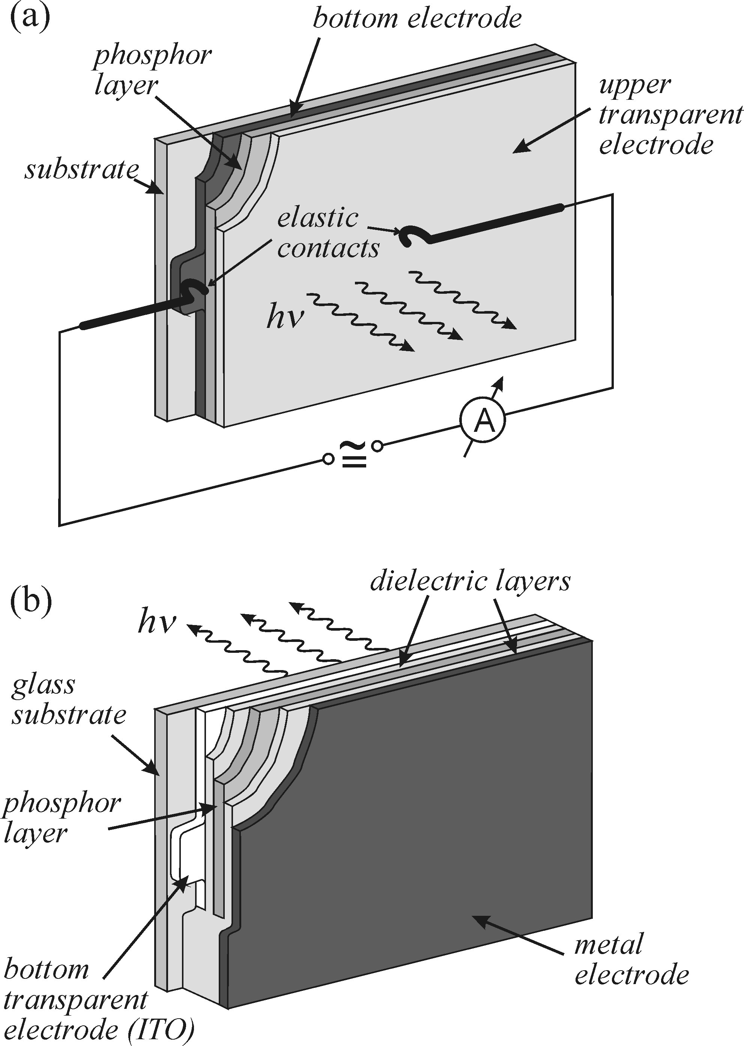
High-field EL
Notes:
Setup of structure, different interface configs
Either direct galvanic contact or insulator in between; one electrode typically transparent

Slide 4
High-field EL
Efficiencies of interest:
Excitation eff
excited luminescence centres per electron
Radiative eff
radiatively decays per excited centre
Outcoupling eff
photons emitted per photon generated
Total eff (all together)
photons emitted per electron injected
Notes:
efficiencies

Slide 5
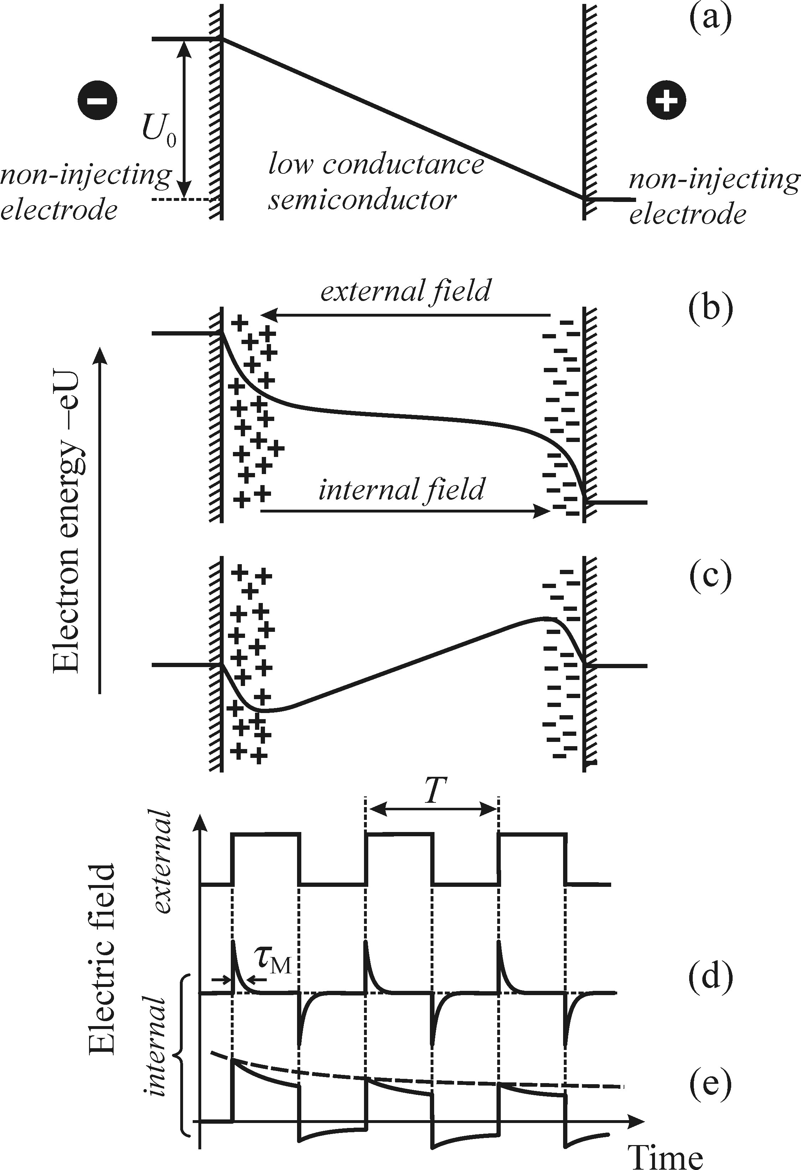
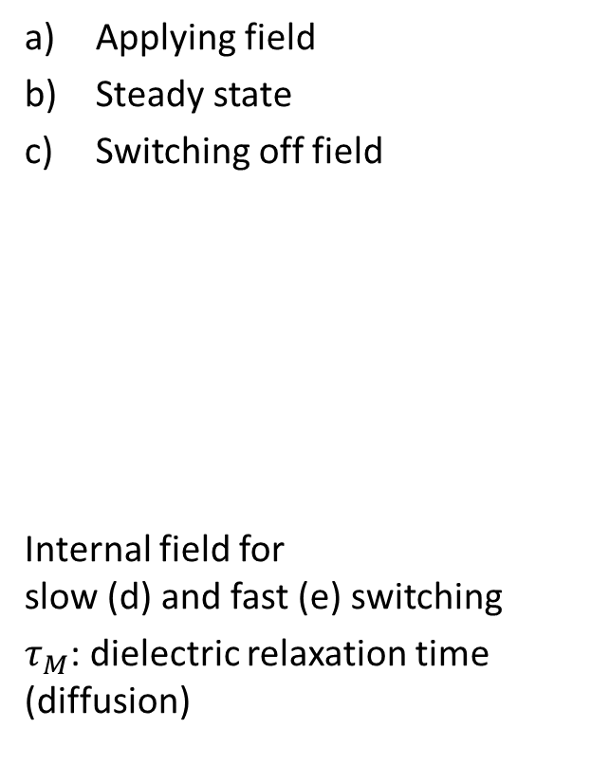
High-field EL
Applying field
Steady state
Switching off field
Internal field for
slow (d) and fast (e) switching
$τ_{M}$: dielectric relaxation time (diffusion)
Notes:
What happens when there is a field?
internal field (recap of p-n junction)
Apply voltage -> free carriers (from impurities or doping) travel to electrodes
-> internal field with oppiste sign offsets external field
-> (c) switching of ext voltage leads to reverse field in the structure
-> carriers start to diffuse with dielectric relaxation time ~1ps (mean time to disperse into material instead of recombining)

Slide 6
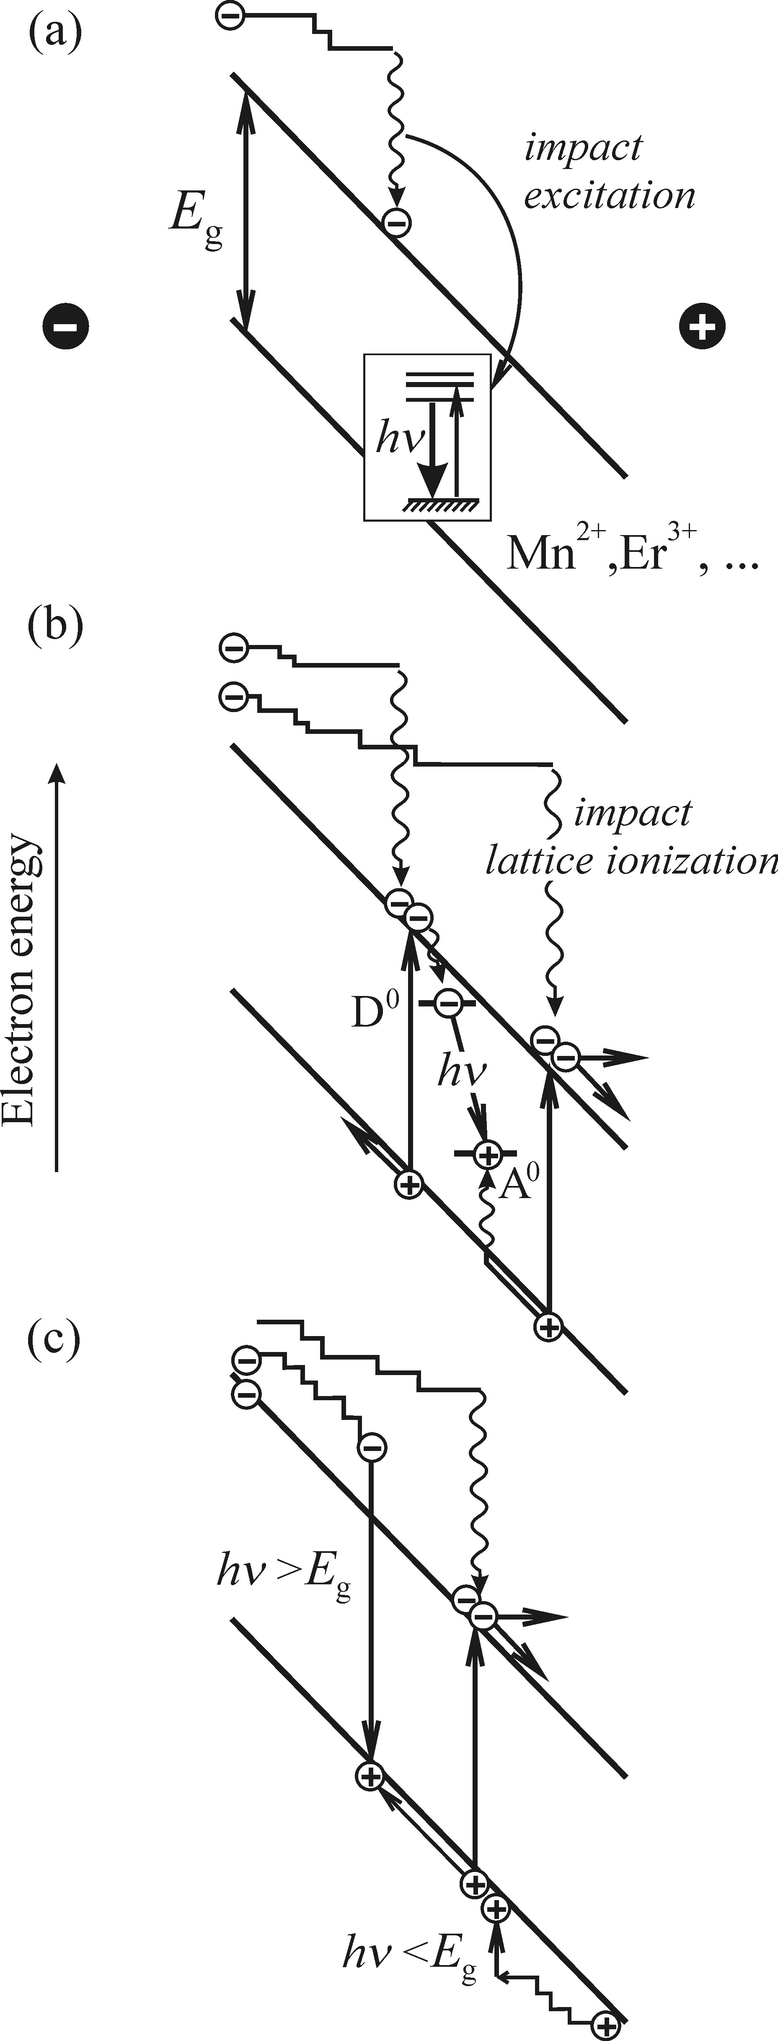
High-field EL
Impact ionisation and excitation:
Extrinsic luminescence via localised centres (sec 5.6)
Recombination via neutral acceptors and donors
Intrinsic recombination of free electron-hole pairs
Important: free carriers accelerated in field for impact ionisation!
High kinetic energy -> hot carrier
Notes:
What are the mechanisms in HFEL?
Most effects known from PL do not play a role. Only 3 radiative recomb mechs remain:
These three effects employ accelerated free carriers for impact ionisation end excitation
Since the accelerated electrons nrg has to be large (opical transition in centre), it is also called hot carrier
First discuss ionisation, origin of free carriers later
(see list)
Electrons are accelerated in field an collide with lumin centre (Mn2+); inelastic; nrg transfer; lumin via electronic transition
Electrons and holes collide with and transfer energy to neutral D/As and ionise them; recombination luminesces; h\nu < gap
Direct free carrier recomb, electron goes down (left)
C is intrinsic, a and b are extrinsic

Slide 7
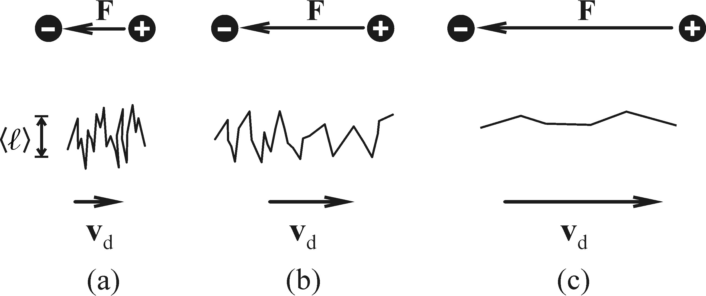
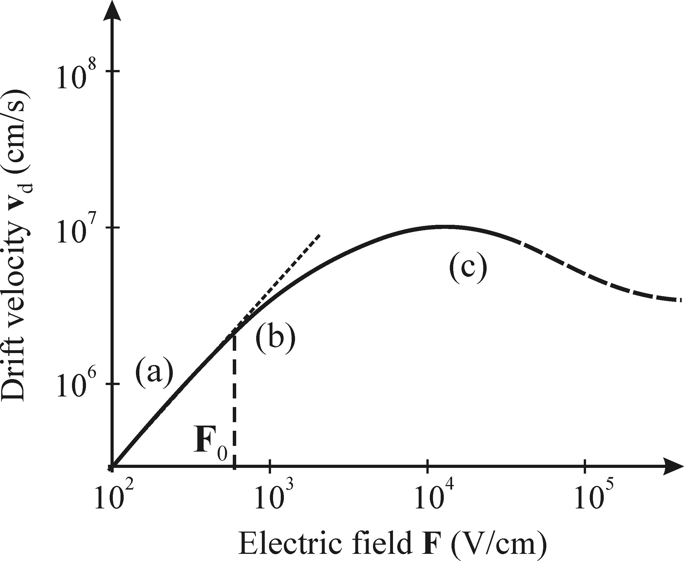
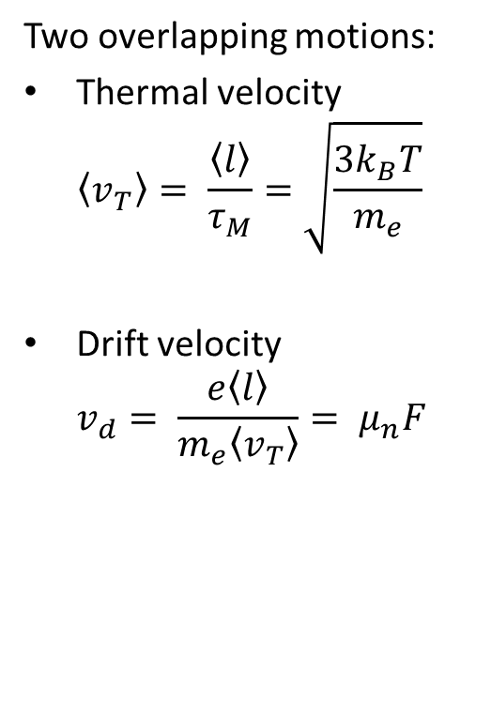
High-field EL – Drift velocity
Two overlapping motions:
Thermal velocity
$\left\langle v_{T}\right\rangle = \frac{\left\langle l\right\rangle }{τ_{M}}=\sqrt{\frac{3k_{B}T}{m_{e}}}$
Drift velocity
$v_{d}= \frac{e\left\langle l\right\rangle }{m_{e}\left\langle v_{T}\right\rangle }= μ_{n}F$
Intervalley scattering
mobility
External field strength
Notes:
How does the motion of the free carrier look like?
In addition to the regular thermal velocity, the free carrier experiences drift velocity via external field F
V_t is the mean velocity between two collisions
V_d depends on field strength, but is only linear, as long as v_d is smaller than v_T (which is determined by temperature) (a)
If field becomes reasonably strong (b), mean velocity v_T rises, since v_d appreciably accelerates carrier between two collisions. Mean velocity is now larger than thermal velocity (carrier becomes hot); carriers may lose nrg in form of acoustical phonons due to scattering -> mobility (i.e. Slope of v_d(F)) decreases
Once carrier can gain enough nrg for optical phonon emission, its energy and average drift velocity are drastically reduced upon scattering
At high energies, lattice ionisation might occur, generating more free e-h pairs -> avalanche effect
For high enough energies, free carriers might wander off to higher lying local band minima (intervalley scattering)

Slide 8
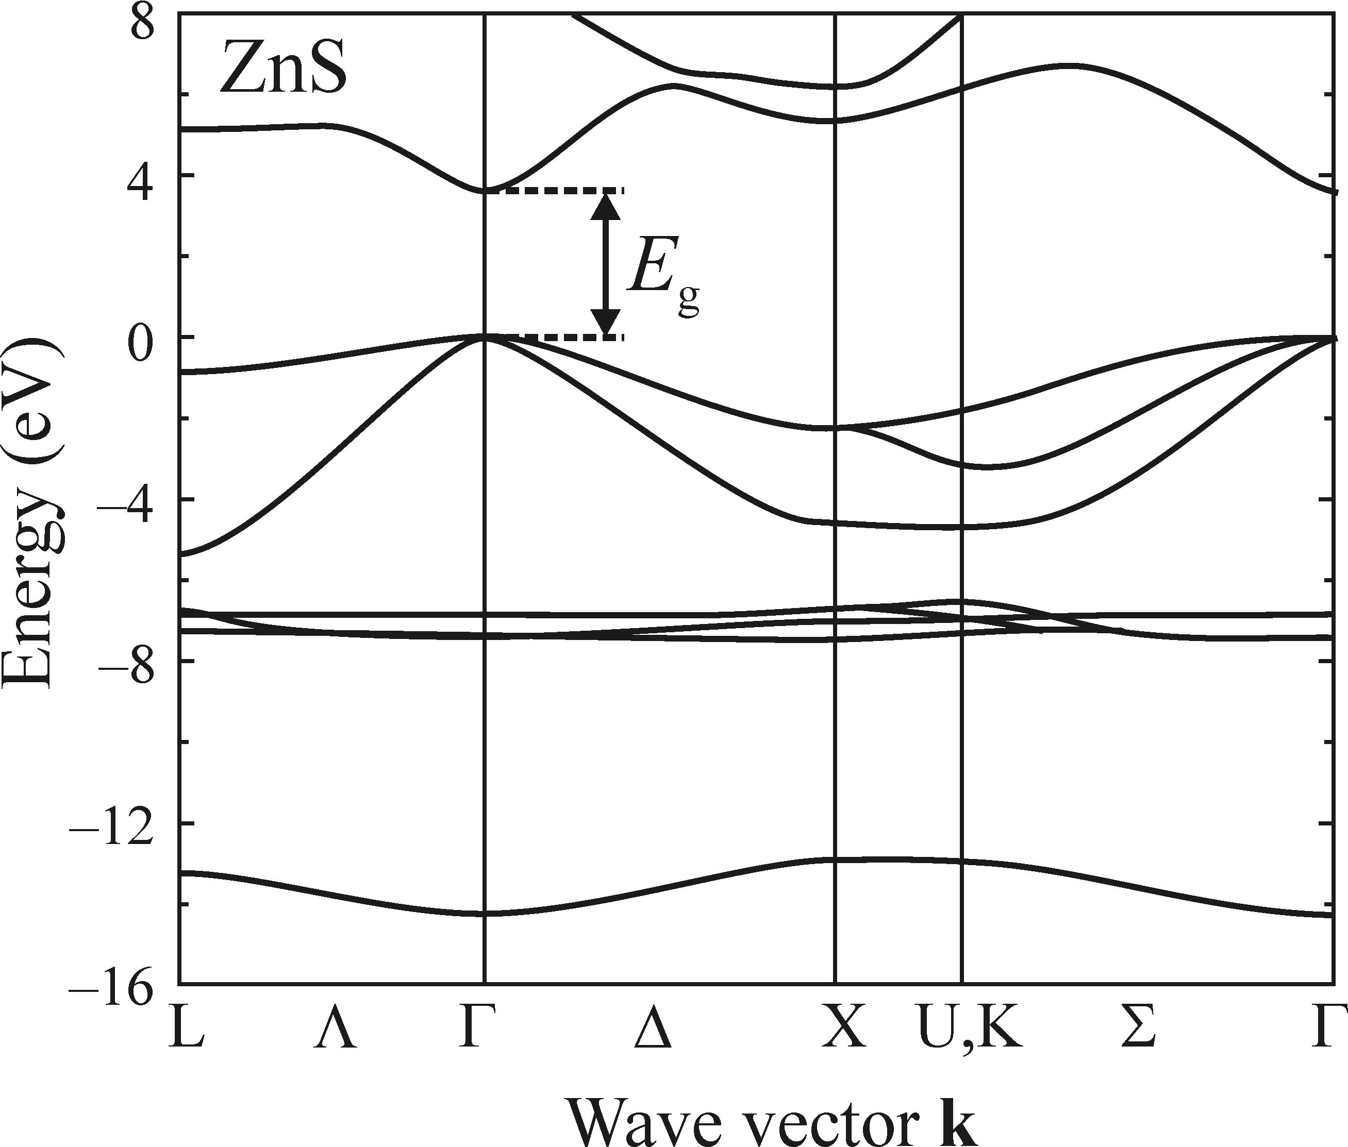
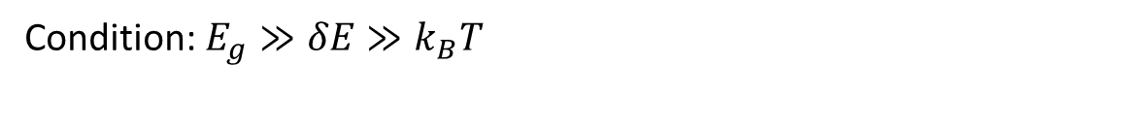

High-field EL
Intervalley scattering
$$δE$$
Condition: $E_{g}≫δE≫k_{B}T$
Notes:
Energy seperation between band minima has to be larger than kbT, so that o thermal population blocks the states and smaller than the gap, otherwise recombination over the gap is preferred
Other bands are usually shallower -> higher mass, lower mobility, lower velocity (see (c) on previous slide)

Slide 9
High-field EL
Generation of free carriers:
Injection
Release from deep trap
Release from interface trap
Notes:
How to generate free carriers?

Slide 10
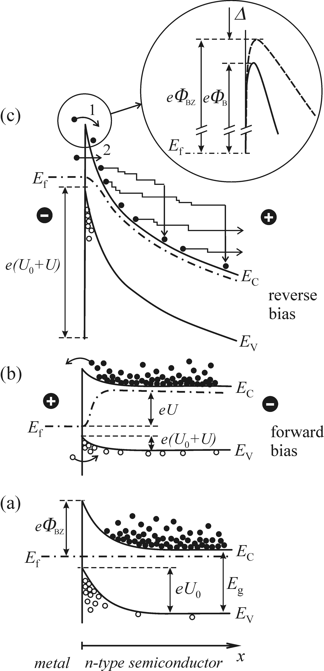
High-field EL
Injection via electrode
Only via reverse bias (c)
Reverse bias:
injection of majority carriers
lowers barrier
narrows barrier width
Forward bias:
injection of minority carriers
takes away electrons
destroys barrier
Steady state
Notes:
Forward and reverse bias, control of interface region, injection (1)
Two currents in the material: injection in the direction of external field and drift opposite to field
Injecting minority carriers: minoroty carriers will drift along the field and distribute evenly
Arrow 2 is Fowler-Nordheim tunneling

Slide 11
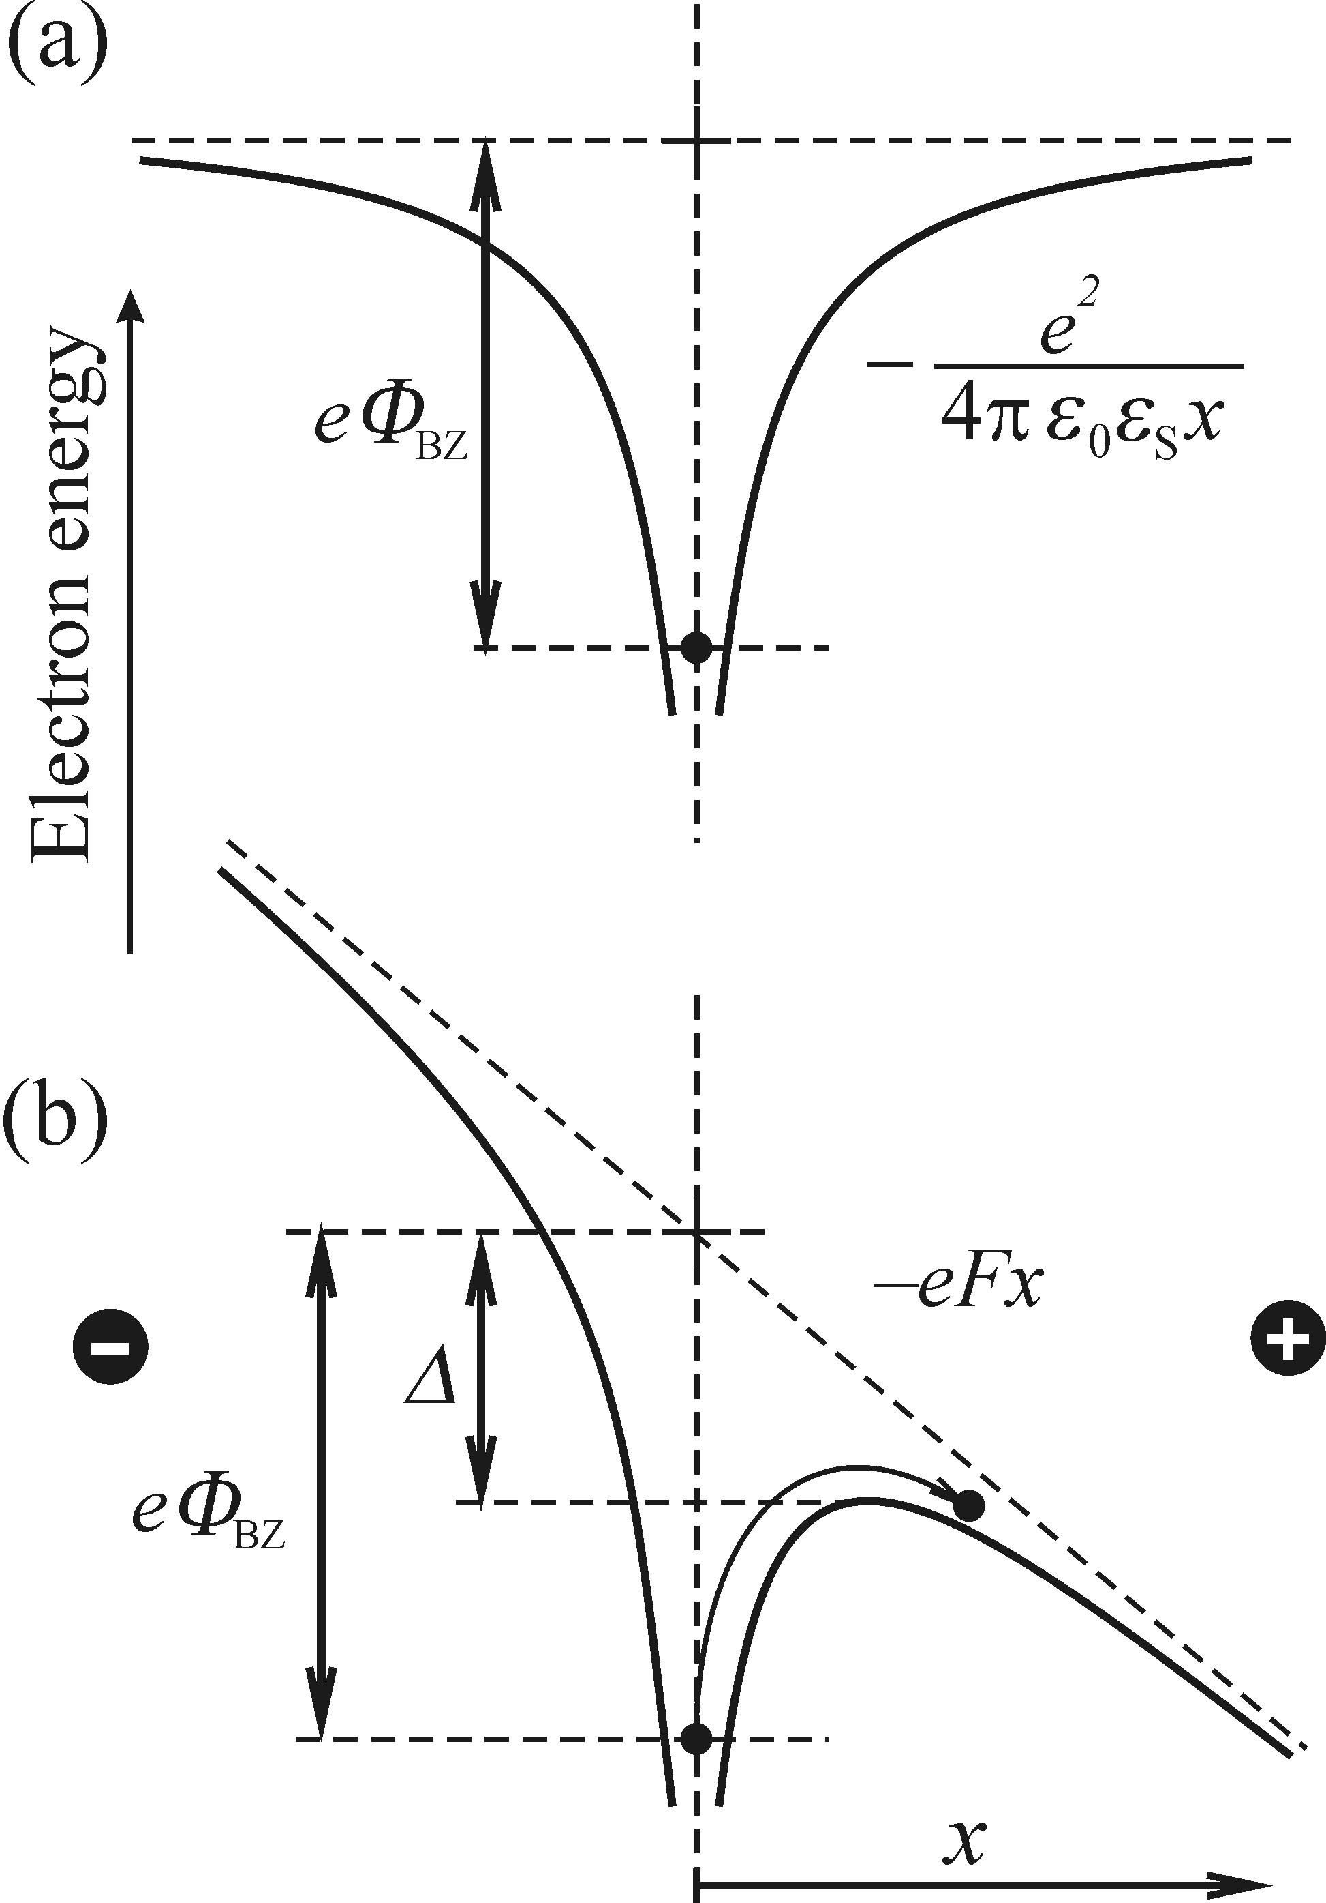
High-field EL
Release from deep trap
(carriers caught at impurities)
External field deforms potential
Carriers can spill over
(thermal release)
Tunneling becomes more
likely (10⁶ V/cm needed)
Poole-Frenkel effect
Tunnelling
Notes:
Release from traps (deep) (2)
Extrinsic effect
External field bends potential
Teo ways for escape:
1 lower barrier -> spill over (Poole-Frenkel)
2 tunnelling (current is not temperature dependent)

Slide 12
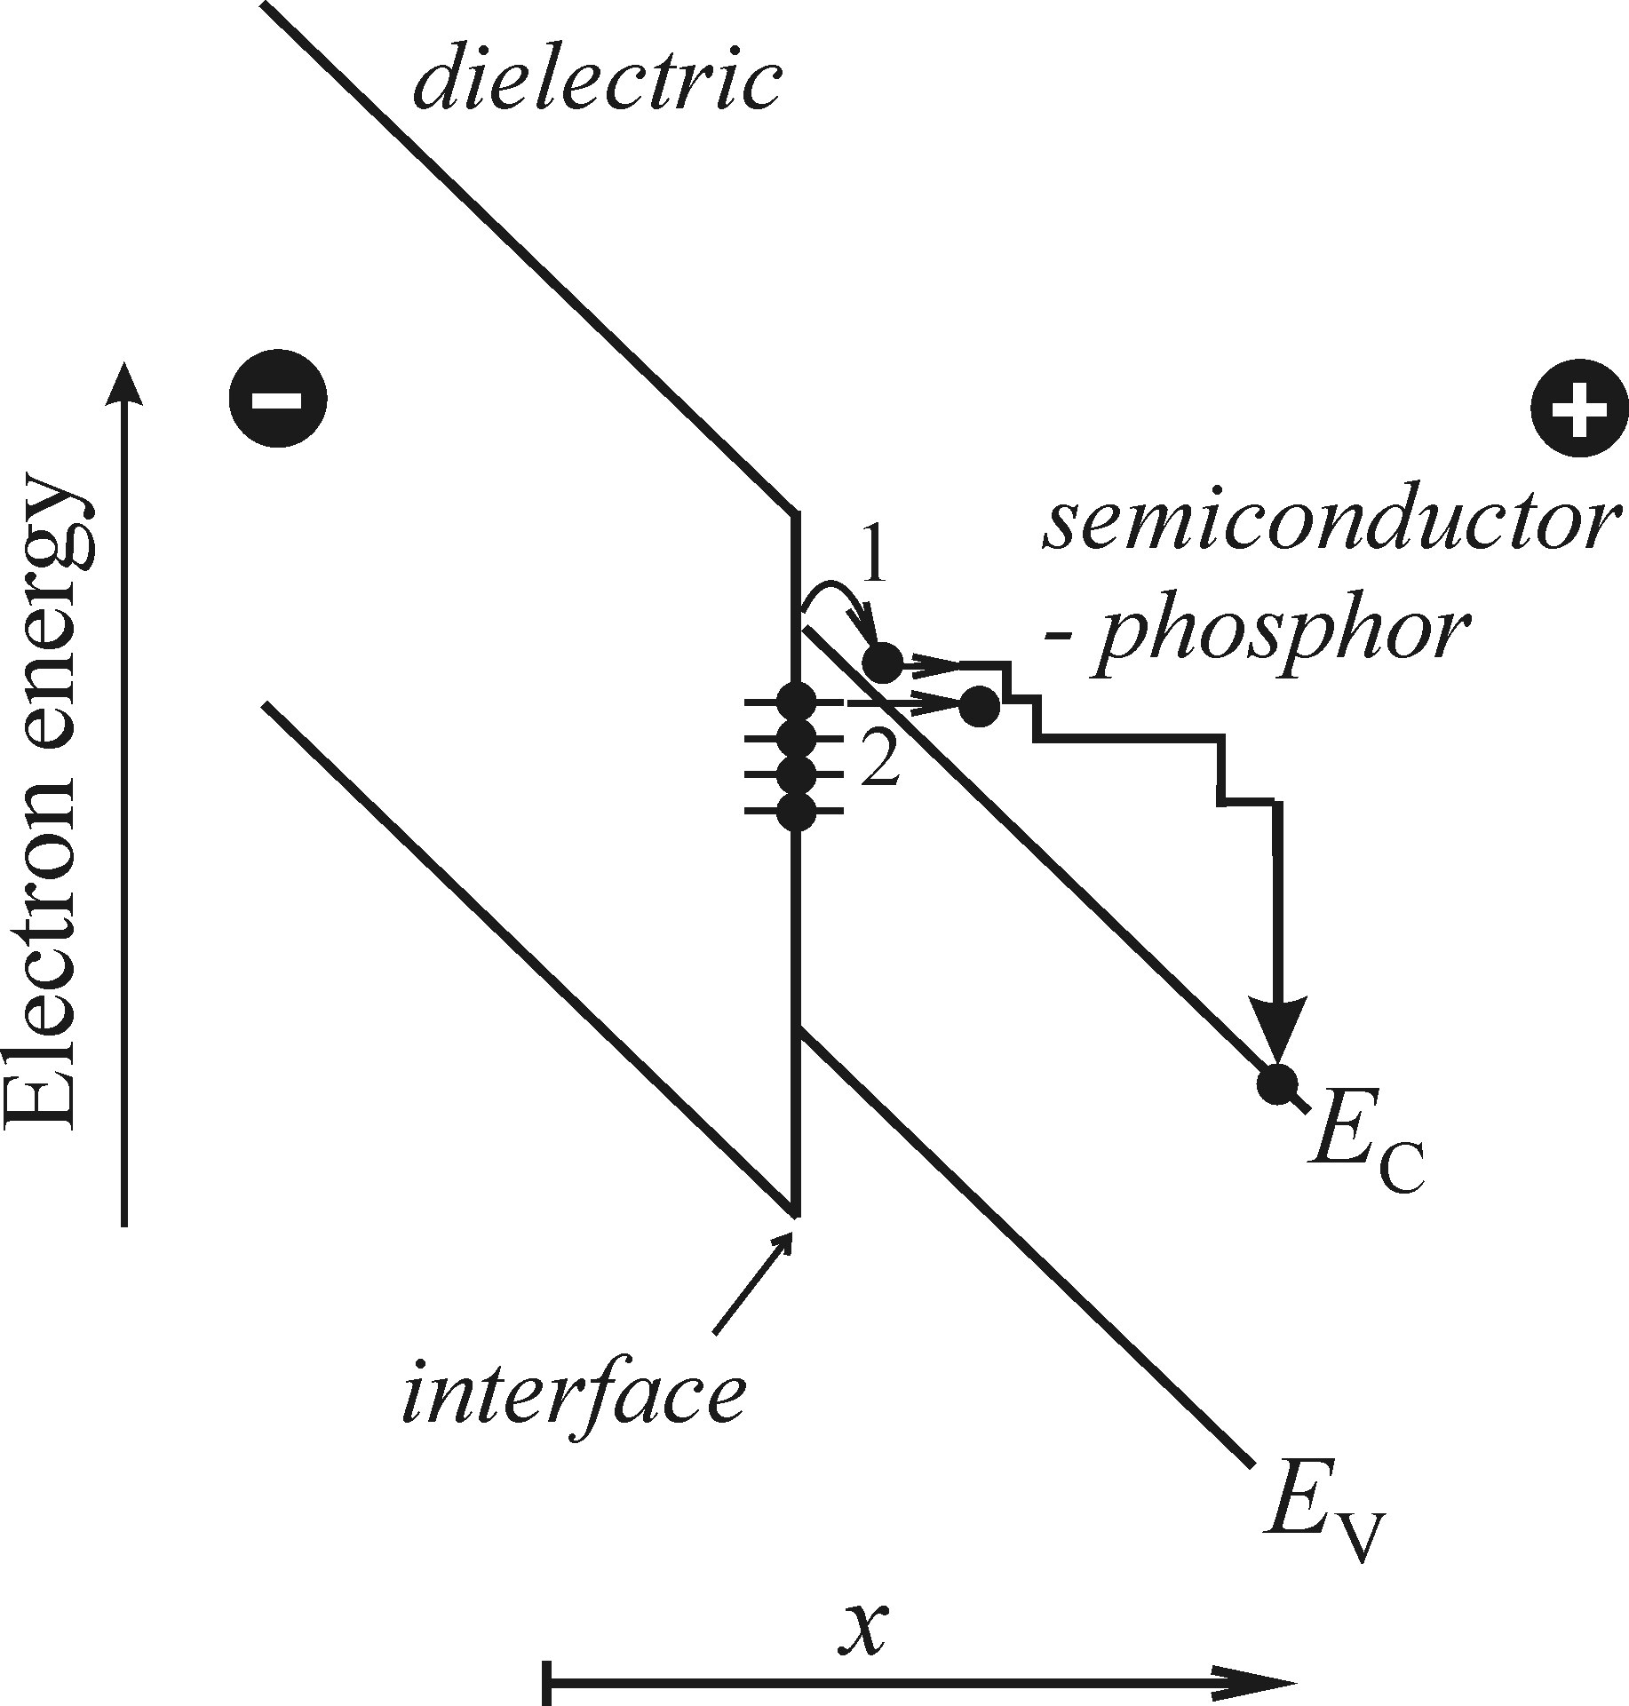
High-field EL
Active layer surrounded by insulator
Traps at the boundary
Notes:
Release from traps (interface), (3)
Active layer surrounded by isolator
Lattice defects at boundary act like traps
Injection possible via Poole-Frenkel and tunnelling (like in case of deep traps)

Slide 13
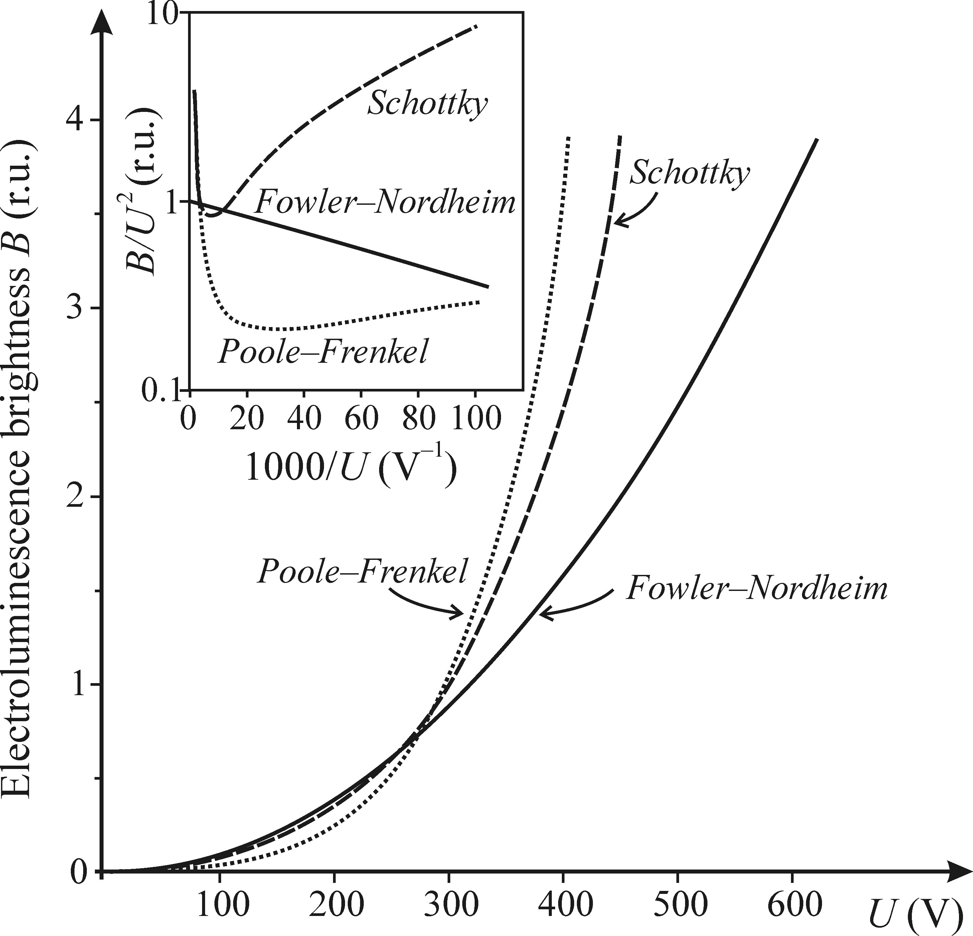

High-field EL – Intensity contributions
Shottky
(over the barrier)
$j=T^{2}\text{exp}\left(\frac{a\sqrt{U}}{T}−\frac{eΦ_{BZ}}{k_{B}T}\right)$
Poole-Frenkel
(escape deep trap)
$j≈U \text{exp}\left(\frac{b\sqrt{U}}{T}\right)$
Fowler-Nordheim
(tunneling)
$j≈U^{2} \text{exp}\left(−\frac{b′}{U}\right)$
Notes:
Luminescence intensity characteristics of three mechanisms
All three effects with mathematical description
Difference becomes clear, when using special axes
From this, one can deduce the principal effect at work
However, mixing is possible and one should be careful
Wide range of voltages should be tested.

Slide 14
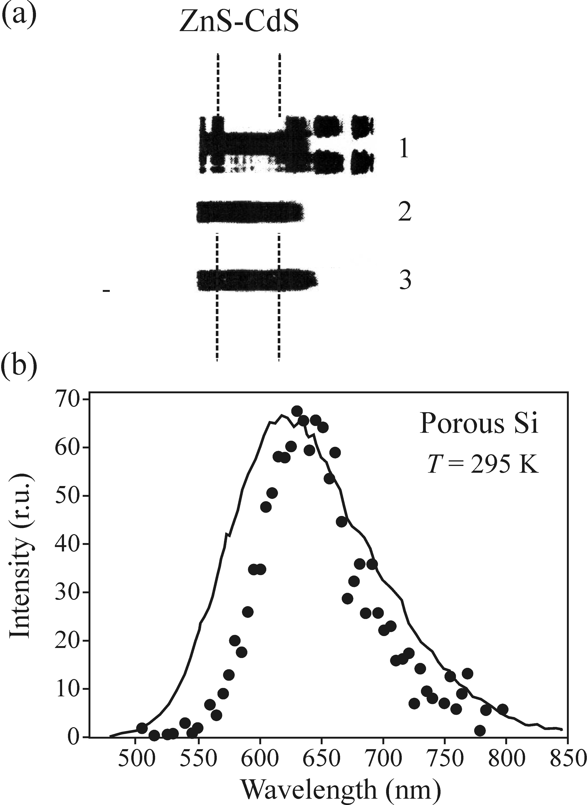
High-field EL - Spectra
Photoluminescence
Electroluminescence
Wavelength
Electroluminescence
Photoluminescence
Notes:
Comparison EL and PL
If curves look alike, than the same luminescence centre is active
They might differ though because of PL excitation wavelength dependence or EL AC-current frequency dependence

Slide 15
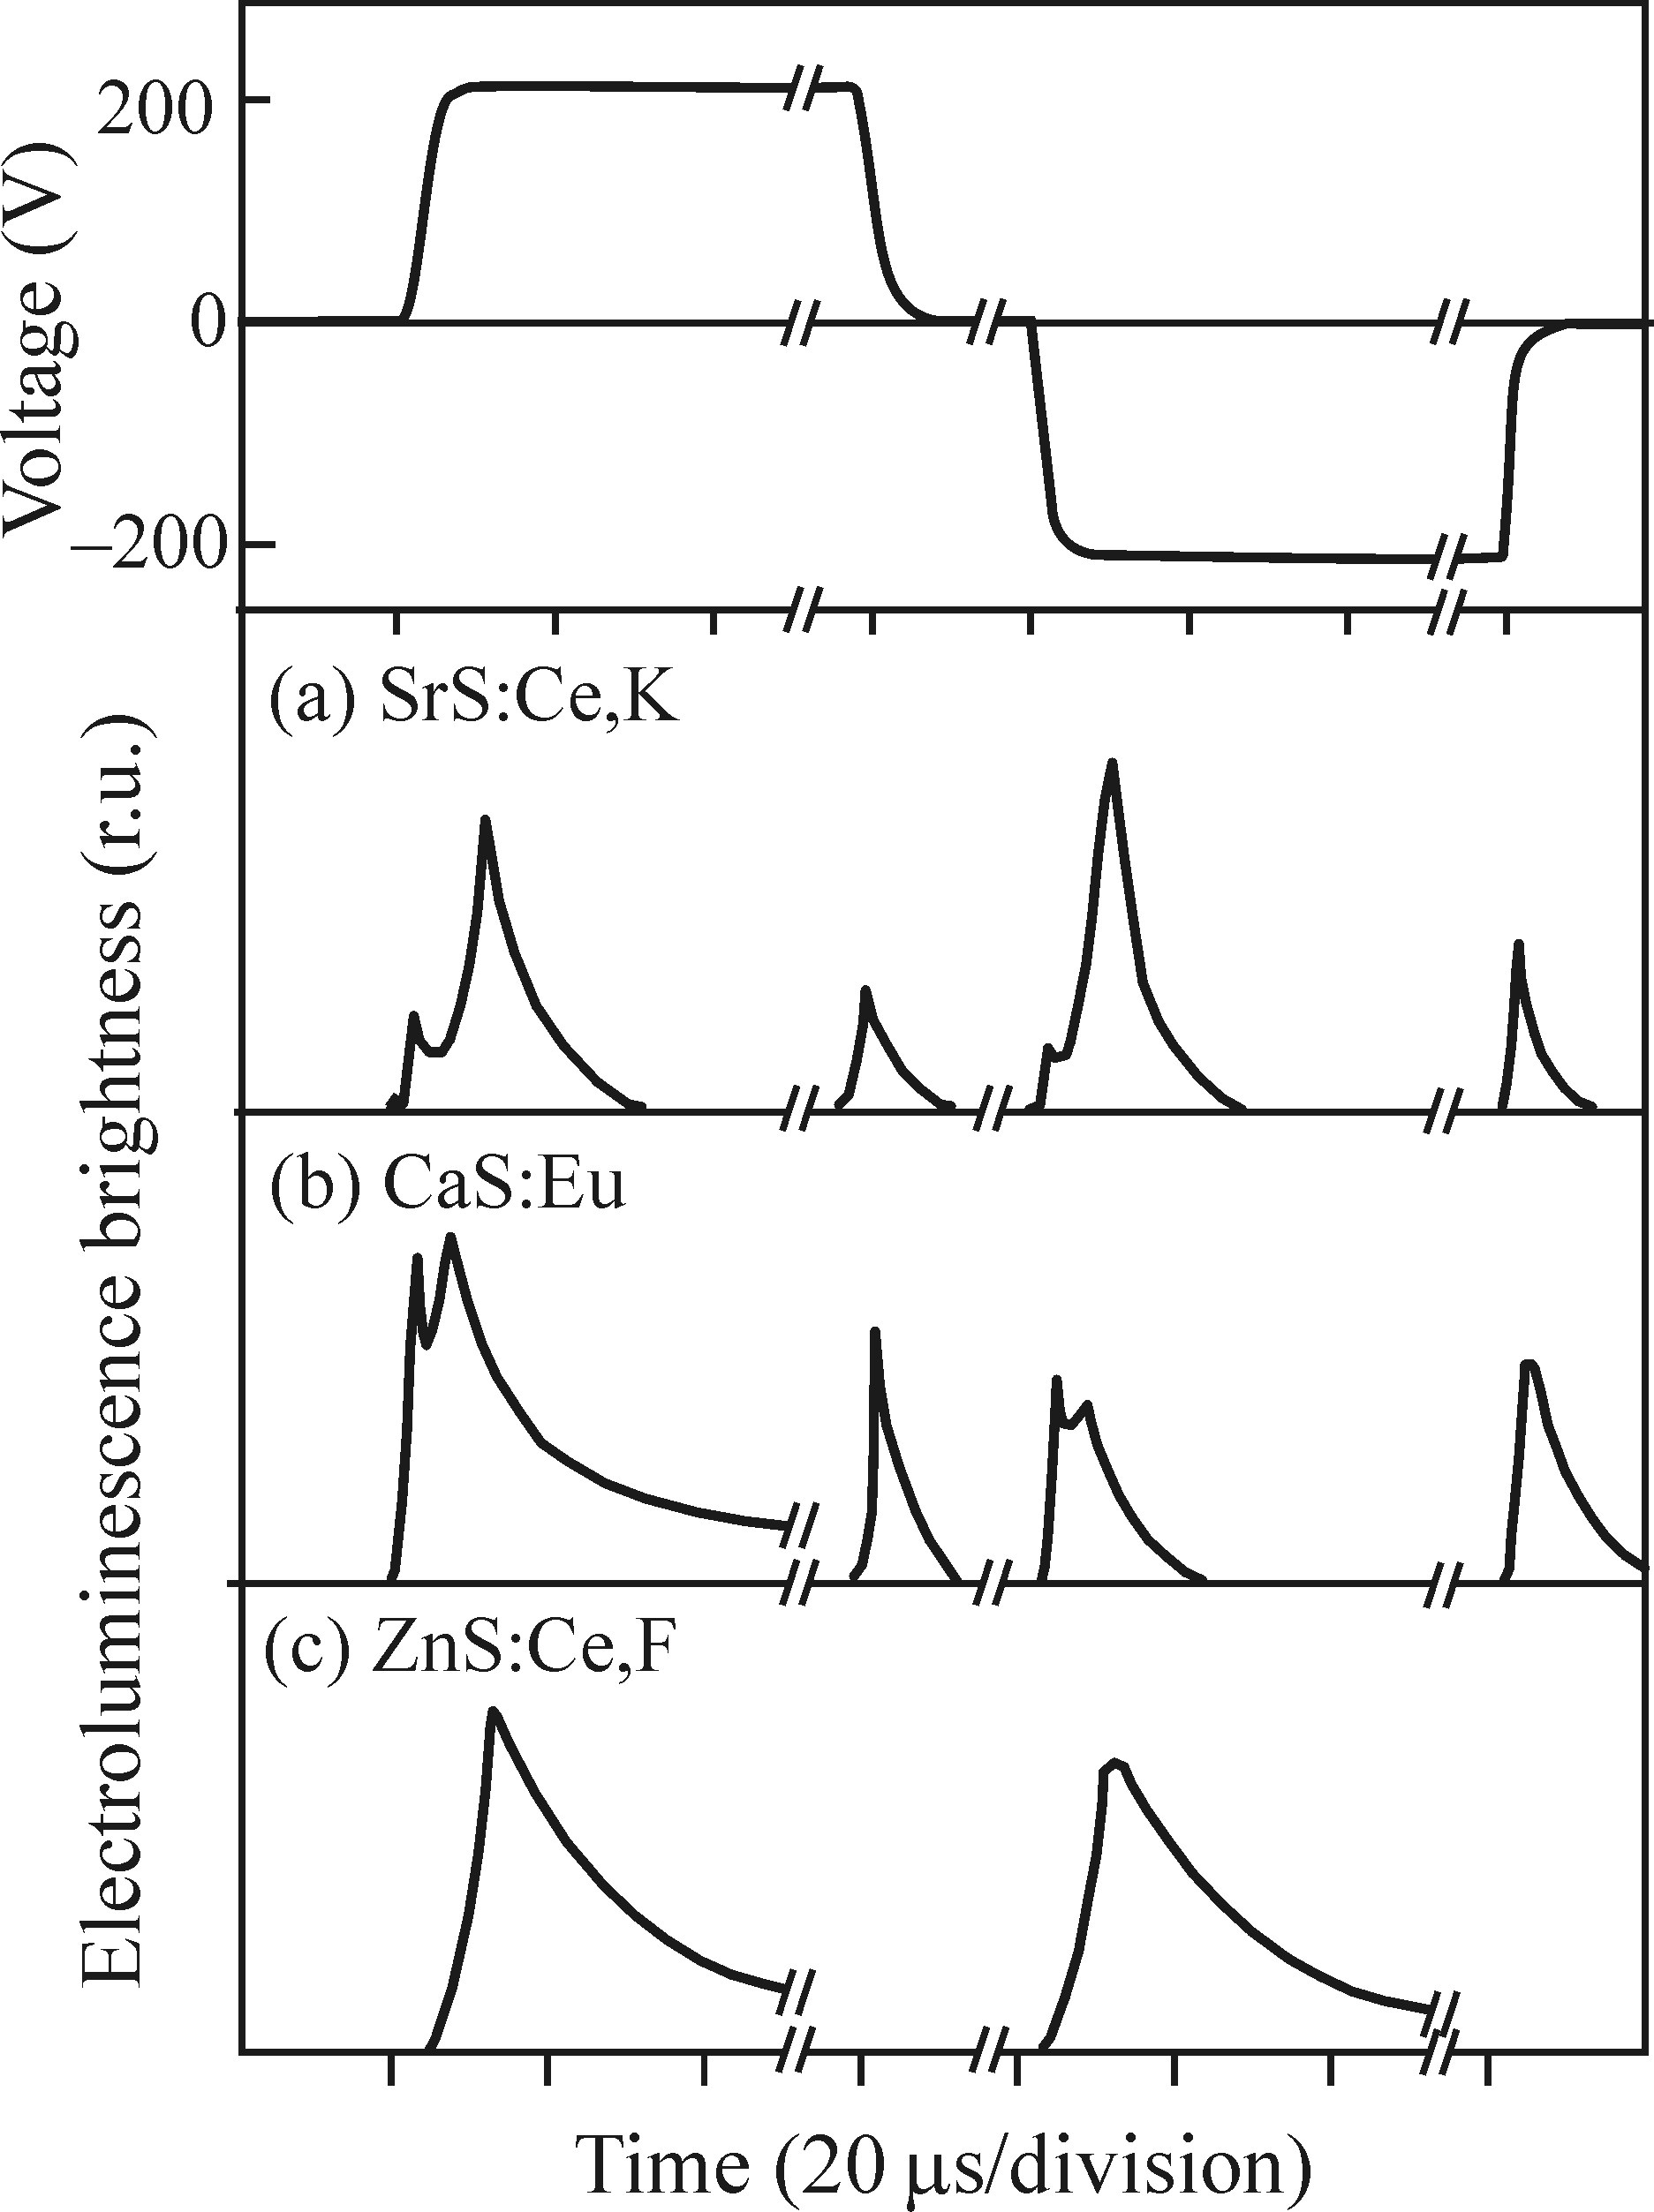
High-field EL – Transient behaviour
Rare-earth doped IIa-VIb compunds
Release of trapped electrons
No switch-off pulse,
due to band structure
Notes:
Temporal behaviour of EL
Sandwich structure biased with alternating voltage flashes
Luminescence centres (Ce, Eu) are further ionised
Released electrons are trapped and released when voltage is switched off
Band structure of ZnS does not support this mechanism

Slide 16
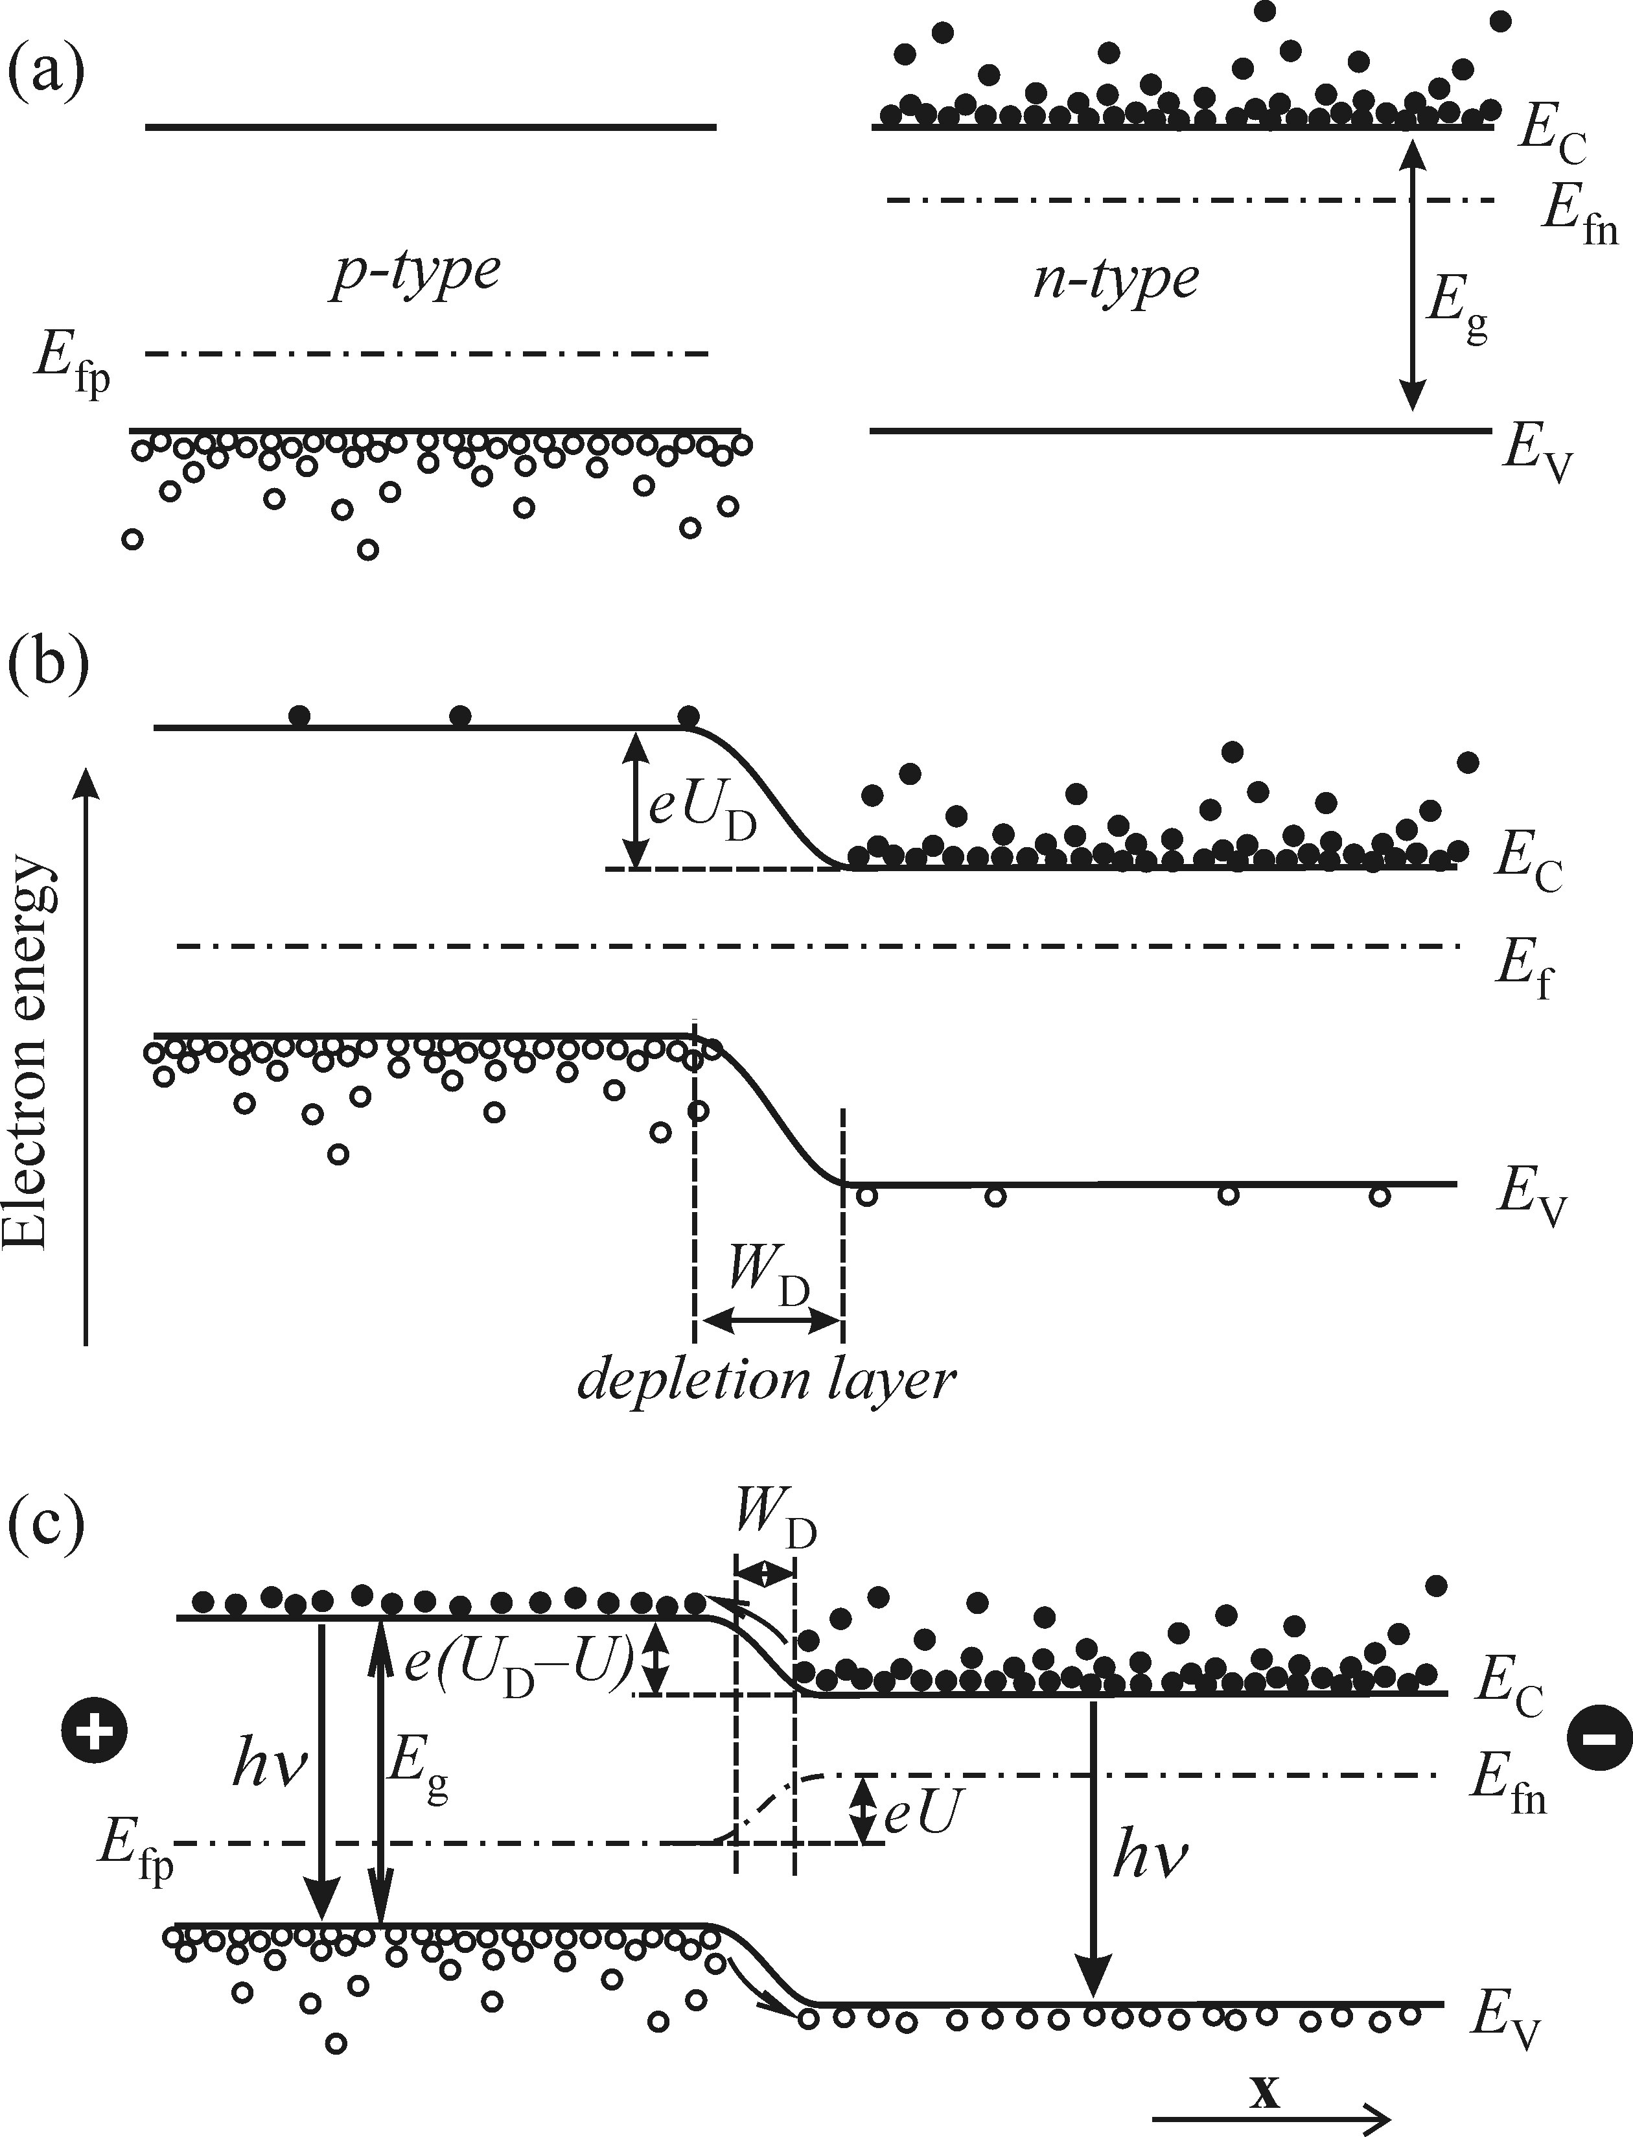
Injection EL
Diffusion potential
Forward biased
Minority carrier injection
Notes:
Overview of the process
Upon contact of p- andn-type material depletion region formes via diffusion of carreirs
P charges negatively, n charges positively
Resulting internal field (+ to -, i.e. n to p) prevents further charge movement
Barrier with diffusion potential U_D created
Forward bias pushes majority carriers of respective region towards depletion layer
Potential lowered, depletion reduces
Majprity carriers from one section are injected into the other as minority carriers
This provides high concentration of both types of carriers at the same space -> radiative recombination

Slide 17
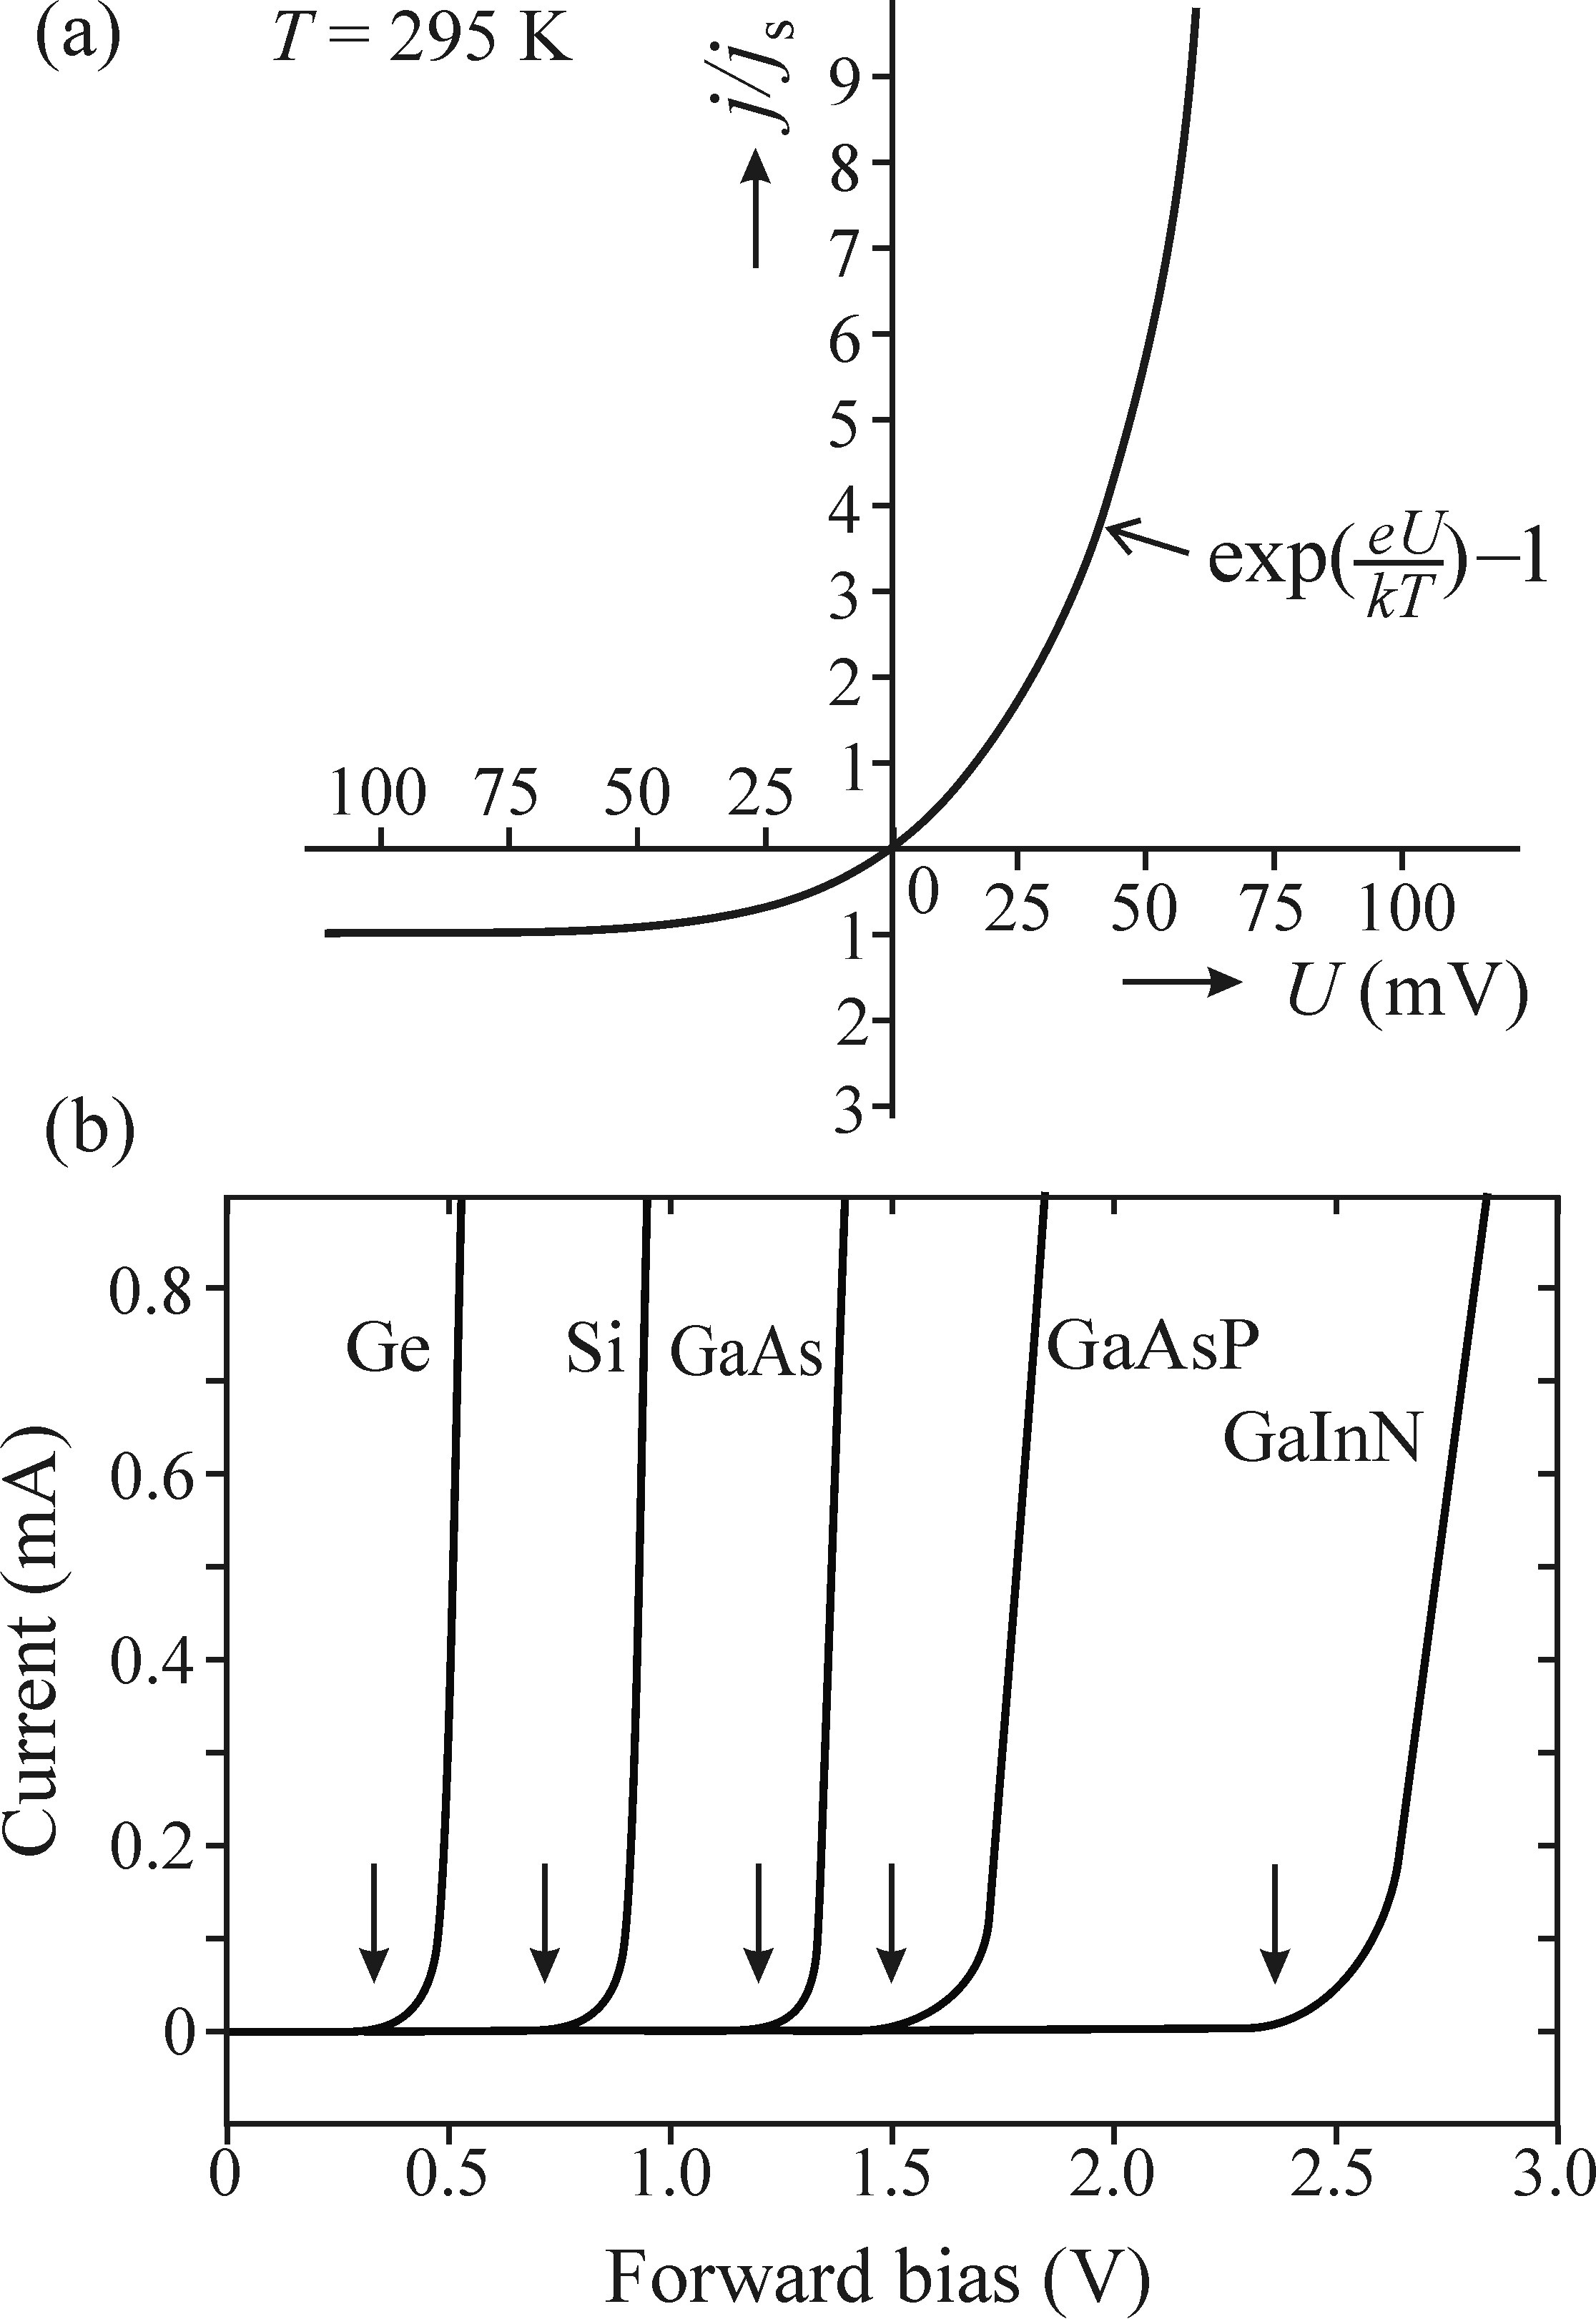
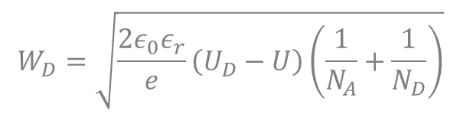
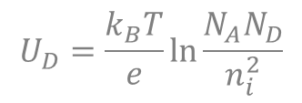

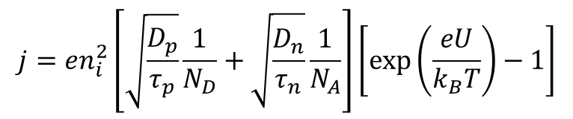
Injection EL – Electrical properties
$$U_{D}=\frac{k_{B}T}{e}\ln{\frac{N_{A}N_{D}}{n_{i}^{2}}}$$
$$W_{D}=\sqrt{\frac{2ε_{0}ε_{r}}{e}\left(U_{D}−U\right)\left(\frac{1}{N_{A}}+\frac{1}{N_{D}}\right)}$$
Shockley equation:
$$j=en_{i}^{2}\left[\sqrt{\frac{D_{p}}{τ_{p}}}\frac{1}{N_{D}}+\sqrt{\frac{D_{n}}{τ_{n}}}\frac{1}{N_{A}}\right]\left[\text{exp}\left(\frac{eU}{k_{B}T}\right)−1\right]$$
$j_{s}$: saturation current
Notes:
(Electrical props. of p-n: Shockley equation for current, extreme cases)
Exact formulation of U_D and W_D (assuming full ionisation of dopants, i.e. carrier concentration equals dopant concentration)
n_i is intrinsic carrier concentration
observations: U_D prop. to donor concentration; W_D decreases with don. conc. and increases with U (forward bias)
expression for current through the pn-junction can be found: Shockley equation
contains two parts:
1 exponential increase for forward bias
2 constant saturation current for reverse bias (ultimately break down will occur)

Slide 18
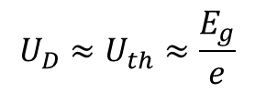
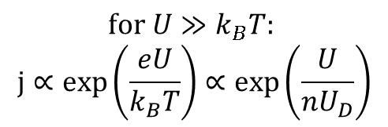
Injection EL – Large forward bias
$$\text{for} U≫k_{B}T\text{: }$$
$$\text{j}∝\text{exp}\left(\frac{eU}{k_{B}T}\right)∝\text{exp}\left(\frac{U}{{nU}_{D}}\right)$$
Ideality factor
Threshold bias
Gap: sum of
- (lowered) barrier potential
- Fermi level displacement
- Fermi levels (relative to bands)
$$U_{D}≈U_{th}≈\frac{E_{g}}{e}$$
Notes:
(Threshold bias, ideality factor)
When applying a forward bias larger then kT, Shockley can be approximated by exponential law
with characteristic voltage U_D as threshold voltage
threshold depends on material
gap energiy is composed of
1 the barrier reduced by forward bias
2 the Fermi levels relative to the corresponding band
3 the displacement of the Fermi levels due to the external potential (forward bias)
Fermi level displacement (3) is usually negligible compared to gap in highly doped materials
threshold thus determined by gap (Threshold is potential needed to get a charge across the gap)
threshold is a metrial parameter
for real curves a phenomenological ideality factor n >1 is introduced to compare real pn-junction to perfect case n=1

Slide 19
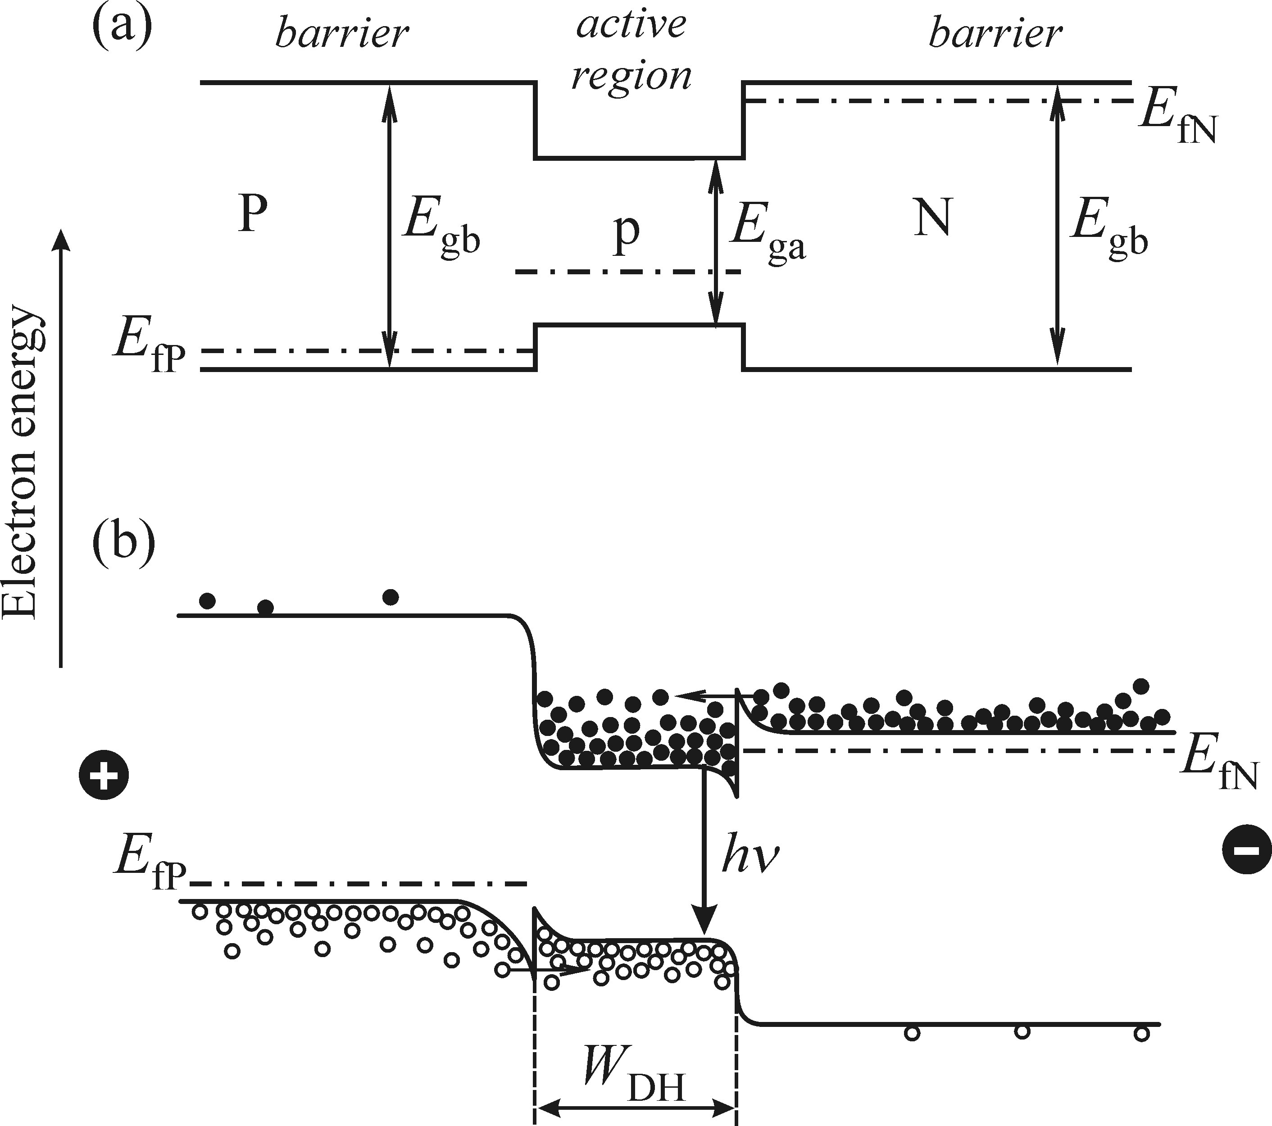

Injection EL - Heterojunction
Double heterostructure
increased efficiency
waveguiding possible
Spatial confinement to region $W_{DH}<L_{D}$
Notes:
(Heterostructures for efficient EL, benefits)
active region is surrounded by heavily doped, i.e. wider bandgap material
spatial confinement keeps carriers closer than diffusion length (W_D ~1µm, L_D ~10µm)
higher concentration -> more luminescence
larger gap in barrier material also means larger refractive index
-> waveguiding along the region
-> laser action across the region (larger gap: barrier material is transparent)

Slide 20
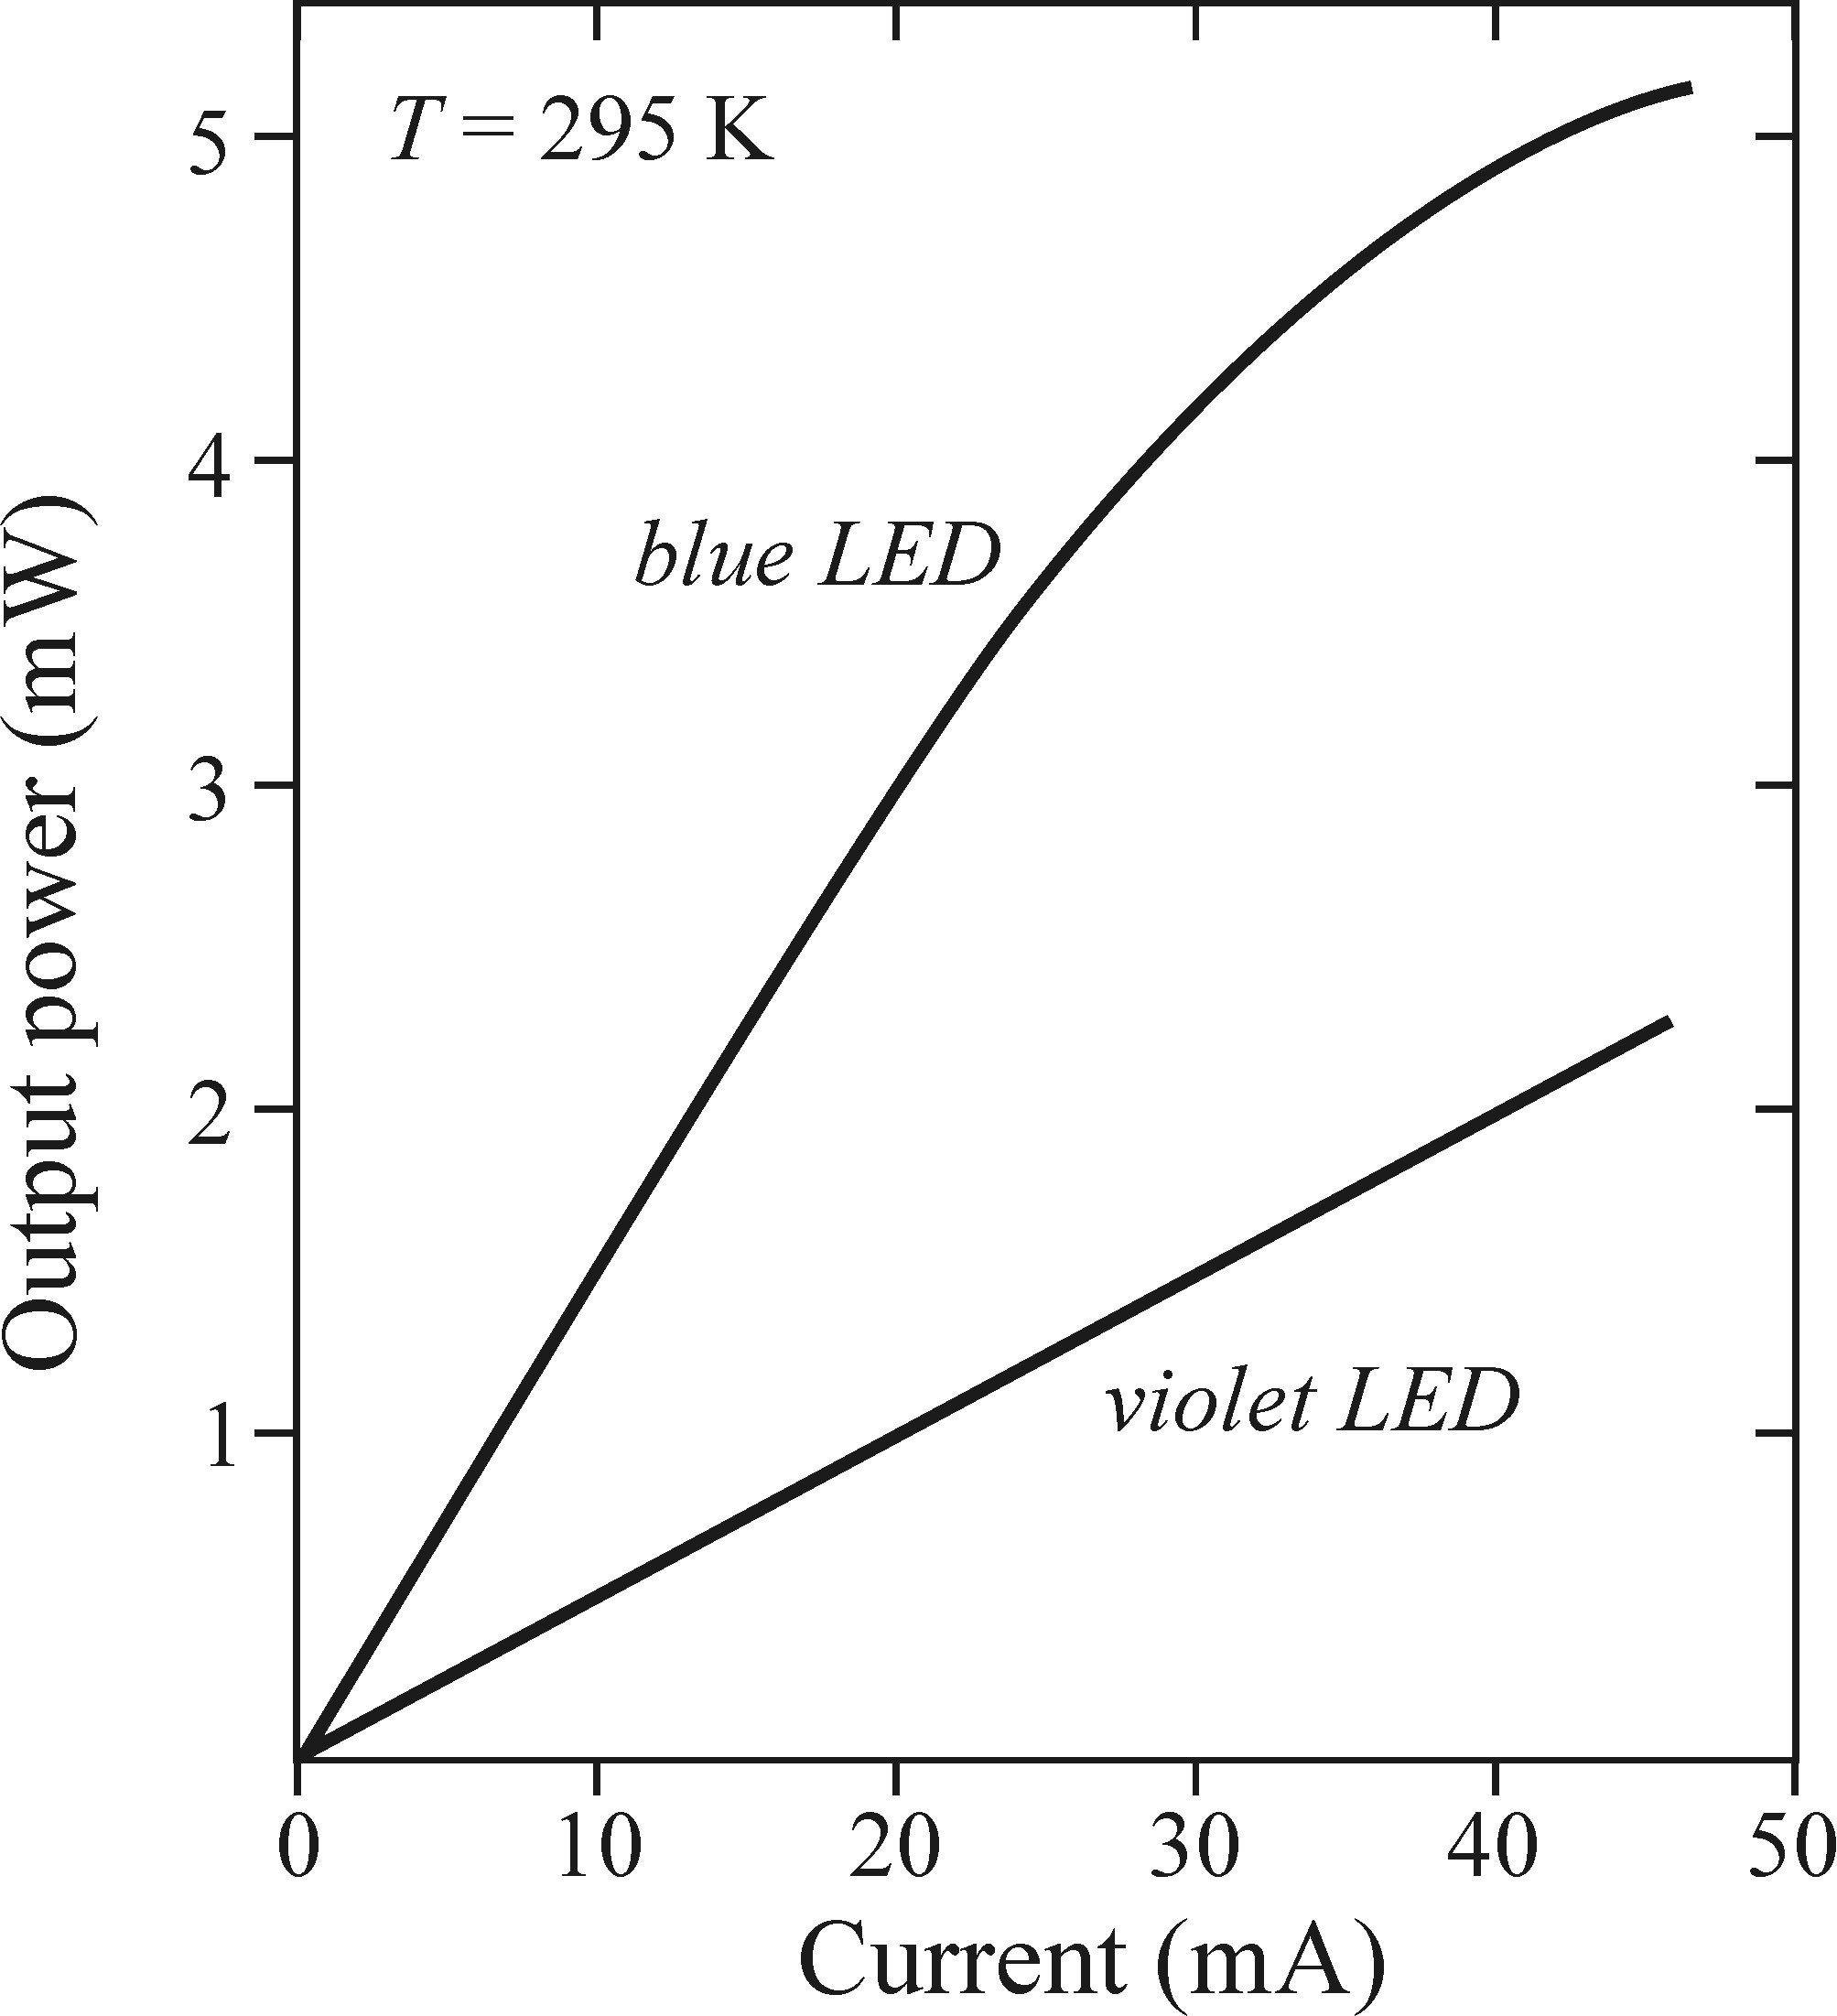
Injection EL – LED intensity
Acceptor-donor pairs (extrinsic)
InGaN:Si,Zn
InGaN
Band-to-band recombination (intrinsic)
Slope is linear close to threshold
Notes:
Intensity characteristics, depend on mechanism
starts linear after threshold
origin of blue luminescence is recomb of acceptor-donor pairs (i.e. extrinsic), which saturates at high currents
origin of violet luminescence is intrinsic band-to-band (bimolecular) recombination, which does not saturate
saturation might also occur in heterostructures due to carrier-overflow, i.e. active layer 'well' is full and carriers leak into barrier regions

Slide 21
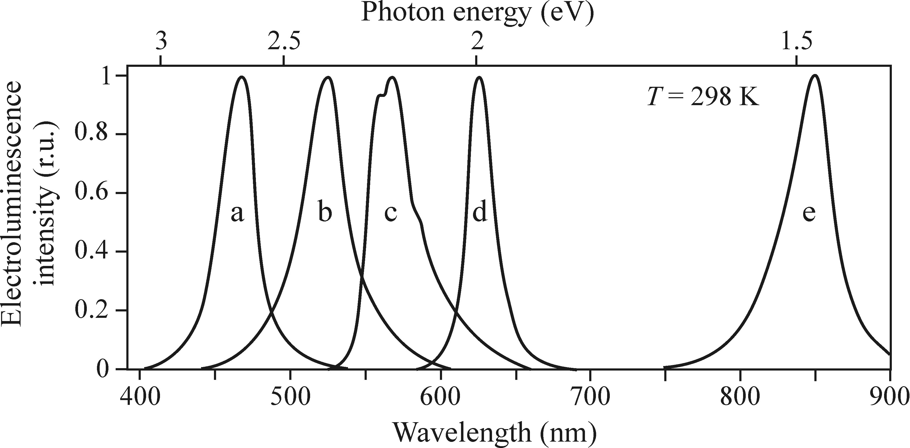
Injection EL
Indirect gap transition (GaP:N) leads to structuerd spectrum (c)
X-TO
X-LO
NN
GaInN
GaP:N
AlGaAs
GaInN
AlGaInP
Notes:
emission wavelength depends on gap
often used: acceptor-donor pairs or excitons bound to impurities
-> then wavelength can be longer (lower energy)
typical spectral widths are 50-100meVindirect gap transitions can be recognised by their spectral structure
short wavelength peaks are different because of different phonon transitions involved
long wavelength-side signal is attributed to recombination of two excited and neighbouring nitrogen atoms
GaInN: ratio of constituents tunes gap and wavelength

Slide 22
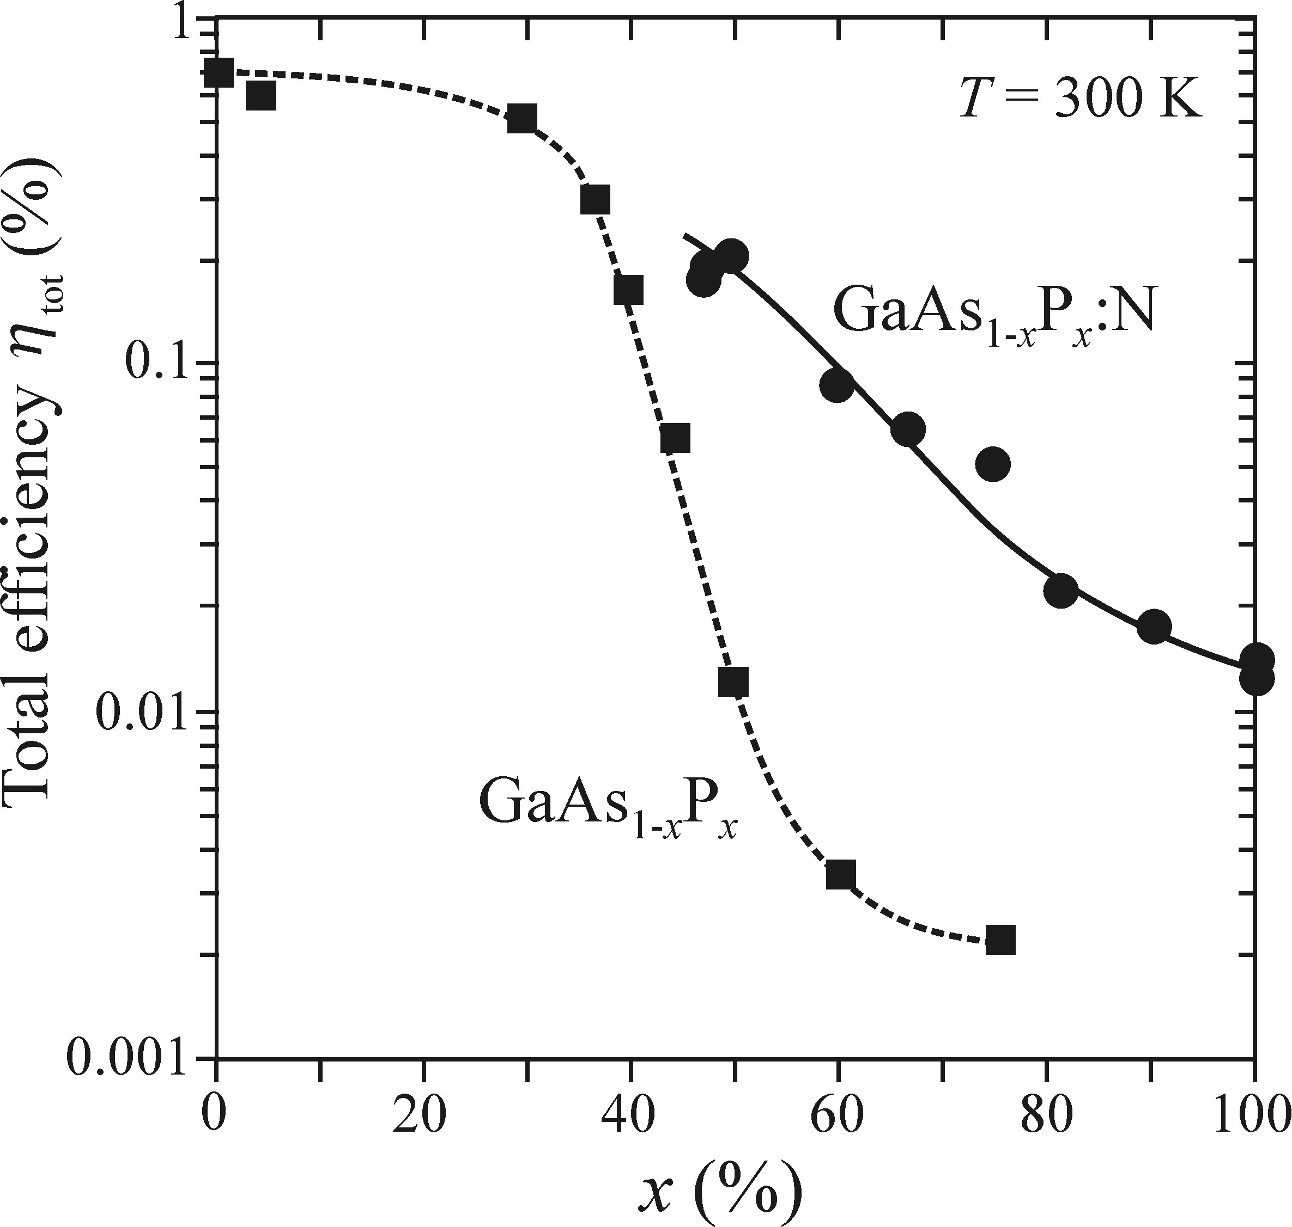
Injection EL
Direct gap
Indirect gap
Notes:
tuning ratio of As and P in combination with Ga
GaAs is direct, GaP is indirect: tuning between different semiconductor types
tremendously affects luminescence efficiency
introducing nitrogen helps as impurity and thus additional channel, increasing efficiency
also: nitrogen can be used for tuning, since it traps excitons and lowers the recombination energy

Slide 23
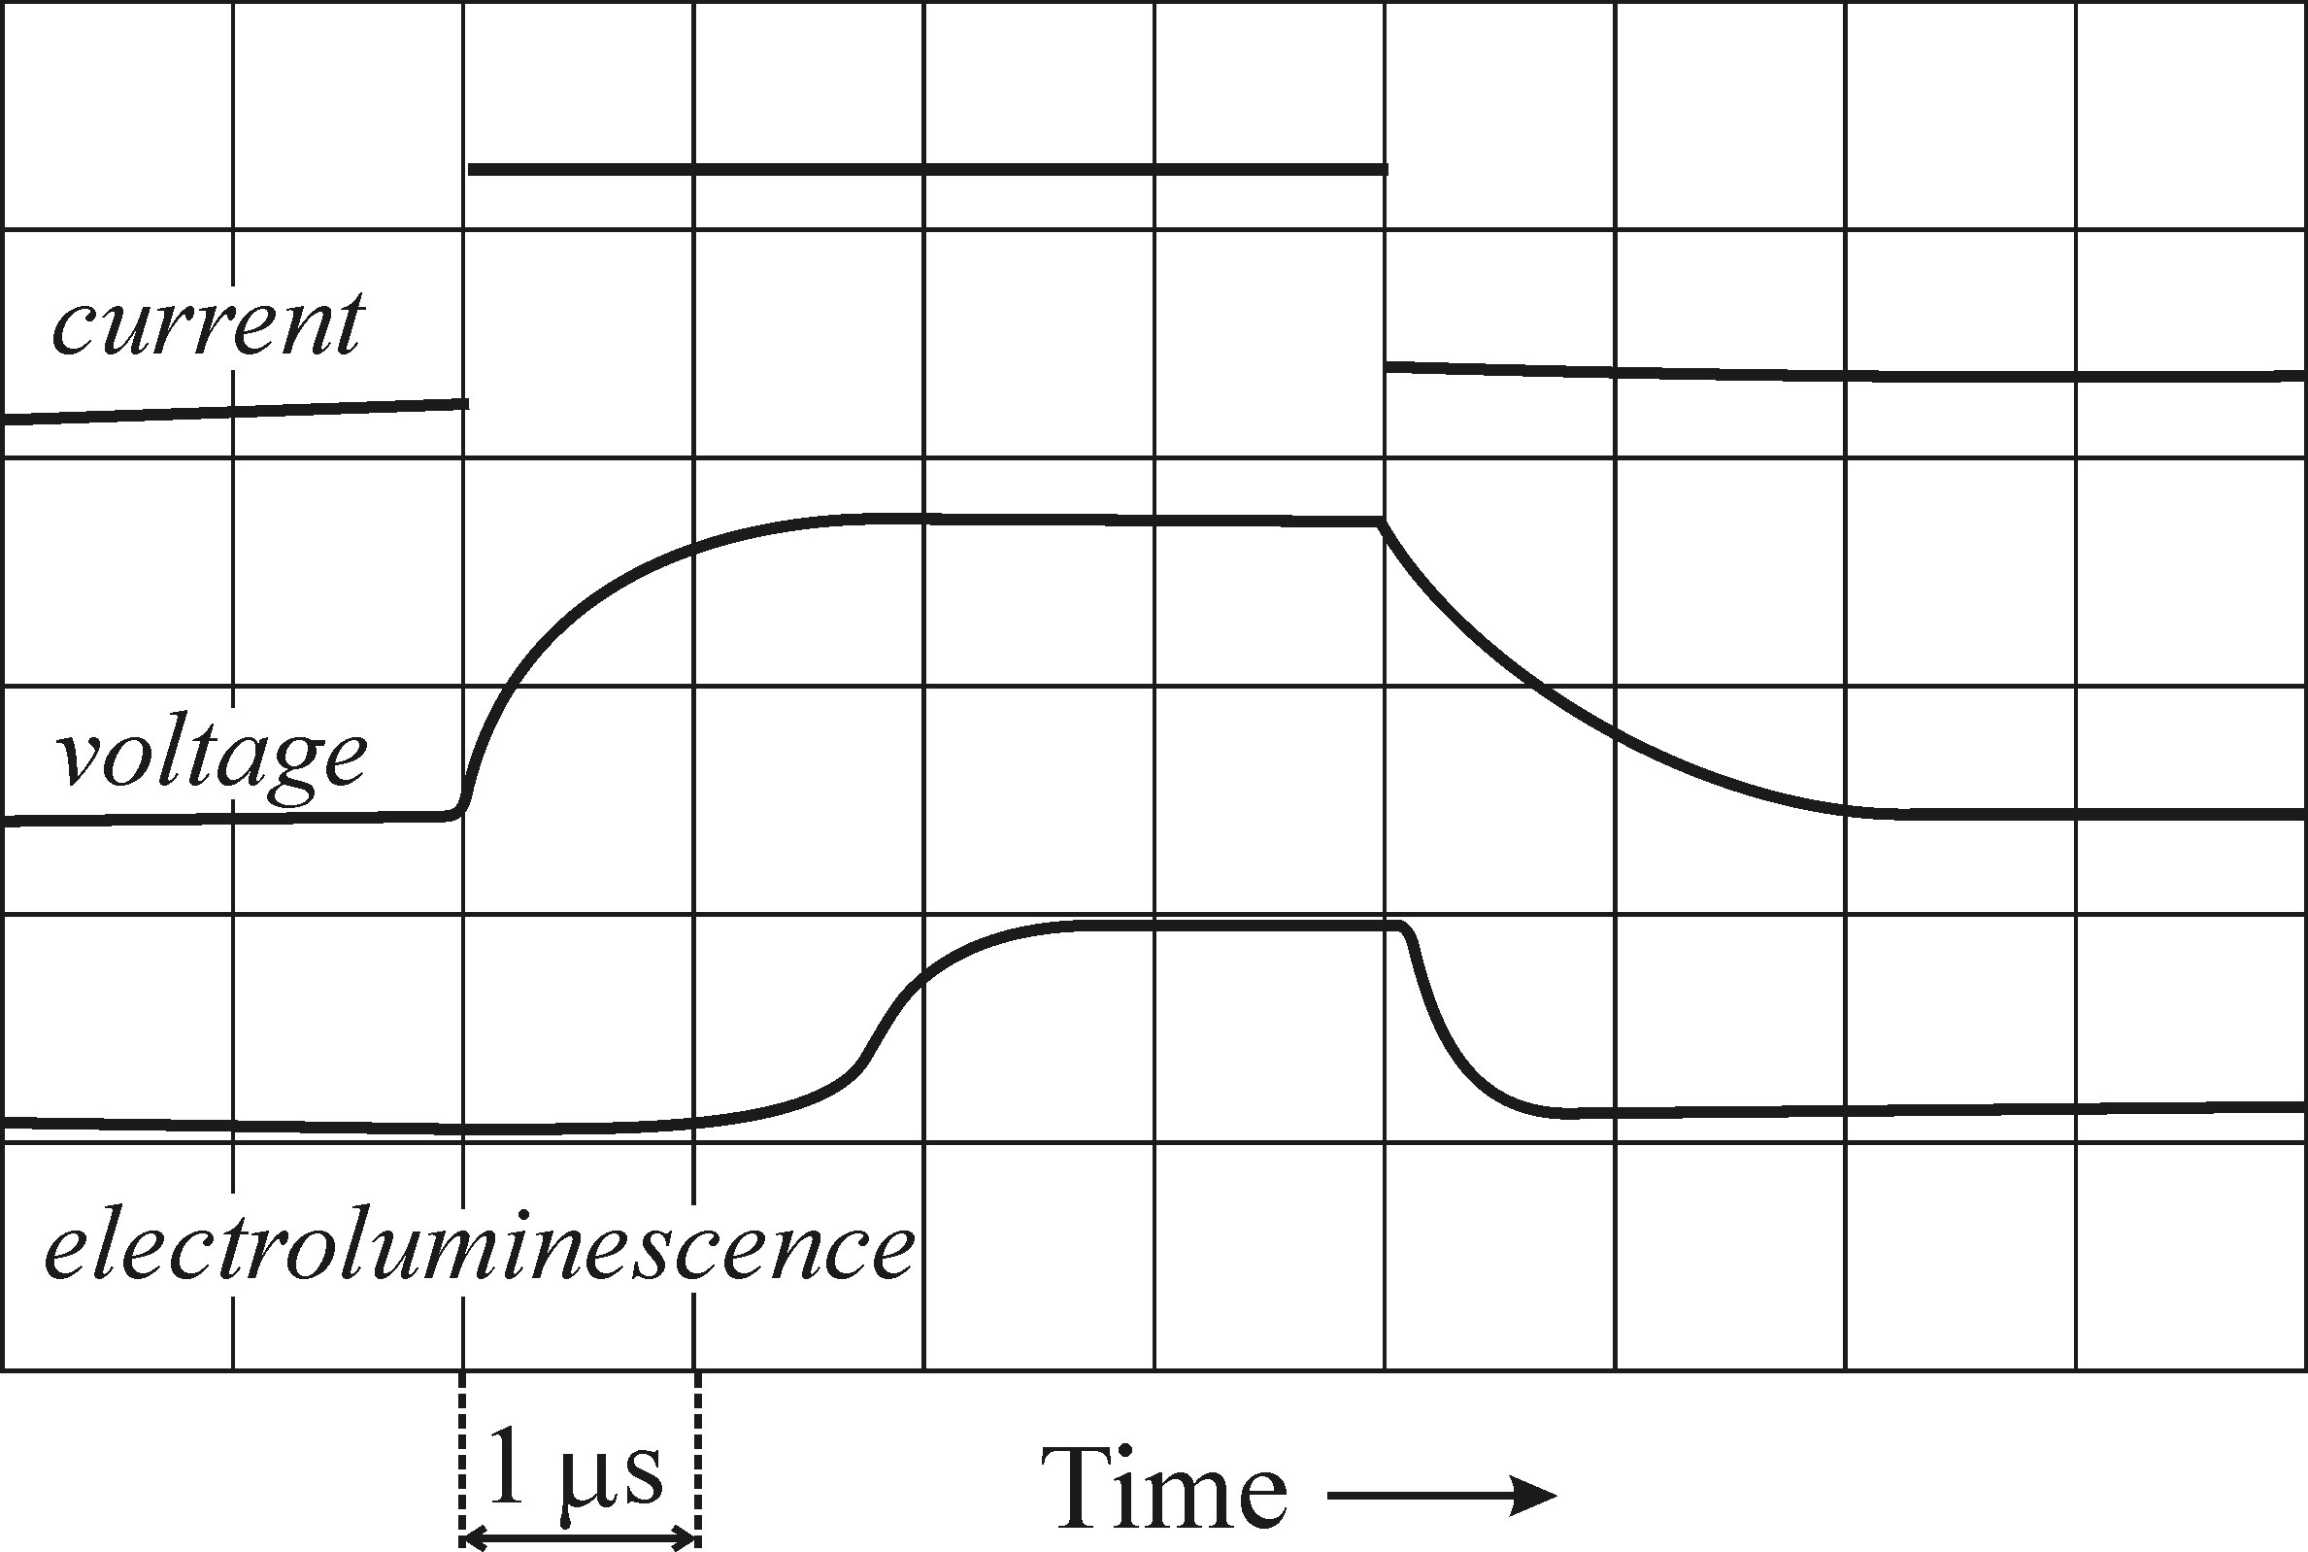
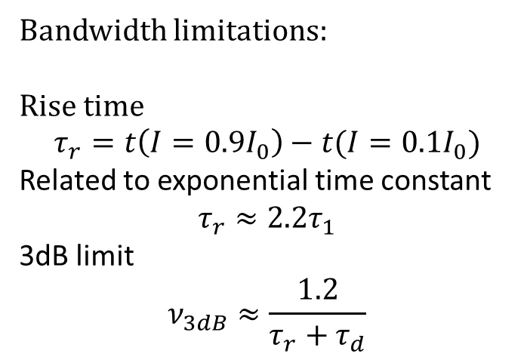
Injection EL - Transient behaviour
Delay
(loading)
Bandwidth limitations:
Rise time
$$τ_{r}=t\left(I=0.9I_{0}\right)−t(I=0.1I_{0})$$
Related to exponential time constant
$$τ_{r}≈2.2τ_{1}$$
3dB limit
$$ν_{3dB}≈\frac{1.2}{τ_{r}+τ_{d}}$$
Notes:
(Temporal characteristics, decay and rise time, bandwidth limitations)
transient behaviour does not only depend on lifetimes of participating particles but also on many other parameters, like geometry
when applying current, the LED is loaded like a capacitor; see voltage
luminescence starts, when voltage approaches saturation
no delay when switching off
voltage build-up consumes time and thus delays luminescence -> bandwidth limit
rise and decay time defined as time between 10% and 90% intensity
can be related to exponential time constants
rise and decay times can be used to find 3dB bandwidth limit (via transfer function)
typical values: rise/decay 2ns, bw-limit 300MHz (10MHz-1GHz possible)

Slide 24
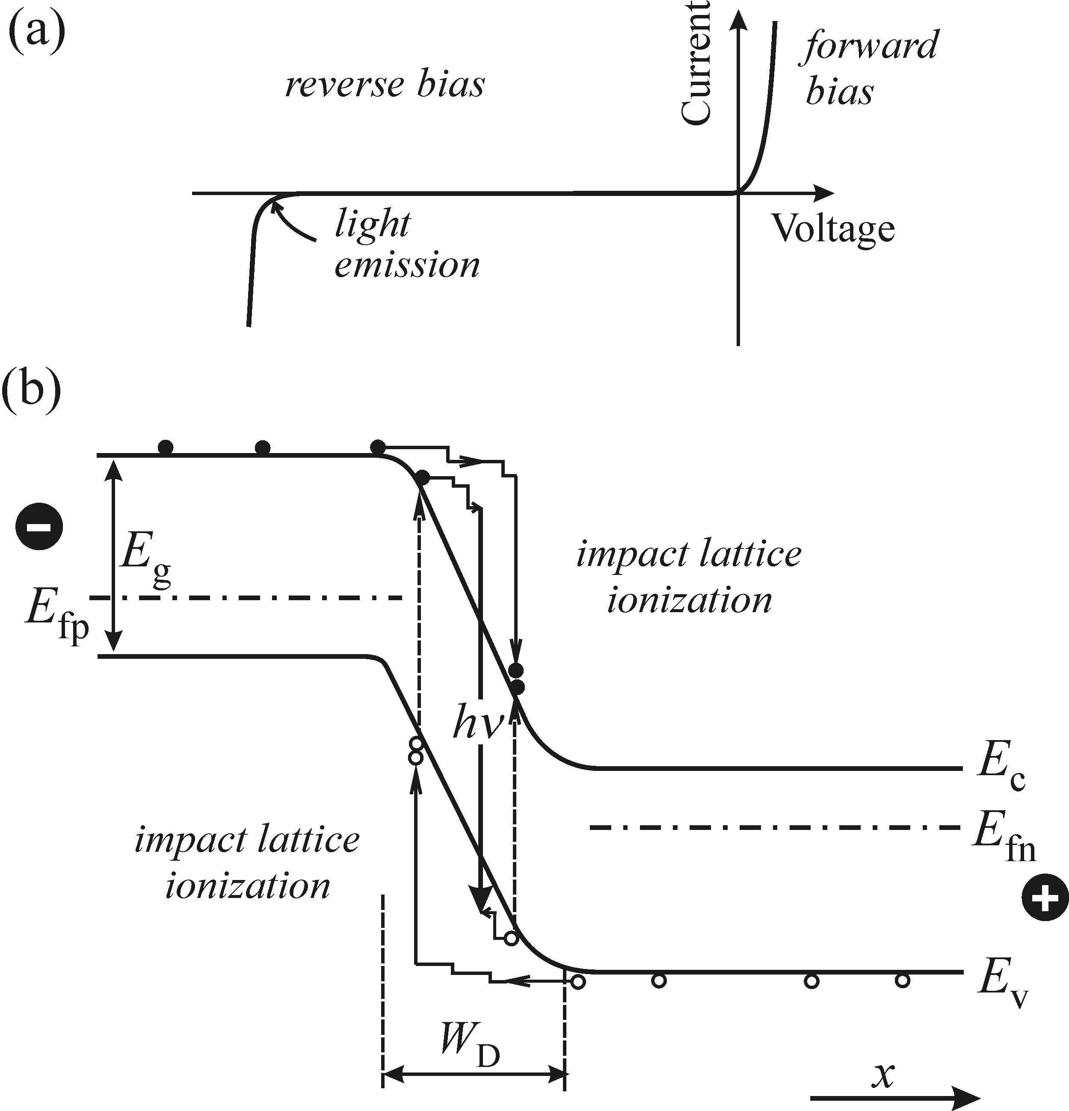
EL from a reverse biased pn-junction
EL mechanism:
Minority carriers are created thermally
then acellerated in depletion region
Impact ionisation of lattice
Avalanche like creation of more carriers
Radiative recombination
Effciency: 10⁻⁶%
Hot carrier temperature: 3800-7500K
No thermalisation as in PL
Acelleration of thermally
created carriers
Notes:
(Mechanism, specific for EL, not present for PL (reason: fast thermalisation), happens at breakdown edge, avalanche)
weak luminescence can be observed from a reverse biased junction when operating close to break down
this is solely due to thermally generated minority carriers being accelerated in the field over the depletion region
similar to avalanche effect
impact ionisation of the lattice leads to EL
-> this is high-field EL (as discussed before)
this mechanism is specific to EL and does not happenin PL
in PL, these highly excited carriers would rapidly thermalise, instead of recombining radiatively

Slide 25
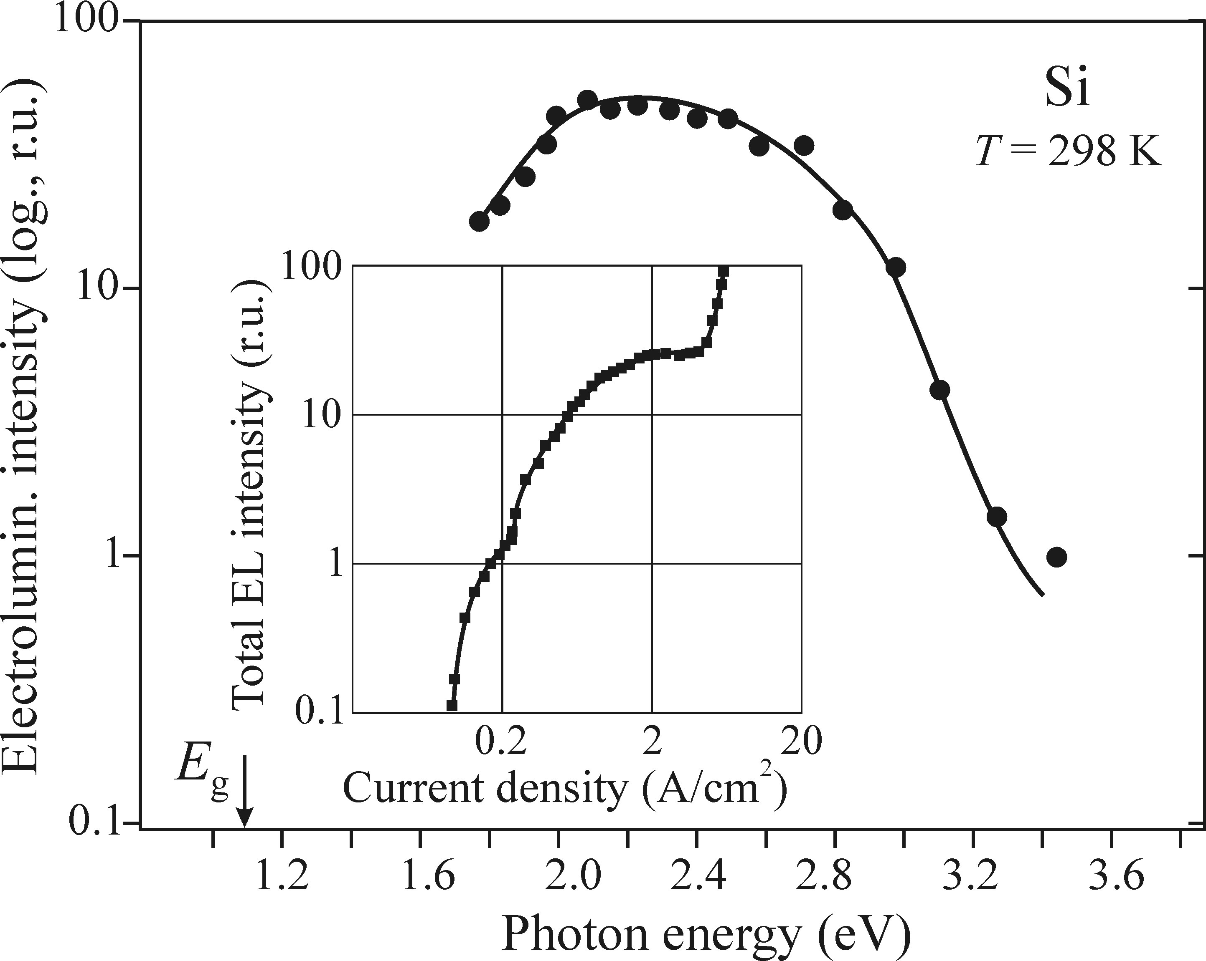
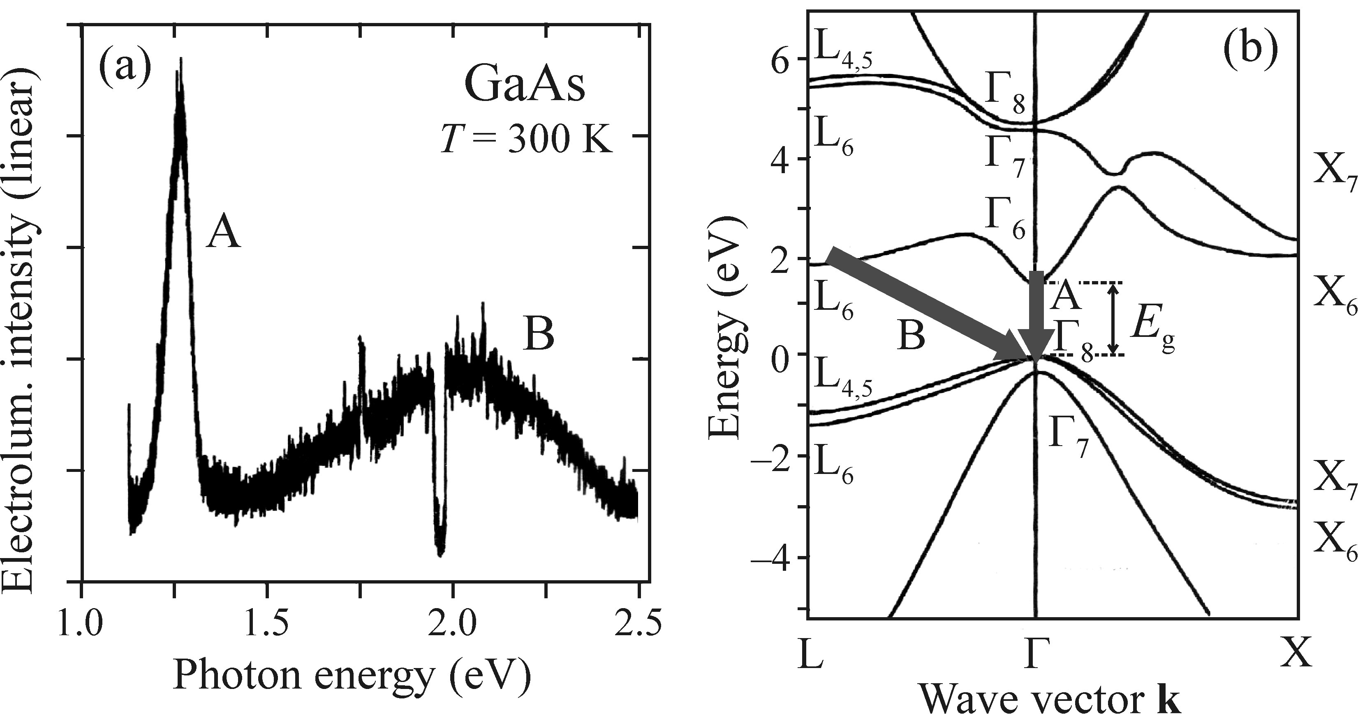
EL from a reverse biased pn-junction
Si
GaAs
Notes:
intensity is highly erratic (non-linear) due to avalanche mechanism
if such a behaviour is seen in a device, it is like that there is a reverse biased junction close to break down
in case of GaAs, the specific band structure permits direct and indirect transitions at the same time, leading to a more complex spectrum

Slide 26
Electronic structure and luminescence of low-dimensional semiconductors

Slide 27
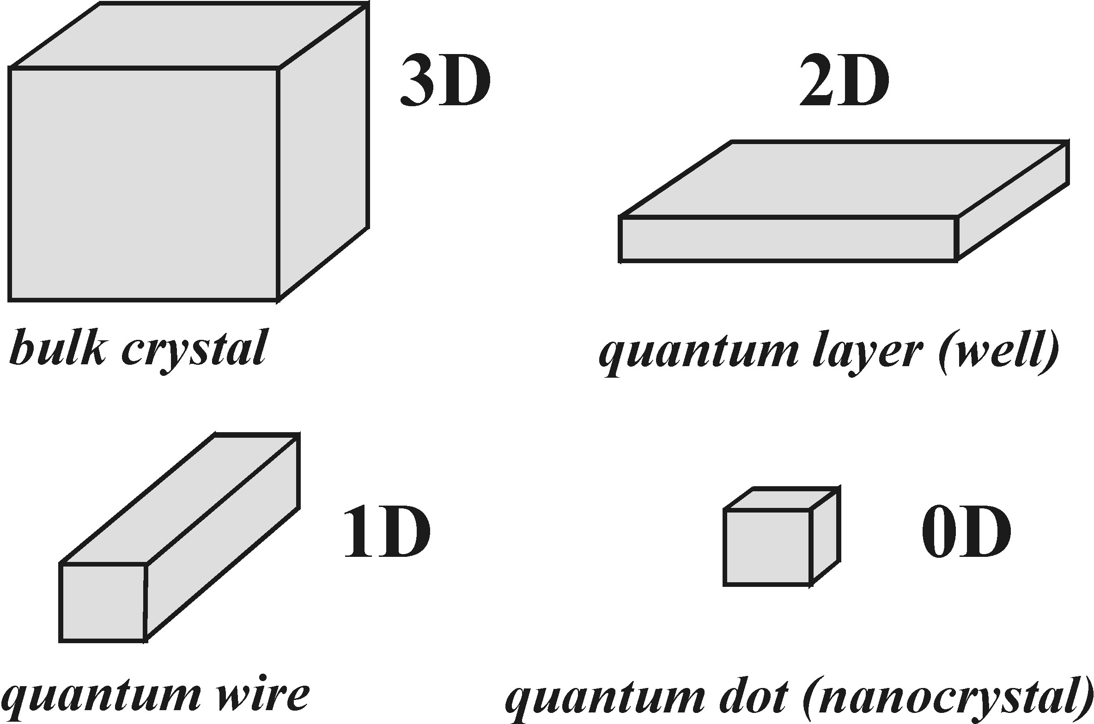
Reduced dimensions
Exciton size:
Confinement: exciton size > material's spatial dimension
Notes:
definition of confinement
4 classes of confinement
use top-down (lithographie) or bottom-up (growth, MBE, MOVPE) for construction
superlattices can be generated by placin several confined structures into close proximity to each other (overlapping wavefunctions)

Slide 28
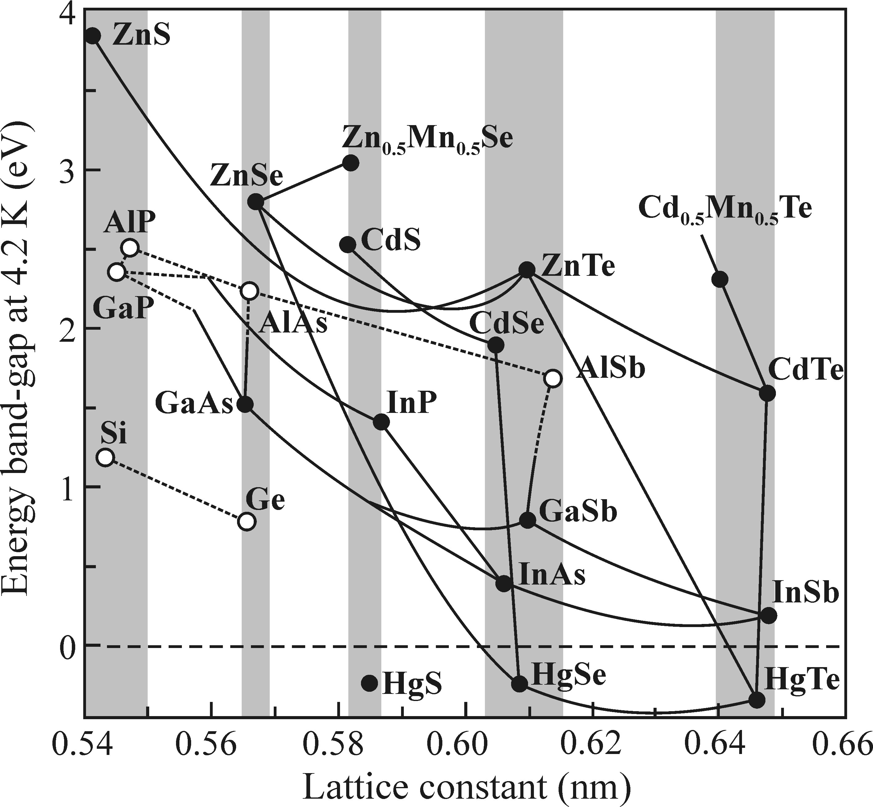
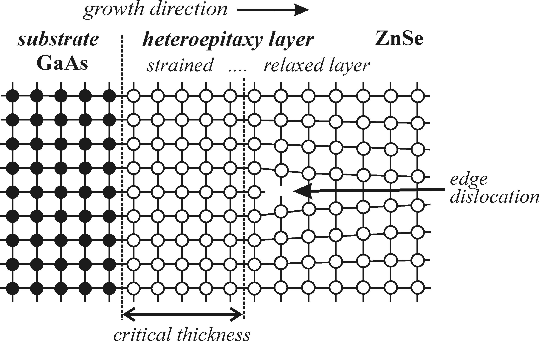
Reduced dimensions
Compound materials (heterostructures)
protection
embedding
design energy structure
Defects in case of lattice mismatch
GaAs/AlGaAs
Defect: can be useful
Notes:
heterostructures (i.e. combination of different materials) has advantages:
1 protection of nano-structure
2 embedding into macrostructure for easy manipulation
3 control energy structure
however, defects can result from a lattice mismatch
strain destabilises structure but might also be useful (trapping, fast relaxation)
GaAs/AlGaAs compund is an almost perfect match (important discovery on the way towards working heterostructures)

Slide 29
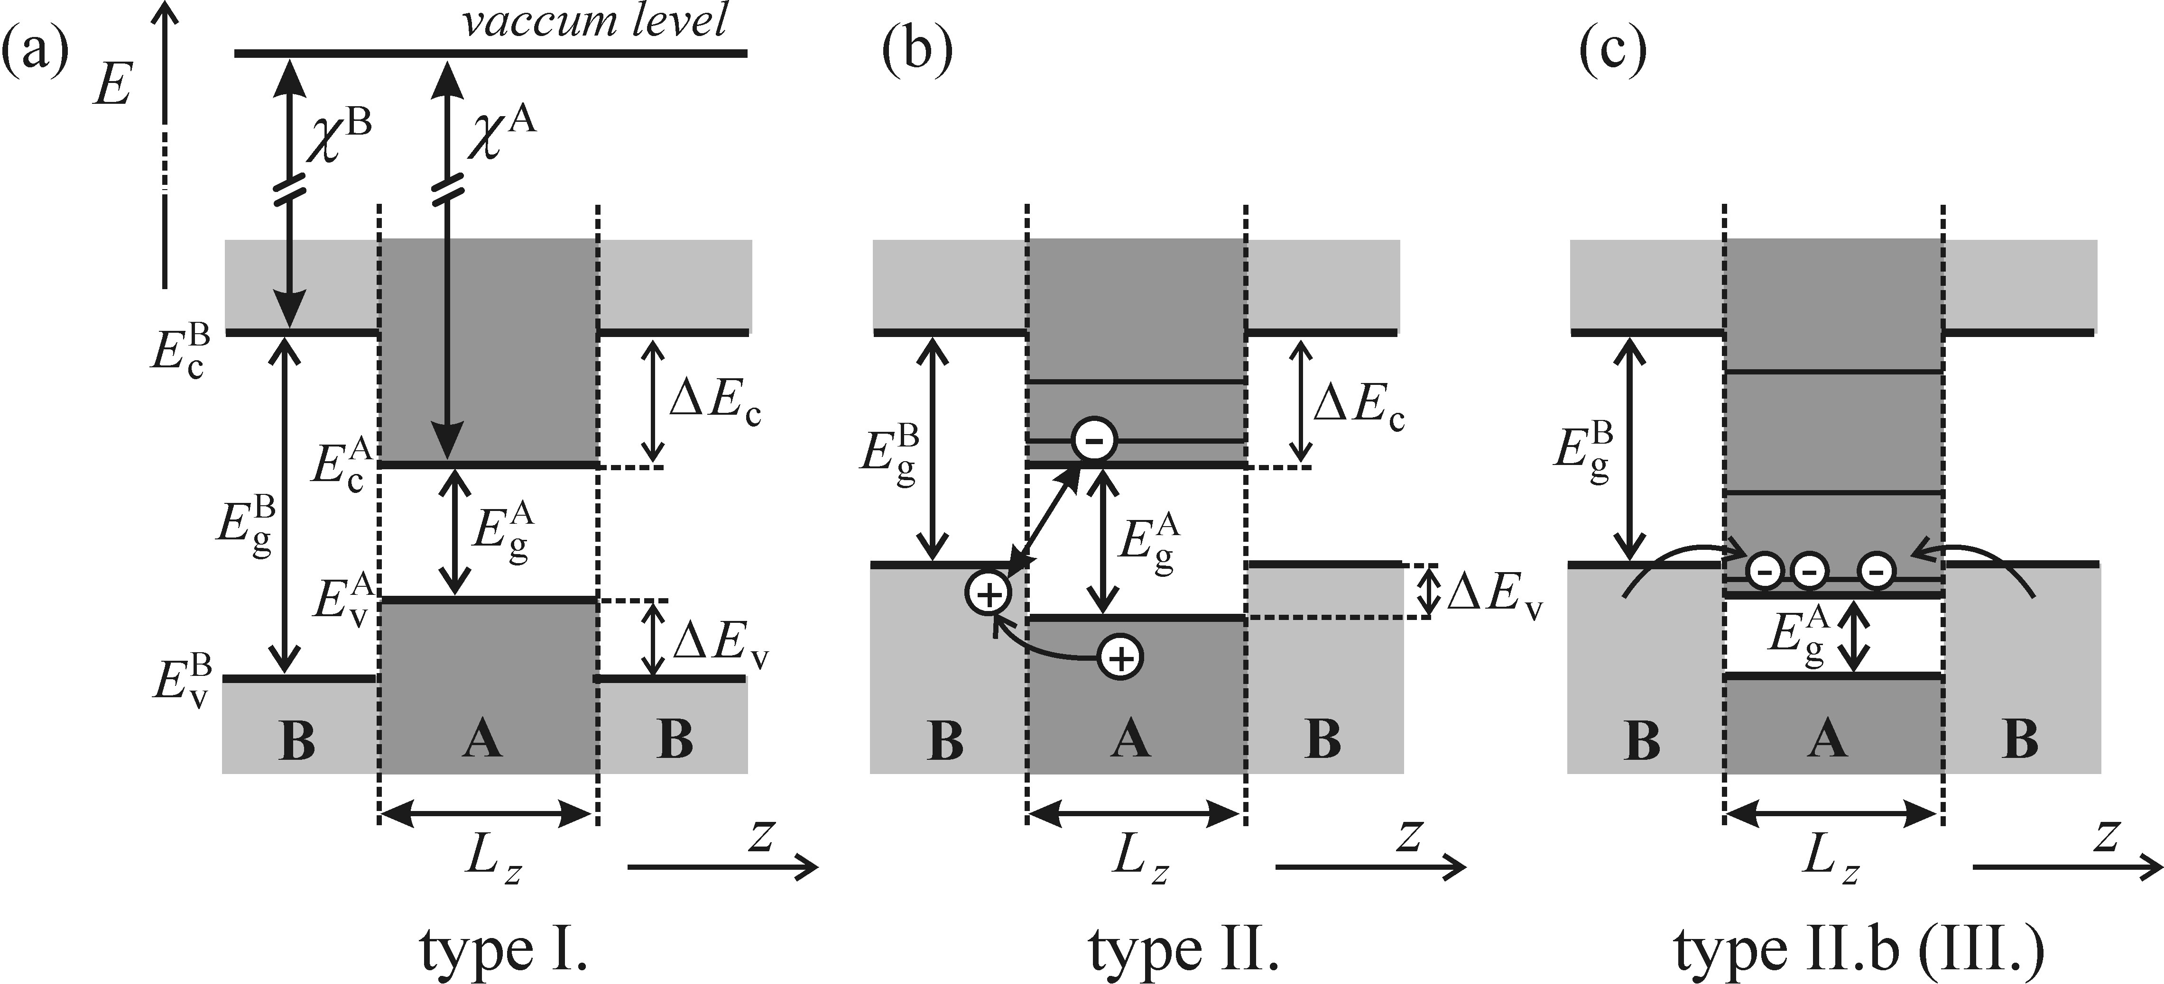
Reduced dimensions
Align here
(Anderson rule)
Type I: minimum of CB and maximum of VB in the same layer
Type II: minimum of CB and maximum of VB in different layers
Type Iib (III): minimum of CB below maximum of VB
Notes:
for examination of compound energy band structure align all bands at their vacuum levels
several types can be distinguished depending on the spatial position of band maxima and minima
I both in the same layer
II in different layers
Iib VB and CB of different layers overlap

Slide 30
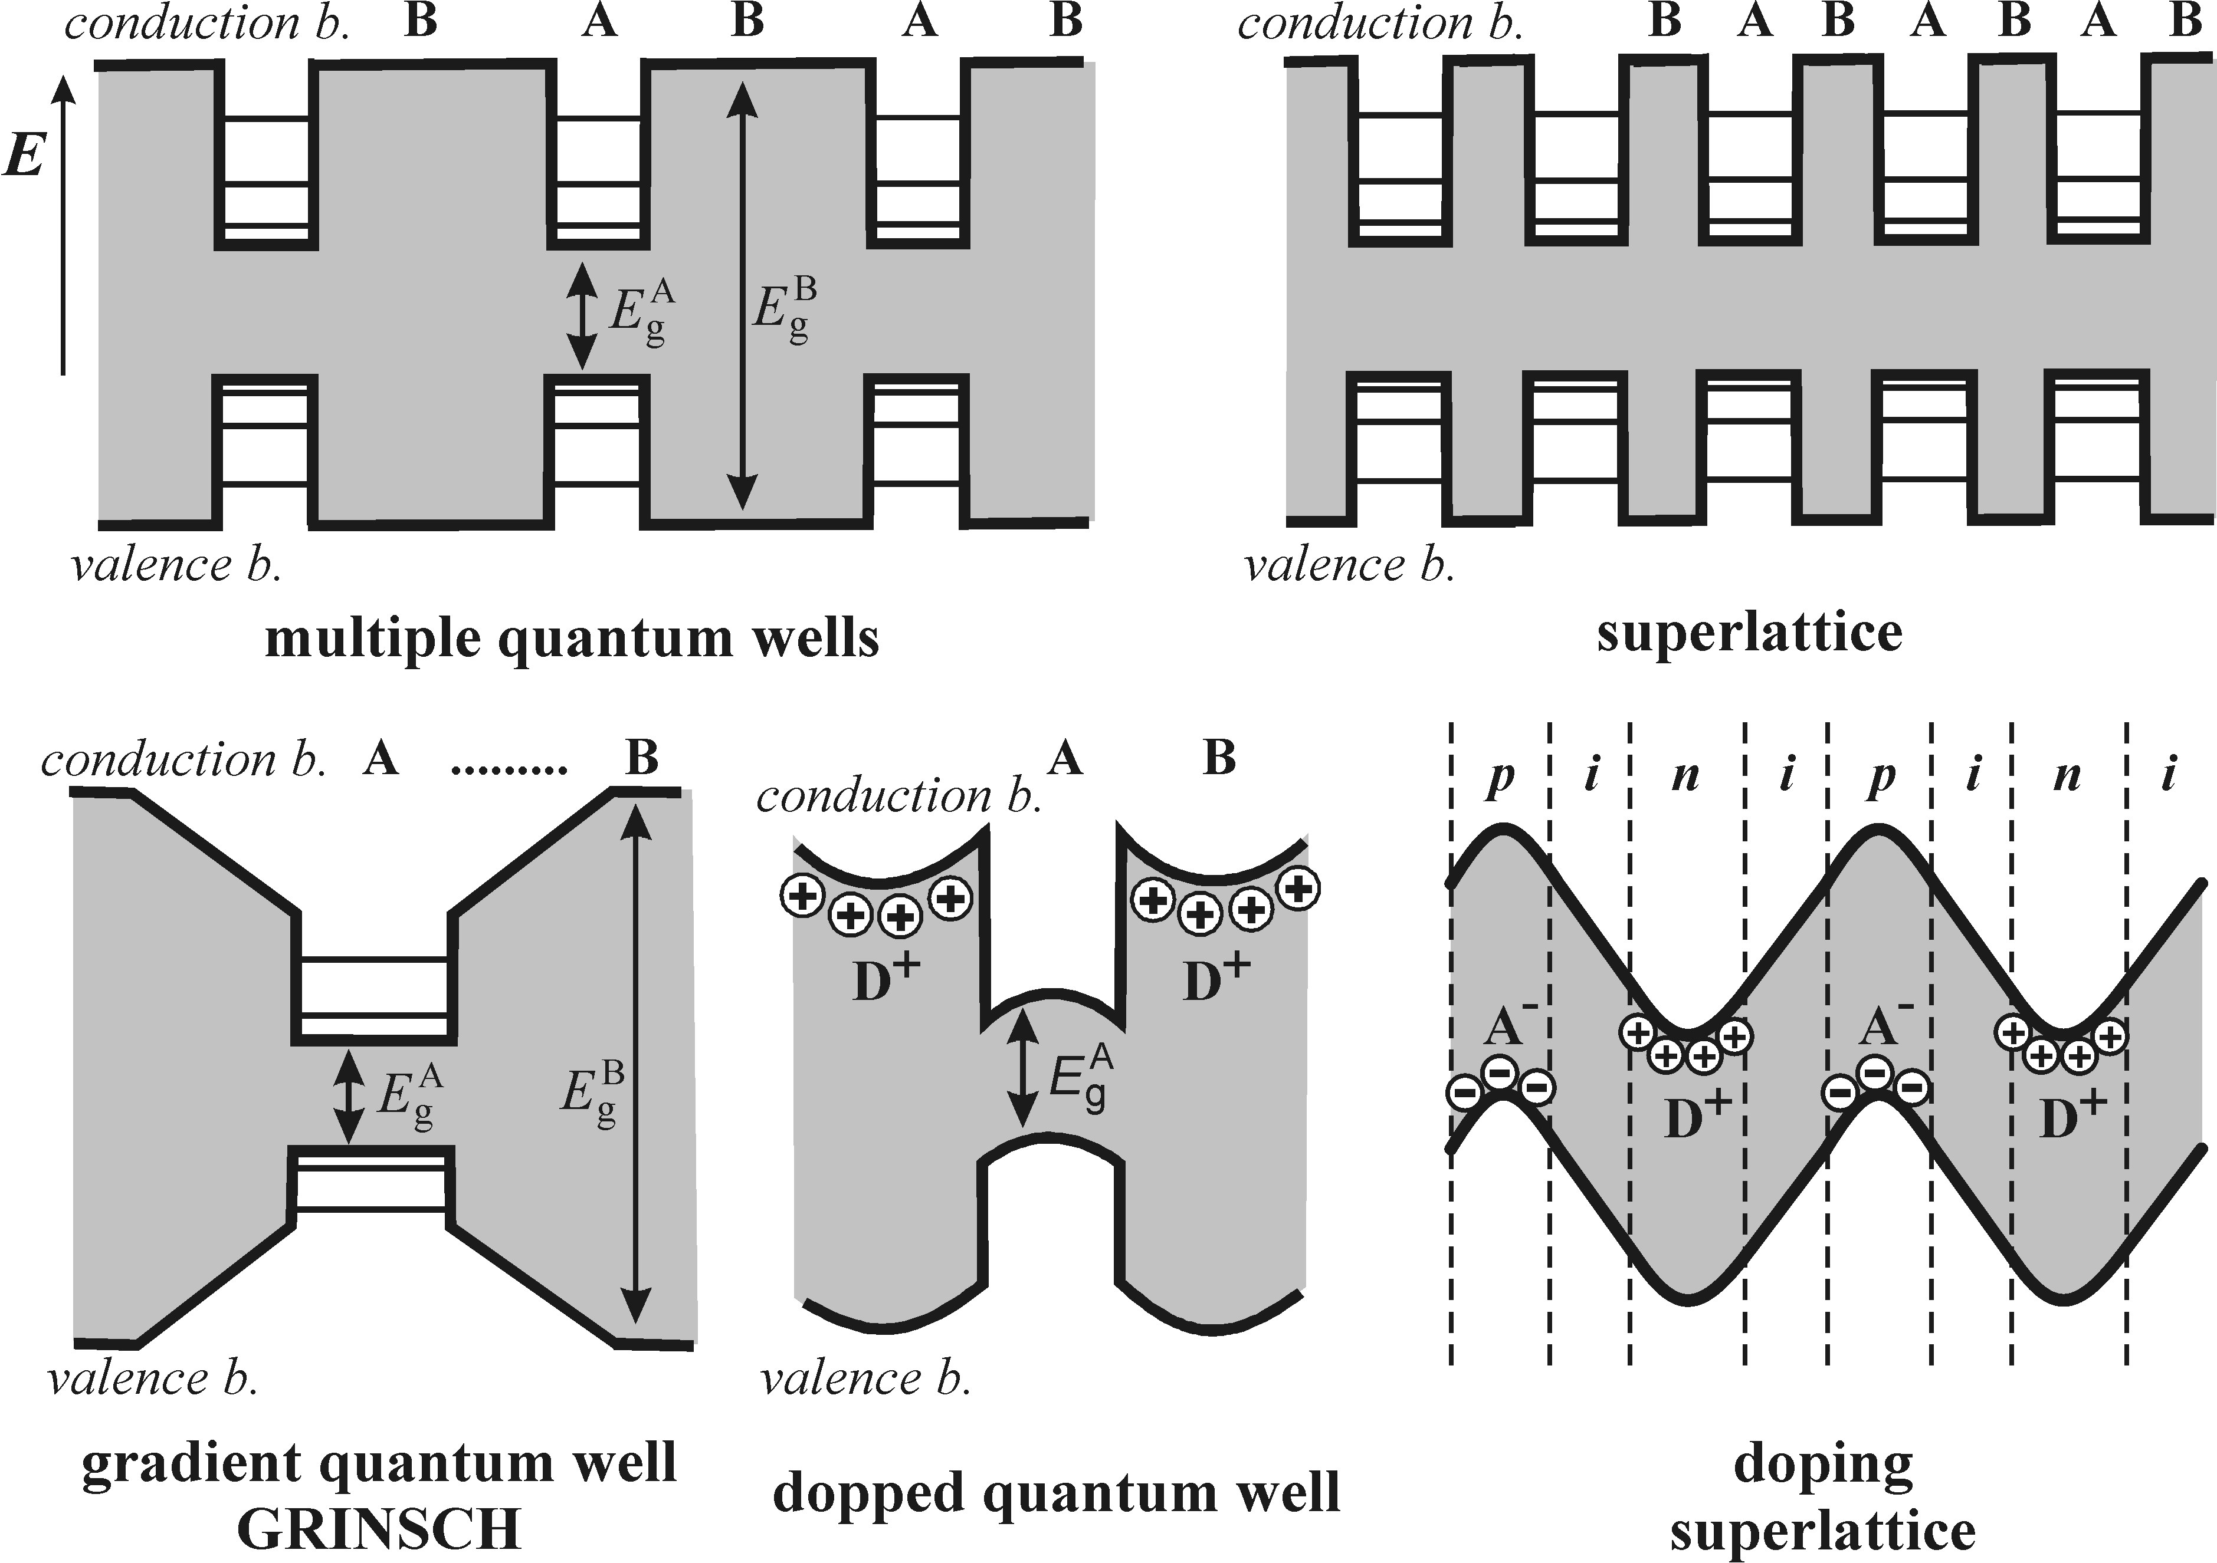
Reduced dimensions
Examples of engineered band structures
Multi-well
Superlattice
Alternating
material
Varying
doping
Notes:
examples of several QW designs
wells can be placed well seperated from each other or in a way as to make their wave-functions overlap (superlattice)
energy levels can either be control by the choice of proper material (top row) or by varying doping concentration
when varying concentration, wells can be made from a singel material with locally different dopant concentration (nipi, bottom right)

Slide 31
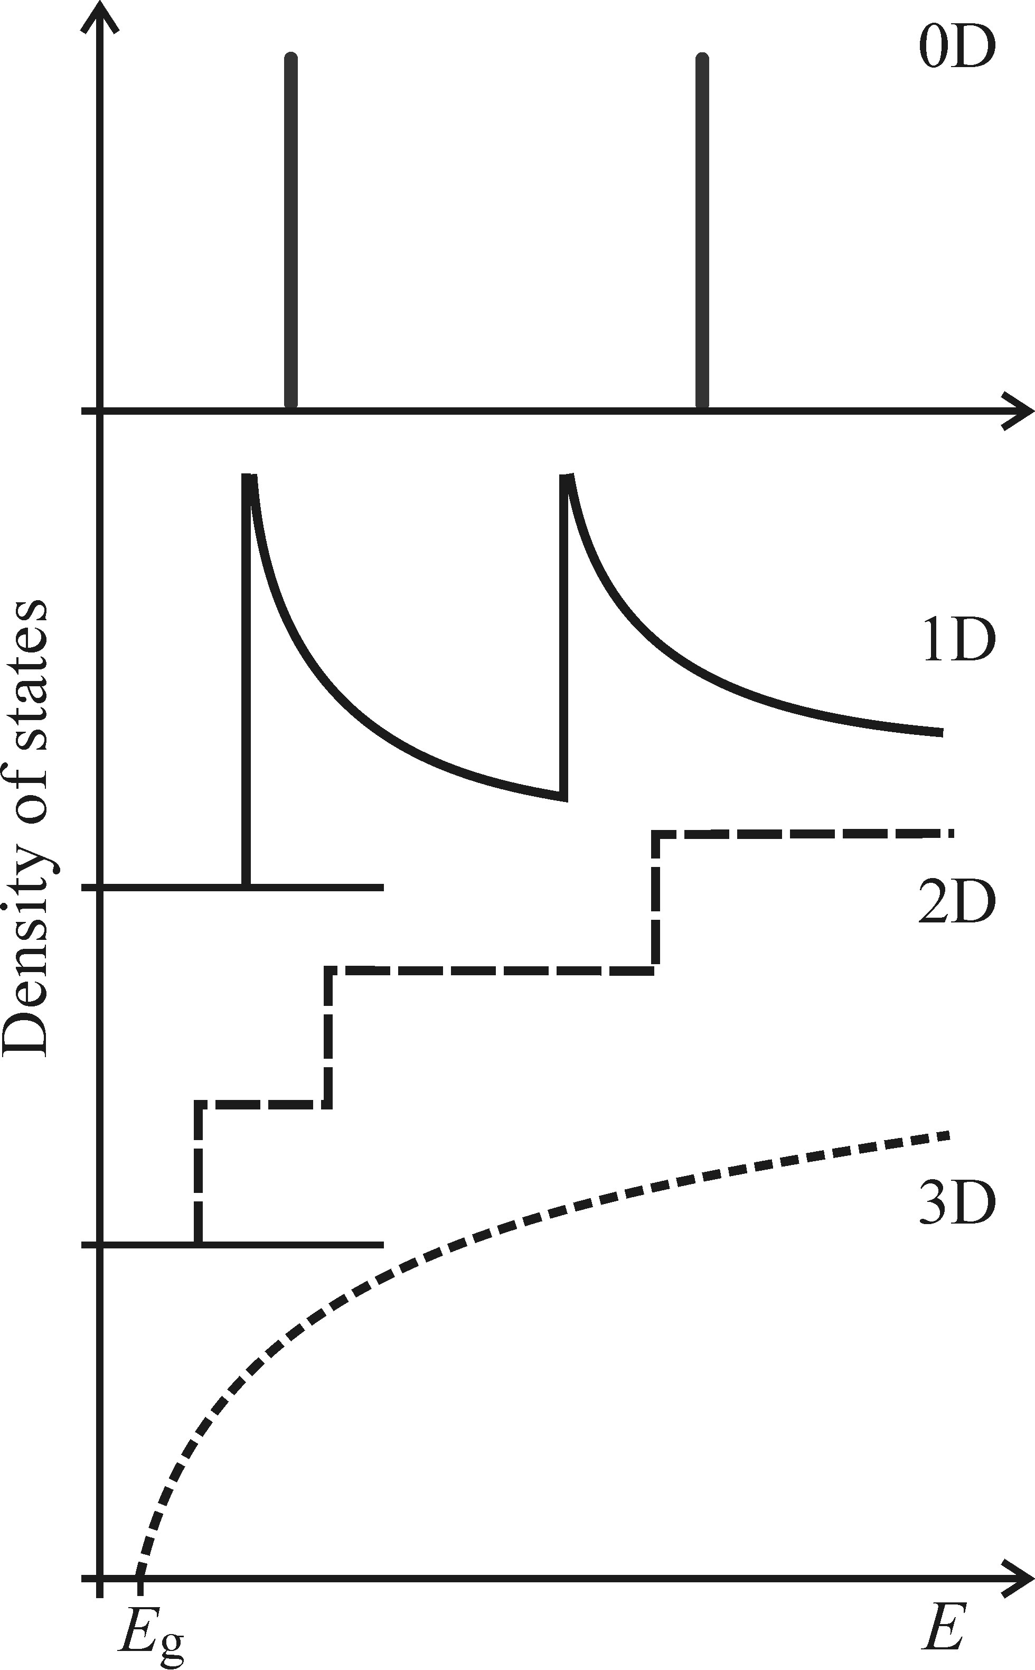
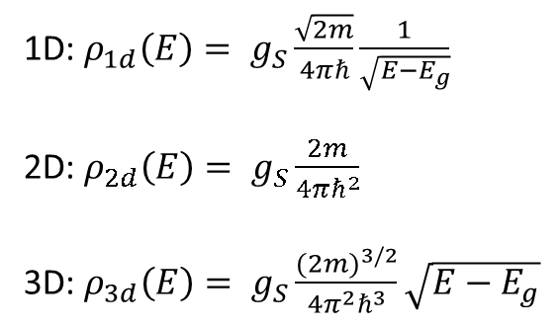
Reduced dimensions – DOS
Density of states (DOS) for confined systems
1D: $ρ_{1d}\left(E\right)= g_{S}\frac{\sqrt{2m}}{4πℏ}\frac{1}{\sqrt{E−E_{g}}}$
2D: $ρ_{2d}\left(E\right)= g_{S}\frac{2m}{4πℏ^{2}}$
3D: $ρ_{3d}\left(E\right)= g_{S}\frac{{(2m)}^{3/2}}{4π^{2}ℏ^{3}}\sqrt{E−E_{g}}$
Notes:
density of states is found via calculation of mode-volume in confined spaces
wave-function becomes discrete in the direction of the confinement
3D is the know square-root law
2D is constant; step function results from discrete number of states in higher bands
1D has singularities decaying with 1-over-square-root
0D is a discrete, atom-like density of states
observation: the lowest state's energy increases with deceasing dimensionality

Slide 32
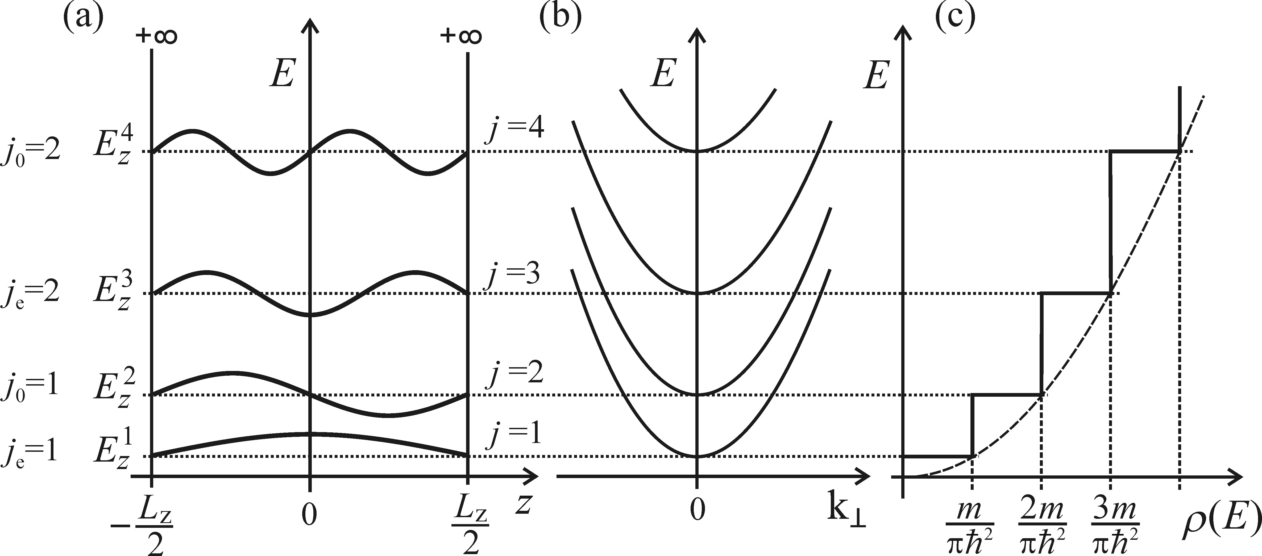
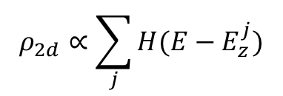
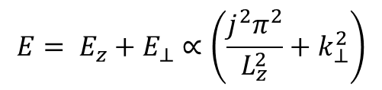
Quantum wells – Infinite barrier
Infinite barrier
(z-direction)
No barrier
(xy-direction)
Ground state
$$E= E_{z}+E_{⊥}∝\left(\frac{j^{2}π^{2}}{L_{z}^{2}}+k_{⊥}^{2}\right)$$
$$ρ_{2d}∝\sum_{j}{H(E−E_{z}^{j})}$$
Notes:
solution is found by seperation of Schrödinger equation into continuous part in xy-plane (orthogonal) and confined part in z-direction
continuous part gives parabolic contribution
discrete part ahs even (+) and odd (-) solutions
sum is total solution (explains offset from 3d case)
H is Heaviside's step-function

Slide 33
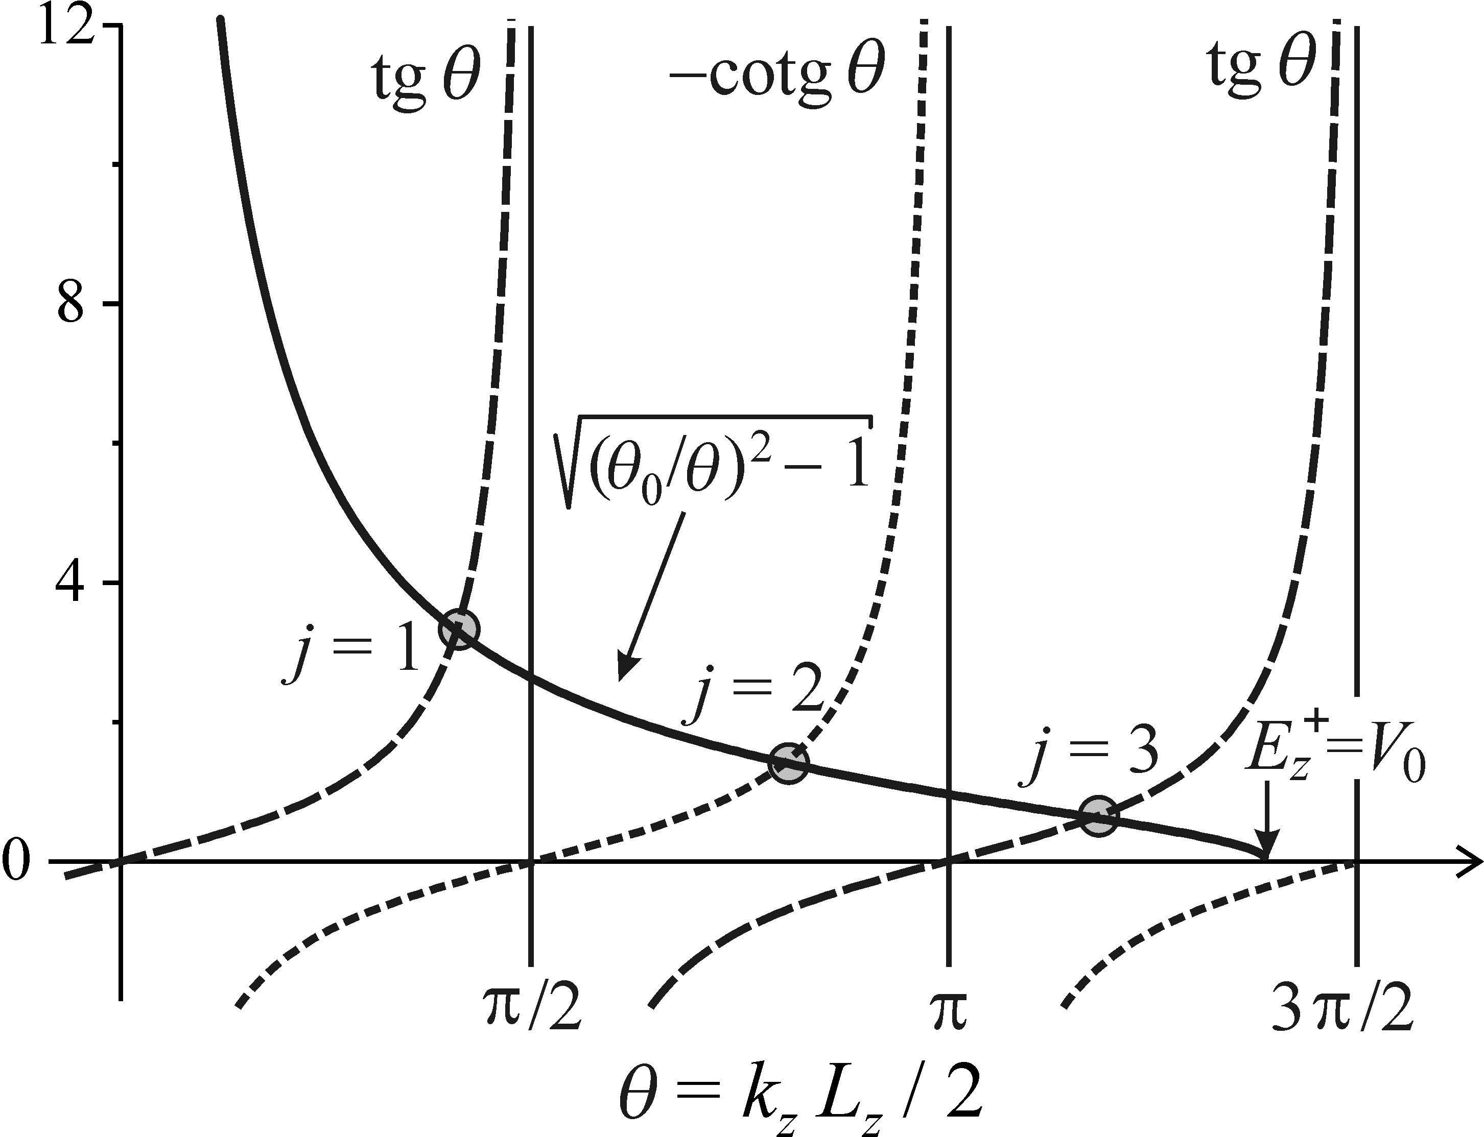
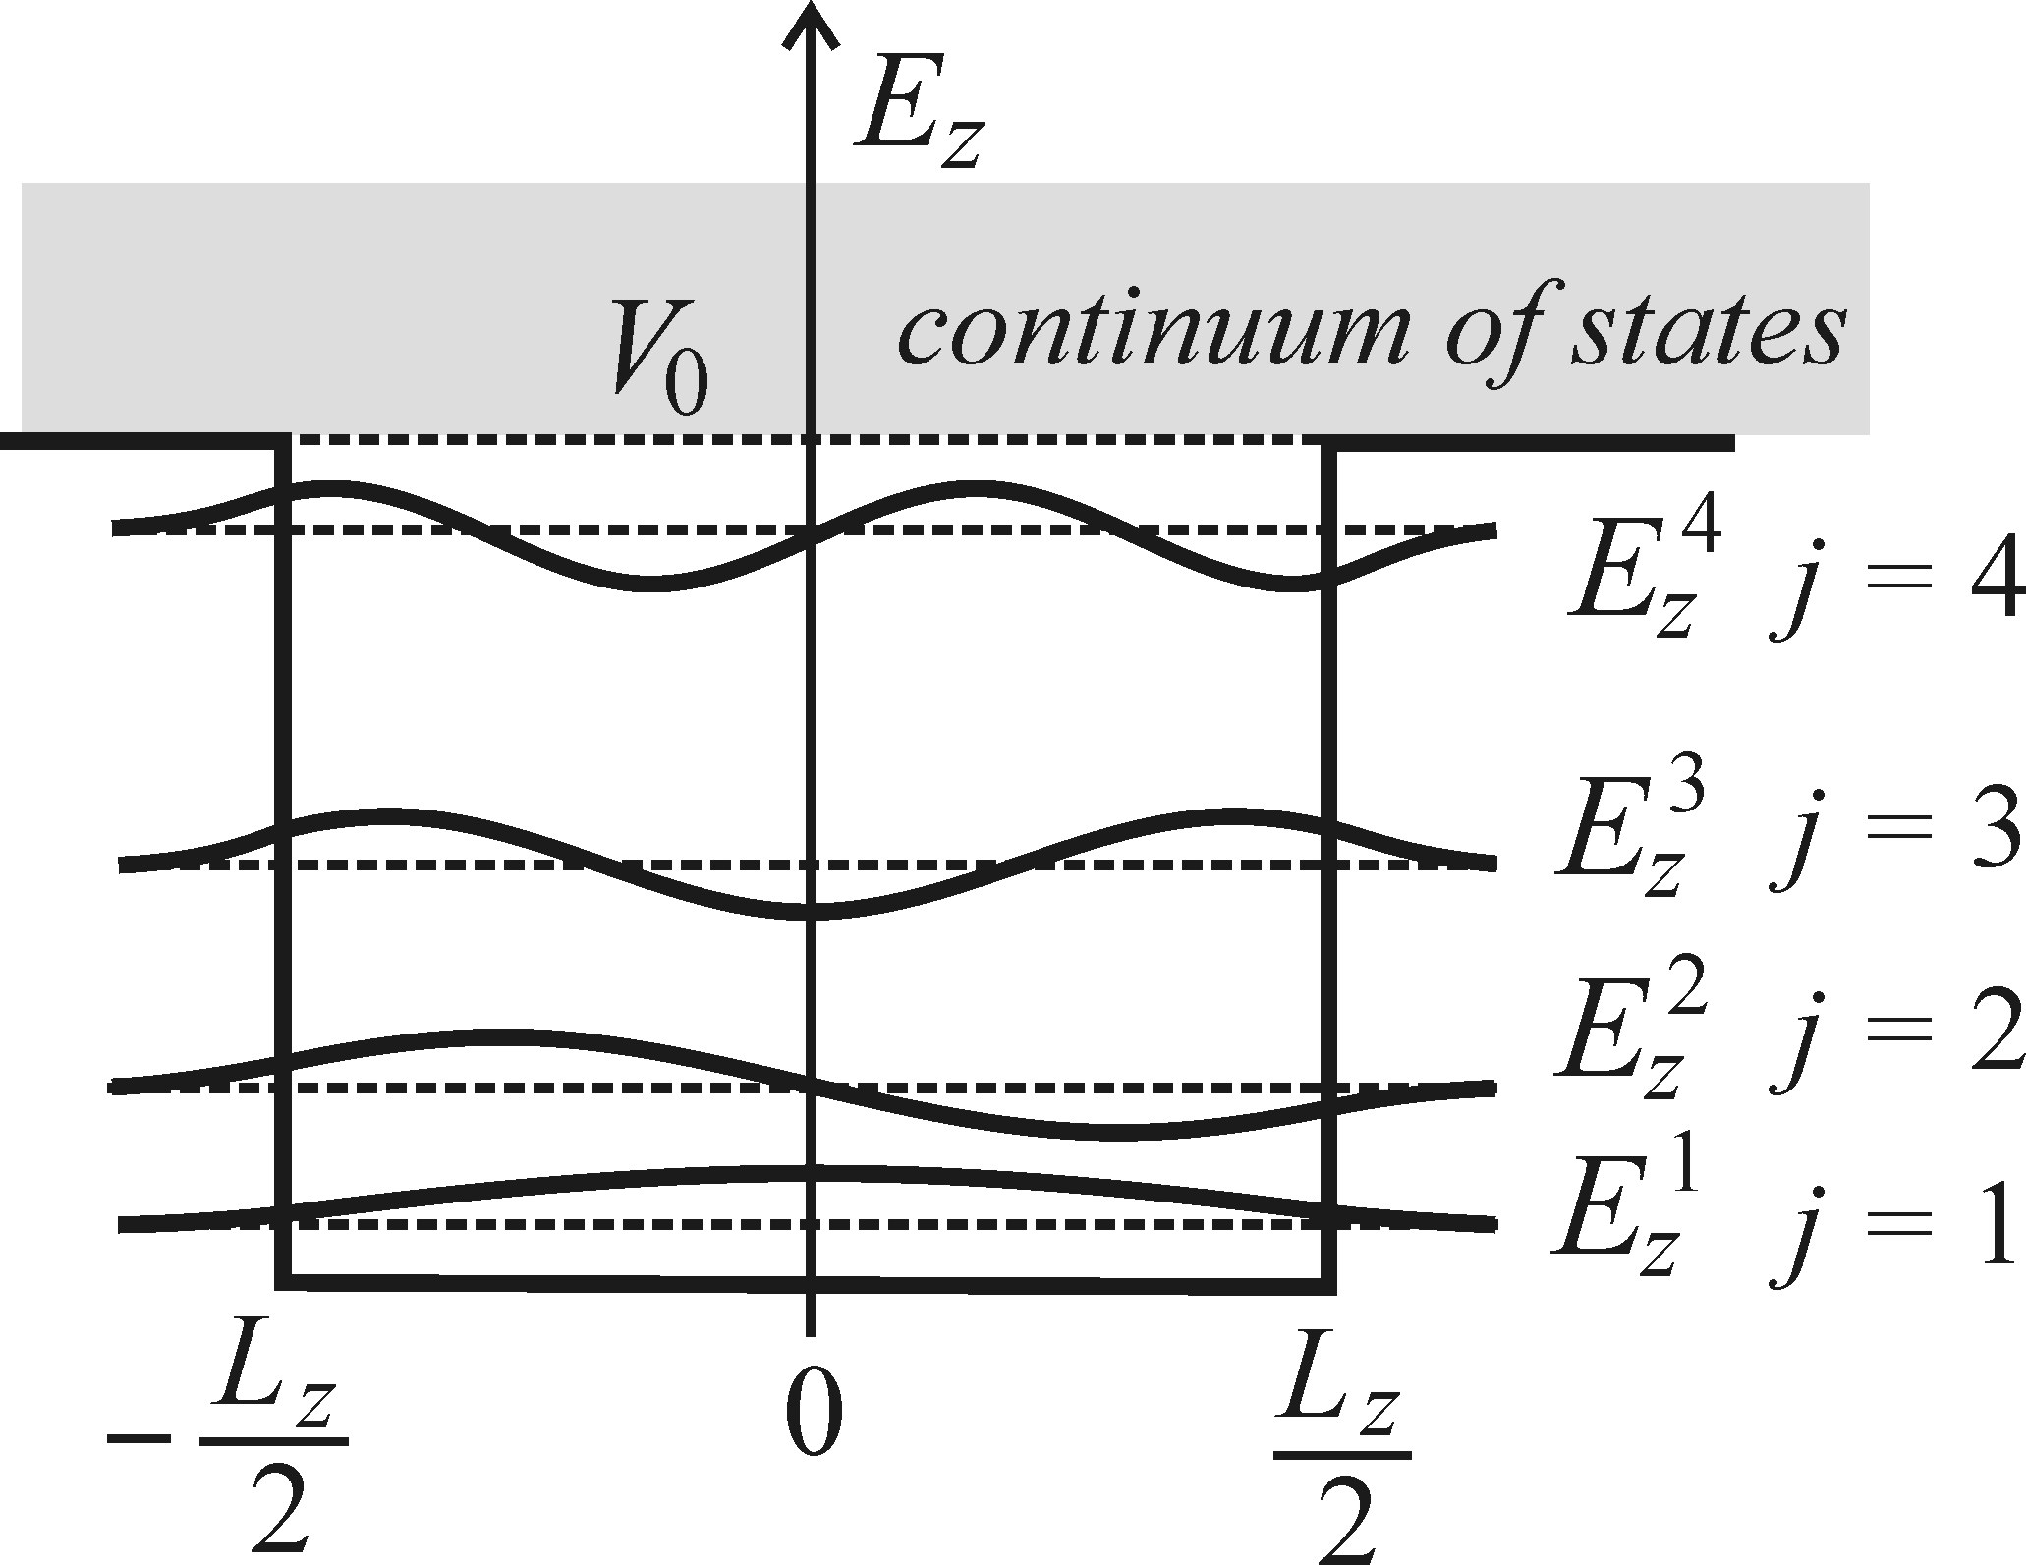
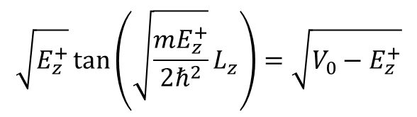
Quantum wells – Finite barrier
Continuum
Even
(tan)
Odd
(cotan)
Discrete state
(solution)
$$\sqrt{E_{z}^{+}}\tan\left(\sqrt{\frac{mE_{z}^{+}}{2ℏ^{2}}}L_{z}\right)=\sqrt{V_{0}−E_{z}^{+}}$$
Even solutions:
Notes:
there is no analytical solution for a finite barrier
however, solution can be found graphically by plotting both sides of the equation
points of intersection mark discrete states
observations:
1 the lowest solution (first odd) always exists
2 there is a limited number of discrete states; E = V_0 marks the continuum

Slide 34

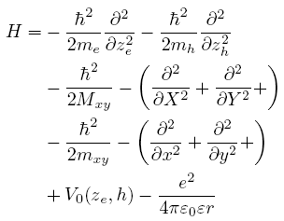
Quantum wells – Excitons
Hamiltonian for two particles
Additional Coulomb potential
Kinetic energy of
electron and hole
Well potential
Strong quantum confinement approximation
Motion of quasi-free carriers
Motion of exciton's centre of mass
Motion of reduced exciton mass
Well and Coulomb potential
Notes:
to understand excitons, extend discussion to a two-particle system
before: only single particle was discussed to understand the basic features of confinement
2-particle H will include Coulomb interaction between electron and hole, which was not included before
also included are kinetic energies of electron and hole
if the well is substantially smaller than the exciton radius, strong q-conf approx can be used
this means, that the Coulomb interaction in z-direction is negligible
intuitively this is given, since e and h are not likely to be on line in z-dir but more likely distributed in xy-plane (sandwich)
H has then a parts describing the carrier motion in z-dir, which is essentially free motion and part to describe exciton movement in xy-plane

Slide 35
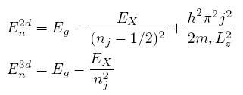
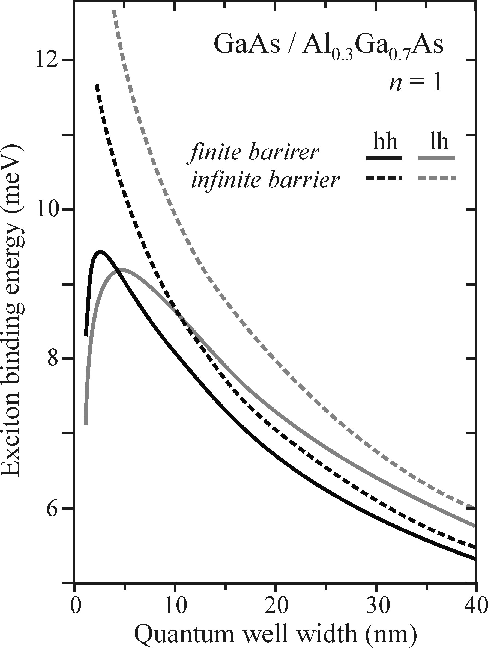
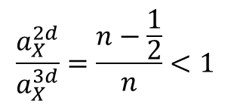
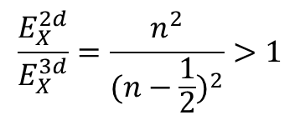
Quantum wells – Excitons
Energy in well (2d) and bulk (3d)
Exciton
binding energy
Confinement
Comparison
$$\frac{E_{X}^{2d}}{E_{X}^{3d}}=\frac{n^{2}}{{(n−\frac{1}{2})}^{2}}>1$$
$$\frac{a_{X}^{2d}}{a_{X}^{3d}}=\frac{n−\frac{1}{2}}{n}<1$$
Optimal width
Notes:
solving the equation, one obtains a description for the energy
the total energy levels are then given by the sum of the gap, exciton binding and discrete confinement energy
each discrete level j (that results from conf) has a set of n exciton levels
comparison with the 3d energy levels, shows:
a the additional contribution of the confinement
b a larger exciton binding energy
comparison of the binding energies shows, that excitons in wells are bound stronger (squeezed together)
consequently, their radius is smaller
the biggest difference occurs for the lowest state n=1
graph shows binding energy as function of well width (here in GaAs/AlGaAs heterostructure)
for a finite barrier, there is a width which maximises the energy

Slide 36



Quantum wells - Absorption
bulk
wells
Additional contribution for wells
$$\int{ζ_{e,i}(z)ζ_{h,j}\text{dz}}$$
Motion (wavefunction)
of electron and hole
in z-direction
Allowed for
$$Δj=±2n$$
$$\text{i}\text{.}\text{e}\text{.:} 0,±2,±4,…$$
Notes:
intensity directly related to transition probability, which is linked to matrix element and joint density of states
in bulk, dj = 1,3,... favoured
in wells: confinement limits integration over wavefunction (DOS) to the small confinement region
largest value is obtained for states of same parity (i=j)
thus: confinement in wells materials favours transition in the same band, i.e. dj = 0
graph (c) also shows the lifting of degeneracy of the light and heavy hole bands in the confined system
splitting increases with decreasing well width

Slide 37

Quantum wells - Luminescence
20 wells
Only one luminescence line
Stokes shifted
Inhomogenous broadening
60 wells
Notes:
Luminescence spectra of wells differ from absorption spectra
1 there is only one line; the one from the lowest transition (efficient non-radiative relaxation into that state)
2 the line is Stokes-shifted due to emission from the lower end of the inhomogeneously broadened line
3 line in inhomogeneously broadened due to impurities and locally varying width of the well
the last effect grows stronger, when examining a larger ensemble of wells

Slide 38

Quantum wells - Luminescence
Differences between wells and bulk material
Emission wavelength depends on well size
Emission line is narrower (see figure)
Excitonic effects are more pronounced
Non-linear optical effects are stronger
Effects play an even more important role
Notes:
differences in wells when compared to bulk material
1 wavelength depends on size and is usually longer, but approaches bulk limit for larger well width
2 line is narrower due to DOS function (which is constant in 2d)
3 excitonic binding energy is stronger and excitonic effects are thus more pronounced; can be seen at room temperature
4 confinement leads to higher electron-hole concentrations, which helps non-linear optical effects
5 confinement also makes defects and impurities more relevant; quasi 2d movement easily leads excitons towards traps

Slide 39
Injection EL – Saturation current
examine current in one region (here: p)
use assumption and law of mass action

Slide 40

Injection EL
Notes:
Concepts for white LEDs

