Slide 1
IH1611
Halvledarkomponenter
VT 2013, period 4
Gunnar Malm
gunta@kth.se, 08-790 4332

Slide 2
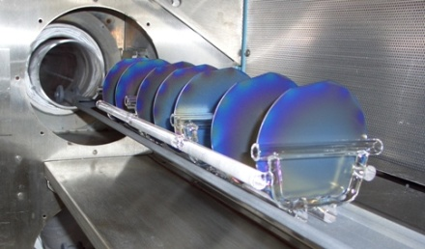
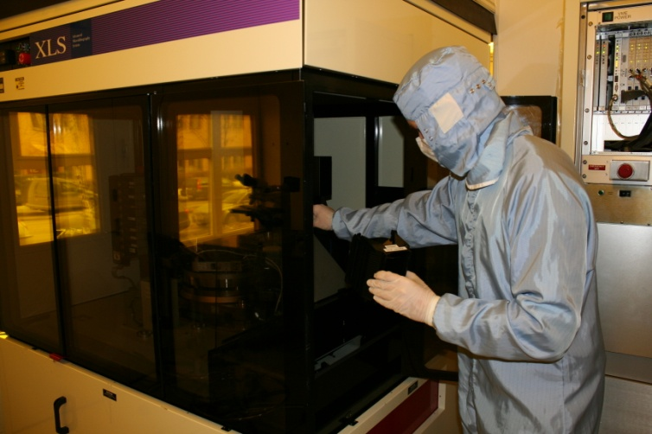
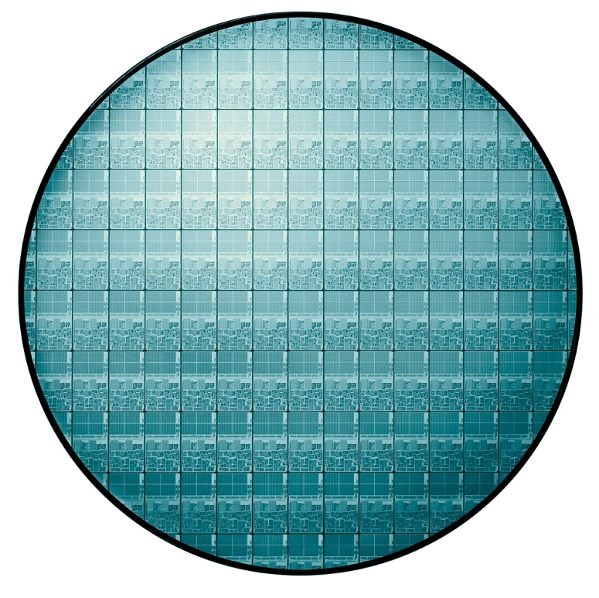
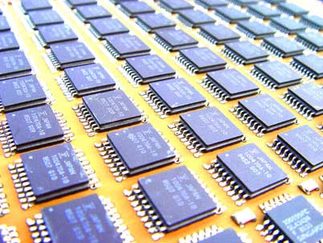
Semiconductor procesing at KTH Electrum Laboratory
Stepper Lithography at KTH Electrum Laboratory
MOSFET made at
KTH Integrated Devices and Circuits
Si wafer with INTEL’s XEON Processor
Integrated Circuits (IC)

Slide 3
Course goals
The overall goal of the course is that you should be able to describe the function of the pn-diode, the bipolar and the MOS transistor and how these three devices are used in applications. You should be able to derive and calculate the currents inside these devices and be able to analyse the internal state of the charge distribution, the electric field and the current density.
In detail, after a successful completion of the course you will be able to:
qualitatively describe the electronic energy band structure of insulators, semiconductors and metals
calculate the electron and hole concentration in the conduction and valence band using Fermi-Dirac statistics and the energy band model.
describe the constituents of the current density in semiconductors and derive analytical expressions for the current density in the case of low-level injection, electron-hole recombination, externally applied voltage and external generation by light, using the drift-diffusion model.
describe the function of the pn-diode, the bipolar and the long channel MOS transistor.
analyse and calculate the internal electrostatics (electric charge, electric field and potential) of the pn-diode, the bipolar and the long channel MOS transistor.
derive and calculate the current density in the pn-diode, the bipolar and the long channel MOS transistor using the drift-diffusion model.
describe major process technologies, used to fabricate semiconductor devices and relate these to schematic cross-section drawings of devices.
extract device properties from electrical measurements of devices.
perform oral and written presentation of the subject Semiconductor Components.

Slide 4
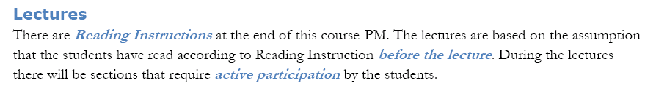
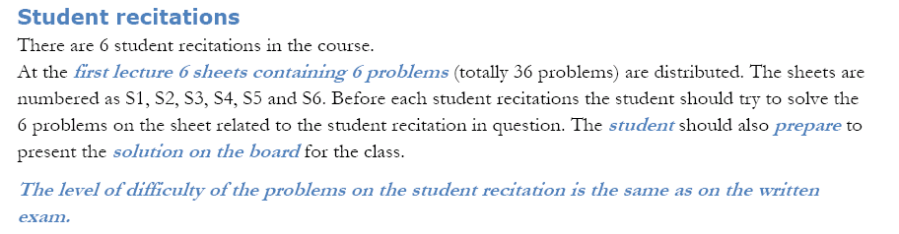

Slide 5
Student recitations
There are 6 student recitations in the course.
At the first lectures 6 sheets containing 6 problems (totally 36 problems) are distributed. The sheets are numbered as S1, S2, S3, S4, S5 and S6. Before each student recitations the student should try to solve the 6 problems on the sheet related to the student recitation in question. The student should also prepare to present the solution on the board for the class.
The level of difficulty of the problems on the student recitation corresponds to the written exam.
In detail a student recitation is organized as follows:
At the beginning of the student recitation each student will put a cross on a list to indicate which of the 6 problems he/she is prepared to present to the class
One student is randomly picked to present each problem.
After the solution has been presented there is a discussion, in which all students are expected to participat. Students are expected to give feedback on the presented solution and possibly provide alternative solutions.
When the discussion is finished a new student presents a solution to the next problem
When all 6 problems have been presented and discussed the student recitation ends.
The number of crosses a student has on the list indicates how many problem the student has solved. The total number of problems is 36. To be allowed to attend the written exam the student has to acquire a minimum of 20 crosses after the 6 student recitations.

Slide 6
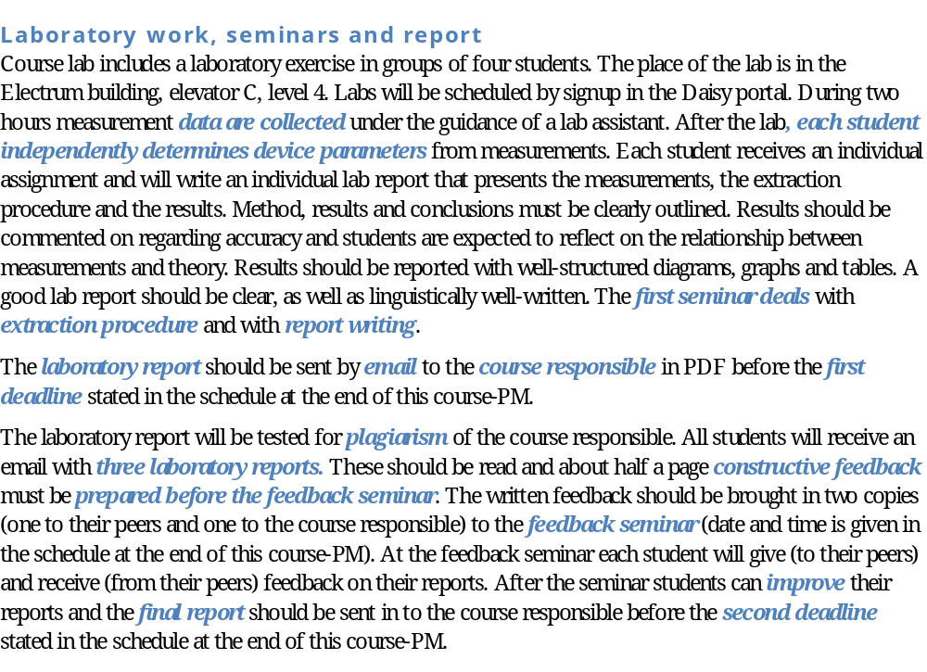

Slide 7
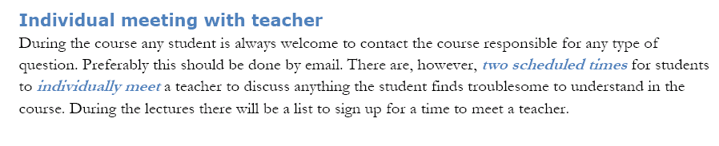

Slide 8
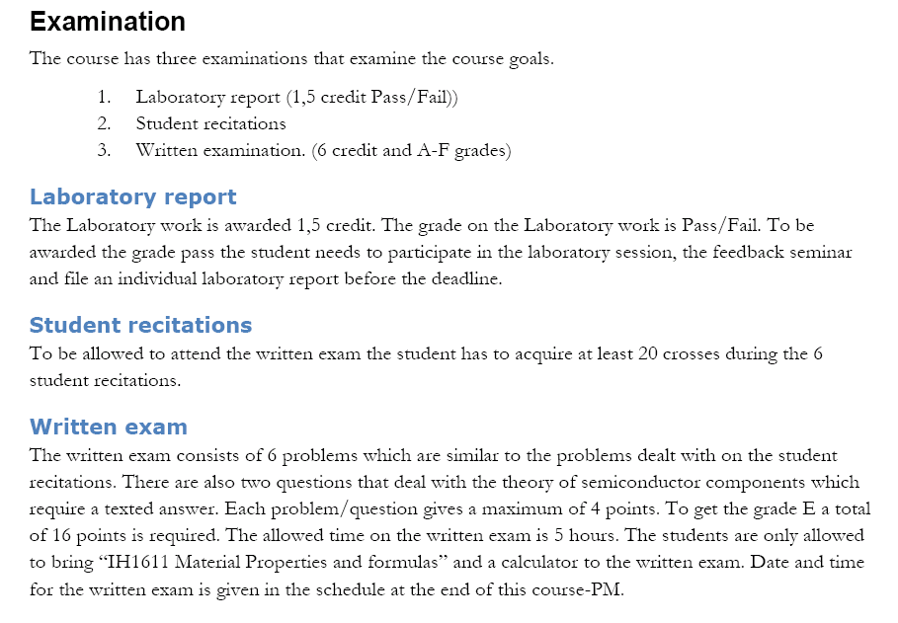

Slide 9
Teachers and additional information
Course responsible
Associate Professor, Docent. Gunnar Malm, 08-790 4332, School of ICT, Integrated Devices and Circuits, Electrum C4 (Kista)
Teachers and lab assistant
To be announced
Examiner
Associate Professor, Docent. Gunnar Malm, 08-790 4332, School of ICT, Integrated Devices and Circuits, Electrum C4 (Kista)
Course prerequisites
Electromagnetic theory and Applied Physics or Physics I
Course literature
Modern Semiconductor Devices for Integrated Circuits, Chenming Calvin Hu, 2010, Pearson Education , ISBN-10: 0-13-700668-3.

Slide 10
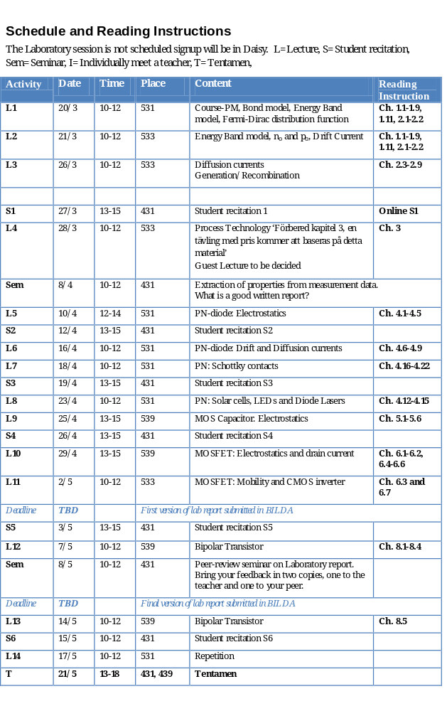

Slide 11
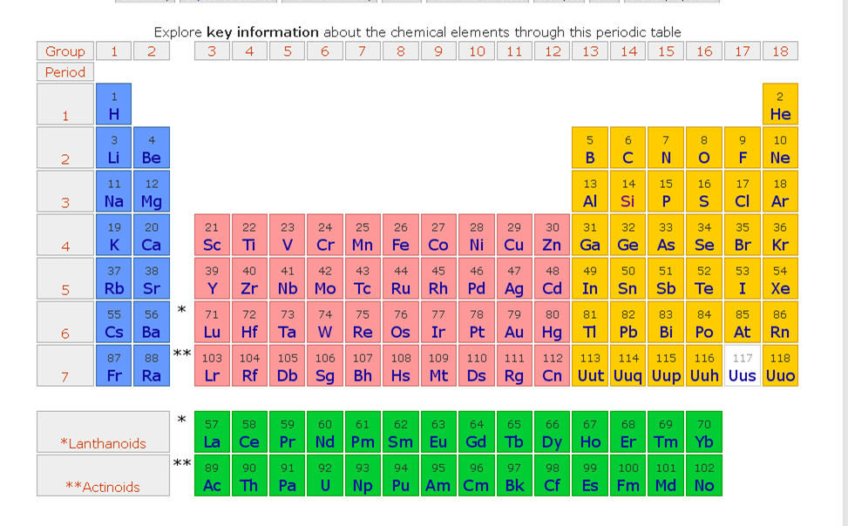
Vad är en halvledare?
Ämnen i det periodiska systemet med rätt elektroniska egenskaper, bestäms av gruppen (valenstalet)
Kisel (Si) absolut vanligast

Slide 12
Elektron-bindningar
Jonisk/kovalent/metallisk
Halvledare har medelbra förmåga att leda ström och ledningsförmågan kan enkelt varieras

Slide 13
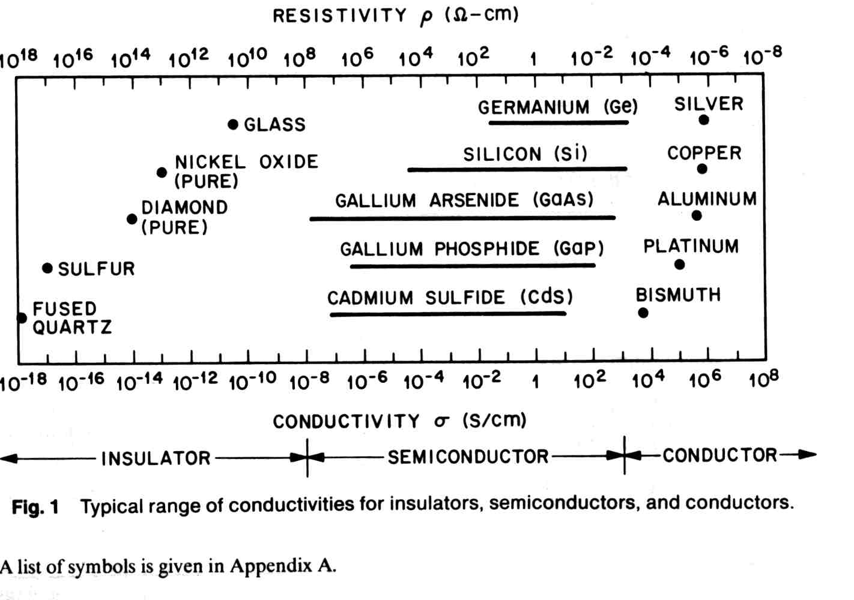
Ledningsförmåga hos material

Slide 14
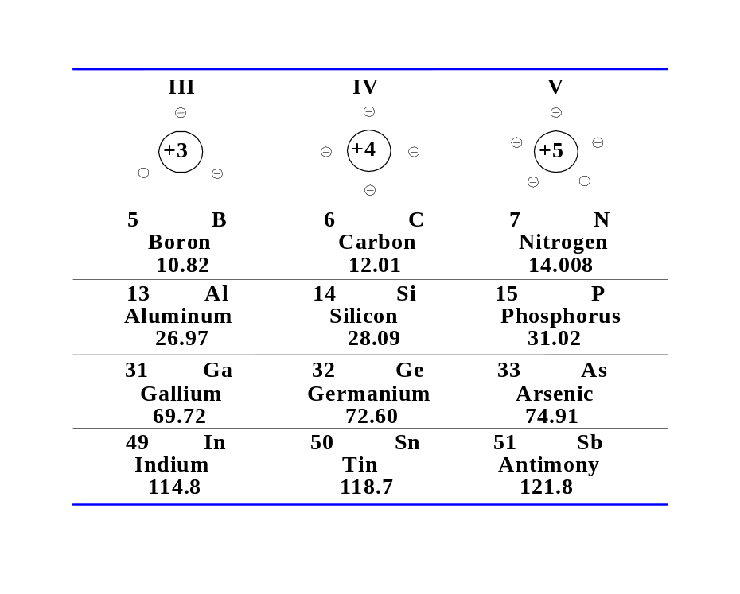
Grupperna III, IV och V
Grundämneshalvledare i periodiska systemets kolumn IV
Sammansatta ofta kombination av III och V, ex. GaAs, InP

Slide 15
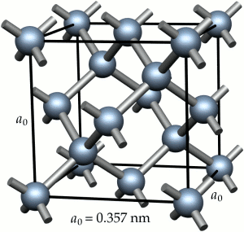
Halvledare är kristaller
Diamantstruktur (Si) betyder att atomerna är regelbundet placerade med kubisk symmetri (men mer komplicerat än så)

Slide 16
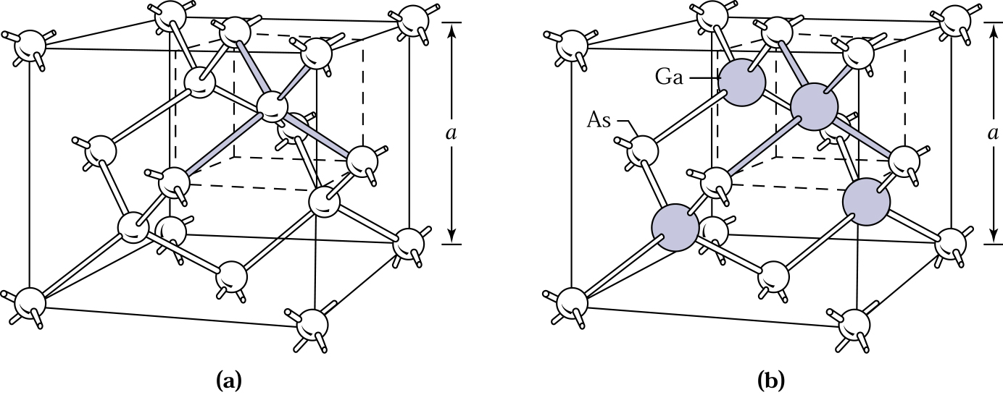
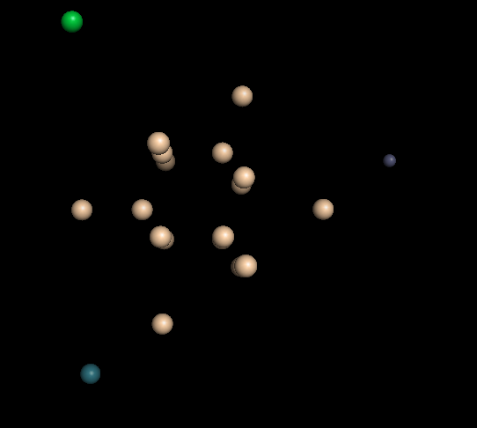
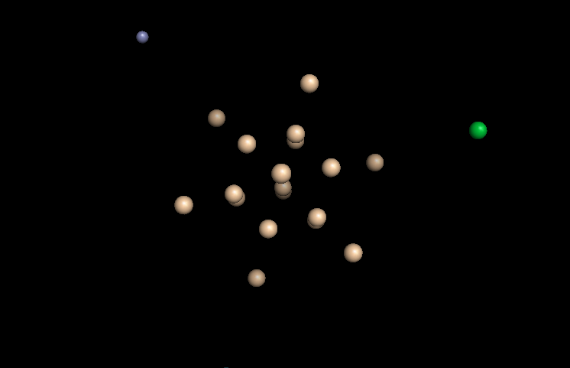
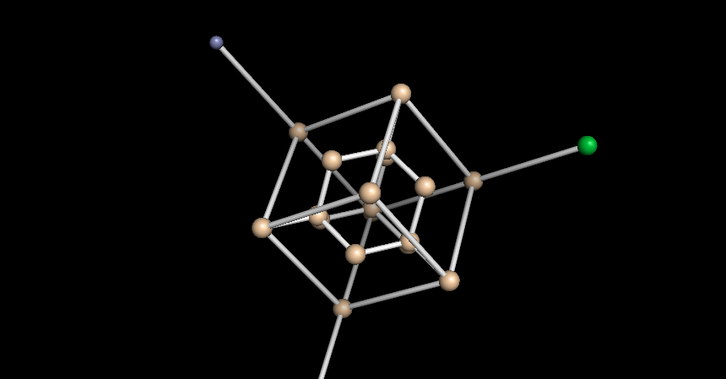
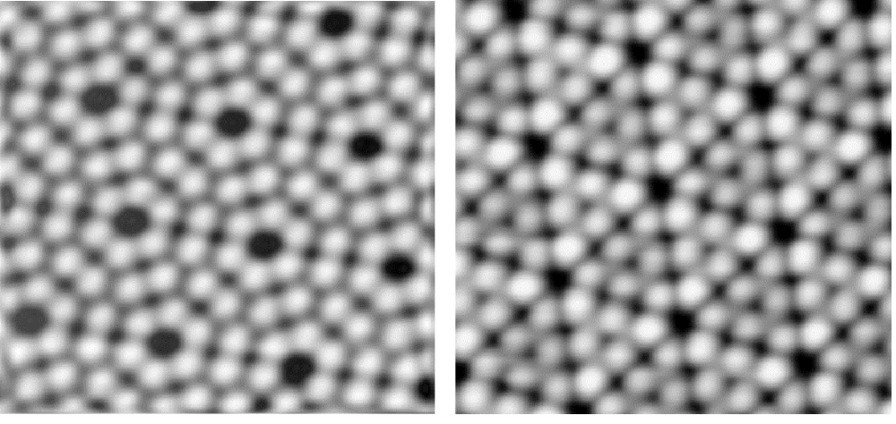
Si
Kisel har kovalent bindning och diamantstruktur
Varje atom har bindning till fyra grannar
GaAs har samma struktur men varannan atom
Ga och As

Slide 17
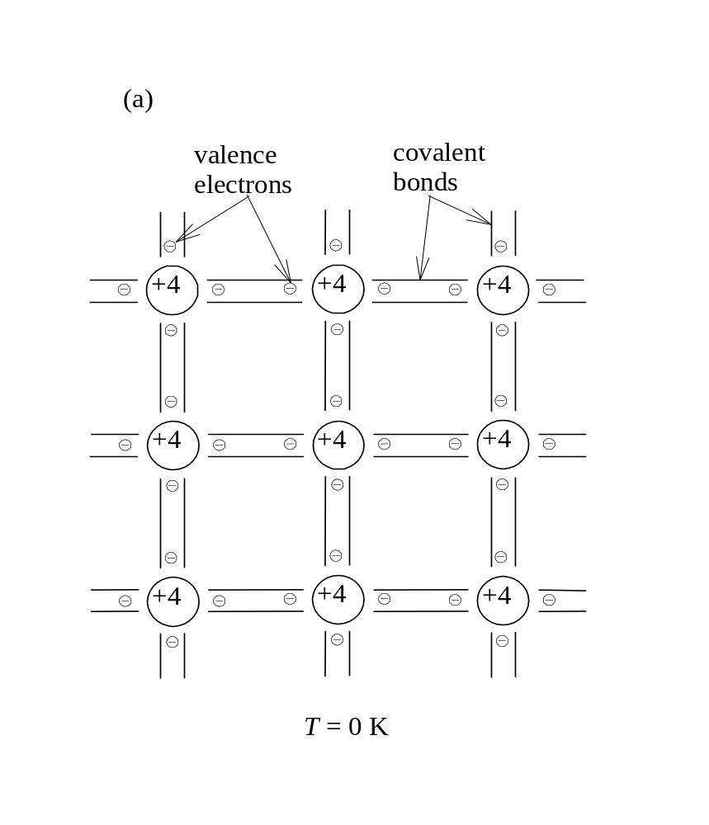
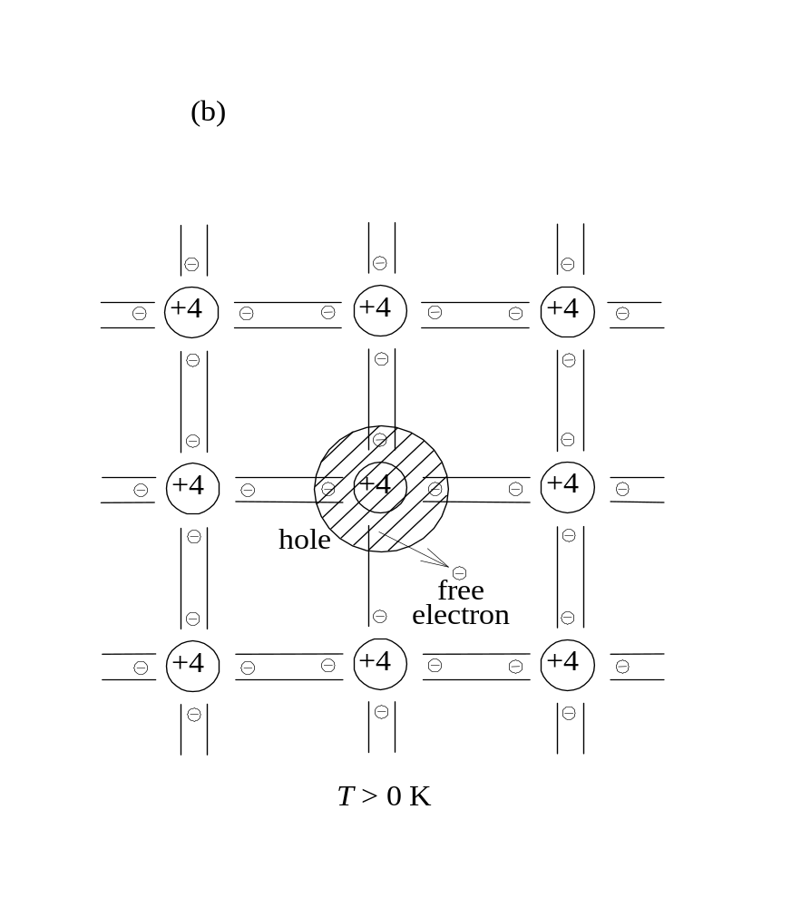
Atom i period 4 har fyra valenselektroner och binds till fyra grannar
En del elektroner frigörs m.h.a. termisk energi och tom plats blir hål

Slide 18
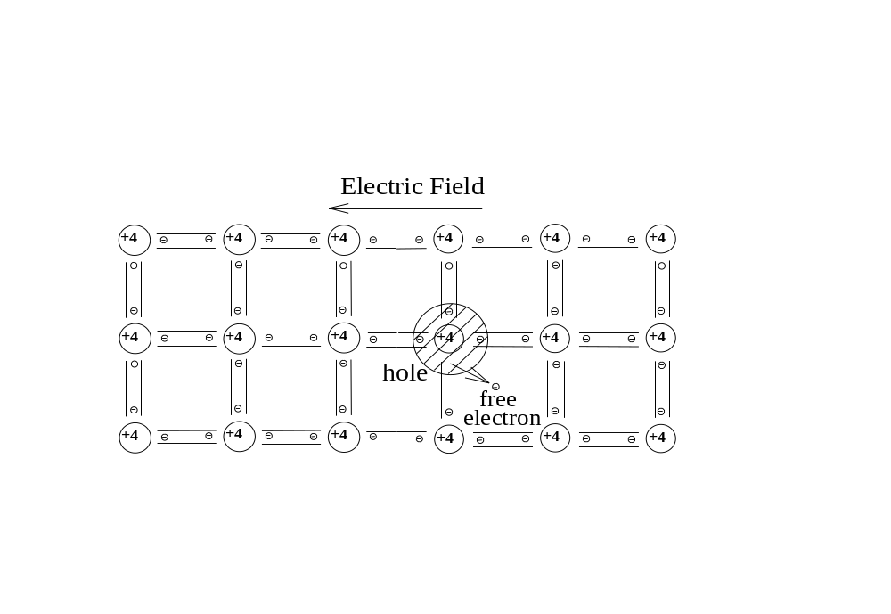
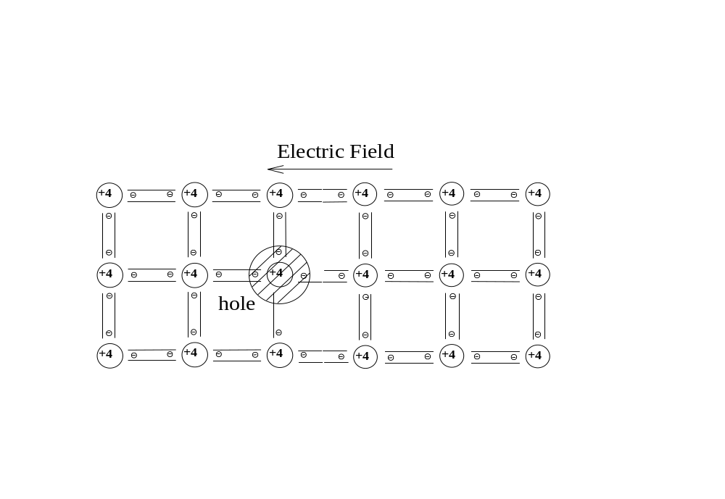
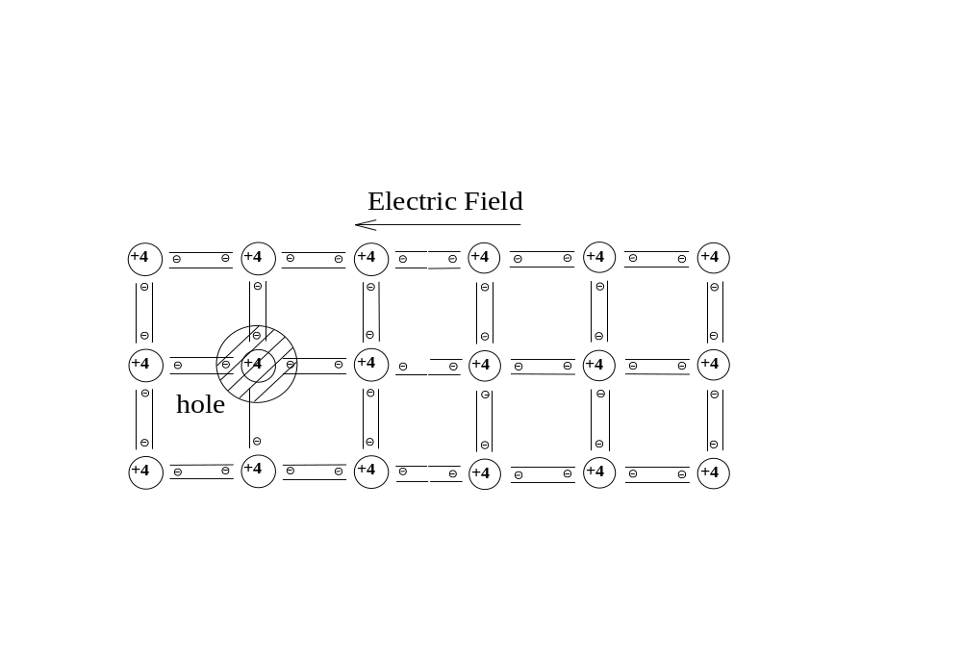
Fria elektroner kan röra sig i elektriskt fält och ge ström
Även hål (tomma platser) rör sig i elektriskt fält.
Elektron hoppar från grannatom till tom plats

Slide 19
Ren (intrinsisk) halvledare:
Lika många elektroner och hål som
ges av intrinsisk koncentration n_{i}
n_{i} beror på hur många elektroner som frigjorts av termisk energi, kraftigt temperaturberoende
Si Rumstemperatur: n_{i} = 1.5*10¹⁰ cm⁻³

Slide 20
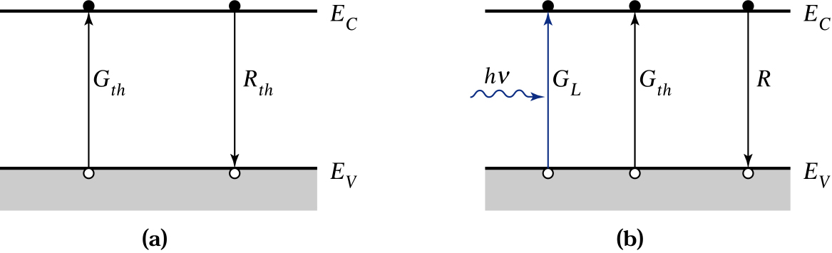
Vid jämvikt är termisk generation G_{th} lika stor
som rekombination R_{th} och detta bestämmer n_{i}(T)
Rekombination sker då elektron och hål möts
och leder till att elektron-hål paret försvinner

Slide 21
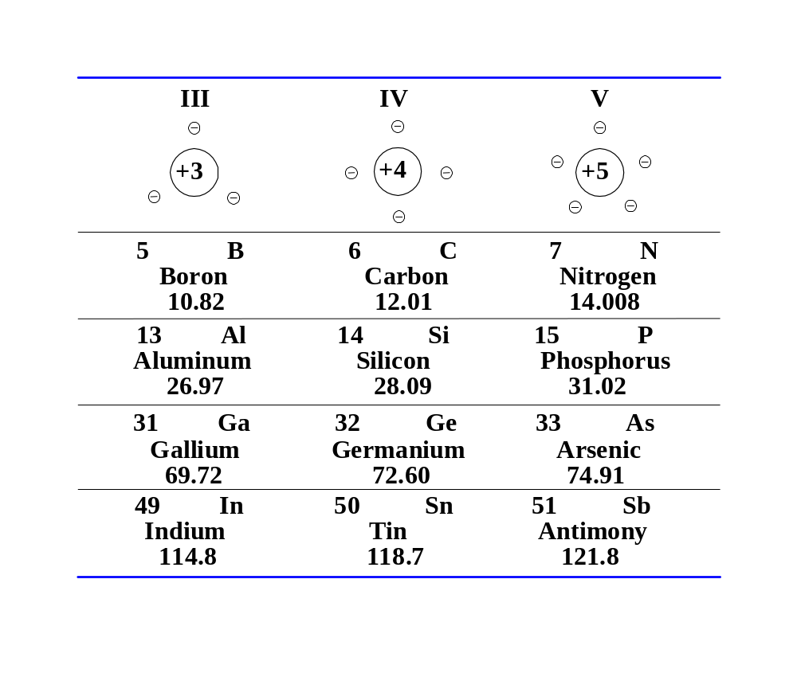

Slide 22
Notes:
no=po=ni
no,po are free to move and can therefore give current.

Slide 23
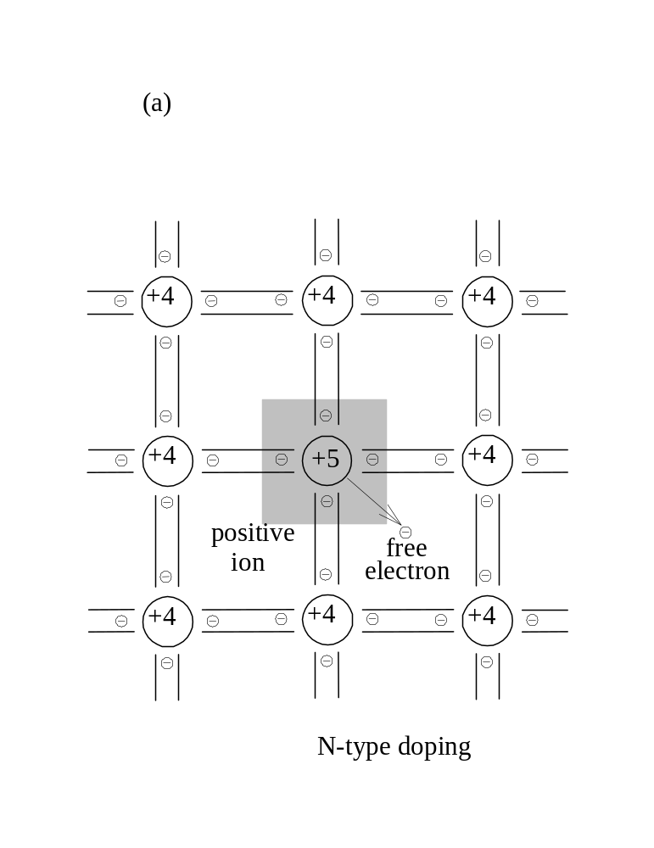
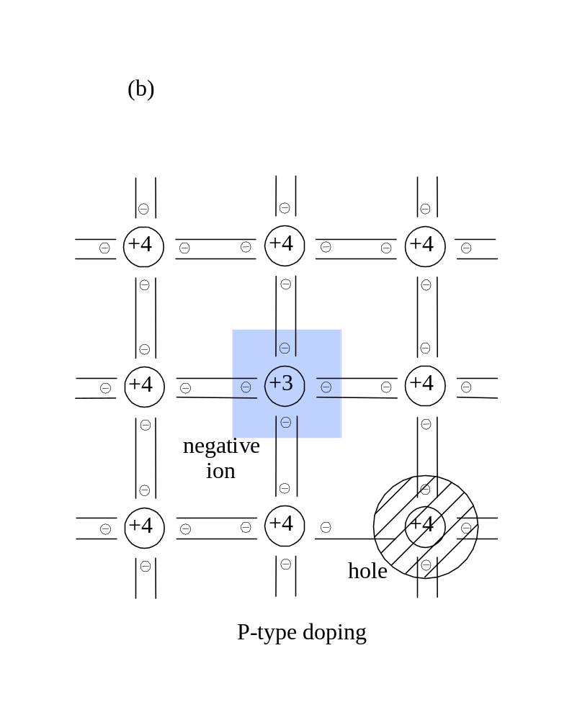
Notes:
no+Na=po+Nd
Även i det dopade fallet gäller no*po=ni^2 (kommer att visa det senare)
Typ dopnivåer är 1e15-1e20, jämföra med ni=1e10 för Si
Lös andragradaren för Nd=1e17 och visa att no=Nd och po=ni^2/Nd.

Slide 24
En kisel kristall är dopad med 10¹⁶ cm⁻³ bor atomer. Vad är n₀ och p₀?
n₀=10¹⁶ cm⁻³ , p₀=10¹⁰ cm⁻³
n₀=10⁴ cm⁻³ , p₀=10¹⁶ cm⁻³
n₀=10¹⁶ cm⁻³ , p₀=10⁴ cm⁻³
n₀=0 cm⁻³ , p₀=10¹⁶ cm⁻³
Hur säker är du på ditt svar?
- Jag gissar
- Jag är rätt säker
- Jag vet att jag har rätt

Slide 25
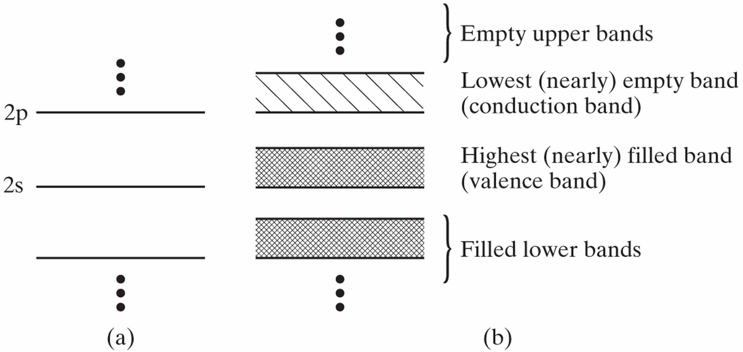

Slide 26
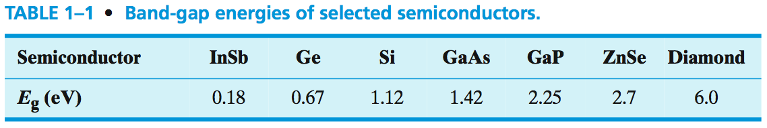
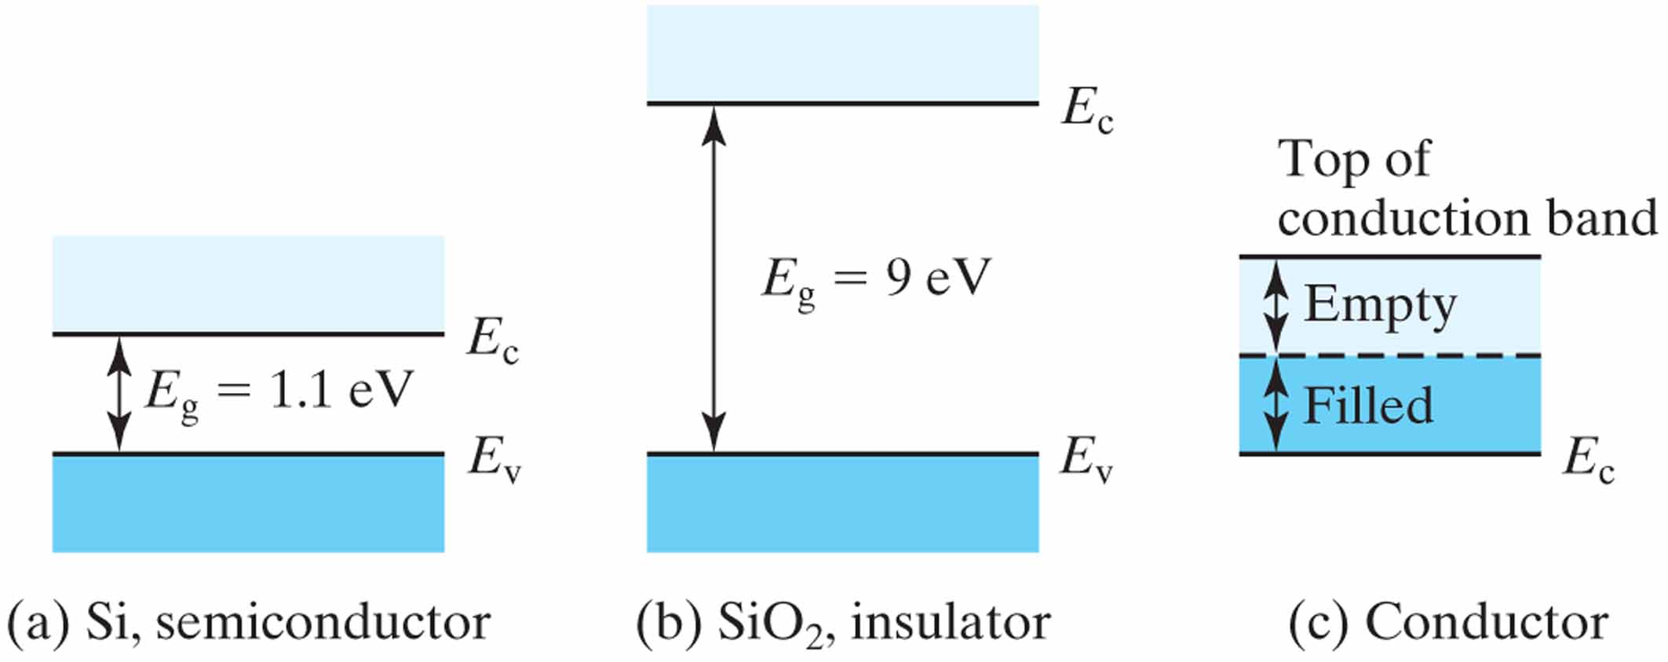

Slide 27
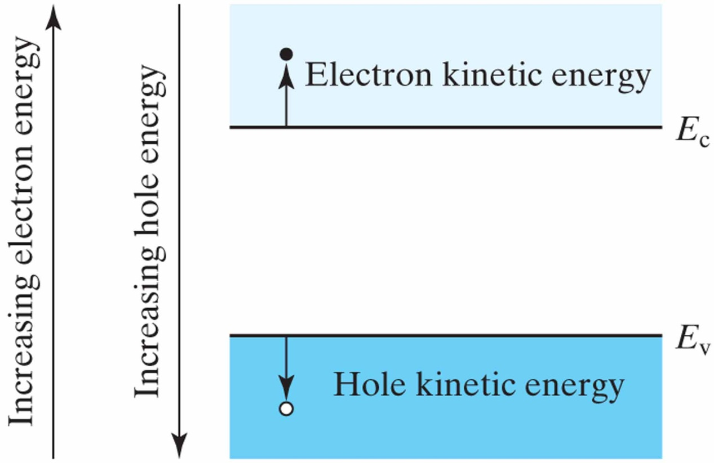
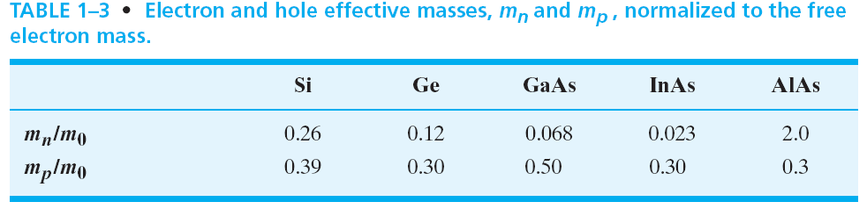

Slide 28
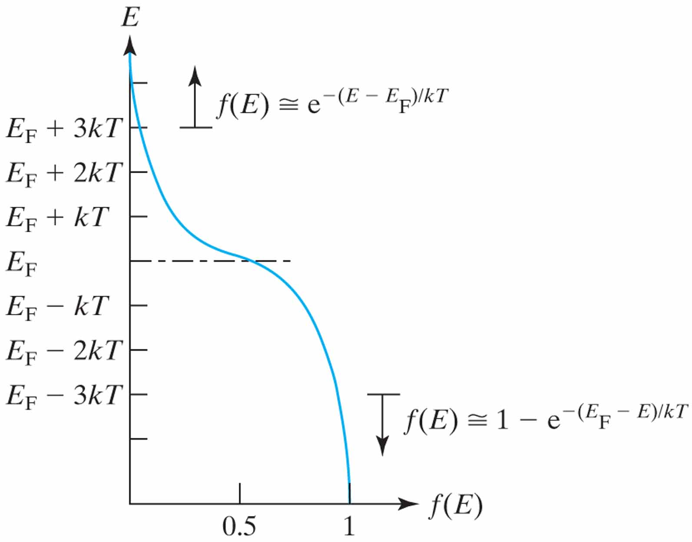
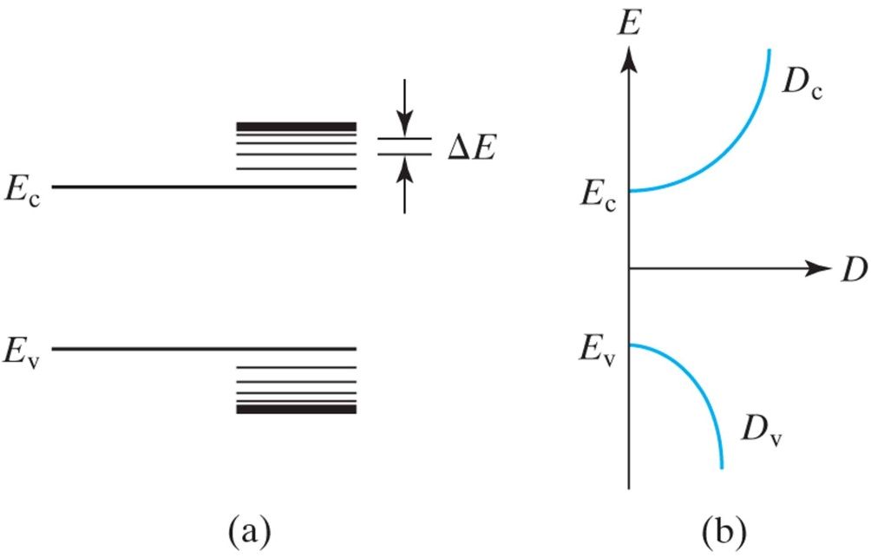

Slide 29
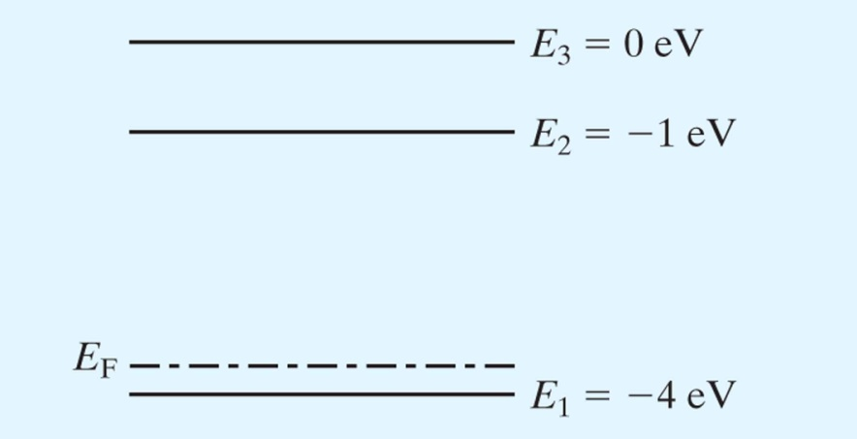
I ett hypotetiskt system finns 3 energinivåer. Varje nivå kan endast vara besatt av en elektron. Hur många elektroner är det i systemet?
A: 3 B: ∞ C: 1 D: 2
Hur säker är du på ditt svar?
- Jag gissar
- Jag är rätt säker
- Jag vet att jag har rätt

Slide 30
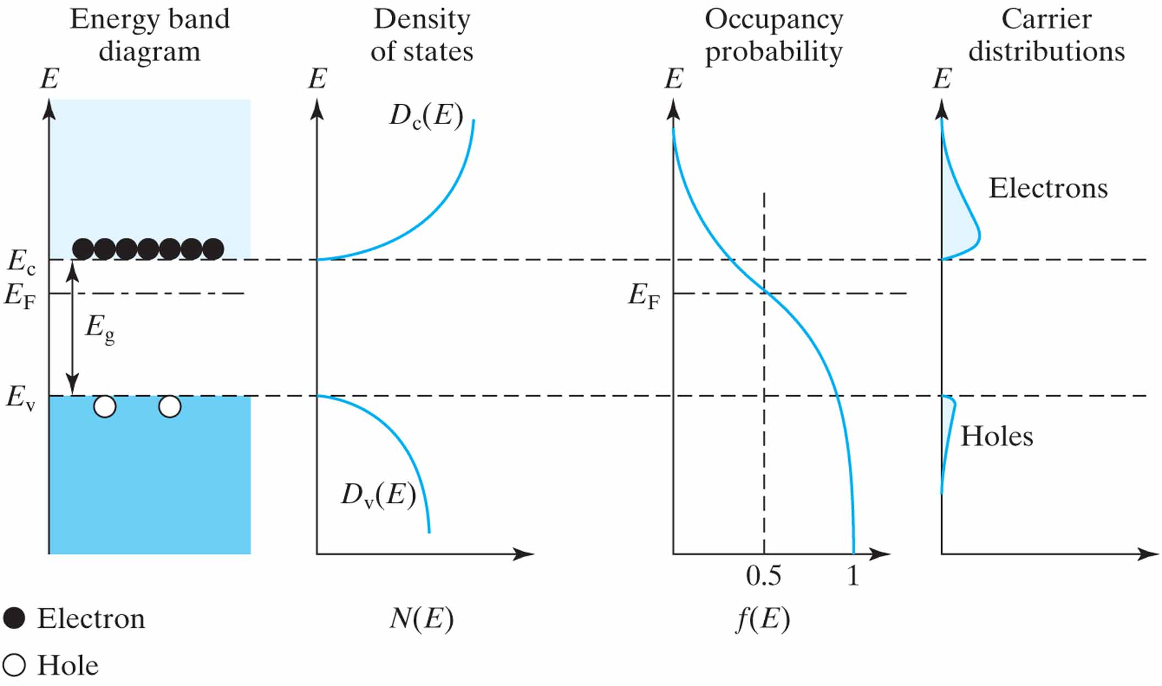
Notes:
Derive no as a function of Ec-Ef on the white board.
Effective density of states is like putting all states at Ec edge
End derivation with writing down the important no and po formulas and describe how to remember them.
The also show that no*po=ni^2

Slide 31
