Slide 1
SGAM-Template

Slide 2
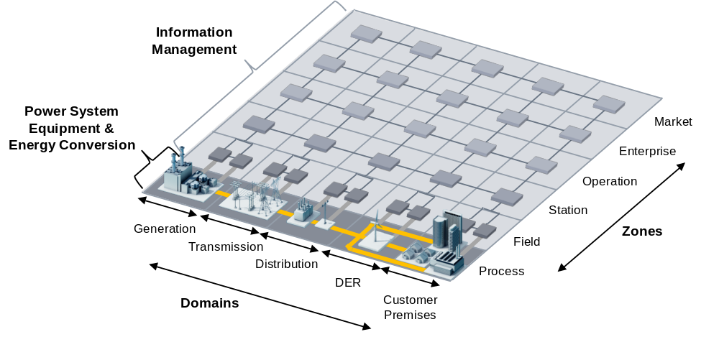
The Smart Grid Architecture Model (SGAM):
General: The SGAM framework and its methodology are intended to present the design of smart grid use cases in an architectural but solution and technology neutral manner. In accordance to the present scope of the M/490 program, the SGAM framework allows the validation of smart grid use cases and their support by standards.
Smart Grid Plane: In general power system management distinguishes between electrical process and information management viewpoints. These viewpoints can be partitioned into the physical domains of the electrical energy conversion chain and the hierarchical zones (or levels) for the management of the electrical process
Layers: In order to allow a clear presentation and simple handling of the architecture model, interoperability aspects are aggregated into five abstract interoperability layers.

Slide 3
SGAM-Domains:
Domain | Description
Bulk Generation | Representing generation of electrical energy in bulk quantities, such as by fossil, nuclear and hydro power plants, off-shore wind farms, large scale photovoltaic (PV) power– typically connected to the transmission system
Transmission | Representing the infrastructure and organization which transports electricity over long distances
Distribution | Representing the infrastructure and organization which distributes electricity to customers
DER | Representing distributed electrical resources, directly connected to the public distribution grid, applying small-scale power generation technologies (typically in the range of 3 kW to 10.000 kW). These distributed electrical resources can be directly controlled by DSO
Customer Premises | Hosting both - end users of electricity, also producers of electricity. The premises include industrial, commercial and home facilities (e.g. chemical plants, airports, harbors, shopping centers, homes). Also generation in form of e.g. photovoltaic generation, electric vehicles storage, batteries, micro turbines… are hosted
SGAM-Zones:
Zone | Description
Process | Including both - primary equipment of the power system (e.g. generators, transformers, circuit breakers, overhead lines, cables, electrical loads …) - as well as physical energy conversion (electricity, solar, heat, water, wind …).
Station | Representing the aggregation level for fields, e.g. for data concentration, substation automation…
Operation | Hosting power system control operation in the respective domain, e.g. distribution management systems (DMS), energy management systems (EMS) in generation and transmission systems, microgrid management systems, virtual power plant management systems (aggregating several DER), electric vehicle (EV) fleet charging management systems.
Enterprise | Includes commercial and organizational processes, services and infrastructures for enterprises (utilities, service providers, energy traders …), e.g. asset management, staff training, customer relation management, billing and procurement.
Market | Reflecting the market operations possible along the energy conversion chain, e.g. energy trading, mass market, retail market...

Slide 4





SGAM-Layers:
The layers will be described during the application process.
Business
Function
Information
Communication
Component
Market
Enterprise
Operation
Station
Field
Process
Generation
Transmission
Distribution
DER
Customer

Slide 5
Step 3 – Sub-functionality Analysis and SGAM Classification
After identifying all information that should be visualized, the next step is to analyze which parts of the SGAM are of interest. This is a first estimation where to locate the relevant elements of the sub-functionality to be visualized within each SGAM layer. It aims at reducing the complexity by only focusing the required part of the SGAM layers.
On the next slide it is explained how all cells of the SGAM can be labeled with a unique identifier by using the x-, y-, and z-axes of the SGAM-coordination systems:
Layers: A - E
Domains: 1 - 5
Zones: a - f
After that, the next two slides will briefly describe the meaning of the layers – as previously done for the zones and domains.
In order to simplify the realization of this step, the Business Layer of the SGAM is utilized. The original meaning of that layer is only vaguely described so that it can be used in different ways. In case of visualizing sub-functionalities the business aspects are not in the scope – but they will be later in the project. Due to that reason it is suggested to start with the Business Layer in order to identify the zones and domains that have to be considered for the specific sub-functionality. Due to that reason the Business Layer is already considered during this step. Besides the layer itself also a slide specifying a legend for the used semantics is provided.
Finally, the last slide of this step includes a table that can be used to summarize the cell-element-pairs of the SGAM and the sub-functionality. This can be derived from the collected information related to the sub-functionality.

Slide 6
Interoperability Layers
E
D
C
B
A
Identifier:
D4c
Zones
f
e
d
c
b
a
1 2 3 4 5 Domains

Slide 7
Component Layer (A):
The emphasis of the component layer is the physical distribution of all participating components in the smart grid context. This includes actors, applications, power system equipment (typically located at process and field level), protection and telecontrol devices, network infrastructure (wired/wireless communication connections, routers, switches, servers), and any kind of computers.
Communication Layer (B):
The emphasis of the communication layer is to describe protocols and mechanisms for the interoperable exchange of information between components in the context of the underlying use case, function or service and related information objects or data models.
Information Layer (C):
The information layer describes the information that is being used and exchanged between functions, services, and components. It contains information objects and the underlying canonical data models. These information objects and canonical data models represent the common semantics for functions and services in order to allow an interoperable information exchange via communication means.

Slide 8
Function Layer (D):
The function layer describes functions and services including their relationships from an architectural viewpoint. The functions are represented independent from actors and physical implementations in applications, systems, and components. The functions are derived by extracting the use case functionality, which is independent from actors.
Business Layer (E):
The business layer represents the business view on the information exchange related to smart grids. SGAM can be used to map regulatory and economic (market) structures and policies, business models, business portfolios (products & services) of market parties involved. Also business capabilities and business processes can be represented in this layer. In this way it supports business executives in decision making related to (new) business models and specific business projects (business case) as well as regulators in defining new market models.

Slide 9
Layer E: Business
f
e
d
c
b
a
Market
Enterprise
Operation
Station
Field
Process
1 | 2 | 3 | 4 | 5
Generation
Transmission
Distribution
DER
Customer Premise

Slide 10

Legend Layer E:
Symbol | Description
 | business objectives, business processes, economic and regulatory constraints

Slide 11
Layer A: Component
f
e
d
c
b
a
Market
Enterprise
Operation
Station
Field
Process
1 | 2 | 3 | 4 | 5
Generation
Transmission
Distribution
DER
Customer Premise

Slide 12






Legend Layer A:
Symbol | Description
 | computer (CRM, DMS, HES, etc.)
 | gateway
 | HMI
 | data collector
 | controller and IED
 | transmitter
 | generator
 | substation
 | information flow (wired)
 | information flow (wireless)
 | power grid
 | bus
 | power line

Slide 13
Layer B: Communication
f
e
d
c
b
a
Market
Enterprise
Operation
Station
Field
Process
1 | 2 | 3 | 4 | 5
Generation
Transmission
Distribution
DER
Customer Premise

Slide 14







Legend Layer B:
Symbol | Description
 | component (from Component Layer)
 | communication protocols for the data exchange (area)
 | communication protocols for the data exchange (point-to-point)

Slide 15
Layer C: Information
f
e
d
c
b
a
Market
Enterprise
Operation
Station
Field
Process
1 | 2 | 3 | 4 | 5
Generation
Transmission
Distribution
DER
Customer Premise

Slide 16


Legend Layer C:
Symbol | Description
 | component (from Component Layer)
 | exchanged information objects
 | canonical data model (standards)

Slide 17
Layer D: Function
f
e
d
c
b
a
Market
Enterprise
Operation
Station
Field
Process
1 | 2 | 3 | 4 | 5
Generation
Transmission
Distribution
DER
Customer Premise

Slide 18

Legend Layer D:
Symbol | Description
 | function
 | interrelation (exchanged information)

Slide 19
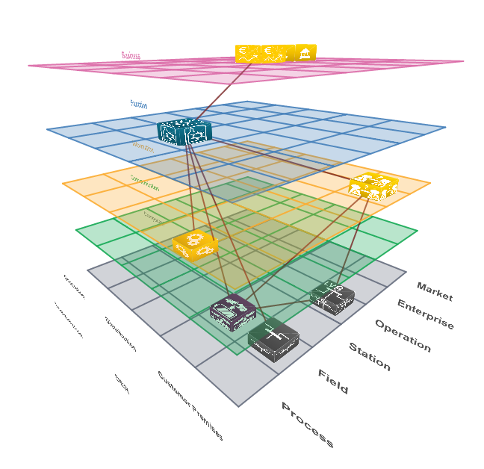
What did we achieve with that approach so far?
A textual documentation of components, information, communication, functions, and business processes for a particular Smart Grid scenario, i.e., description of several architecture views for different stakeholders, e.g., addressing technical components, exchanged information or functionality available for business processes
A model of elements used in the SGAM stories
This serves as a basis for communication for among different Smart Grid scenarios
Allows rough comparability of several scenarios
Since one key issue in the DISCERN project is to share information, the SGAM application in terms of creating a common view on sub-functionalities facilitates two ways of sharing information:
  Among DSOs and
  Across different work packages
A populated SGAM cube for
analysis of overarching
Smart Grid concerns

