Slide 1
Research & Development
Roberto Roverso
Thursday 25 April 13

Slide 2
The company
11 Employees
Different Background
  Researchers (2 Professors, 1 Ph.D. Student and 2 Research Engineers)
  Developers (2 Senior and 2 Junior)
  Management (2)
Located in Stockholm
Specialized in scalable systems based on Peer-To-Peer

Slide 3




The product
Peer-To-Peer Live Streaming Software
  Greatly diminishes bandwidth consumption
  at the distribution point (CDN) and enables corporate multicast

Slide 4
The numbers
Proxy which sits between CDN and the local player
~80.000 installations in corporate networks
~30.000 WAN installations
  7000 concurrent users
Notes:
Since when?

Slide 5
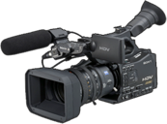
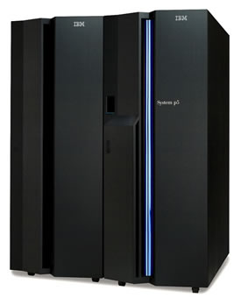

Live Streaming
Definition:
  “The process of broadcasting live media over the Internet”
Content is recorded, encoded and distributed in real-time
A streaming service provides the media to a client using specific control and transport protocols
Distribution of the stream usually happens using a Content Delivery Network (CDN)
CDN

Slide 6
Protocols
An encoder digitalizes and compresses media as it is recorded:
  Variety of Video codecs (H.264, VP8), Audio codecs (MP3, Vorbis, AAC) and Media Containers (FLV, WebM, ASF or ISMA)
Media delivery and Streaming protocols
  Stateful/Push/VCR-like: ( OLD )
    Implementations: Real Time Session Protocol (RTSP), Microsoft Media Services (MMS), Adobe’s FLV, etc..
    Single bitrate
    UDP-based transport protocols ( RTP and RealNetwork RDT )
  Stateless/Pull/HTTP-based ( NEW STANDARD )
    Implementations: Apple’s HTTP-Live (HLS), Microsoft Smooth Streaming, Adobe HTTP dynamic streaming (HDS)
    multi-bitrate support

Slide 7



Content Streaming
Streaming Service
  Sufficient computational power to receive, encode, convert and protect the media content
Distribution
  Streaming is demanding in terms of bandwidth consumption
    You Tube: 256Kbit/s with H.264 codec
    HD Stream: >2Mbit/s
  Yet CDN Bandwidth is not expensive
    Volume: 0.7$ per GB
    Scaling is handled automatically
Vs.
Notes:
Distribution site?

Slide 8
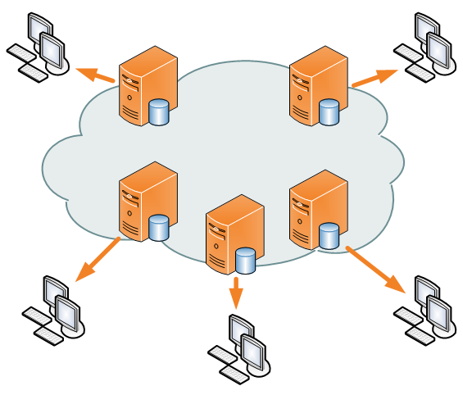
The case for P2P live streaming
Redirect
The Reach
  CDN cache cannot serve more than the X capacity it was dimensioned for
  Scaling operations are usually slow
Peer-To-Peer can scale the number of viewers using a fraction of CDN capacity
X+N
x
CDN

Slide 9
The Corporate Live Streaming case
CDN
CDN doesn’t help
Bottleneck on the site’s internet link
Multicast complex to configure
Expensive to introduce hardware CDN nodes inside the Sites
Main Site
gateway
Secondary
site
Secondary
site
Secondary
site
Notes:
- Imagine a company…
- Company Townhall case – CEO speech
- Netwok collapse

Slide 10
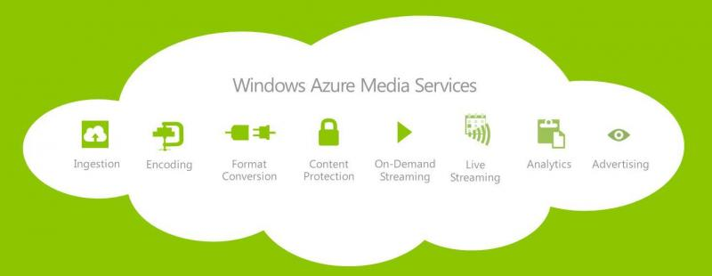


Peer2View streaming chain
CDN

Slide 11

Business requirements on P2P streaming application
Hard technical requirements dictated by business reasons
  Given a number of viewers, distribution load by contract:
    Average amount (X)
    Max peak value (Y)
  Infrastructural cost (Z)
  Streaming chain cannot be modified
    Streaming Protocol stack must be maintained “as is”
    Deal with implementations of
      Recorders
      Multitude of Streaming servers and players
  Enforce policies according to customer demands
    Access control, locality, radio network politeness
Notes:
What are the variables?
What r the constraints

Slide 12

P2P Live Streaming Challenges
Streaming Server
Real-time nature of the service
  Hard deadlines on the delivery of content
Coping with
  Network Congestion
  Limited bandwidth capacity of peers and source
  Churn
  Connectivity constraints between hosts
    Firewalls and Network Address Translation (NAT)
Maintaining
  Low Delay from the source of the content
    Video played n seconds after it was broadcasted
  Locality of content
    Keep overlay traffic inside the same network segment (ISP and/or AS)
P2P Swarm

Slide 13
How to build a peer-to-peer software?
Development
Framework
Services
Algorithm
Design and Implementation
Network Library
Testing
Money and Time

Slide 14


Development Framework
Mesmerizer
  Software infrastructure for event-based systems development
    Mesmerizer applications can be tested in emulation and deployed in production
    Applications consists of a set of components
  Based on Google’s Guice
    Injection framework
  Event-Driven Runtime
    Emulation: emulated network interactions, DES scheduler
    Deployment: remote event interactions, concurrent event scheduler
  Components written in:
    Java, Python and Scala

Slide 15
Emulation
Emulation allows for fast debugging and large scale evaluation of the application
Sequential runtime in emulation
  Reproducibility of execution
Network interactions
  Bandwidth allocation dynamics
    Transfers with different/variable priority
  Network Address Translation behavior
  Delays
  Hierarchical Network topology
    AS/ISP/LAN

Slide 16
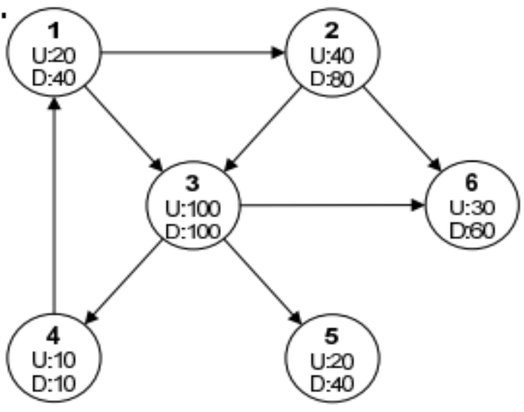
Bandwidth emulation
Flow-level bandwidth emulation
  Modeling the transfer as whole (flow) rather than datagrams
  Viable trade-off between accuracy and scalability
  Emulates the transfer as a fixed rate bandwidth allocation on the sender and receiver
  The duration of the flow is the emulation target
  Ripple effect: cascade of allocation and de-allocation events
MsgA

Slide 17
How to build a peer-to-peer software?
Development
Framework
Services
Algorithm
Design and Implementation
Network Library
Testing
Money and Time

Slide 18
Network library
P2P Sockets
  Socket-like abstraction library for peer-to-peer applications
    Same interface as the emulated network library
  UDP-based
  Implemented in Java NIO for portability
  State of the art NAT Traversal
  Flow Control and Reliability (as TCP)
  Variable and dynamic transfer priority
    Inter-Protocol / Intra-Protocol

Slide 19
NAT Problem
Network Address Translators prevent direct communication between peers in different private networks
NAT Box
NAT Box
n_{a}
n_{b}
p₁
p₂
v₁
u₁
u₂
v₂
v₃
u₃
u₄
v₄
v_{x} Private endpoint (IP:Port)
u_{x} Public endpoint (IP:Port)
Notes:
What to describe? Introduce the relay?

Slide 20
NAT Traversal – Model
We classify NAT Types as Set T of three Policies:
  Mapping (3) [EI,HD,PD]
    “When a new port is opened by the NAT”
  Allocation (3) [PP,PC,R]
    “Which” port number is used
  Filtering (3) [EI,HD,PD]
    “How” the open port can exploited
We claim that Traversal, i.e. hole punching, has to be carried out by considering combinations of all 27 types
  Which leaves 378 possible combinations
    27 possible NAT Types

Slide 21
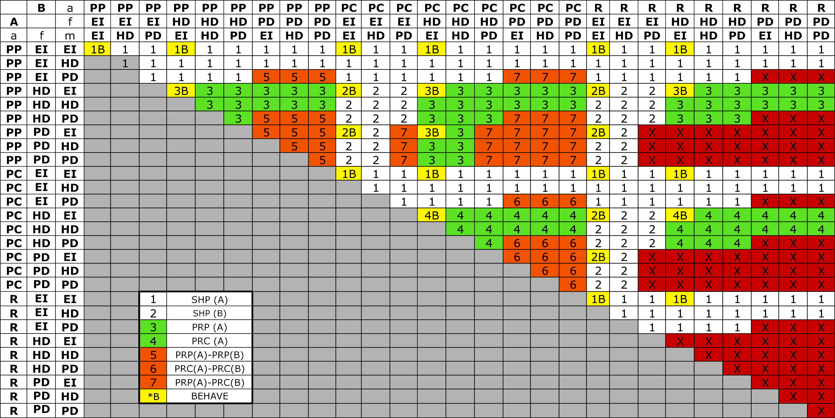
NAT combinations table
80% of all combinations are traversable

Slide 22
NAT Traversal
Experimental results:
  ~4800 peers located in Sweden
  “Open”/not natted peers: 18.1%
  Average connectivity probability
    Direct both ways all-to-all: 85%
    One-way: 8%
    Direct both ways excluding not supported types/one-way: 92%
  Average connection establishment time: 1.8 seconds
  NAT Types observed 18 over 27

Slide 23
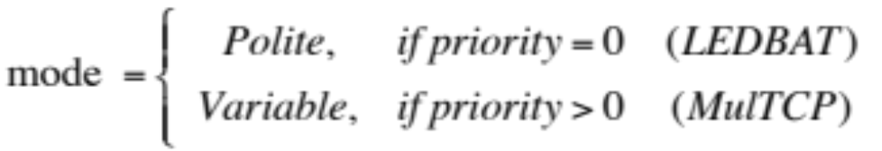
Traffic Prioritization - DTL
Different congestion control mechanisms for traffic prioritization
Lower than best effort priority
Background traffic
Delay based
Packet-loss based
Same priority as TCP or higher
Urgent traffic
Notes:
- Goal of the congestion control

Slide 24

Traffic Prioritization
LEDBAT as congestion control:
  Maximizes throughput
  Fast initial ramp-up
  Shares bottleneck equally with other LEDBAT flows
  Minimizes latency introduced on other traffic
Unfortunately tweaking LEDBAT parameters does not lead to a corresponding degree of aggressiveness
  Delay-based is good for politeness, not for aggressiveness
Runtime switch congestion control from a delay-based algorithm (LEDBAT) to a packet-loss one (MulTCP)
  Without re-establishing the connection!

Slide 25
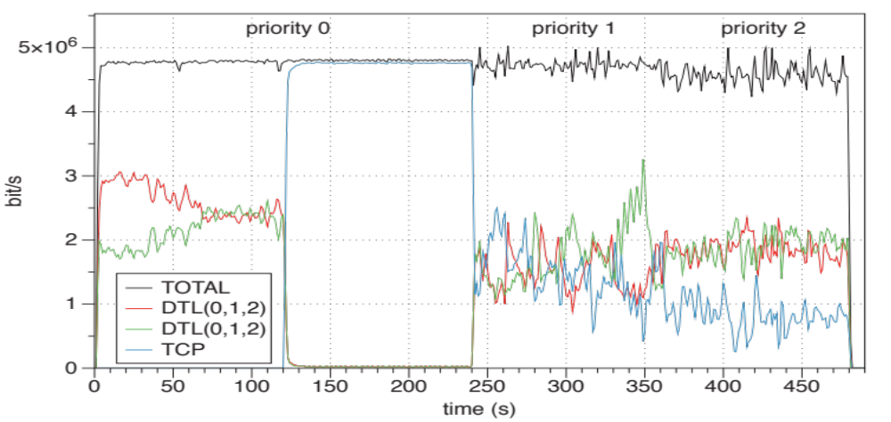
Traffic Prioritization
LEDBAT
MulTCP

Slide 26
How to build a peer-to-peer software?
Development
Framework
Services
Algorithm
Design and Implementation
Network Library
Testing
Money and Time

Slide 27
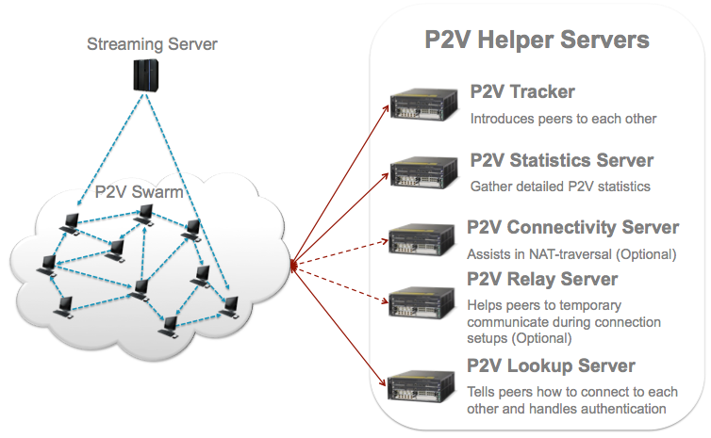
Services

Slide 28
How to build a peer-to-peer software?
Development
Framework
Services
Algorithm
Design and Implementation
Network Library
Testing
Money and Time

Slide 29
Peer2View
Requirement: support HTTP-based streaming with adaptive bitrate
  Encoder provides:
    X video and Y audio bitrates for same stream
  Media server appears normal HTTP server
  Player pulls fragments and decides:
    Pace of requests
    Buffering time and length
    Quality to reproduce, depending on:
      CPU load
      Bandwidth available
      Rendering capabilities
    Requests for fragments are totally uncorrelated between each others
    Heuristics behavior cumbersome to predict
Encoder
and
Media Server
Publish
CDN
HTTP GET
Player

Slide 30
Peer2View
Approach to the problem:
  Peer-To-Peer caching
    Overlay network seen as a cache for content fragments
  When player requests a fragment:
    Cache hit (neighbors have fragment): retrieve from peers as fast as possible
    Cache miss: retrieve from the CDN
  This approach allows us to provide quality of user experience (QoE) comparable to the CDN
    We strive not to interfere with heuristics of the player

Slide 31
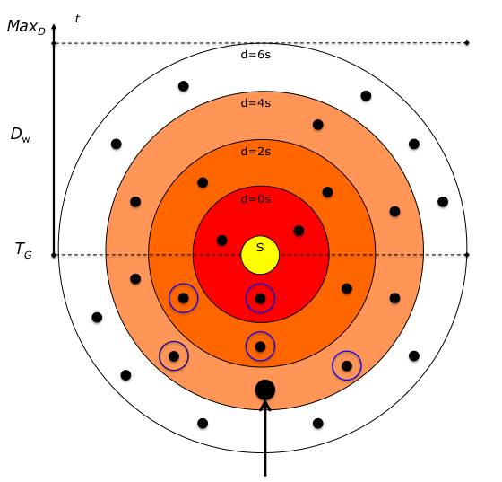
Peer2View Overlay
Mesh-based overlay network
  Place peers with higher bandwidth at the center of the gradient
  Peer prefers neighbors that are requesting with the same delay from the source
  Adapt neighbors choice to current bitrate
  Peers with higher bandwidth capacity bubble up closer to the center by pre-fetching
    Requesting fragments ahead of time
  We use prioritization of traffic for prefetching
    +80% P2P transfers happen using LEDBAT
      Politeness towards other applications
Notes:
Introduce delays?

Slide 32
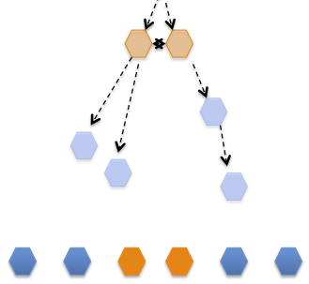
The Corporate Live Streaming overlay
CDN
Minimize amount of CDN pre-fetched data
Maximize amount of P2P pre-fetched data
Minimize the amount of data entering each site
Main Site
gateway
Secondary
site
Secondary
site
Secondary
site

Slide 33
How to build a peer-to-peer software?
Development
Framework
Services
Algorithm
Design and Implementation
Network Library
Testing
Money and Time

Slide 34
Testing
Test1 multi-bitrate
Test2 single bitrate
DEMO TIME!

Slide 35
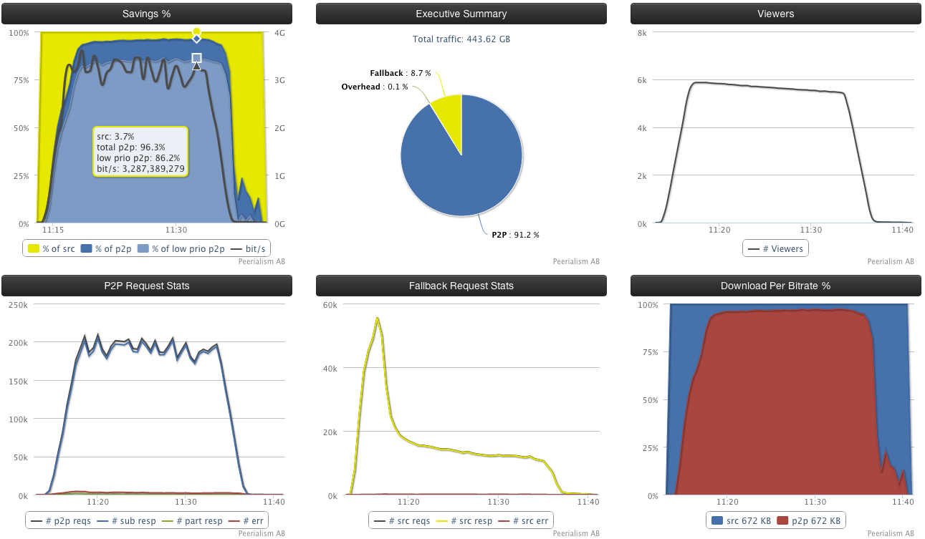
Single Bitrate Results

Slide 36
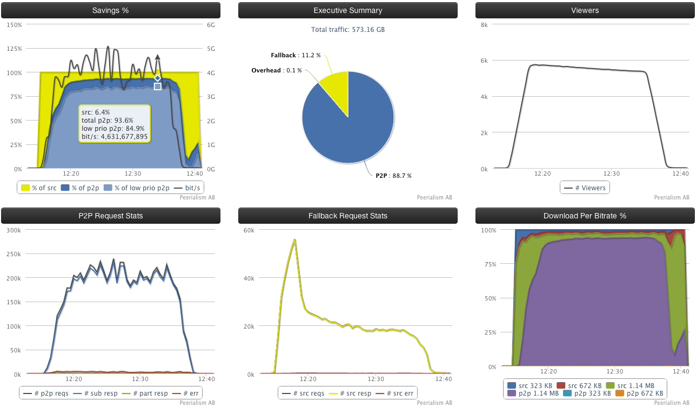
Multi Bitrate Results

Slide 37
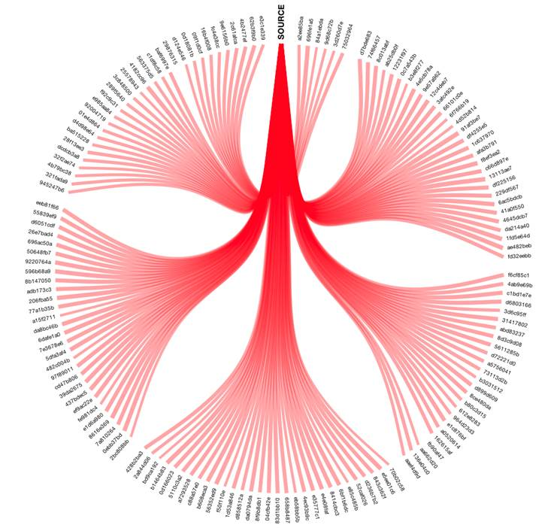
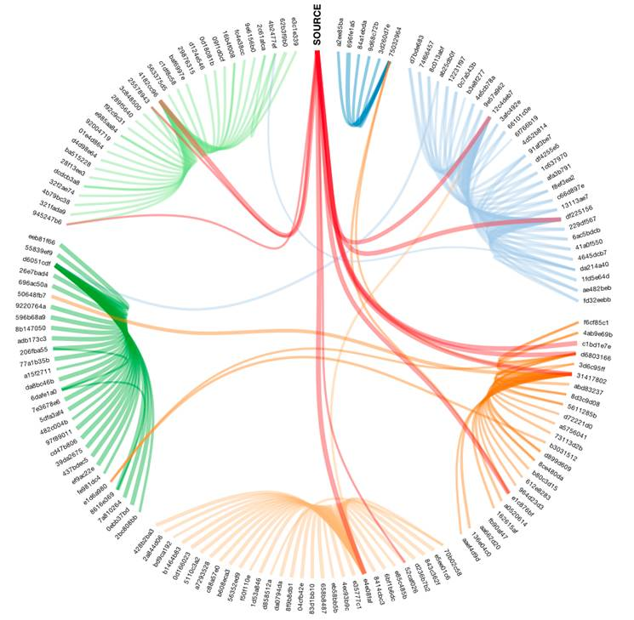
Testing Corporate
Corporate live stream only CDN
Corporate live stream P2P

Slide 38
Thanks

