Slide 1
IM3008 Luminescence Spectroscopy of Semiconductors: Theory and Experiment
(7.5 credits)
To pass the course:
one approved presentation (figures can be downloaded from the course page)
60% mark on home assignments (6 tasks total)
laboratory work (design and conduct an experiment using our equipment and,
for example, your samples)
Our equipment:
micro-PL (imaging and spectroscopy)
low-temperature micro-PL
PLE (with a tunable excitation source)
time-resolved measurements with APD
quantum yield measurements with an integrating sphere…

Slide 2
Outline of the first lecture
Main definitions. Specific case of semiconductor luminescence
Photoluminescence (PL) and photoluminescence excitation (PLE) techniques
Photodetectors: photomultiplier tube (PMT), avalanche photodiode (APD), CCD
Monochromators and spectrographs: resolution, throughput and signal-to-noise ratio
Spectral and resolution corrections
Other methods: lock-in amplifier, photon counting and Fourier spectroscopy

Slide 3
Main definitions. Specific case of semiconductor luminescence
1. Thermal radiation. Black-body source.
Wien’s law: λ [nm]= 2.9·10⁶/T[K], human thermal radiation peak is ~ 10 μm
Thermally provided energy gives rise to the emission
2. Scattering and reflected radiation.
Raman scattering (interaction of initial photons with phonons)
Rayleigh scattering (interaction of inital photons with particles smaller than λ₀)
Brillouin scattering (interaction of initial photons with refractive index variations)
These processes are fast and almost elastic (very small energy loss for initial photons)
THIS IS NOT LUMINESCENCE

Slide 4
Main definitions. Specific case of semiconductor luminescence
LUMINESCENCE:
”slow” relaxation of extra energy provided to the system through light emission
(”slow” compared to light wave oscillations (fs): from nanoseconds to hours)
Classified by the source of extra energy:
Classified by the decay rate:

Slide 5
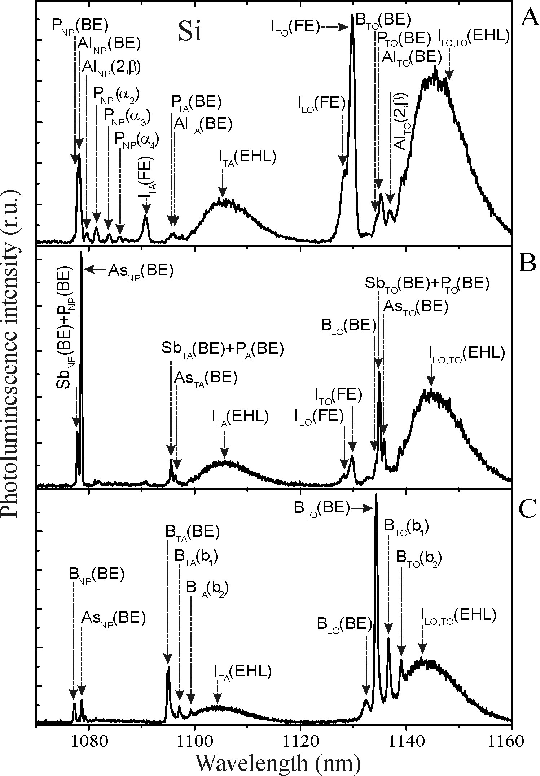
Main definitions. Specific case of semiconductor luminescence
For a solid-state object luminescence can be caused by the material itself or by impurities
Low-temperature luminescence spectra of Si crystal:
I – intrinsic components
P, Al ,B, Sb, As – common impurities/dopants
NP – no-phonon line
TA, LO, TO – specific phonon modes (transverse,
longitudinal, acoustic and optical)
EHL – electron-hole liquid
BE, FE – bound and free excitons
LUMINESCENCE for impurity analysis

Slide 6
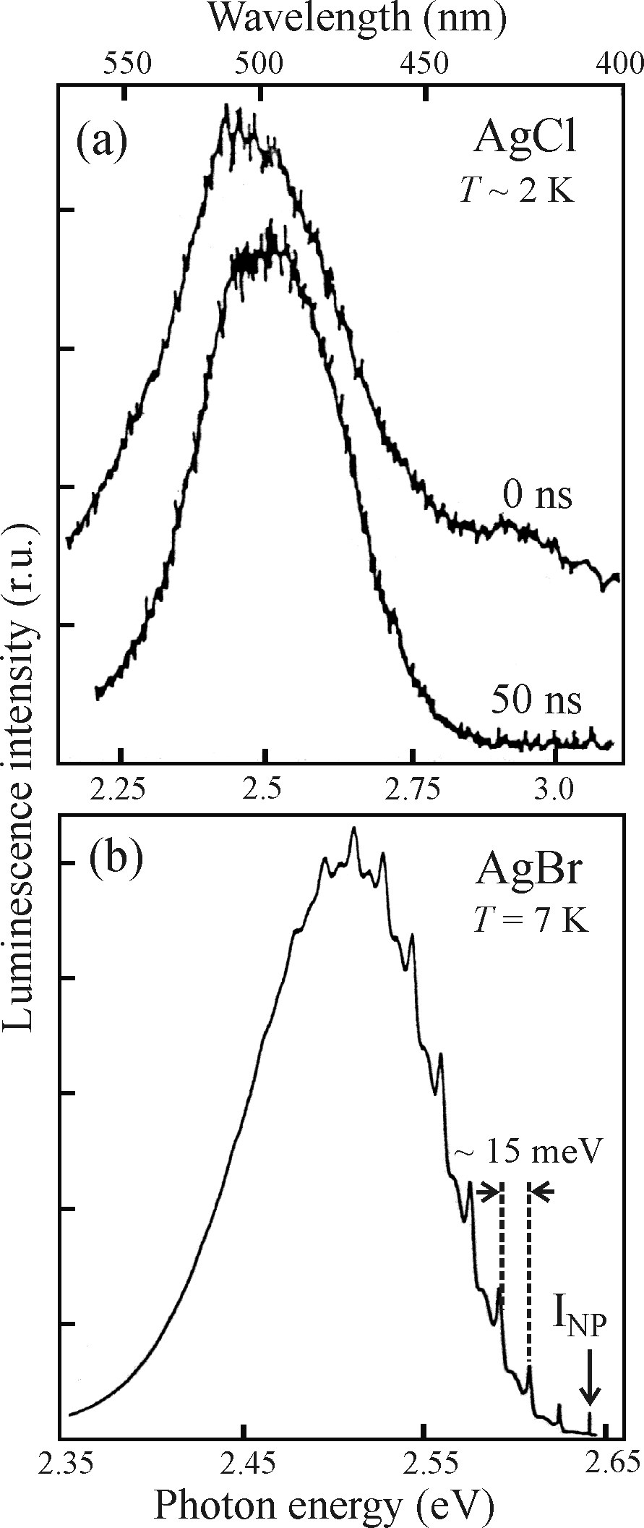
Main definitions. Specific case of semiconductor luminescence
Peak identification can be ambiguous sometimes, especially for broad lines
Intrinsic spectra
Extrinsic spectra

Slide 7
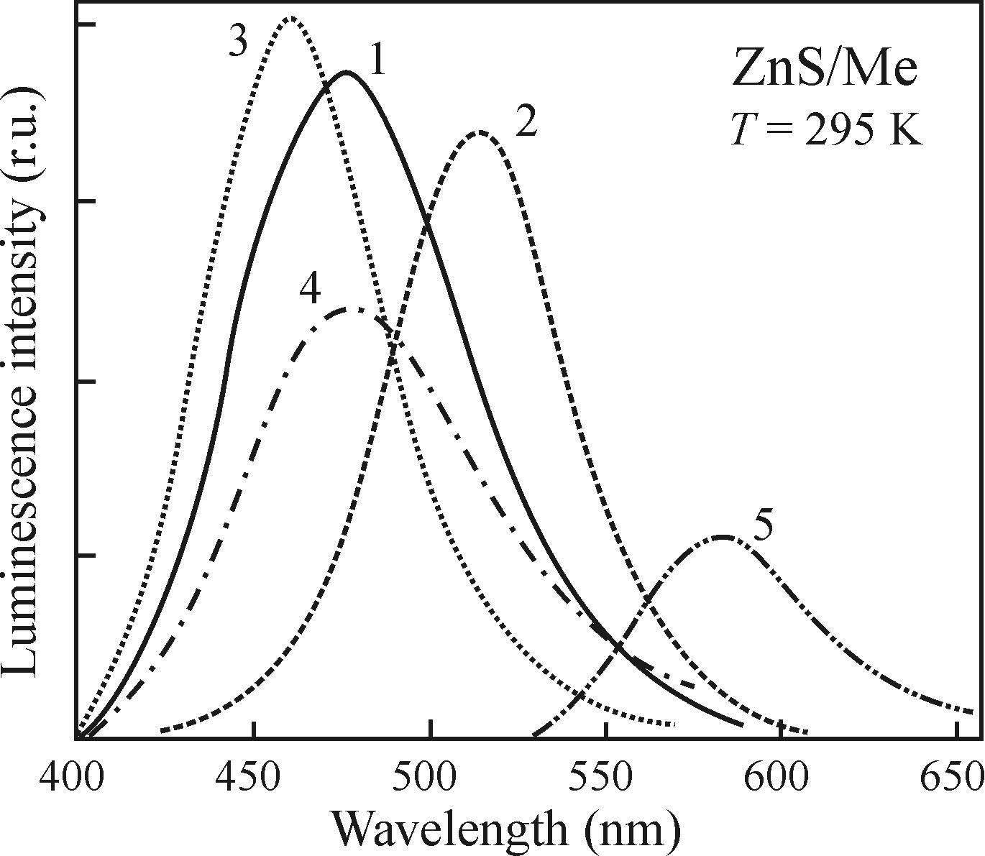
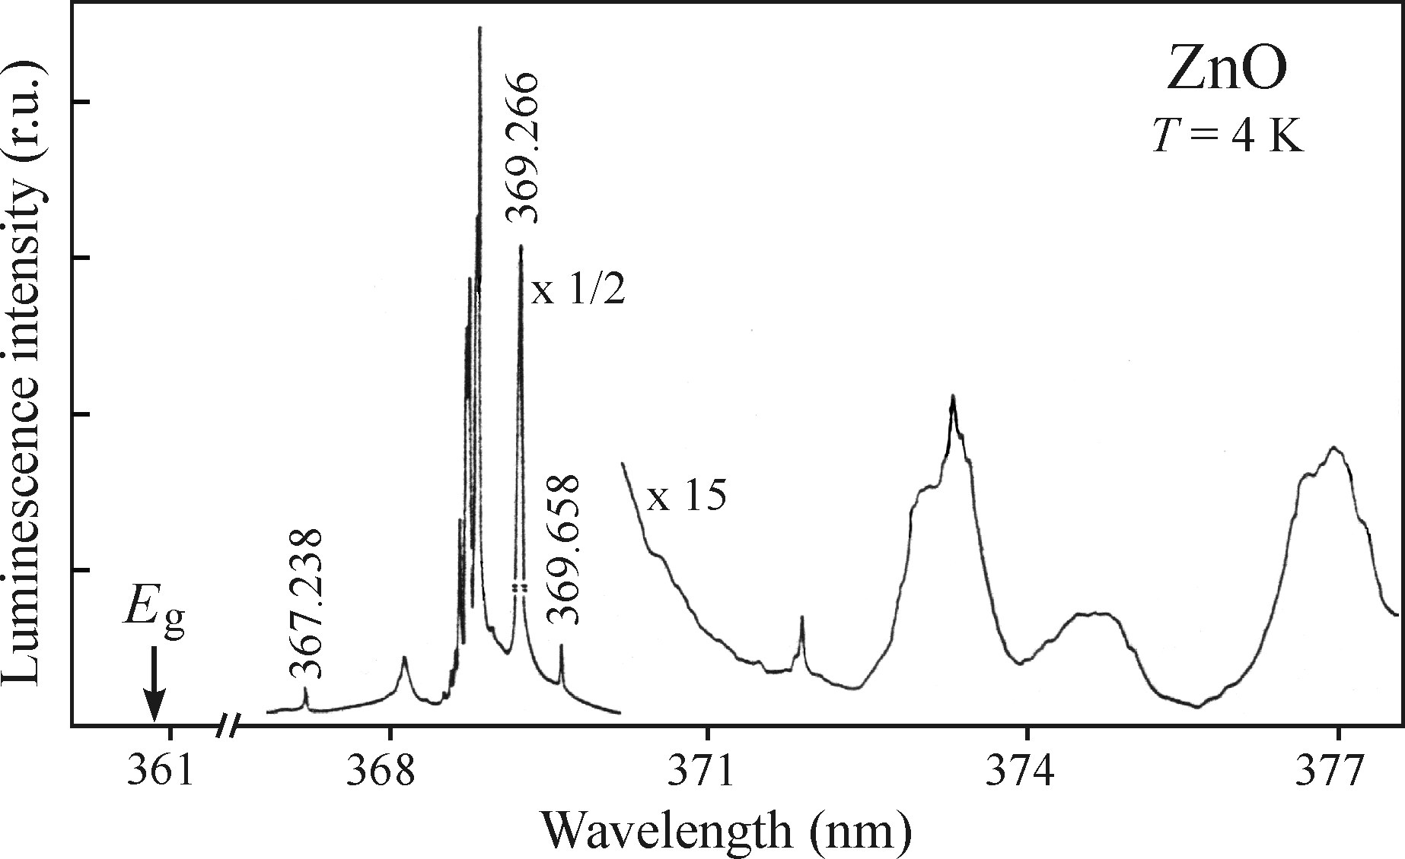
Main definitions. Specific case of semiconductor luminescence
Low-temperature measurements give a better picture – sharper lines, higher intensity:
linewidth depends on interaction with phonons, less phonons at low-temperature
thermal quenching can reduce luminescence intensity (e.g. dissociation of excitons)
Room temperature PL of ZnS with
1. Zn 2. Cu 3. Ag 4. Au 5. Mn
Low temperature CL of ZnO:
sharp excitonic transitions

Slide 8
Outline
Main definitions. Specific case of semiconductor luminescence
Photoluminescence (PL) and photoluminescence excitation (PLE) techniques
Photodetectors: photomultiplier tube (PMT), avalanche photodiode (APD), CCD
Monochromators and spectrographs: resolution, throughput and signal-to-noise ratio
Spectral and resolution corrections
Other methods: lock-in amplifier, photon counting and Fourier spectroscopy

Slide 9
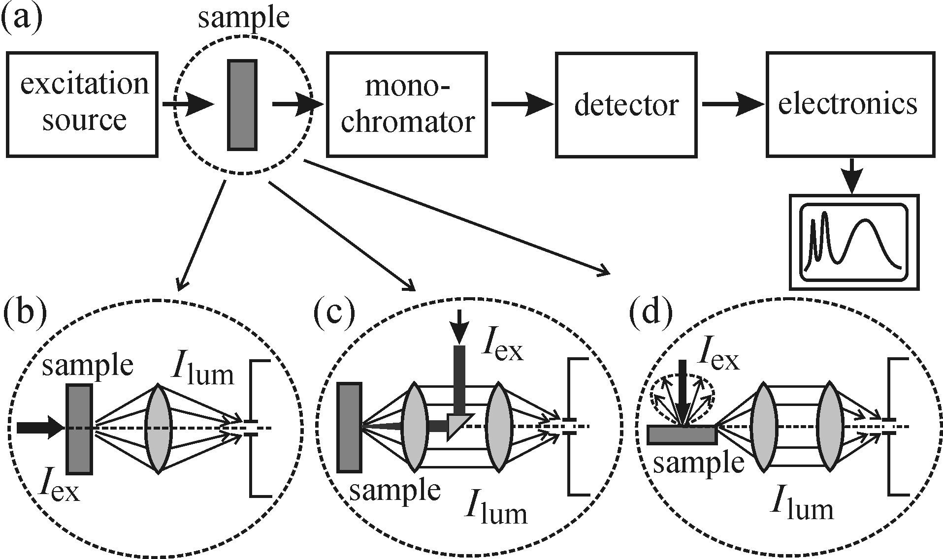
Photoluminescence (PL) and photoluminescence excitation (PLE) techniques
Photoluminescence is a practical, convenient method of luminescence measurements
fixed excitation and spectrally dispersed emission I_{lum}(λ_{em}) for λ_{ex0} – PL
fixed detection wavelength under variable excitation I_{lum}(λ_{ex}) for λ_{em0} - PLE
General geometrical configuration
(scanning monocromator with fixed λ_{ex} is PL; varying λ_{ex} with fixed monochromator is PLE)
configuration (c) with a dichroic mirror is the most typical one

Slide 10
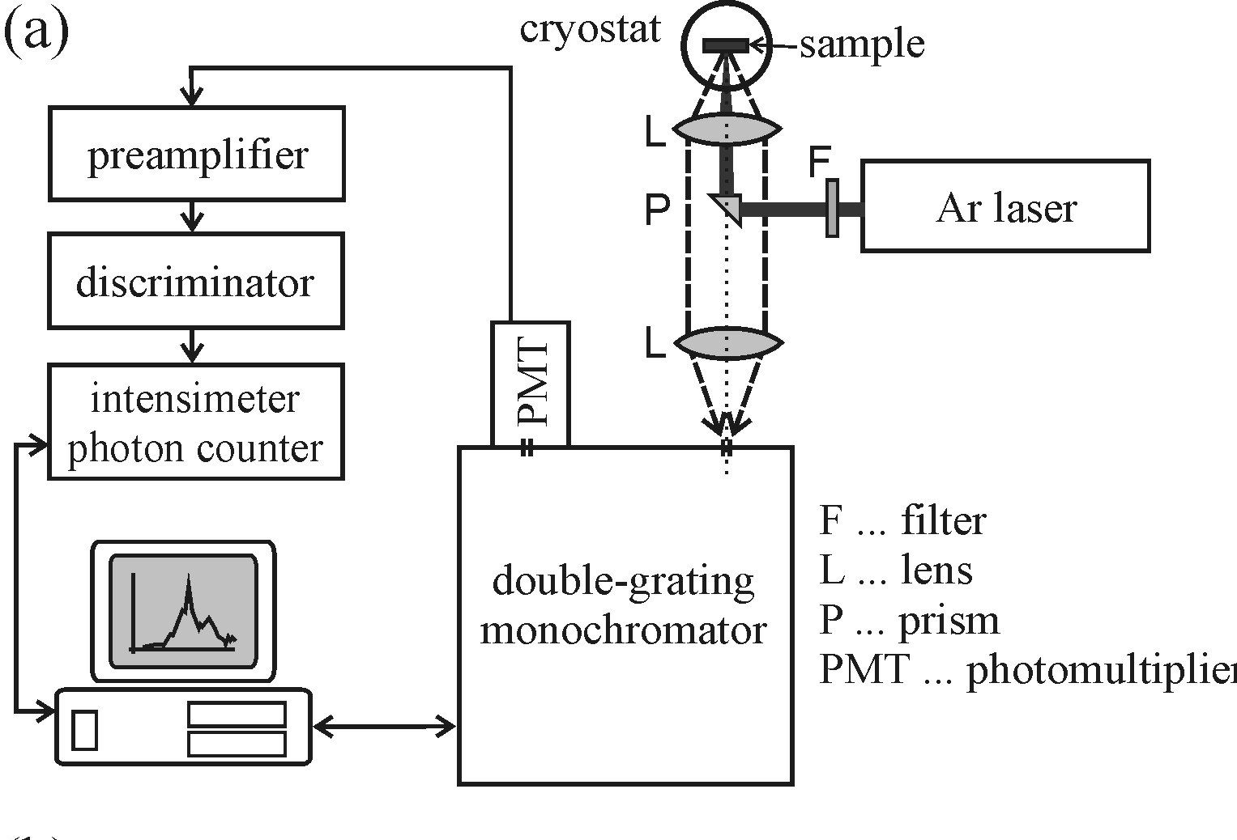
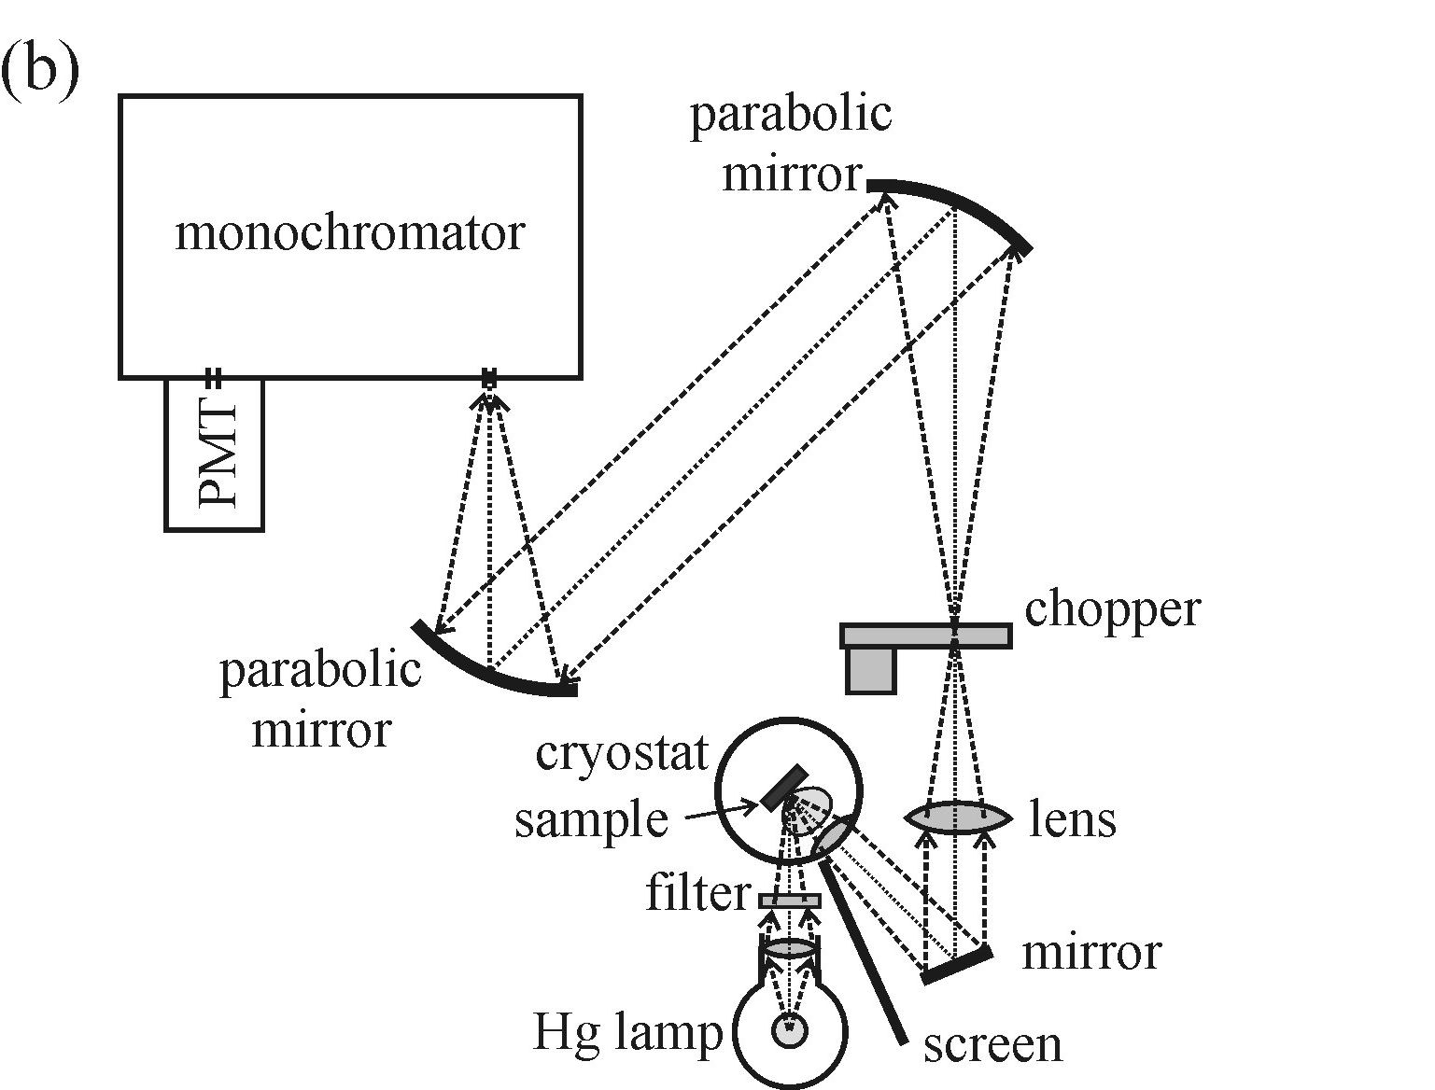
Photoluminescence (PL) and photoluminescence excitation (PLE) techniques
PL setup examples
laser as an excitation source, λ_{ex} = 488 nm
sample in the cryostat
excitation and collection through the same
optical path with a dichroic filter – bright field
Hg lamp with a filter as an excitation source
sample in the cryostat
collection through a different path than excitation -
dark field configuration
mechanical beam chopper for lock-in amplification
Radiation must be focused on the entrance slit of monochromator

Slide 11
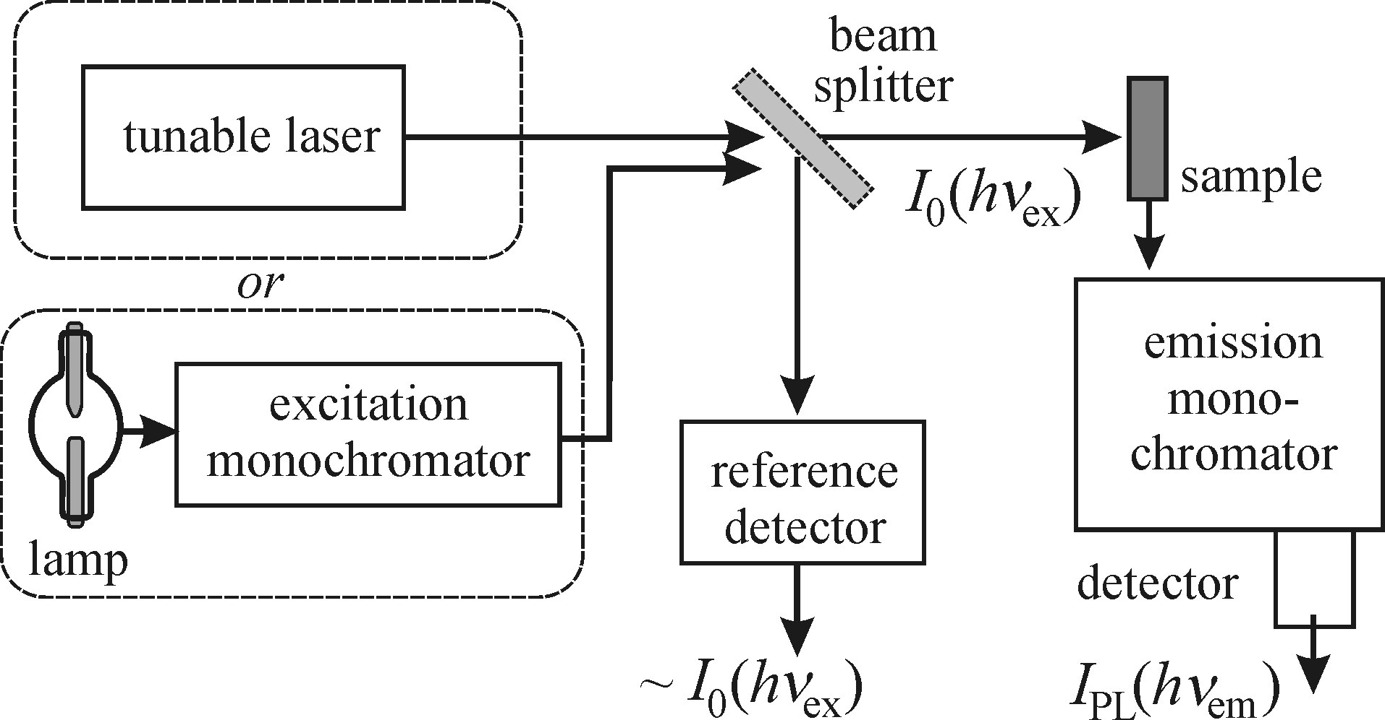
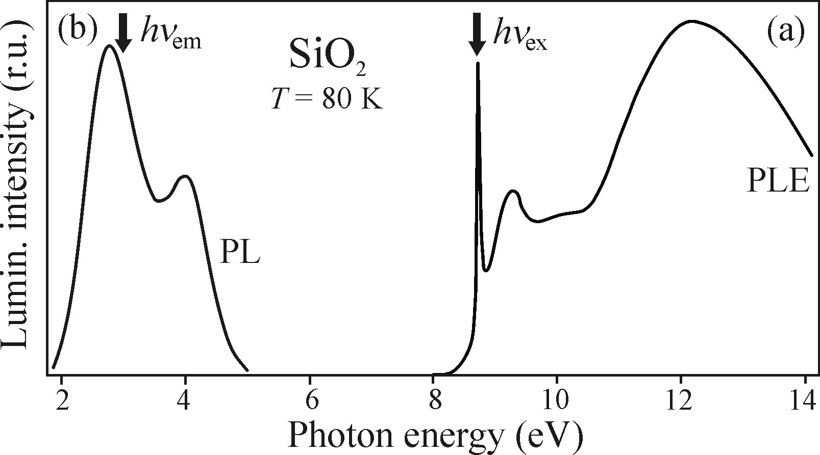
Photoluminescence (PL) and photoluminescence excitation (PLE) techniques
PLE setup example
- for weakly absorbing sample:
I_{PL}(hν_{em})/I₀(hν_{ex}) ~ α (hν_{ex})
PLE gives an absorption spectrum,
related to the density of states
PLE is an alternative to transmission measurements,
where e.g. substrates are non-transparent
also gives you best excitation wavelength
for PL measurements
Stokes shift between PL and PLE peaks contains
information about material structure (luminescence via
defect centers)

Slide 12
Outline
Main definitions. Specific case of semiconductor luminescence
Photoluminescence (PL) and photoluminescence excitation (PLE) techiques
Photodetectors: photomultiplier tube (PMT), avalanche photodiode (APD), CCD
Monochromators and spectrographs: resolution, throughput and signal-to-noise ratio
Spectral and resolution corrections
Other methods: lock-in amplifier, photon counting and Fourier spectroscopy

Slide 13
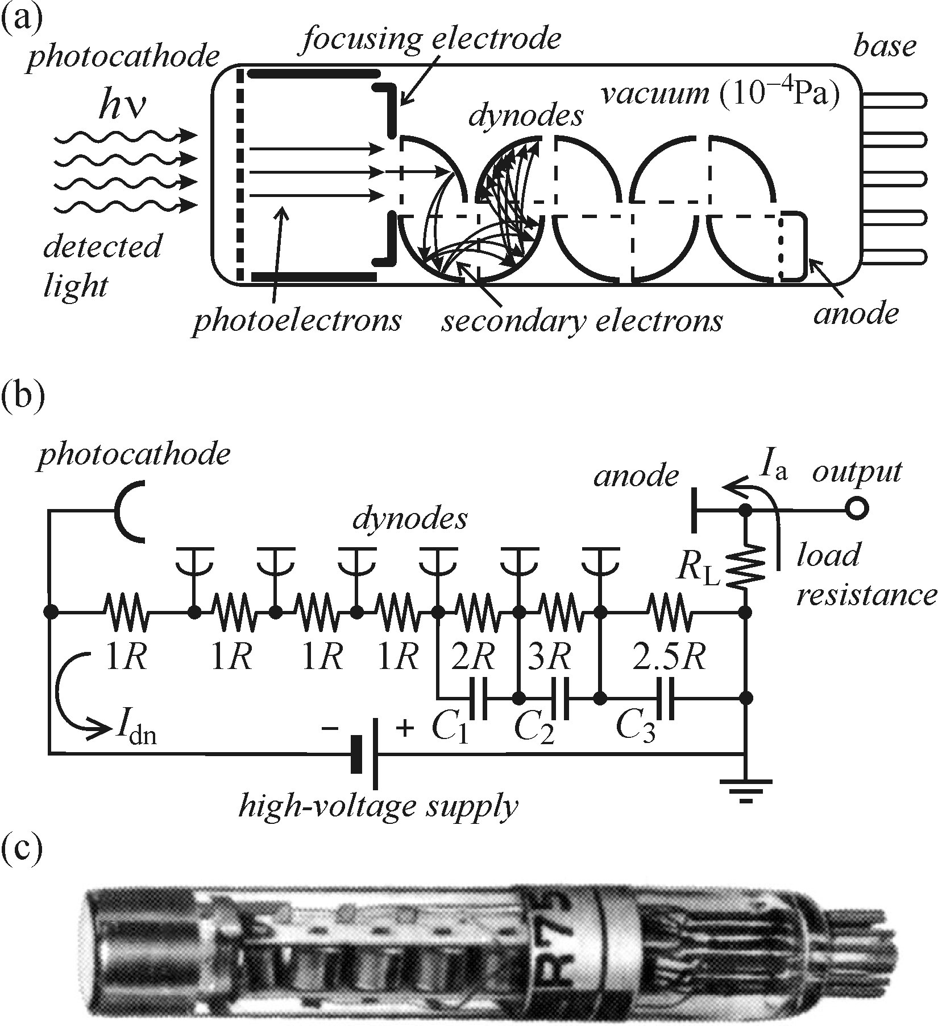
Photodetectors: photomultiplier tube (PMT), avalanche photodiode (APD), CCD
PMT operation principle
PMT is a single channel detector (vacuum tube):
photoelectron emission from cathode with
a low work function φ < hν
electron is accelerated to the first dynode
secondary electron emission with coefficient
δ (typically 3−10) multiplies signal
voltage drop across array of n dynodes drives
and multiplies electrons to the anode
final number of electrons (gain) G = δ^{n} ≈ 10⁶

Slide 14
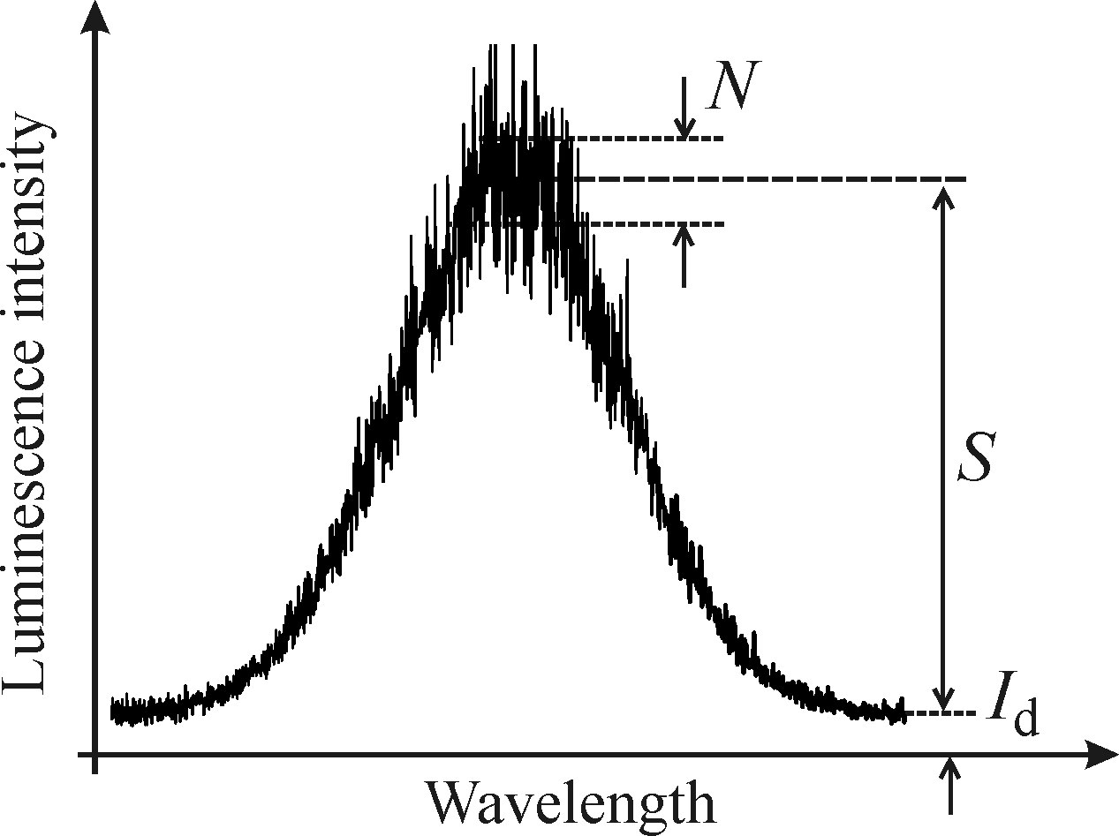
Photodetectors: photomultiplier tube (PMT), avalanche photodiode (APD), CCD
PMT main parameters
spectral range (defined by photocathode material, typically 150 – 1100 nm)
gain G ≈ 10⁵⁻⁷
quantum efficiency (photon-to-electron conversion probability) η_{ph} ~ 0.1-20 %
anode sensitivity (output current per light power unit) k(λ) ~ 10³⁻⁵ A/W
maximum current I ~ 10-100 μA not to overheat and damage electrodes
PMT background and noise
dark current I_{d} (thermionic emission of electrons from photocathode) can be reduced by cooling of the PMT with a Peltier element or LN2
the main problem is not the background itself but the noise associated with it
lowest detectable signal level (noise equivalent power) NEP ~ 10⁻¹⁵⁻¹⁶ W
Shot noise
random nature of the incident photon flux and photoemission
at any given time the output signal value fluctuates around <S>
and obeys Poisson statistics
shot noise: N =S^{1/2}

Slide 15
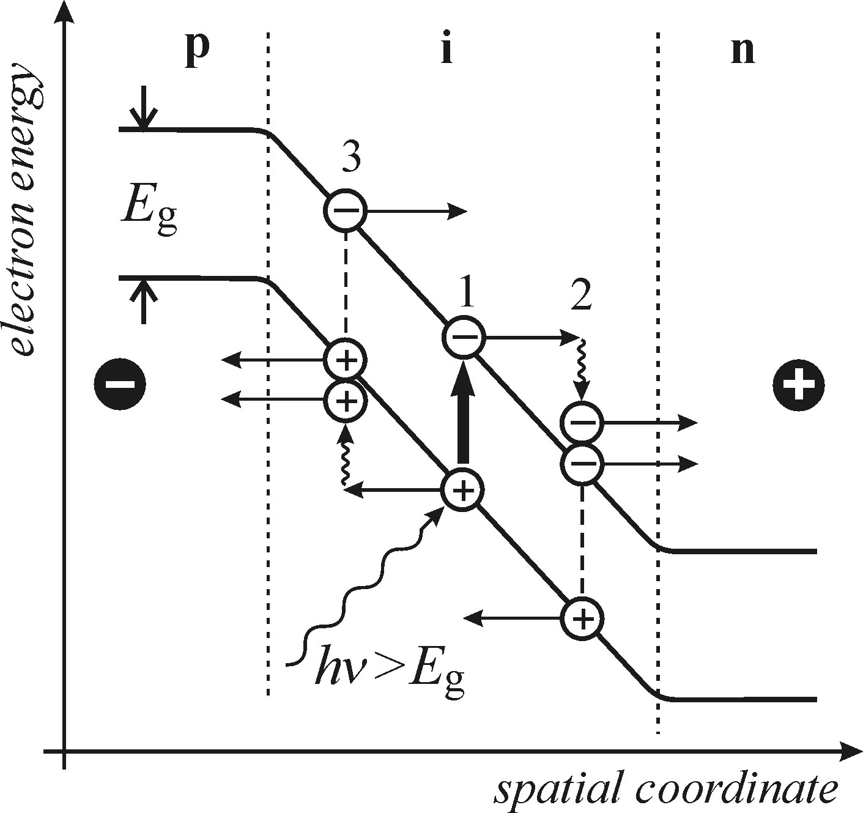
Photodetectors: photomultiplier tube (PMT), avalanche photodiode (APD), CCD
APD operation principle
APD is a single channel detector (solid state):
photon absorption generates an electron-hole pair (E_{g} < hν)
the pair is dissolved by high external bias of the diode
carriers are accelerated to the electrodes
impact ionization creates an avalanche of carriers
APD main parameters
spectral range (defined by the bandgap of active layer, e.g. 600-1800 nm for Ge)
ionization coefficient (number of ionization events per unit distance) α_{e} or α_{h}
practically only one type of carriers is used for signal, so ionization ratio α_{e}/α_{h} → 0 or ∞
photodiode gain G = α_{e}·w, w – width of the multiplication region
for fast response a small size of the sensitive area is used ~ 1 mm² (downto 20x20 μm)

Slide 16
Photodetectors: photomultiplier tube (PMT), avalanche photodiode (APD), CCD
Comparison of single channel detectors
PMT
APD
smaller, more robust
(solid state, no cooling)
lower dark noise
higher detectivity (1/NEP)
larger sensitive area (~3x12 mm²)
suitable for spectroscopy
fast response suitable for
single photon counting

Slide 17
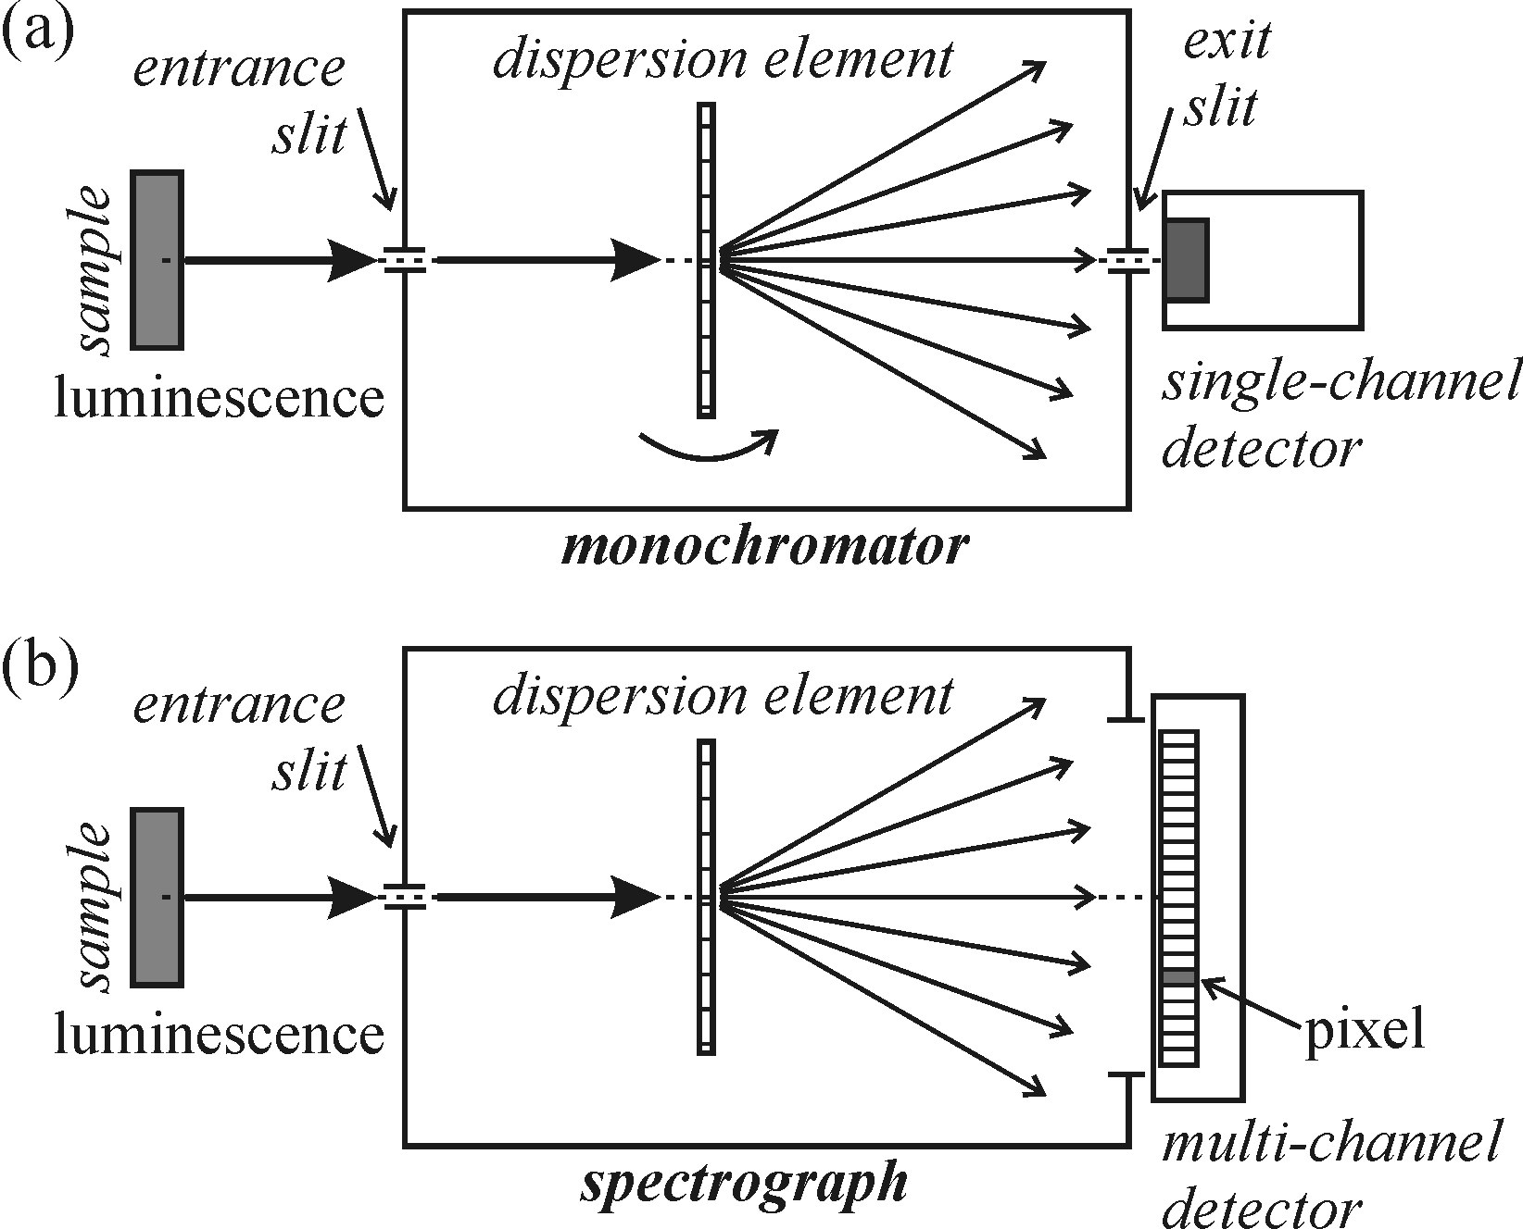
Photodetectors: photomultiplier tube (PMT), avalanche photodiode (APD), CCD
CCD history
Nobel prize in physics 2009: ”…In 1969 Willard S. Boyle and George E. Smith invented
the first successful imaging technology using a digital sensor, a CCD (Charge-Coupled
Device). The CCD technology makes use of the photoelectric effect, as theorized by
Albert Einstein and for which he was awarded the 1921 year's Nobel Prize.
By this effect, light is transformed into electric signals. The challenge when designing
an image sensor was to gather and read out the signals in a large number of image
points, pixels (= picture elements), in a short time.”
CCD is a multi-channel solid state detector
(not just an array of many photodiodes!)

Slide 18
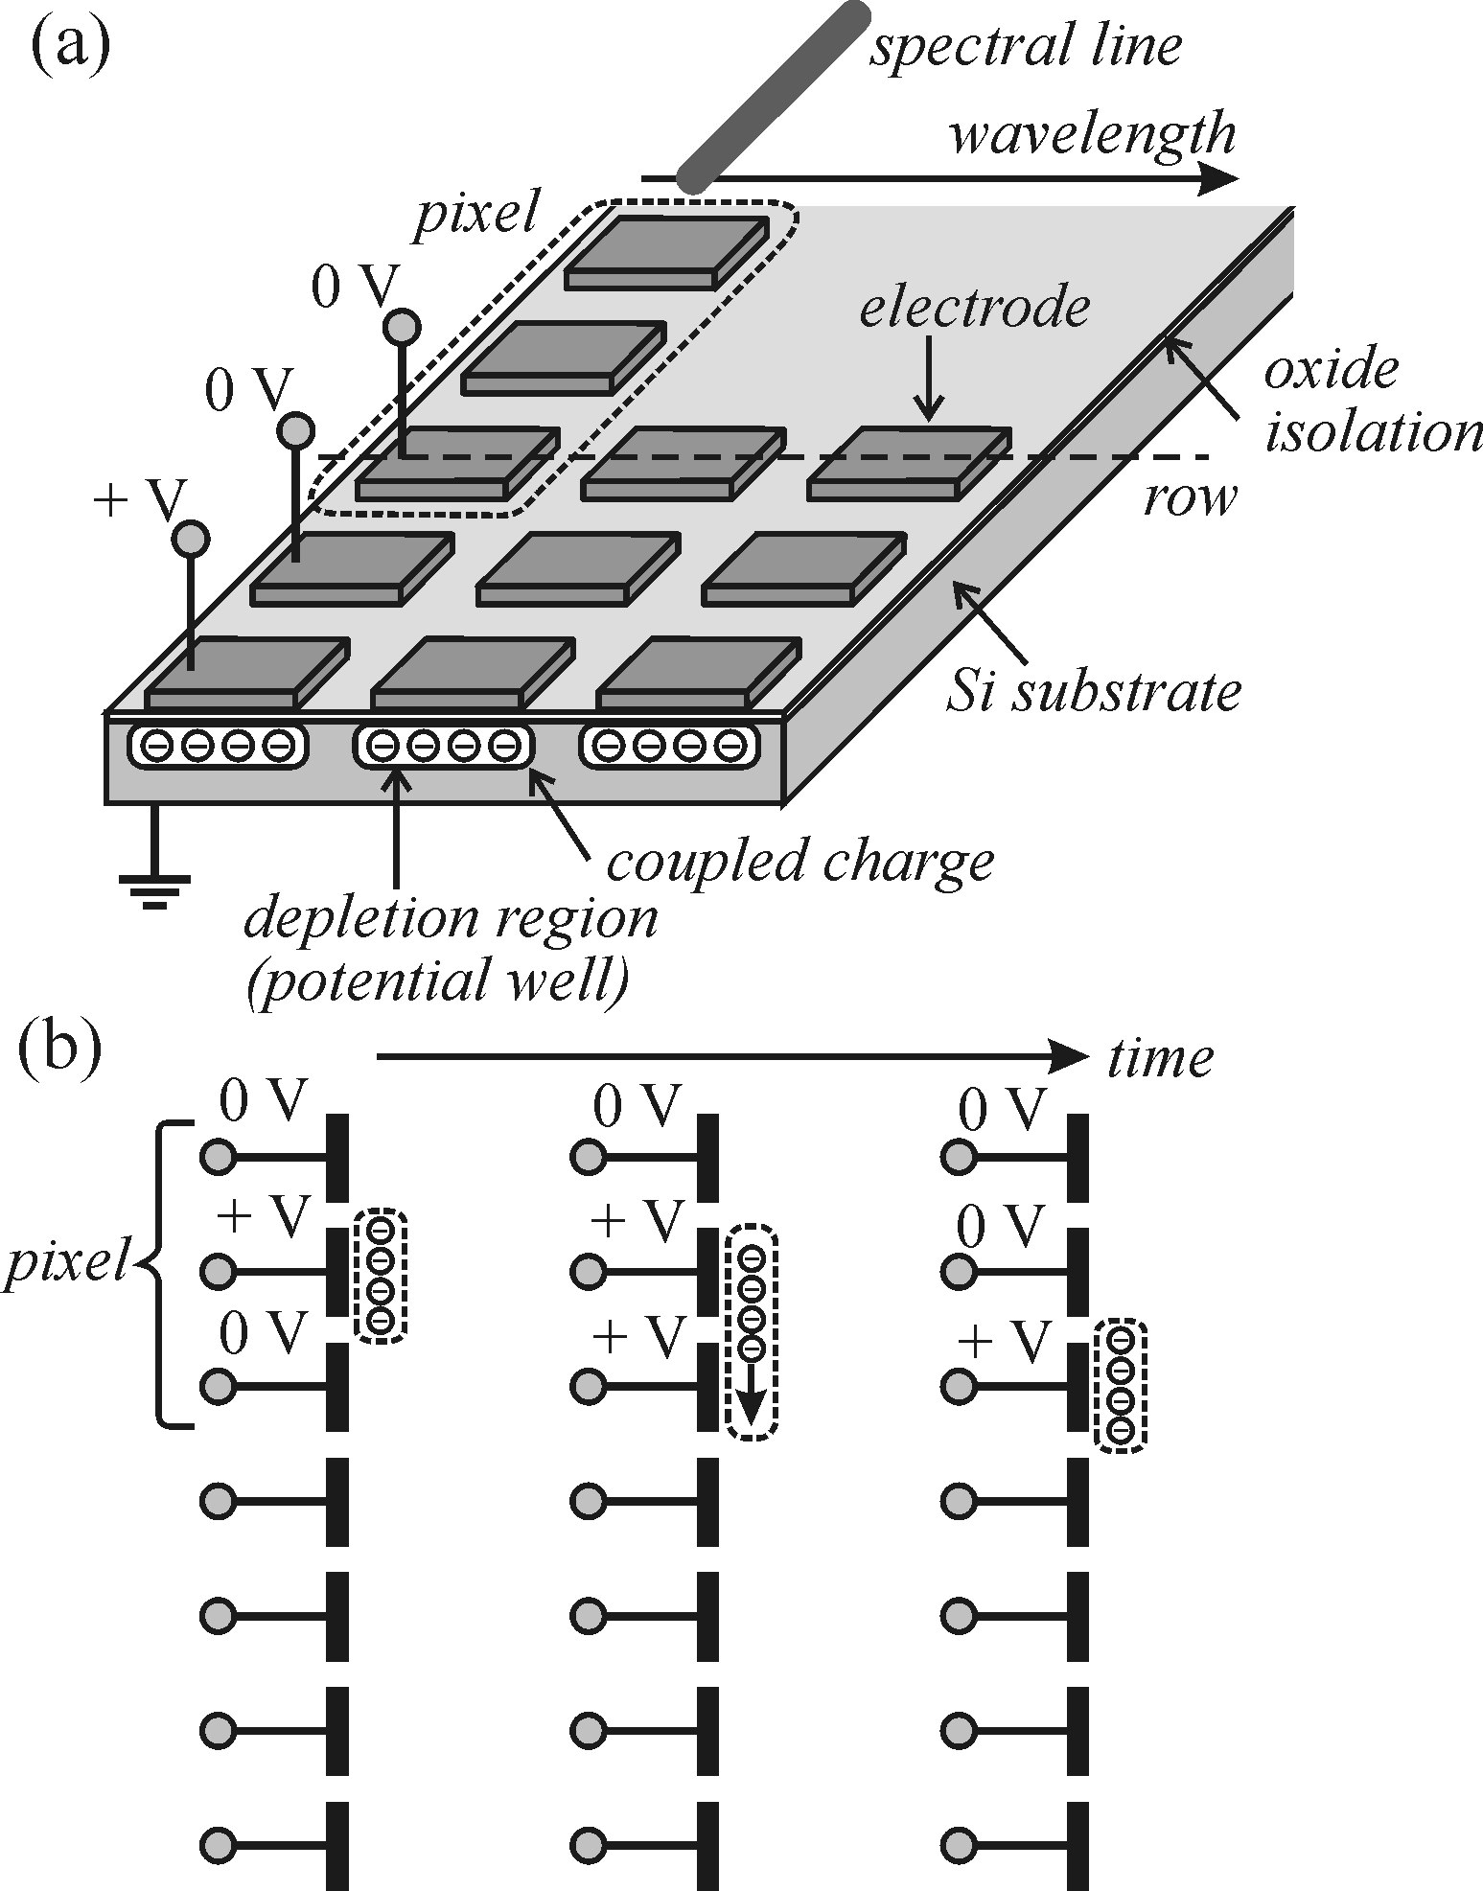
Photodetectors: photomultiplier tube (PMT), avalanche photodiode (APD), CCD
CCD operation principle
generation of electron-hole pairs by incident light
electrons are stored in a potential well below varying bias
electrode for each pixel
collected charge is transferred row-by-row to the
readout register by gradual variation of individual biases
ampification of the collected signal, visualization
Read-out is not from every pixel, as in photodiode arrays
but from a common register – read-out noise reduction
pixel size is 20x20 μm, 12x12 μm…
array size is 1024x256, 1024x1024,…

Slide 19
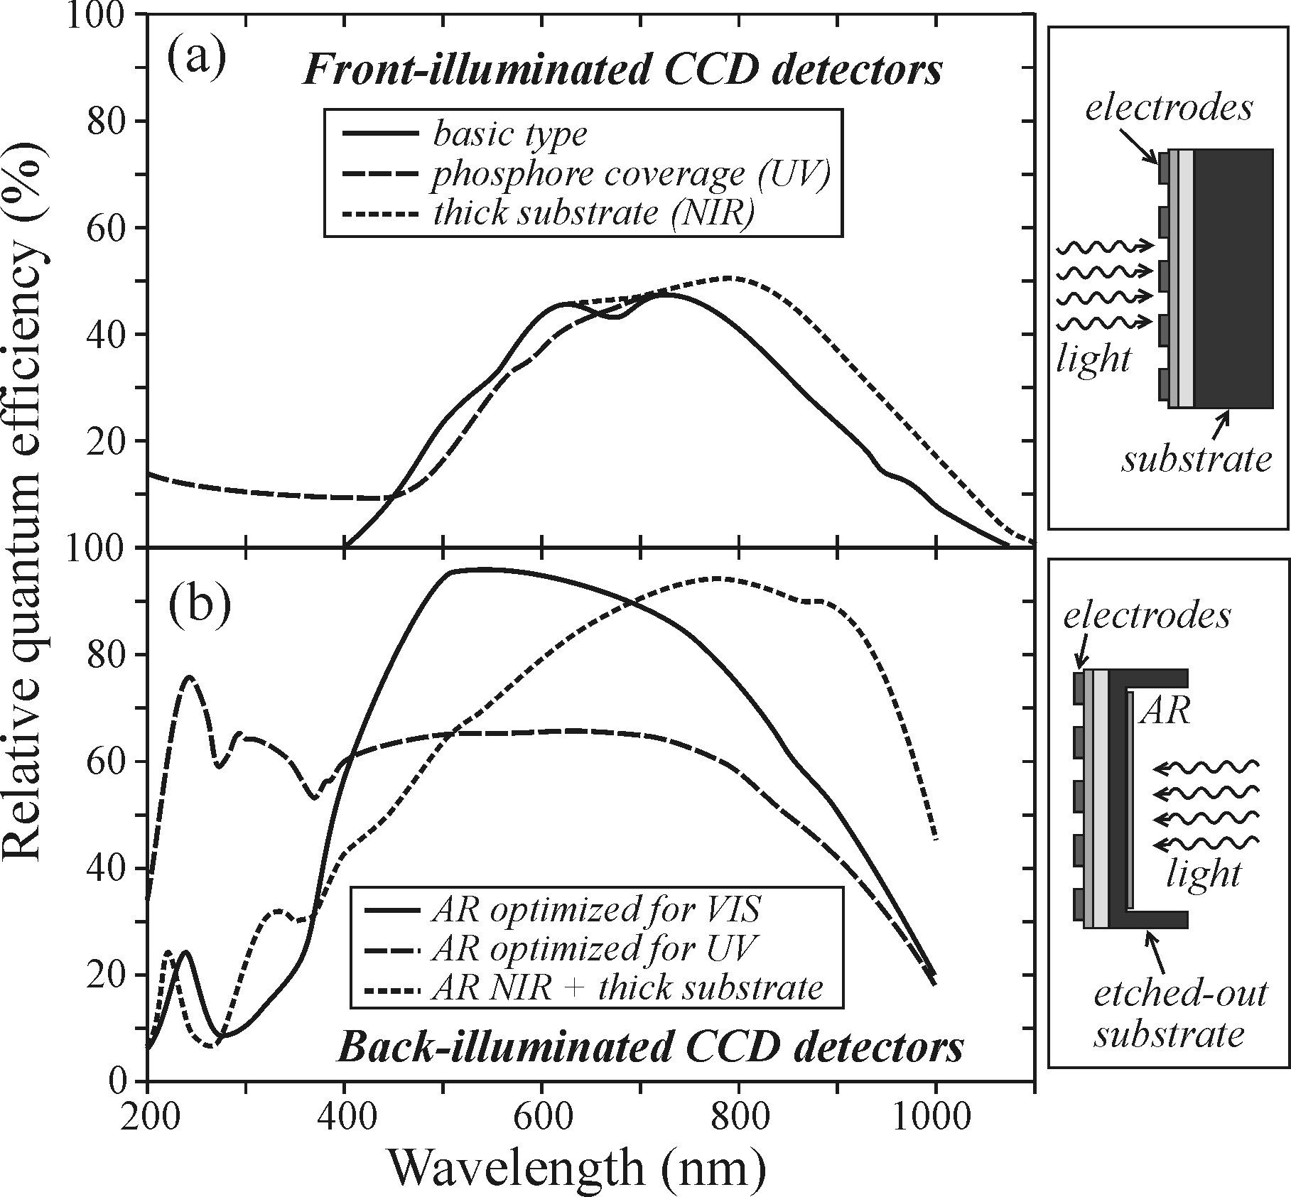
Photodetectors: photomultiplier tube (PMT), avalanche photodiode (APD), CCD
CCD main parameters
spectral sensitivity (defined by detector bandgap, e.g. for Si 400-1000 nm)
multiplexing advantage: parallel acquisition form n channels reduces signal-to-noise
ratio by n^{1/2} compared to serial read-out, like in PMTs (1/n faster total readout)
spectral coverage (range of wavelength detectable with one shot) from 30 to 300 nm
quantum efficiency is wavelength dependent
dark current is very low for cooled detectors
total noise consists of shot noise, dark current
noise (suppressed by cooling) and readout noise
(constant)
signal grows linearly with time, while shot noise
as a square root – longer acquisition time can yield
S/N>1

Slide 20
Outline
Main definitions. Specific case of semiconductor luminescence
Photoluminescence (PL) and photoluminescence excitation (PLE) techiques
Photodetectors: photomultiplier tube (PMT), avalanche photodiode (APD), CCD
Monochromators and spectrographs: resolution, throughput and signal-to-noise ratio
Spectral and resolution corrections
Other methods: lock-in amplifier, photon counting and Fourier spectroscopy

Slide 21
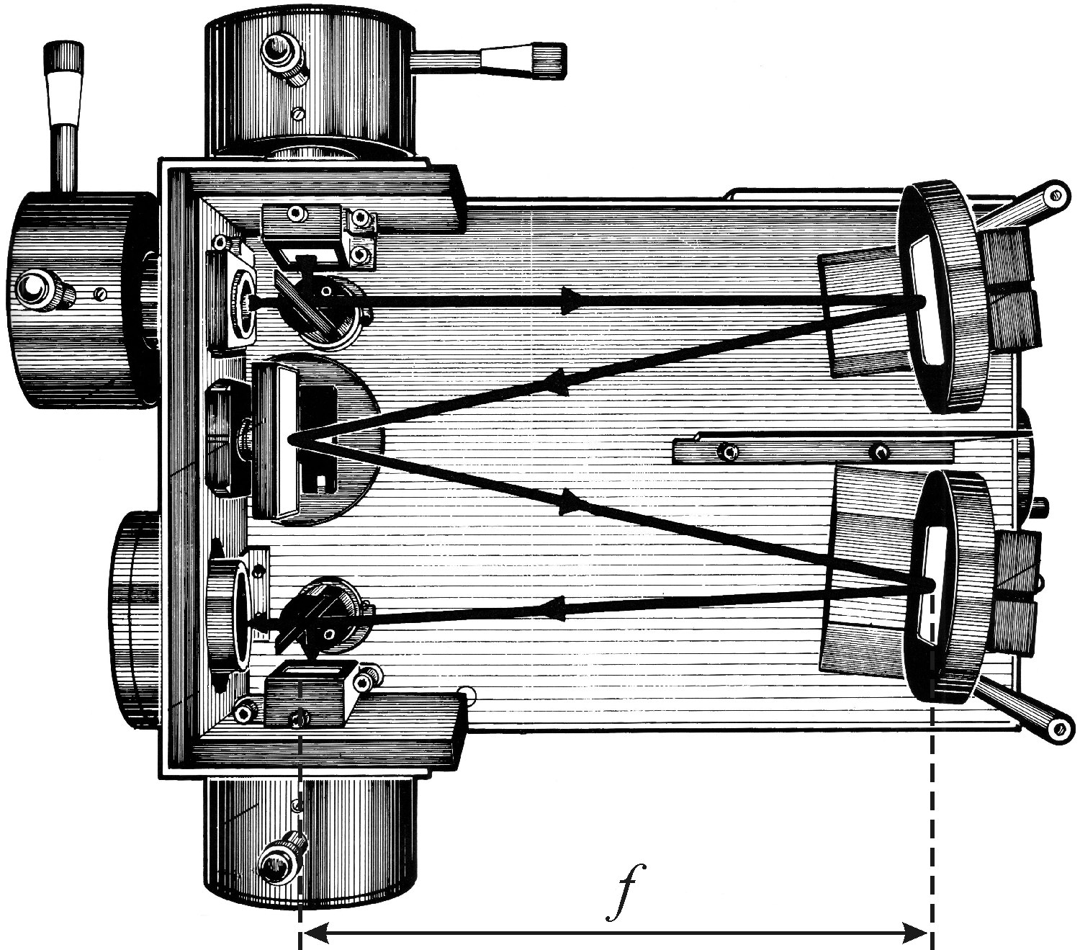
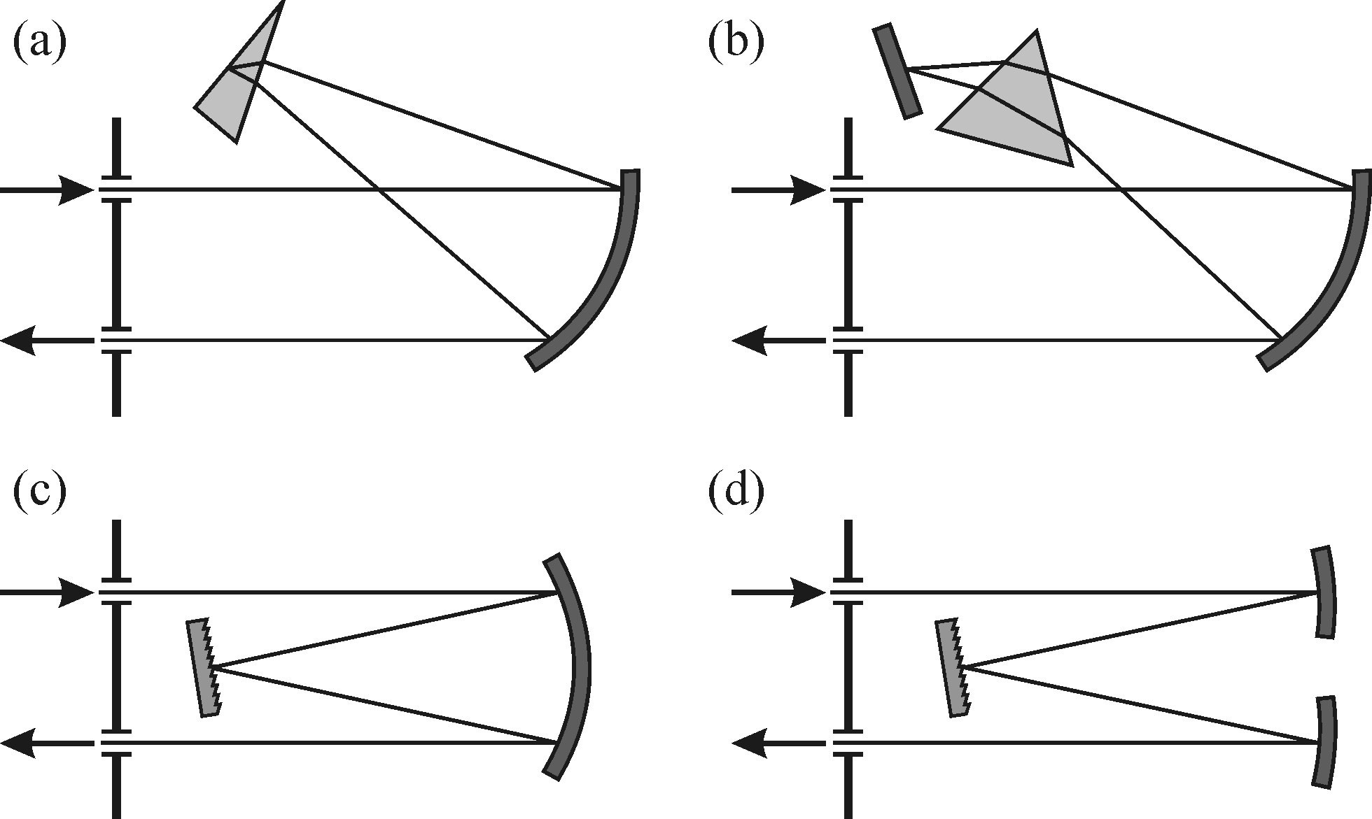
Monochromators and spectrographs: resolution, throughput and signal-to-noise ratio
Definitions and types
monochromator focuses signal with a
specific wavelength at the output slit for a
single channel detector
spectrograph produces spectrum focused
at the output port for a multichannel detector
imaging spectrograph has better optics for
aberration free spectrum image
They all contain a light dispersion element
(prism or grating) and focal planes coincide with
input and output ports
Different geometries, Czerny-Turner type (d)
is the most common nowadays

Slide 22
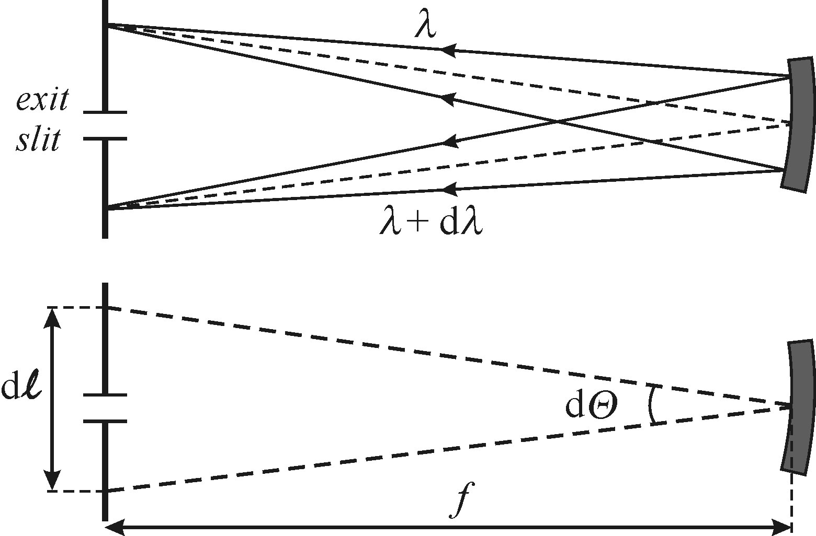
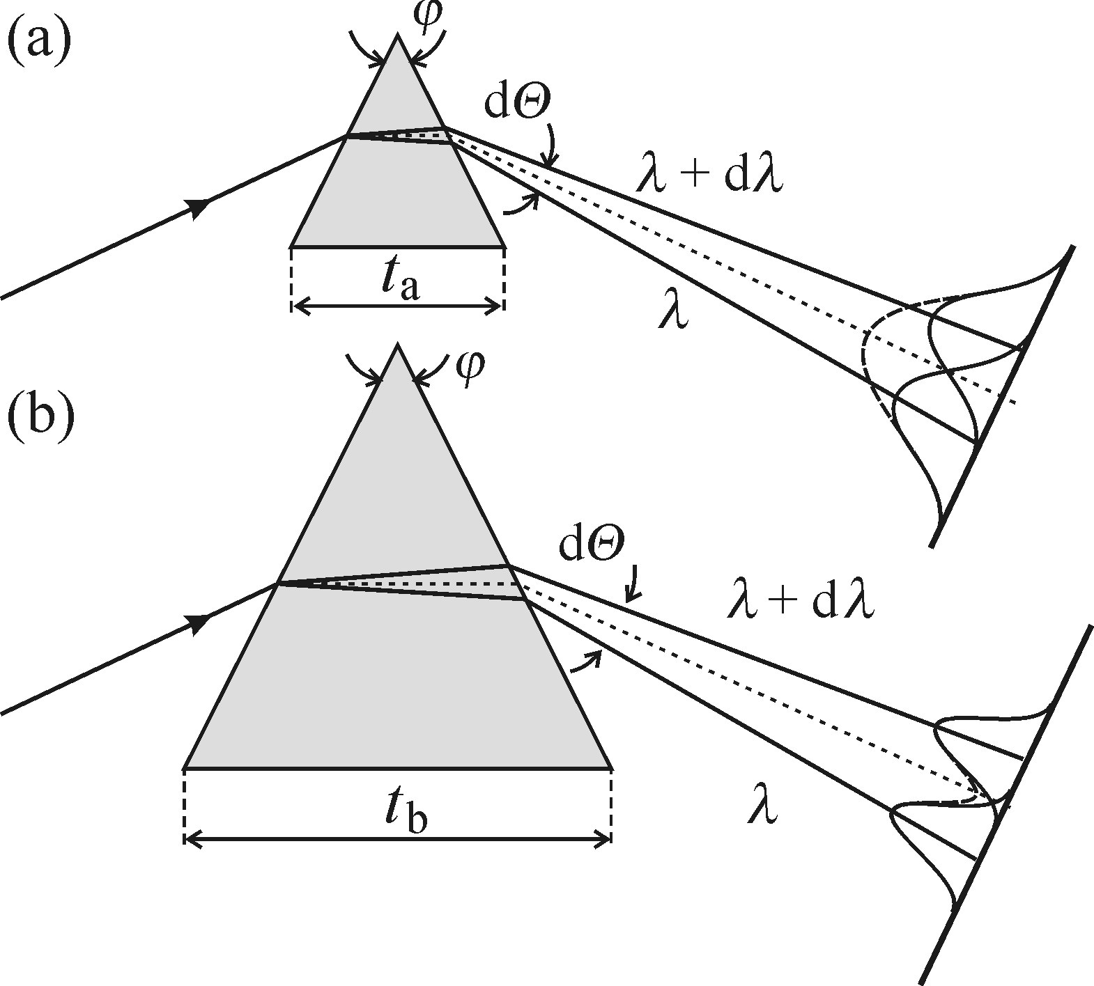
Monochromators and spectrographs: resolution, throughput and signal-to-noise ratio
Dispersion - how far different wavelengths end up from each other at the output plane
linear dispersion: L = f·dθ/dλ = dℓ/dλ ,
dθ/dλ – angular dispersion defined by grating (prism)
f – focal length the monochromator/spectrometer
typical reciprocal linear dispersion L⁻¹ ~ 1-10 nm/mm
(for a CCD chip 26 mm long and L⁻¹ = 5 nm/mm the total
spectral range detected at a single exposure is 130 nm)
Resolving power – ability to distinct between two closely spaced lines
R = λ/Δλ, Δλ – resolution (resolvable difference between 2 lines)
R ~ number of grooves for the grating, R ~ prism base length
limited by diffraction of the light beam defined by
the entrance slit and dispersion element size (for a prism)
or a groove density (for a grating):
Δλ = L⁻¹ · Δl, Δl is a slit width (defines source size)
- small source size and large dispersive element – best spectral resolution

Slide 23
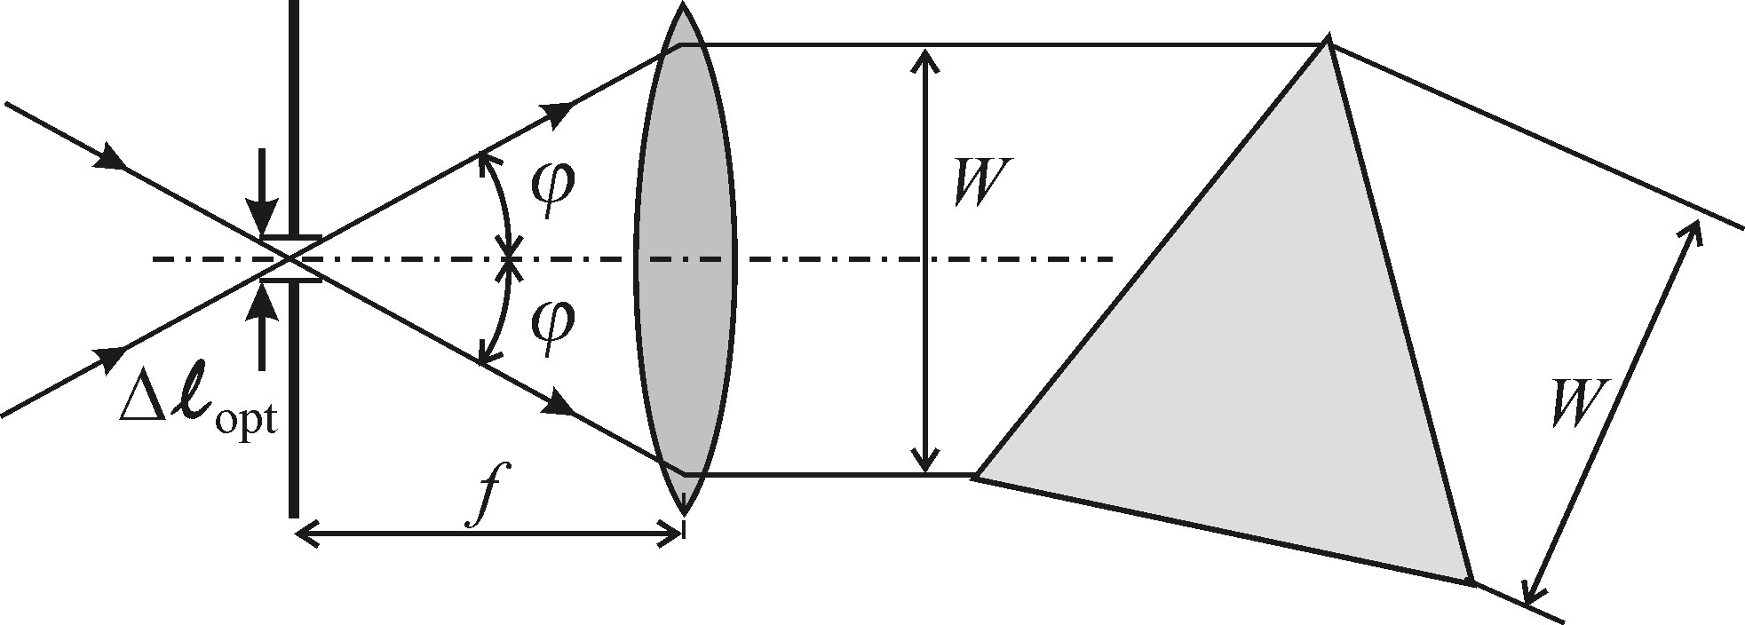
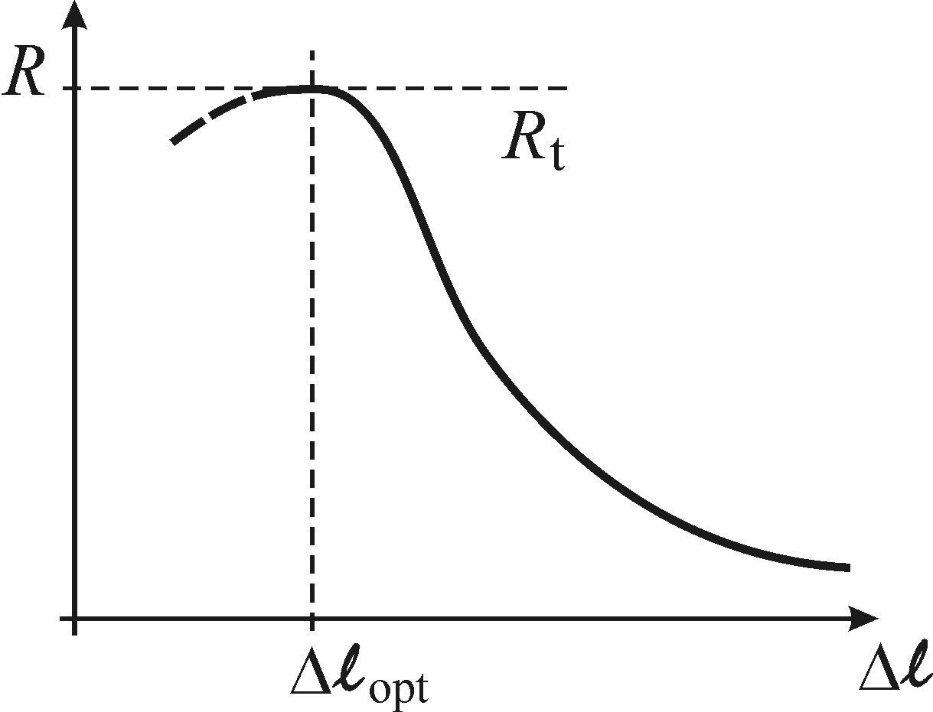
Monochromators and spectrographs: resolution, throughput and signal-to-noise ratio
Optimal slit width (source size)
slit diffraction angle ϕ_{d} = λ/ Δl
there is an optimal value of the slit Δl_{opt}
below which the incoming light misses the
collimating lens due to diffraction on the slit
practical values for Δl are 10-100 μm
thus optimal resolution R corresponds to this value
Optimal dispersive element
holographic gratings (made by two laser interference) are usually used these days;
several gratings mounted on a rotating turrent provide different resolution and
working spectral range;
Caution: gratings have several order diffractions – should be taken into account
Caution: spectral response of gratings is wavelength dependent

Slide 24
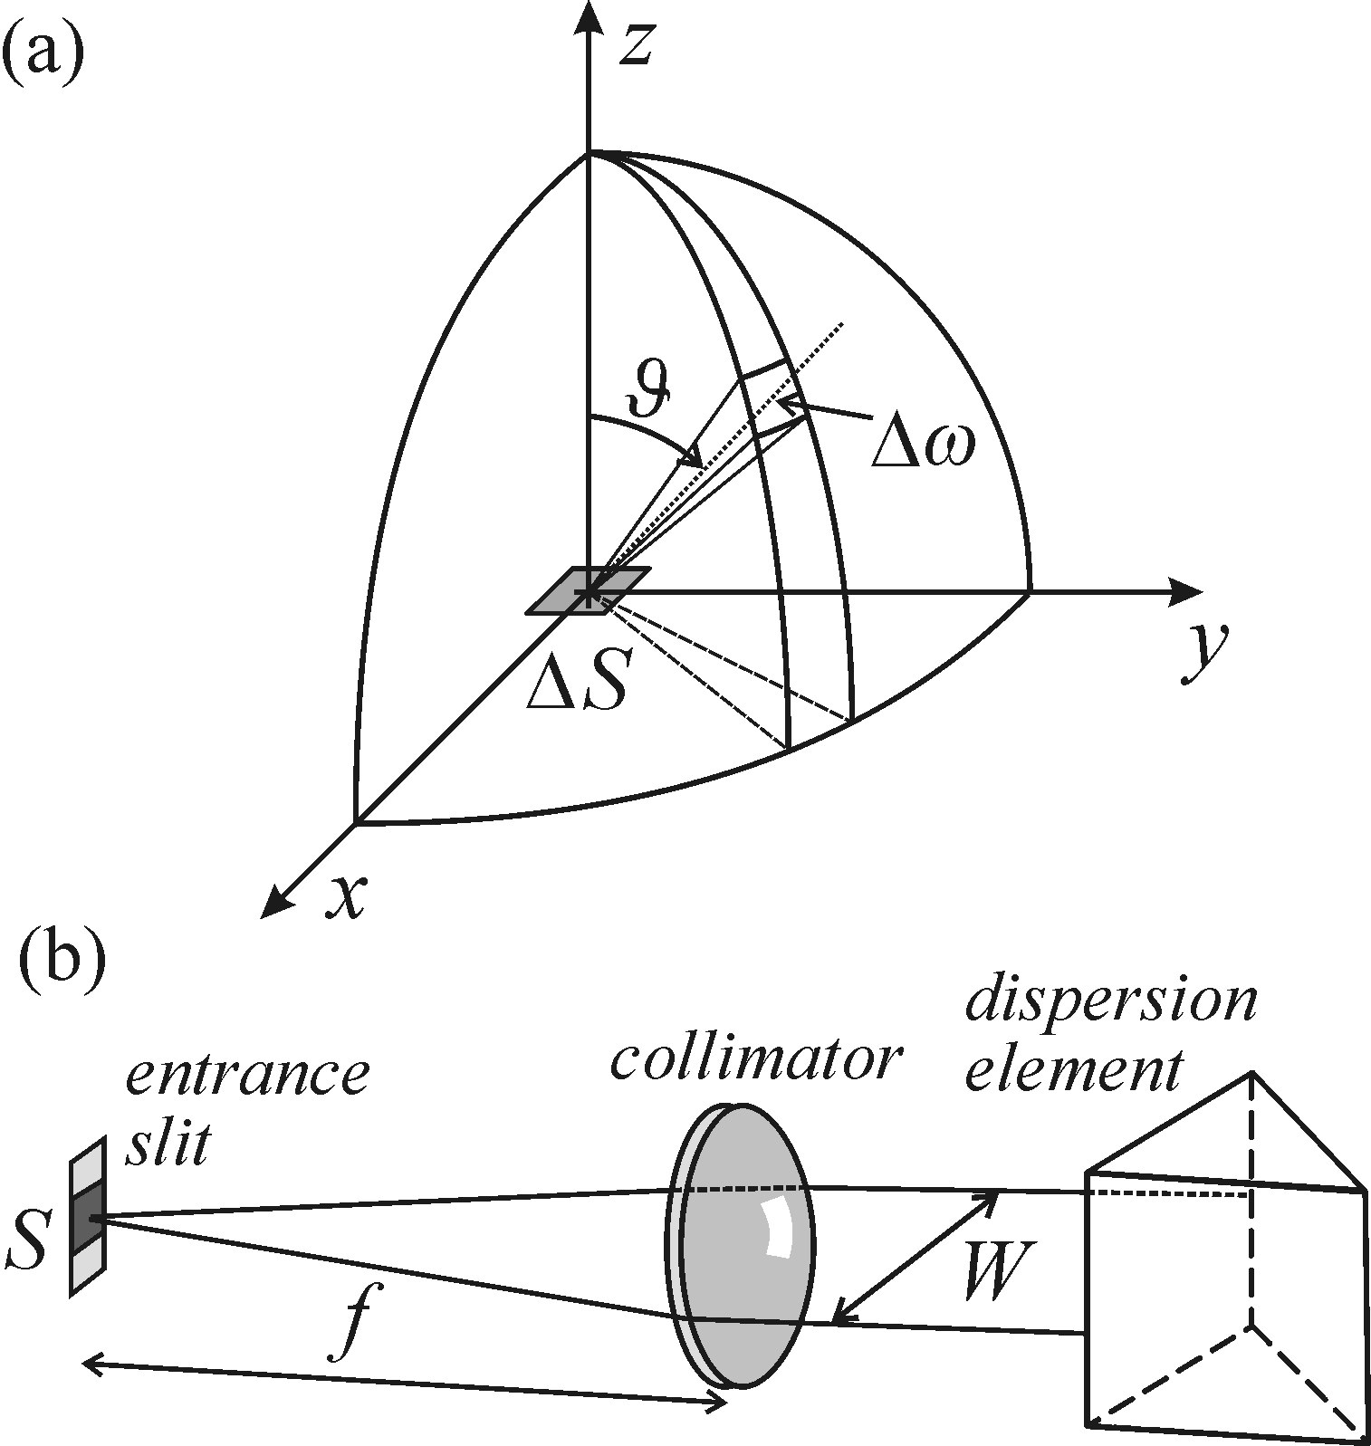
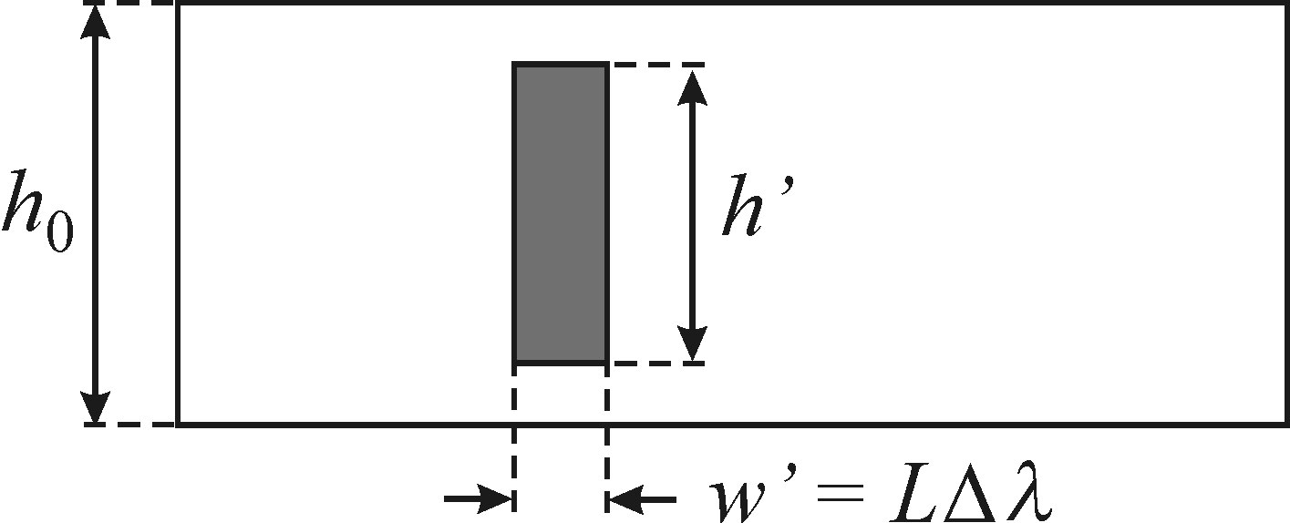
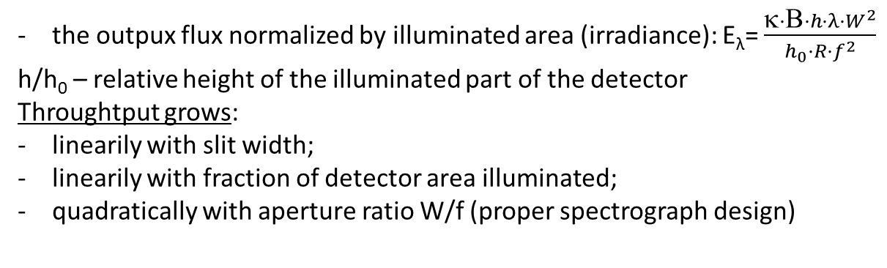
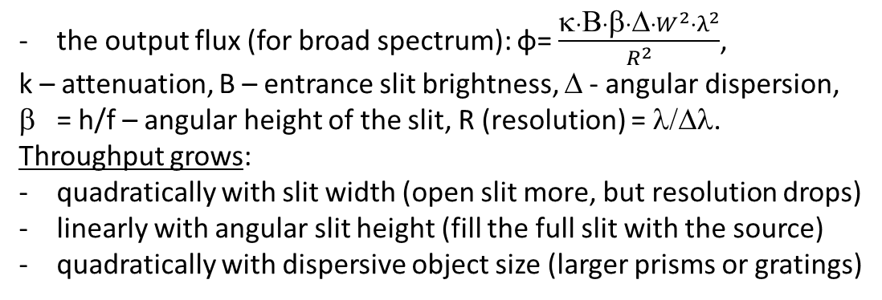
Monochromators and spectrographs: resolution, throughput and signal-to-noise ratio
Throughput of monochromators
the output flux (for broad spectrum): φ= $\frac{κ·Β·β·Δ·W^{2}·λ^{2}}{R^{2}}$,
k – attenuation, B – entrance slit brightness, Δ - angular dispersion,
= h/f – angular height of the slit, R (resolution) = λ/Δλ.
Throughput grows:
quadratically with slit width (open slit more, but resolution drops)
linearly with angular slit height (fill the full slit with the source)
quadratically with dispersive object size (larger prisms or gratings)
Throughput of spectrographs
the outpux flux normalized by illuminated area (irradiance): E_{λ}= $\frac{κ·Β·h·λ·W^{2}}{h_{0}·R·f^{2}}$
h/h₀ – relative height of the illuminated part of the detector
Throughtput grows:
linearily with slit width;
linearily with fraction of detector area illuminated;
quadratically with aperture ratio W/f (proper spectrograph design)

Slide 25
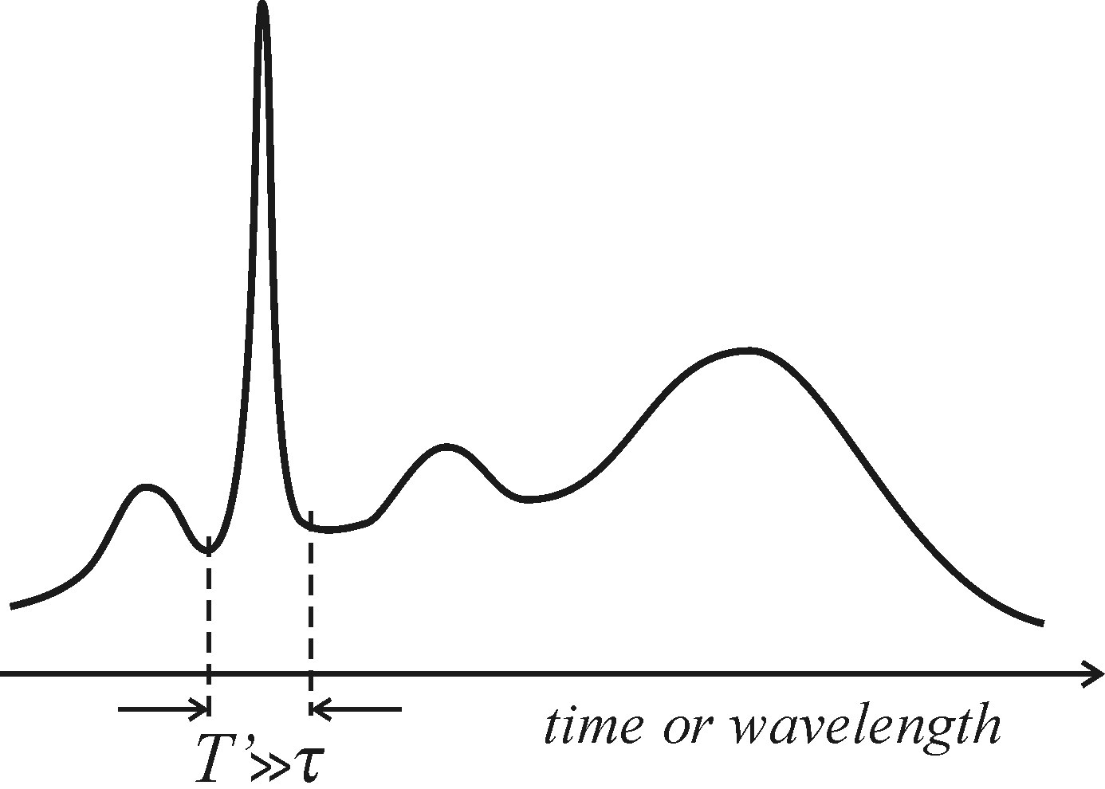
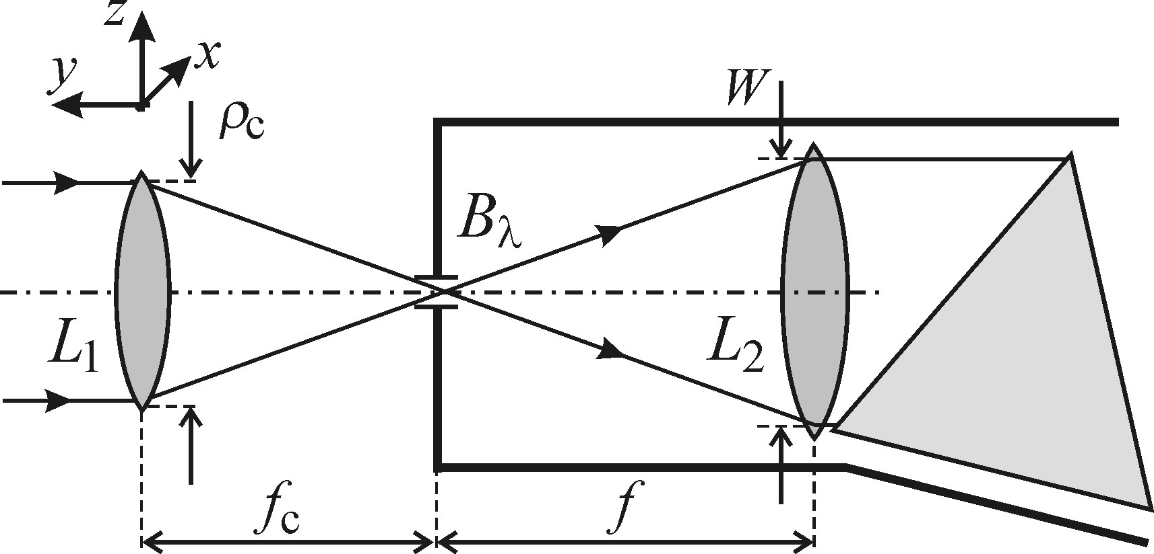
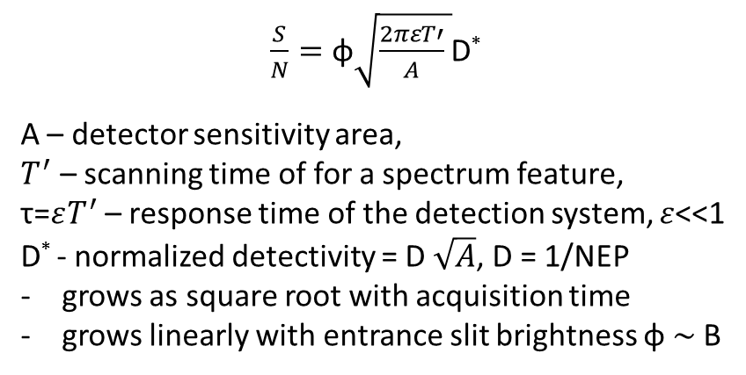
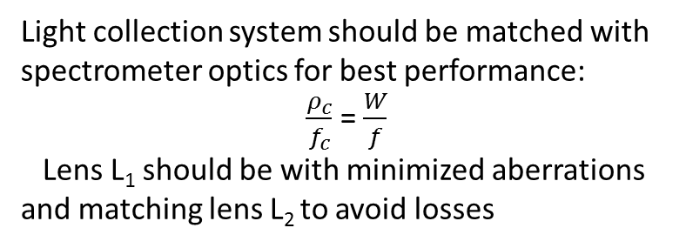
Monochromators and spectrographs: resolution, throughput and signal-to-noise ratio
Signal-to-noise ratio in a scanning monochromator
$\frac{S}{N}=\text{φ}\sqrt{\frac{2πεT′}{A} }$D*
A – detector sensitivity area,
$T^{′}$ – scanning time of for a spectrum feature,
τ=$εT^{′}$ – response time of the detection system, $ε$<<1
D* - normalized detectivity = D $\sqrt{A}$, D = 1/NEP
grows as square root with acquisition time
grows linearly with entrance slit brightness $\text{φ} \sim$B
Light collection system should be matched with
spectrometer optics for best performance:
$\frac{ρ_{c}}{f_{c}}$ = $\frac{W}{f}$
Lens L₁ should be with minimized aberrations
and matching lens L₂ to avoid losses

Slide 26
Outline
Main definitions. Specific case of semiconductor luminescence
Photoluminescence (PL) and photoluminescence excitation (PLE) techiques
Photodetectors: photomultiplier tube (PMT), avalanche photodiode (APD), CCD
Monochromators and spectrographs: resolution, throughput and signal-to-noise ratio
Spectral and resolution corrections
Other methods: lock-in amplifier, photon counting and Fourier spectroscopy

Slide 27
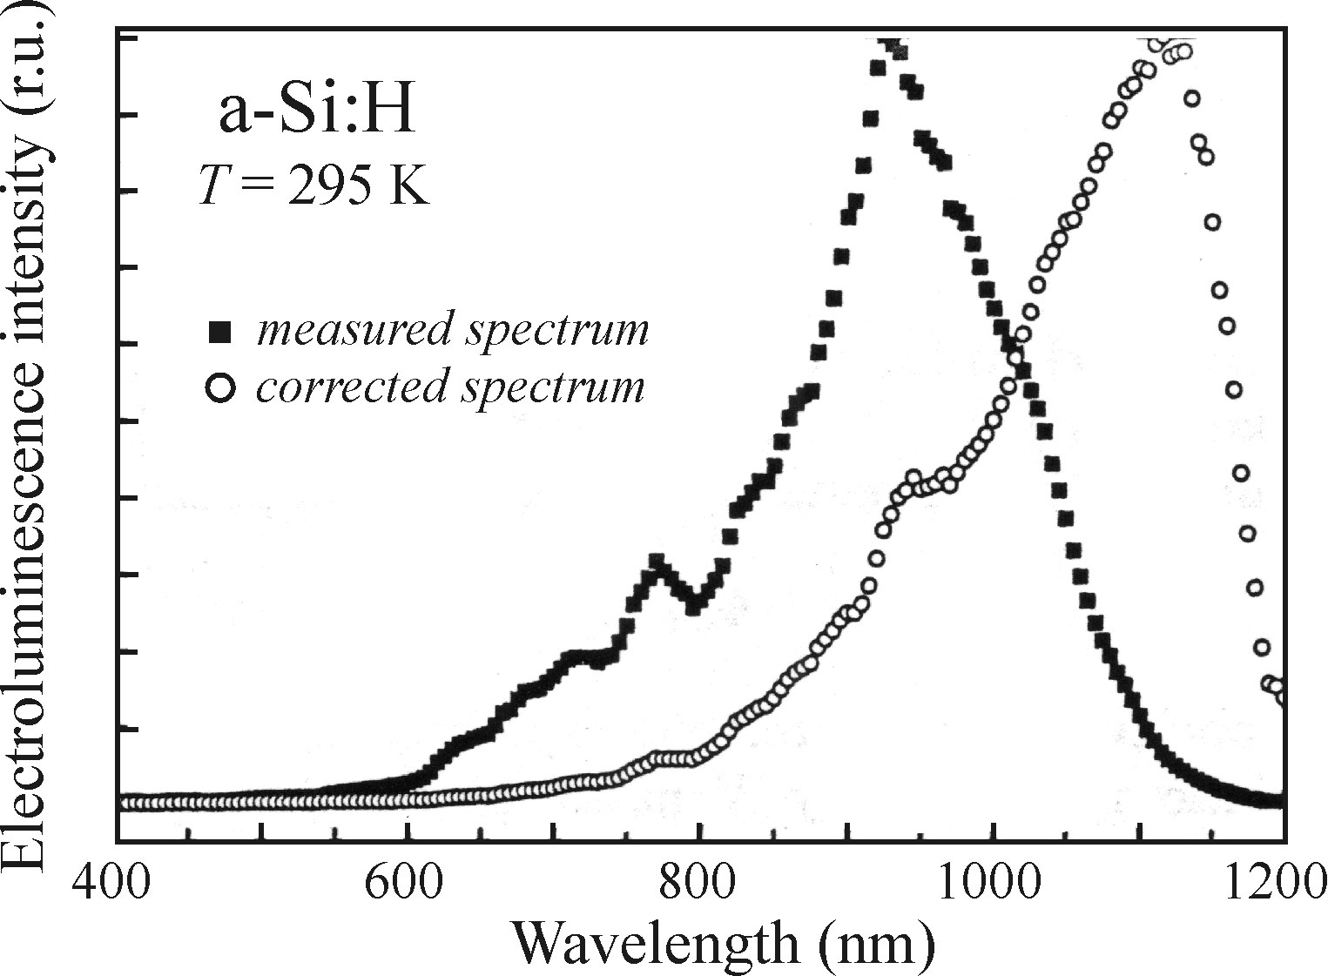
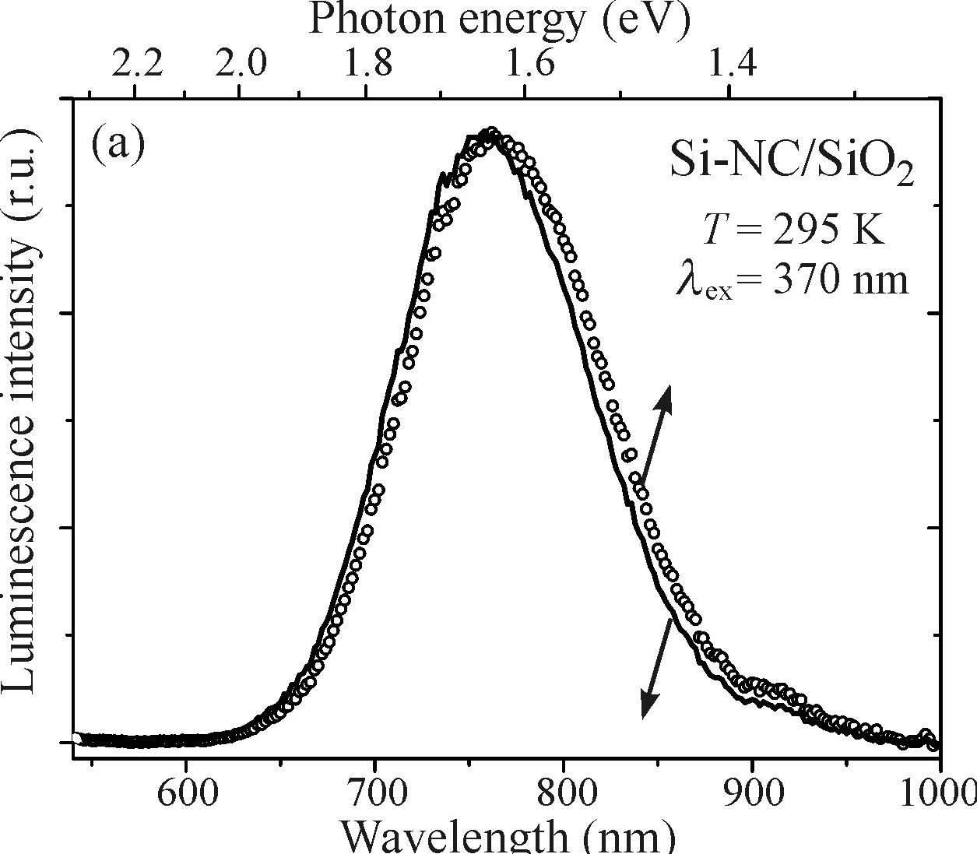
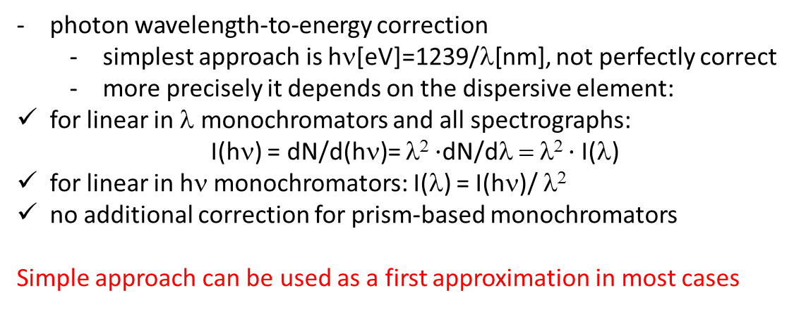
Spectral and resolution corrections
Even the best spectrometer/detector system distorts the signal
Spectral corrections
non-uniform spectral response of all optical components: system correction function Q (λ):
  can be measured with a black body radiation source of known temperature
  all measured broad spectra must be corrected with Q (λ)
  especially important for the edges of detection sensitivity
photon wavelength-to-energy correction
  simplest approach is hν[eV]=1239/λ[nm], not perfectly correct
  more precisely it depends on the dispersive element:
    for linear in λ monochromators and all spectrographs:
    I(hν) = dN/d(hν)= λ² $·$dN/dλ = λ² $·$I(λ)
    for linear in hν monochromators: I(λ) = I(hν)/ λ²
    no additional correction for prism-based monochromators
    Simple approach can be used as a first approximation in most cases

Slide 28
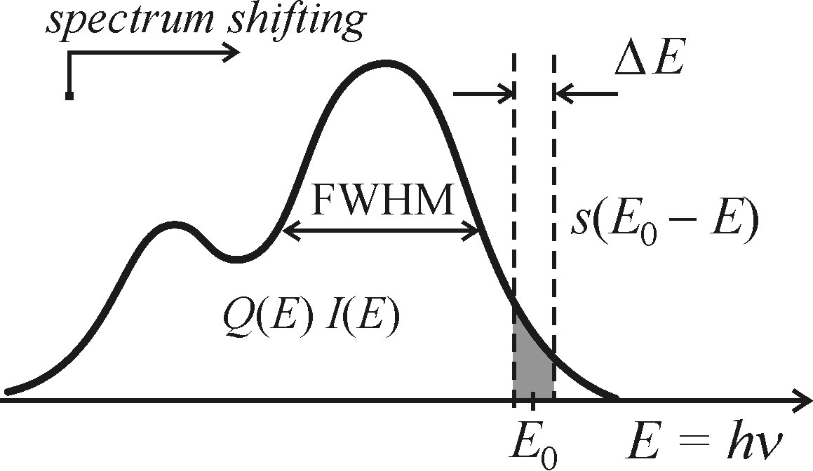
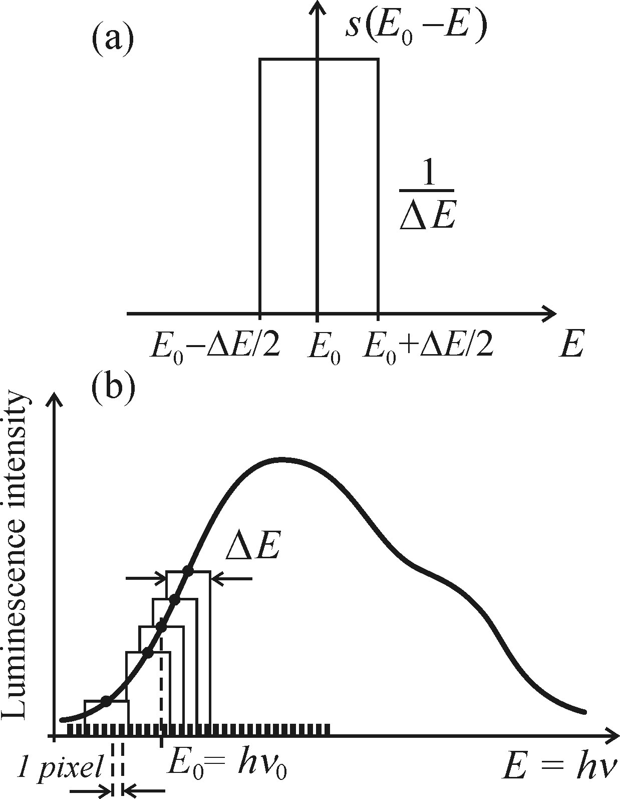
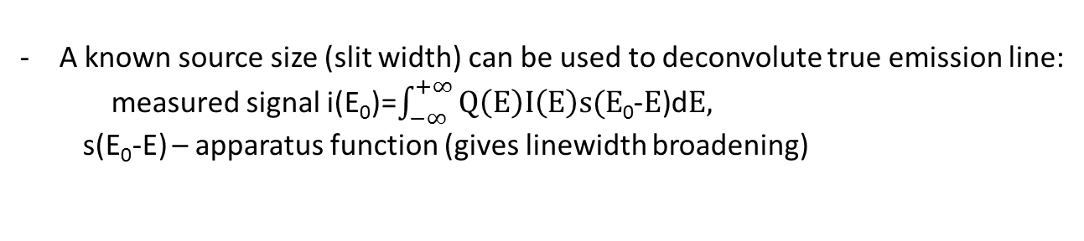
Spectral and resolution corrections
Even the best spectrometer/detector system distorts the signal
Resolution corrections
A known source size (slit width) can be used to deconvolute true emission line:
  measured signal i(E₀)=$\int_{−∞}^{+∞}{Q\left(E\right)I\left(E\right)s(E\text{0}}$-$E$)d$E,$
  s(E₀-E) – apparatus function (gives linewidth broadening)
this function can be measured with a source of atomic lines:
the dominant broadening is the one introduced by the spectrometer
can be neglected for very broad spectra
can be taken into account for narrow spectra assuming Gaussians:
Δλ²_{meas}=Δλ’²+ Δλ²_{real}

Slide 29
Outline
Main definitions. Specific case of semiconductor luminescence
Photoluminescence (PL) and photoluminescence excitation (PLE) techiques
Photodetectors: photomultiplier tube (PMT), avalanche photodiode (APD), CCD
Monochromators and spectrographs: resolution, throughput and signal-to-noise ratio
Spectral and resolution corrections
Other methods: lock-in amplifier, photon counting and Fourier spectroscopy

Slide 30
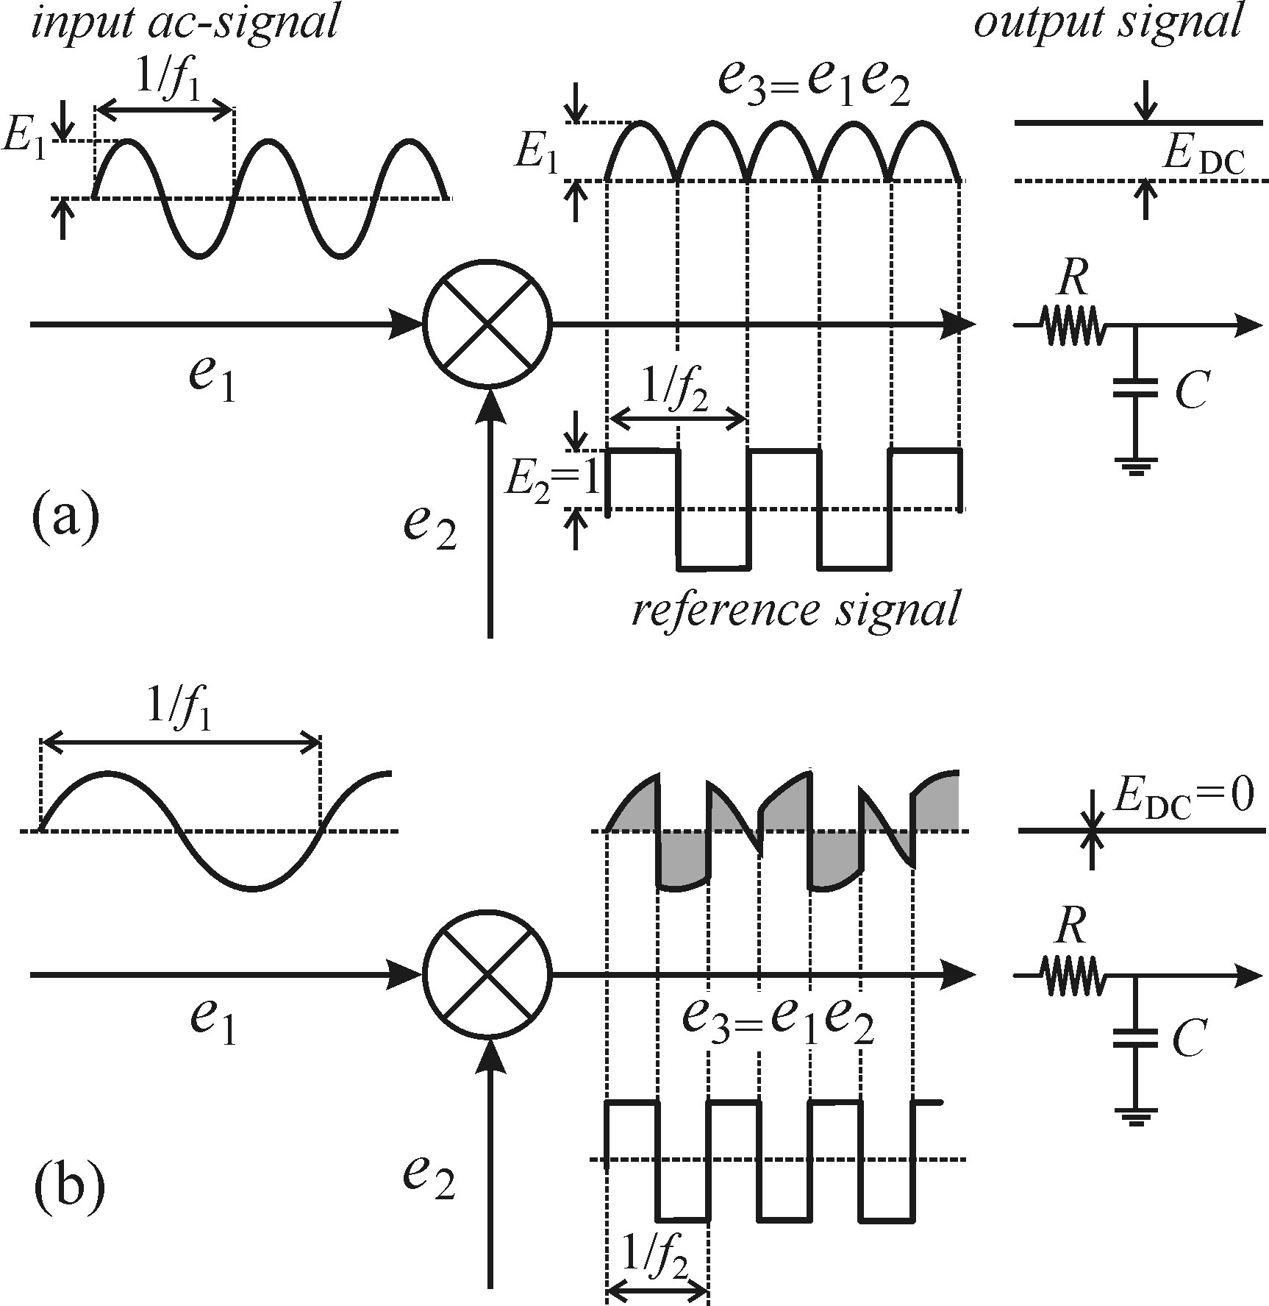
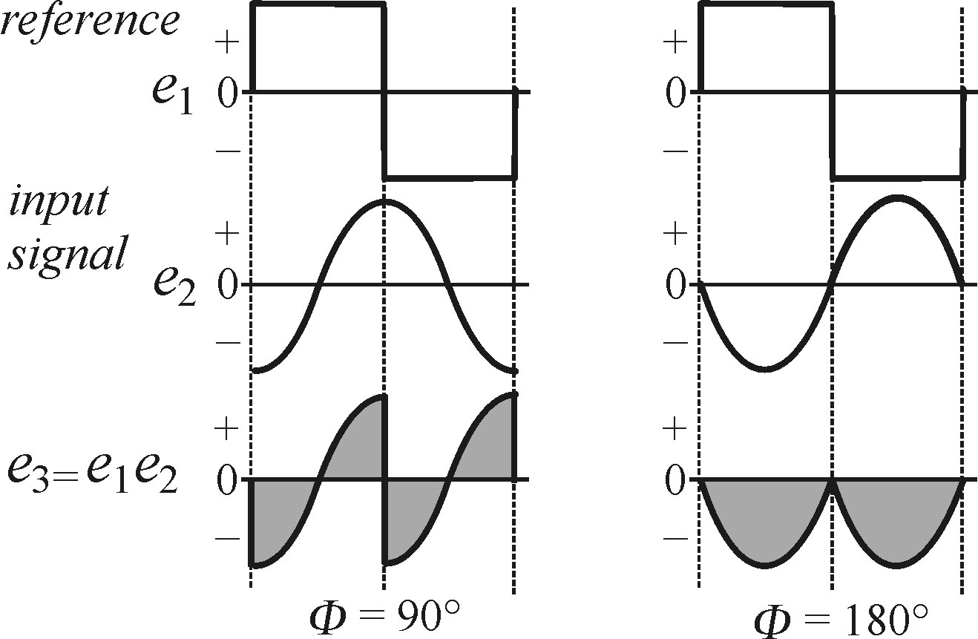
Other luminescence detection methods
Lock-in amplifier
enhancement of weak signals using modulation synchronized amplification:
- signal e₁ is modulated with a mechanical chopper
- external modulation source e₂ is synchronized with it
- as a result only frequency-matching signal is amplified
in a mixer device e₃ = e₁ ∙e₂
small shifts in phase can be easily detected
  this is a tuning parameter for achieving maximum
  amplification compensating for delays in lines of two signals

Slide 31
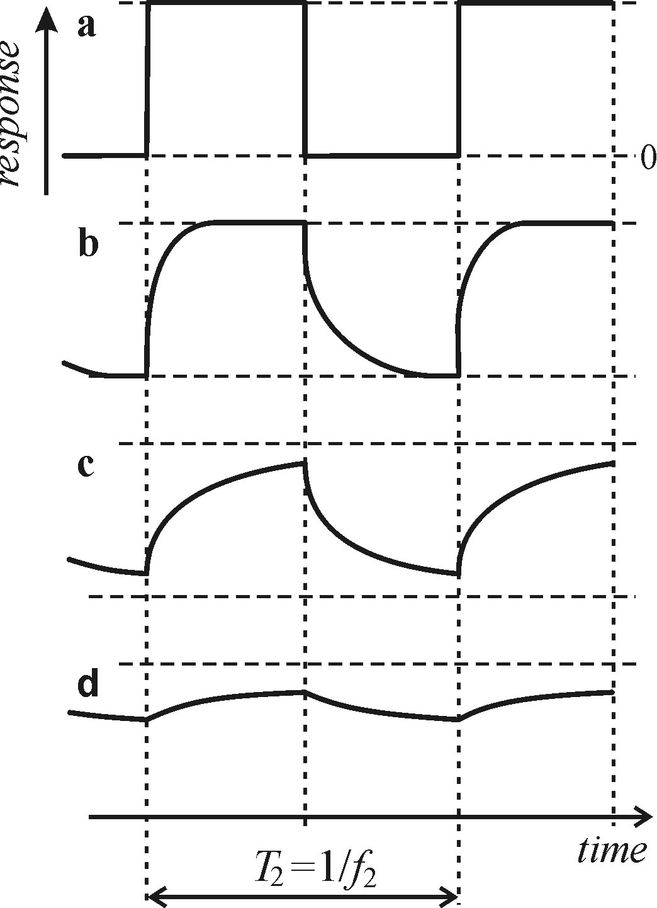
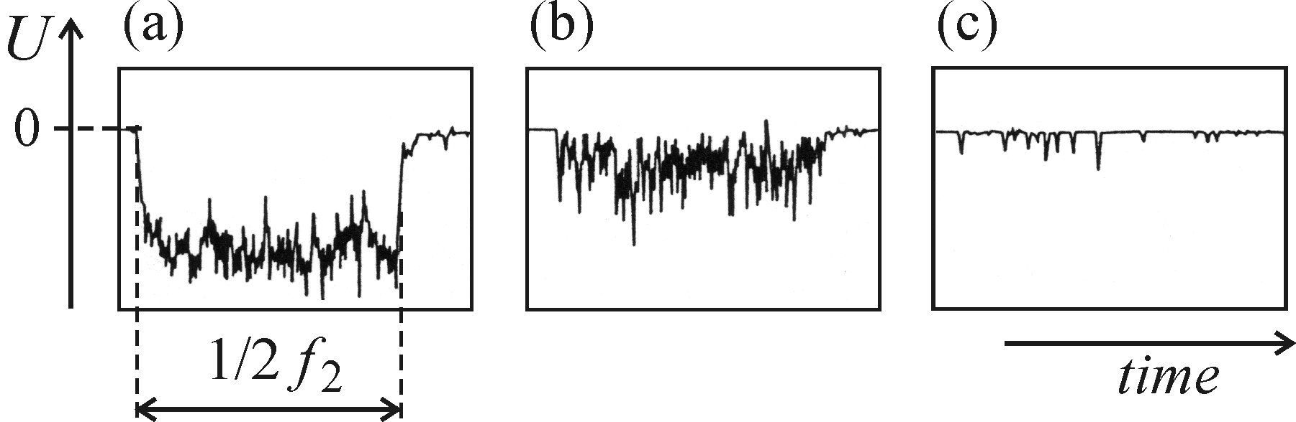
Other luminescence detection methods
Lock-in amplifier
not suitable for luminescence with long lifetimes
(weak signal in the “window” between excitation pulses)
not suitable for extremely weak signals, where
discrete nature of photons becomes apparent

Slide 32
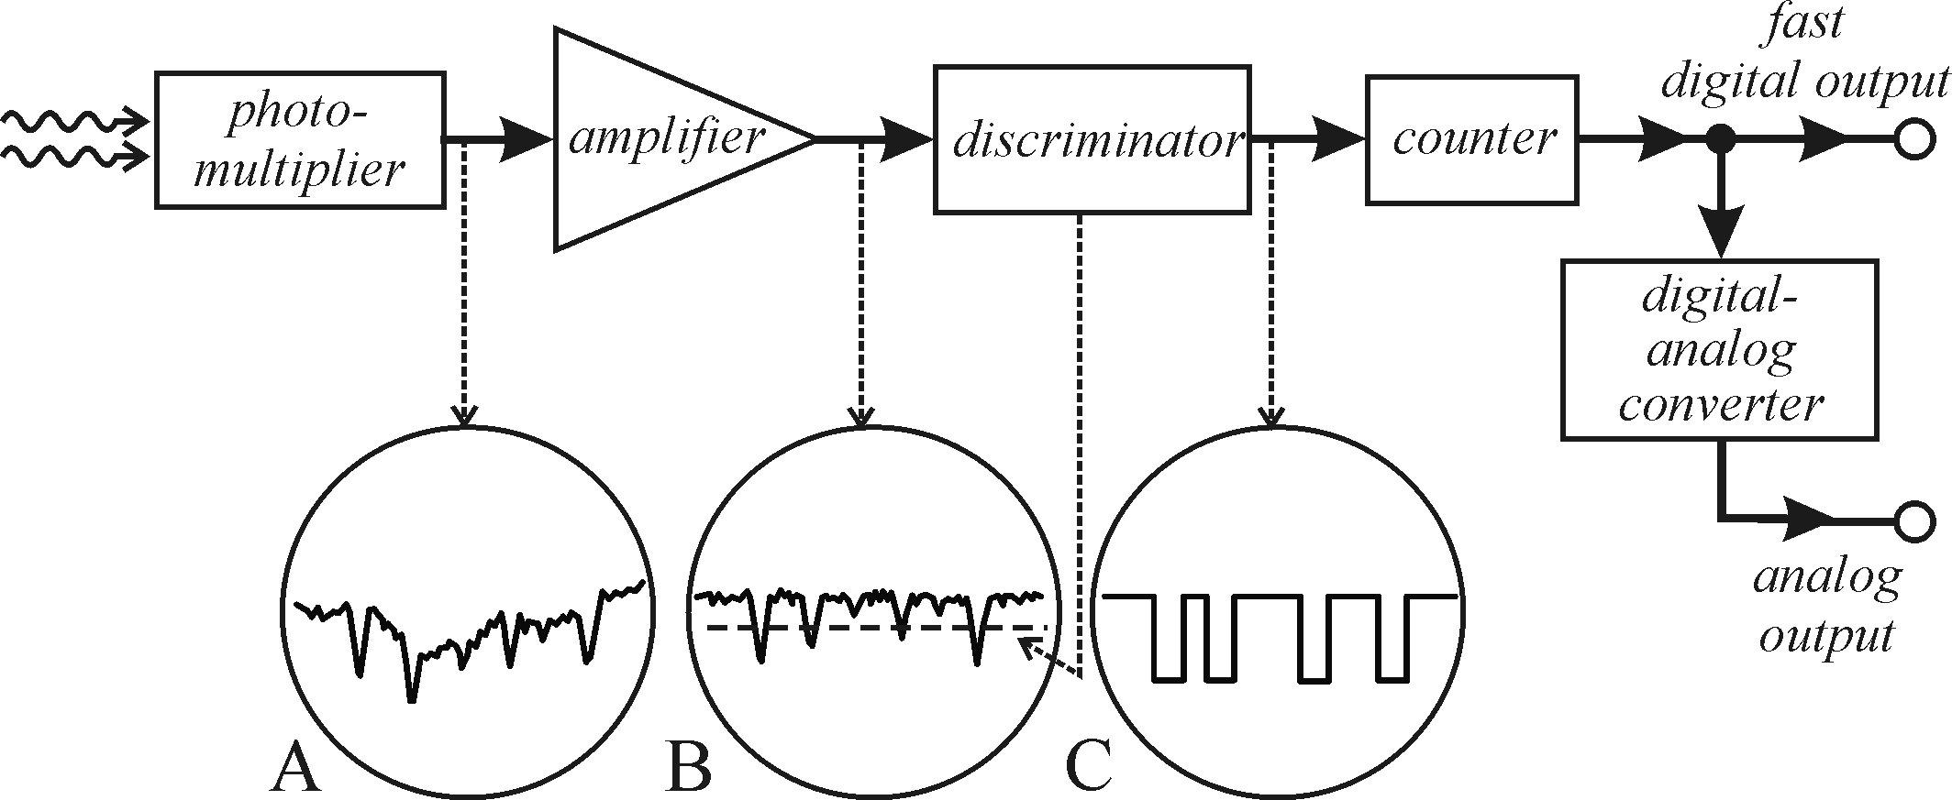
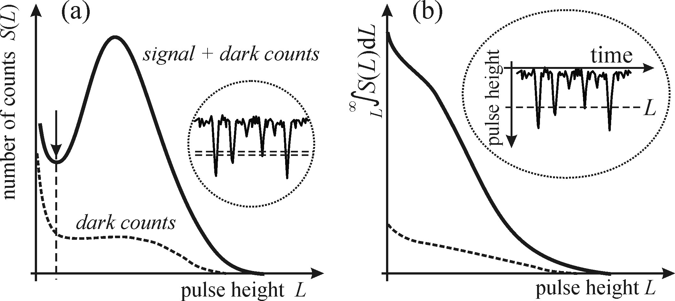
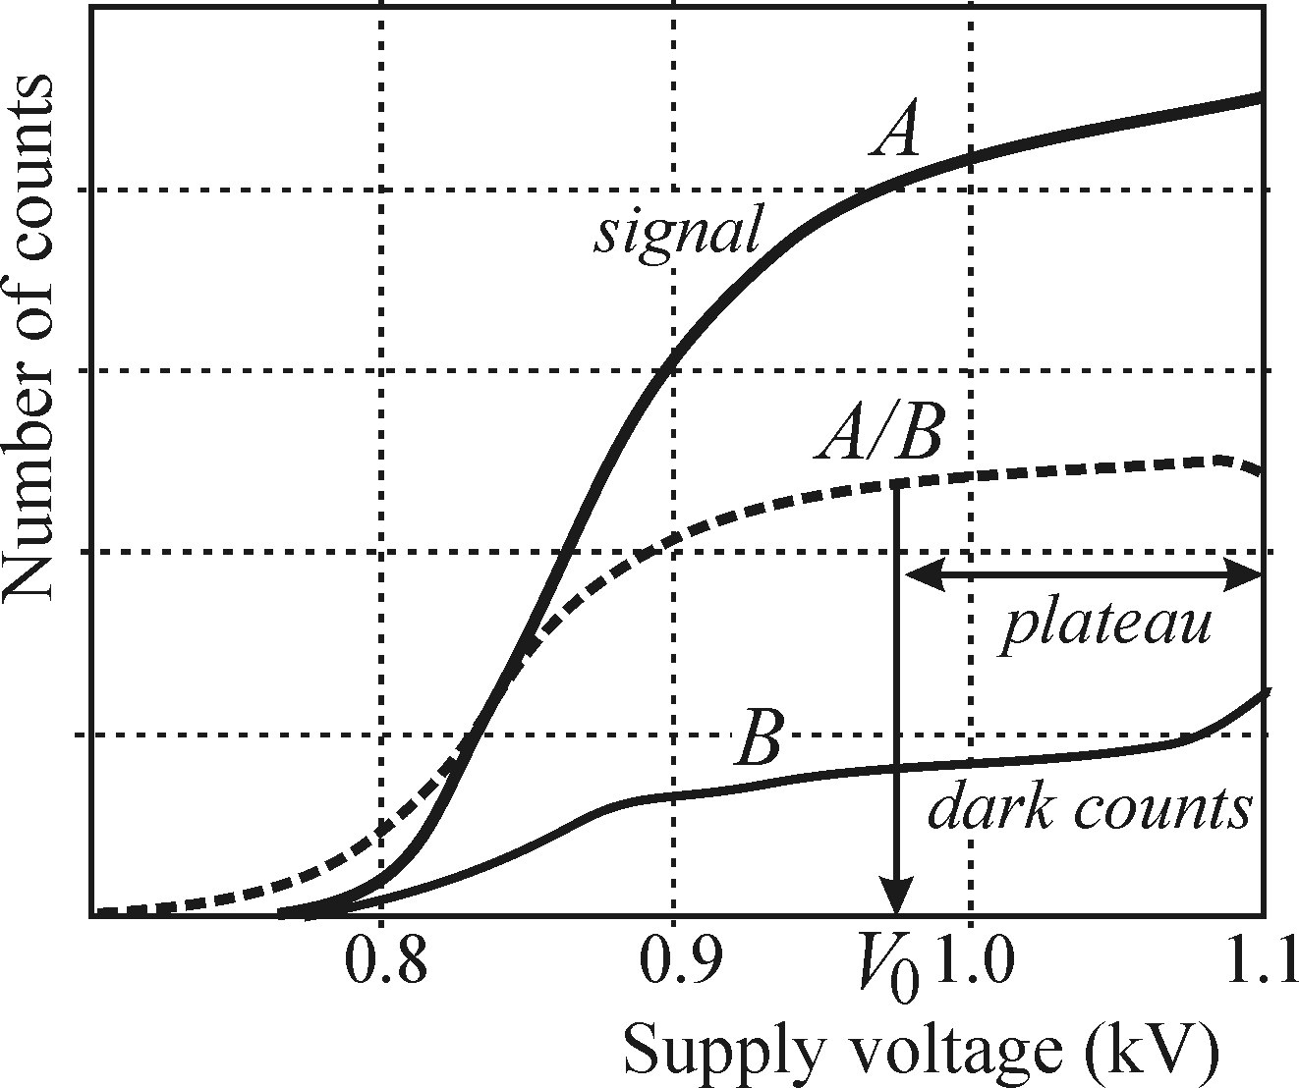
Other luminescence detection methods
Photon counting
PMT, APD and CCD can work in photon counting mode
the result is the pulse train of incoming photons vs time
important parameters for PMTs:
fast response time (< 10 ns)
high quantum efficiency (> 20%)
narrow response counts distribution
proper operation voltage (plateau region)

Slide 33
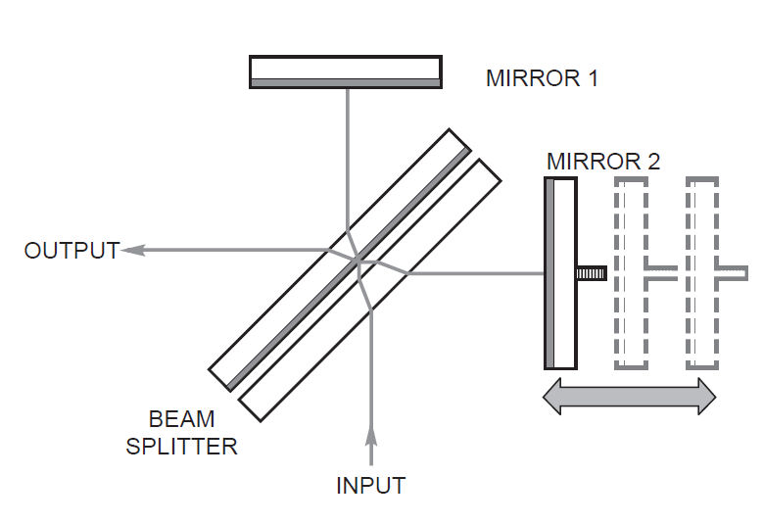
Other luminescence detection methods
Fourier luminescence spectroscopy
applied for high spectral resolution (Δλ<0.001 nm) spectroscopy in the infrared region
Michelson interferometer with a varying arm length
Temporal interference signal is Fourier processed
Multiplexing (all wavelengths at once)
and high throughput (no slit necessary) are advantages

