Slide 1
Urban Modelling and
Decision Support
AH2307
Anders Karlström
Head of Department
Transport Science
KTH Royal Institute of Technology

Slide 2
From
Transport Data Analysis and Collection:
Planning and Policy
Operations
Monitoring
Management and Control
THIS COURSE!
Quantitative methods
Computational Methods
Modelling
Computer aided decision support

Slide 3
Content
“The main contents are
discrete choice theory, the multinomial and nested logit model,
network equilibrium and assignment theory for car and public transport,
and the development and application of a simple forecast and analysis system”

Slide 4
What is this about?
Quantitative methods or
Computational methods….
… for Modelling Urban System
… in particular in relation to
Interaction between
Location of activities and land use
and the Transport System
MODELS

Slide 5
Learning outcomes
After the course you should be able to:
Describe and critique the application of rational models in decision-making processes
Apply urban theories to building a simple forecasting system
Analyze policy changes in the urban system and produce decision support for decision-makers
Write a report of a simple transport planning study

Slide 6
Examination
Examination
PRO1 - Project, 4.5 credits,
grade scale: A, B, C, D, E, FX, F
TEN1 - Examination, 3.0 credits,
grade scale: A, B, C, D, E, FX, F

Slide 7
Learning outcomes vs examination
 | PROJECT | EXAM Categories
 |  | 1 Logit | 2 Ass. | 3 LUTI | 4 Mod.
Describe rational-based models for decision support | x | xx | xx | xx | xx
Critique rational-based models for decision support | x | x |  |  | xxx
Apply urban theories to build simple forecasting systems | xxx | x | x | x | x
Analyze policy changes in the urban system | xxx
…and provide decision support for decision makers | xxx
Write a report of a simple transport planning study | xxx

Slide 8
Project
You will use a simple travel demand model
Stylized city of Stockholm
Evaluate Policy Measures
Examine interaction of land-use and transport
Write a report
Oral examination

Slide 9
Written examination
Four exam categories
Demand modelling with Logit
Assignment
LUTI
Models and appraisal

Slide 10
Content Demand
Demand modelling with Logit
Where to people locate?
How often do they travel?
Where do they travel?
By which mode do they travel?
Transport, housing, workplaces

Slide 11
Content Demand
Demand (contd)
Logit model (repetition)
Nested logit model
Trip generation, Trip distribution and modal split
Locational choice modelling
(car ownership)

Slide 12
Content Assignment
2. Assignment
If travel, either by car, bike, walk or transit
Road network
Transit assignment
Car assignment, network loading
Static network equilibrium

Slide 13
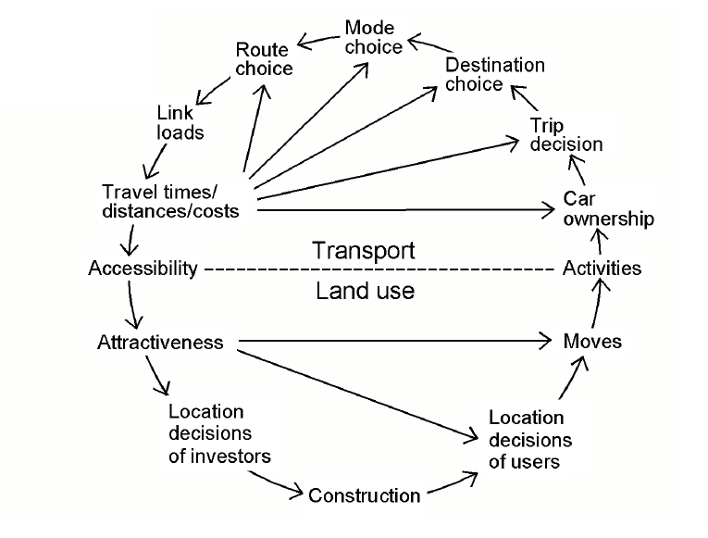
Content 3. LUTI

Slide 14
Content LUTI
3. Land use and transport interaction (LUTI)
Interaction of LU and T
Location of economic activities
… and freight

Slide 15
Content Modelling and Appraisal
4. Modelling and Appraisal
Other models than Logit
Car ownership modelling
Scheduling models
Appraisal: What is it? What is it, really?
Critique and defense

Slide 16
How to pass the course
Last year debriefing:
There were 21 students last year
20 took the exam
Only one received F on the first exam
20 passed the course

Slide 17
How to pass the course (1)
1. Project
Get an overview
Read the project documentation immediately
Follow the lab on Wednesday
Start early
Ask Daniel and Masoud
Use lab hours to Q/A
Understand the requirements of the written report
Understand the requirements of the oral exam
Keeep the deadline

Slide 18
Oral exam?
Project (contd)
The main purpose is to ensure individual examination of each student
Make sure that you know your way around the code
No presentation is required.
There will be time slots available on the web to book

Slide 19
How to pass the course (2)
2. Written Examination
Get an overview
Read the FAQ: On how to pass the exam
Look at the Example Problem Sets and Example Exams
Understand the four categories of the Exam
Locate learning activities associated with each category
Make sure that you are able to tick off each category in the exam

Slide 20
Grading
The final grade will then be set according to the grades on the Project and Examination:
First, the grade on the Project is defined to be the anchor
If you receive a grade on the Examination that is higher than the Project, your final grade will be one step higher than the Project.
If your Examination grade is the same as the Project, you will have the grade of your Project.
If your Examination grade is lower than the grade on the Project, your final grade will be one step lower than the Project grade.
There is one exception to this rule: For final grade A you will have to have grade A on both the Project and the Examination.
(AND, of course, you will have to pass (A-E) both the Project and the written Exam.)

Slide 21
Important!
If you have any questions, please send them to me or Daniel/Masoud (Project)
- email amail@kth.se
danjo@kth.se
masoud.fadaei@abe.kth.se
Answers for a general audience will be on Social
Questions of PROJECT should be addressed to Daniel/Masoud

Slide 22
Course committee
Free lunch!
Yes, and it is a nice lunch too.

Slide 23
END OF FORMALIA

Slide 24
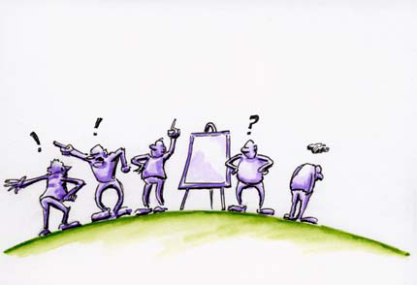
Background for modelling
Approaches to planning
Why models?
Limitations of models, critique and defense

Slide 25
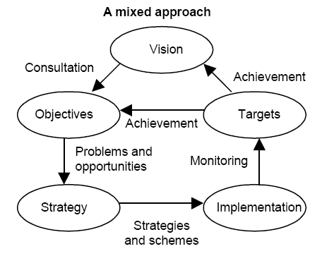
Approaches to decision-making
Rational analysis or muddling-through?
Vision
Plan
Consensus

Slide 26
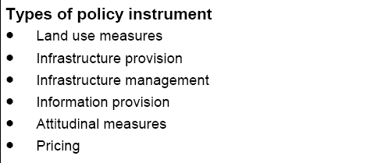
Policy instruments

Slide 27
We need more than the solution
Innovation
Political Acceptance
Public Acceptance

Slide 28
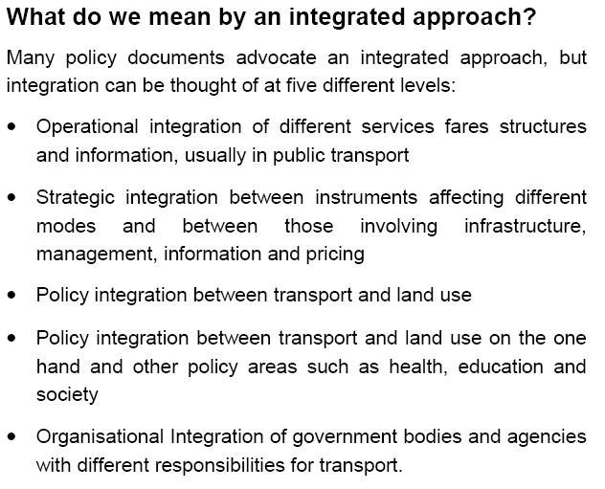
Integrated approach

Slide 29
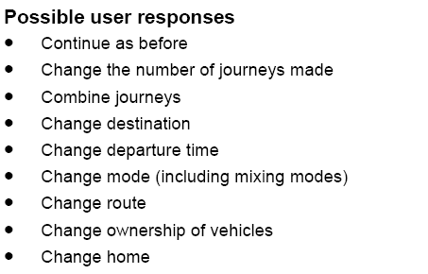
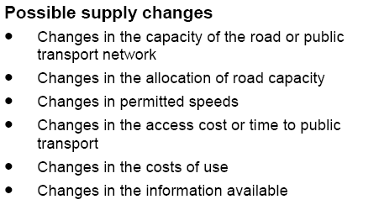
What do we need to know?

Slide 30
Land-use and transport

Slide 31
A sustainability paradox
Land-use policies will have only a minor effect as a measure for increased sustainability
It is the land-use pattern that is the dominating significant factor with a huge impact of sustainability

Slide 32
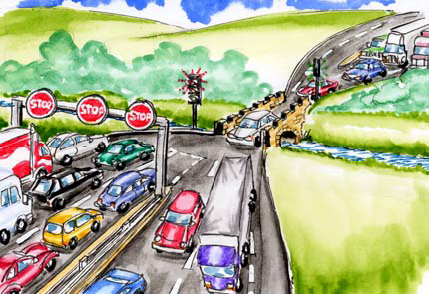
Identifying the problem

Slide 33
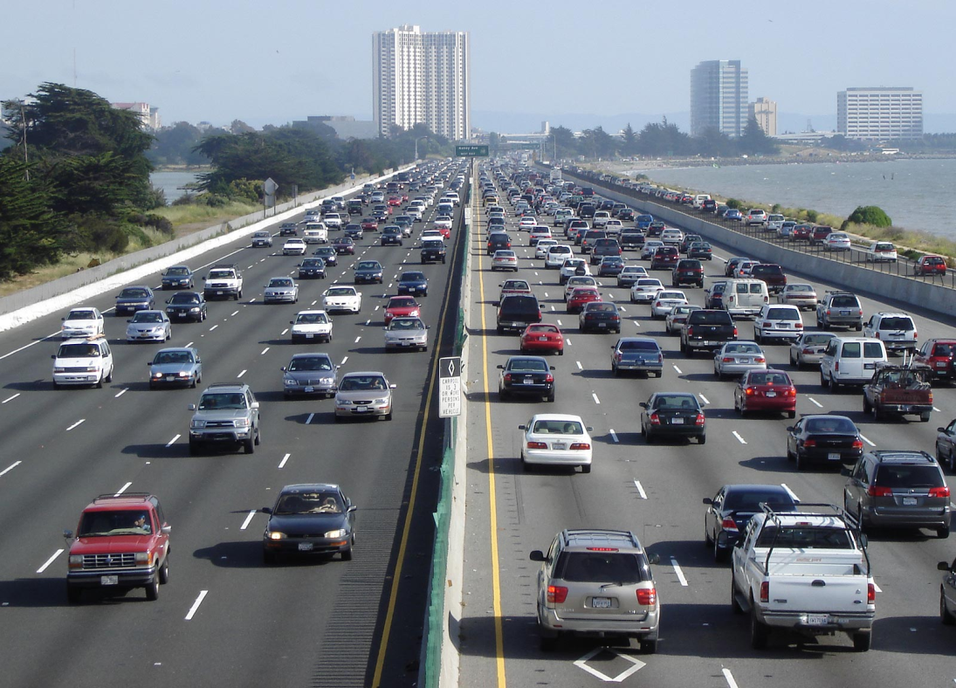
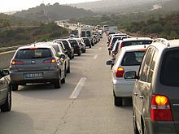
Identifying the problem (2)

Slide 34
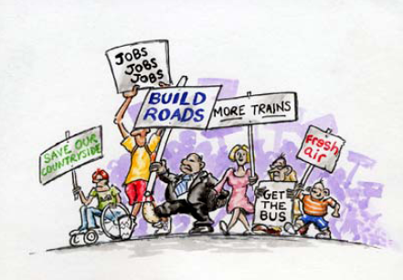
Problem or Solution?

Slide 35
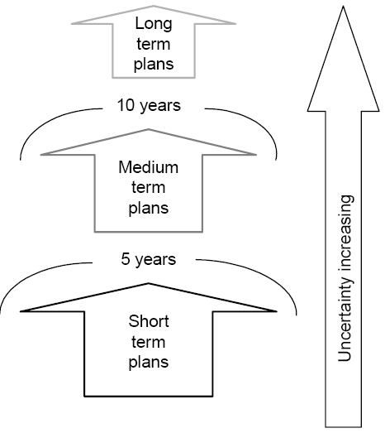
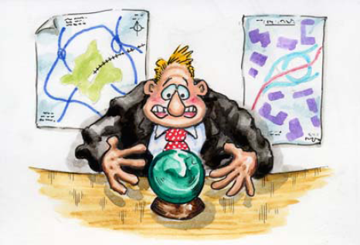
It is difficult to predict, in particular the future
Does it work??

Slide 36
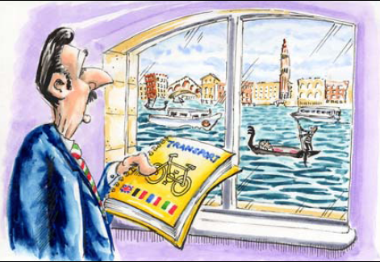
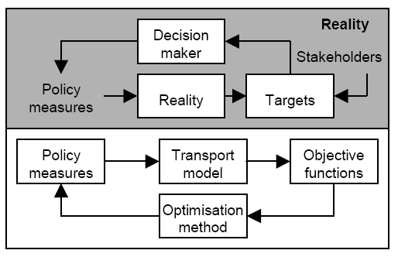
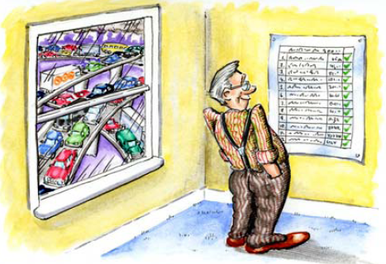
Model and reality?
Urban model

Slide 37
Models
Why use computational models (or mathematical models)?
Rigour
Comprehensiveness
Logic
Accessibility
Flexibility

Slide 38
A good model…
should be
theoretically sound
based on good data
reproducing observations and other data reasonably well
providing the required output
easy to use
accepted by the user
well documented
?!
What about understanding?

Slide 39
Validation
Practical validation
Theoretical validation
Internal validation
External validation

Slide 40
Dynamics
Time marching vs forward-looking
Equilibrium vs disequilibrium and simulation

Slide 41
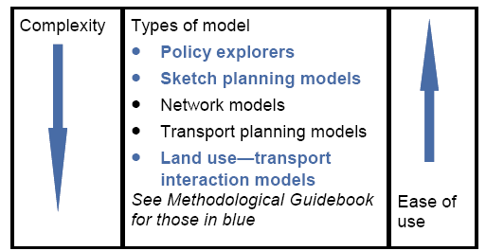
Types of models
OW ch 1, PMG ch 1-2

Slide 42
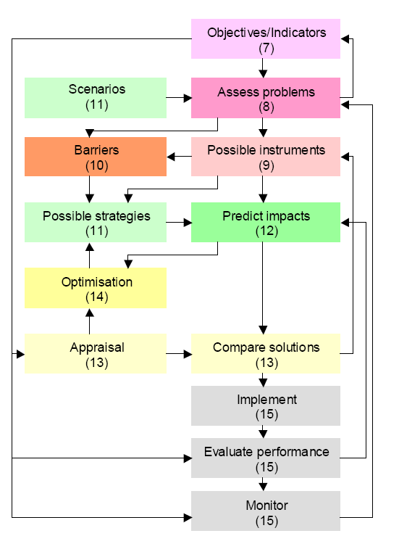
A structure

Slide 43
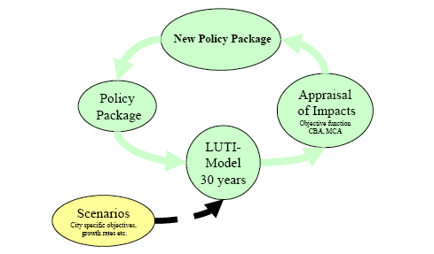
Policy evaluation?

Slide 44
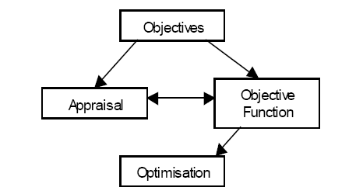
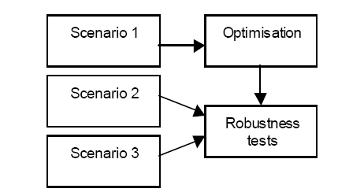
A rather different question
What policy measures should we use to achieve a certain objective?
(What is backcasting?)

Slide 45
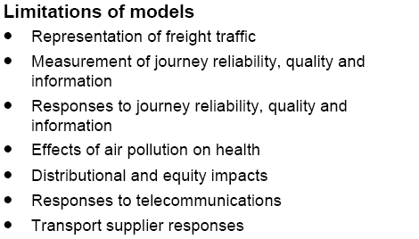
Limitations

Slide 46
Critique
People are complex and heterogeneous
People cannot be represented by a mathematical formula
People are not rational
People are not utility maximizers
Social contracts and social norms are crucial, which is badly or not at all represented
Where is political decision-making?
People will change attitudes towards big fossile cars, which is not reflected in your models
People behave according to habits, and we need to break them
You are not considering the environment, only economics
You cannot address issues of sustainability
A model cannot build high speed rail, which we need

Slide 47
Defense?
People are complex and heterogeneous
People cannot be represented by a mathematical formula
People are not rational
People are not utility maximizers
Social contracts and social norms are crucial, which is badly or not at all represented
Where is political decision-making?
People will change attitudes towards big fossile cars, which is not reflected in your models
People behave according to habits, and we need to break them
You are not considering the environment, only economics
You cannot address issues of sustainability
A model cannot build high speed rail, which we need

Slide 48
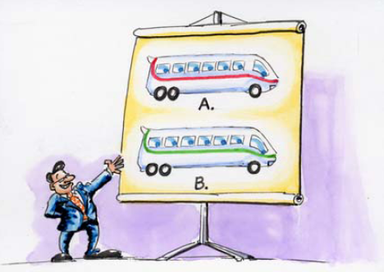
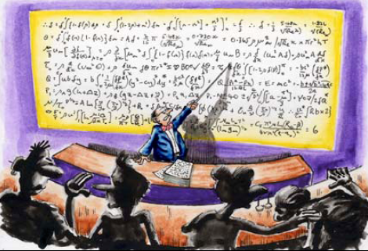
Red bus / Blue bus

