Slide 1
IM3008 Luminescence Spectroscopy of Semiconductors
Time-resolved luminescence: equipment and kinetic description of processes. Phonons.
By :
Giriprasanth Omanakuttan
HMA

Slide 2
Outline
Time-resolved luminescence: equipment
Direct Imaging of the luminescence response
Phase Shift method
Time‐correlated photon counting
Boxcar integrator
Streak camera
Kinetic description of processes.
Radiative and non-radiative recombination.
Luminescence efficiencies
Monomolecular process
Bimolecular process
Stretched exponential
Simultaneous occurrence
Phonons
Lattice vibrations –phonons
Electron–phonon and exciton–phonon interactions
Lattice vibrations associated with point defects
Localized optical centre in solid matrix
The shape of absorption and emission spectra of a localized centre

Slide 3

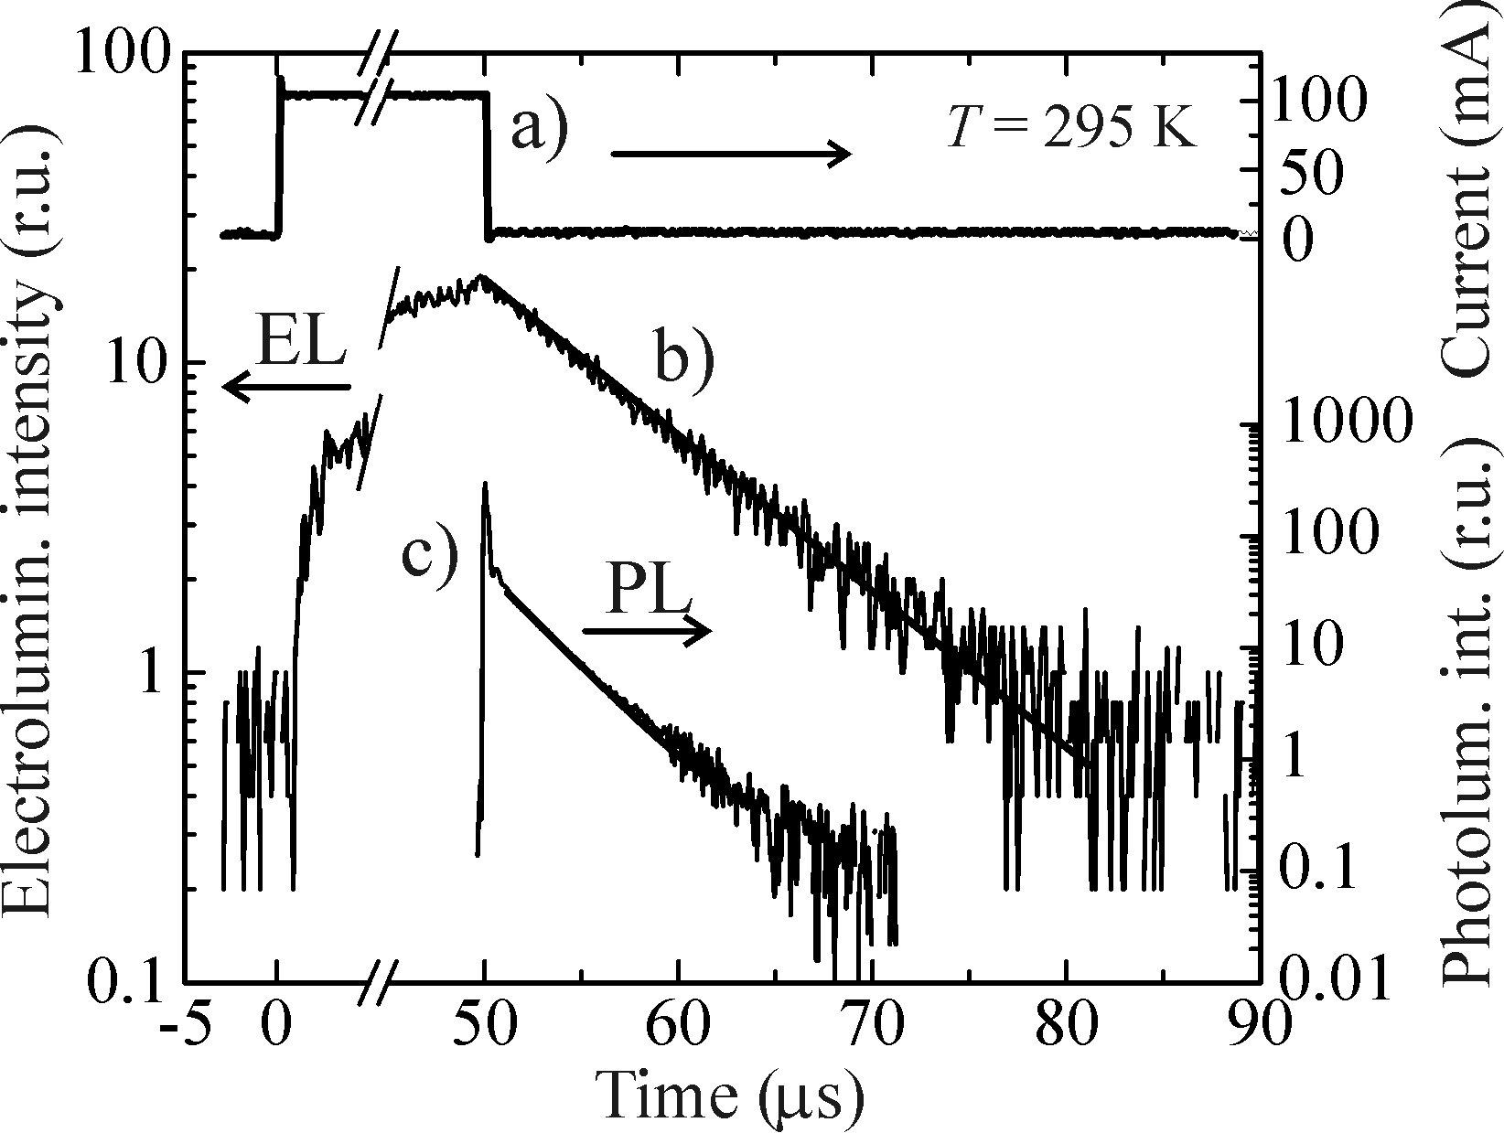
Time-resolved luminescence / Life time measurement
Studying the shape of the Luminescence decay curve after the excitation is switched off.
Direct Imaging of the luminescence response
Pulsed excitation source
Decay :
I (t) = I(0) exp (-t/τ)
where τ is luminescence decay time or lifetime.
Challenges:
Excitation source, PMT and oscilloscope should be : fast, Sensitive and perfectly linear
The excitation is not exactly rectangular
with mechanical choppers and (t> 0.1µs)
Pulse width should be < decay time
In Electroluminescence: electric effects plays
t_{EL}=8µs, t_{PL}=2.5µs

Slide 4
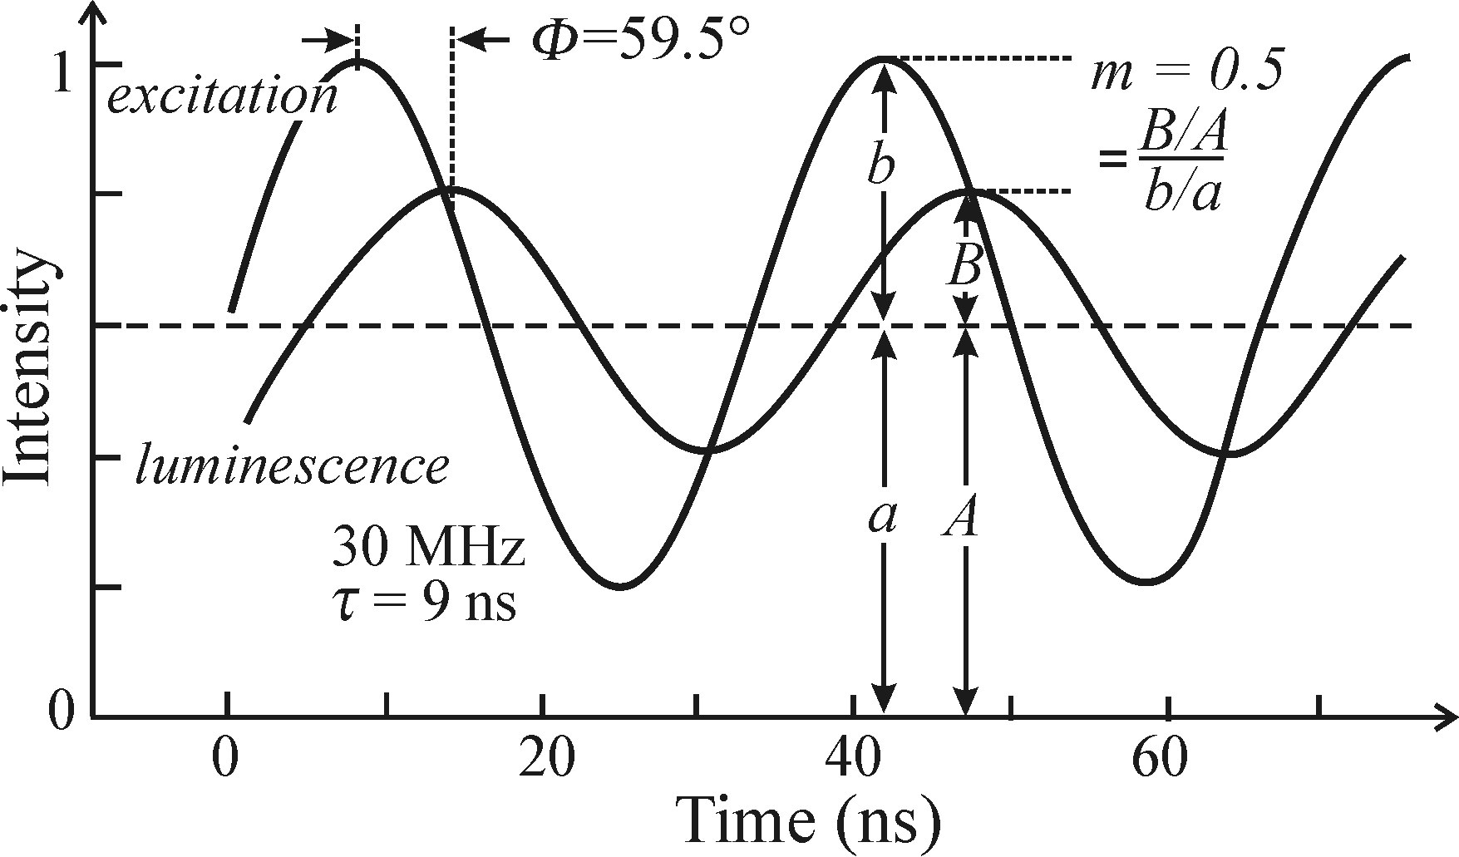
Phase Shift method
Excitation with sinusoidally modulated light ( freq: ω)
Luminescence response phase shifted by an angle φ
Modulation depth decreased
(same freq.)
Tan φ = ωt
m = (1+ ω²t²)^{-1/2} = cos φ
m = (B:A)/(a:b)
Condition:
ω must be comparable to 1/t
t = 10⁻¹ to 10⁻⁹ can be measured
Can measure fast luminescence kinetics without ultra short pulses
CW lamps with output modulated at high freq can be used
φ = 59.5’
m = 0.5
t = 9 ns

Slide 5
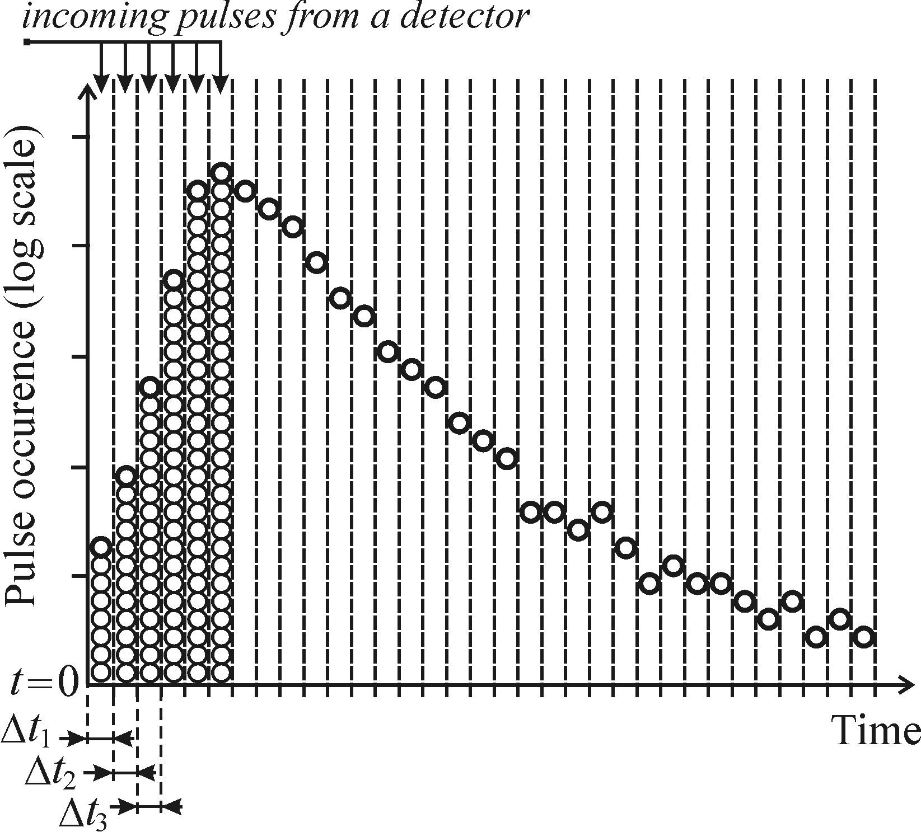
Time‐correlated photon counting
Based on statistical character of luminescence photon emission
Excitation by a short light pulse
Recording the arrival time of single photon within a solid-angle
t= 0 when the excitation pulse was emitted
Excitation is repeated many times
Histogram of the pulse occurrence within
time intervals Δt (time slots)
The probability of emitting a photon into the
solid angle at any time is proportional to the
no of luminescence centres in the excited state
Note: the curve is plotted randomly,
not in sequence

Slide 6
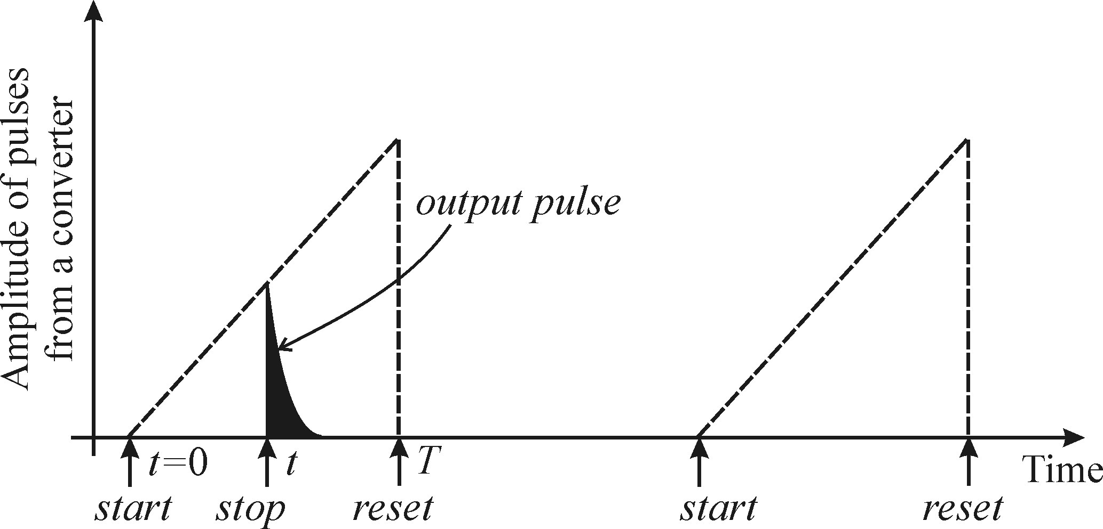
Basic requirements:
Low intensity to record single photons
High no of photons must be detected:
May take from min. up to hours
(Time‐correlated photon counting)
One essential part: Time-Voltage converter
Converter initiated by the excitation pulse at t=0 and begins to generate a DC voltage
Voltage rise is stopped by the pulse coming from the photomultiplier
Resulting voltage amplitude is proportional to the time delay btw t=0 and stop pulse
V is sorted and ranked into the corresponding channel of multichannel analyzer
Gives the fig. in previous page
Sensitive and accurate,
But, time-consuming and special electronics

Slide 7
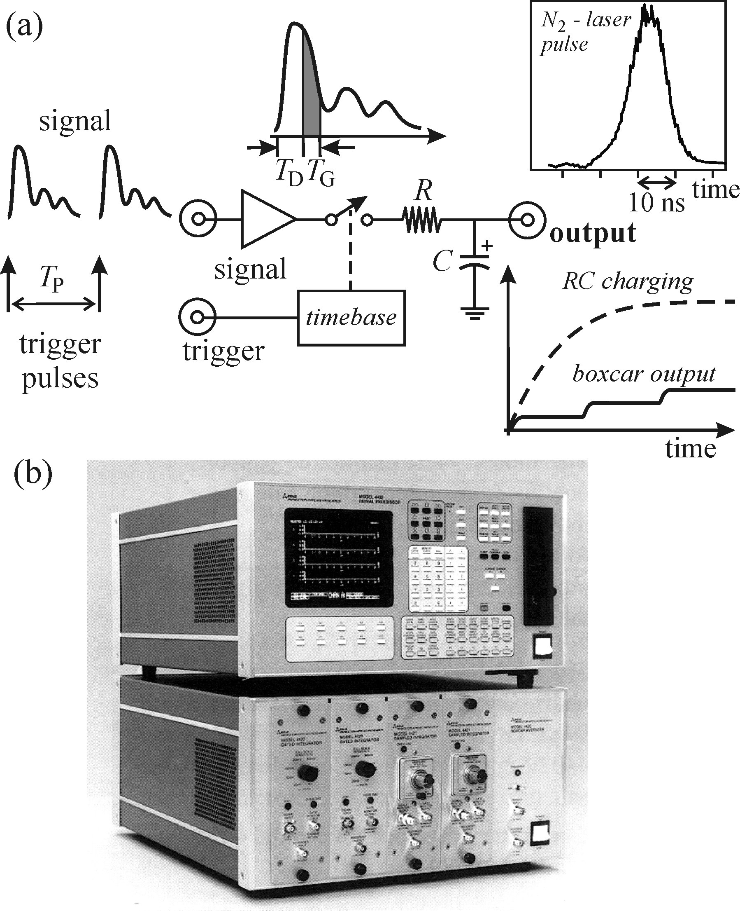
Boxcar integrator/ Boxcar averager
Enables both the time evolutions of ultrafast light signals and time-resolved emission spectra

Slide 8
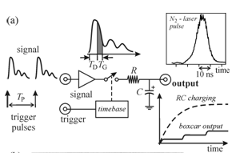
Boxcar integrator/ Boxcar averager
Records complete time-resolved luminescence spectra
Can detect weak repetitive signals unprocessable by the lock-in detection technique
Two inputs:
Investigated signal (Pulsed output from detector) repeated with a period T_{p}
Trigger pulse, synchronous with the signal
With incoming trigger pulse, the sampling unit (gate) is switched on (with delay T_{d}) for a time interval T_{G}
The whole process is repeated with a freq f=1/T_{p}
The RC time >>T_{G} , thus voltage on Capacitor C increases in small steps and slow discharging also
The C output signal asymptotically approaches the avg value of the input pulse amplitude
Called the exponential averaging
Caution : too fast gate scanning distorts pulse shape and
: too slow is time consuming and errors due to drift of parameters
Eg: here optimal time of signal scanning T_{M}=60s

Slide 9
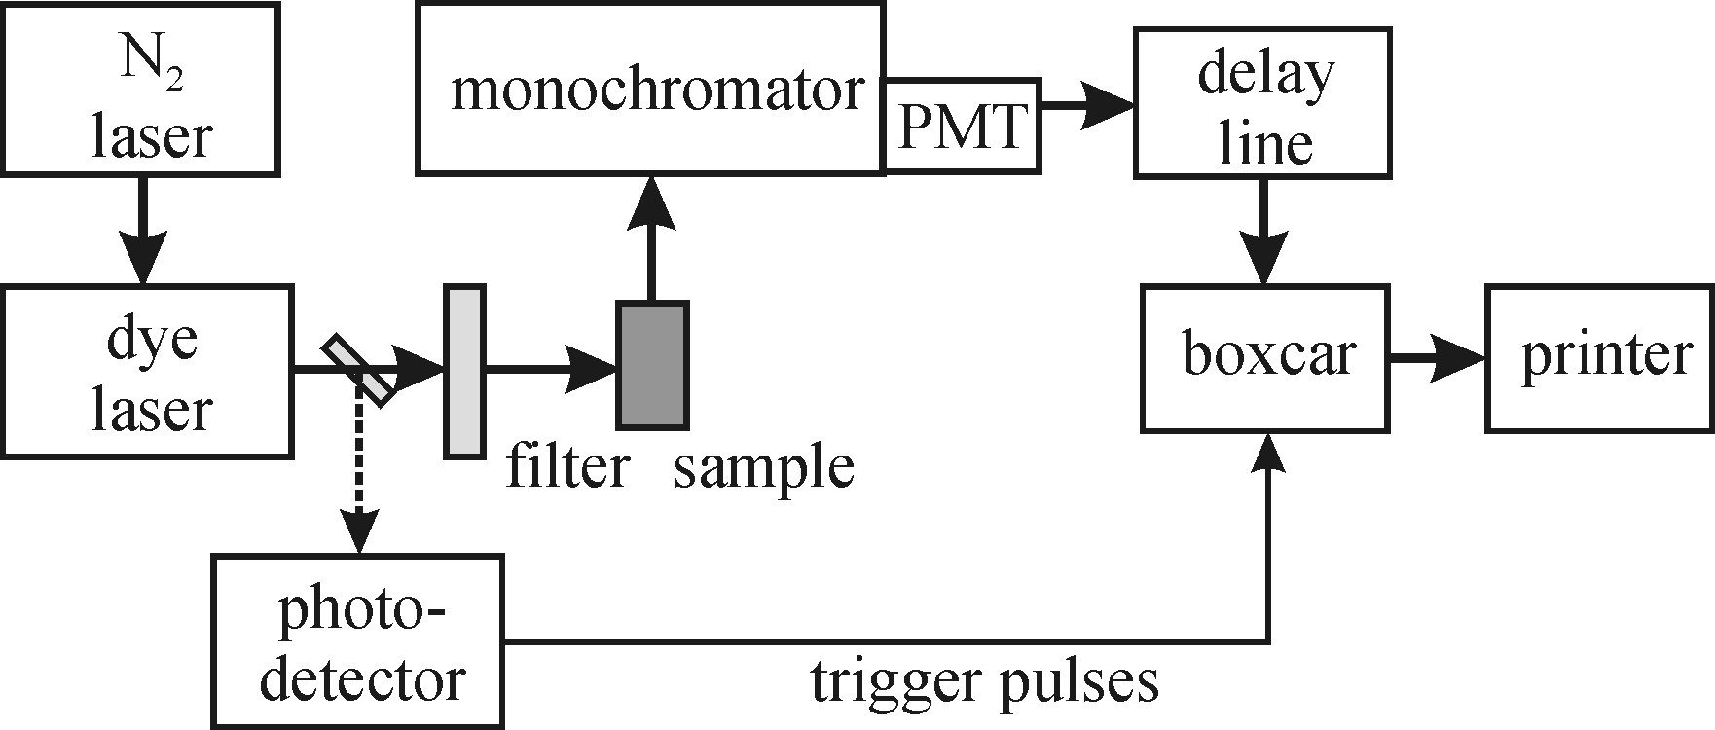
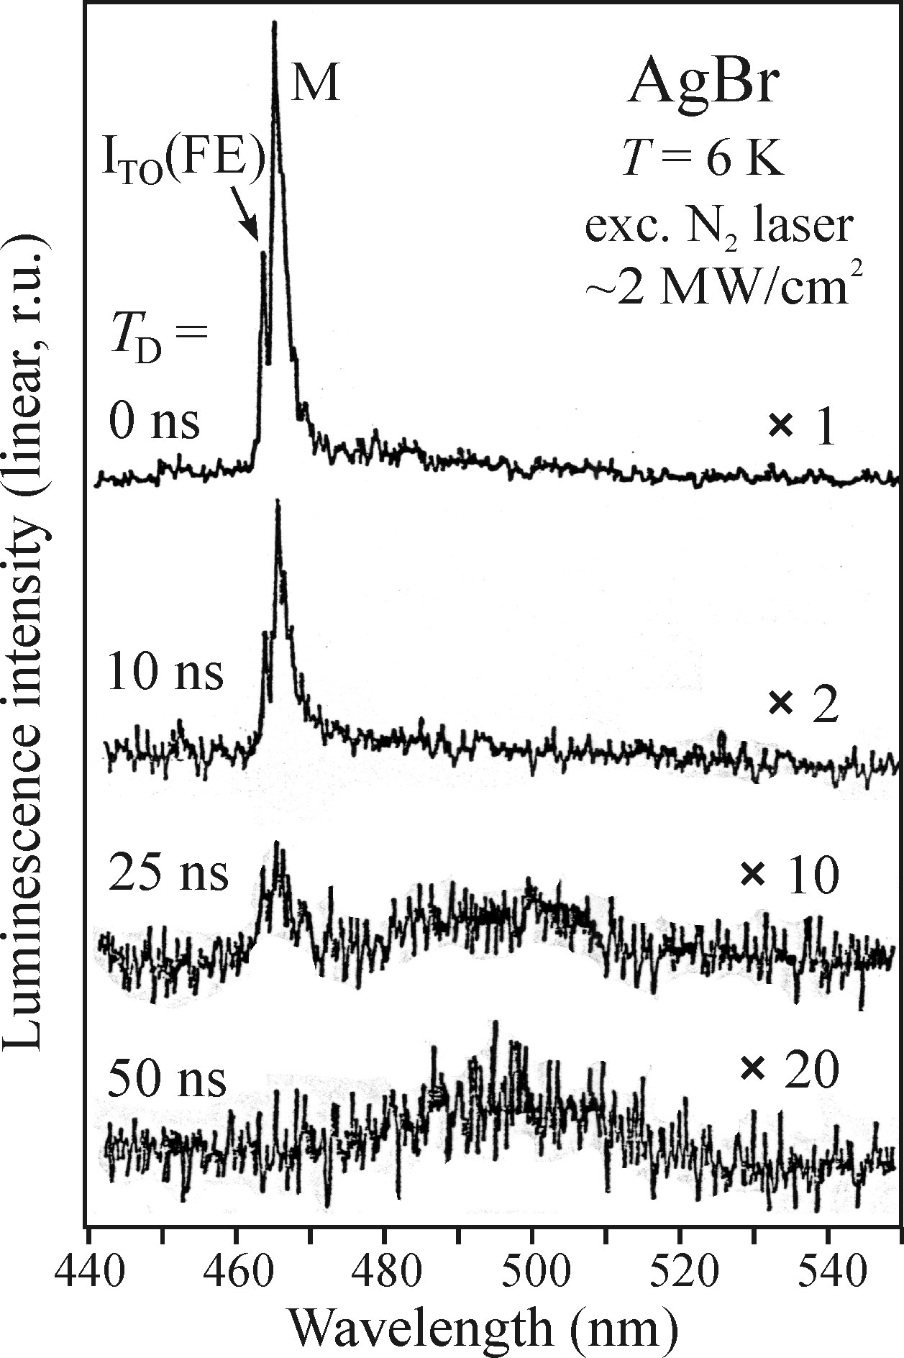
(Boxcar integrator)
Luminescence spectrum is continuously recorded under a pulsed excitation
Signal to noise ratio is improved
(the input noise is not coherent with the trigger pulse rate and its contribution to the integrated output signal is therefore small)
Eg: Spectra of AgBr under pulsed excitation with a N2 laser (337nm)
Can study decay times from 500ps to hundreds of ns
Enables both the time evolutions of ultrafast light signals and time-resolved emission spectra

Slide 10
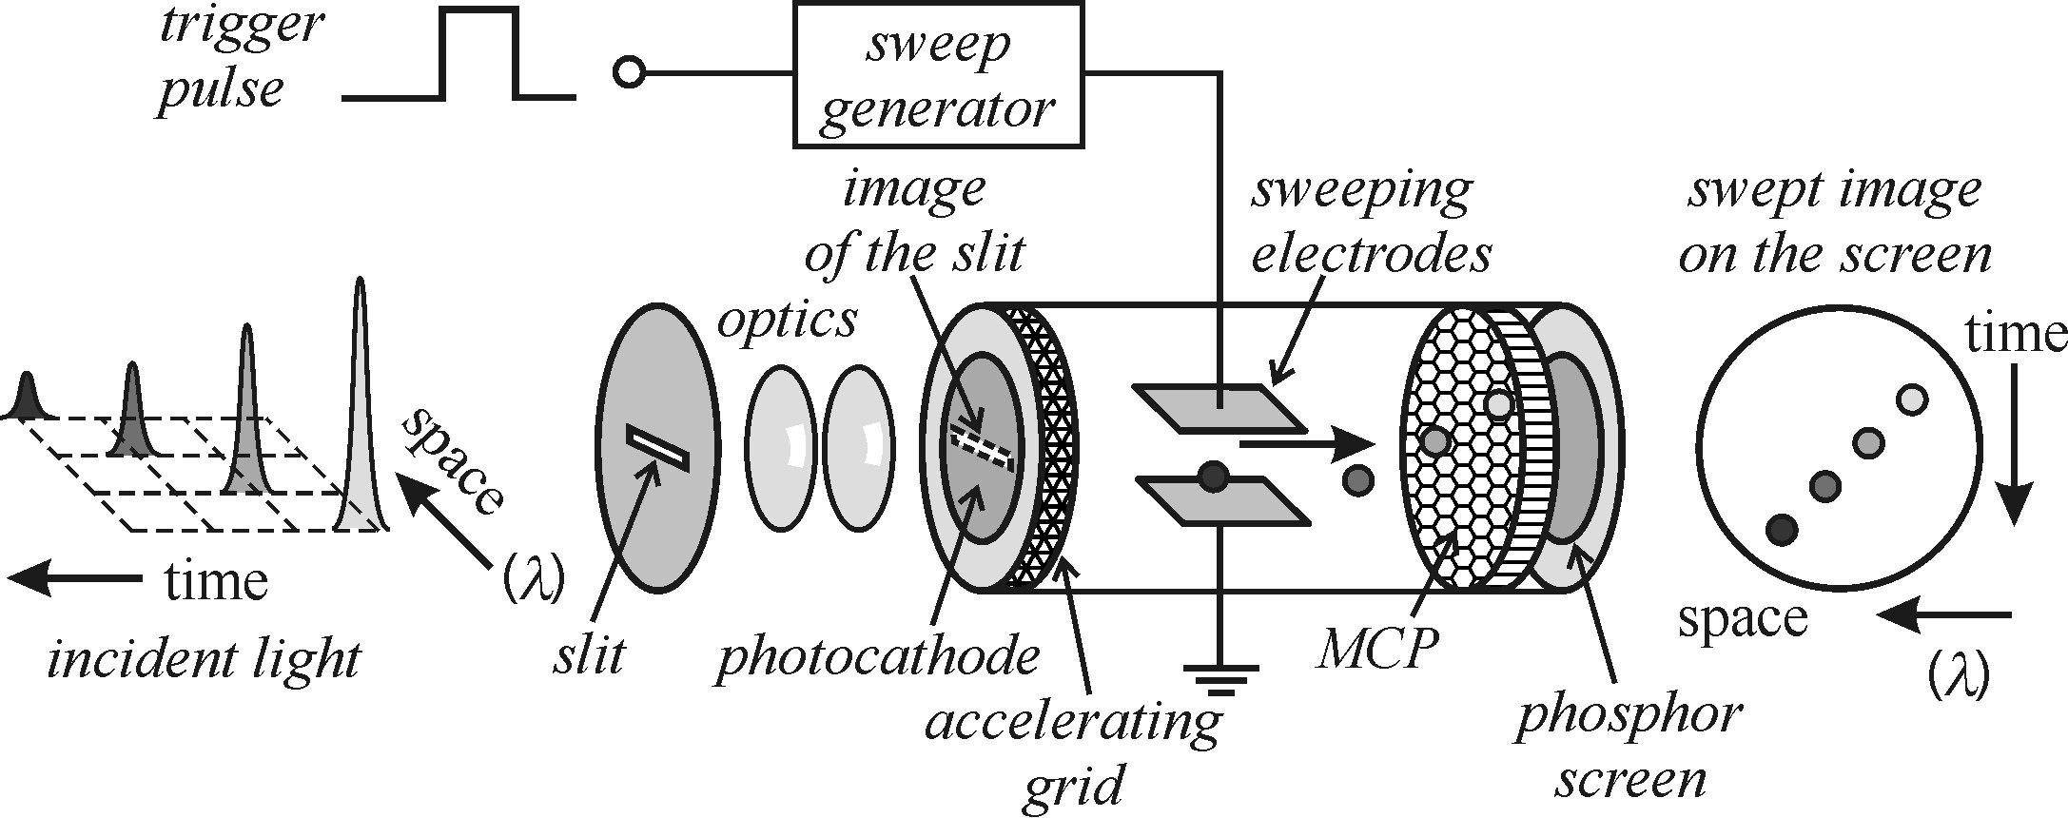
Streak camera
Can be used for Luminescence transients occurring on the time scale of picoseconds and femtoseconds
Enables both the time evolutions of ultrafast light signals and time-resolved emission spectra
Developed by Hamamatsu Co. Ltd in 1970

Slide 11
(Streak camera)
The light pulse hitting the photocathode induces emission of photoelectrons inside an evacuated tube.
photoelectrons are accelerated horizontally by voltage and deflected by a voltage in the vertical direction. This deflection voltage is synchronously with the incoming light pulse.
Thus time information is coverted into spatial info.
These electrons are multiplied via secondary e- emission in microchannel plate
The electrons hitting the phosphorescence screen produce a phosphorescent trace with spacial distribution of intensity corresponding to the temporal profile of the pulse.
The phosphorescence image is recorded (eg: in CCD), treated and displayed on screen.

Slide 12
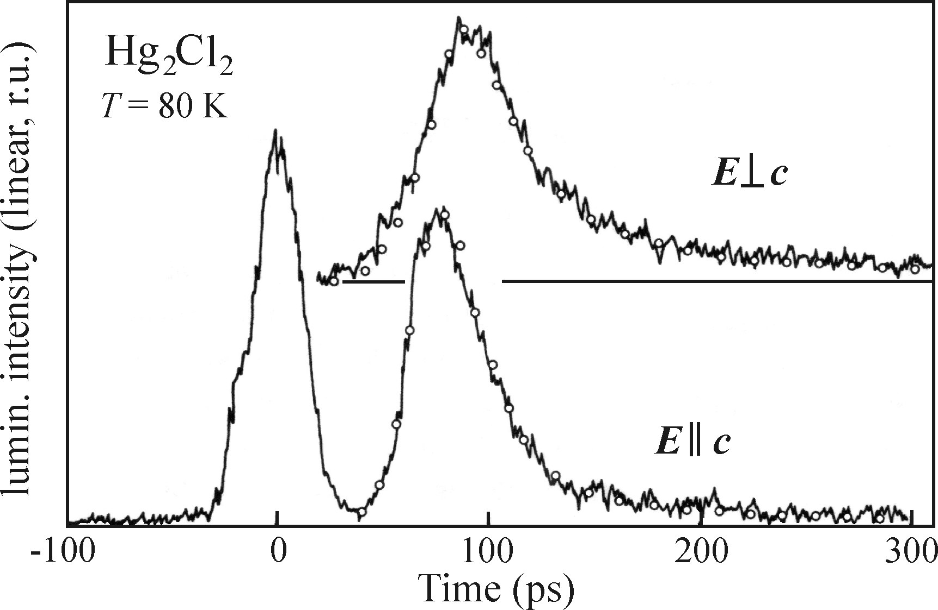
Excitation pulse
Luminescence of Hg2Cl2 crystals excited by 35ps pulses , 532nm laser and Polarised light.
Time resolution < 1ps are available in market
Can operate in single shot mode and at in high repetition rate modes (of order of 100MHz)

Slide 13
Outline
Time-resolved luminescence: equipment
Direct Imaging of the luminescence response
Phase Shift method
Time‐correlated photon counting
Boxcar integrator
Streak camera
Kinetic description of processes.
Radiative and non-radiative recombination.
Luminescence efficiencies
Monomolecular process
Bimolecular process
Stretched exponential
Simultaneous occurrence
Phonons
Lattice vibrations –phonons
Electron–phonon and exciton–phonon interactions
Lattice vibrations associated with point defects
Localized optical centre in solid matrix- the configurational coordinate model
The shape of absorption and emission spectra of a localized centre

Slide 14
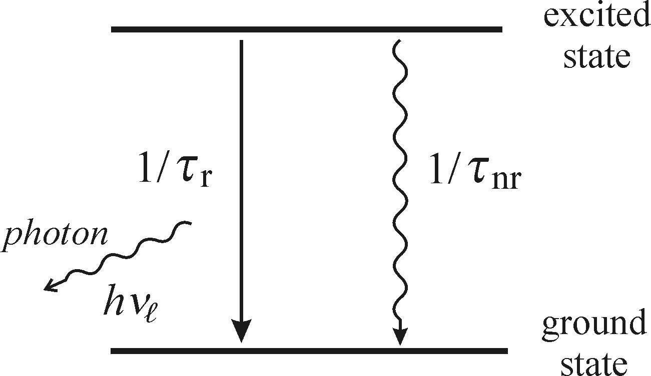
Radiative and non-radiative recombination.
Radiative transition: the excitation energy is radiated away in the form of a Luminescence photon after the mean lifetime t_{r.}
t_{r} is the radiative lifetime.
non-radiative transition: the excess energy is transmitted in the form of heat (vibrations) to the cryatal after time t_{nr}
t_{nr} is the non-radiative lifetime.
The inverse values of t_{nr} and t_{r} represent the probability of the corresponding transition per unit time ( recombination rate)
Probability of transition to the ground state is given by
1/t = (1/t_{r}) + (1/t_{nr})

Slide 15
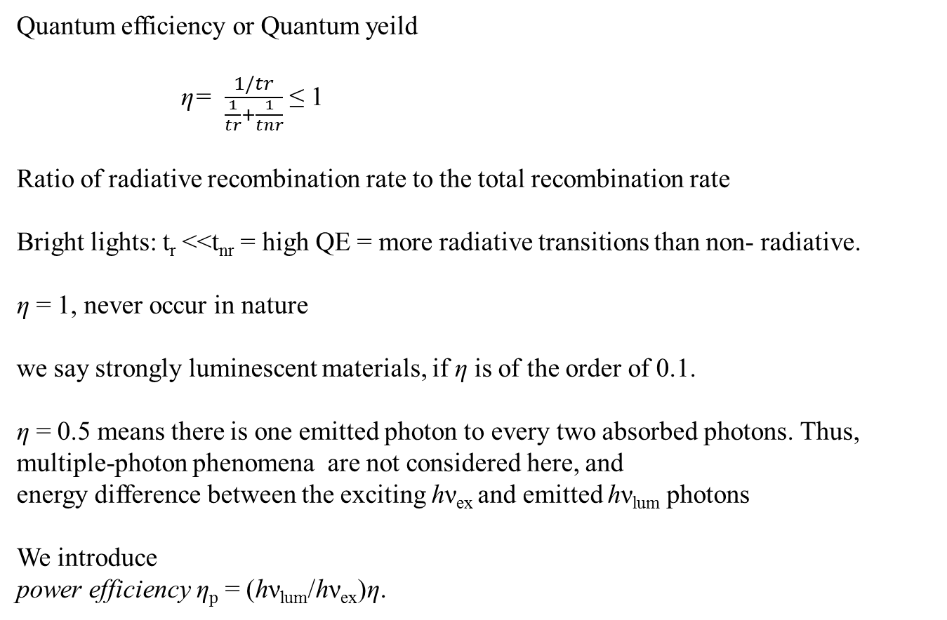
Quantum efficiency or Quantum yeild
η= $\frac{1/tr}{\frac{1}{tr}+\frac{1}{tnr}}$ ≤ 1
Ratioofradiativerecombination rate to the total recombination rate
Bright lights: t_{r}<<t_{nr} = high QE = moreradiativetransitionsthan non-radiative.
η = 1, never occur in nature
wesaystronglyluminescent materials, if η is of the order of 0.1.
η = 0.5 means there is one emitted photon to every two absorbed photons. Thus, multiple-photon phenomena are not considered here, and
energy difference between the exciting hν_{ex}and emittedhν_{lum}photons
Weintroduce
power efficiency η_{p}= (hν_{lum}/hν_{ex})η.

Slide 16
In experiment,
weak luminescence decay very quickly : due to strong influence of non-radiative transitions
Intense luminescence of porous silicon and of silicon Nanocrystals
Si is a poor phosphor : as a result of its indirect bandgap
If we ‘forbid’ all non-radiative transitions : (eg:)
τ _{nr} → ∞, τ_{r}≪ τ_{nr}
The electronically excited system has to go to the ground state via radiative transitions. Makes η ≅ 1
Reason for intense luminescence of porous silicon and of silicon nanocrystals
We can obtain material featuring efficient luminescence (η ≅ 1).
(total number of photons emitted per unit of time will be low)
.

Slide 17
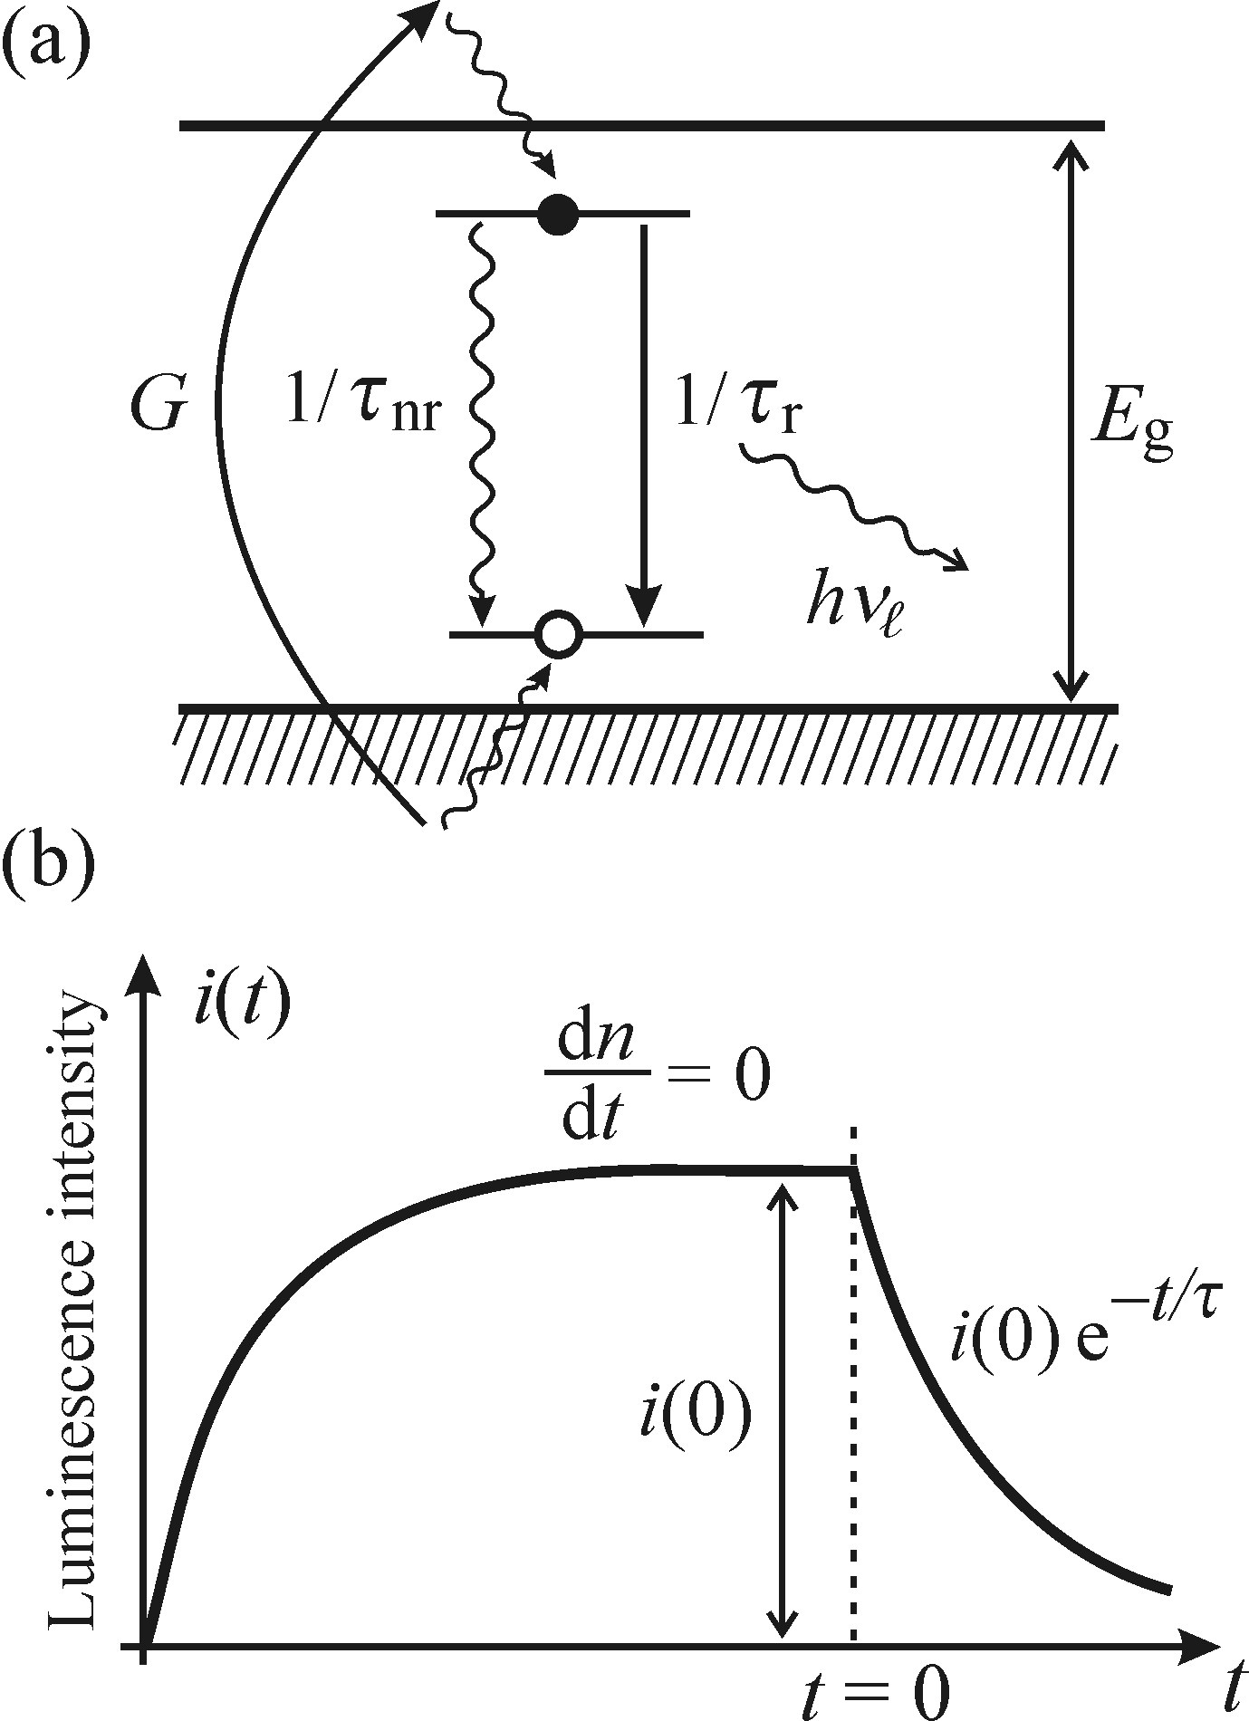
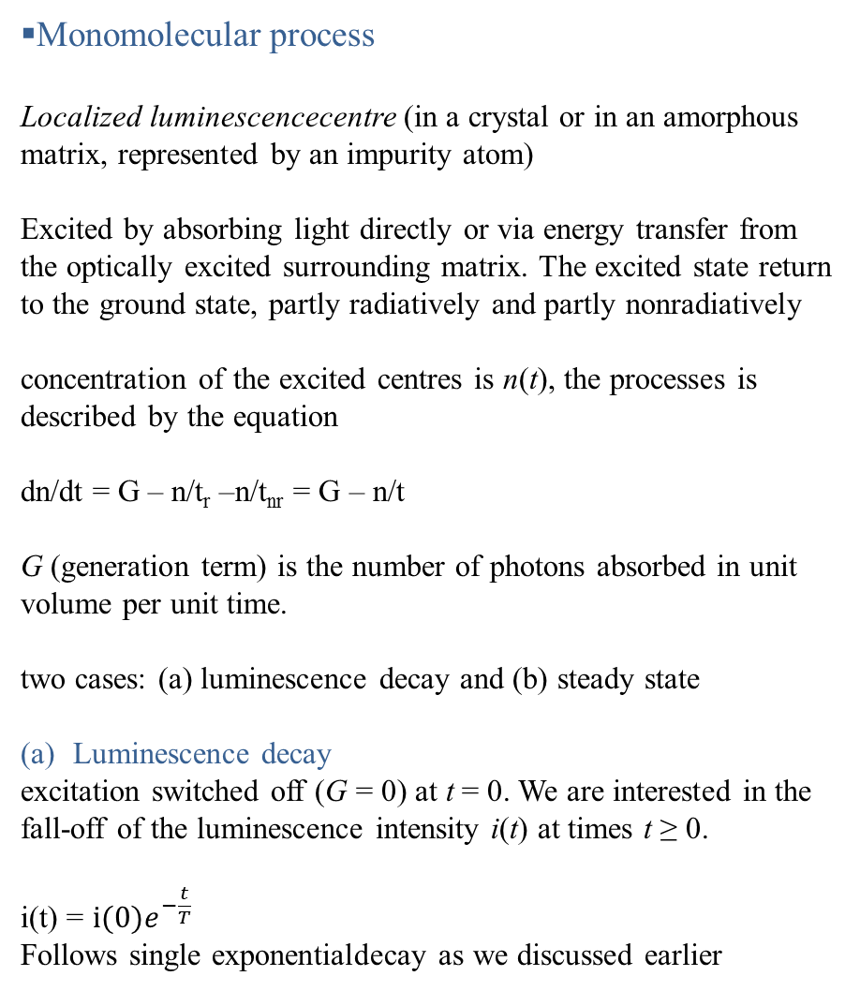
Monomolecular process
Localized luminescencecentre (in a crystal or in an amorphous matrix, represented by an impurity atom)
Excited by absorbing light directly or via energy transfer from the optically excited surrounding matrix. The excited state return to the ground state, partly radiatively and partly nonradiatively
concentration of the excited centres is n(t), the processes is described by the equation
dn/dt = G – n/t_{r} –n/t_{nr} = G – n/t
G (generation term) is the number of photons absorbed in unit volume per unit time.
two cases: (a) luminescence decay and (b) steady state
Luminescence decay
excitation switched off (G = 0) at t = 0. We are interested in the fall-off of the luminescence intensity i(t) at times t ≥ 0.
i(t) = $i(0)e^{−\frac{t}{T}}$
Follows single exponentialdecay as we discussed earlier

Slide 18
(b) The steady state
Excitation G is on and after the initial increase in i(t), the intensity of luminescence settles at a constant value determined by the condition dn/dt = 0… (maths..)
i(0) = η α I_{ex} (where α is the absorption coefficient)
the stationary value of the luminescence intensity, i(0), is directly proportional to the excitation intensity I_{ex}.
Observing a single-exponential decay together with a linear increase in luminescence intensity indicates microscopic origin of the examined luminescence lie within a localized centre.
Similar features can be seen in the luminescence of a free quasi-particle, free exciton, etc. such an observation helps us to exclude a number of other types of recombination processes.

Slide 19
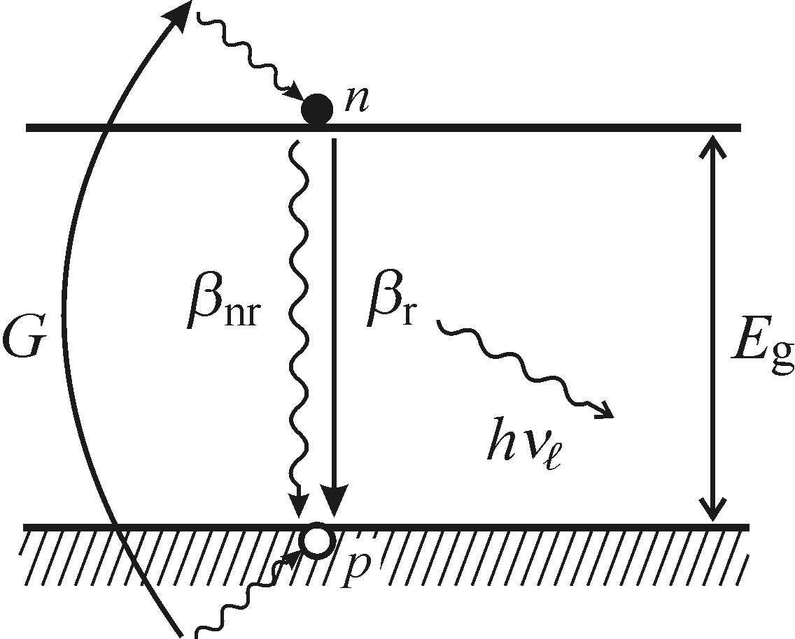
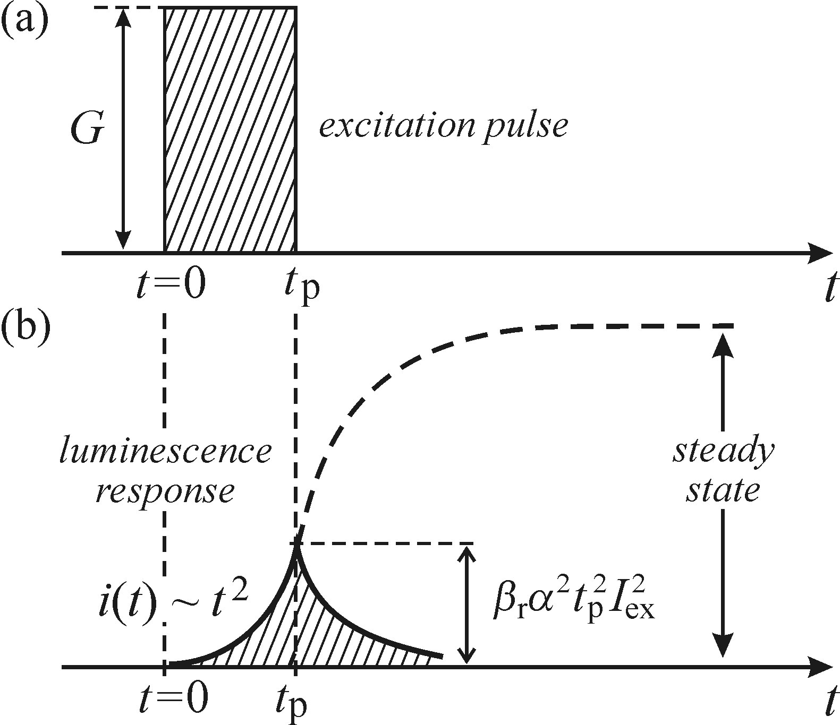

Biomolecular process
If a semiconductor absorbs a photon of energy above the bandgap, E g, then free electron-hole pairs are produced.
electrons and holes will diffuse along the edges of the respective bands and, eventually, electrons will recombine with the nearest holes whether radiatively or non-radiatively.
Luminescent decay, G=0, the form of the bimolecular luminescence decay differs substantially from the exponential function. i(t) ≈ t ⁻²
The steadystate luminescence intensity (G is on and dn/dt = 0)
remains a linear function of the excitation intensity I_{ex}
Under pulsed excitation
the luminescence intensity i(t) = β _{r}t²α² I²_{ex}
the amplitude of the luminescence response pulse is proportional to the square of the excitation intensity I ex

Slide 20
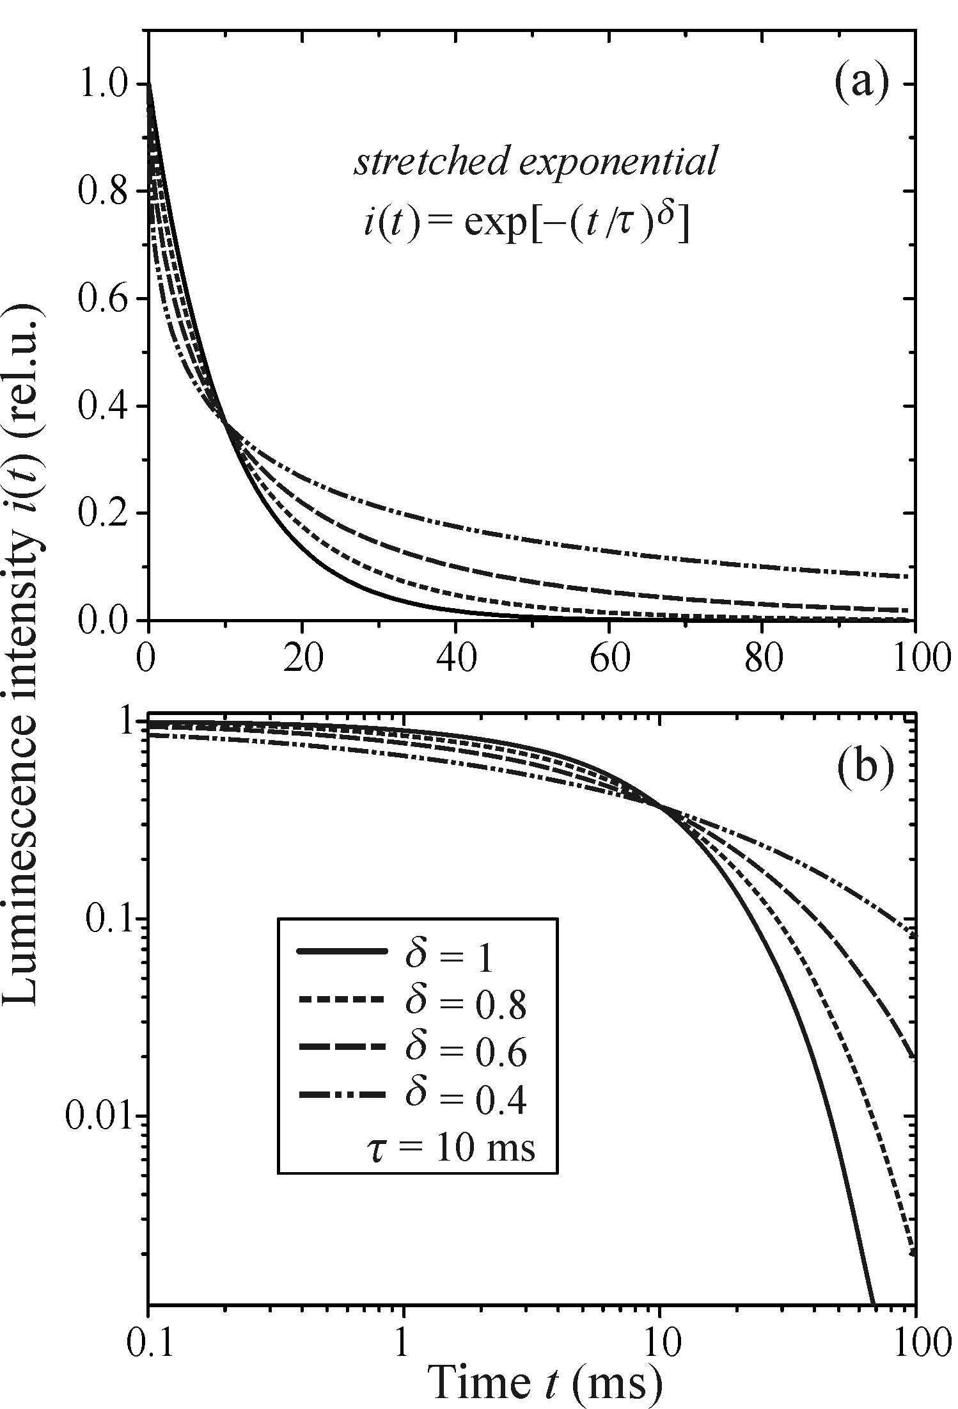

Stretched exponential
luminescence decay curve is governed by the so-called stretched exponential
where τ is called the decay time and δ is the dispersion factor
for the limiting value δ = 0, eqn represents
a constant function, and for δ = 1 relationship reduces to the standard exponential decay
Between the limiting values of the parameter δ, the function interpolates these two extremes

Slide 21
Often observed in disordered systems
due to : dispersion diffusion of photoexcited carriers. (diffusion can occur due to carriers being excited from localized to free states or hopping directly between the localized states.)
The presence of the stretched exponential function makes it difficult to identify the luminescence centre in microscopic detail.
Plausible explanations—
In a silicon nanocrystal system, due to : photocarrier migration
The degree of the dispersion of motion is measured by δ, which depends on the trap density, the distribution of their depths, etc.
Note :
δ and τ depends on temperature and wavelength at which the decay is measured.

Slide 22
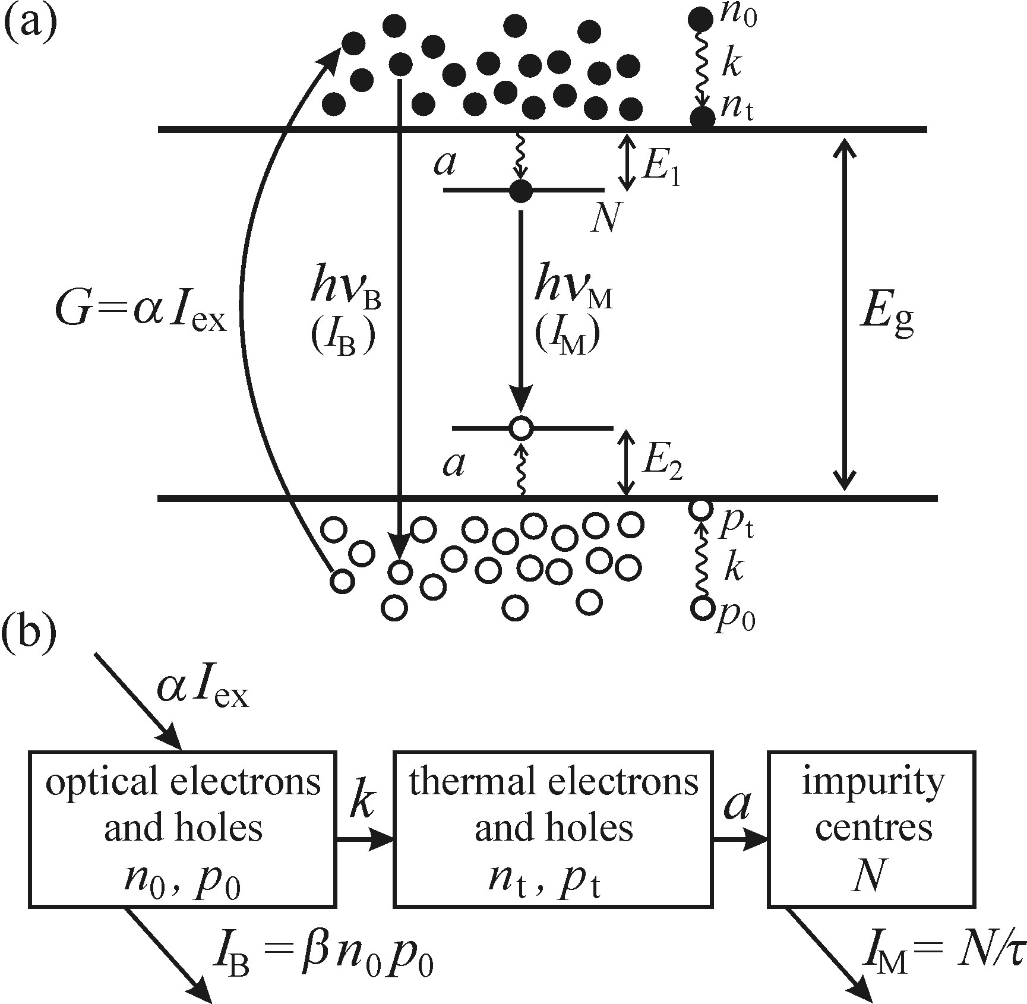
Multiple processes present simultaneously
We shall deal with two parallel recombination channels: bimolecular
(intrinsic) recombination of free electron-hole pairs produced by optical
excitation G = αI _{ex}
monomolecular (extrinsic) recombination of impurity atoms present in a total concentration N ₀.
both monomolecular and bimolecular luminescence processes present
in the material simultaneously, they can be distinguished by their typical
intensity dependences

Slide 23
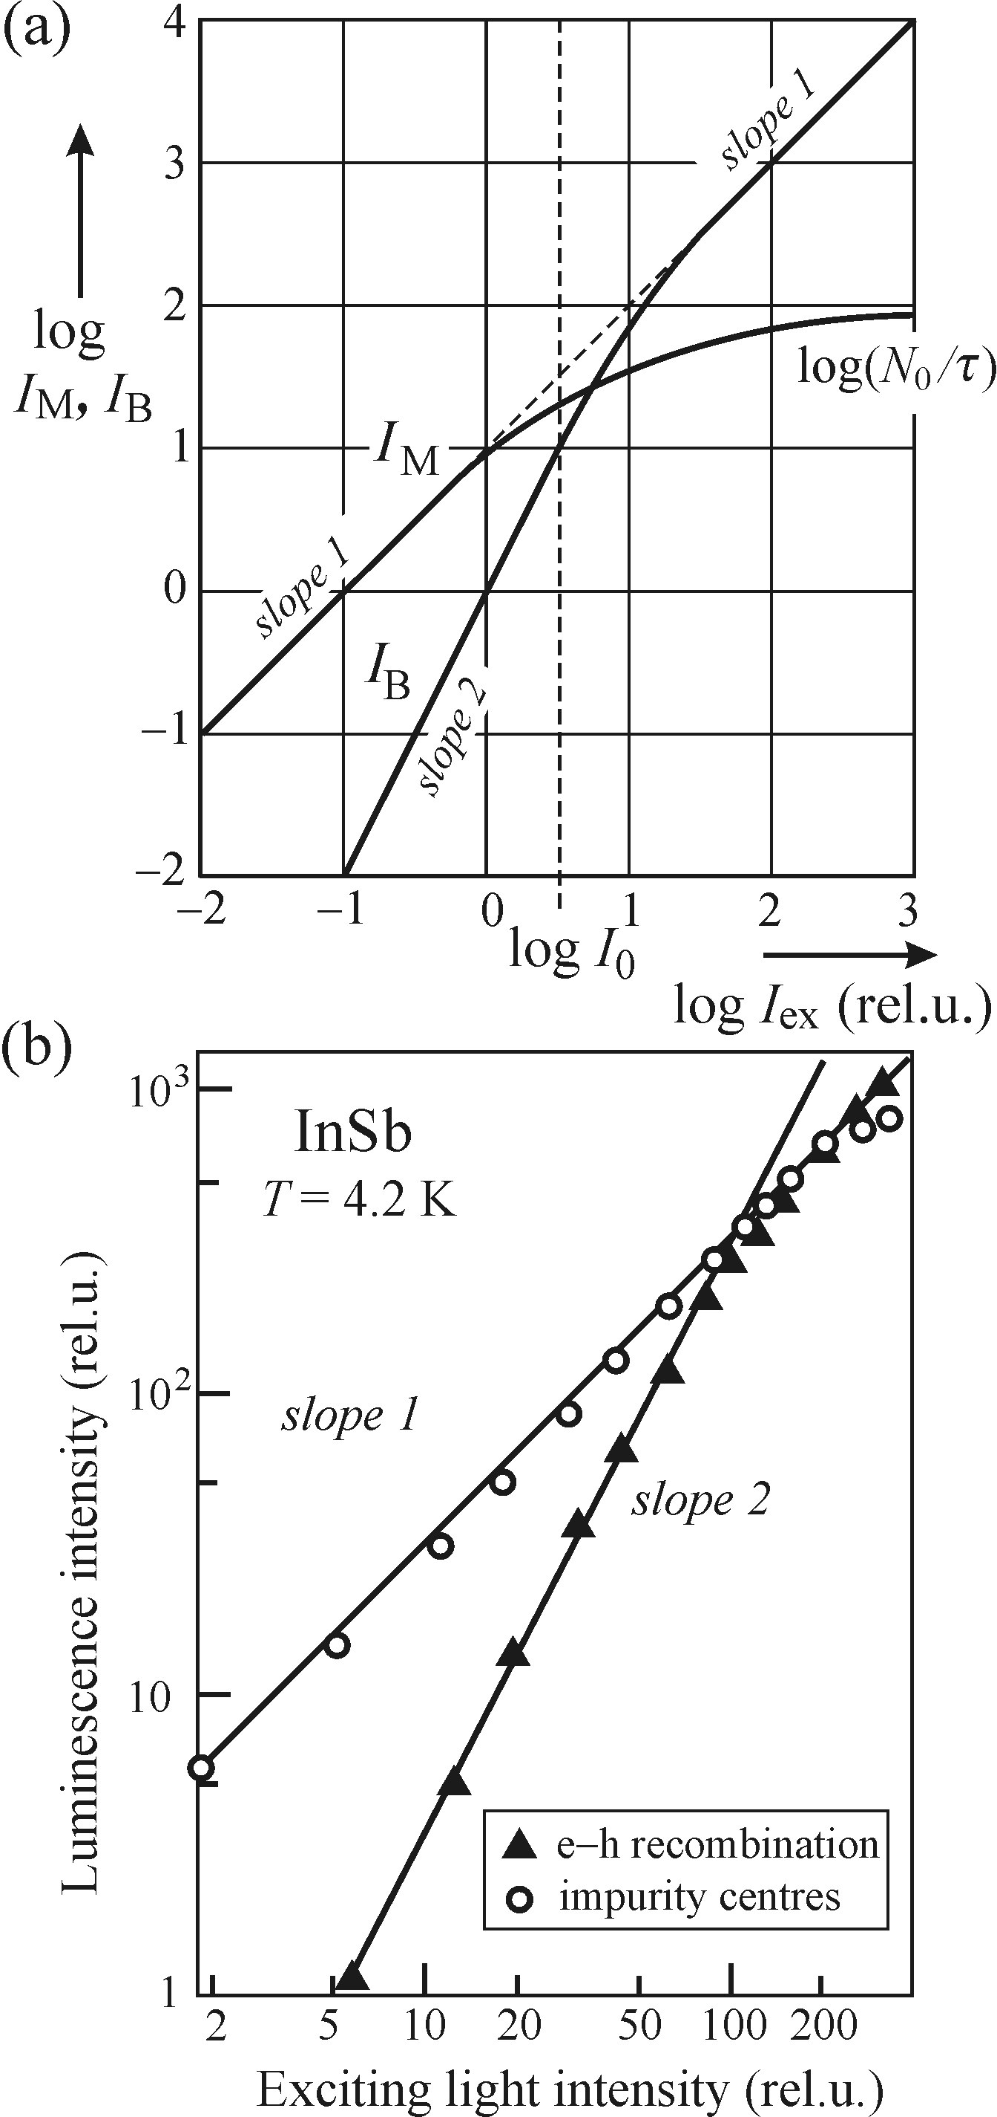


weak excitation and strong excitation,
(assuming 100% quantum efficiency)
weak excitation (I _{ex} ≪ I ₀).
bimolecular luminescence
varies quadratically with
excitation intensity.
And monomolecular luminescence
increases linearly with the excitation.
bimolecular emission is substantially weaker than monomolecular emission (I _{B} ≪ I _{M}), since the density of the ‘optical’ electron-hole pairs is low and it is difficult for the electrons and holes to find one another to recombine
Low intensity : since not all impurity atoms are brought into the excited state

Slide 24
Strong excitation.
Monomolecular luminescence,
I_{m}= N₀/t
Not dependence on the excitation intensity. Therefore, the extrinsic radiative recombination channel becomes saturated.
Bimolecular luminescence
I_{B}= αI _{ex}
increases linearly in the strong excitation limit

Slide 25
Outline
Time-resolved luminescence: equipment
Direct Imaging of the luminescence response
Phase Shift method
Time‐correlated photon counting
Boxcar integrator
Streak camera
Kinetic description of processes.
Radiative and non-radiative recombination.
Luminescence efficiencies
Monomolecular process
Bimolecular process
Stretched exponential
Simultaneous occurrence
Phonons
Lattice vibrations –phonons
Electron–phonon and exciton–phonon interactions
Lattice vibrations associated with point defects
Localized optical centre in solid matrix- the configurational coordinate model
The shape of absorption and emission spectra of a localized centre

Slide 26
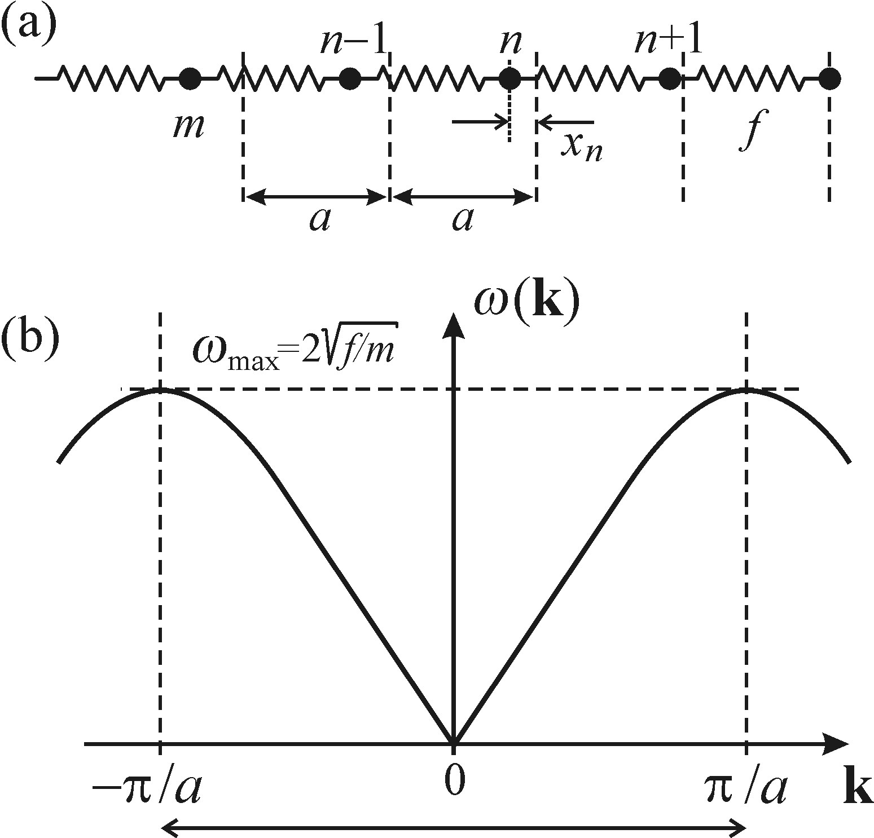

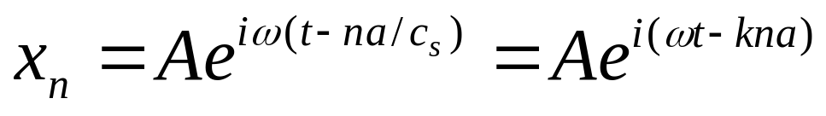
Lattice vibrations—phonons
Atomic nuclei in a crystal keep oscillating around their
equilibrium positions.
The amplitudes of these oscillations rise with increasing temperature; however, they remain small compared to
the lattice constant a
For a one-dimensional crystal made of an infinite chain of identical atoms of mass m, we can write the equation of motion in the form
The solution to above eqn in the form of a wave of
frequency ω, running along the chain
where c_{s}= c_{s}(ω) is the velocity of the wave motion
k = |k|= ω/c_{s} = magnitude of corresponding wave vector.
The dispersion relation for the given system, i.e. the dependence ω = ω(k) is obtained by using the above two equations.

Slide 27


Quantization
Analogous to the quantization of an oscillating electromagnetic field.
Considering the number of atoms in the chain to a large but finite number, N,
we can view the chain as an ensemble of N harmonic oscillators.
The mean energy of a quantized harmonic oscillator
Thus, the energy of the entire one-dimensional crystal will be
So the total vibrational energy of the one-dimensional crystal is given by the sum of the energies of N_{k} quasiparticles, which are the quanta of the vibrational energy of a solid—phonons

Slide 28

In statistical physics, the statistical distribution of the phonons is defined as the mean number of phonons in one quantum state.
For a linear chain of N oscillating atoms, the number of allowed quantum states is equal to N [1], we obtain for the phonon
distribution function
This equation tells us that the phonons are subject to Bose–Einstein statistics
Thus chemical potential of an ensemble of phonons is equal to zero.
And phonon population depends temperature T —as the temperature
drops, the phonon population decays quickly

Slide 29
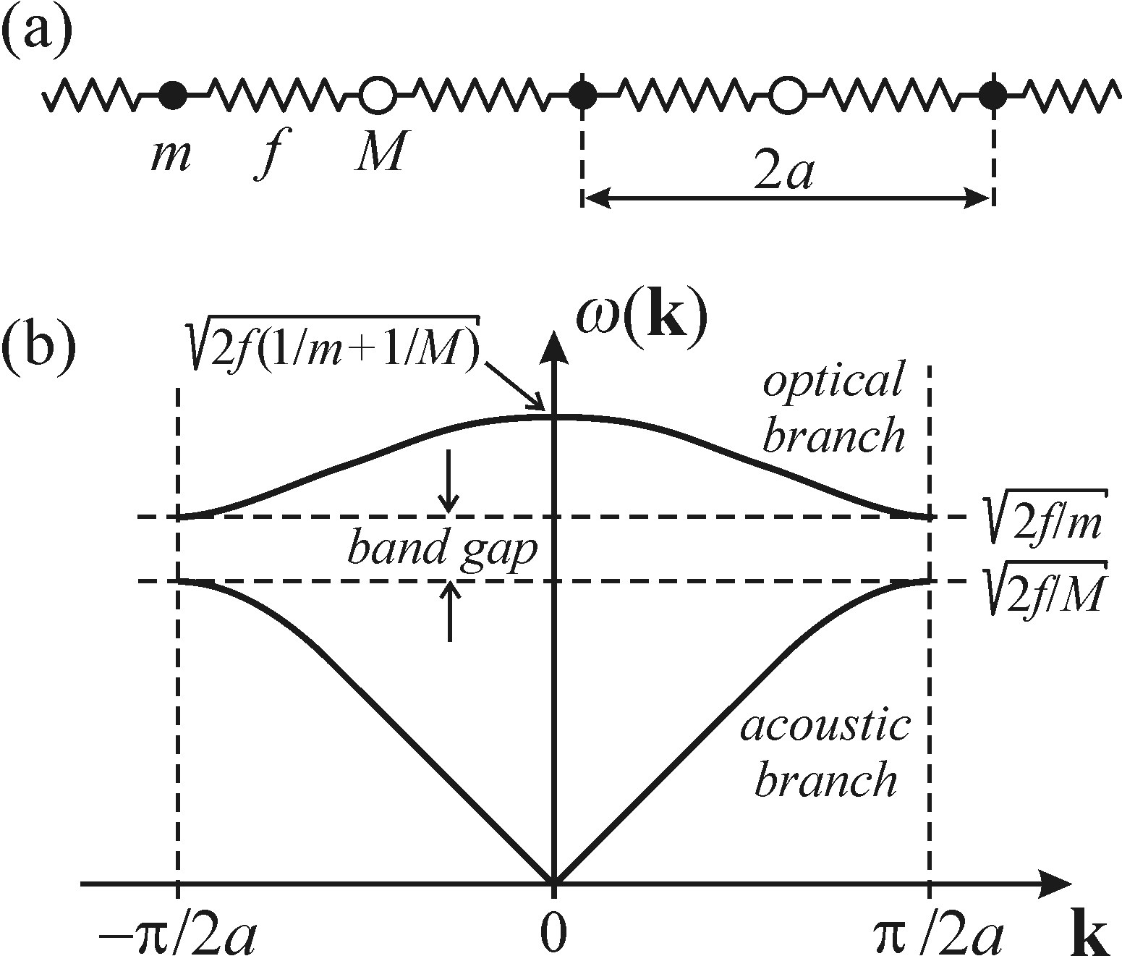
Modifying the one-dimensional model to be able to represent all the features of vibrations in a three-dimensional crystal.
Two kinds of atoms into the chain. Masses m and M (m < M).
lattice constant = 2a and are two atoms per unit cell
Two branches of phonons separated by a frequency gap.
Acoustic branch:
Both kinds of atoms vibrate in phase, with the centre of mass in each cell moves forming compression and expansion travelling through the crystal, as for sound propagation.
Optical branch:
Due to the atoms moving in counter-phase—leave the centre of mass
of the unit cell at rest. The name ‘optical vibrations’ from the fact that if there
are two kinds of atoms of opposite charge per unit cell (ionic bond), then the counter-phase motion means electric dipole oscillations.

Slide 30
Important facts
Near the first Brillion zone boundary (k = ±p/2a), both phonon branches are basically dispersionless, i.e. dω/ dk 0.
(b) Near the Brillouin zone centre (k = 0), the optical branch is dispersionless while the acoustic branch has its highest dispersion.
(c) If atoms move perpendicularly to the chain it is called transverse vibrations.
We have transverse acoustic (TA), longitudinal acoustic (LA), transverse optical (TO) and longitudinal optical (LO) phonons.

Slide 31
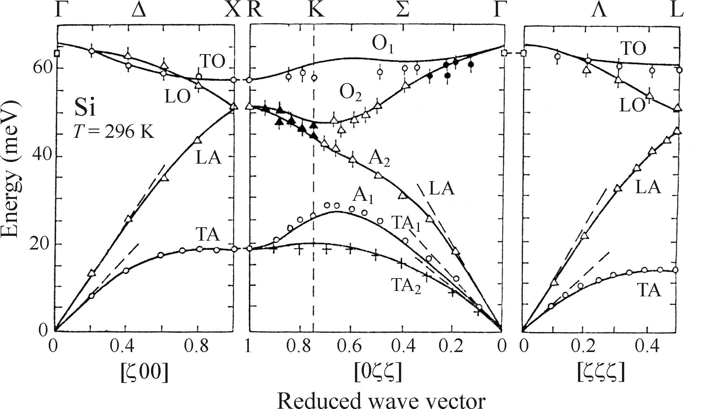
Phonon dispersion curves of crystalline silicon in the principal
directions of the Brillouin zone at room temperature
In silicon the gap between the optical and acoustic branches disappears in a certain direction in the Brillouin zone. This is due to the fact that there are two Si atoms per unit cell in the silicon (diamond) structure, and the atoms have the same mass.

Slide 32
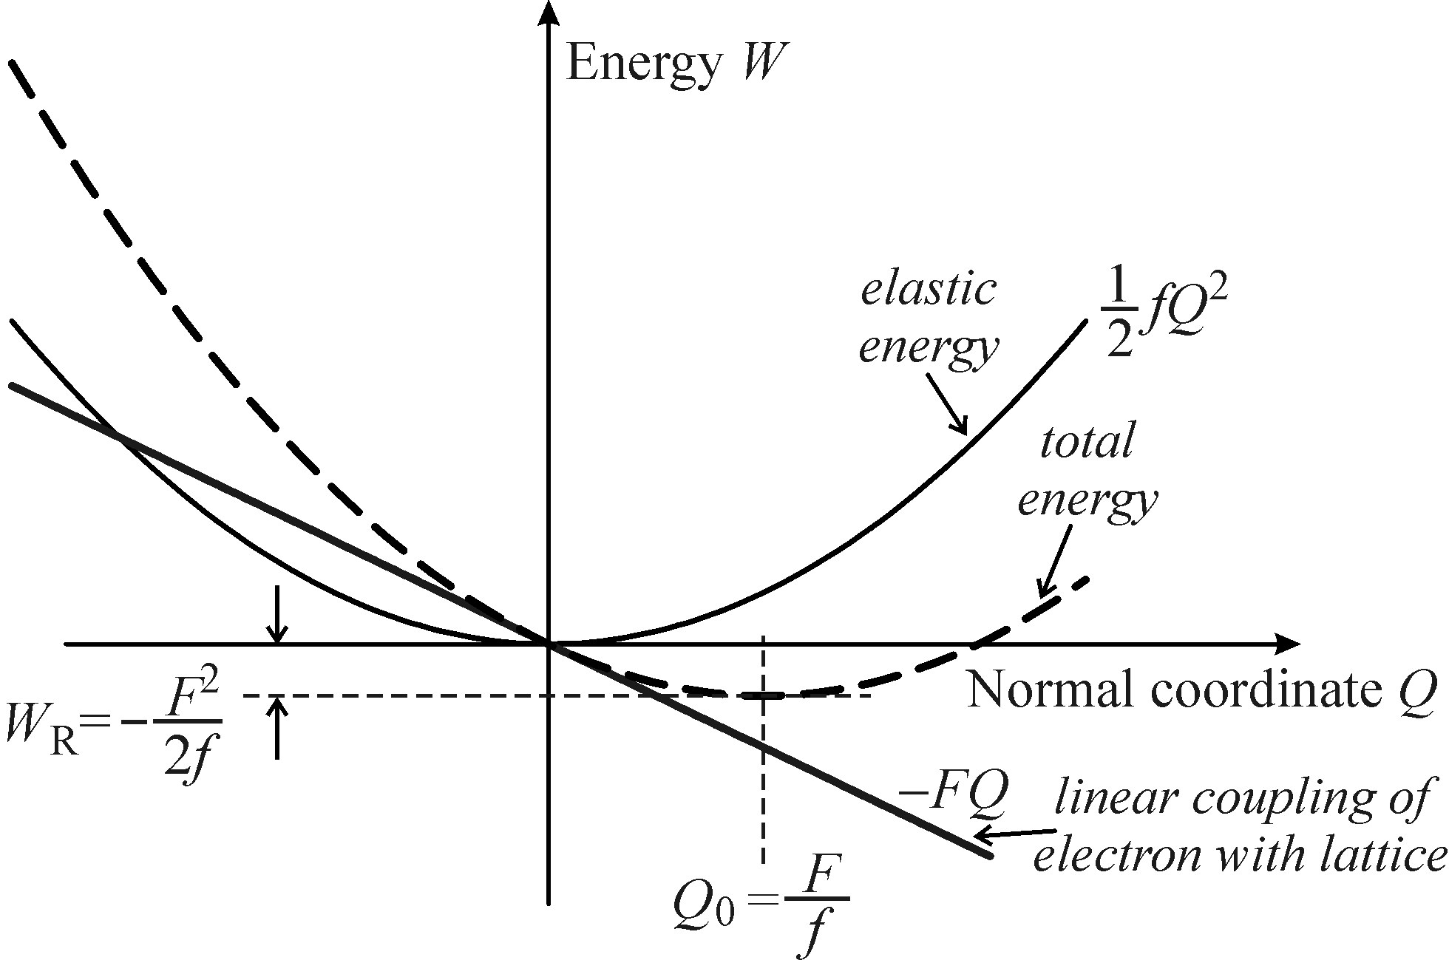
Electron–phonon and exciton–phonon interactions
Phonon participation in optical processes naturally requires interaction with the system of electrons occupying energy levels in the valence or conduction band : we call electron–phonon interaction.
Similar type of interaction in semiconductor
Electrons in an excited state and returns to the ground state, the phonon system participating in emission of luminescence radiation.
We call the excited electronic system of the crystal an ‘exciton’
And the corresponding interaction we call exciton–phonon interaction.
The parabolic potential energy of harmonic oscillations in an ionic
Lattice ,
together with the linear coupling to the inserted electric charge (–FQ) result in a shift of the curve to a new equilibrium
position, and release of relaxation energy, W

Slide 33
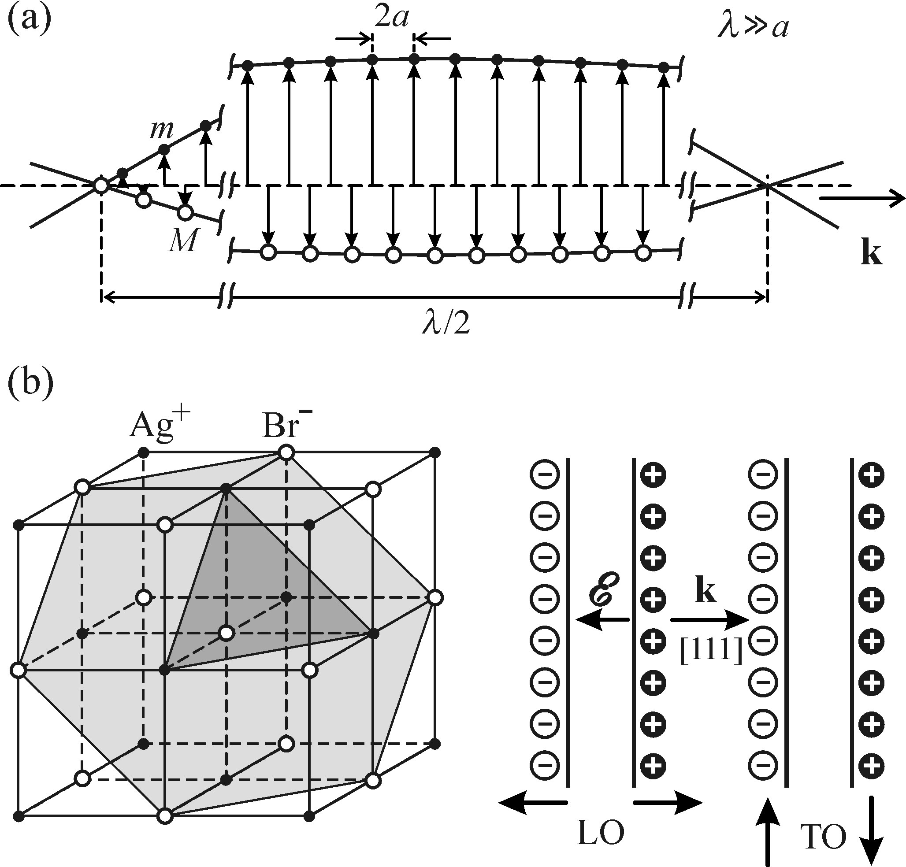
microscopic mechanisms mediating the electron–phonon and exciton–phonon interactions
Deformation: caused by an external force
changes the bandgap value of a semiconductor
The piezoelectric mechanism :
An electric voltage associated with a macroscopic electric field inside the material may develop, in particular between opposite sample surfaces under mechanical deformation
The Fröhlich mechanism:
Occurs in ionic crystals and in semiconductors with an ionic contribution to the lattice energy.
In AgBr, planes occupied by positive ions alternate with planes of negative ions perpendicular to the [111] direction. Longitudinal Optical-phonons vibrations then represent a vibrating capacitor with a constant charge but varying plate separation. This produces a varying macroscopic electric field ℰ along the wave propagation direction of wavevector k. This field enters the Coulomb interaction with charge carriers or Excitons.

Slide 34
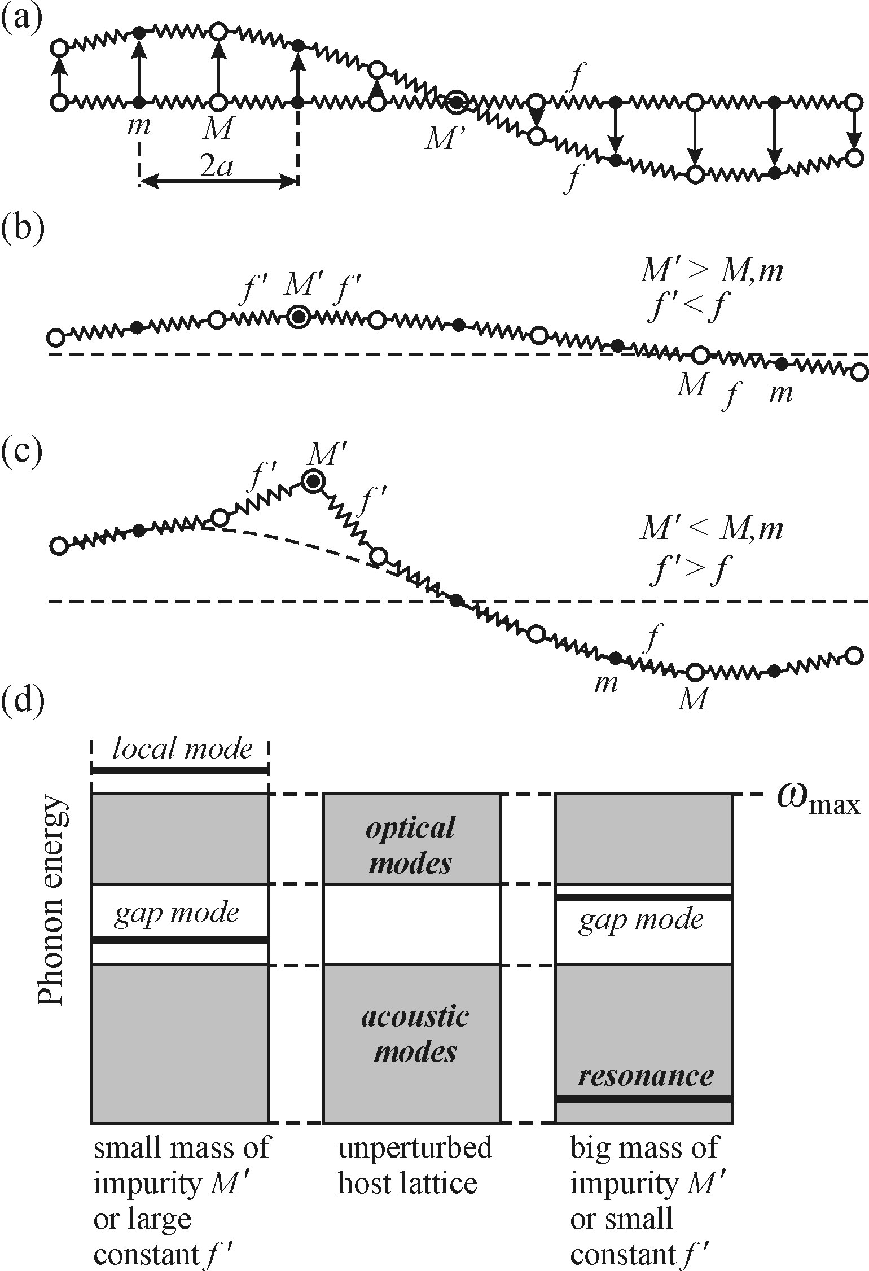
Lattice vibrations associated with point defects
Three different types of vibrational modes.
Not affected:
If the defect atom has a different mass M' but the harmonic force (‘spring’) constant, f, remains unchanged in its neighborhood.
2. Resonance mode.
If the mass M' is large (a heavy impurity atom) or the
force constant f‘ in the neighbourhood of the impurity
decreases due to a different type of interatomic bond
(f‘ < f), or possibly if both effects are present
simultaneously, then there appears a mode of a rather low
frequency ω_{R} = (f'/M') ½
3. Neighborhood of an impurity atom, the mass M' of which is lower than the masses of atoms in the unperturbed crystal and the neighbouring force constant f' is high, f‘ > f. The frequency of such a mode ω _{L} = (f'/M')^{1/2} is then located above the highest allowed frequency of perfect lattice vibrations ω_{max}.

Slide 35
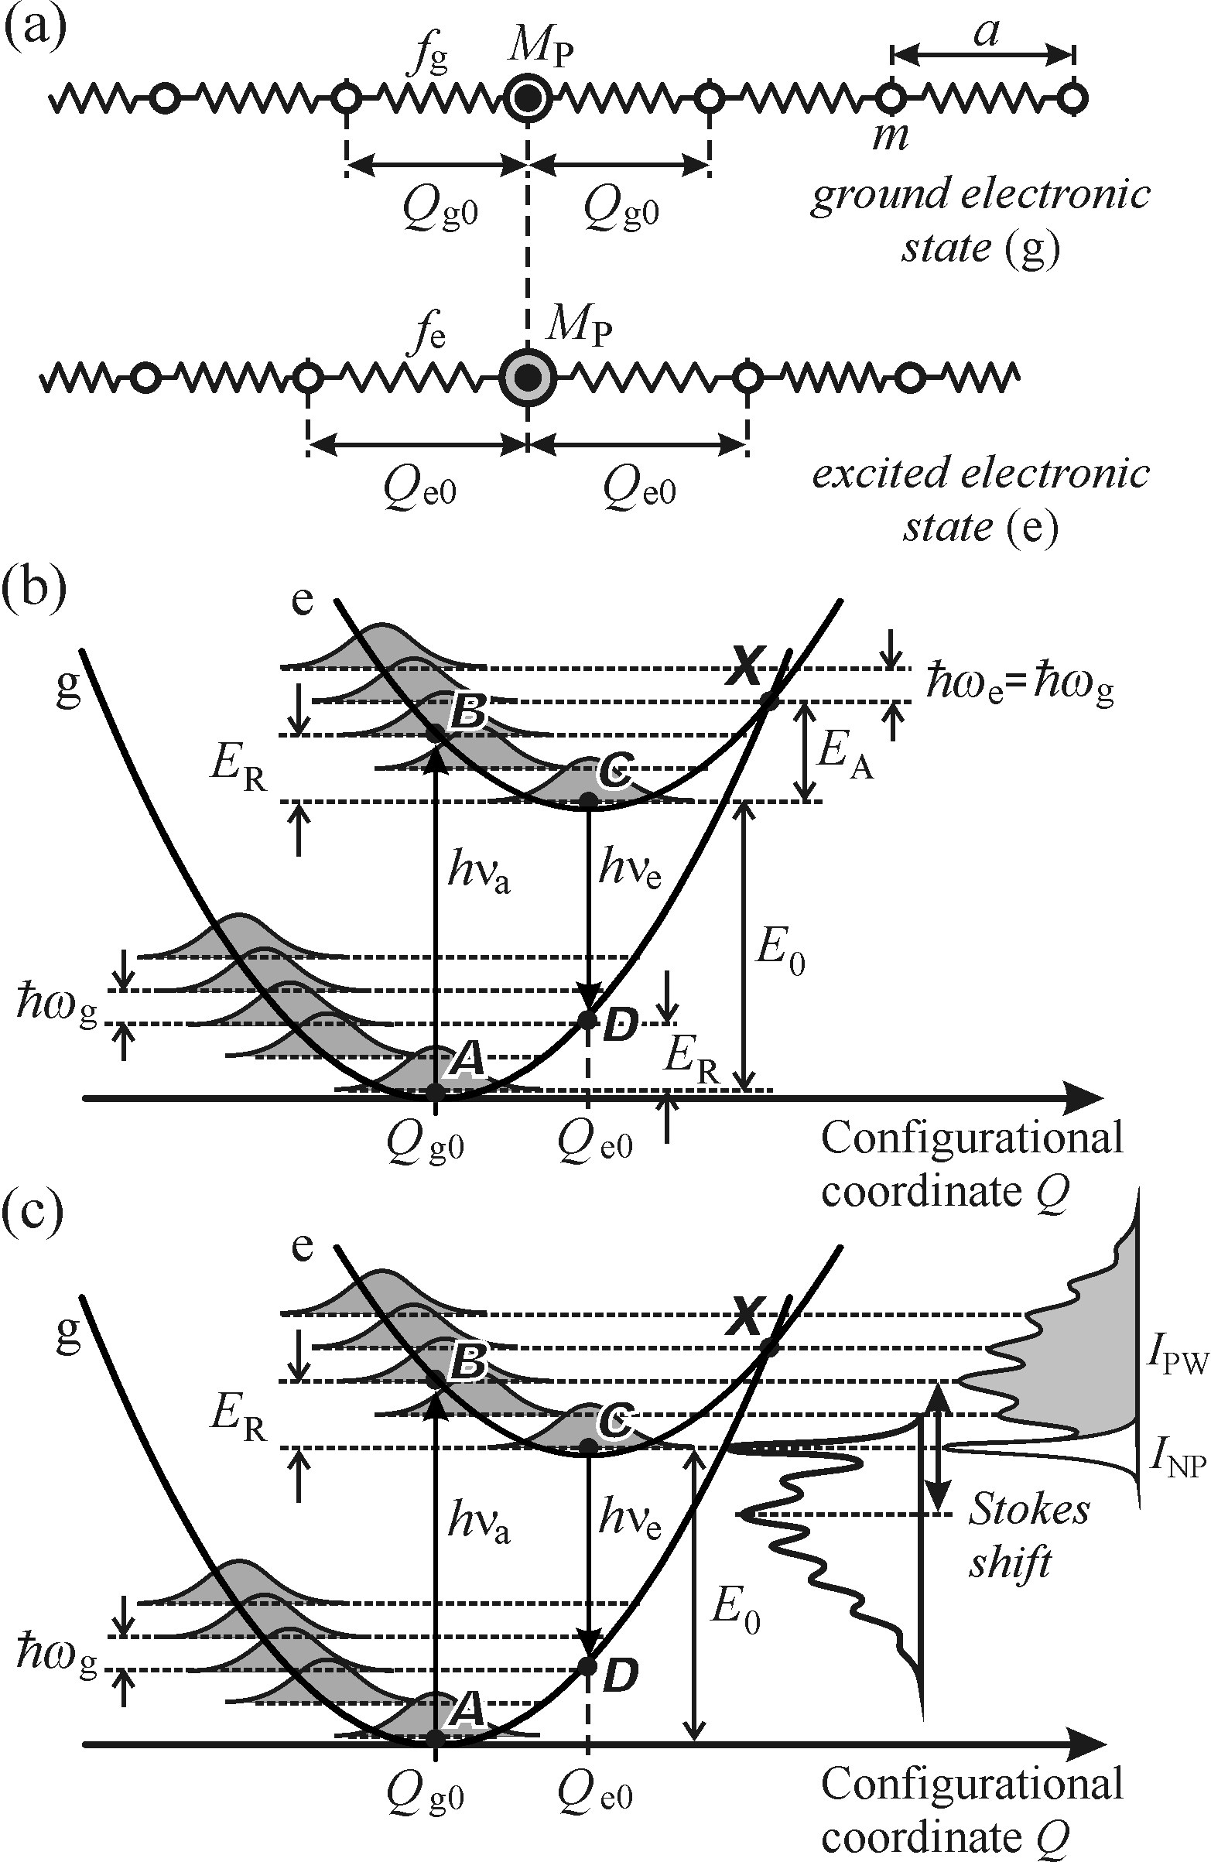

localized optical centre in a solid matrix
Electronic properties of impurities
A one-dimensional chain of atoms (‘matrix’) containing an optically active impurity atom of mass M p.
Energy of the ground (g) and excited (e) electronic states of a localized centre as a function of the configurational coordinate Q
Origin of optical absorption and luminescence spectra within the framework of the Franck–Condon principle at T = 0K.
relaxation energy
S, Huang–Rhys factor, represents the mean number of phonons (hω) emitted as the centre relaxes along the path
B → C or D → A.

Slide 36

The shape of absorption and emission spectra of a
localized centre
Consist of a series of narrow lines spaced equidistantly by the phonon energy hω,
Their intensities modulated by a certain probability distribution.
Analogous reasoning may be applied to the emission spectrum as well, only reversing the transition directions, the shape of the emission spectrum is expected to be mirror-like with respect to the absorption spectrum, both spectra sharing a common line at the zerophonon energy E ₀.
At absolute zero temperature, the shape of the absorption spectrum is given by the Poisson distribution
where n numbers the vibrational level of the excited electronic state, as T → 0 K, the transition begins from the ground vibrational level (point A) of the ground electronic state.

Slide 37
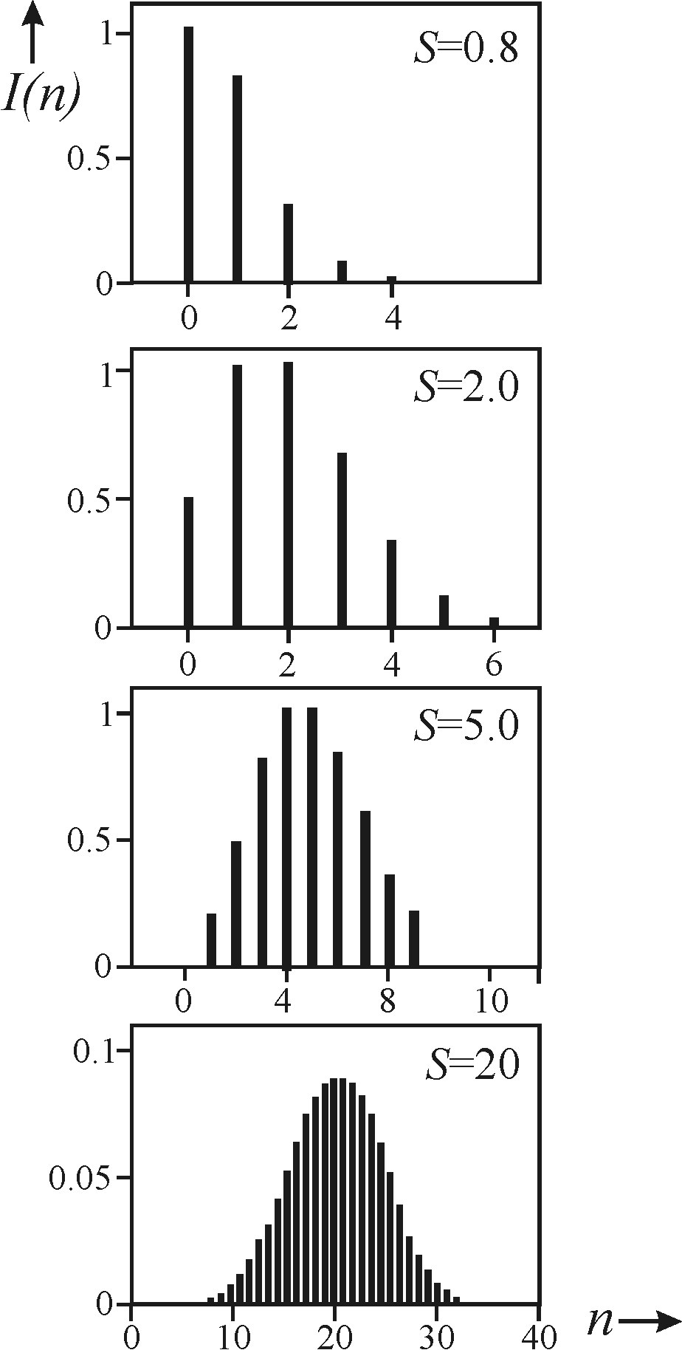
spectra for various values of the parameter S.
three cases:
exciton–phonon coupling :
weak (S ≤ 1), a distinct no-phonon line and a negligible phonon wing
medium (S ≈ 5–10), a number of phonon satellites (up to n ≈ 10) in the phonon wing
strong (S ≥ 20), the spectrum takes the form of a broad, structureless Gaussian band
With increasing values of S : more lines with a higher n appear
The lines are broadened at T = 0 K,
Due to : zero-point oscillations (1/2 hω), homogeneous broadening due to the finite excited state lifetime (uncertainty limit) and inhomogeneous broadening due to the variable matrix parameters of localized centre.
* S, Huang–Rhys factor, represents the mean number of phonons (hω) emitted as the centre relaxes along the path

Slide 38
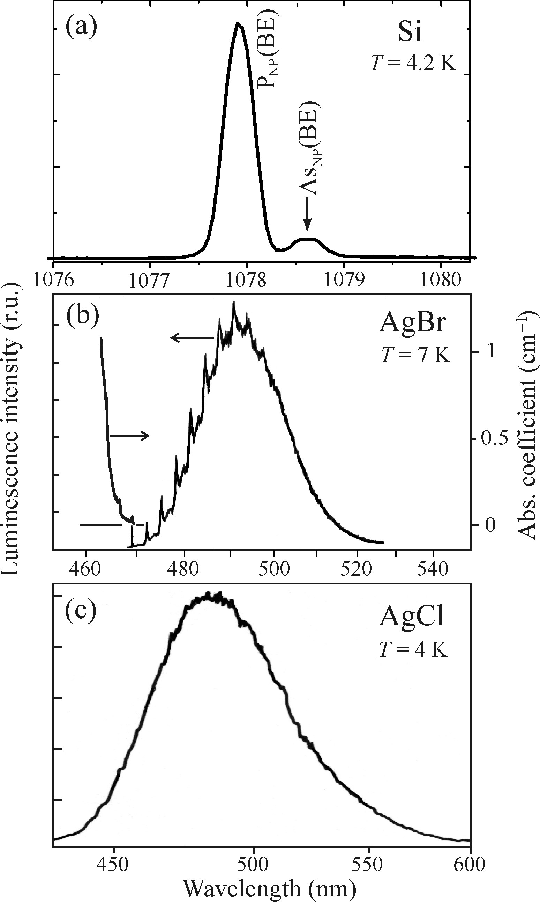
Emission spectra of localized optical centres in semiconductors.
(a) Weak exciton–phonon coupling: The luminescence line of phosphorus atoms in crystalline silicon. We can also see a weak no-phonon line associated with arsenic atoms present at a lower concentration.
(b) Medium exciton–phonon coupling: AgBr/I− luminescence.
coupling between the iodine-related I− centre and the lattice vibrations is suppressed
The left part shows the corresponding absorption spectrum
(c) Strong exciton–phonon coupling: luminescence of a self-trapped
exciton in AgCl.

Slide 39
Thank you

