Slide 1
Radiative and Non-Radiative Recombination in Semiconductors
Sethu Saveda Suvanam
IM3008

Slide 2
Over View
Recombination process
Radiative
Non-Radiative
Low excitation
High excitation
Excitation energy transferred into:
Heat
Lattice defects
Photochemical changes in material.
Recombination's in:
Free exciton
Free exciton with simulation of phonon
Bound exciton
Donor-acceptor pair
Band to band recombination.
Luminescence from:
Excitonic molecule
Inelastic collison
Electron hole liquid
Electron-hole plasma
condensate
Notes:
Y

Slide 3
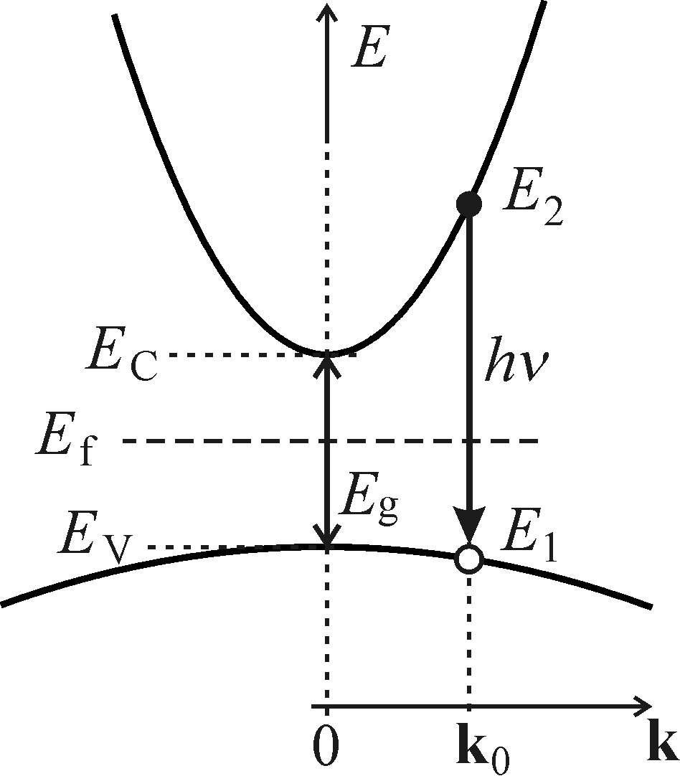

Recombination of free electron –hole pair
Direct Bandgap
Determine the relation btw I_{sp} (hν) w.r.t spontaneous emission of photon energy hν.
Three factors influencing these transitions
  Probability of occupancy of band states.
  Quantum mechanical probability of this transition.
  Joint density of states of the bands.

Slide 4
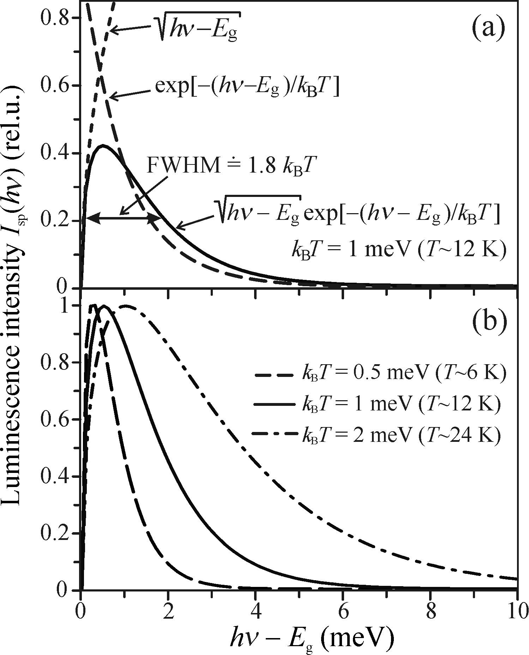

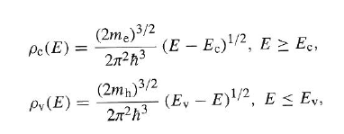
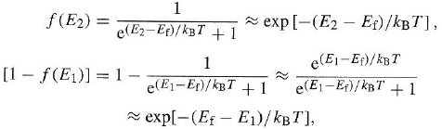



Direct Bandgap

Slide 5

Direct Bandgap
This is called Maxwell-boltzman distribution.
Note: In the above expression consist of reduced mass (m_{r}) which means it is impossible to determine the values of eff. masses using this curve.
FWHM is directly proportional to temp.
High temp → photo excited carriers occupy states further in band → thus high energy is generated → while onset is same for all because Eg is same.

Slide 6
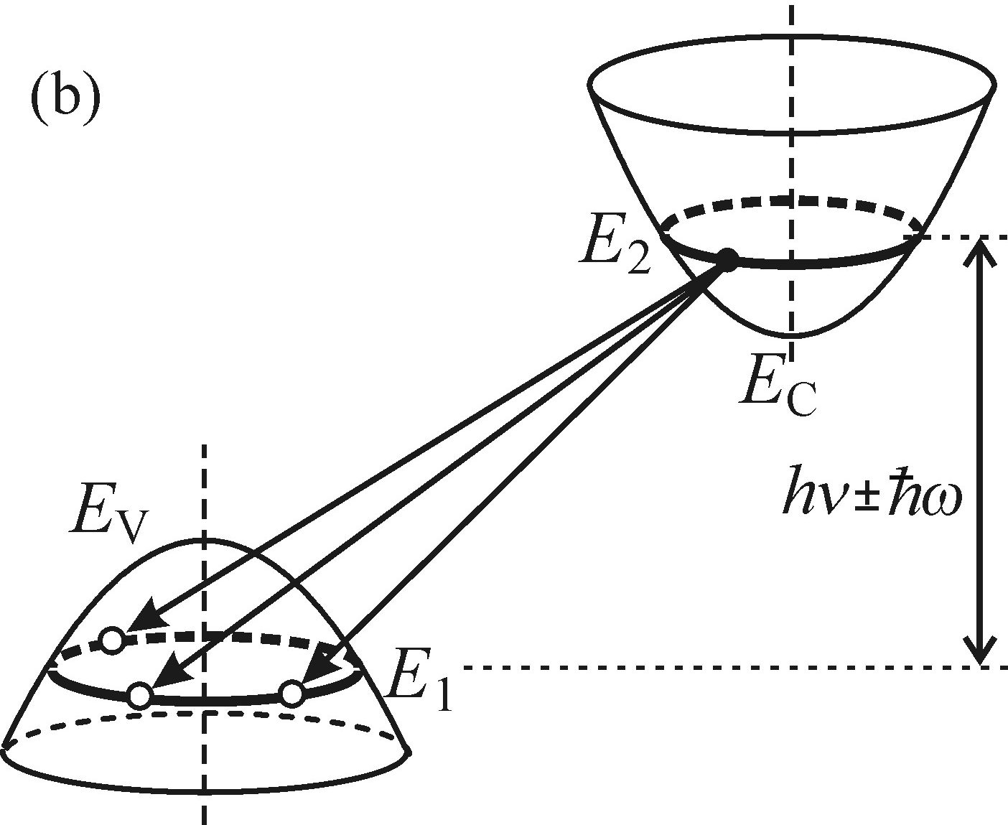

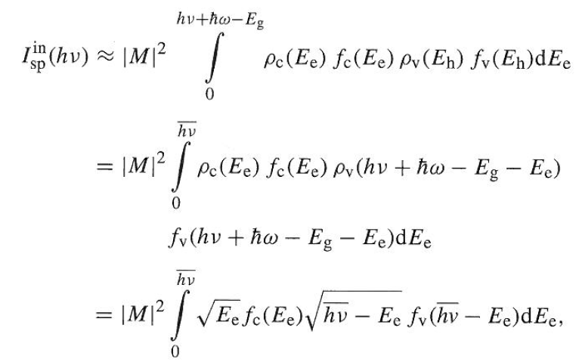
Indirect Bandgap
Recombination takes place varying K as long as energy is conserved:
Consider: Low temp→ less phonon
Recombination of electron-hole pairs in the energy band structure diagram, hv and hω stands for energy of photon and phonon resp.

Slide 7
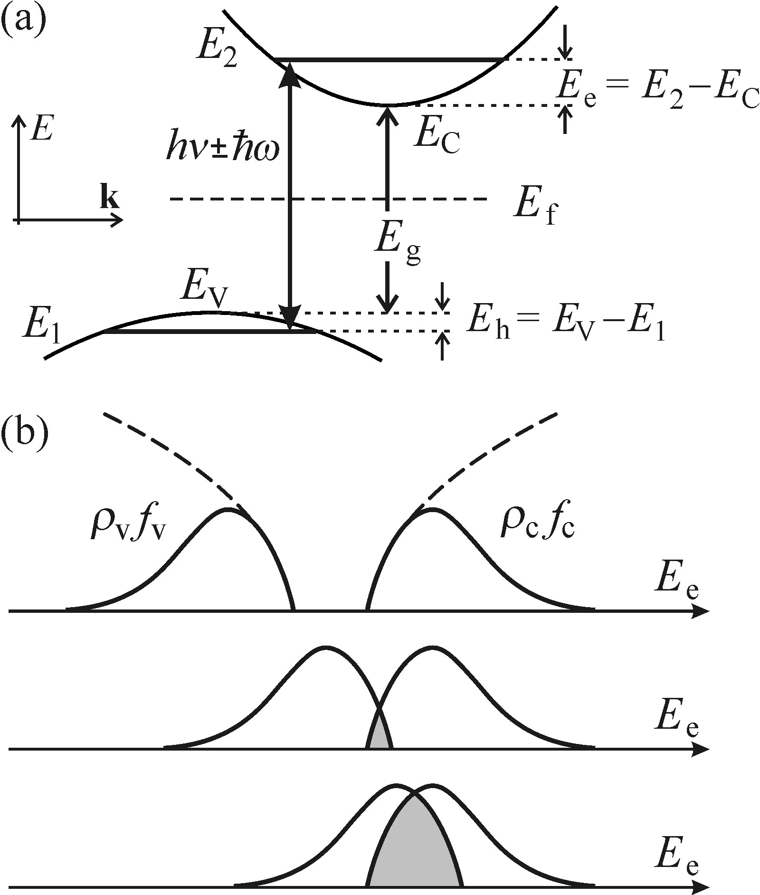
Indirect Bandgap
Illustrating the calculation of the spectral line shape of luminescence coming from the recombination in an indirect bandgap a) details of band structure b) convolution of occupied electron and hole states

Slide 8
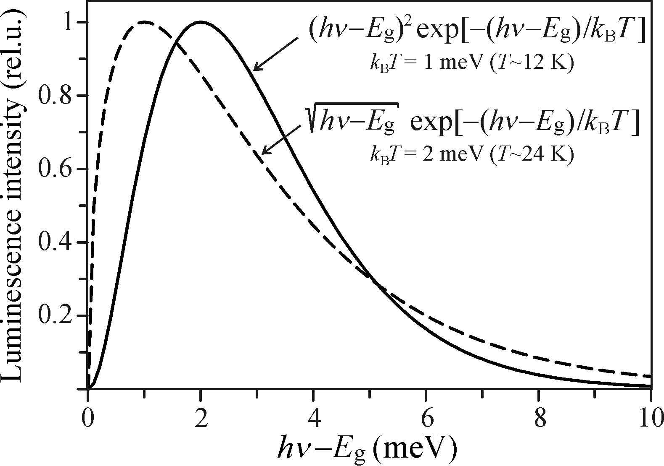



Indirect Bandgap
1
2
Note: these are very spare. Have longer lifetime than direct. Takes place is pure crystal at elevated temp but still the intensity is very less
3
Comparison of emission line shape of recombination in both direct (dashed) and indirect (solid) bandgap

Slide 9
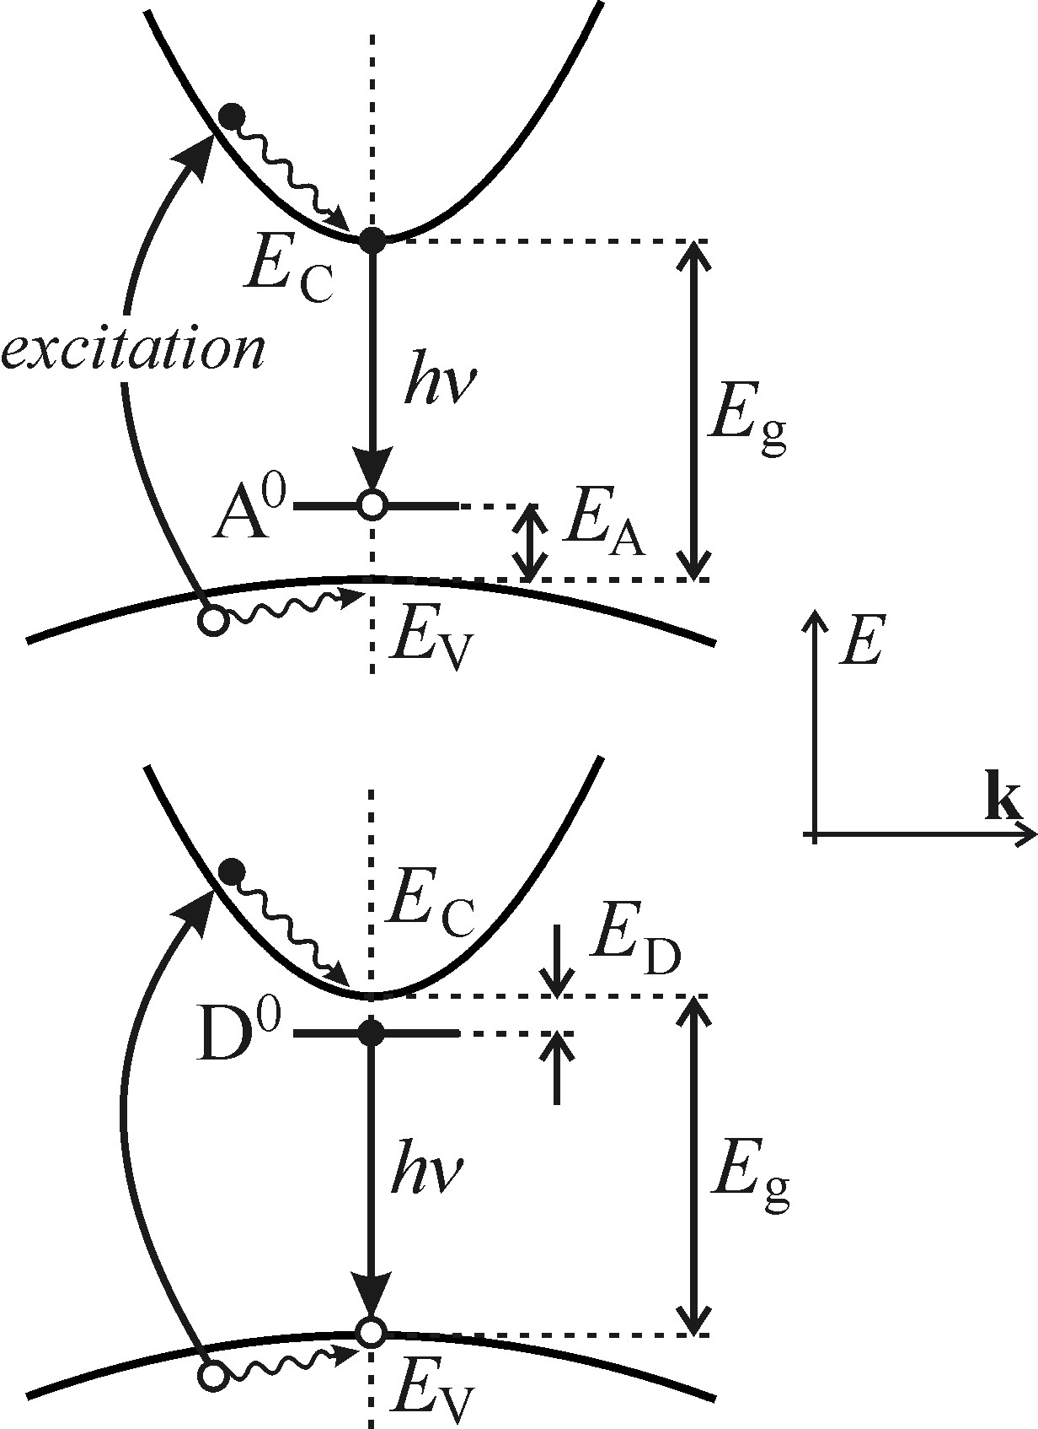
Recombination of exciton with neutral dopant
These shallow energy states are due to doping atoms.
Neutral acceptor (donor) is a non-ionized hole (electron).
These are localized in band structure thus quasi momentum is zero.

Slide 10
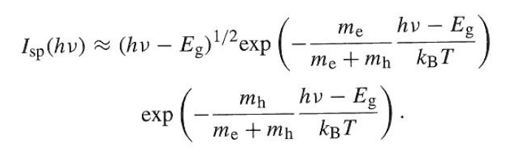
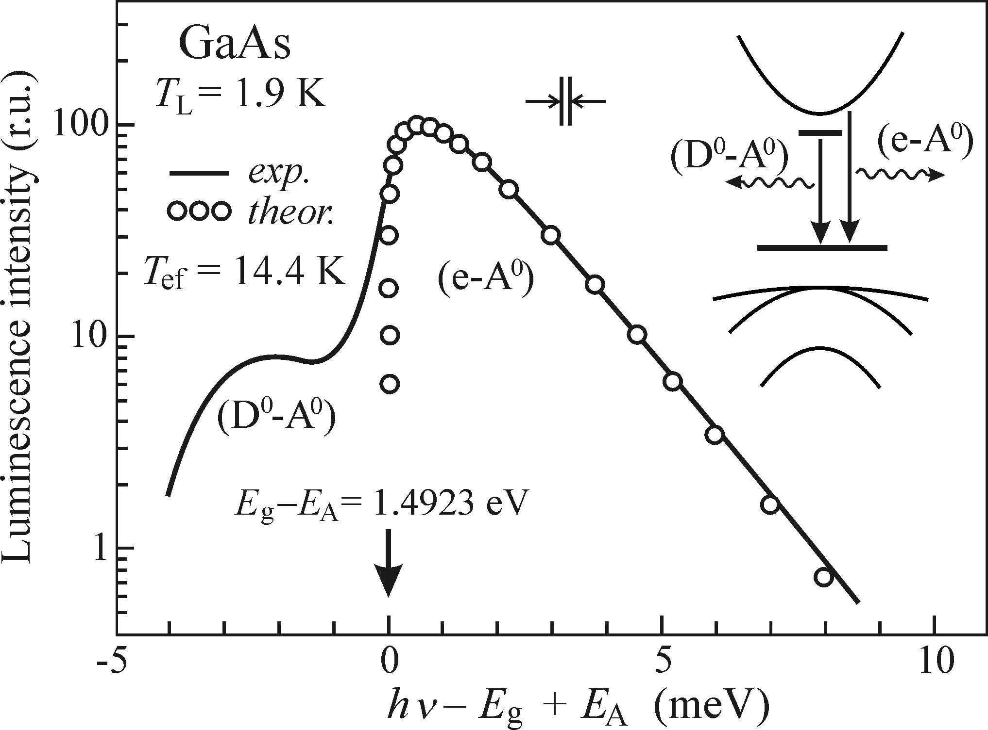


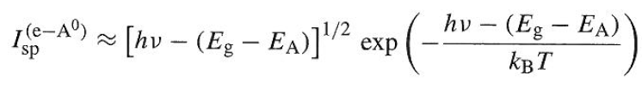
Recombination of exciton with neutral dopant
PL of Pure GaAs at low temp.
Containing a single residual acceptor E_{A} =27 meV
Both pure and low temp are essential for this process.
T_{L} is the bath temp (subsystem of atoms in lattice) and it is lower than the Tef-eff temp(free quasi particle) due to excitation.
Difficult to see them in an indirect due to negligible free quasi particles w.r.t to excitons.
Impure → diff E_{A} and E_{D} → PL shifted w.r.t another → two inhomogeneous broad lines.
Low temp → reduce thermal quenching and importantly prevent thermal ionization.

Slide 11
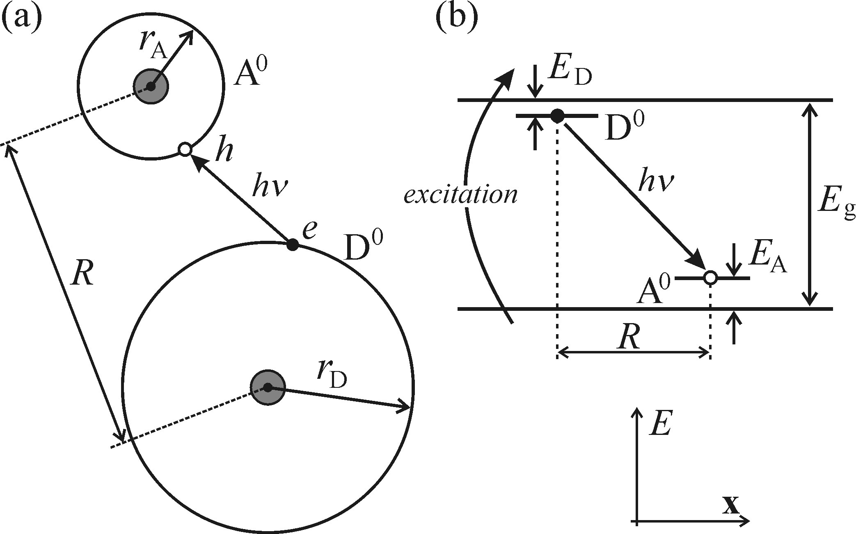




Recombination of Donor-Acceptor pairs
Schematic description of process:
Probability of radiative recombination
Donor and acceptor atoms located at different position in crystal lattice separated by distances R. Since dopents replace atom sites the values of R can be discrete.

Slide 12
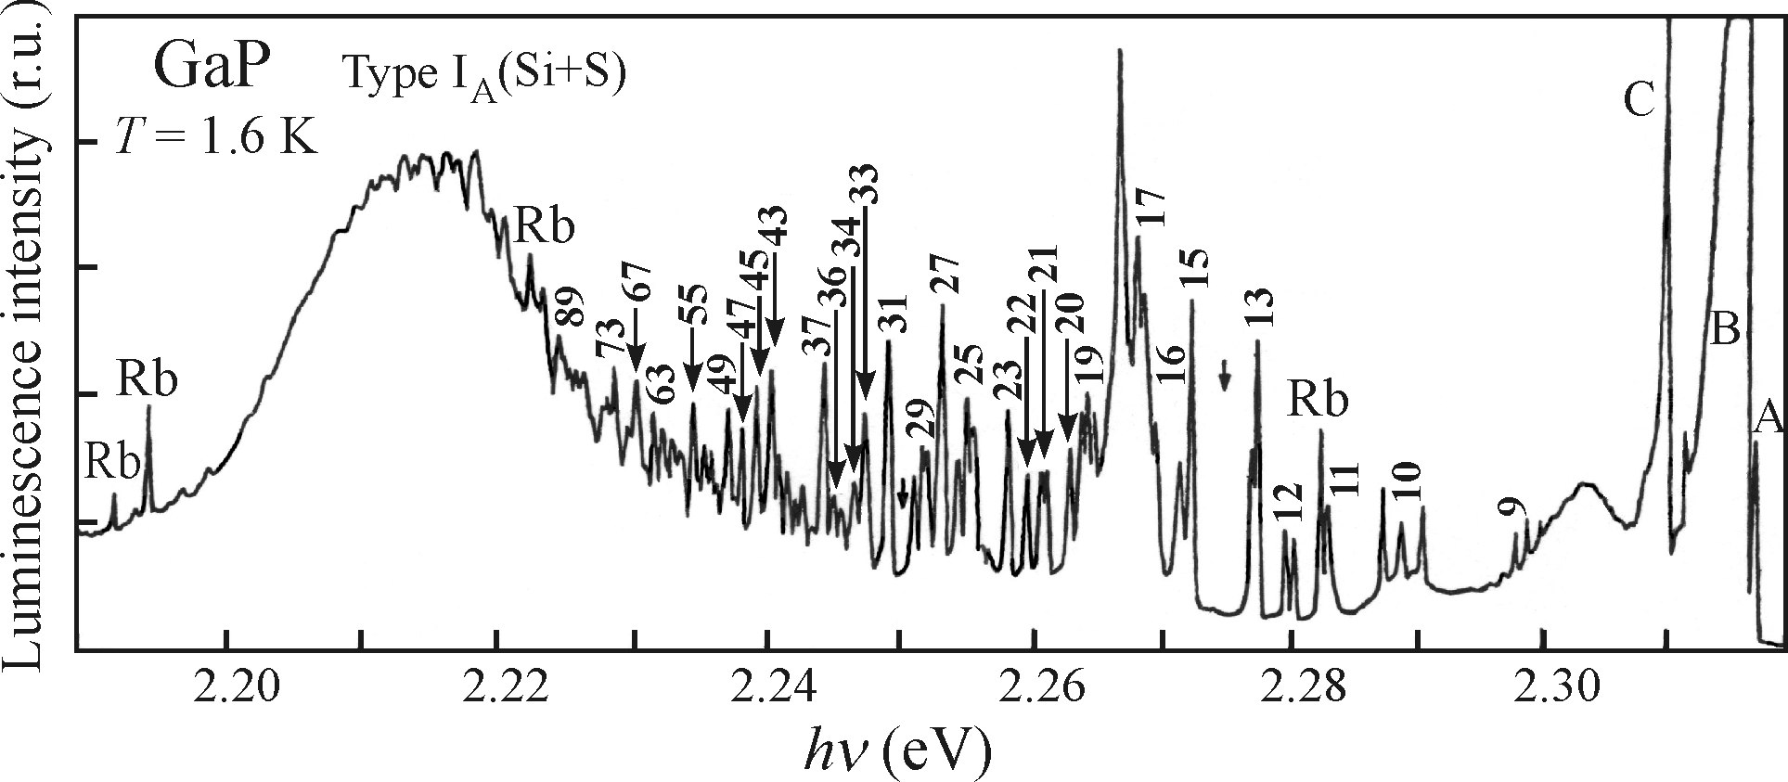
Recombination of Donor-Acceptor pairs
Weak Electron-Phonon interaction
PL of Si and S doped GaP, numbers denote the number of allowed R(virtual spherical shells). Type I substitution atoms (Sip,Sp).
High energy → sparse and low intensity
Low energy → dense and increase in intensity
Very low energy → intensity decrease and lines merge to finite modulated wide band.

Slide 13
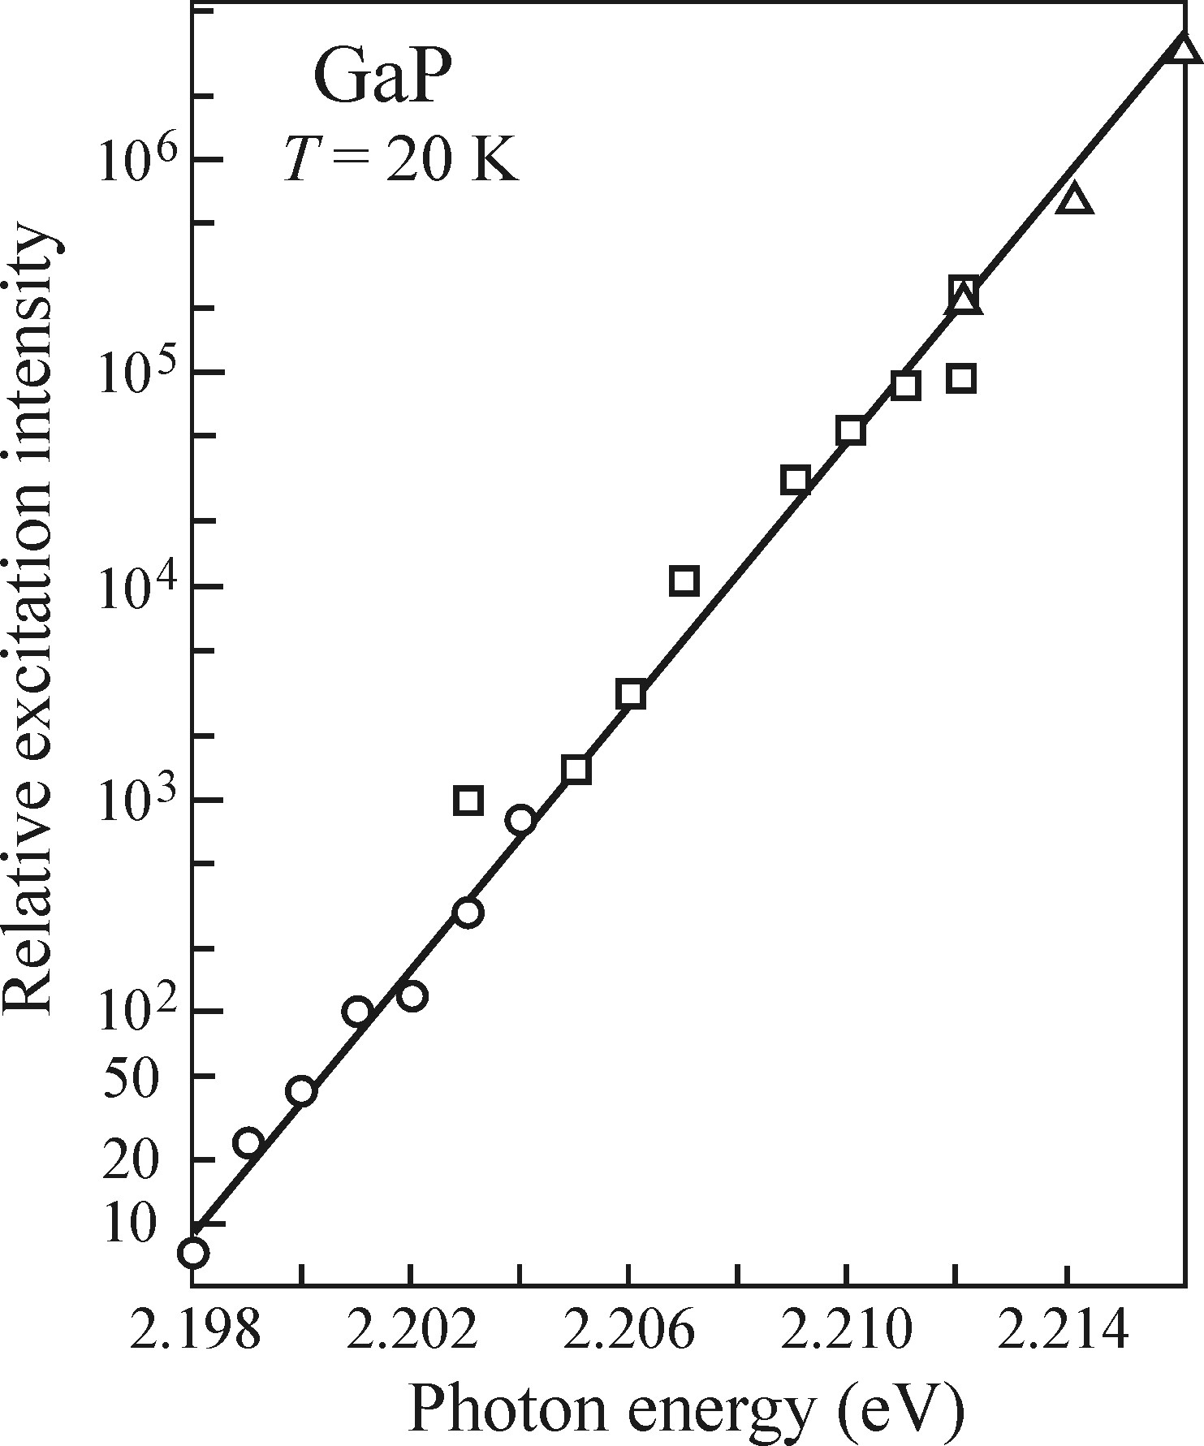
Recombination of Donor-Acceptor pairs
Weak Electron-Phonon interaction
Position of max of broad band. Symbols represent diff samples and excitation.
Two additional characteristics for this type of luminescence:
Overall blue shift broad band with increasing intensity. Reason being more intensity makes the D0 – A0 atoms come closer and increases influence of the columbic term.
Second is behavior in time resolved experiments: increasing delay after excitation impulse results in red shift of emission spectra. Reason for this is closer pair will have high prob to recombine and it reduces as R increases.

Slide 14
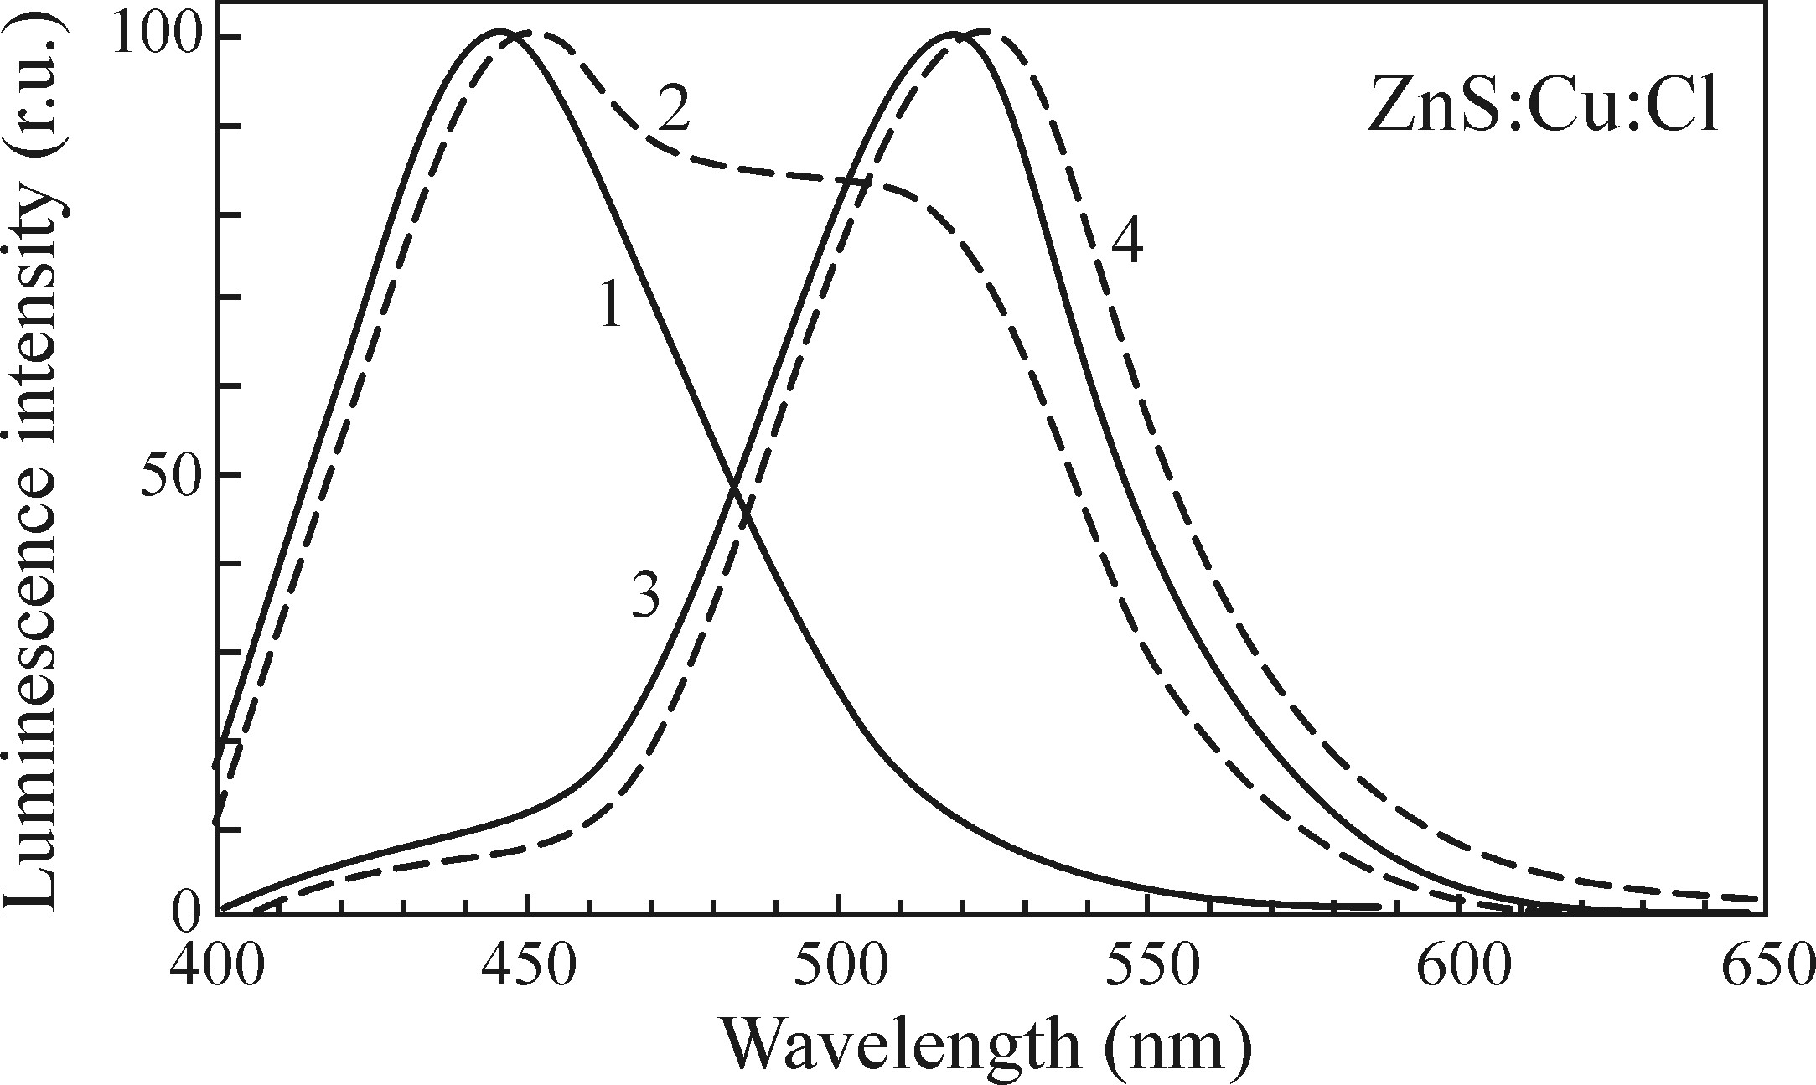
Recombination of Donor-Acceptor pairs
Strong Electron-Phonon interaction
Spectral distribution of ZnS doped with Cu_{Zn} acceptor and Cl_{S} donor. Curves 1-4 correspond to increasing Cu with 1 being pure ZnS. The luminescence band is broad, lacks any structure and located far from emission (large stokes shift) .

Slide 15

Luminescence excited by two photon absorption
So far, seen a single photon absorption process governed by lambert-beer law.
Typically depth of penetration in sample is
Such low values surface states and sub surface states strongly influence the radiative recombination and can pose problem.
These states can either quench or be source of the luminescence. Thus spectra not reflect the material of interest.
So, Compare both single and two photon spectra.

Slide 16
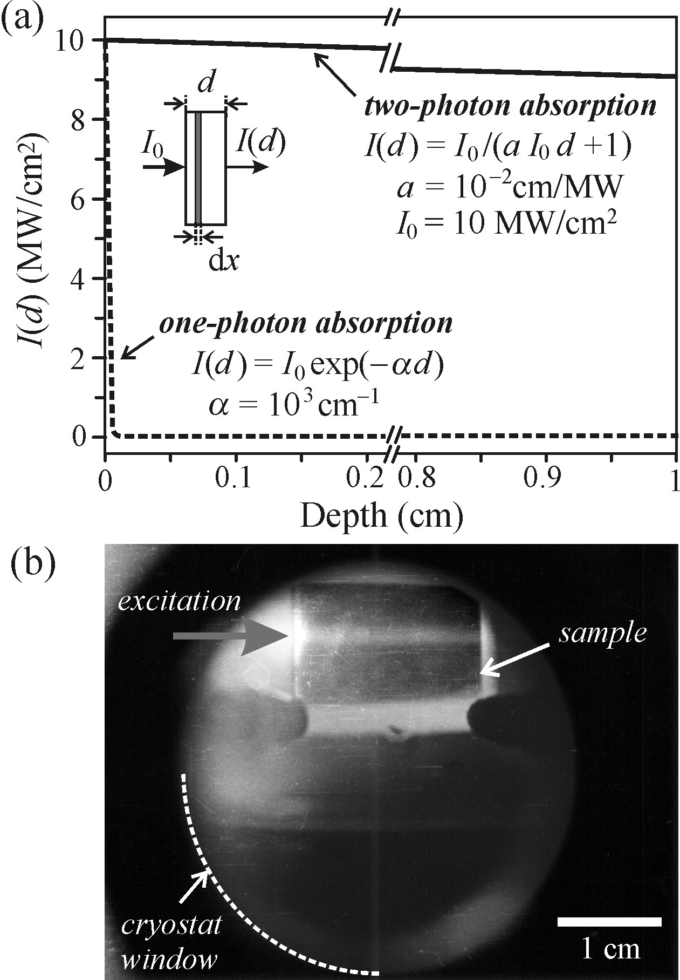

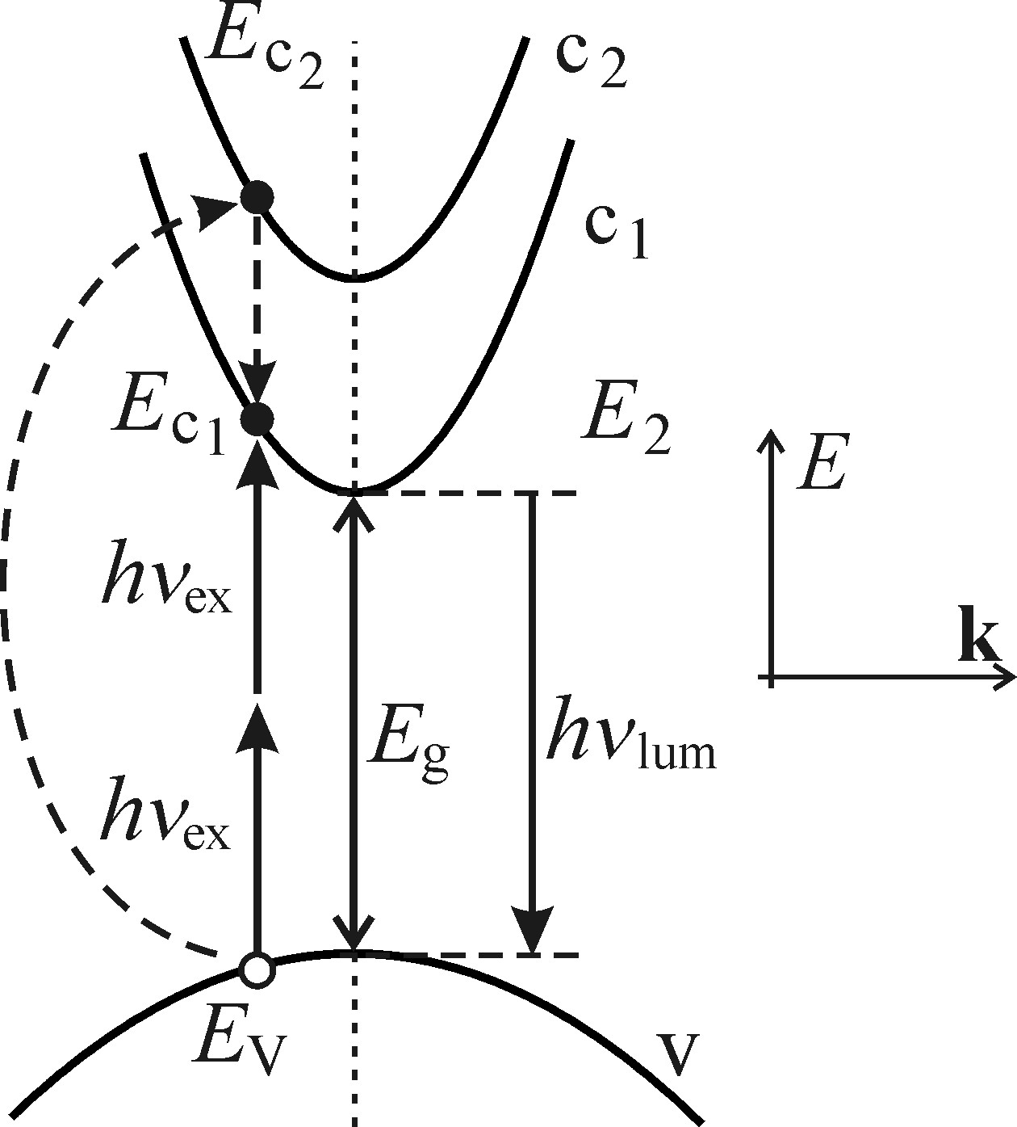


Luminescence excited by two photon absorption
Non-linear optical phenomenon, two photon are absorbed at the same time in single elemental act.
Two photon anology of lambert law-.
Here absorption coefficient is proportional to intensity of the excitation.
Typically d=1cm
Thus at these penetrations the luminescence are from bulk of the sample.
A view through the window cryostat of bulk AgCl with a horizontal trace two photon lumniscence across whole length of the sample.

Slide 17
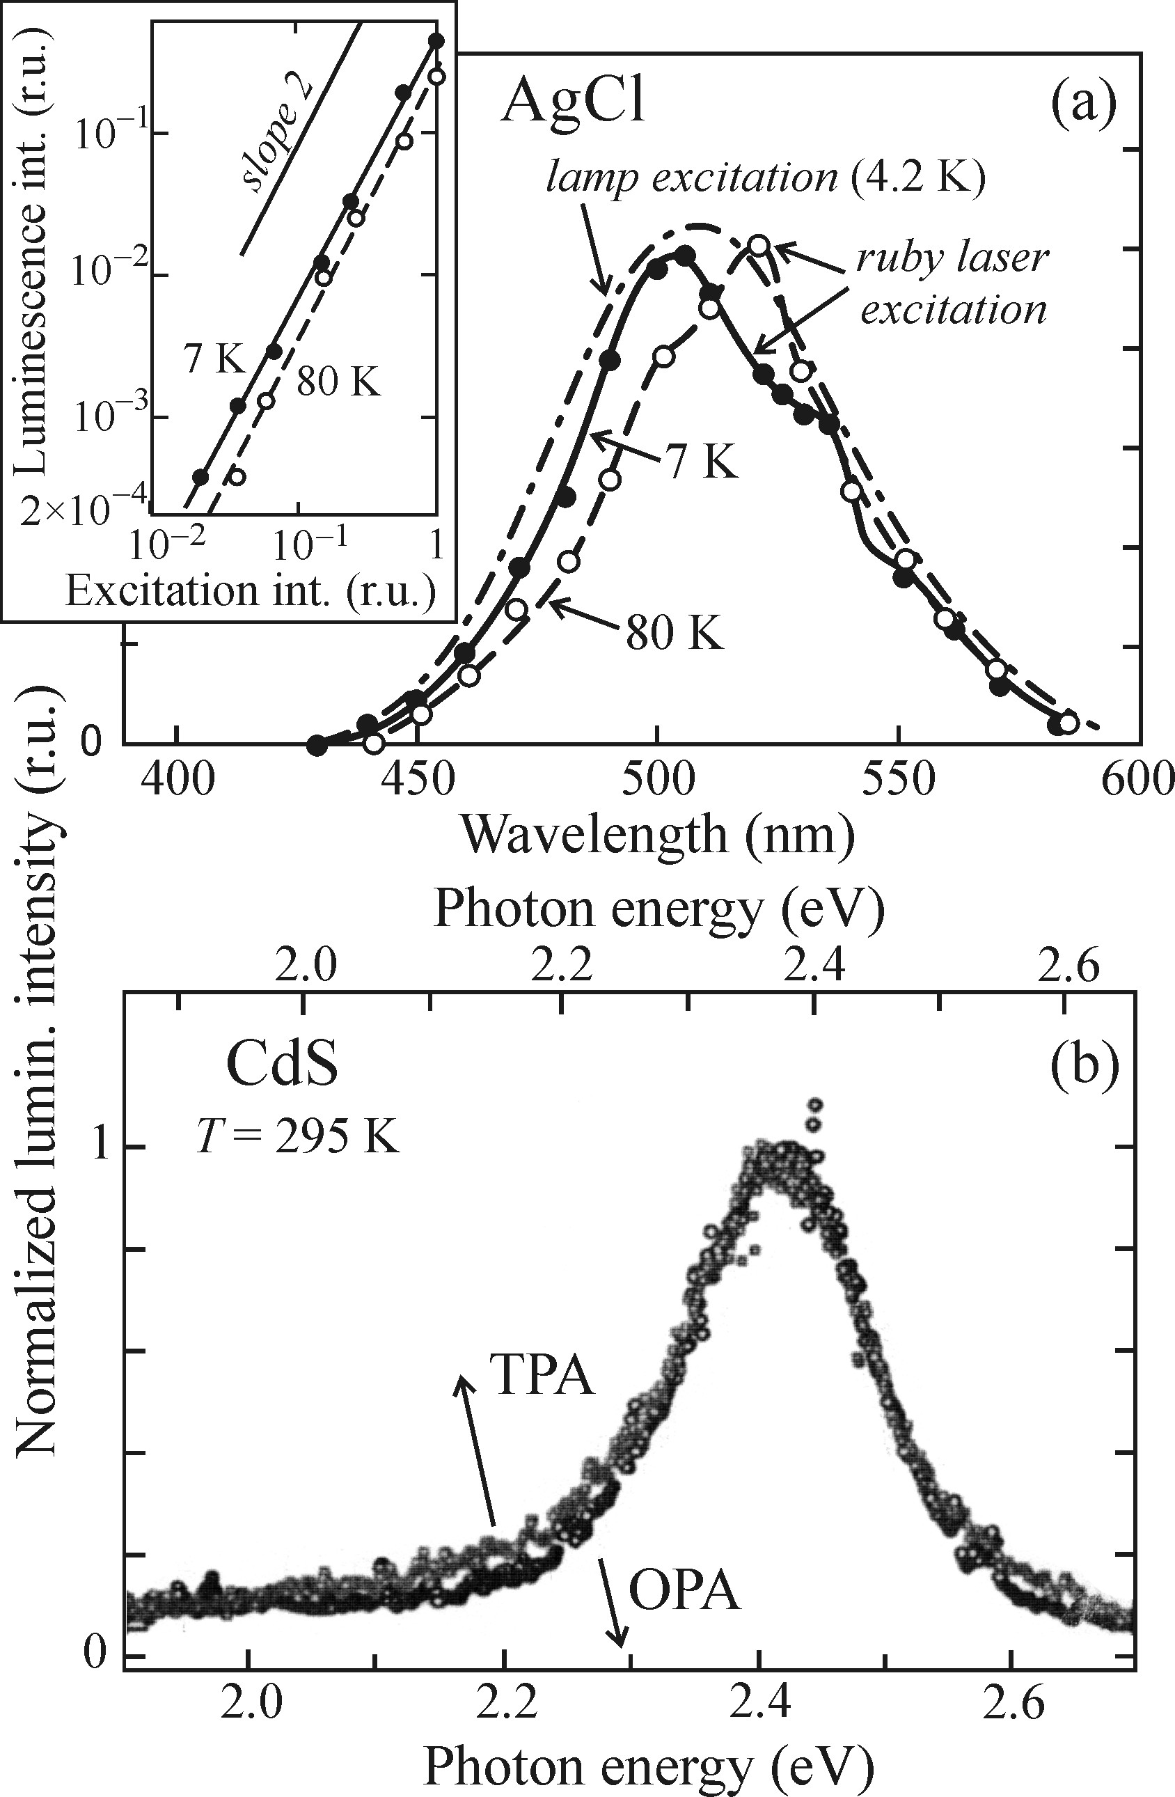
Luminescence excited by two photon absorption
Comparison of emission spectra of one and two photon excitation a) AgCl crystal b) CdS thin film.
This indicates that the influence of surface states on luminescence is not so pronounced as was commonly supposed in the past

Slide 18
Luminescence from transition metal and rare earth ion impurities
Apart from donors number of impurities are introduced in the material to boost the luminescence and achieve particular emission of wavelength.
But, two types of impurities are utilized in many commercial applications
        transition metals and rare earth ion.
Transition metals:
Luminescence as a result of electro transitions between partially filled 3d shells.
The 3dn* → 3dn transitions are dipole-forbidden since they don’t comply with the condition
But when embedded into crystal, the electric field of crystal makes it partially allowed.
Spectra shape depends on arrangement of ligands, radius of d-orbit, distance btw metal ion and the ligand.

Slide 19
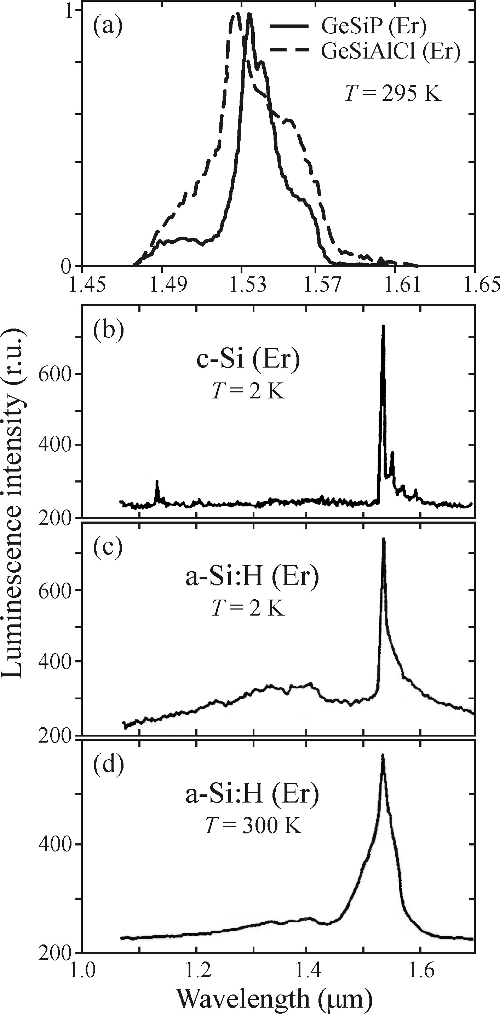
Luminescence from transition metal and rare earth ion impurities
The luminescence are due to transition in 4f orbital. These process are similar to the pervious one.
The major difference is that here the 4f orbital are shielded by the externally filled 5s2 and 5p6 orbital.
So, on one hand the crystal field is strong enough to have partial excitation and on the other hand this screening manifest itself by keeping atomic like emission spectra.
In fig. a,b,c confirms that the emission of Er3+ is having relatively narrow peak at 1530 regardless of its incorporation.
Fig. c,d shows that in hydrogenated sample the intensity is reduced by 20% by increasing temp.

Slide 20
Non-Radiative Recombination
Luminescence efficiency or quantum yield never reaches 1.
Even if so Stokes law implies, not all energy is transformed into luminescence.
Divided into three in accordance to excitation energy transferred:
  Heat.
    Multiphonon transitions.
        Bi-molecular
        Localized centres
        Surface states
    Auger recombination.
  Lattice defects.
    Wide-bandgap material btw semiconductor and ionic crystal.
  Photochemical changes in material.
    Limited to halides of silver and thallium.

Slide 21
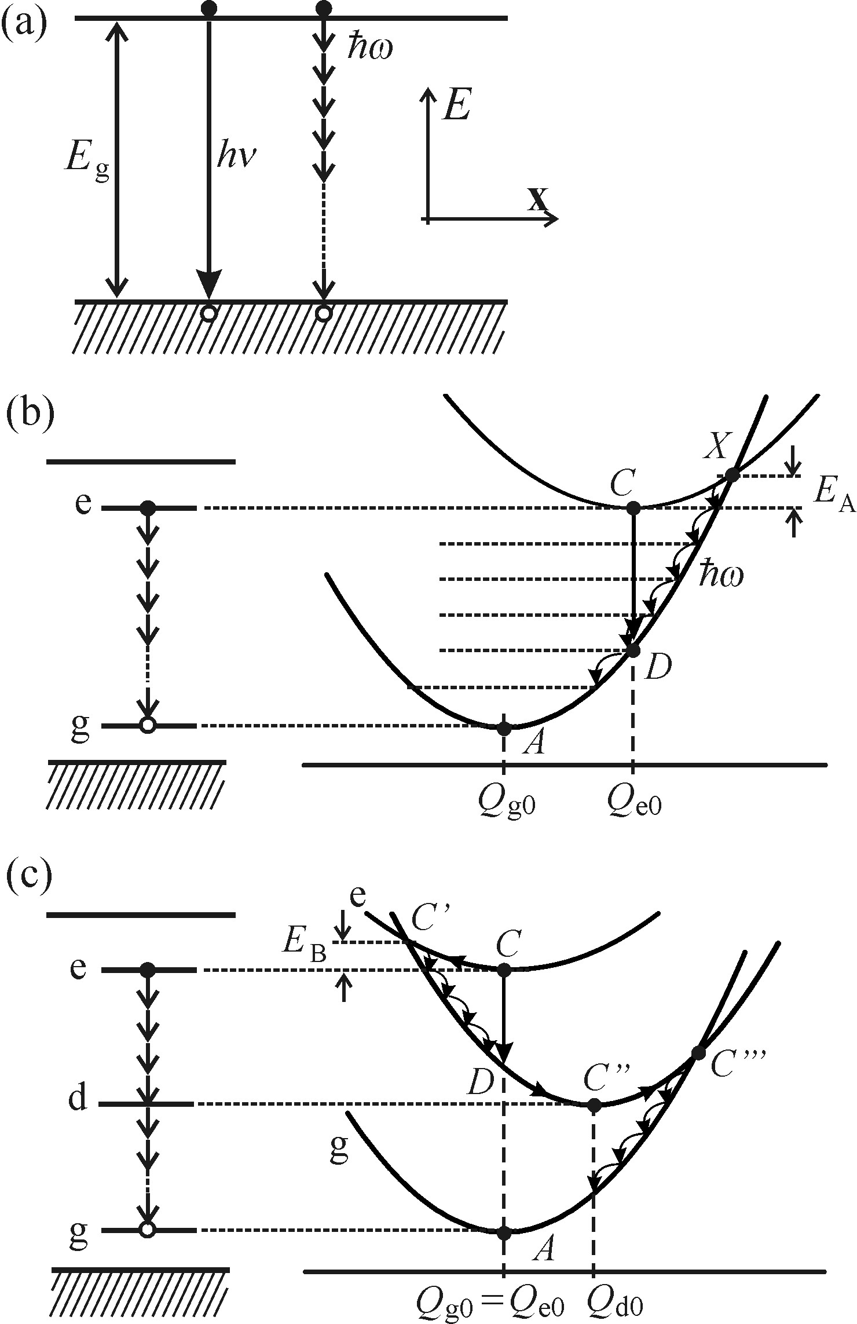



Multiphonon Recombination
Bimolecular
This process can be can a simple exciton recombination across the bandgap by n phonon process.
Analogy of bimolecular process as seen in previous talk.
The probability of such almost zero.
and hence
In case if there are any deep levels in the midgap then the prob. will substantially increase.

Slide 22
Localized centres
Intersection point X lowers with increasing difference of Qgo-Qeo and so does E_{A}
C → X goes down X → A by emission of local phonons.
The phonon emission character is a sequential application of one-phonon process and is different from bimoclecular (mediated by virtual electron levels and nth order process)

Slide 23
Localized centres
If the localized centres interact weakly with the surrounding lattice Qgo~Qeo and X doesn’t exist.
Important factor mediating these recombination are deep levels in midgap (due to the defects in material).
These defects are strongly interacting with lattice and changes configurational co-ordinate Qeo to Qdo, during exciatation energy to this defect.
Electron energy dissipated by ‘cooling transitions’
C → C´ → C´´. remaining energy by
C´´ → C´´´ → A

Slide 24
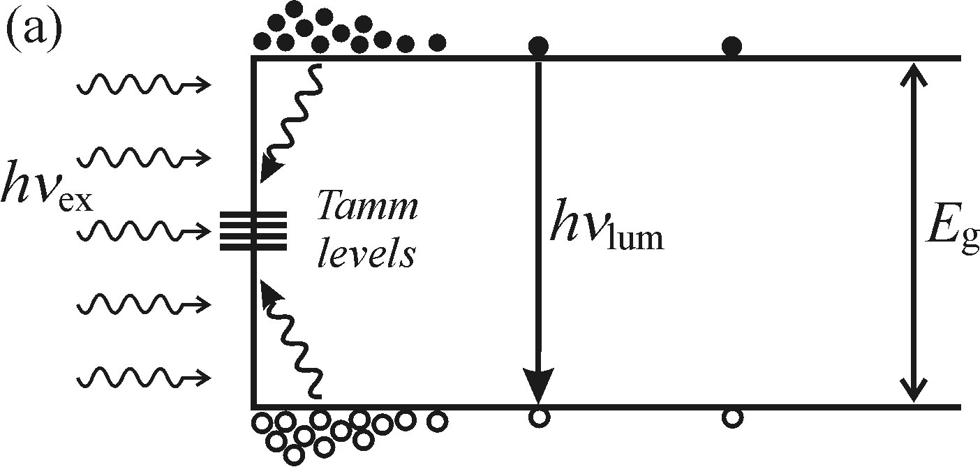
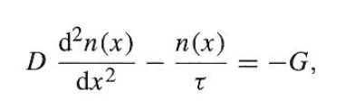
Surface Recombination
Sl (SRV at left edge)
Epi- substratete interface
S_{r} (SRV at right edge)
Epi- oxide interface
Sample
Diffusion coefficient (D)
Bulk Lifetime(τ)
Pump (UV source)
Detector
Probe (Laser source)
Effective lifetime (τeff)
Thickness of the sample
Boundary Condition:
On left edge: D dn/dx = S₁*n(l)
On right edge: D dn/dx= -S₂*n(r)
parameters used in this simulation:
Doping of the sample is 10¹⁸ cm⁻³,
Thickness of the sample is 400 μm
Diffusion coefficient of the material is 15 cm²/s
Lifetime of the carriers is taken as 0.5 μsec.
S. S. Suvanam, et.al, Materials Science Forum Vols. 740-742 (2013) pp 465-468

Slide 25
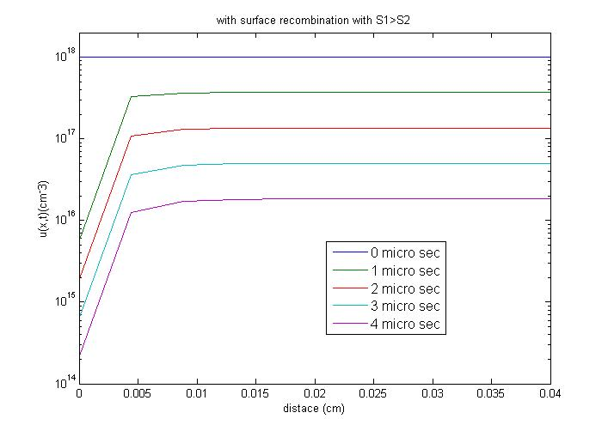
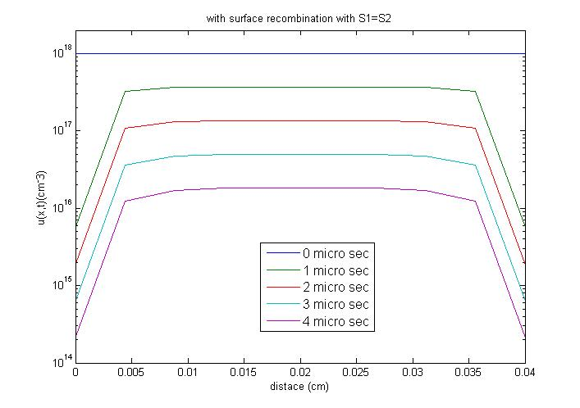
Surface Recombination
With Surface Recombination S_{l}>>S_{r}
With Surface Recombination S_{l}=S_{r}
S. S. Suvanam, et.al, Materials Science Forum Vols. 740-742 (2013) pp 465-468

Slide 26
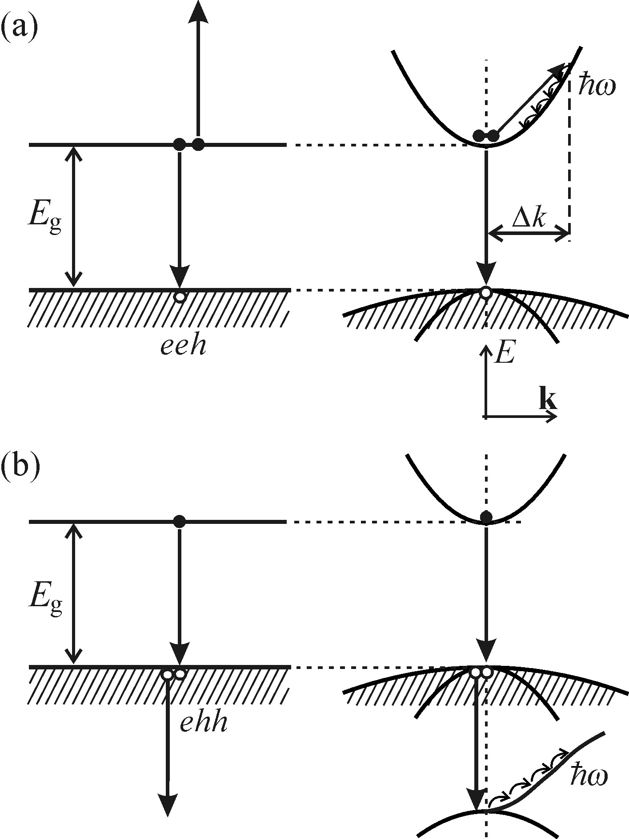
Auger Recombination
It is a 3 quasi particle process. E-H recombine and this energy is given as a kinetic energy (KE) of 3rd particle .
So instead of PL the energy transferred to excitation of electron.
Finally, KE of the 3rd particle is converted to multiphonon emission in crystal, mostly by heat
Both energy and momentum as to be conserved.
Fig shows both with and without involving conservation of momentum.
It is a intrinsic auger process, not defect involves.

Slide 27
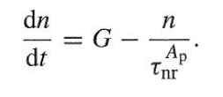
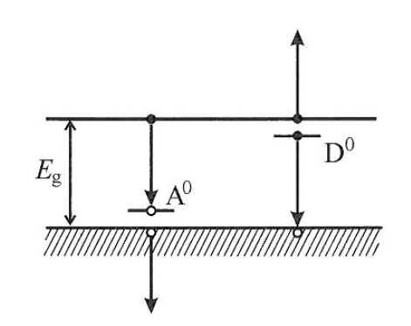


Auger Recombination
Diffusion relation for 3 particle system:
Typically
This signifies that intrinsic auger recombination occurs at high carrier concentration.
In addition to intrinsic auger , there also exsits extrinsic auger recombination when carrier localized impurities also play a role

Slide 28
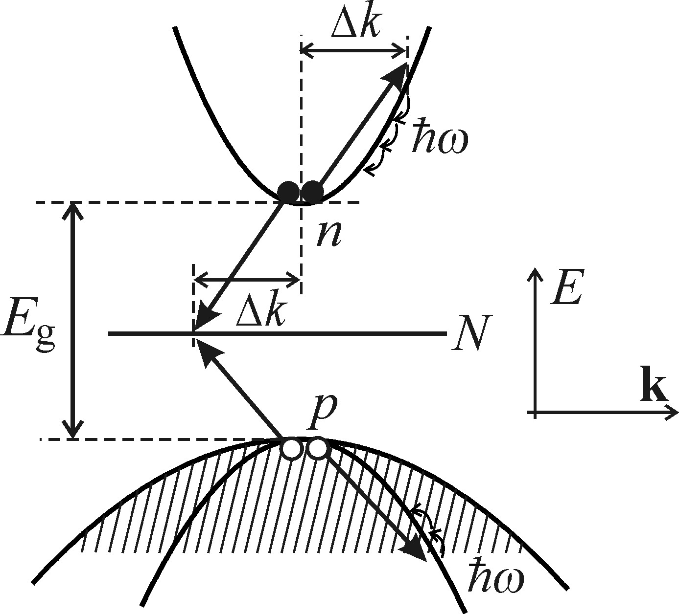
Bimolecular Auger Recombination
This process is similar to auger just that the energy is released from deep in band gap.
Characterized by quadratic nature of recombination.
Seen before(multiphonon) the probability is zero, in spite this widely occurs in many materials.
Reason for this lies in localized states in mid gap.
Strongly localized states in ‘r’ space → strongly delocalized in ‘k space’ → hence probability of such transitions are very high.

Slide 29


Creation of lattice defect
Excitation localised at atom occupying regular lattice position
Released energy transferred to relevant atom as whole
Thus kick off an atom to produce interstitial
Transient or permanent damage
Following criteria must be fulfilled to make this recombination:
Localization of the electronic excitation must occur.
Energy criterion.
Protection against degradation of heat-phonons.
    Guarantees no spread of localized energy to whole crystal.
Orientation criteria.
    Energetically favourable symmetry for defect creation

Slide 30
Photochemical changes
A photoelectron is captured at photosensitive centre
Captured electron attracts Ag+ (created by previ. process) which rather free diffusethrough lattice
Successive trapping Ag+ and e- leads in Ag cluster
Silver Halides. At high temp.
A neutral Ag0 atom is resulted
While, holes get localized on a Cl⁻ ion.
This process Neutralize the Cl⁻ and Cl gas leaks out
Finally results in photochemical dissociation

Slide 31
Thank you.

