Slide 1
Nuclear Fuel Cycle 2013
Lecture 7: Reactor Chemistry

Slide 2
Water Chemistry
Big deposits on fuel ⇒ decrease cooling, damage encapsulation, lower reactivity
Corrosion ⇒ aging of power plant
FUEL
MATERIAL
WATER CHEMISTRY
RADIATION
WASTE
Water chemistry, corrosion and material interact giving radioactive contamination
CLEANING SYSTEMS
DECONTAMINATION
DEGASSING

Slide 3
Water Chemistry, 25°C
Angle between H-O-H
⇒ high dipole moment
⇒ great solvent for salts
δ-
Hydrogen bonds
between molecules
⇒ high boiling point
δ+
1.8Å
Addition of acid increases
conductivity greatly since
H⁺ can easily “jump” through
the structure (and so can OH⁻)
104.45°
1.0Å

Slide 4
Water Chemistry, 300°C
11
12
13
-LOG K_{w}
High thermal movement
Most H-bonds broken
lower viscosity
Lower steam pressure
14
15
Harder for dipoles to align
in electric fields
Less polar solvent; more
like benzene
lower solubility for salts
0
100
200
300
Temperature, °C
K_{w}=[H₃O⁺][OH⁻]~2×10⁻¹¹ M²
Neutral pH=5.65

Slide 5
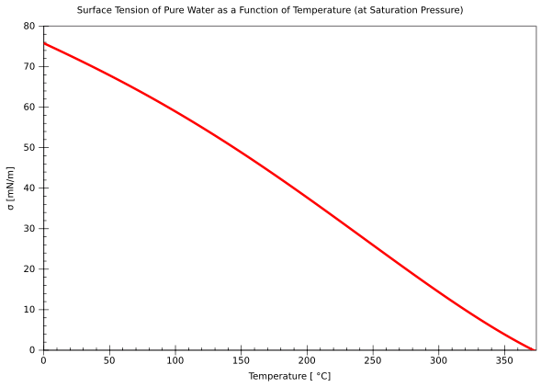
Surface tension

Slide 6
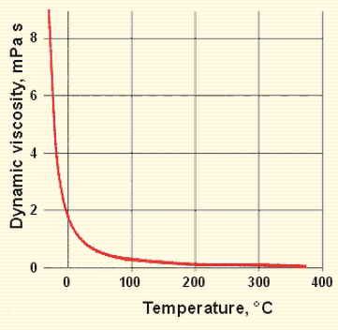
Viscosity

Slide 7
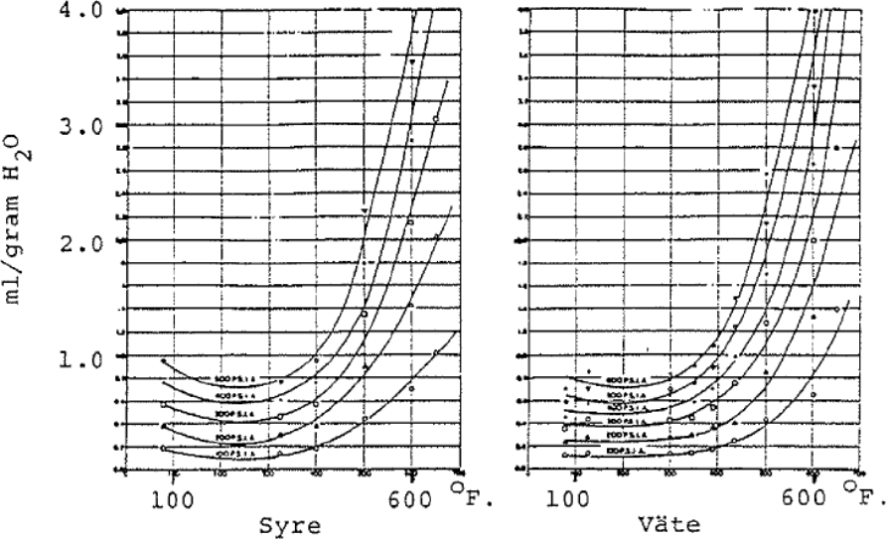
Solubility of gases
Henry’s law:
p = k_{H} c
p = Partial pressure of gas
k_{H} = Henry’s constant (temperature dependent)
c = concentration of gas in solution
Solubility of H₂, O₂, N₂ more than twice as high at 300 °C
O₂
H₂

Slide 8
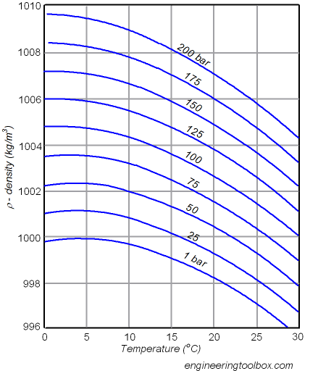
Density

Slide 9
Conductivity
Dependent on concentration and mobility of ions
κ = 10⁻³ Σλ_{i} c_{i}
κ = conductivity [S/cm]
λ_{i} = equivalent conductivity for ion i [cm²·S·mol⁻¹]
c_{i} = concentration of ion i [mol·l⁻¹ ]
λ high for H⁺ and OH⁻
Pure water κ = 0.054 µS
Feeding water κ = 0.1 µS
Reactor water κ = 0.1-0.3 µS
Tap water κ = 100-300 µS

Slide 10
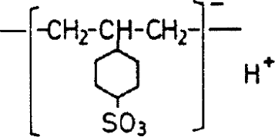
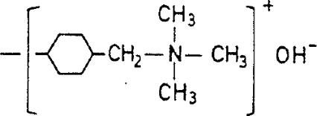
Ion exchangers
To remove undesired ions from the waters of a nuclear power plant, ion exchangers are used
Organic
Polymeric resins
Usually polystyrene with functional groups
Cross-binding with divinylbenzene
Functional group
cation exchanger
(sulphonic acid)
Functional group
anion exchanger
(quartinary ammonium)

Slide 11
Radiation chemistry
The radiation field in a reactor is of course very strong
γ-radiation and neutrons will cause water radiolysis

Slide 12
Water Radiolysis
Event
Time scale
H₂O
H₂O×
H₂O⁺ + e⁻
10⁻¹⁶ s
H₂O
•OH + H₃O⁺
10⁻¹⁴ s
H• + •OH
H₂+•O
10⁻¹³ s
Formation of molecular products
in the spurs and diffusion of
radicals out of the spurs
e_{aq}⁻, H•, •OH, H₂, H₂O₂, H₃O⁺
10⁻⁷ s

Slide 13
Radical reactions following water radiolysis
OH• + H₂ → H• + H₂O k= 4.0×10⁷ OH• + H₂O₂ → HO₂• + H₂Ok= 2.25×10⁷
OH• + O₂⁻• → O₂ + OH⁻ k= 1.0×10¹⁰ H• + O₂ → H⁺ + O₂⁻• k= 2.0×10¹⁰
H• + O₂⁻• → HO₂⁻ k= 2.0×10¹⁰ e_{aq}⁻• + O₂ → O₂⁻• k= 2.0×10¹⁰
e_{aq}⁻• + H₂O₂ → OH• + OH⁻ k= 1.6×10¹⁰ e_{aq}⁻• + O₂⁻• → HO₂⁻ + OH⁻ k= 1.2×10¹⁰
e_{aq}⁻• + H⁺ → H• k= 2.2×10¹⁰ e_{aq}⁻• + H₂O → H• + OH⁻ k= 2.0×10¹
e_{aq}⁻• + HO₂⁻ → O⁻• + OH⁻ k= 3.5×10⁹ OH• + HO₂• → H₂O + O₂ k= 1.2×10¹⁰
OH• + OH• → H₂O₂ k= 4.0×10⁹ H• + HO₂• → H₂O₂ k= 2.0×10¹⁰
H• + H₂O₂ → H₂O + OH• k= 6.0×10⁷ H• + OH⁻ → e_{aq}⁻• + H₂O k= 2.0×10⁷
HO₂• + O₂⁻• → O₂ + HO₂⁻ k= 8.5×10⁷ HO₂• + HO₂• → H₂O₂ + O₂ k= 7.5×10⁵
H⁺ + O₂⁻• → HO₂• k= 5.0×10¹⁰ HO₂• → H⁺ + O₂⁻• k= 8.0×10⁵
H⁺ + HO₂⁻ → H₂O₂ k= 2.0×10¹⁰ H₂O₂ → H⁺ + HO₂⁻ k= 3.56×10⁻²
OH• + OH⁻ → H₂O + O⁻• k= 1.2×10¹⁰ O⁻• + H₂O → OH• + OH⁻ k= 1.7×10⁶
H⁺ + OH⁻ → H₂O k= 1.43×10¹¹ H₂O → H⁺ + OH⁻ k= 2.6×10⁻⁵
H• + OH• → H₂O k= 2.5×10¹⁰ H• + H• → H₂ k= 1.0×10¹⁰
e_{aq}⁻• + H• → H₂ + OH⁻ k= 2.0×10¹⁰ e_{aq}⁻• + e_{aq}⁻• → H₂ + OH⁻ + OH⁻ k= 5.0×10⁹
e_{aq}⁻• + OH• → OH⁻ k= 2.0×10¹⁰ O⁻• + H₂ → H• + OH⁻ k= 8.0×10⁷
O⁻• + H₂O₂ → H₂O + O₂⁻• k= 2.0×10⁸ OH• + HO₂⁻ → HO₂• + OH⁻ k= 5.0×10⁹
HO₂⁻ + O⁻• → OH⁻ + O₂⁻• k= 8.0×10⁸ e_{aq}⁻• + O₂⁻• → HO₂⁻ + OH⁻ k= 2.0×10¹⁰
OH⁻ + H₂O₂ → HO₂⁻ + H₂O k= 5.0×10⁸ HO₂⁻ + H₂O → H₂O₂ + OH⁻ k= 5.735×10⁴

Slide 14
Radiation chemistry
H₂O₂, O₂ and H₂ are the molecular products formed from water radiolysis
The system will reach steady state concentrations of radicals
The steady state concentrations can easily change when other species are added to the system
O₂ is not desired in the reactor water of a PWR.
The reactor water contains H₃BO₃ and LiOH. The conductivity is high and O₂ could corrode materials in the reactor.
The O₂ concentration is kept <1 ppb by adding H₂ to reactor water (no continuous addition is required)

Slide 15
BWR water chemistry
Traditionally two “schools” to control water chemistry
- No additions. Instead highest possible purity (NWC)
- Addition of H₂ to avoid risk of intercrystalline stress corrosion of the construction materials of the reactor. (AWC/HWC)

Slide 16
Sources of impurities
- Corrosion and erosion of construction material of turbine and reactor systems (metal ions)
- Radiolysis of the coolant (radicals, H₂, O₂, H₂O₂)
- Activation of impurities that have deposited on the fuel encapsulation (radioactive nuclides in the system)
- Radiolysis of the coolant (radicals, H₂, O₂, H₂O₂)
- Introduction of impurities by dilution water
Temporary introduction of impurities. For instance
  Fission products from damaged fuel.
  Seepage of filter and ion exchange material
  Seepage of seawater through damaged turbines

Slide 17
Corrosion products
Corrosion products are the impurities that are present in the highest concentrations
Originates from erosion and corrosion of construction materials of the turbine and reactor systems
Most often deposit on the reactor core
Increased hydraulic resistance
> increased pressure drop over the core
- Heat resistance in deposit decreases heat conduction between fuel and coolant
- Reactivity loss due to increased fuel temperature and neutron absorption in deposit
Formation and spreading of activated corrosion products
-> main source to dose to personnel

Slide 18
Organic substances
Humic substances
Bacteria
Leakage of synthetic organic substances (ion exchangers, cleaners, oils, etc.)
Humic substances: Originates from leakage when desalinating water
Causes operation problem; corrosion, lowering efficiency of filters, can adsorb irreversibly to ion exchangers
Bacteria: can grow in almost any system, best 0-80°C and access to carbon
Exchange resin: Relatively common. Decomposes at higher temperatures, gives nitrate and sulfate in reactor water

Slide 19
PWR water chemistry
The goals for the water treatment:
- Control the reactivity of the fuel (Boric acid; H₃BO₃)
- pH control (LiOH)
- Control the corrosion of the construction material (H₂(aq), Zn)
- Contribute to lower the radiation levels

Slide 20
Activated corrosion products
CRUD: “Chalk River Unidentified Deposit”
Radioactive deposits in reactor systems
The main part of doses to personnel originates from activated corrosion products.
⁶⁰Co worst. Gives 2/3 of dose to personnel
~75% of the dose to personnel is given at maintenance work (during outage)

Slide 21
Actions
Low Co-supply: Minimize the usage of Co in construction material
Lower the rate of deposit release from fuel (force deposits to stay on fuel)
More efficient water purification. Send larger part of reactor water through purification system.
Lower tendency to deposit on surfaces in reactor system. Smoother surfaces, avoid pockets where crud can accumulate
(add Zn)

Slide 22
Decontamination
Removal of CRUD/Decontamination:
Non chemical methods
Chemical methods
Electrochemical methods

Slide 23
High pressure water jet cleaning
+ Fast
+ Good decontamination results
+ Water is compatible with most materials
- Produces big volumes of waste
- Blasting units might become jammed

Slide 24
Mechanical decontamination
+ Fast
+ Well established
+ Automation possible
- Destructive
- High particle production
- Waste

Slide 25
Chemical decontamination
+ Good contamination results
+ Small waste volumes
+ Can contaminate small to large systems
+ Can contaminate complex geometries
- Time consuming (oxidation, reduction, removal in cycles)
- Complex assembling/disassembling
- Material incompatibility

Slide 26
Electrochemical decontamination
+ Fast
+ Good contamination results
+ Smoothens the surface on the base material, preventing
recontamination
- Does not work with tight oxide layers
- Expensive
- Complex construction

Slide 27
Activation of coolant
Activation of oxygen: Gives short-lived nuclides ¹⁵C (t_{½}=2.45s, Eγ=5.3MeV) and ¹⁶N (t_{½}=7.13s, Eγ=6MeV)
N-16 dominating radiation source in water and steam
In reactor systems where H₂ is added NH₃ will form which increases activity in steam
Other coolant activation products: O-19, F-18. N-13 and H-3

Slide 28
Corrosion
Galvanic corrosion
Erosion corrosion
Pitting corrosion
Local corrosion
Stress corrosion

Slide 29
Erosion Corrosion
Local corrosion
Occurs in streaming systems. The higher the flow, the thinner the diffusion layer at the surface of the metal
-> supply of corroding agents and removal of corrosion products faster
Also mechanic part. Shear stress tears off corrosion products
Choose low alloy steel
(add oxygen; gives some protection to erosion)

Slide 30
Stress Corrosion
Intergranular or transgranular corrosion:
progress along grain boundaries or not
Alkaline transgranular stress corrosion (TGSCC): Tension in combination with high OH- concentrations.
Occurs in gaps and crevices where concentration can increase
Intergranular stress corrosion (IGSCC): Biggest material problem for BWR.
Occurs close to weldings and austenitic stainless steel
Tension, sensibilized material and oxidizing conditions are needed
Remove one of these condition to prevent corrosion.

Slide 31
Influence of added elements
Addition of Cl⁻: Accelerates IGSCC
Addition of SO₄²⁻: Accelerates IGSCC. Accumulates in oxide films giving long term effects
Addition of Cu²⁺: Accelerates IGSCC. Synergic effect together with Cl-.
Addition of NO₃⁻: Does not increase risk of IGSCC, can have positive effects
Addition of Si: Small increased risk of IGSCC at c>500 ppb
Addition of CO₂: Small effect on IGSCC

Slide 32
Water purification
BWR work with very pure water
Most important water purification systems:
Condensate purification system and Reactor water purification
Mainly: Filtration (of mainly FeOOH) in Condensate purification
Ion exchange in Reactor water purification

Slide 33
Water purification
PWR more complex since boric acid and LiOH are added
Control concentration of boric acid, H₂ and LiOH in reactor water
Control water level in pressure vessel
Remove corrosion and fission products from reactor water

