Slide 1
Travel demand models
Anders Karlström
Dept of Transport Science
Division of Transport and Location Analysis (TLA)

Slide 2
Where are we?
Remember, there are four exam categories
Demand modelling with Logit
Assignment
LUTI
Models and appraisal

Slide 3

Content Demand
Demand (contd)
Logit model (repetition)
Nested logit model
Trip generation, Trip distribution and modal split
Locational choice modelling (Nov 27)
(car ownership)

Slide 4
Assignment
2. Assignment
Dec 4

Slide 5
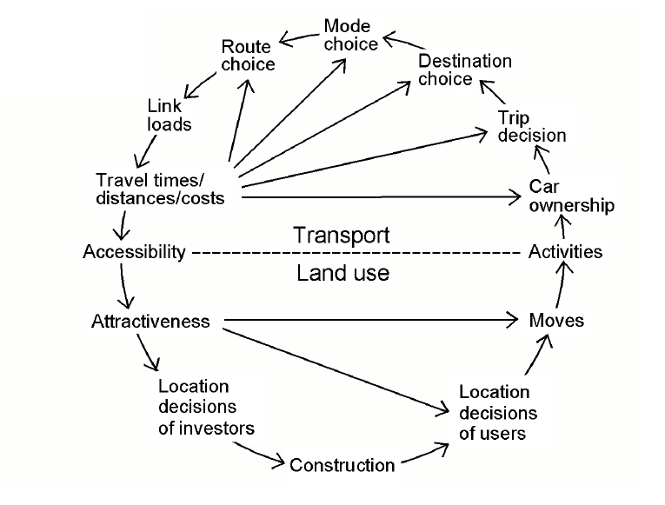
Content 3. LUTI

Slide 6
Content Modelling and Appraisal
4. Modelling and Appraisal
Other models than Logit
Car ownership modelling
Scheduling models (Mon Dec 9)
Appraisal: What is it?
What is it, really?
Critique and defense (more on Dec 16)

Slide 7
On appraisal
vW ch 14 (contd)
Consumer surplus
Valuation of time, what is it?
Relation to GDP?
Trip purposes, non-linearities?
RP vs SP
SCBA vs MCA

Slide 8
Travel demand models
So-called four step models
Trip generation
Trip distribution
Modal split
Assignment
Land-use?

Slide 9
Definition and notation
Trip matrix
Generalized cost of travel
Value of time

Slide 10
Definition and notations
Transit terminology
In-vehicle time
Access and egress time
Waiting time

Slide 11
Singly and doubly constrained models
(OW 5.3-5.4)

Slide 12
Example nested logit

Slide 13
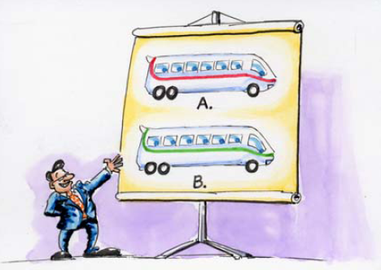

Nested logit, remember the
Red bus - Blue bus ?

Slide 14
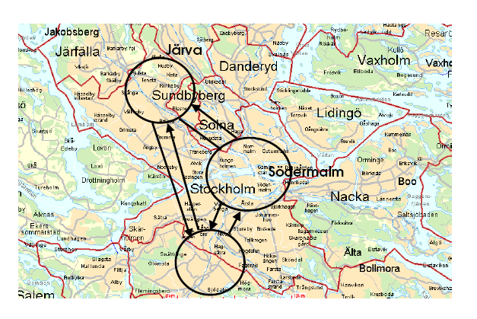
3 destinations

Slide 15
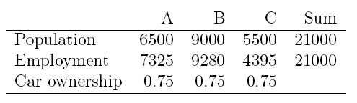
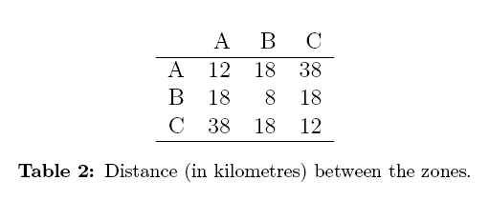
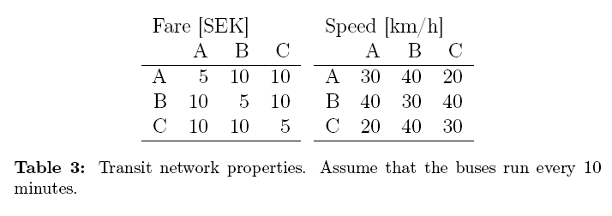

Slide 16
The nested logit model
Known as the hierarchical logit (HL) in the book OW

Slide 17

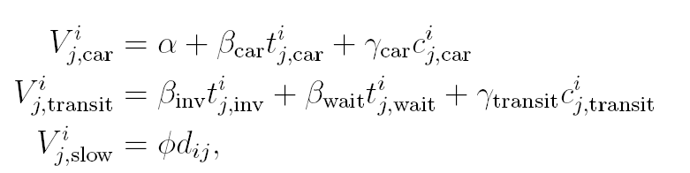

Slide 18
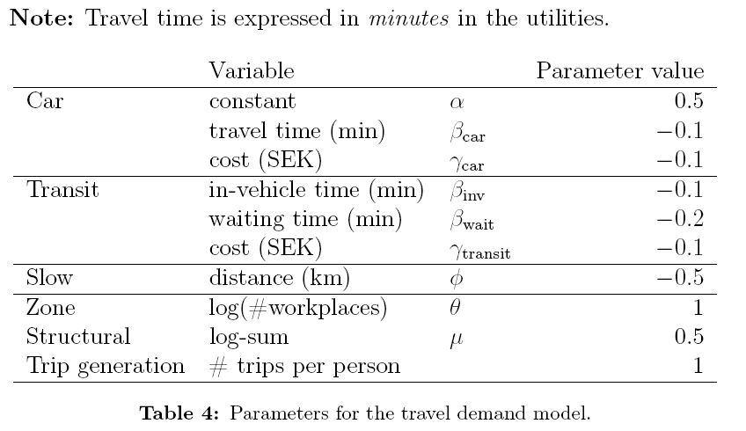
Variables

Slide 19
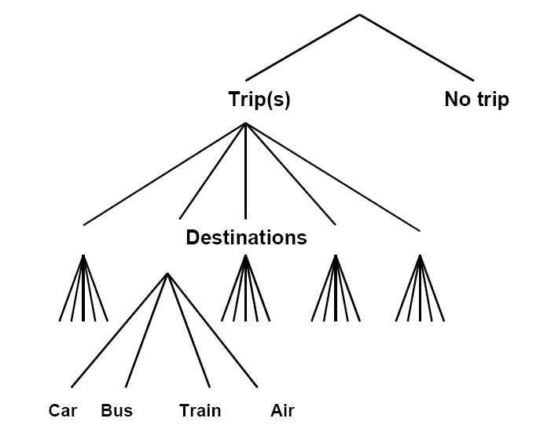
Standard model

Slide 20
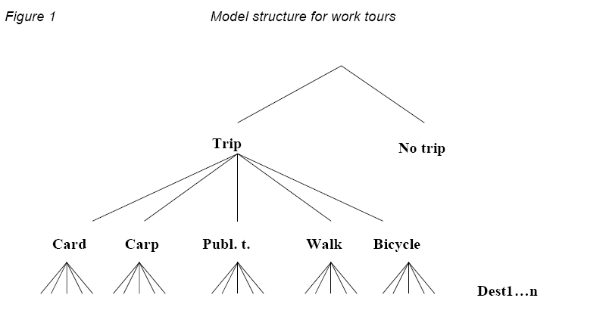
Work tour model

Slide 21
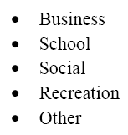
Trip purposes

Slide 22
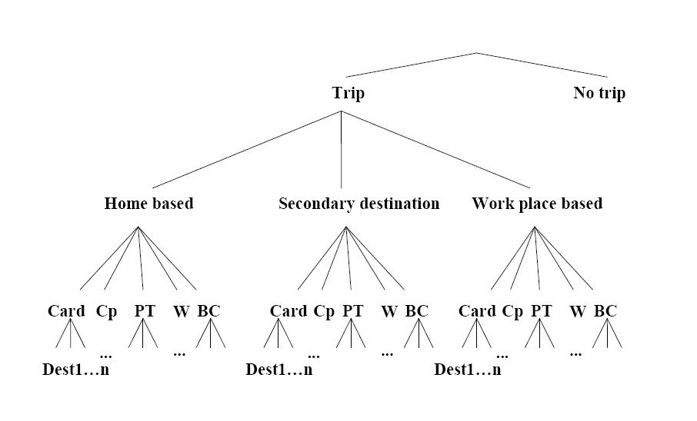
Non work tours

Slide 23
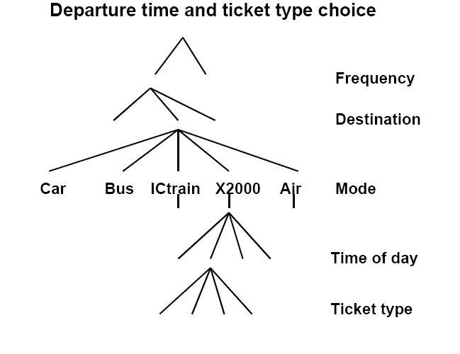
Extensions

